Slide 1
Technical Meeting on MQXFB07 :
Assembly and Pre-load target
Susana Izquierdo Bermudez, Penelope Quassolo on behalf of MQXF team
11/09/2024
Technical Meeting MQXFB07 Assembly (September 11, 2024) · Indico (cern.ch)

Slide 2
Shimming plan

Slide 3
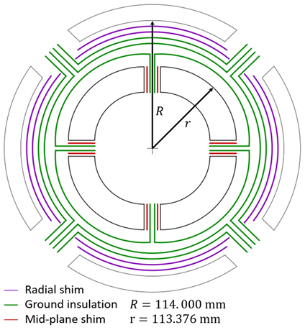
Shimming strategy -
Mid-plane and radial shims
Strategy: coils with different azimuthal sizes are shimmed to match the largest one. If all coils are smaller than nominal size, they are shimmed to match the latter value. Shimming is placed on the mid-plane.
The resulting variation of outer radius is compensated by adding/removing radial shims*.
0.125 mm of radial shims are removed systematically to improve contact on the mid-plane between collar and coil → experience from LARP and MQXF short models
  So-called “LQ effect”
*The ground insulation layers must be respected. Targeting as a baseline to remove at least one of the radial shims, coil average size is exceeded when L+R_{average} > 200 µm. Non-optimal contact with the collars.

Slide 4
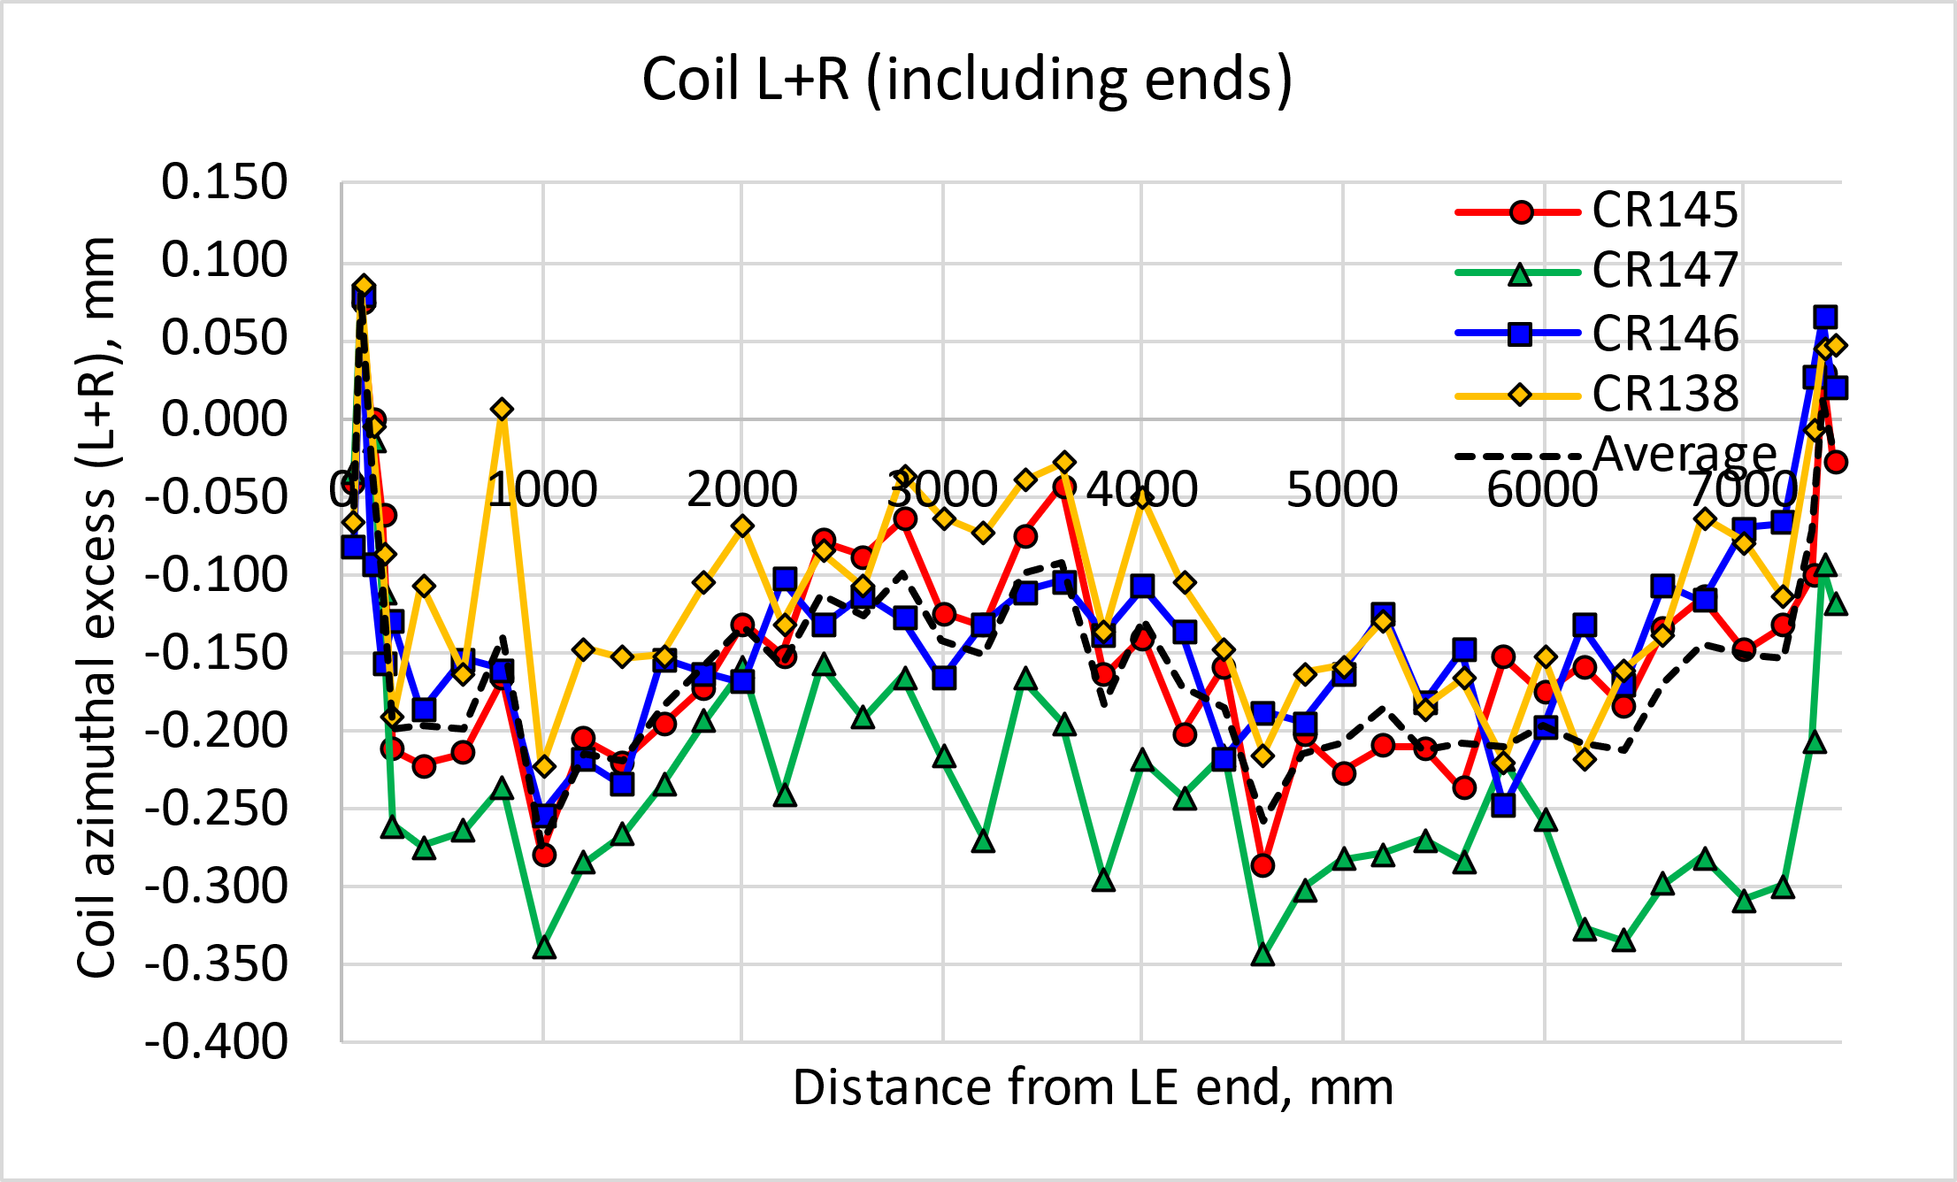
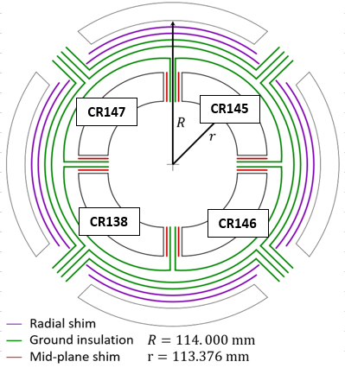
MQXFB07: Coil Size + midplane shim
 |  | Average (Excluding ends) | Rounded value
Azimuthal excess L+R [µm] | CR145 | -166 | -150
 | CR147 | -254 | -250
 | CR146 | -154 | -150
 | CR138 | -122 | -150
MQXFB07 largest coil (CR138) is smaller than the nominal azimuthal size, so all the coils are shimmed to the nominal azimuthal size. CR147 is the smallest.
 | Shim
CR145 | 150
CR147 | 250
CR146 | 150
CR138 | 150

Slide 5
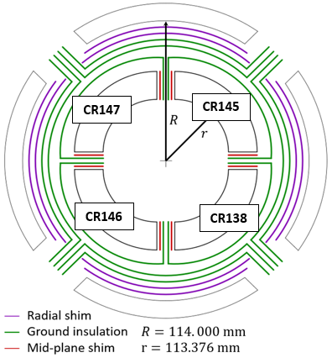
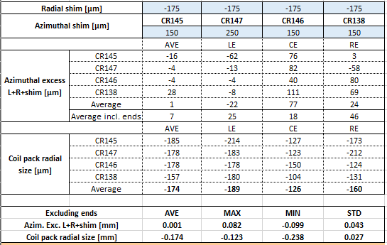
MQXFB07 -175 um shimming plan
-175 µm removed from radial shimming to compensate for the azimuthal size.
125 µm ground insulation
75 µm radial shim
Midplane shimming

Slide 6
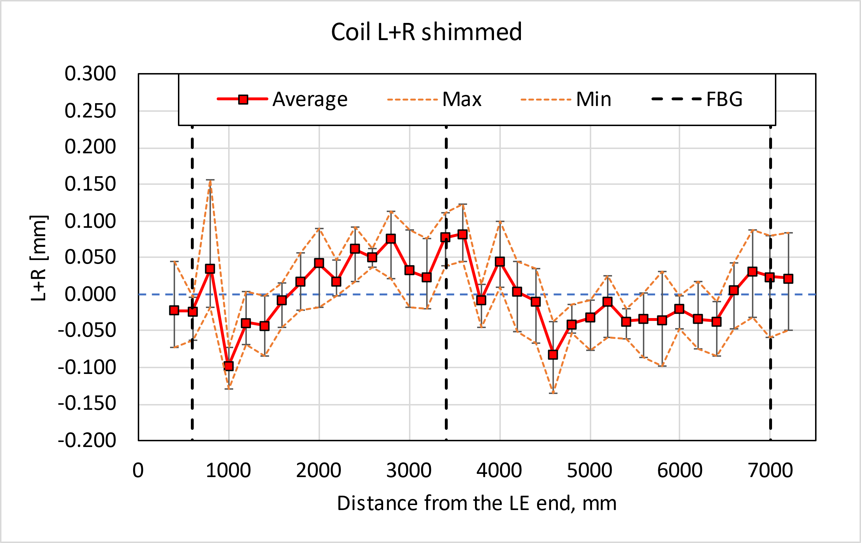
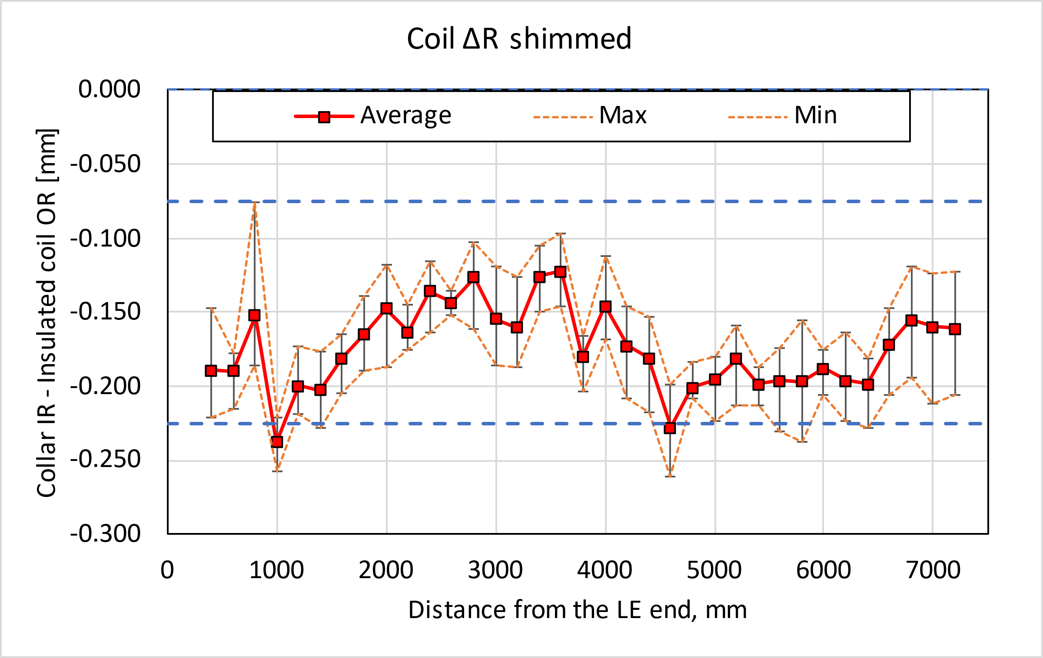
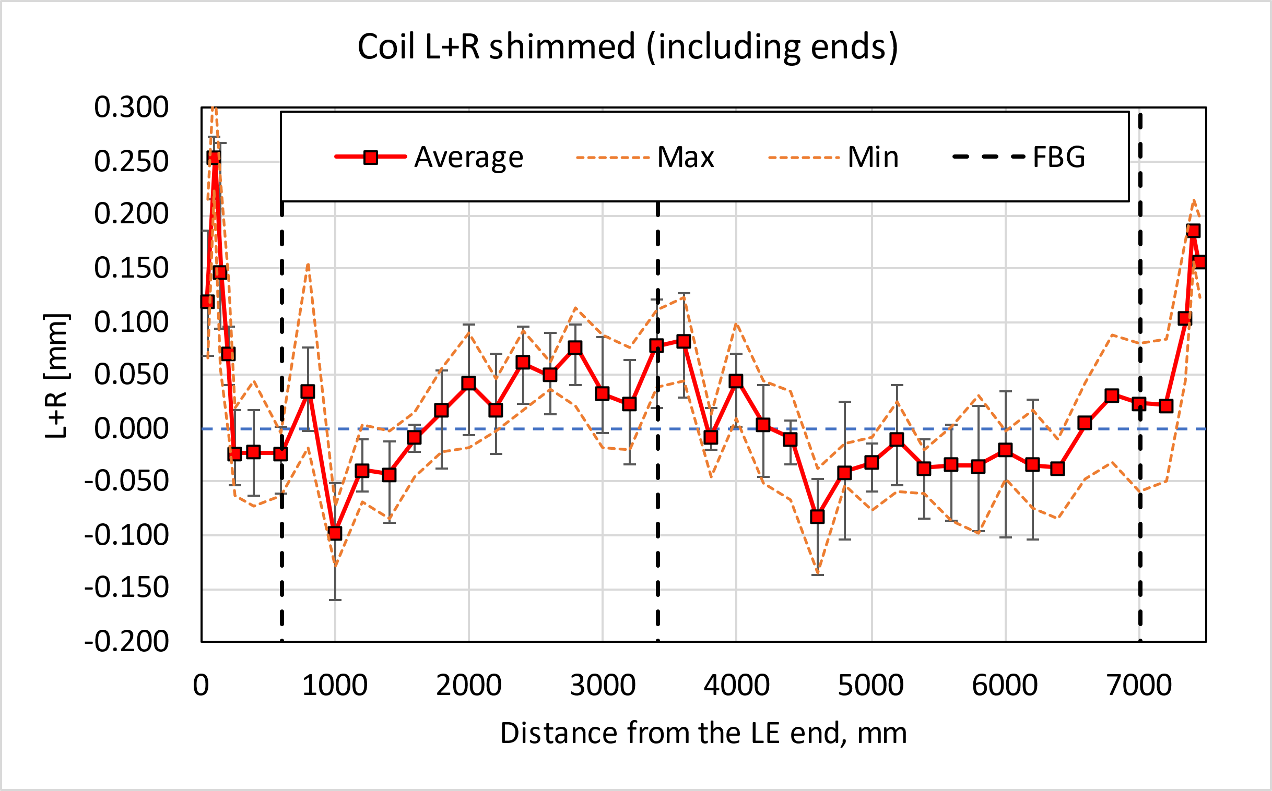
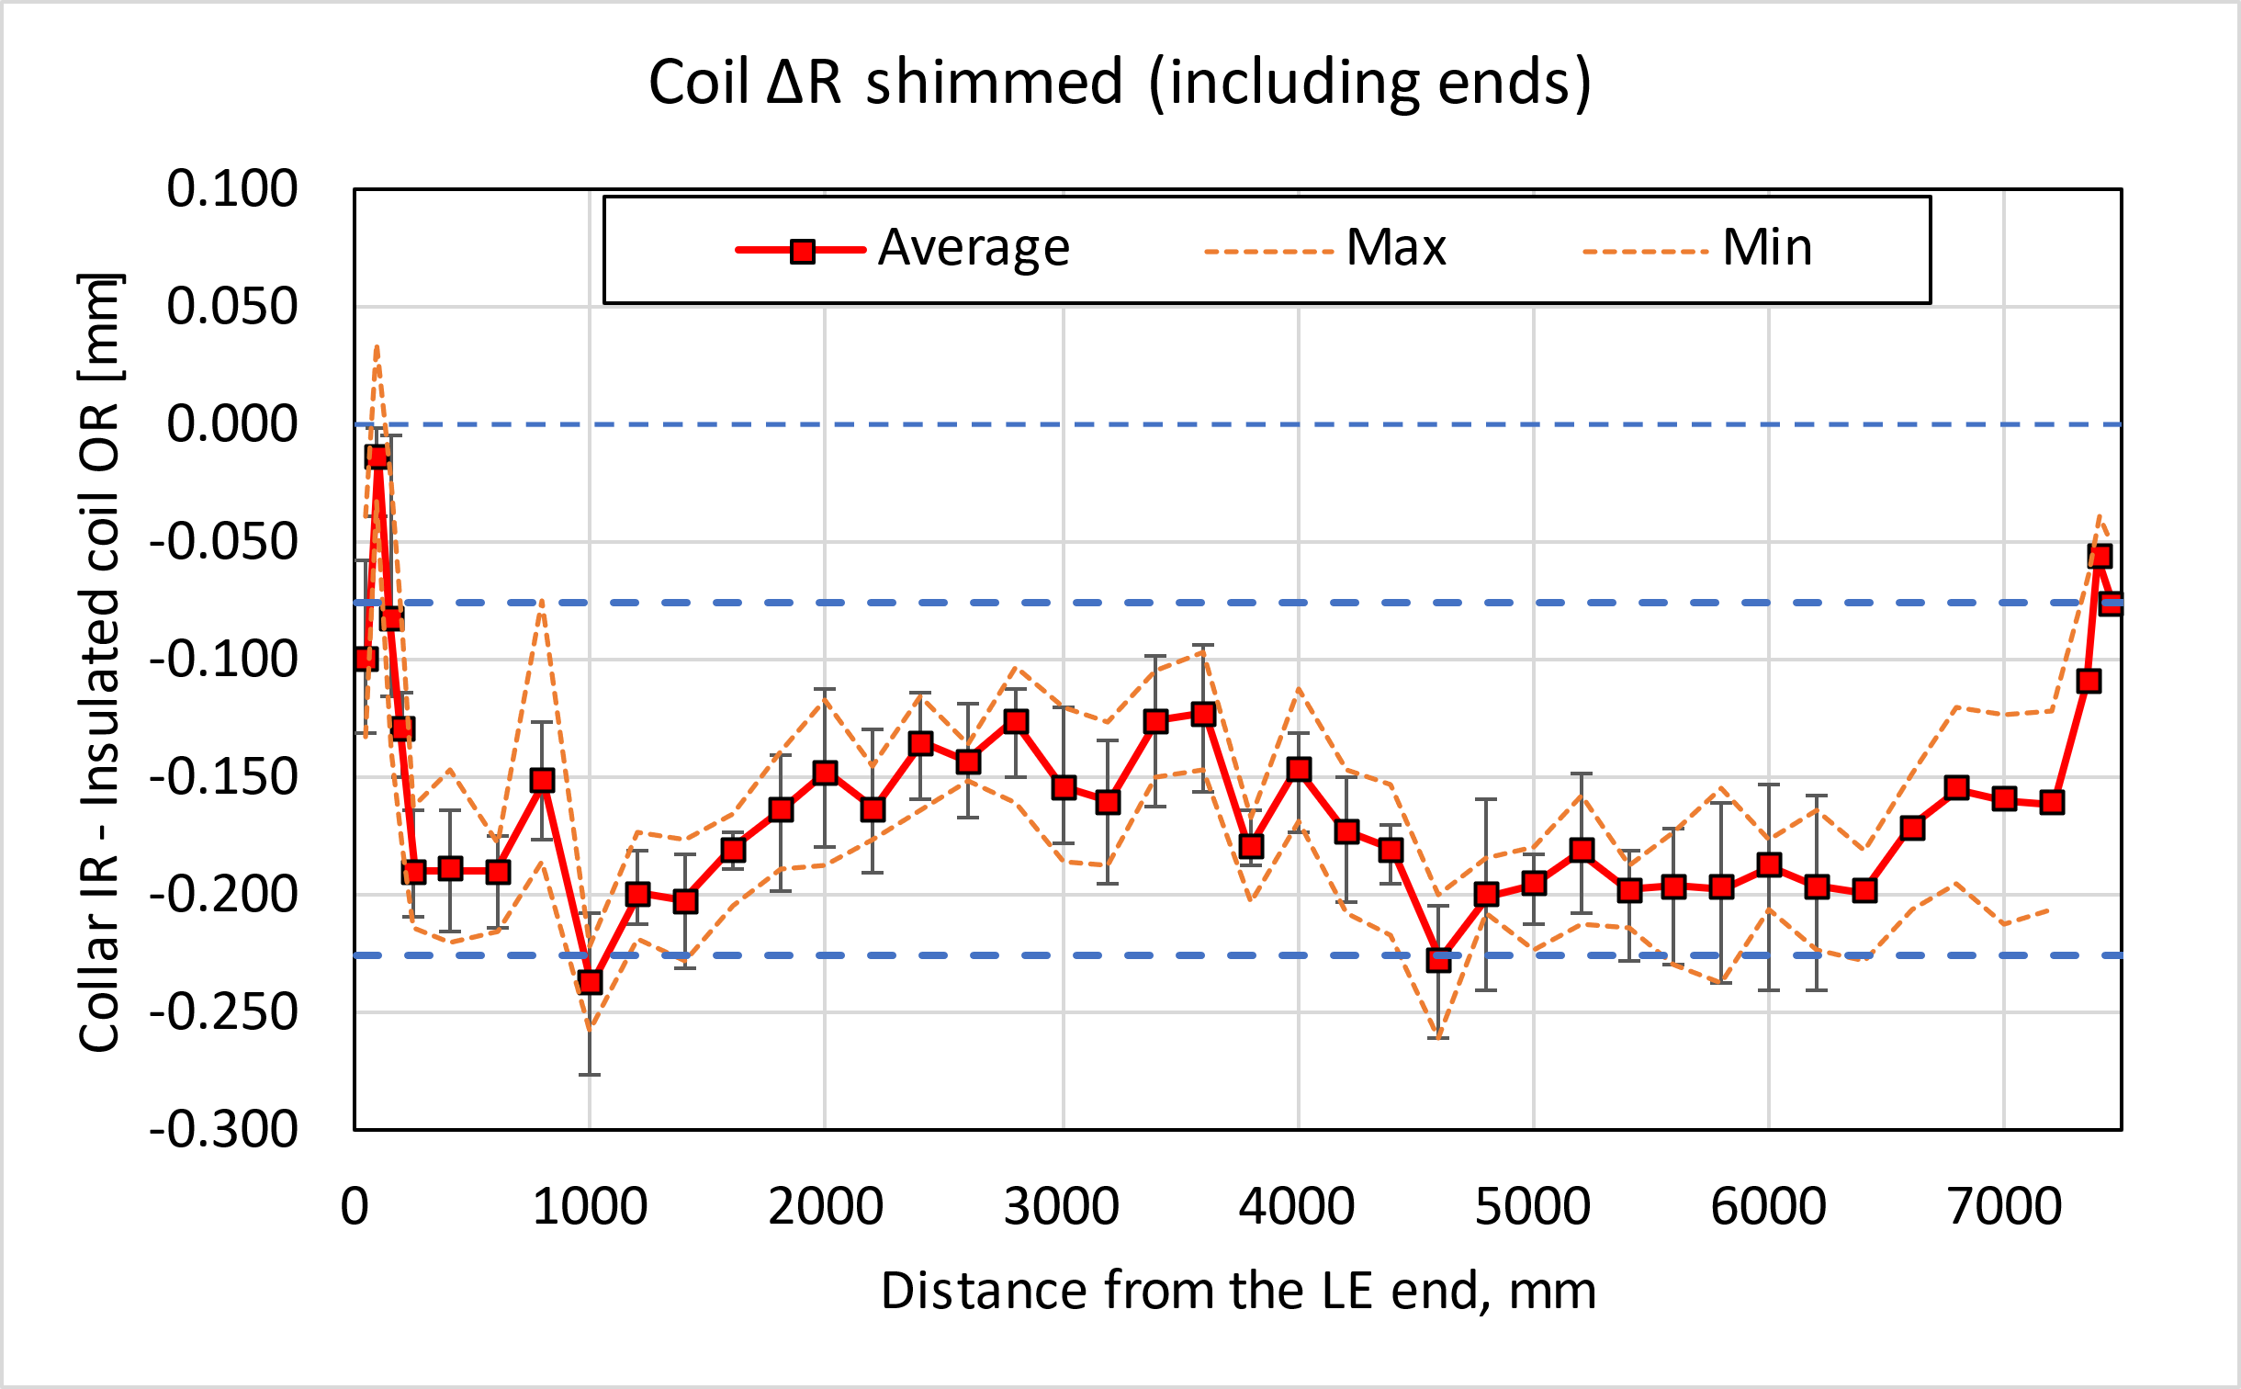
MQXFB07 -175 um shimming plan
Azimuthal and radial size

Slide 7
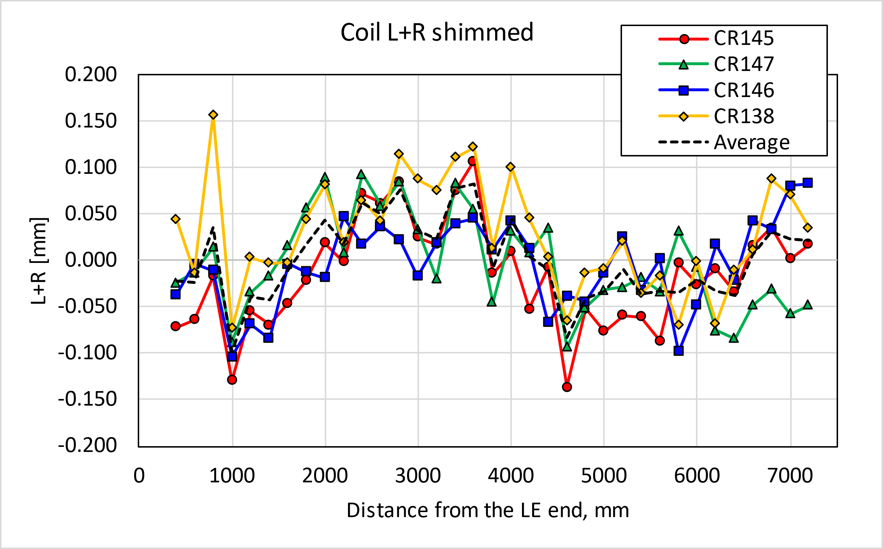
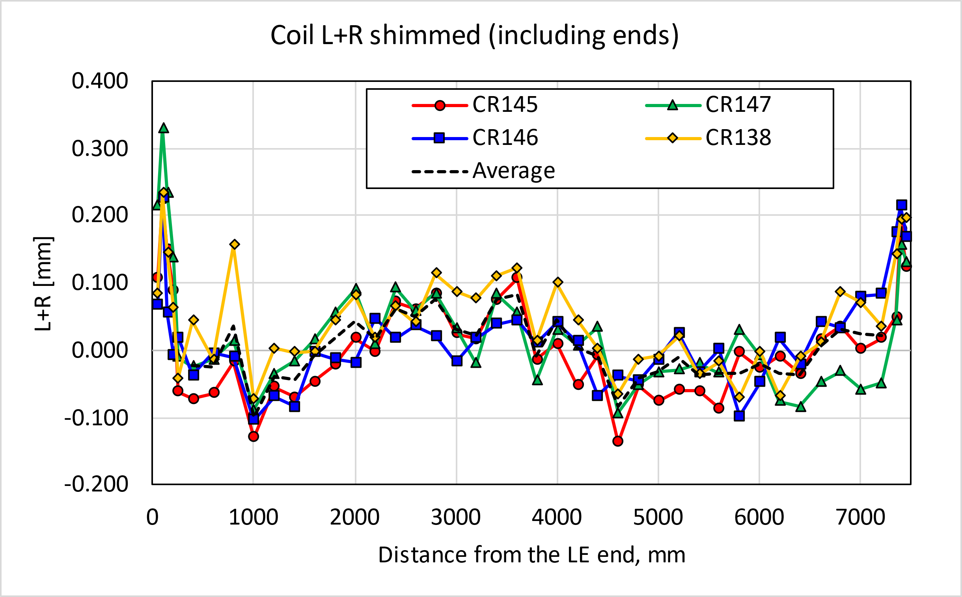
MQXFB07

Slide 8
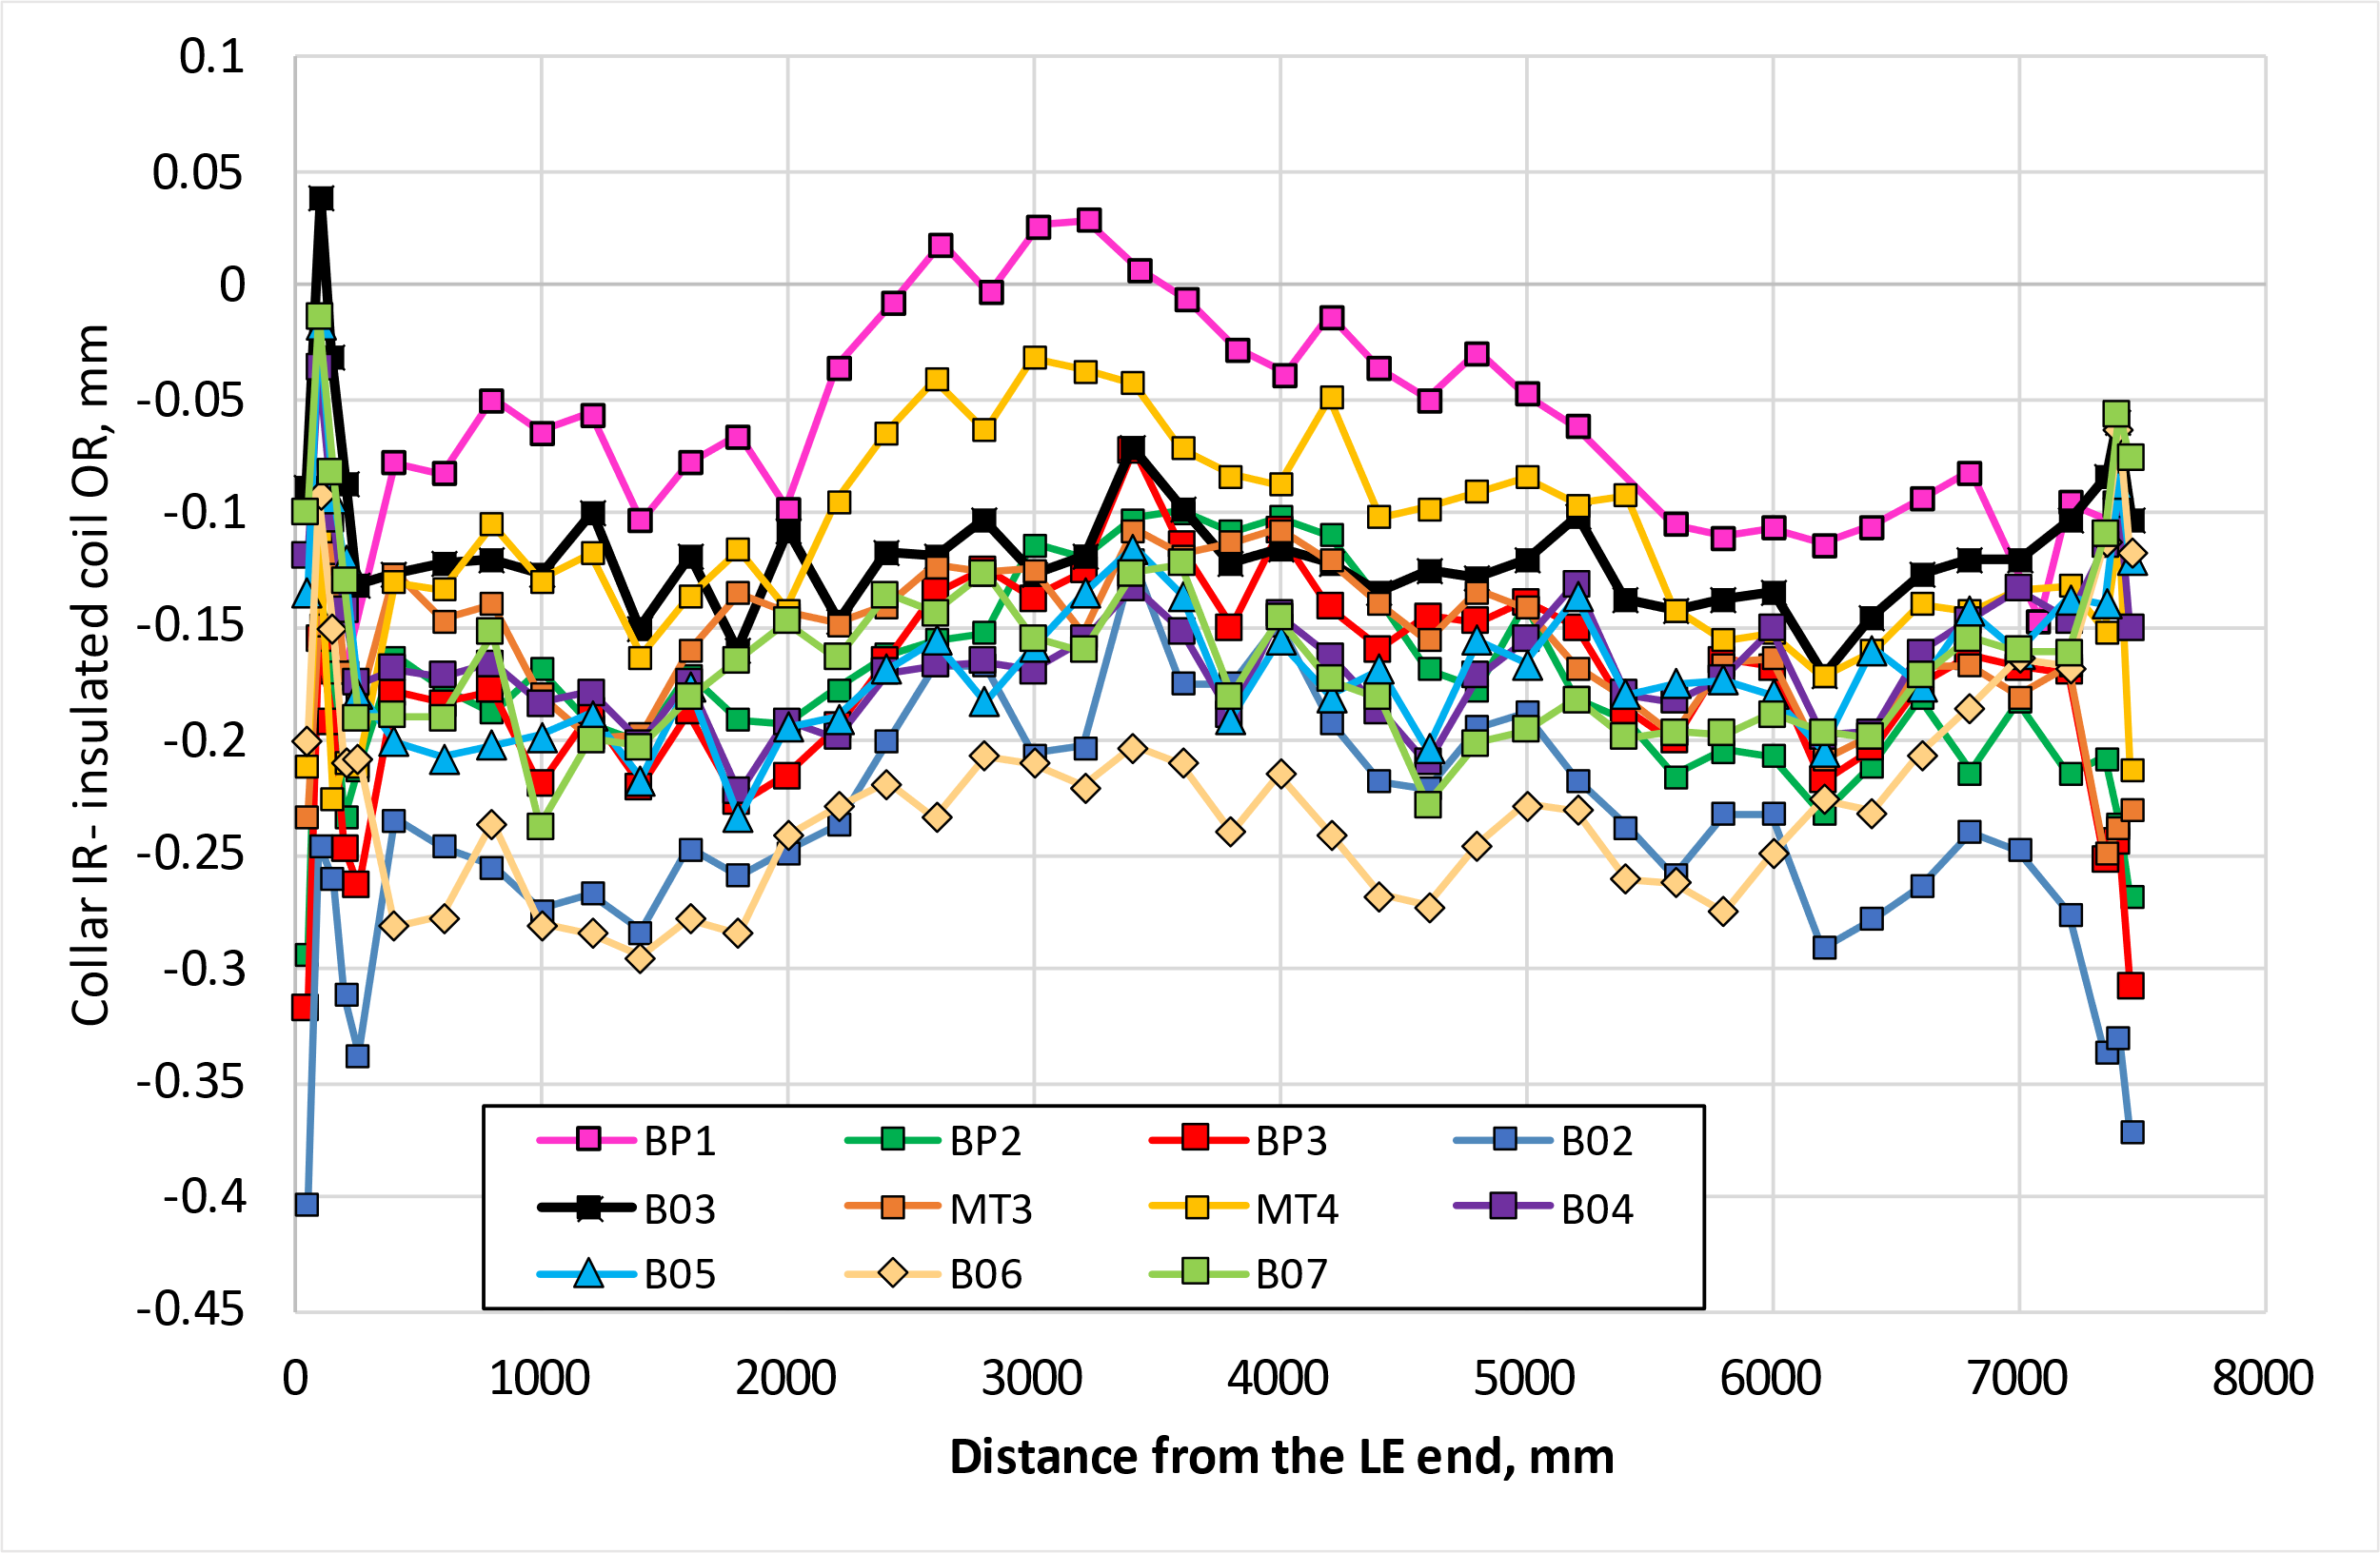
MQXFB07 -175 um shimming plan
Radial size and comparison to previous magnets
The radial shim is defined in order to have a coil pack dimensions close to B04/B05. The ends have a similar size to previous magnets.

Slide 9
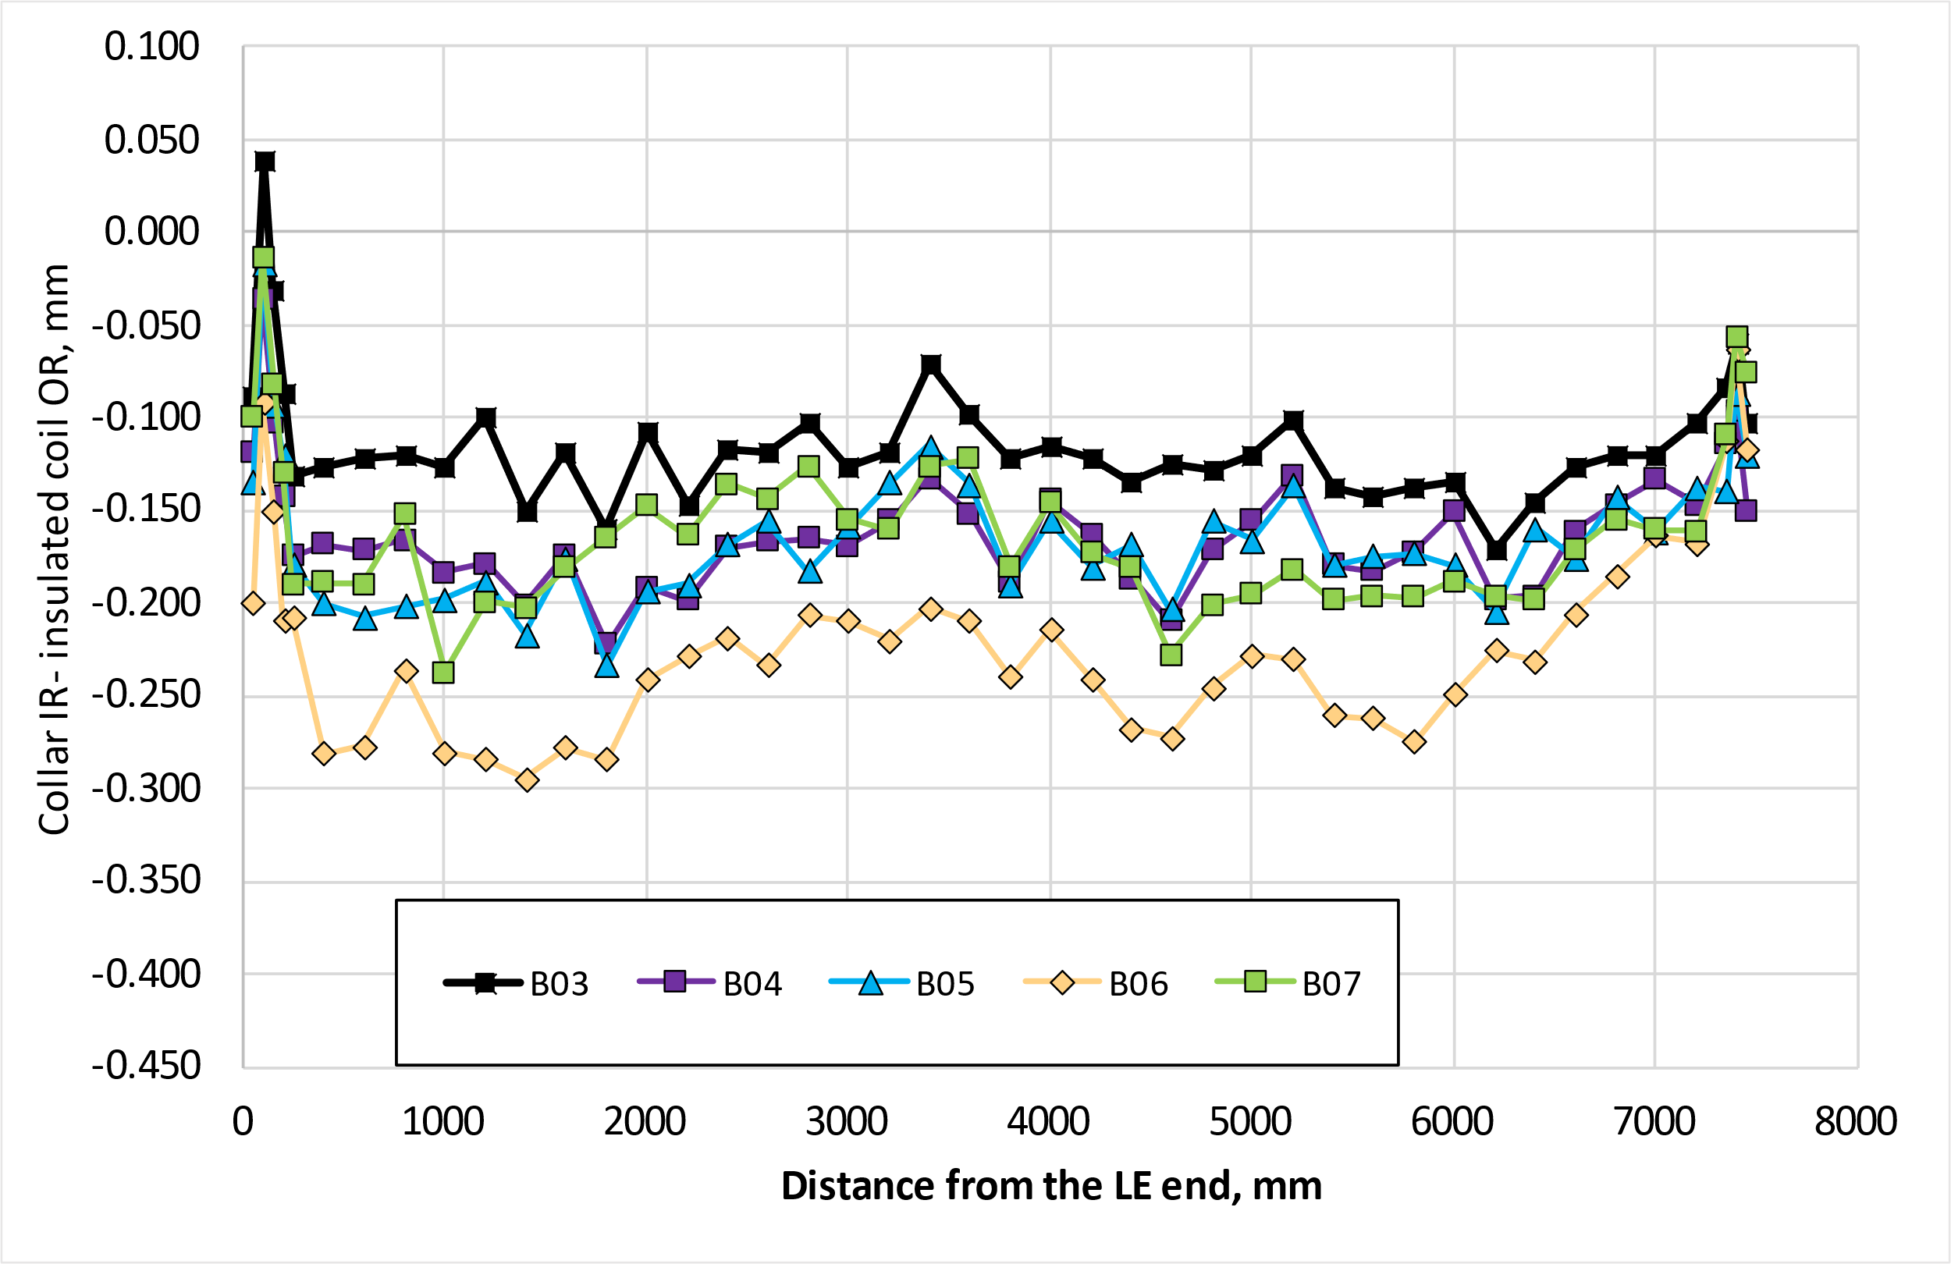
MQXFB07 -175 um shimming plan
Radial size and comparison to previous magnets
The coil pack size is really similar for all the magnets with the ‘new generation’ coils. B06 size is smaller on purpose, to have a conservative size of the ends, similar to the previous magnets.

Slide 10
Pre-load targets

Slide 11
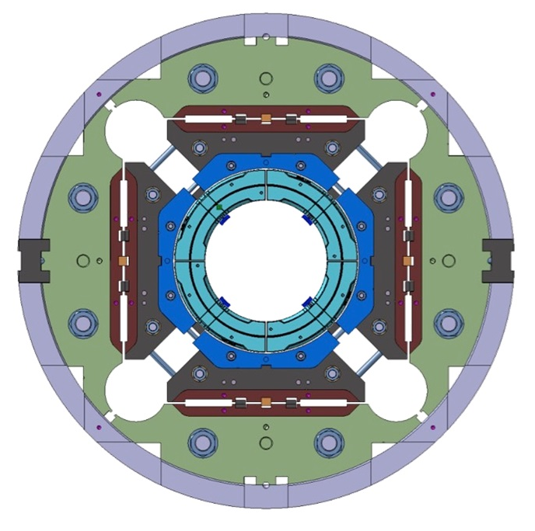
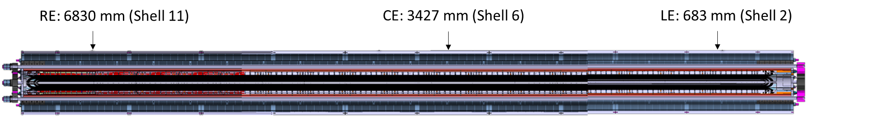
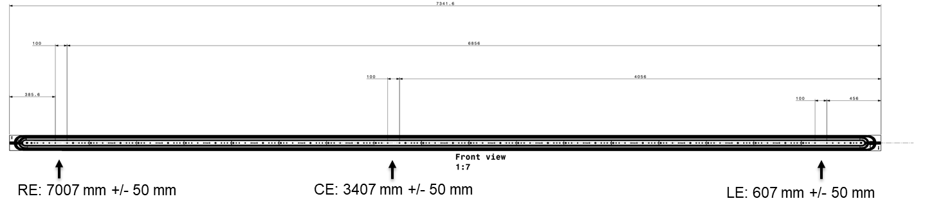
Instrumentation overview
Magnet component | Number & Directions | Bridge configuration | Type
SHELL | 12 (Θ) 12 (Z) | SG quarter bridge + thermal compensator | Cr – Ni / Polyimide HBM LC11-6/350
COILS | 12 (Z) 12 (Θ) | FBG (+ temperature sensor to compensate T effect) | FemtoSecond® 4 arrays with 2 FBG
RODS | 4 (Z) | SG full bridges | Cr – Ni / Polyimide HBM LC11-3/350
Rod C
Rod A
Coil
Coil
Coil
Coil
Rod D
Rod B
Coil and shell are instrumented in three axial locations (LE (lead), CE (center), RE (Return))

Slide 12
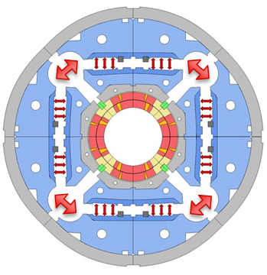
Azimuthal pre-load target (from B03 on)
The allowable peak stress in the coil during loading is -110 MPa, achievable thanks to the new loading procedure with auxiliary bladders (AUP has -135 MPa as maximum allowable stress).
The target room temperature preload for MQXFB03/B04/B05/B06:
  Average shell stress: 58 ± 6 MPa;
  Average pole coil stress: -80 ± 10 MPa
  Rod strain: 650 µε
  This is a target not a requirement, and in case the maximum allowable peak stress in the conductor (110 MPa) is reached, the average pre-load will be lowered accordingly to fulfill the peak stress requirement
With the new welding procedure (applied from MQXFBP3), we expect no increase on the azimuthal stress of the coils during welding

Slide 13
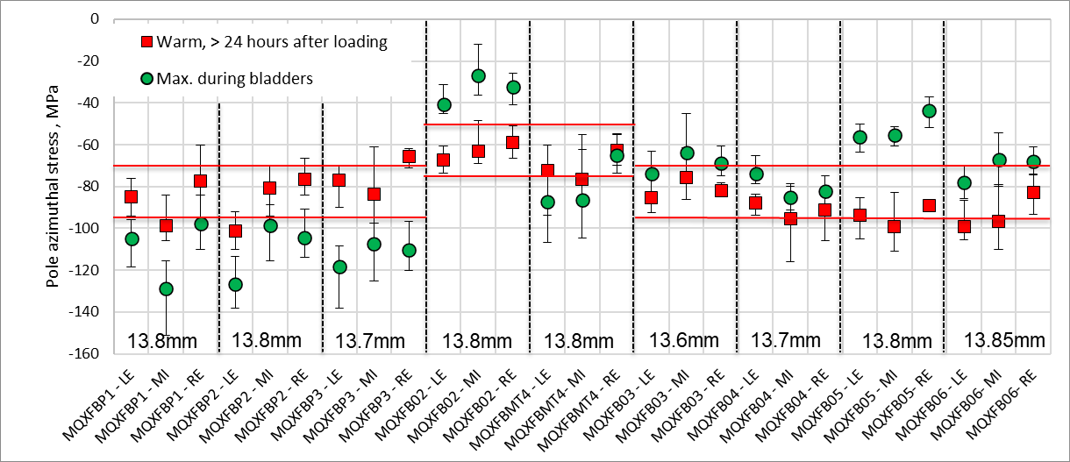
RT: Targets vs achieved

Slide 14
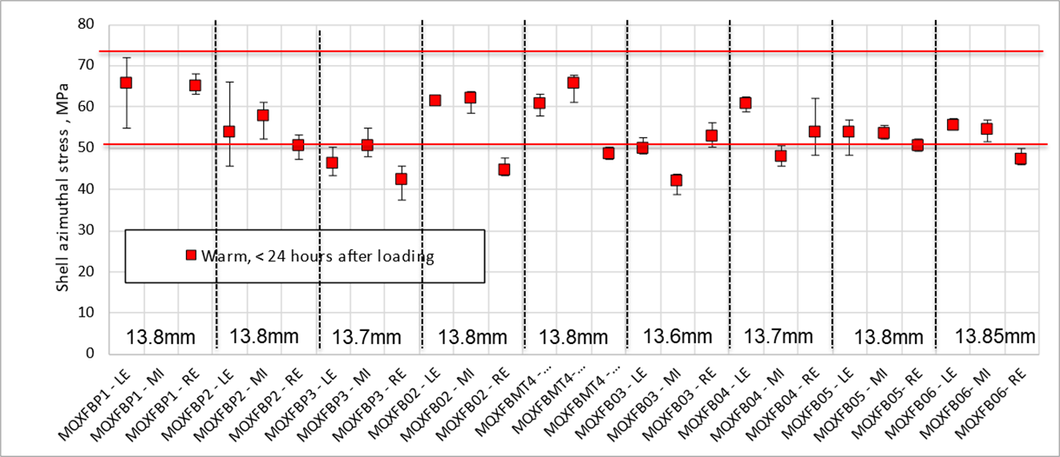
RT: Targets vs achieved

Slide 15
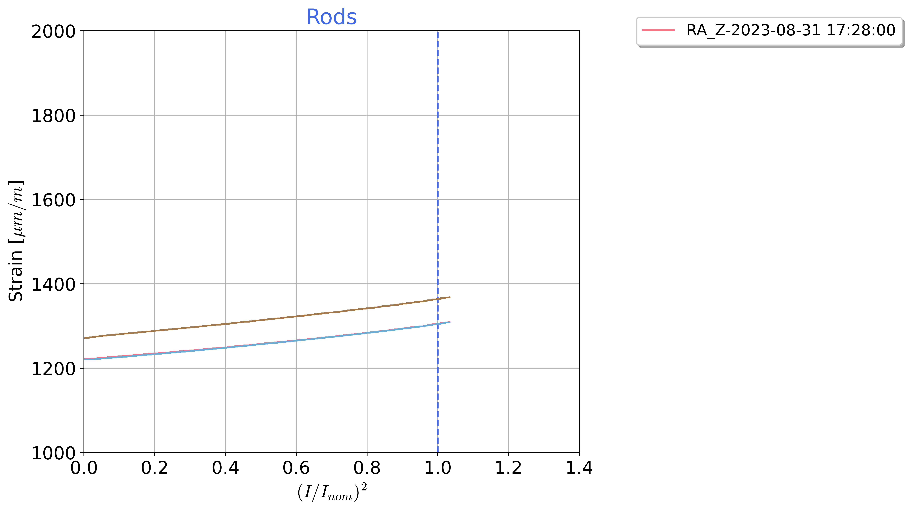
Axial pre-load
Small change of strain on the rods during powering → longitudinal stiffness of the structure is as expected, and overall behaviour is like what we have seen in MQXFS and MQXFA
Similar behaviour to the previous magnets, although now the magnet is mostly quenching in the ends
Proposal for MQXFB07: keep the same target as all previous magnets: i.e., 650 µε after loading
Delta rods strain during powering MQXFB03

Slide 16
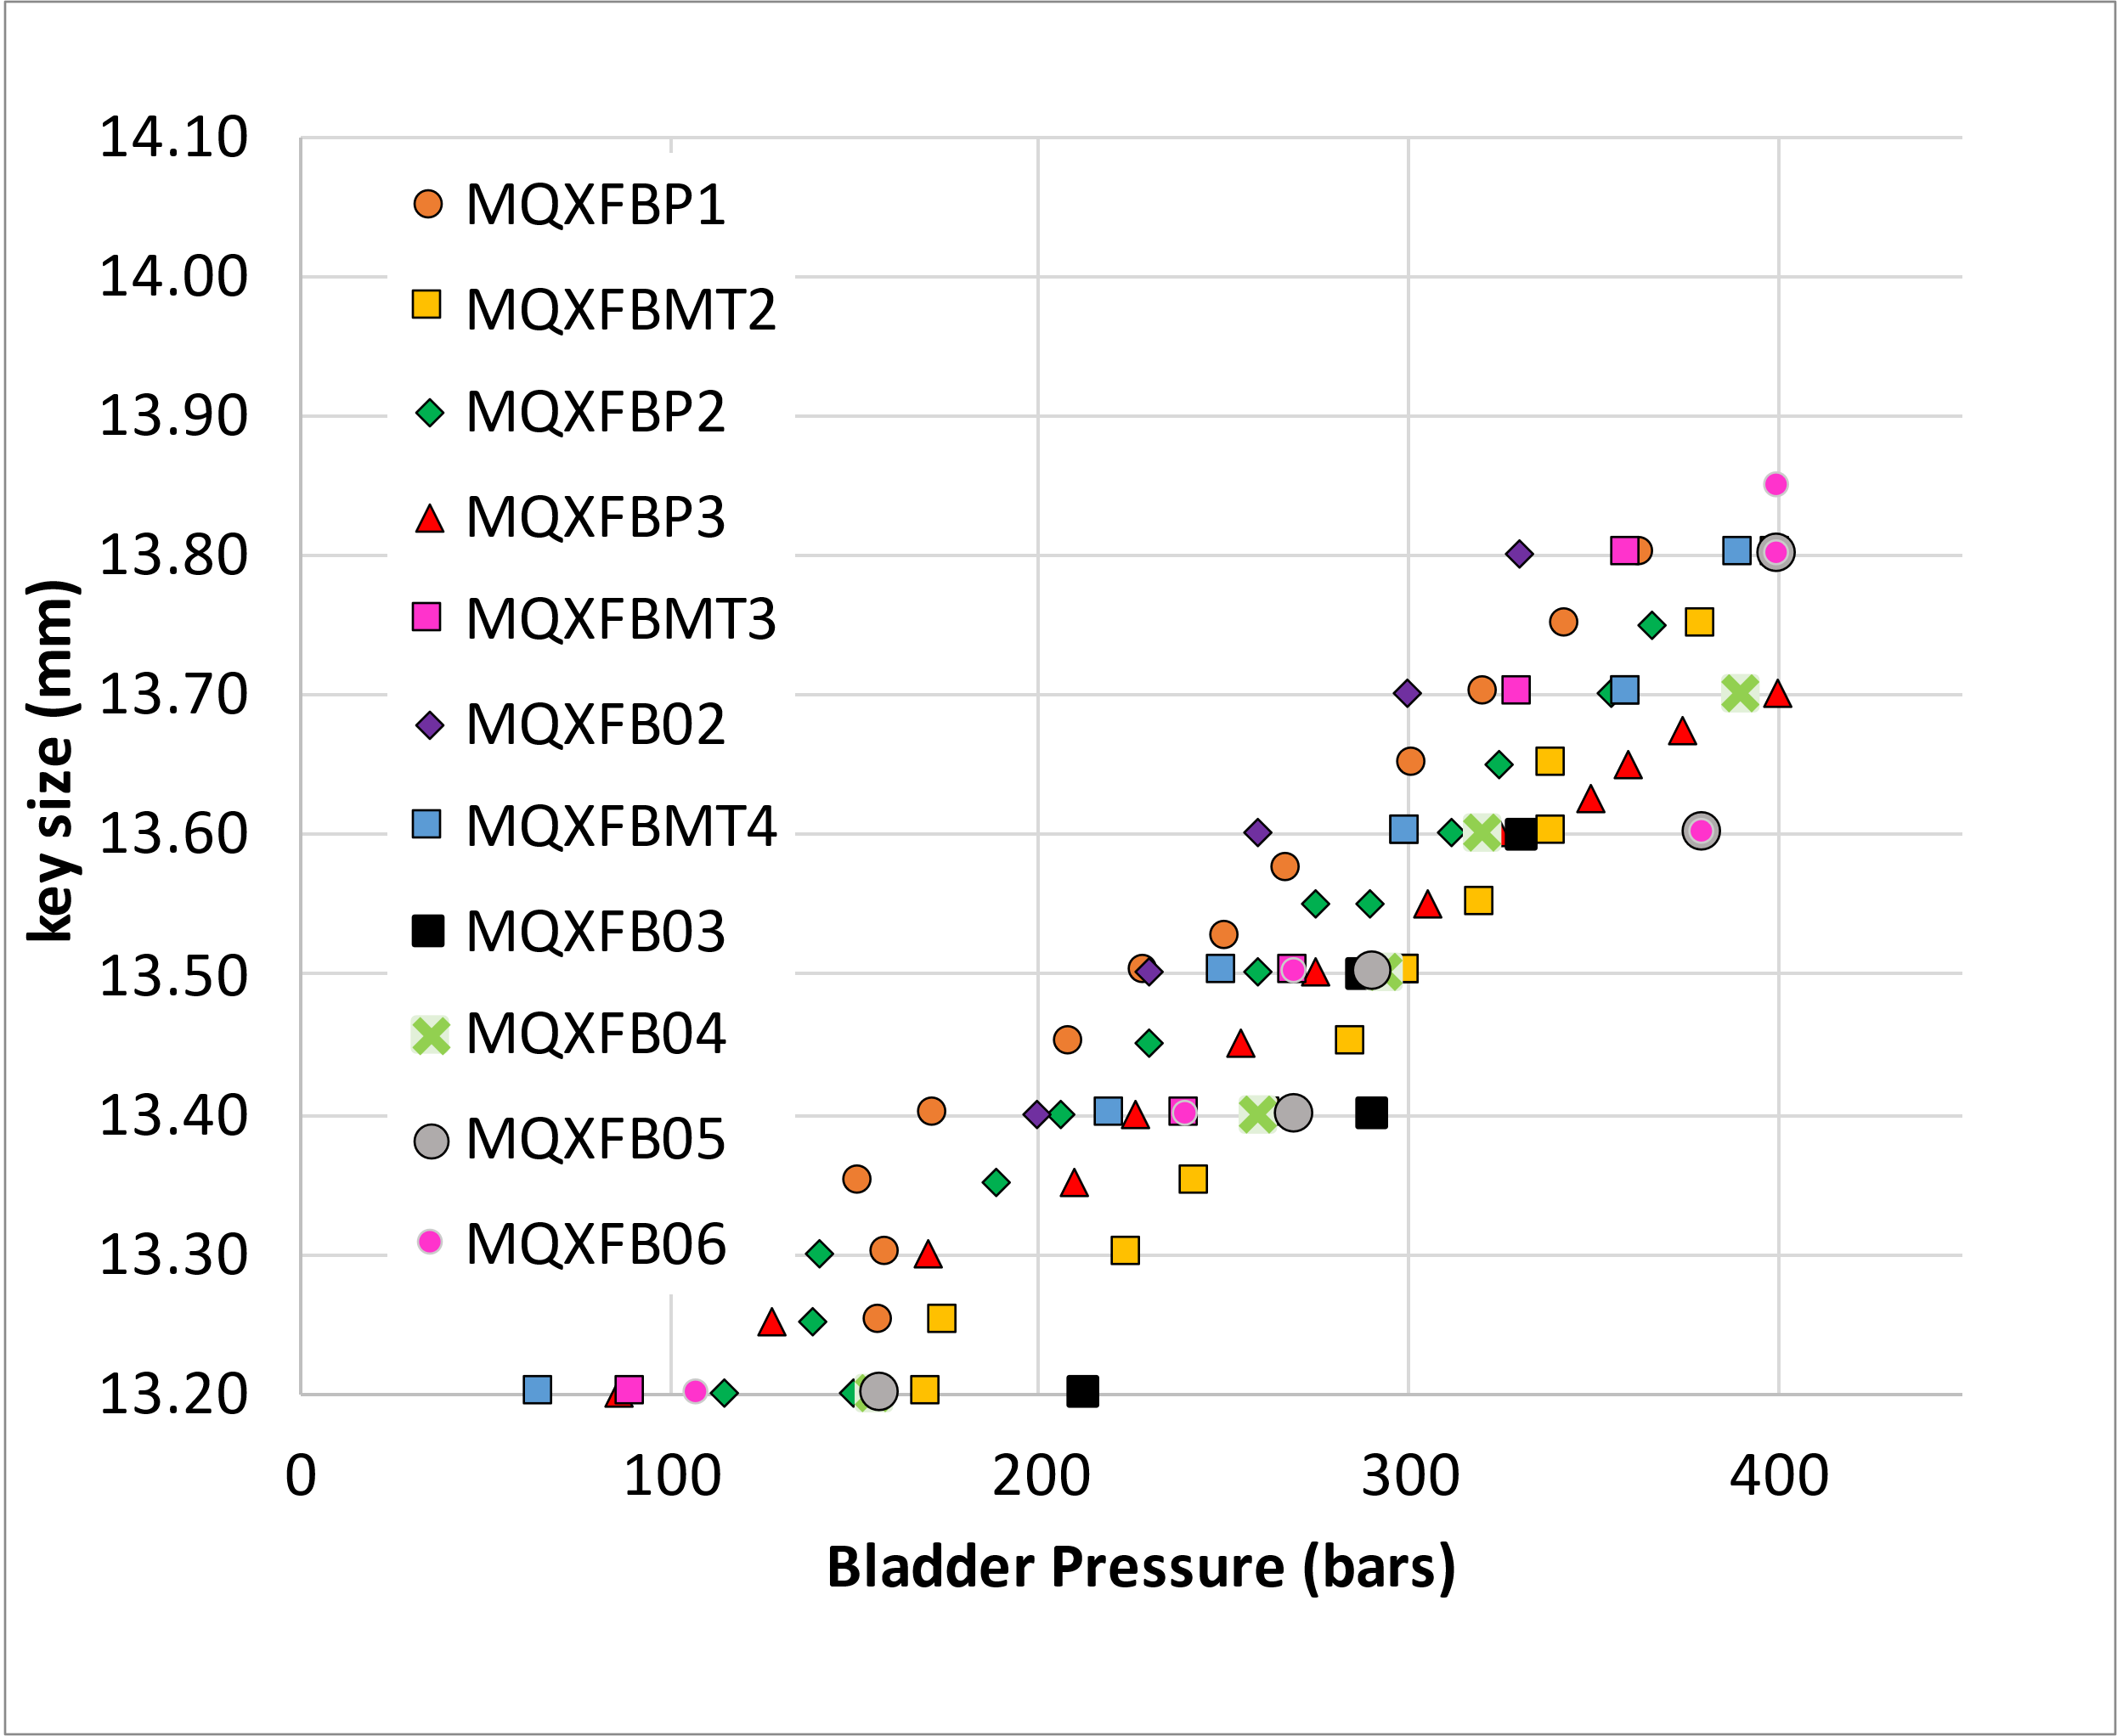
Bladder pressure
The other observable we have during assembly is the bladder pressure
  Assembly tolerances play a role, on some occasions, you need 20-30 bars to overcome a singularity in the structure
  Requirement: never exceed 400 bars

Slide 17
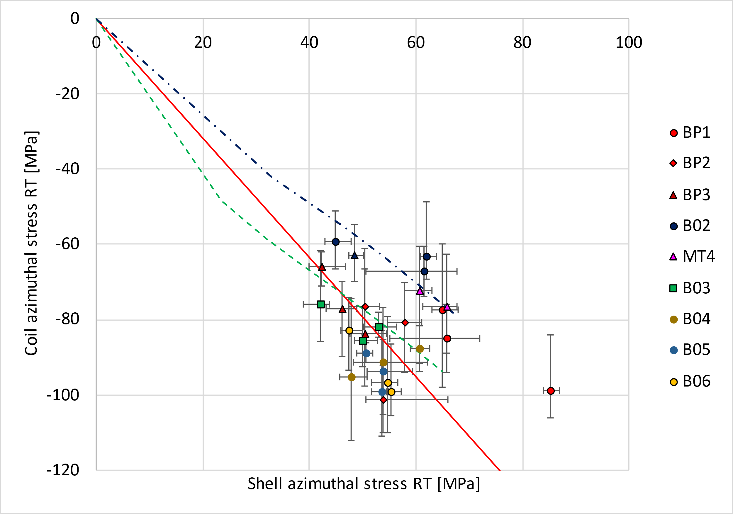
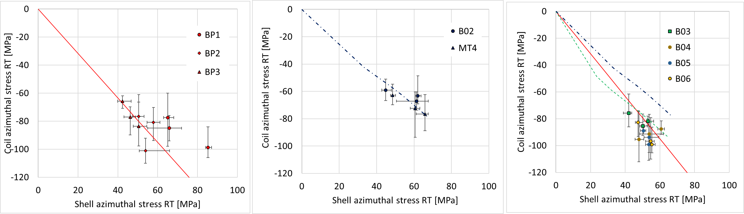
RT transfer function
So far, relatively good agreement between expected transfer function and measured transfer function
  In B02/MT4 we show the change of slope due to the new loading procedure
  In B03/B04/B05/B06 we are closer to the original slope due to the ‘new coil geometry’

Slide 18
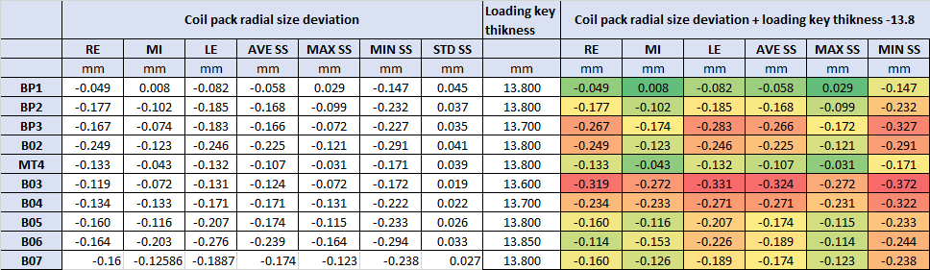

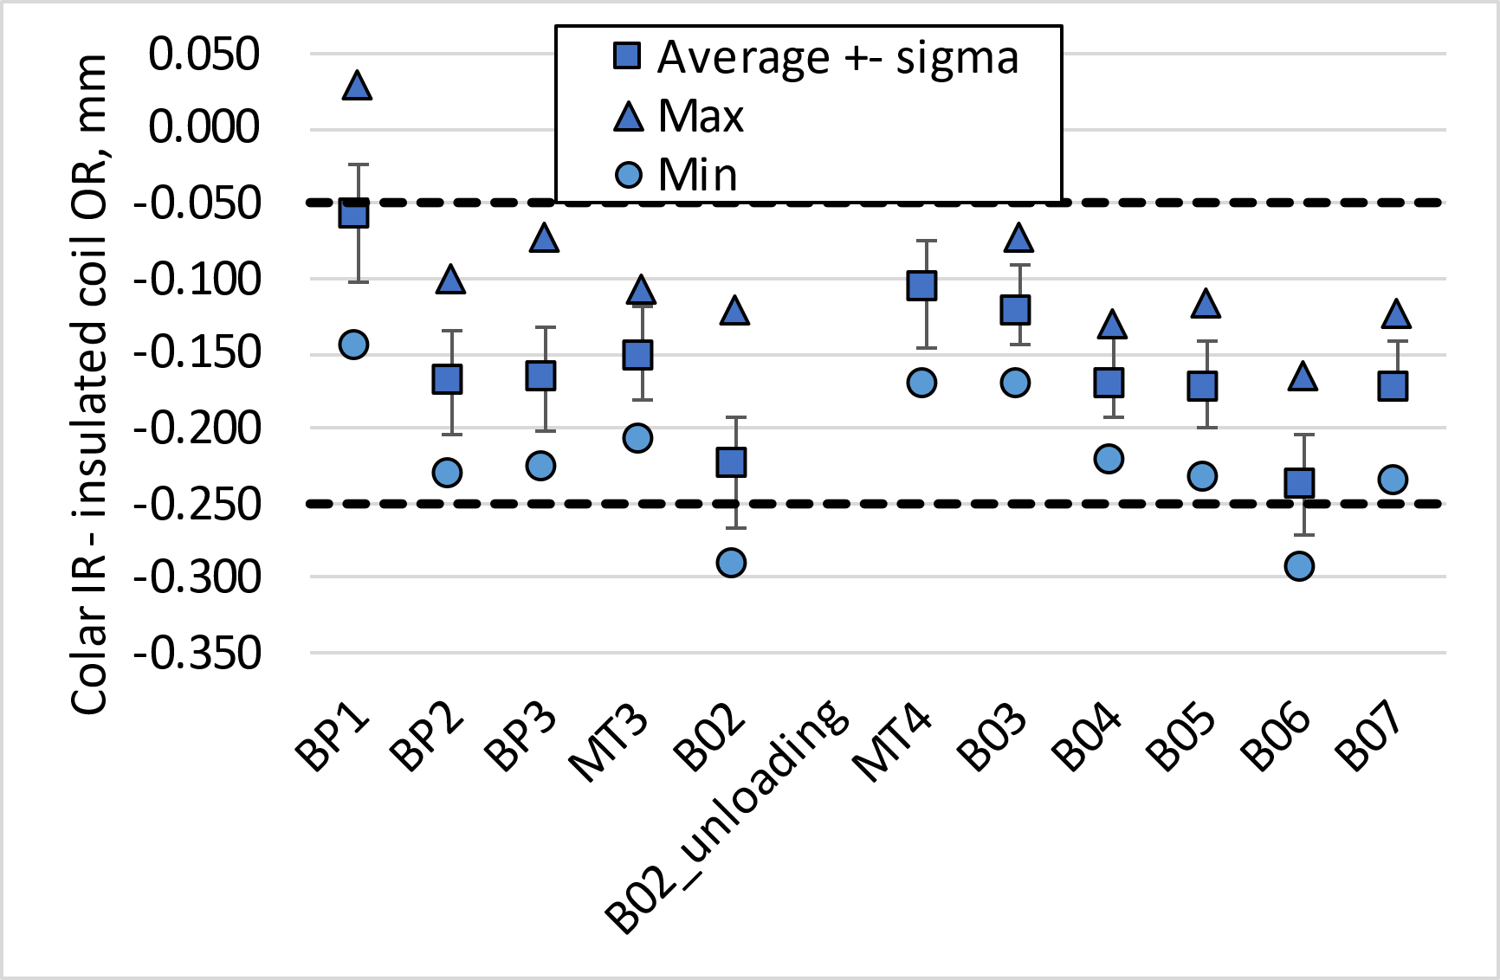
Loading key target
The target is to have a key 13.8 mm
  At CERN we don’t have finer granularity
‘Straight section’ only, i.e., from 400 mm to 7200 mm

Slide 19
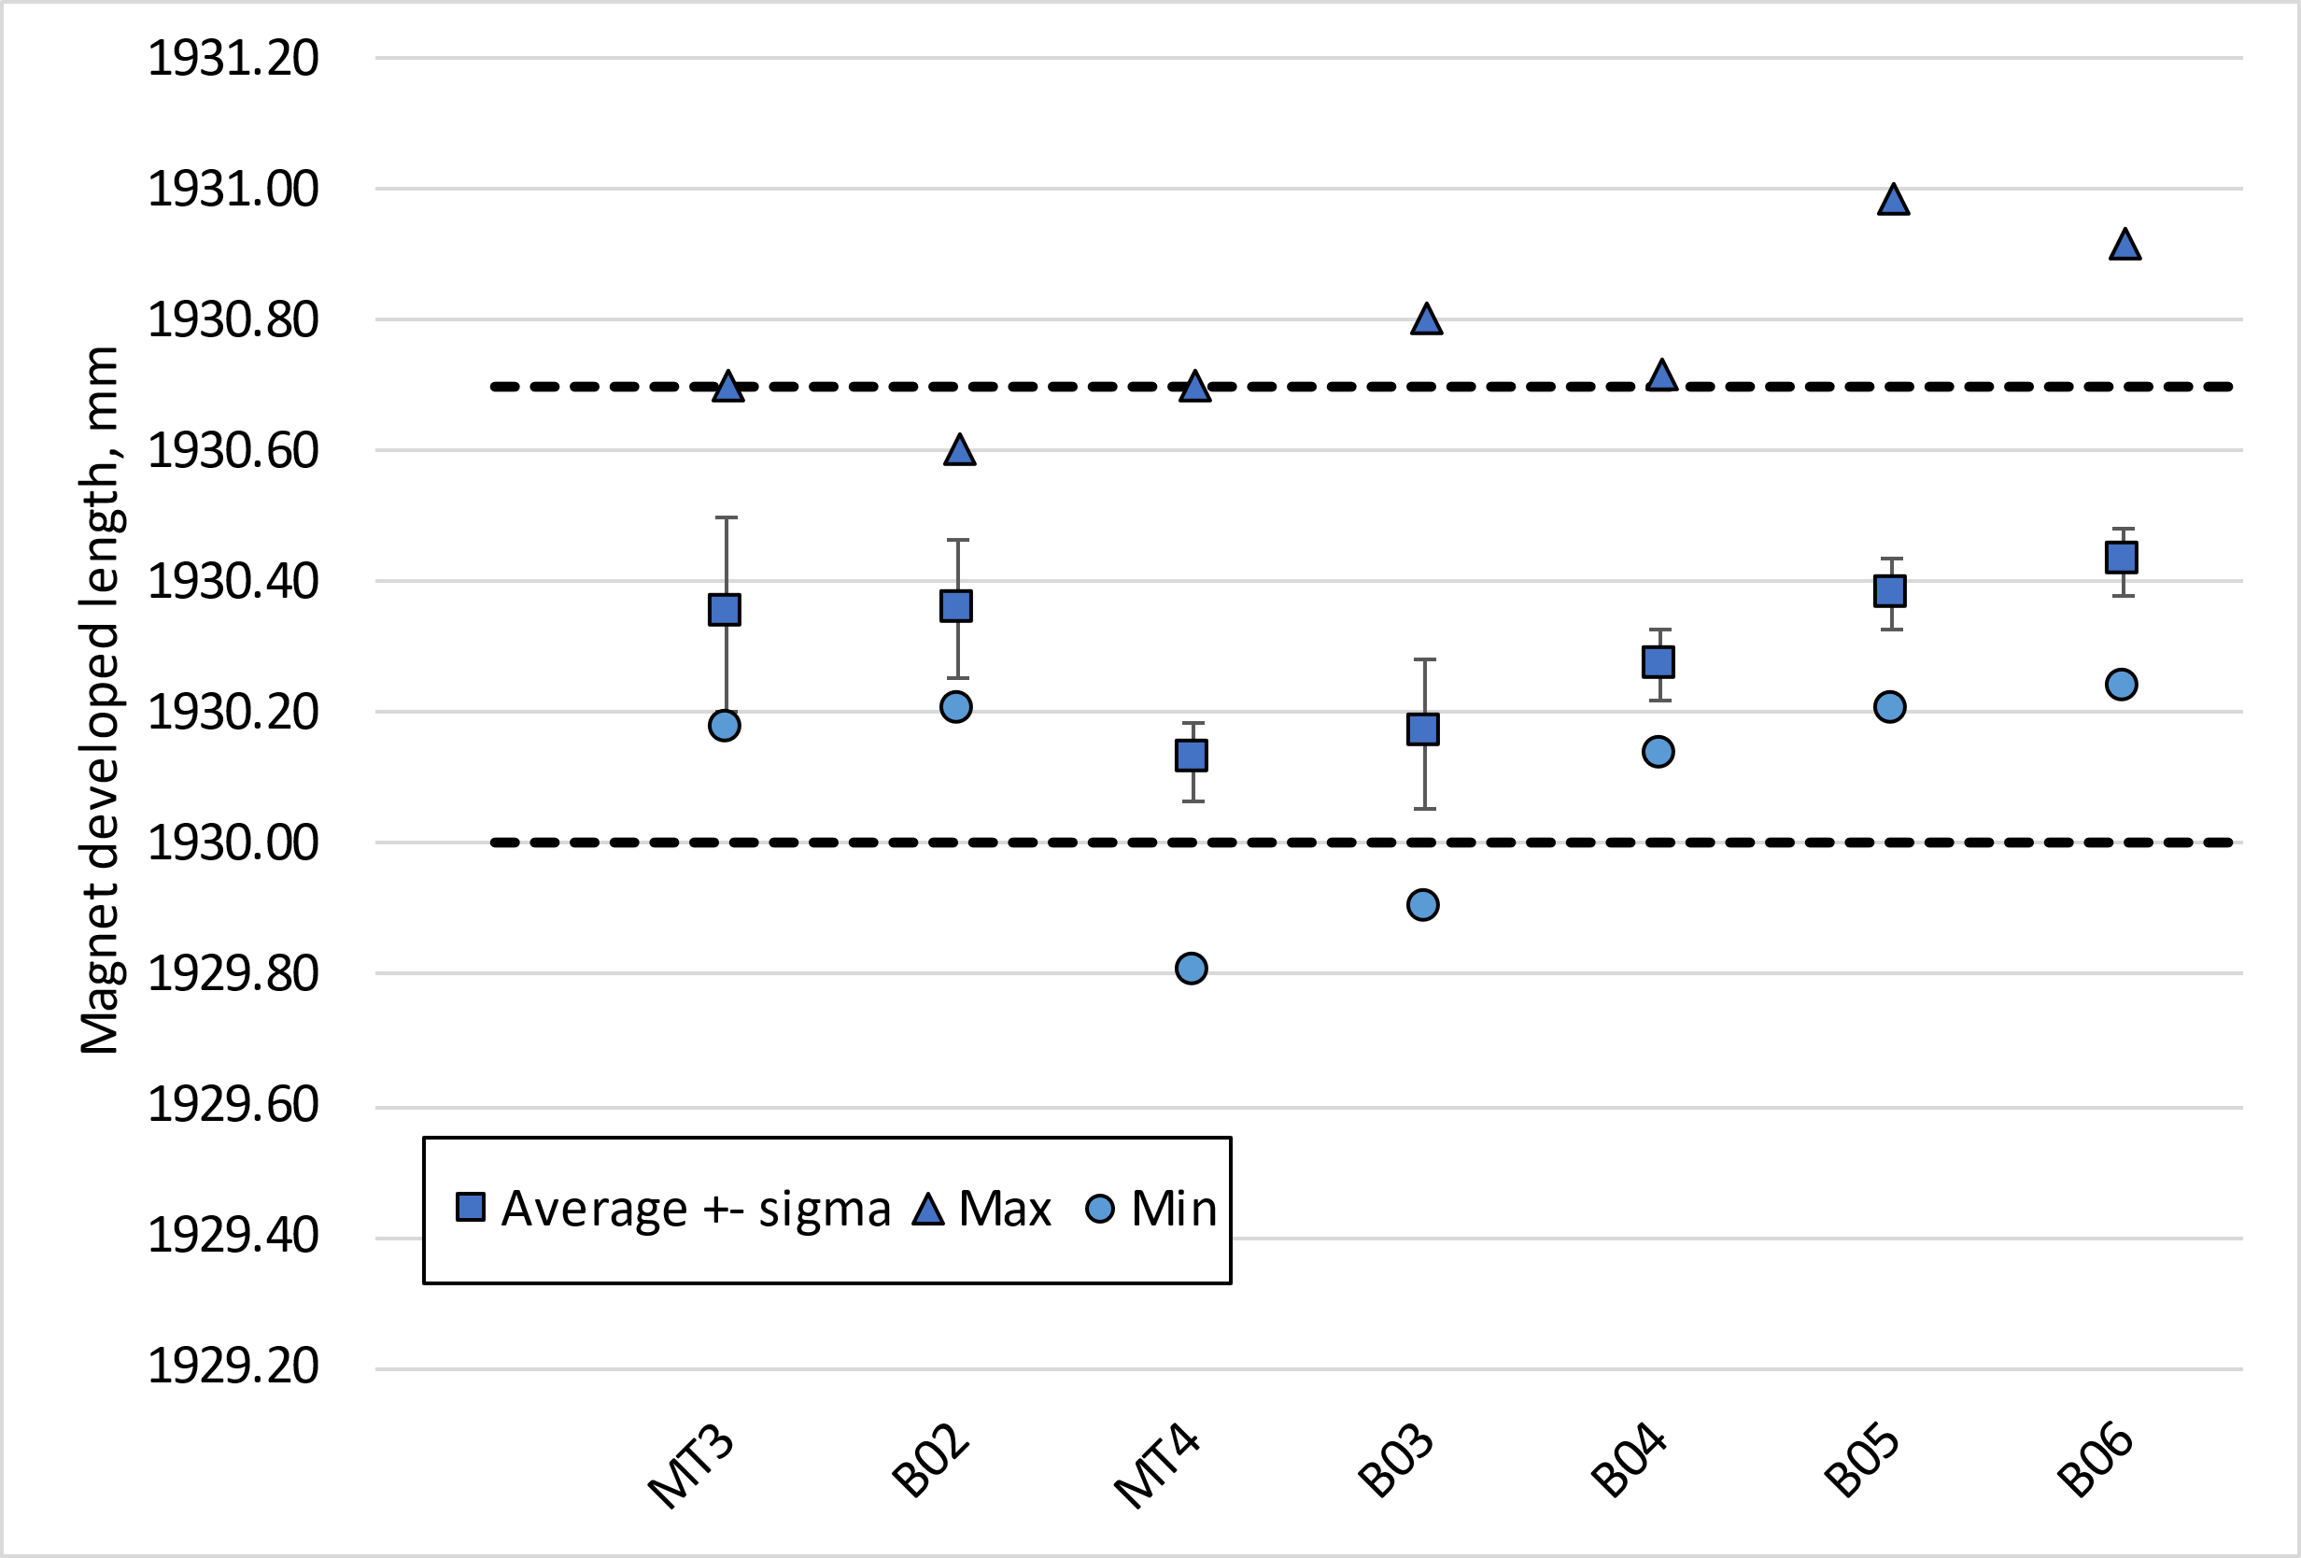
Magnet outer developed length
In the middle of the aluminium shells, the developed length after loading shall be 1930.2 mm +0.5/-0.2 mm
  For a pole pre-stress of 80 MPa, the expected increase of circumference is 1.2 mm in the middle of the aluminium shells, 1.6 mm in the extremities
  Remark: these measurements are done with a pi-tape, precision ≈ 0.2 mm
  This info is used for the pairing for the stainless steel shells for welding (see for example MQXFBMT4, EDMS 2847270)

Slide 20
Summary
Target for MQXFB07: reproduce MQXFB05 pre-load conditions (see EDMS 3064348)
The target loading key thickness is 13.8 mm
The target room temperature preload:
  Average shell stress: 58 ± 6 MPa;
  Average pole coil stress: - 80 ± 10 MPa
  Rod strain: 650 µε
  This is a target not a requirement, and in case the maximum allowable peak stress in the conductor (110 MPa) is reached, the average pre-load will be lowered accordingly to fulfill the peak stress requirement
Based on the experience gained with MQXFB assemblies, a series of observables are monitored along the assembly and compared to previous magnets to verify at every step that we reach our targets (EDMS 2872430)
  Here we focus on geometrical and strain measurements, but field quality is also closely monitored, see additional slides.

Slide 21
Thank you!

Slide 22
Additional slides

Slide 23
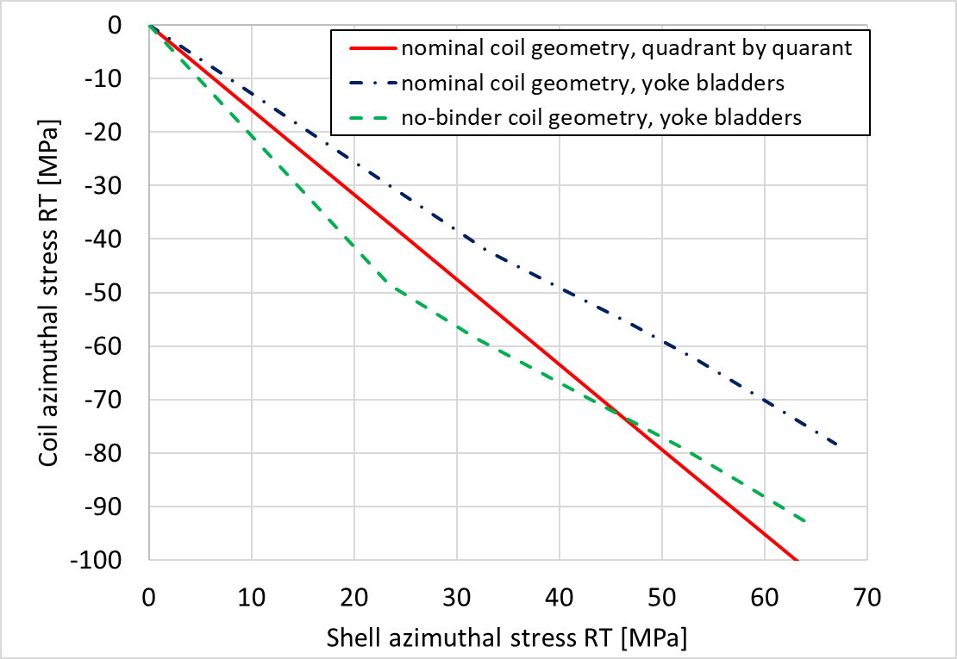
Reminder of impact on modifications in the TF
With the new loading procedure (yoke bladders), we expect less pole stress at RT for the same shell stress → we modified the loading target in B02 to 70 +- 10 MPa (before it was 80 +- 10 MPa) (see https://indico.cern.ch/event/1158577/)
With the new coil geometry (wedged mid-plane due to no binder in the OL), we expect 15-20 MPa more in the pole for the same shell stress (see https://indico.cern.ch/category/10520/)

Slide 24
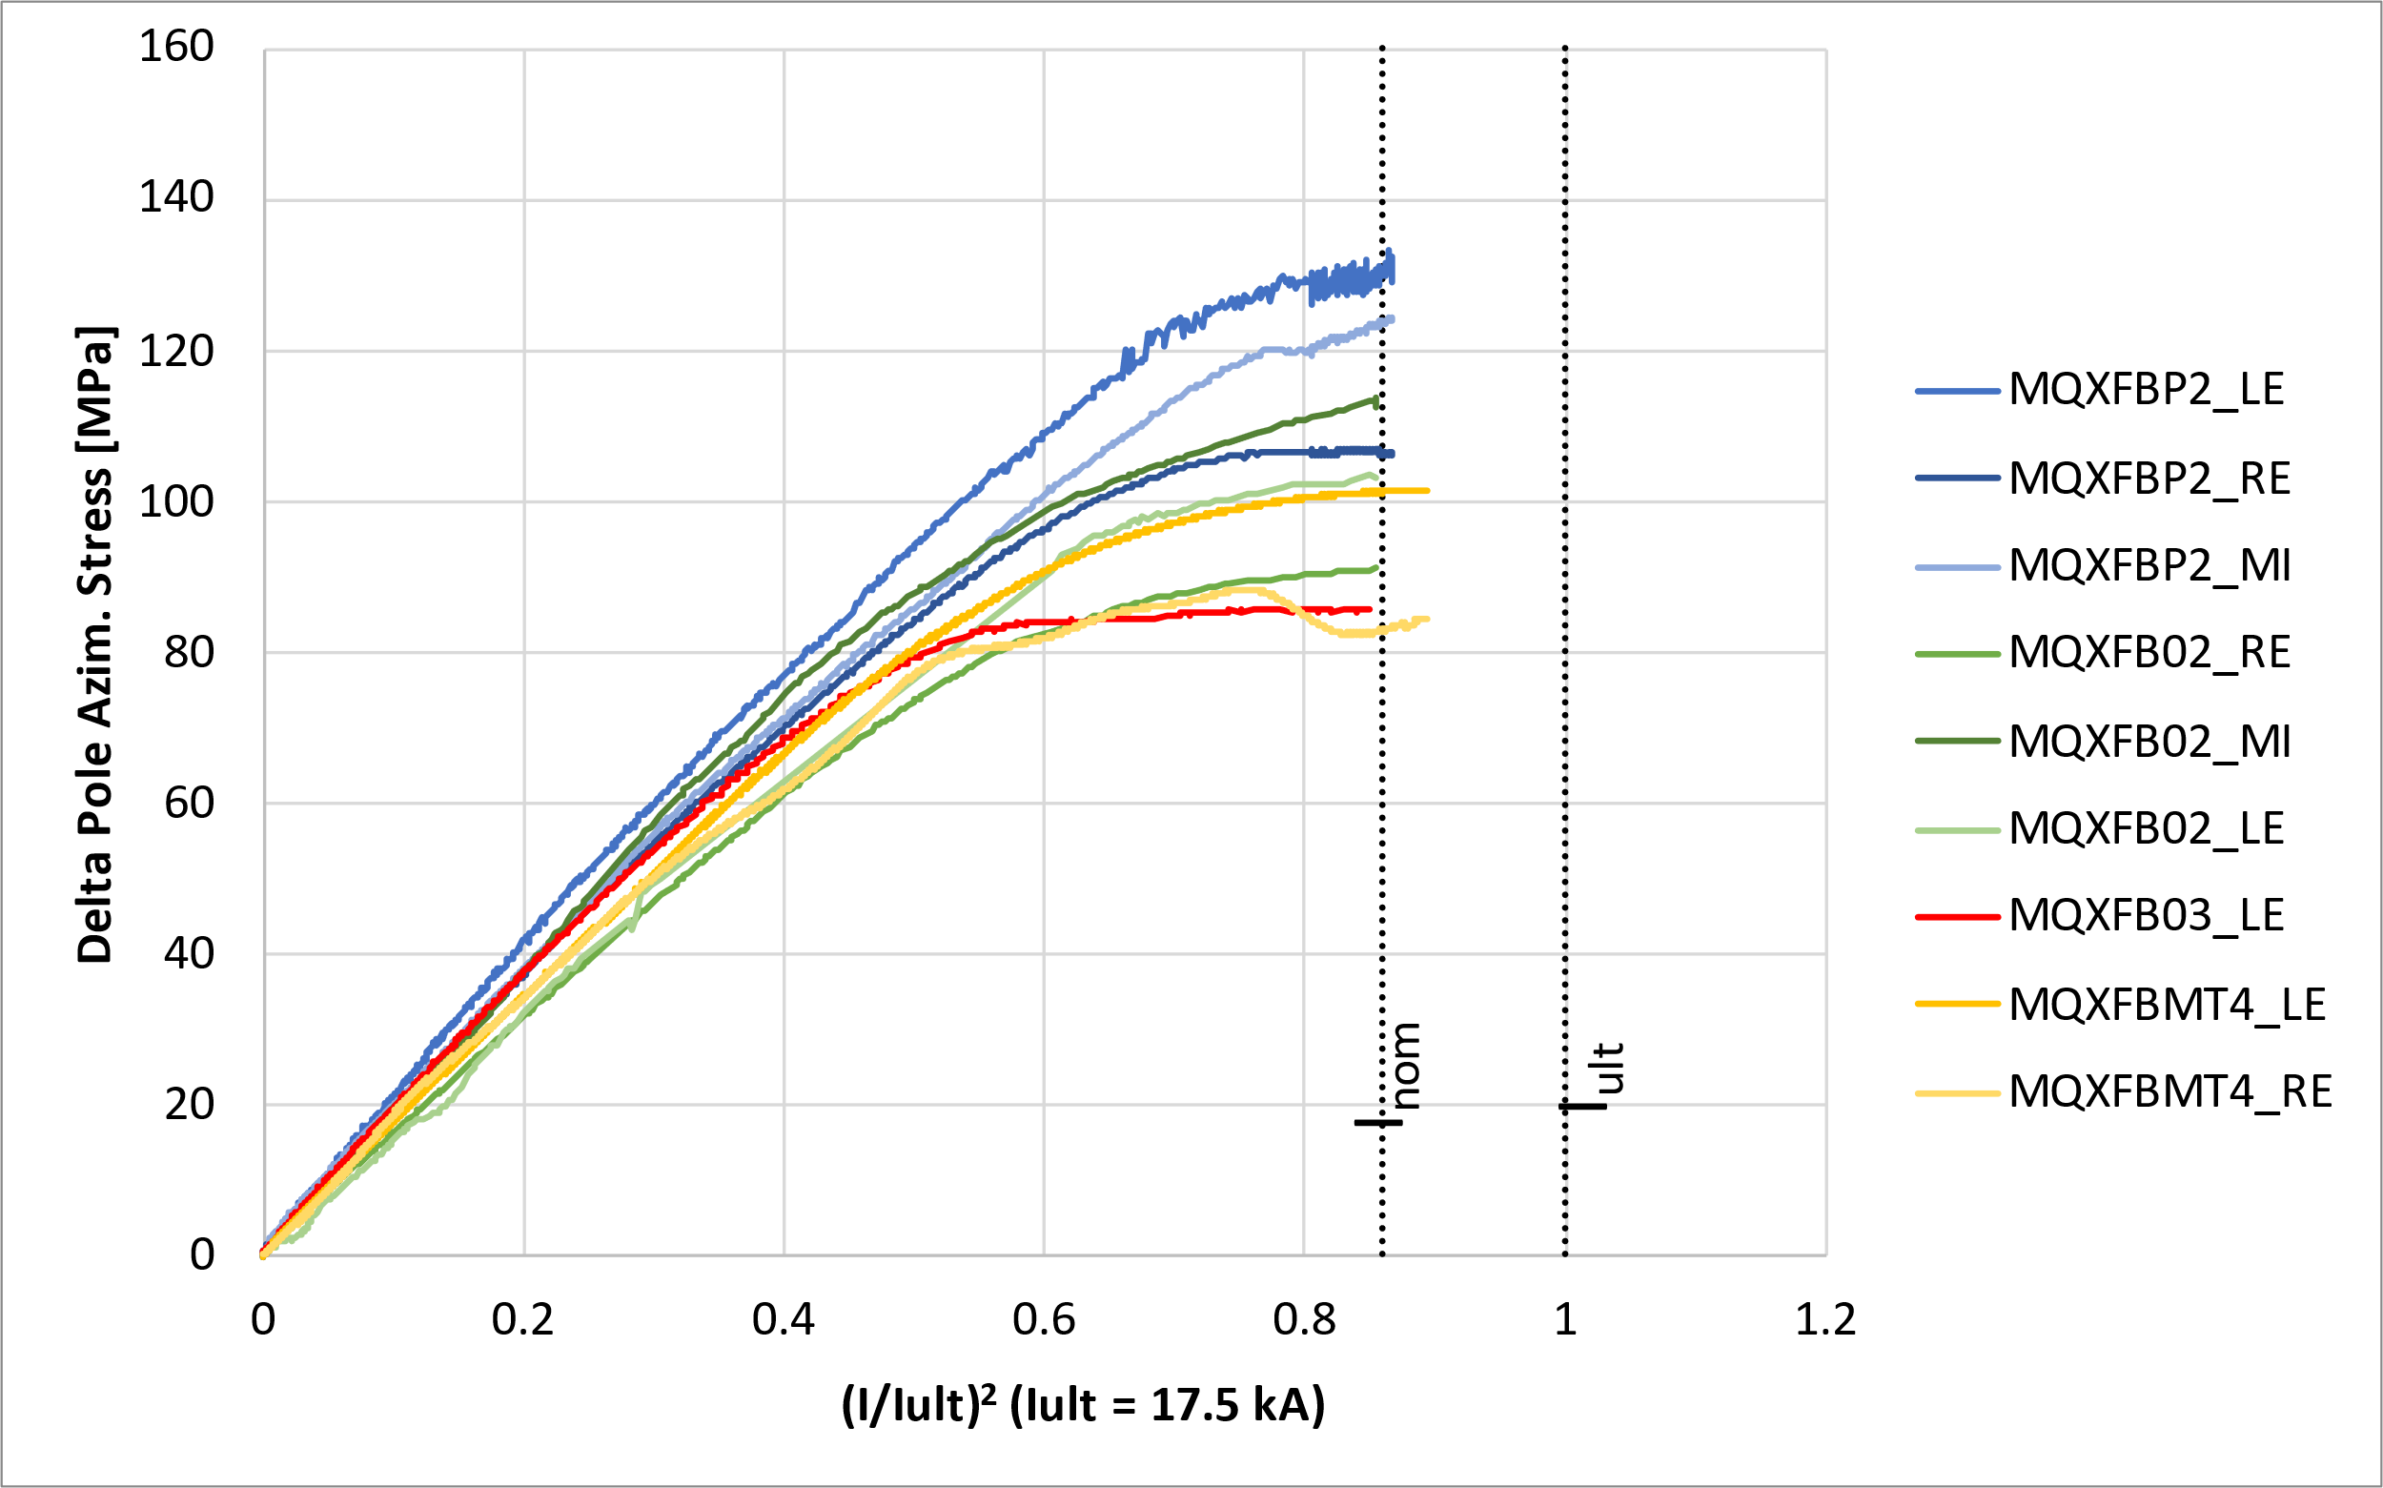
Cold: Targets vs achieved
At cold, MQXFB02 had 90-110 MPa pole azimuthal compression, corresponding to a pole un-loading around nominal current
For MQXFB03, we only have ‘clean’ measurements from the LE end, 85 MPa.
Data courtesy EN-MME

Slide 25
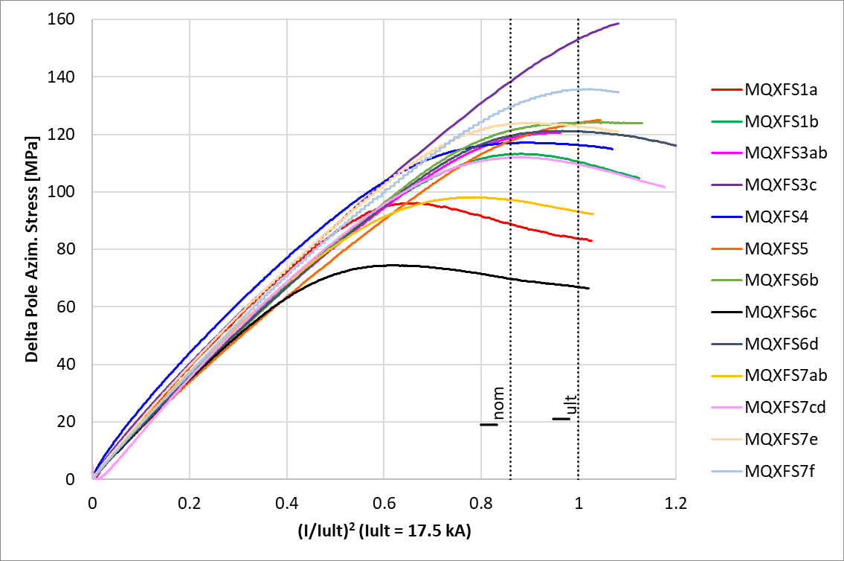
Cold: Targets vs achieved
MQXFS explored a wide range of pre-load, with magnets reaching performance requirements with a pole azimuthal compression at cold of 70-180 MPa.
  Low pre-load does not seem to be a limitation for performance, but might have an impact on the training (AUP has some evidences that magnets with higher pre-load train less, see Structure WG re MQXFA13 analysis and preload targets (September 5, 2023) · INDICO-FNAL (Indico))
Data courtesy EN-MME

Slide 26
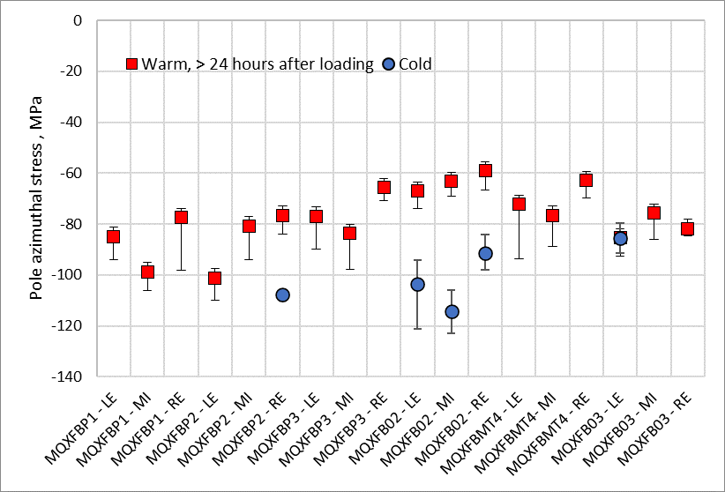
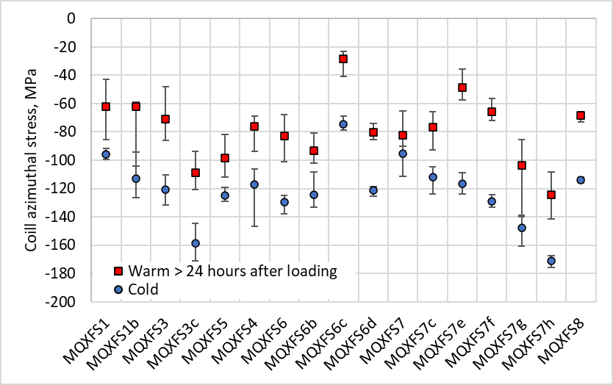
Cold: Targets vs achieved
So far, we have very little data from B03, but we see basically no increase of the azimuthal pre-compression with the cool down (when deriving the pole compression from the delta powering)
MQXFS explored a wide range of pre-load, with magnets reaching performance requirements with a pole azimuthal compression at cold of 70-180 MPa.
Estimated pole stress from delta powering, MPa
MQXFB03 - LE | C129 | C130 | C131 | C128 | AVE
Peak during magnet assembly | -87 | -80 | -63 | -65 | -74
> 24 hours after loading | -87 | -92 | -77 | -86 | -85
Cold | -80 | -91 |  |  | -85

