Slide 1

Welcome to the second HiTAT Workshop on High Temperature Superconductors for accelerator technology
The main focus of this edition is on REBCO, though we also have some presentations on BSCCO 2212
The first Workshop was held at CERN in March 2023, and this year’s meeting continues the discussion with a stronger emphasis on applications and technology development
The goal of this workshop is to exchange recent results, identify and discuss common challenges among experts in the field. Open discussions are encouraged throughout the sessions
Participation is primarily in-person, but we have Zoom connections for some colleagues in the USA who were unable to travel

Slide 2
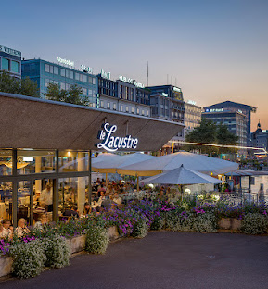
For those registered, the Workshop Dinner is this evening at Le Lacustre, in central Geneva, right by the lake
We’ll take the group photo this morning, just before the coffee break
We are planning to have proceedings in the form of short contributions summarizing the talks
Special thanks to IFAST, a European collaborative project funded by the EU’s Horizon 2020 programme, for supporting this Workshop
Special thanks to Valerie Brunner, the soul of the organization of this Workshop
Let’s raise the curtain!

