Slide 1

HTS Landscape
Objectives
Standard HTS-2212 wire
Low loss HTS-2212
(Wire, Cable. Coil)
Applications
Solid Material Solutions (SMS)
55 Middlesex Street, #205
Chelmsford, MA USA 01863
978-455-7182
Developments
High Je low loss wire and cable
Designs
Property validation
Scale up and production
Coils
Racetrack and solenoid
Performance
Production
Summary and Discussion
What is the status of 2212 wire, cable and coil at Solid Material Solutions?
Alexander Otto
President
Guidance from CERN: The proposed title of your talk is:
“Progress on BSCCO 2212 wire and cable”, with focus on low pressure heat treatment.
Solid Material Solutions (SMS)
Chelmsford, MA USA 01863 978-455-7182
HiTAT at CERN 23 – 24 October 2025 Alexander Otto Solid Material Solutions LLC

Slide 2

Mission
Address unmet HTS opportunities and demand
2212 wire, cable and coils for ac, fast-ramp and some high field applications
Fast ramp-able with low loss
Fine filamentary and transposed
Mechanically robust with inorganic bonding
High temperature margin
Normal zone propagation in field with 2212’s shorter distance to Hirr
Competitive Jc / Je and cost / price
Product development, utilization with sufficient revenue growth
HiTAT at CERN 23 – 24 October 2025 Alexander Otto Solid Material Solutions LLC

Slide 3

Value Progression for our 2212
Our focus
Standard designs for dc use
End user system
Wire
Cable
Coil
Magnet
Component
Low loss, small φ for ac use
Drop in forms
-Accelerators
-Instruments
-Motors and generators
-Ion beam therapy
-MRI and NMR
-Fusion reactors…
Field Boosting?
-Cost / performance
-Proven designs
-Production volume
- Large Iop range
- Many designs
-High Jop
-Resists burnout
-Robust
-Affordable
-Easily cooled
HiTAT at CERN 23 – 24 October 2025 Alexander Otto Solid Material Solutions LLC

Slide 4
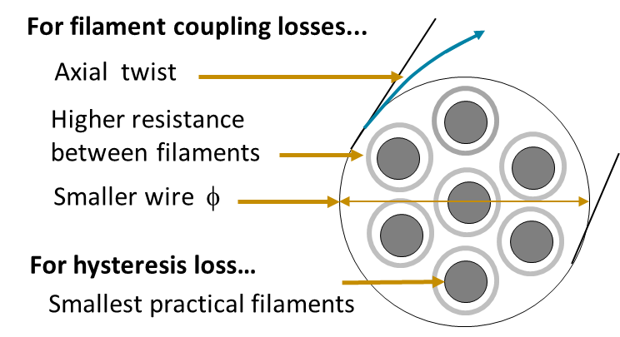

HTS Conductor features for fast ramp / ac use
See for example Martin Wilson’s book
POWER LOSS
dB/dt - induced voltages drive current in conductive loops
HOW REDUCE LOSS for 1 T/s to 3,000 T/s?
- Make loops smaller
- Increase resistances in loops
- Reduce number of loops
HOW APPLY TO CONDUCTOR?
- Smaller diameter wire
- Small, unmerged filaments
- Optimally higher resistance between filaments and strands
- Wire axial twist and cabling to short pitch
- Transposed strands in cable
Loop Examples
ac dB/dt → V, I
In HTS
~0 resistance to Jc
Current, I = V/R
Inter filament with twist,
Matrix resistance
For inter-strand coupling losses …
Short cable pitch
Increased inter-strand resistance
HTS with these features and high J_{op}
HiTAT at CERN 23 – 24 October 2025 Alexander Otto Solid Material Solutions LLC

Slide 5
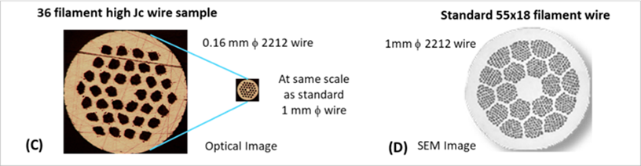
2212 wires with low loss and high Je developed
Powder-in-Tube Process
similar to Nb3Sn, MgB2, Bi2223
36 filament mainline wire design
φ 0.16 mm, capability to φ 0.12 mm
Functionally ~unmerged ~ 10 μm filaments
5 mm and 10 mm short twist pitches
Inter-filament resistance increased ~5X
High Jc / Je (1 – 1.5 kA/mm2 Je at 4.2K, 5T)
Validated by Robinson Research Institute and other facilities
∅ 0.16 mm low loss wire
With 36 filaments
1-stack
∅ 1 mm standard wire
with 990 filaments
2-stack
HiTAT at CERN 23 – 24 October 2025 Alexander Otto Solid Material Solutions LLC

Slide 6
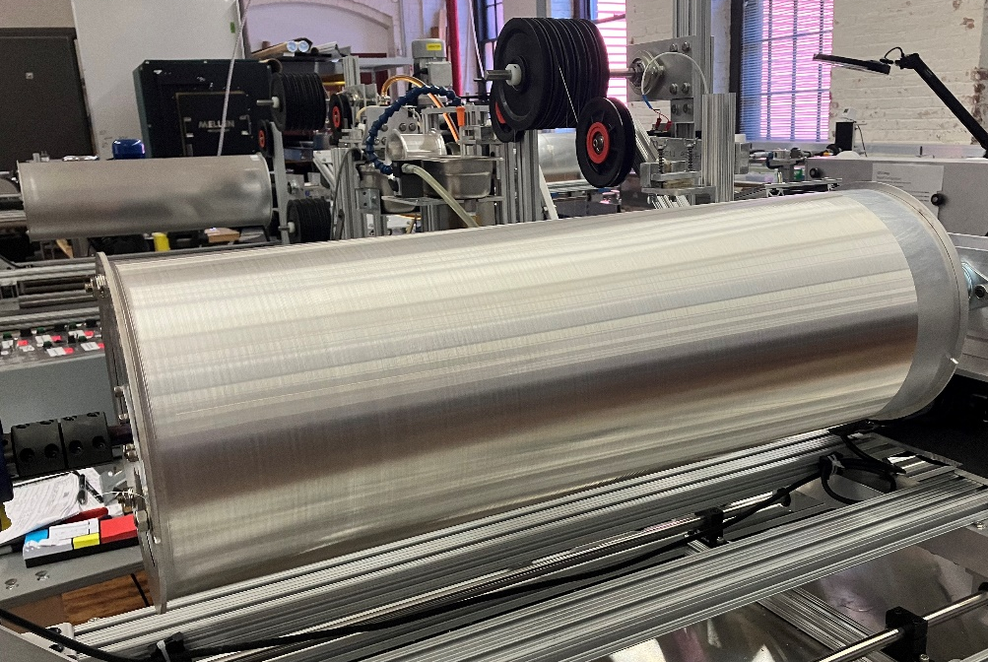
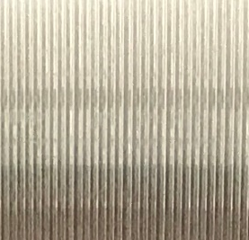
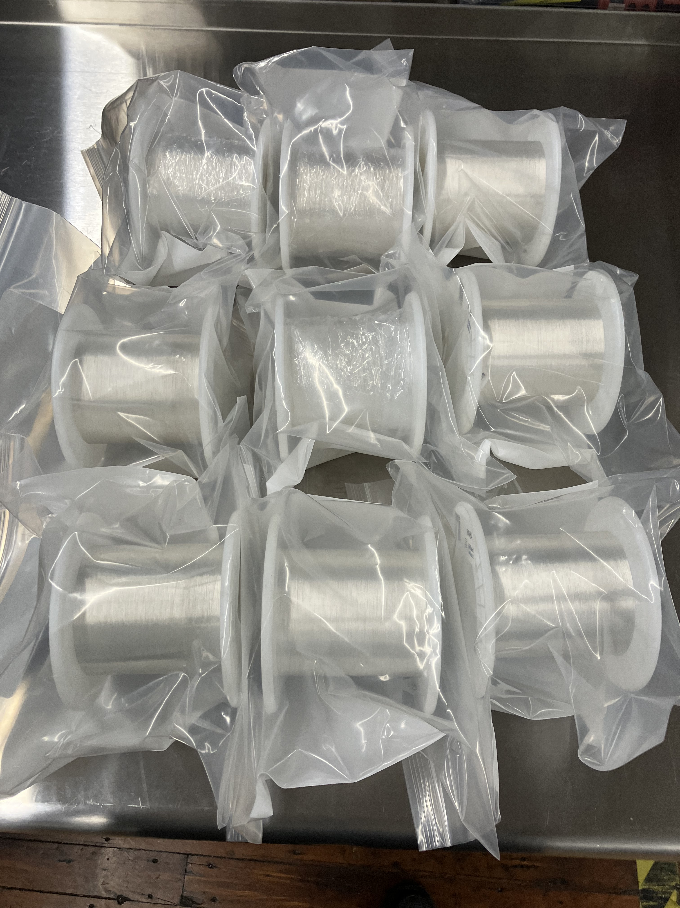
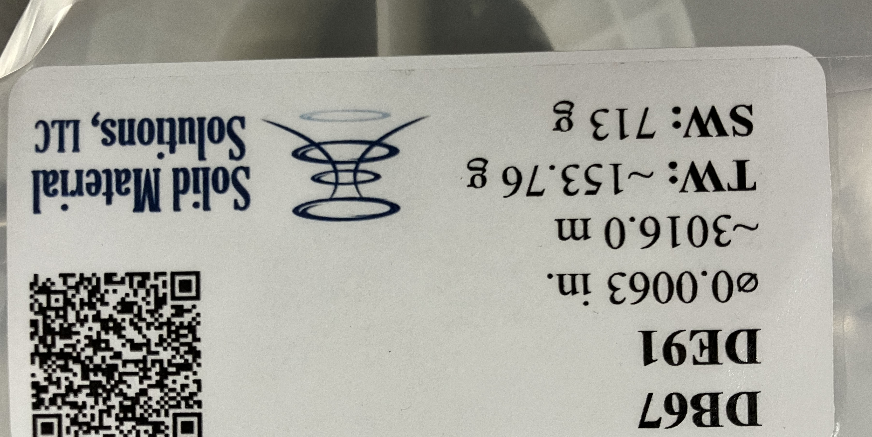
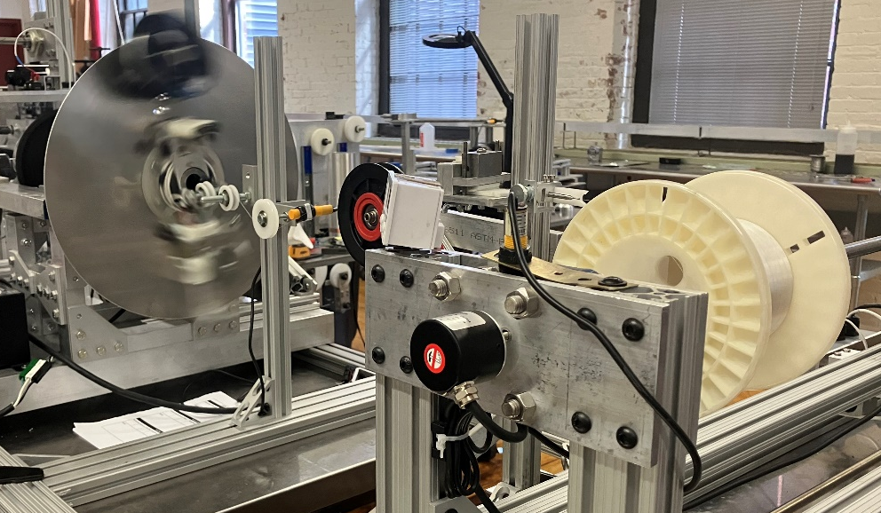
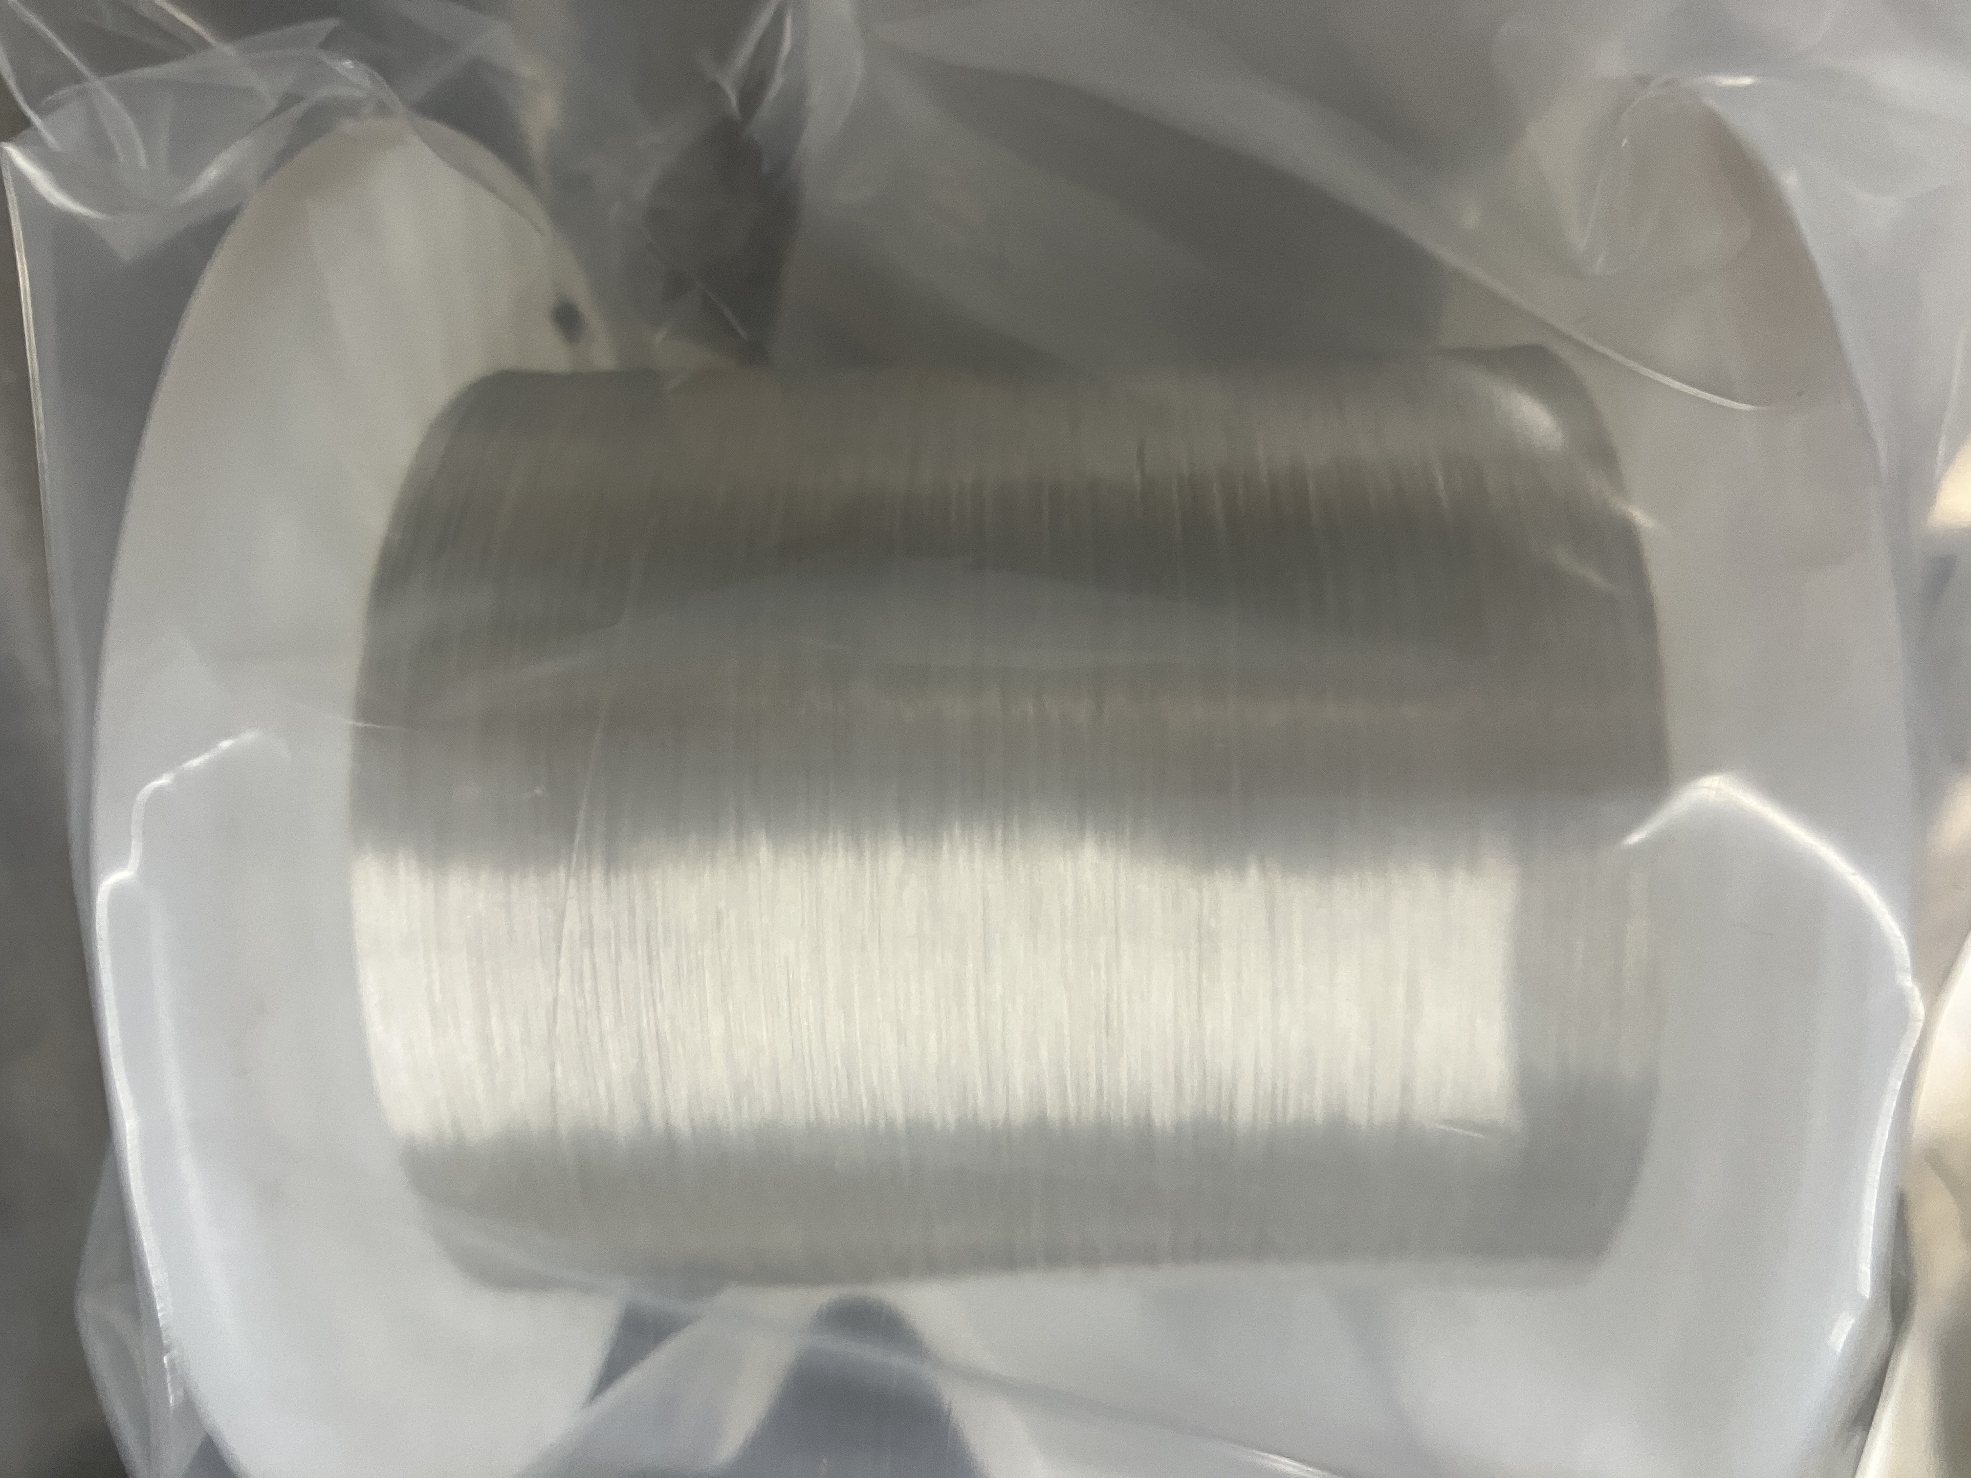
Scaled up to produce 3 km piece lengths
3 km piece length process for φ 0.16 mm low loss wire qualified (we do not sell this wire)
20 km buffer in inventory, 5mm and 10 mm pitch (cables and coils require a lot of wire)
Drawing, take up view
~ 3 km
Axial twisting
3,000 m
HiTAT at CERN 23 – 24 October 2025 Alexander Otto Solid Material Solutions LLC

Slide 7
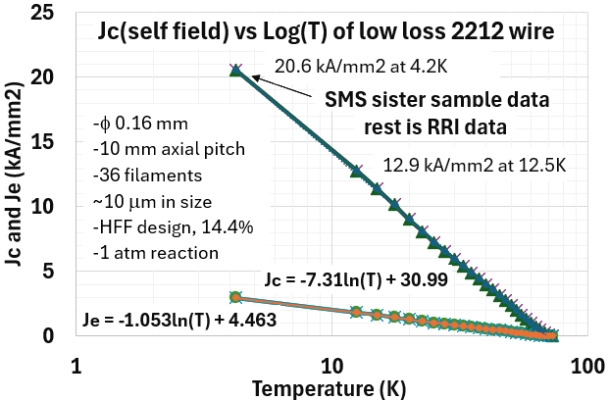
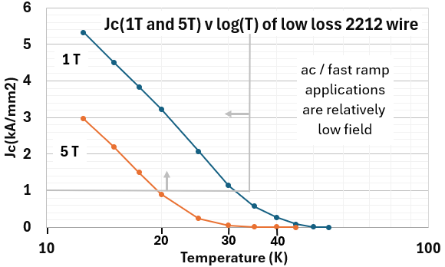
Jc (T)
Data from Robinson Research Institute (RRI) for 12.K to 65K and SMS for 4.2 K
Jc (T) well behaved and rises ~ 32-fold to ~ 21 kA/mm2 at 4.2K from 63.2 K
HiTAT at CERN 23 – 24 October 2025 Alexander Otto Solid Material Solutions LLC

Slide 8
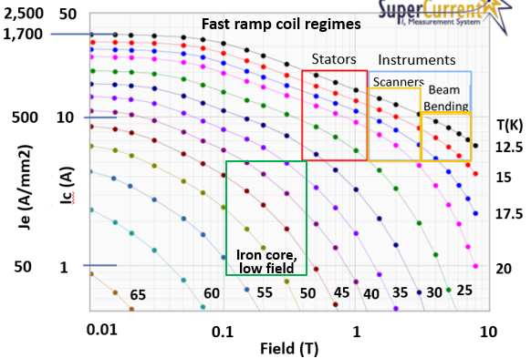
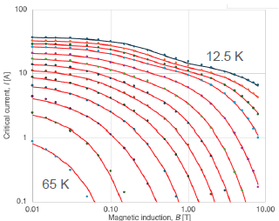
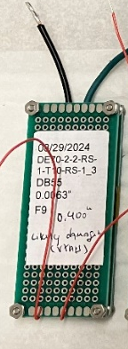

Ic / Je (.01T to 8T, 12.5K – 65K) Generated by RRI
Data
Calculations by fit equations
Wire test
fixture
to avoid
damage
Results show:
- Usefully high Je / Jc levels by 1 atm reaction
- Accurate scaling from low cost 63 K Ic tests
Excellent fit equations developed by A. Godeke
For Ic / Je (T, B) by physics analysis of data
Vital for developing good coil designs
HiTAT at CERN 23 – 24 October 2025 Alexander Otto Solid Material Solutions LLC
8

Slide 9
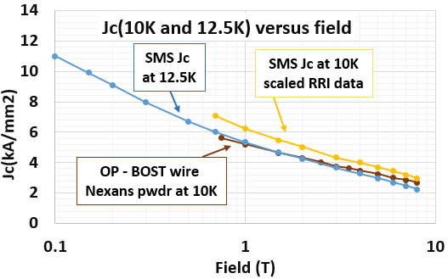
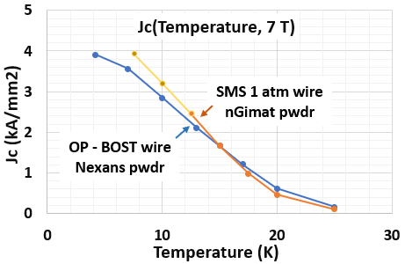
Jc Comparisons at similar conditions
RRI tested SMS wire Jc(T, 7T) is very close to data for OP-BOST wire Jc(T, 7T)
No overlapping test regime data yet for later, better OP-BOST or SMS wire
Jiang et al. IEEE Trans Appl Supercond. 2019 August ; 29(5): doi:10.1109/TASC.2019.2895197. and Ashley Francis data
HiTAT at CERN 23 – 24 October 2025 Alexander Otto Solid Material Solutions LLC
9

Slide 10
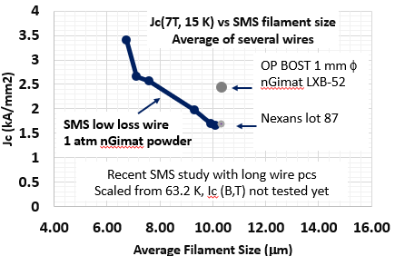
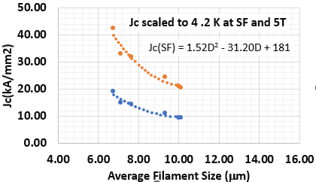
New Jc Advancement Study Yielding Promising Results
Lots of headroom for Jc advances in 2212 wires
Testing Jc(B,T) vital – so far only have 63.2K data that was scaled here with RRI based factors
Extensive optimizations as for 1G and 2G not yet done for 2212 (needs $)
Jiang et al. IEEE Trans Appl Supercond. 2019 August ; 29(5): doi:10.1109/TASC.2019.2895197. and Ashley Francis data
HiTAT at CERN 23 – 24 October 2025 Alexander Otto Solid Material Solutions LLC
10

Slide 11
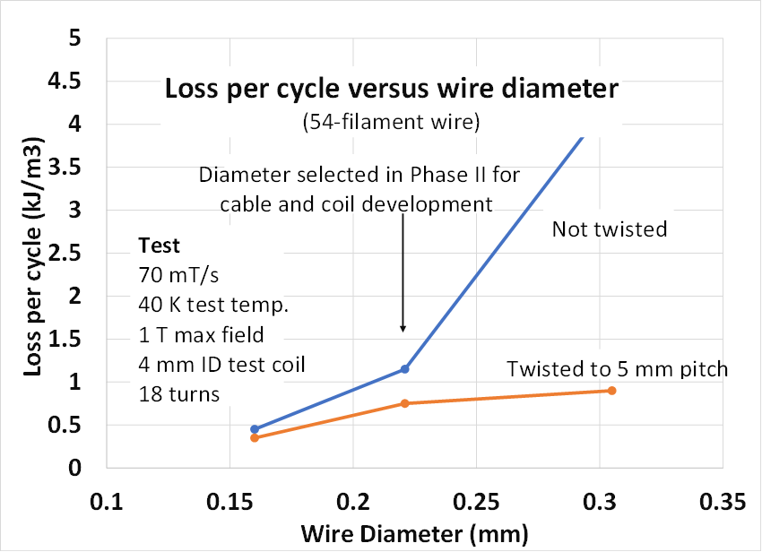
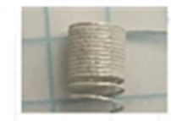
Wire Loss Tested at Ohio State University (OSU)
Loss per cycle versus wire diameter
- Loss decreases 4X with half the wire∅ and shorter twist pitch
No Twist
- Losses reducing features are effective
Twist, 5 mm pitch
- Analysis of loss and fabrication factors led to selection of φ 0.16 mm baseline
Mainline
Power loss tests for energized coil ongoing at OSU
Vital for coil and cooling development, designs and usage regimes
Plan to apply test method developments to test recently built best mode coils
HiTAT at CERN 23 – 24 October 2025 Alexander Otto Solid Material Solutions LLC

Slide 12
Total loss comparison analysis of HTS “Wire” Options
4 mm 2G
Based on magnetization data and analysis for ~ 150 Hz – long lengths terminated
4 mm 1G
Perp
field
2212 loss similar to MgB2 and LTS low loss designs
2212 low loss design
~independent of field direction
Cable
Wire
Perfect par field
Transport loss data required for coil cooling design, validate magnetization data
HiTAT at CERN 23 – 24 October 2025 Alexander Otto Solid Material Solutions LLC

Slide 13
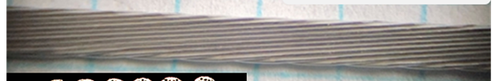
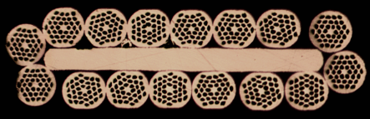
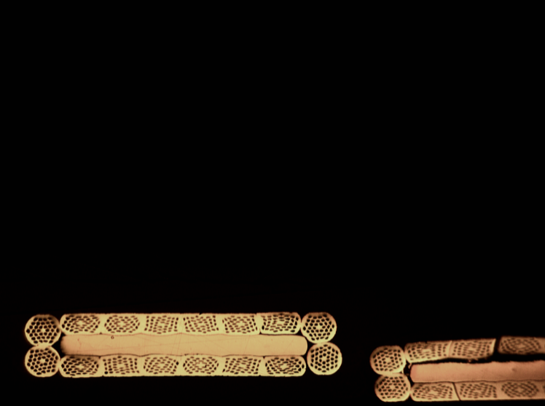
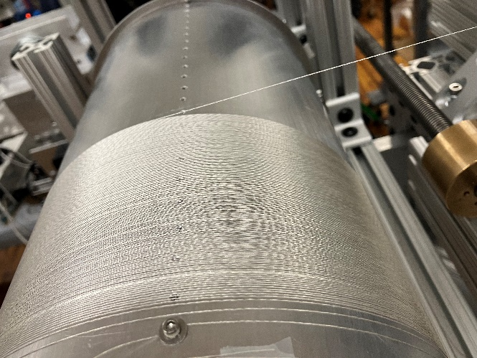
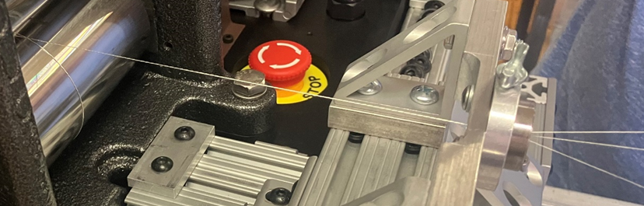
Cable designs and cabling line developed
Fine wire cabling line developed
Higher wire count line being built
Baseline cable design
Rutherford
16-strand
extending to higher strand counts
Roll consolidation
Coilability
~55 cables produced
Bare- and coated-wire cable designs
Typical cable top view
1.45 mm
1.5 mm
16-strand cables with increasing amounts of roll consolidation
HiTAT at CERN 23 – 24 October 2025 Alexander Otto Solid Material Solutions LLC
13

Slide 14
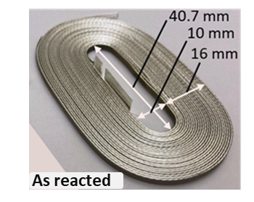
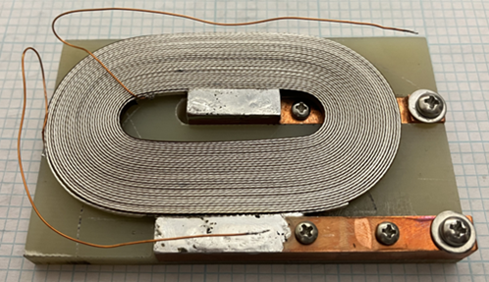
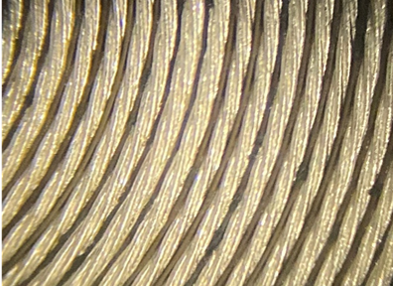
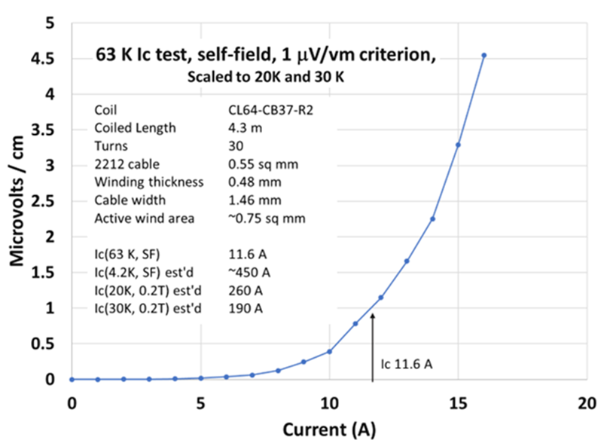
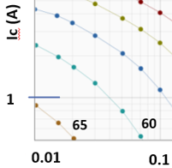
Coil Development: Wind-and-React
Numerous test coils fabricated
Integrated into application initiatives
Racetrack
Cylindrical
Saddle
88 coils produced
Many with high performance
Bonded wind pack
with insulation, reinforcement
Set up to test
Coil for subscale 140 kW motor test bed
63.2K test
Average end to end wire Jc here ~ 70% of RRI wire Jc
.
Ic with coil field effect removed ~ 19.8 A
60K
65K
63.2K
11.6 A
Field T
HiTAT at CERN 23 – 24 October 2025 Alexander Otto Solid Material Solutions LLC

Slide 15
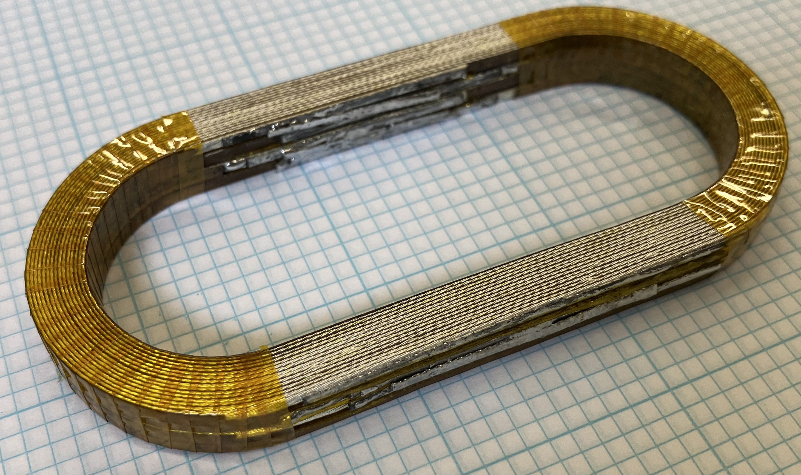
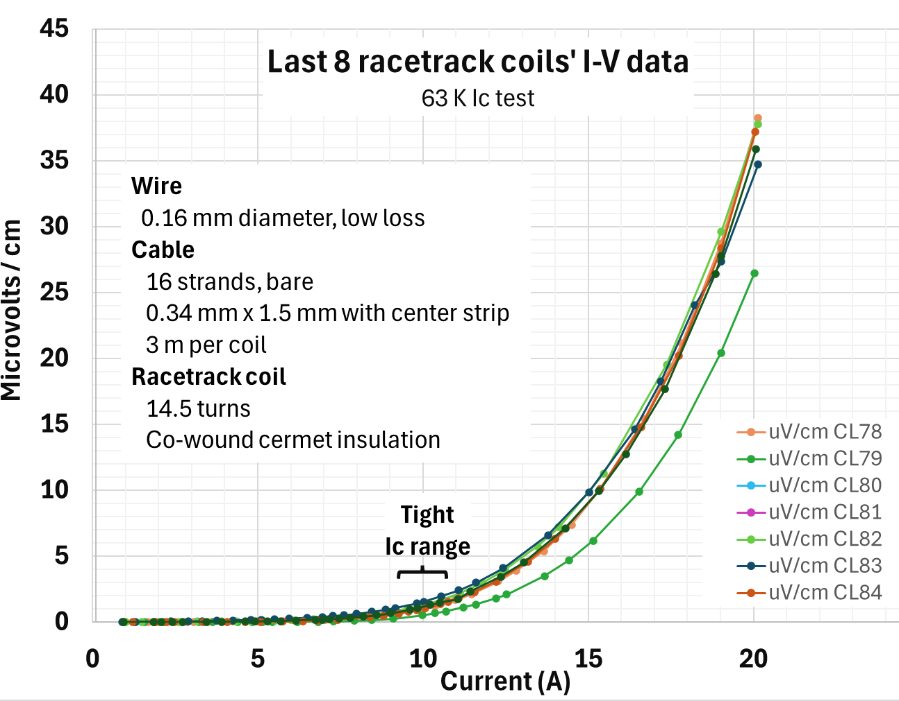
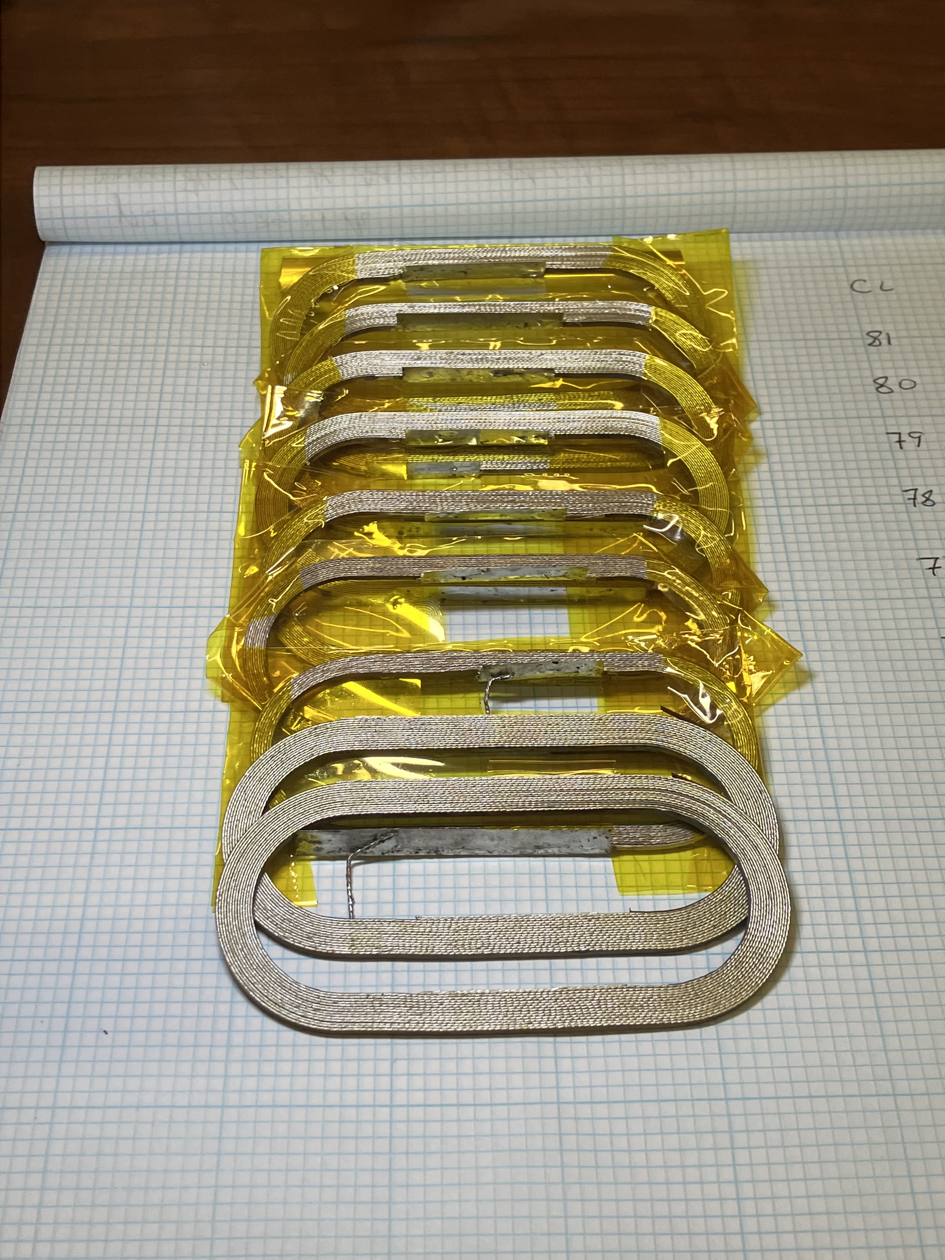
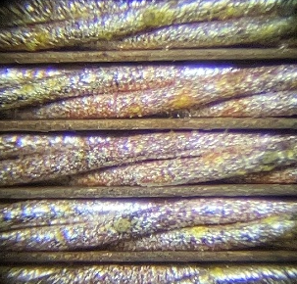
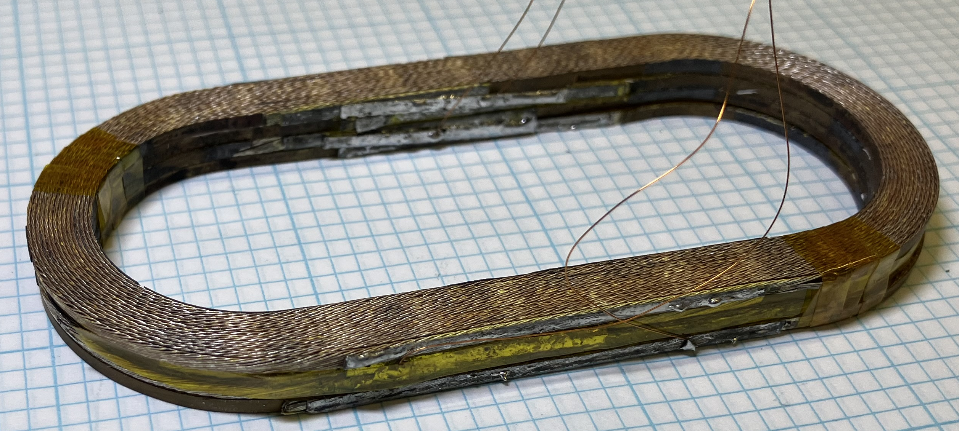
Series Fabrication and Ic of Racetrack Pancakes and Stacks 4-stack pancake coil – serially connected
Bare wire cables
Coated wire cables
Low loss
cable jumpers
- Series made pancake coils
- Bare / coated wire cables
- To application specification
Stack of 4 racetrack pancakes
- Very uniform geometry to tight specs
- Strong sintered structure
- For 1 T at > 300 Hz, > 15K
- Pancake coil I-V data are very similar, Ic ~ 10 A
- Field adjusted Ic ~ 16 A at 63 K, 1 A/wire
- Je(SF, 4.2K) ~ 1.6 kA/mm2 (60% of RRI data)
- Front two before Ic tests
- Wrapped are Ic tested
HiTAT at CERN 23 – 24 October 2025 Alexander Otto Solid Material Solutions LLC

Slide 16
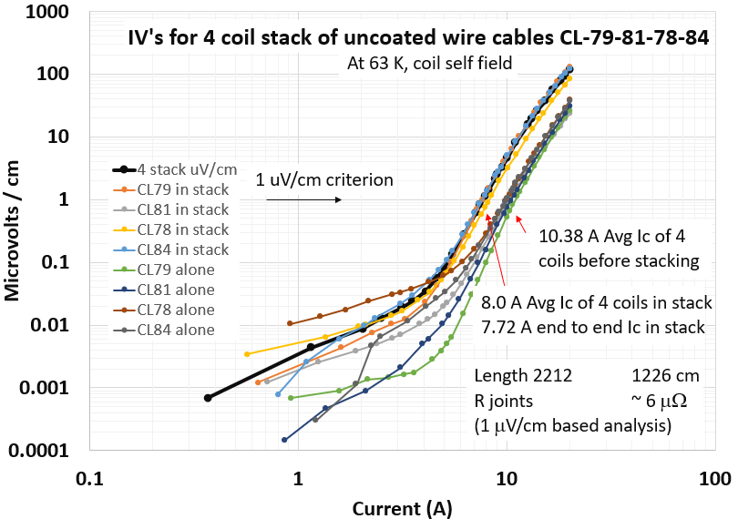
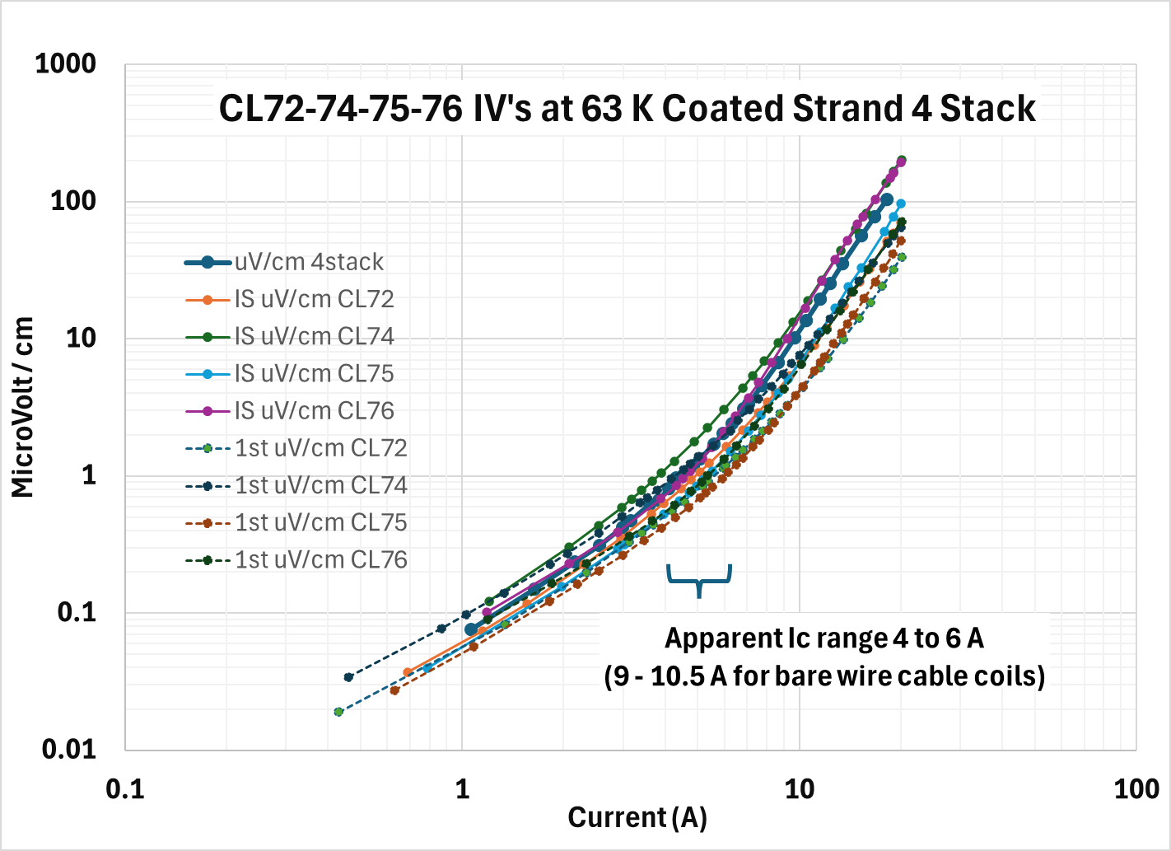
Stack and Constituent Coil Performance Comparisons 4-stack of racetrack pancake – serially connected – coated and bare wire cables used
Coated wire cable in coil
Uncoated wire cable in coil
No Ic decrease except for self field effects with very uniform coil to coil I-V’s and Ic’s
Coated wire cable 4-stack Ic’s show effect on current sharing
Method developed / validated for pancake stacks, jumpers, tight geometric tolerances
HiTAT at CERN 23 – 24 October 2025 Alexander Otto Solid Material Solutions LLC

Slide 17
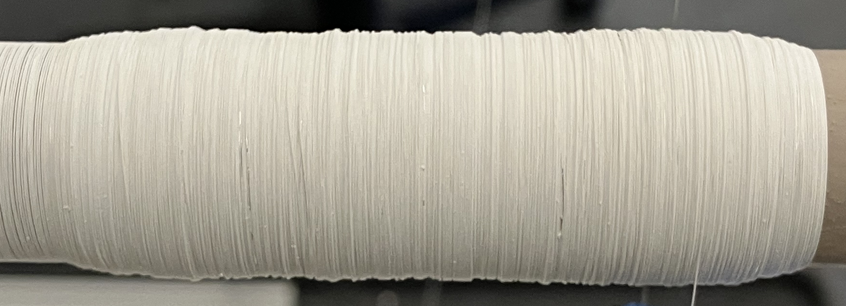
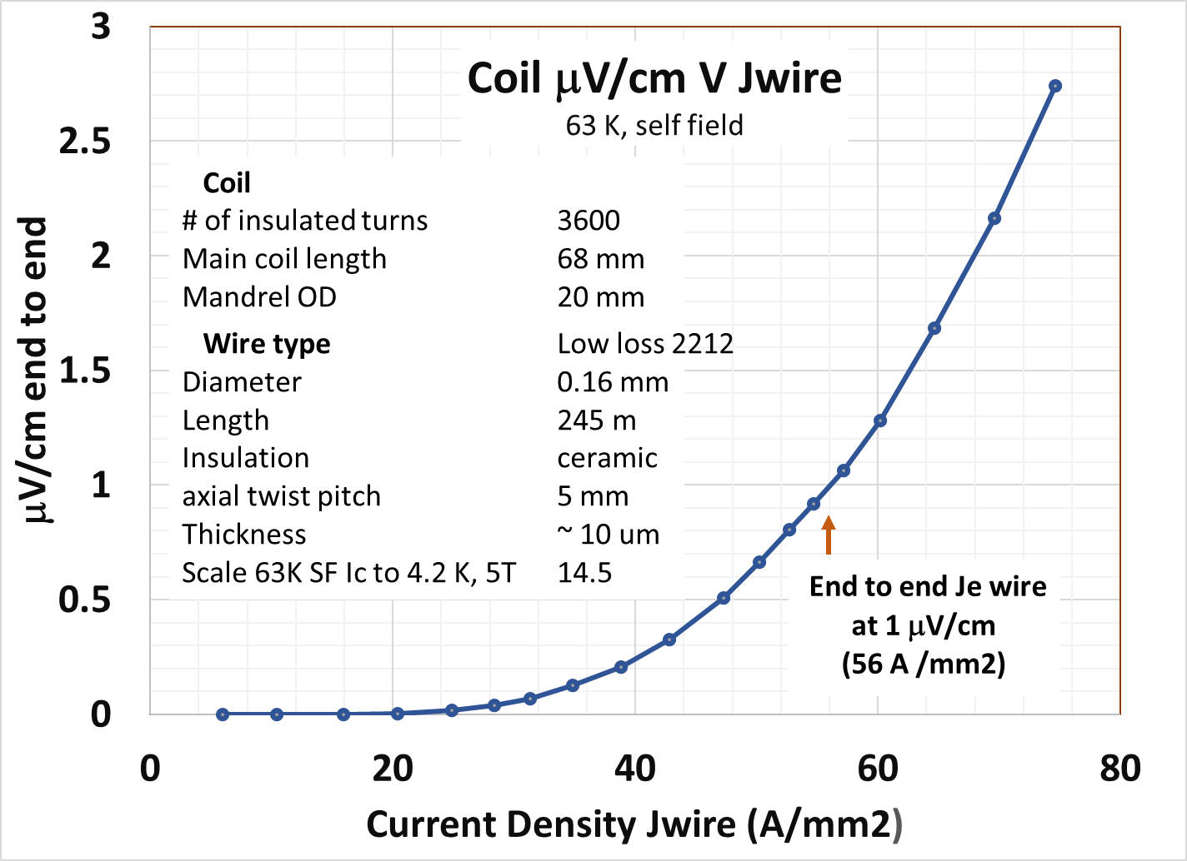

Low loss 2212 Wind and React Wire-Wound Solenoid Test Coils
68 mm
Primary Challenges (to enable long wire coils and data)
Many turns and layers without losing build
End reversal of wind and terminations
Thin, effective insulation without sticking
245 m
wire
20 mm
Coil CE3T
3600 turns with 0.16 mm φ low loss insulated 2212 wire
Build compromised in last few layers, but reacted anyway
→ Good Ic at 63 K, 245 m wire, 10 – 25 K tests planned
HiTAT at CERN 23 – 24 October 2025 Alexander Otto Solid Material Solutions LLC

Slide 18
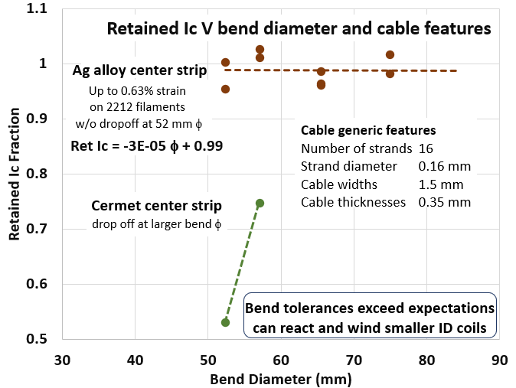
React-and-wind 2212 Cable and Coil Development
With standard 16-strand Rutherford cable
Bend properties of some SMS cable designs show utility to winding smaller ID coils than expected (to ~ 6 cm)
Fine wire Rutherford cable is only 1.4X thickness of 1G tape but also has same of better bend properties
HiTAT at CERN 23 – 24 October 2025 Alexander Otto Solid Material Solutions LLC

Slide 19
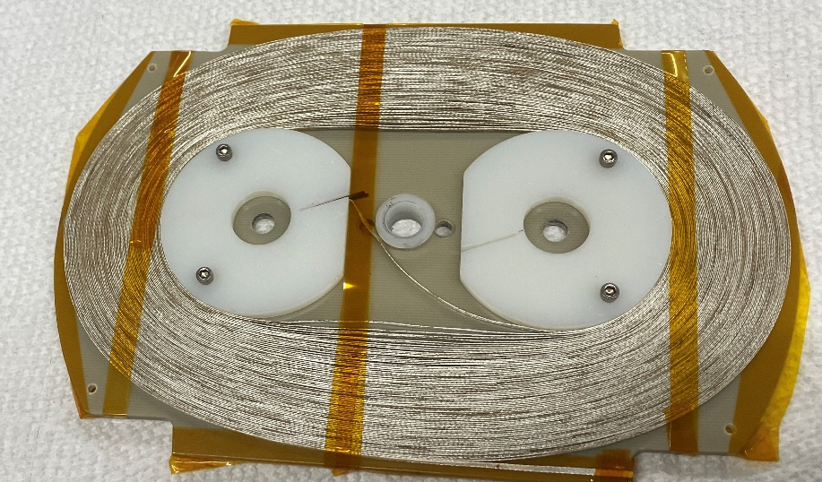
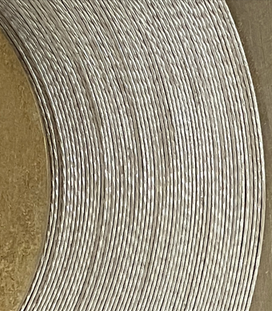
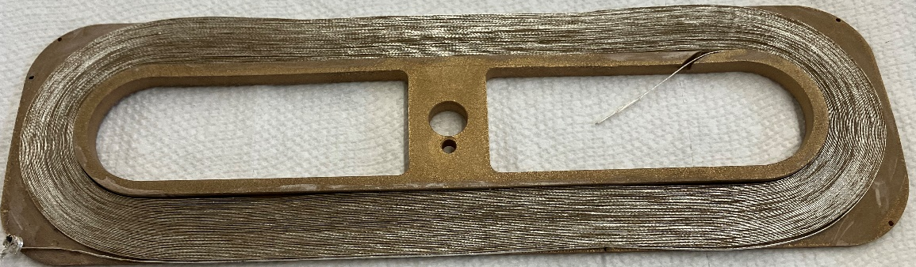
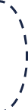
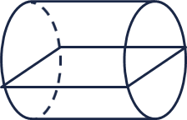
Long length cable 1 atm reaction and Ic testing Scalable racetrack pancake approach for react-and-wind (> φ52 mm) developed
78 turn Ic test mandrel coil with 16-strand cable
35 m cable on reaction mandrel after reaction
Reaction set up
+- 1 degree C plane
φ10 cm →28 cm
Relatively low-cost scalability by adding series modules for much longer cables
30 cm module
HiTAT at CERN 23 – 24 October 2025 Alexander Otto Solid Material Solutions LLC

Slide 20
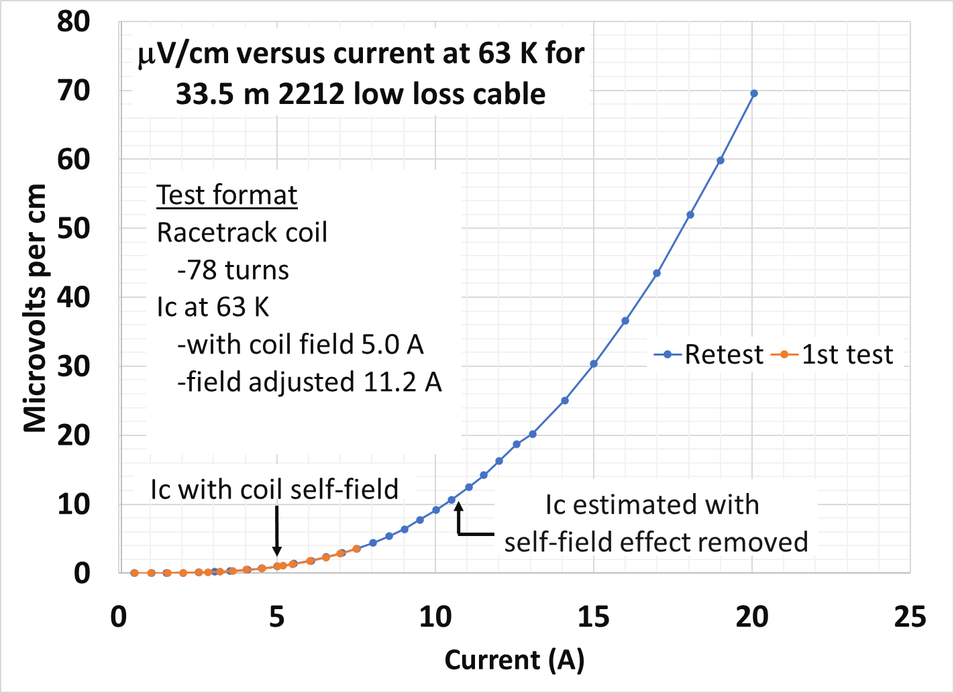
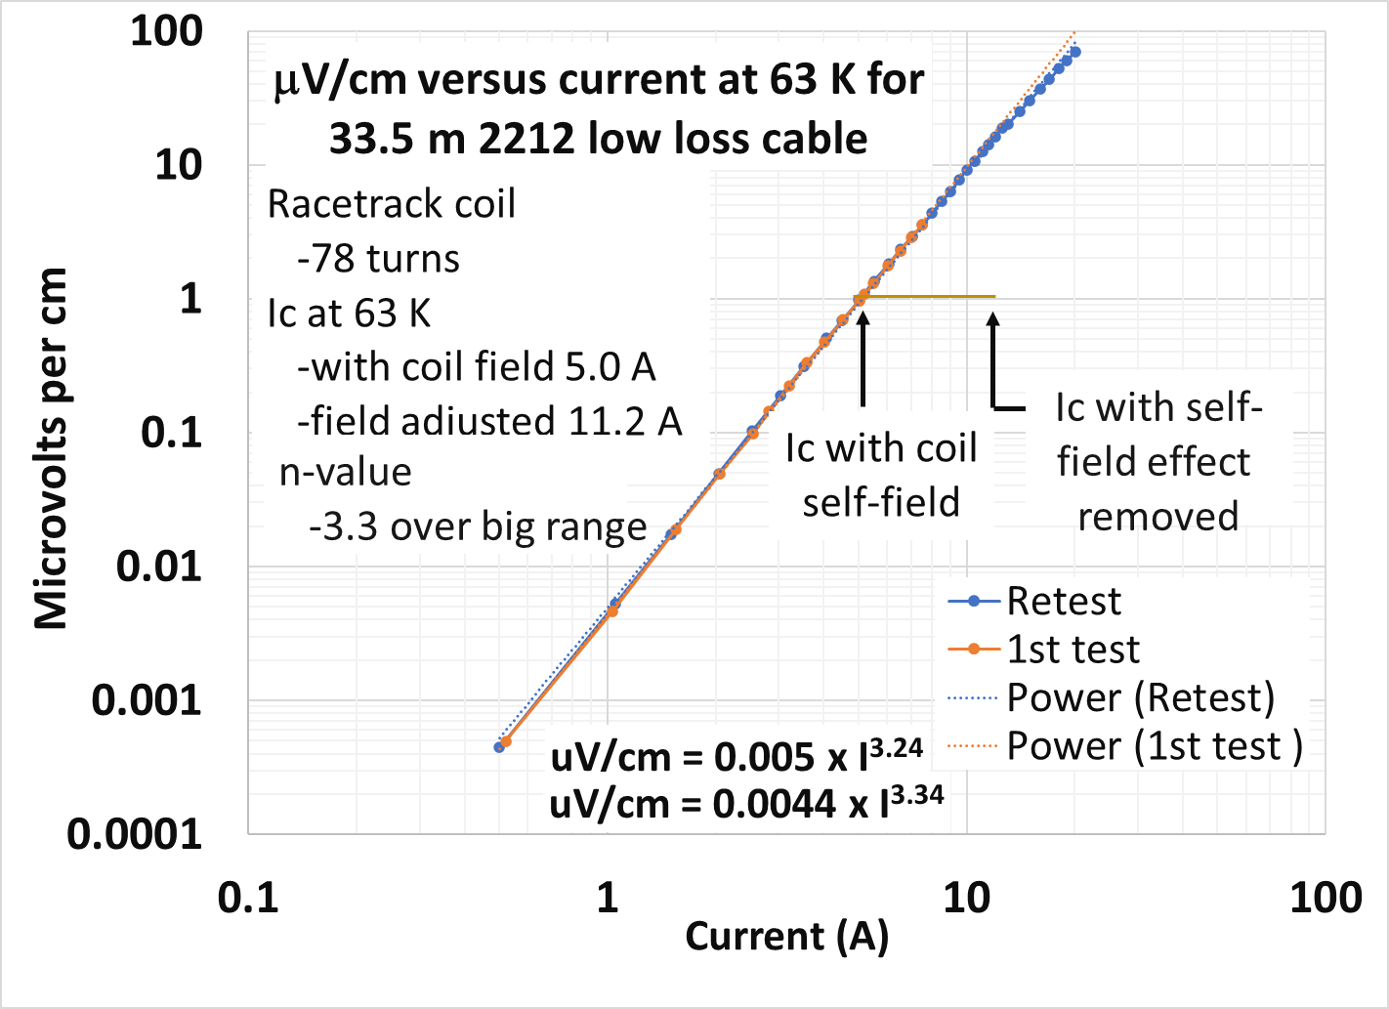
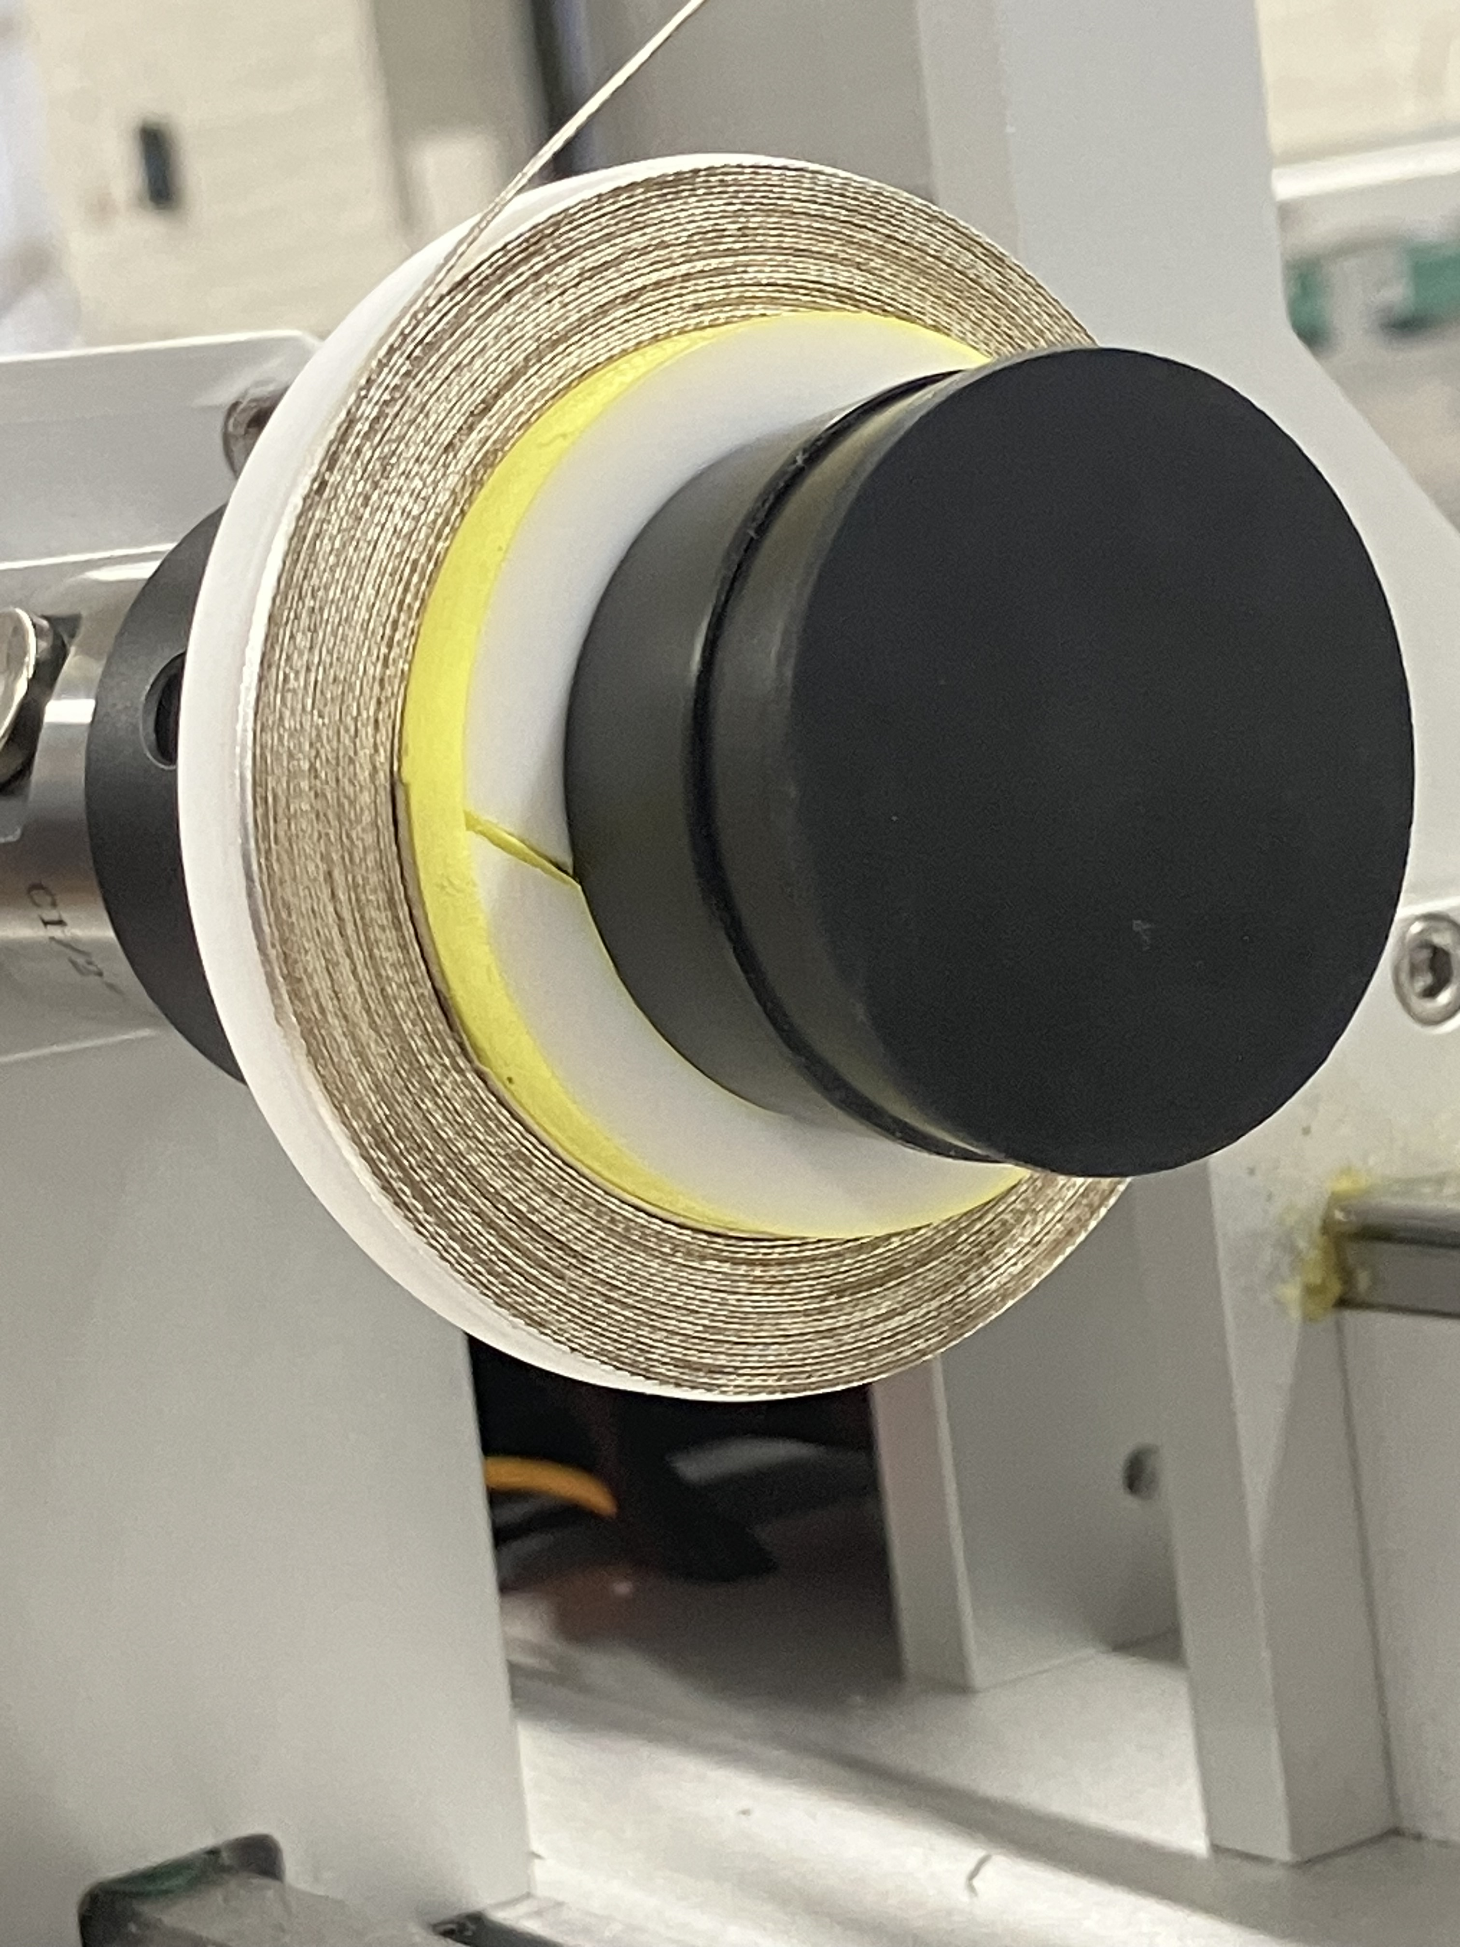
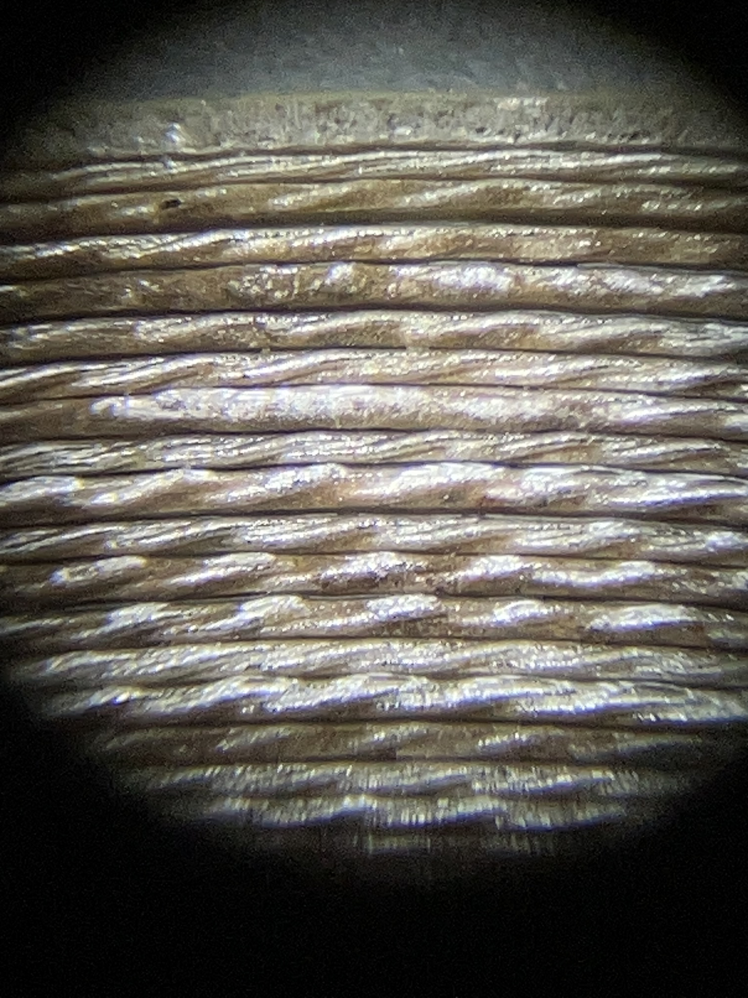
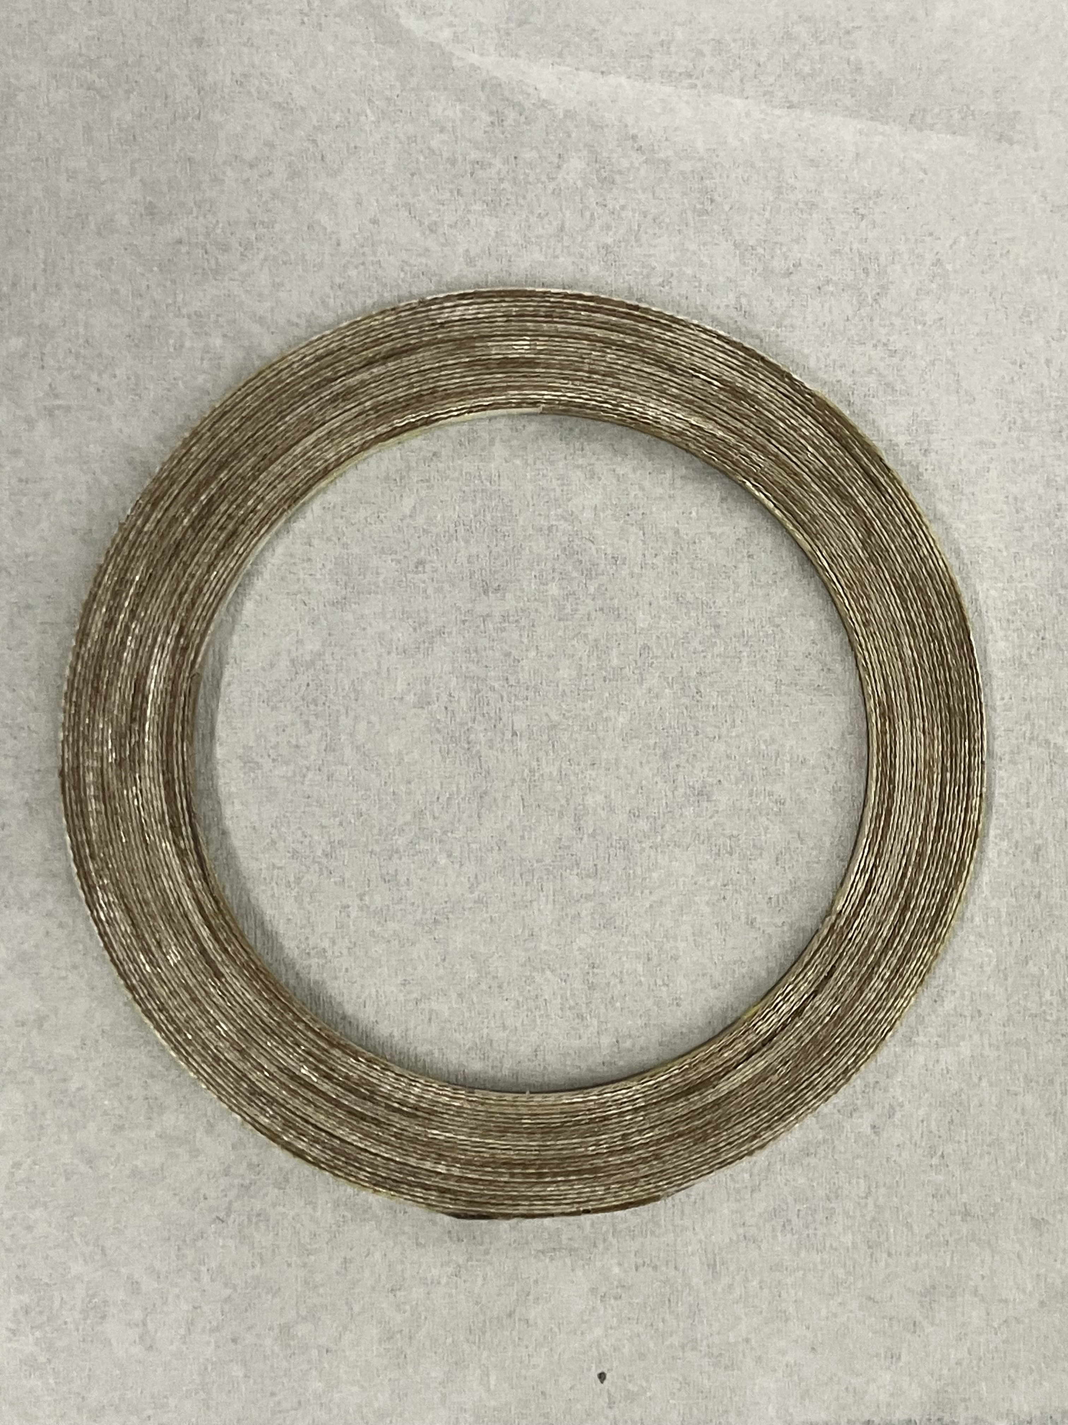
Cable End-to-End Ic in Racetrack Coil form
I-V for 33.5 m cable length
Log – Log I-V
Insert pancake test coil module with reacted cable
Test format
Racetrack coil
78 turns
Ic at 63.5K
with coil field 5.0 A
field adjusted 15 A
Epoxy potted
9 mm
26 turns
- Constant n value over very large I-V range
- Corrected Ic matches Ic’s of short samples cuts from cable ends
- End-to-end Ic in useful regime – many further optimization options
50 mm φ
HiTAT at CERN 23 – 24 October 2025 Alexander Otto Solid Material Solutions LLC

Slide 21
Summary and Discussion Ideas
Summary of SMS 2212 Development Status
High Je, low loss wire designs and their manufacture to 3,000 m piece lengths and by 1 atm reaction
Baseline low-loss 16-strand cable and fabrication with higher strand count
Coil designs and wind and react for them established, and also nascent react and wind capability
Discussion Ideas
Introduction of SMS 2212 into CERN initiatives and its potential usefulness to CERN needs
Ramp induced loss and field boosting in accelerator dipoles as compared to other HTS
Filaments to < 10 μm and possibly 6 μm (what are ramp rates and loss requirements?)
Are all other required loss-reducing features required?
No need for training, and stability / quench characteristics?
Mechanical properties – including compression
Jop / Iop trade offs – optimal cable designs with reinforcement
Scalability of SMS 2212 conductor tech, plus possibility of reacted 2212 cables for coil winding
Cost? – similar to PIT in general x a silver / complexity factor ~ 2 x that of high quality NB3Sn in high volume (Also no rare earths)?
HiTAT at CERN 23 – 24 October 2025 Alexander Otto Solid Material Solutions LLC

Slide 22
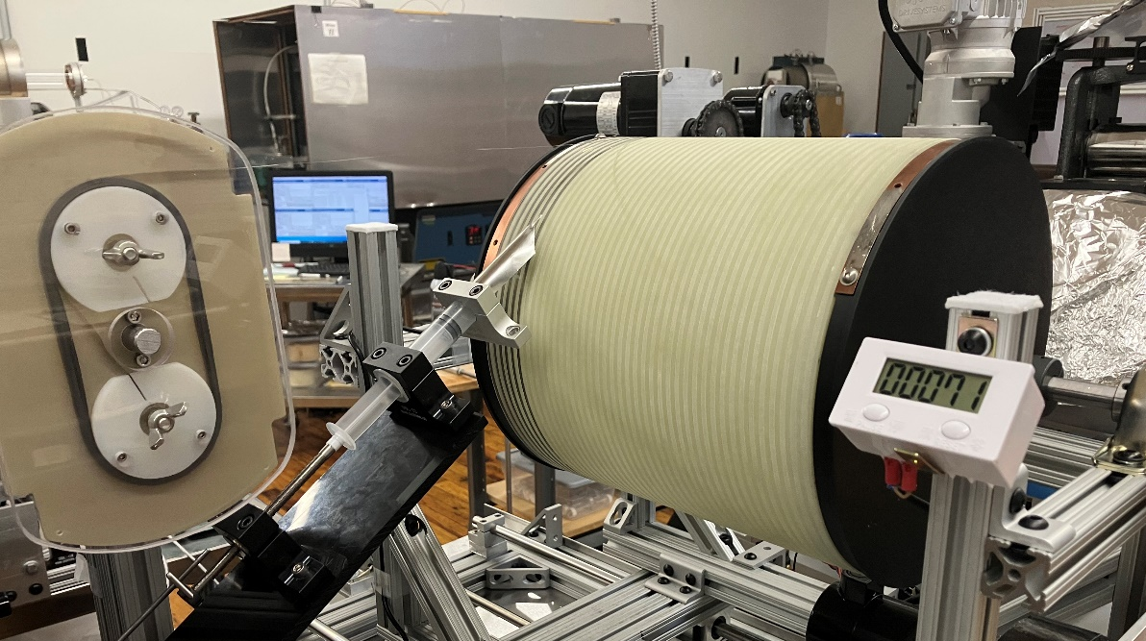
Coiling React-and-Wind Set up and Development
.
Test level wet wind solenoid
Winding set up
25 cm ID solenoid coil winding set up for reacted cable
Wind stations set up, qualified
5 cm ID pancakes wound, potted, Ic tested with good results
25 cm ID solenoid wound with good results, shipped
(higher field usage require wind and react for 5 cm ID regime)
HiTAT at CERN 23 – 24 October 2025 Alexander Otto Solid Material Solutions LLC

