Slide 1
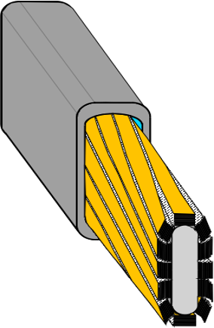



REBCO FReTC Conductors Rutherford-Type Cables
FReTC-CICC
Makoto Takayasu¹, Luisa Chiesa², and Vyacheslav Solovyov³³
¹Massachusetts Institute of Technology,
Plasma Science and Fusion Center,
Cambridge, MA 02139, USA.
²Tufts University, Mechanical,
Engineering Department,
Medford, MA 02155, USA.
³Brookhaven Technology,
Group, Stony Brook,
NY 11794, USA.
2nd HiTAT Workshop, CERN
October 23 - 24, 2025
Acknowledgment
This work was partially supported by the U. S. Department of Energy (DOE), Office of Fusion Energy Science under DE-FC02-93ER54186, DE-SC0019905 and DE-SC0024864, and the DOE Office of High Energy Physics under Grant DE-SC0023458.
This work would not be possible without the generous support of Eni and MIT PSFC.
The REBCO/copper cable used for this project was supplied by Dr. A.E. Haight, CTD.

Slide 2
Outline
1. REBCO Rutherford-Type Cable Review
2. FReTC
FReTC cabling: Method I
Method II
3. FReTC Fabrication Device
4. FReTC Characteristics:
Current density, hysteresis loss, and bending
5. Summary
FReTC

Slide 3

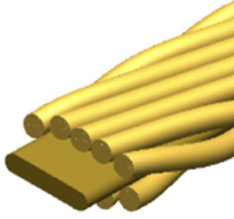
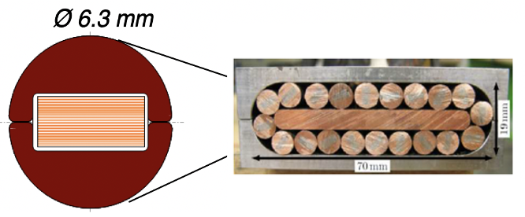
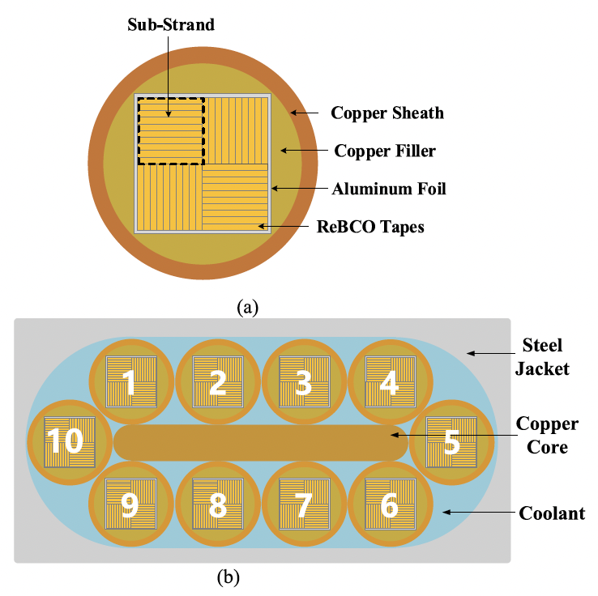
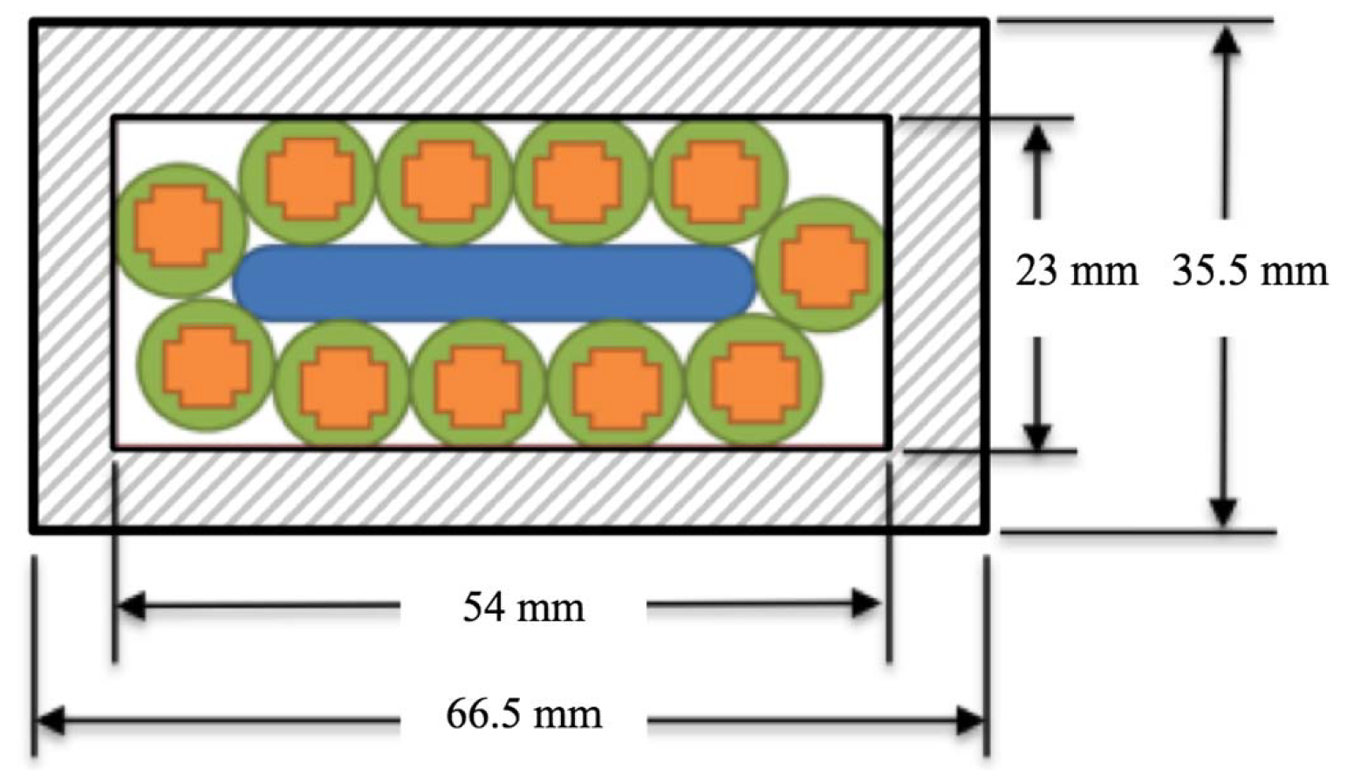
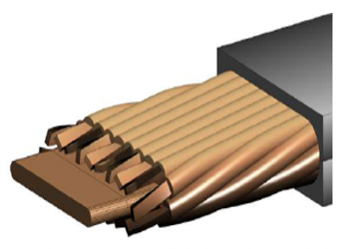
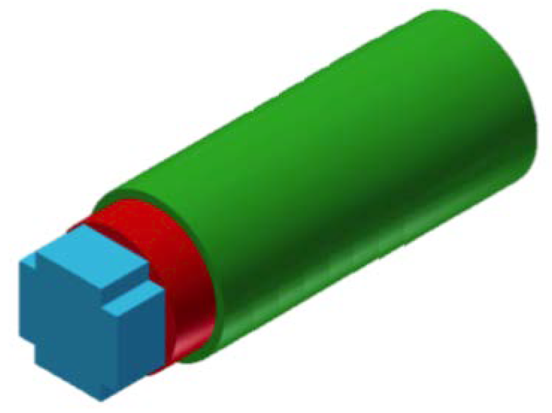
REBCO Rutherford-Type Cable Review
North China Electric Power University
Roebel Cable
20 strands x 16 tapes, 60 kA at 12 T
HTS-CroCo Cable
Quasi-Isotropic strands
11 HTS-CroCo strands (each 20 x 6 mm W + 10 x 4 mm W tapes)
A. Kario et al., Supercond. Sci. Technol., 26, 085019, 2013.
W.H. Fietz et al., IEEE Trans. Appl. Supercond, 26, 4800705, 2016.
Y. He et al., IEEE Transactions on Applied Superconductivity, 35, 4800207, 2025.
D. Uglietti et al., Supercond. Sci. Technol., 28, 124005, 2015.

Slide 4
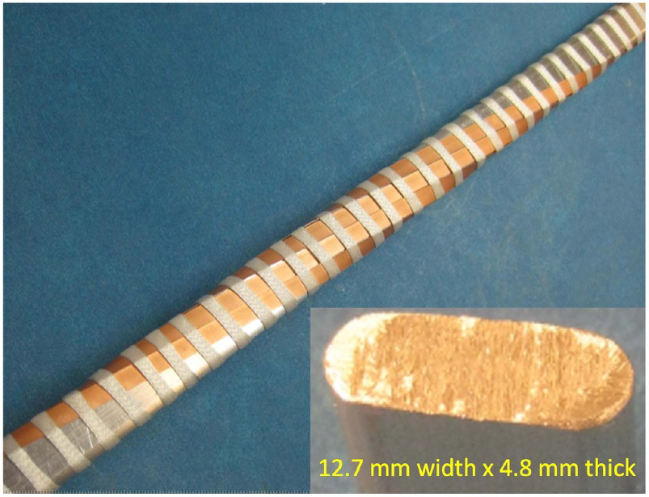
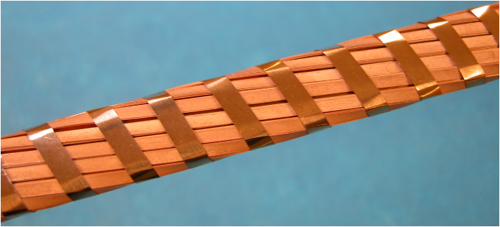
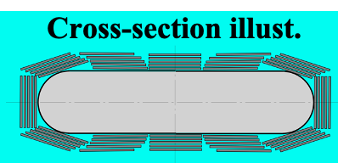
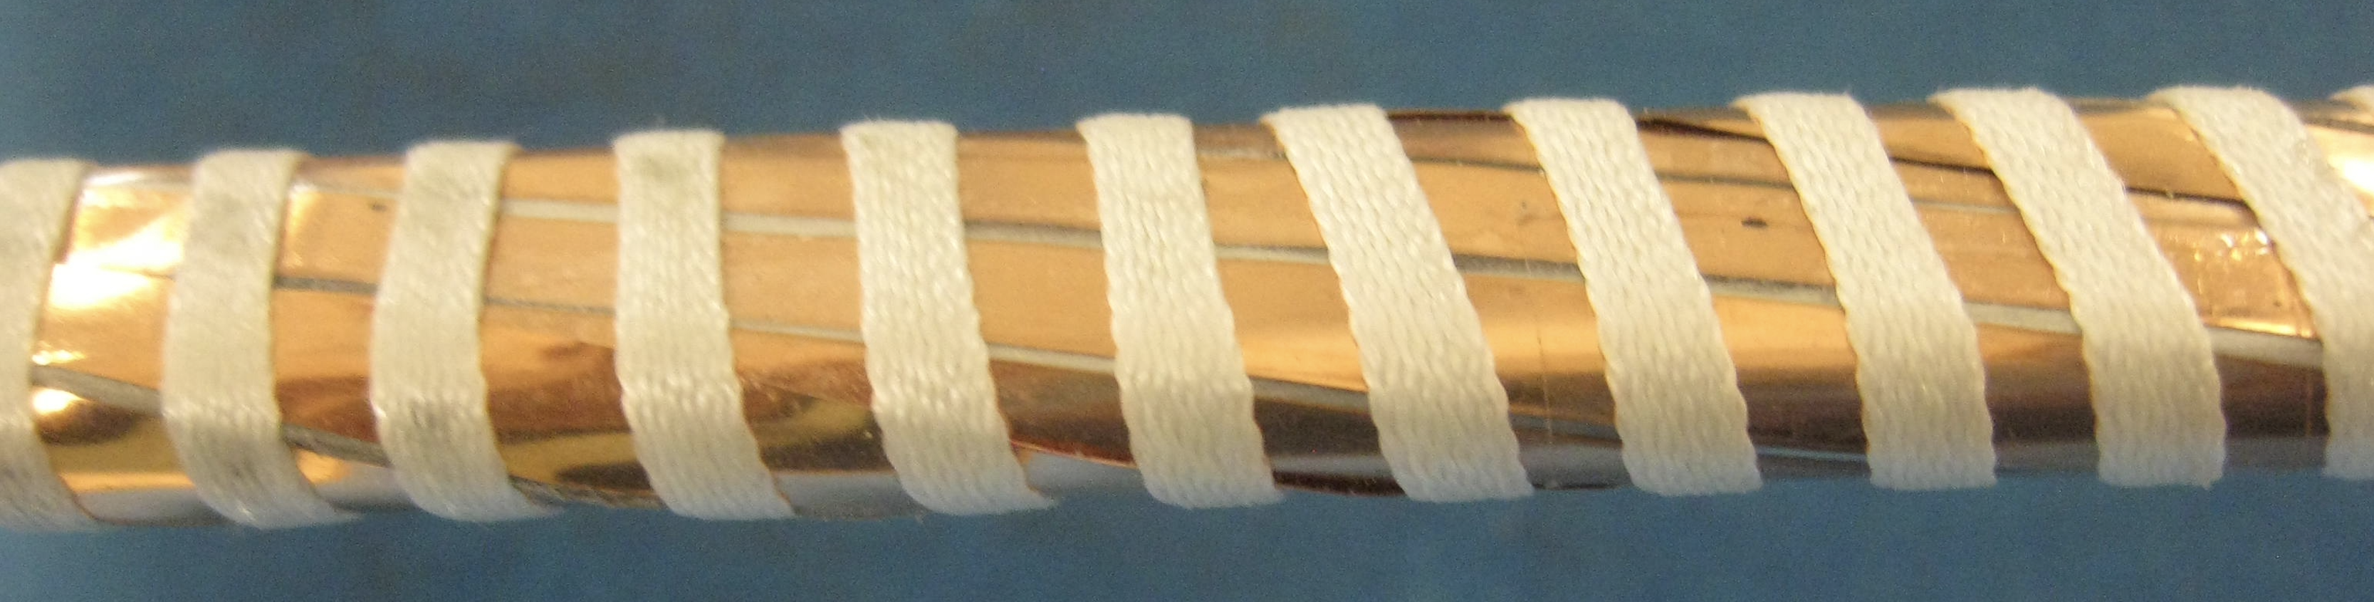
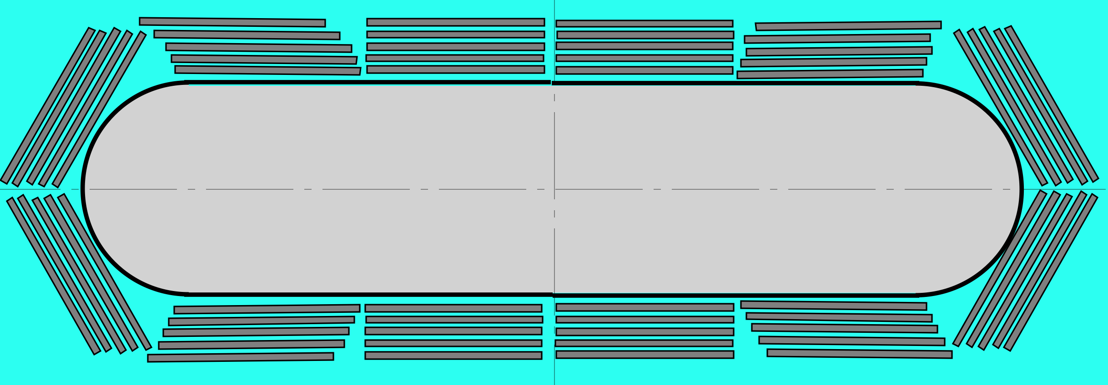
Rutherford-Type Cabling Methods
FReTC
(Flat Round-edge-former Tape Cable)
Method I
Method II
Tightly winding on a round-edge-former.
Winding around a flat round-edge former.
2.5 mm width Nomex lacing tape
2 mm-60 tape FReTC
4 mm width copper dummy tape with Nomex Tape.
12 sub-cables
Fabrication
Difficult and complicate.
Simple and easy.
Suitable for large cables.
Suitable for wide tapes.
M. Takayasu, Supercond. Sci. Technol., vol. 34, 2021.
M. Takayasu, IEEE Trans. Appl. Supercond., vol. 34, 2024.

Slide 5
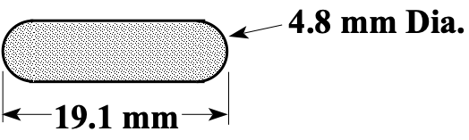
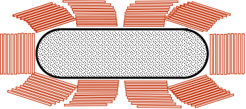
Fabricated 400 Tape FReTC
Former: 19.1 mm width, 4.8 mm round edge copper rod
Former cross-section
Cable: 10 sub-cables of 40 Tapes (5 REBCO tapes and 35 copper tapes)*
4 mm wide, 1.2 m long 400 tapes (10 sub-cables x 40 tapes).
If all tapes are REBCO,
Ic = 60 kA (150 A x 400 tapes at 18 T and 20 K)
(Tape Ic = 150 A at 18 T, 20 K)
Schematic view of FReTC cross-section
* The stacked tape dummy cables were previously used for a CTD project (Dr. A.E. Haight).

Slide 6
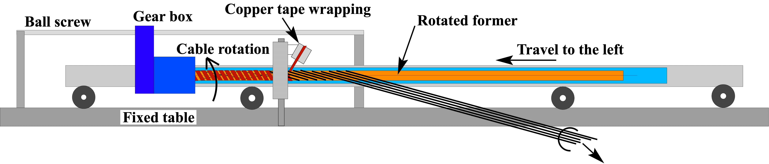
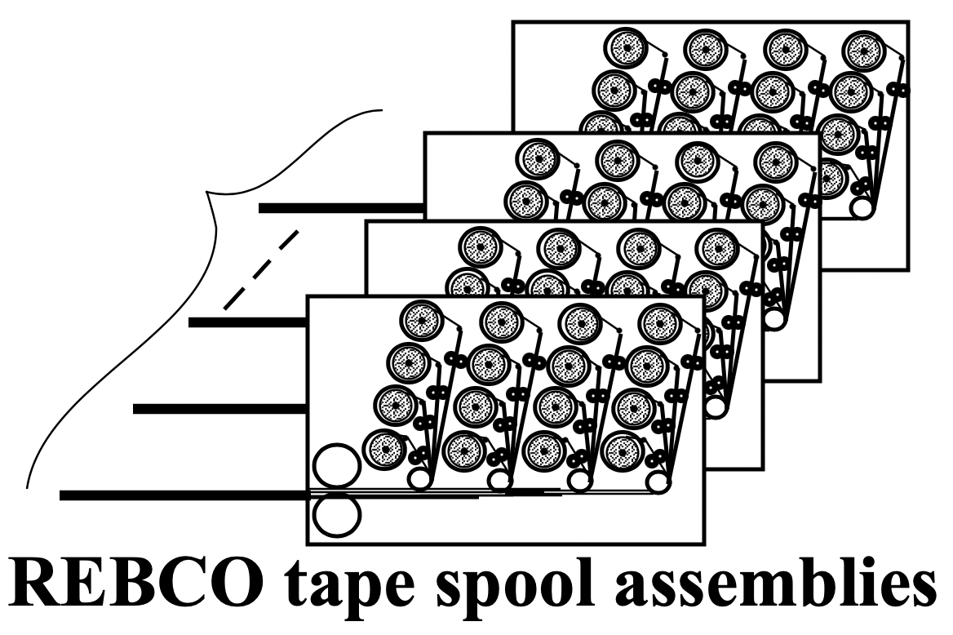
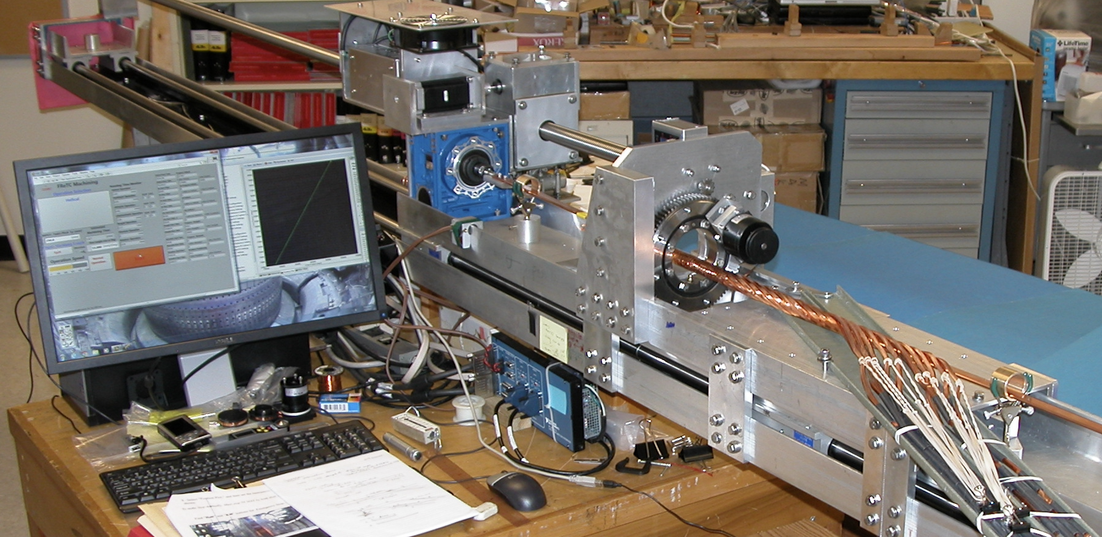
FReTC Fabrication Device
3 m FReTC cabling
Stacked REBCO tape subcables
3 m-FReTC cabling machine
DSCN2496

Slide 7
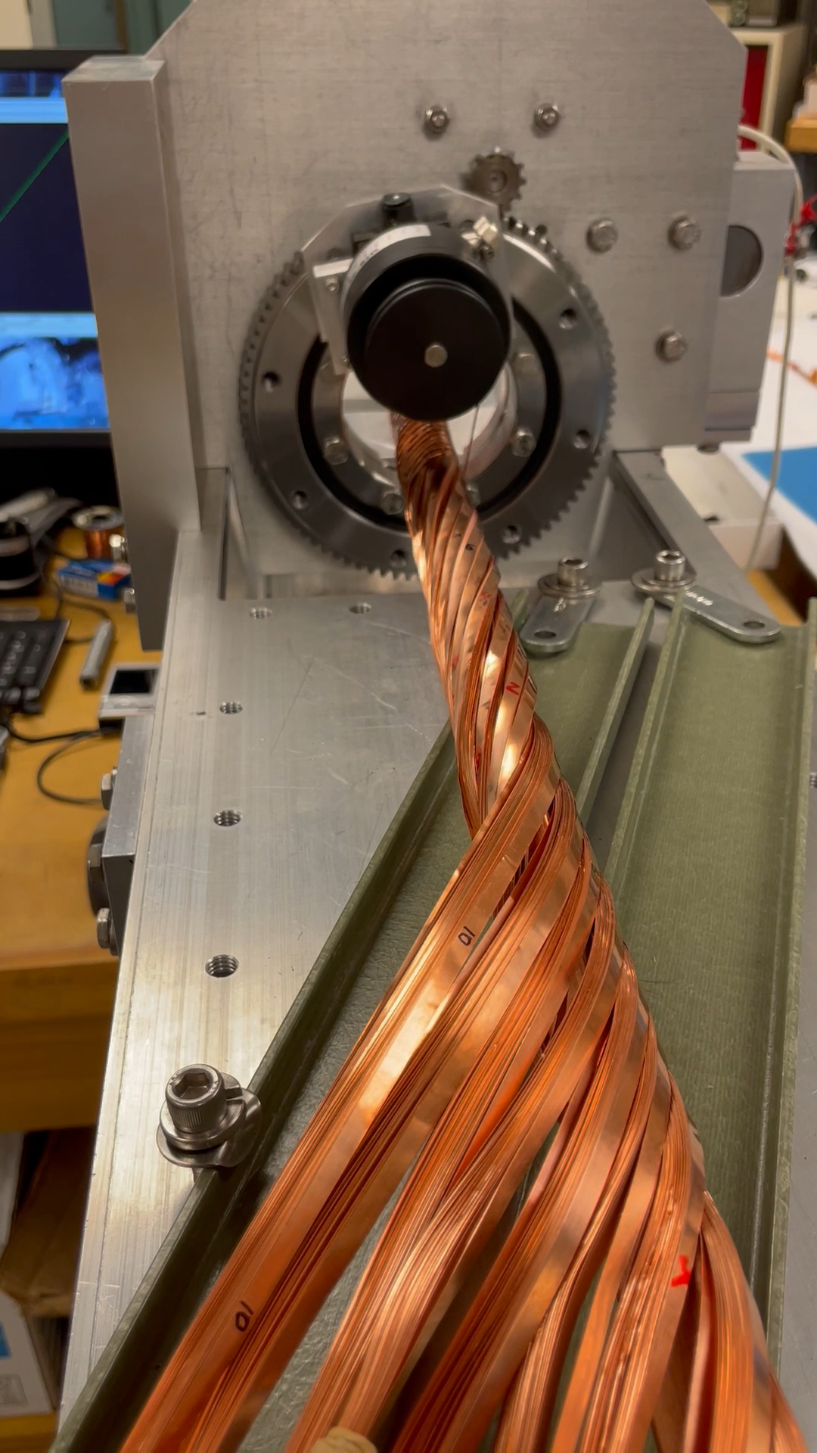
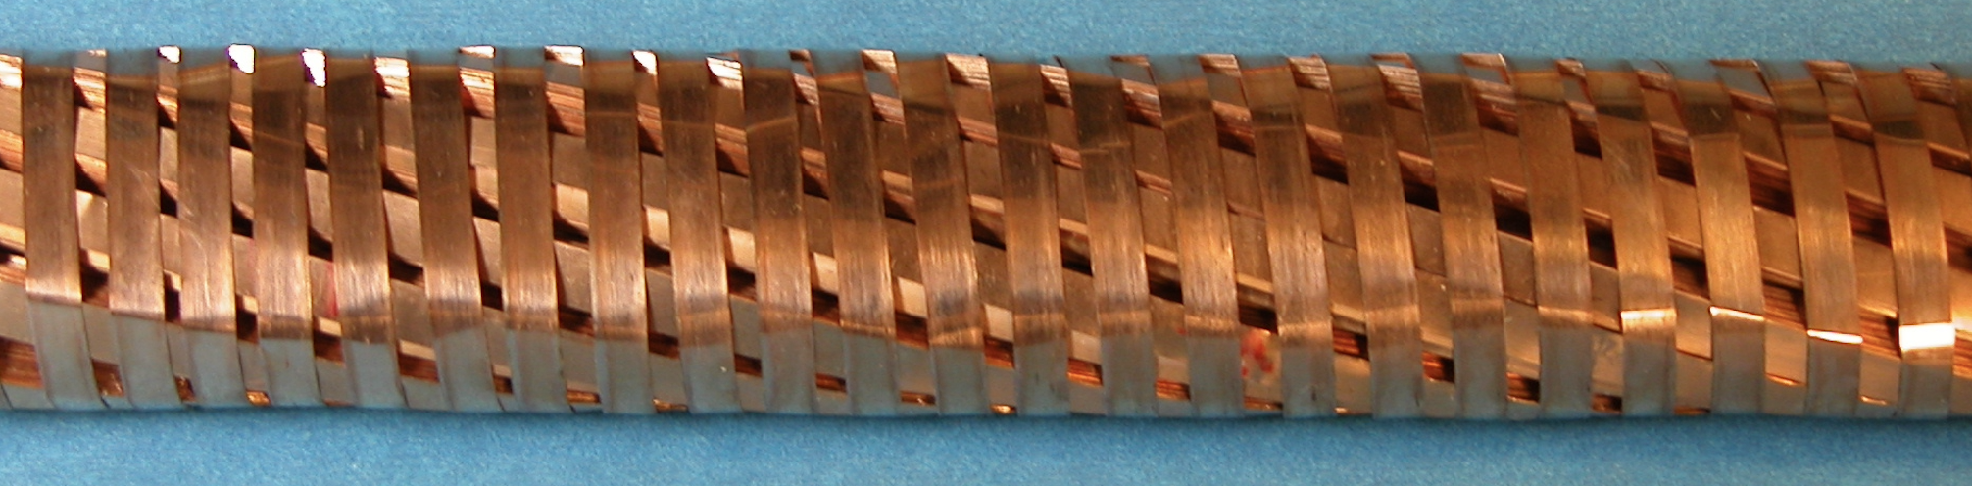
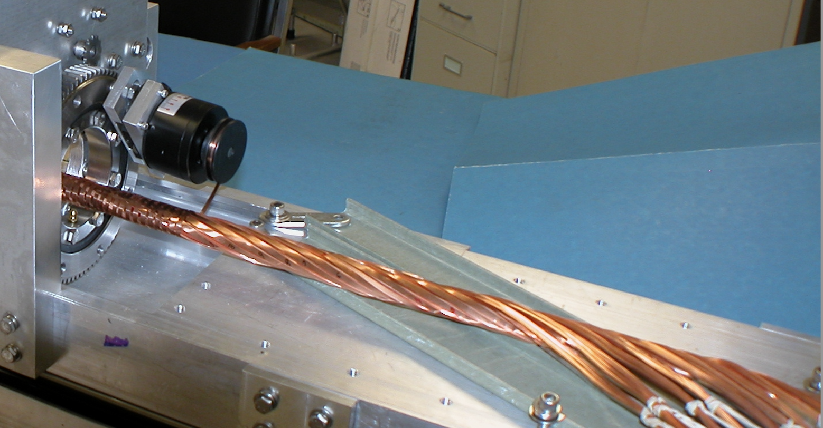
FReTC Fabrication Device (cont’d)
Demo fabrication of a 4 mm wide 400 tapes FReTC for a 60 kA FReTC.
28 mm
Fabricated 400 Tape FReTC Top view
Subcable feeders
One full twist-pitch
pre-winding
DSCN2511
Twist-pitch = 250 mm
Rotate a former, and move to the left.
Cabling speed : 1 m / 30 min.

Slide 8
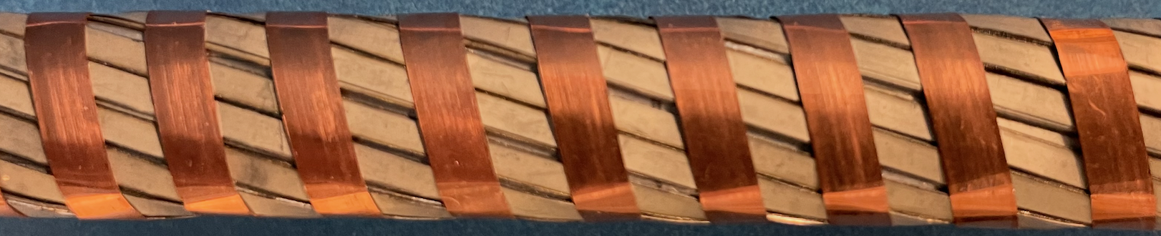
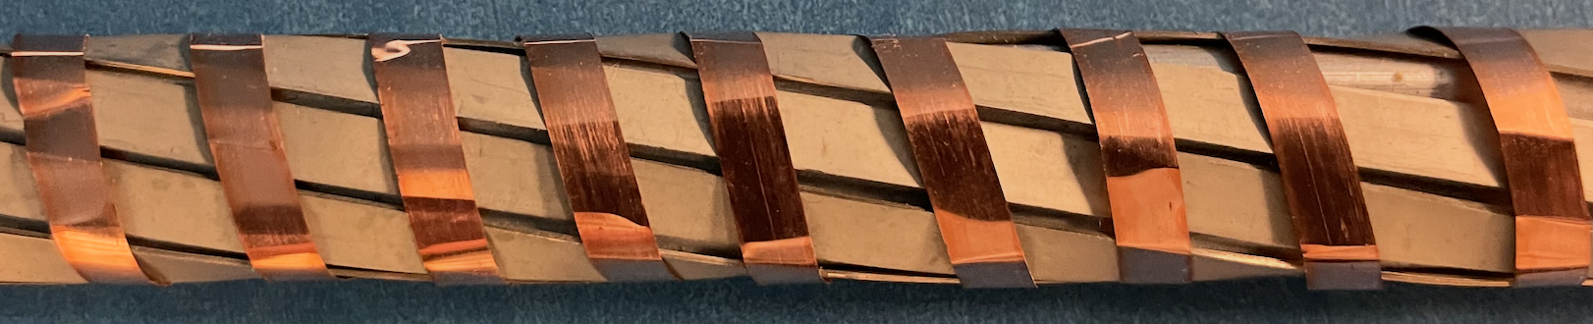
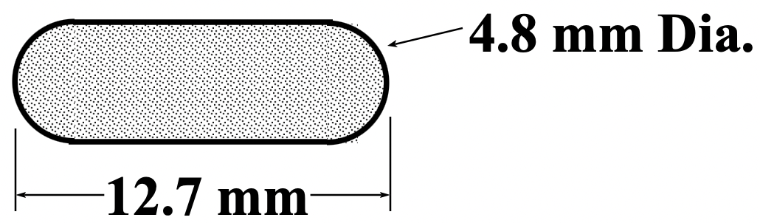
Other Fabricated FReTC Samples
REBCO tapes : BTG exfoliated 4 mm and 2 mm
(BTG : Brookhaven Technology Group, Inc.)
BTG 2 mm, 42 tape
BTG 4 mm tape striated to
1 mm filaments
REBCO tapes: 42 tapes
(14 stacks of 3 taps)
REBCO tapes: 28 tapes
(7 stacks of 4 tapes)
Top view
Twist-pitch = 200 mm
Top view
Former: 12.7 mm wide, 4.8 mm round edge aluminum rod
Former cross-section

Slide 9
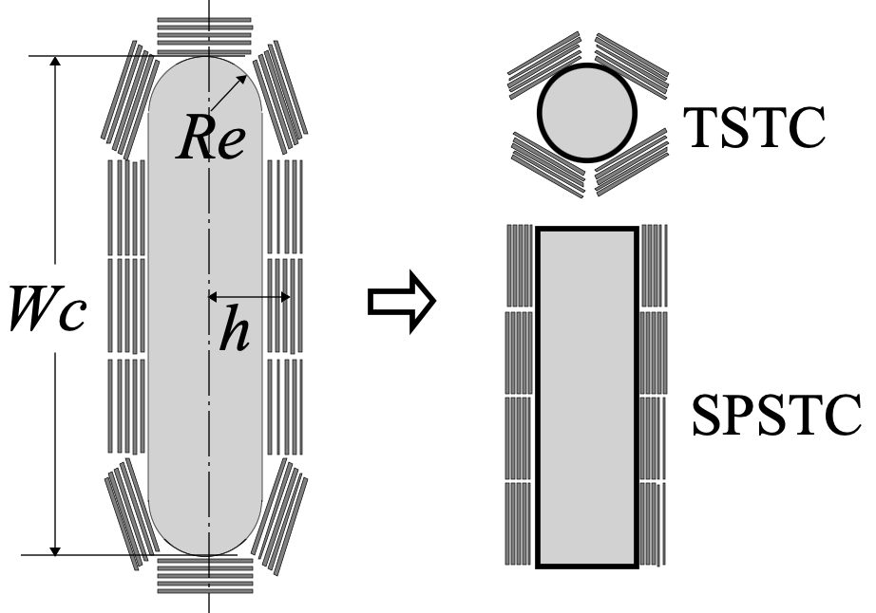
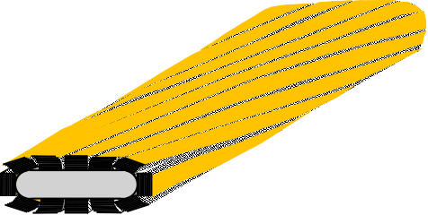
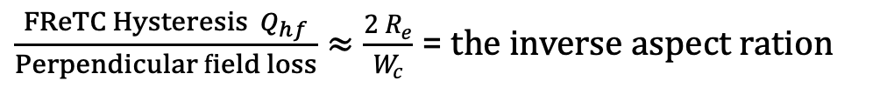
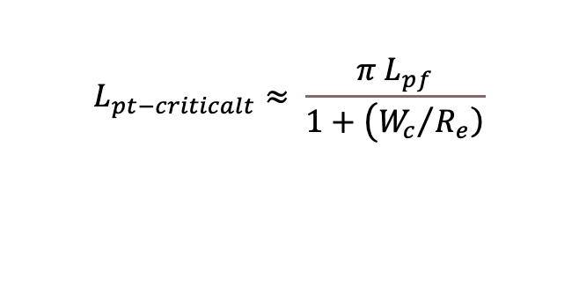
Characteristics of FReTC
Modeling
Critical Twist-Pitch
TSTC
$$L_{pt−criticalt}≈ \frac{π{ L}_{pf}}{1+\left({W_{c}}/{\left.R_{e}\right)}\right.}$$
L_{pf} is the FReTC twist-pitch.
Tapes are parallel to
former surfaces
Critical Bending
Bending characteristics are similar to TSTC conductors.
Hysteresis Loss
REBCO tapes are parallel to the magnetic field. Therefore, hysteresis loss can be reduced.
Field
$\frac{{FReTC Hysteresis Q}_{hf}}{Perpendicular field loss}≈\frac{2 R_{e}}{W_{c}}$ = the inverse aspect ration

Slide 10
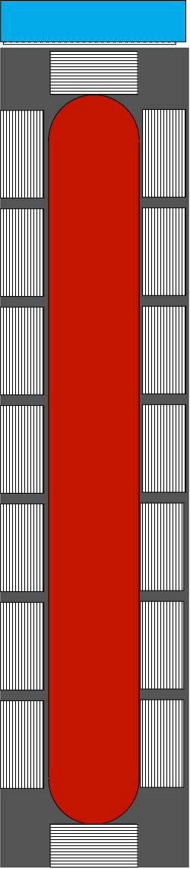
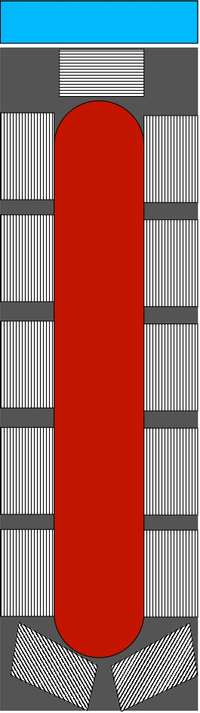
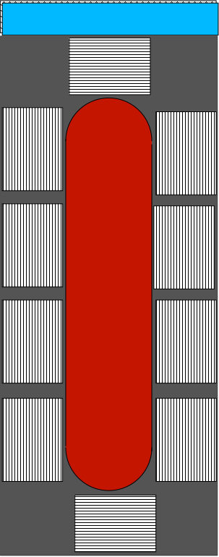
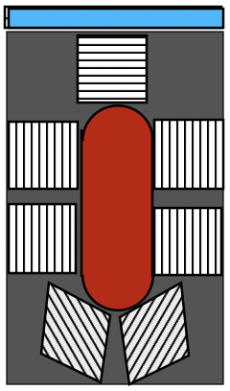
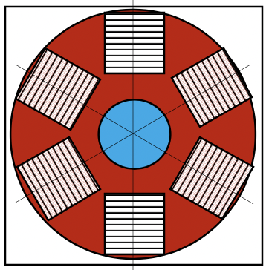
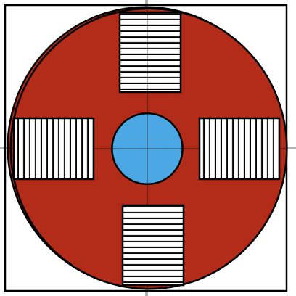
FReTC Compared with TSTC : Current Density JE
50 kA Cables at 18 T and 20 K
REBCO Tape:
4 mm wide, 90 μm thick
Ic = 150 A at 18 T, 20 K)
* Cooling channel space
of 4 mm x 4 mm is added.
Current Density JE

Slide 11
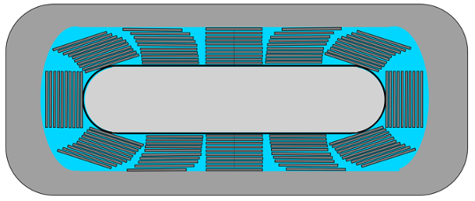
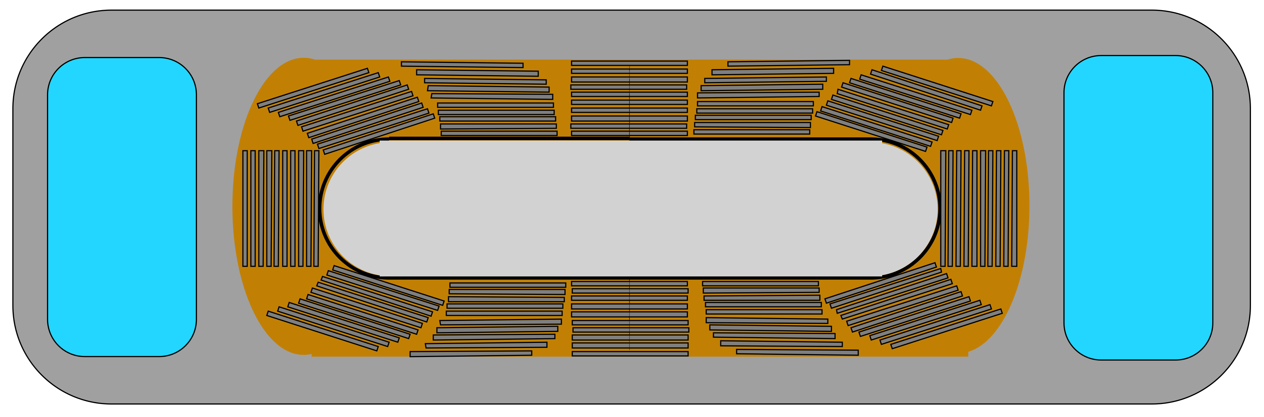
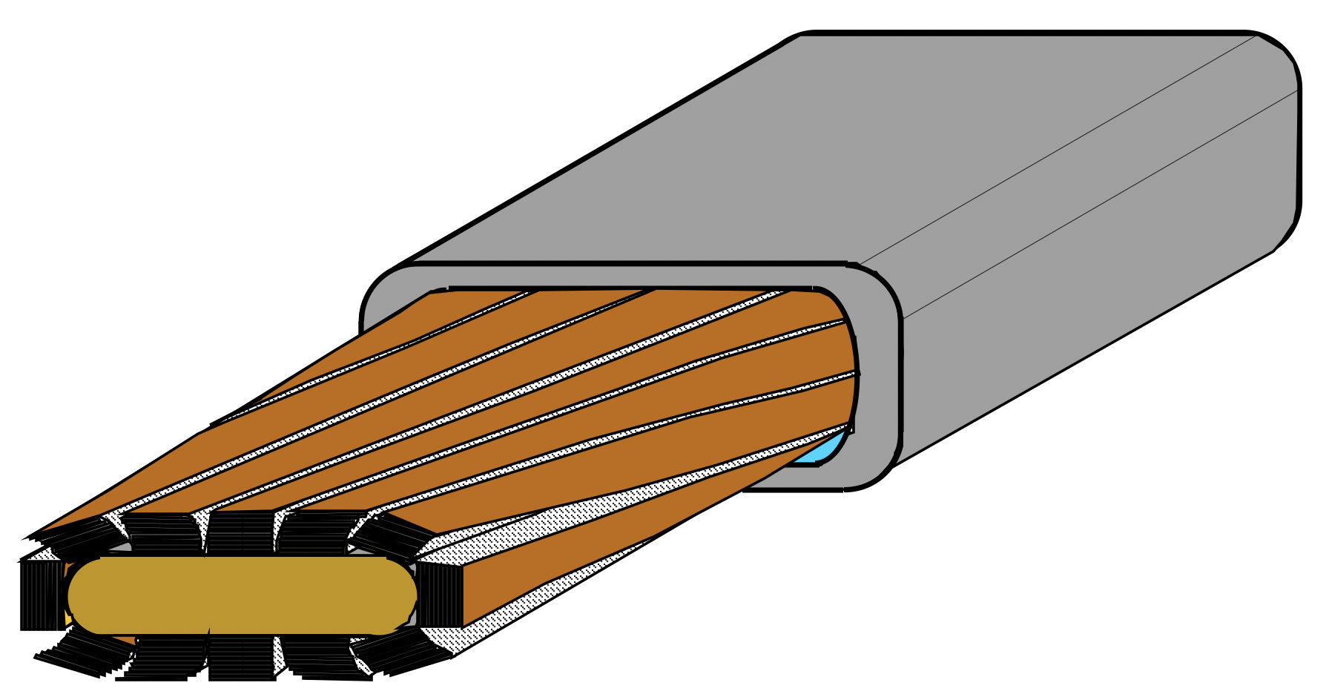
Characteristics of FReTC (cont’d)
CICC
(Cable-In-Conduit Conductor)
Transverse forces
Good structure supports against electromagnetic transverse forces.
Direct cooling
Conduction cooling

Slide 12
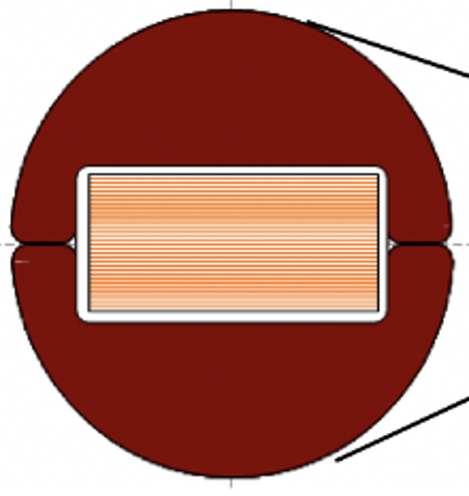
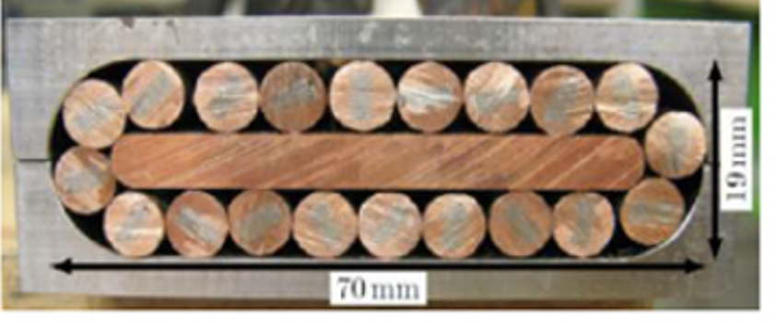
Differences of FReTC from other REBCO Rutherford-type cables
Typical Rutherford-type cables
FReTC
2 mm-60 tape FReTC
Roebel Cable
12 sub-cables
16 tapes x 20 strands
Full-size cable fabrication from tape spools.
All tapes face the former surface.

Slide 13
Summary
REBCO Rutherford-type cabling of FReTC could provide cost-effective high-current cables.
- Mechanical support structure against electro-mechanical forces
- Easy fabrication
- Minimizing AC losses
- Design flexibility
- Excellent tape usage
Need more work

Slide 14
Thank you for your attention

