Slide 2











High Field Magnet program targets and requirements
Ezio Todesco
Thanks to B. Auchmann for feedback

Slide 3
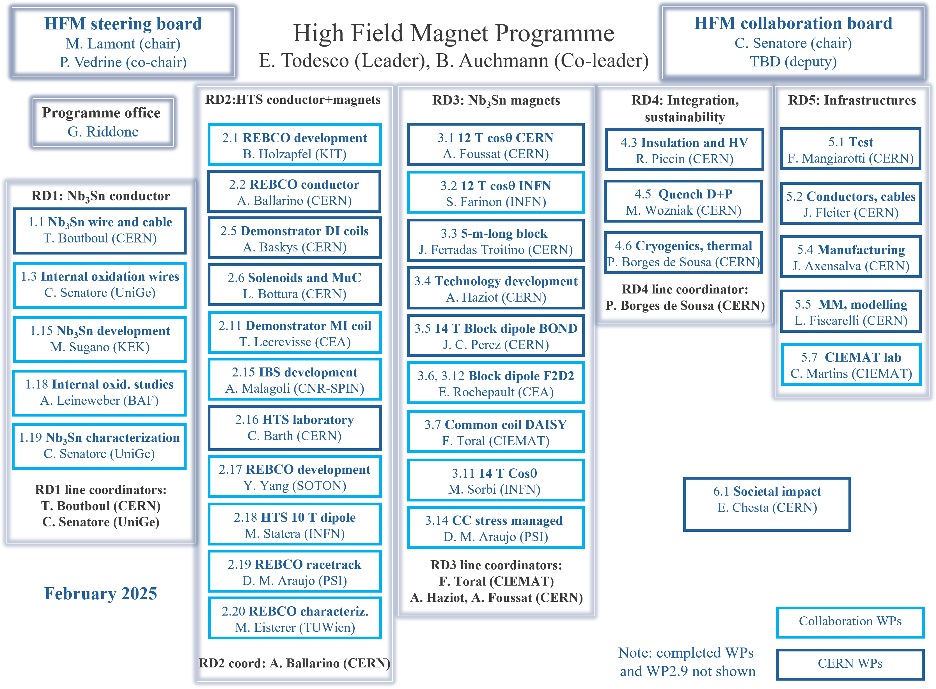
11 collaborating institutes
33 workpackages, half from CERN
HFM forum
HFM WG
www.cern.ch/hfm
Five RD lines
Nb₃Sn conductor
Nb₃Sn magnets
HTS
Integration & sust.
Infrastructures
Plus societal impact

Slide 4
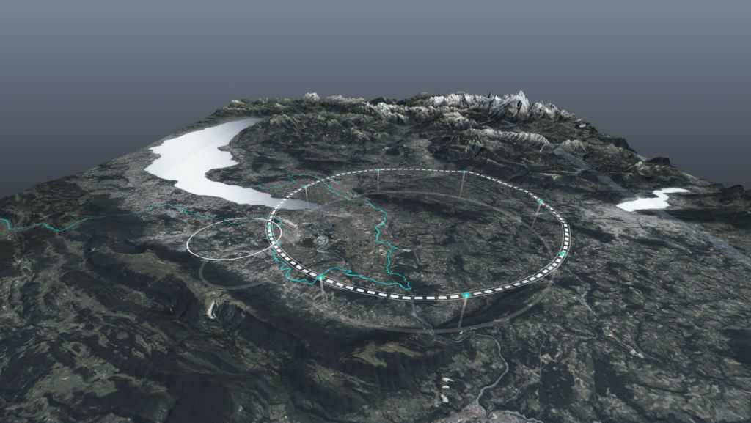
Main target for HFM R&D
Baseline for FCC-hh: Future Circular Collider with 85 TeV c.o.m. energy (42.5 TeV + 42.5 TeV)
Baseline is 14 T dipole (operational field) in Nb₃Sn, operating at 1.9 K, with 20% loadline margin
Note that previous baseline was at 16 T and 100 TeV
There is a HTS option
HTS allows opening the way towards higher field, and (possibly) simpler manufacturing, and (possibly) lower costs
We keep for HTS the field range from 14 to 20 T giving 85 to 120 TeV
However, note that synchrotron radiation scales with E⁴: so 50% more energy gives 4 times more synchrotron radiation
This radiation falls not on the magnet, but on the beam screen and therefore 20 TeV does not seem compatible with the target of sustainability
However we keep it as a strategic goal of the program
FCC-hh parameters | Nb₃Sn | HTS option
Dipole field (T) | 14.0 | 14-20
Temperature (K) | 1.9 | 4.5-20
Tunnel length (km) | 90.7 | 90.7
Arc length (km) | 76.9 | 76.9
Arc filling factor (adim) | 0.83 | 0.83
Energy c.o.m (TeV) | 85 | 85-120
Non Cu jc 16 T 4.2 K | 1200 | TBD
Loadline margin | 80% | TBD
E. Todesco, “Status and perspectives of high Field magnets for particle accelerators”
Plenary talk at ASC, IEEE TAS 35 (2025) 4002914

Slide 5
Which margins
The baseline for Nb₃Sn is to be at 80% of loadline, corresponding to 20% loadline fraction, 60% current margin, 4.5 K temperature margin and 20 mJ/cm³ enthalpy margin
What about HTS ? Critical current surface slope is very different from Nb₃Sn
20% loadline margin would imply half current margin (30% rather than 60%), double temperature margin (9 K rather than 4.5 K, when operating at 4.5 K) – and physics is quite different !
Today, we do not have a clear view on the margins required for HTS dipole operation in an accelerator
The concept of short sample is also more complex than in Nb₃Sn

Slide 6
Sustainability
The importance of the aspect related to the energy consumption of the accelerator has become more and more significant in the past years
At 85 TeV, half of the consumption is due to the synchrotron radiation (independent of the magnet temperature) and half by the magnet operating at 1.9 K and with losses during ramp assumed to be 10 kJ/m per cycle
First aspect:
The hysteresis losses during the ramp are a dominant parameter for the accelerator
Concern about large filaments of HTS, and striation + twist techniques should be studied
Second aspect:
As operating at 4.5 K with Nb₃Sn would give 25-30% saving, in the hypothesis of matching with HTS the budget of hysteresis losses (to be verified) operating at 4.5 K would give similar saving
Operating at 20 K would give a larger saving, but not beyond 50% since half of the budget is for synchrotron radiation – but cryogenics infrastructure could be simpler
Third aspect
If we were able to go to 120 TeV, we would be largely dominated by synchrotron radiation losses on the beam screen, independently of the temperature of the magnets

Slide 7
Sustainability for FCC-hh
Baseline: 90 km, 85 TeV, 14 T, Nb₃Sn at 1.9 K with 10 kJ/m
85 TeV, 14 T, 4.5 K Nb₃Sn/HTS option with 10 kJ/m
85 TeV, 14 T, 20 K HTS option, with 10 kJ/m
120 TeV, 20 T, 20 K, with 10 kJ/m*
Previous FCC baseline, 100 km, 100 TeV, 16 T, with 10 kJ/m
20 T stays as a strategic objective for HFM
Operation at 20 K is interesting, but does not reduces energy consumption by factors 5-10 of the accelerator as it is sometimes stated
*higher field likely to have larger losses – so this budget could be optimistic
⁺M. Benedikt, slide 22, FCC week, 2025 Wien https://indico.cern.ch/event/1408515/contributions/6506636/
<2.5 TWh⁺
<2.0 TWh⁺
<4.0 TWh⁺
Magnet
Synchrotron radiation

Slide 8
HTS for accelerator dipoles: advancement in the last ten years
Apertures
C1, C2, C3: 65 mm
Feather2, cosθ: 40 mm
IHEP: 20 mm
Cables
Bin5 (BSCCO): Rutherford
Feather2, Cosθ: Roebel
IHEP, CERN 2025: tapes
CEA 2025: MI tapes
C1/C2/C3: CORC ®
Design
Feather2: aligned block
C1, C2, C3, Bin5: CCT
IHEP: racetracks with gap

Slide 9

Requirements on field quality: a new paradigm ?
Today, an HTS superconductor is available, developed and strongly supported by fusion community, matching the requirements in critical current and with a decreasing cost
Many colleagues advocate a change of paradigm: rather than developing a conductor targeting accelerator needs, adapt the accelerator to the existing tape
This option should be carefully explored – but our baseline is developing a high current density twisted cable based on tape
I recall that during the preliminary phases of HL-LHC,
strands with different number of subelements were used
(108/127, 132/169) – at the end the larger filament was
kept since smaller filaments were not needed and were
much more expensive – final optimization should be done
on cost vs performance
Deep Throat advice to R. Redford in All the president’s men (Wildwood Enterprise, 1976)

Slide 10
Requirements on field
A lot of emphasis on multipoles, but first requirement is on generation of main component
Dipole: stability and reproducibility with 0.001-0.01% (10-100 ppm)
Residuals are cured by orbit correctors and feedback system
Note that linearity of TF is not needed, any reproducible effect can be implemented in the control system
Note that Tevatron dipoles had iron very far from the coil also to minimize the saturation – later experience shows that this is not an issue
What is critical is the reproducibility
Similar values for the quadrupole
Residuals are cured by tune correctors and feedback system
see also E. Todesco, «The magnetic model of the LHC at 6.5 TeV», IEEE TAS 26 (2016) 4005707

Slide 11
Requirements on harmonics
Quadrupolar component in the dipoles during ramp : during EuroCirCol we had a requirement of <20 units
This is a relevant parameter, since due to high field and large saturation, it would be helpful to release this constraint
This depends on the conversion from b₂ to units of tune, and the precision of correction with tuning magnets
I personally believe we could try to work with much higher b2 components
see also D. Tommasini, et al., «The 16 T Dipole Development Program for FCC and HE-LHC», IEEE TAS 29 (2019) 4003109

Slide 12
Requirements on harmonics
Sextupolar component in the dipoles during ramp: we had a requirement of 20 units
This is a relevant parameter, since it is related to superconductor hysteresis, and to the magnet design (cross-talk between aperture, partially corrected by iron, but not all along the ramp die to saturation)
This depends on the conversion from b₃ to units of chromaticity, and the precision of chromaticity correction with sextupoles
In the LHC 1 unit of b₃ of 40 units of chroma, we should tune chroma with less than 5 units, and therefore b₃ should be corrected with a 0.1 units precision, with a 7 units swing of b₃ during ramp this means that our correction has order of 1% error (already very good)
Feedback system to correct chromaticity are much less effective (on line measurement is not trivial)
So 20 units of b₃ looks quite challenging to me

Slide 13
Conclusions
The possibility of adapting the accelerator (main) magnets to the available REBCO tape should be carefully studied
This is a change of paradigm, but we should not exclude it a priori
Stability and reproducibility of main components (dipole and quadrupoles) are the fist requirement
Today requirement is 0.01% to 0.001% (10 to 100 ppm), over a large range of fields (for dipoles from 1 to 14 T) – could we release it ?
Requirements on b₂ and b₃ are stringent (less than 20 units in absolute value, all along the ramp) and due to the precision of correction via tuning quadrupoles and sectupole correctors
Could we release it via better correction ? Today is already very precise
More work to be done in close connection to the beam dynamics experts

