Slide 1

HFM
High Field Magnets
Progress on REBCO Accelerator Magnets @ PSI/CHART
Programme
D. Araujo, B. Auchmann, A. Brem, M. Duda, J. Kosse, C. Lindner, T. Michlmayr, I. S. P. Peixoto, K. Puthran, H. Rodrigues, J. Schmidt, D. Sotnikov, A. Stampfli
HiTAT-2, CERN, 23-24 October 2025
This work was performed under the auspices of and with
support from the Swiss Accelerator Research and Technology
(CHART) program, http://chart.ch.

Slide 2
Fastest route to contribute…

Slide 3


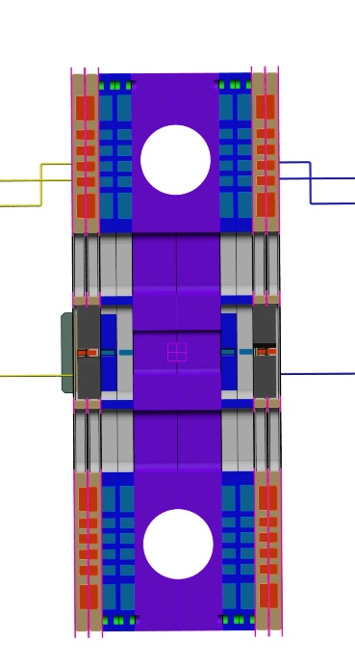
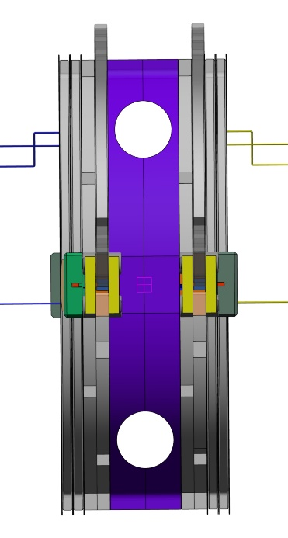
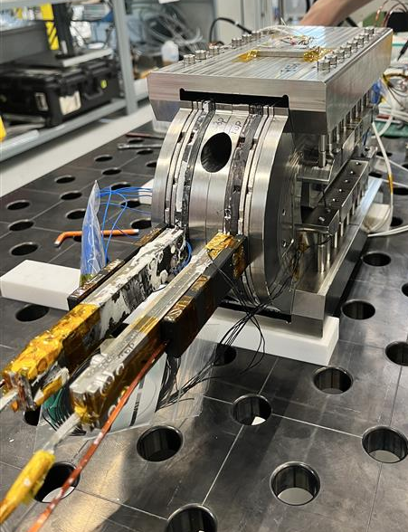
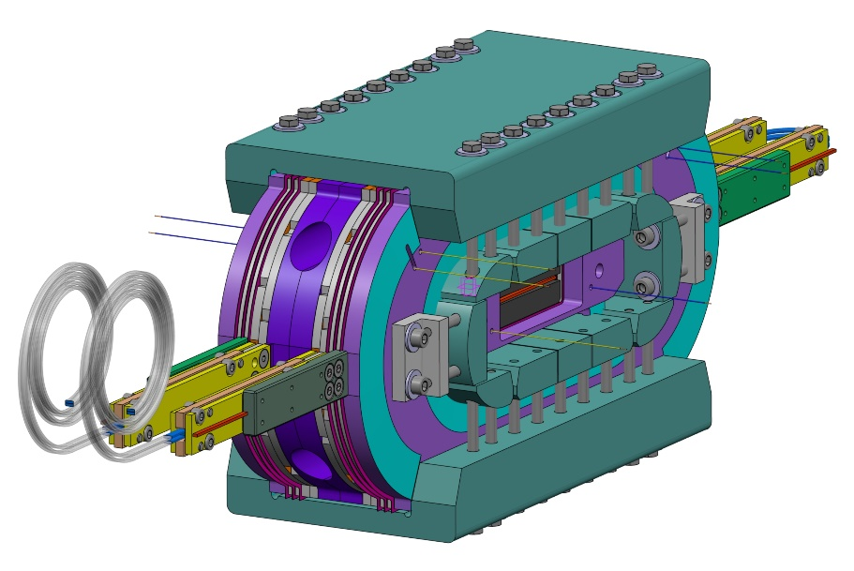
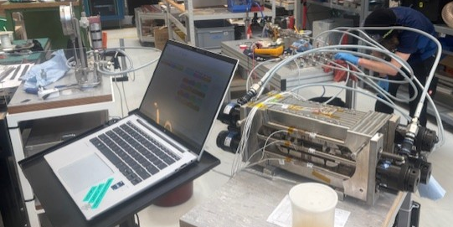
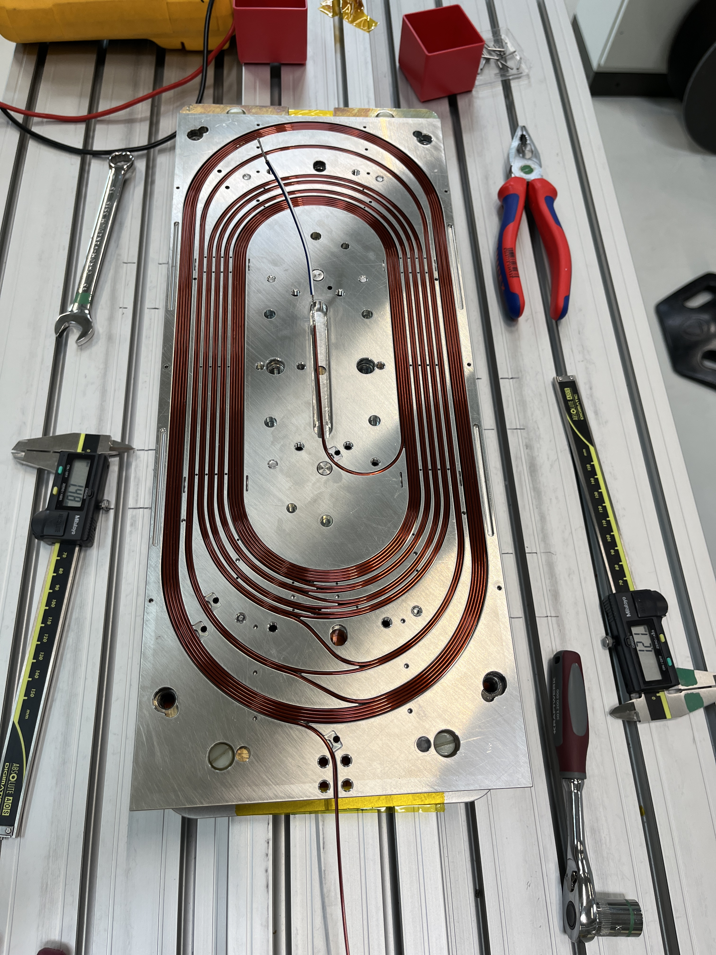
Re-use of subscale Stress-Managed Common Coil magnet – subSMCC 1 and 2
subSMCC2 magnet was assembled with additional auxiliary coils for ESC-based protection
“Manufacturing and Testing of subscale SMCC2: the second Nb₃Sn Subscale Stress-Managed Common Coil Dipole Magnet including Energy Shift with Coupling (ESC) Quench Protection Method”, submitted to TAS, 2025

Slide 4
Fastest route to contribute…

Slide 5
contribute…
PSI common coil magnet: stack of tapes based insulated cable
+ soldered stack
+ stress-management
+ impregnated coils
+ co-winding for noise cancellation
+ auxiliary coils for protection studies

Slide 6
contribute…
PSI common coil magnet: stack of tapes based insulated cable
+ soldered stack
> reproducibility (thermal and electric contact resistance)
> mechanical stability
+ stress-management
+ impregnated coils
> enhanced mechanical robustness
+ co-winding for noise cancellation
> detection with lower threshold
+ auxiliary coils for protection studies
> try out protection methods
CERN common coil magnet: dry stack of tapes based insulated cable
A. Ballarino, A. Baskys et al, https://indico.cern.ch/event/1565580/

Slide 7
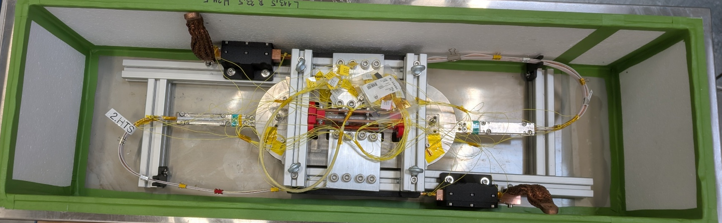
REBCO Subscale 1 - RS1

Slide 8
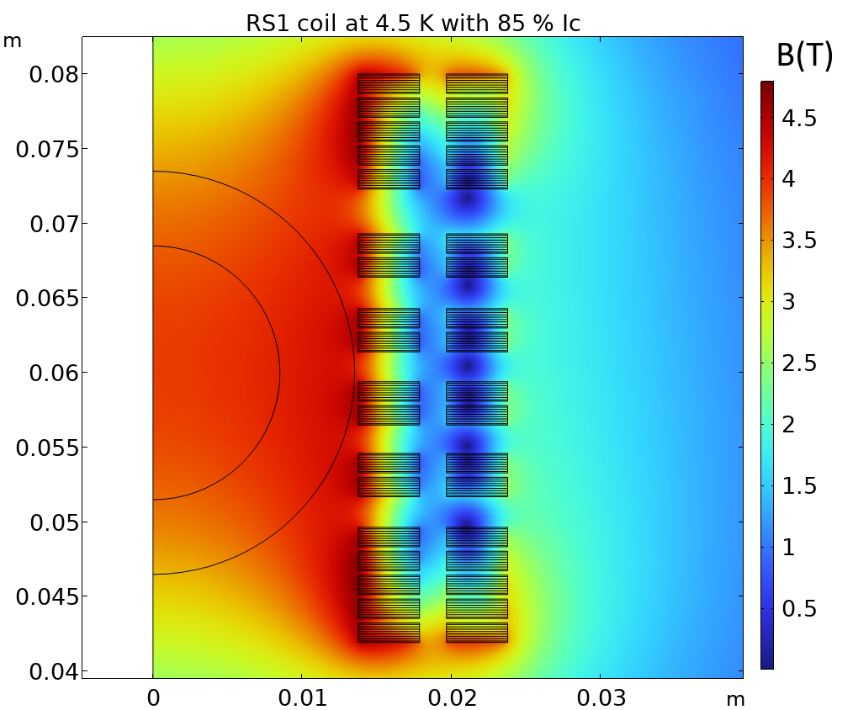
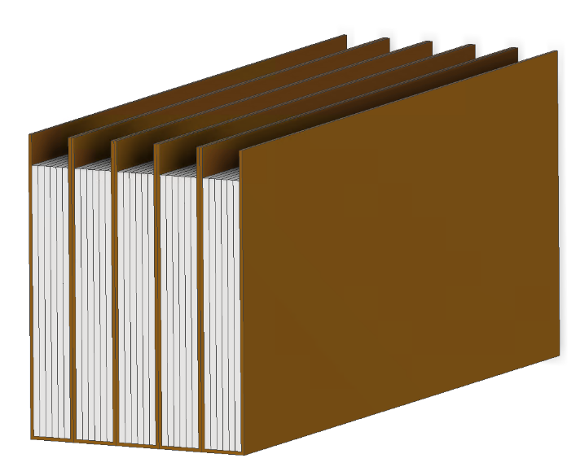

ReBCO Subscale magnet 1 - RS1 - Cable
Parameter | Value | Unit
ReBCO tape width | 4 | mm
Tape type | Face-to-face (F2F) pre-tined | -
Tape manufacturer | Faraday Factor | -
Number of F2F tapes per turn | 4 | -
Copper tape dimensions | 4 x 0.15 | mm x mm
Number of copper tapes per turn | 3 | -
Insulation thickness | 0.15 | mm
Insulation type | Kapton tape | -
Cable type | Soldered stack | -
Insulated cable illustration 5 turns - block
RS1 magnetic simulations performed by D. Sotnikov
Param | Current | B_{peak} | B_{bore} | Inductance | E_{mag} | % of I_{c}
Value | 7.0 | 4.8 | 3.9 | 388 | 30.6 | 85
Unit | kA | T | T | uH | kJ/m | -
Protection studies performed @ PSI and CERN (M. Wozniak et al.)

Slide 9
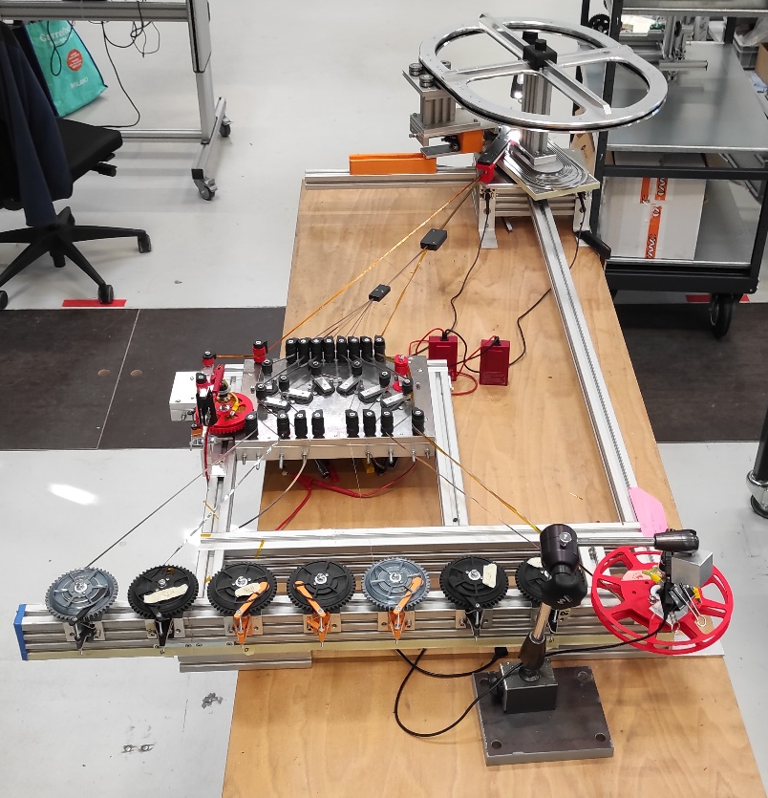
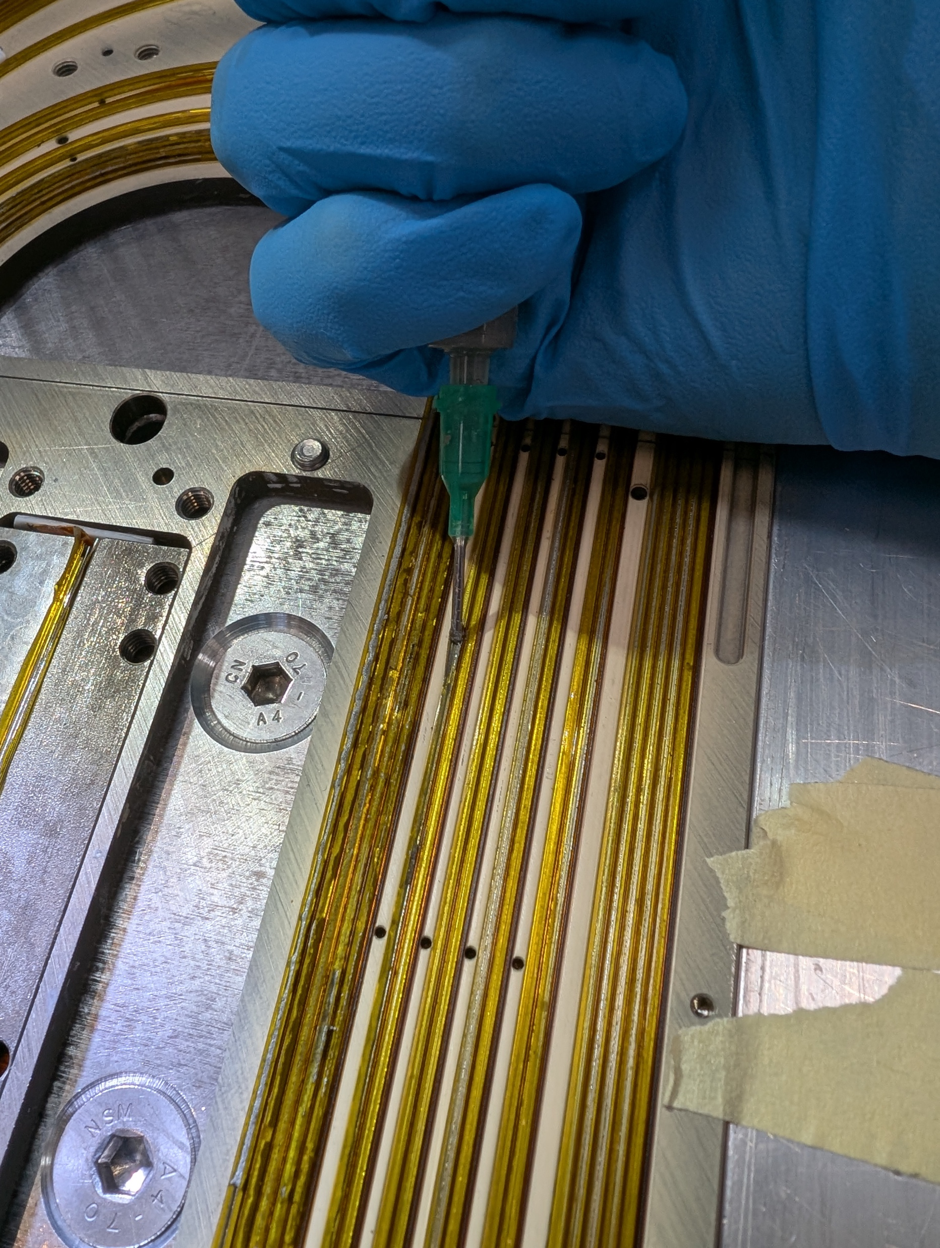
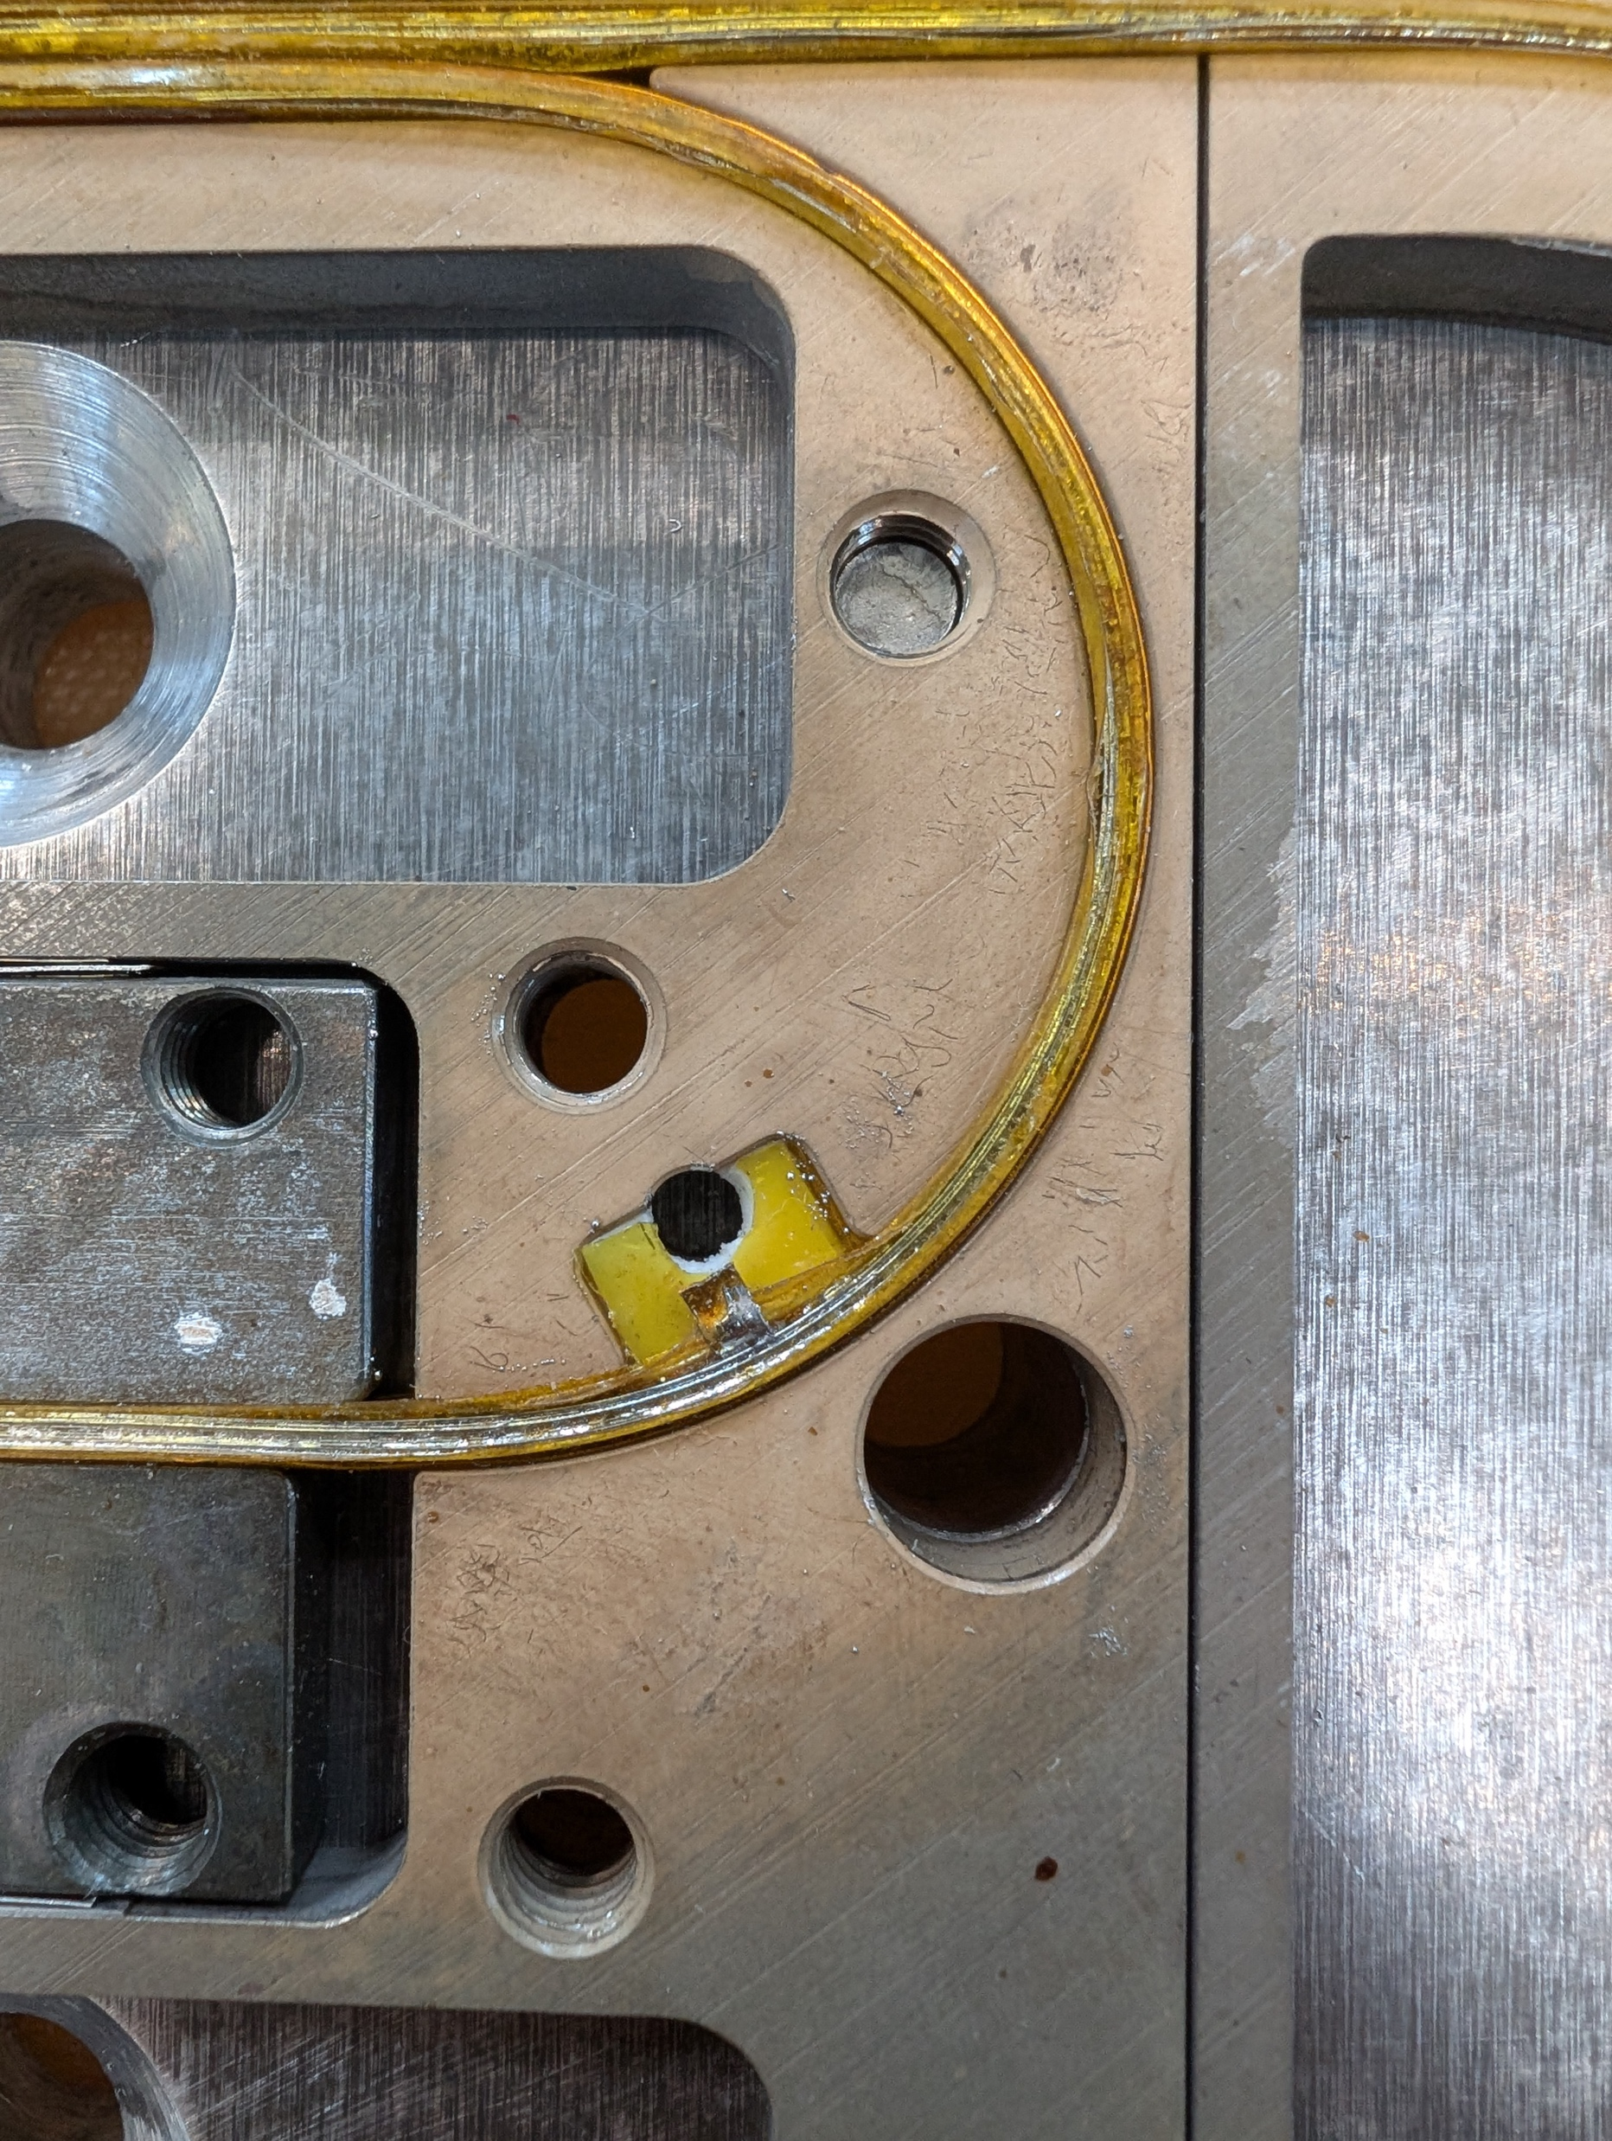
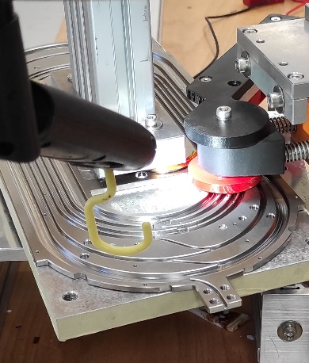
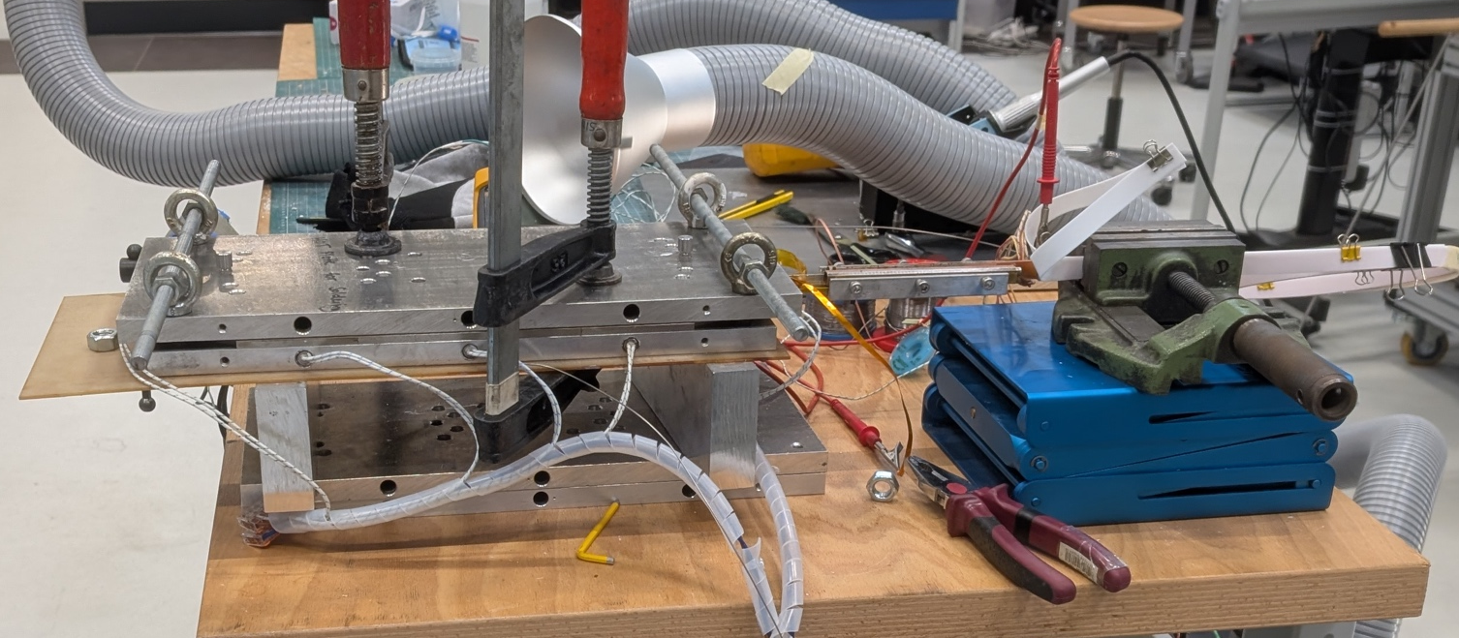
RS1 - Cable and Coil Manufacturing
Insulating and
winding tools
Pusher roller and Insulating tool
Set-up developed by C. Linder and colleagues
Applying soldering paste and flux
Pocket for voltage taps
Co-winding copper tape reel
Coli former
HTS-cable
Tape supply
Soldering with thick plate, pre-heated with oven. T_{coil} = 194 °C.
Process developed by A. Stampfli and colleagues

Slide 10
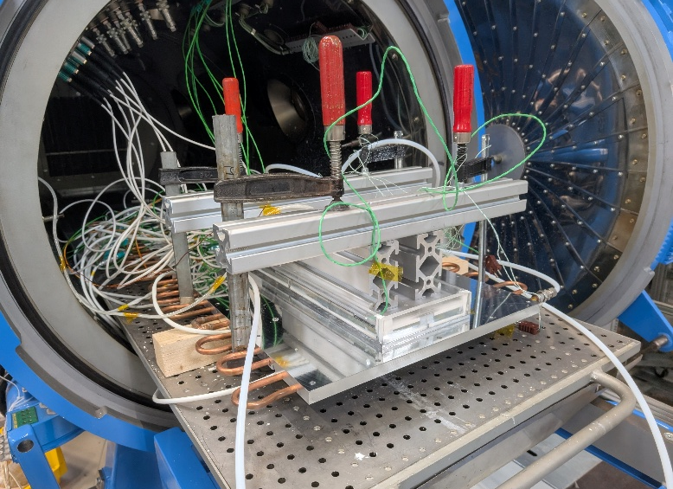
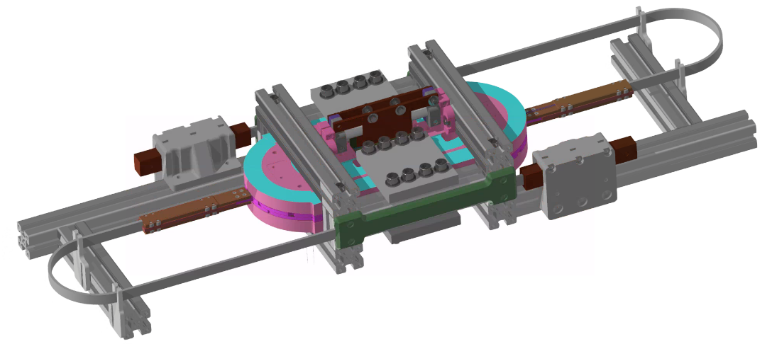
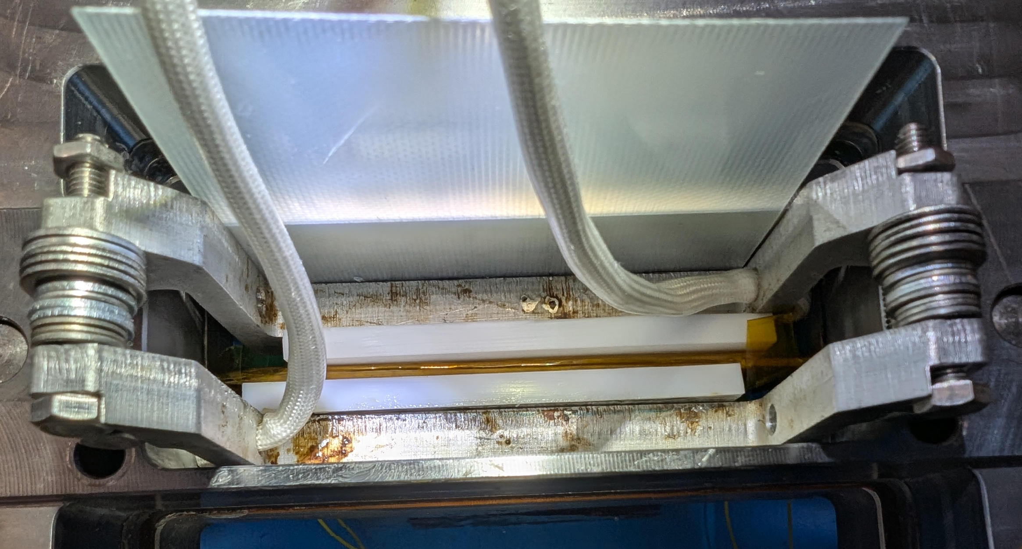
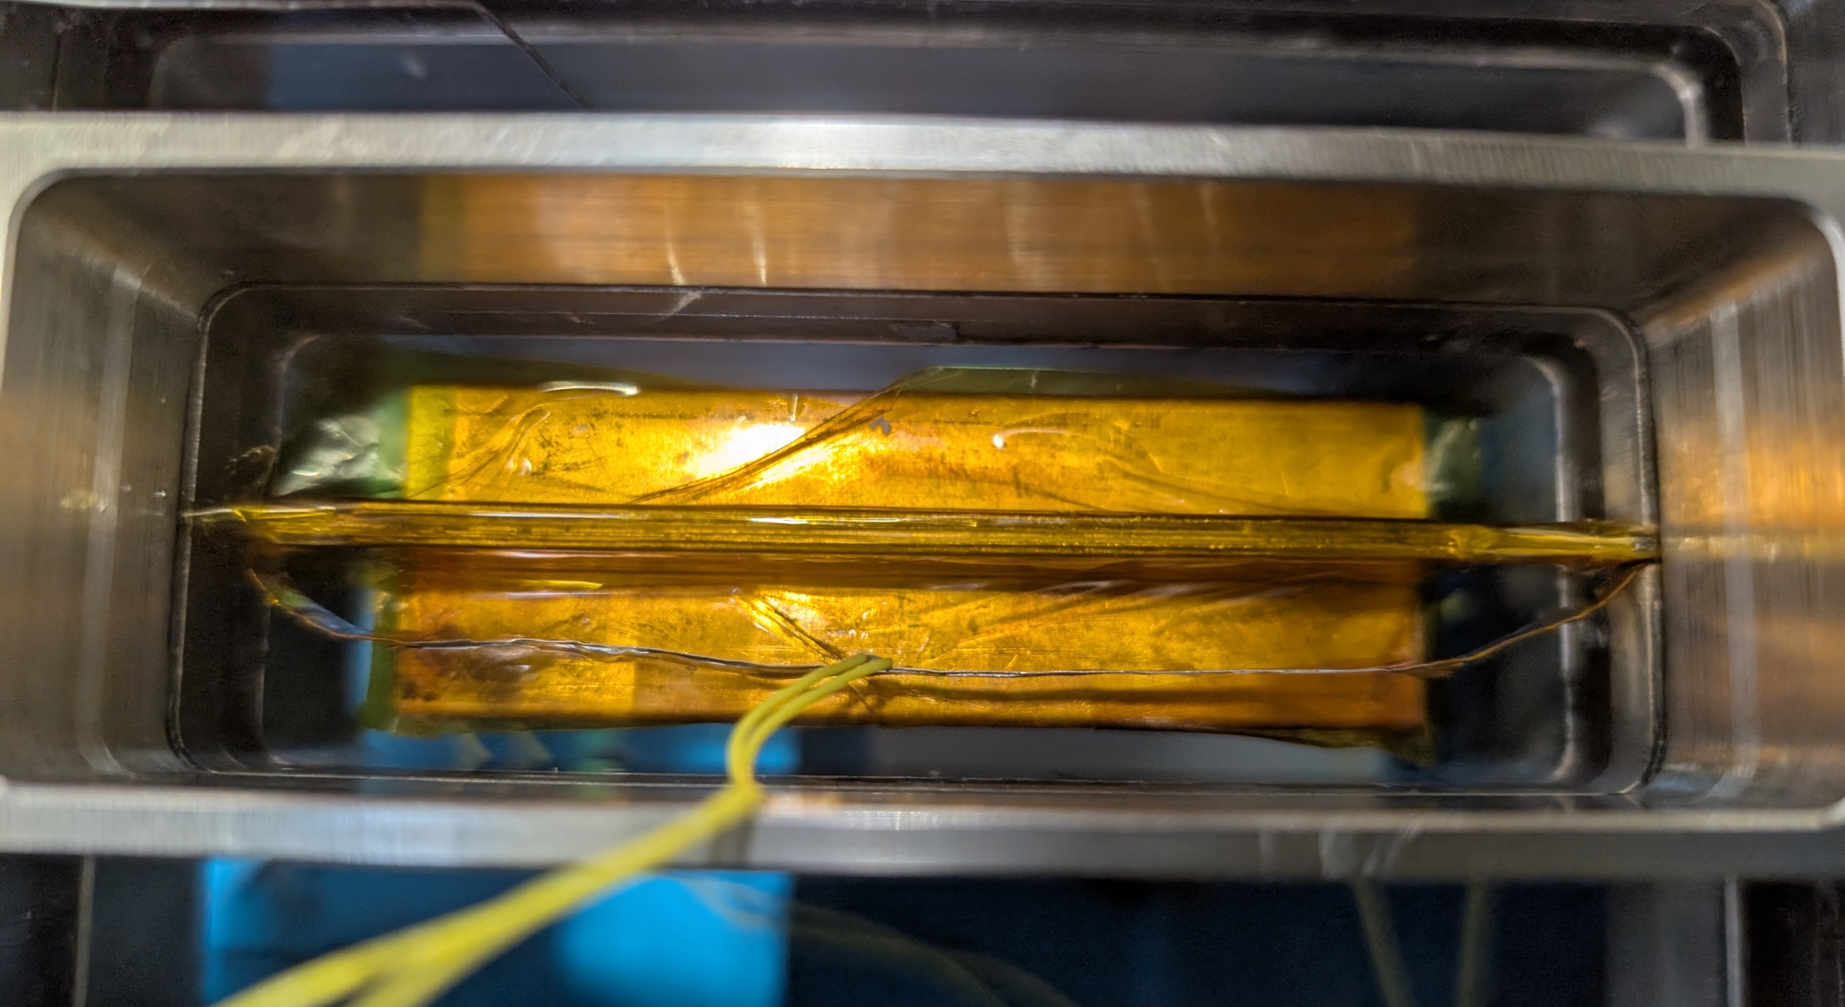
RS1 – Impregnation, splicing and assembly
Impregnation set-up: heaters for the box
Cooling plate
Temperature sensors for box, former and cooling circuit
The coil dries overnight
The wax is injected under vacuum when the mold is at 80 to 90 °C
After 3 cycles (vacuum to atmospheric pressure), the cooling circuit is activated
Connection outer splice
Connection leads for powering
Cooling copper plates inner splice
View of inner splicing process: heater and cable
12 mm-based tapes and copper sheet used as shunt between the layers
Cooling copper plates inner splice
Connection leads for powering
Support frame
Clamping device of the coil pack

Slide 11
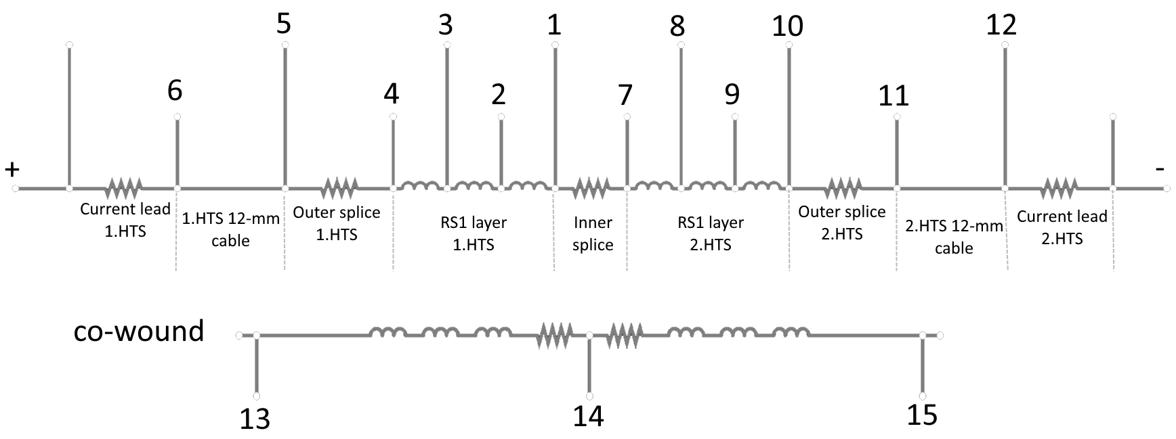
LN₂ Test Results: V-I segments and current decay
Quench Integral (QI) from transition: 41.1 MIITs
Quench Integral (QI) from discharge: 17.3 kIITs
The transition occurred consistently and simultaneously in Layer 1 (RS1.1), segments 1–2 and 3–4.
Measurement performed by M. Duda and colleagues

Slide 12
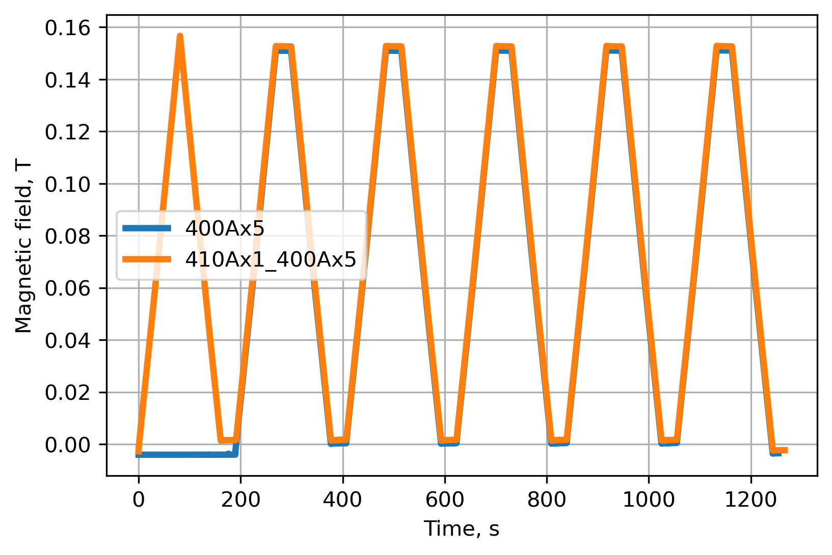
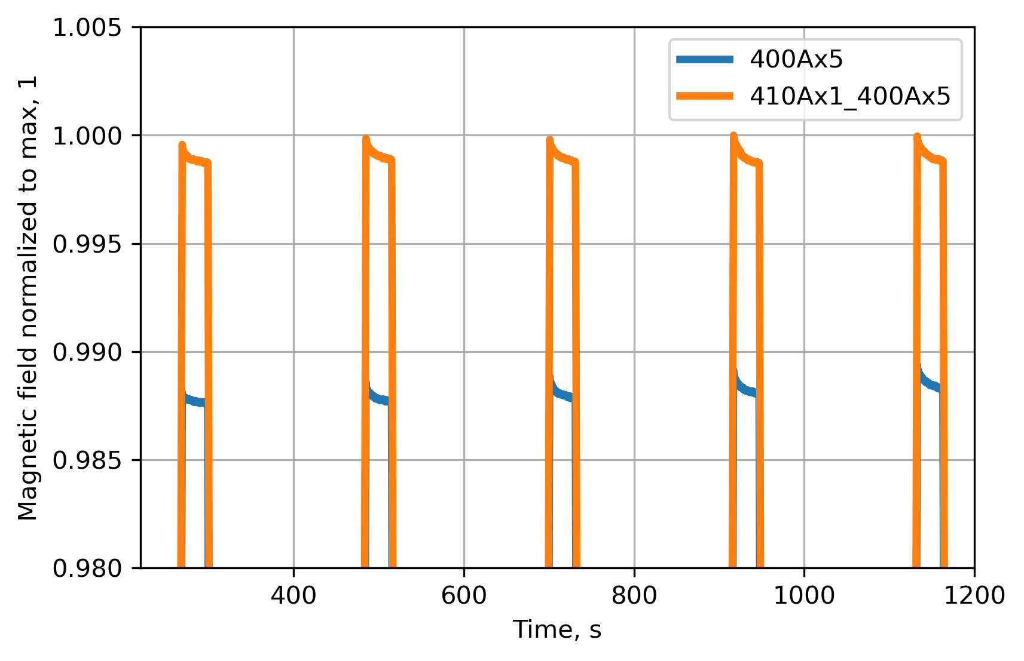
LN₂ Test Results: Magnetic field
2 cycles: 400 A x 5 and 410 A + 400 A x 5
Normalized to max field
First measurements on a pair of coils in LN₂ indicate the presence of strong screening currents

Slide 13
Improvement on the field alignment
REBCO block-coil dipole

Slide 14

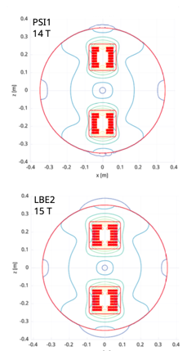
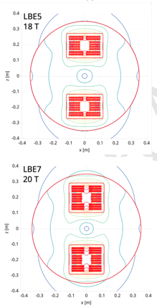
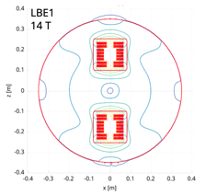
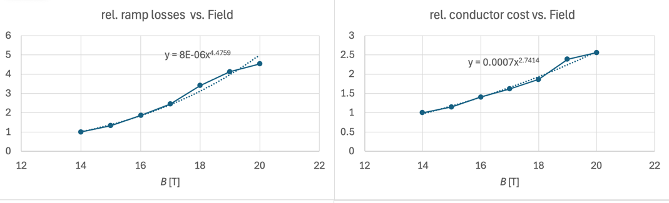
REBCO Block-Coil Dipole Scaling Exercise
As expected, AC losses grow non-linearly with field due to larger field sweep and growth in coil-size.
In this exercise AC losses increase 4-fold from 14 to 20 T.
HFM-PUB-RPT-0267 v.1 "Deliverables KE5943 / PSI-D2.1”, EDMS 3028682

Slide 15
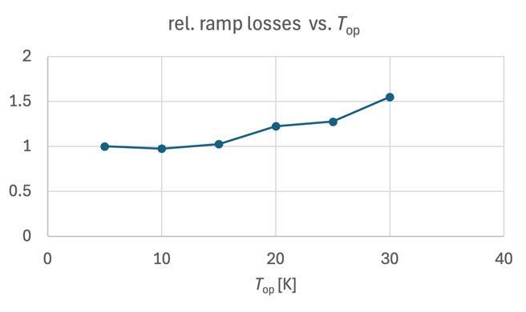
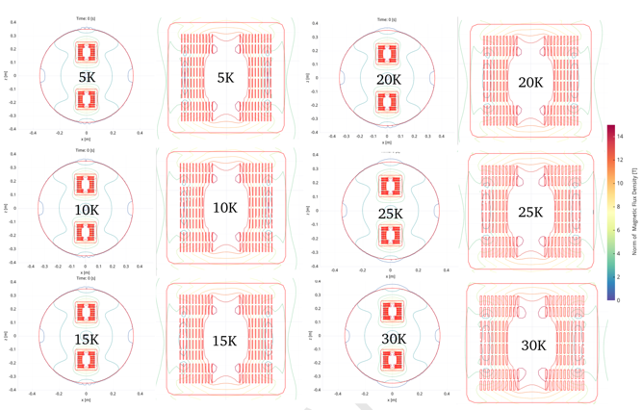
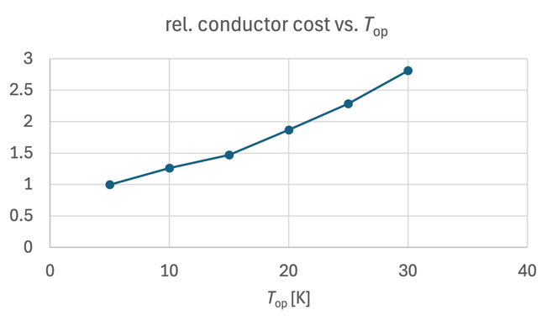
REBCO FCC-hh Dipole Scaling Exercise
Analogue study for scaling with temperature (5-30 K) for constant 14 T bore field indicates weak scaling of
AC losses, notable cost increase.
HFM-PUB-RPT-0267 v.1 "Deliverables KE5943 / PSI-D2.1”, EDMS 3028682

Slide 16
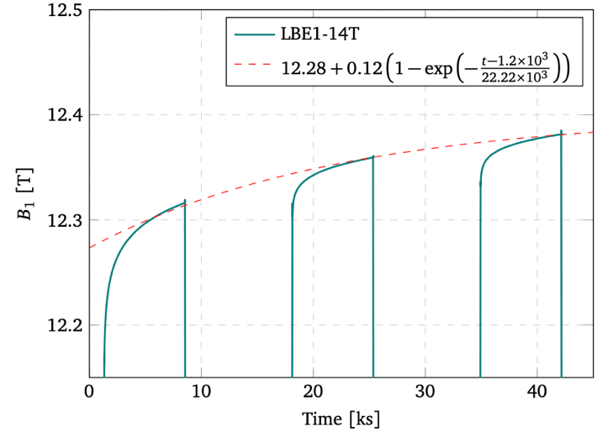
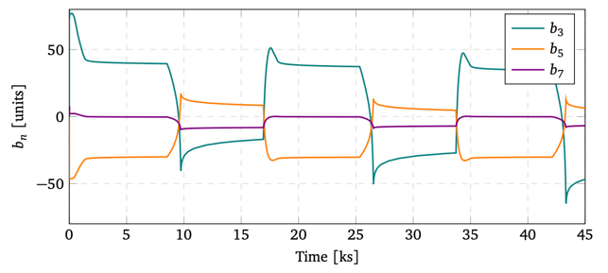
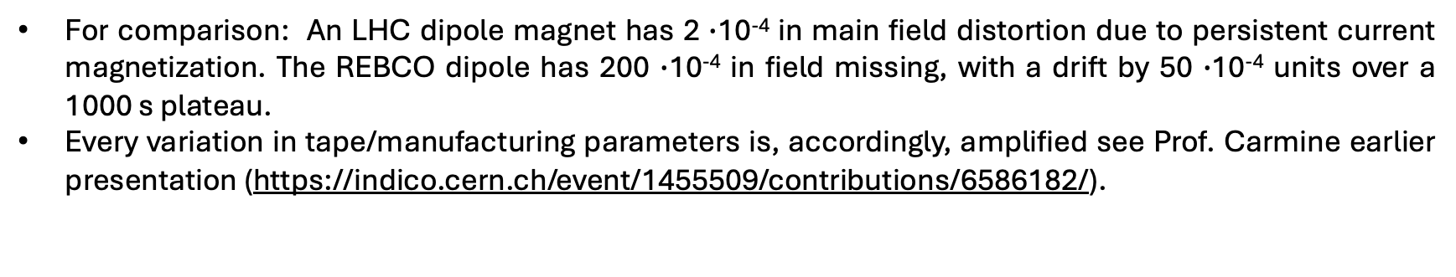
Field stability
Ironless
For comparison: An LHC dipole magnet has 2 $∙$10⁻⁴ in main field distortion due to persistent current magnetization. The REBCO dipole has 200 $∙$10⁻⁴ in field missing, with a drift by 50 $∙$10⁻⁴ units over a 1000 s plateau.
Every variation in tape/manufacturing parameters is, accordingly, amplified see Prof. Carmine earlier presentation (https://indico.cern.ch/event/1455509/contributions/6586182/).
Confirmed by simulations at CERN, INFN, PSI; see https://indico.cern.ch/event/1536352/
HFM-PUB-RPT-0267 v.1 "Deliverables KE5943 / PSI-D2.1”, EDMS 3028682

Slide 17
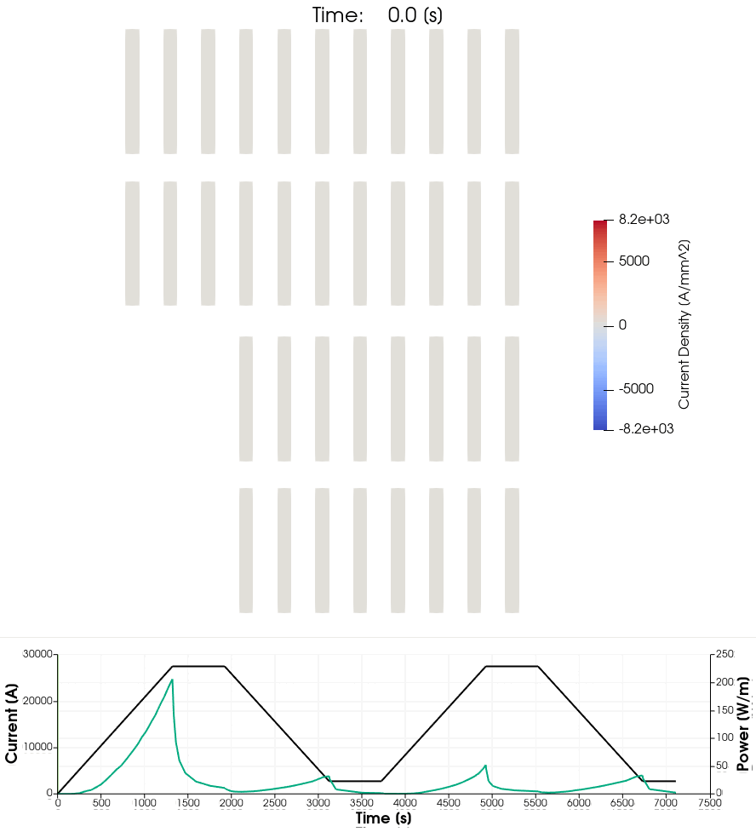
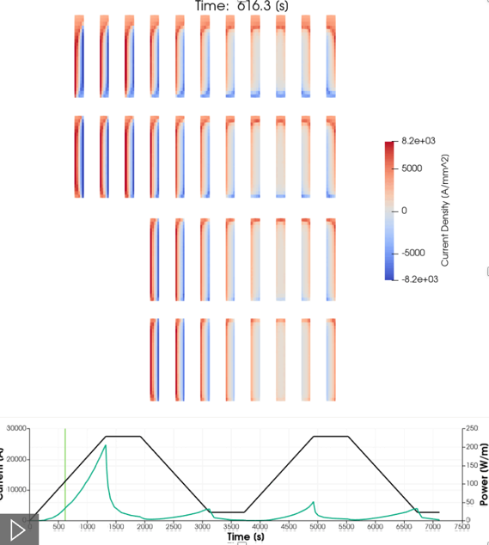
Dynamic Effects
Intense macroscopic screening current distribution.
The wide variability in tape properties and contact resistances, adds on the challenge related to field reproducibility as well as stability.
HFM-PUB-RPT-0267 v.1 "Deliverables KE5943 / PSI-D2.1”, EDMS 3028682
Notes:
For LHC field sweep at injection energy

Slide 18
Challenges
Reduce screening currents for improved FQ and reduced AC loss
Reduce coupling currents (time constants)
Maintain sufficiently high engineering current density
Reduce flux creep
Improve reproducibility

Slide 19
Challenges
Available tools

Slide 20
Cables and Coil Geometries
Reduce screening currents
Smaller tapes
Field alignment
Reduce coupling currents (time constants)
Twisted striated tapes > short time constants
Roebel
Maintain sufficiently high engineering current density
Field alignment with tape stacks
Roebel
Small-bending-radius tapes based twisted cables
Reduce flux creep
Smaller cables or twisted striated cable > protection?
Improve reproducibility
Soldered stack to homogenize cable
Standard common coil (with vertically-oriented pole coils)
Convenient for most cables (increased screening currents)
Pole-coil bending radius > limiting for twisted cable and Roebel
Asymmetric common coil
Increased screening currents for tape-stack cables
No down-side for twisted striated cables
Easy winding of Roebel cable
Cloverleaf
Favorable tape-stack orientation
Sophisticated winding, assembly, structural concepts required
Cos-theta
A possibility with tape-stack for sufficient coil-end subdivision
Restrictions on bending radius for twisted cables and Roebel
Field aligned common coil (RS2 magnet)

Slide 21
Further improvement on the field alignment

Slide 22
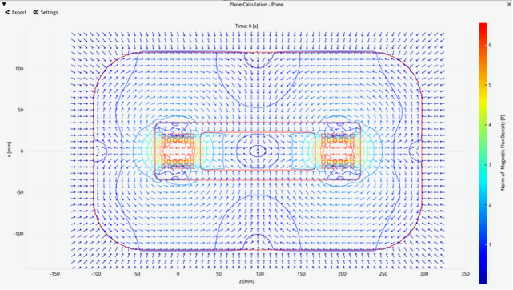
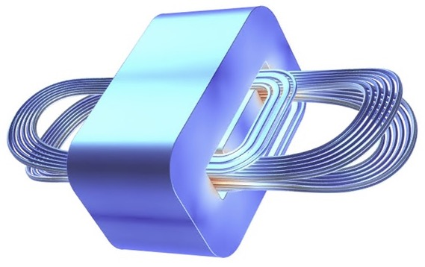
Next step: REBCO Subscale 2 - RS2
Field-angle optimized coil geometry
High-field coils wound cos-theta style between the apertures, where each block of windings in the high field follows a path like a midplane block in a cos-theta dipole, but with elliptical ends
Low-field turns wound common-coil style
Two winding positions (0° and 90°); intermediate positions are being implemented to improve field alignment.

Slide 23
Further options
Field alignment and cable with full transposition
Twisted striated tapes –based cable in stress-managed structure

Slide 24
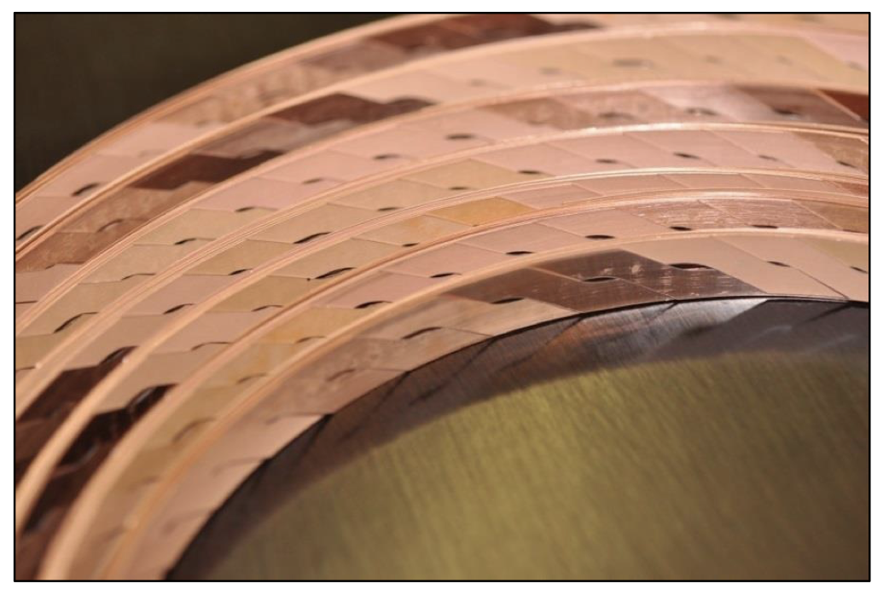
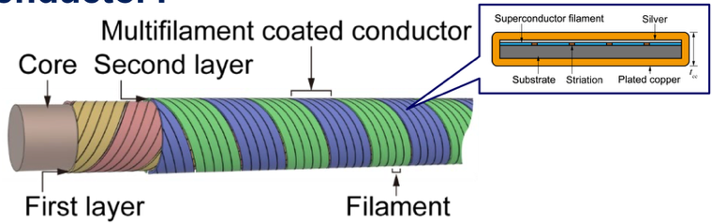
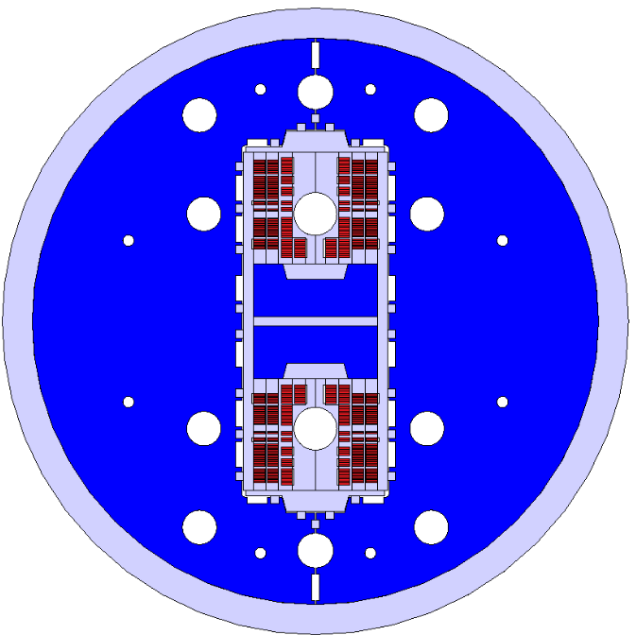
Further options
Courtesy of A. Kario et al..
Explore a REBCO SMACC (re-use parts of Nb₃Sn SMACC1) with twisted striated cables.
https://indico.cern.ch/event/489475/contributions/1166833/attachments/1263291/1868932/
RS2 Could be wound with tape-stack cable or Roebel
N. Amemiya et al., “Effective reduction of magnetisation losses in copper-plated multifilament coated conductors using spiral geometry,” doi: 10.1088/1361-6668/ac3f9c.

Slide 25
Other REBCO accelerator magnets @ PSI

Slide 26
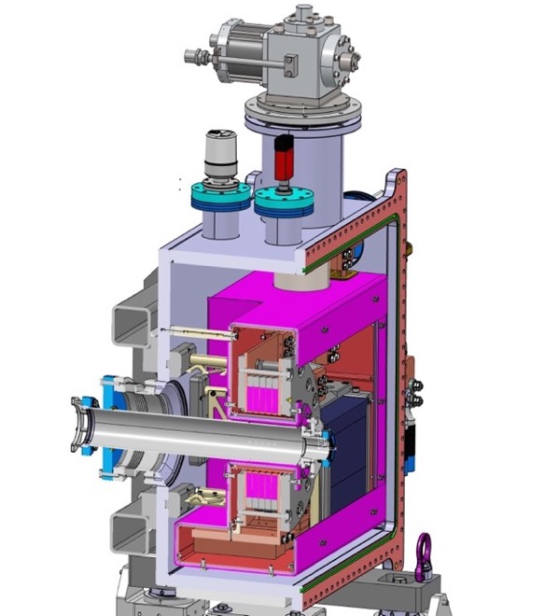
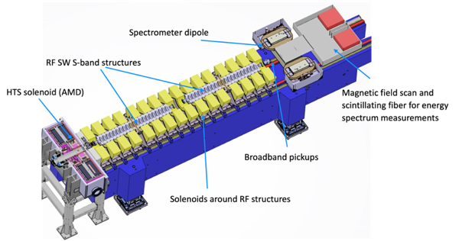

FCCee Injector Study: P3 experiment
(PSI Positron Production)
15 K conduction-cooling
HTS no-insulation positron-capture solenoid.
Increased positron yield allows for fixed (non-rotating) target.
Commissioning under way. Experiment at SwissFEL in 20226.
5 coils from 12 mm ReBCO, 110 mm ID
21 T peak field
https://iopscience.iop.org/article/10.1088/1361-6668/ada9d3/pdf
target
Solid-state (Pb)
thermal buffer
15 T in 72 mm
warm bore
Coil technology licensed from
Courtesy: M. Duda, H. Garcia Rodigues, J. Kosse, T. Michlmayr

Slide 27
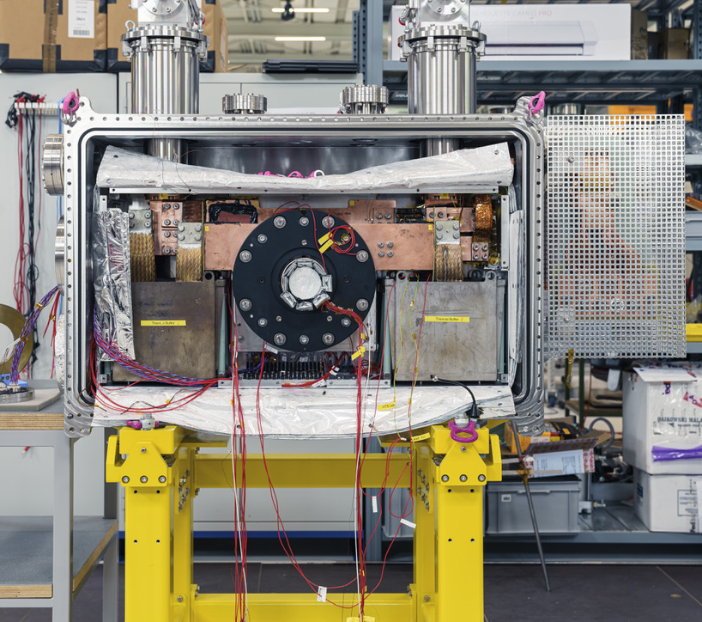
P3: Worst-Case Protection Scenario
Cryo-coolers
R_turnturn
HTS path
Current leads
During normal operation, the system operates with a large enthalpy margin (the minimum quench energy is 12 J)
In the event of a fault in the power supply and/or the cryocoolers, the system must safely ramp down.
Stored energy gets dissipated
in coils & thermal buffers
Pb thermal buffers

Slide 28
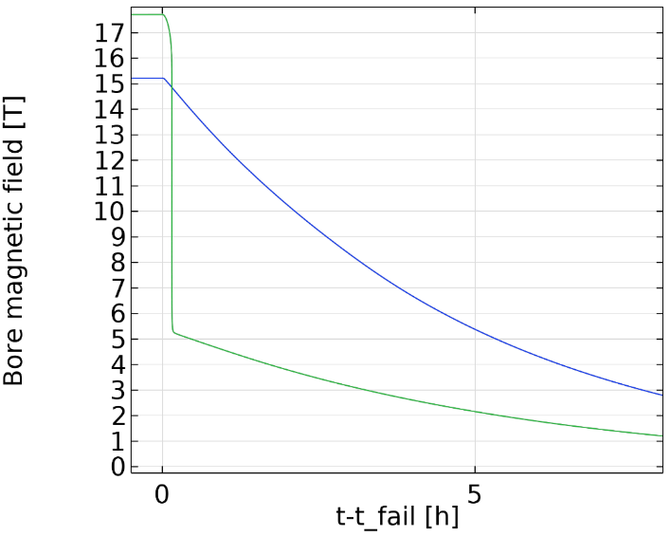
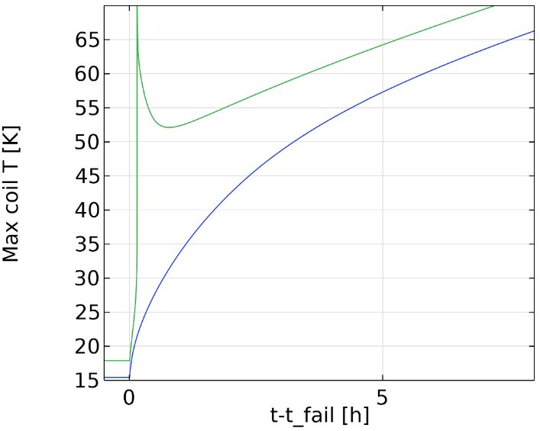
P3: Buffer sizing
Slow ramp-down
less mass
Quench
Nominal
operation
more mass
Courtesy of Jaap Kosse

Slide 29
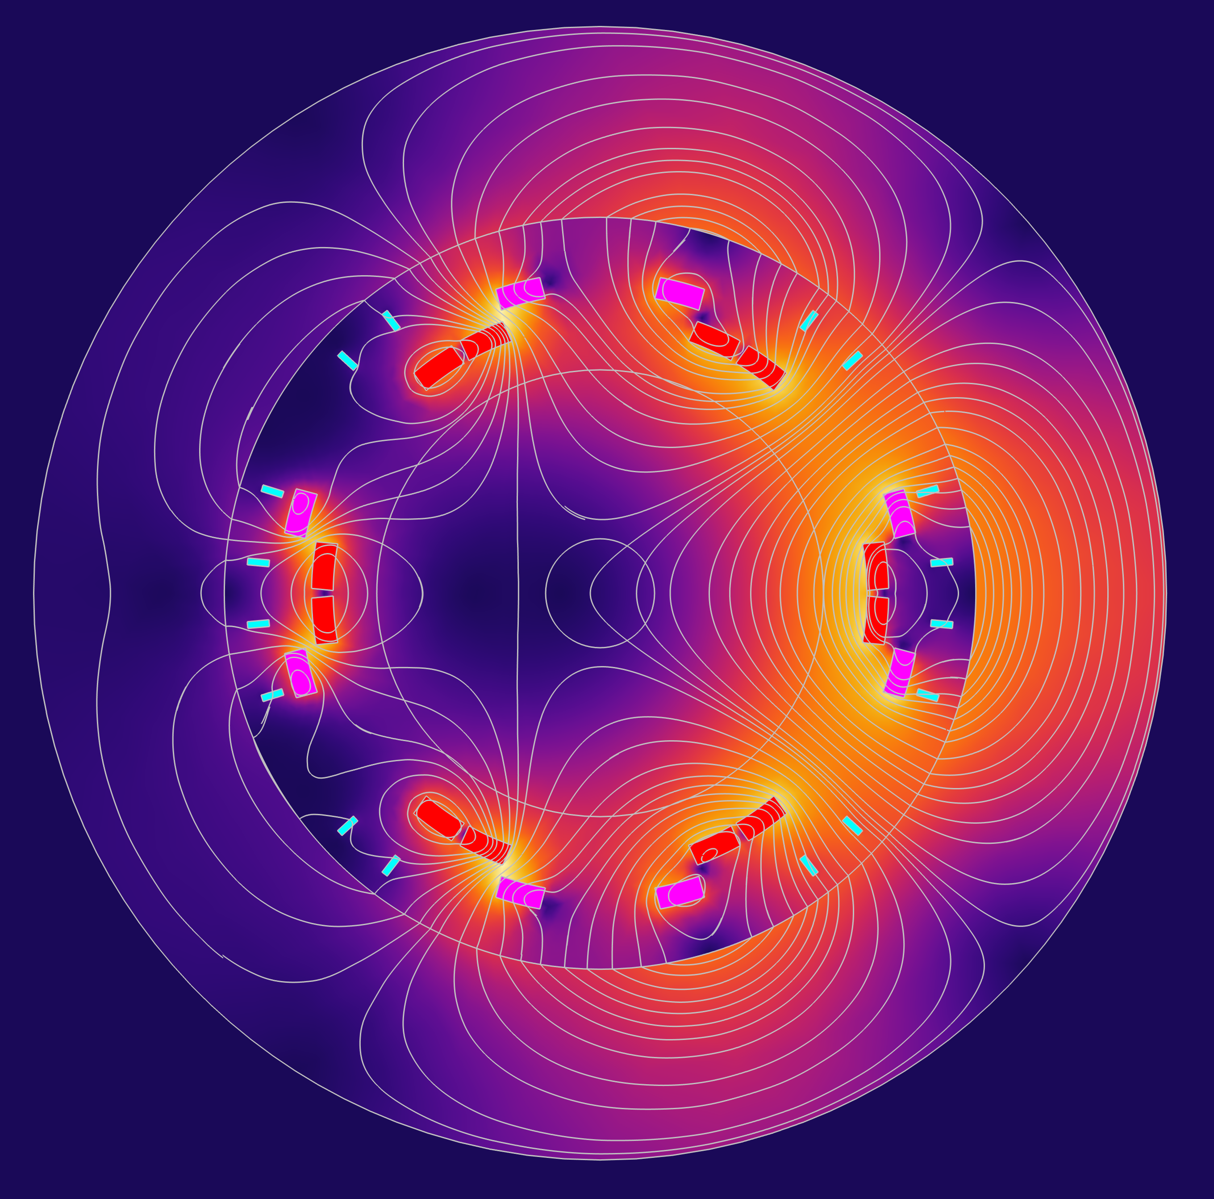
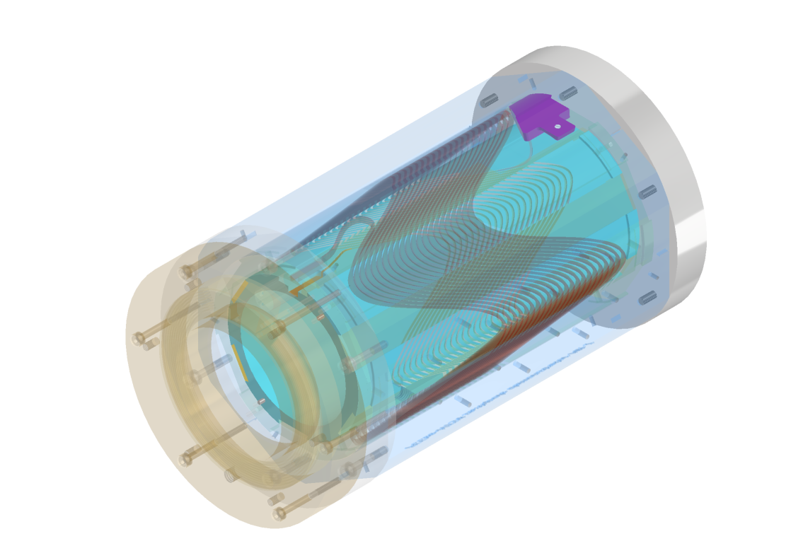
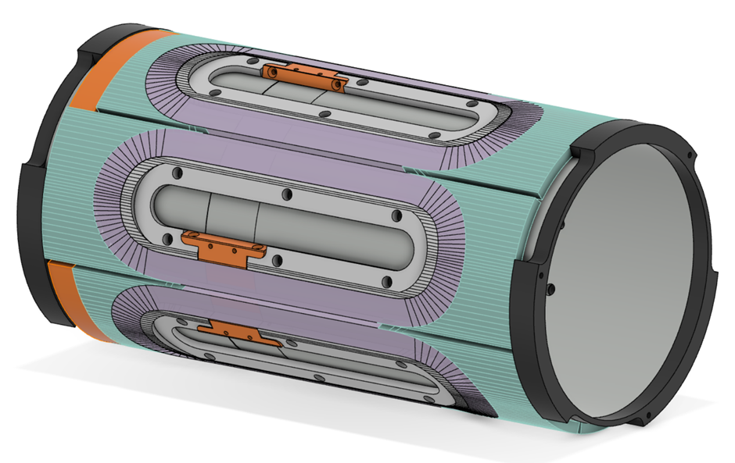
HTS Short Straight Section – HTS4
Proposal: HTS nested dipole + sextupole + quadrupole
Save 2.8 TWh on joule heating in S+Q
Save 2 TWh on SR radiation
Pay ~ 1 TWh for cryocooling
~20% reduction of total FCC-ee consumption
Gain optics flexibility
Demonstrators:
Iron
Quadrupole
Cos-ϑ
~ PSI
Sextupole
Dipole
20 mm
Canted Cos-ϑ
~ CERN

Slide 30
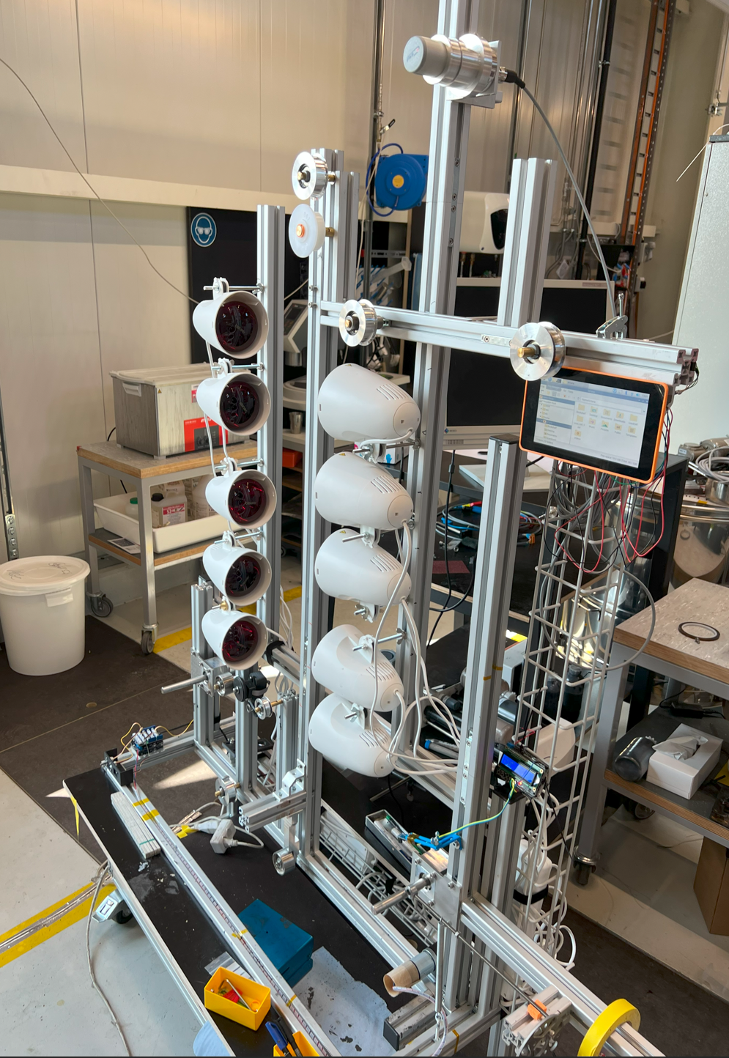
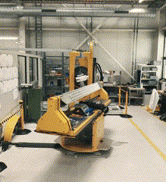
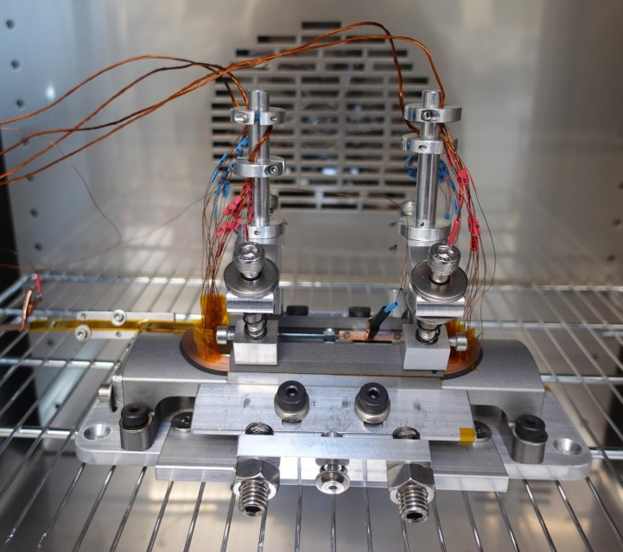
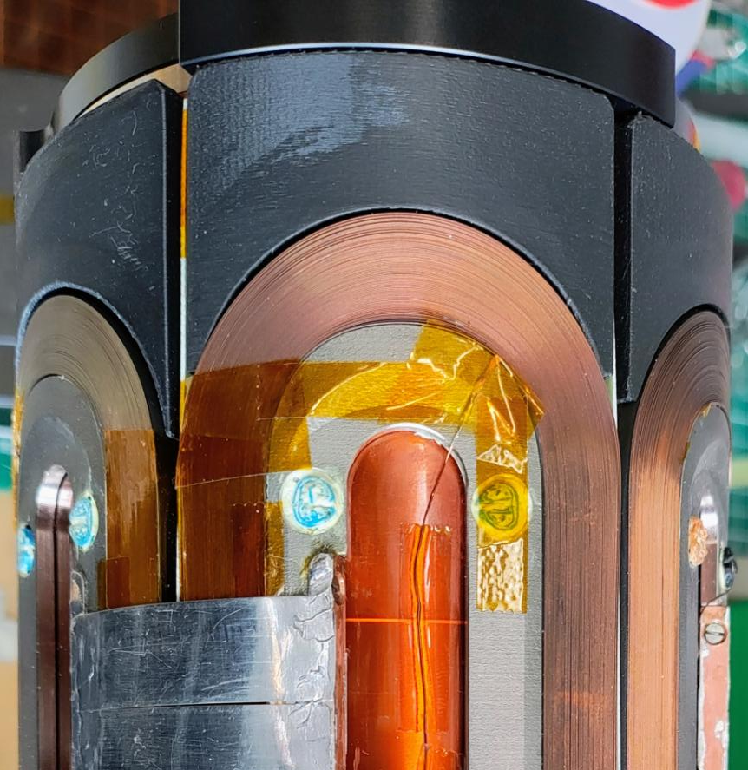




HTS4: Coil Fabrication (K. Puthran, J. Schmidt et al.)
1 coil per day
In-situ measure and control of coil resistance while baking
IV. Assembly
II. Automated winding
III. Curing / Tuning of
Contact Resistance
I. Coating
Partial Insulation (PVB)
Developed by Andre Brem, Matteo Crescenti :
“Filled thermoplastic based coating for tailored
contact resistance in HTS coils “ -
Submitted conference paper at IEEE TAS
IV. Impregnation

Slide 31




HTS4: CT Subscale Performance Test
Ic
Expected Ic performance
reached from 30 to 70 K
Measurement performed by M. Duda and colleagues @ PSI
CCT sextupole subscale cold
performance test under way.
Nested sextupole/quadrupole magnets
test in Q2/26.

Slide 33

LN₂ Test Results: Co-winding
Difference between SC and co-wound coils voltage < 10 uV
This means that the noise cancellation is very effective.
This allows the use of very tight protection threshold voltage.
V_diff not filtered n this plot
Measurement performed by M. Duda and colleagues

Slide 34
Instrumentation & Test Set-up
Connection leads for powering
Cooling copper plates inner splice
Connection outer splice
Main protection: Ldi/dt removal algorithm
V_tot: V_2LRS1_10-4
Splices: V_os1_4-5 and V_os2_11-10
HTS leads: V_c12.1_5-6 and V_c12.2_12-11
Backup protection: differential voltage between coils and co-wound
Mechanical switch with varistor, connecting coils to energy extraction.
Cooling copper plates inner splice
Connection leads for powering
Support frame
Clamping device of the coil pack

Slide 35
Test Results – Day 1: parameters validation and I_{c} limit 1/2
powering to 20 A, protection/ee verification x3
powering to 50 A with 1, 2, 5 and 10A/s
powering to 400 A with steps and ramp down with 10 A/s trip because of tight V threshold
Ramp up to nominal current in steps
powering to 400 A with 10 A/s x3
Measurement performed by M. Duda and colleagues

Slide 36
Test Results – Day 1: parameters validation and I_{c} limit 2/2
powering to 510 A with steps 1 A/s,
Ramp up to Ic in steps
Trip on ramp down with 5 A/s because of the 100 uV threshold
powering to 510 A with steps 1 A/s verification, ramp down 2 A/s
Measurement performed by M. Duda and colleagues

Slide 37
Test Results – Day 2: powering to nominal current and Ic limit
powering to 400 A with 5 A/s 30 s plateaus x5, trip on ramp down because of small threshold of 100 uV
powering to 400 A with 5 A/s 30 s plateaus x5
powering to 510 A with steps 1 A/s, I_max verification
Measurement performed by M. Duda and colleagues

