Slide 1
REBCO conductor improvements needed for engineering high-field user magnets at NHMFL
Lance Cooley
Director, Magnet Enterprise, NHMFL

Slide 2
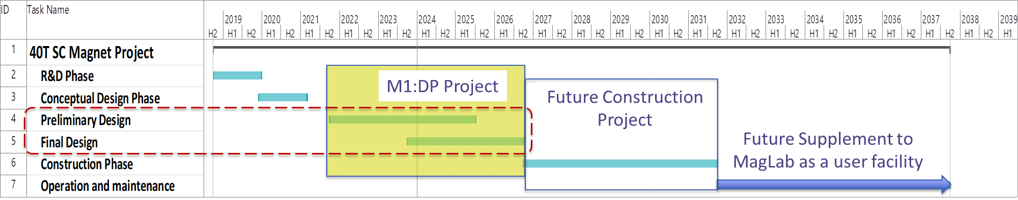
MagLab’s 40 T all-superconducting magnet project
NSF DMR 1644779, 1839796, and 2131790: Mark Bird (PI), Hongyu Bai (Proj. Mgr.), Eric Palm and Lance Cooley (co-PIs)
Present estimate
Parameter | Minimum | Desired
Central Field* | ≥40T | same
Experiment Duration | 8 hours | continuous
Quench Protection* System Validation | Full-scale test coil(s) | At 40T
Operating Temperature | 4.2 K | 4.2 K
Clear Bore Environment | 4.2 K, LHe | 4.2 K, LHe
Clear Bore diameter | ≥34 mm | ≥34 mm
Ramp rate | ≥0.5T/min | same
Inhomogeneity (1 cm DSV) | ≤500 ppm | same
Parameter | Minimum | Desired
10 gauss fringe field | < 2.0 m | < 2.0 m
Operating lifetime* | 10 years or 25,000 cycles | 20 years or 50,000 cycles
Field set-ability* | 10 mT | 5 mT
Cycling repeatability* | 10 mT | 5 mT
Stabilization at set point* |  | < 3 minutes
Drift at stable set point* | 20 ppm | 10 ppm
* Focus areas of design stage

Slide 3
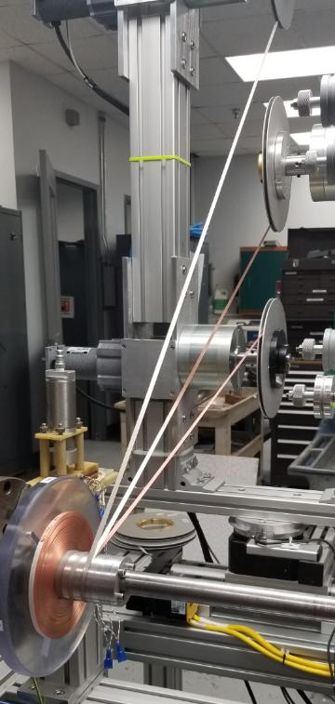
40 T magnet design: 2-in-hand “multi turn insulated” approach
2 x REBCO + Cu strip + thin SS with insulated coating
Conductor Ic grading
New designs for crossovers and terminations
Lower inductance traded for higher current operation (target: 70% Ic)
Increased tolerance for REBCO defects vs. 32 T
Add sol-gel insulated SS co-wind and over-banding to oppose screening current deformation
Combinations of co-wind and over-banding to tailor stress management
Improved modeling and validation testing
Screening current and implications for strain and quench
Sensitivity analyses for variations in parameters such as Ic
Extensive fatigue testing
Coil module testing
Shield
Coil
Stainless-steel Mandrel
Two-in-hand
REBCO tape
Copper tape
Sol-gel insulated
stainless-steel tape

Slide 4
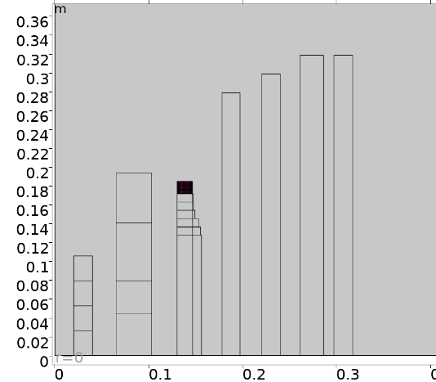
Present status: Full-size single coil test
Quadrant view of the 40 T design
Tests of the first Large Scale Coil have been completed
Target operating current has been achieved
Tests also demonstrated repeated quenches without degradation
A second LSC is planned for 2026
Preliminary design and construction execution baseline is complete (~70% level of definition)
Final design expected by anticipated 2027 start of NSF Mid-Scale 2 project
Final design will improve based on findings from large coil tests
LTS
Winding pack
(with co-wound SS)
HTS
SS Overband
+Shield
Coil
meters
Coil 3 is the most challenging, and is selected for validation

Slide 5
REBCO specification for the 40T magnet acquisition
Conductor team – Dmytro Abraimov, Jun Lu, Jeremy Levitan, Aniket Ingrole, Jan Jaroszynski, Jozef Kvitkovic, Yan Xin Students: Hannah Matos Pimentel, Adonay Almanza-Enriquez, Cade Watson, Aaron Bates, Carina Zha, Nicole Bishop, Noah Gavin, Aliya Hutley
REBCO Conductor Technical Specification (synopsis) for the 40T SC Magnet
Dimensions
Width of tape: 4.0 ± 0.05 mm
Substrate Hastelloy C276: 50 ± 1 μm thick;
Copper layer: 20 ± 7 μm on each side, copper area 0.164 mm² ± 10%
Silver layer: 2.0 ± 0.5 µm on REBCO side, sealing all REBCO
Thickness difference between two edges: < 8.0 µm
Piece length > 125 m (whole units of this length; spools can have multiple units)
Acquisition will be more than 40 km
Performance
Three grades of I_{c} (4.2K, 14T, 18º)
Supplier may vary REBCO thickness but not pinning additive
Grade 1: I_{C} mean = 420 A ± 15%
Grade 2: I_{C} mean = 340 A ± 15%
Grade 3: I_{C} mean = 250 A ± 15%
N-value ≥ 30
End-to-end I_{c} variation < 10%
Electrical
Copper RRR: ≥ 50
Soldered lap joint resistivity < 120 nOhm-cm²
Mechanical
Critical current irreversible strain limit: 0.5%
Bending diameter without degradation: 12 mm
Peel strength: reject at < 0.1 N/cm, Target: 1.0 N/cm
Insulation: none
Solder tinning: none
No manufacturer can connect REBCO magnet performance requirements to internal QC and process controls at the present time
A. Francis et al, Supercond. Sci. Technol. 33 (2020) 044011
Ic spec is not final
Input for process control
Operating environment of 32T magnet
Specifications not usually required by other projects.

Slide 6
The 40T conductor quality plan will require extensive resources
Test Plan (synopsis) of REBCO Conductor for 40T
Full end-to-end Tapestar data from supplier (77 K, s.f.); re-scan at NHMFL upon receipt, each spool (Supplier + Lab)
Surface condition survey each spool (S+L)
Transport I_{c} and N-value on short samples from spool ends
15 T, 4.2 K and fixed angles (90°, 18°, third angle for curve fitting) each spool, each end (L)
Up to 11 T, 4.2 K, variable angle, laser-cut bridges, selected tapes from production lot (L)
Torque magnetometry (J. Jaroszynski) to cover full Ic(B, T, θ) space up to 31 T, selected tapes from production lot (L)
RRR measurement of the copper layer (requires removing REBCO), once per strand lot or copper plating run (L)
ab-plane tilt angle XRD measurement, once per spool (L)
Scanning electron microscopy
Visualization of the REBCO layer surface (requires removing Cu+Ag) once per strand lot (L)
Conductor cross-section and thickness, each spool (L)
FIB patterning for REBCO thickness measurements, once per strand lot (L)
EDS analysis of defects, as needed (L)
Transmission electron microscopy as needed (L)
Peel test each spool, each end (L)
Joint resistance once per strand lot (L)
Transport Ic under stress once per strand lot (L)
1-2 weeks per spool with present resources

Slide 7
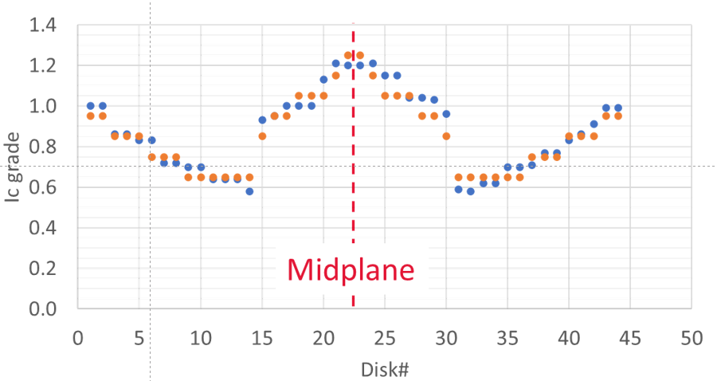
Critical Current Grading is needed to control magnet margins and facilitate quench protection
Ic can be too high!
Only “standard” conductors were available for LSC.
40 T will grade this region
Manufacturers were approached to deliver three conductor grades by varying the REBCO thickness
Need to keep Ic(B,T,θ) scaling the same to facilitate quench modeling and protection → changes in pinning were discouraged
One manufacturer responded positively
Broad range of Ic for delivered spools allowed some design needs to be met from inventory
Is this really optimal for a project?
LSC Actual
Design
Graded conductors
Risk to magnet development: Without a large conductor inventory, development uses what is on hand, which may not be optimal.

Slide 8
Testing standard tape: comparison of two orders
Takeaway: Manufacturers are not (yet) able to adjust processes outside of production sweet spots to meet requested specs.
Order K25060
Delivered and
tested in 2023
Order K25039
Delivered and
tested in 2024
Although the spread at 8º orientation reduced, the spread at 18° increased and the average Ic value declined.
Notice the low variation of 77K s.f., which is presently the primary process feedback.
4.2K, 14T, 8°
Expected I_{c}(4.2K, 14T, 18º) =539 A (target)
4.2K, 14T, 18°
4.2K, 14T, ⊥
77 K s.f.
Spool chronological ID

Slide 9
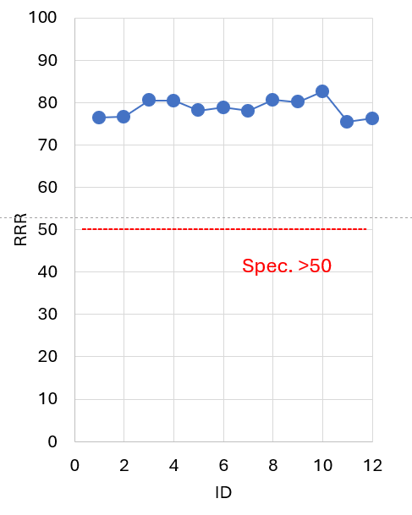
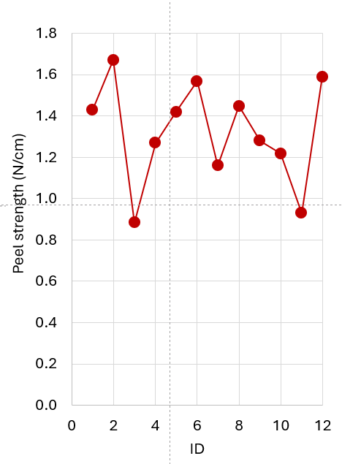
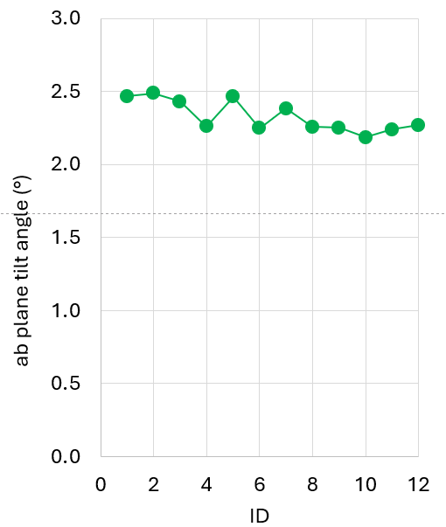
RRR, peel strength, tilt angle along a 120 m length of a single conductor
Takeaway: 10-15% (or more) variations still occur along a single piece of conductor. Spool-to-spool variations are somewhat higher.

Slide 10
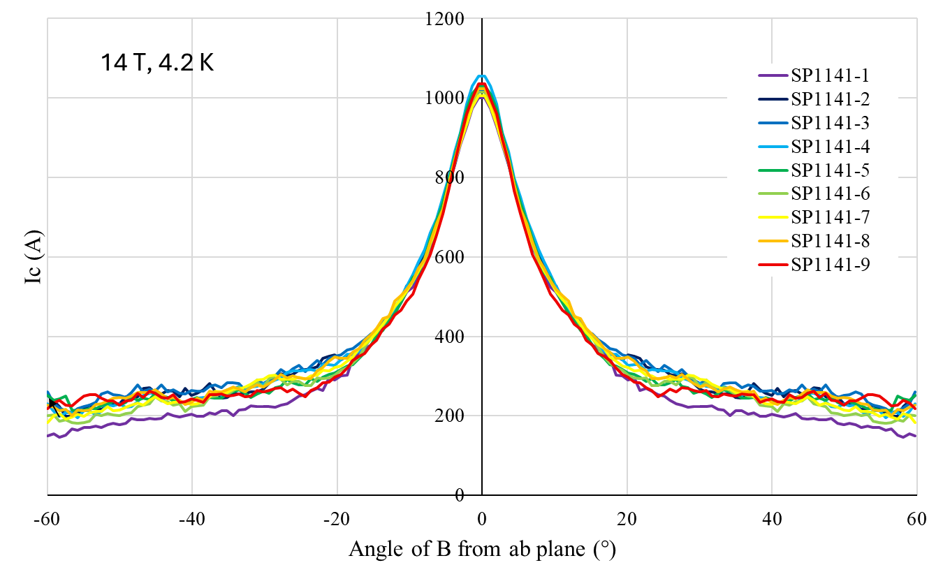
Ic angular dependence at different locations along the length Torque magnetometry by Jan Jaroszynski now available for broad distribution
Here, multiple samples along a 120 m conductor length were scanned. Uniformity is within 15% of mean.
Transport at 8, 18, and 90 degrees is used to scale torque magnetization data
Can be used in variable temperature to build scaling fits for quench modeling and prediction of Ic at e.g. 20 T, 20 K
J.W. Levitan, et al., Fri-Mo-Po.08-04, MT-29

Slide 11
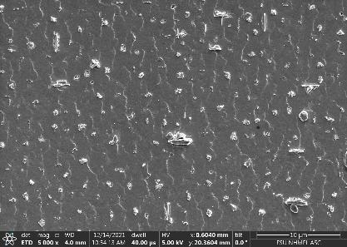
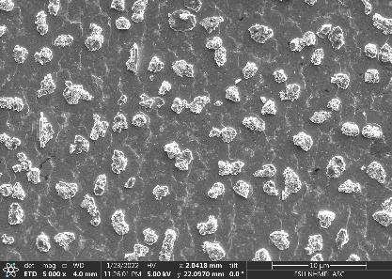
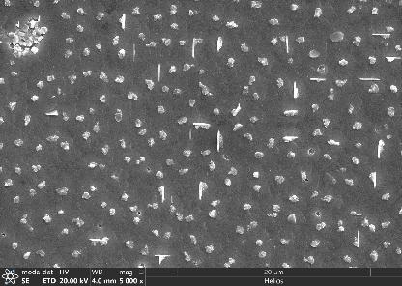
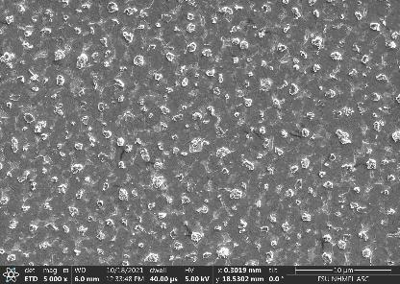
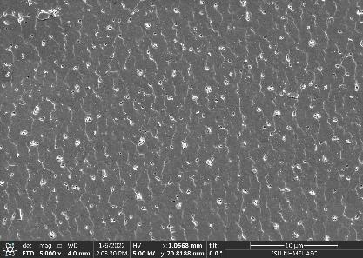
Correlation of J_{c}(20K, B, 18º) with SEM images of REBCO layer D. Abraimov demonstration of scaling 40 T conductor data to region of interest for fusion
Takeaway: Process control + feedback to eliminate defects is still needed. Larger J_{c} is for tapes with a smaller density and size of defects.
Same manufacturing line. No apparent association with chronology.
Middle slit
Notes:
Slightly smaller To was observed for tapes with a smaller density and size of defects.
Above 15-20T tape-to-tape spread of To(B) is decreasing.
Larger f_{p} is for tapes with a smaller density and size of defects.

Slide 12
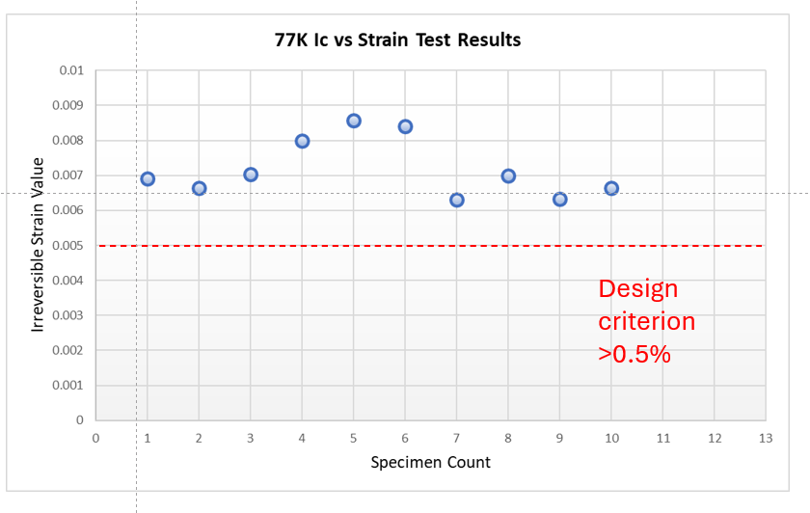
Ic-Strain is a challenging specification for manufacturers
So far, only 1 manufacturer has been able to consistently deliver Ic-strain above specification
Some values are excellent – What is the key microstructural feature of the conductor that enables high ε_{irr}?

Slide 13
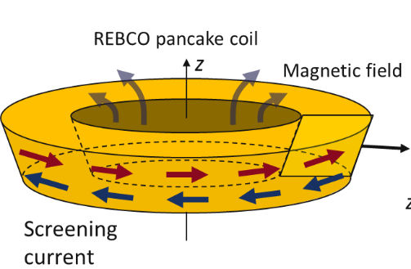
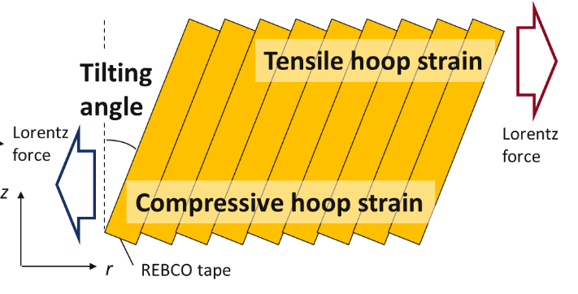
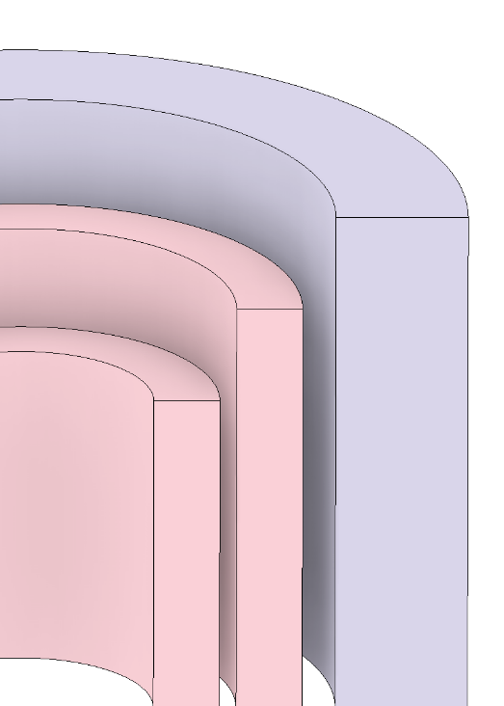
Key aspect for structural design: Screening current induced stress (SCIS)
The next slides are the result of excellent work by young faculty Yu Suetomi, Shannon Griffin (PD), and John Rogers (PD) with mentoring and further contributions by Tom Painter, Iain Dixon, Mark Bird, Andy Gavrilin, and Hongyu Bai
Example of a cross-section of a high-field SC magnet
Schematic of SCIS in a REBCO pancake coil
z
Outboard
Inboard
Screening currents generate inward and outward Lorentz force in addition to those from transport currents, resulting in
Enhancement of tensile hoop strain at outboard edge → Criterion: 0.45% determined by the fatigue test coil in 2020
Compressive hoop strain at inboard edge → Criterion: ?
Conical deformation with tape tilting → Criterion: ?
REBCO inserts
LTS
outsert
Midplane
r
Notes:
Key aspect for structural design is screening current induced stress.
Screening currents in a REBCO tape generate outward and inward Lorentz forces.
This results in
Enhancement tensile hoop strain
Compressive hoop strain
Conical deformation with some degrees of tape tilting angle,
As for tensile hoop strain, we had already determined the criterion as 0.45% which is determined by fatigue test coil results in 2020.
However, we didn’t figure out the criterion of compressive hoop strain and tilting angle.

Slide 14
Combinations of preload, axial pressure, and SCIS also threaten modules near the coil midplane
Example of cross-section of a high-field SC magnet
Pancakes at mid-region experience the combination of axial pressure from the outer disks and tilting deformation due to SCIS.
z
Axial pressure from upper disks and axial pre-load
Axial pressure by B_{r} x J_{θ}
REBCO tape
Tilting due to SCIS
Result
Mandrel
Spacer between pancakes
Concerns about axial pressure:
Increases the tensile stress at the outboard edge
Increases the compressive stress at the inboard edge and concentrate stress against the mandrel
Affects contact with the spacer between pancakes, which incorporates the quench heaters, in ways that are difficult to model
REBCO inserts
LTS
outsert
Midplane
r
14
Notes:
And, the actual situation is more complicated.
Because the mod-region of HTS coils, they will experience the combination of axial pressure from the upperdisks and tilting deformation due to SCIS.
The concern is that Axial pressure will likely enhance the magnitude of tilting deformation and hoop strain.
So, we need to figure out the criterion on the combination of tilting angle and axial pressure.

Slide 15
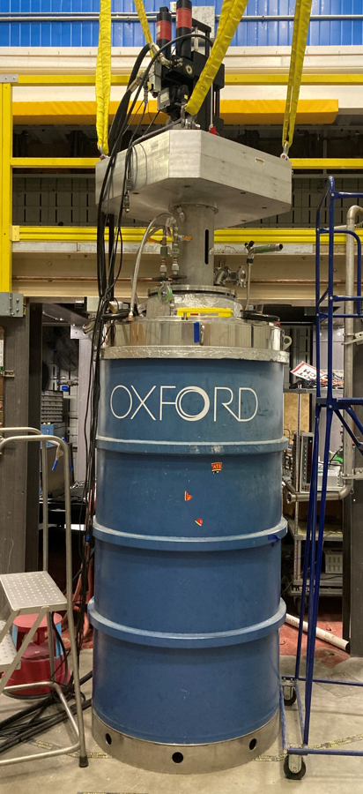
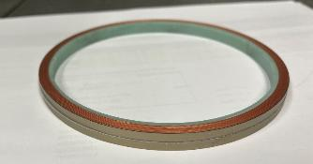
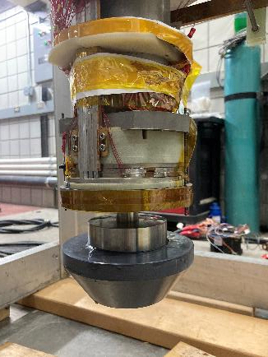
Combined Axial pressure and Tape Tilting (CATT) test
Schematic of CATT test
Actuator
Field produced by the split magnet
F (up to 250 kN)
“CATT” Coil
(REBCO double pancake coil)
CATT Coil
124.0 mm
12 T split magnet
The outsert field induces SCIS and tape tilting, and the actuator applies axial load mechanically.
Notes:
To evaluate this, we conducted combined axial pressure and tape tilting test, for short, CATT test.
This is the cryostat of the 12 T split-magnet, and actuator is attached at the top of the probe, and double pancake test coil is inserted like this.
located at some offset in magnet axial direction from the midplane of the outsert.
This way, The outsret field induces SCIS and tape tilting, and Actuator applies axial load mechanically.
which result in Combined Axial pressure and Tape Tilting

Slide 16
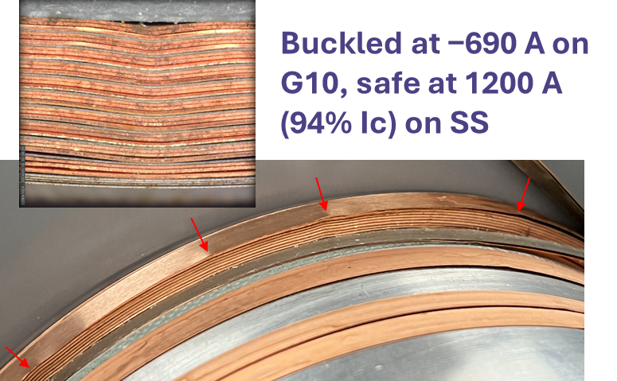
Combined Axial pressure and Tape Tilting (CATT) test
Actuator
“CATT” Coil
(REBCO double pancake coil)
124.0 mm
Notes:
To evaluate this, we conducted combined axial pressure and tape tilting test, for short, CATT test.
This is the cryostat of the 12 T split-magnet, and actuator is attached at the top of the probe, and double pancake test coil is inserted like this.
located at some offset in magnet axial direction from the midplane of the outsert.
This way, The outsret field induces SCIS and tape tilting, and Actuator applies axial load mechanically.
which result in Combined Axial pressure and Tape Tilting

Slide 17
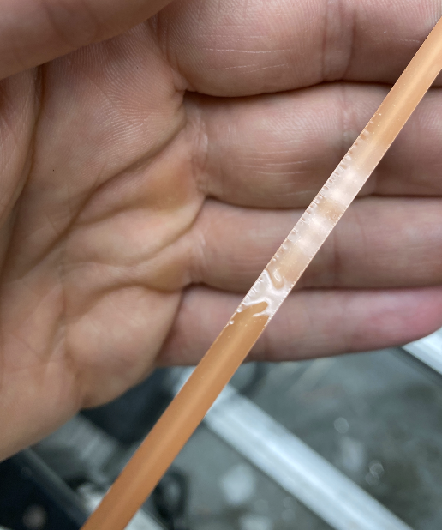
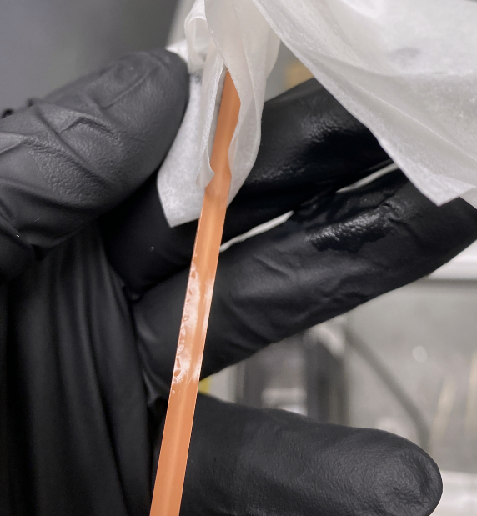
Inspection after LSC initial test (Jan. 2025): Delamination is a root cause of module degradation
Delamination was found in several locations in a module that generated voltage and showed other behavior consistent with degradation.
Takeaway: Copper plating “art” continues to be an important component of REBCO conductor.
Improving the plating consistency is of high importance

Slide 18
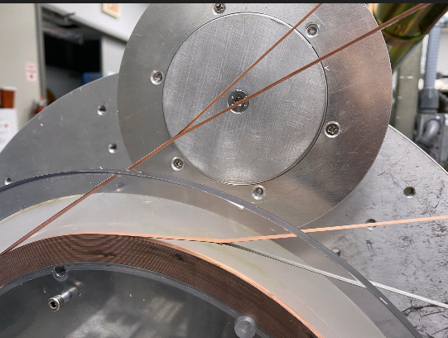
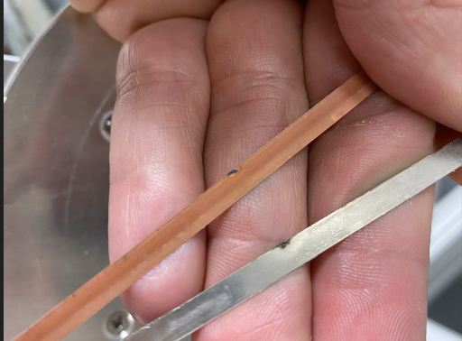
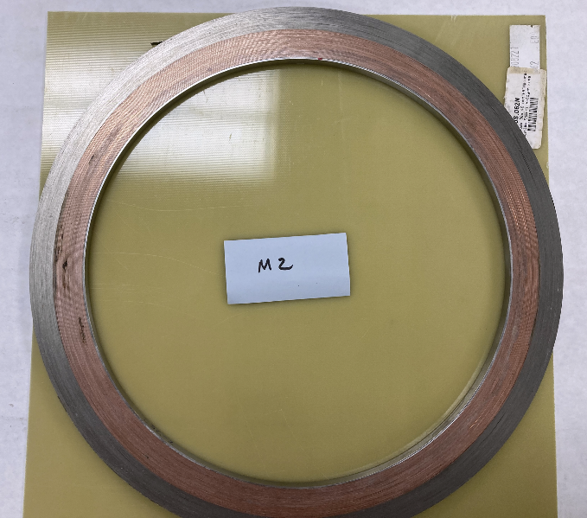
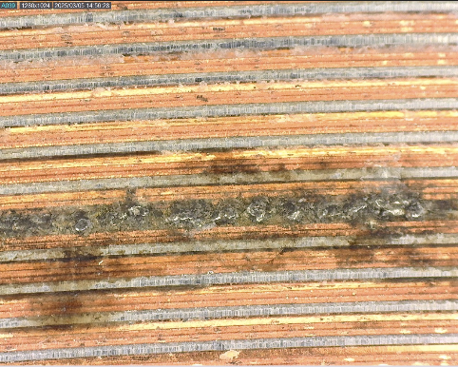
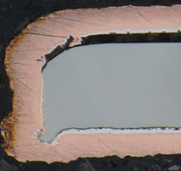
Inspection after LSC initial test: Evidence for arcing
Dark spots were visible on some modules indicating shorts across conductor turns
Locations do not seem to be correlated with the coil components → local defects
In some cases the tapes were welded together
Among possible causes under investigation: Delamination of copper combined with slit edge “hook” amplified electric field during quench

Slide 19
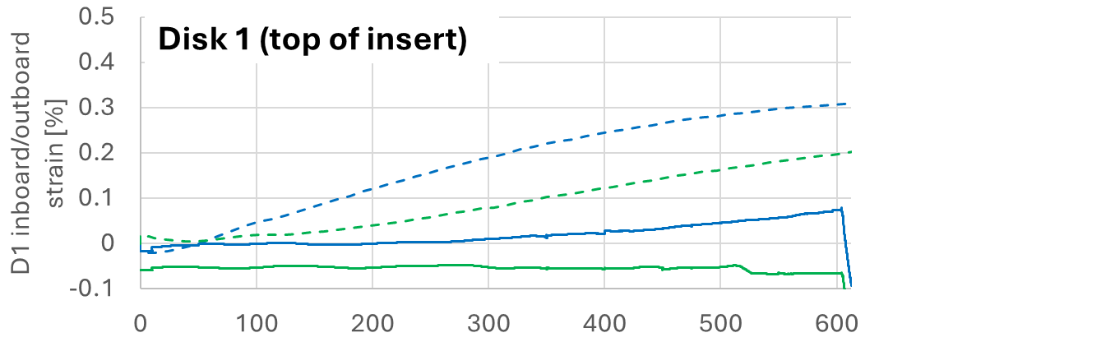

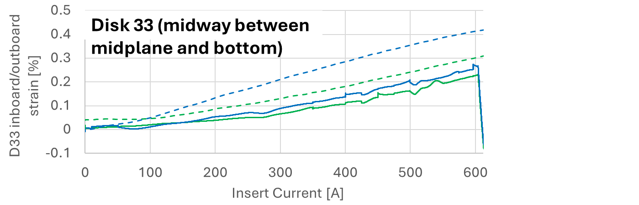

Discrepancy between measured and simulated strain: Are we missing other threats to the conductors?
Test sequence:
First, outsert is charged (generates a background field of 11.4 T).
Strain is close to 0 during outsert charging.
Then, HTS insert is charged to 609 A.
Measured strain was compensated by compensation gauge
Outboard
Simulated
Inboard
Measured
Outboard
Inboard
Overall tilt is over-estimated
Are large local tilts overlooked?
End flange
Outboard
Inboard
Midplane

Slide 20
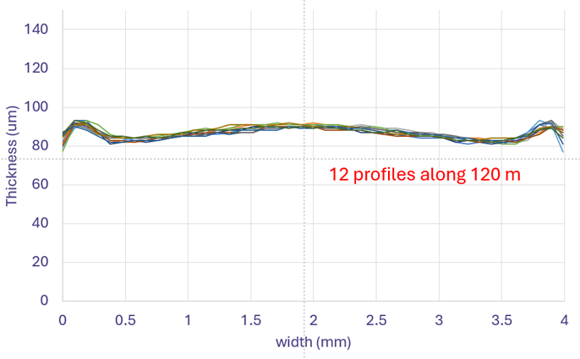
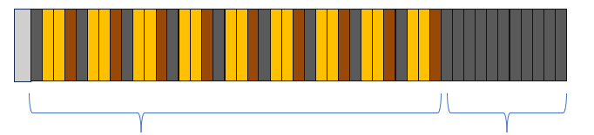
Dimensional variations and surface roughness motivate corrections to the “hard contact” model used to assess screening currents
~25 µm
Effective radial modulus should be dominated by a… systematic macroscopic thickness distribution of REBCO tapes
Effective radial modulus should be dominated by a… random microscopic roughness on steel tapes.
The effective radial modulus should not be the same as the material property.
Assumed contact area
Actual contact area
Takeaway: Dimensional variations of the conductor reduce the effective transmission of stress to the support structure.
Takeaway: End-to-end and side-to-side micrometer data would be helpful, but measurements are not routinely implemented in QC.
4 mm
~30 μm
Assumed contact area
Actual contact area
~0.4 μm
Evidence of radial compressibility on REBCO tapes:
Yan, Y., Kim, J., Bong, U., Jang, W., Kim, G., Park, J., & Hahn, S. (2023). Measurement and analysis of winding stresses in dry-wound pancake coils considering nonlinear compressive behaviors. Superconductor Science and Technology, 36(11), 115019. https://doi.org/10.1088/1361-6668/
Xue, S., Kwon, J., Guo, Y., Garg, T., Sumption, M. D., & Collings, E. W. (2023). Compressive Stress-Strain Behavior of Rebco coated conductors and Cables. IEEE Transactions on Applied Superconductivity, 33(5), 1–6. https://doi.org/10.1109/tasc.2023.3247370
Park, J., Kim, J., Yan, Y., & Hahn, S. (2024). Diameter Change of Dry Wound rebco solenoid pancake coil by winding tension. IEEE Transactions on Applied Superconductivity, 34(5), 1–5. https://doi.org/10.1109/tasc.2024.3362772

Slide 21
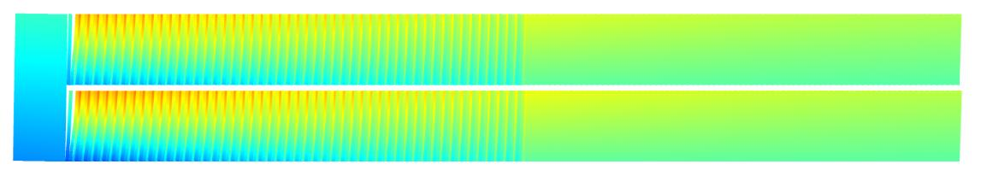
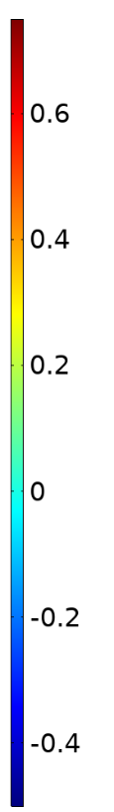
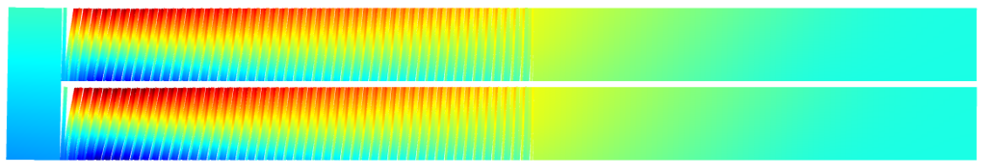
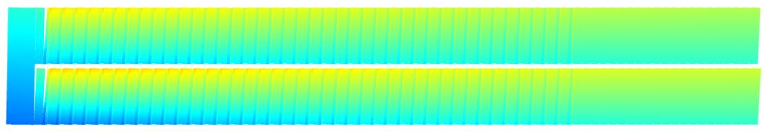
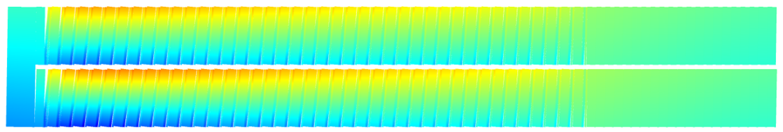
Updated LSC model and strain distribution with more co-wind
WCP: winding compressibility
Max: 0.46, Min: −0.25
Hoop strain [%]
Over-band
2024 Design (heavy over-band)
w/o WCP
Coil 2, End module
(8 mil SS tape)
Max: 0.80, Min: −0.49
Strain concentration
w/ WCP
Max: 0.36, Min: −0.24
2025 Update (heavy co-wind)
Over-band
Coil 2, End module
(25 mil SS tape)
w/o WCP
Max: 0.45, Min: −0.39
Strain concentration is reduced
The next LSC will use heavy co-wind.
w/ WCP
Notes:
This slide shows simulated hoop strain distribution of each design.
Each of this shows calculation results without and with winding compressibility effects
As explained in the Shannon Griffin’s presentation, the strain drastically concentrated at inner region in thea case of heavy-overbanding design, which due to winding compressibility.
The maximum hoop strain is 0.8%. I would say this is very dangerous.
On the other hand, heavy co-wind design.
In this case, Strain concentration was reduced.
because co-wound reinforcement directly supports the REBCO tapes.

Slide 22
Summary of conductor takeaway points from the 40 T project experience
Only one REBCO vendor so far has been qualified. Ic(strain) is a major hurdle for manufacturers.
QC at 4.2K and high field still must be done at MagLab.
We are working with manufacturers to build an in-house QC measurement, e.g. torque magnetometry, relevant to user magnet applications.
Conductors must be graded but make-to-grade manufacturing takes processes out of sweet spots and leads to variations along length and spool-to-spool.
40T took advantage of variations to build up an inventory and cover grading needs.
Lack of dimensional uniformity reduces stress transfer to over-banding, leading to local stress concentration. Co-winding thicker SS may be a mitigation if manufacturers cannot tighten tolerances.
No dimensional QC, e.g. laser micrometer, is done across width and along entire length yet.
Delamination continues to be found in degraded regions. Copper plating needs improvement.
What breaks down in the present copper plating methods? What QC might be needed?

Slide 23




L. English
A. Francis
n
J. Gillman
SS. Hahn
X. Hu
K
J.
BL. Kim
K. M. Kim
Thank You!
The 40 T project team
D. Abraimov
T. Adkin
K. Amm
E. Arroyo
H. Bai
A. Bangura
M. Belton
M. Bird
G. Boebinger
H. Boenig
N. Bonaventura
E. Bosque
K. Cantrell
E. S. Choi
L. Cooley
J. Deterding
I. Dixon
L. Eaton
Gavrilin
L. Greene
S. Griffin
V. Griffin
S. Gundlach
S. Hannahs
A. Ingrole
J. Jaroszynski
B. Jarvis
K. Kim
J. Kvitkovic
D. Larbalestier
J. Levitan
J. Lu
J. Lucia
D. Lunger
D. Markiewicz
L. Marks
S. Marshall
H. Matos-Pimentel
T. Murphy
T. Painter
E. Palm
A. Powell
J. Rogers
Rowney
D. Shukla
R. Stanton
Y. Suetomi
E. Stiers
U. Trociewitz
M. White

