Slide 1
REBCO cable and magnet activities in the USA
Luisa Chiesa, Tushar Garg, Vadim Kashikhin, Claudia Navarro, Emily Romancew, Mike Sumption, Venkat Selvamanickam, Makoto Takayasu, Danko van der Laan
With special coordination by Xiaorong Wang (LBNL) and Yuhu Zhai (PPPL)
Speaking on behalf of the contributors above – Lance Cooley

Slide 2
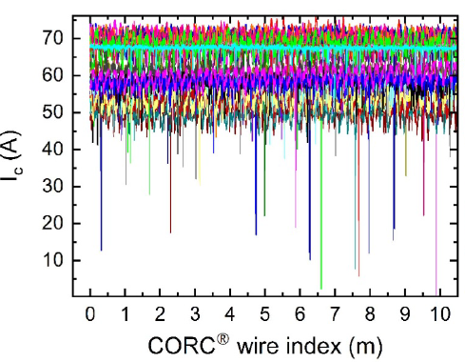
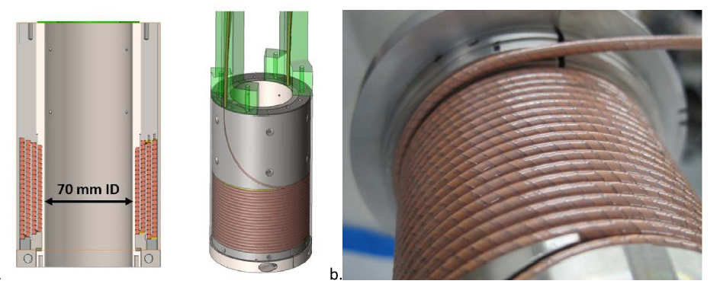
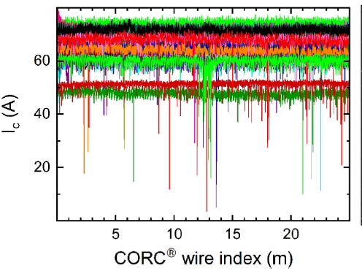
Cables with “run of the mill” tapes share current effectively
DOE Advanced Mfg. Office grant from 2015 resulted in “variable Ic” cables now tested as a magnet
10 m CORC cable
25 m CORC cable
Weiss, J.D., et al., 2025 Superconductor Science and Technology, 38(8), p.085007. https://doi.org/10.1088/1361-6668/adedbd

Slide 3
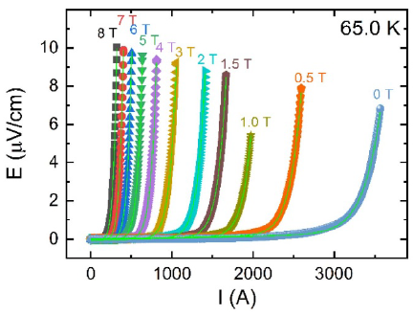
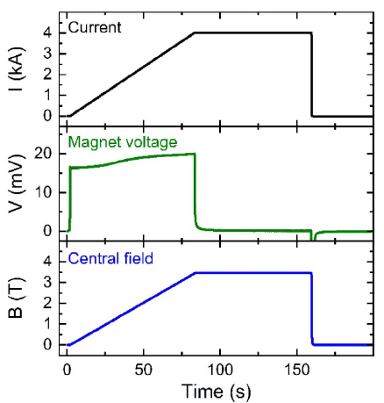
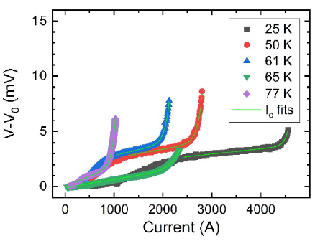
25 K
Current sharing seems to be robust; Inter-layer transitions are evident

Slide 4
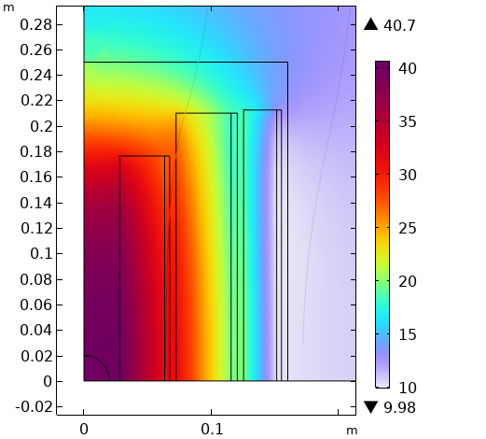
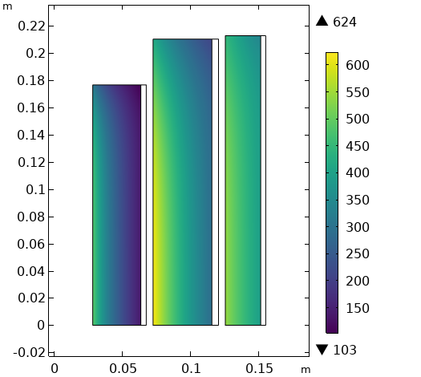

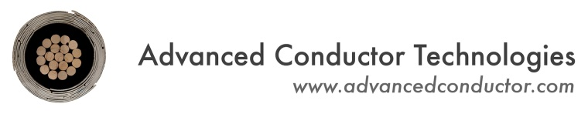




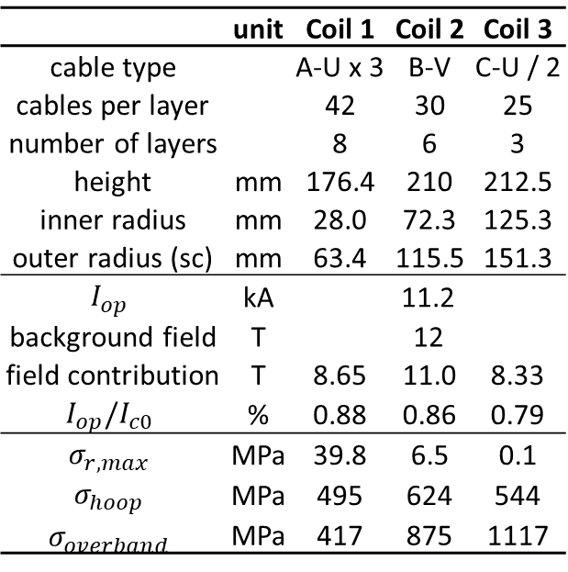

Series-connected low-inductance CORC® insert for 40 T
Initial iteration of 40 T solenoid
50 mm bore
12 T LTS outsert (Oxford Instruments – i.e. the present 32 T and 40 T outsert )
Three CORC® coils connected in series
Stainless steel overbanding over each coil
Operating at 11.2 kA at 80 - 88 % of I_{c}
$$\left|B\right| (T)$$
 | unit | Coil 1 | Coil 2 | Coil 3
cable type |  | A-U x 3 | B-V | C-U / 2
cables per layer |  | 42 | 30 | 25
number of layers |  | 8 | 6 | 3
height | mm | 176.4 | 210 | 212.5
inner radius | mm | 28.0 | 72.3 | 125.3
outer radius (sc) | mm | 63.4 | 115.5 | 151.3
$$I_{op}$$ | kA | 11.2
background field | T | 12
field contribution | T | 8.65 | 11.0 | 8.33
$$I_{op}/I_{c0}$$ | % | 0.88 | 0.86 | 0.79
$$σ_{r, max}$$ | MPa | 39.8 | 6.5 | 0.1
$$σ_{hoop}$$ | MPa | 495 | 624 | 544
$$σ_{overband}$$ | MPa | 417 | 875 | 1117
$$σ_{φ} (MPa)$$
12 T
+
28 T
Slides provided by D. van der Laan
4

Slide 5
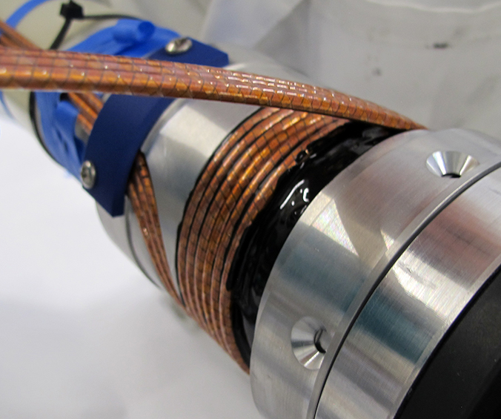
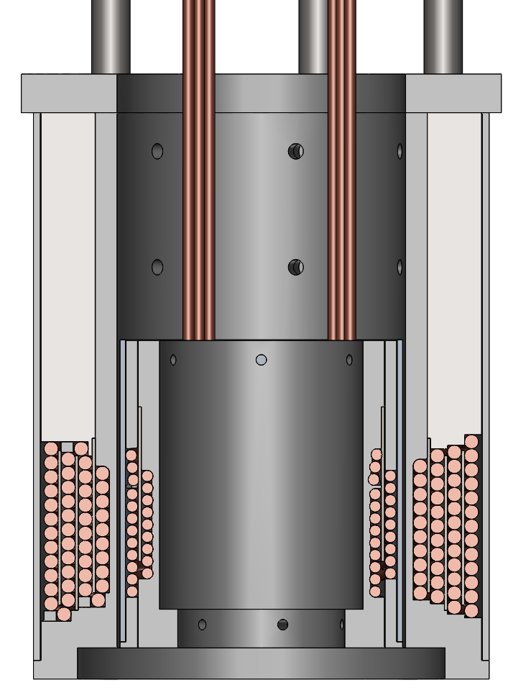
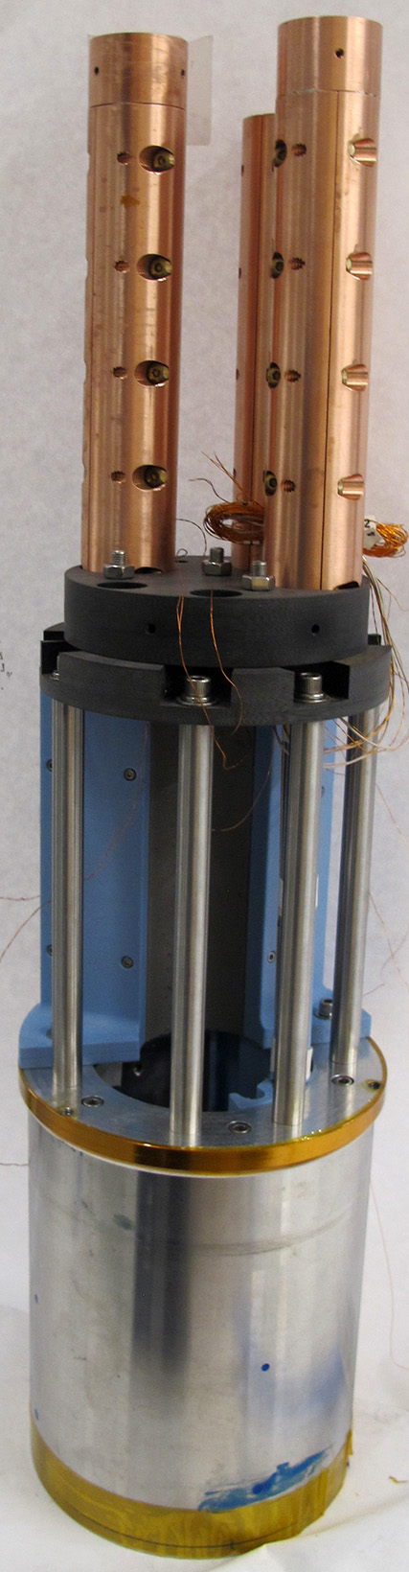
Demonstration of series-connected CORC® solenoids
Series-connection of inner and middle coil
Inner coil wound from three parallel CORC® wires
3 turns per layer, 2 layers
Middle coil based on a single CORC® cable
46 turns, 4 layers (magnet from 2019)
Results
Hall sensors show even current distribution between the three parallel CORC® wires
Peak axial field of 5.14 T reached at 10 kA
150 mm
5.14 T at 10 kA
90 mm
60 mm
This will be tested at ASC
Slides provided by D. van der Laan
5

Slide 6
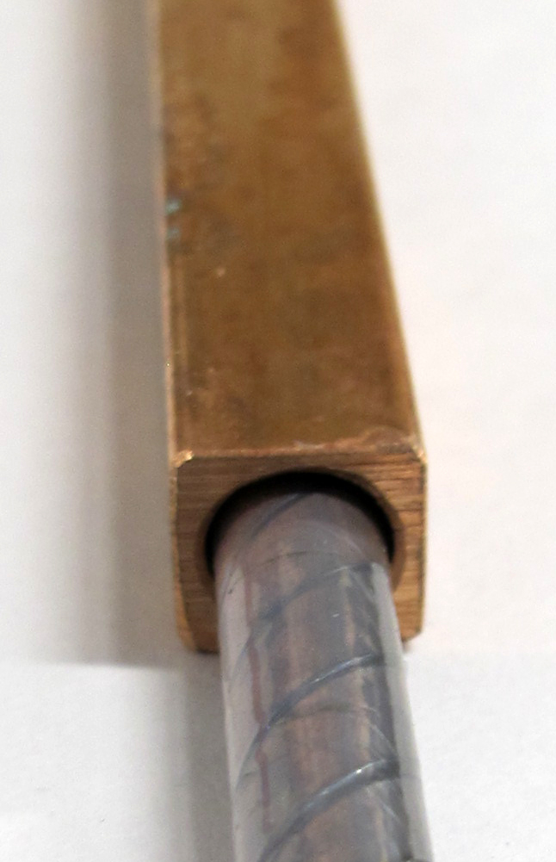
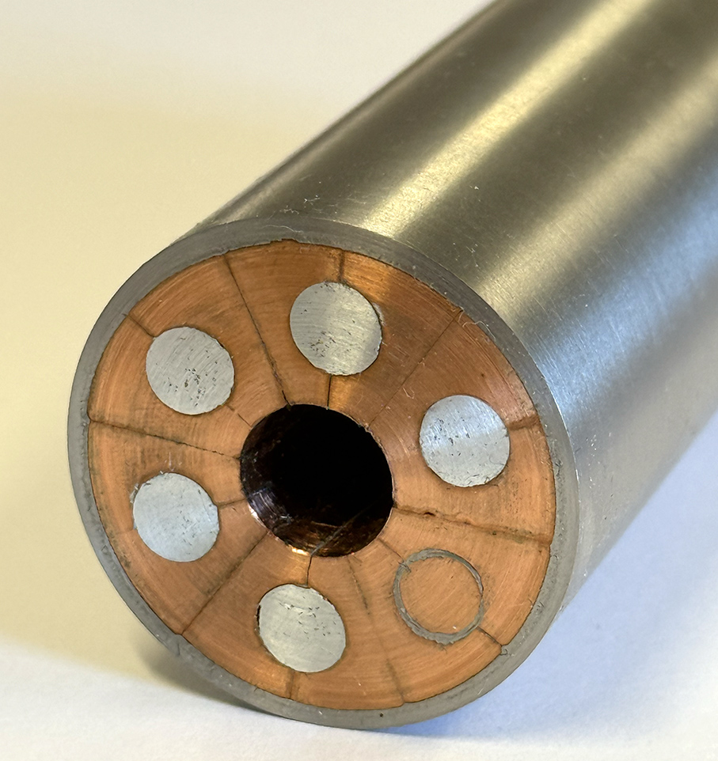
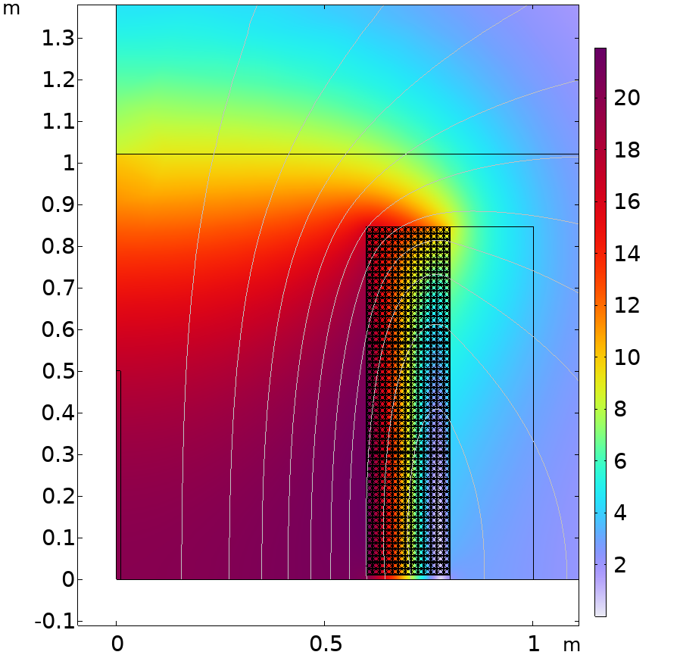
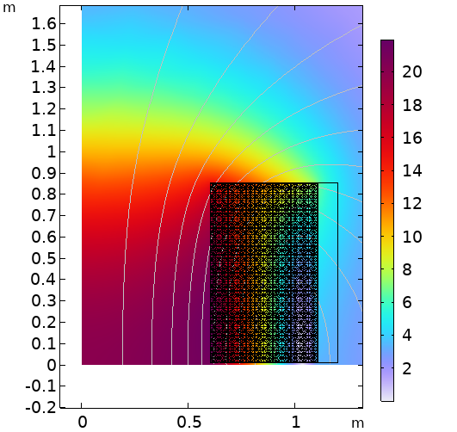

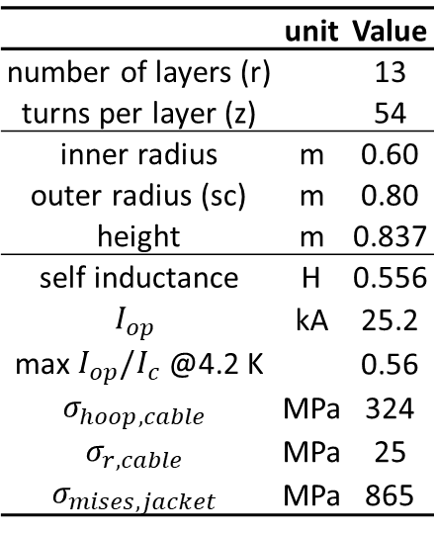

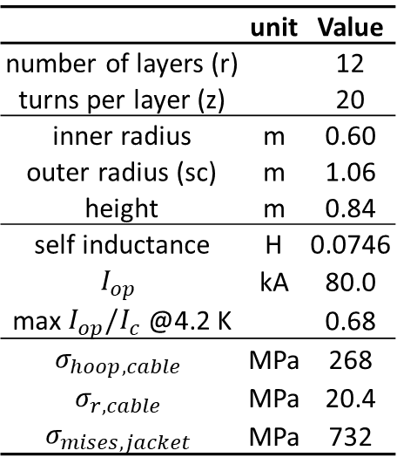
20 T Large-bore CORC® solenoids
Initial iterations of large-bore 20 T solenoids
Single CORC® coil
1.2 m bore as needed for the muon collider target and capture solenoids
Two options are considered
6-around-1 CORC®-CICC
Jacketed CORC® cable
Dummy cables
CORC cable
 | unit | Value
number of layers (r) |  | 12
turns per layer (z) |  | 20
inner radius | m | 0.60
outer radius (sc) | m | 1.06
height | m | 0.84
self inductance | H | 0.0746
$$I_{op}$$ | kA | 80.0
max $I_{op}/I_{c}$ @4.2 K |  | 0.68
$$σ_{hoop, cable}$$ | MPa | 268
$$σ_{r, cable}$$ | MPa | 20.4
$$σ_{mises, jacket}$$ | MPa | 732
 | unit | Value
number of layers (r) |  | 13
turns per layer (z) |  | 54
inner radius | m | 0.60
outer radius (sc) | m | 0.80
height | m | 0.837
self inductance | H | 0.556
$$I_{op}$$ | kA | 25.2
max $I_{op}/I_{c}$ @4.2 K |  | 0.56
$$σ_{hoop, cable}$$ | MPa | 324
$$σ_{r, cable}$$ | MPa | 25
$$σ_{mises, jacket}$$ | MPa | 865
$$|B|(T)$$
$$\left|B\right| (T)$$
Slides provided by D. van der Laan
6

Slide 7
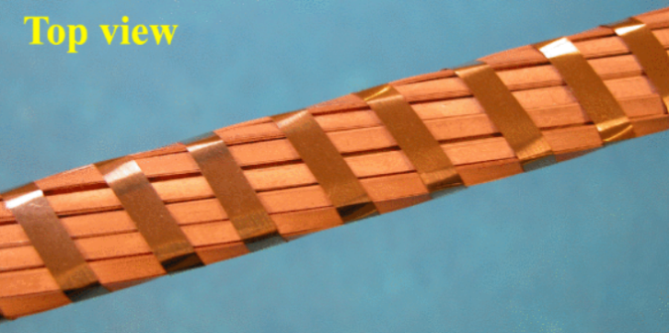
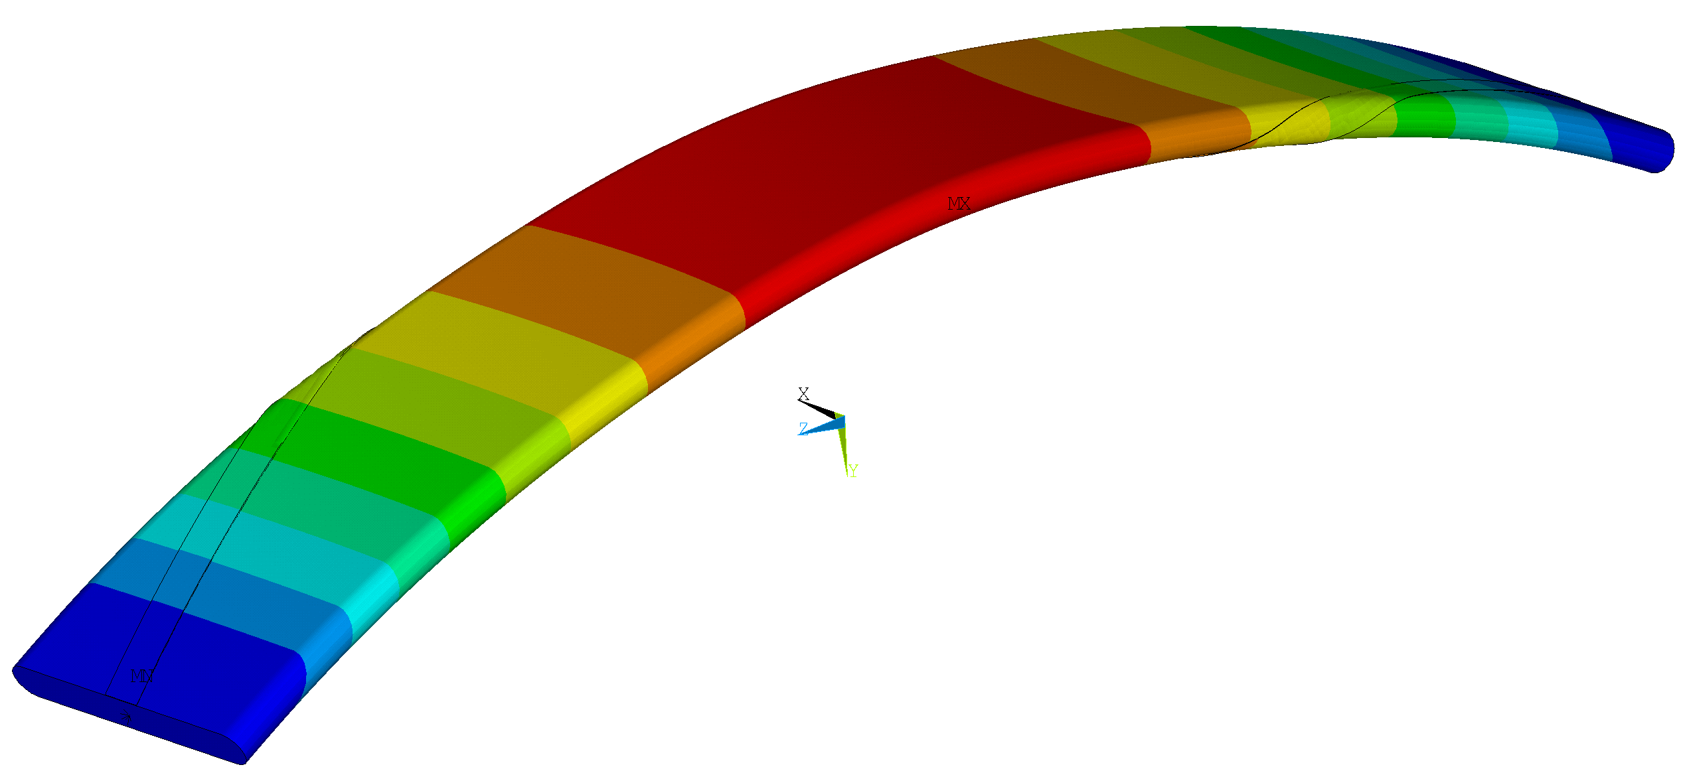
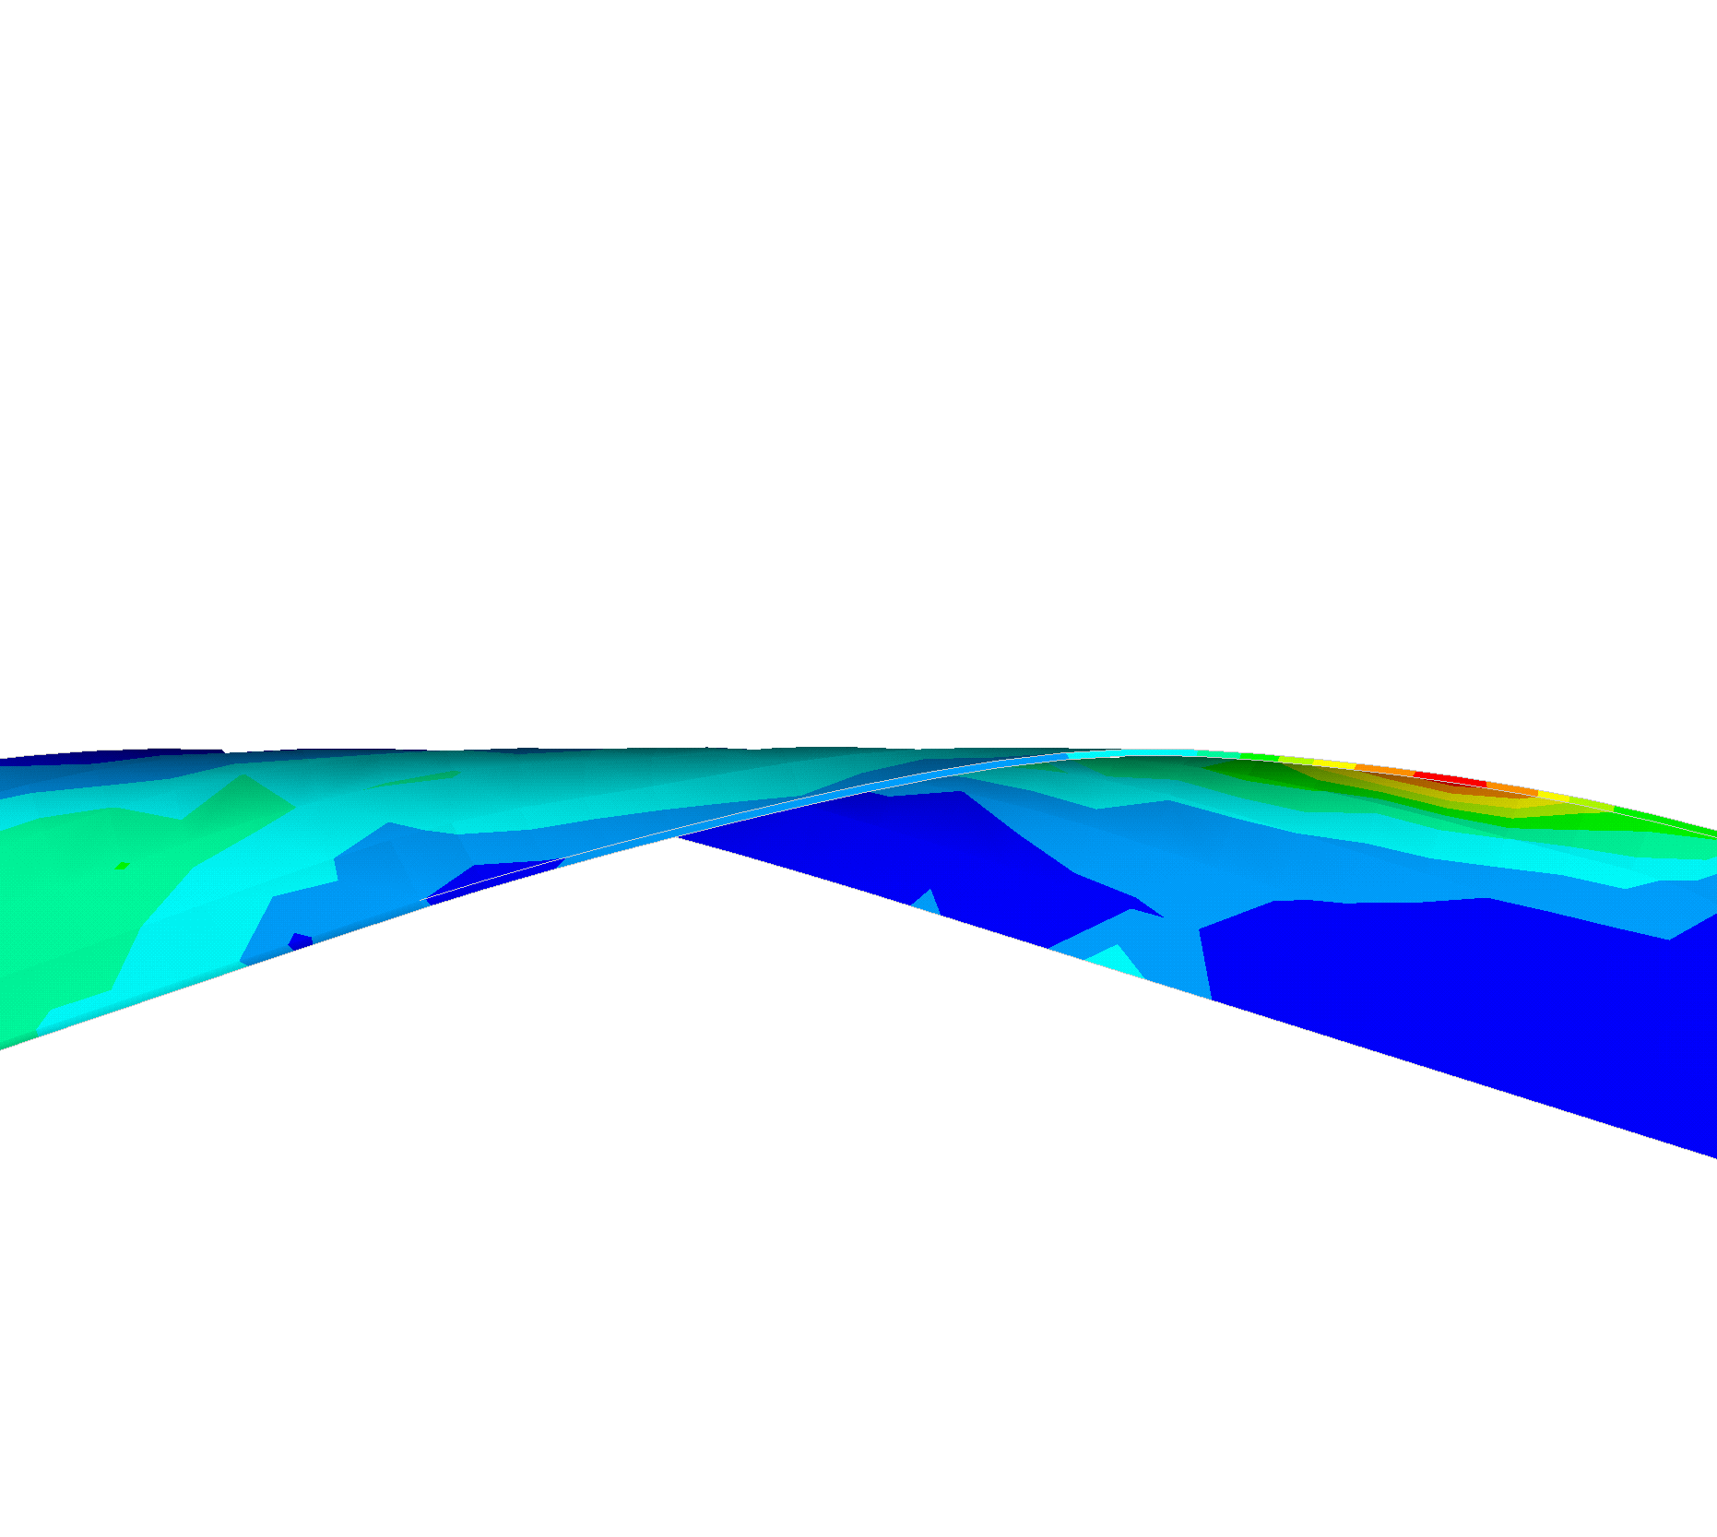
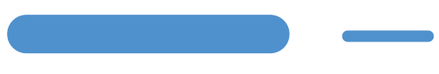


REBCO Flat Round edge former Tape Cables for High-Current and High-Field Applications
More details see Makoto’s presentation at this workshop
Modeling effort at Tufts University by Claudia Navarro and Luisa Chiesa
Objective: Develop parametric modeling tool for the optimization of Rutherford-type REBCO tape cables
Status
One sub-cable single-twist-pitch parametric model for the FReTC developed in collaboration with M. Takayasu (single tape wrapped around large former shown at left)
  Parametric model can be extended to a multi-tape subcable
Preliminary model results show strain maximum at tape edges
Can the parametric model adapt to cable specifications of interest to accelerator magnets? 200 mm → 20 mm bend radius w/ thin REBCO
Copper tape
REBCO Tape Subcable
(a)
Figure 2: (a) Displacement sum result for single-tape FReTC (R_{B} = 200 mm)
(b) Equivalent strain result at wrapped tape edge
(b)

Slide 8
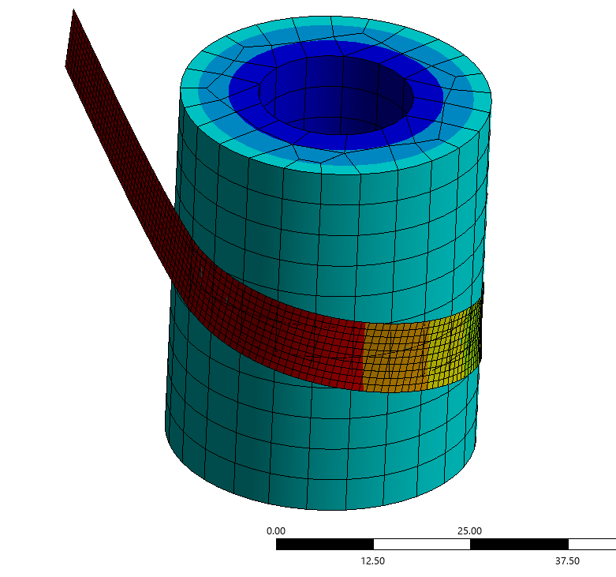
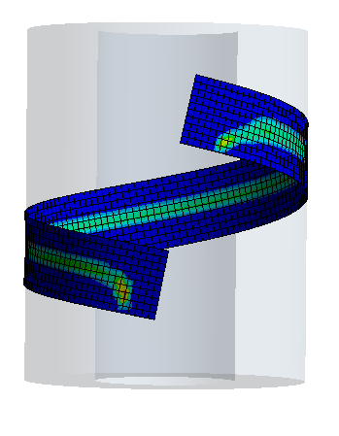
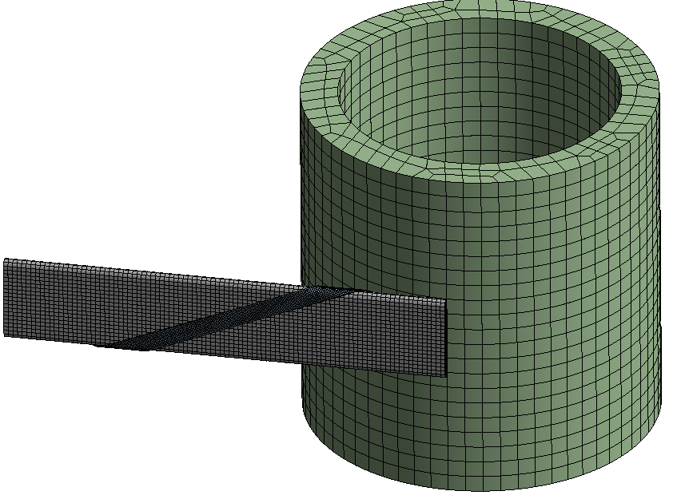
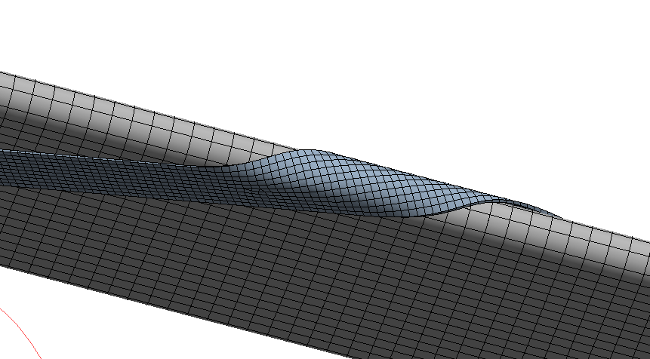


Collaboration on model development
(a)
(b)
Slides provided by Claudia Navarro
FNAL REBCO Tape Cable
Claudia Navarro¹, Emily Romancew², Vadim Kashikhin³
¹Tufts University (Medford, MA), ²Northern Illinois University (DeKalb, IL), ³FNAL (Batavia, IL)
Detail: Experimentally validate scalability of parametric modeling tools for FNAL bend radius
Status
Additional model (fig. 1) is under development by E. Romancew for the evaluation of the longitudinal strain in a REBCO layer for a cable under bending
This model aims to include strain effects from tape wrapping (around the former) in the helical cable bending model
Alternative bending approach can be evaluated for geometry generated by the FReTC parametric model (fig. 2)
This alternative model should also be validated by experimental data
Figure 1: Helical wrap with 30 mm radius (a) Tape (shell) deformation (b) Sliding distance
Figure 2: (a) FNAL Tape Cable geometry imported from FReTC parametric model into helical wrapping model (b) Mesh for tape wrap

Slide 9
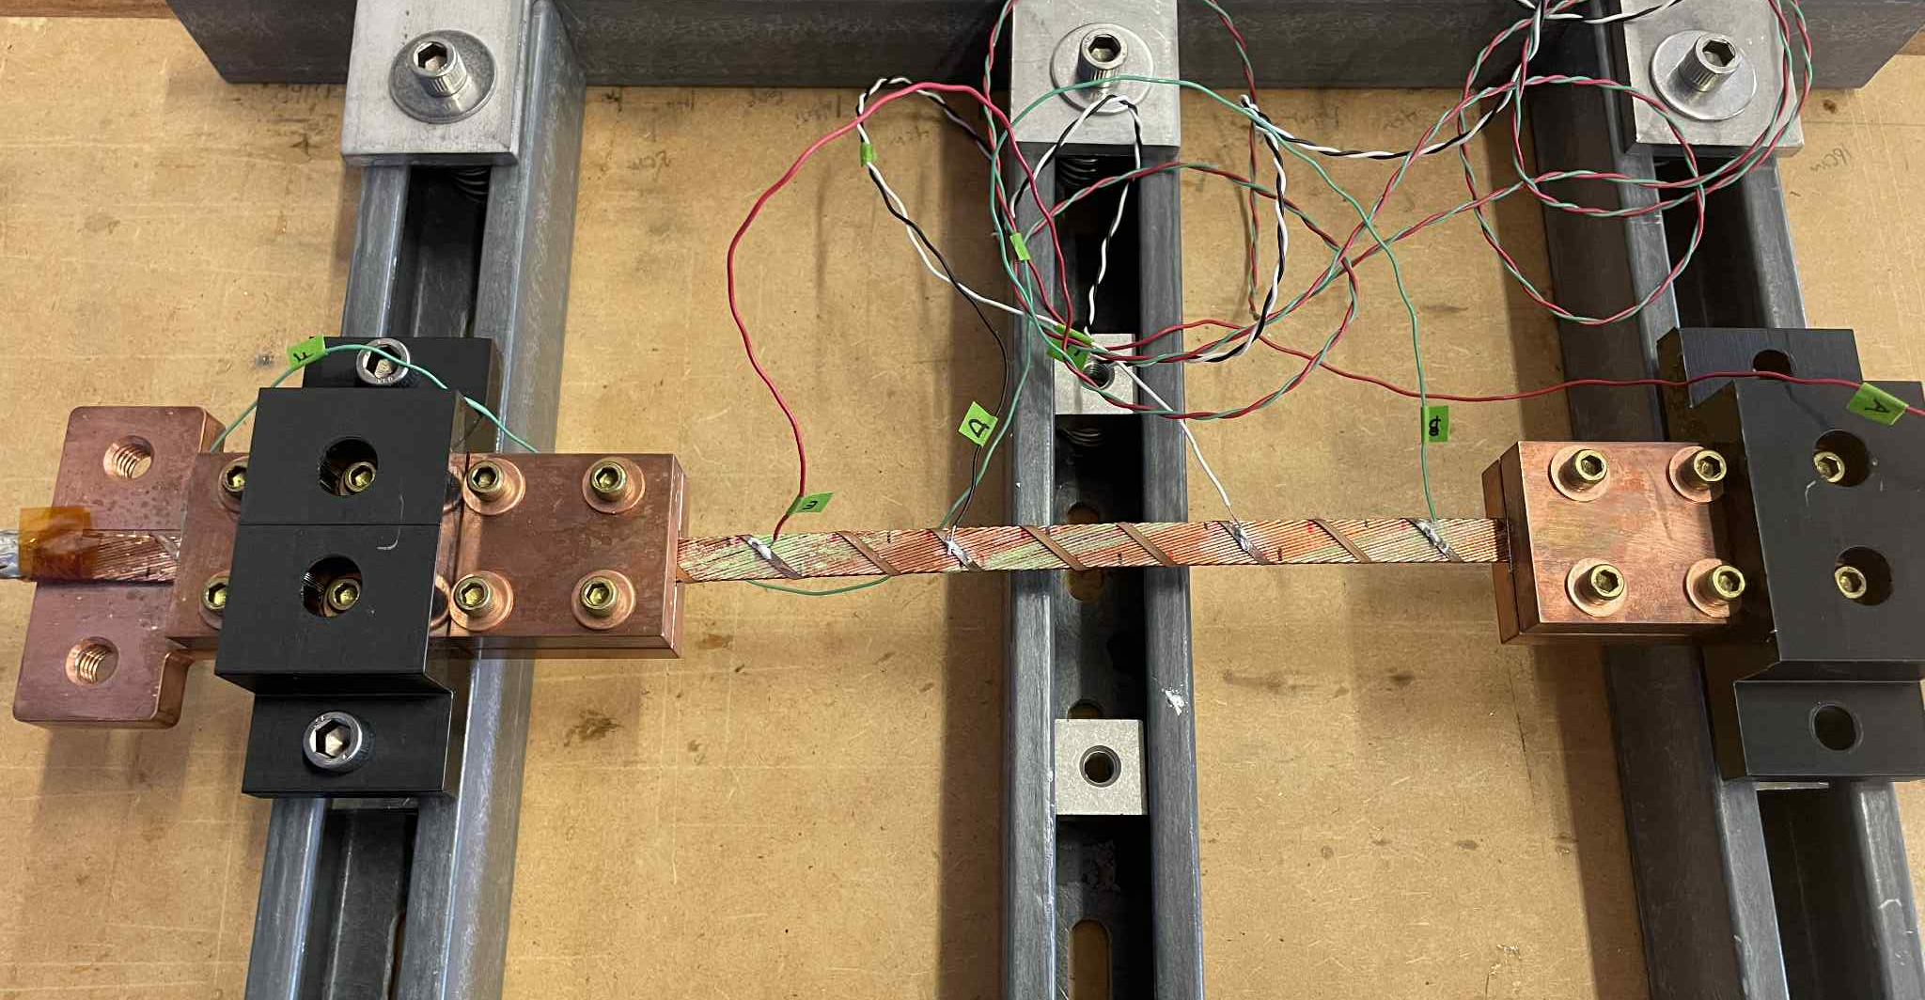
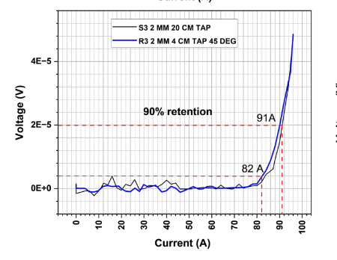
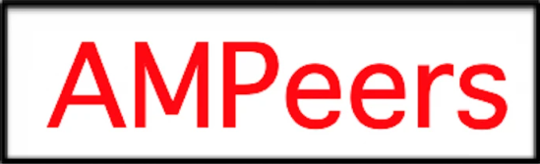
Fermilab / AMPeers / NIU Rutherford-type cable
Slides provided by Emily Romancew
Figure 5: Setup for critical current testing on straight cable with wrapped REBCO

Slide 10
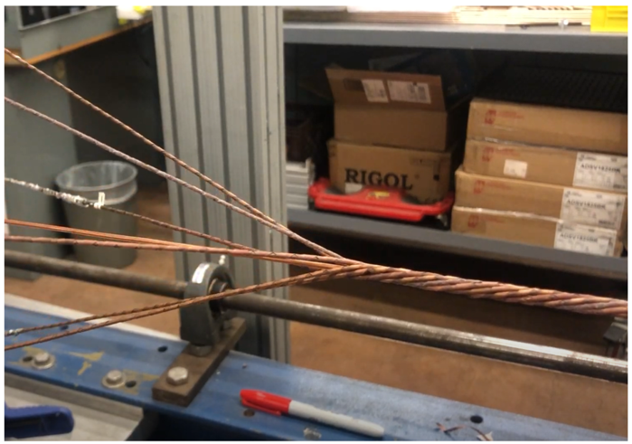

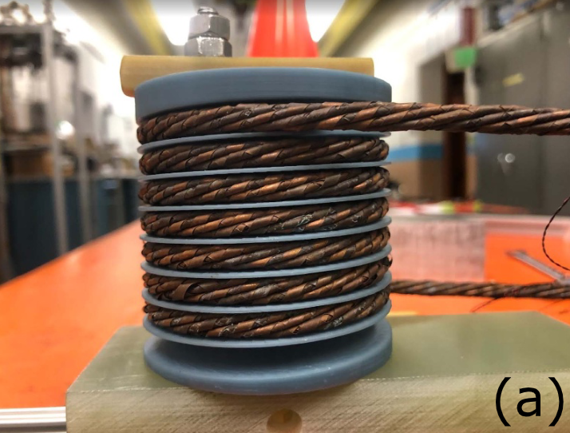
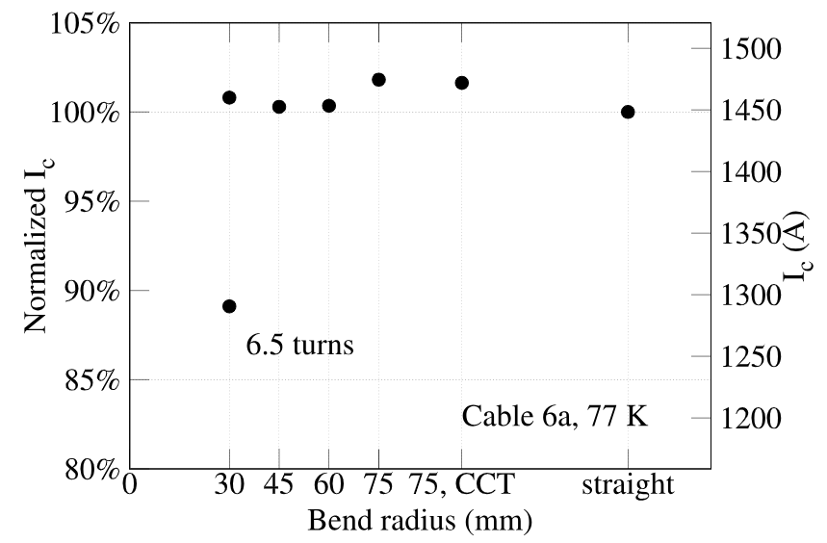
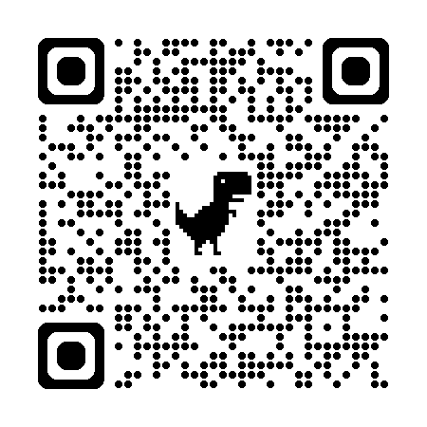
Develop 6-around-1 cable for magnet applications
Wind into a 6-turn solenoid coil, bend radius 30 mm
Retained ~ 90% of straight-cable I_{c} in the solenoid coil
A short video on the cabling
Hairpin test
Coil
Castaneda et al. 2024. “A 6-around-1 Cable Using High-Temperature Superconducting STAR ® Wires for Magnet Applications.” SuST.

Slide 11
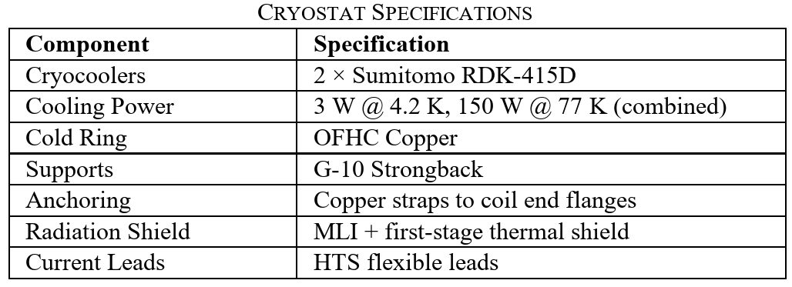
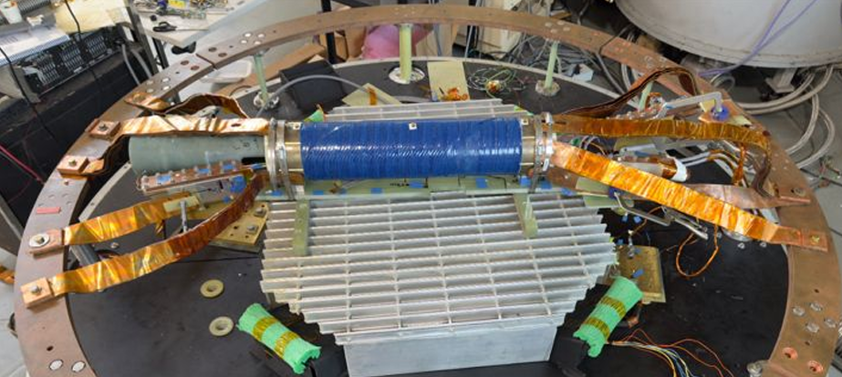

Conduction-cooled REBCO dipole magnet “C2” test at OSU
Cold copper ring
Cooling strap
Cooling strap
Power I/O
4-layer CCT dipole magnet using CORC® wires developed by US MDP
Previously tested at 4.2 K
Shipped to OSU for conduction-cooled test
Joint 1-2
Temp. Sens. A-C-B
Joint 2-3
Joint 3-4
Cooling Straps
613 mm
75 kg
Cooling strap
T. Garg et al., Thermal Performance of a Conduction-Cooled CCT Dipole ReBCO Magnet: Cyclic Cool-Down and Thermal Gradient Measurements, 2025, submitted to IEEE TAS.

Slide 12
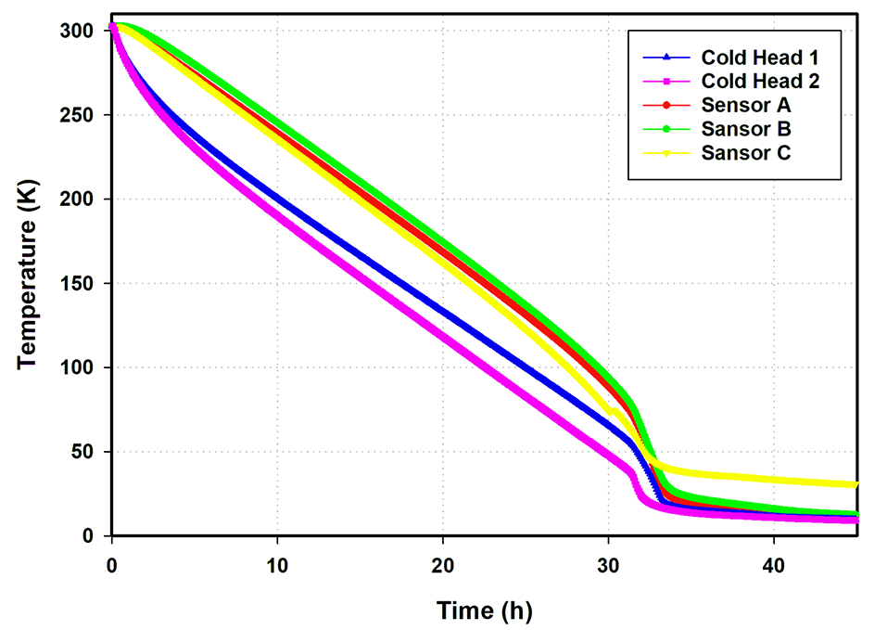
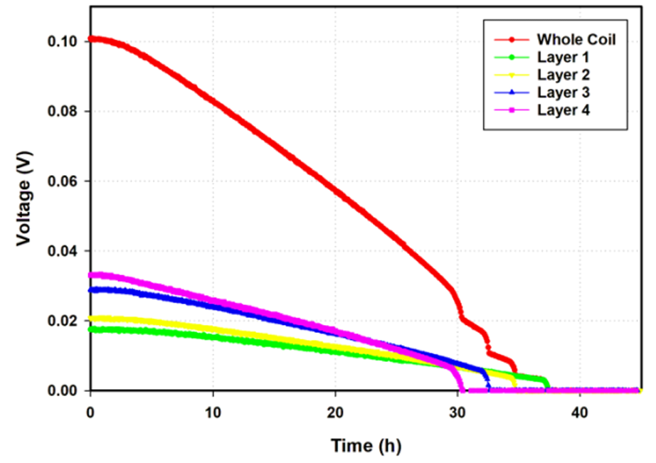
Cooldown performance shows the magnet is superconducting
Measured temperature during the cooldown
Voltage in each layer with 0.5 A current
~30 K @ 40 h
sensor C
Next step is the powering test

Slide 13
PPPL HTS Activities
Y. Zhai and PPPL Team

Slide 14
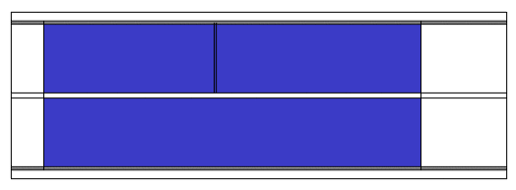
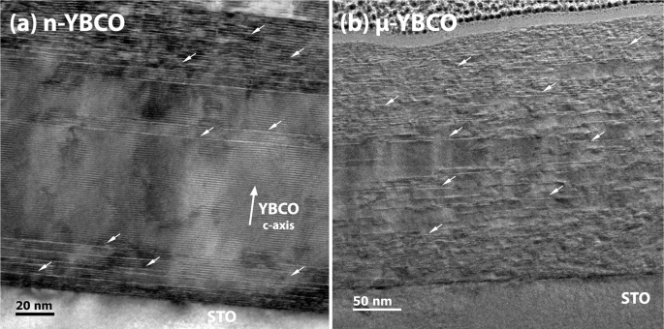
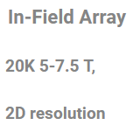
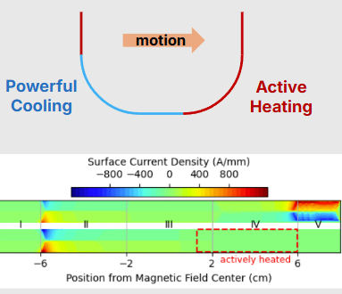
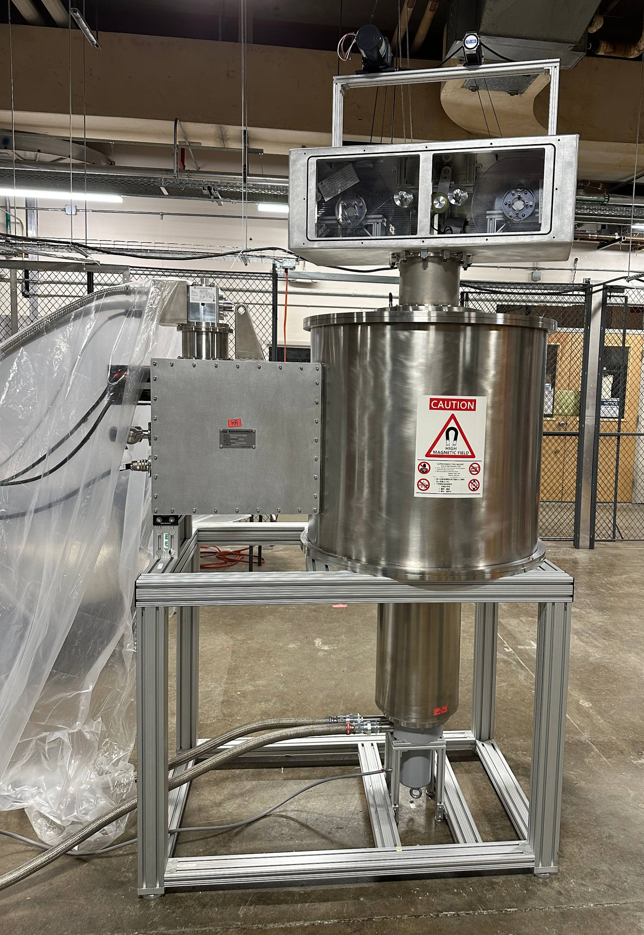
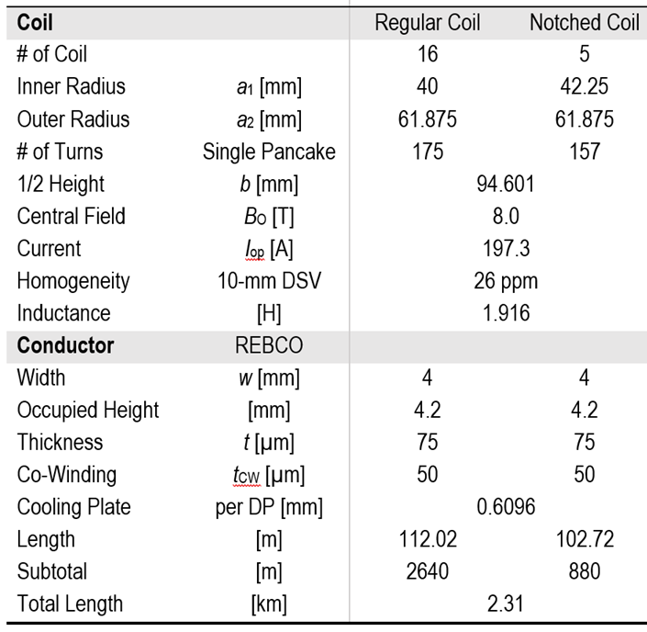
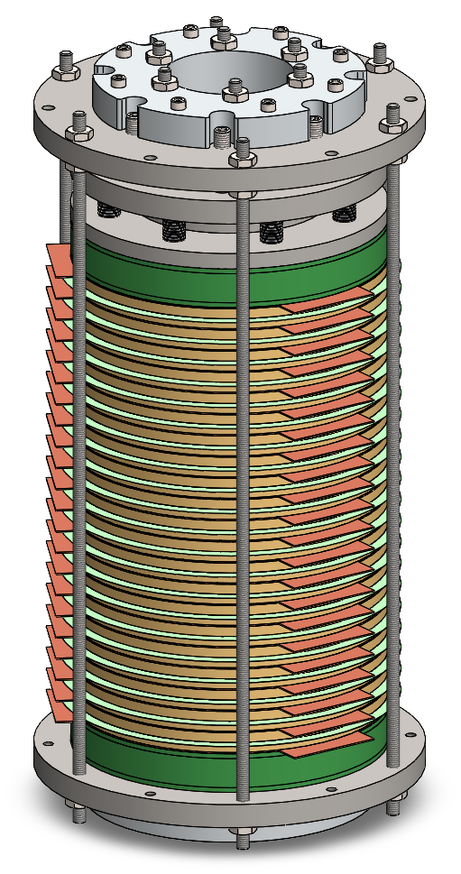
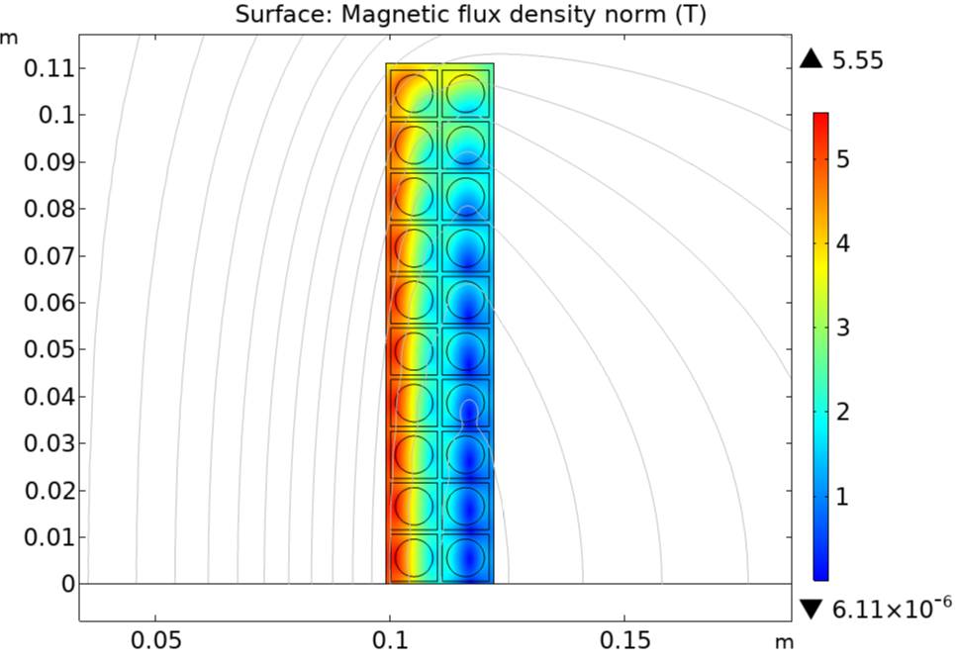
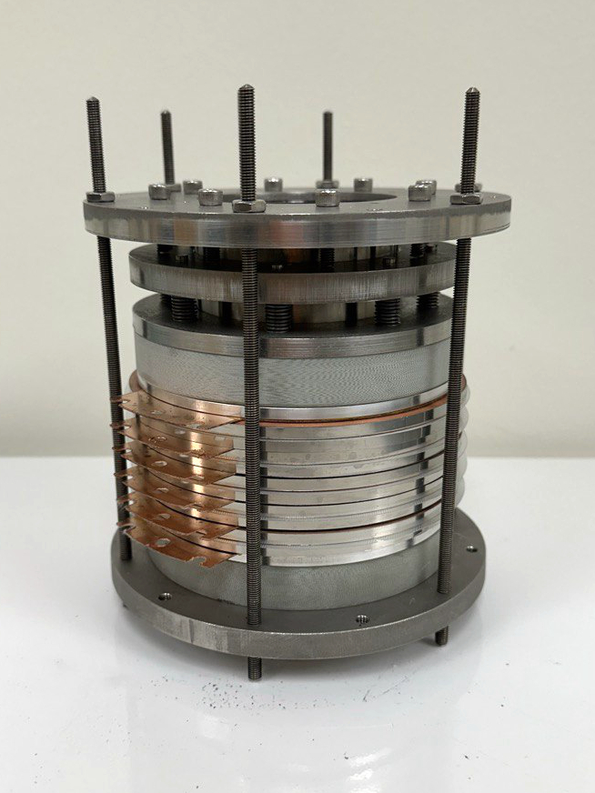
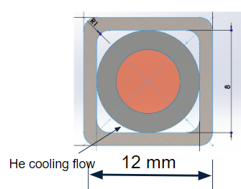
R2R Characterization for Commercial HTS Conductors
Develop Continuous HTS Inspection System at PPPL
(1) Industrial standard needed for inspecting HTS performance consistency
Winding Improvement with R2R Measurements
Upgraded to Enable Low-T High-B Measurements
Mock-Up 5 DP coils

Slide 15
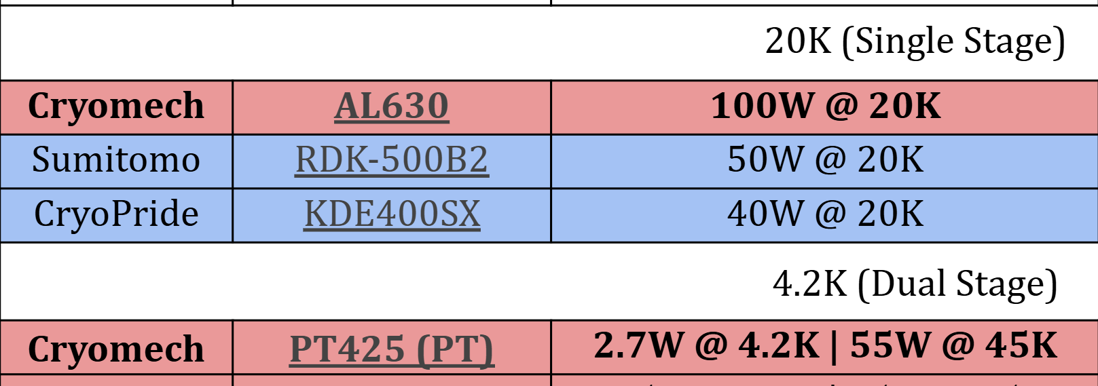
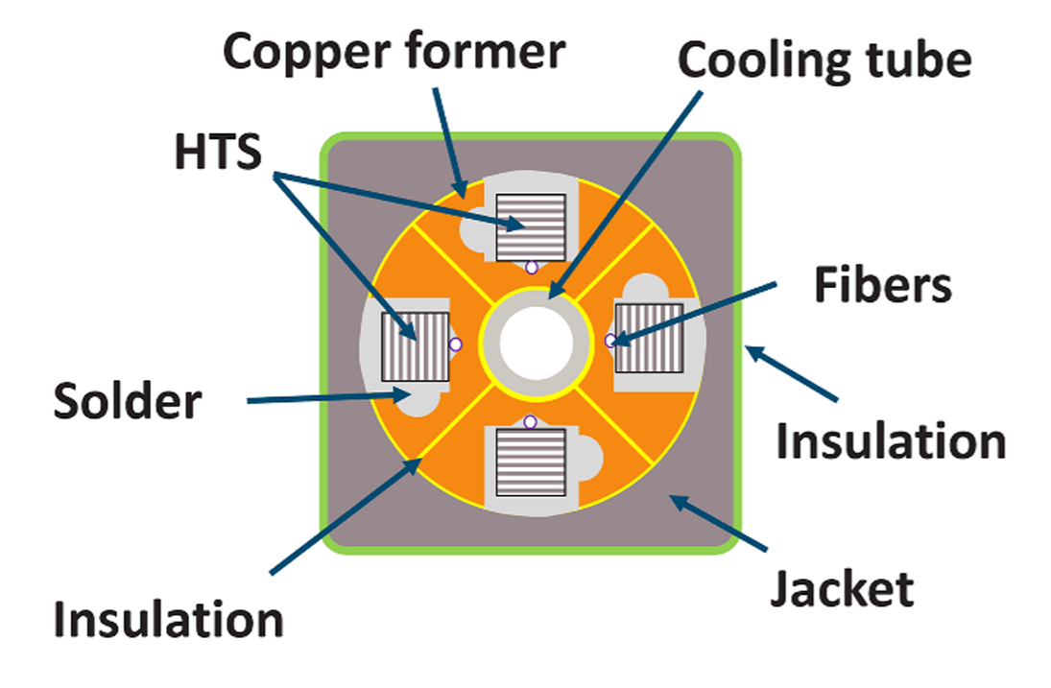




Large Bore, Fast Ramp Dummy Load Coil for Cable Qualification
The HTS cable samples (e.g., 11" long) are subjected to a linearly increasing magnetic field with values between 0.2 T/s, 1 T/s or higher (up to 10 T/s).
Test stand has a horizontal clear bore size of 20.55” (522 mm) for cryostat assy
C. Sanabria, SuST, 2024

Slide 16

Conceptual Design Consideration for 30T for Quantum Physics
Will propose the 30-T magnet once we finalize approach to manage the screening-current stress and quench in Phase 2.
Parameters | Coil 1 (Insert) | Coil 2 (Outsert)
Material | REBCO + SUS304 Co-Winding
Conductor (Width; Thickness) | 6 mm; 75 um | 4 mm; 60 um
Co-Winding SUS304 Thickness | 50 um | 50 um
Winding ID 2a₁; OD 2a₂ | 104 mm; 179 mm | 200 mm; 256.3 mm
Coil Height 2b | 120 mm | 148 mm
# of Turns/Double-Pancake | 600 | 512
# of Double-Pancakes | 20 | 37
SUS304 Overband | 2 mm | 5 mm
Transport Current | 254.7 A
Conductor Current Density | 566.0 A/mm² | 1061.3 A/mm²
Winding Pack Current Density | 339.6 A/mm² | 578.9 A/mm²
Winding Pack Hoop Stress | 581 MPa | 389 MPa
Central Field Contribution | 13.78 T | 16.22 T
Conductor Length Required | 5.4 km | 13.6 km
Stress level critical even without considering screening current.

Slide 17
Summary thoughts
Everybody needs thin REBCO
  ACT is presently sourcing conductor with excellent performance from Shanghai SC
  AMPEERS is presently developing 20 µm substrates (or thinner)
  SuperPower is being encouraged to restore 30 µm production with new “HM” additive
Fusion cable activities are behind confidentiality walls
  These cables generally aim for large bend radii, where a few (like FReTC) could be scaled for accelerator magnet purposes
  Fusion is driving transformative expansion of test facilities that will also benefit HEP
HEP-MDP works continuously to help university programs and SBIRs be allied & aligned with the accelerator magnet community’s needs and priorities
University programs and SBIRs are generating and testing new ideas essential to the technology development of REBCO for HEP applications
  Stronger and robust support is critical to sustain a healthy and robust ecosystem

