Slide 1


Status and plans for the treatment of antibaryons in INCLXX,
…neutrinos, and uncertainties/errors
Jean-Christophe David
07-11 October 2024 - Catania

Slide 2
Plan
Antiprotons
Antineutrons in INCL
(light) Antinuclei in INCL
Bonus track
Neutrino
Uncertainties, errors (too early to discuss them, but…)
Antibaryons in INCL…

Slide 3

Why Antibaryons?
→ We have been asked to implement antiproton as projectile
  by people from AD (Cern) at rest (low energy - MeV)
physics of anti-matter (% matter)
new cross section measurements at ASACUSA
  by people from PANDA (FAIR) in-flight (higher energy - GeV)
study of Λ$\overline{Λ}$ interaction
→ And the GAPS (*) experiment might be interested in $\overline{d}$, $\overline{\text{3}\text{He} }$ .
(*) The General AntiParticle Spectrometer (GAPS) aims to study dark matter through sensitive observations of cosmic-ray antiprotons, antideuterons, and antihelium.
Antibaryons in INCL…

Slide 4
Antiprotons
In-flight
E_{at rest}=200 MeV < E < 10 GeV
At rest
E < E_{at rest}= 200 MeV
p
p
b
e⁻
Main ingredients
  Cross sections
    Elastic
    Annihilation
    Production
    Charge exchange
  Final products (types; momenta)
  Potential ( )
Main ingredients
  Annihilation nucleon (p or n)
  Position of the Annihilation
  Final products (types; momenta)
p
Antibaryons in INCL…

Slide 5
Antiprotons
Results
In-flight
E_{at rest}=200 MeV < E < 10 GeV
At rest
E < E_{at rest}= 200 MeV
Multiplicities
Charged particles (total) ~OK
Charged particles (w/ K⁰) ~OK
Charged particles (w/ Λ) To be improved
Spectra
neutron OK
Multiplicities
π^{+/-}, n, α OK
p ~underestimate
d ~overestimate
t, ³He underestimate
Kaon To be understood
Particle Spectra
OK
Residues
OK
Antibaryons in INCL…

Slide 6
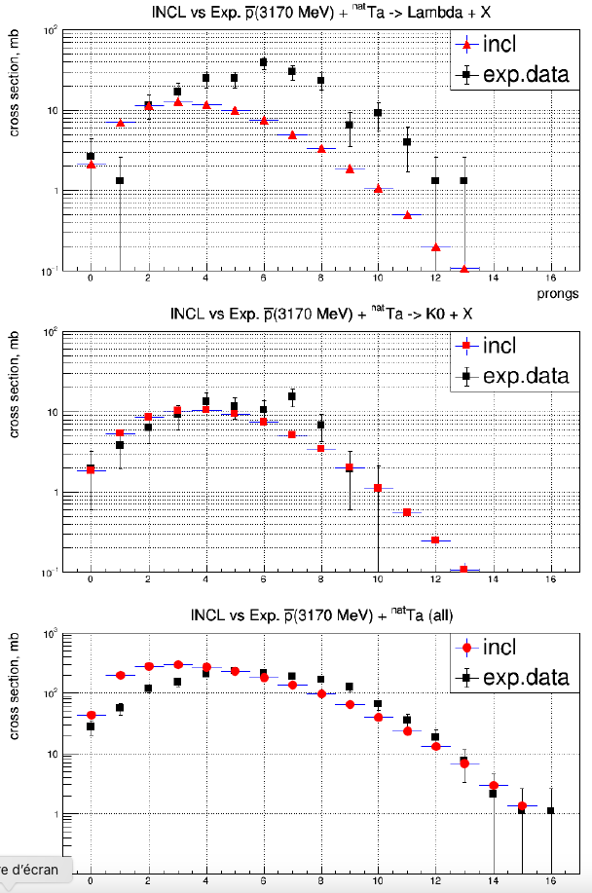
In-flight
Antiprotons
Results
Multiplicities
(charged particles)
(4 GeV/c) + Ta
p
Antibaryons in INCL…

Slide 7
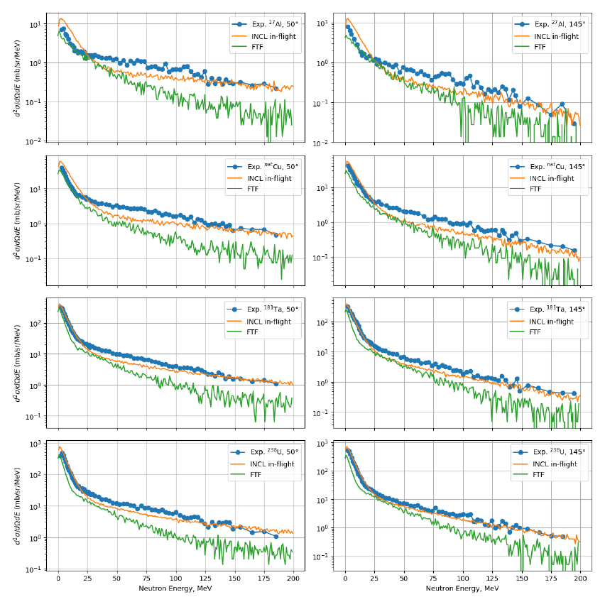
In-flight
Antiprotons
Results
Spectra
(neutron)
(1.22 GeV) + ²⁷Al
p
(1.22 GeV) + ²³⁸U
p
Antibaryons in INCL…

Slide 8
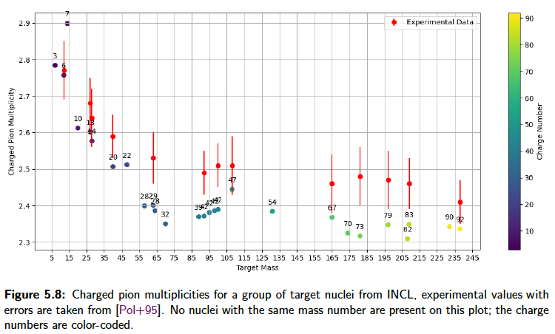
At rest
Antiprotons
Results
Multiplicities π^{+/−}
D. Polster et al.
Phys. Rev. C51 (1995), 1167–1180.
Quite good, except a little too low multiplicities (4% too low)
  → Lack of information on annihilation with (very) high meson multiplicity…?
Antibaryons in INCL…

Slide 9
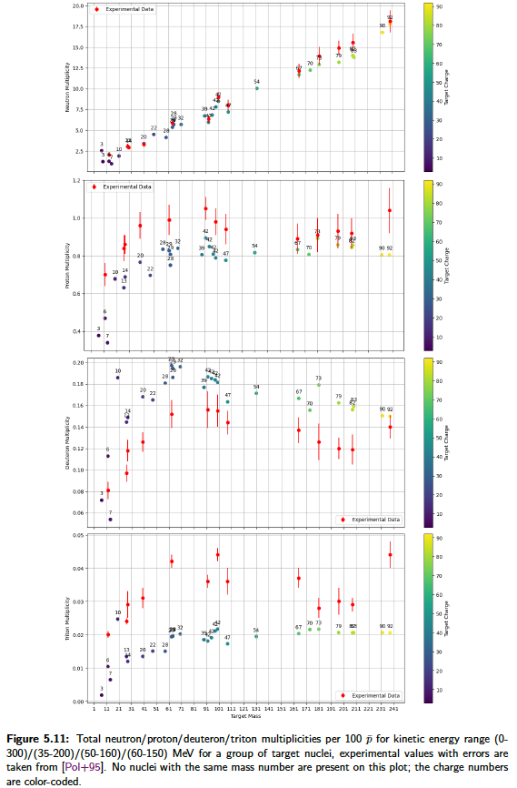
At rest
Antiprotons
Results
Multiplicities n & p
n
n: ~perfect
p: little underestimation (< 20%)
p
D. Polster et al.
Phys. Rev. C51 (1995), 1167–1180.
Antibaryons in INCL…

Slide 10
At rest
Antiprotons
Results
Multiplicities d & t
d
d: overestimation (< 25%)
t: underestimation (< x2)
t
D. Polster et al.
Phys. Rev. C51 (1995), 1167–1180.
Antibaryons in INCL…

Slide 11
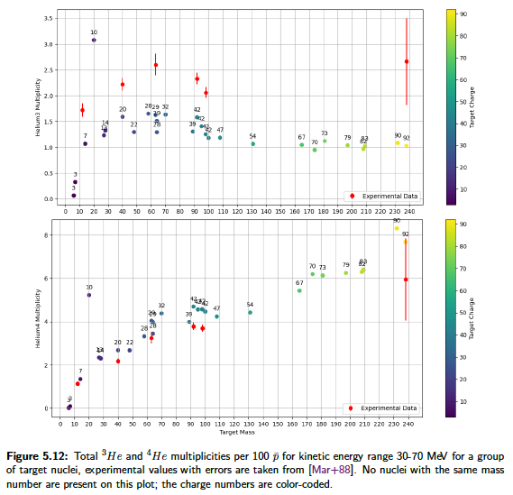
At rest
Antiprotons
Results
Multiplicities ³He & ⁴He
³He: underestimation (< x1.5)
⁴He: rather good
³He
⁴He
W. Markiel et al. Nuclear Physics A 485.3 (1988), 445–460.
Antibaryons in INCL…

Slide 12
At rest
Antiprotons
Results
Multiplicities ³He & ⁴He
³He: underestimation (< x1.5)
⁴He: rather good
Here for given kinetic ranges… INC (→ Coalescence model?)
Deexcitation?
³He
⁴He
⚠️
W. Markiel et al. Nuclear Physics A 485.3 (1988), 445–460.
Antibaryons in INCL…

Slide 13
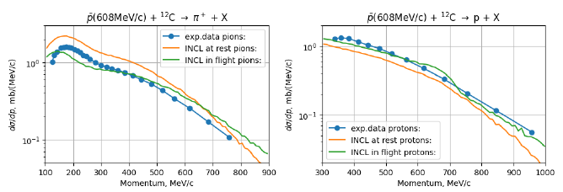
At rest
Antiprotons
Results
Spectra π⁺ & p
P. L. McGaughey et al., Phys. Rev. Lett. 56 (1986), 2156–2159.
Shape ~OK
overestimate = artefact (INCL σ_{reac} too high here)
p underestimate as previously seen
Antibaryons in INCL…

Slide 14
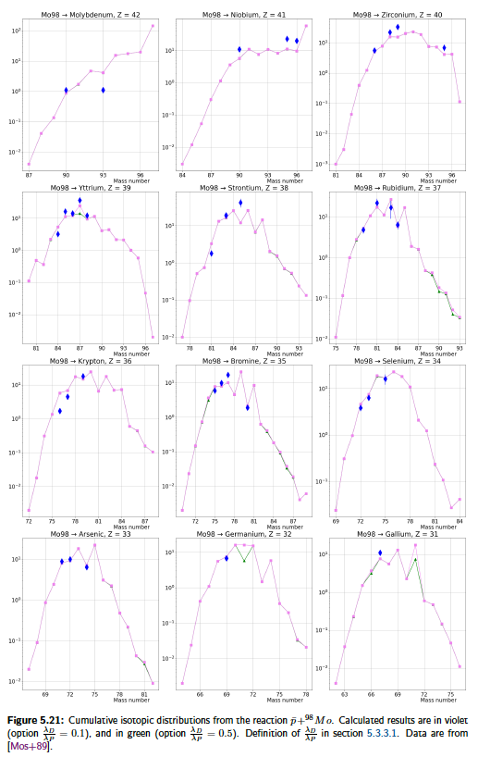
At rest
Antiprotons
Results
Residue production
Here, cumulative production (progenitors accounted for)
Not bad at all, is it?
(same reliabilty as in p + A)
Mass distributions
E. F. Moser et al.,
Z. Phys.A –
AtomicNuclei 333, 89-105 (1989)
+ ⁹⁸Mo → Z
p
Antibaryons in INCL…

Slide 15
Antiprotons
Status
In Geant4 (since Geant4-11.2)
Rather good results,
but place to improvements
      π high multiplicities (refinement)
      p ~underestiamted
      d overestimated; t and ³He underestimated
      K K⁰ ~OK
        K^{+/-} underestimated
      Λ undestimated
Some not-so-well-known ingredients …
(potential, position of the annihilation, on which nucleon (n? p?) the annihilation…)
new data
from AD (ASACUSA)
expected soon…
Antibaryons in INCL…

Slide 16
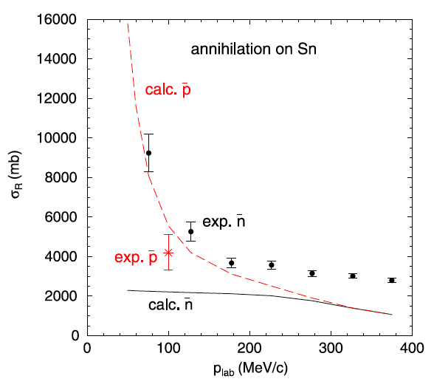








Antineutrons
Beyond ~500 MeV/c =
Below
captured by electrons
should not be…
But
Exp. data exist only down to 100 MeV/c → Below, extrapolation is bad!
And…
From E. Friedman / Nuclear Physics A 925 (2014) 141–149
So
0 → 165 MeV/c force annihilation
165 MeV/c → 500 MeV/c fit ( ) ≠ fit ( )
500 MeV/c → … =
$$\overline{n}$$
$$\overline{p}$$
$$\overline{p}$$
$$\overline{n}$$
$$\overline{n}$$
$$\overline{p}$$
$$\overline{n}$$
$$\overline{p}$$
Antibaryons in INCL…

Slide 17
Antiprotons
In-flight
E_{at rest}=200 MeV < E < 10 GeV
At rest
E < E_{at rest}= 200 MeV
p
p
b
e⁻
Main ingredients
  Cross sections
    Elastic
    Annihilation
    Production
    Charge exchange
  Final products (types; momenta)
  Potential ( )
Main ingredients
  Annihilation nucleon (p or n)
  Position of the Annihilation
(overlap: wave function( ) x nucleon density)
  Final products (types; momenta)
p
p
Antibaryons in INCL…

Slide 18
Antineutrons
In-flight
E_{at rest}=14 MeV < E < 10 GeV
« At rest »
E < E_{at rest}= 14 MeV
n
n
b
Main ingredients
  Cross sections
    Elastic
    Annihilation
    Production
    Charge exchange
  Final products (types; momenta)
  Potential ( )
Main ingredients
  Annihilation nucleon (p or n)
  Position of the Annihilation
(approximated by a gaussian)
  Final products (types; momenta)
n
Antibaryons in INCL…

Slide 19
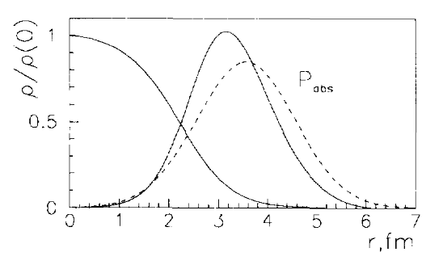
Antineutrons
In-flight
E_{at rest}=14 MeV < E < 10 GeV
« At rest »
E < E_{at rest}= 14 MeV
n
n
b
Main ingredients
  Cross sections
    Elastic
    Annihilation
    Production
    Charge exchange
  Final products (types; momenta)
  Potential ( )
Main ingredients
  Annihilation nucleon (p or n)
  Position of the Annihilation
(approximated by a gaussian)
  Final products (types; momenta)
n
n
p
p
p
From E. S. Golubeva and L. A. Kondratyuk, Nucl. Phys. B56, 103 (1997).
Antibaryons in INCL…

Slide 20
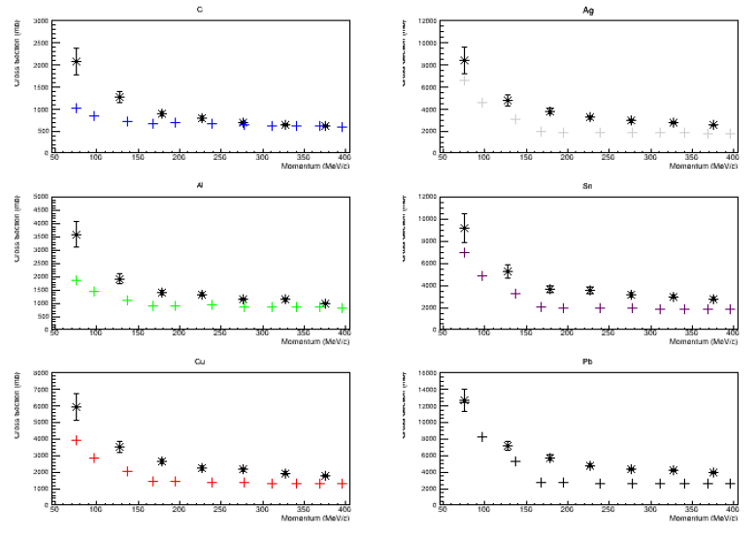
Antineutrons
Results
Annihilation σ
Underestimation
Depending on
  the target
  the energy
But encouraging
Antibaryons in INCL…

Slide 21
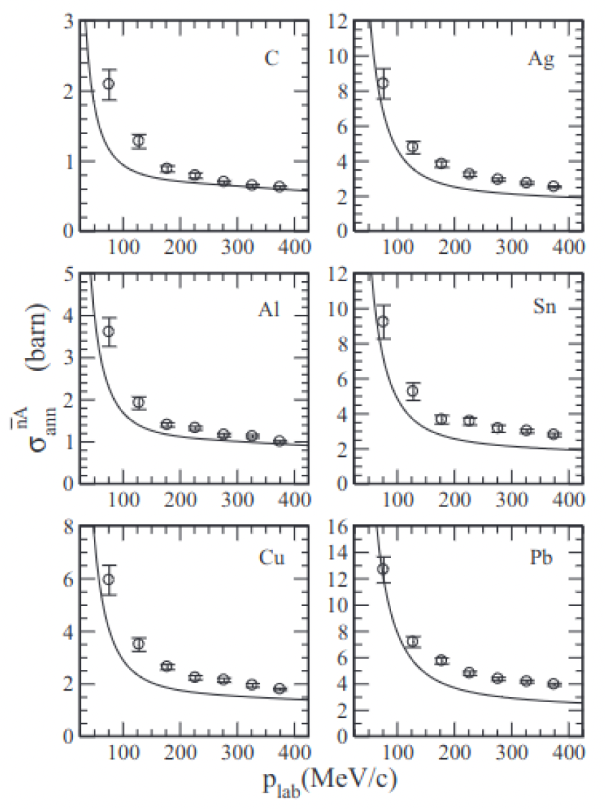
Antineutrons
Results
Annihilation σ
Underestimation
Depending on
  the target
  the energy
But encouraging
…and similar to other model
Lee and Wong. Phys. Rev. C 93, p. 014616 (2016)
Antibaryons in INCL…

Slide 22
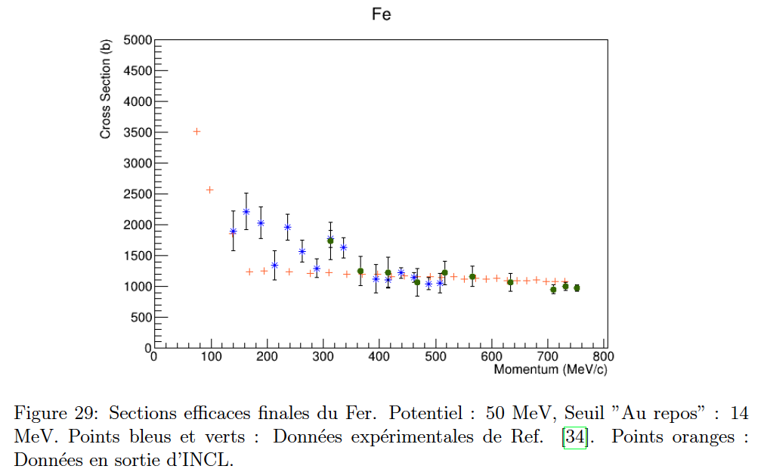
Antineutrons
Results
Annihilation σ
Underestimation
Depending on
  the target
  the energy
But encouraging
…and even better at higher energy
Antibaryons in INCL…

Slide 23
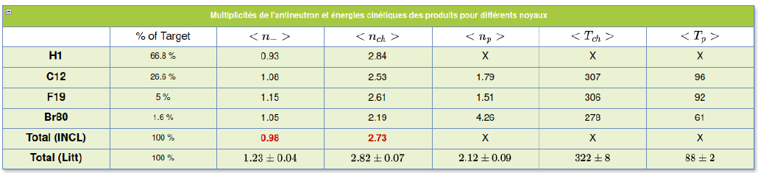
Antineutrons
Results
Pion multiplicity
antineutron (750 MeV)
on a target made of
π⁺ + π⁻ OK
π⁻ a little too low
Well well well…
π⁻
π⁺ + π⁻
Antibaryons in INCL…

Slide 24
Antineutrons
Status
Probably not in Geant4 this year (some checks)
Results comparable to others
As with antiprotons, some not-so-well-known ingredients …
(potential, position of the annihilation, on which nucleon (n? p?) the annihilation…)
Antibaryons in INCL…

Slide 25
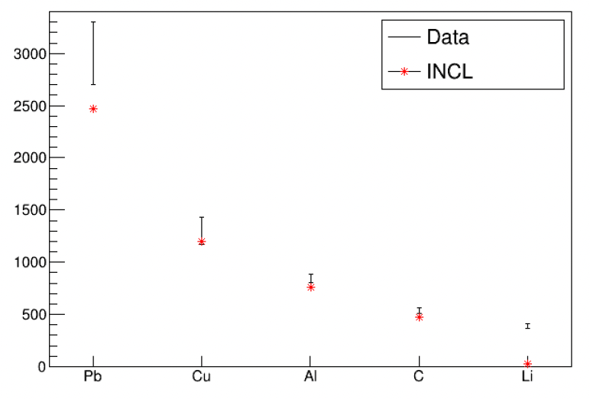
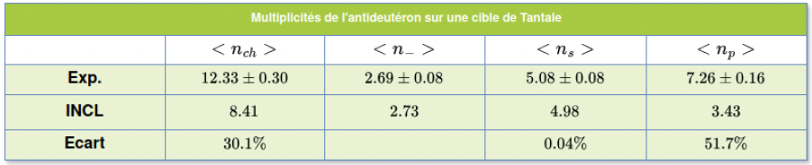












$\overline{d}$,
$\overline{t}$,
$\overline{3He}$,
$$\overline{4He}$$
INCL treats d, t, ³He, ⁴He-induced reactions (and more)
Now and -induced reactions available
So, why not -induced reactions?
It’s in progress… but at an (very) early stage with antideuteron!
First results are encouranging.
$$\overline{n}$$
$$\overline{p}$$
$\overline{d}$,
$\overline{t}$,
$\overline{3He}$,
$$\overline{4He}$$
preliminary results
$$\overline{d}\left(\text{6.1 }\text{GeV}\text{/}\text{c} \text{per} \text{nucleon} \right)+Ta$$
multiplicity
$$\overline{d} (13.3 GeV/c)$$
π⁺/π⁻
p
preliminary results
cross section (mb)
bias
V. F. Andreyev et al.,
Il Nuovo Cimento A 103.8 (1990), pp. 1163–1176
S.P. Denisov et al., Nuclear Physics B 31.2 (1971), pp. 253–260.
Antibaryons in INCL…

Slide 26
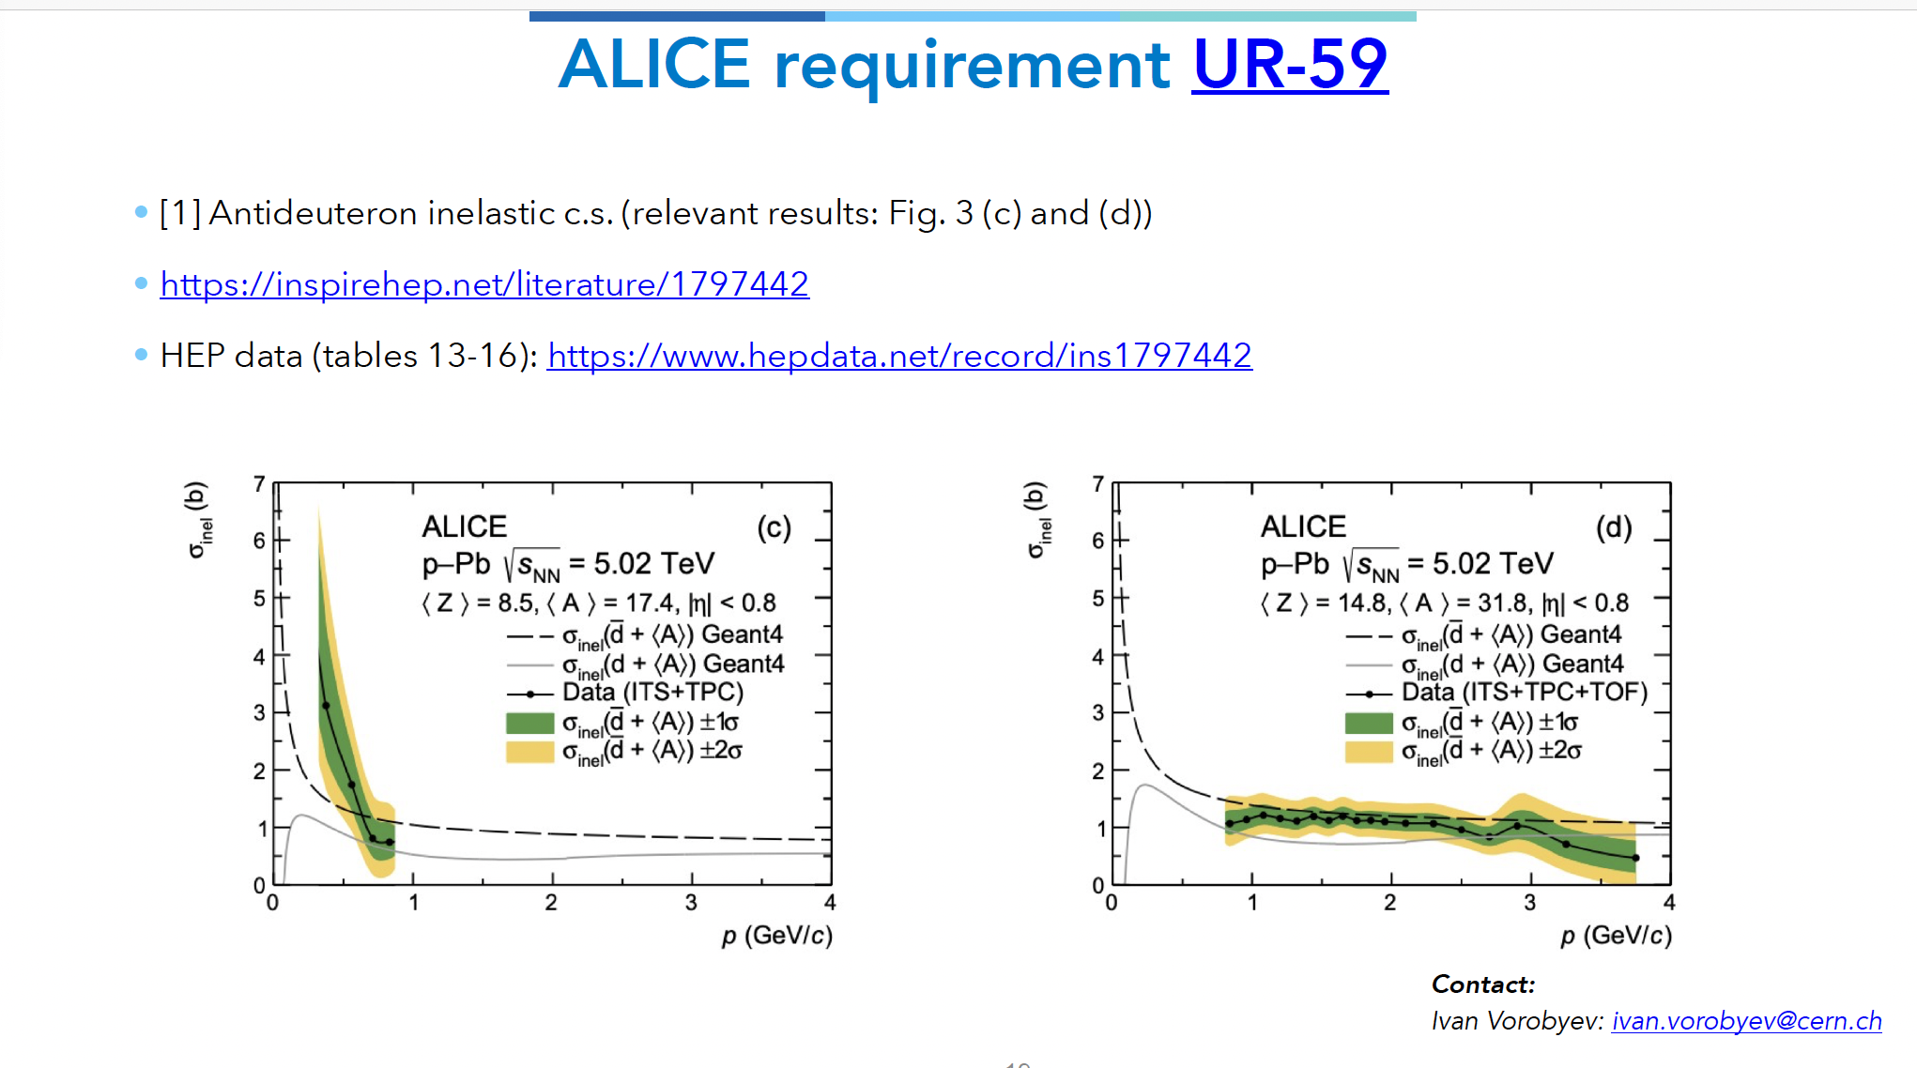

$\overline{d}$,
$\overline{t}$,
$\overline{3He}$,
$$\overline{4He}$$
From talk of Marilena (Monday)
INCL treats d, t, ³He, ⁴He-induced reactions (and more)
Now and -induced reactions available
So, why not -induced reactions?
It’s in progress… but at an (very) early stage with antideuteron!
First results are encouranging.
$$\overline{n}$$
$$\overline{p}$$
$\overline{d}$,
$\overline{t}$,
$\overline{3He}$,
$$\overline{4He}$$
preliminary results
~ $\overline{d}$ + ³²P
Antibaryons in INCL…

Slide 27
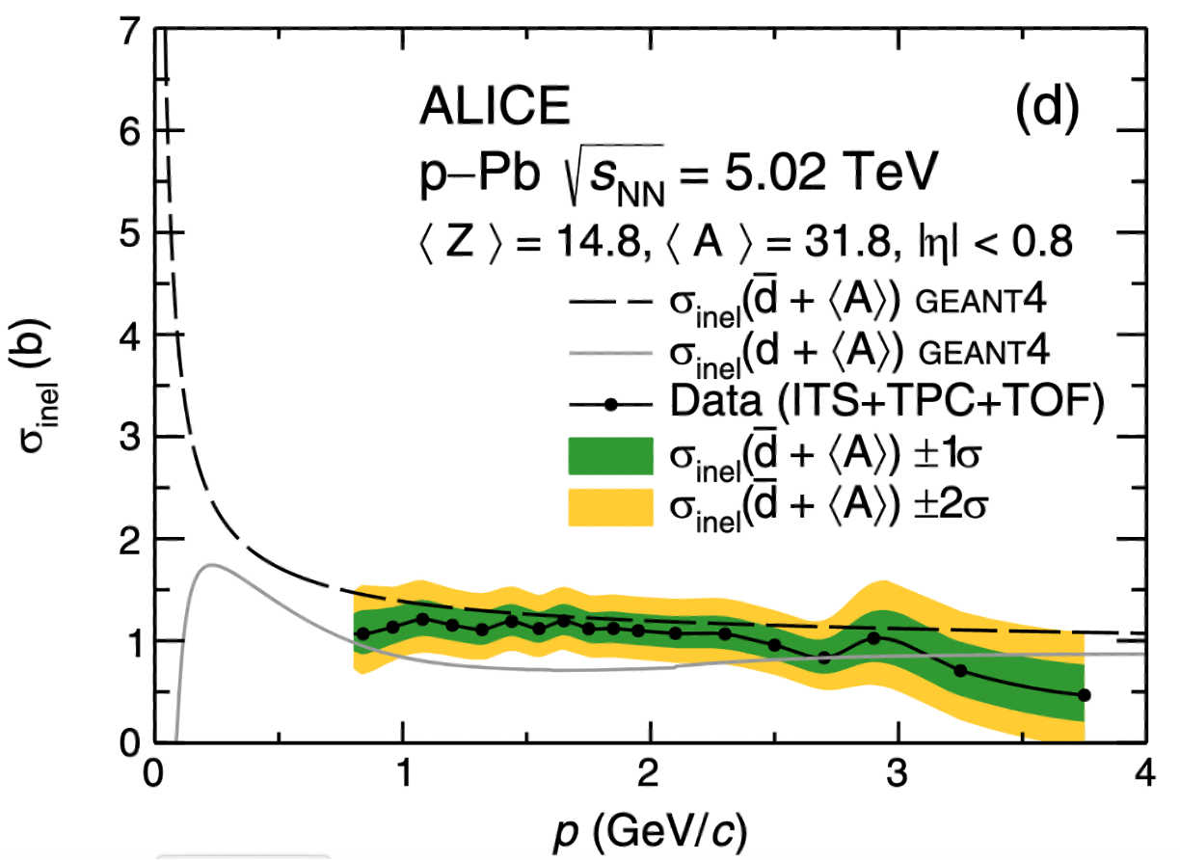
$\overline{d}$,
$\overline{t}$,
$\overline{3He}$,
$$\overline{4He}$$
INCL treats d, t, ³He, ⁴He-induced reactions (and more)
Now and -induced reactions available
So, why not -induced reactions?
It’s in progress… but at an (very) early stage with antideuteron!
First results are encouranging.
$$\overline{n}$$
$$\overline{p}$$
$\overline{d}$,
$\overline{t}$,
$\overline{3He}$,
$$\overline{4He}$$
preliminary results
Antibaryons in INCL…

Slide 28
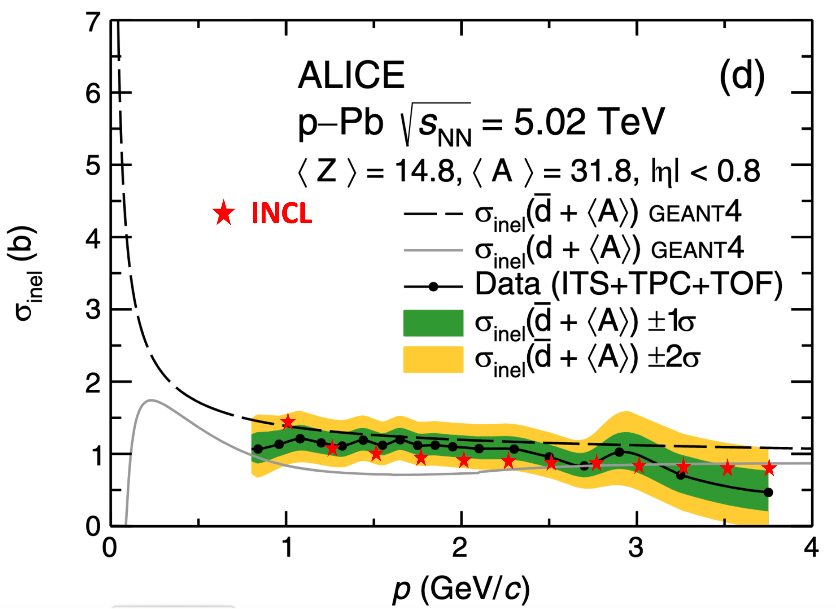
$\overline{d}$,
$\overline{t}$,
$\overline{3He}$,
$$\overline{4He}$$
INCL treats d, t, ³He, ⁴He-induced reactions (and more)
Now and -induced reactions available
So, why not -induced reactions?
It’s in progress… but at an (very) early stage with antideuteron!
First results are encouranging.
$$\overline{n}$$
$$\overline{p}$$
$\overline{d}$,
$\overline{t}$,
$\overline{3He}$,
$$\overline{4He}$$
preliminary results with
dbar + ³²P
Antibaryons in INCL…

Slide 29
Just for informations…
(linked to Geant4 on the medium and long term)
Antibaryons in INCL…

Slide 30
Neutrinos
In some neutrino experiments,
Energy of the neutrino is known thanks to ν-Nucleus interaction products
BUT
Increasing precision of the experiments means better/refined results in ν-Nucleus interactions
Then
Need to use models known to treat well Final State Interaction (FSI)
Reminder (several type of interactions)
QE (CCQE – NCQE) Quasi-elastic (Charge/Neutral Current)
RES Resonant (Δ)
DIS Deep Inelastic Scatering (higher resonances)
Consequences for INCL
 | 2019 | 2020-2023 | 2024 | 2024 | 2024
Who | GENIE | A. Ershova (Thesis CEA) | Antoine L.T. Internship (CEA) | GENIE | NEUT
Link/Goal | Contact | ν-oscillation exp. INCL to treat FSI | CCQE in INCL | New contact | Contact
Work | Implementing INCL | NuWro ν-N INCL FSI | It works Some points to be understood | Implementation OK? Used within Geant4? | Implementing INCL
Antibaryons in INCL…

Slide 31

Uncertainties, errors
At the 23rd Geant4 Collaboration Meeting (2018 in Lund)
A presentation on the optimization of parameter thanks to Bayesian statistics…
Also the idea to determine the bias (error) of the model
Difficulties
Building the tools
From the stand-alone model to the use in Geant4
Status for INCL
A project (NuRBS: Nuclear Reaction model improvement with Bayesian Statistics)
has been funded (2024->2027) – CEA & Bern U. (and IAEA+Coruña U.)
Goals:
      Building tools for biasing and parameter optimisation
      Applying them to INCL and ABLA for several cases
Next steps propogate errors in Geant4…?
Projet-ANR-23-CE31-0008
Antibaryons in INCL…

Slide 32
Conclusions
Antiprotons
    In Geant4 (since Geant4-11.2)
    room for improvements
    Some not-so-well-known ingredients → Nurbs project could help
Antineutrons
    Not yet in Geant4 (almost ready, but some checks are necessary)
    Improvements (see antiprotons)
Antideuterons and heavier
    Work has started only… (but encouraging)
Antibaryons in INCL…

Slide 33

Thanks for your attention!
And thanks to the students
          D. Zharenov (antiprorons + antineutrons)
          O. Lourgo (antineutrons + antideuterons)
          A. Ershova (neutrino in INCL using NuWro)
          A. Legendre-Terrolle (neutrino CCQE in INCL)
and
J. Hirtz who gave advices
Antibaryons in INCL…

Slide 34
Backup
Antibaryons in INCL…

Slide 35
References
Most of the work presented here come from the thesis of Demid Zharenov,
where all references are available (exp. data, input ingredients, etc.)
https://theses.hal.science/tel-04511526
Antibaryons in INCL…

Slide 36
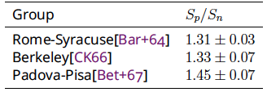

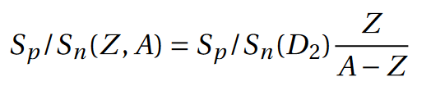

Antiprotons in INCL
Hypotheses – ingredients
At rest - Choice of nucleon to annihilate
We
know
More on proton than neutron
And, for a same experiment
S_{p}/S_{n}(D₂) between 57 and 170 MeV can range between 1.113 and 1.369
We
use
R. Bizzarri
Il Nuovo Cimento A (1965-1970) 53.4 (Feb. 1968), pp. 956–968
Antimatter-Nucleus reactions with the INCL code

Slide 37
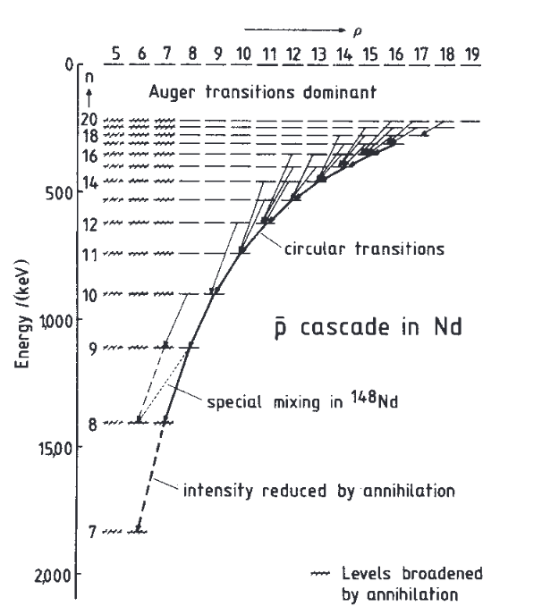
Antiprotons in INCL
Hypotheses – ingredients
At rest - Position of annihilation
pbar
  Captured in a high Bohr orbit
  Cascades toward the nucleus
  Stops/annihilates at a given « n »
Antimatter-Nucleus reactions with the INCL code

Slide 38
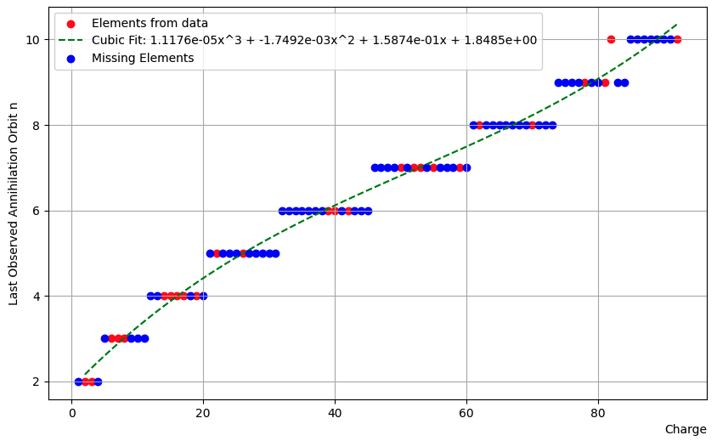
Antiprotons in INCL
Hypotheses – ingredients
At rest - Position of annihilation
pbar
  Captured in a high Bohr orbit
  Cascades toward the nucleus
  Stops/annihilates at a given « n »
Determination of « n »
(fits from exp. Data)
Antimatter-Nucleus reactions with the INCL code

Slide 39
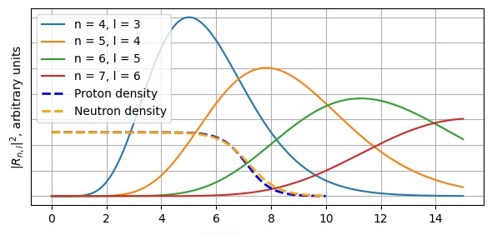
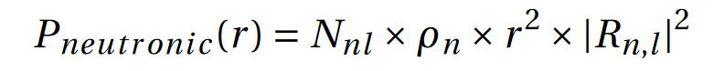
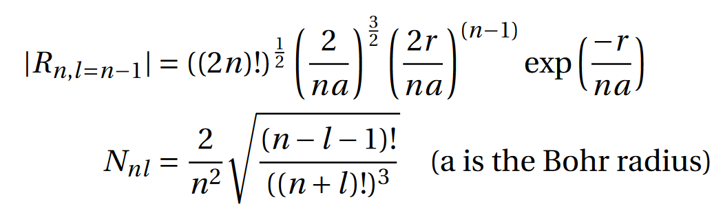
Antiprotons in INCL
Hypotheses – ingredients
At rest - Position of annihilation
pbar
  Captured in a high Bohr orbit
  Cascades toward the nucleus
  Stops/annihilates at a given « n »
Determination of « n »
(fits from exp. Data)
Position of annihiliation
When overlap of nuclear density
and antiprotonic radial density
Antimatter-Nucleus reactions with the INCL code

Slide 40
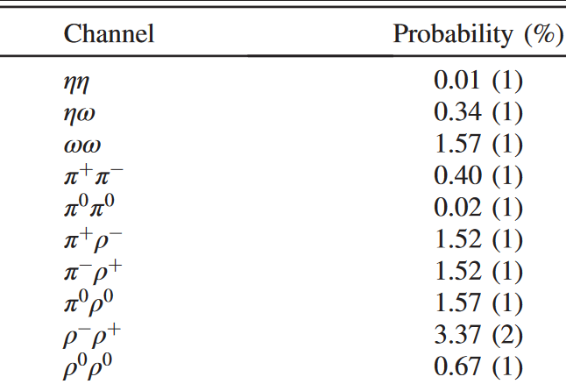
Antiprotons in INCL
Hypotheses – ingredients
At rest - Final states
In INCL we consider only π, η, ω and K (ρ goes directly to decay products)
Kaon frequency is put at 5%
    2 old values 6.82 +/- 0.25 % and 4.74 +/- 0.22 %
    « Recent » one 5.4 +/- 1.7 %
Final states with π, η, ω taken from
    E.S. Golubeva et al.
    Nuclear Physics A 537 (1992), 393–417.
and with K from
    Eberhard Klempt et al.
    Physics Reports 413 (2005), 197–317.
Example
Of
Final States
Antimatter-Nucleus reactions with the INCL code

Slide 41
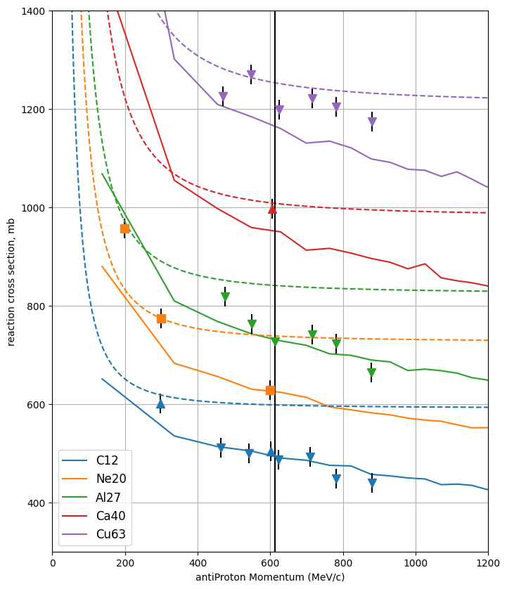
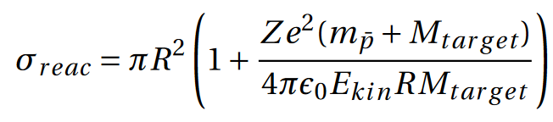
Reaction Cross section
Solid lines: INCL calculations
Dashed curves: at rest normalization
Antimatter-Nucleus reactions with the INCL code

Slide 42
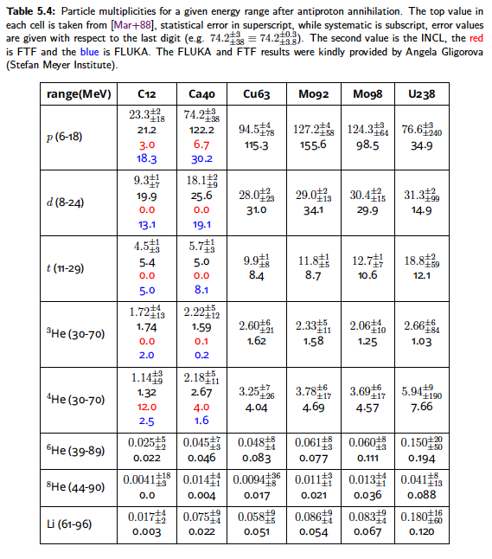
Antiprotons in INCL
Results
Multiplicities p to ⁴He, even beyond
(comparisons to FLUKA, FTF)
INCL is clearly competitive
🙂
Antimatter-Nucleus reactions with the INCL code

Slide 43
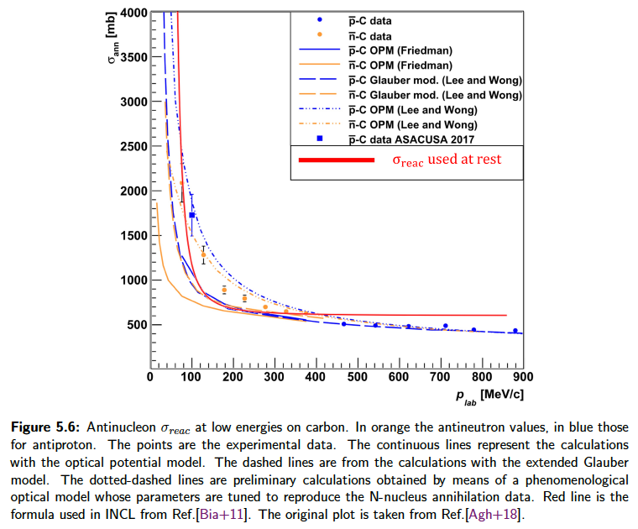
Antiprotons in INCL
Results
Spectra π⁺ & p
σ_{reac}
Carbon
π⁺ over and p under…!?
Not really…
pbar+C
Antimatter-Nucleus reactions with the INCL code

