Slide 1
RAON Beam Simulation
29th Geant4 Collaboration meeting
Four Point Sheraton Hotel, Catania, Italy
October 7-11, 2024
2024. 10. 9
Kihyeon CHO (KISTI/UST)*
Kyungho KIM (KISTI)
* Presenter

Slide 2
Contents
Introduction
Production of Secondary Particles
Collaboration with IBS for RAON
Summary

Slide 3
1. Introduction

Slide 4
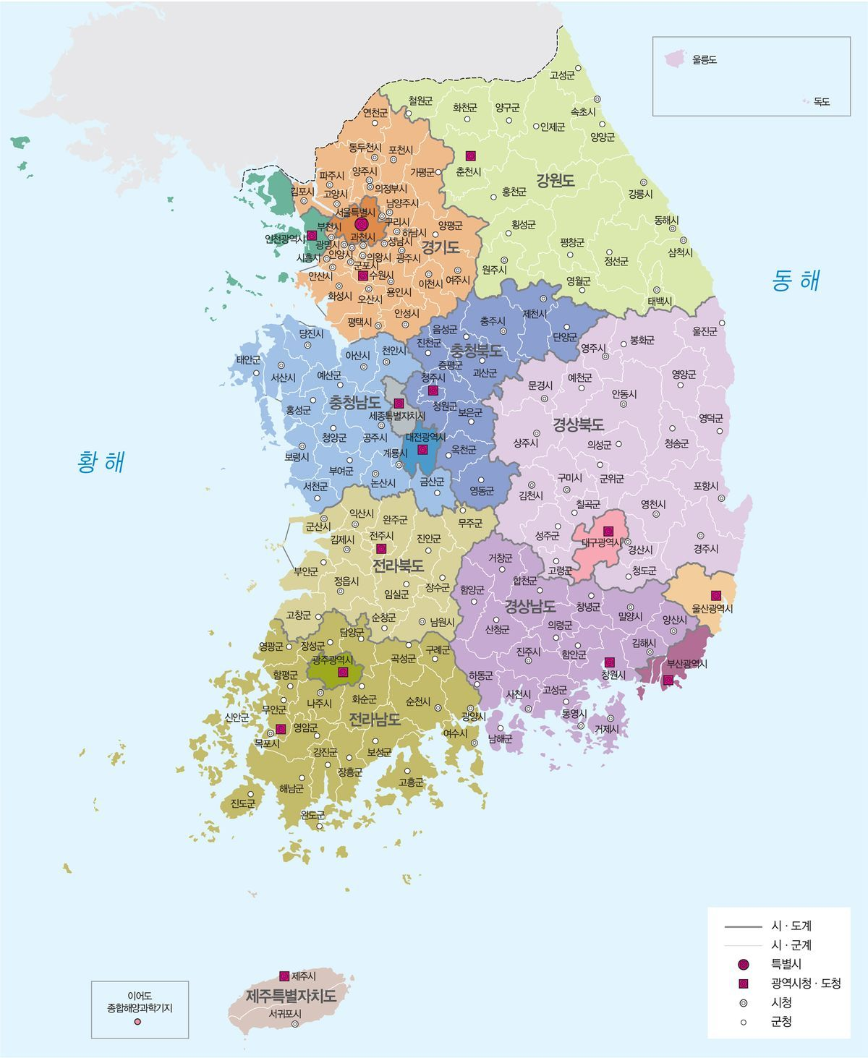

Accelerators in Korea
The last few years, there have seen a rise in the number of particle accelerators in Korea.
  Confirmed
    RAON, 2024 (Scientific)
    Yonsei Severance hospital, 2023 (Medical)
    Seoul national university hospital, 2025 (Medical)
  Consideration
    Asan medical center (Medical)
    Sejong city (Medical)
  .. And so on.
However, there has been relatively little focus on accelerator-based study of secondary particles.
Need to study heavy ion beam simulation
Yonsei severance hospital
Asan medical center
RAON
Sejong city
Seoul national university hospital

Slide 5
RAON
RAON - Rare isotope Accelerator complex for ON-line experiments
RAON accelerator
  Proton, oxygen, xenon & uranium beams of a few 100MeV/u
  Period:
    2011.12~2022.12: 1st Phase
    2022. 1~2025.12 : 2nd Phase R&D SCL2
    2024.5~ : First Experiment
Goals of this study
  To assess Geant4 performances in predicting isotope production
  To use it to anticipate isotope natures and production yields
  To foresee what measurements apparatus would be appropriate
However, note that the study interest is not limited to the RAON.
Notes:
5

Slide 6
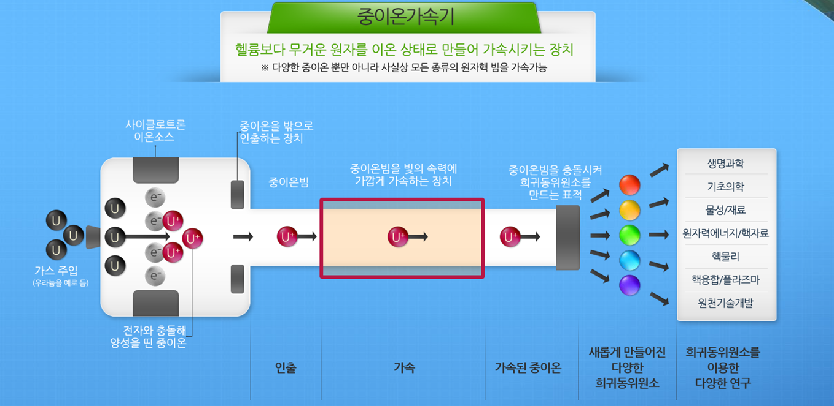
RAON

Slide 7
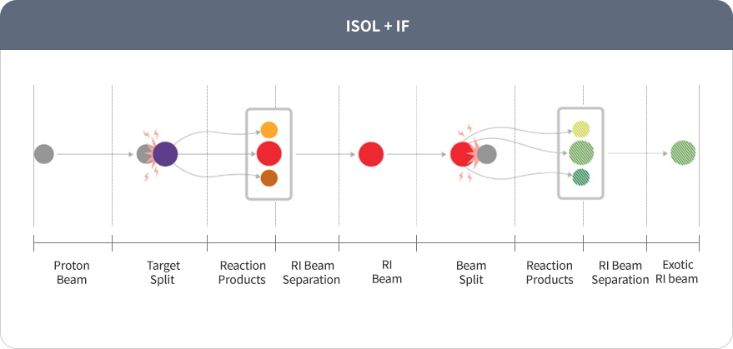
RAON
중이온가속기 라온
The first kind of facility having ISOL(Isotope Separation On-Line) and IF(In-flight) method combined
To increase the rate of discovery of rare isotopes

Slide 8
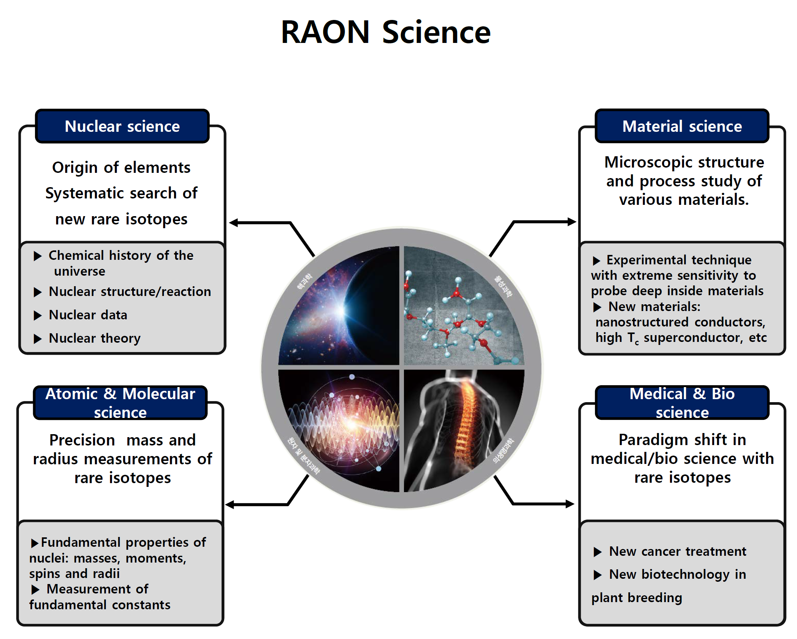
S. Jeong, P. Papakonstantinou, H. Ishiyama, Y. Kim, ”A Brief Overview of RAON Physics,” J. Korean Phys. Soc. 73 (2018) 516

Slide 9
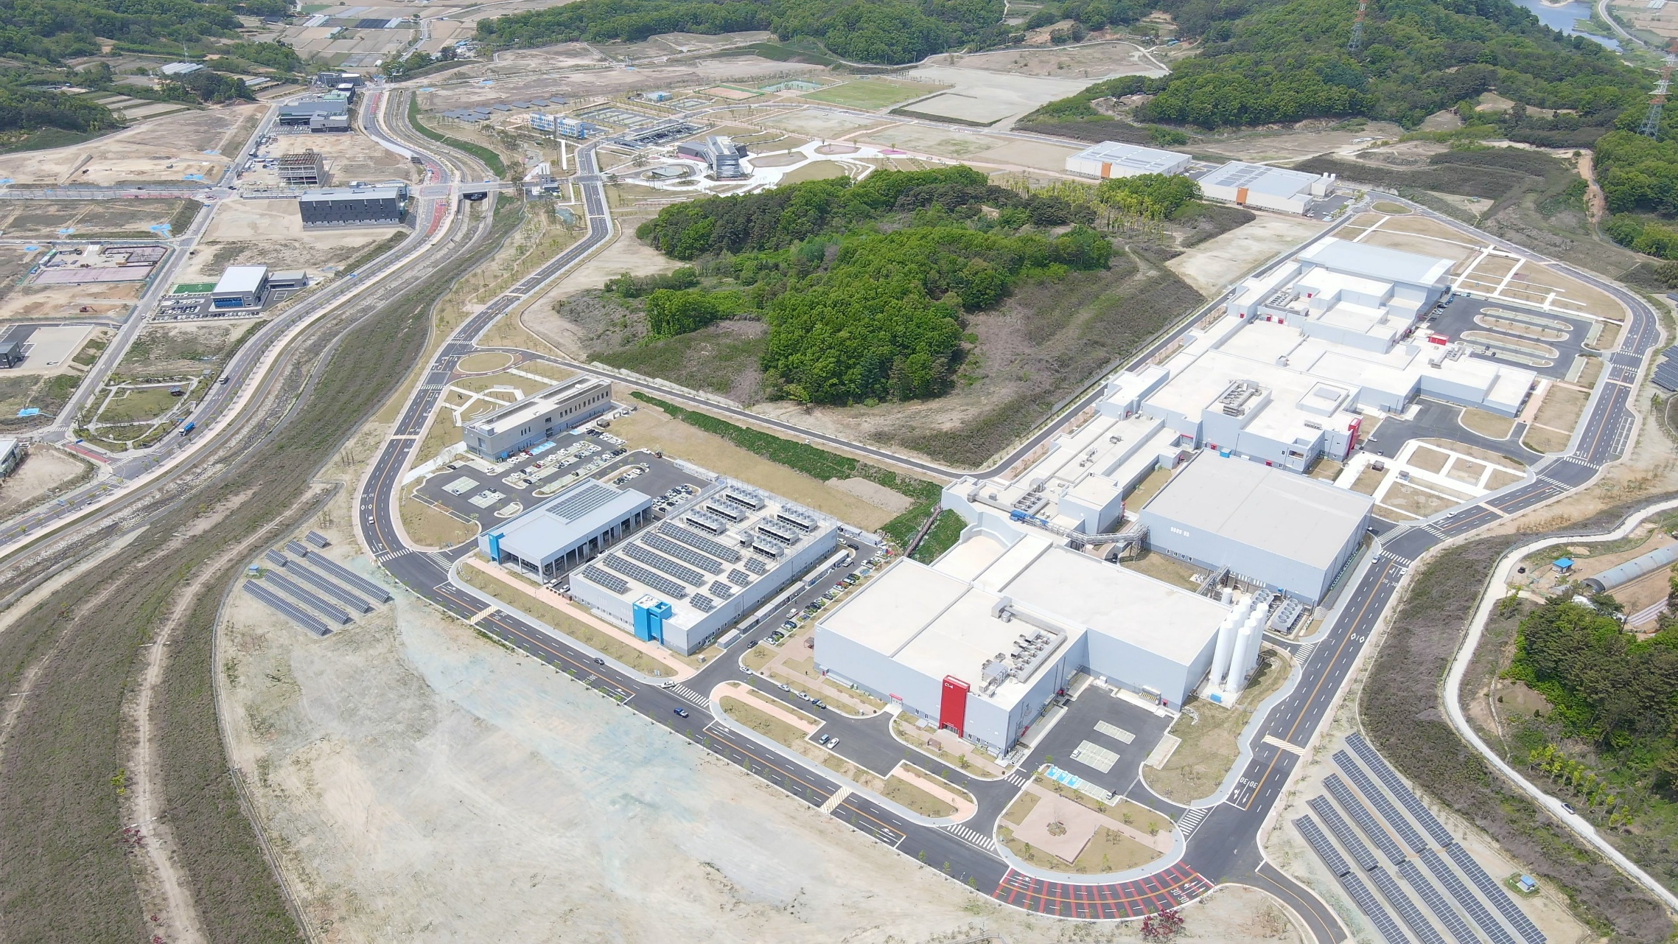

Slide 10
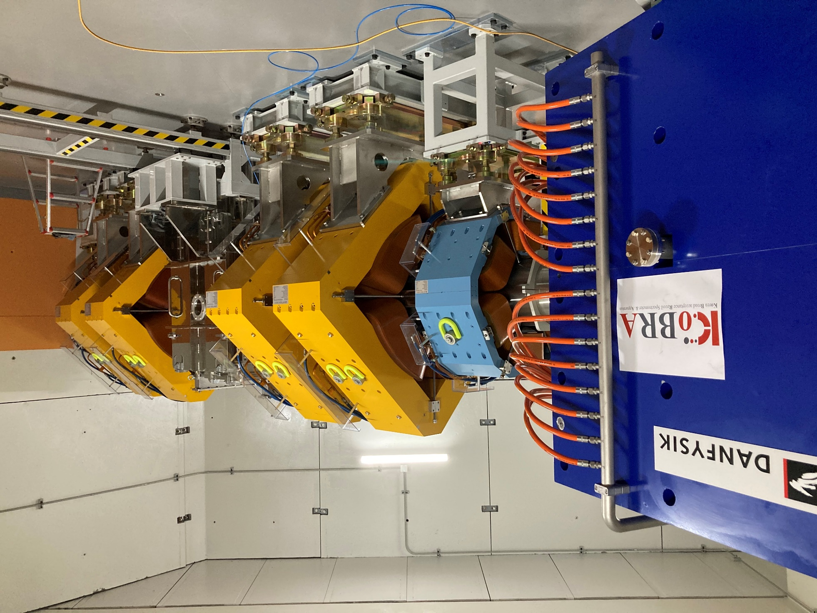

Slide 11
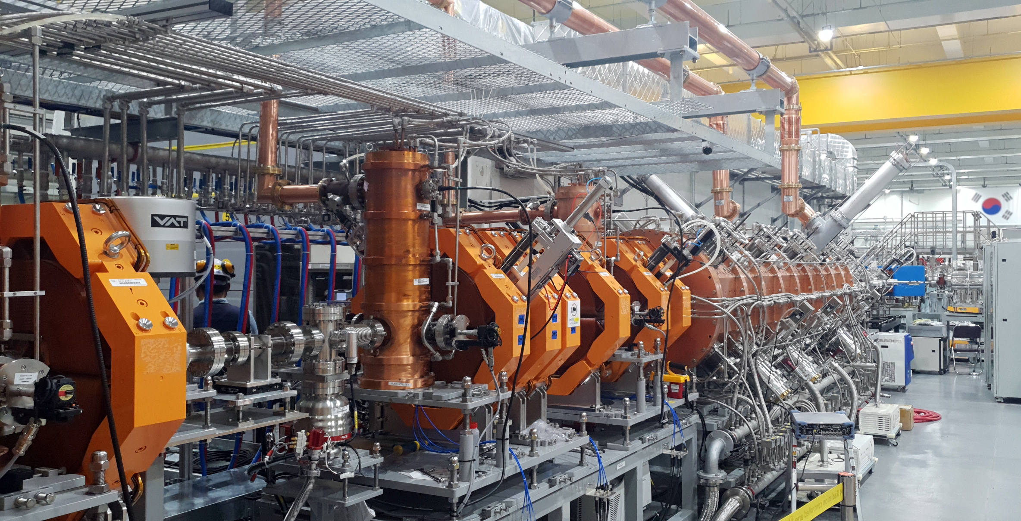

Slide 12
2. Production of secondary particles

Slide 13
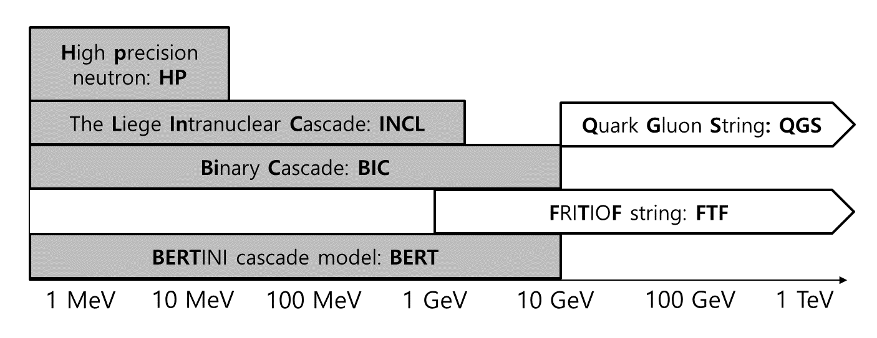
Physics List
Considered physics list in Geant4
  FTFP_BERT, FTFP_BERT_HP, FTFQGSP_BERT, QGSP_FTFP_BERT
  FTF_BIC, QGSP_BERT, QGSP_BERT_HP, QGSP_BIC
  FTFP_INCLXX, FTFP_INCLXX_HP, QGSP_INCLXX, QGSP_INCLXX_HP
  Shielding
  ⇒ Found “FTFP_INCLXX” for RAON
K. Cho, Geant4 meeting (2023)

Slide 14
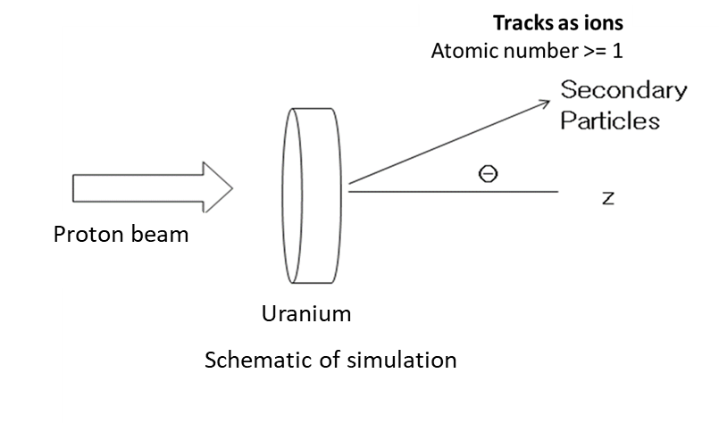
Conditions
Conditions of experiments
  Geant4 version: 11.0.2
  1 million events per each condition
  FTFP_INCLXX
Simulation | Geant4 Beam |  | Target
 | Particle | Energy (MeV/u) | Materials | Thickness (mm)
Proton → U | Proton | 100, 200, 500, 1000 | Uranium | 6
Proton → U | Proton | 100 | Uranium | 1, 2, 5, 6, 10
Beam & target conditions for validation

Slide 15
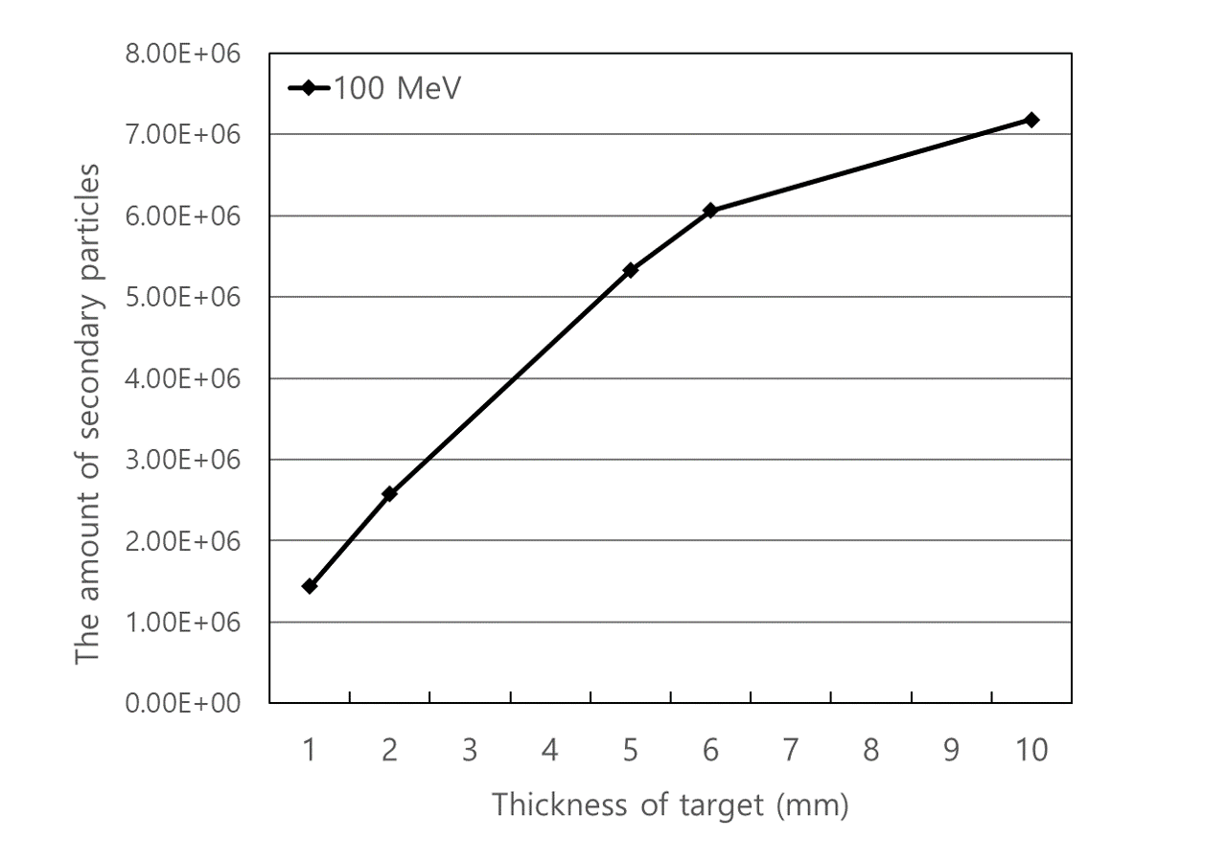
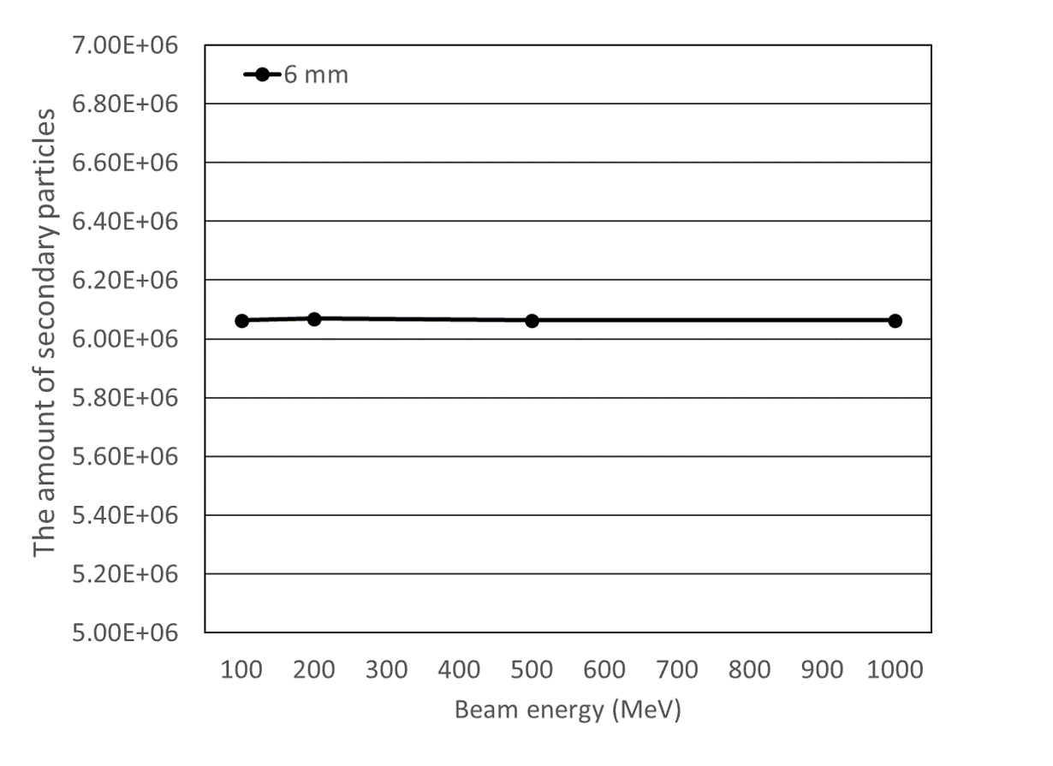
Amount of Secondary Particles
Amount per thickness of target
Amount per beam energy

Slide 16
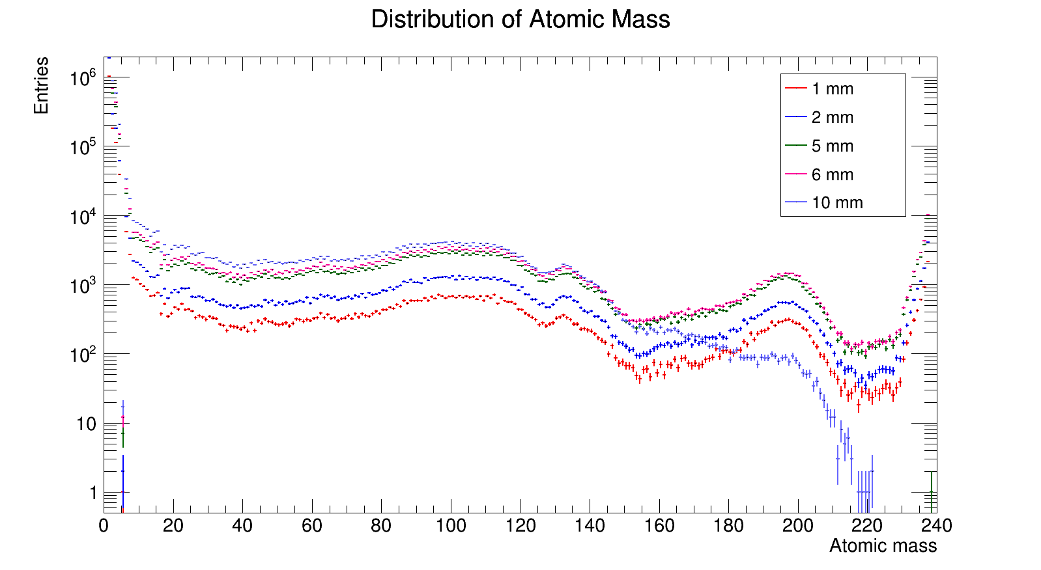
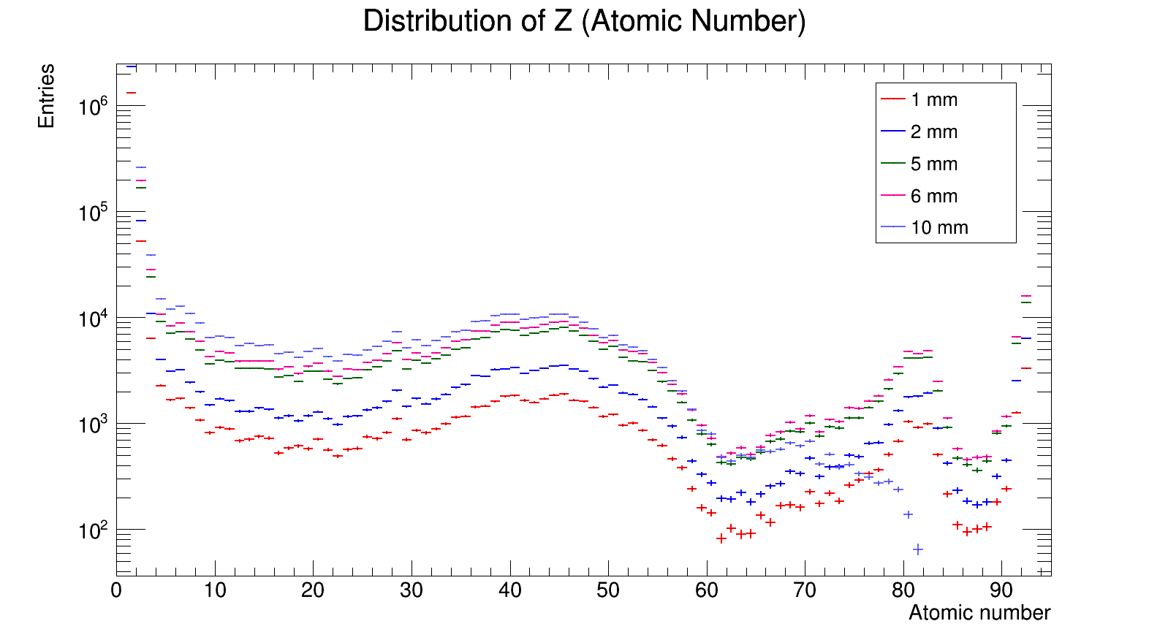
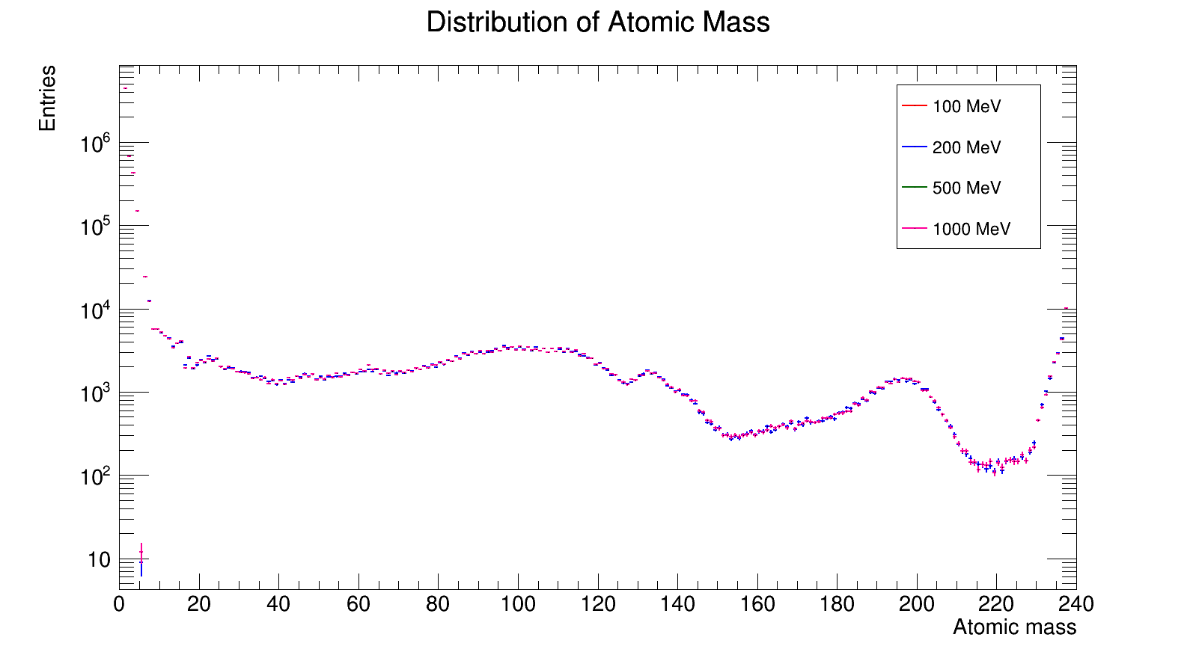
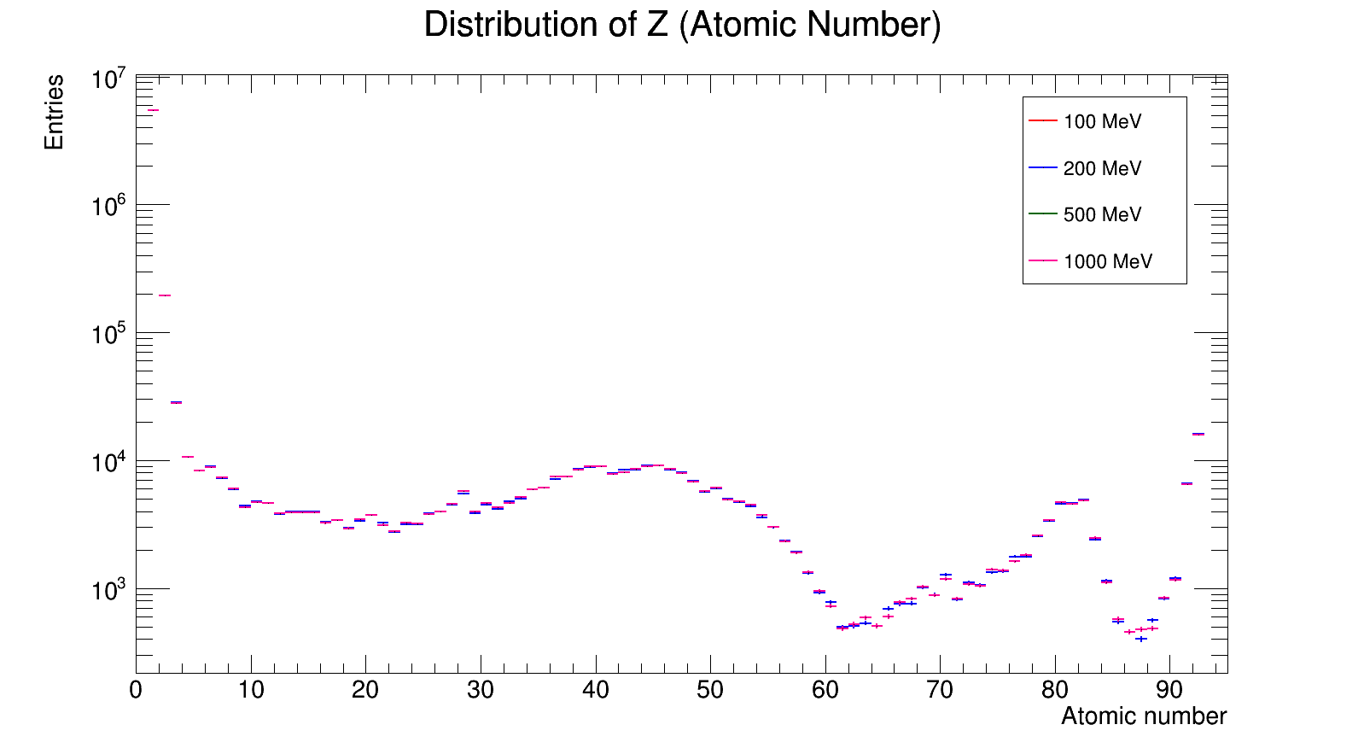
Amount of Secondary Particles

Slide 17
3. Collaboration with IBS for RAON

Slide 18
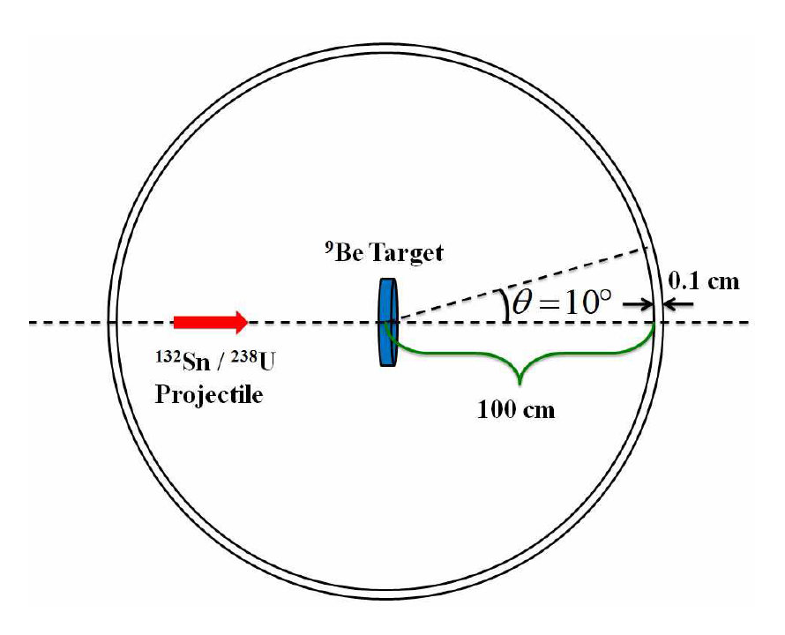
Sn132/U238 beam
Sn132/U238 collides to Be target.
Ion counting condition
  Escaped from Be target
  Travel 100cm from target
  Forward direction with θ < 10°
Simulation | Geant4 Beam |  | Target
 | Particle | Energy (MeV/u) | Materials | Thickness (mm)
Sn → Be | Sn132 | 200 | Beryllium | 1 ~ 10 mm (1mm step)
U → Be | U238 | 200
Beam & target conditions for KoBRA simulation

Slide 19
Simulation Conditions
Sn132/U238 collides to Be target.
Conditions of experiments
  Geant4 version: 11.0.2
  100,000 events per each condition
  PhysicsList: FTFP_INCLXX
Simulation | Geant4 Beam |  | Target
 | Particle | Energy (MeV/u) | Materials | Thickness (mm)
Sn → Be | Sn132 | 200 | Beryllium | 1 ~ 10 mm (1mm step)
U → Be | U238 | 200
Beam & target conditions for KoBRA simulation

Slide 20
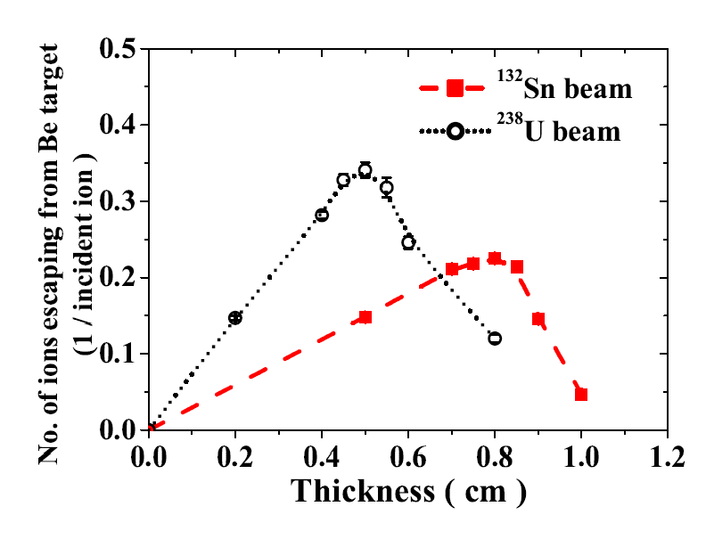
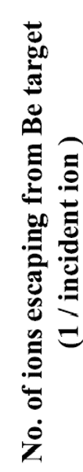
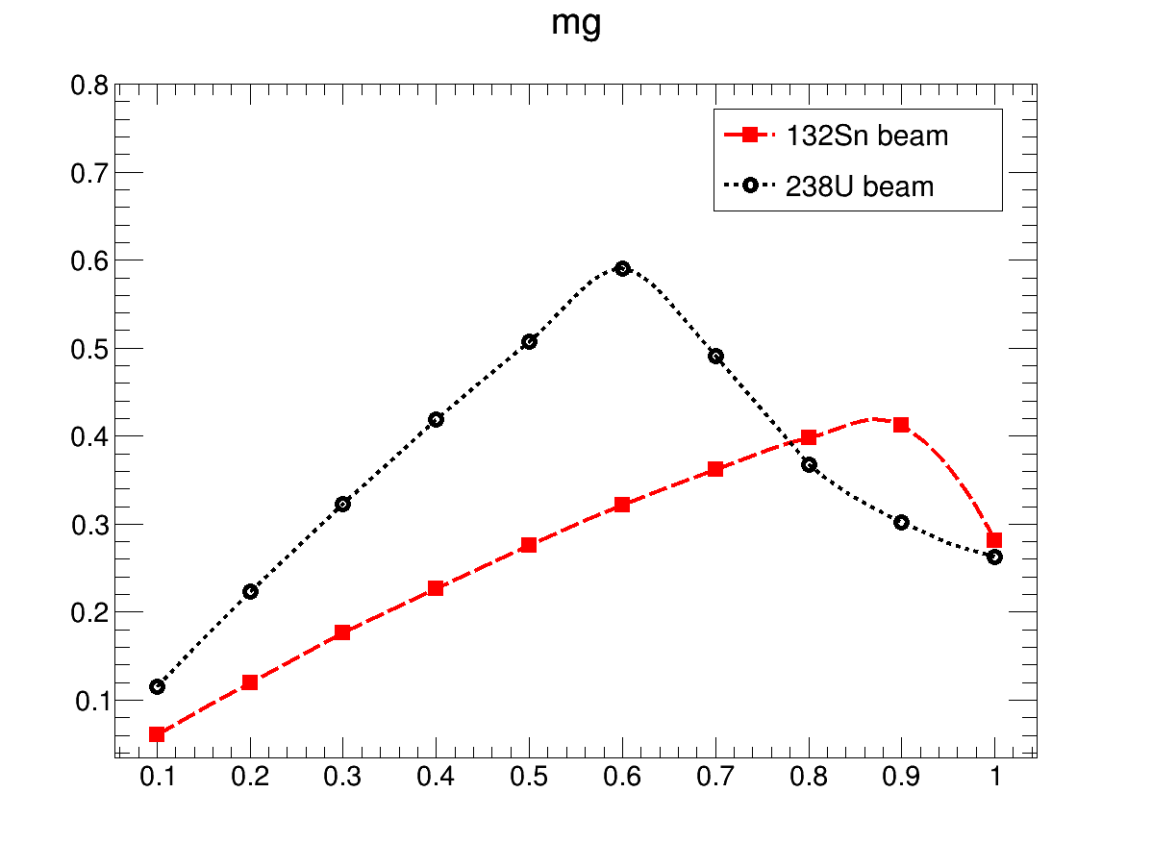
Results
Amount of events
  Thin target: penetrate the target
  Thick target: ions cannot escape from target
  What is the best target thickness for given condition?
Comparison with previous study [NIMB349 (2015]
  Different version (10.0 vs. 11.02)
  Different physics list (FTF_BIC vs. FTFP_INCLXX)
  Similar shape but different ‘maximum number of ions’
J. W. Shin et al., NIM B 349, 221 (2015)
This work

Slide 21
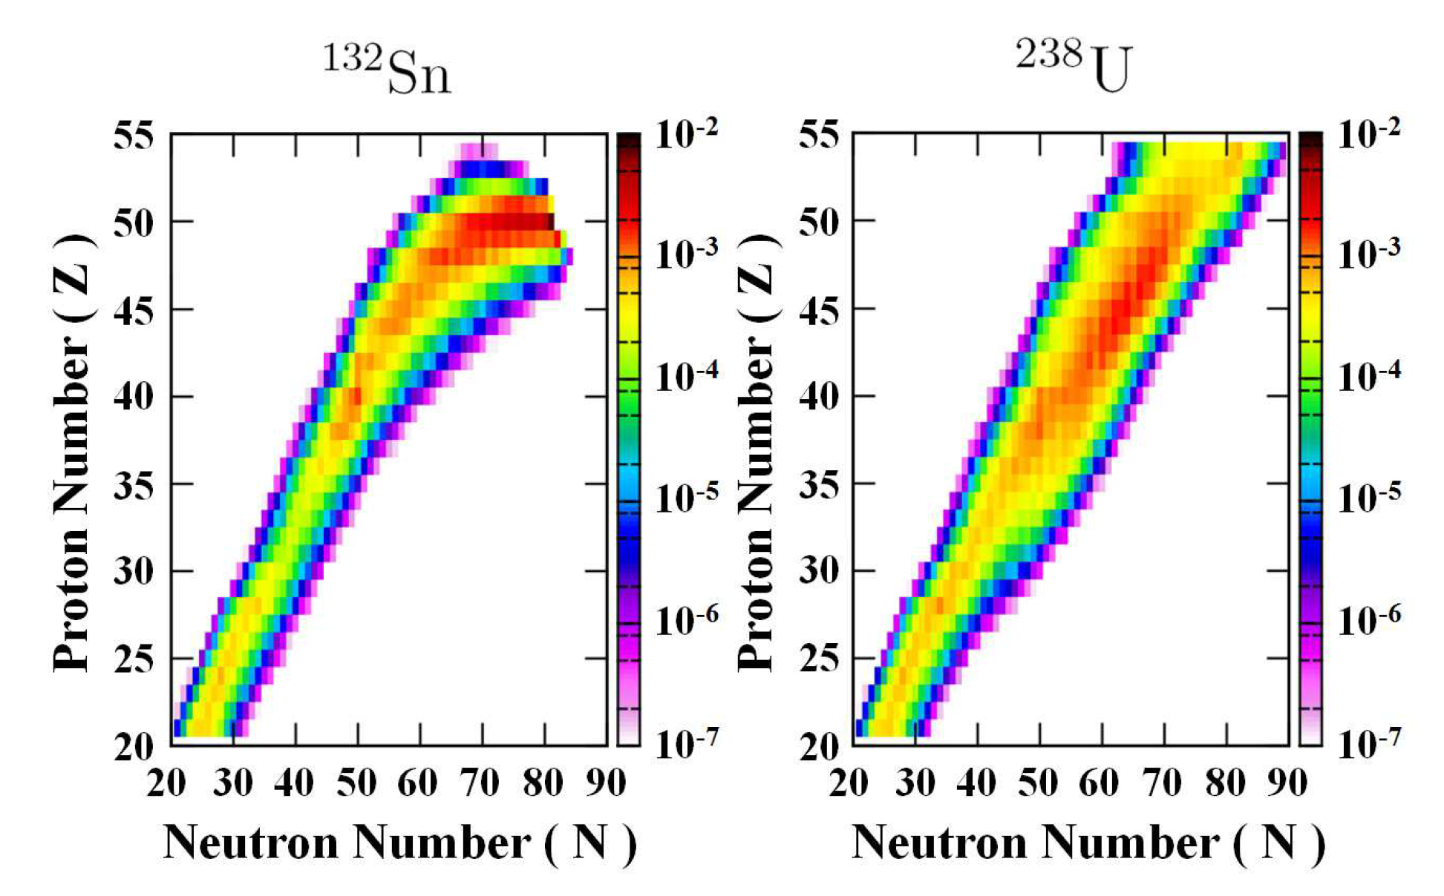

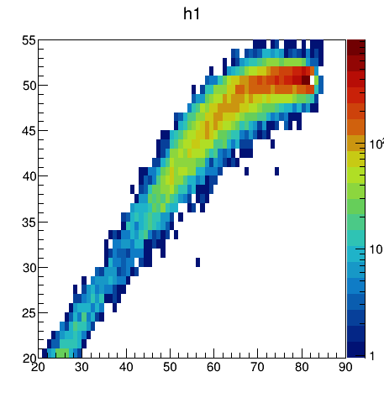

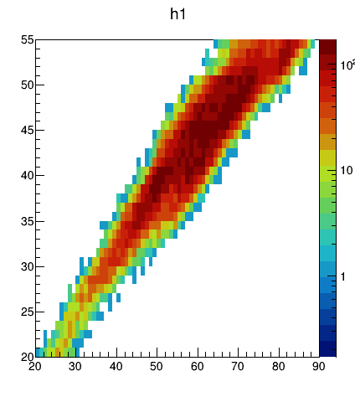

Isotopic Production Yields
J. W. Shin et al., NIM B 349, 221 (2015)
This work

Slide 22
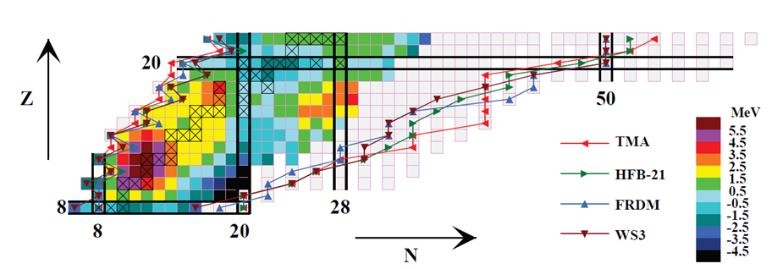
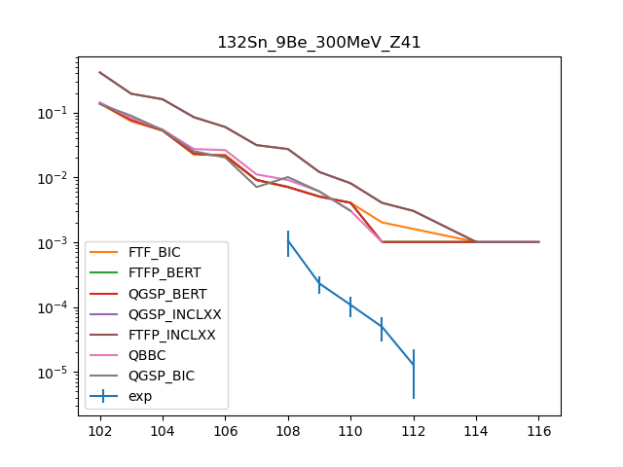
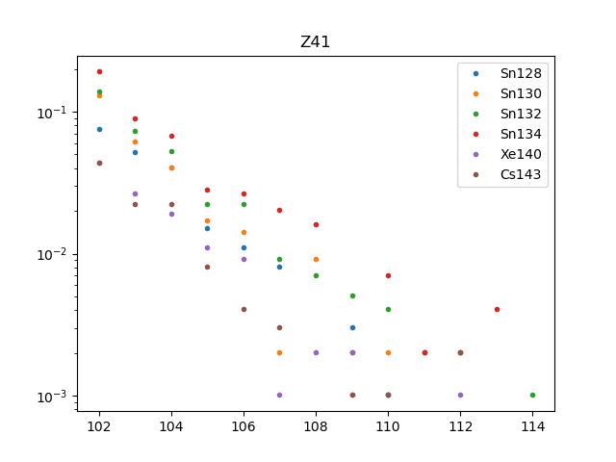
Neutron-excessive nuclide
Rare-isotope production to study Neutron-excessive nuclide
Various beam, target and energy
Sn(128, 130, 132, 134), Xe140 beam
Example)
Y. Song

Slide 23
4. Plan
RAON experiment plan
  To see the generation of nuclides near 34Si
  by colliding a 40Ar (20 MeV/u) beam with the C target
  Not only for the total cross section,
  but also momentum distribution of the final nuclei
If Geant4 can explain these experimental results,
or if it can be improved to explain the experimental results
⇒ To update the experiments
X.H. Zhang et al., PRC85, 024621 (2012)

Slide 24
Acknowledgement
The major institutional R&D program of KISTI (No. K-24-L02-C04-S01) and National Supercomputing Center with supercomputing resources including technical support.

Slide 25
Thank you.

Slide 26
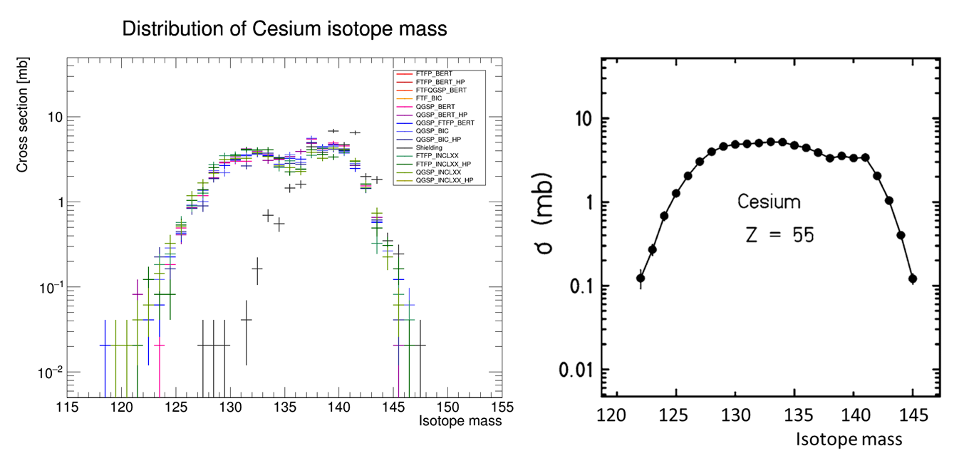
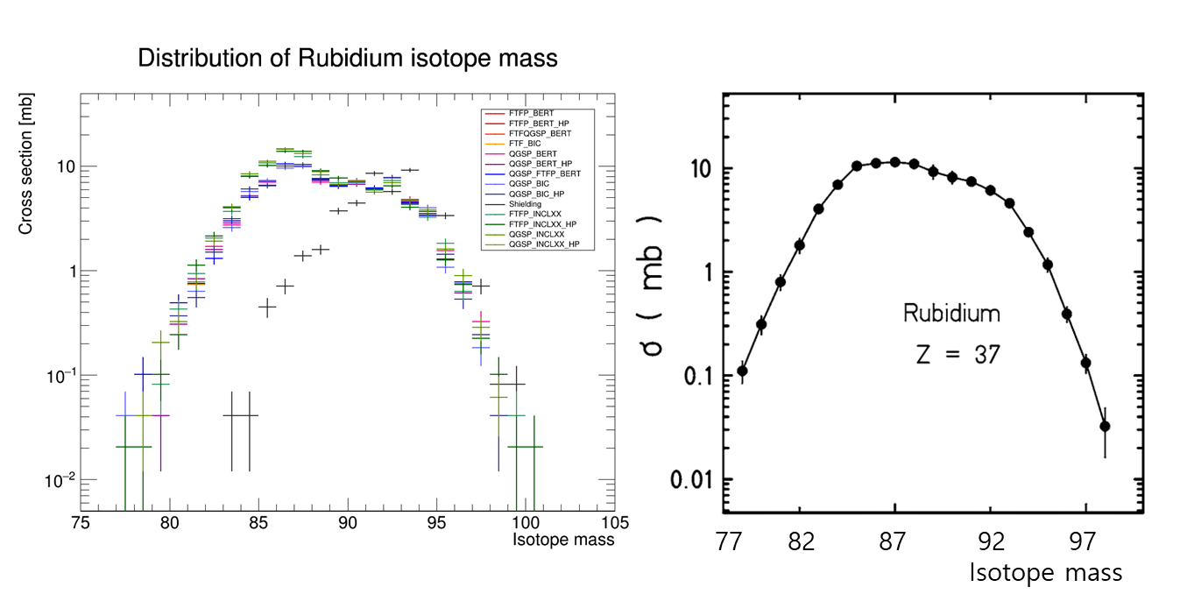
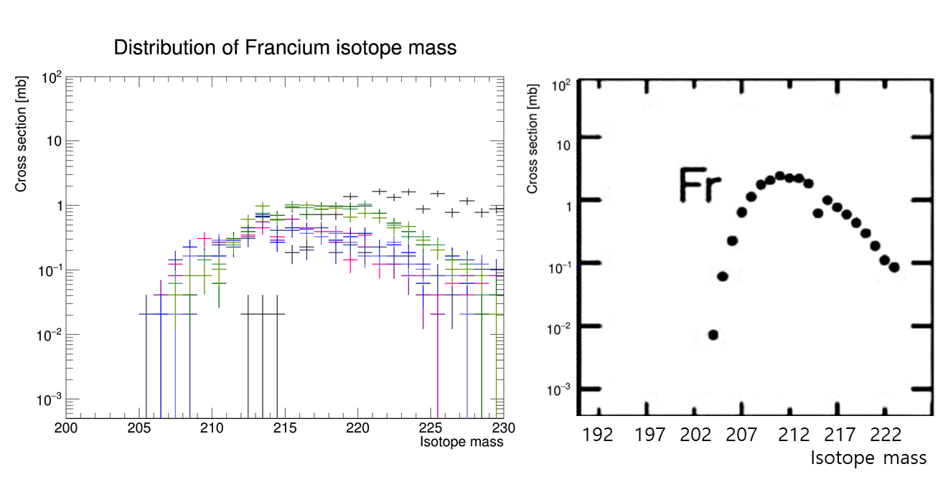
Isotope Distribution
M. Bernas, et al., Nucl. Phys. A 725, 213 (2003).
M. Bernas, et al., Nucl. Phys. A 725, 213 (2003).
J. Taieb, et al. Nucl. Phys. A 724, 413 (2003).
  FTFP_INCLXX

