Slide 1
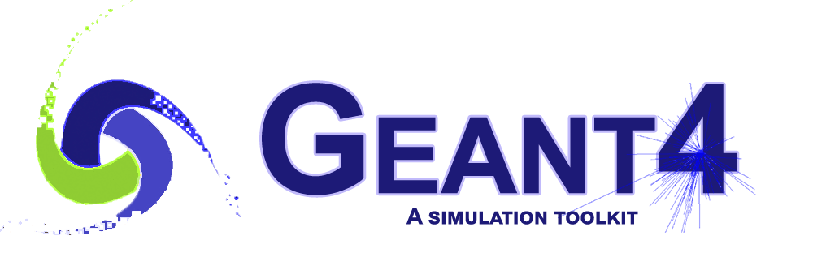
Updates on
Sub-Event Parallelism
Makoto Asai (JLab/CST)
asai@jlab.org

Slide 2
Geant4 evolutions in parallelization
Sequential mode : original since Geant4 v1.0
  Single core (thread) does everything
Multithreaded event-level parallel mode : since Geant4 v10.0 (Dec.2013)
  Taking the advantage of independence of events, many cores (threads) process events in parallel (event-level parallelism)
  Geometry / x-section tables are shared over threads
Task-based event-level parallel mode : since Geant4 v11.0 (Dec.2021)
  Decoupling task (event loop) from thread
  More flexible load-balancing
Task-based sub-event parallel mode : planned (Dec.2024~)
  Split an event into sub-events and task them separately
  Sub-event :
    Sub-group of primary tracks, or
    Group of tracks getting into a particular detector component
      Suitable for heterogeneous hybrid hardware
N.B. We made these evolutions without forcing the user to migrate
  Except for using the new functionalities

Slide 3
Sub-event parallel mode
Split an event into sub-events and task them separately to worker threads.
Two major use-cases:
  CPU only
    Ultra-high energy event that takes long time, e.g. air shower
    Event-level parallelism does not help here.
  Heterogeneous hardware
    If several different types of accelerations are available, e.g. optical photon, EM physics, etc.
    Different kind of sub-events could be tasked to different worker threads dedicated to their applicabilities.

Slide 4
Geant4 as a detector simulation engine
Initialization
- geometry
- x-section
Simulation output
- detector hits
- Monte Carlo truth
- histograms
Run
Event
Stack
Track
MC Event Gen
(Primary event)
Step
Process
- physics
- field integration
- volume boundary
Detector

Slide 5
Sequential mode
main()
G4RunManager
G4Run
G4EventManager
G4Event
G4TrackingManager
G4Track
G4SteppingManager
G4Step

Slide 6
Event-level parallel mode (thread / task)
Initialization
- geometry
- x-section
Run
Simulation output
- detector hits
- Monte Carlo truth
- histograms
Run
Event
Stack
Track
MC Event Gen
(Primary event)
Step
Process
- physics
- field integration
- volume boundary
Detector
Worker Thread / Task

Slide 7
Task-based parallel mode
main()
Master thread
G4TaskingRunManager
G4Run
Worker thread
G4WorkerRunManager
G4Run
Worker thread
G4WorkerRunManager
G4Run
G4WorkerRunManager
G4Run
G4WorkerRunManager
G4Run
G4WorkerRunManager
G4Run
Worker thread
G4EventManager
G4Event
G4EventManager
G4Event
G4EventManager
G4Event
G4EventManager
G4Event
G4EventManager
G4Event
G4TrackingManager
G4Track
G4TrackingManager
G4Track
G4TrackingManager
G4Track
G4TrackingManager
G4Track
G4TrackingManager
G4Track
G4SteppingManager
G4Step
G4SteppingManager
G4Step
G4SteppingManager
G4Step
G4SteppingManager
G4Step
G4SteppingManager
G4Step
Worker thread #0
Task

Slide 8
Task-based sub-event parallel mode (Phase I)
Initialization
- geometry
- x-section
Simulation output
- detector hits
- Monte Carlo truth
- histograms
Run
Event
Stack
Stack
Track
Stack
Stack
MC Event Gen
(Primary event)
Step
Sorter / Merger
Process
- physics
- field
- volume
In Phase I, all tasks have the same physics processes and see the same detector geometry.
Detector
Sub-event Task

Slide 9
Task-based sub-event parallel mode (Phase II)
Initialization
- geometry
- x-section
Simulation output
- detector hits
- Monte Carlo truth
- histograms
Run
Event
Stack
Stack
Track
Stack
Stack
MC Event Gen
(Primary event)
Step
Sorter / Merger
Dedicated Processes
- physics
- field
- volume
In Phase II, each task has only the necessary physics processes and sees the limited detector geometry that are necessary for that particular task.
Essential for heterogeneous simulation
Detector
Sub-event Task

Slide 10
Sub-event parallel mode
main()
Master thread
G4SubEvtRunManager
G4Run
Worker thread
G4Event
G4EventManager
G4SubEvent
Worker thread
Worker thread
A Tracking Manager
A Track
A Stepping Manager
A Step

Slide 11
Sub-event parallel mode
main()
Master thread
G4SubEvtRunManager
G4Run
Worker thread
G4EventManager
G4Event
Worker thread
G4SubEvent
Worker thread
A Tracking Manager
A Track
G4SEPWorkerRunManager
G4WEPWorkerRunManager
G4WorkerSubEvtRunManager
A Stepping Manager
G4Event
G4EventManager
A Step
G4EventManager
G4Event
G4Event
G4EventManager
A Tracking Manager
A Track
A Tracking Manager
A Track
A Tracking Manager
A Track
Task
Task
A Stepping Manager
A Step
A Stepping Manager
A Step
A Stepping Manager
A Step
Task

Slide 12
What is / will be unchanged / seamless
Applications that work in the event-level parallel mode both with original MT mode or with the task-based MT mode work as-is. No modification needed.
In the sub-event parallel mode:
  Methods in G4EventManager that are used in the worker thread are not changed.
    ProcessOneEvent(G4TrackVector*) method is used instead of ProcessOneEvent(G4Event*).
  G4TrackingManager is unchanged.
  “Specialized” tracking manager can be used as-is in the worker thread. It can be assigned to all worker threads or to some selected number of worker threads.
    May have more than one kinds of specialized tracking managers.
  Scores defined by the command-based scorers are automatically merged.
  Trajectories created in worker threads are merged to the corresponding G4Event.
    Optional – as it requires rather heavy copy operations.

Slide 13
Top-level scenario
In the master thread, in addition to the ordinary stacks (Urgent, Waiting, (Waiting_1, …)), user may add stacks for each kind of sub-event tasks (G4SubEventTrackStack).
  e.g. optical photons in scintillator, EM particles in calorimeter, …
A G4SubEventTrackStack stacks tracks of selected type, and once the number of tracks becomes the user-specified threshold, it packs them into G4SubEvent.
Worker thread thread pulls a sub-event of its type from the master thread.
  G4Event in the master thread keeps record of spawned G4SubEvent objects.
  Master thread may proceed to the next event(s) while workers still work for the sub-event(s) of previous event(s).
Worker pushes the resulting thread-local G4Event object to the master.
  It contains all the necessary outcomes (hits, scores, trajectories, etc.) made in the worker thread.
  Thread-local event is merged into the corresponding G4Event in master.
  After merging, thread-local event object and its contents are safely deleted by the worker thread.
Worker thread does not have PrimaryGeneratorAction but use G4EventManager::ProcessOneEvent(G4TrackVector*) to process tracks provided in G4SubEvent.
  G4EventManager of the worker thread does the job just the same as what it does in the event-level parallel mode.

Slide 14
G4UserSubEvtThreadInitialization
By default, all worker threads have G4WorkerSubEvtRunManager with the default sub-event type 0.
By overriding CreateWorkerRunManager() method of G4UserSubEvtThreadInitialization class, user may assign dedicated sub-event type to each worker.
  Assignment can be changed on the fly if load-balancing is needed.
  G4WorkerRunManager* MyUserSubEvtThreadInitialization::CreateWorkerRunManager() const
  {
  G4int threadID = G4Threading::G4GetThreadId();
  G4int subEvtType = 0;
  switch(threadID)
  {
  case 0: case 1: case 2:
  subEvtType = 1; break;
  default: break;
  }
  return new G4WorkerSubEvtRunManager(subEvtType);
  }

Slide 15
G4UserActionInitialization::BuildForMaster()
In sub-event parallel mode, PrimaryGeneratorAction must be assigned to the master thread.
If UserRunAction or UserEventAction is needed, it must also be assigned to the master thread.
  There is no “run” or “event” in the worker thread. G4Event object created in the worker thread is used as a container to bring the results made by the tasked sub-event.
As the master thread does the ordinary tracking, it may take UserTrackinigAction and UserSteppingAction as well.
  void MyActionInitialization::BuildForMaster() const
  {
  if(G4RunManager::GetRunManager()->GetRunManagerType()
  ==G4RunManager::subEventMasterRM)
  { SetUserAction(new MyPrimaryGeneratorAction);
  SetUserAction(new MyStackingAction);
  }
  SetUserAction(new MyRunAction);
  }
MyRunAction is used for both event-level and sub-event-level parallel modes

Slide 16
G4UserActionInitialization::BuildForMaster() (continued)
For each sub-event type, capacity of G4SubEvent may be specified. Default is 1000.
Once tracks in the stack for a sub-event type reach to the specified maximum capacity, a G4SubEvent object is instantiated and tasked to the corresponding worker.
  At the end of an event (of master thread), remaining tracks are stored in a new G4SubEvent object and tasked. I.e. a sub-event does not contain tracks of more than one events.
  void MyActionInitialization::BuildForMaster() const
  {
  if(G4RunManager::GetRunManager()->GetRunManagerType()
  ==G4RunManager::subEventMasterRM)
  {
  G4RunManager::GetRunManager()->RegisterSubEventType(0,2000);
  G4RunManager::GetRunManager()->RegisterSubEventType(1,500);
  }
  }

Slide 17
G4UserActionInitialization::Build()
UserTrackingAction, UserSteppingAction or UserStackingAction may be set to the worker thread. User may alter these classes depending on the sub-event type.
  void MyActionInitialization::Build() const
  {
  auto* runM = G4RunManager::GetRunManager();
  if(runM->GetRunManagerType()==G4RunManager::subEventWorkerRM)
  {
  if(runM->GetSubEventTyp() == 0)
  { SetUserAction(new MyEventActionForPhoton); }
  else if(runM->GetSubEventTyp() == 1)
  { SetUserAction(new MyEventActionForEM); }
  }
  else
  {
  SetUserAction(new MyPrimaryGeneratorAction);
  SetUserAction(new MyEventAction);
  }
  }
In event-level parallelism PrimaryGeneratorAction is set to worker threads

Slide 18
UserStackingAction in the master thread
In the master thread, in addition to the ordinary stacks (Urgent, Waiting, (Waiting_1, …)), user may add stacks for each kind of sub-event tasks (G4SubEventTrackStack).
  e.g. optical photons in scintillator, EM particles in calorimeter, …
In the UserStackingAction::ClassifyNewTrack() method, depending on the particle type, position, energy, volume/region etc., a track can be directed to the dedicated stack for sub-event.
  G4ClassificationOfNewTrack
  MyStackingAction::ClassifyNewTrack(const G4Track* aTrack)
  {
  if(aTrack->GetParticleDefinition()==G4OpticalPhoton::Definition())
  { return fSubEvent_0; }
  if(aTrack->GetParticleDefinition()==G4Gamma::Definition()
  && aTrack->GetKineticEnergy()>1.0*GeV)
  { return fSubEvent_1; }
  else
  …
  }

Slide 19
Shortcut alternative to UserStackingAction
If classification is based only on the particle type, it can be defined in UserActionInitialization.
  void MyActionInitialization::BuildForMaster() const
  {
  if(G4RunManager::GetRunManager()->GetRunManagerType()
  ==G4RunManager::subEventMasterRM)
  {
  G4RunManager::GetRunManager()->SetDefaultClassification
  (G4OpticalPhoton::Definition(),fSubEvent_0);
  }
  }

Slide 20
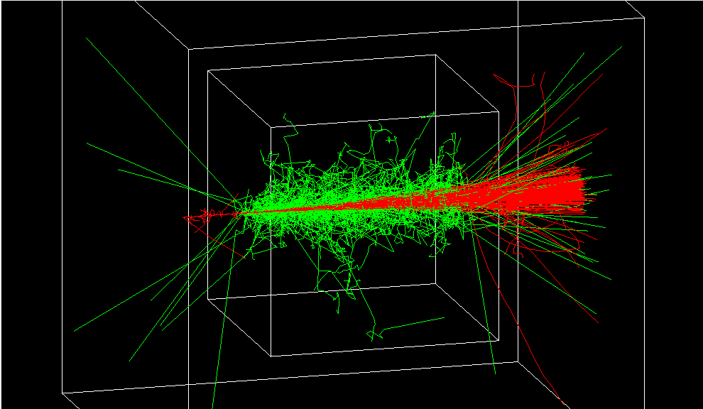
RE03 in event-level parallel mode (1 GeV muons)

Slide 21
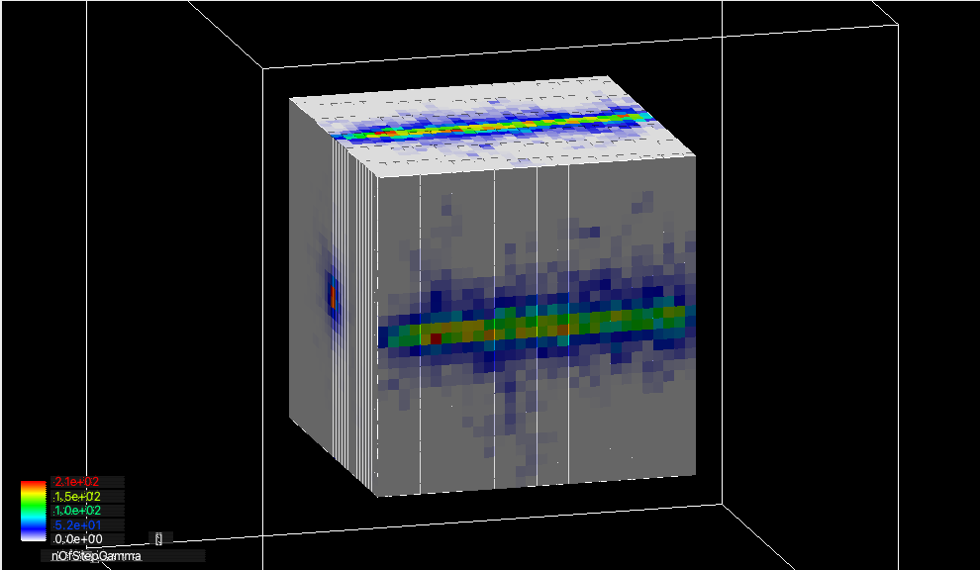
RE03 in event-level parallel mode (1 GeV muons)

Slide 22
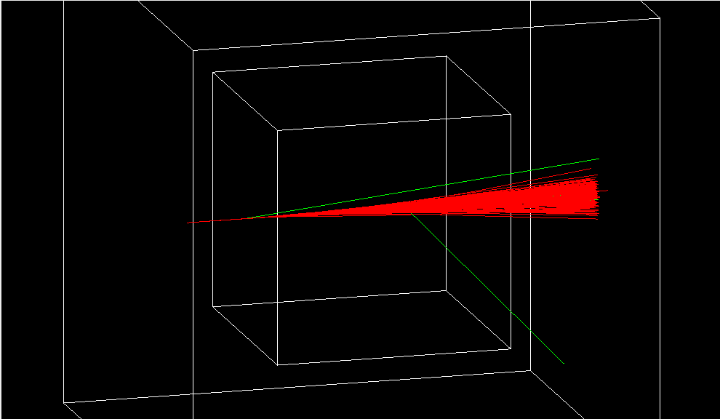
in sub-event parallel mode (e-, e+, γ sent to worker)
By default, trajectories created in worker threads are not merged to the master.
Scores are automatically merged.

Slide 23
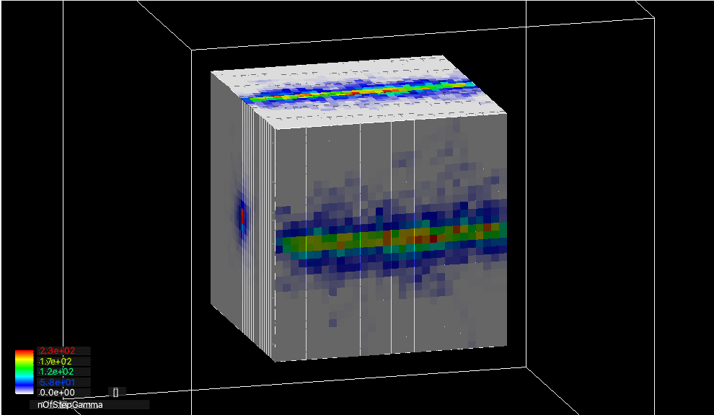
in sub-event parallel mode (e-, e+, γ sent to worker)
By default, trajectories created in worker threads are not merged to the master.
Scores are automatically merged.

Slide 24
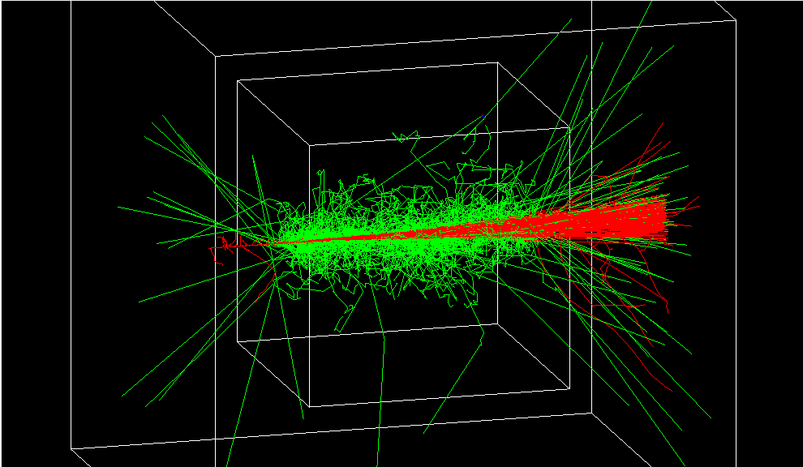
in sub-event parallel mode (trajectories merged)

Slide 25
in sub-event parallel mode (trajectories merged)

Slide 26
Object ownership
Given we use G4Allocator, we need clean management of
Who-Owns-What, Who-Deletes-What and -When.
  Objects instantiated by the master thread must be deleted by the master. Objects instantiated by the worker thread must be deleted by the responsible worker.
G4SubEvent object and tracks in it are deleted by the master after the worker refers/uses them.
  Tracks must be copied when sent from master to worker.
Thread-local G4Event created by a worker thread and objects contained by it (hits, scores, trajectories) are deleted by the worker after letting the master thread copy/merge the contents.
  Scores – automatically merged by Geant4 kernel classes
  Trajectories – copied by CloneForMaster() method and stored into the master G4Event
    Optional as it requires massive copying
  Hits – user needs to implemet += operator of HitsCollection

Slide 27
Good news
As a side effect of this sub-event parallelism development, G4Event are now cleanly deleted as soon as possible if these events are not requested to be kept for redrawing during the following Idle state.
  Both in the original MT and Tasking event-level parallel modes
    And in sub-event parallel mode
  Kept events are deleted at the beginning of next run or at the termination of the program.
    Up to now, all events were kept until next run due to some race issues between worker threads and the visualization thread.
  Deletion of unnecessary events is essential when user simulates thousands of events and selects just a few interesting events to be revisited after the run.
    In the EndOfEventAction, invoke G4Event::KeepTheEvent() for the events that are of your interest.

Slide 28
Current status and plan
Most of the classes have been committed to the repository.
Toward 11.3 release
  Currently only the basic G4Trajectory can be merged to the master. G4RichTrajectory and G4SmoothTreajectory will be updated.
  G4RunManagerFactory needs update
  Code cleanup
  A new example derived from extended/runAndEvent/RE03 will be added.
  Documentation
Phase-II development
  Each worker may have only the necessary physics processes and sees the limited detector geometry that are necessary for that task.
  Physics list / geometry per task

