Slide 1

User drawing from C++
G4 Workshop Catania 2024

Slide 2
User drawing (from C++ code)
The Draw methods of the vis manager
  Restrictions and limitations
User vis actions
  Treated like a model—refreshed as required
Draw method of trajectories
Draw methods of hits and digis

Slide 3


The Draw methods
The user interacts with the vis manager through the abstract interface G4VVismanager in the low level library graphics_reps.
  It has many Draw methods—18 at the last count
  Also DrawGeometry
  The header files are copiously commented
They must be protected by validating
the pointer to the vis manager
  G4VVisMananger::GetConcreteInstance()
  There might be no vis manager
    But your code will still compile
  This is also used to switch vis off
They are inhibited if called from a worker thread
in multithreaded mode (e.g., stepping action)
  So use Serial mode if you want to draw during a run
But you can add trajectories and hits to the scene,
and write user vis actions (next slide), even in
Multithreading/Tasking mode, or write your
own Draw methods of the trajectory or hits classes
  This is because the vis manager then can control when to draw
Optional Begin/EndDraw methods
can improve speed
G4VVisManager* pVVisManager = G4VVisManager::GetConcreteInstance();
if (pVVisManager) {
// Draw methods for Geant4 Visualization Primitives, useful
// for representing hits, digis, et
virtual void Draw (const G4Circle&,
const G4Transform3D& objectTransformation = G4Transform3D()) = 0;
...
virtual void Draw2D (const G4Polyline&,
const G4Transform3D& objectTransformation = G4Transform3D()) = 0;
...
// Draw methods for Geant4 Objects as if they were Visualization
// Primitives. Note that the visualization attributes needed in
// some cases override any visualization attributes that are
// associated with the object itself - thus you can, for example,
// change the colour of a physical volume.
virtual void Draw (const G4VTrajectory&) = 0;
virtual void Draw (const G4VHit&) = 0;
virtual void Draw (const G4VDigi&) = 0;
virtual void Draw (const G4LogicalVolume&, const G4VisAttributes&,
const G4Transform3D& objectTransformation = G4Transform3D()) = 0;
virtual void Draw (const G4VPhysicalVolume&, const G4VisAttributes&,
const G4Transform3D& objectTransformation = G4Transform3D()) = 0;
...
virtual void DrawGeometry
(G4VPhysicalVolume*, const G4Transform3D& t = G4Transform3D());
// Draws a geometry tree starting at the specified physical volume.

Slide 4
User vis actions
G4VisManager* visManager = new G4VisExecutive;
// Register User Vis Action with optional extent
visManager->RegisterRunDurationUserVisAction(
"My nice logo", new UVA_VisAction,
G4VisExtent(-20 * cm, -10 * cm, -25 * cm, -15 * cm, 20 * cm, 40 * cm));
visManager->Initialize();
/examples/extended/visualization/userVisAction
#ifndef UVA_VISACTION_HH
#define UVA_VISACTION_HH
#include "G4VUserVisAction.hh"
class UVA_VisAction : public G4VUserVisAction
{
virtual void Draw();
};
#endif
void UVA_VisAction::Draw()
{
G4VVisManager* pVisManager = G4VVisManager::GetConcreteInstance();
if (pVisManager) {
// A simple logo...
G4Orb orb("my_logo_orb", 5 * cm);
G4Box box("my_cut_box", 5 * cm, 5 * cm, 5 * cm);
G4SubtractionSolid logo("my_logo", &orb, &box, G4Translate3D(-3 * cm, 3 * cm, 3 * cm));
G4VisAttributes va1(G4Colour::Red());
va1.SetForceSolid(true);
pVisManager->Draw(logo, va1, G4Translate3D(-15 * cm, -20 * cm, 25 * cm));
G4Text text("My beautiful logo");
G4VisAttributes va2(G4Colour::Magenta());
text.SetVisAttributes(va2);
text.SetScreenSize(12.);
pVisManager->Draw(text, G4Translate3D(-16 * cm, -18 * cm, 25 * cm));
}
}
If you were smart you would put some of this in the constructor

Slide 5
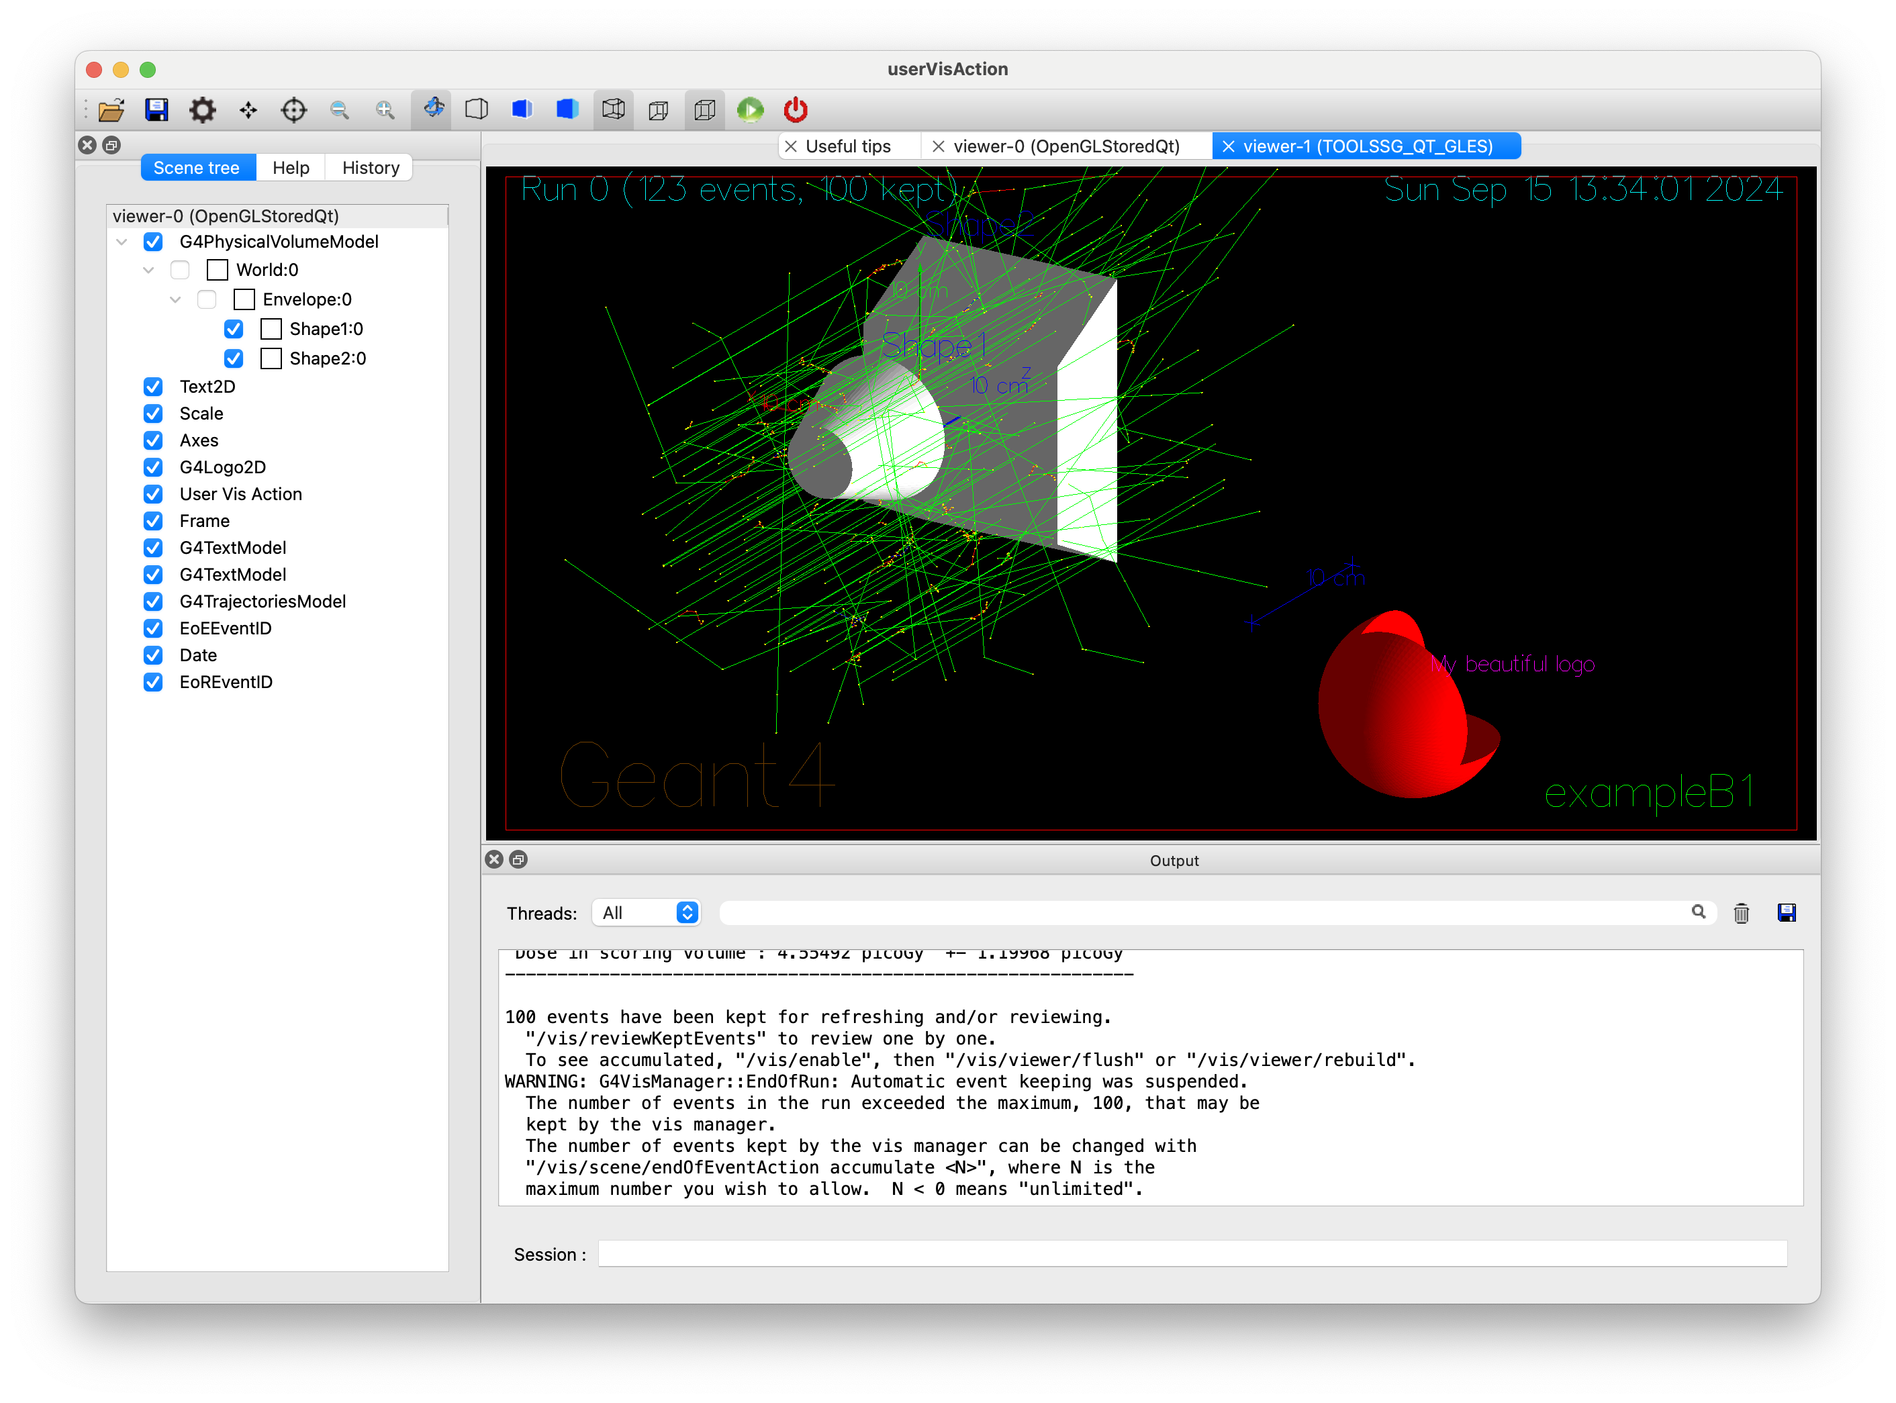
User vis actions (contd)
Each user vis action gets turned into a model
  Demo
User vis actions are better than using direct draw methods
  They are automatically re-drawn as required
    They can be refreshed
    Opened with any driver
      Including file writing drivers (to get a pdf, etc.)

Slide 6
User vis actions (contd)
DrawGeometry can be used in a vis action
  Do as much as you can in the constructor (once and for all)
Note: this is part of /examples/extended/visualization/
standalone
  See next slide
DrawGeometryVisAction::DrawGeometryVisAction()
{
// Get a physical volume from your detector construction
fDetectorConstruction = new B1::DetectorConstruction();
fPhysicalVolume = fDetectorConstruction->Construct();
// Give this an overall transform to avoid clash with other vis
// action(s) in this case
fTransform = G4Translate3D(-20 * cm, 20 * cm, 0);
G4PhysicalVolumeModel pvModel(fPhysicalVolume);
fExtent = pvModel.GetExtent();
fExtent.Transform(fTransform);
}
DrawGeometryVisAction::~DrawGeometryVisAction()
{delete fDetectorConstruction;}
void DrawGeometryVisAction::Draw()
{
G4VVisManager* pVisManager = G4VVisManager::GetConcreteInstance();
if (pVisManager) {
pVisManager->DrawGeometry(fPhysicalVolume, fTransform);
}
}

Slide 7
Standalone
For debugging geometry you can build an app without a run manager and all its required accompaniments (physics lists, etc.)
  Useful when run initialization (physics tables, etc.) takes a long time
  E.g., medical examples
  ICRP examples have a standalone version
int main(int argc, char** argv)
{
G4UIExecutive* ui = new G4UIExecutive(argc, argv);
G4VisManager* visManager = new G4VisExecutive;
visManager->Initialize();
auto standaloneVisAction = new StandaloneVisAction;
visManager->RegisterRunDurationUserVisAction
("A standalone example - 3 boxes, 2 with boolean subtracted cutout",
standaloneVisAction,
G4VisExtent(-10 * cm, 10 * cm, -10 * cm, 10 * cm, -10 * cm, 10 * cm));
auto geometryVisAction = new DrawGeometryVisAction;
visManager->RegisterRunDurationUserVisAction
("A detector geometry", geometryVisAction,
geometryVisAction->GetVisxtent());
G4UImanager::GetUIpointer()->ApplyCommand("/control/execute standalone.mac");
ui->SessionStart();
delete geometryVisAction;
delete standaloneVisAction;
delete visManager;
delete ui;
}

Slide 8
Trajectories
  Trajectories have a draw method, DrawTrajectory()
  The default implementation dispatches the
  trajectory to the vis manager so that it can
  use the provided modeling and filtering
  But, if you write your own trajectory class, you can override with your own version—see examples/extended/runAndEvent/RE01
  All the trajectories—simple, smooth, rich—provide G4Atts on request
    Some viewers use them to offer picking (doesn’t seem to be working in Qt6)
void G4VTrajectory::DrawTrajectory() const {
...
pVVisManager->DispatchToModel(*this);

Slide 9
Hits and digis
G4VHit::Draw() and G4VDigi::Draw()
  Empty default functions
    The user may provide in the concrete derived class
      The vis manager will draw on request
        /vis/scene/add hits
        /vis/scene/add/digis
  The user may also provide GetAttDefs() and CreateAttValues()

Slide 10
Thankyou

