Slide 1

UI and Visualisation
Updates and reports
G4 Workshop Catania 2024

Slide 2
Overview
Geant4 11.3 adapted to Qt6
  Qt6 will power our “flagship” GUI
    Qt5 is still functional
  Development by Guy Barrand—see Guy’s report
Vtk comes of age
  Development by Stewart Boogert – see Stewart’s report
Some consolidated features
  A review—this report
  The future – a discussion

Slide 3
Contributors
Main contributors listed (with approximate start year)—but there is much cross-fertilization, including from the Geometry Category
UI systems
  Core framework: Hajime Yoshida, Koichi Murakami, and Guy Barrand (1998)
  Xm GUI: Guy Barrand (1998)
  Qt GUI: Laurent Garnier (2007), Guy Barrand (2007) and John Allison (2023)
  Win32 GUI: O. Pena-Rodrigue and Gabriele Cosmo (2021)
Graphics Reps (low-level library of graphics primitives, etc)
  Core primitives and vis manager virtual interface: John Allison (1994)
  Polyhedron and Boolean processors: Evgueni Tchernaev (1998)
Modeling
  Core models: John Allison (1994)
  Trajectory models and filters: Jane Tinslay (2005)
Graphics
  Core vis manager: John Allison (1994)
  OpenGL drivers
    Core scene handling: Andy Walkden and John Allison (1996)
    Qt extension: Laurent Garnier (2007)
  Open Inventor drivers: Joe Boudreau (1996), Guy Barrand (2004), Fred Jones (2012)
  Ray Tracer: Makoto Asai (2000)
  DAWN and VRML: Satoshi Tanaka (1996)
  HepRepFile: Joseph Perl (2001)
  Vtk drivers: Stewart Boogert (2021)
  ToolsSG drivers: Guy Barrand (2021)
  ASCII Tree: John Allison (2001)
  Others…

Slide 4
Available User Interfaces and Graphics Drivers
User Interfaces
  Plain terminal
    csh & tcsh
  Graphical
    Xm (motif)
      In-window graphics, interactive help, and output
    Win32 (Windows)
      As above
    Qt (cross-platform UI system)
      As above, plus an interactive scene tree
        Select visibility and colour of geometry objects…and more (described later)
Graphics Drivers
  Graphical
    OpenGL (some advanced features, also export)
    OpenInventor (some advanced features, VRLM export)
    ToolsSG (GLES/Qt/ZB, export and plotting)
    Qt3D (prototype)
    Vtk (many interactive options and export formats)
    RayTracerX (export jpeg)
    …
  File-writing (always registered):
    DAWNFILE (browse with DAWN)
    HepRepFile (browse with HepRApp)
    VRML2FILE (browse with any web browser)
    RayTracer (export jpeg)
    ToolsSGOffscreen (numerous picture formats)
  Diagnostic (always registered):
    ASCIITree (always registered, dumps to G4cout)

Slide 5
Installing libraries
Installing X11
  MacOS: Xquartz
  Linux: native
  Windows: X11 not available, but special drivers use the native windowing system.
Installing Qt
  MacOS: brew install qt
    For Qt5: brew unlink qt (to avoid linking to Qt6)
  Linux: apt install qtbase5-dev
  Windows: Binaries from Qt web site (qt.io)
Installing Vtk
  MacOS: brew install vtk
  Linux: apt
  Windows: conda?
Installing Coin3D (Open Inventor)
  Coind3D (Open Inventor): See https://www.coin3d.org

Slide 6
UI and vis build options
From the Installation Guide, Build Options:
  GEANT4_USE_INVENTOR (DEFAULT : OFF)
  GEANT4_USE_INVENTOR_QT (DEFAULT : OFF)
  GEANT4_USE_OPENGL_WIN32 (DEFAULT : OFF, Windows Only)
  GEANT4_USE_OPENGL_X11 (DEFAULT : OFF, Unix Only)
  GEANT4_USE_QT (DEFAULT : OFF)
  GEANT4_USE_QT_QT6 (DEFAULT : OFF)
  GEANT4_USE_RAYTRACER_X11 (DEFAULT : OFF, Unix only)
  GEANT4_USE_VTK (DEFAULT : OFF)
  GEANT4_USE_XM (DEFAULT : OFF, Unix Only)
Set required options ON, e.g:
  GEANT4_USE_QT=ON
Don’t mix X11 and Qt (unless you know what you’re doing!!)
GEANT4_USE_QT brings in:
  OpenGLQt
  ToolsSGQt
  Qt3D (under development)
My cmake – suppress messages:
---------
cmake -Wno-dev --log-level=ERROR \
-DCMAKE_INSTALL_PREFIX=`pwd` \
-DGEANT4_USE_GDML=ON \
-DGEANT4_USE_QT=ON \
-DGEANT4_USE_QT_QT6=ON \
-DCMAKE_PREFIX_PATH=\
"$(brew --prefix qt@5)” \
-DGEANT4_ENABLE_TESTING=ON \
-DGEANT4_USE_FREETYPE=ON \
-G Xcode \
~/Geant4/geant4-dev

Slide 7



A minimal starter
int main(int argc,char** argv) {
auto ui = new G4UIExecutive(argc,argv);
auto runMan = G4RunManagerFactory::CreateRunManager();
runMan->SetUserInitialization(new DetectorConstruction);
auto physList = G4PhysListFactory().ReferencePhysList();
runMan->SetUserInitialization(physList);
runMan->SetUserInitialization(new ActionInitialization);
auto visMan = new G4VisExecutive;
visMan->Initialise();
auto UImanager = G4UImanager::GetUIpointer();
UImanager->ApplyCommand("/control/execute vis.mac");
ui->SessionStart();
delete ui;
delete visMan;
delete runMan;
}
A minimal main()
A simple vis.mac
And gps.mac
  Uses G4GeneralParticleSource—see next slide
vis.mac
-------
/control/verbose 2
/run/initialize
/vis/open
/vis/drawVolume
/vis/viewer/set/viewpointThetaPhi 110 170 deg
/vis/scene/add/axes
/vis/scene/add/trajectories
/vis/scene/endOfEventAction accumulate
/control/execute gps.mac
gps.mac
-------
/gps/particle proton
/gps/position 0 0 -20 cm
/gps/direction 0 0 1
/gps/energy 70 MeV

Slide 8


A PrimaryGeneratorAction
#ifndef PrimaryGeneratorAction_hh
#define PrimaryGeneratorAction_hh 1
#include "G4VUserPrimaryGeneratorAction.hh"
class G4GeneralParticleSource;
class PrimaryGeneratorAction :
public G4VUserPrimaryGeneratorAction {
public:
PrimaryGeneratorAction();
~PrimaryGeneratorAction();
void GeneratePrimaries(G4Event*);
private:
G4GeneralParticleSource* fpParticleGun;
};
#endif
Uses G4GeneralParticleSource
  Instantiated in PrimaryGeneratorAction
    Itself instantiated in ActionInitialization
#include "PrimaryGeneratorAction.hh"
#include "G4GeneralParticleSource.hh"
PrimaryGeneratorAction::PrimaryGeneratorAction()
{fpParticleGun = new G4GeneralParticleSource;}
PrimaryGeneratorAction::~PrimaryGeneratorAction()
{delete fpParticleGun;}
void PrimaryGeneratorAction::GeneratePrimaries(G4Event* anEvent)
{fpParticleGun->GeneratePrimaryVertex(anEvent);}

Slide 9

How to choose your UI and Vis driver at run time
If you do nothing before start-up, the “best” UI and vis are chosen according to your original build flags
Choosing with environment variables
  UI: G4UI_USE_TCSH=1, G4UI_USE_WIN32=1,
  G4UI_USE_XM=1, or G4UI_USE_QT=1
  Vis: G4VIS_DEFAULT_DRIVER=TSG (or any from the list of
  registered drivers)
Using ~/.g4session
  This is a dot (.) file you keep in your home directory (~/)
  The format is:
    First line: chosen default UI session: Qt, Xm, Win32, tcsh or csh
    Subsequent lines: <app> <session> [<vis>] [<window-size>]
Note: Environment takes precedence.
After all the above you can still change driver with /vis/open [driver]
Qt # Default session
#exampleB1 tcsh
#exampleB1 Qt TSG 1000x1000+0-0
#exampleB1 Qt Qt3D
#exampleB2a tcsh
exampleB2b Qt Qt3D
#exampleB2b tcsh
#exampleB3 tcsh
#mvexampleB4a Xm
exampleB5 Qt TSG
#test202 tcsh
#test202 Qt Vtk
#userVisAction tcsh

Slide 10
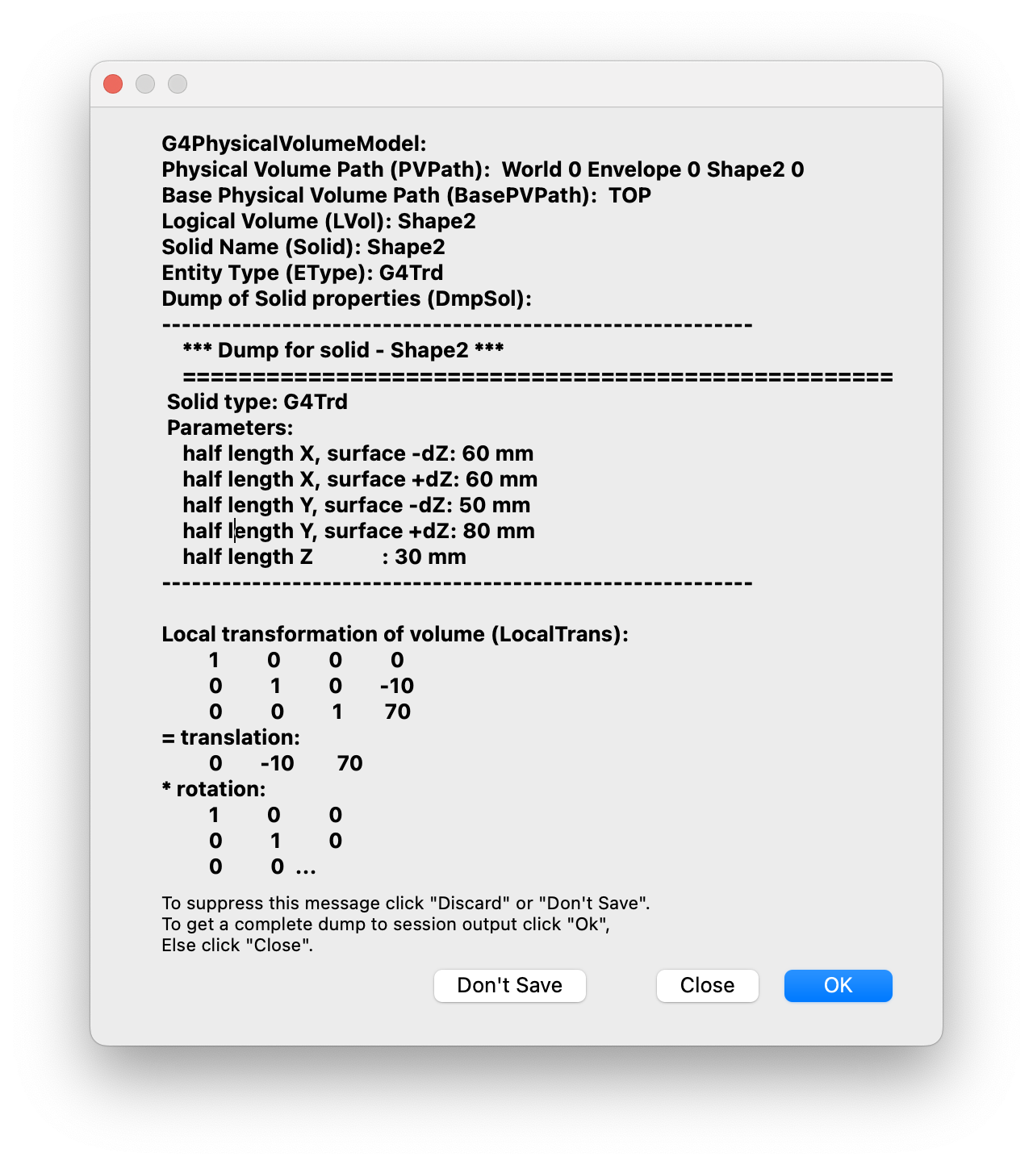
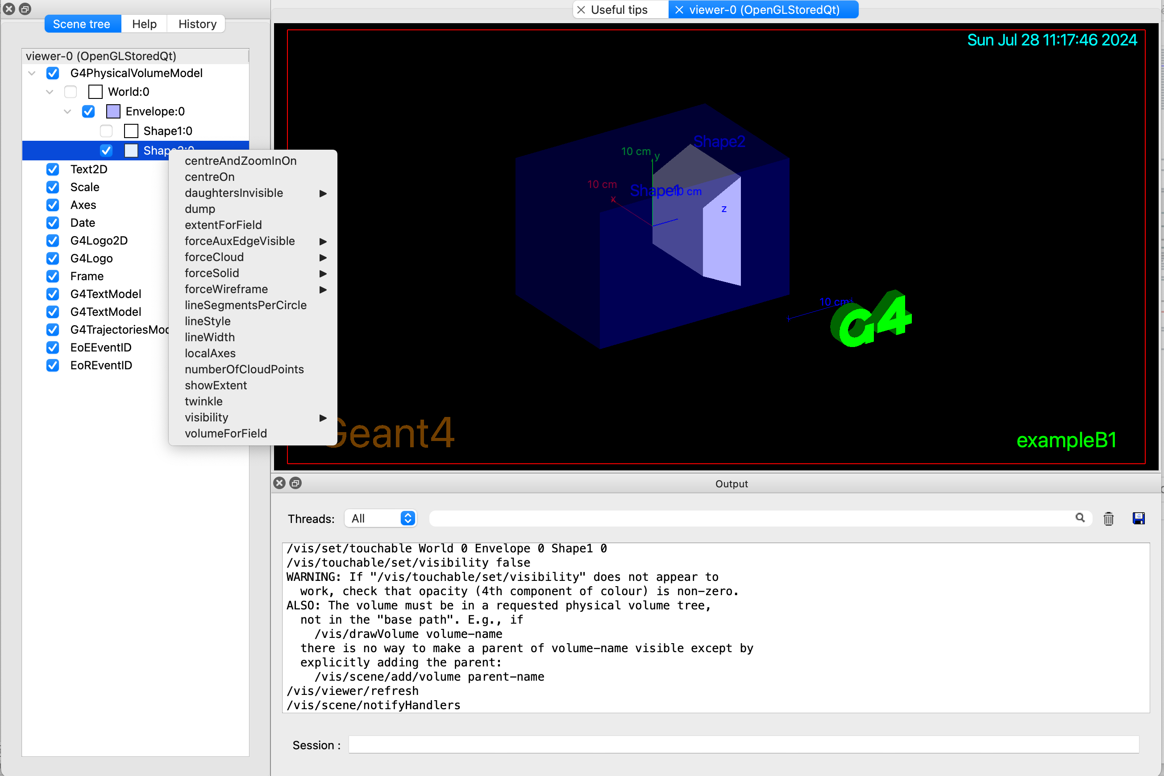
The Qt GUI
Scene tree
  Click to make
  (in)visible, or
  change colour
  Right-click to get
  other actions (see
  video
  “Scene tree
  centreAndZoomInOn.mov”)

Slide 11
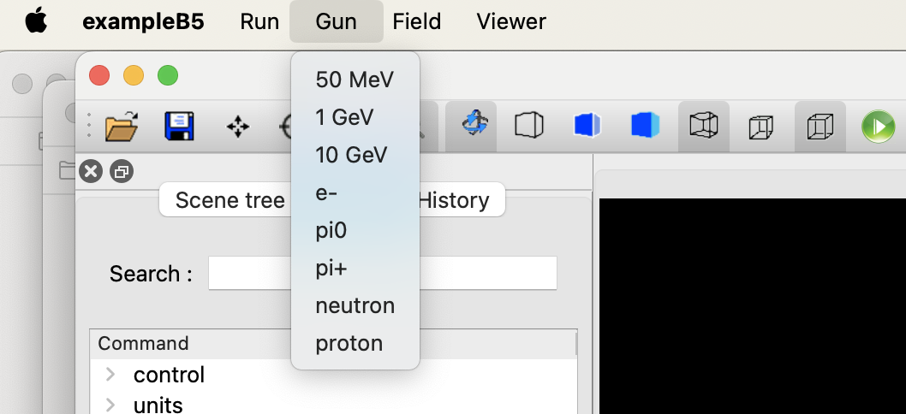
Adding your own action buttons or icons
The Qt GUI has several built-in buttons
  You can remove, then add back what you want
    /gui/defaultIcons false
    /gui/addIcon "Move" move
    See examples/basic/B5/icons.mac
You can add your own gui.mac
(applies also to the the Xm GUI)
  See basic examples B2, B4 and B5
UImanager->ApplyCommand("/control/execute init_vis.mac");
if (ui->IsGUI()) {
UImanager->ApplyCommand("/control/execute gui.mac");
}
/gui/addMenu gun Gun
/gui/addButton gun "50 MeV" "/gun/energy 50 MeV"
/gui/addButton gun "1 GeV" "/gun/energy 1 GeV"
/gui/addButton gun "10 GeV" "/gun/energy 10 GeV"

Slide 12
Command-based visualization—basics
Simple graded message scheme - digit or string (1st character defines):
0) quiet, // Nothing is printed.
1) startup, // Startup and endup messages are printed...
2) errors, // ...and errors...
3) warnings, // ...and warnings...
4) confirmations, // ...and confirming messages...
5) parameters, // ...and parameters of scenes and views...
6) all // ...and everything available.
To echo commands: /control/verbose 2
Adjust verbosity:
/vis/verbose [verbosity]
    E.g., /vis/verbose confirmations
/vis/disable
  Good to turn off trajectory storing as well: /tracking/storeTrajectory 0
Useful commands: /vis/list, /vis/viewer/list, /vis/scene/list
/vis/open [<driver>]
  There is a default driver (OGL at present)
    The default can be changed by environment or ~/.g4session
  /vis/open is actually /vis/sceneHandler/create + /vis/viewer/create
  You can open multiple drivers of the same or different type, and multiple viewers of each driver
/vis/drawVolume [<physical-volume-name>]
  Actually /vis/scene/create + /vis/scene/add/volume + /vis/sceneHandler/attach
/vis/scene/add/trajectories [rich] [smooth]
  Adjust presentation with /vis/modeling/…, selection with /vis/filtering/
/vis/scene/add/axes, et (see examples/basic/B1/vis.mac)

Slide 13
Scene editing
Adding specific volumes (the extents are accumulated so always seen in standard view)
    /vis/scene/create
    /vis/scene/add/volume A
    /vis/scene/add/volume B
    …
    /vis/sceneHandler/attach
Adding trajectories (also hits or digis, if Draw methods implemented)
  /vis/scene/add/trajectories [rich] [smooth]
Event display and keeping behaviour (similarly for run)
  /vis/scene/endOfEventAction <refresh|accumulate> [number-of-events-to-be-kept]
Activate and de-activate models with /vis/scene/activateModel

Slide 14
Scene editing (contd)
Changing a vis attribute with /vis/geometry
  E.g., /vis/geometry/set/colour <logical-vol-name> <colour>
  Changes the vis attributes in the actual logical volume
    So changes them for all touchables that have that logical volume
  Restore original vis attributes with /vis/geometry/restore
To change the vis attributes of a specific touchable, use /vis/set/touchable and /vis/touchable/set
— see later: View Control

Slide 15
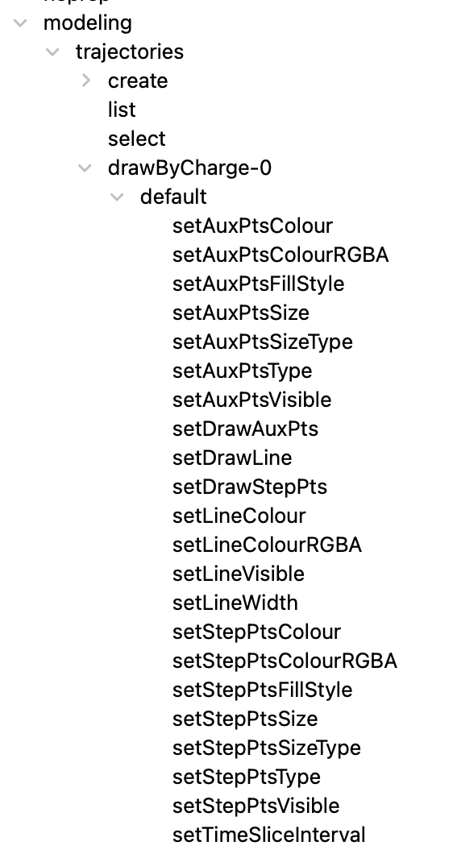
Trajectory modeling
Models and filters come with a fertile and versatile set of commands
  Well documented for models and filters, but in-app guidance somewhat cryptic
Creating a model creates its specific commands
  E.g., /vis/modeling/trajectories/drawByCharge-0/set 0 pink
  The commands are created “on the fly” for each model or filter
Also, every model has a set of “defaults”
  This creates a corresponding set of commands for customisation
    Use help and guidance to see them
    Of particular interest is setTimeSliceInterval
      Needs rich trajectories
/vis/scene/add/trajectories rich
/vis/modeling/trajectories/drawByCharge-0/default/setTimeSliceInterval 0.01 ns

Slide 16
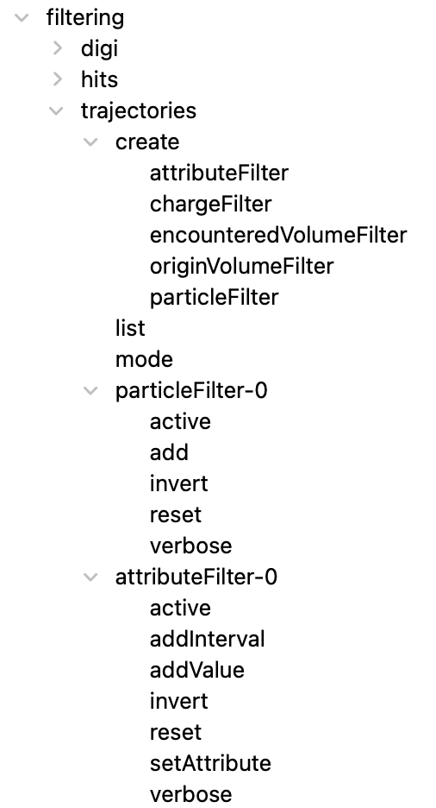
Trajectory filtering
Similarly, create a filter
Or its inverse
Filters can be chained
# To draw only gammas:
/vis/filtering/trajectories/create/particleFilter
/vis/filtering/trajectories/particleFilter-0/add gamma
# To draw all except gammas
/vis/filtering/trajectories/particleFilter-0/invert true

Slide 17
Event keeping
By default, the vis manager keeps 100 events
  The default can be changed with /vis/scene/endOfEventAction
  They can be viewed at end of run
    One by one: /vis/reviewKeptEvents
If you want to keep your own events
  For example, select a rare event in
  end-of-event action
  /vis/drawOnlyToBeKeptEvents
    This turns off event keeping by the vis manager
      You can do this manually with /vis/scene/endOfEventAction accumulate 0
Actually, the events are kept by the run manager
  They are deleted at the start of the next run
auto evMan = G4EventManager::GetEventManager();
if (<selection-success>) {
evMan->KeepTheCurrentEvent();
}

Slide 18
Saving, replaying and interpolating views
/vis/viewer/save [filename.g4view]
  By default, saves to g4_00.g4view, g4_01.g4view,…
Then, to get the view again
  /control/execute g4_00.g4view
Or interpolate to get an animation
  /vis/viewer/interpolate
  Can be used to file and make a movie
This extends to time-slicing—next slide…

Slide 19
Time-slicing
See examples/extended/visualization/movies
/vis/scene/add/trajectories rich
/vis/modeling/trajectories/drawByCharge-0/default/setTimeSliceInterval 0.01 ns
# Optionally add features (see guidance on /vis/viewer/set/timeWindow/)
/vis/viewer/set/timeWindow/displayLightFront true 0 0 -20 cm -0.01 ns
/vis/viewer/set/timeWindow/displayHeadTime true
/vis/viewer/set/timeWindow/fadeFactor 1
/run/beamOn
# Then set a time window and save
/vis/viewer/set/timeWindow/startTime 0 ns .1 ns
/vis/viewer/save
# Then zoom, pan etc to a view of interest
# Then set the next time window and save
/vis/viewer/set/timeWindow/startTime .5 ns .1 ns
/vis/viewer/save
# Then zoom, pan etc to a view of interest
# Then set the next time window and save
/vis/viewer/set/timeWindow/startTime 1 ns .1 ns
/vis/viewer/save
# Then another view, the next time window, and a save...
# ...repeat a few more times
# Then try
/vis/viewer/interpolate

Slide 20
Making movies
On MacOS, Quicktime has a “Screen recording” feature
  Just run your app
    To record sound: on the small control panel: Options/Microphone and select
    To stop recording, there’s a button on the top bar
Alternatively, export images (OpenGL only, I think)
  /vis/viewer/interpolate ! ! ! ! export
    This produces lots of files
  You can change export format with (for example)
    /vis/ogl/set/exportFormat jpg
  Then import them into your favourite movie maker – see Making a movie

Slide 21
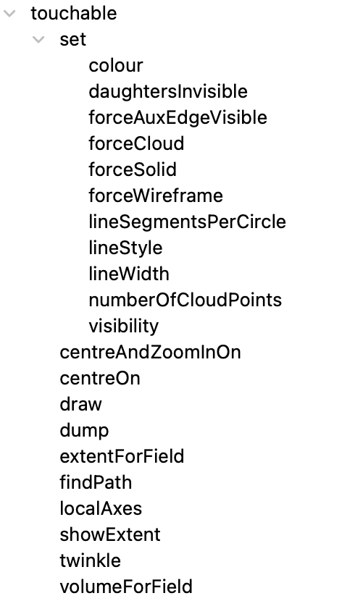
Touchables
Touchables are the leaves of the geometry hierarchy tree
To print the tree: /vis/drawTree
  Various verbosity options: /vis/ASCIITree/verbose
To find the path to a touchable
  /vis/touchable/findPath <physical-vol-name>
Then, with information supplied, /vis/set/touchable
Then /vis/touchable/set/colour (other options!!)
Also /vis/touchable/twinkle (and other options!!)
This is all achieved using Vis Attribute Modifiers (VAMs)
  VAMs belong to the viewer, and may be copied with
  /vis/viewer/clone or /vis/open + /vis/viewer/copyViewFrom
    So they can be different for different views of the same scene

Slide 22
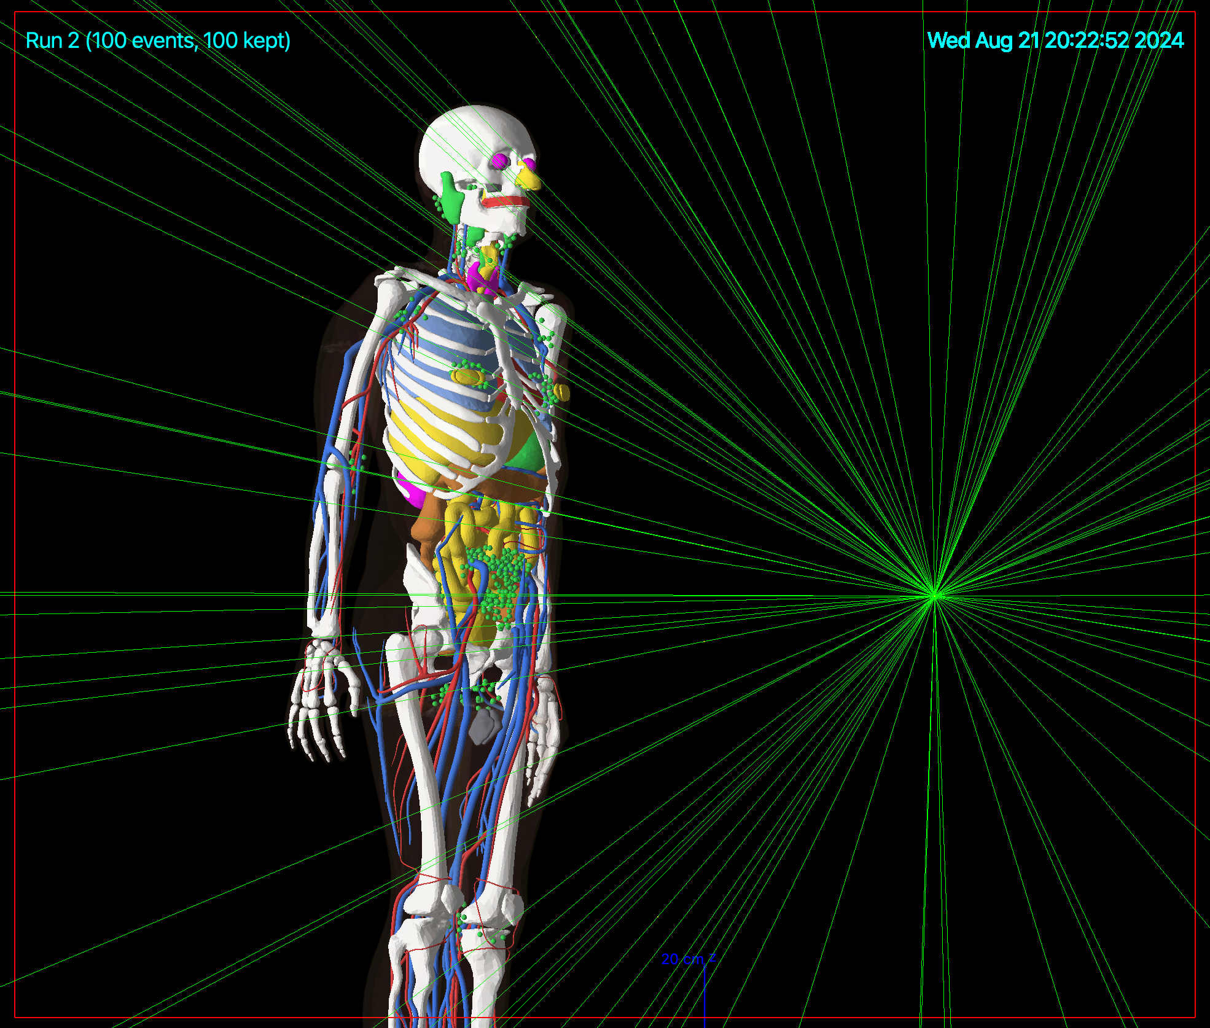
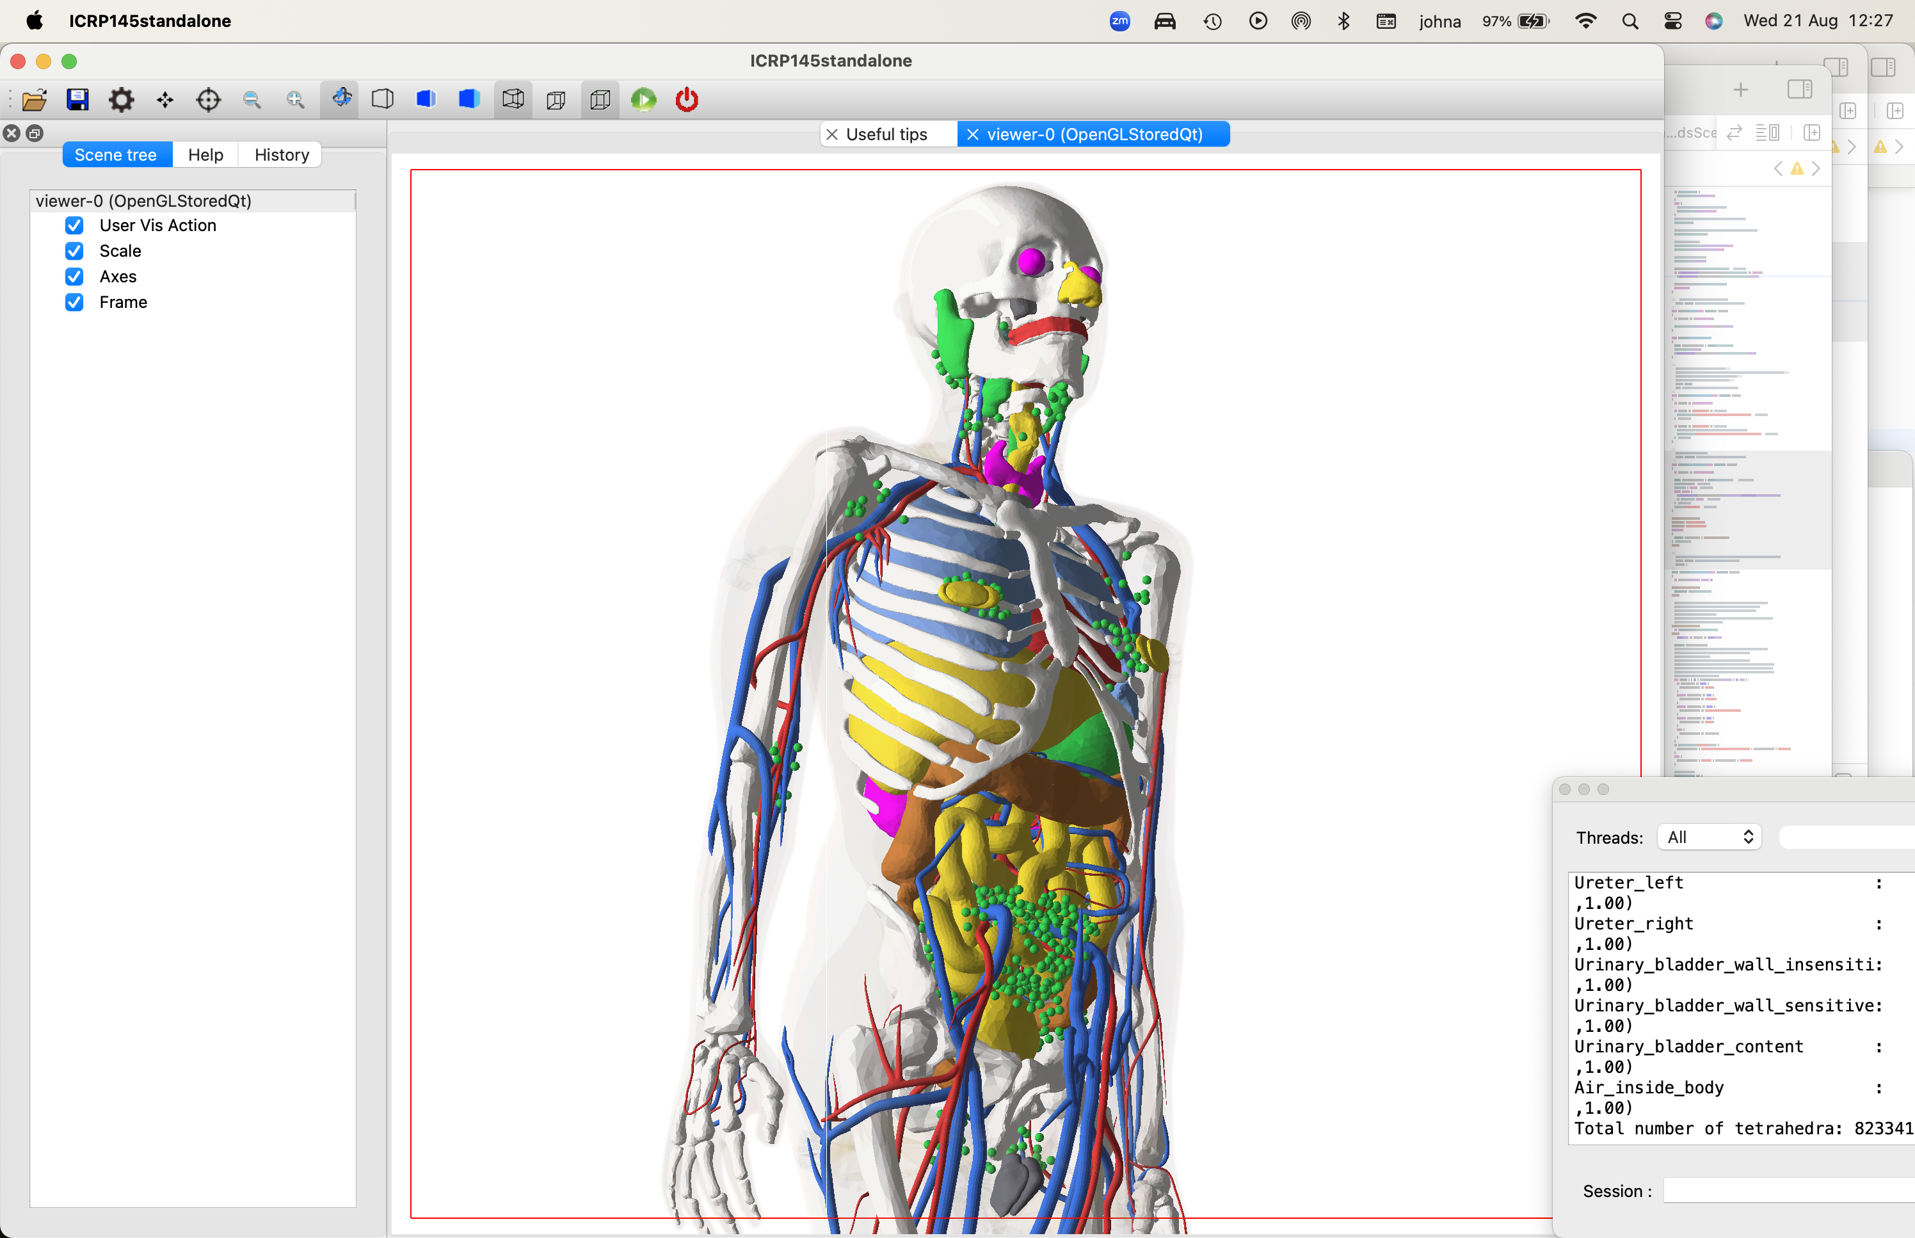
Meshes (G4VNestedParameterisation)
Typically used for representing regions of variable
material
  E.g., human phantom,
  examples/advanced/
  ICRP145_HumanPhantoms
Only rectangular and
tetrahedral at present
  Clever algorithm to eliminate
  shared surfaces (E. Tcherniaev)
Dots or surfaces
representation
# Draw geometry:
/vis/viewer/set/specialMeshRendering
/vis/viewer/set/specialMeshRenderingOption surfaces
/vis/drawVolume

Slide 23
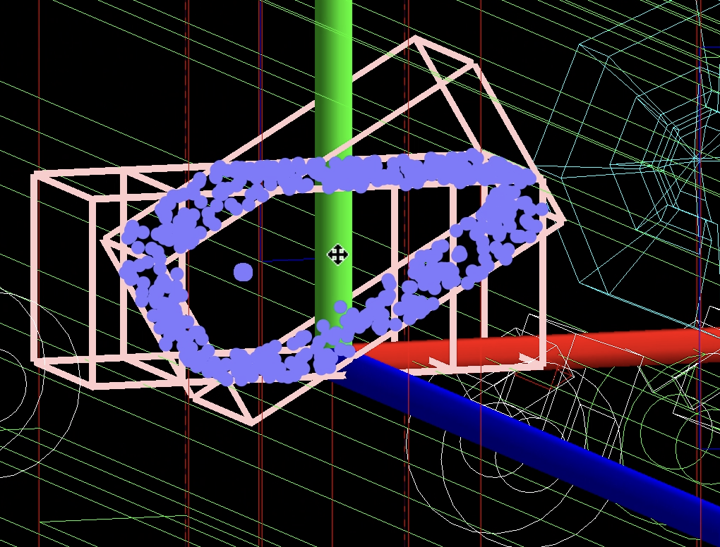
Geometry overlaps and other useful things
/vis/drawLogicalVolume <log-vol-name>
  Boolean components
  Geometry voxels
  Local axes
  Geometry overlaps
  Demo
Command /vis/drawLogicalVolume
Guidance :
Draws logical volume with additional components.
Synonymous with "/vis/specify".
Creates a scene consisting of this logical volume and asks the
current viewer to draw it. The scene becomes current.
Adds a logical volume to the current scene,
Shows boolean components (if any), voxels (if any), readout geometry
(if any), local axes and overlaps (if any), under control of the
appropriate flag.
Note: voxels are not constructed until start of run -
"/run/beamOn". (For voxels without a run, "/run/beamOn 0".)

Slide 24
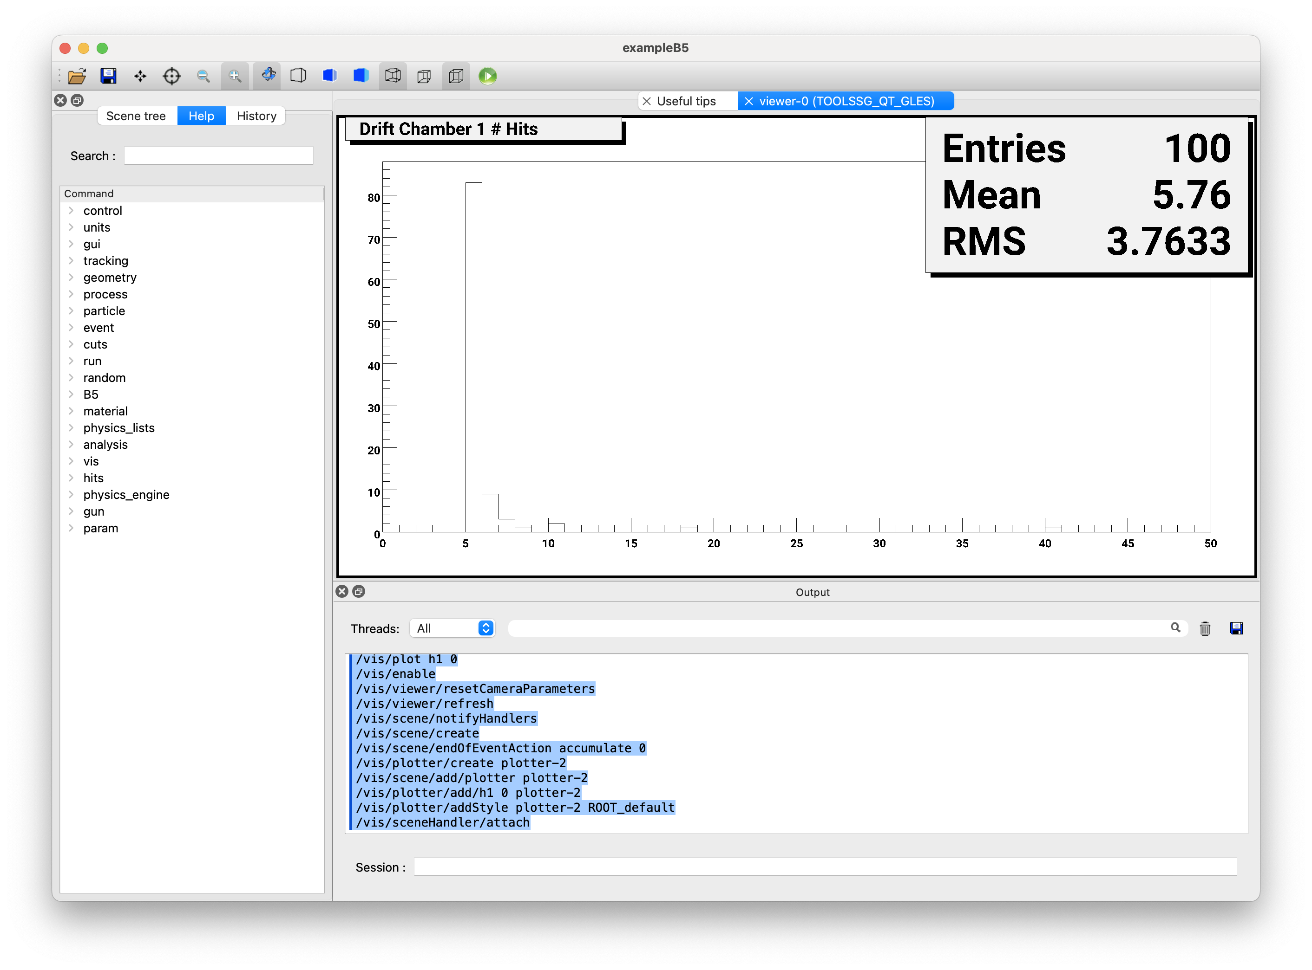
Plotting
100 events have been kept for refreshing and/or reviewing.
"/vis/reviewKeptEvents" to review one by one.
To see accumulated, "/vis/enable", then
"/vis/viewer/flush" or "/vis/viewer/rebuild".
There are histograms that can be viewed with visualization:
2 h1 histograms(s)
2 h2 histograms(s)
List them with "/analysis/list".
View them immediately with "/vis/plot" or "/vis/reviewPlots".
If you have histograms registered with the Analysis Manager you can plot them at end of run
  Only simple 1D and 2D with boxes for now
At the end of run, the run manager prints
Only with ToolsSG (TSG) viewer
  For best results, build with GEANT4_USE_FREETYPE=ON
    Choice of styles – see guidance
    From Geant4 11.3 (December 2024)
Try basic example B5
  /run/beam 100
  /vis/plot h1 0

Slide 25
User drawing (from C++ code)
The Draw methods of the vis manager
  Restrictions and limitations
User vis actions
  Treated like a model—refreshed as required
Draw method of trajectories
Draw methods of hits and digis
See separate presentation

Slide 26
The future
“Prediction is difficult, especially of the future”—unattributed quote!
The Qt GUI will continue to be our “flagship” UI
So far, OpenGL has been our “flagship” graphics driver
  Some features, notably time-slicing (drawing by time), is available only with OpenGL
    Time slicing uses display lists, an OpenGL-1 deprecated feature
  Cutting is somewhat crude (uses clipping planes)
ToolsSG parallels OpenGL in almost all respects
  Quite light and zippy
  As well as OpenGL-ES, it has a ZB driver (with its own z-buffer), including offscreen
    Memory-based (non-GPU), thus cannot compete for performance, but OK
    Requires only the ability to draw or dump a pixel map
  Has plotting
Vtk: now fully released, and being used
  Very high performance
  Interfaces to ParaView (and FreeCAD?)
  Nice cutters and slicers
  Needs manpower to develop into a truly useful driver
  Can it do zoom-in-on and twinkling?
  Can it do time-slicing?
These—and other—drivers will continue to be offered as a choice for users

Slide 27
Discussion
OpenGL
  OpenGL-1 will probably be continued to be supported because of a huge amount of legacy code, including ours
  So I recommend continuing our OpenGL drivers
    To keep the very nice features, such as time-slicing
ToolsSG
  Parallels OpenGL in almost all respects
  Needs no installation (all platforms have OpenGL support)
  Offer off-screen rendering
  Let’s continue to invest in it
Vtk
  Has some really nice features
    Excellent performace
    Clipping and cutting
    Export to ParaView and other nice applications
  At present, Vtk in Geant4 appears to be somewhat specialist. So my question is: how much do we push it as a vis tool? There is an overhead, of course, namely the installation of Vtk libraries, followed by a rebuild of Geant4. On Mac, at least, that is simple and in my experience error free.
  Let’s continue to invest in it
Open Inventor
  Again, somewhat specialist
  Not so easy to install
  But worth continuing
Fukui renderer/DAWN/DAVID
  Still works
VRML
  Still works
HepRep
  Still works
  But the browser, HepRApp, is no longer supported and works only on an old Java version
  Deprecate?
Qt3D
  Deprecated by Qt, so we should do the same
RayTracer
  Essential, but needs support
gMocren
  Not supported
  Deprecate?

Slide 28
Thankyou

