Slide 1
Changing anti-phishing threshold protection for the IT dept for testing
Roman Sumailov
ASDF 17.10.2024

Slide 2
Changing phishing threshold for Exchange Online
From 1 (default) to 2 (aggressive)
Recommendation of the 2023 Cyber-Security Audit (R-21.6)
In total 4 levels:
Standard
Aggressive
More aggressive
Most aggressive

Slide 3
Impact: Probably none
Please report to the Computer Security Team increased false positives rate
MS internal phishing levels according to threshold docs | Distinguishable phishing levels in MS Defender and email headers
Low Medium High Very high | Normal High - We quarantine these emails
Currently - high-level confidence (right column) phishing emails are quarantined
Change will make the system treat high-level confidence phishing emails as if they were very high confidence level (left column)
Unclear if there are additional differences for “very high confidence phishing” - Support ticket with Microsoft open for clarification
Probably high level phish emails will continue being quarantined as they do now
Probably it will not increase emails quarantine rate
Docs link - https://learn.microsoft.com/en-us/defender-office-365/anti-phishing-policies-about#advanced-phishing-thresholds-in-anti-phishing-policies-in-microsoft-defender-for-office-365

Slide 4

MS support on Anti-phishing threshold levels
Roman
MS
…MS

Slide 5

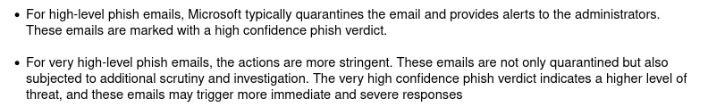
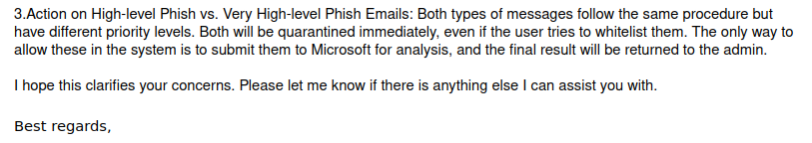
MS support on Anti-phishing threshold levels
(contd.)
Roman
MS
Roman
MS

Slide 6
Enabling impersonation protection for the IT dept for testing
Roman Sumailov
ASDF 17.10.2024

Slide 7
Enabling impersonation protection
Recommendation of the 2023 Cyber-Security Audit (R-21.6)
Microsoft feature for protecting VIP accounts from being impersonated
Based on display name + email address
Max 350 email addresses can be protected per organisation
Functionality description:
Malicious actor sends email with display name “Roman Sumailov” from “roman.sumailov@hotmail.com” to any of you & asks for money/nudes
This gets detected & blocked
Nuances:
MS has safeguards to avoid blocking emails for simply similar/overlapping names
Impersonated emails moved to Junk folder
Docs link - https://learn.microsoft.com/en-us/defender-office-365/anti-phishing-policies-about#user-impersonation-protection

Slide 8
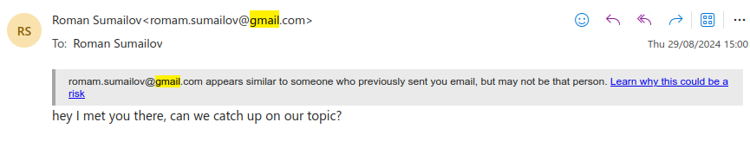
Impersonation protection (2) Tips
First contact, impersonation & unusual character tips are enabled

Slide 9
Impersonation protection for domain
Analogous workflow for domain as for users
Enabled for CERN domains: cern.ch, alumni.cern, mail.cern.ch etc
Please report to the Computer Security Team any false positives

Slide 10
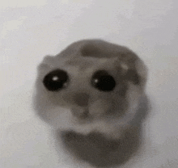
Questions?
pls no hard questions

