Slide 1
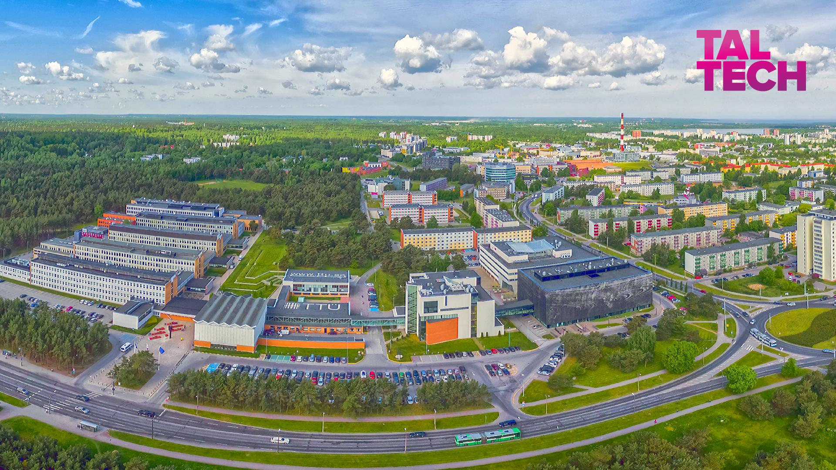


Slide 2
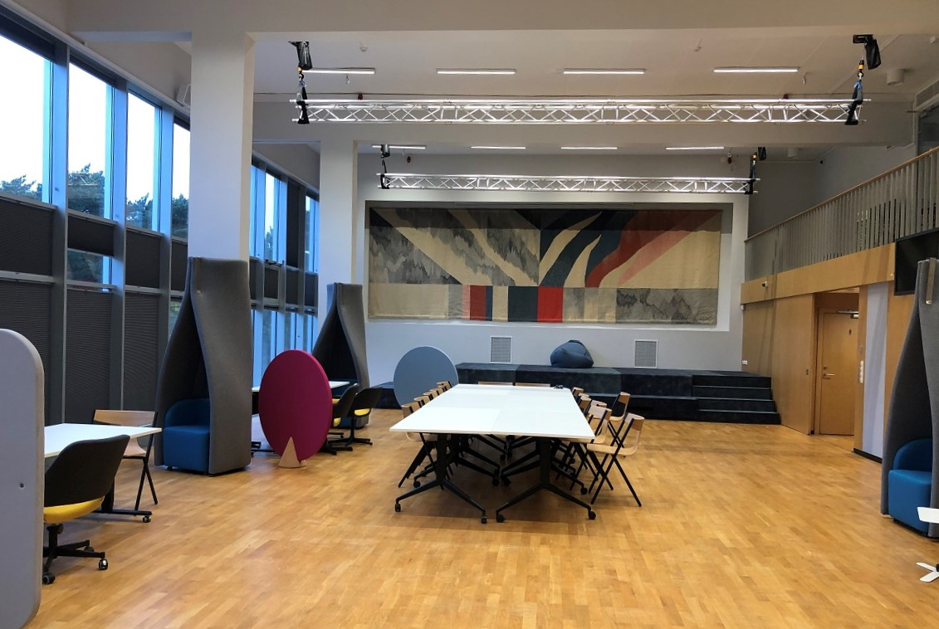
Location:
Taltech campus, Student House
41+7 participants
2 full days + 1 half day
1 keynote
30 presentations + 3 posters
5 welcome addresses

Slide 3
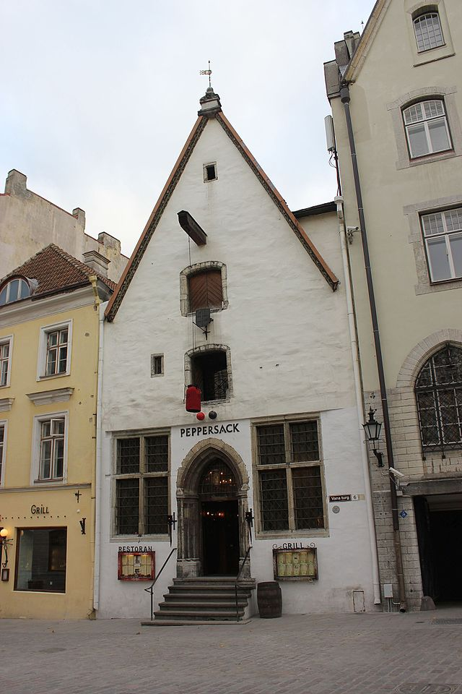
Premises | € 2,598.60
3x40 Coffee + 1x60 Networking | € 1,343.00
Networking II | € 123.20
1x40 +extra, dinner | € 1,360.00
 | € 5,424.80
Participant fees | € 2,050.00
Covered by Taltech, KbFI, TU | € 3,374.80

