Slide 1
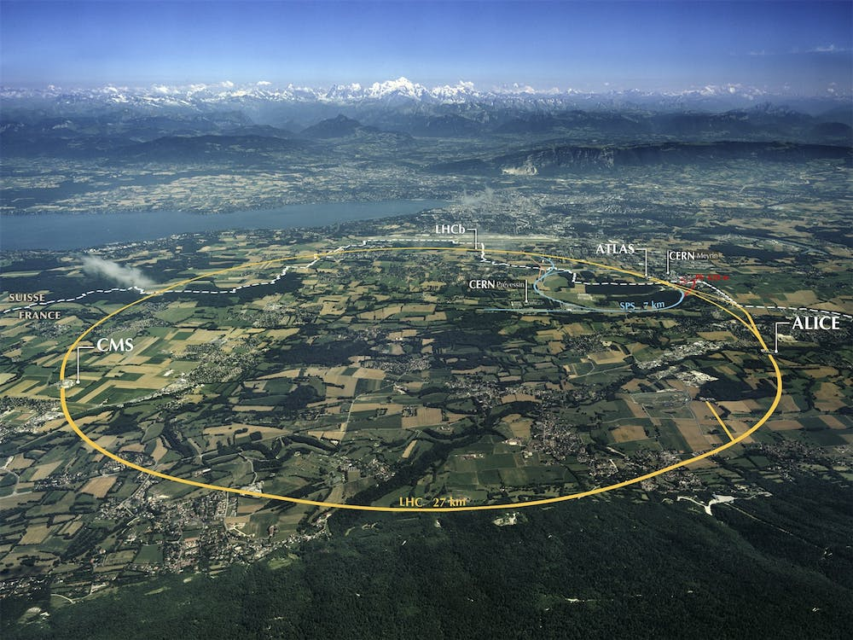
Baltic ILO activities and industrial engagement
14th CERN Baltic Group General Meeting
18/ 10/ 2024

Slide 2
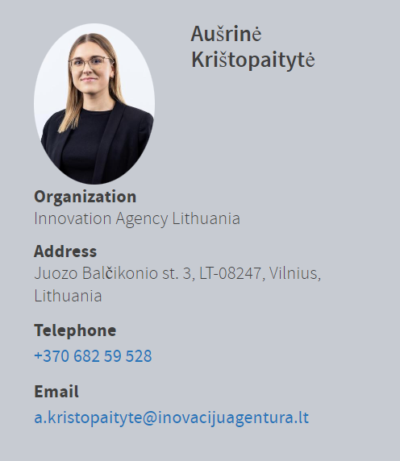
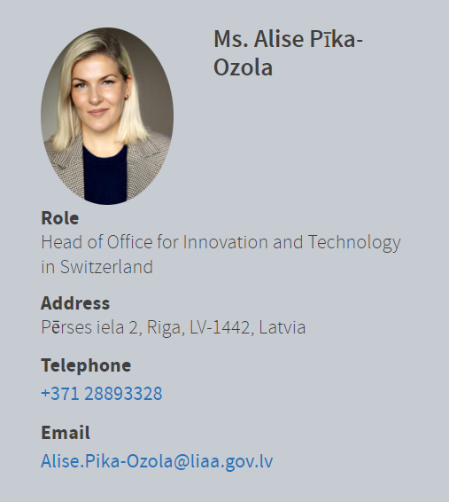
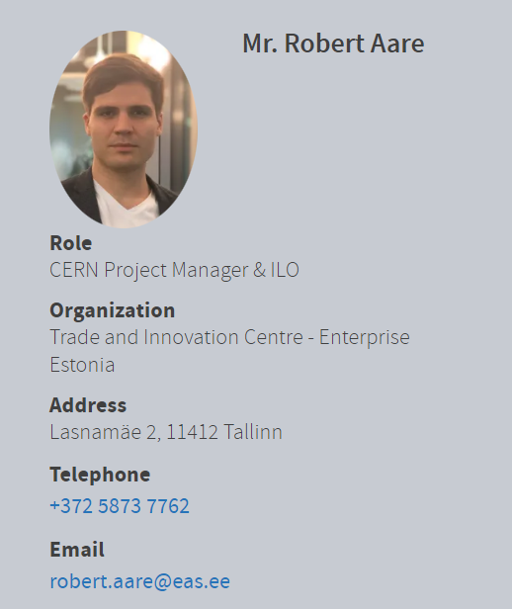
Baltic ILOs: Industry Liaison Officers – team complete
Lithuania
Latvia
Estonia

Slide 3
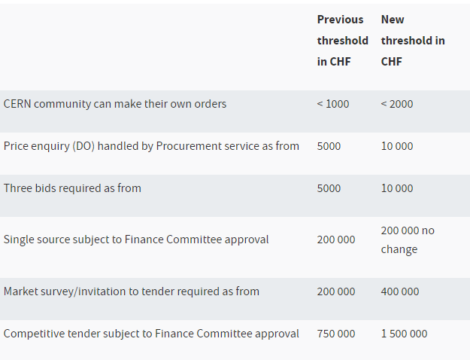
New procurement rules in place
The CERN Council unanimously approved changes to the Procurement Rules in June.
Prices in Switzerland have increased fivefold since 1965, yet that was the last time procurement thresholds were set by CERN’s Finance Committee. CERN’s thresholds were much lower than in any other organisation.
New rules optimise CERN’s resources, reduces paperwork and increases flexibility across CERN and for our suppliers.
Widened use of limited tendering, now will consider supplies and services from firms originating in the 12 Member States with the lowest industrial return coefficient (list reviewed annually).
The Finance Committee no longer needs to approve in advance whether a contract will be awarded on a lowest-compliant basis or on a best-value-for-money (BVFM) basis. This saves time, encourages competition and enables environmental aspects to be part of the adjudication criteria.
New thresholds

Slide 4
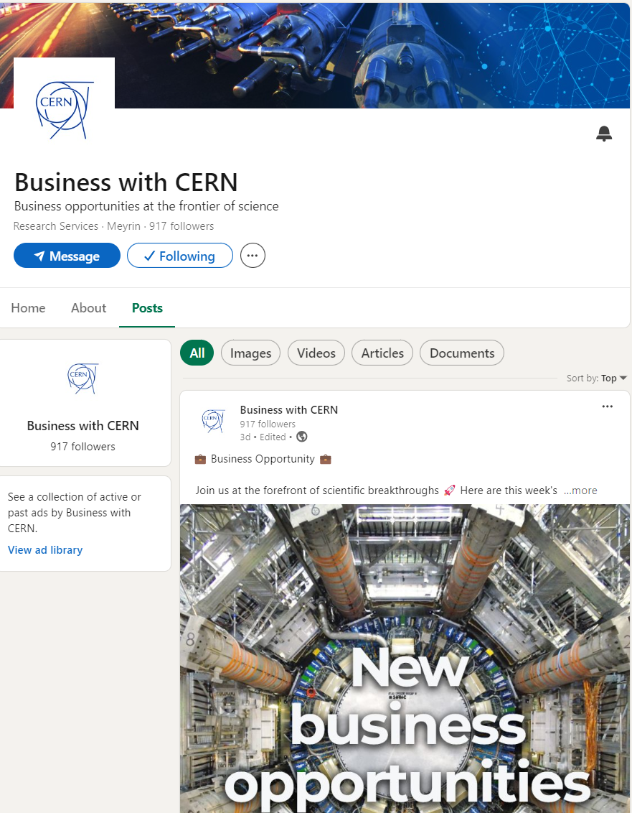
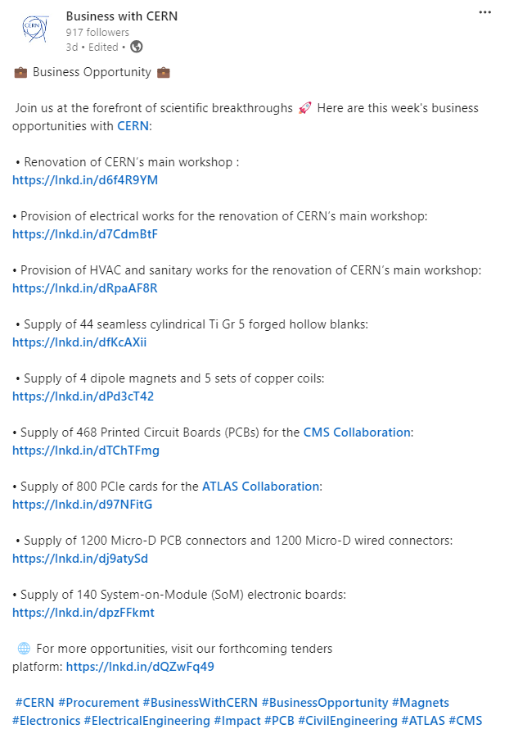
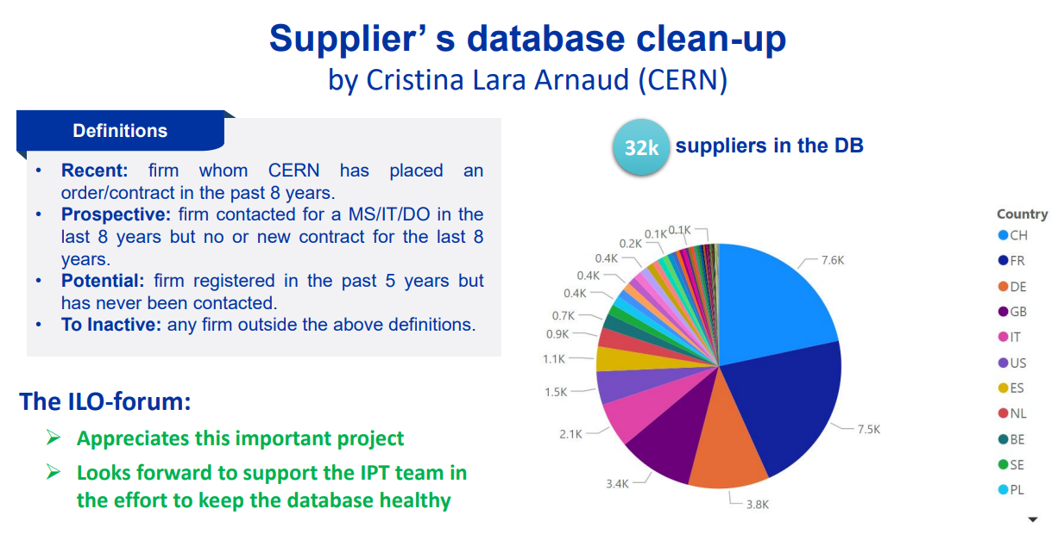
CERN’s outreach to companies
Webinar on 18th September was a success – 500 registrations from companies
Next Thematic Event - Precision Machining - 22nd November 2024 (Minimum 2 industry webinar events held/year)
CERN business opportunities now on Linked IN (Objective to obtain 2000 followers on LinkedIn by end of 2025)
Supplier database clean up (Decrease by 20% the number of no responses following a tendering procedure by end of 2028 )
New procurment strategy to be drafted for 2025-2030 (Formalise a strategy for M/L term and ndevelop KPIs to assess progresss, draft a set of key policies to support strategy)

Slide 5
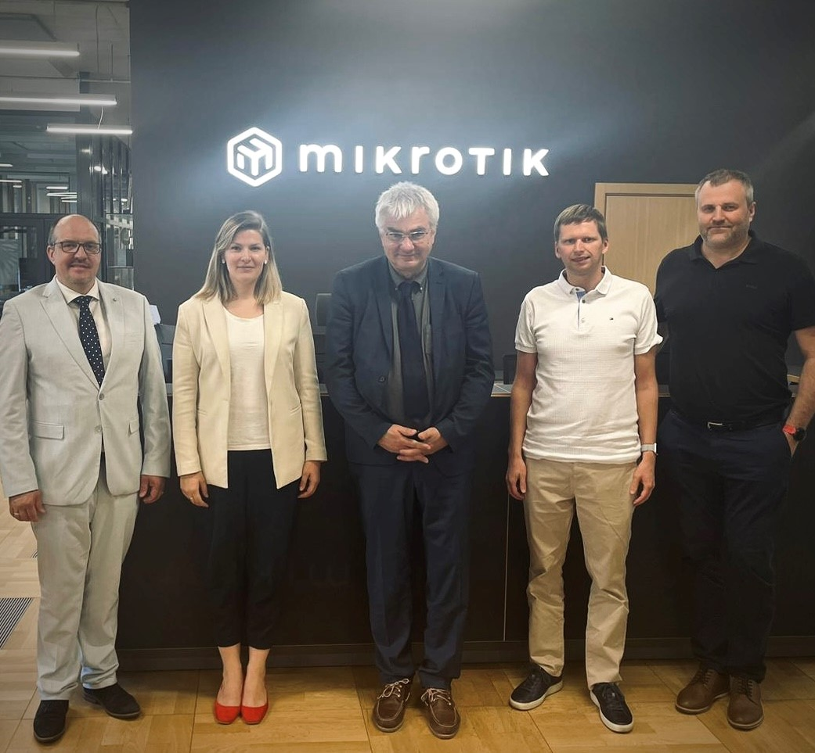
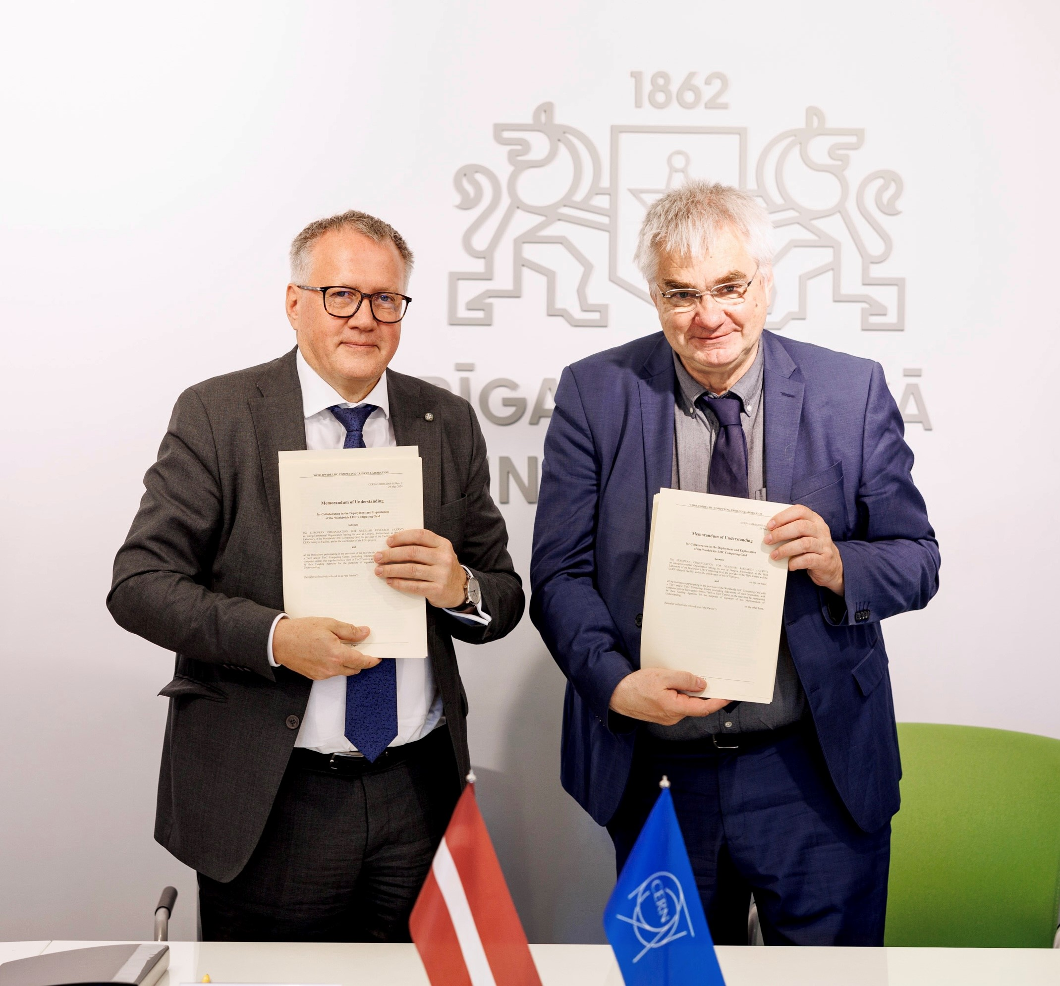
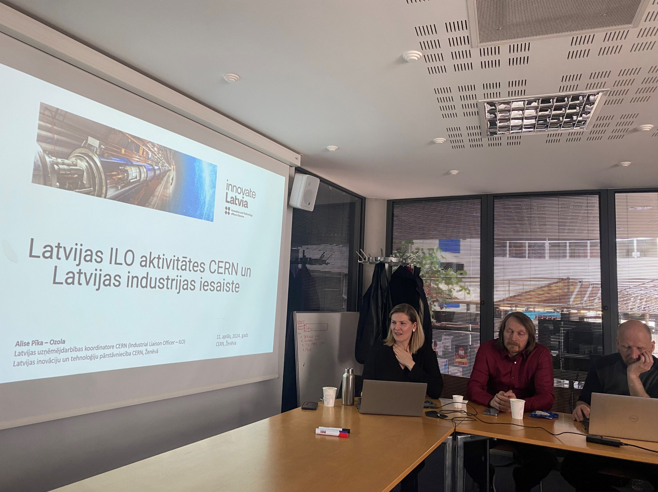
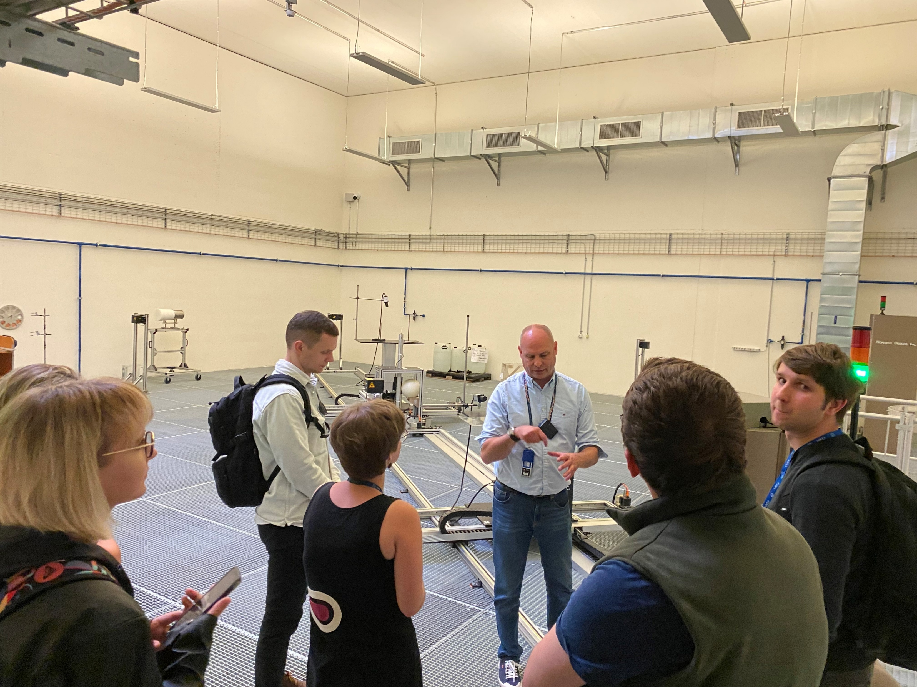
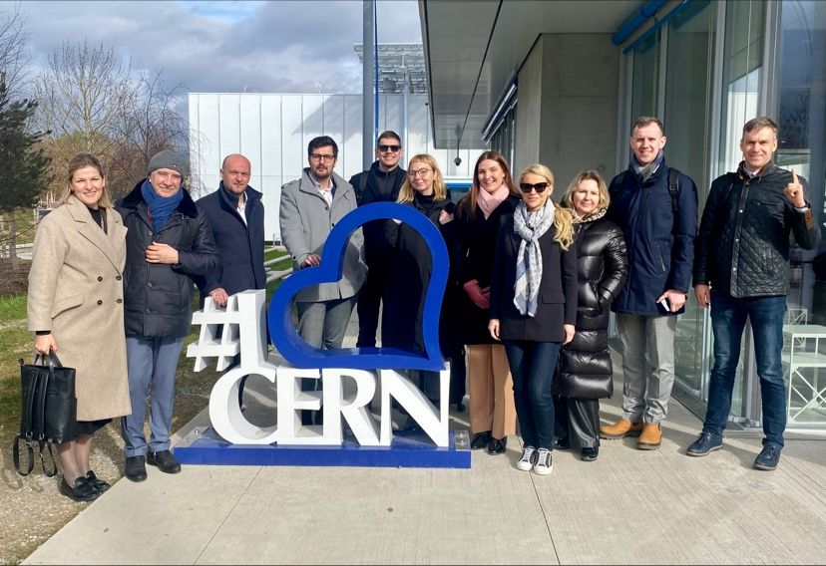
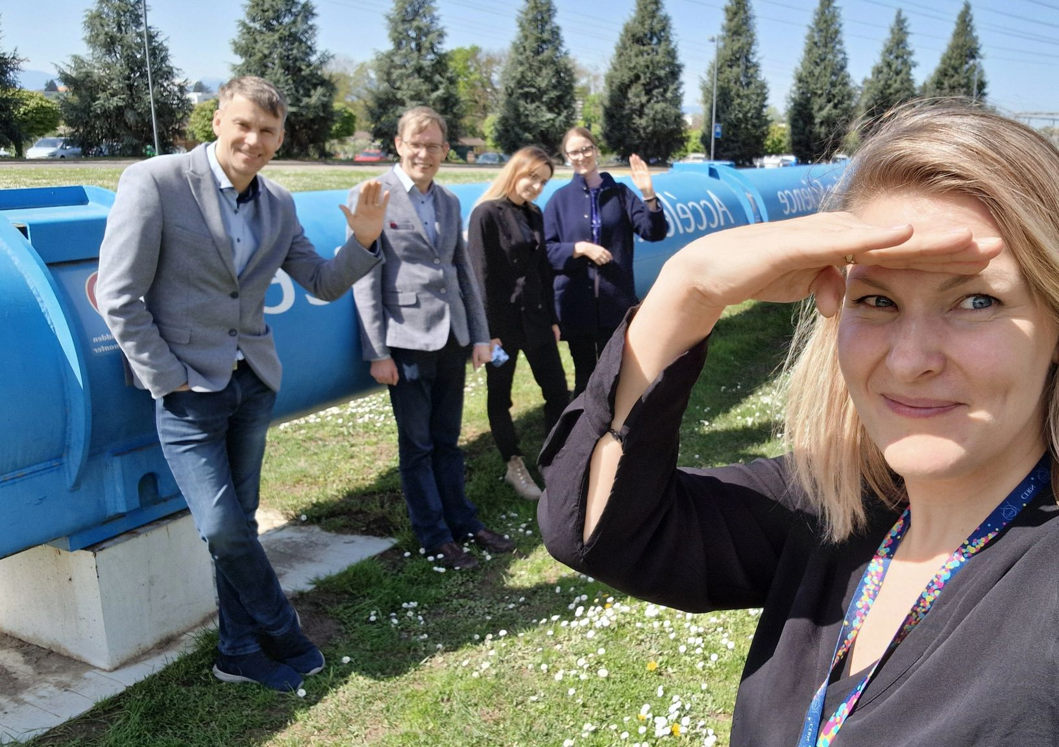
Latvian ILO’s activities
Match Latvian companies with CERN business opportunities
Involve new companies and Latvian industry partners with CERN
Deeper focus on R&D engagement
45 Latvian companies on CERN suppliers database (+11)
55 companies individually consulted about CERN opportunities
11 Latvian company representatives have visited CERN in 2024
First industrial partner to join the Latvian TIER 2 Ccomputing centre in
Upcoming events in Latvia:
29/10 Riga Tech dinner (Riga) meeting with the Riga tech community presenting opportunities at CERN
31/10 5G Techritory (Riga) Panel participation by Stefan Lüders, Head of Computer Security at CERN

Slide 6
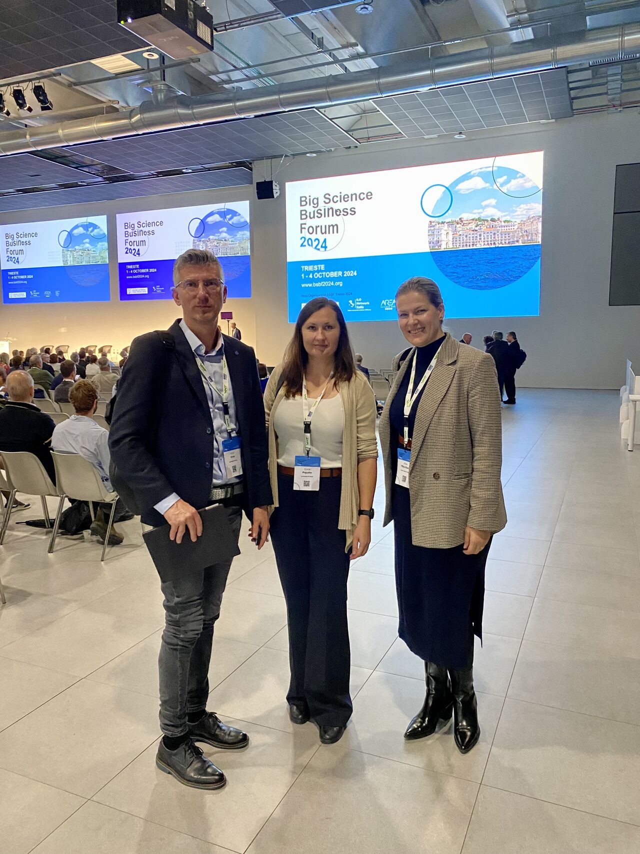
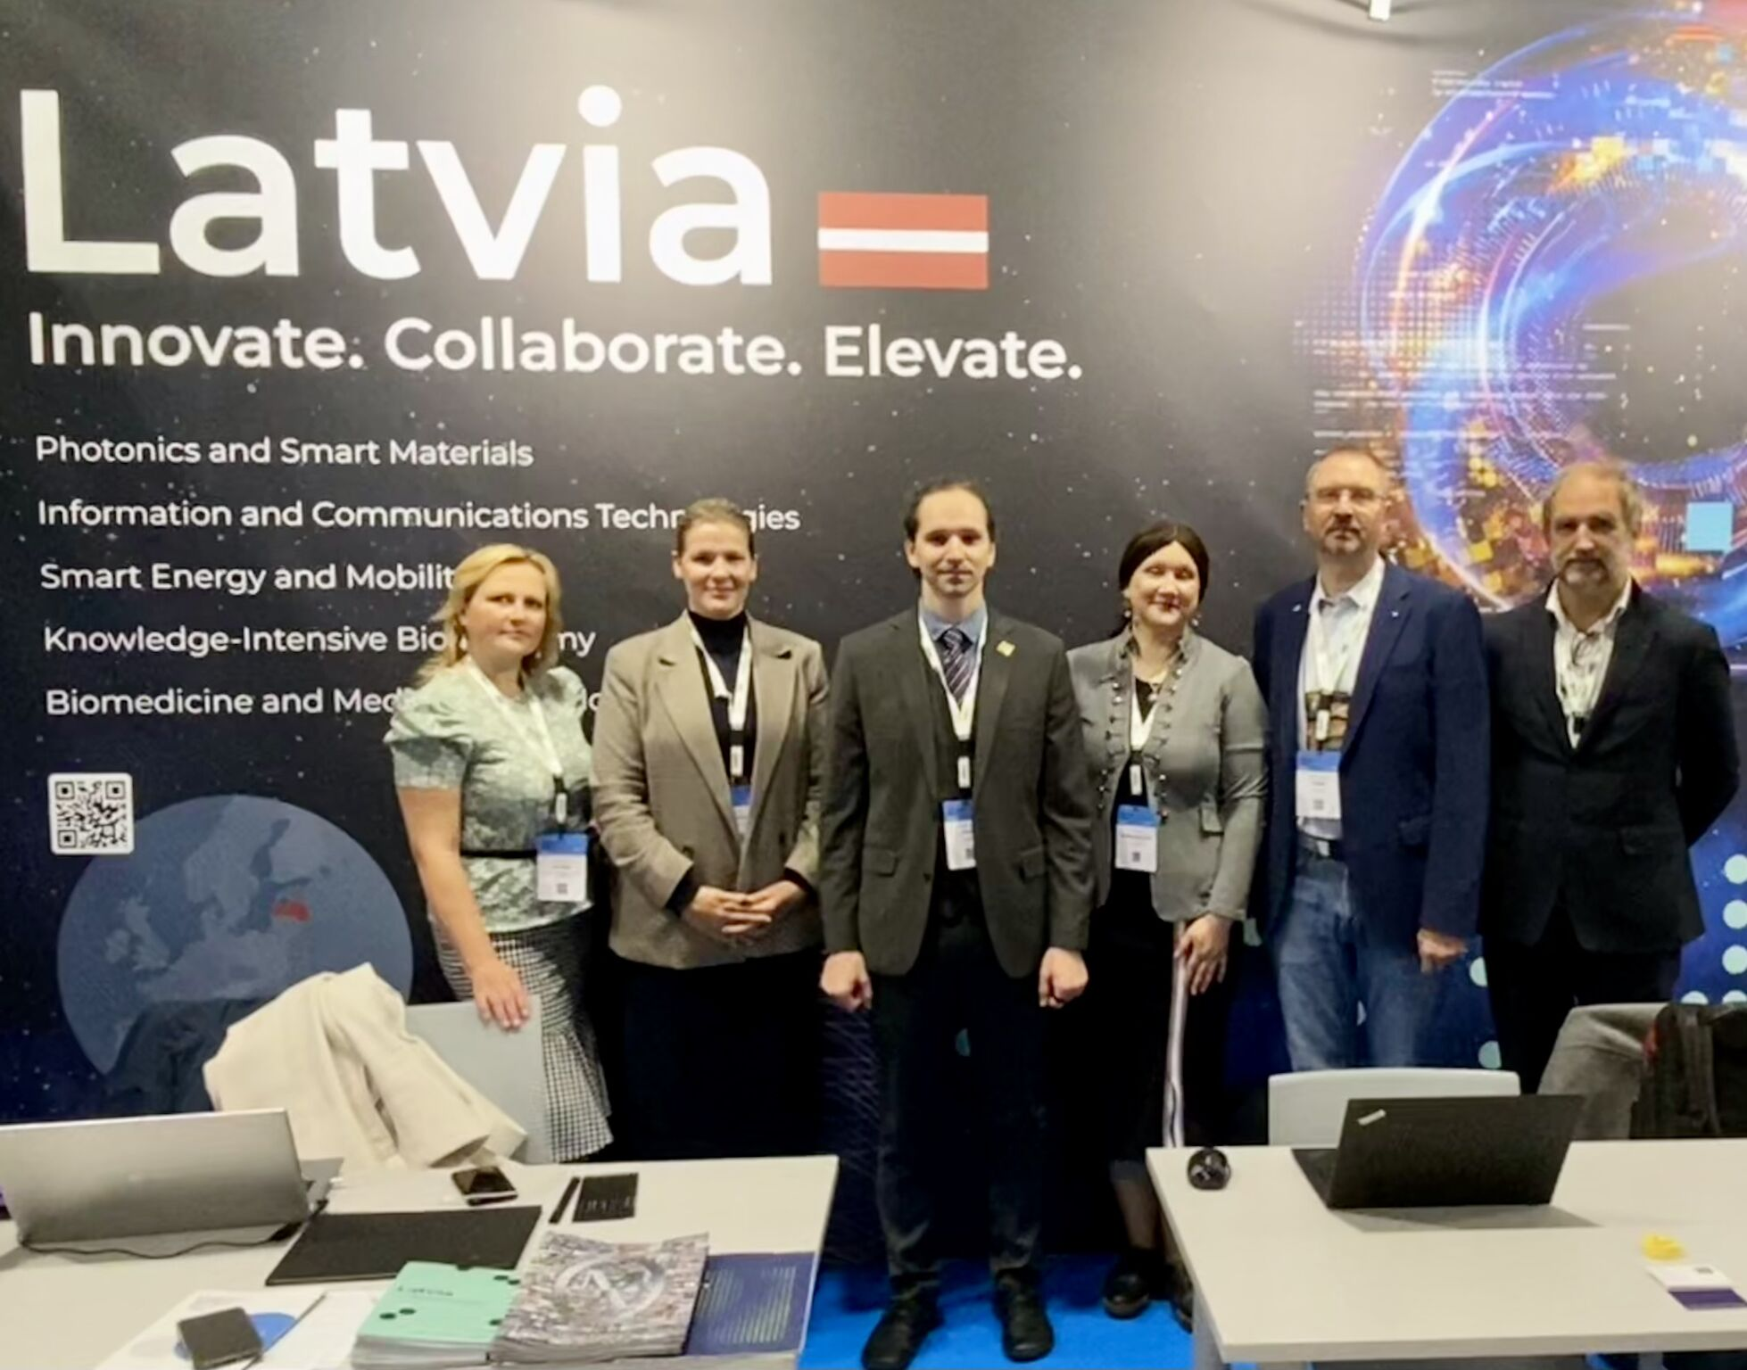
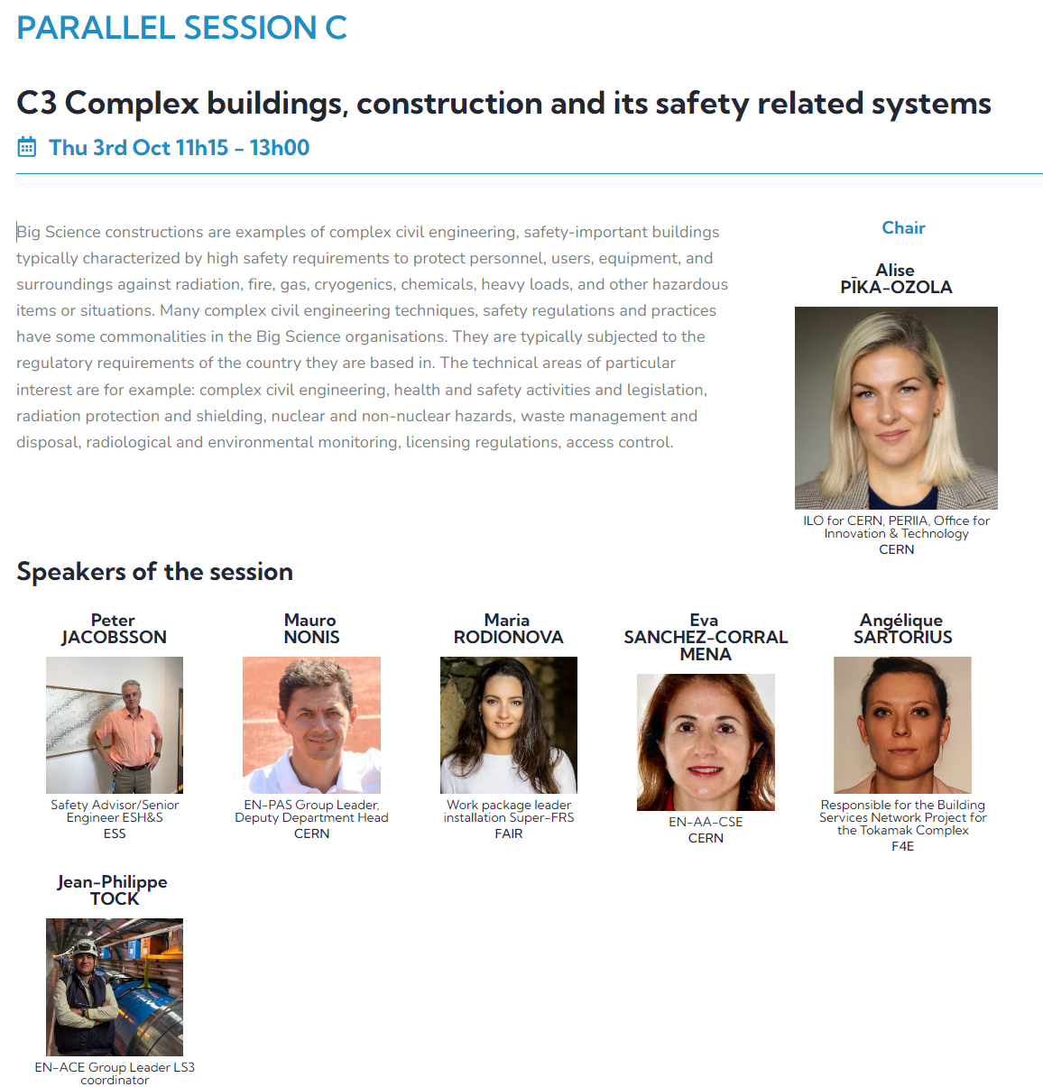
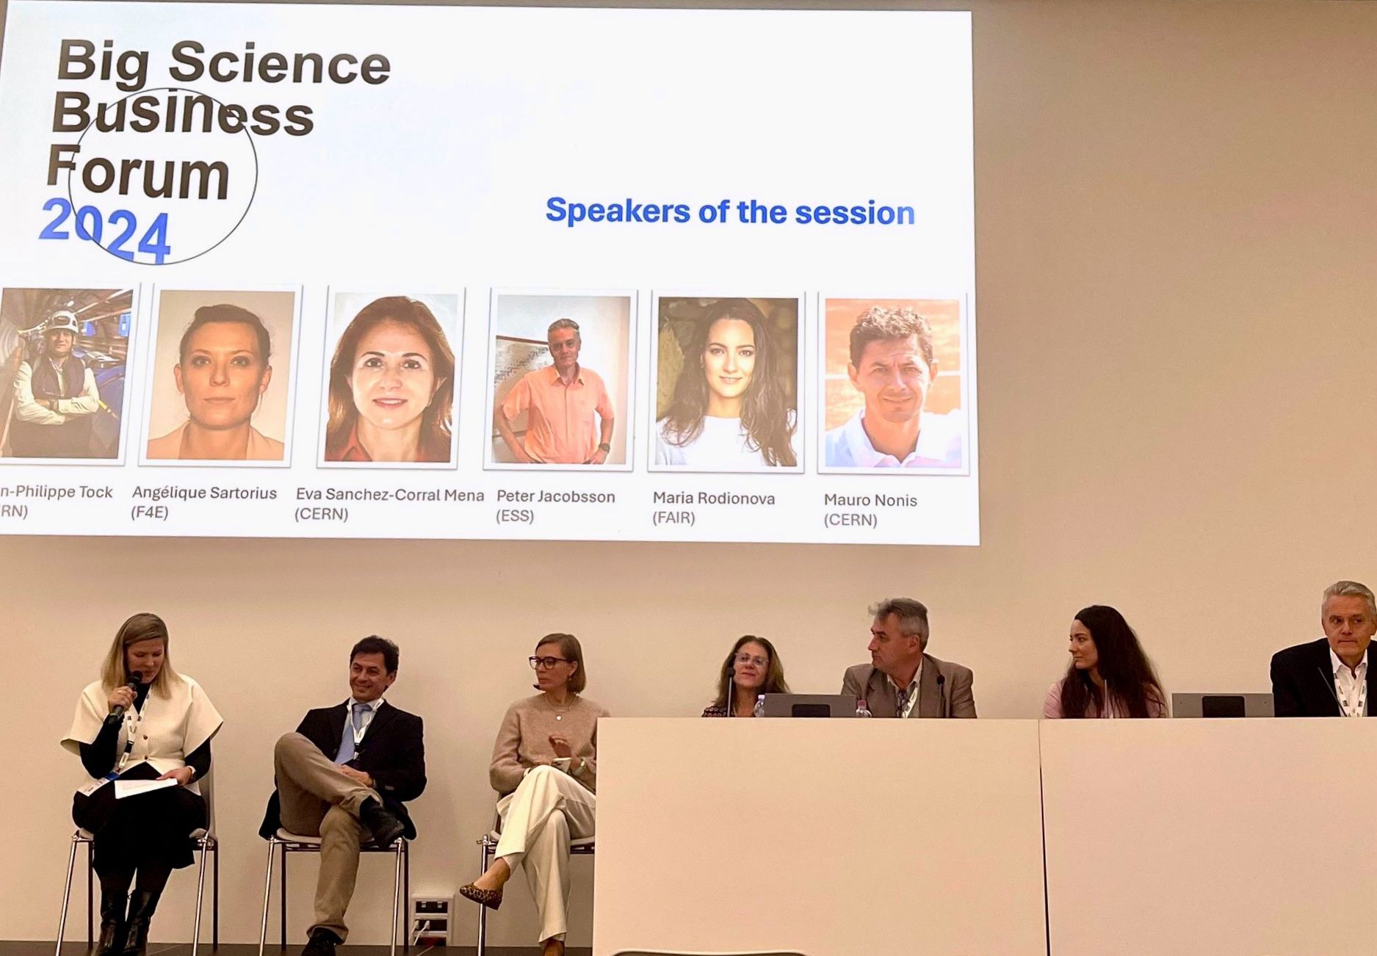
Big Science Business Forum 2024
1-4 October, Trieste
Latvia and Estonia had country stands at BSBF2024. Largest Big science event in Europe ~ 1000 participants in 4 days.
Latvia had 3 companies and 3 universities / research institutions at BSBF 2024
Latvian ILO moderating parallel discussion with Big science organisation representatives.
2020 – 2025 value of the European big science infrastructure projects: ~35 bn EUR with growth 7,4% per year (Avots: bccResearch.com)
Notes:
Millions and billions of dollars are spent daily to construct telescopes, synchrotrons, and other Big Science infrastructures to solve the most challenging questions of our societies of today. These infrastructures are not only the home of future technologies, such as the internet, medical diagnostics, and various information technologies but also – potential business partners.
What is the Big Science market?
Big Science is all the large-scale instruments and facilities, supported by funding from governments or international agencies, in which research is conducted by teams or groups of scientists and technicians from different countries. CERN, EMBL, ESA, ESO, ESRF, ESS, ITER, European XFEL, and ILL are amongst the most known BigScience facilities in the market.
These complex infrastructures are in constant need of advanced engineering, electrical and mechanical products, sophisticated materials, and maintenance services in many fields A range of suppliers, contractors, consultants, and other stakeholders are working in this growing Big Science market.
According to bccResearch.com, the Big Science Market was estimated to be valued at $29.1 Billion in 2020 with a 7.4% annual growth rate. It is estimated that by 2025 it will reach $41.6 Billion.
Although the scientific goals of CERN, ESA, the European XFEL, and the ITER fusion project are very different, when you get down to the nuts and bolts of everyday operations, the technologies required to probe the fundamental nature of the universe and to explore our little corner of it are strikingly similar. If a company can make instruments that can withstand the harsh environment of space, they might be able to build instruments that can operate in a fusion reactor, too.

Slide 7
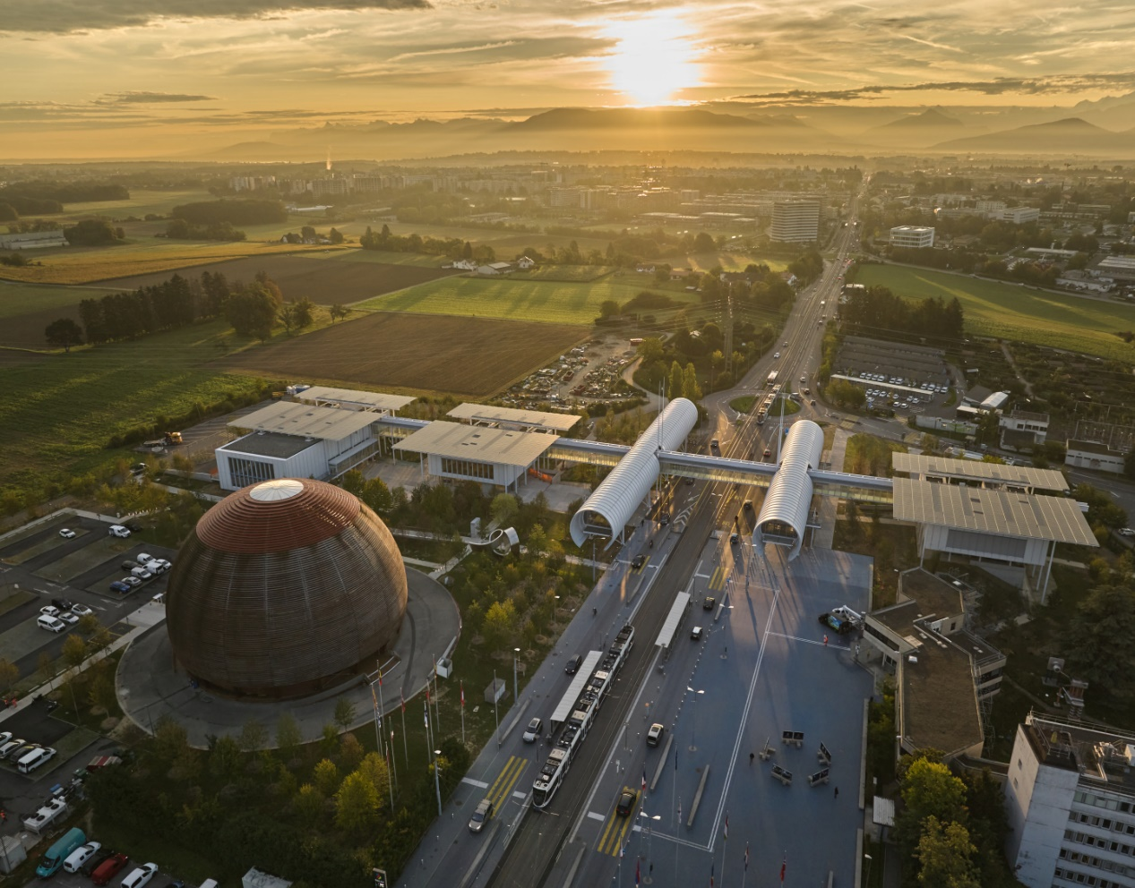
Thank you
Notes:
–spēka elektronika un enerģētika
–materiālu apstrādes tehnoloģija
–robotika
–materiālzinātne

