Slide 2
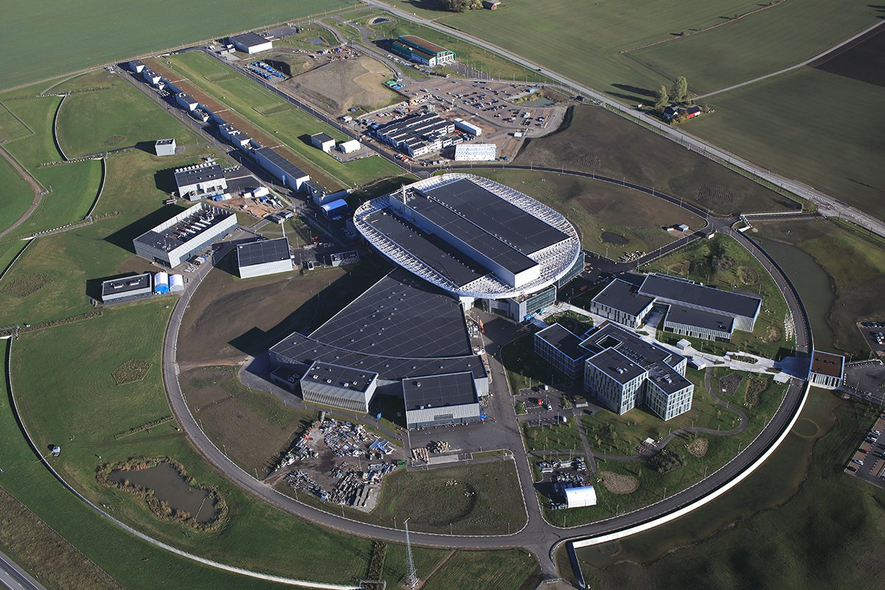
ESS
Will provide the most intense pulsed neutron beams in the world
Commissioning of full accelerator 2024, BoT (Beam on Target) 2025

Slide 3
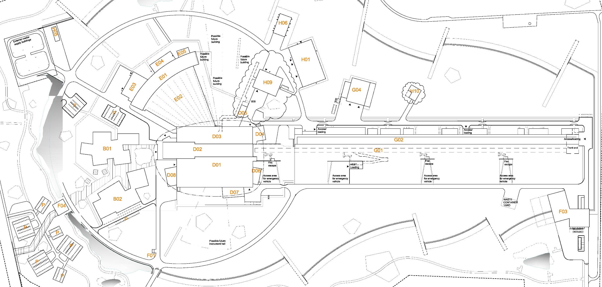
Personnel Safety Systems at ESS
Instrument 1 PSS
Instrument 2 PSS
Instrument 16 PSS
TS2 PSS
TS4 PSS
Bunker PSS
Target PSS
Accelerator (ACC) PSS

Slide 4
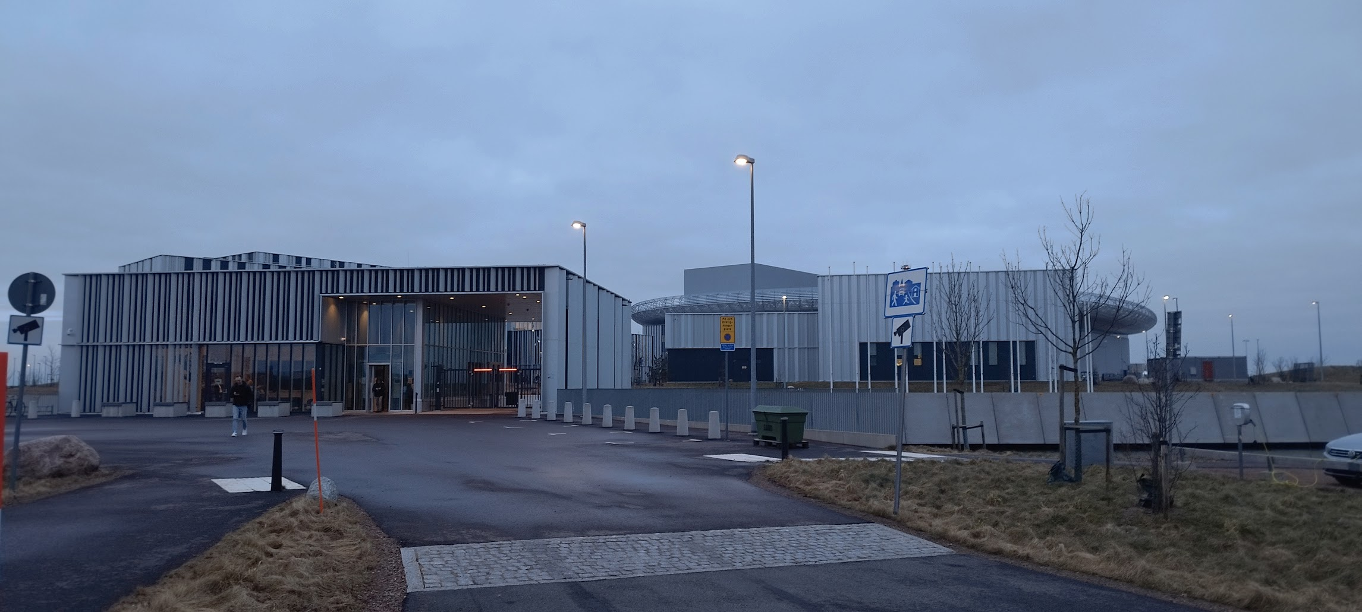
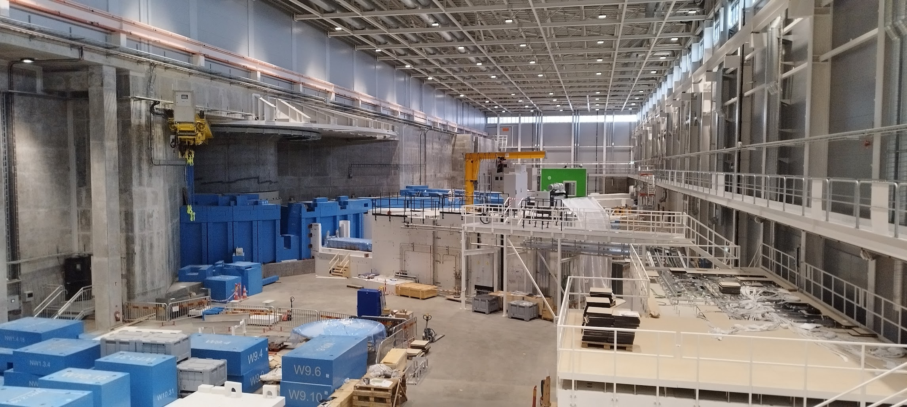
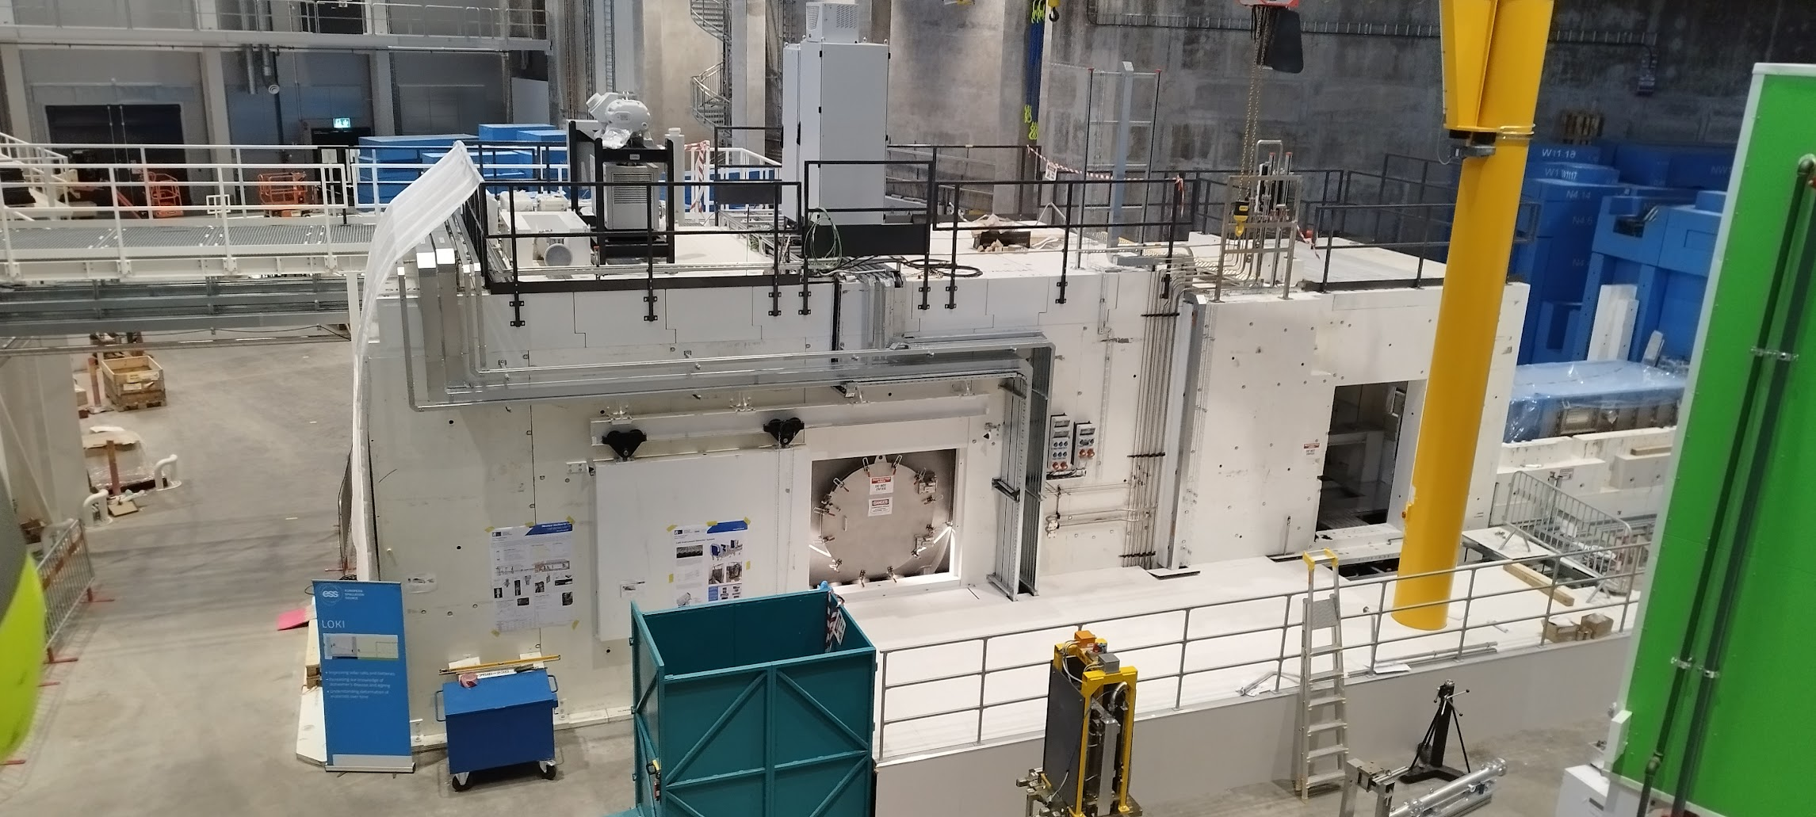
Photos

Slide 5
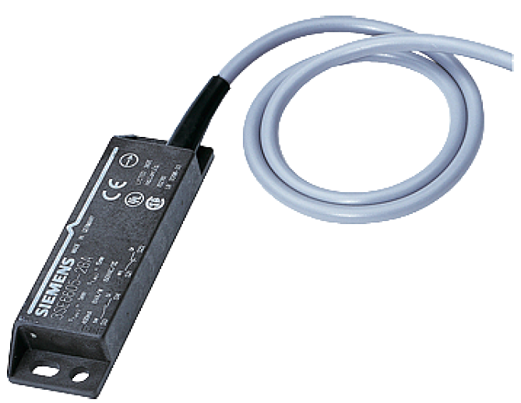
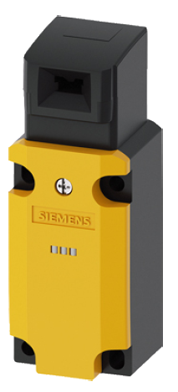

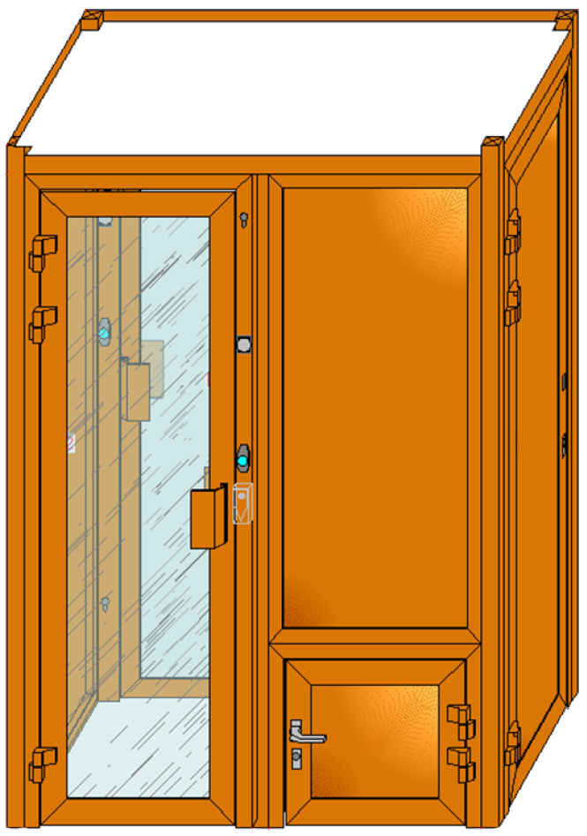
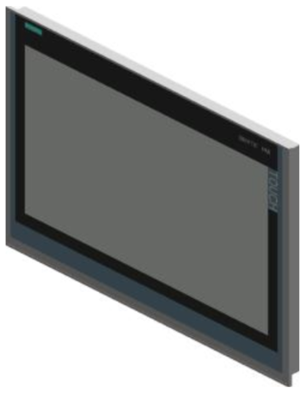
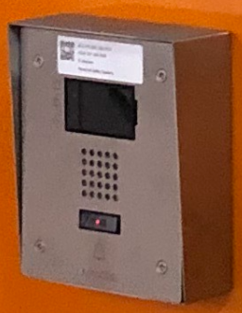
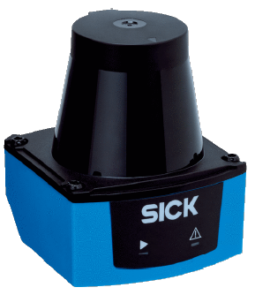
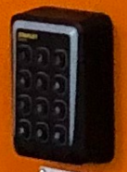
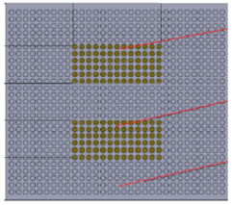
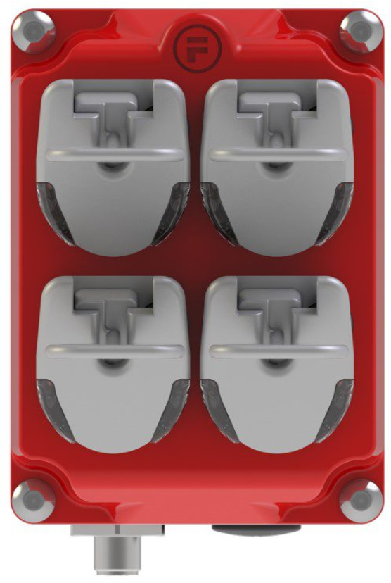
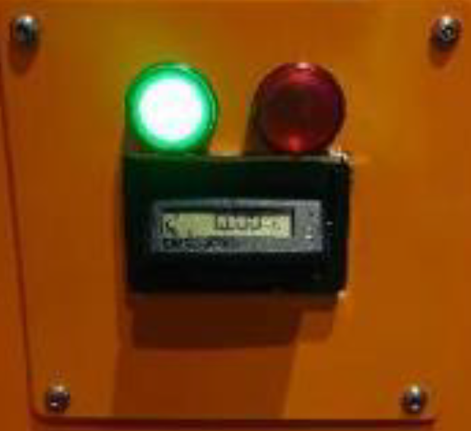
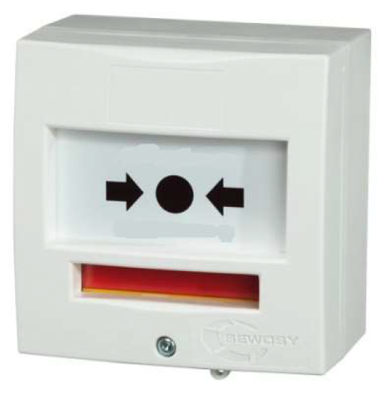
Example: Access Control System
PAS & mini-MAS
MAGNETIC &
MECHANICAL
SWITCHES
NETWORK
CAMERA
MESSAGE
DISPLAY
INFRARED RADAR
SOLOTEK
DETECTION
INTERCOM
LASER
SCANNER
CARD
READER
PRESSURE
FLOOR MAT
RFID
SAFETY TOKEN
EPD
READER
BREAK GLASS UNIT

Slide 6
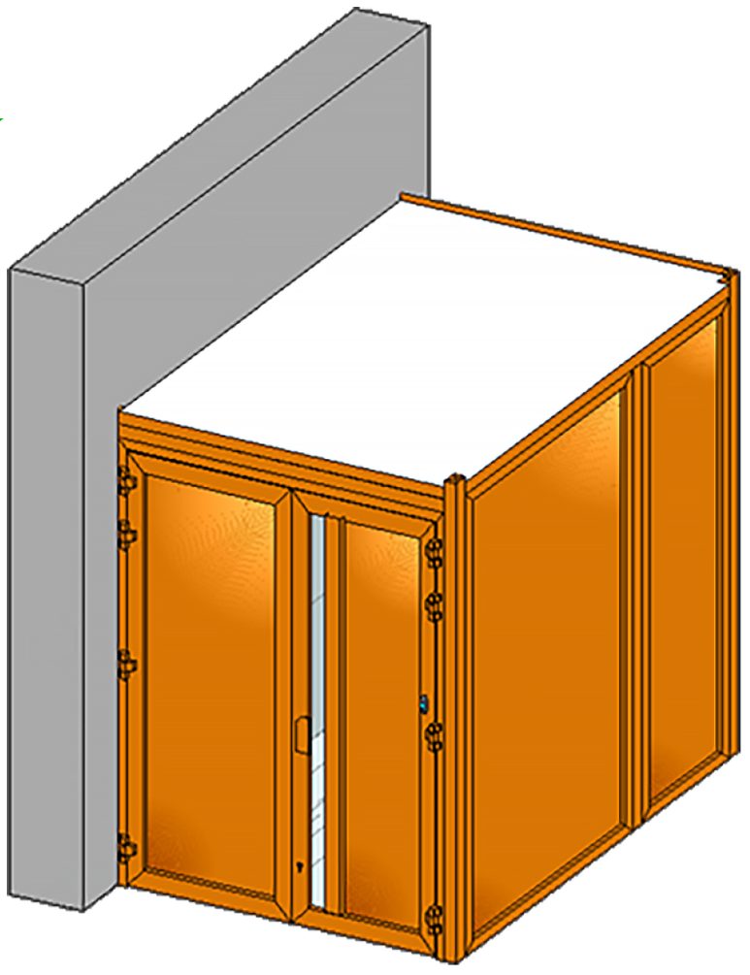
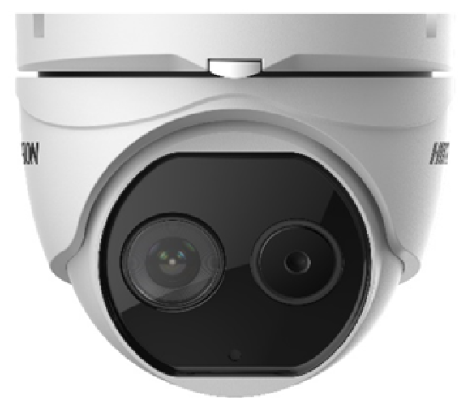

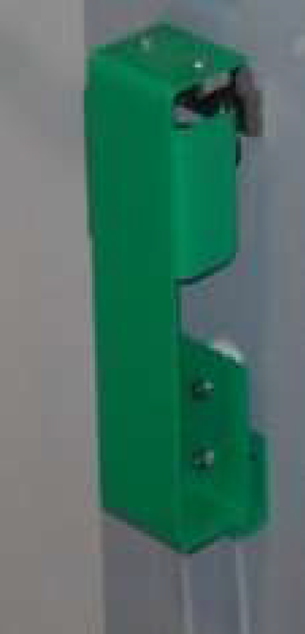
Access Control System
MAS
THERMAL & MOTION
CAMERA
MAS OVERRIDE
KEY
PAS OVERRIDE
KEY
MAS
DOOR KNOB

Slide 7
ESS PSS Types

Slide 8
Accelerator PSS
Main hazards to be mitigated by ACC PSS:
  Prompt ionizing radiation from proton beam,
  Prompt ionizing radiation from RF-powered cavities,
  Ionizing radiation (gamma) from target,
  High voltage from the Ion Source (ISrc) platform.
The basic functions realized by ACC PSS:
  Ensure no one is in the tunnel and access is prevented when the above-mentioned hazards exist.
  Ensure the above-mentioned hazards are mitigated prior to permitting access to the tunnel.

Slide 9
ESS PSS
Personnel Safety Systems at ESS (ESS PSS) can be considered as an integrated system that is composed of several PSS systems across the facility.
There are: ACC PSS, TS PSS, Bunker PSS an PSS systems for instruments.
Terminologies:
  PSS controlled area: An area within which a PSS mitigates designated hazards or the PSS contributes to access control.
  EUC: Equipment (under Control) that the PSS interlocks, in order to mitigate designated hazards associated with equipment and/or processes.

Slide 10
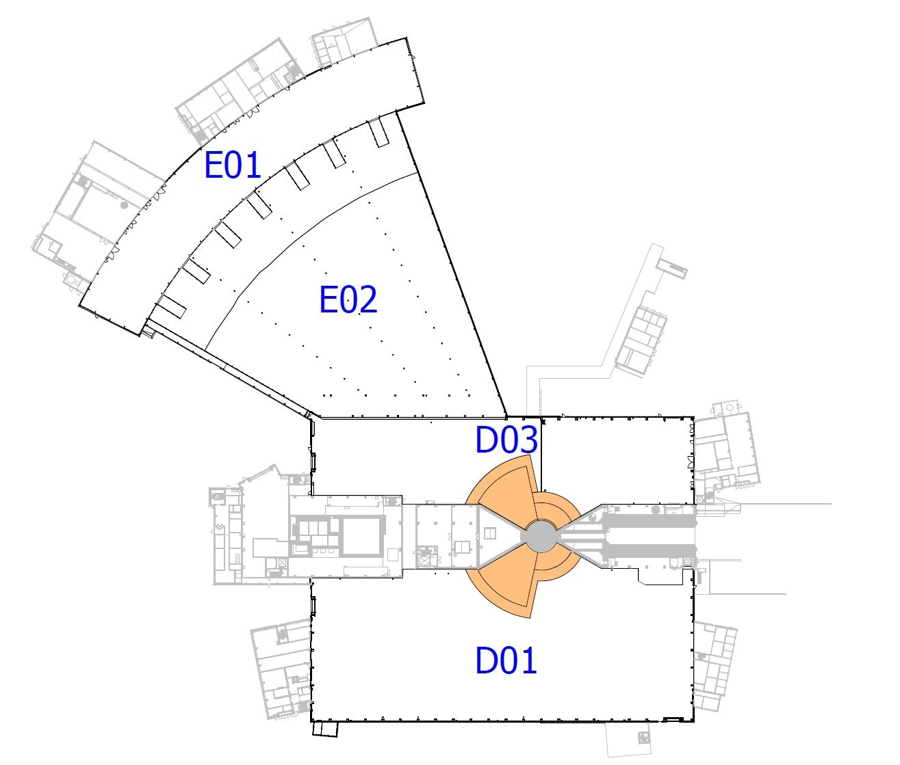
Bunker
Plan view of the NSS buildings, with the Bunker PSS controlled area marked in orange.

Slide 11
Bunker PSS
Main hazards to be mitigated by Bunker PSS:
  Prompt ionizing radiation due sending proton beam to target,
  Ionizing radiation (gamma) from target monolith.
The basic functions realized by Bunker PSS:
  Ensure no one is in inside the bunker when the above-mentioned hazards exist.
  Ensure the above-mentioned hazards are mitigated prior to permitting access to inside the bunker, and designated parts of neutron guides.

Slide 12
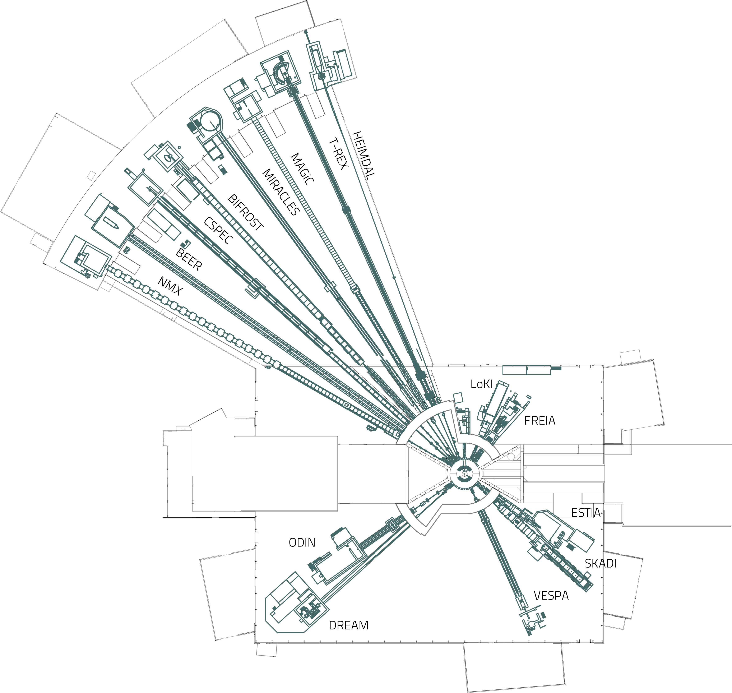
Instruments
LoKI PSS

Slide 13
Instrument PSS
Main hazards to be mitigated by any Instrument PSS:
  Prompt ionizing radiation from Neutron beam
The basic functions realized by Instrument PSS:
  Ensure no one is in inside the cave and removal of shielding blocks is prevented when the above-mentioned hazards exist.
  Ensure the above-mentioned hazards are mitigated prior to permitting access to the instrument cave.
Instrument PSS may contribute to mitigating other hazards such as vacuum, laser or motion.

Slide 14
FSA (Functional Safety Assessments)
FSAs have to be performed to be in conformance with IEC 61511 (Safety instrumented systems for the process industry sector) and these are done by an external organisation through a Functional Safety Assessor (ZHAW).
  After PDR
  After CDR
  Before handover/SRR
  After significant modifications.
The responsibilities of the Functional Safety Assessor are:
  Assess PSS compliance with relevant functional safety standards
  during the whole PSS lifecycle
  Ensure documentation meets requirements set by functional safety standards
  Provide functional safety assessment reports and give recommendations

Slide 15
Example: PSS SIL Assessment

Slide 16
Review Focus: PSS SIL Assessment
Risk Assessment
SIL Determination
  Inputs – Risk Assessments, ConOps
  Outputs – SIL targets for each SIF in terms of PFD/PFH and SIL
SIL Verification
  Inputs – SIL Determination, SIF configurations, Failure Data
  Method – Reliability Block Diagram (RBD)
  Outputs – SIL Verification results in terms of achieved PFD/PFH and SIL
SIL Determination
SRS
SIL Verification
(IEC 61511)
Notes:
Note for Fan: Point out during presentation that this was already presented in the PDR. We want to give an introduction for new committee members and present results from SIL verification

Slide 17
SIL Determination and Verification
Objectives
SIL Determination
  To determine the required SIL target (and reliability target PFD/PFH) for each SIF
  Layers of Protection Analysis (LOPA) used for SIL determination
  Guideline for SIL Assessment for Personnel Safety Systems
SIL Verification
  To verify the proposed SIF design will meet the corresponding SIL (and PFD/PFH) target
  Reliability Block Diagram (RBD) used for SIL verification
  Event Tree Analysis (ETA) used to confirm frequency of individual hazardous scenarios meet the risk target
PFD = Probability of Failure on Demand
PFH = Average frequency of a dangerous failure per hour

Slide 18
Example ZHAW Activities (since 2016)
Example Recommendations/FSAs:
Perform Global Risk Assessment including all stakeholders
Advice on design choices and documents (e.g. safety plan)
Traceability of requirements, efficient document structure (e.g. redundancies)
Checked calculations (for example FMEDAs), missing reliability data
Challenge assumptions in LOPA, RBD, FTA, ETA or Human Reliability (HEP values)
Ensure all final elements are in SIFs
Improve ConOps descriptions and procedures etc.
Participation in PDR, CDR and SRR (Sven, Christian and Joanna)
as observer, committee member or committee chair.

Slide 19
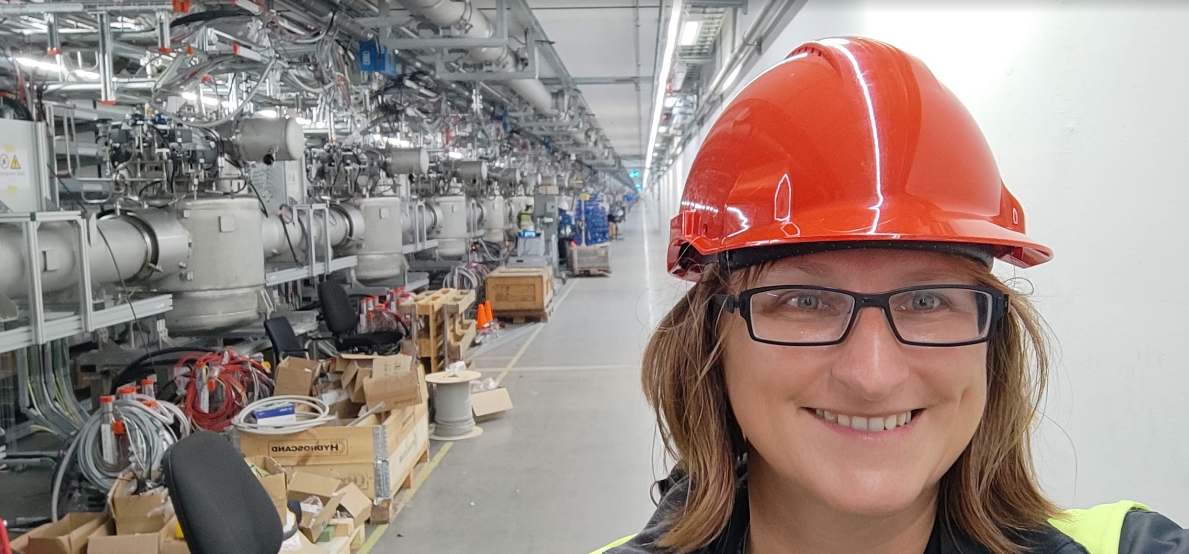
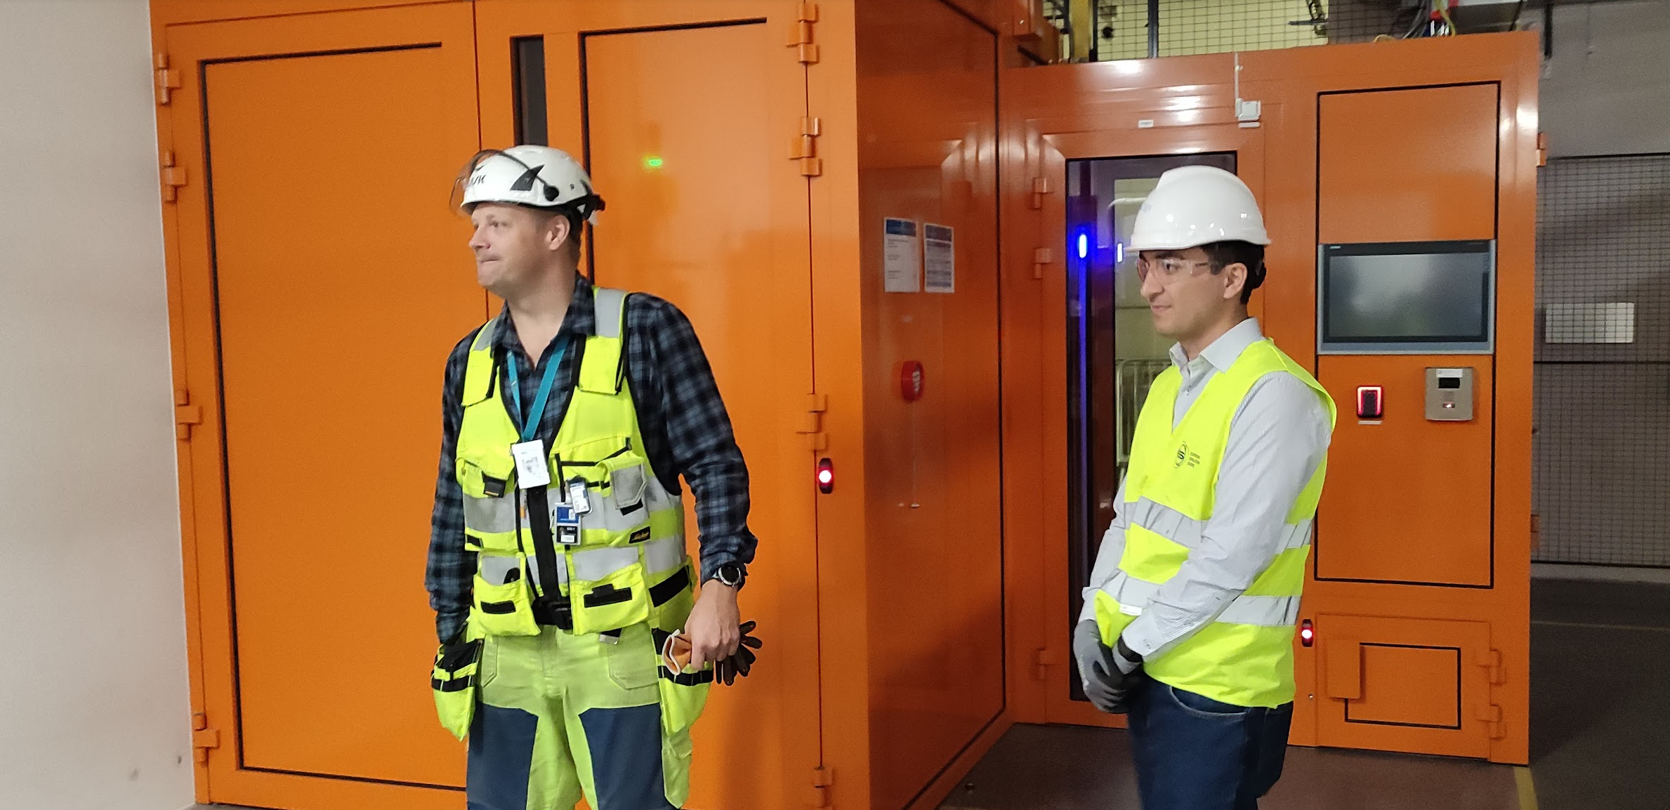
Conclusion
With ZHAW input to Design, PDR, CDR, SRR etc.
PSS in good shape, ready in time and accepted by the Swedish regulator
(SSR, Swedish Radiation Safety Authority)
Currently final FSA of Accelerator PSS ongoing

