Slide 1
BISv2 Reliability Analysis
L. Felsberger
Based on materials and work carried out with Milosz Blaszkiewicz, Antoine Colinet, Christophe Martin, Ivan Romera Ramirez, Raffaello Secondo, Jan Uythoven, Daniel Wollmann

Slide 2
Introduction
Machine Protection systems follow defined life-cycle
Ensures that risks are mitigated
Inspired by IEC 61508 and adapted for CERN context
The scope of the BISv2 reliability analysis is to
  Identify risks and hazards and quantify requirements for their mitigation
  Qualify the hardware design according to the defined requirements
  Clear and exhaustive specifications of the project
  Thorough risk and hazards analysis, definition of safety requirements
  Design of the system
  Reliability analysis
  Dependability
  Availability
  Testing and validation
  Commissioning of the system
  Operation and maintenance
  Experts’ advice
  Trainings
  Procedures
  Periodic testing
Courtesy of M. Kalinowski

Slide 3
Methodology
Top-Level FMECA
Identify risks and hazards and possible end-effects
Accelerator Risk Matrix
Quantify reliability requirements to mitigate risks and hazards
Top-Down FTA model
Capture system structure, redundancies, critical/non-critical parts, Demand, inspection rates
Bottom-Up FMECA
Analyse each sub-system to identify their failure probabilities for each end-effect
→ Design qualification
Feed results from Bottom-up FMECA into Top-Down FTA to qualify design or require design improvements

Slide 4
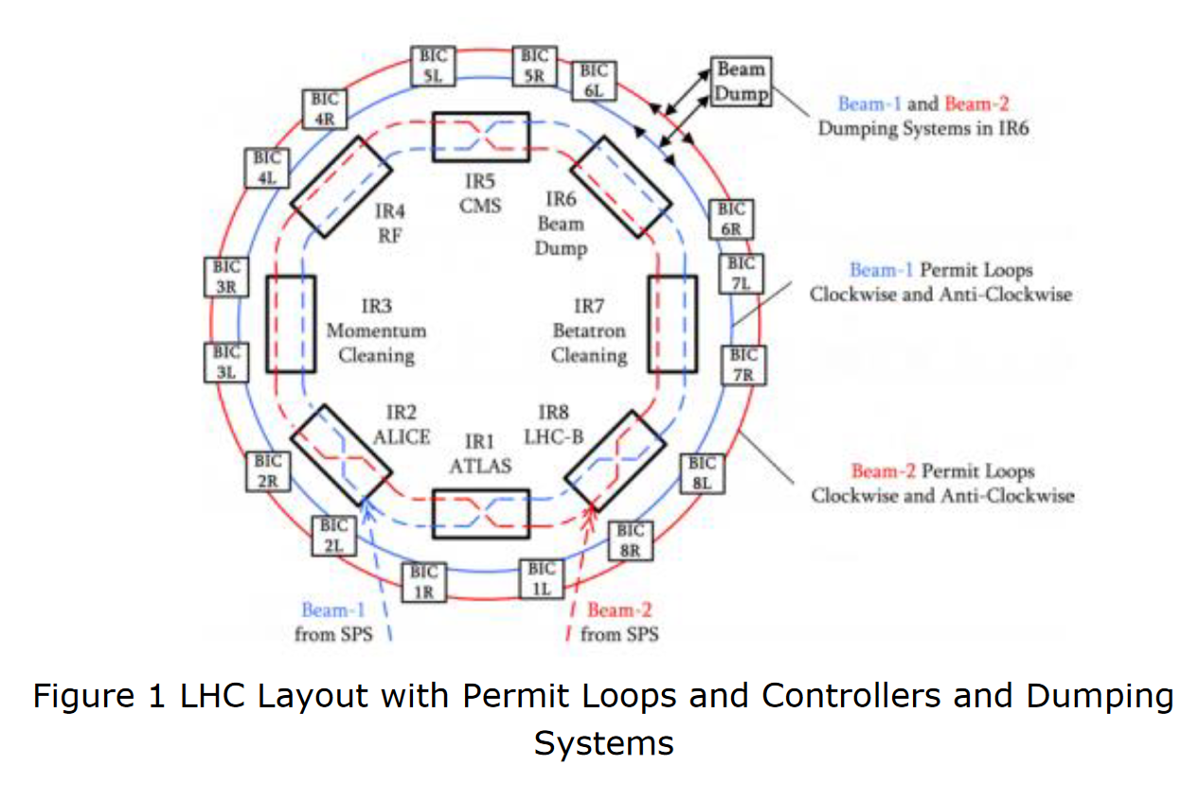
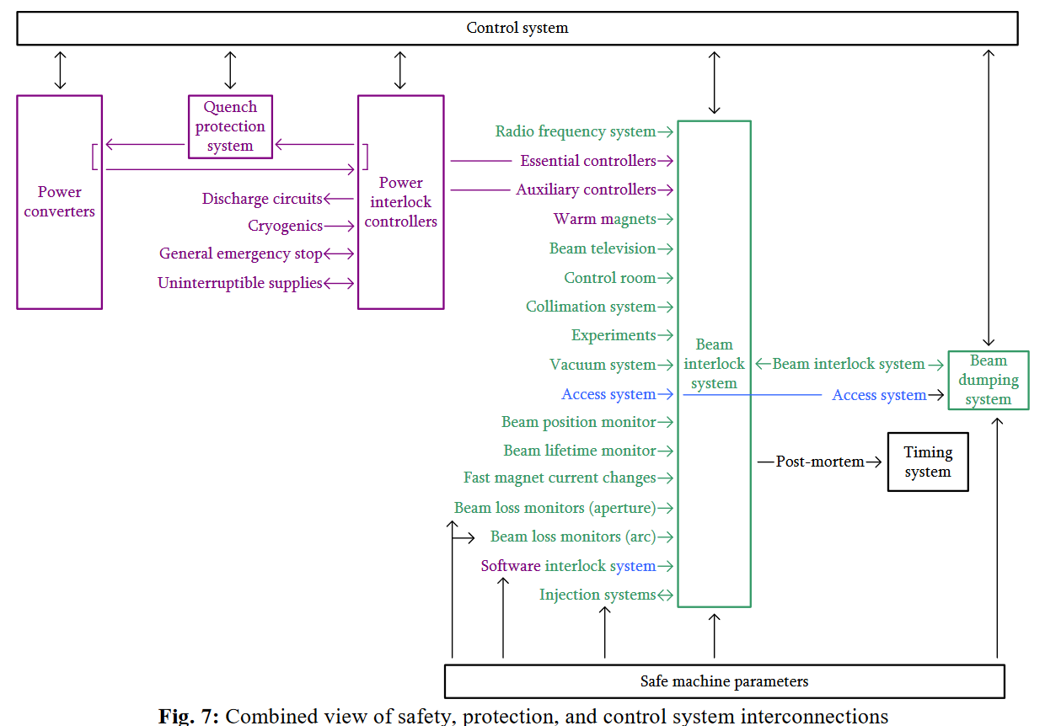
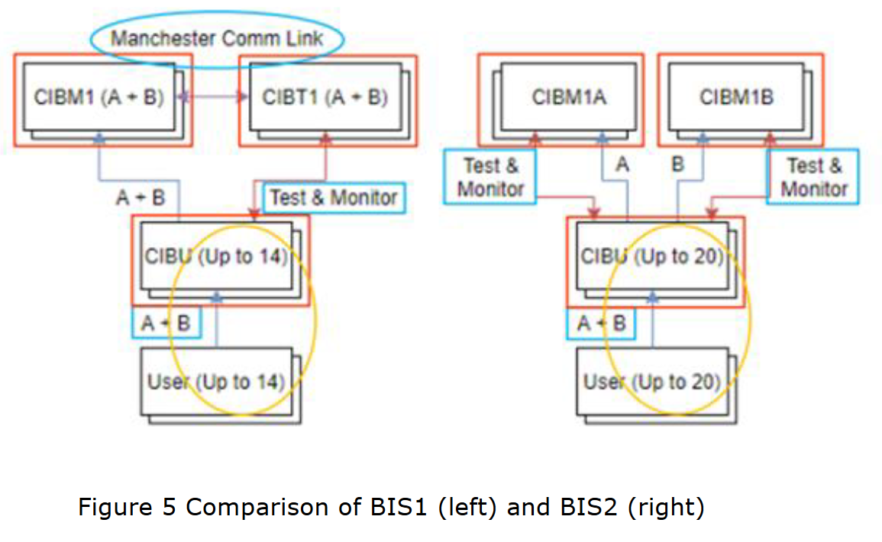
Top-Level FMECA
LHC situation:
BIS requests beam dump when machine enters unsafe state
Has numerous interfaces with other systems, and in particular the beam dump system
Mainly two failure modes:
  Missed beam dump (blind failure)
  False beam dump
Risk and Machine Protection for Stored Magnetic and Beam Energies
Todd, B.; Kwiatkowski, M.

Slide 5

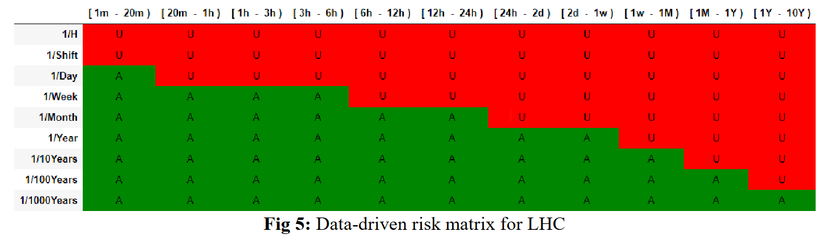
Defining Reliability Requirements – Accelerator Risk Matrix
BISv1 achieved
Recovery time following failure
Acceptable Frequency
All failures leading to false beam dump
All failures leading to significant damage (missed dump)
Requirement for single system leading to false beam dump
Requirement for single system leading to significant damage
The risk matrices for the different accelerators are available in EDMS: https://edms.cern.ch/document/2647881/1

Slide 6
Top-Down FTA Models
BIS has two redundant paths for its main function (beam dump requests). However, spurious triggers of any path will lead to beam dumps
False Beam Dump (spurious)
[1 per year allowed]
Missed Beam Dump (blind)
[1 in 1000 years allowed]
False dump
OR
Beam1 false dump
OR
Beam2 missed dump
Path A false dump
OR
Path A false dump
Path B false dump
Any CIB_ Beam1 Path A spurious
Any CIB_ Beam1 Path B spurious
Any CIB_ Beam1 Path A spurious
Path B false dump
Any CIB_ Beam1 Path B spurious
Missed dump
OR
Beam1 missed dump
AND
Beam2 missed dump
Path A blind
Path B blind
AND
Path A blind
Path B blind
Any CIB_ Beam1 Path A blind
Any CIB_ Beam1 Path B blind
Any CIB_ Beam1 Path A blind
Any CIB_ Beam1 Path B blind
Initial estimate for requirement per board:
500 FITS (failures per 10^9 hours)
Initial estimate for requirement per board and channel:
100 FITS (failures per 10^9 hours)
* For common mode failures (across path A/B – not in FT) it is 0.05 FITS.

Slide 7
Bottom-Up FMECA - Introduction
Failure Modes, Effects, and Criticality Analysis (FMECA)
Purpose: identify potential failure modes of individual components within a system & quantify failure impact at system level
Id | Component | Description | failure_mode | Alpha | Component Failure Rate | Failure Mode Rate | End Effect
1.1 | C2 | ¬±10% 50V X7R SMD Multilayer Chip Ceramic Capacitor | Open | 9 | 0.357 | 0.032 | False dump
1.1 | C2 | ¬±10% 50V X7R SMD Multilayer Chip Ceramic Capacitor | Parameter change | 61 | 0.357 | 0.218 | No effect
1.1 | C2 | ¬±10% 50V X7R SMD Multilayer Chip Ceramic Capacitor | Short | 30 | 0.357 | 0.107 | False dump

Slide 8
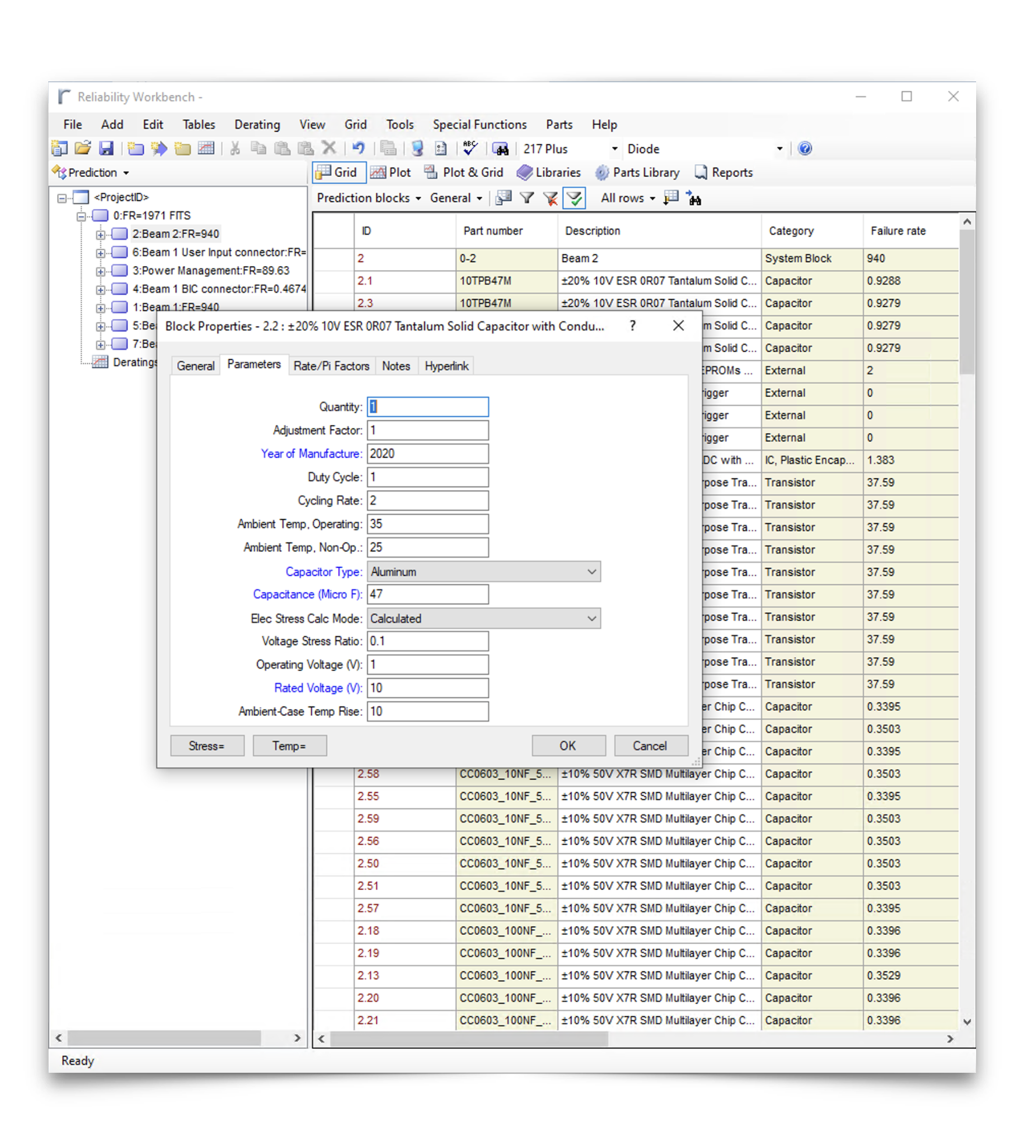
FMECA Process
Key steps
Using Bill of Materials, do a component-wise Failure Rate Prediction.
  Mainly based on 217Plus standard (2015/RIAC, but also available: Telcordia TR/SR, MIL-217, NSWC). Completed by manufacturer and test data.
  Requires definition of mission profile/environment as well as operating conditions for individual components
Identification & apportionment of component failure modes
  i.e., capacitor -> {open, param. change, short}.
  Based on handbooks (MIL-HDBK338, FMD2016).
Assigning end-effects to each failure mode of every component of the system.
  i.e., Capacitor C1: open -> no effect, short -> false dump, param. change -> blind failure.
Screenshot of Isograph Reliability Workbench (tool used for FMECA analysis)

Slide 9
FMECA Process
Previously
Manually assigning failure rates for a design with 800 components takes roughly
20 hours.
Very error-prone process, with multiple parameters to be set repeatably.
Failure mode apportionment
Manual assignment of end-effects for every component failure mode is very work-intense and non-trivial, putting a heavy requirement on the system experts.
Manually assigning possible component failure modes
will take equally long.
Tools exist to facilitate this process.
Failure rate estimation
End-Effect assignment

Slide 10
FMECA Process
Now
Video demonstration
The first step can be automated using the project files available in EDMS.
To make the process more comprehensive, certain design conventions need to be present in the file. For instance, the Design Office processed files keep the same format of the Bill of Materials, making it easier to process.
Failure mode apportionment
Manually assigning failure rates for a design with 800 components takes roughly
20 hours.
Very error-prone process, with multiple parameters to be set repeatably.
Difficult to automate.
Exploring possibilities for using circuit simulation to support this phase of study.
Manual assignment of end-effects for every component failure mode is very work-intense and non-trivial, putting a heavy requirement on the system experts.
Straightforward replacement by an automated script assigning each category of components a given set of failure modes with corresponding probabilty.
Manually assigning possible component failure modes
will take equally long.
Tools exist to facilitate this process.
Failure rate estimation
End-Effect assignment

Slide 11
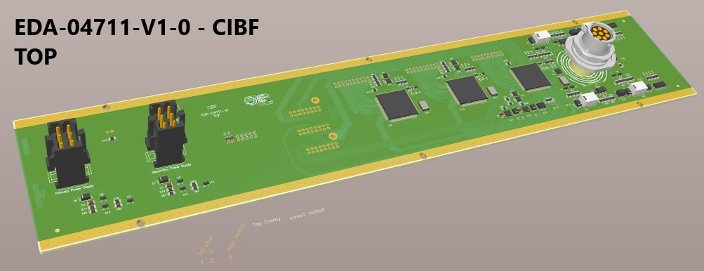
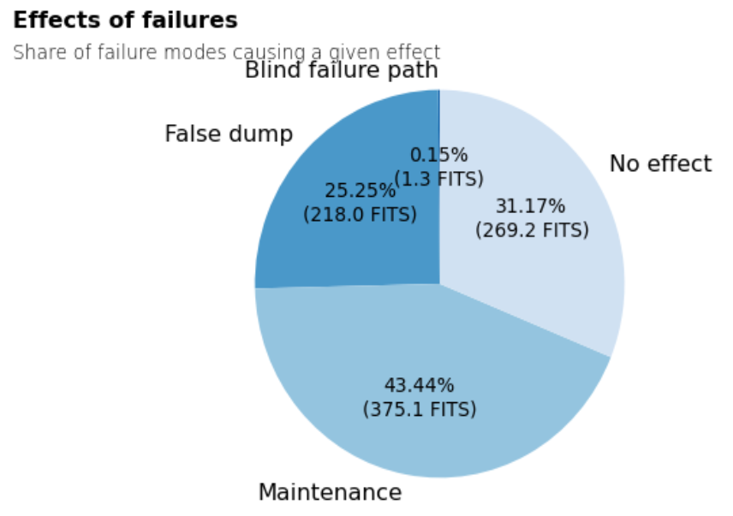
Bottom-up FMECA – Example CIBF
Mission profile:
Year of manufacture: 2020
Duty Cycle: 1
Cycling Rate: 2
Operating temperature: 35°C
Non-operating temperature: 25 °C
When such fields were available, the following parameters were set:
Ambient case temperature rise: 10°C
Using Bill of Materials, do a component-wise Failure Rate Prediction.
  Automated based on design files and 217+ standard
  Mission profile/environment globally defined for BISv2 systems
    For capacitors, operating voltages are extracted from design files
Identification & apportionment of component failure modes
  Automated based on handbooks (MIL-HDBK338, FMD2016).
Assigning end-effects to each failure mode of every component of the system.
  Done by system designers
  reviewed together with reliability experts
CIBF – 2 blind failure modes:
• Components IC2 and IC19 (FOD060L):
optocouplers stuck low in User Permit A/B;
• Components IC3 and IC21 (74LVT14D):
inverter stuck high in User Permit A/B;

Slide 12
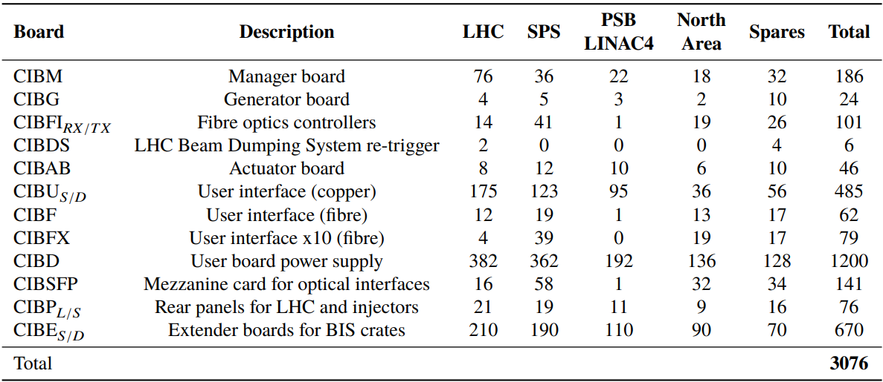





Status and Outlook
BISv2 reliability studies are well advanced
Main next step is to feed the board analyses (bottom-up FMECA) back into the global model and include latest reliability studies on TSU upgrades (part of beam dumping system)
Preliminary results show that
  The requirement for missed dumps are made with orders of magnitude margin
  The requirement for spurious dumps will be a closer call
Analysis finished
Not in scope (only patch panels)
To be done
See below

Slide 13
Summary
The BISv2 follows a defined life-cycle for protection systems, which includes a reliability analysis to
  Identify hazards and quantify reliability requirements to mitigate them
  Qualify the hardware design to conform with the reliability requirements
The reliability analysis has been carried out using a well-established process
  Automated tools are being used to speed up the analysis process and minimize human err
  This allows to focus more time on analysing the design and iterate faster through design iterations
The BISv2 reliability study is almost complete
  Preliminary results show that critical functionality requirements are made with orders of magnitude margin
  The final steps will be to feed the individual board results into the global model for a final confirmation

Slide 14
Back up slides

Slide 15
List of contents
FMECA Process
Failure rates prediction
Failure modes apportionment
End-effects
Future directions

Slide 16
Introduction
Component-level FMECA
Failure Modes, Effects, and Criticality Analysis (FMECA)
Purpose: identify potential failure modes of individual components within a system & quantify failure impact at system level
Id | Component | Description | failure_mode | Alpha | Component Failure Rate | Failure Mode Rate | End Effect
1.1 | C2 | ¬±10% 50V X7R SMD Multilayer Chip Ceramic Capacitor | Open | 9 | 0.357 | 0.032 | False dump
1.1 | C2 | ¬±10% 50V X7R SMD Multilayer Chip Ceramic Capacitor | Parameter change | 61 | 0.357 | 0.218 | No effect
1.1 | C2 | ¬±10% 50V X7R SMD Multilayer Chip Ceramic Capacitor | Short | 30 | 0.357 | 0.107 | False dump

Slide 17
FMECA Process
Key steps
Establish system definition including boundaries, main functions, top-level failures & end-effects.
Using Bill of Materials, do a component-wise Failure Rate Prediction.
  Mainly based on 217Plus standard (2015/RIAC, but also available: Telcordia TR/SR, MIL-217, NSWC). Completed by manufacturer and test data.
Identification & apportionment of component failure modes
  i.e., capacitor -> {open, param. change, short}.
  Based on handbooks (MIL-HDBK338, FMD2016).
Assigning end-effects to each failure mode of every component of the system.
  i.e., Capacitor C1: open -> no effect, short -> false dump, param. change -> blind failure.
Screenshot of Isograph Reliability Workbench (tool used for FMECA analysis)

Slide 18
FMECA Process
Previously
Manually assigning failure rates for a design with 800 components takes roughly
20 hours.
Very error-prone process, with multiple parameters to be set repeatably.
Failure modes
Manual assignment of end-effects for every component failure mode is very work-intense and non-trivial, putting a heavy requirement on the system experts.
Manually assigning possible component failure modes
will take equally long.
Tools exist to facilitate this process.
Failure rates
End-Effects

Slide 19
FMECA Process
Now
The first step can be automated using the project files available in EDMS.
To make the process more comprehensive, certain design conventions need to be present in the file. For instance, the Design Office processed files keep the same format of the Bill of Materials, making it easier to process.
Failure modes
Manually assigning failure rates for a design with 800 components takes roughly
20 hours.
Very error-prone process, with multiple parameters to be set repeatably.
Difficult to automate.
Exploring possibilities for using circuit simulation to support this phase of study.
Manual assignment of end-effects for every component failure mode is very work-intense and non-trivial, putting a heavy requirement on the system experts.
Straightforward replacement by an automated script assigning each category of components a given set of failure modes with corresponding probabilty.
Manually assigning possible component failure modes
will take equally long.
Tools exist to facilitate this process.
Failure rates
End-Effects

Slide 20
Failure rates prediction
Id | Component | Description | failure_mode | Alpha | Component Failure Rate | Failure Mode Rate | End Effect
1.1 | C2 | ¬±10% 50V X7R SMD Multilayer Chip Ceramic Capacitor | Open | 9 | 0.357 | 0.032 | False dump
1.1 | C2 | ¬±10% 50V X7R SMD Multilayer Chip Ceramic Capacitor | Parameter change | 61 | 0.357 | 0.218 | No effect
1.1 | C2 | ¬±10% 50V X7R SMD Multilayer Chip Ceramic Capacitor | Short | 30 | 0.357 | 0.107 | False dump
Automatic assignment of failure rates to individual components.

Slide 21
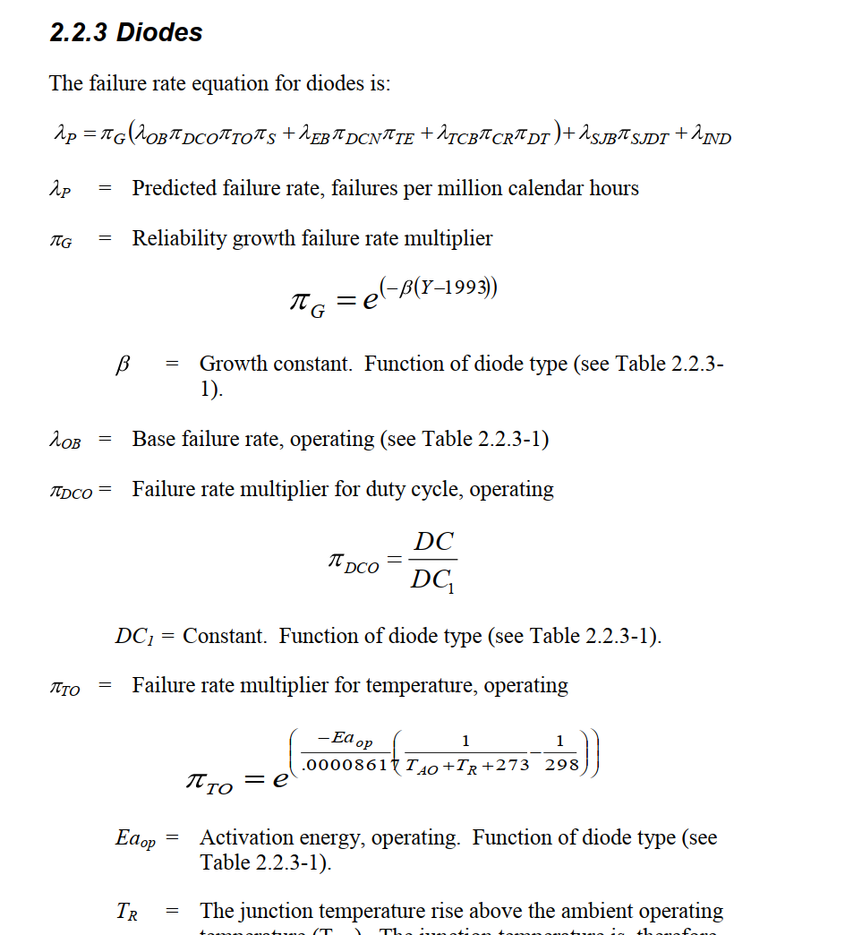
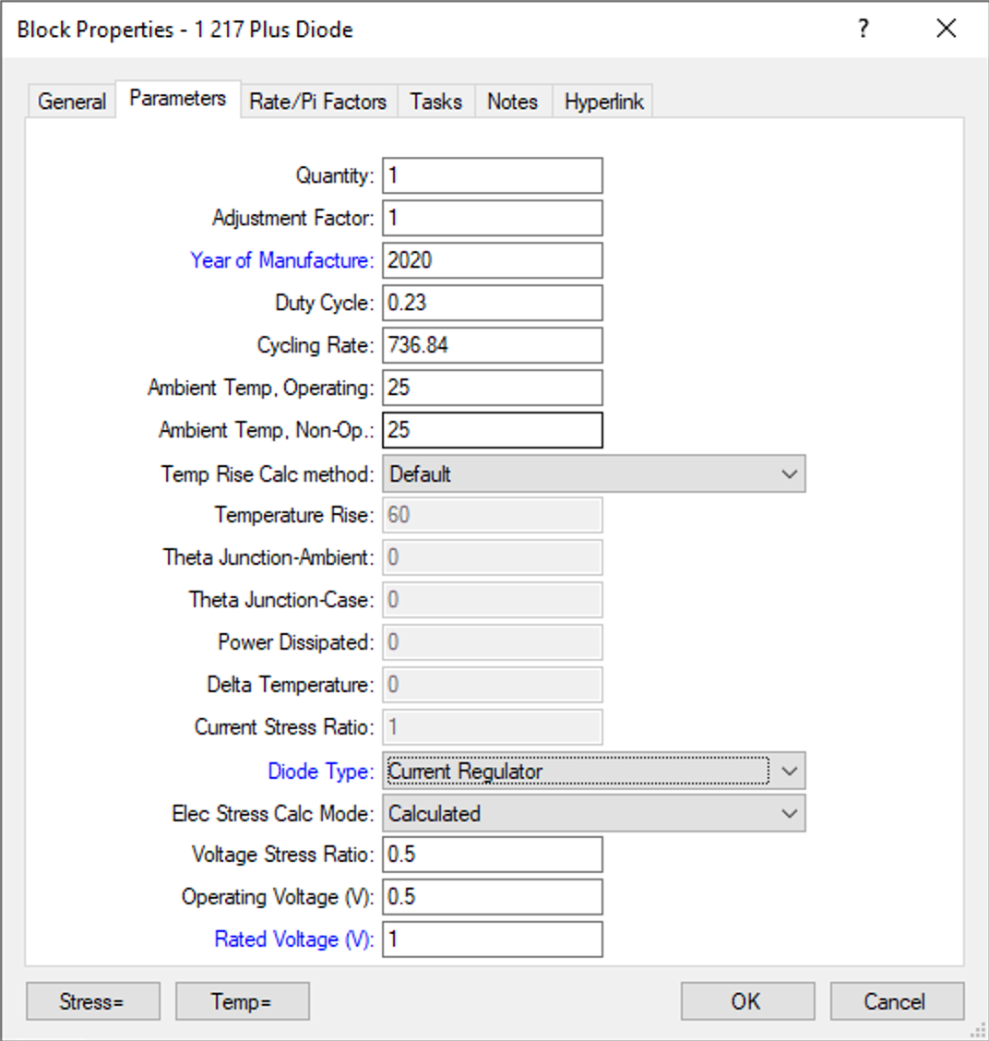
Manual failure rate calculation

Slide 22









Automatic Failure Rate Prediction Tool
Inputs & Outputs
Sources
Resources
Other Parameters | Value
Ambient temperature | 45C
Environment | Ground, benign
Quality, etc… (modifiable per component)
Project configuration parameters
Isograph’s parameter strings
External components’ failure rates
String markers to 217 Plus designators
Operating voltages of the capacitors
PCB Schema with Metadata
Design files from EDMS
Bill of materials
CSV
XLS
PDF
CSV
Automatic Failure Rate Prediction Tool
Isograph-friendly CSV file
General parameters
Netlist file from Altium
Christos Gentsos script
Notes:
+ animations and/or numbering

Slide 23
Automated Failure Rate Prediction Tool
Footnotes
The prediction model still contained in Isograph.
  For that reason the output of the tool is a CSV file which is supposed to be imported to Isograph tool.
  Implementing prediction formulas of one of the standards would remove the dependency on Isograph.
The results of the script to be reviewed
  Works generally well with PCB designs processed by the design office.
    Components recognized by keywords
    Operating voltages of capacitors depend on naming conventions used for nets
  → Results still require checking by the person performing the analysis for components not contained in the prediction standard and to look for any potential mismatches.

Slide 24
Failure modes apportionment
Id | Component | Description | failure_mode | Alpha | Component Failure Rate | Failure Mode Rate | End Effect
1.1 | C2 | ¬±10% 50V X7R SMD Multilayer Chip Ceramic Capacitor | Open | 9 | 0.357 | 0.032 | False dump
1.1 | C2 | ¬±10% 50V X7R SMD Multilayer Chip Ceramic Capacitor | Parameter change | 61 | 0.357 | 0.218 | No effect
1.1 | C2 | ¬±10% 50V X7R SMD Multilayer Chip Ceramic Capacitor | Short | 30 | 0.357 | 0.107 | False dump
Adding the failure modes to the failure rate predictions.

Slide 25

Failure mode apportionment
Failure rates for all components exported from Isograph
 | Component | Description | Failure rate
C1 | Capacitor | Non-polarized ceramic capacitor | 33.333
D1 | Diode | Transient Voltage Suppressor | 5.41
EX1 | FPGA | Field-Programmable Gate Array | 11
Failure rate apportionment taken from FMD-93, FMD-2016, other
Table specifying failure modes for each component in the project (including probability estimation based on the failure prediction step)
Capacitor, Fixed, Ceramic
Diode, Suppressor, Transient
Failure mode | Apportionment
Drift | 60.6%
Shorted | 30.1%
…
Failure mode | Apportionment
Shorted | 84.6%
Opened | 7.7%
…
…

Slide 26
Establishing end-effects
Id | Component | Description | failure_mode | Alpha | Component Failure Rate | Failure Mode Rate | End Effect
1.1 | C2 | ¬±10% 50V X7R SMD Multilayer Chip Ceramic Capacitor | Open | 9 | 0.357 | 0.032 | False dump
1.1 | C2 | ¬±10% 50V X7R SMD Multilayer Chip Ceramic Capacitor | Parameter change | 61 | 0.357 | 0.218 | No effect
1.1 | C2 | ¬±10% 50V X7R SMD Multilayer Chip Ceramic Capacitor | Short | 30 | 0.357 | 0.107 | False dump
Understanding

Slide 27

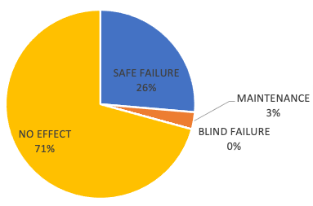
Assinging end-effects to failure modes
 | Component | Failure mode | Failure rate x alpha | Expert-assigned end-effect
C1 | Capacitor | Drift | 19.98 | NO EFFECT
C1 | Capacitor | Shorted | 10 | BEAM DUMP
…
D1 | Diode | Shorted | 4.57 | NO EFFECT
…
Experts & designers
Designers assigning end-effect for the entire system to each failure mode
Common review with designers, experts, reliability team
Exploring possibilities for using circuit simulation to partially automatize this phase of study.

Slide 28

Prediction Pipeline in Action

Slide 29
Summary
An overview of the state of development and future directions.

Slide 30
Summary
A tool to automatize component-FMECA analyses for electronics has been presented
  Significantly accelerates and simplifies FMECA generation for electronics designs
Usability
  The tool is available on https://gitlab.cern.ch/mblaszki/failure-rate-prediction-automation, see back-up slides for examples on how to use it
  Works well with PCB designs processed by the Design Office
  Tool & Workflow could be simplified and better documented if there is common interest
Points of improvement
  Currently relying on Isograph for prediction models and manual corrections
  JSON database of external failure rates in the repository
  Investigate possibility of automatic end-effect assignment

Slide 32
Introduction
Component-level FMECA
Failure Modes, Effects, and Criticality Analysis (FMECA)
Purpose: identify potential failure modes of individual components within a system & quantify failure impact at system level
Importance: enhance system reliability by addressing component-level vulnerabilities
Benefits:
Identifies potential failure points before they impact system operation
Enables targeted mitigation strategies to minimize the likelihood and impact of failures
Reduces downtime and maintenance costs associated with unexpected component failures
Integration: Validates sub-system design with respect to systems level reliability requirements.

Slide 33
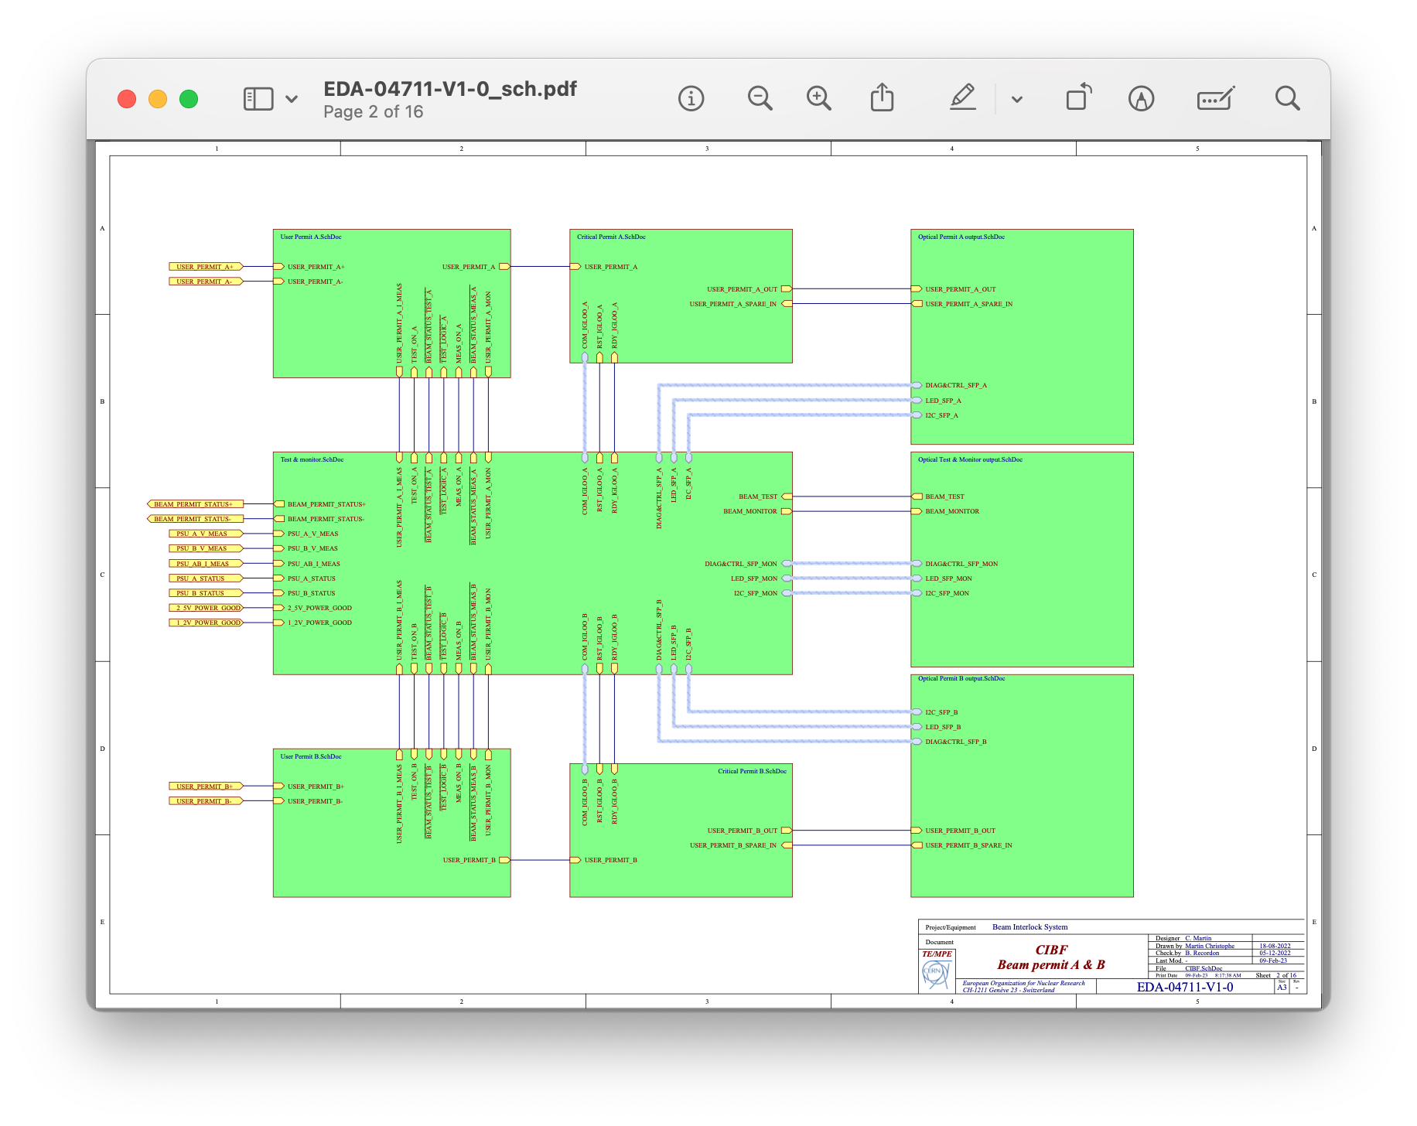
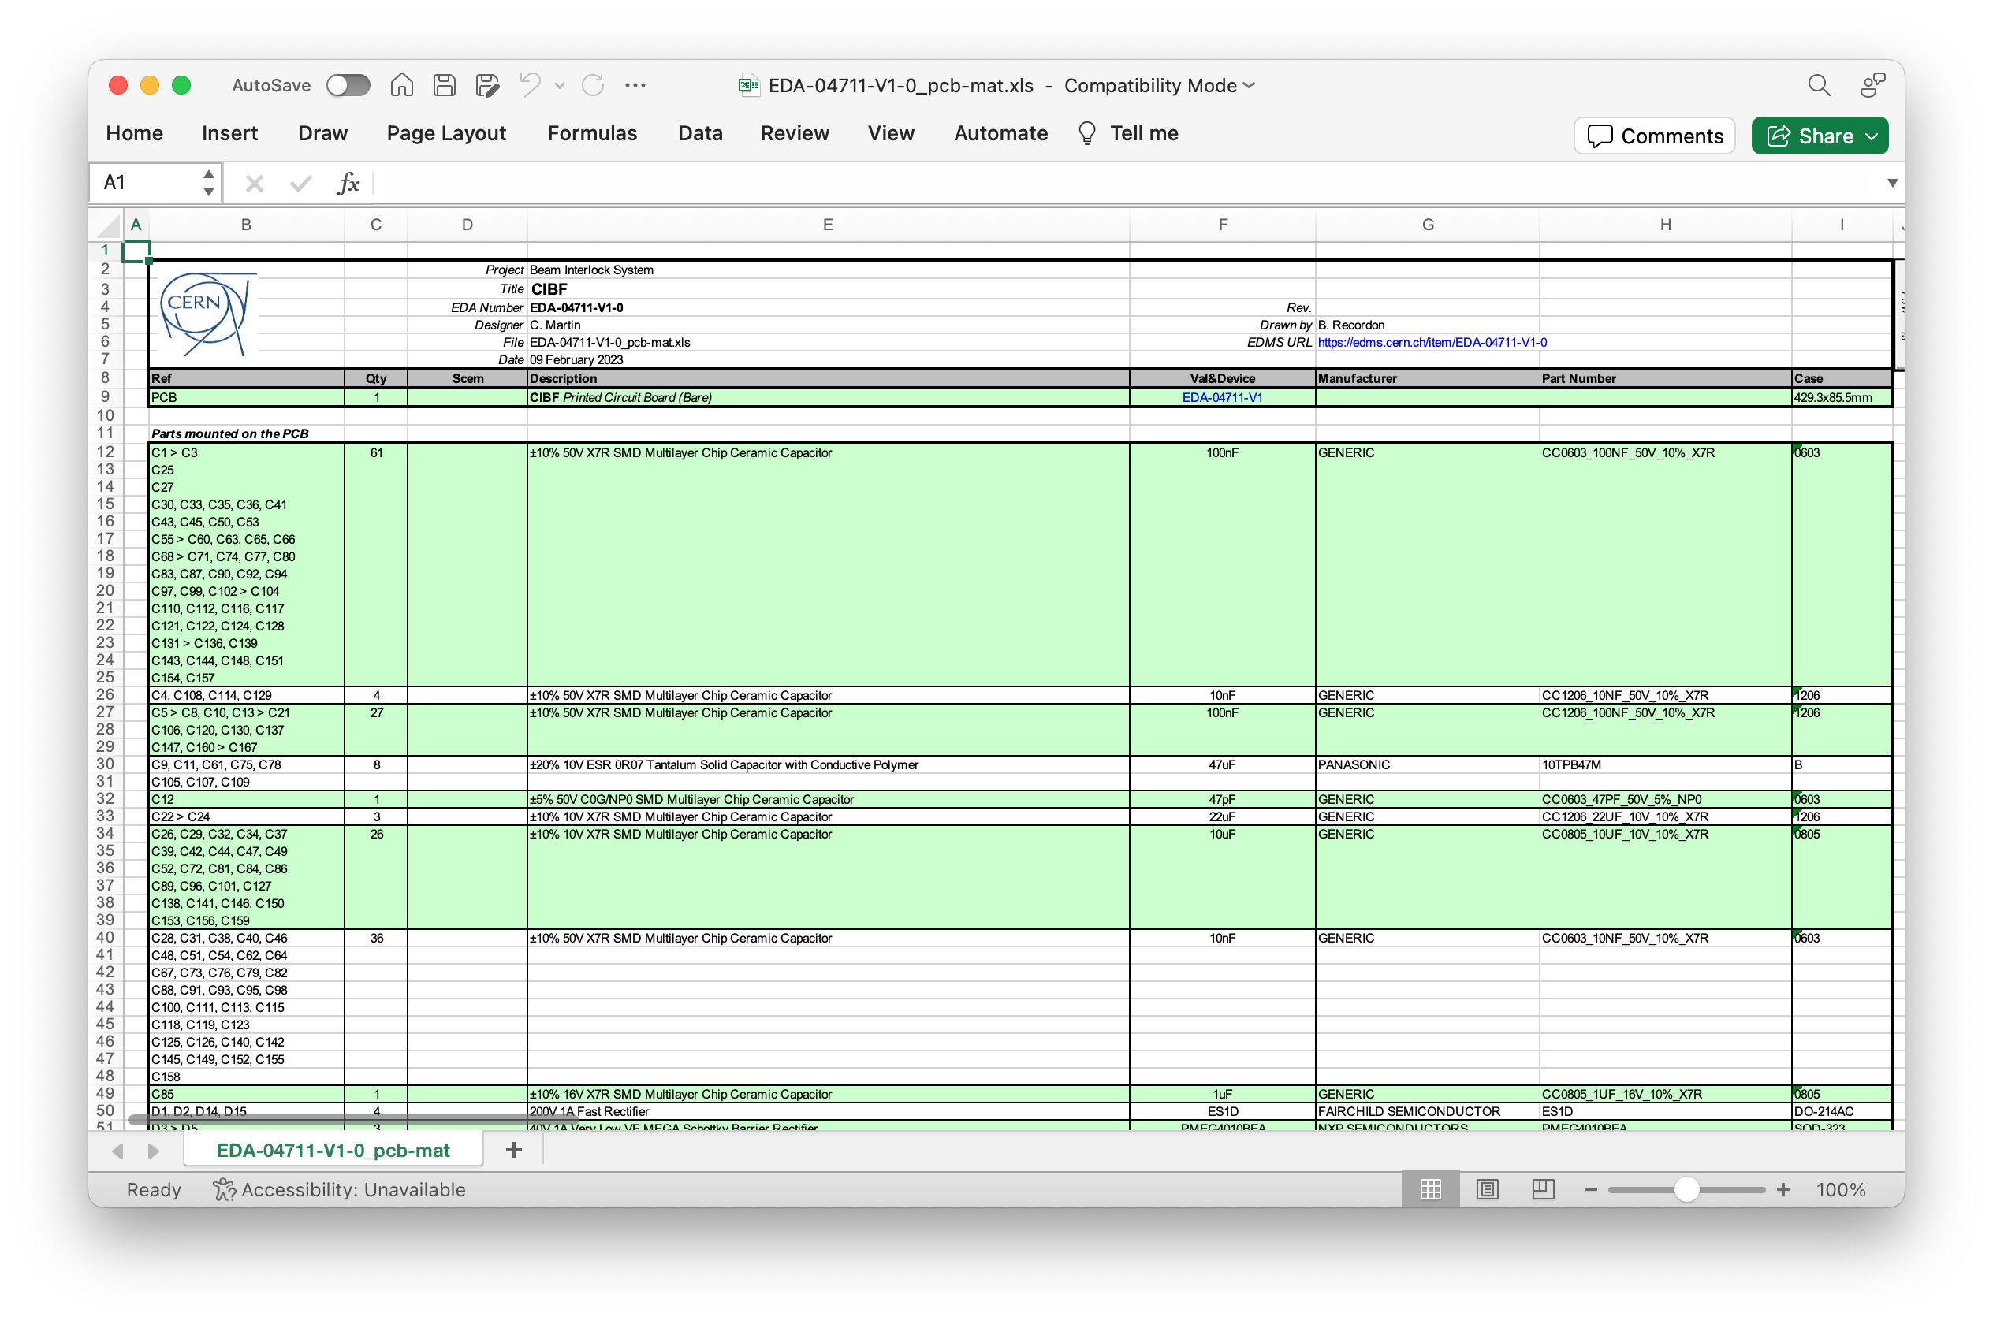
Example
CIBF
Bill of Materials from the EDMS files produced by the Design Office
PDF of the schematics from the same project

Slide 34
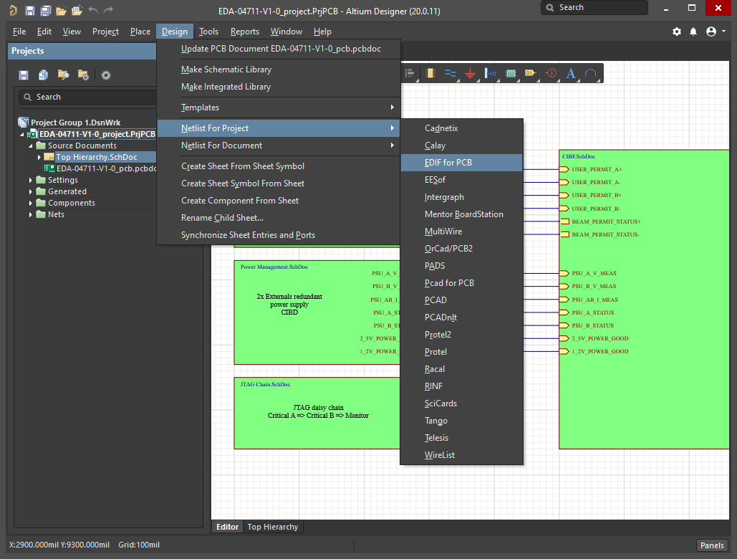
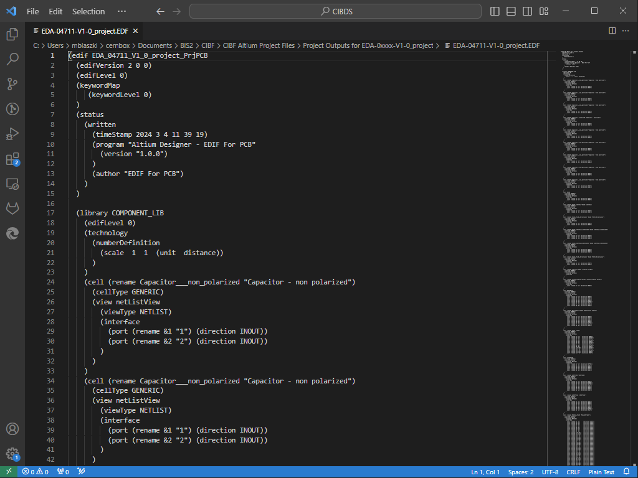
BISv2 CIBF Example
Creating a netlist from Altium
In an Altium project, select one of the project files and go to Design > Netlist for Project > EDF for PCB
Netlist file

Slide 35
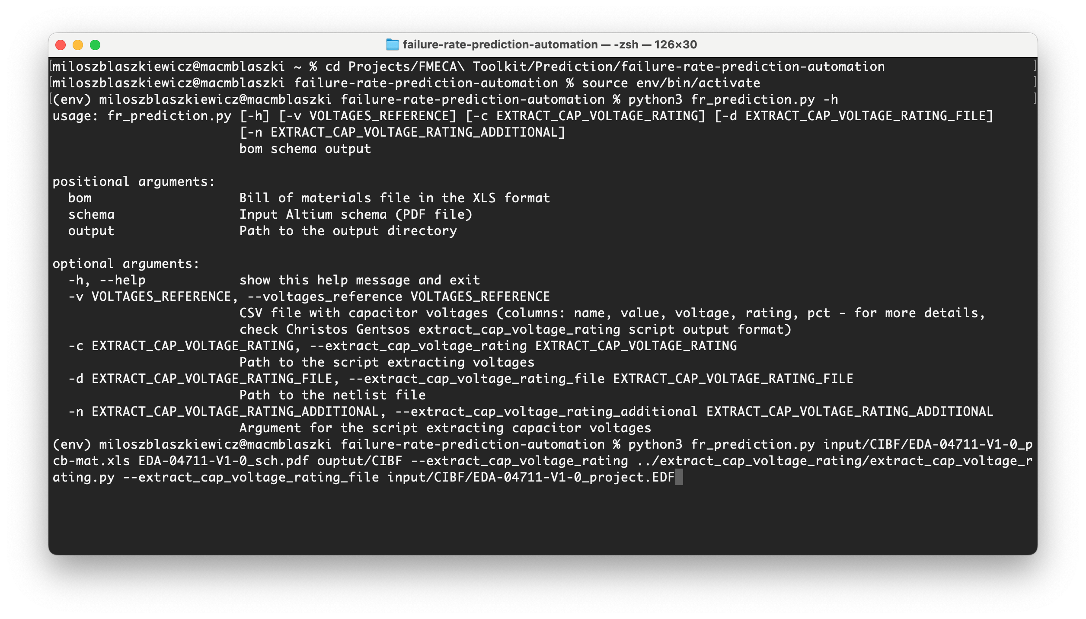
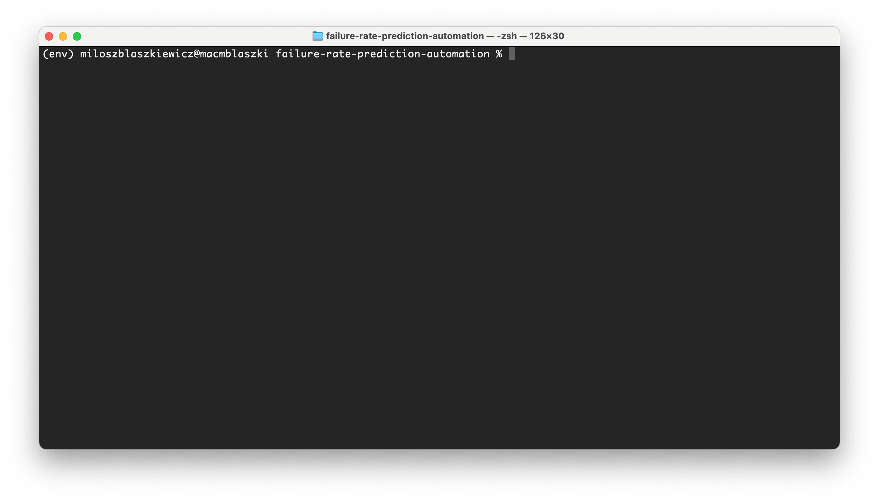
BISv2 CIBF Example
Running the script
1. Enter the project’s directory:
cd Projects/FMECA\ Toolkit/Prediction/
failure-rate-prediction-automation
2.1. Activate the environment:
source env/bin/activate
2.2. Alternatively, if no environment:
python –m venv env
source env/bin/activate
pip install –r requirements.txt
3. Run the script with appropriate options
[add most commonly used command]

Slide 36
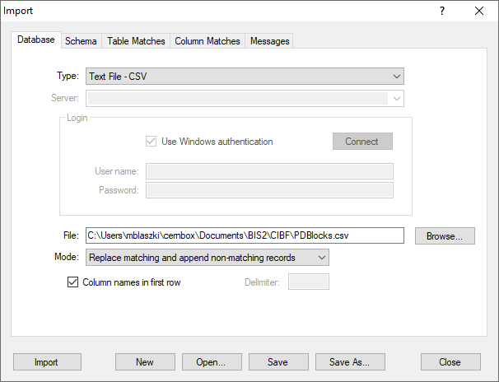
BISv2 CIBF Example
Importing to Isograph
Go to File > Import
In the Database tab:
  Select “Type”: “CSV”
  Select the input file produced by the script
  Tick “Column names in first row”
In the Table Matches, indicate a connection between imported table and “PDBlocks”
In the Column Matches, click on “Auto match” and check if columns are correctly mapped.
Click “Import”.

Slide 37
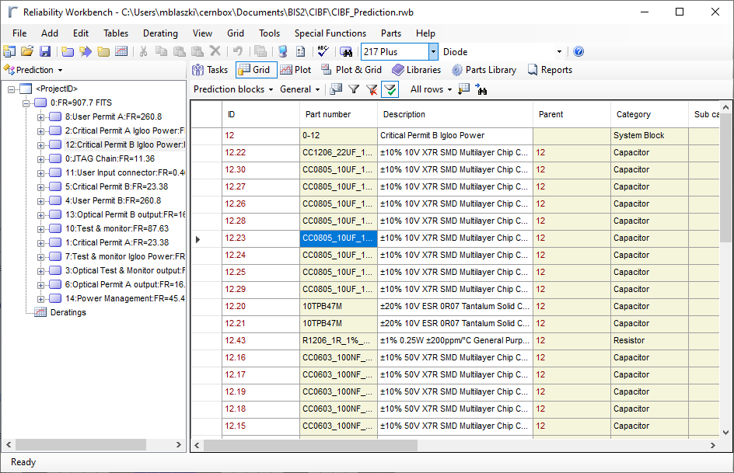
BISv2 CIBF Example
Reviewing in Isograph

Slide 38
Practical takeaways
In the current development state
Benefits
Limitations
Works generally well with PCB designs processed by the design office.
Obtaining an instantaneous estimation of FITs for the project. Saves many hours of manual work.
Database of external failure rates library to cover the wide scope of components (will grow as the tool is used with more projects).
Isograph GUI for checking the model representation for possible mistakes.
Not all voltages of capacitors can be detected: adding missing mappings of voltages in to net names (while +3.3VCC is recognised automatically, but names such as PSU_AB_I_MEAS_1 are impossible to auto-classify)
Adding missing values and parameters which are not supported yet: e.g., 217Plus standard defines many parameter dependencies – some are not supported by Isograph
Furthermore, categorization is largely based on recognising specific keywords in the description string. Mapping them is not straightforward (and a clear definition is missing in the standard).

Slide 39
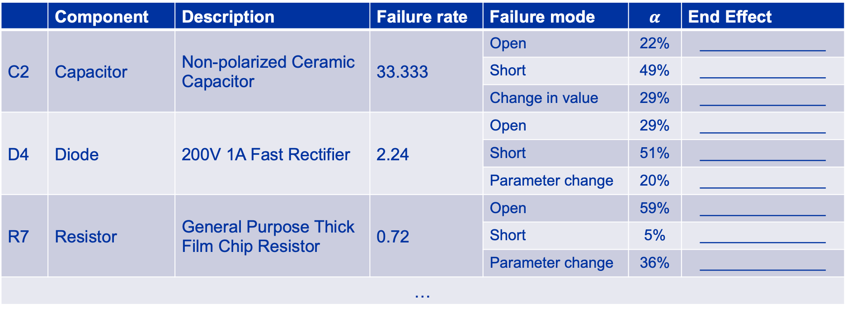
Failure modes apportionment
Example of a template for end-effects step
 | Component | Description | Failure rate | Failure mode | $$α$$ | End Effect
C2 | Capacitor | Non-polarized Ceramic Capacitor | 33.333 | Open | 22% | _______________
 |  |  |  | Short | 49% | _______________
 |  |  |  | Change in value | 29% | _______________
D4 | Diode | 200V 1A Fast Rectifier | 2.24 | Open | 29% | _______________
 |  |  |  | Short | 51% | _______________
 |  |  |  | Parameter change | 20% | _______________
R7 | Resistor | General Purpose Thick Film Chip Resistor | 0.72 | Open | 59% | _______________
 |  |  |  | Short | 5% | _______________
 |  |  |  | Parameter change | 36% | _______________
…

