Slide 1
Overview of the MYRRHA/MINERVA project
Daneels Ruben
25.09.2024

Slide 2


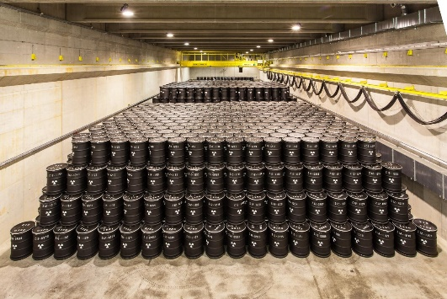
Why do we want an Accelerator driven System (ADS)?
Advanced Recycling
(P&T)
Nowadays
Reprocessing
(PUREX*)
No Reprocessing
Towards sustainable nuclear energy:
Subcritical nuclear reactor
  … the LINAC stops, the reactor “stops”
“Burning” existing nuclear waste
  … while delivering electrical energy
1000
300 years
>10 000 years
>300 000 years
1
Time

Slide 3

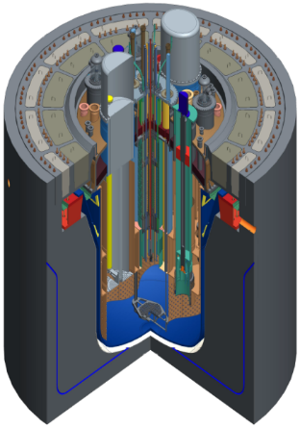
Purpose:
  ADS technology demonstrator at pre-industrial scale
  Flexible irradiation facility (Radio isotope production, reactor fuel research, …)
At SCK CEN – the Belgian nuclear research center
Pre-studies since decades
SUBCRITICAL REACTOR (~70MWth)
600 MeV Protons
4mA - CW
MTBF > 250h for beam trips over 3s
3 types of SC-cavities

Slide 4
Belgian Governmental decision of Sept 2018:
build MYRRHA, a new large research infrastructure in Mol
allocate a budget of € 558 m for the first phase
  € 287 m for 2019 – 2027: construction of MINERVA
  € 115 m for 2019 – 2026: design, R&D and licensing for phases 2 (extended accelerator) & 3 (reactor)
  € 156 m for the period 2027 – 2038: to operate MINERVA
establish a non-profit organization MYRRHA IVZW/AISBL
  in charge of the MYRRHA facility international outreach and serving as the legal structure for welcoming international partners
establish governmental support for promoting MYRRHA international partnerships

Slide 5
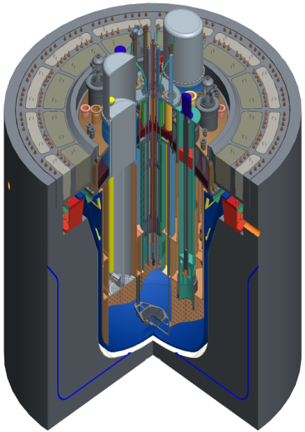
MYRRHA, a phased approach
Phase 2 - 600 MeV
Phase 1 - 100 MeV
“MINERVA”
Application Centers
Phase 3 - Reactor

Slide 6
MINERVA = MYRRHA phase 1 implementation
100 MeV
  1 injector
  1 SC cavity type
Test the reliability concepts (RF-fault tolerance)
Two target stations:
  ISOL system (PTF): reduced duty factor (50kW)
  Full power Facility (FPF): Fusion material research, 400 kW

Slide 7
The MINERVA accelerator
Has been studied academically for some time
  Simulations, “test cryo-module”, injector test stand
End 2019: accelerator team was created at the final site
  Current size ≈30 persons
  -> heavily relying on collaborations and industry
Critical review of the acc layout and components lead to significant design changes since 2020

Slide 8
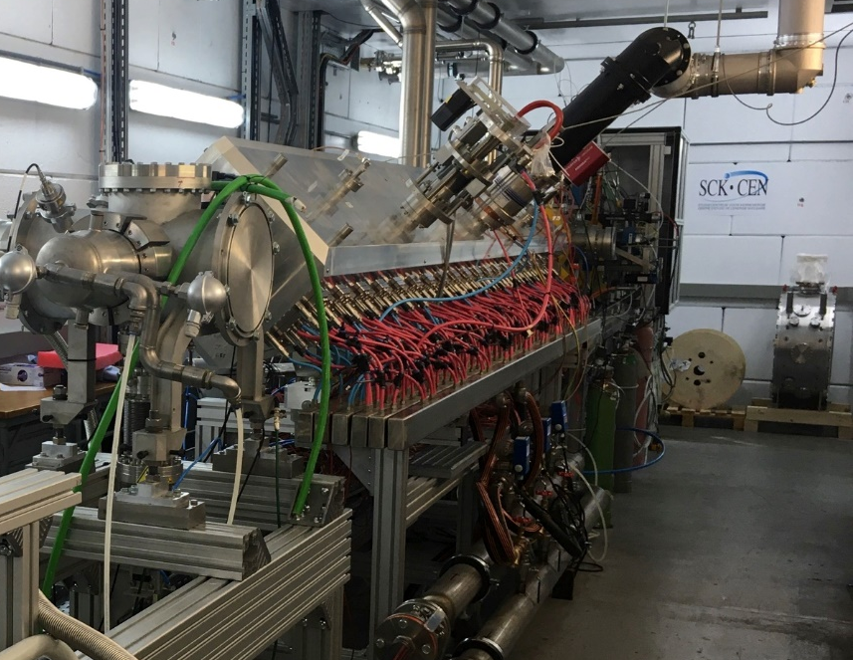
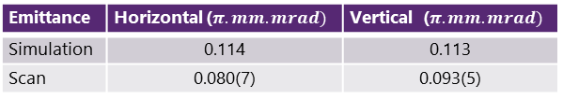
Injector
Normal conducting CH-cavities up to 17MeV, 176MHz
Experimentally validated up to exit RFQ in R&D manner
  ECR ion source, 4-rod RFQ with up to 160 kW
  Emittance measurement done
Full Beam characterization including collimation (also in stand-by inj.)
Emittance | Horizontal ($π.mm.mrad)$ | Vertical ($π.mm.mrad)$
Simulation | 0.114 | 0.113
Scan | 0.080(7) | 0.093(5)
Diagnostic & Collimation
CH-linac
Dogleg
SC-linac
Injector test stand currently being dismantled

Slide 9
SC-linac
Optics & layout “classic high-power SC-linac-style”:
  30 cryo modules with each 2 single spoke cavities (352.2 MHz, β = 0.352)
  Warm section with doublet & diagnostic
  BPM & correctors integrated into quadrupoles
Last doublet used to match into “HEBT”
Significant RF-overhead for serial fault tolerance
Matching optimization still ongoing

Slide 10
100 MeV “HEBT”
Feed-down quadrupole
Magnetic septum
kicker
FPF
PTF beam size (6σ)
PTF
kicker
Pulse pattern
(RF = CW)
Space for SC-rebunching cryo-module for matching to future medium beta linac

Slide 11
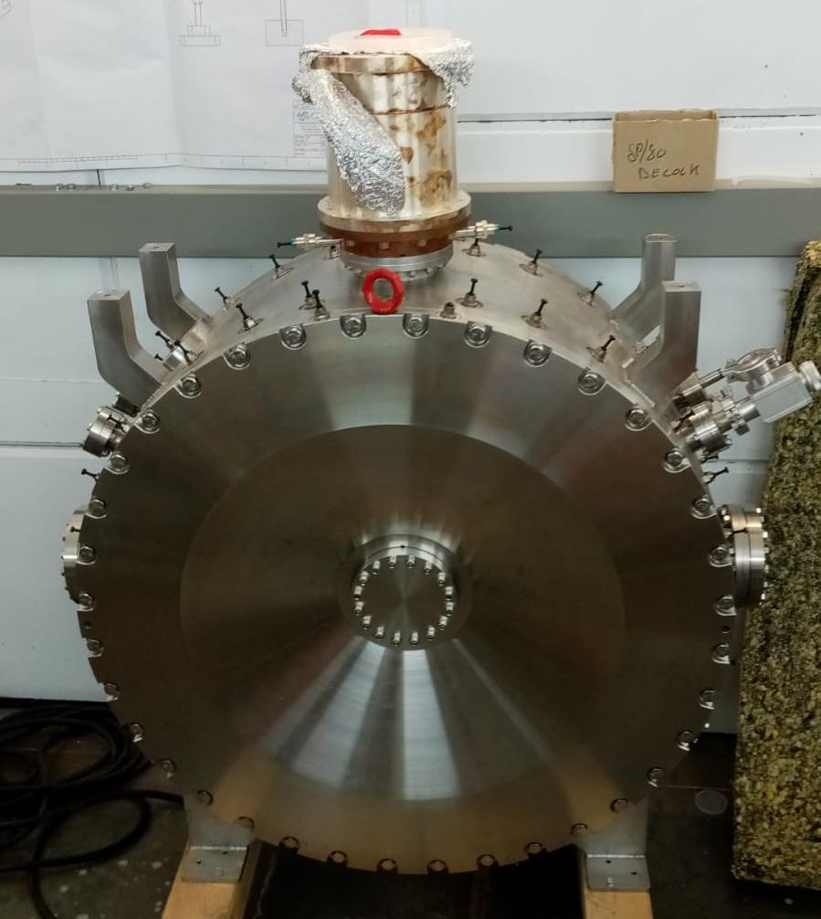
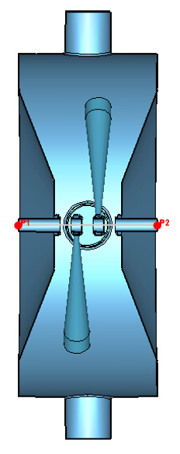
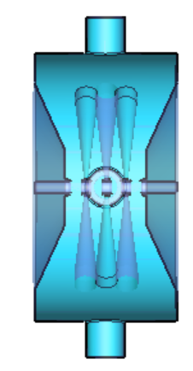
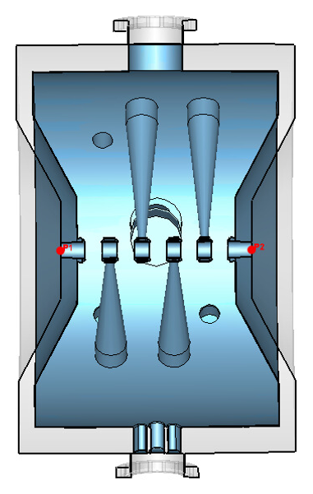
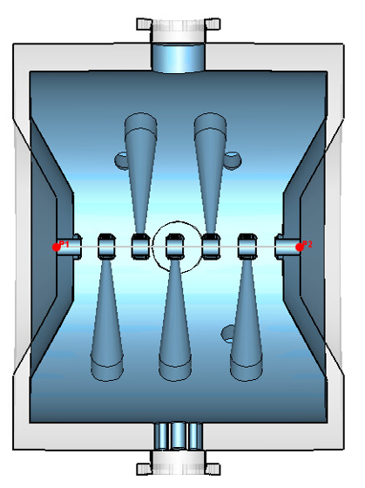
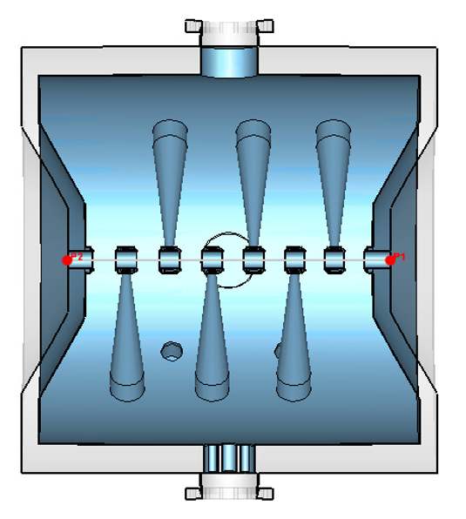
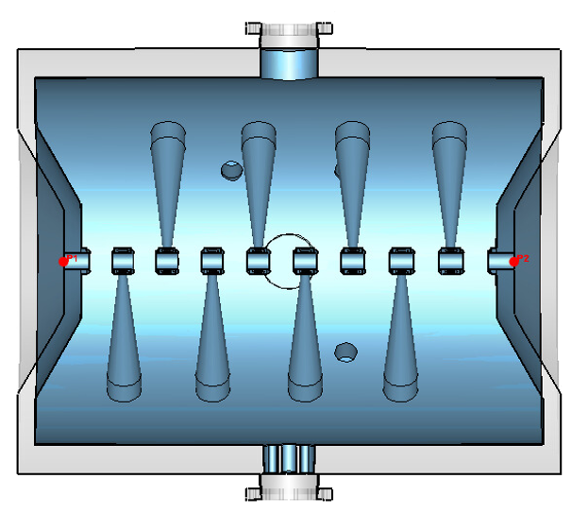
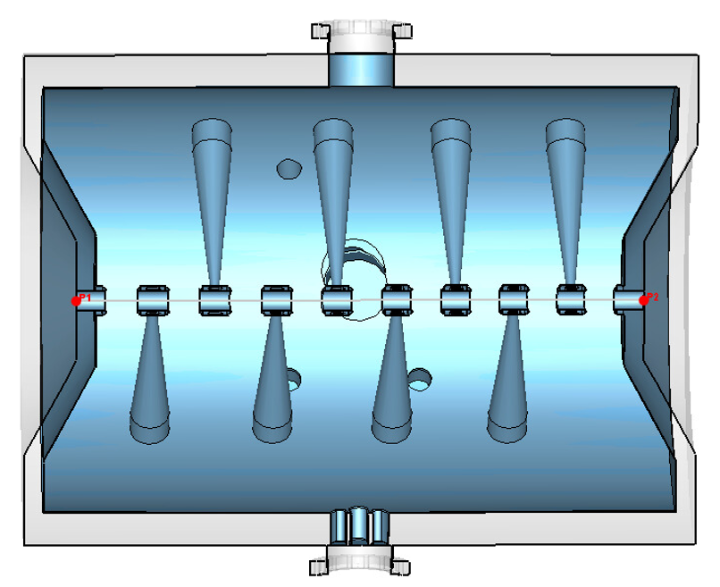
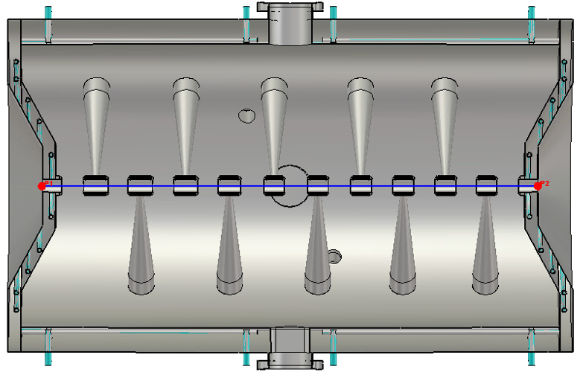
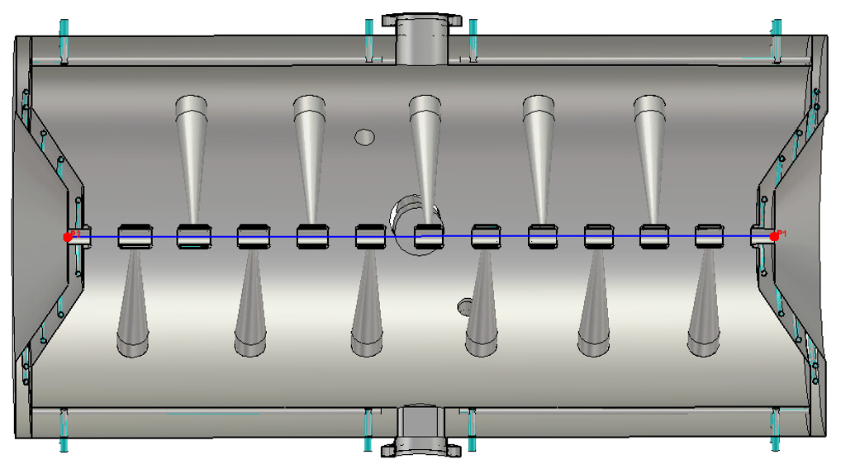
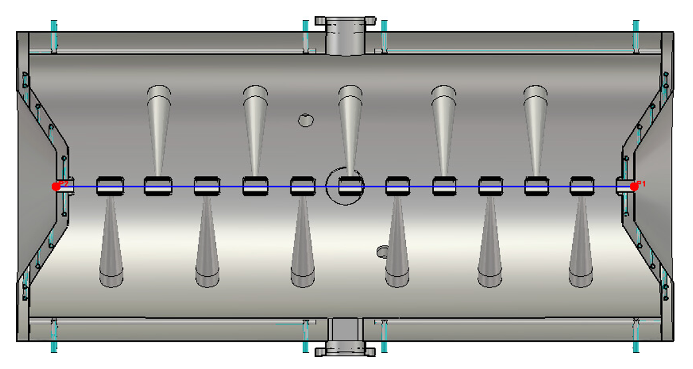
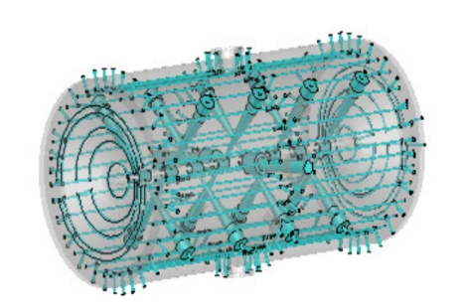
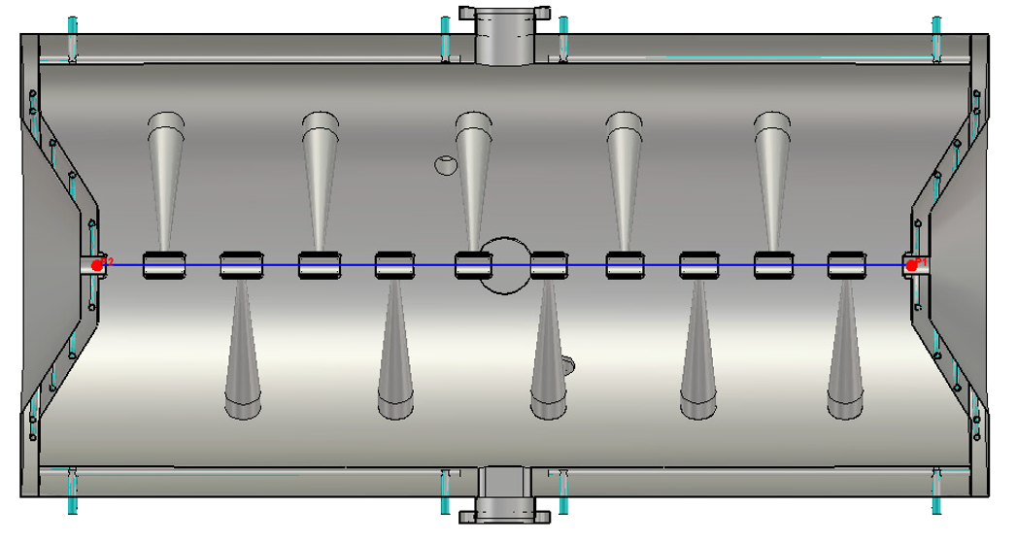
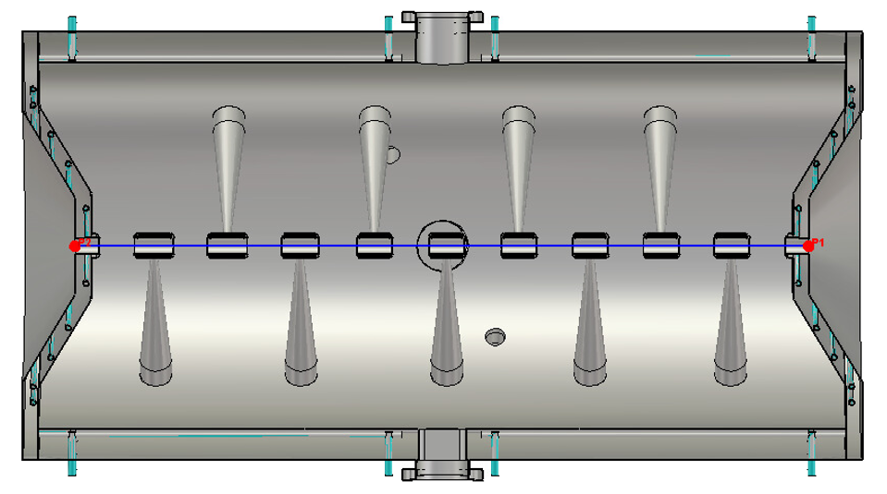
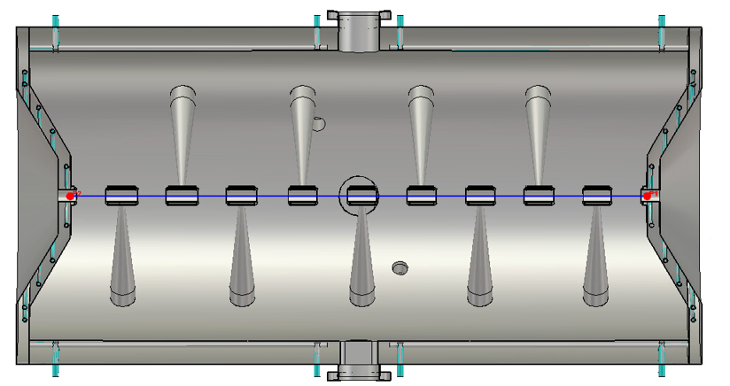
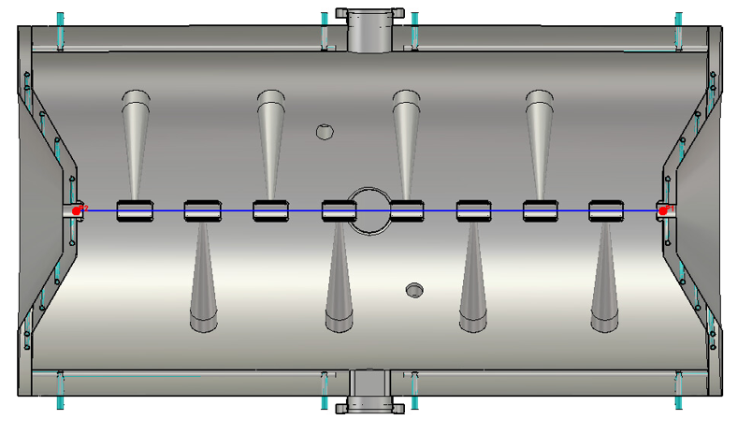
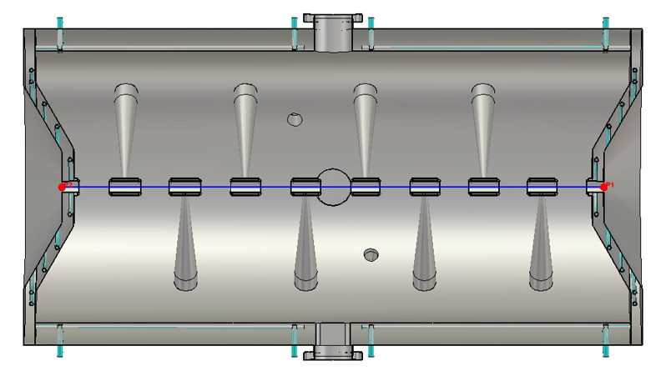


CH-cavities
Design by IAP/Bevatech, currently iterating internally & with RI
First two already produced by NTG / Pink
Series contract awarded to RI, production start imminent
1.5 - 16.6 MeV
CH1
CH2
CH3
CH4
CH5
CH6
CH7
CH8
CH9
CH10
CH11
CH12
CH13
CH14
CH15
CH15 - integrated water channels

Slide 12
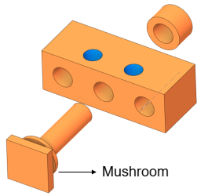


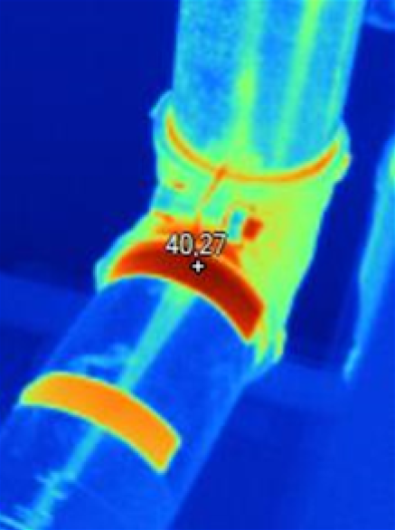



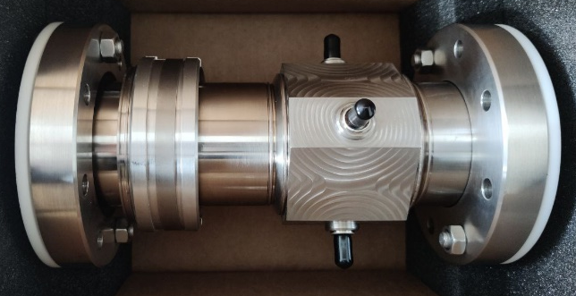


Other components
LLRF system
  Demonstrator systems used at the injector test stand
  Final system: uTCA-based, collaboration with DESY
Magnet design engineer appointed
Beam dumps: designs by ESS Bilbao
Beam diagnostic: designs e.g. by
Solid state amplifiers
  Testing systems available for the injector testing (176 MHz) and cavity testing (352 MHz)
  Critically reviewed the requirements (reliability, drain voltage adaptation, …)
  Contract recently awarded to Cryoelectra
  Using Coaxial-lines
Component OCD with
MPS: requirement collection
Reliability modeling – study completed together with

Slide 13

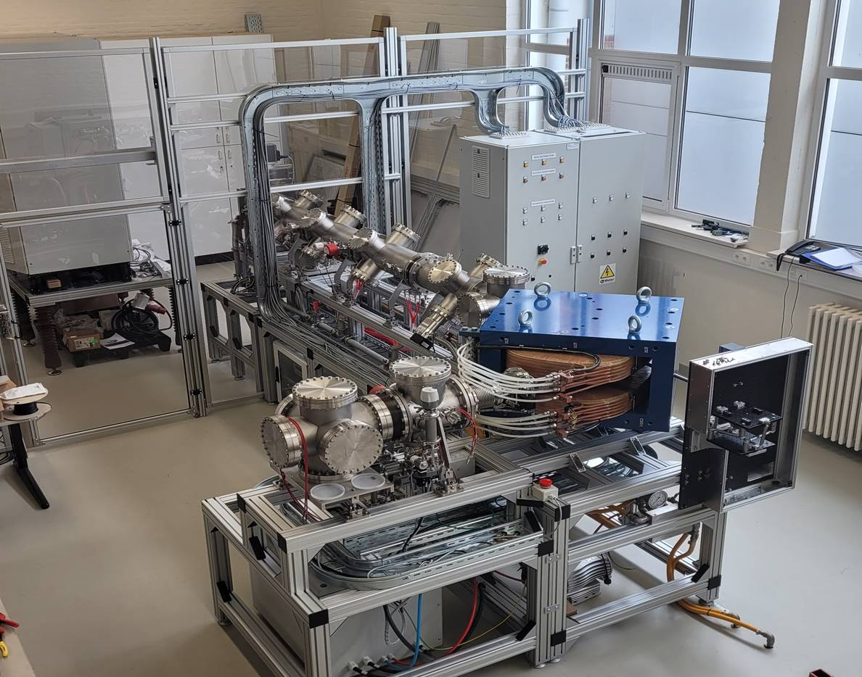
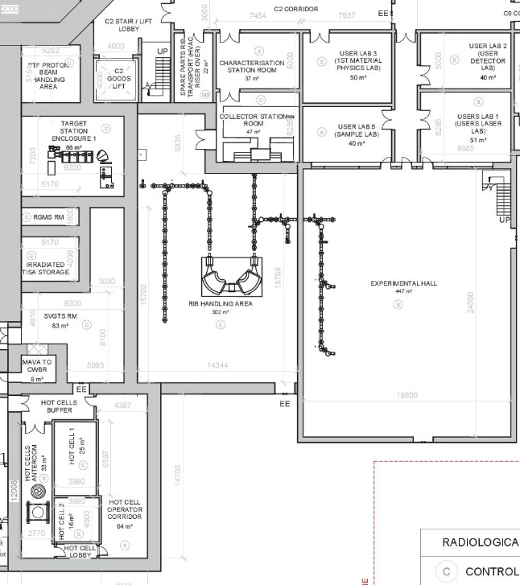
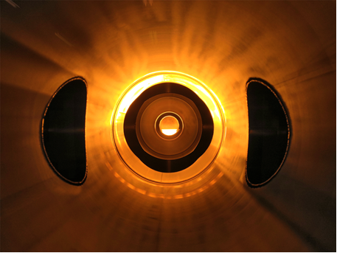
PTF: ISOL
TRIUMF ARIEL concept at the basis of the facility design
4mA, ≤ 250Hz, ≤ 0.5ms on non-actinide or ≤ 0.2ms on actinide targets
RIB mass resolving power: initial ≈1500, upgradable to 10 000
100MeV protons
Isotopes collector
station
Test stand
RIB-handling and purification system
Experimental
Hall
Target heated
up to 2000K
90° pre-separator
cleaning most RIB impurities

Slide 14
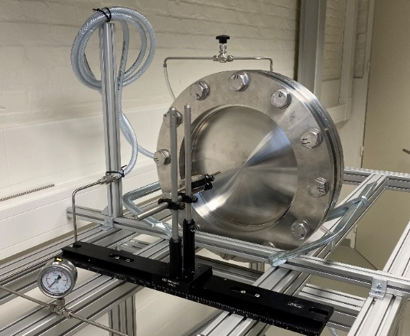
Full Power Facility (FPF)
  Inspired by IPF@LANSCE
  Beam dump for reliability studies
  Fusion material research:
    Direct proton irradiation
    Via spallation neutrons
Hot cell
Rastering magnets
Cooling water
6m
Beam window test stand

Slide 15
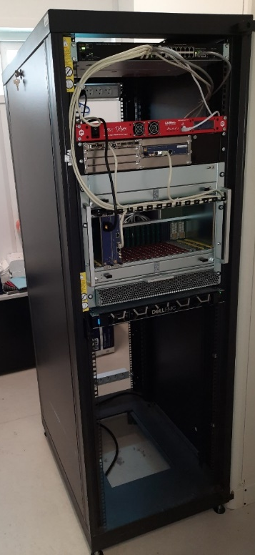
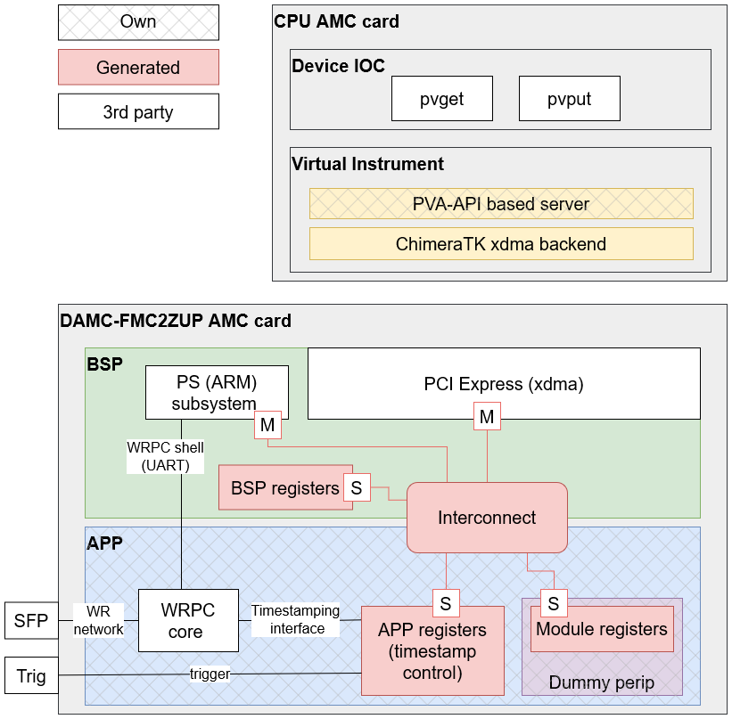
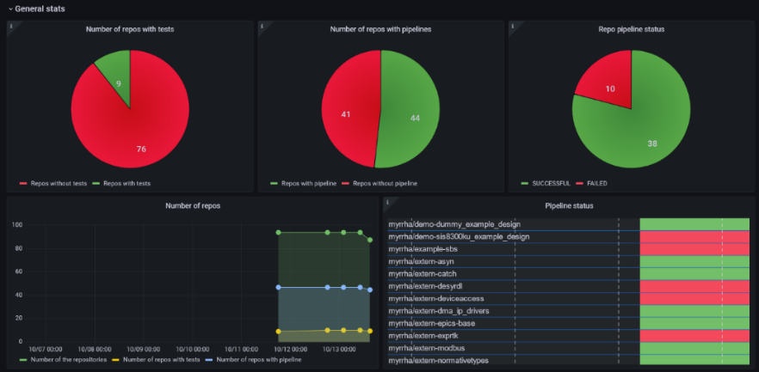
Control system
Agile based lifecycle including DevOps and Test Driven Development (TDD)
based on EPICS, µTCA4, White Rabbit and standard industrial solutions
In-house team of 6 persons to coordinate and gather input
Solution delivery mainly by Framatome Hungary and EvoPro Innovation

Slide 16
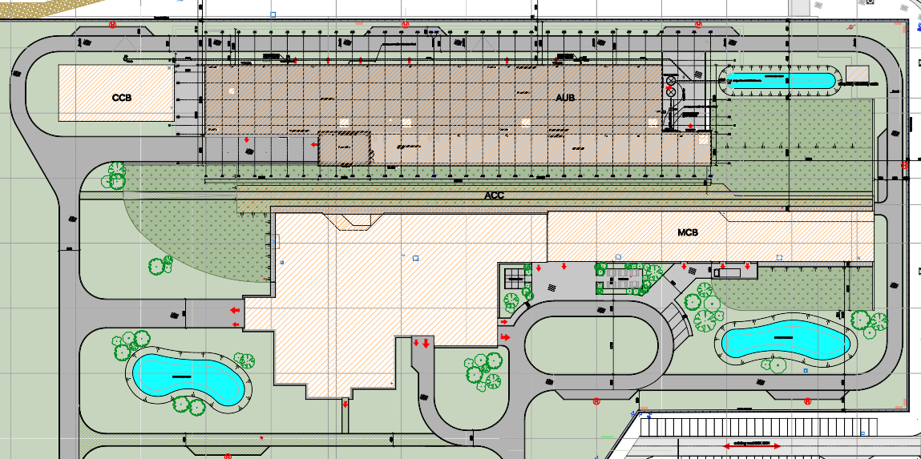
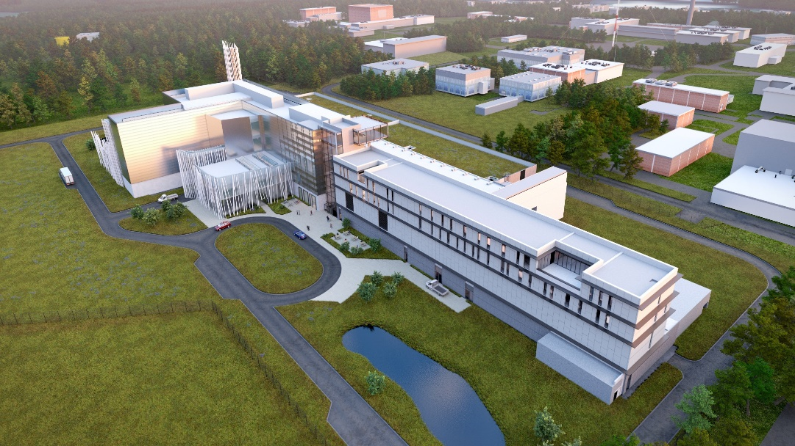
Building & infrastructure
Approach:
  One Design Engineer from conceptual design till commissioning
  Buildings, systems and specialized systems contractor
Status
  Area fenced off, cutting of trees just finished
  Construction start: Q1’25
CRYO
Accelerator utilities
RF GALLERY
stack
Central building
User building
Footprint:
  Accelerator related: 8 000 m²
  User building: 3 600 m²
Electrical: 9.8 MVA
Cryo: Equivalent heat load at 4.5K: 2.33 kW

Slide 17
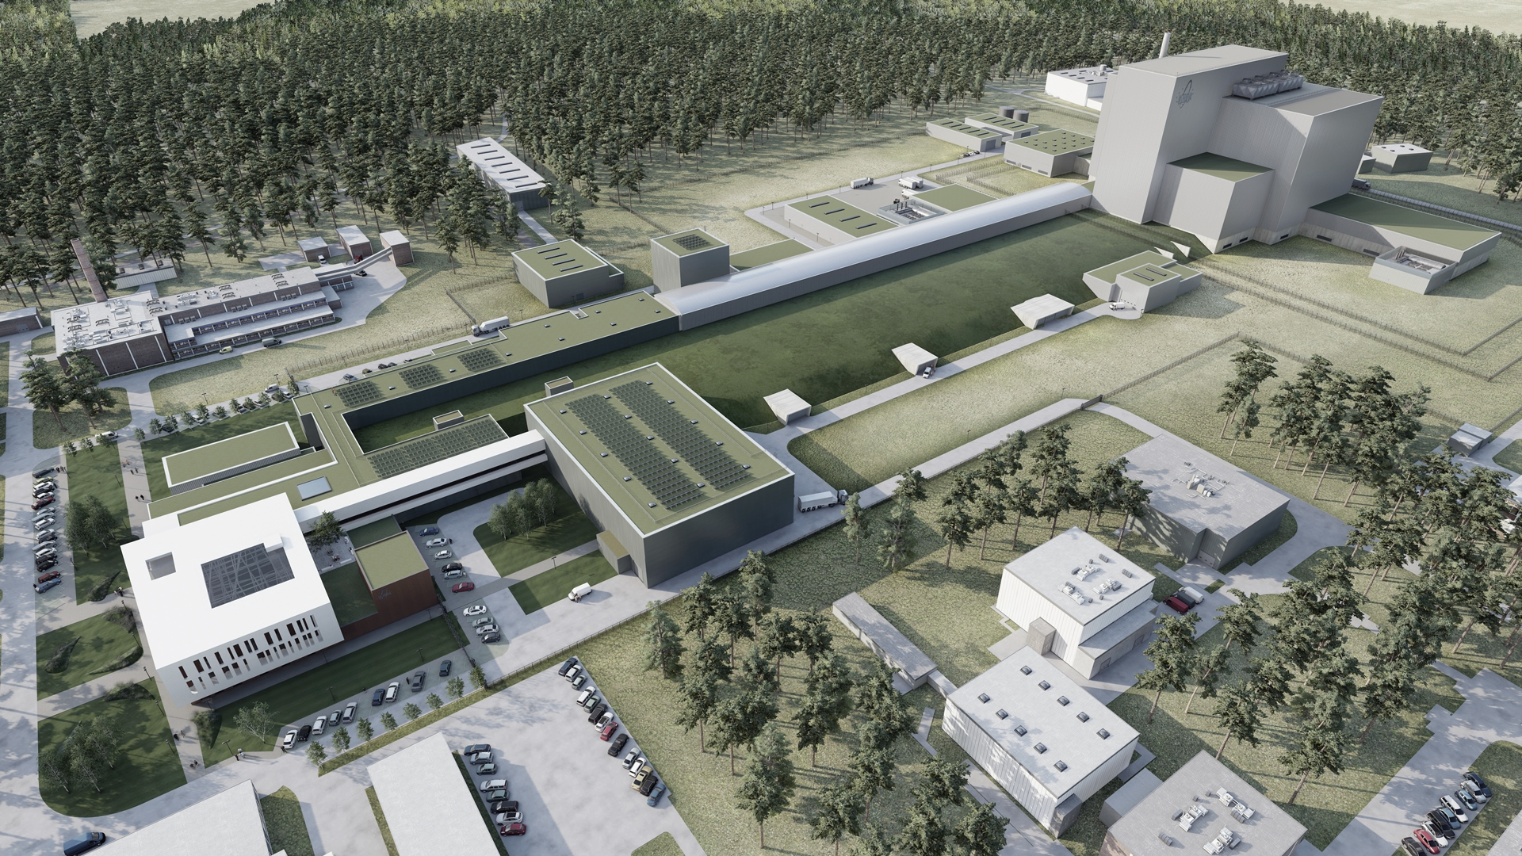
Summary
MYRRHA Phase 1 is funded & international not-for-profit organization established since 2022 as legal entity enabling interested parties (countries, organizations, companies) to join MYRRHA
Design consolidation of accelerator optics & components being finalized
First series components in production
Heavily relying on collaborations & industry

Slide 18
Copyright © SCK CEN
All property rights and copyright are reserved.
This presentation contains data, information and formats for dedicated use only and may not be communicated, copied, reproduced, distributed or cited without the explicit written permission of SCK CEN.
If this explicit written permission has been obtained, please reference the author, followed by ‘by courtesy of SCK CEN’.
Any infringement to this rule is illegal and entitles to claim damages from the infringer, without prejudice to any other right in case of granting a patent or registration in the field of intellectual property.
SCK CEN
Belgian Nuclear Research Centre
Studiecentrum voor Kernenergie
Centre d'Etude de l'Energie Nucléaire
Foundation of Public Utility
Stichting van Openbaar Nut
Fondation d'Utilité Publique
Registered Office:
Avenue Herrmann-Debrouxlaan 40 - 1160 BRUSSELS - Belgium
Research Centres:
Boeretang 200 - 2400 MOL - Belgium
Chemin du Cyclotron 6 - 1348 Ottignies-Louvain-la-Neuve - Belgium

