Slide 1
CERN ZHAW & SCK CEN Workshop
Kris Meeus - 26/09/2024

Slide 2
The team
Principles and Architecture
Development tools
Physical view
Hardware
Systems

Slide 3
Integrated Control System team
In-house team of
  DevOps team, supported with SCK CEN’s ICT team
  Product Owners for Control and Interlock System (CIS) development and integration
    Design and Integration Partner (contractor, tender granted)
    3 development teams
  Independent Test Partner team
    Tender process is ongoing

Slide 4
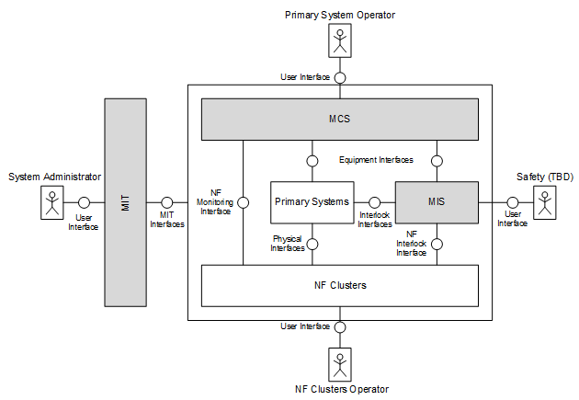
MIS principles and architecture
Control and Interlock System (CIS) is the top project,
existing out of
  MINERVA Control System (MCS)
  MINERVA Interlock System (MIS)
  MINERVA Information Technology (MIT)

Slide 5
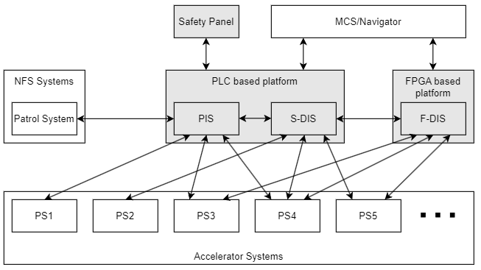
MIS principles and architecture
MIS exists out of Personnel Interlock System (PIS) and Device Interlock System (DIS)
  Exists out of the COTS components according to safety standards
  Typically, on PLC technology,
  except for fast acting interlocks
  (e.g. stopping the beam)
    Therefore, DIS is split in Slow-DIS (S-DIS)
    and Fast-DIS (F-DIS)
    F-DIS is on mTCA technology

Slide 6
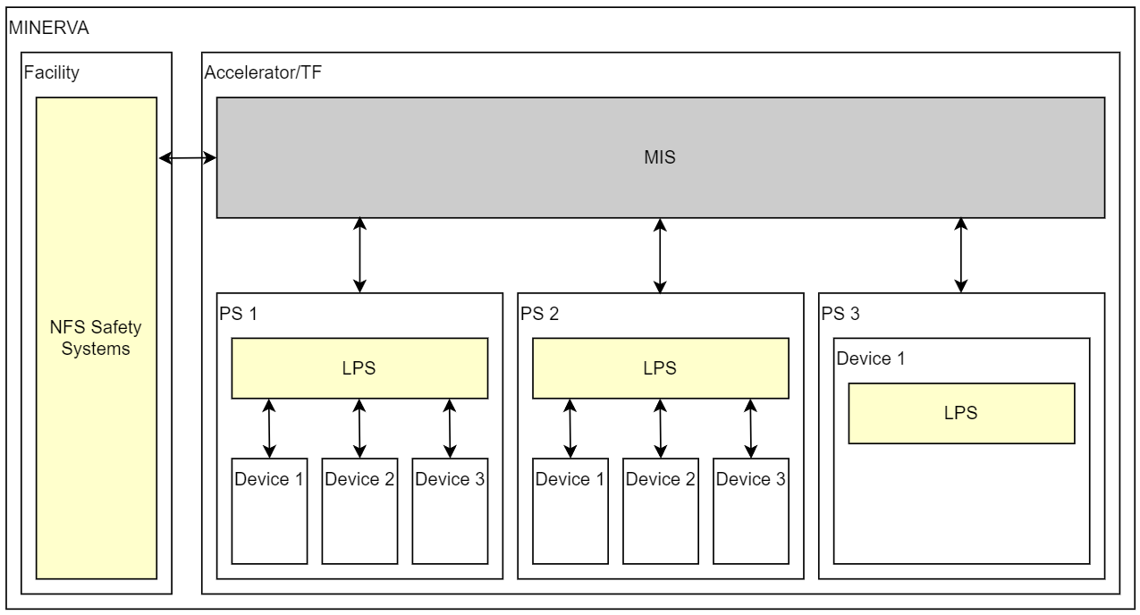
MIS principles and architecture
LPS: Local Protection System (LPS) are localized protection function within the Primary System (PS) to protect itself
MIS: if an effect of a LPS also has a global effect on other PS, the LPS will propagate to MIS.
  MIS is responsible on a global scale,
  between different PS.
MIS ≠fault recovery
  MIS will solely deal with protection of
  machine and personnel
  Fault recovery is implemented in MCS,
  mainly in the Timing and Triggering
  System (TTS) of MCS

Slide 7
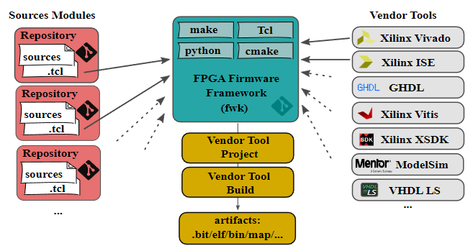
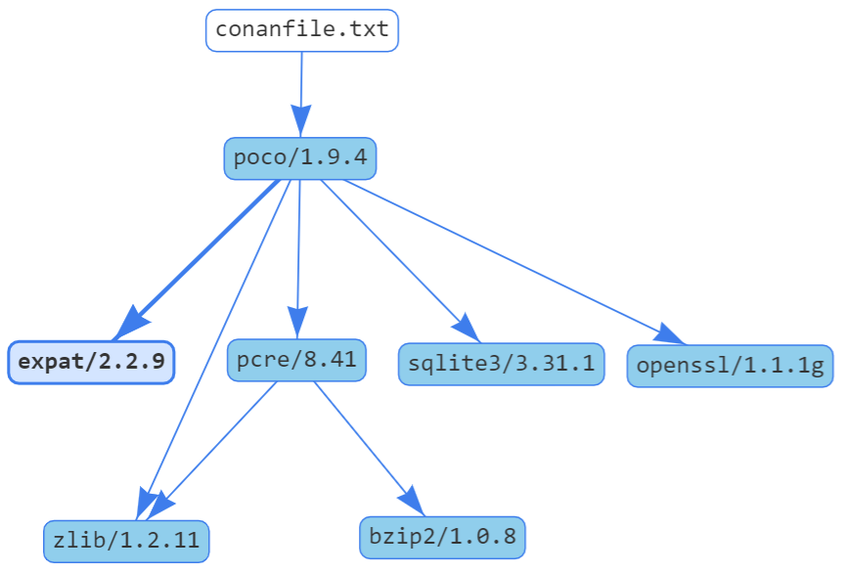
F-DIS development
Development in git repositories
  Modular, where projects depending on modules and libraries
  Based on FPGA Firmware Framework (FWK) (DESY) https://fpgafw.pages.desy.de/docs-pub/fwk/index.html
  ChimeraTK DeviceAccess (DESY) https://chimeratk.github.io/
  Packages managed by Conan https://conan.io/
Vivado projects
  CI/CD environment with unit tests and simulation at each commit
  SIL/HIL tests at each PR
  OSVVM and Cocotb testbenches for simulation (GHDL)

Slide 8
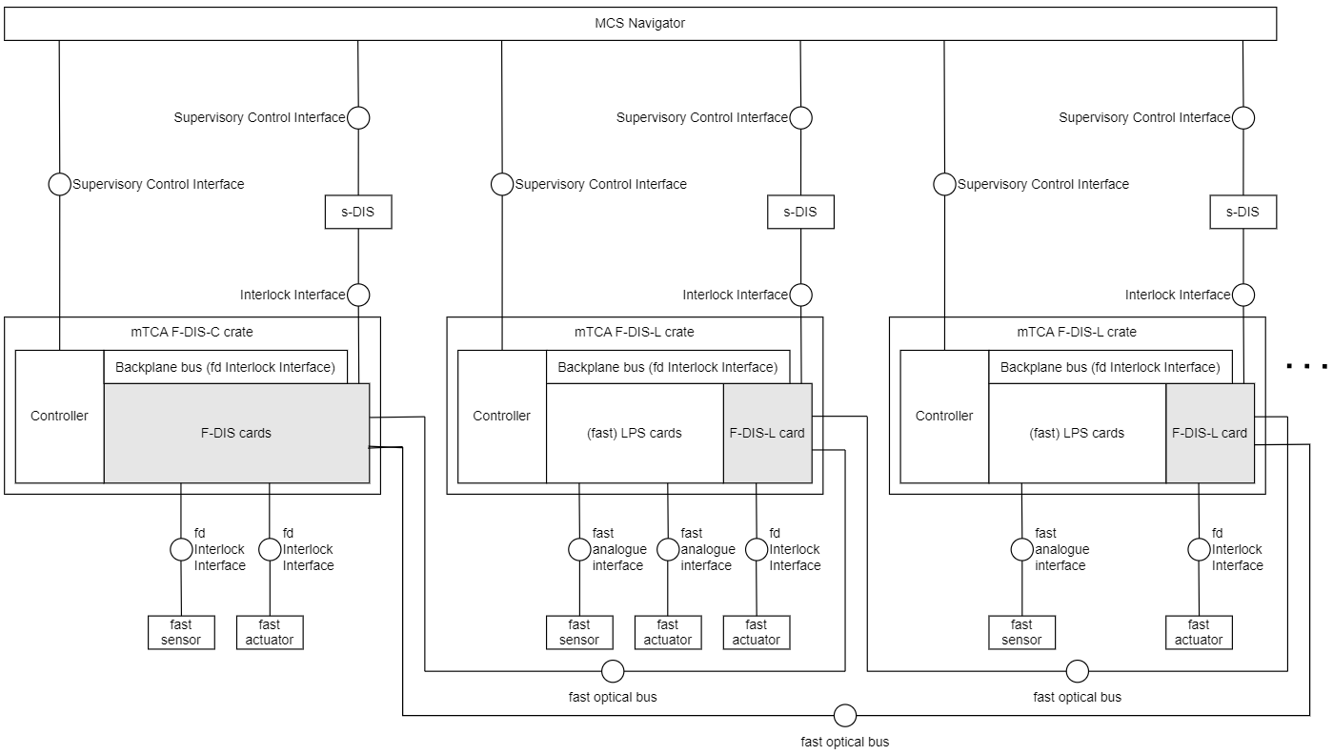
F-DIS physical view
Dedicated F-DIS crates with (fast)
LPS cards of PS and F-DIS cards
Topology to interconnect the
F-DIS crates still to be decided
  Working assumption is a ring topology
    Local F-DIS (F-DIS) crate with (fast) LPS systems and a F-DIS card
    F-DIS crates interconnected in ring with optical links
    F-DIS real-time optical link between crates not defined yet
      Custom protocol ?

Slide 9
F-DIS hardware
COTS mTCA products
  Tender process ongoing
Custom development where no COTS solutions are available
  Covered by DIP tender
Where MIS specific hardware exists, this can be evaluated.

Slide 10
Systems connected to F-DIS
Fast DF-Cells (chopper, kicker, …)
Fast valves
BCMs
BLMs
RF-Cells (LLRF)
Target stations
Machine Protection Strategy analysis ongoing…

Slide 11
Copyright © SCK CEN
PLEASE NOTE!
This presentation contains data, information and formats for dedicated use only and may not be communicated, copied, reproduced, distributed or cited without the explicit written permission of SCK CEN.
If this explicit written permission has been obtained, please reference the author, followed by ‘by courtesy of SCK CEN’.
Any infringement to this rule is illegal and entitles to claim damages from the infringer, without prejudice to any other right in case of granting a patent or registration in the field of intellectual property.
SCK CEN
Belgian Nuclear Research Centre
Foundation of Public Utility
Registered Office: Avenue Herrmann-Debrouxlaan 40 – BE-1160 BRUSSELS
Operational Office: Boeretang 200 – BE-2400 MOL

