Slide 1
Measurements of the effect of the plasma density step on electron energy gain
AWAKE Collaboration Meeting
06.11.24
F. Pannell and the AWAKE Collaboration

Slide 2
Introduction
F. Pannell | AWAKE Collaboration Meeting 06.11.24 | 1
The magnetic spectrometer
Design recap, optics upgrades
Acceleration with density steps
The plunger experiment, requirements
First look: Preliminary results 2024
Energy gain with uniform and steps

Slide 3
F. Pannell | AWAKE Collaboration Meeting 06.11.24 | 2
The magnetic spectrometer

Slide 4
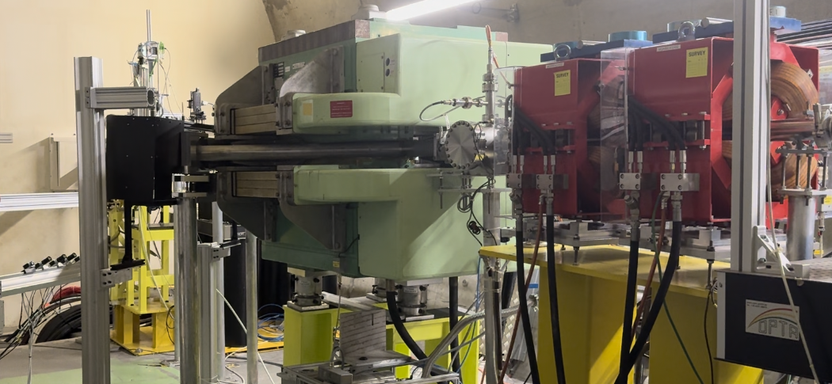
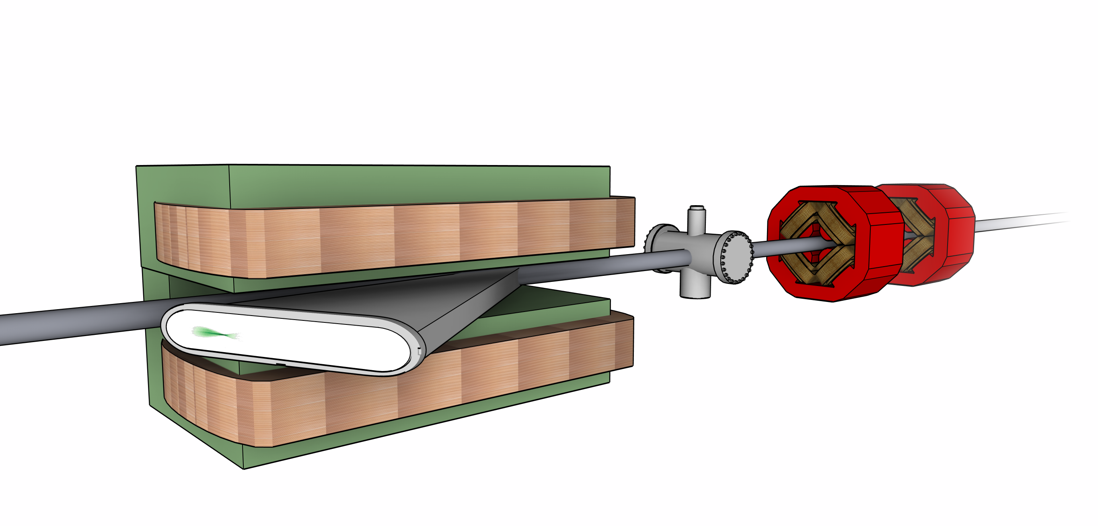
Design recap
F. Pannell | AWAKE Collaboration Meeting 06.11.24 | 3
The main diagnostic to study the accelerated electrons
Quadrupole doublet → electron bunch focusing
C-shaped dipole → separate electrons from protons
Scintillator screen → electron impact causes scintillation
Camera systems → capture the scintillation light
Integrating current transformer → charge calibration
Measurements of the energy, energy spread, charge
Run 2b: Upgrades to the imaging systems for measurements of the transverse emittance
Light to intensified camera
Camera array
Scintillator screen
C-shaped dipole
Beam current transformer
Quadrupole doublet

Slide 5
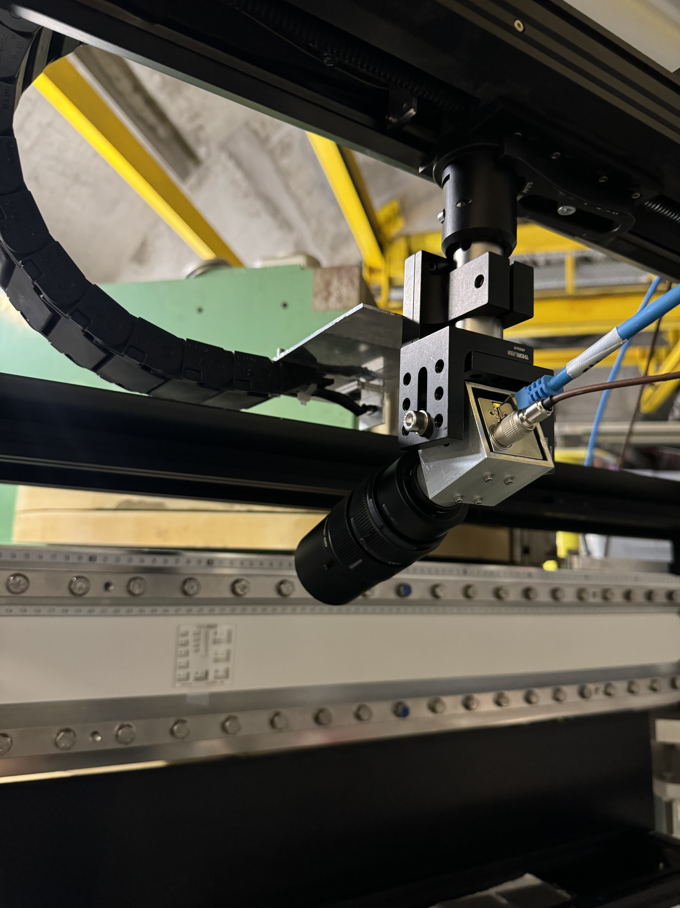
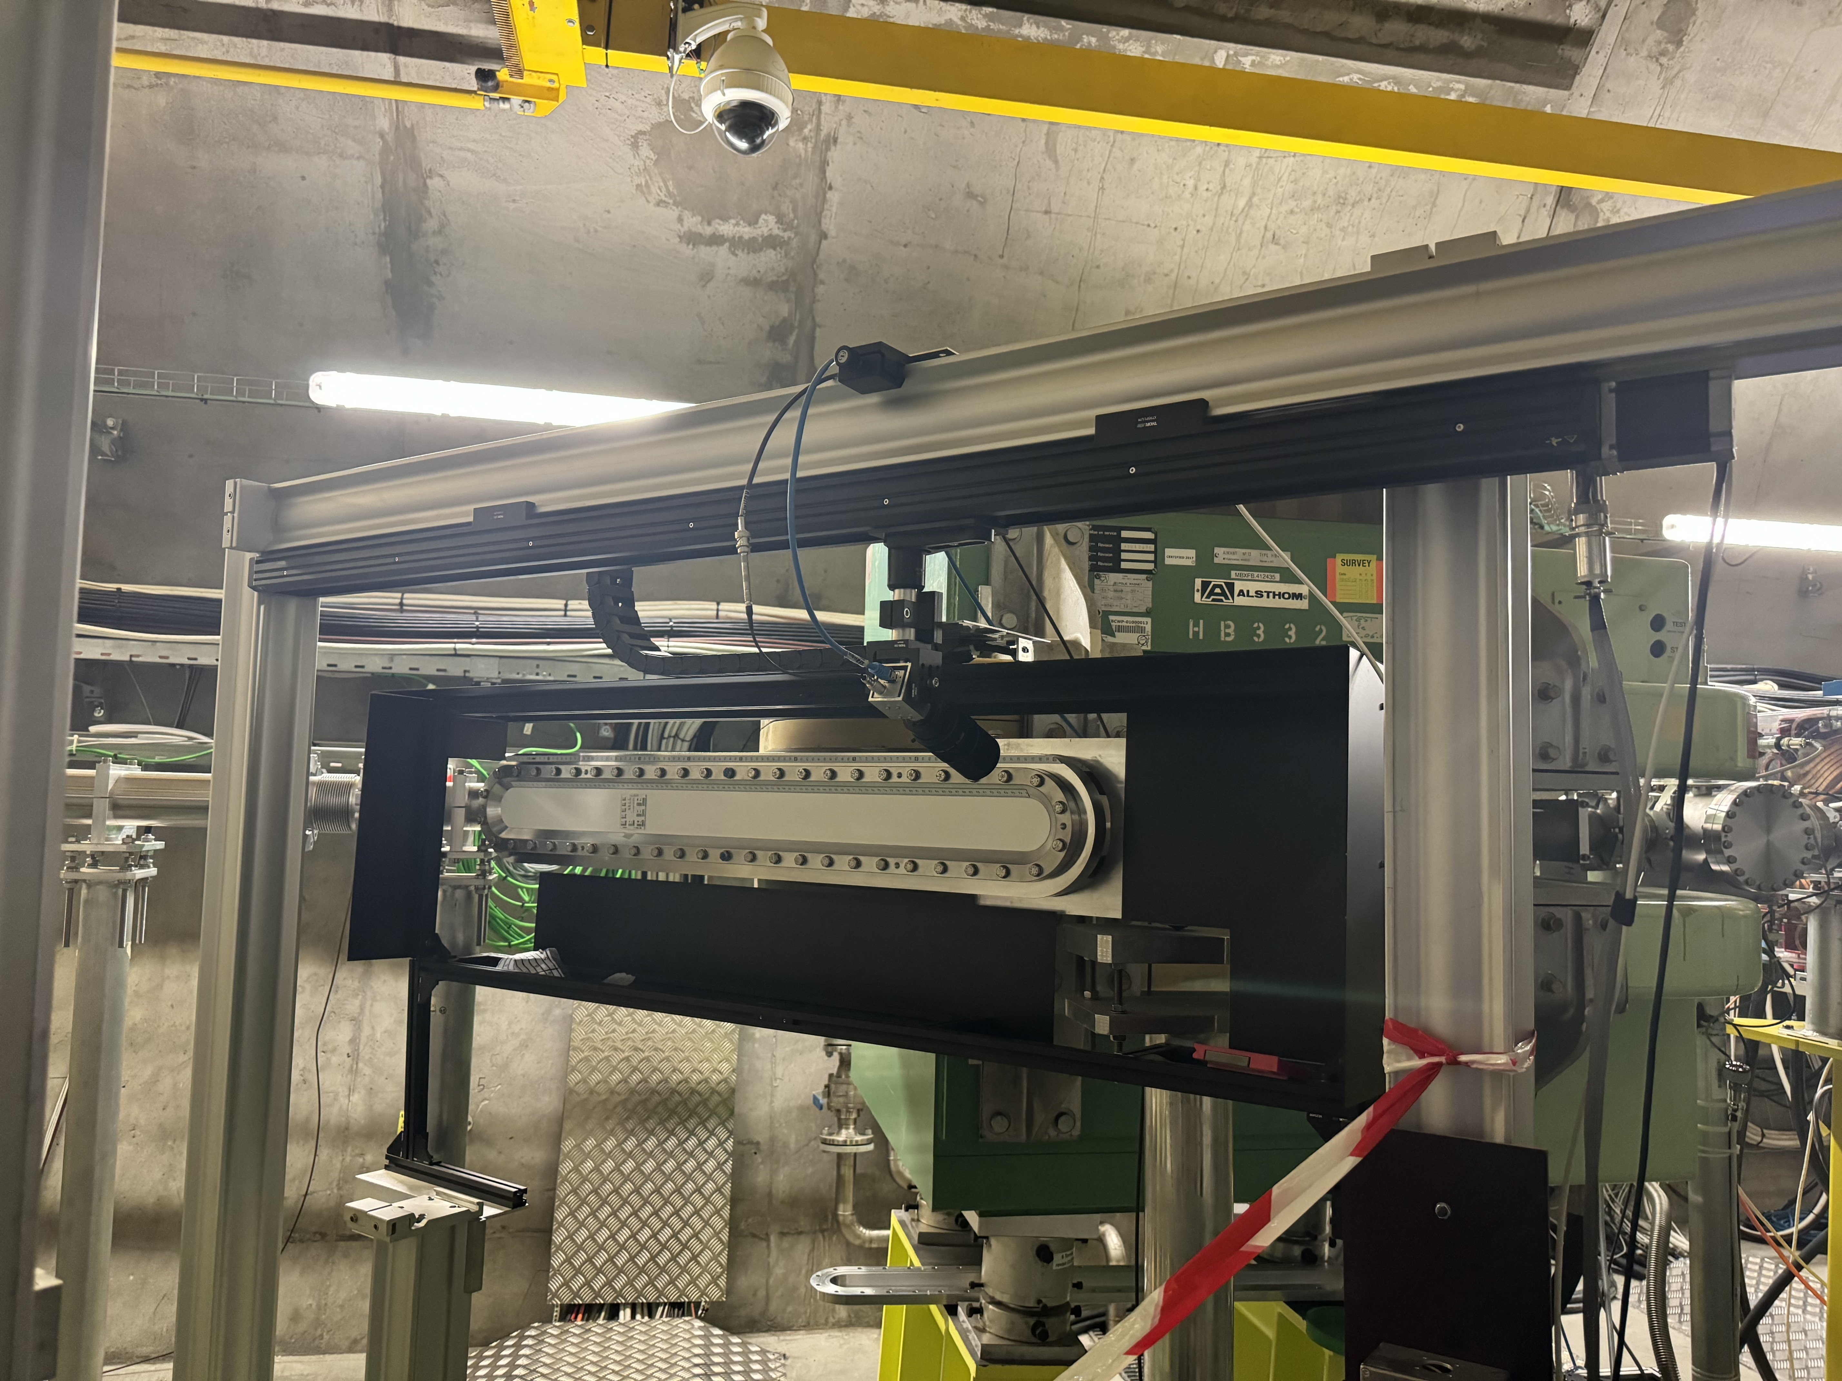
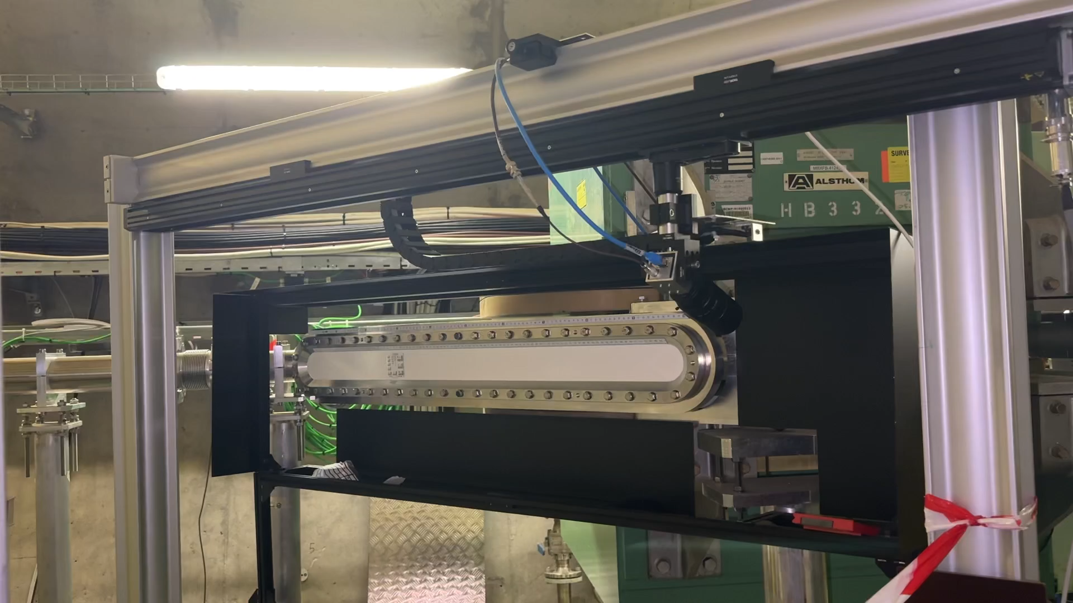
New installation: High resolution camera
F. Pannell | AWAKE Collaboration Meeting 06.11.24 | 4
High resolution imaging of beam waist
Project completed May 2024
Many thanks to the support from SY-BI-ML with the construction
CERN spying on us
Old spectrometer calibration support & track
Basler camera & resolution lens
x2 aluminum support profiles

Slide 6
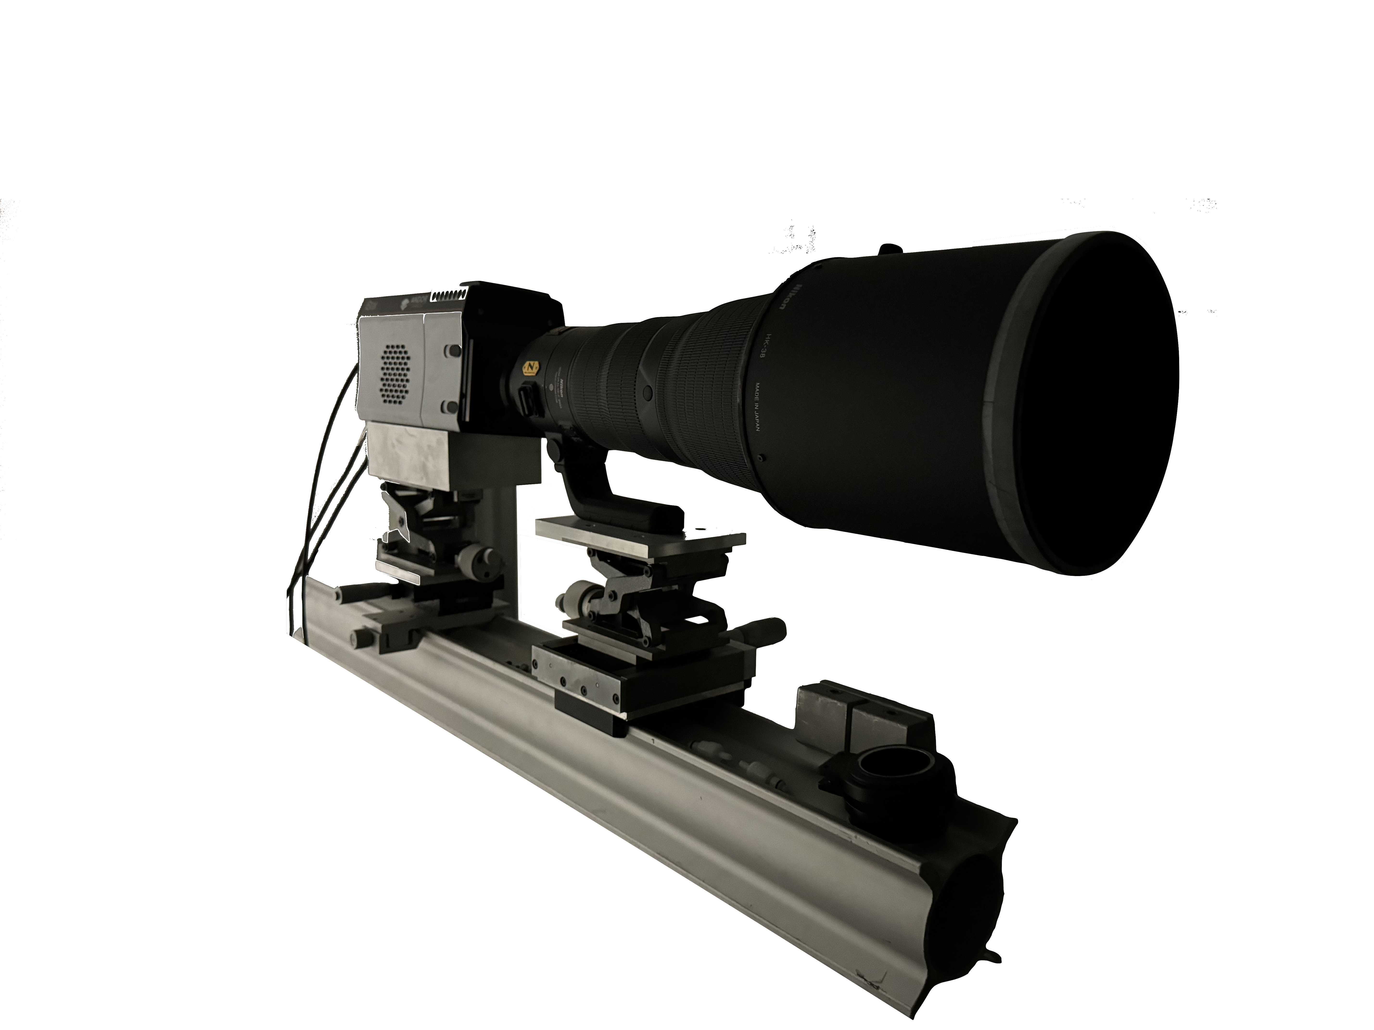
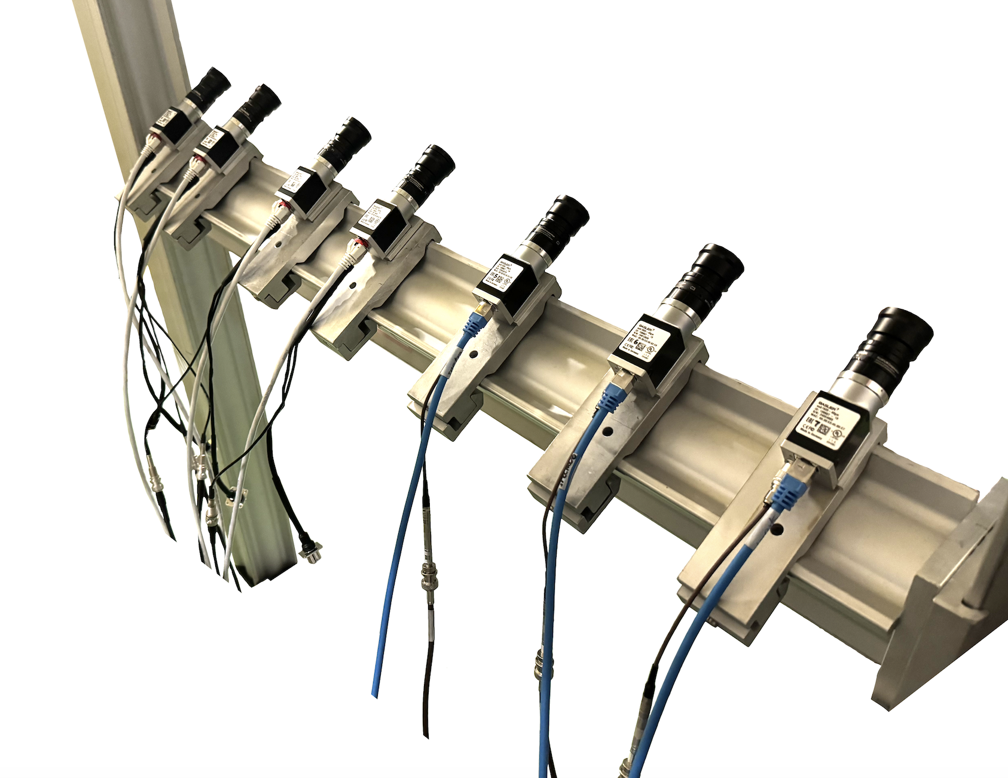
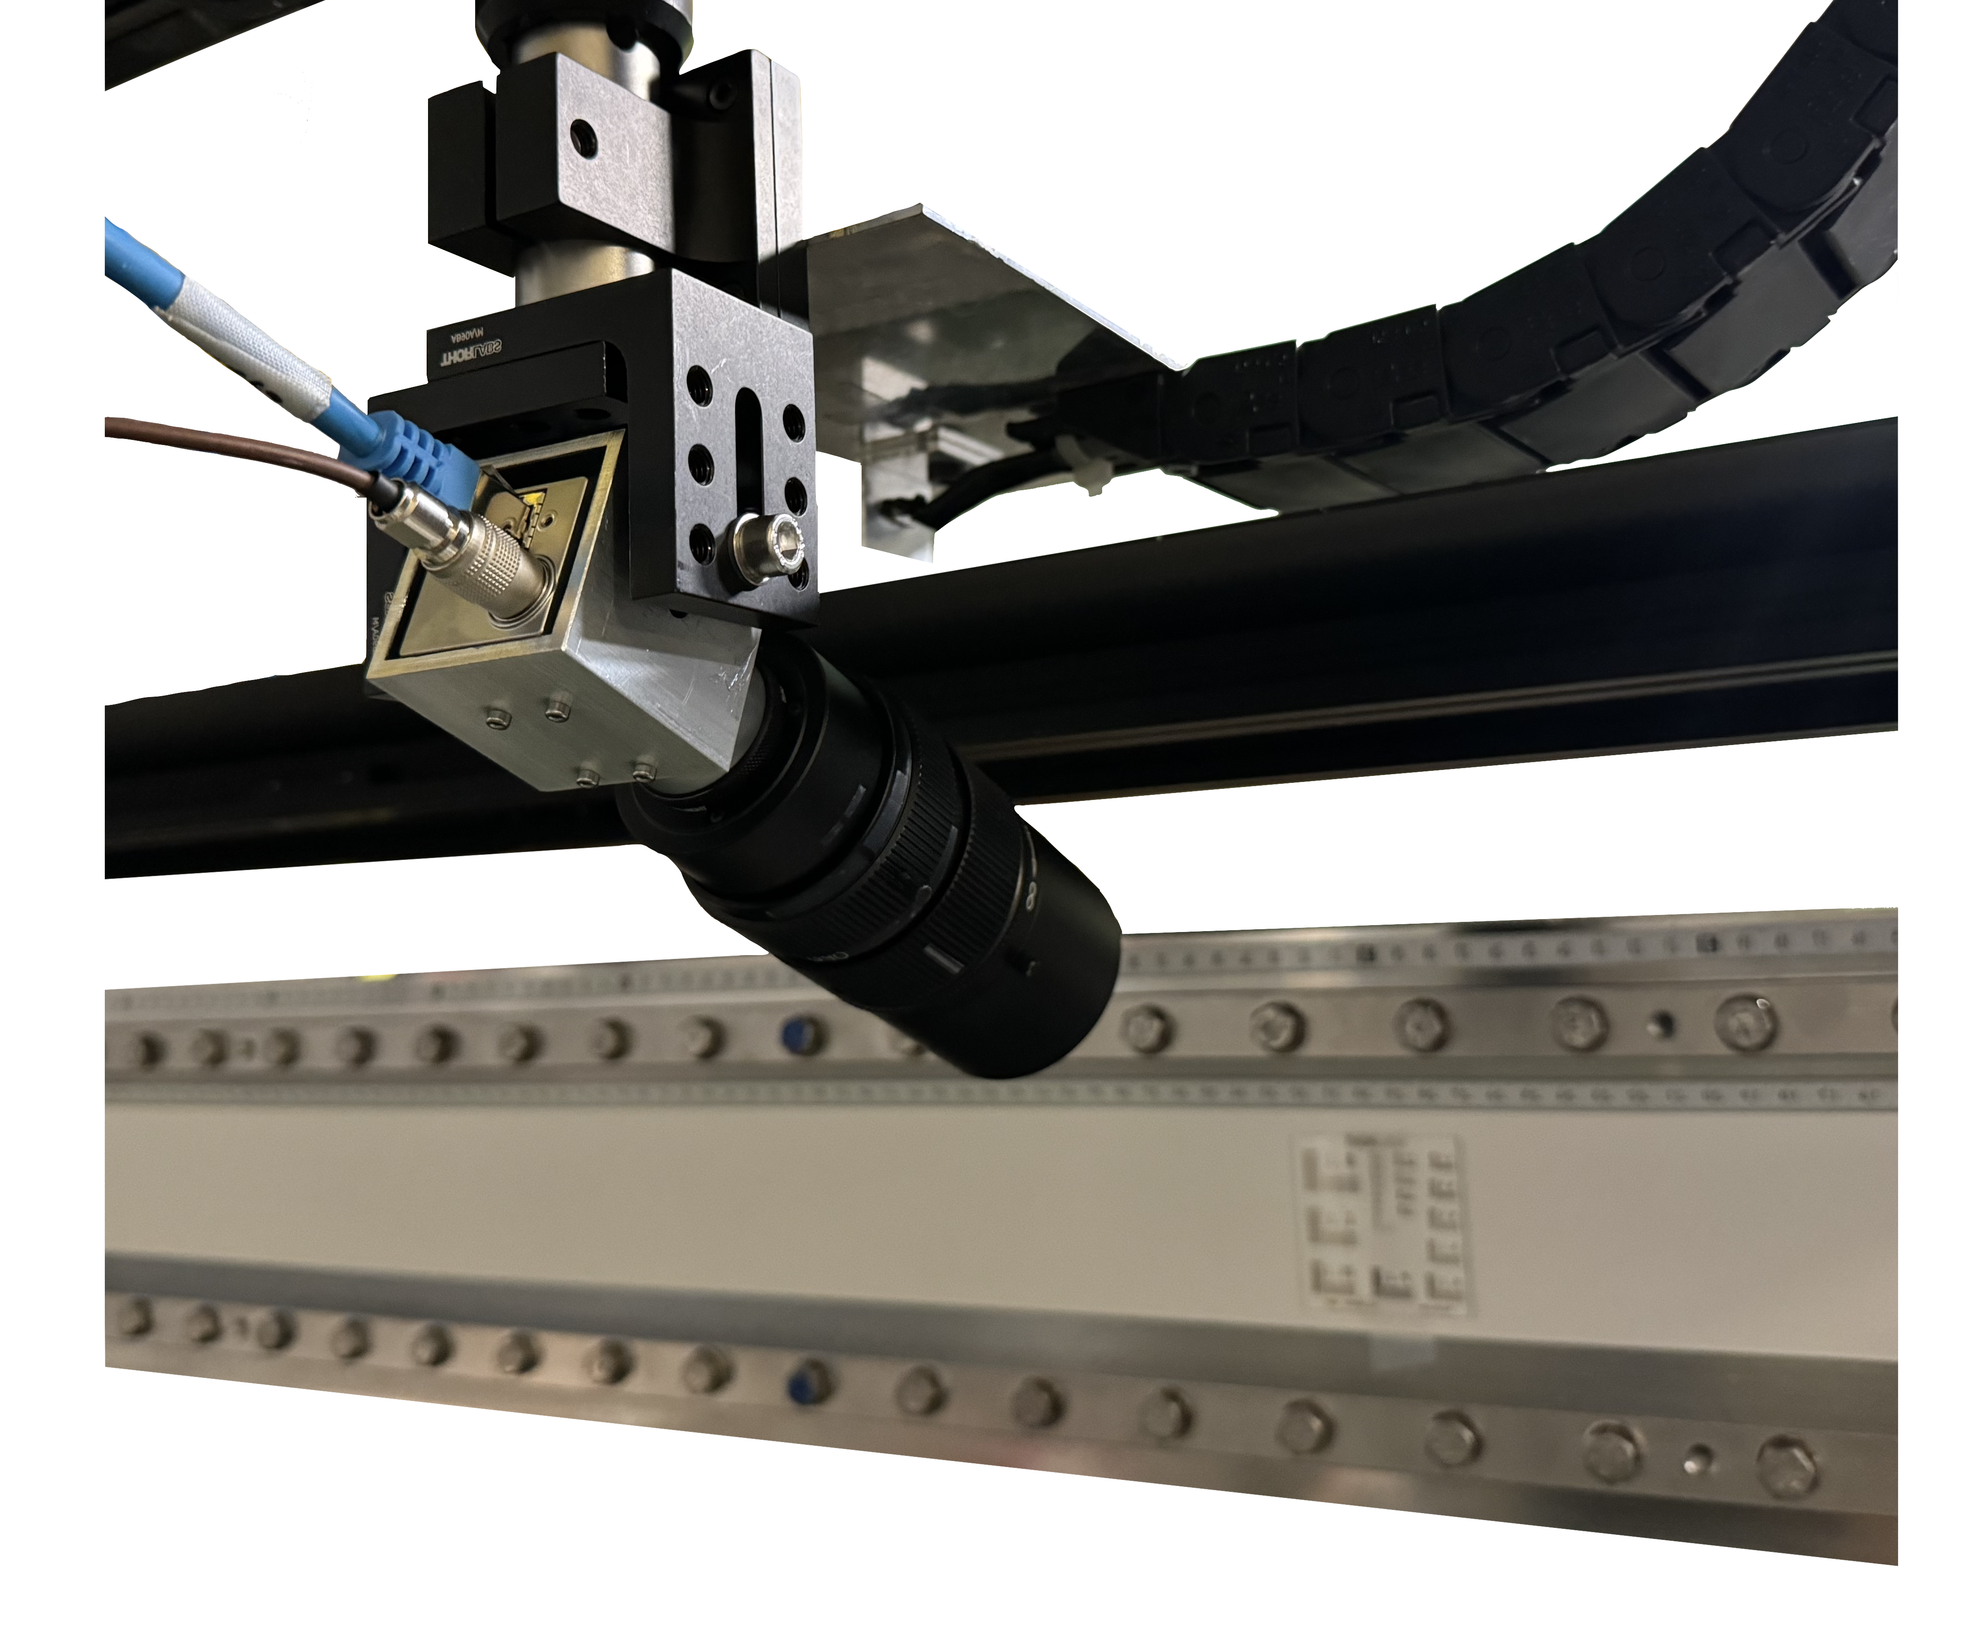
Camera systems
F. Pannell | AWAKE Collaboration Meeting 06.11.24 | 5
Intensified camera
Camera array
High resolution camera
Run 1 → present
Run 2a → present
Run 2b → present
Position from screen: 17m (via mirrors)
Camera: Andor iStar 340T
Lens: Nikon AF-S Nikkor
Focal length: 400mm
Field of view: ~1m
Pixel size (image): 13.5um
Pixel size (object): ~0.5mm
Position from screen: 1.2m, -30°
Camera: Basler aCA 1920-40gm
Lens: Fujinon HF75HA-1S
Focal length: 75mm
Field of view: 0.15m
Pixel size (image): 5.86um
Pixel size (object): ~80um
Position from screen: 0.25m, +40°
Camera: Basler aCA 1920-40gm
Lens: Edmund Optics DG
Focal length: 75mm
Field of view: ~0.02m
Pixel size (image): 5.86um
Pixel size (object): ~10um

Slide 7
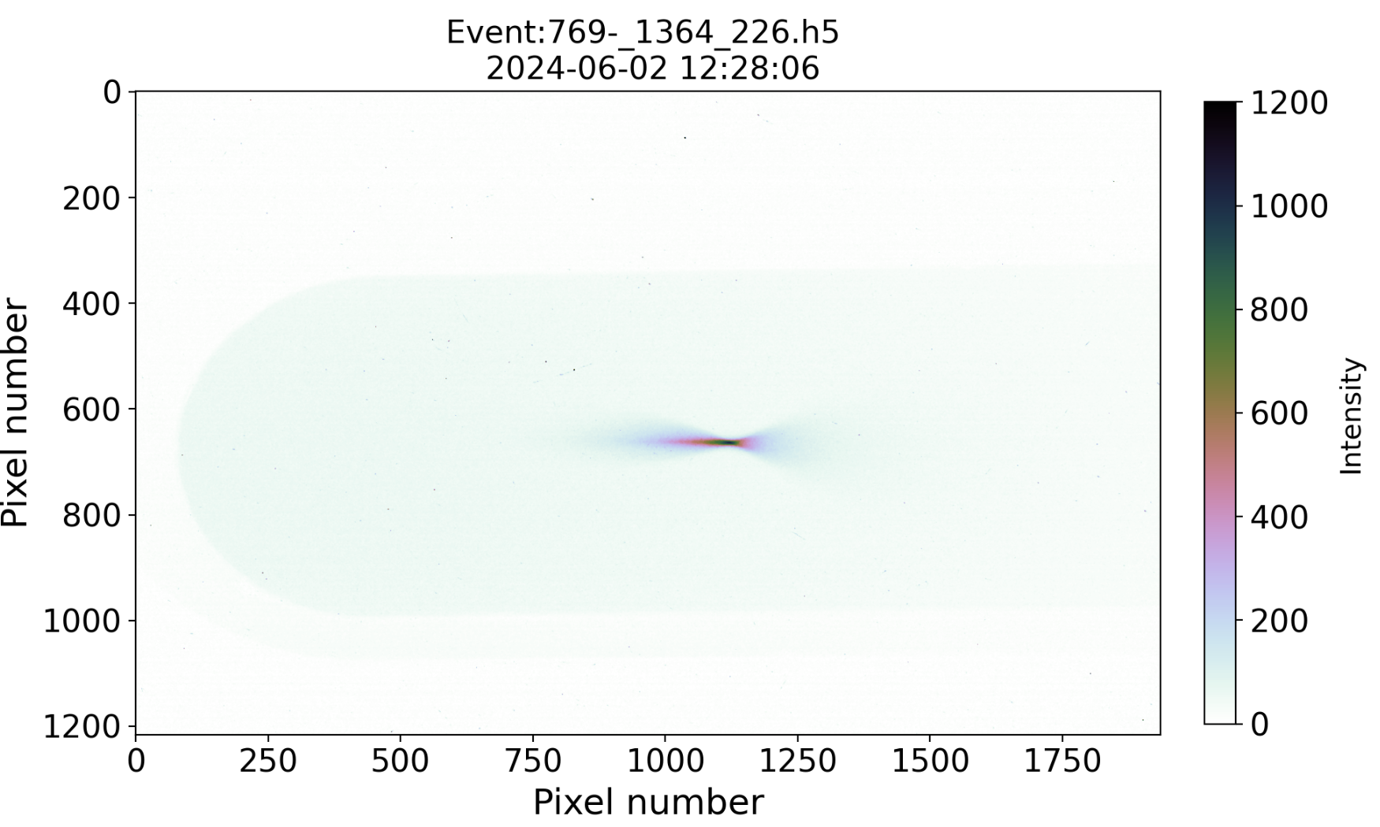
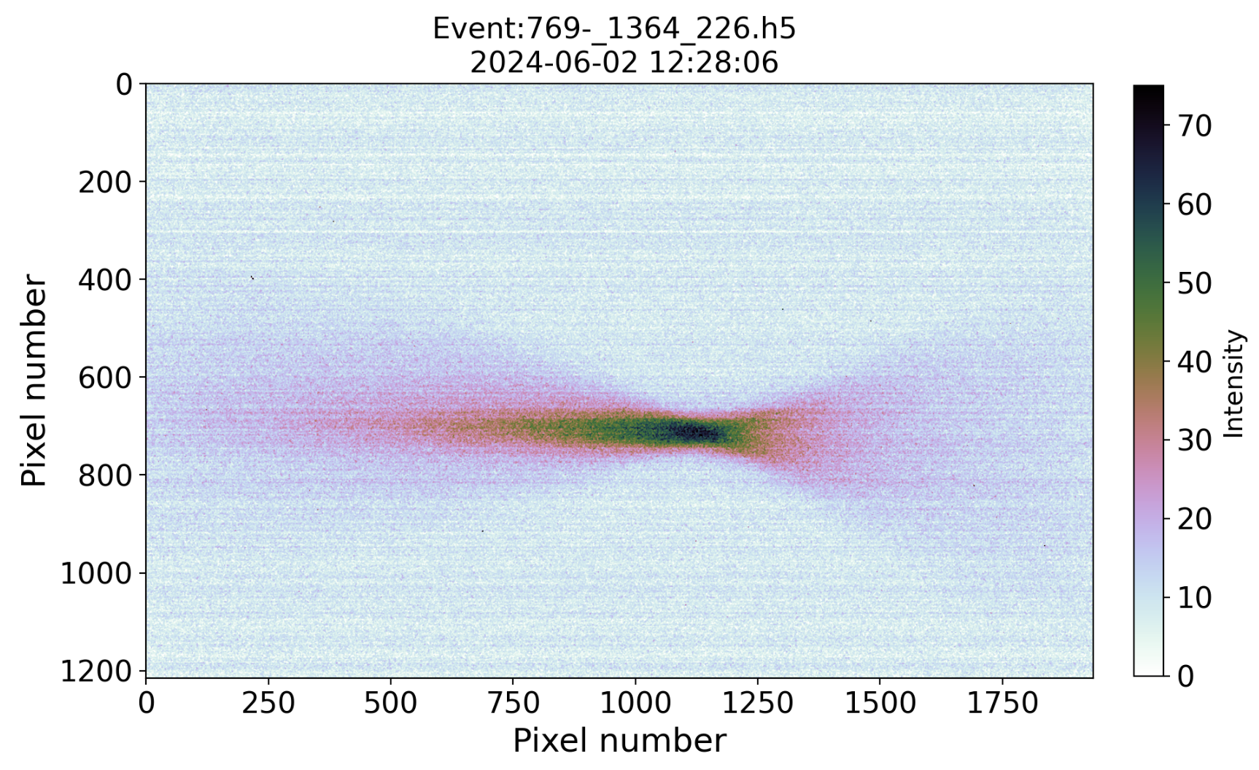
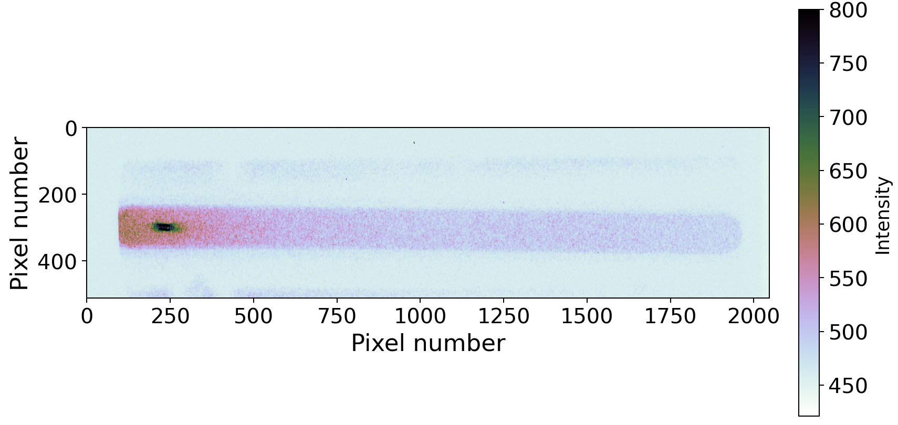
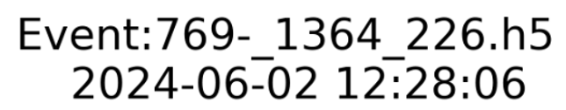
Camera systems
F. Pannell | AWAKE Collaboration Meeting 06.11.24 | 7
Intensified camera
Camera array
High resolution camera

Slide 8
F. Pannell | AWAKE Collaboration Meeting 06.11.24 | 8
Acceleration with density steps

Slide 9
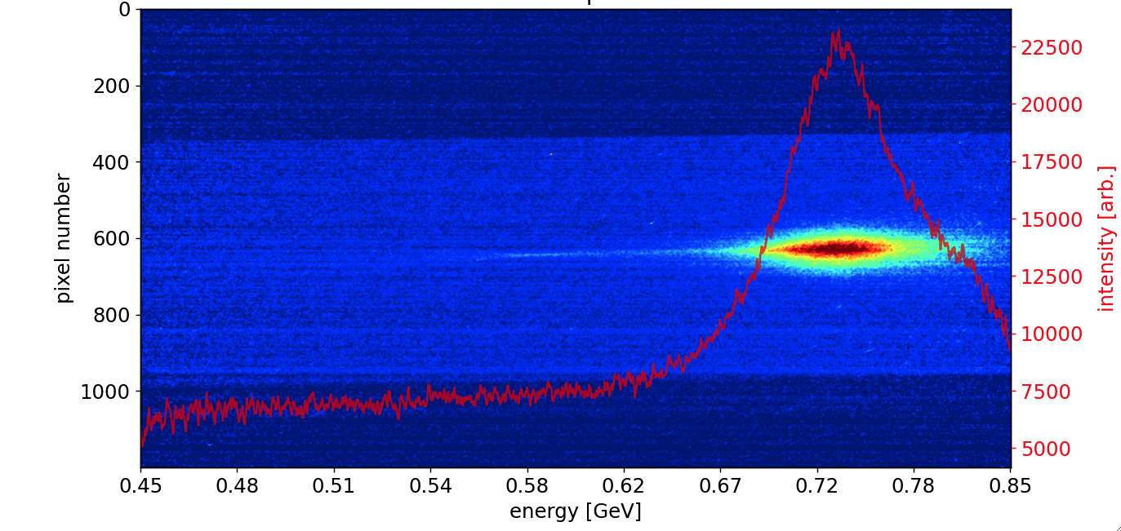
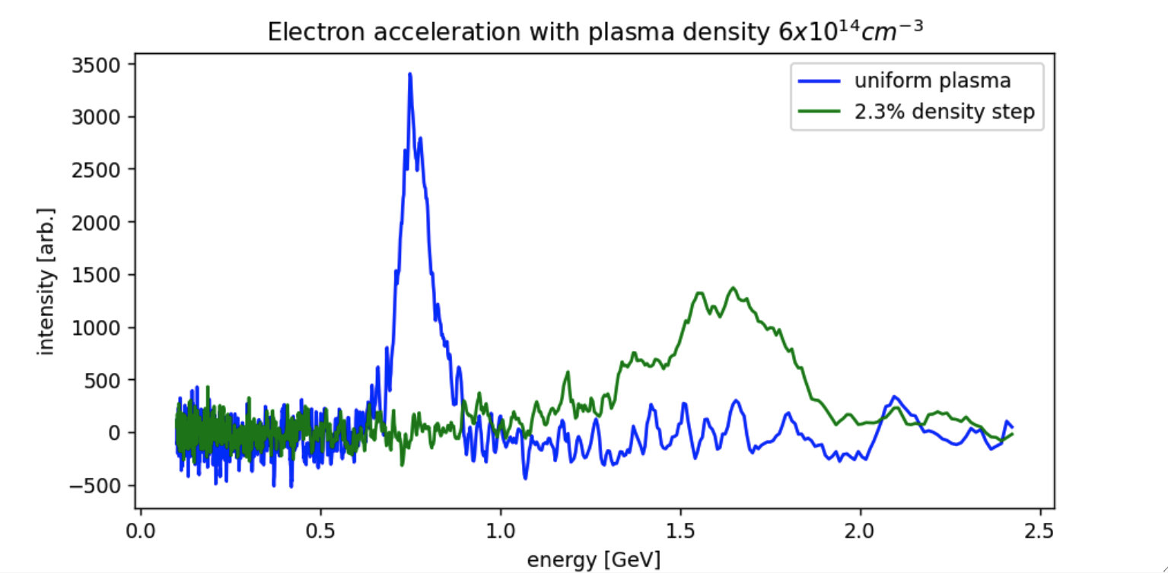
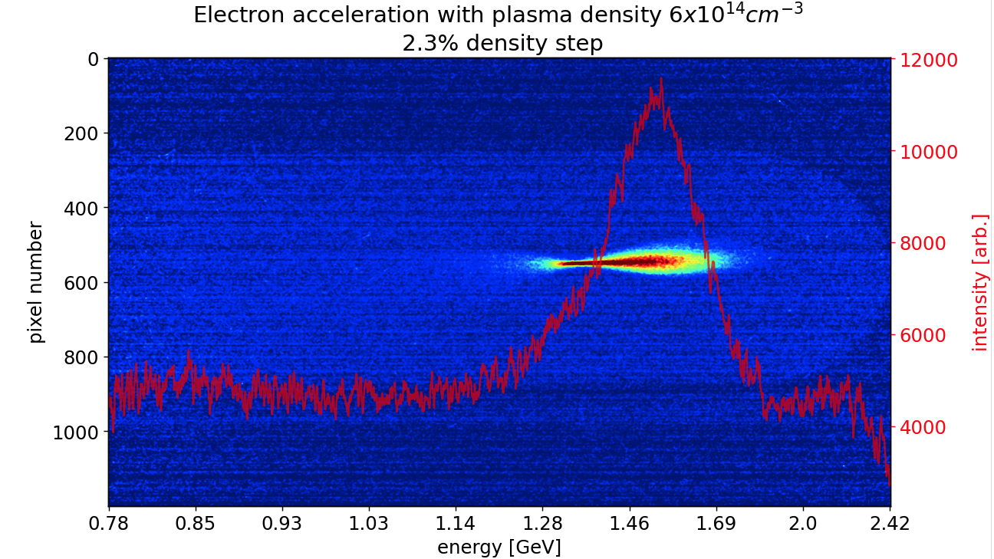
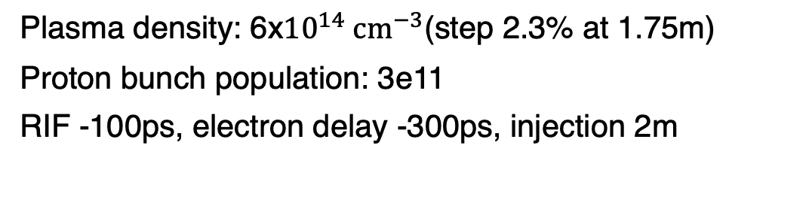
Reminder: First look at density steps (2023)
F. Pannell | AWAKE Collaboration Meeting 06.11.24 | 9
Plasma density: 6${\text{x}10}^{14} {cm}^{−3}$(step 2.3% at 1.75m)
Proton bunch population: 3e11
RIF -100ps, electron delay -300ps, injection 2m
Uniform plasma
Density step (2.3%)

Slide 10

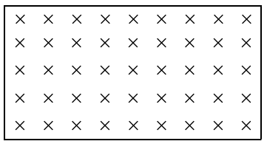

The plunger experiment
F. Pannell | AWAKE Collaboration Meeting 06.11.24 | 10
The ‘plungers’ (laser dumps) allow us to study the acceleration as a function of the plasma length
We can attempt to perform a direct measurement on the accelerating gradient (dE/dz)
Vapour source
Spectrometer
Scintillator screen
Camera array
Plungers
Laser dump 2 (LBDP2)
0.5m
1
2
3
4
5
6
7
8
9
10
Injected electrons
Accelerated electrons
Laser-ionised plasma 10.3m
Dipole
Protons
10.3m
Quadrupole doublet
Diagram not drawn to scale

Slide 11
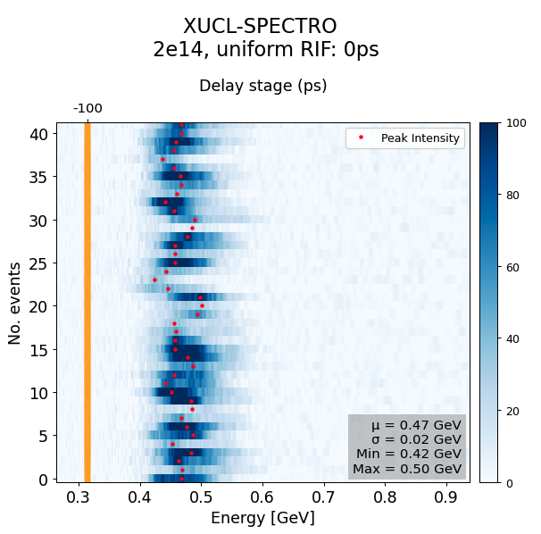
Requirements: Consistent acceleration
F. Pannell | AWAKE Collaboration Meeting 06.11.24 | 11
Due to the number of shots of the laser pulse onto the foil (~500), we must limit the shots on each plunger (10 per experiment).
We must be in as stable a configuration as possible
This includes:
Capture frequency as close as possible to 100%
Minimal shot-to-shot energy variation

Slide 12
The plunger experiment
F. Pannell | AWAKE Collaboration Meeting 06.11.24 | 12
The ‘plungers’ (laser dumps) allow us to study the acceleration as a function of the plasma length
We can attempt to perform a direct measurement on the accelerating gradient (dE/dz)
Vapour source
Spectrometer
Scintillator screen
Camera array
Plungers
Laser dump 2 (LBDP2)
0.5m
1
2
3
4
5
6
7
8
9
10
Injected electrons
Accelerated electrons
Laser-ionised plasma 10.3m
Dipole
Protons
10.3m
Quadrupole doublet
Diagram not drawn to scale

Slide 13
The plunger experiment
F. Pannell | AWAKE Collaboration Meeting 06.11.24 | 13
The ‘plungers’ (laser dumps) allow us to study the acceleration as a function of the plasma length
We can attempt to perform a direct measurement on the accelerating gradient (dE/dz)
Vapour source
Spectrometer
Scintillator screen
Camera array
Plungers
Laser dump 2 (LBDP2)
0.5m
1
2
3
4
5
6
7
8
9
10
Injected electrons
Accelerated electrons
Laser-ionised plasma 10.3m
Dipole
Protons
10.3m
Quadrupole doublet
Diagram not drawn to scale

Slide 14
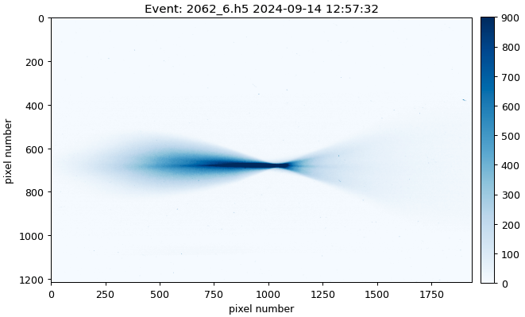
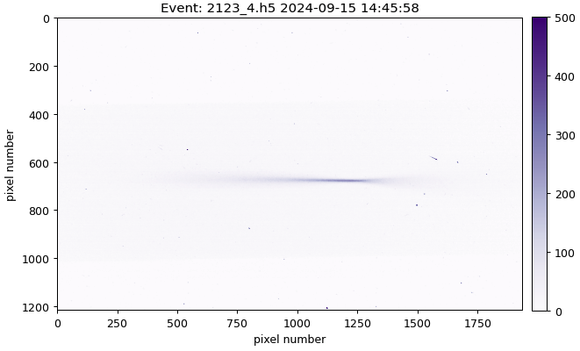
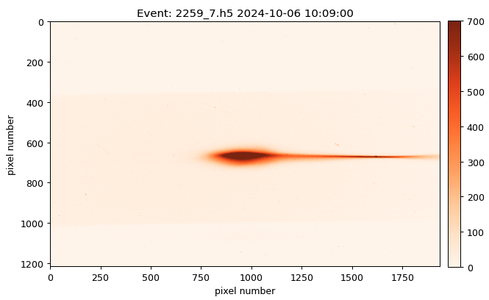
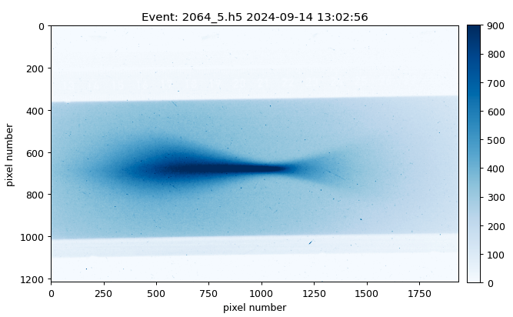
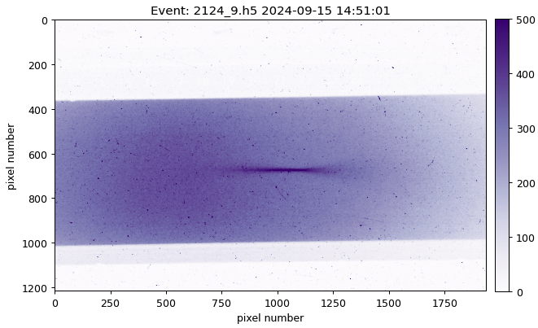
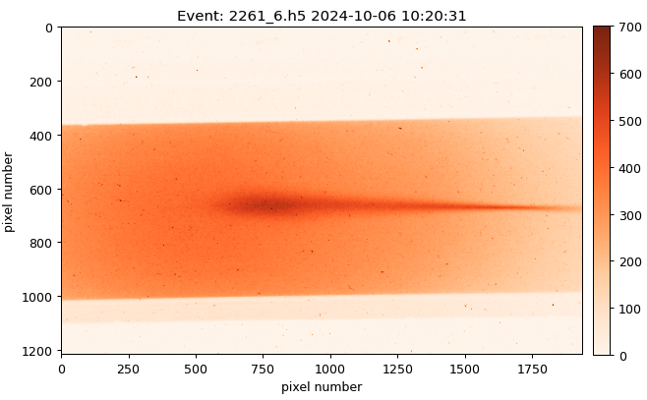
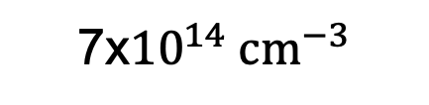
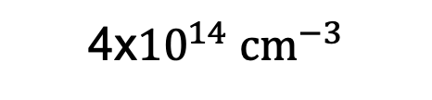

Requirements: Sufficient charge capture
F. Pannell | AWAKE Collaboration Meeting 06.11.24 | 14
2${\text{x}10}^{14} {cm}^{−3}$
4${\text{x}10}^{14} {cm}^{−3}$
7${\text{x}10}^{14} {cm}^{−3}$
Standard
acceleration
Through
Laser dump

Slide 15
The plunger experiment
F. Pannell | AWAKE Collaboration Meeting 06.11.24 | 15
The ‘plungers’ (laser dumps) allow us to study the acceleration as a function of the plasma length
We can attempt to perform a direct measurement on the accelerating gradient (dE/dz)
Vapour source
Spectrometer
Scintillator screen
Camera array
Plungers
Laser dump 2 (LBDP2)
0.5m
1
2
3
4
5
6
7
8
9
10
Injected electrons
Accelerated electrons
Laser-ionised plasma 10.3m
Dipole
Protons
10.3m
Quadrupole doublet
Diagram not drawn to scale

Slide 16

The plunger experiment
F. Pannell | AWAKE Collaboration Meeting 06.11.24 | 15
The ‘plungers’ (laser dumps) allow us to study the acceleration as a function of the plasma length
We can attempt to perform a direct measurement on the accelerating gradient (dE/dz)
Vapour source
Spectrometer
Scintillator screen
Camera array
Plungers
Laser dump 2 (LBDP2)
0.5m
1
2
3
4
5
6
7
8
9
10
Injected electrons
Accelerated electrons
Laser-ionised plasma 9.5m
Dipole
Protons
10.3m
Quadrupole doublet
Diagram not drawn to scale

Slide 17
The plunger experiment
F. Pannell | AWAKE Collaboration Meeting 06.11.24 | 15
The ‘plungers’ (laser dumps) allow us to study the acceleration as a function of the plasma length
We can attempt to perform a direct measurement on the accelerating gradient (dE/dz)
Vapour source
Spectrometer
Scintillator screen
Camera array
Plungers
Laser dump 2 (LBDP2)
0.5m
1
2
3
4
5
6
7
8
9
10
Injected electrons
Accelerated electrons
Laser-ionised plasma 8.5m
Dipole
Protons
10.3m
Quadrupole doublet
Diagram not drawn to scale

Slide 18
The plunger experiment
F. Pannell | AWAKE Collaboration Meeting 06.11.24 | 15
The ‘plungers’ (laser dumps) allow us to study the acceleration as a function of the plasma length
We can attempt to perform a direct measurement on the accelerating gradient (dE/dz)
Vapour source
Spectrometer
Scintillator screen
Camera array
Plungers
Laser dump 2 (LBDP2)
0.5m
1
2
3
4
5
6
7
8
9
10
Injected electrons
Accelerated electrons
Laser-ionised plasma 7.5m
Dipole
Protons
10.3m
Quadrupole doublet
Diagram not drawn to scale

Slide 19
The plunger experiment
F. Pannell | AWAKE Collaboration Meeting 06.11.24 | 15
The ‘plungers’ (laser dumps) allow us to study the acceleration as a function of the plasma length
We can attempt to perform a direct measurement on the accelerating gradient (dE/dz)
Vapour source
Spectrometer
Scintillator screen
Camera array
Plungers
Laser dump 2 (LBDP2)
0.5m
1
2
3
4
5
6
7
8
9
10
Injected electrons
Accelerated electrons
Laser-ionised plasma 6.5m
Dipole
Protons
10.3m
Quadrupole doublet
Diagram not drawn to scale

Slide 20
F. Pannell | AWAKE Collaboration Meeting 06.11.24 | 16
First look: Preliminary results 2024
Disclosure: Very fresh results!!

Slide 21
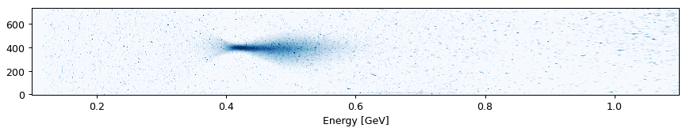
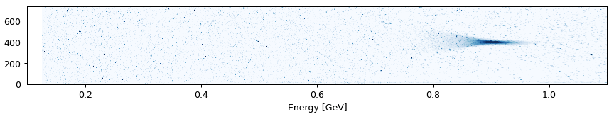
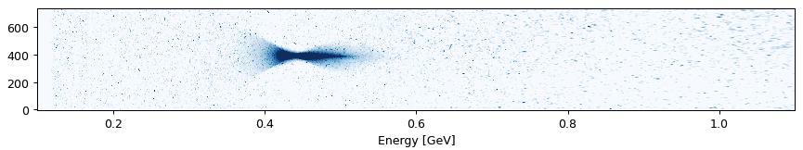
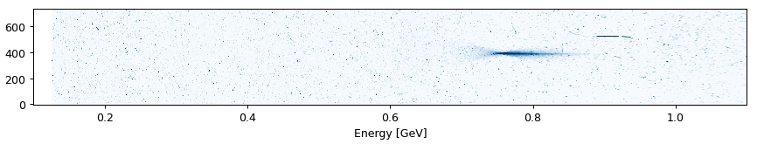
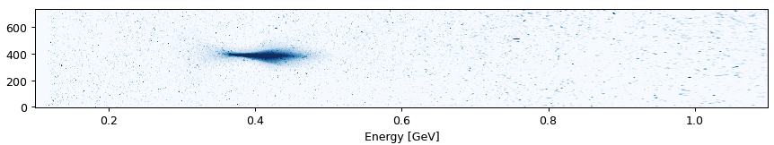
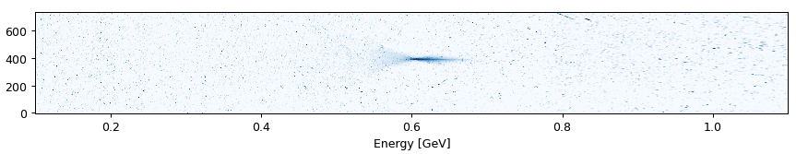
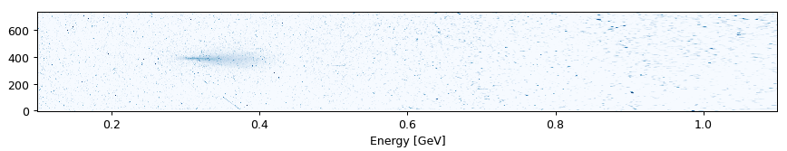
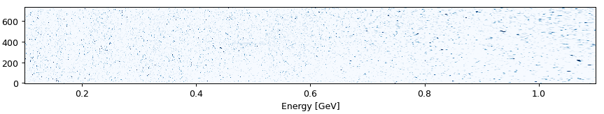
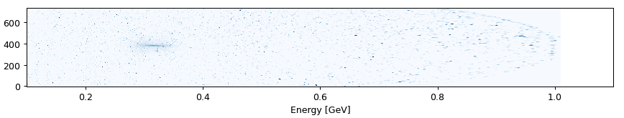
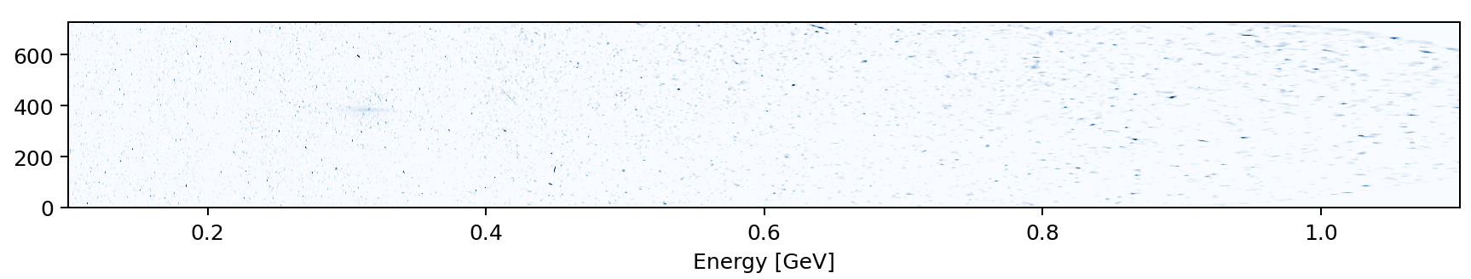
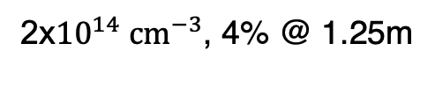
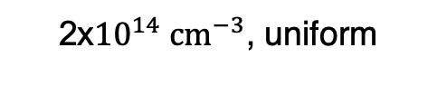
F. Pannell | AWAKE Collaboration Meeting 06.11.24 | 17
Example signals across the scans
2${\text{x}10}^{14} {cm}^{−3}$, uniform
2${\text{x}10}^{14} {cm}^{−3}$, 4% @ 1.25m
LBDP2
(10.3m)
Plunger 10
(9.5m)
Plunger 9
(8.5m)
Plunger 8
(7.5m)
Plunger 7
(6.5m)

Slide 22
F. Pannell | AWAKE Collaboration Meeting 06.11.24 | 18
Analysis approach
There are multiple ways to approach this analysis:
Observing the energy of the charge peak (done here)
Observing the peak (e.g. 95th percentile) in the energy distribution
Observing the mean and rms of the energy distribution (charge weighted)
All analysis approaches will be completed and compared.
Looking at the charge peak was chosen first, as it is the least sensitive to background subtraction techniques.

Slide 23


Acceleration at 2${\text{x}10}^{14} {cm}^{−3}$
F. Pannell | AWAKE Collaboration Meeting 06.11.24 | 19
Parameters for this experiment:
Plasma density 2${\text{x}10}^{14} {cm}^{−3}$
Proton RIF: +100ps
Electron delay: -100ps (uniform) -200ps (step)
Injection z: 1.5m
Density step: ~4% at 1.25m
Clear signal seen up to plunger 6 (5.5m)
Very consistent acceleration, charge peak energy jitter is minimal
preliminary
Preliminary data analysis:
10 shots directed onto each plunger
Data points: The mean of the charge peaks
Error bars: Standard deviation of the charge peaks

Slide 24

Acceleration at 2${\text{x}10}^{14} {cm}^{−3}$
F. Pannell | AWAKE Collaboration Meeting 06.11.24 | 20
Parameters for this experiment:
Plasma density 2${\text{x}10}^{14} {cm}^{−3}$
Proton RIF: +100ps
Electron delay: -100ps (uniform) -200ps (step)
Injection z: 1.5m
Density step: ~4% at 1.25m
Clear signal seen up to plunger 6 (5.5m)
Very consistent acceleration, charge peak energy jitter is minimal
With the density step, the overall energy gain is greater
Seems consistent with theory and 2023 observations
The gradient at uniform could be tapering, but it’s unconvincing for now
The gradient appears constant with the step
preliminary
Preliminary data analysis:
10 shots directed onto each plunger
Data points: The mean of the charge peaks
Error bars: Standard deviation of the charge peaks

Slide 25
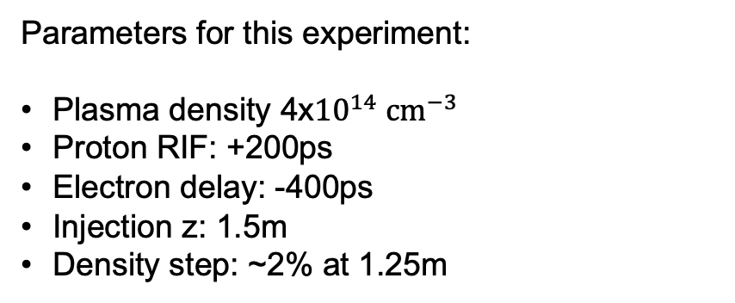

Acceleration at 4${\text{x}10}^{14} {cm}^{−3}$
F. Pannell | AWAKE Collaboration Meeting 06.11.24 | 21
Parameters for this experiment:
Plasma density 4${\text{x}10}^{14} {cm}^{−3}$
Proton RIF: +200ps
Electron delay: -400ps
Injection z: 1.5m
Density step: ~2% at 1.25m
Clear signal seen up to plunger 8 (7.5m) in uniform
Acceleration reasonably consistent, charge peak jitter still small
Higher energy gain than 2e14
Tapering of the gradient is more convincing
preliminary
Preliminary data analysis:
10 shots directed onto each plunger
Data points: The mean of the charge peaks
Error bars: Standard deviation of the charge peaks

Slide 26

Acceleration at 4${\text{x}10}^{14} {cm}^{−3}$
F. Pannell | AWAKE Collaboration Meeting 06.11.24 | 22
Parameters for this experiment:
Plasma density 4${\text{x}10}^{14} {cm}^{−3}$
Proton RIF: +200ps
Electron delay: -400ps
Injection z: 1.5m
Density step: ~2% at 1.25m
Clear signal seen up to plunger 8 (7.5m) in uniform
Acceleration reasonably consistent, charge peak jitter still small
Higher energy gain than 2e14
Tapering of the gradient is more convincing
Clear signal seen up to plunger 7 (6.5m) with a step
With the density step, the overall energy gain is again greater
The gradient with the density step is also tapering similarly to uniform, which may suggest an alternative step would be better
preliminary
Preliminary data analysis:
10 shots directed onto each plunger
Data points: The mean of the charge peaks
Error bars: Standard deviation of the charge peaks

Slide 27
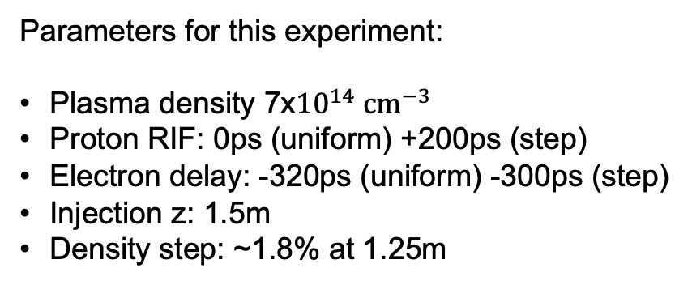

Acceleration at 7${\text{x}10}^{14} {cm}^{−3}$
F. Pannell | AWAKE Collaboration Meeting 06.11.24 | 23
Parameters for this experiment:
Plasma density 7${\text{x}10}^{14} {cm}^{−3}$
Proton RIF: 0ps (uniform) +200ps (step)
Electron delay: -320ps (uniform) -300ps (step)
Injection z: 1.5m
Density step: ~1.8% at 1.25m
Clear signal seen up to plunger 6 (5.5m) in uniform
Higher energy than 2e14 and 4e14
Acceleration is less consistent, charge peak energy jitters
There is little observed acceleration in the final ~5 meters of uniform plasma
preliminary
Preliminary data analysis:
10 shots directed onto each plunger
Data points: The mean of the charge peaks
Error bars: Standard deviation of the charge peaks

Slide 28

Acceleration at 7${\text{x}10}^{14} {cm}^{−3}$
F. Pannell | AWAKE Collaboration Meeting 06.11.24 | 24
Parameters for this experiment:
Plasma density 7${\text{x}10}^{14} {cm}^{−3}$
Proton RIF: 0ps (uniform) +200ps (step)
Electron delay: -320ps (uniform) -300ps (step)
Injection z: 1.5m
Density step: ~1.8% at 1.25m
Clear signal seen up to plunger 6 (5.5m) in uniform
Higher energy than 2e14 and 4e14
Acceleration is less consistent, charge peak energy jitters
There is little observed acceleration in the final ~5 meters of uniform plasma
With the density step, we have acceleration in the final ~5 meters of plasma, but the gradient is low
Looking to answer:
Are the higher fields there, but we cannot inject into them?
Or are the fields not higher with this chosen step?
preliminary
Preliminary data analysis:
10 shots directed onto each plunger
Data points: The mean of the charge peaks
Error bars: Standard deviation of the charge peaks

Slide 29
Summary
F. Pannell | AWAKE Collaboration Meeting 06.11.24 | 25
A key goal for AWAKE Run 2b is to demonstrate the effect of the density step on the wakefield amplitude
The plunger experiments allow us to study the energy gain as a function of the plasma length:
We have plunger scan results, comparing uniform and a density step, at three different plasma densities (2e14, 4e14, 7e14)
Low density experiments seem more consistent with theoretical expectations
High density experiments remain challenging, with greater variations in energy and charge capture
Analysis continues including:
Measurements of the energy gain with plasma length (peak charge, peak energy, mean energy)
Accelerated charge over the plasma length
Single shot emittance measurements, including the effect of the plasma exit ramp

Slide 30
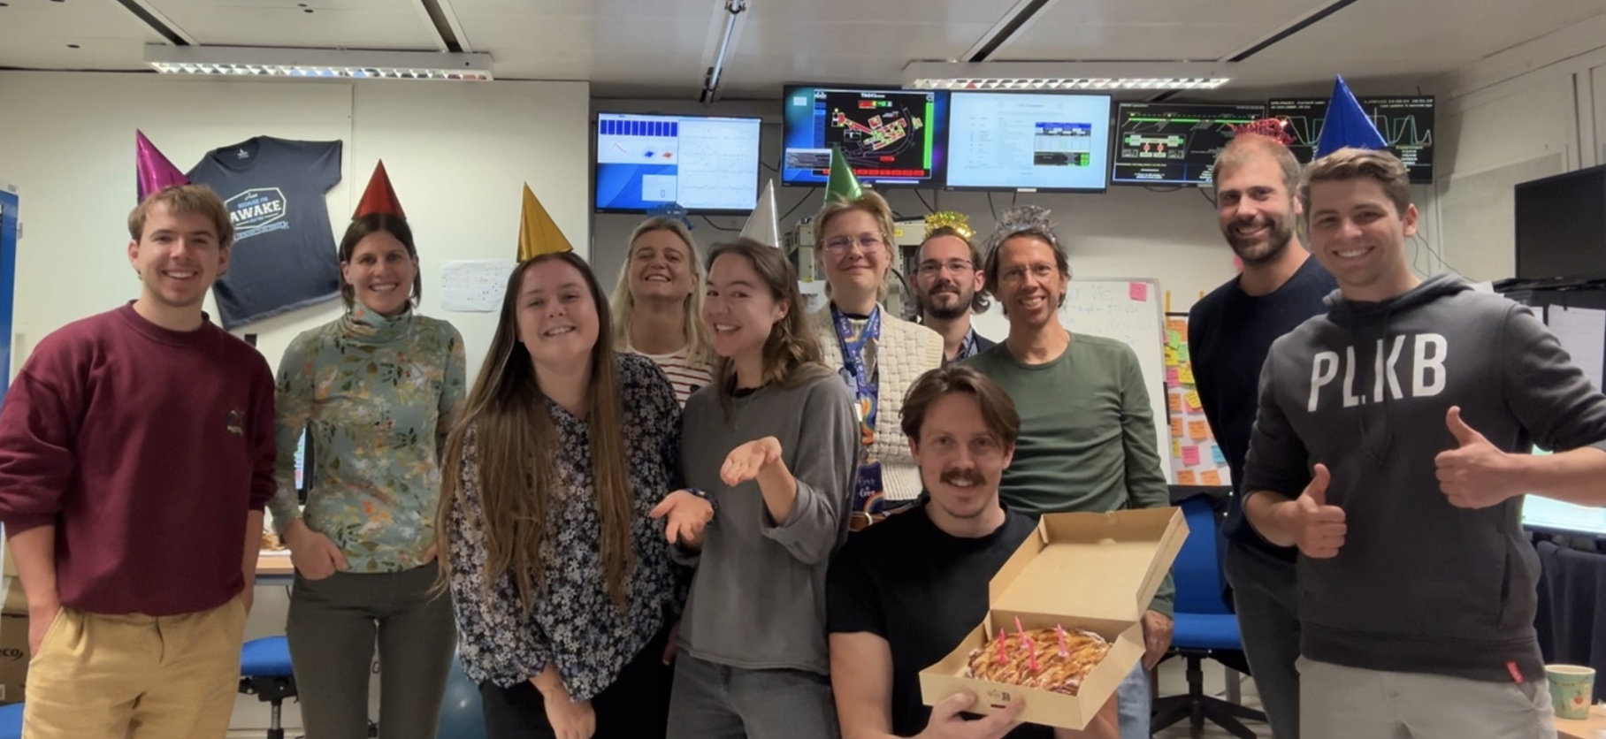
Thanks for listening!
F. Pannell | AWAKE Collaboration Meeting 06.11.24 | 26

Slide 31
F. Pannell | AWAKE Collaboration Meeting 06.11.24 | 27
Backup slides

Slide 32
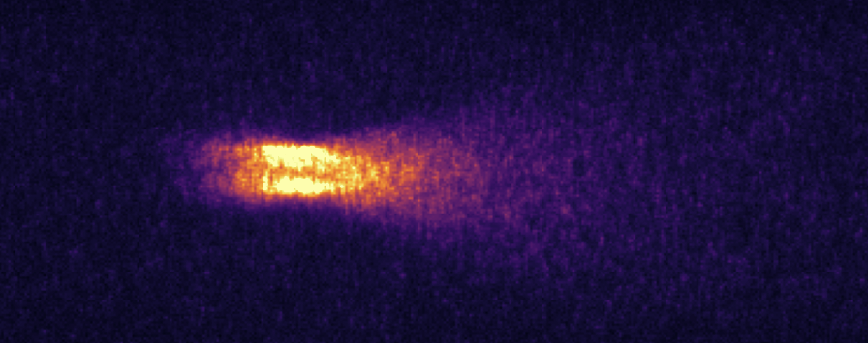
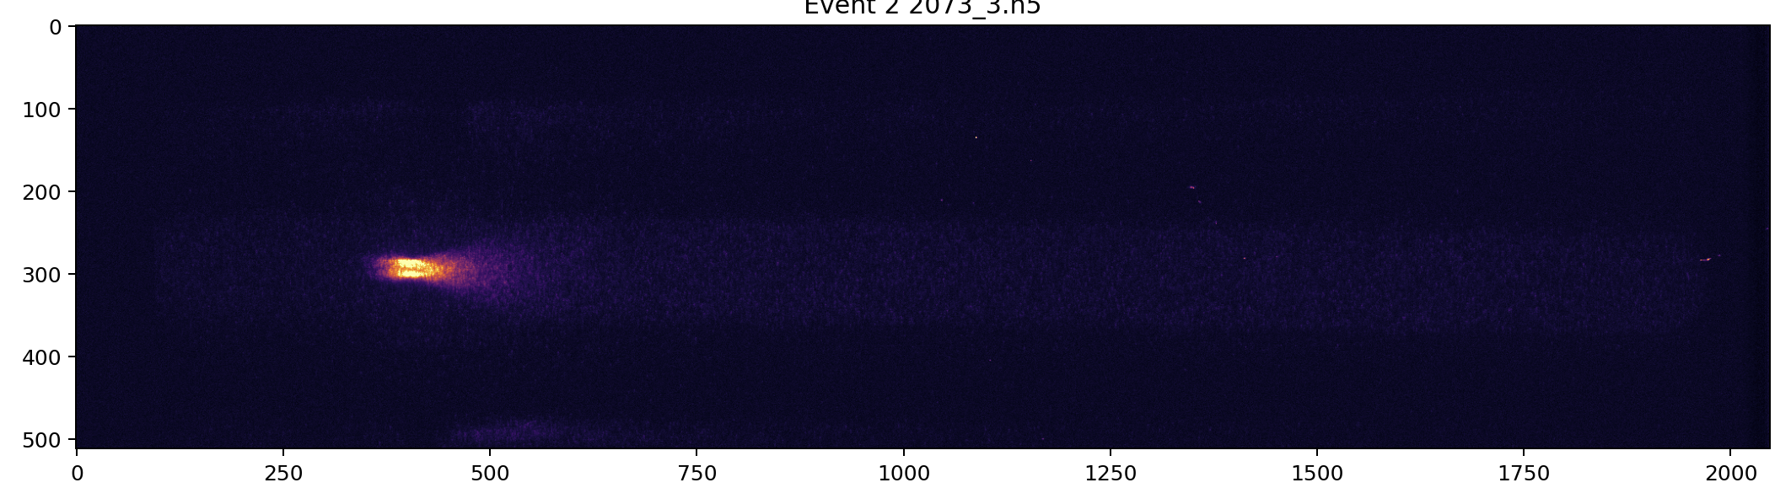
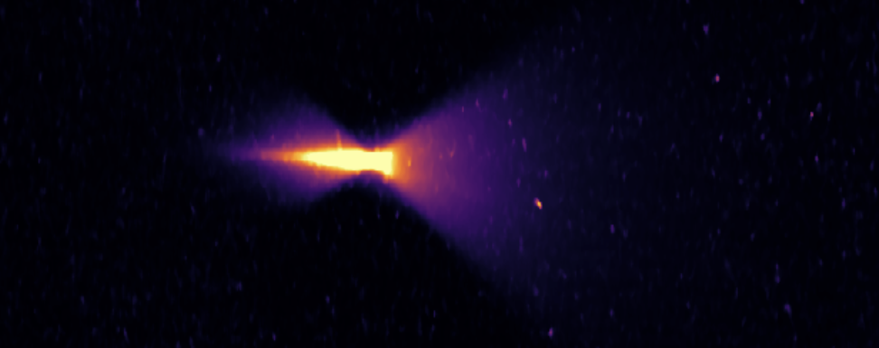
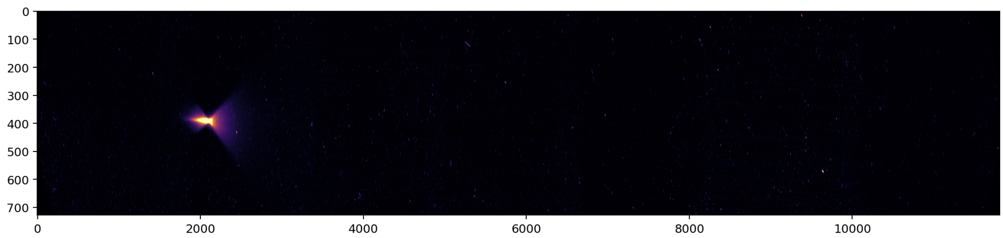
Camera array stitching
F. Pannell | AWAKE Collaboration Meeting 06.11.24 | B1
Intensified camera
Stitched SPECTRO array

Slide 33
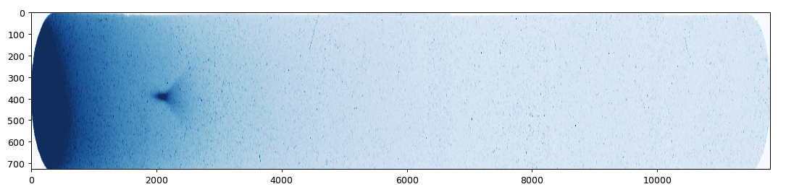
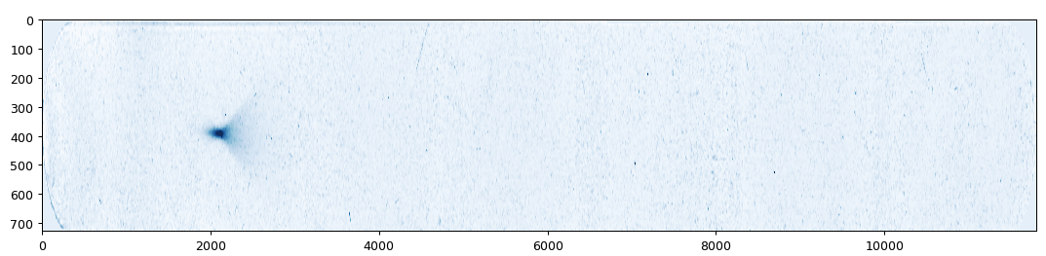
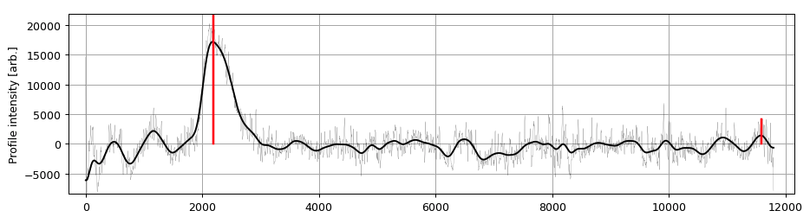


F. Pannell | AWAKE Collaboration Meeting 06.11.24 | B2
The analysis approach
Experimental update
Obtain the 7-camera, corrected and stitched image of the acceleration event
Apply a background subtraction to enhance the signal. Used here: strong background subtraction based off fits to various AWAKE proton conditions
Identify location of peak in the image. Done here by sampling random intervals, optimising and binning.
Convert the image from pixels to energy via the spectrometer position to energy conversion model
Convert the 1D pixel array of the event into energy via the spectrometer position to energy conversion model

Slide 34


F. Pannell | AWAKE Collaboration Meeting 06.11.24 | B3
The experimental approach
Experimental update
LBDP2 (10 meters acceleration)
Select the configuration (RIF and eDelay) that suits the uniform and density step case
Check stability and reproducibility under standard accelerating conditions (no foils, full 10 meters)
Check charge capture through LBDP2, to assess how likely signal will be seen through a plunger
10 laser shots delivered on each plunger, until no hint of a signal remains. For each plunger:
The spectrometer quadrupoles are shifted in accordance with the altered spectrometer geometry and predicted energy gain.
The spectrometer dipole is moved to place the signal, regardless of energy, on SPECTRO2. This is to minimise over-dispersing weaker signals, as well as avoiding the highest radiation camera.
Plunger 7 (6.5 meters acceleration)

Slide 35

Grid scans
F. Pannell | AWAKE Collaboration Meeting 06.11.24 | B4

