Slide 1

Studies of the driver and study of the plasma ramp
AWAKE Collaboration meeting – November 2024
Jan Pucek

Slide 2


PhD
*Designed by Freepik

Slide 3
Presentation outline
Self modulation instability – study of the driver
  Features within the incoming bunch
  Transition between seeding and instability
Study of the density ramp at the plasma entrance
  aka ”the electron witness survivalability study”

Slide 4
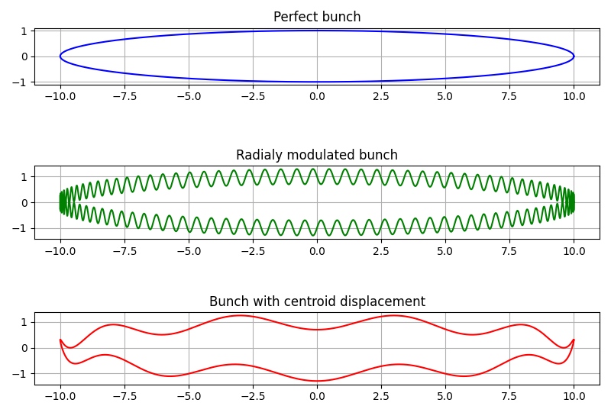
Incoming proton bunch structure
Space axis
time axis
This is what we are looking for

Slide 5
Incoming proton bunch features
Search for a potential seed present in the incoming driver
Streak camera images of the proton bunch propagating through vacuum (to the OTR screen)
Centroid displacement = hosing seed
Radial size modulation = SMI seed
Calculate the power spectrum – reoccuring frequencies?

Slide 6
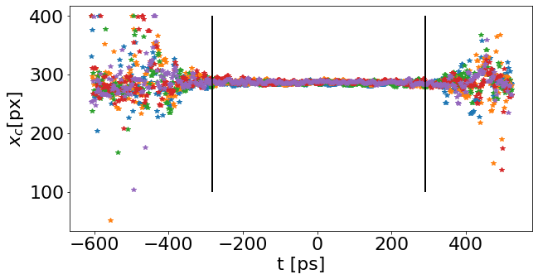
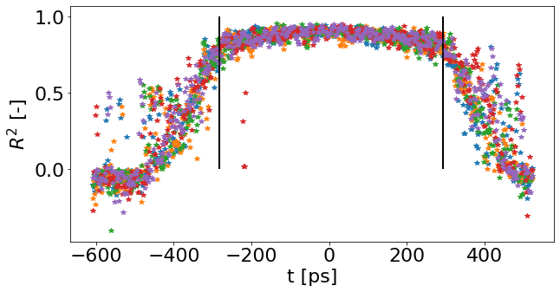
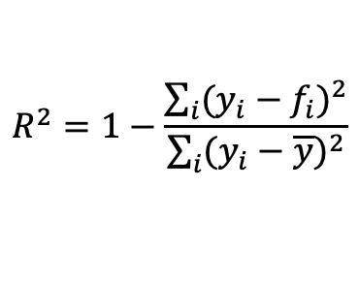
Measurement
Several datasets of proton bunches measured at two timescales (1ns, 210ps)
Identified center and radial size for each pixel row (Gaussian fit)
Measurement
Model
$$R^{2}=1−\frac{\sum_{i}{{(y_{i}−f_{i})}^{2}}}{\sum_{i}{{(y_{i}−\overline{y})}^{2}}}$$
Mean

Slide 7
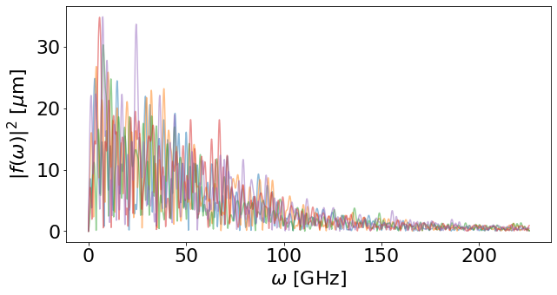
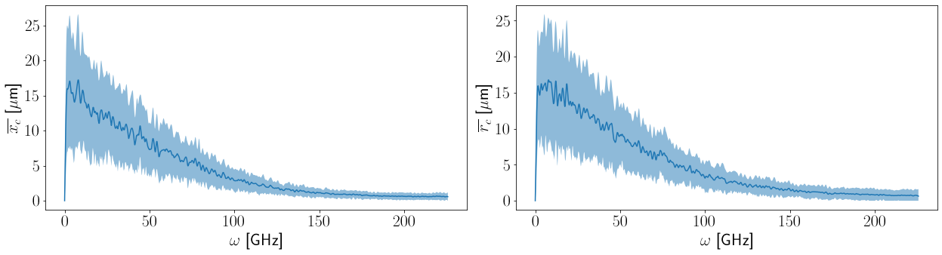
Results
The absolute value of the FT is averaged for each dataset
No signs of persisting seed
Transforms of the individual images
0.95e11
1ns window
69 events
Averaged absolute value of the FT for the dataset
Pixel size at object

Slide 8
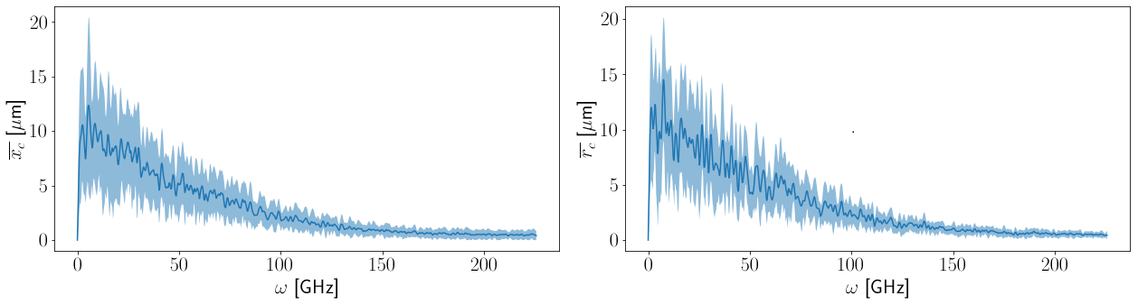
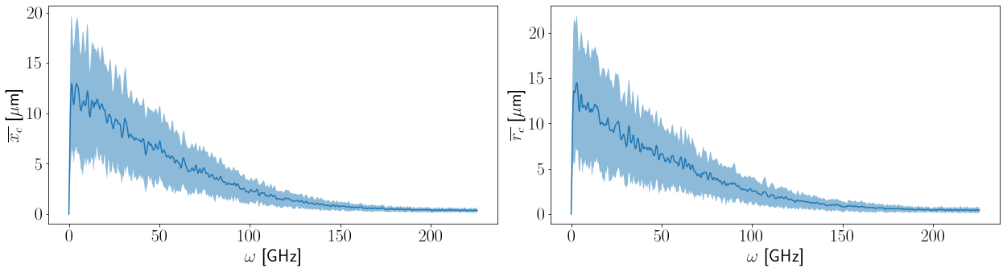
Results
1.9e11
1ns window
20 events
2.7e11
1ns window
79 events

Slide 9
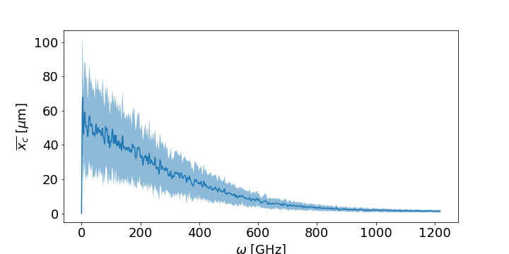
Results
y-scale 5 times larger due to bigger bin size in x
0.95e11
210ps window
65 events
Shorter time window of 210 ps
Not transversely Gaussian → calculated mean position of the center
Same trend as long timescale, no outstanding peeks

Slide 10
Results
No observation of reoccuring frequency in the radial modulation of the bunch nor the centroid displacement
  Be careful! This analysis could not determine the presence of sharp changes (as their spectrum is broad)

Slide 11
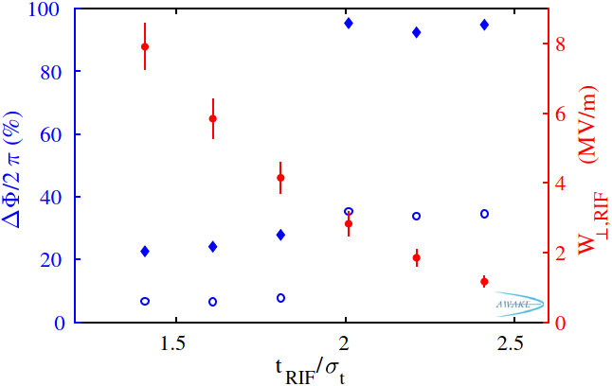
Seeding parameters
No need to introduce Fabian’s work
How does the transition change for different bunch populations and profiles?
Hypothesis:
In case of ”noise” scaling with the total charge the transition between SMI/SSM stays at the location where q/max(q) stays the same

Slide 12
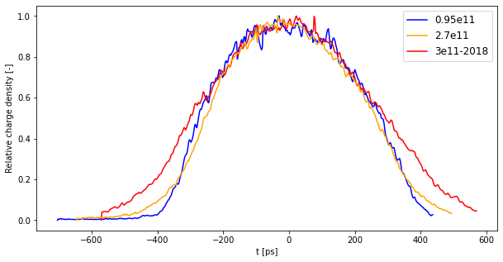
Measurement of seeding
Data from 2022
Normalized (averaged) longitudinal profile
Laser pulse
Front
Back
At least 4 timing settings (2 in SMI, 2 in SSM), at least 10 events per timing

Slide 13
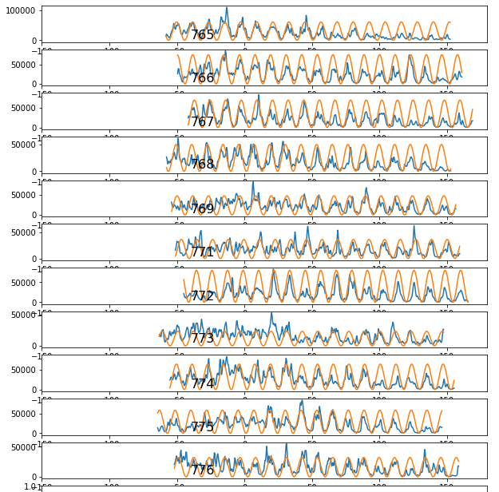
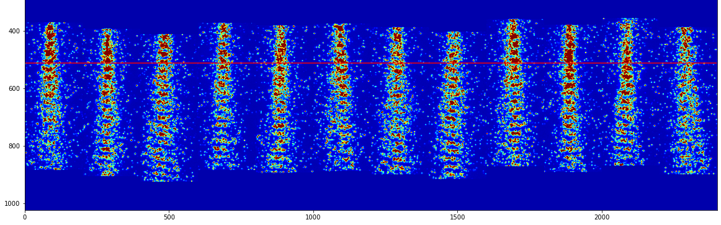
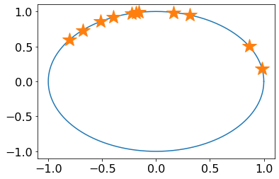
Analysis
Lineout for DFT:
Waterfall plot of events:
Array of phase:
[1.41, 1.98, 1.25, 2.32, 1.8, 0.18, 0.53, 1.76, 2.11, 2.5, 1.73]
Circular variance = 0.21

Slide 14
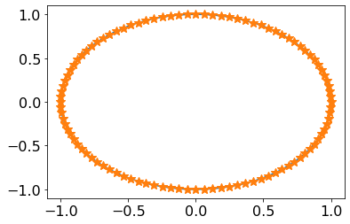
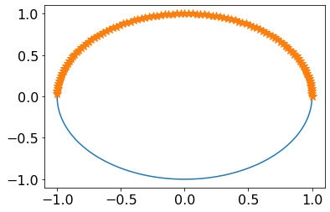
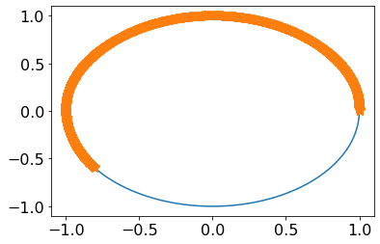
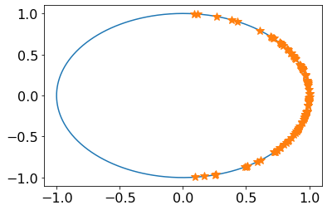
Circular variance (examples)
Uniformly distributed population: cv = 1
Uniformly distributed population in ½: cv = 0.36
Uniformly distrubuted population over 0.6: cv = 0.5
Gaussian with 𝜎 = 0.57rad: cv = 0.15

Slide 15
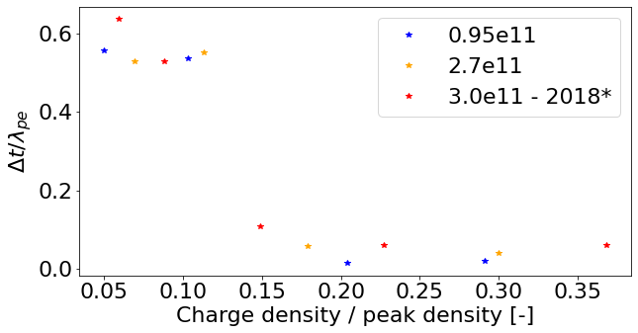
Results
SMI
Transition
Circular variance
SSM
Transition between SMI and SSM happens between 12-15% of the charge density peak

Slide 16
Results
Validates the treshold being at the same relative charge density
If any structure present at the entrance, amplitude scales with total charge
Possible experiments in 2025 to complete the datasets

Slide 17
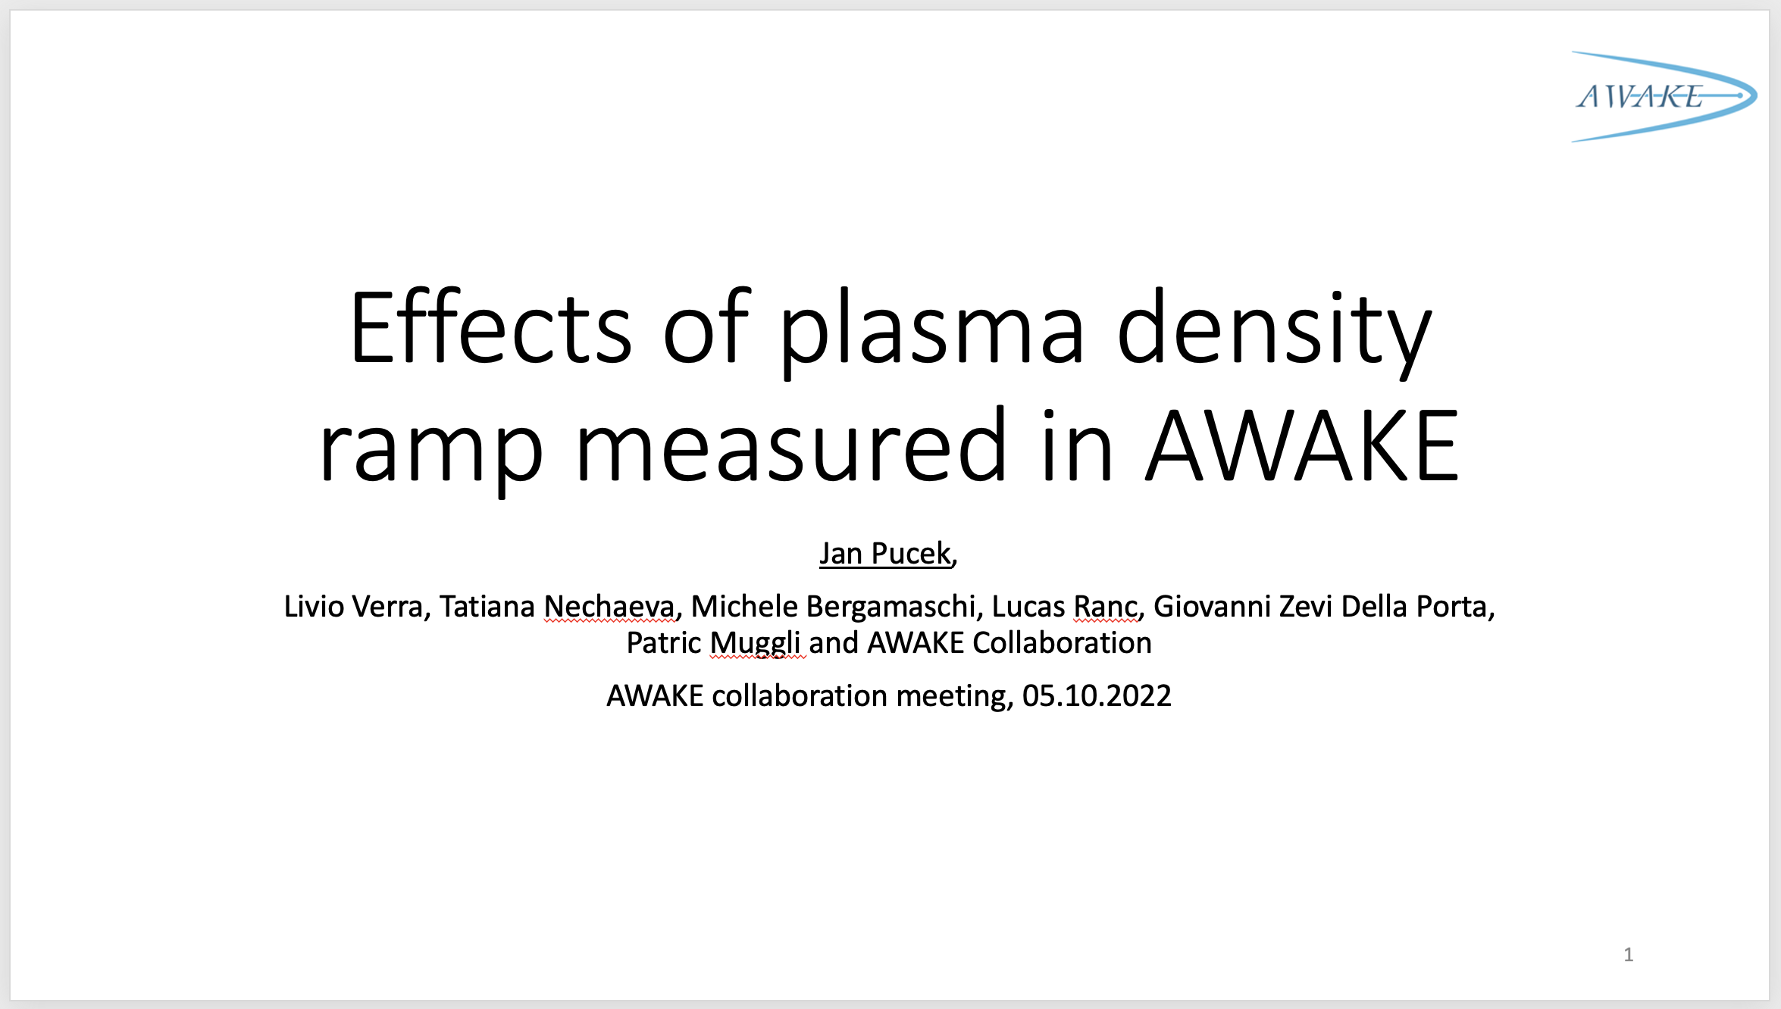
Study of the density ramp at the plasma entrance
Last presentation 2 years ago…
Analysis using circ. var, done additional measurement

Slide 18
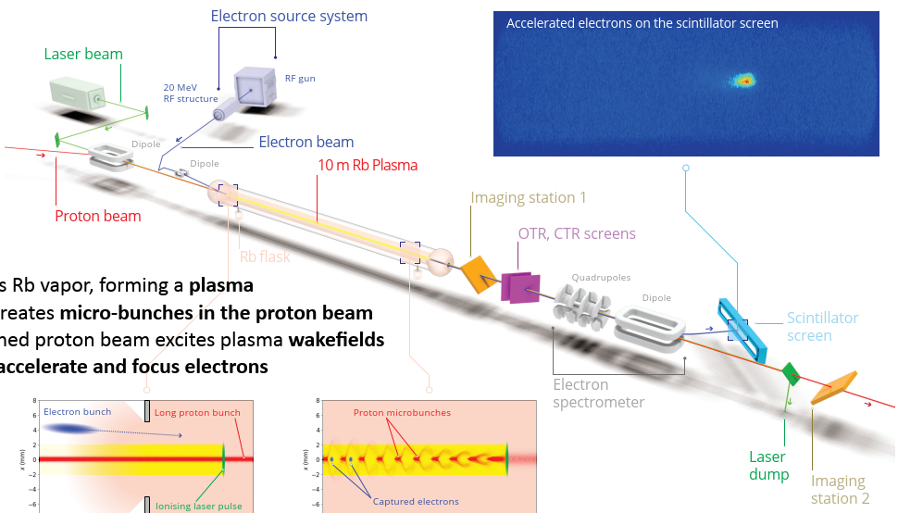
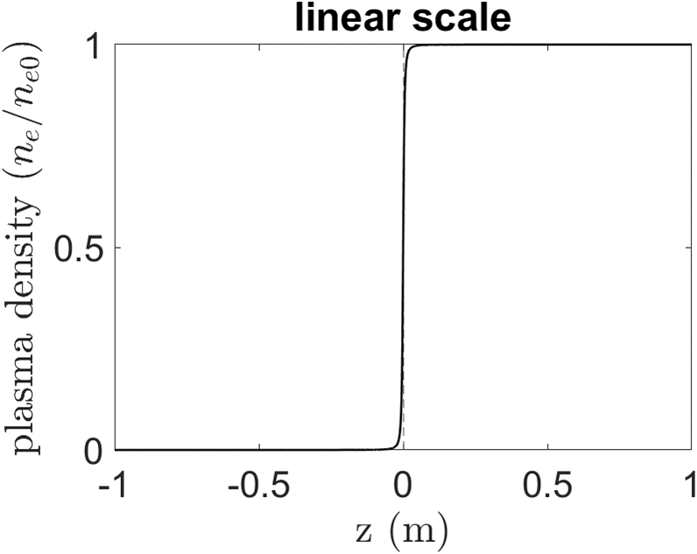
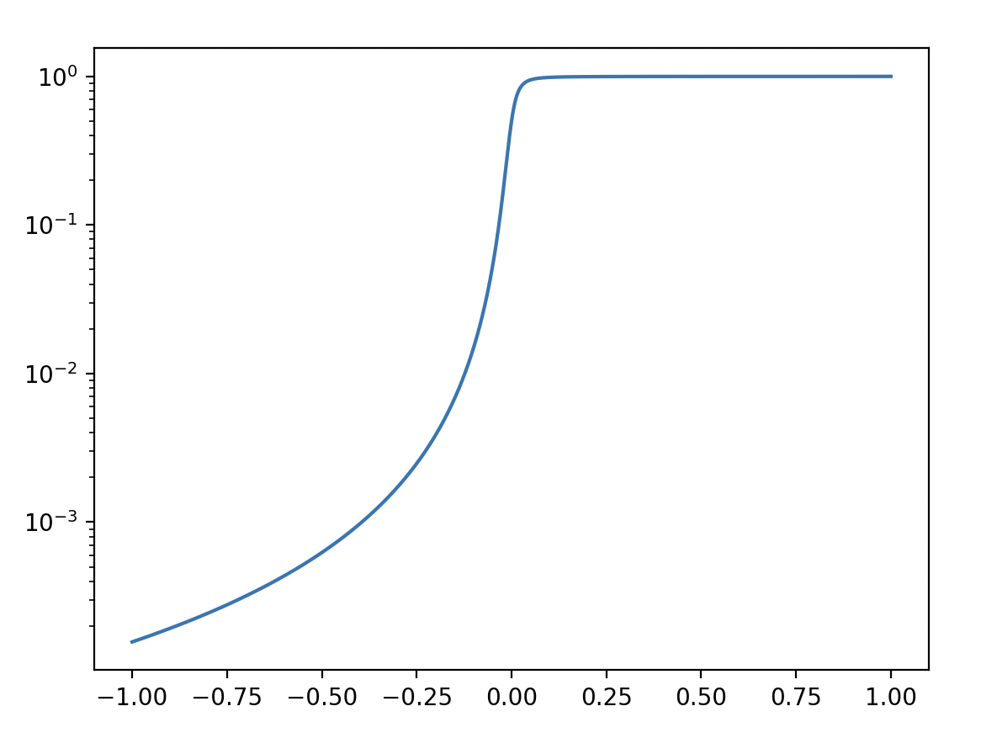
Introduction
Expansion volume
Heat exchanger
Rb reservoir
Cour
Courtesy of Pablo Morales Guzman*
*G Plyushchev et al 2018 J. Phys. D: Appl. Phys. 51 025203
*Danilatos G Proc. 22nd Int. Symp. Rarefied Gas Dynamics (2000)
n_{b}>>n_{e} + p⁺ -> plasma e⁻ filament
Defocusing of e⁻ bunch (seed, witness) when propagating within the p+ bunch
Plasma density in log scale
z [m]

Slide 19
Measurement setup
Direction of motion
Laser pulse
Proton bunch
Electron bunch
Multiple timing location of the e⁻ (the timing between p bunch and laser pulse constant)
Start at eSSM, measure the response of the p⁺ and the propagated charge of the e⁻

Slide 20
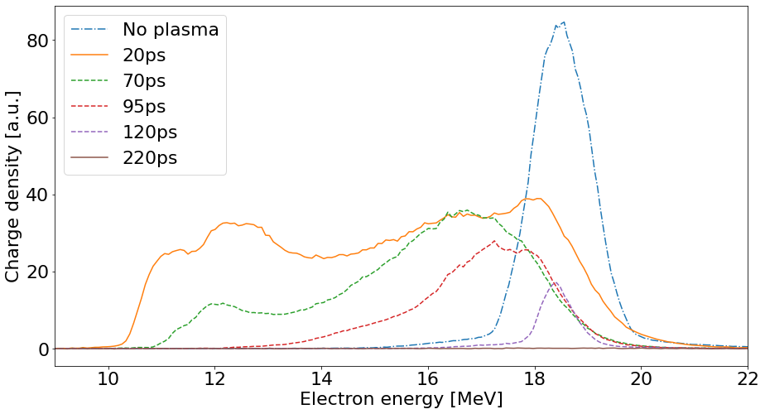
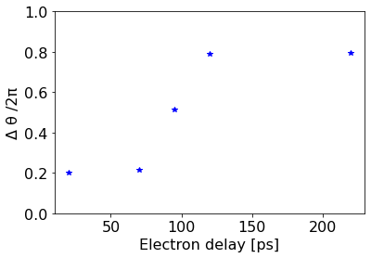
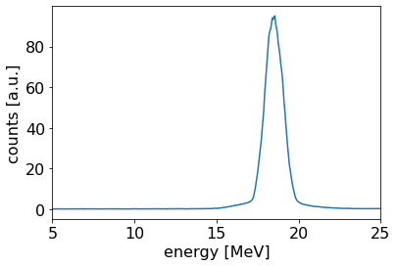
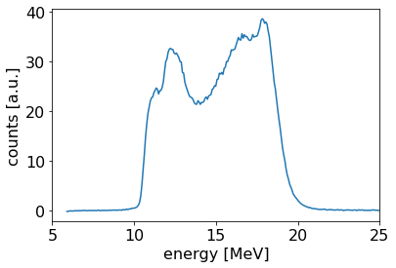
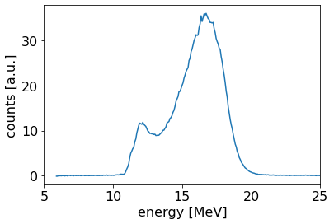
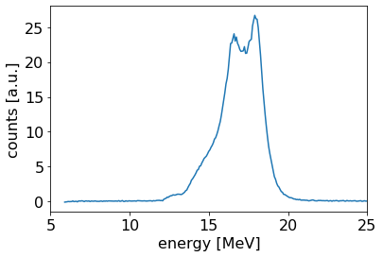
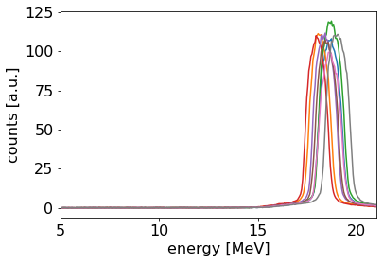
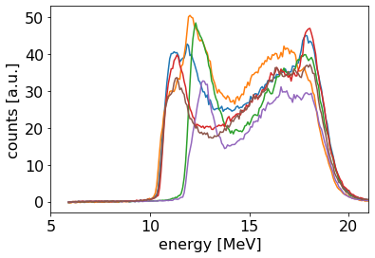
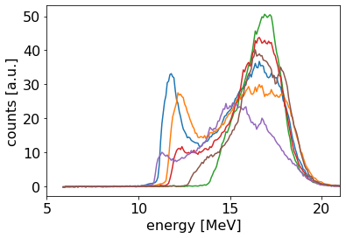
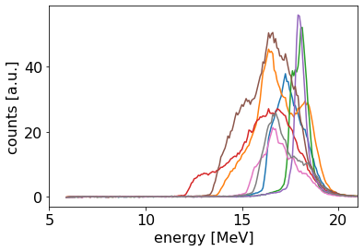
Results
Electron spectrometer measurement
SMI
eSSM
SMI
eSSM
No protons, no plasma
70ps
95ps
20ps
Current ripples

Slide 21
Conclusions
The incoming proton bunch does not exhibit detectable periodic fluctuations that could seed hosing or self-modulation
The transition between seeded self-modulation and the self-modulation instability occurs in the region of charge density equal to 12-15% of the charge density maximum
Due to the plasma electron filament driven by the proton bunch in the ramp at the entrance of the VS, the electron witness bunch cannot be injected on axis within the proton bunch
  (electron seeding possible)

Slide 22
Thank you for your attention

Slide 23
Backup

Slide 24
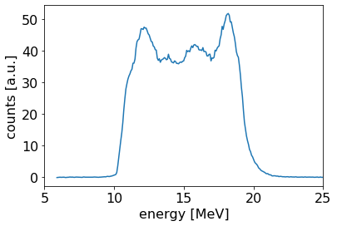
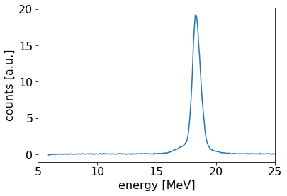
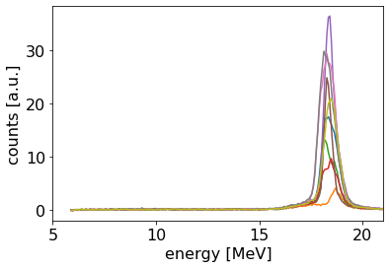
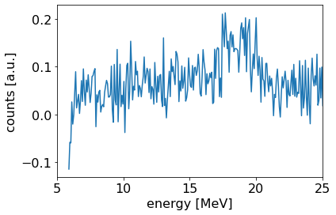
No protons
70ps
95ps
20ps
Low current in the spectrometer – visible ripples -> changed current for all others
120ps
95ps
No protons!
2 events
220ps

