Slide 1



Plasma Light
Locality and
Growth Rate Analysis
Presented by Jan Mezger

Slide 2
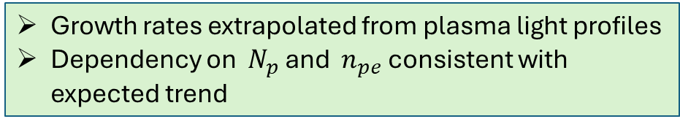
Contents
Plasma light measurements show evolution of SM along the plasma
(Mostly) Consistent with wakefield physics
Introduction
  Plasma light measurements recap
Locality
  Validating locality
  Seeding
  Comparison to DPS
Growth rate analysis
  Bunch population
  Plasma density
Measurements as a function of plasma length (using plungers) indicate:
  Locality for low signal amplitude (low bunch charge)
  Non-locality for high signal amplitude (high bunch charge)
Seeding has a big influence on the evolution of SM (not only phase but amplitude)
DPS measurements (most likely) local
Growth rates extrapolated from plasma light profiles
Dependency on ${ N}_{p}$ and ${ n}_{pe}$ consistent with expected trend

Slide 3
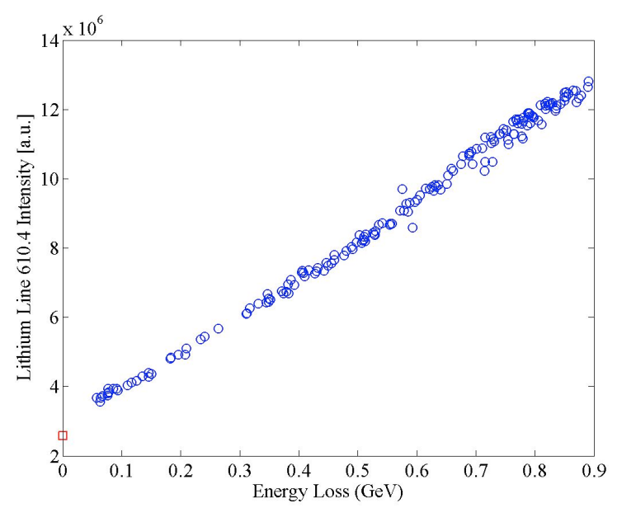
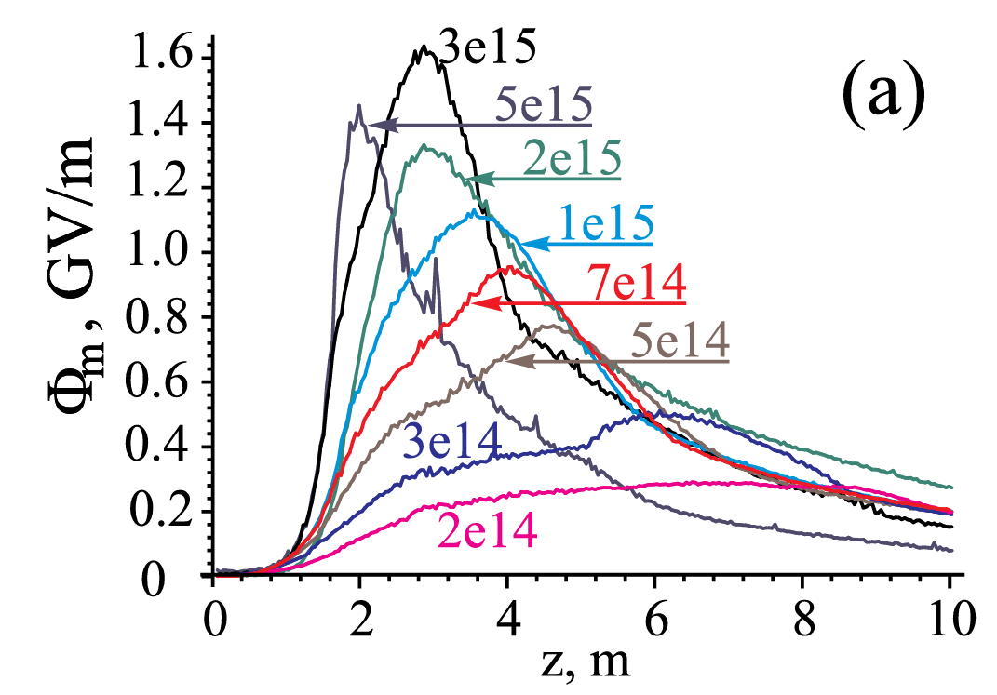
Plasma Light - Recap
E. Oz et al.“Optical Diagnostics for Plasma Wakefield Accelerators”
K. V. Lotov et al. “Parameter sensitivity of plasma wakefields driven by self-modulating proton bunch”
Plasma Light Diagnostic
Amount of emitted light proportional to energy deposited by drive bunch
→ Measuring evolution of wakefields along the plasma

Slide 4
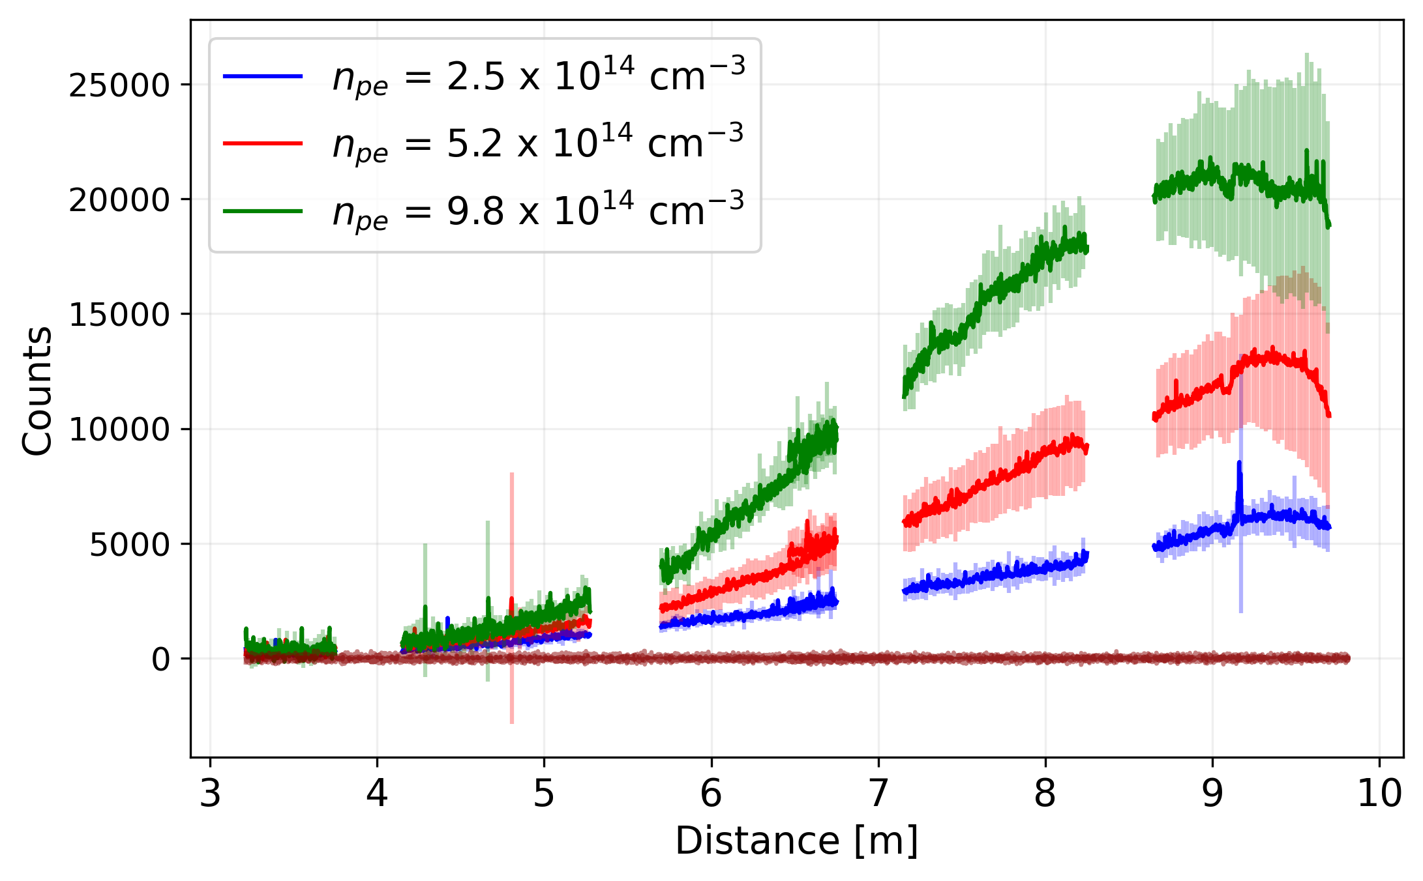
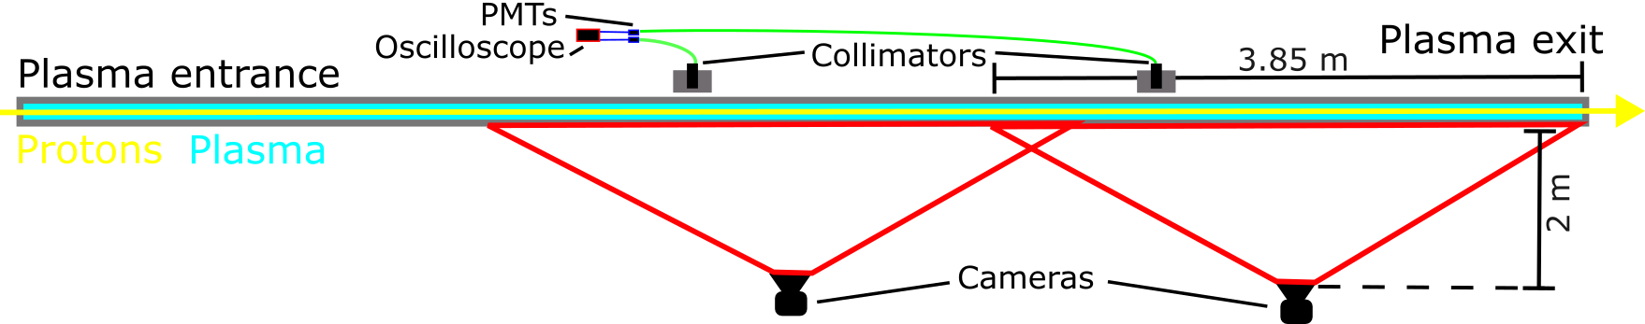
Plasma Light - Recap
E. Oz et al.“Optical Diagnostics for Plasma Wakefield Accelerators”
K. V. Lotov et al. “Parameter sensitivity of plasma wakefields driven by self-modulating proton bunch”
Plasma Light Diagnostic
Amount of emitted light proportional to energy deposited by drive bunch
→ Measuring evolution of wakefields along the plasma
DPS (2 wide angle cameras):
→ Results agree with expectations

Slide 5
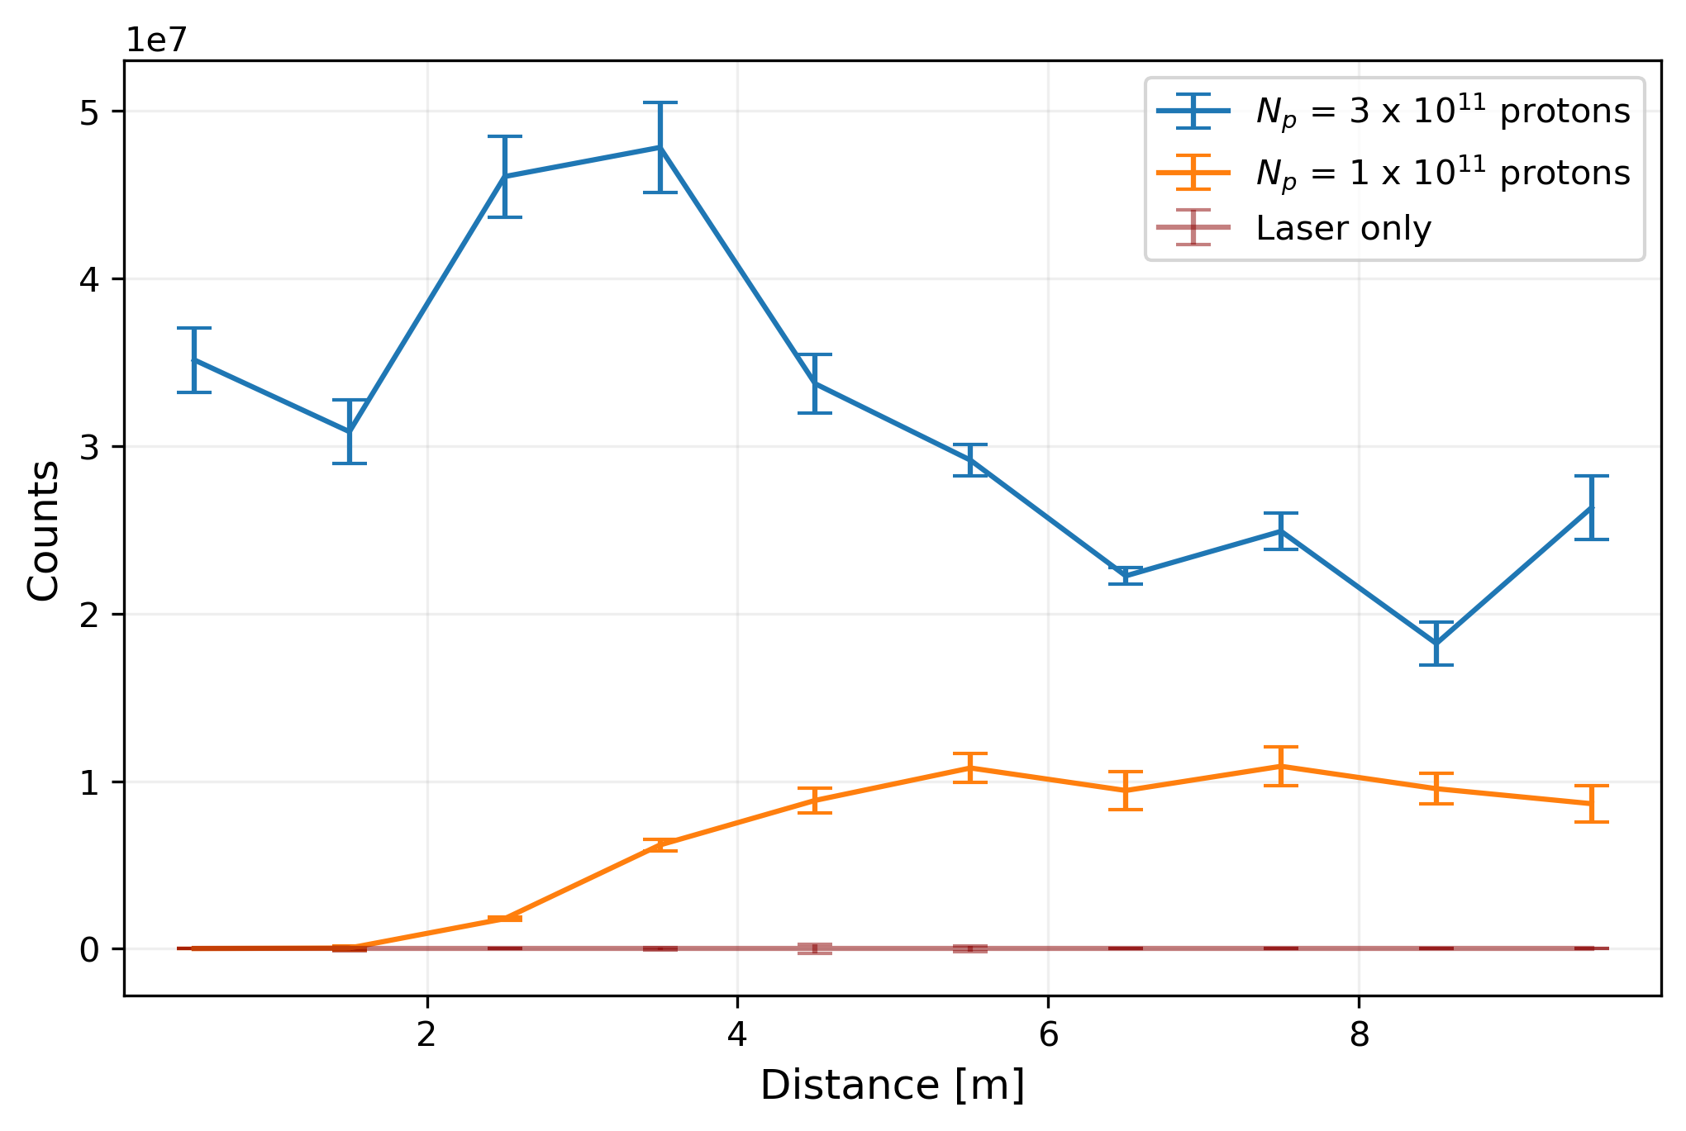
Plasma Light - Recap
E. Oz et al.“Optical Diagnostics for Plasma Wakefield Accelerators”
K. V. Lotov et al. “Parameter sensitivity of plasma wakefields driven by self-modulating proton bunch”
Plasma Light Diagnostic
Amount of emitted light proportional to energy deposited by drive bunch
→ Measuring evolution of wakefields along the plasma
DPS (2 wide angle cameras):
→ Results agree with expectations
VPS (10 cameras at 10 view ports):
→ Results agree with expectations… sometimes

Slide 6
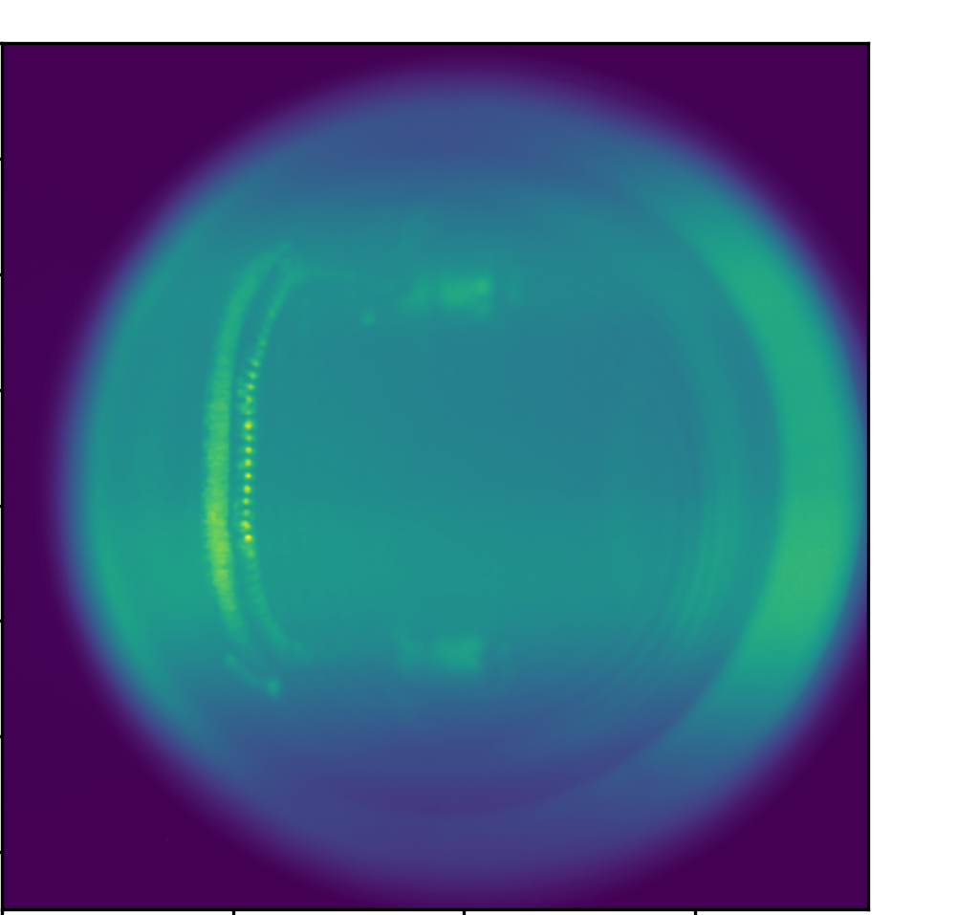
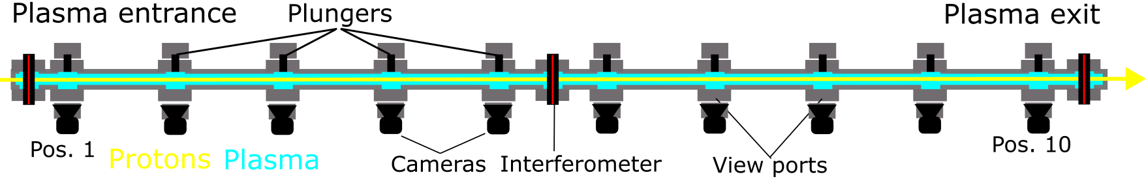
Validating locality
Camera Image – Dump out
Plungers with laser dump foil:
Laser can be stopped at every view port position (0.5m to 9.5m)
→ Laser dump scan

Slide 7
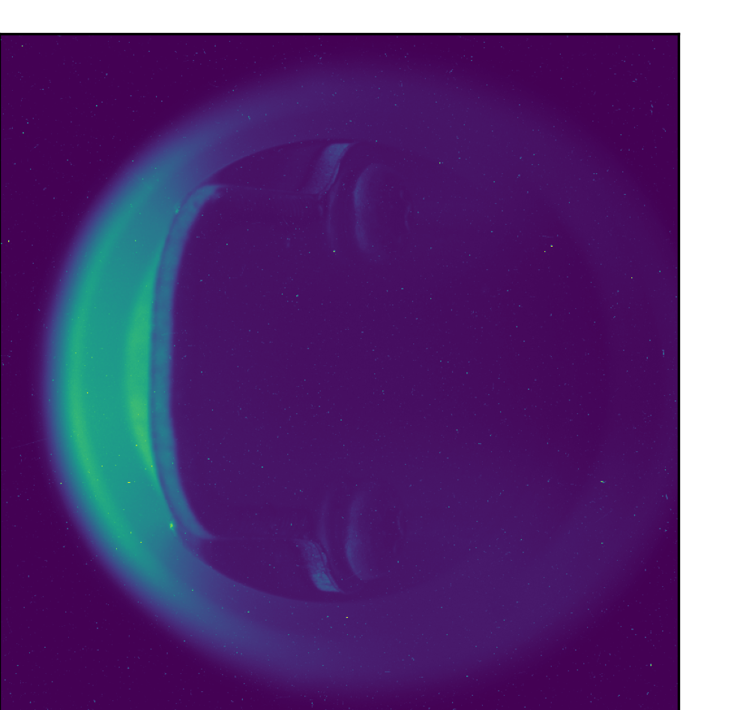
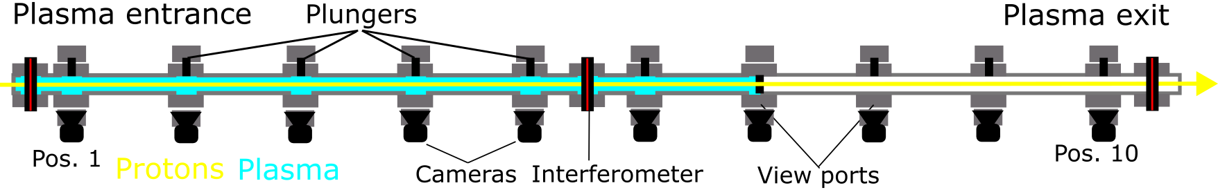
Validating locality
Camera Image – Dump in
Plungers with laser dump foil:
Laser can be stopped at every view port position (0.5m to 9.5m)
→ Laser dump scan

Slide 8
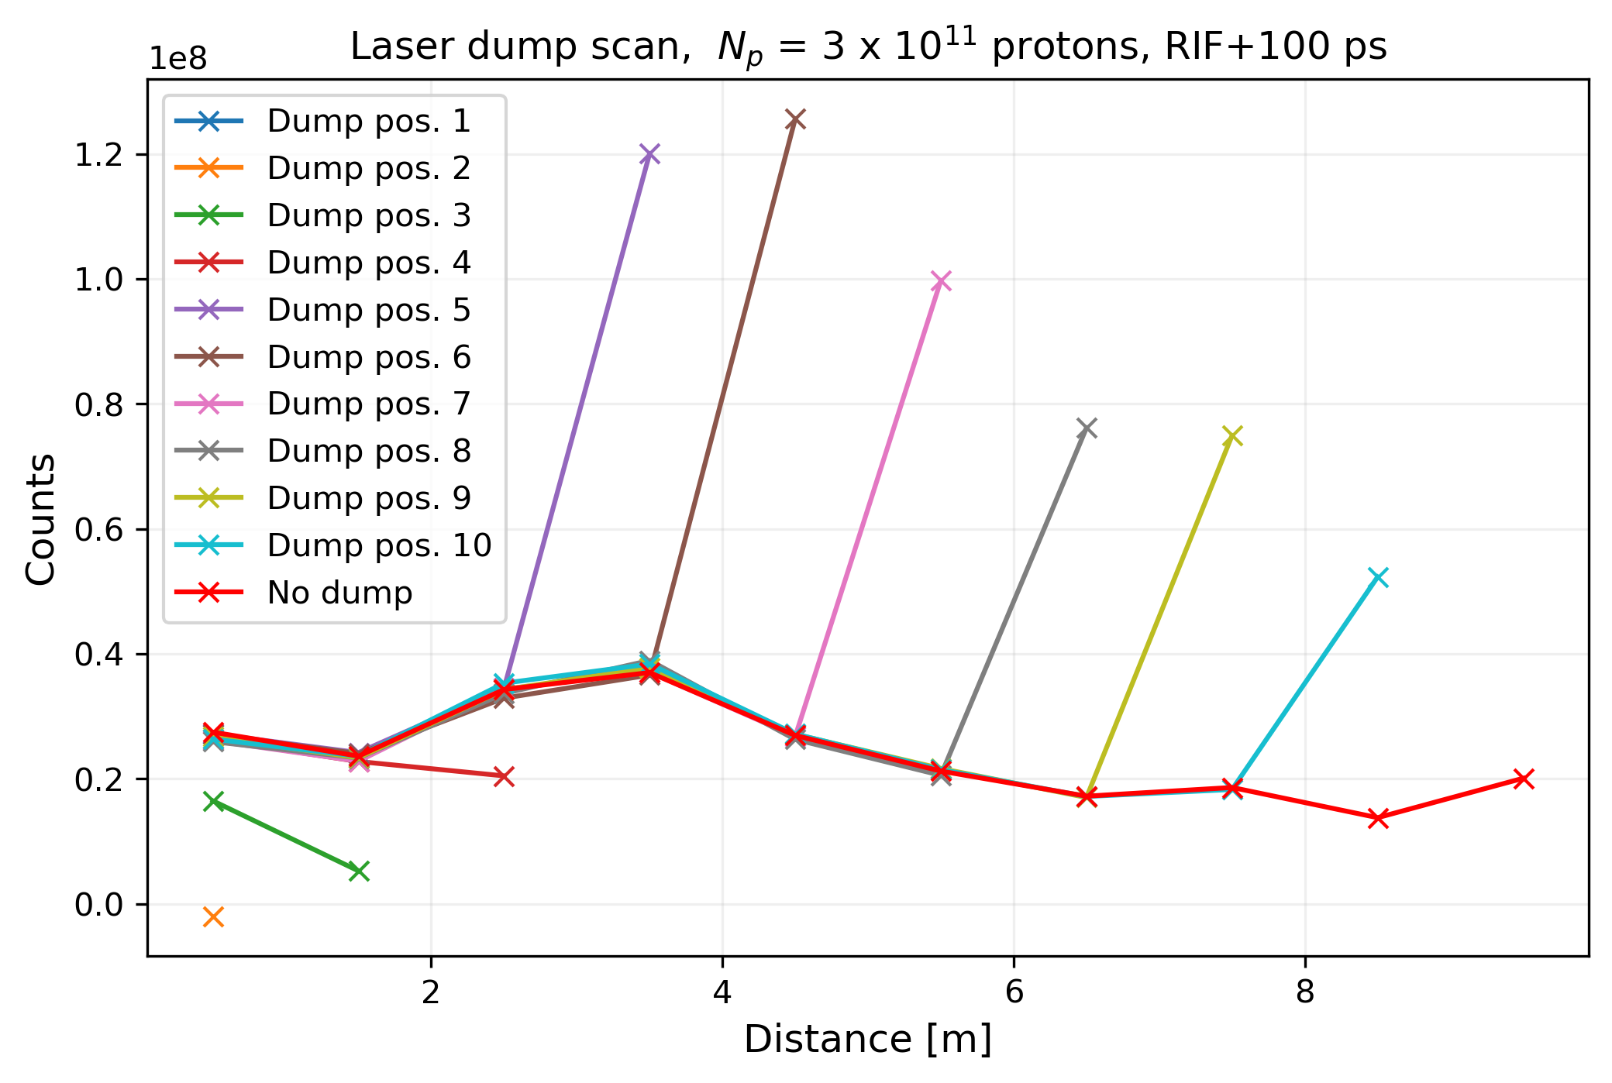

Validating locality
Example of non-local signal:
Plungers with laser dump foil:
Laser can be stopped at every view port position (0.5m to 9.5m)
→ Laser dump scan
Plasma Light locality:
If signal changes upstream when changing plasma downstream
Plasma light signal non-local
No change
→Locality validated
$${ n}_{pe}=7.9 ×{10}^{14}cm^{−3}$$

Slide 9
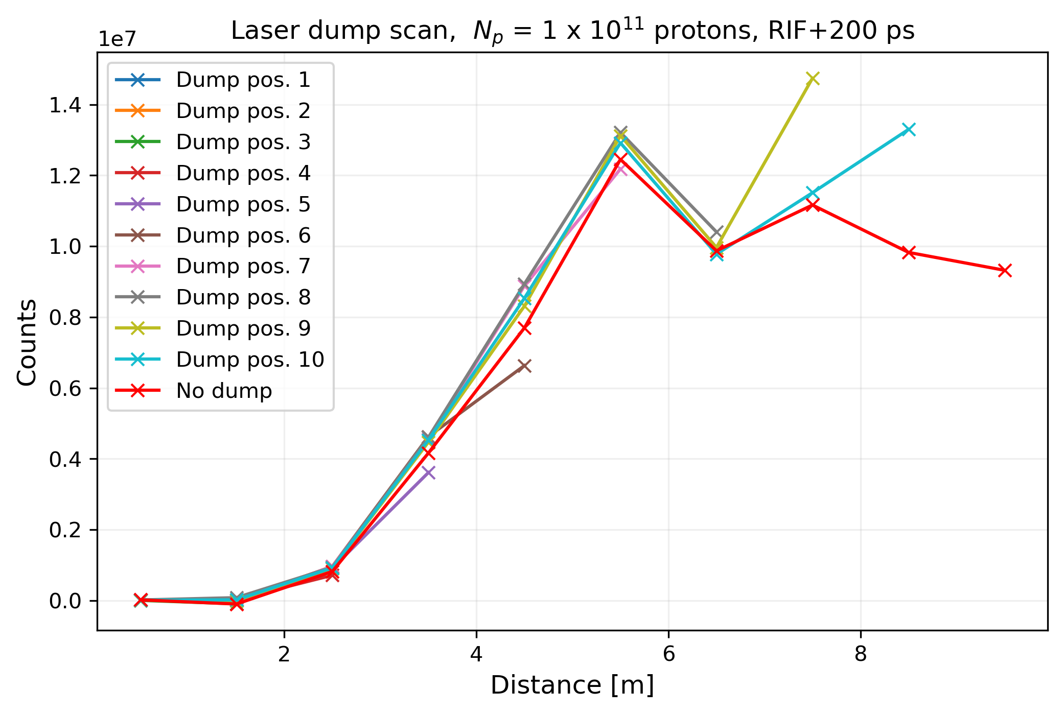
Validating locality
Example of local signal:
Plungers with laser dump foil:
Laser can be stopped at every view port position (0.5m to 9.5m)
→ Laser dump scan
Plasma Light locality:
If signal changes upstream when changing plasma downstream
Plasma light signal non-local
No change
→Locality validated
$${ n}_{pe}=7.9 ×{10}^{14}cm^{−3}$$

Slide 10
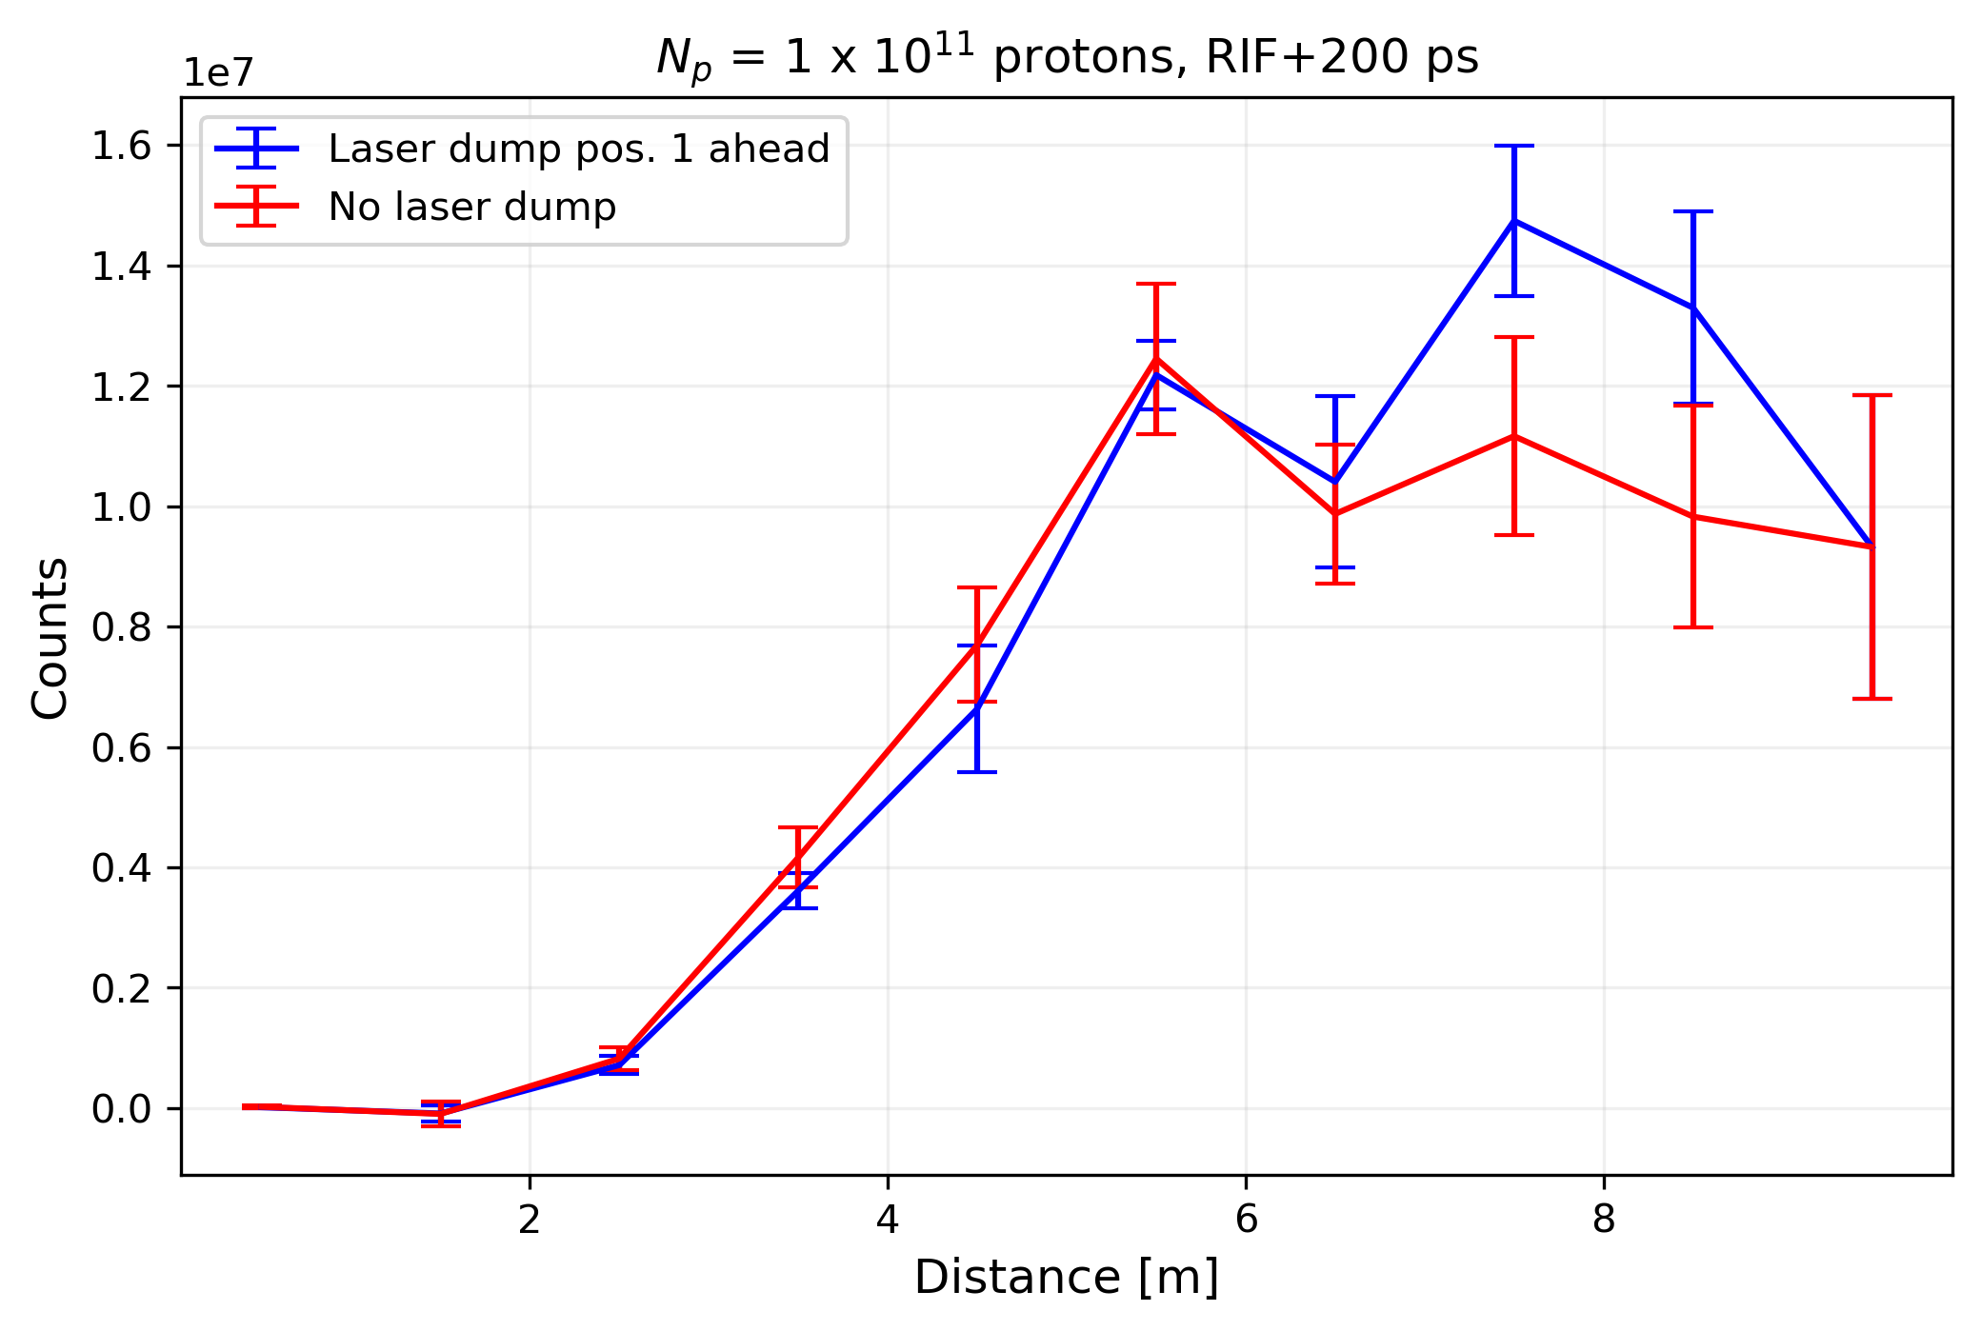
Validating locality
Measurement points 1 ahead
of plunger position with error bars :
Plungers with laser dump foil:
Laser can be stopped at every view port position (0.5m to 9.5m)
→ Laser dump scan
Plasma Light locality:
If signal changes upstream when changing plasma downstream
Plasma light signal non-local
No change
→Locality validated
$${ n}_{pe}=7.9 ×{10}^{14}cm^{−3}$$

Slide 11
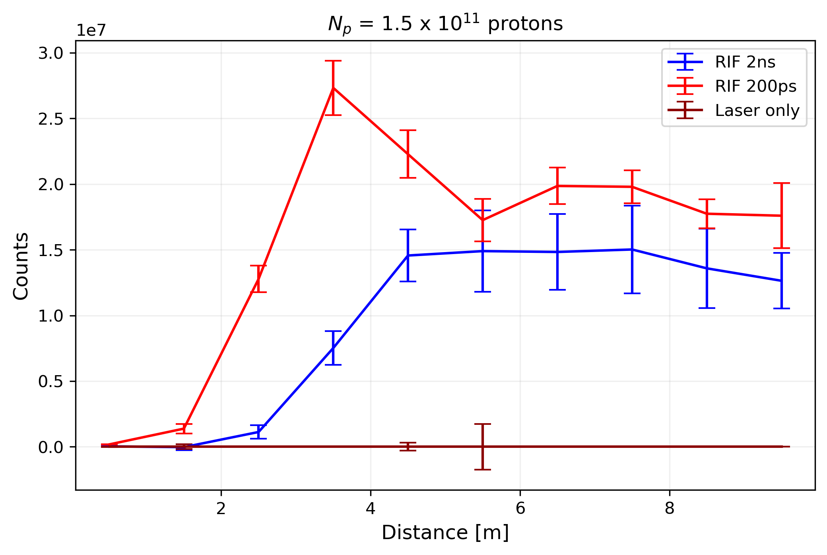
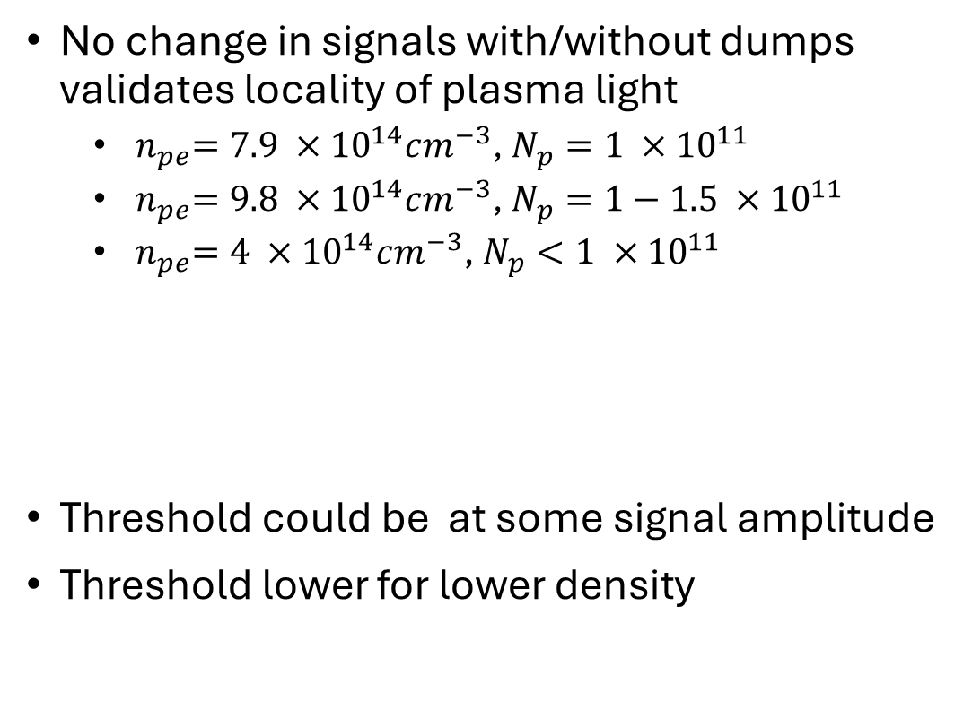

Validating locality
$${ n}_{pe}=9.8 ×{10}^{14}cm^{−3}$$
Non-local
No change in signals with/without dumps validates locality of plasma light
  ${ n}_{pe}=7.9 ×{10}^{14}cm^{−3}$, $N_{p}=1 ×{10}^{11}$
  ${ n}_{pe}=9.8 ×{10}^{14}cm^{−3}$, $N_{p}=1−1.5 ×{10}^{11}$
  ${ n}_{pe}=4 ×{10}^{14}cm^{−3}$, $N_{p}<1 ×{10}^{11}$
Threshold could be at some signal amplitude
Threshold lower for lower density
Local

Slide 12
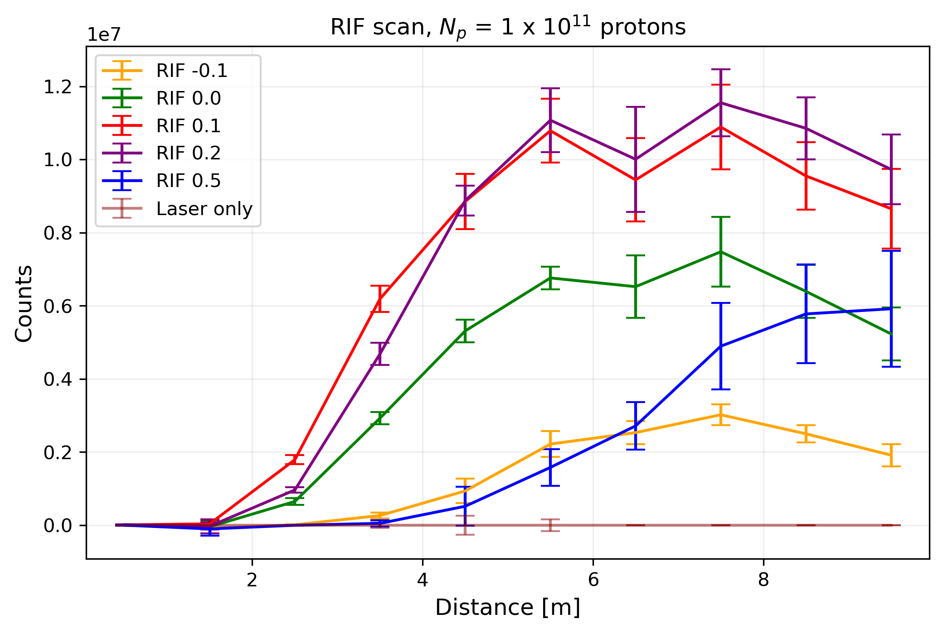
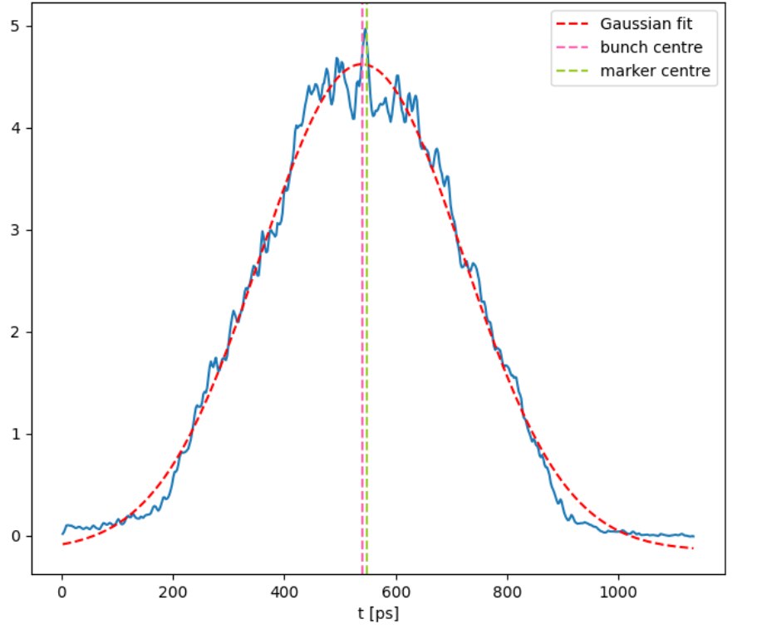

Seeding
Seed wakefields induced by propagating the laser together with proton bunch
RIF position – position of the laser relative to proton bunch center
Threshold SSM-SMI ~ 0.3 ns (0.2 ns → 0.5 ns)
$${ n}_{pe}=7.9 ×{10}^{14}cm^{−3}$$
Bunch length: 182 ps (1σ)
Bunch density [a.u.]

Slide 13
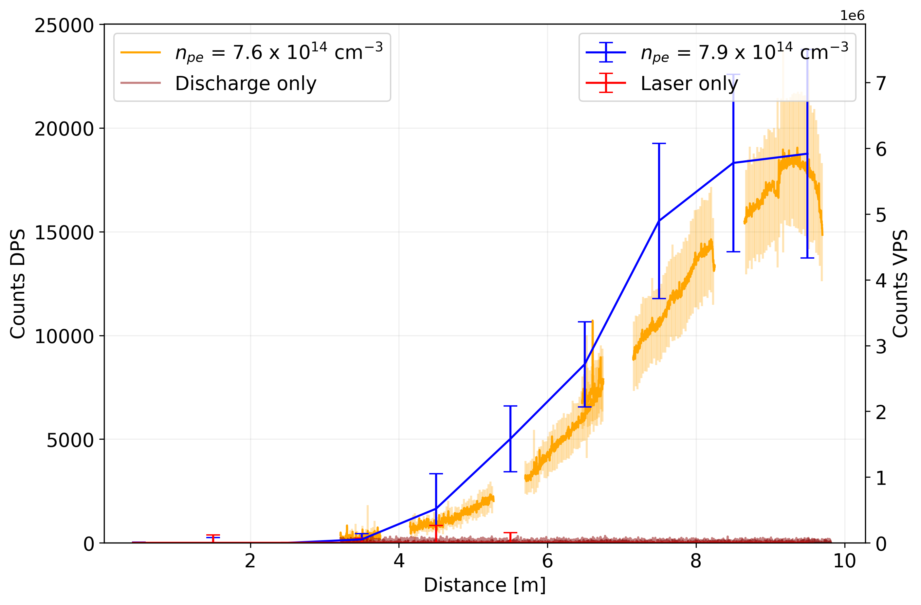


Comparison to DPS
$N_{p}=1.5 ×{10}^{11}$
$N_{p}=1 ×{10}^{11}$
DPS – no seeding (always SMI)
SMI case of VPS in local regime looks very similar to DPS
SMI case of VPS in non-local regime looks very different from DPS
→ Indication that DPS measurements do not have the same problem.

Slide 14
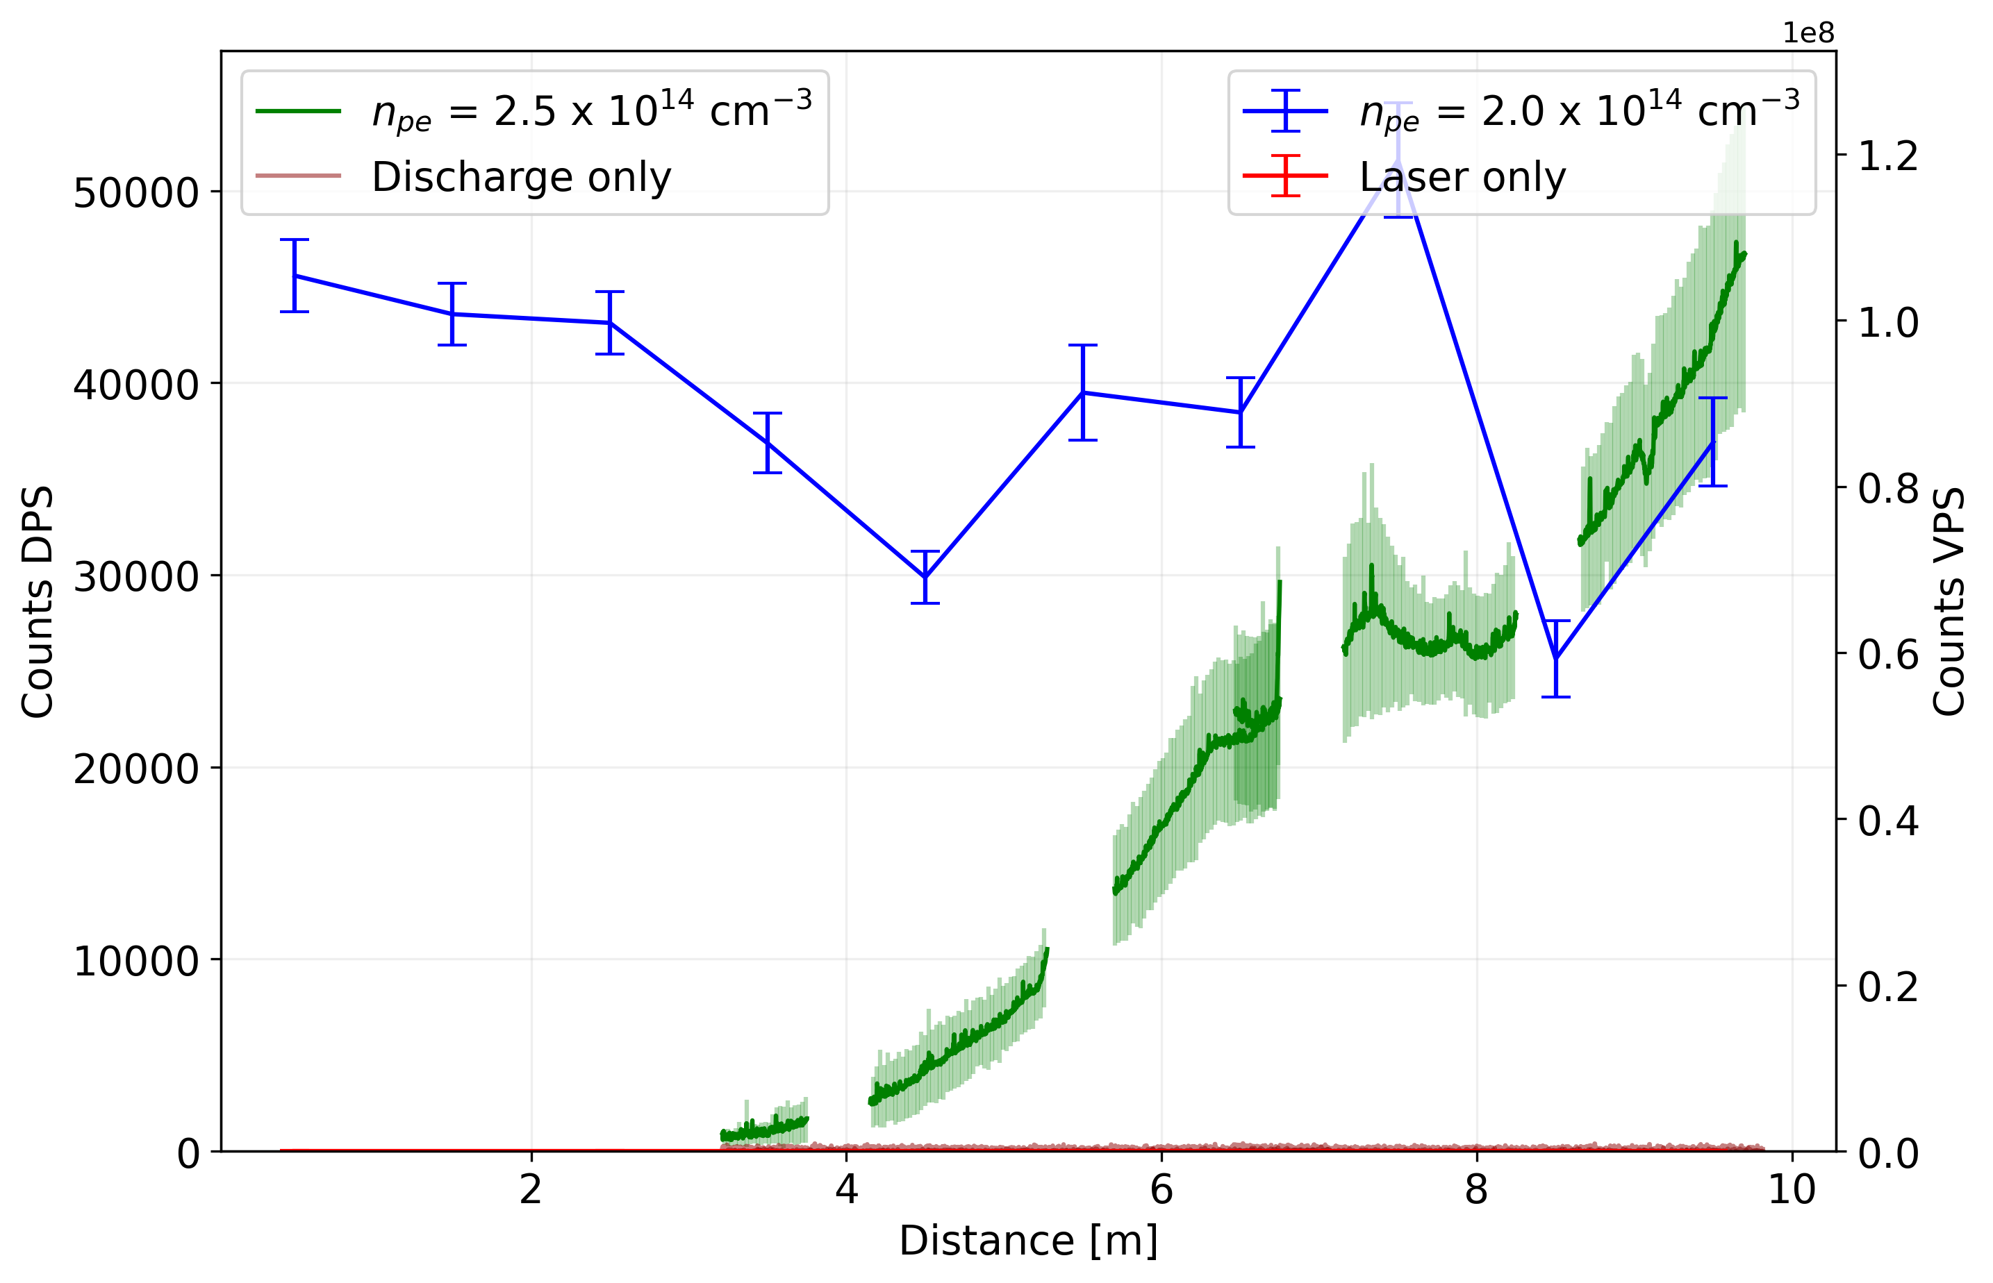


Comparison to DPS
$N_{p}=3 ×{10}^{11}$
$N_{p}=3 ×{10}^{11}$
DPS – no seeding (always SMI)
SMI case of VPS in local regime looks very similar to DPS
SMI case of VPS in non-local regime looks very different from DPS
→ Indication that DPS measurements do not have the same problem.

Slide 15
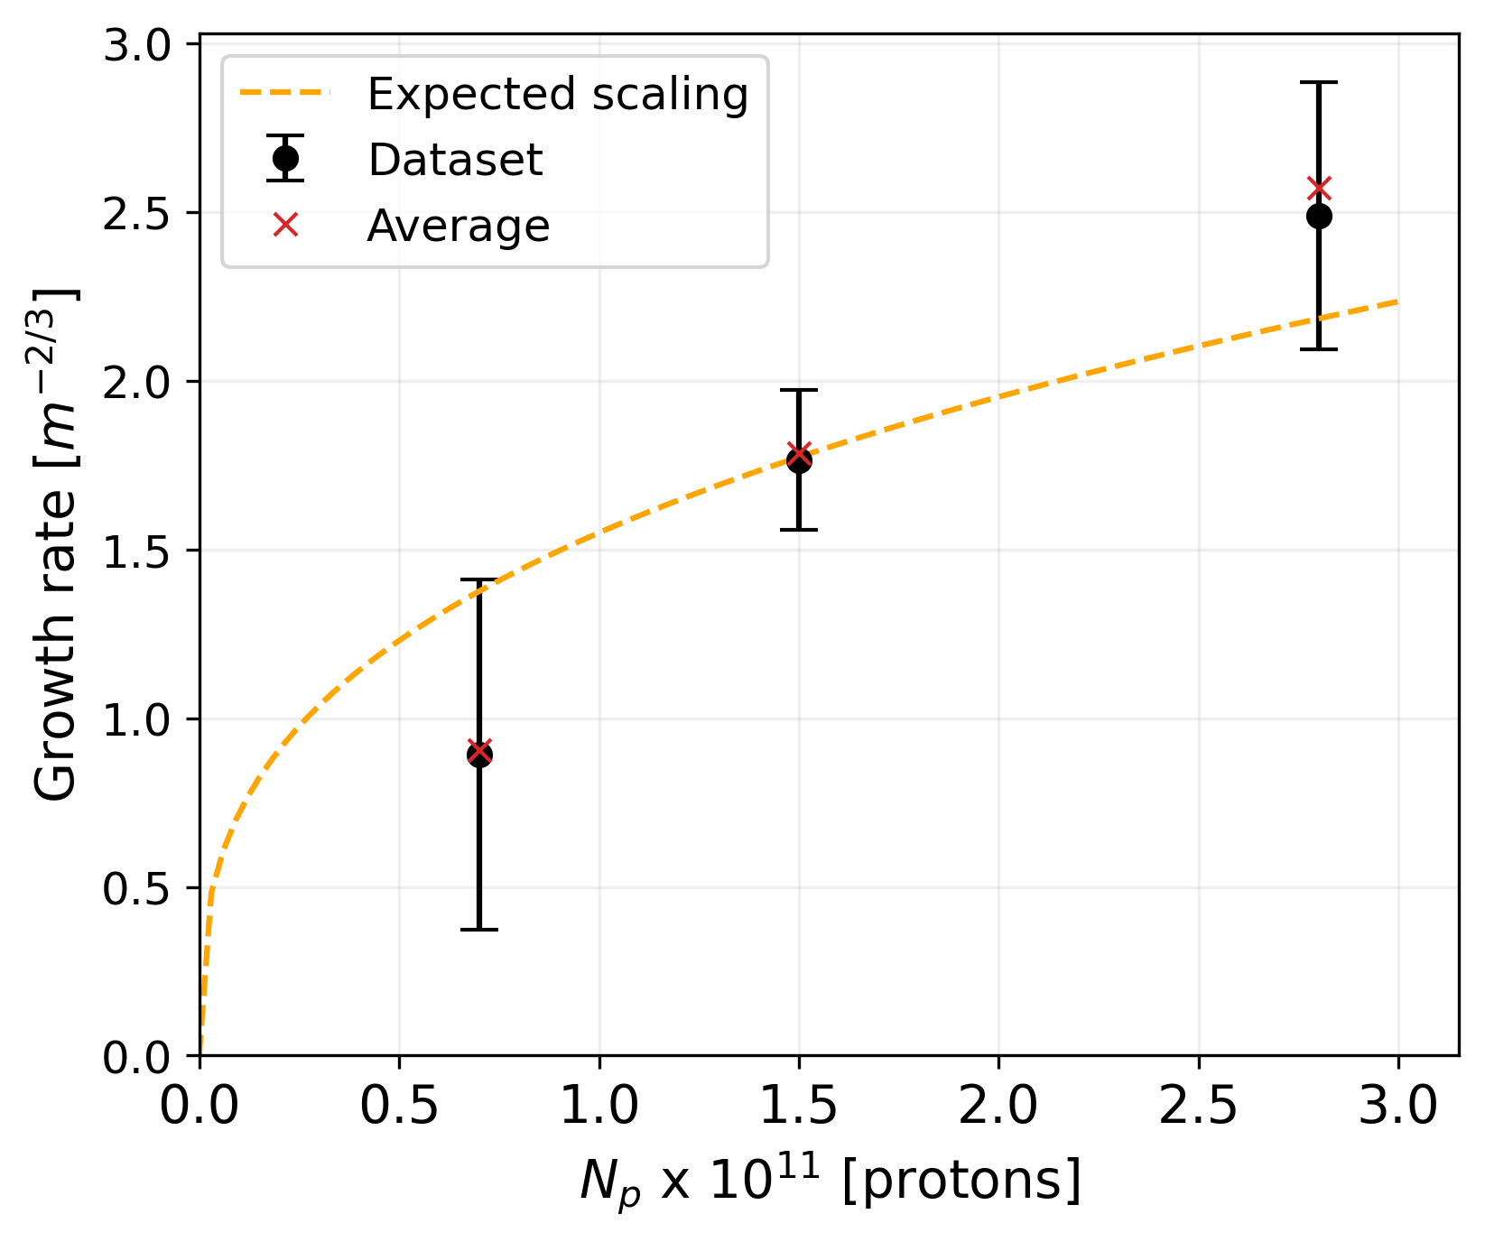
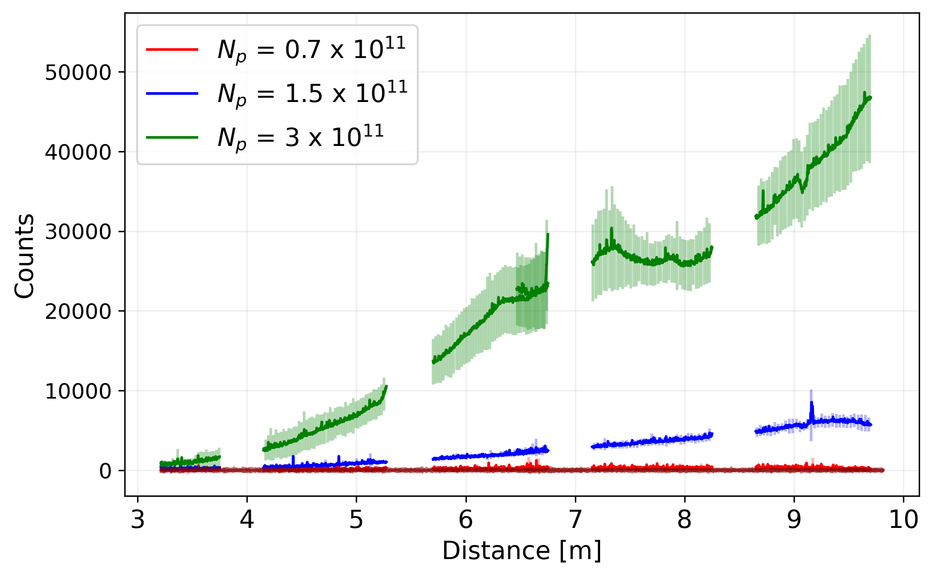
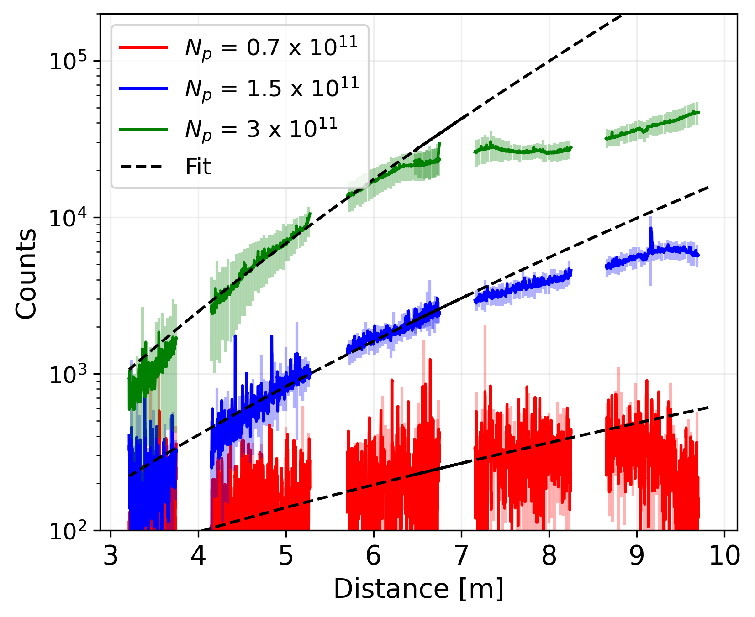

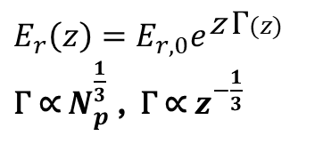
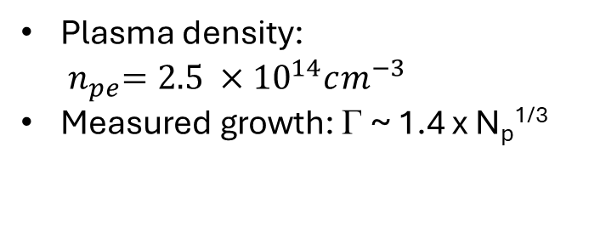
Growth rate analysis
$E_{r}\left(z\right)=E_{r,0}e^{\text{z} \text{Γ}(z)}$
$\text{Γ}$ ∝ $N_{p}^{\frac{1}{3}}$ , $\text{Γ}$ ∝ $z^{−\frac{1}{3}}$
Plasma density: ${ n}_{pe}=2.5 ×{10}^{14}cm^{−3}$
Measured growth: Γ ~ 1.4 x N_{p}^{1/3}
Γ ~ 1.4 x N_{p}^{1/3}
fit function:
$$f\left(x\right)= a e^{\text{Γ}z^{\frac{2}{3}}}$$

Slide 16
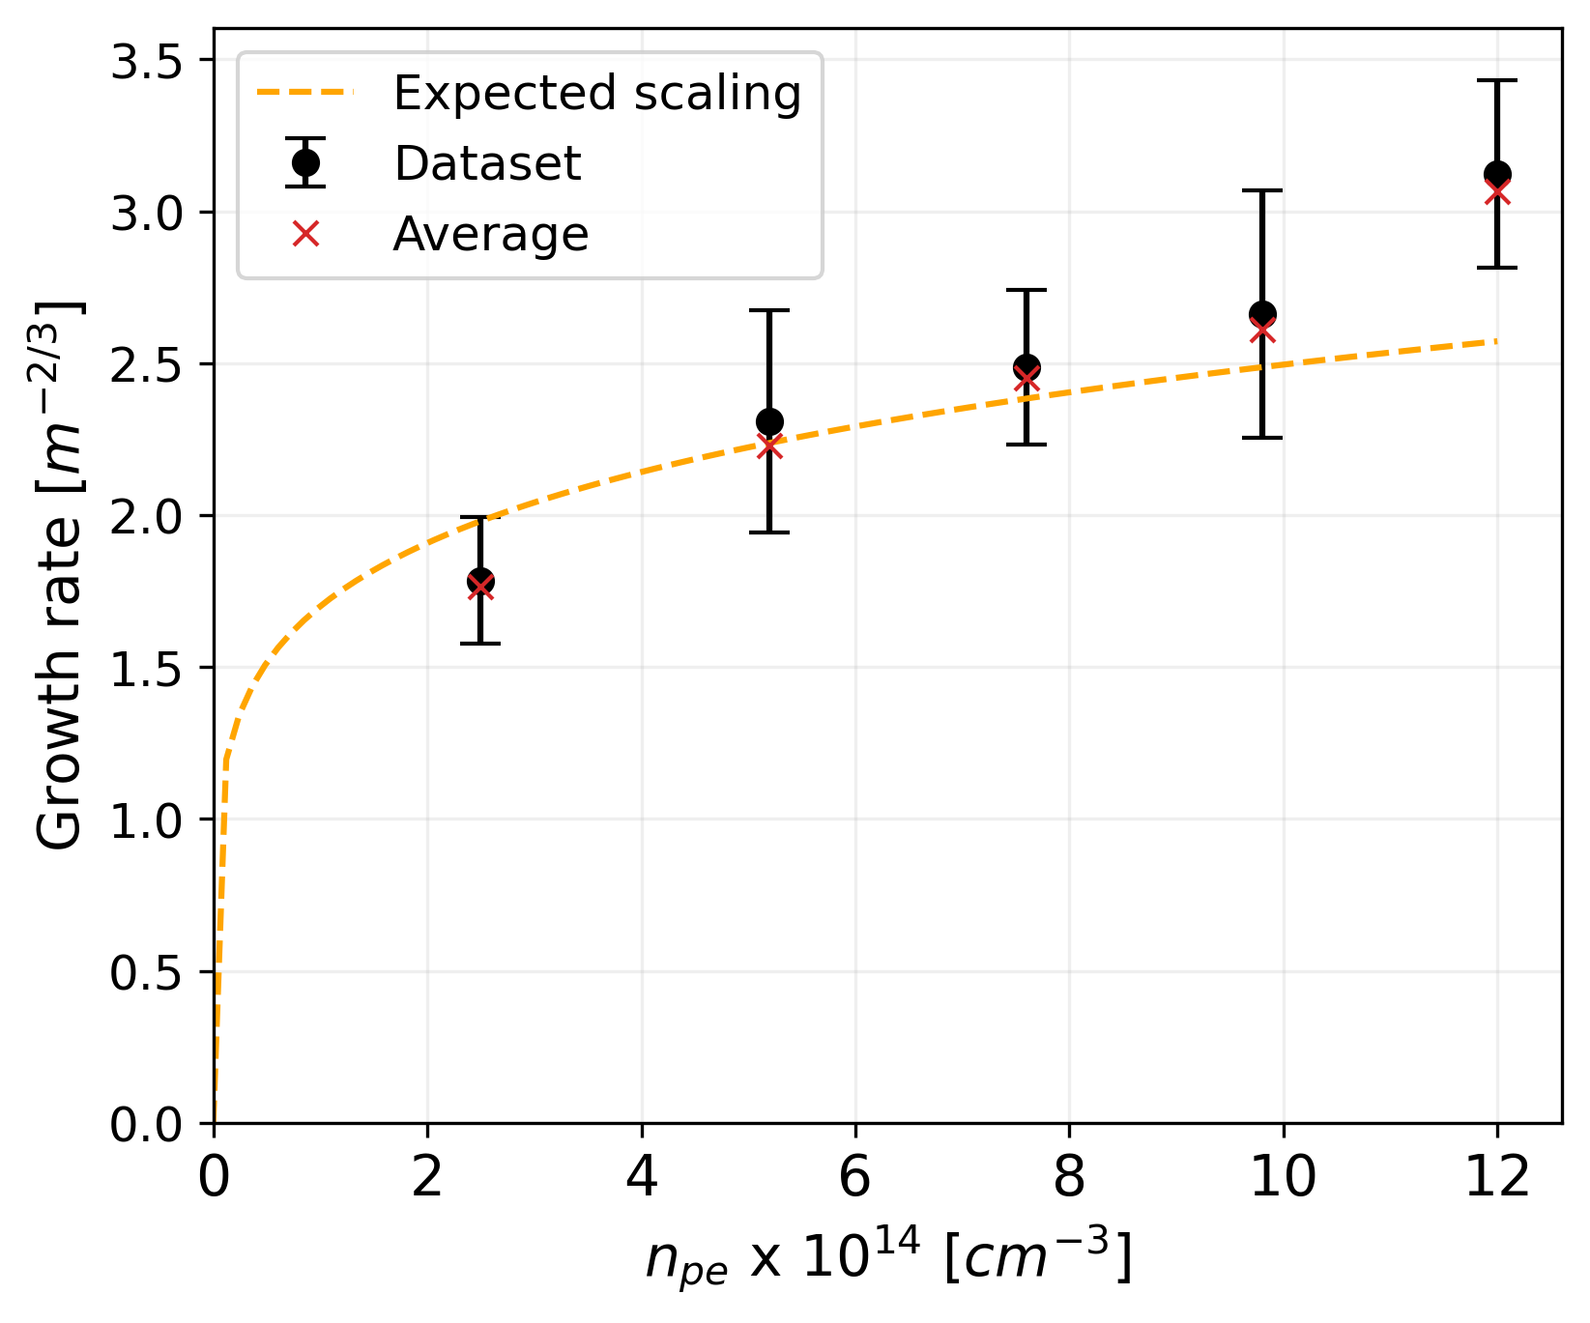
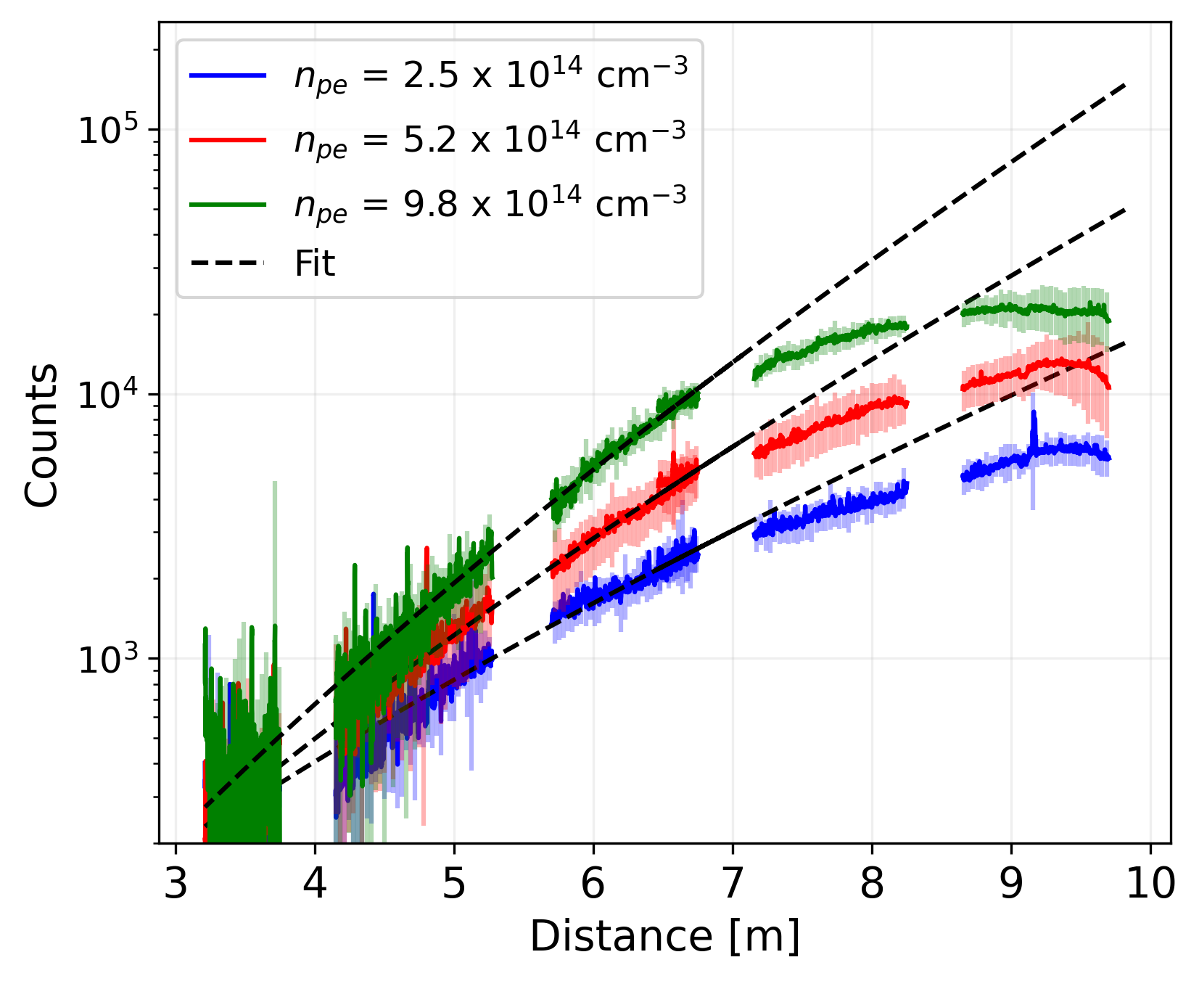
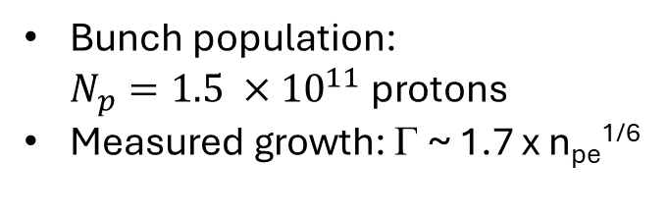
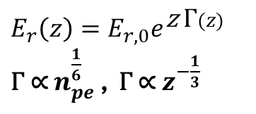
Growth rate analysis
$E_{r}\left(z\right)=E_{r,0}e^{\text{z} \text{Γ}(z)}$
$\text{Γ}$ ∝ $n_{pe}^{\frac{1}{6}}$ , $\text{Γ}$ ∝ $z^{−\frac{1}{3}}$
Bunch population: $N_{p}=1.5 ×{10}^{11}$ protons
Measured growth: Γ ~ 1.7 x n_{pe}^{1/6}
Γ ~ 1.7 x n_{pe}^{1/6}
fit function:
$$f\left(x\right)= a e^{\text{Γ}z^{\frac{2}{3}}}$$

Slide 17
Conclusion
When local: plasma light profiles show the evolution of SM along the plasma
In the VPS local only for low signal amplitude
In the DPS (most likely) local even for high signal amplitude
When not seeded and local: VPS and DPS signals look very similar
Growth rates follow expected trend
Γ ~ 1.4 x N_{p}^{1/3}
Γ ~ 1.7 x n_{pe}^{1/6}

