Slide 1
^{AWAKE Collaboration Meeting}
^{CERN, 6 – 8 November 2024}
Edda Gschwendtner, CERN

Slide 2
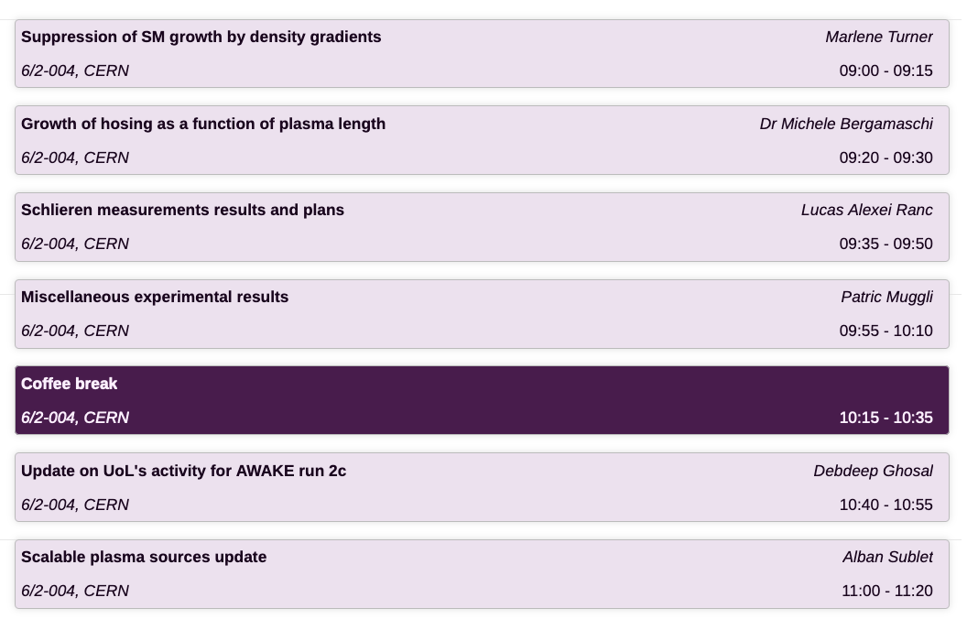
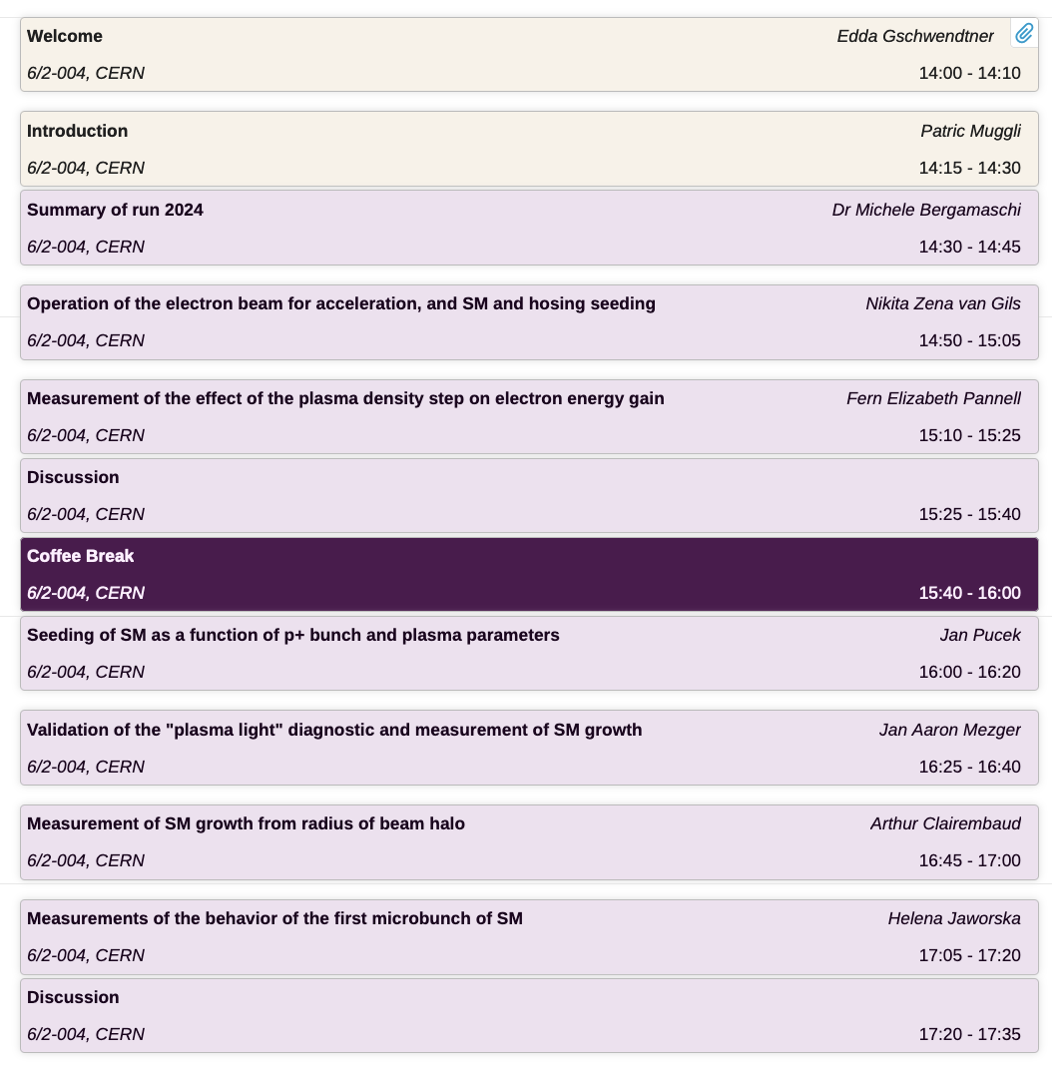
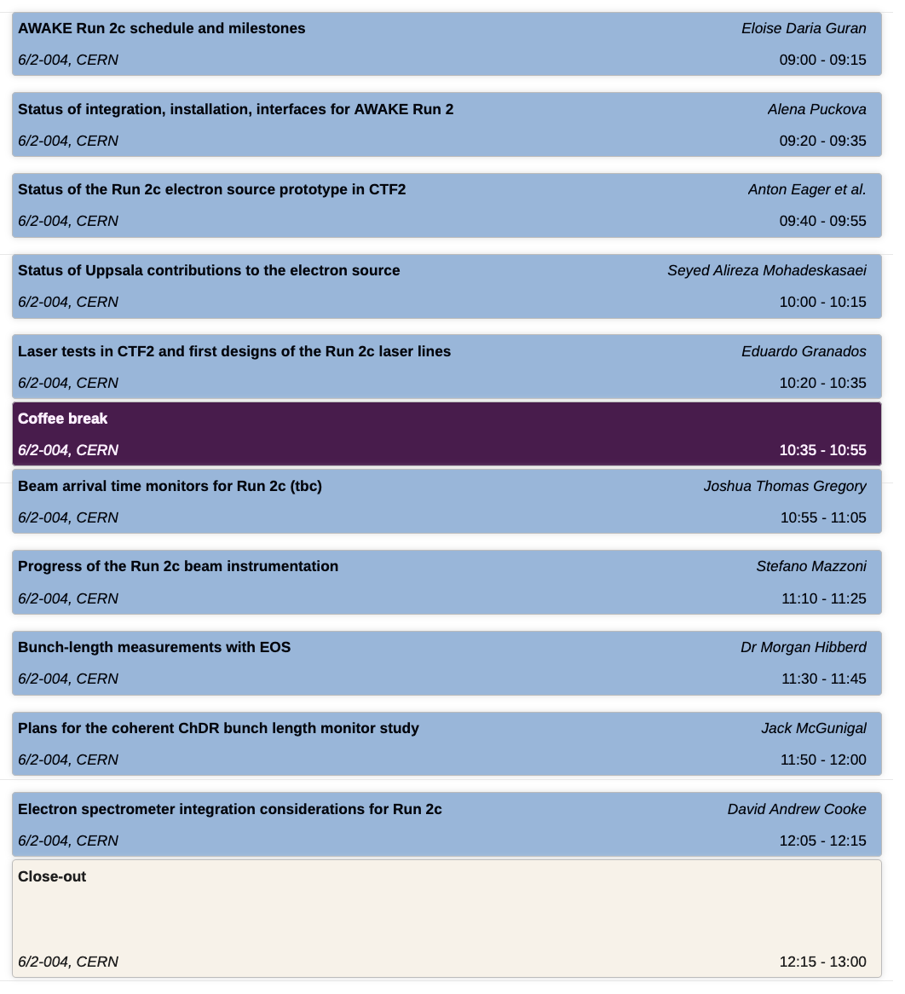
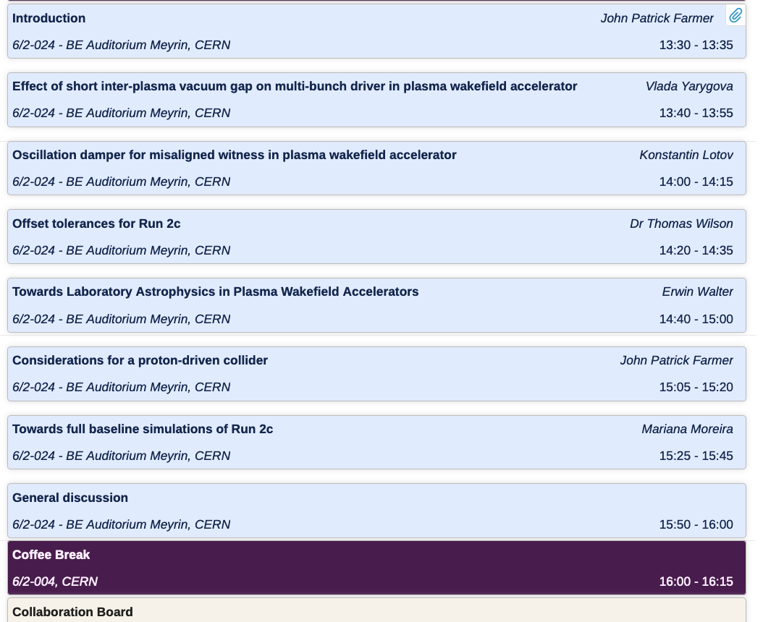
Agenda
Thu, 7 Nov 2024
Run 2b results
Wed, 6 Nov 2024
Fri, 8 Nov 2024
Run 2c/d
Run 2c
Run 2b results
Simulations
Collaboration Dinner

Slide 3
News
AWAKE Run 2c and 2d has been approved in this year’s MTP
(CNGS Target area Dismantling, CTD, was already approved in 2022)
“An amount of 10 MCHF is allocated in addition to AWAKE for the construction, during LS3, of the necessary hardware (e.g. second electron line) to be deployed in Runs 2c and 2d. Additional funds may be necessary for these runs.”

Slide 4
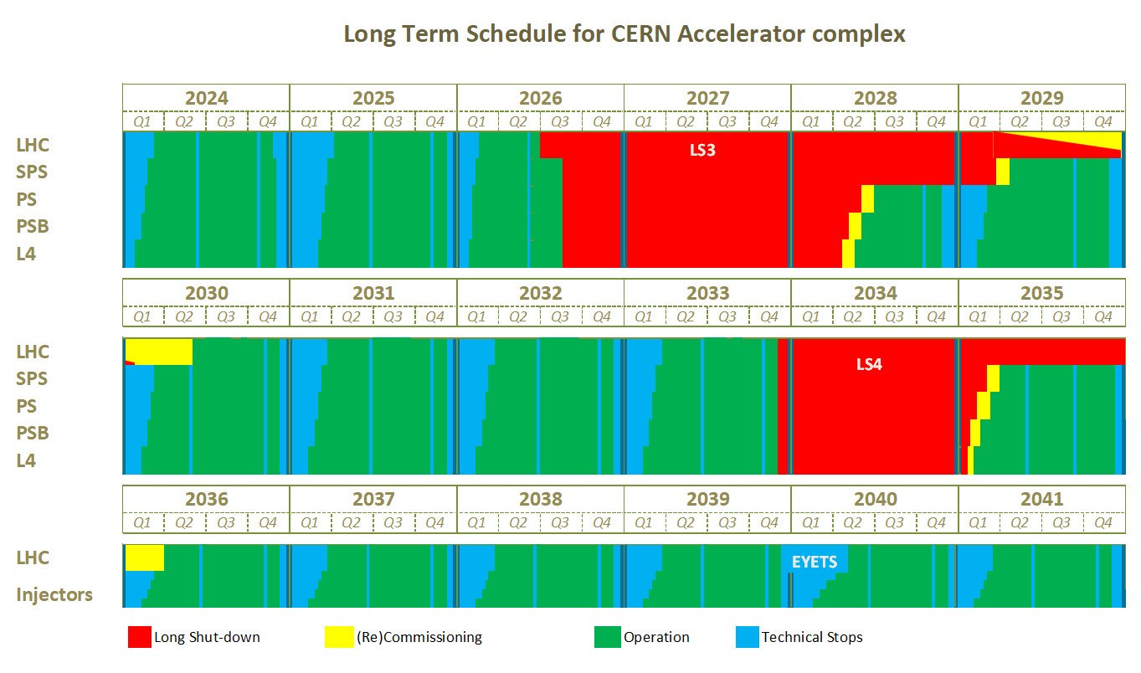
News
LS3 has been delayed

Slide 5
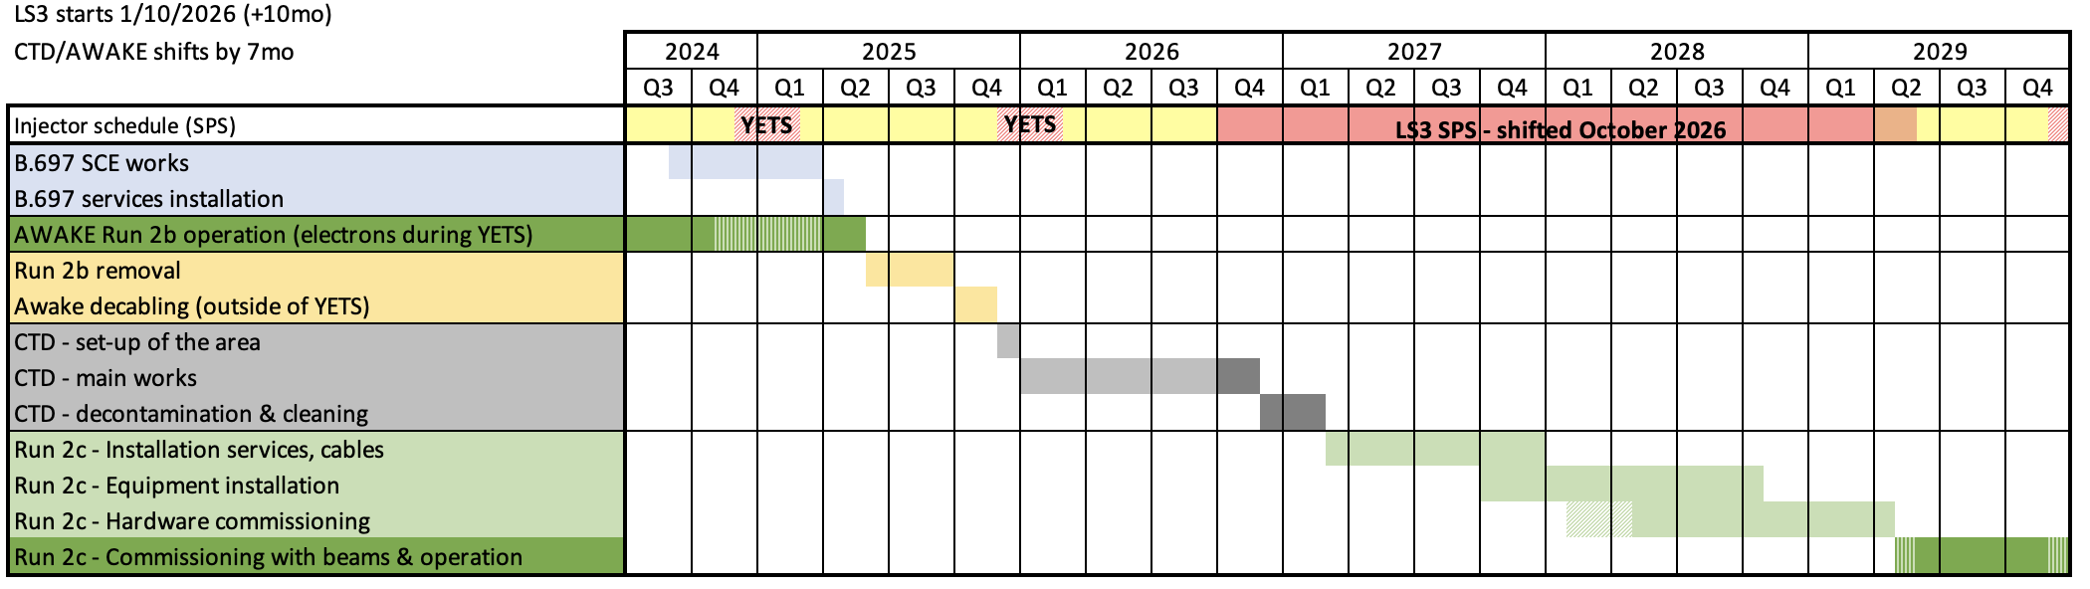
News
New Master Schedule for CNGS Target Area Dismantling and AWAKE
Strategy:
In order to guarantee funding and keep the momentum of the collaborating institutes (e.g. students, post-docs,…), we need to keep the proton down-time as short as possible and start with the Run 2c program as soon as possible.

Slide 6
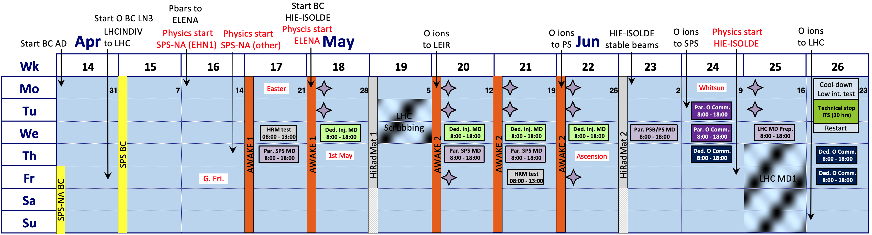
News
AWAKE Proton Beam Request for 2025

Slide 7

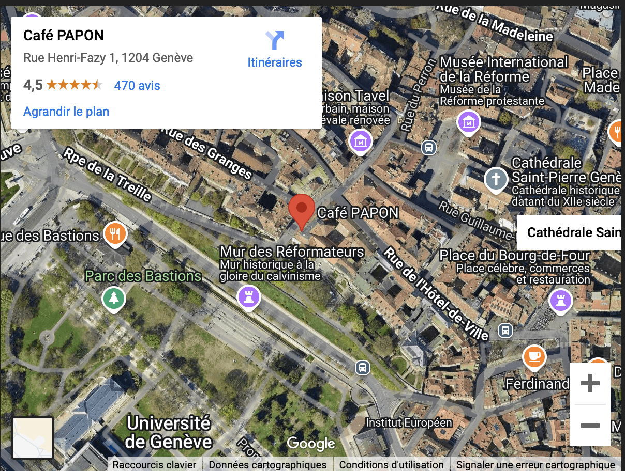
Collaboration Dinner
Café PAPON
Rue Henri Fazy 1
CH-1204 Genève
Tél : +41 22 311 54 28
info @ cafepapon.ch
Tram 18
Take the tram 18 from CERN to Place de Neuve, walk to Café Papon

