Slide 1


Oscillation damper for misaligned witness
in plasma wakefield accelerator
K. Lotov, I. Kargapolov, P. Tuev
Budker Institute of Nuclear Physics
Novosibirsk State University

Slide 2
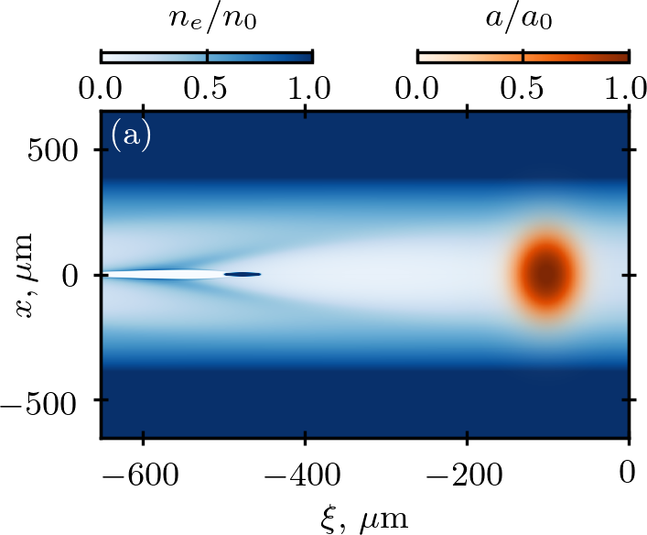
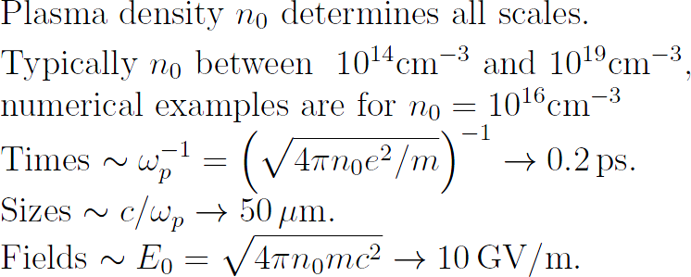
K. Lotov, AWAKE Collaboration Meeting, 07.11.2024, p. 2 of 11
Plasma (laser) wakefield acceleration and problem of witness injection
3. The witness (accelerated bunch) :
must somehow appear in the right wave phase and have a given shape and small emittance.
How?
Capture and accelerate plasma electrons: the most popular solution, but it doesn't always work, doesn't always have enough degrees of freedom for optimization.
(or)
Produce and pre-accelerate the witness in a conventional RF accelerator and inject it into the plasma:
blowout regime not required
more freedom to control bunch parameters and shape
strict time synchronization requirements
strict requirements for the alignment of witness and driver
AWAKE, SPARC_LAB, DESY,
FACET-II, EuPRAXIA
1. The driver:
one or several laser pulses or particle bunches,
creates the wave
~c/ω_{p}
2. The wakefield: travelling at the speed of light
ξ=z-ct
4. What if the alignment cannot be ensured?

Slide 3
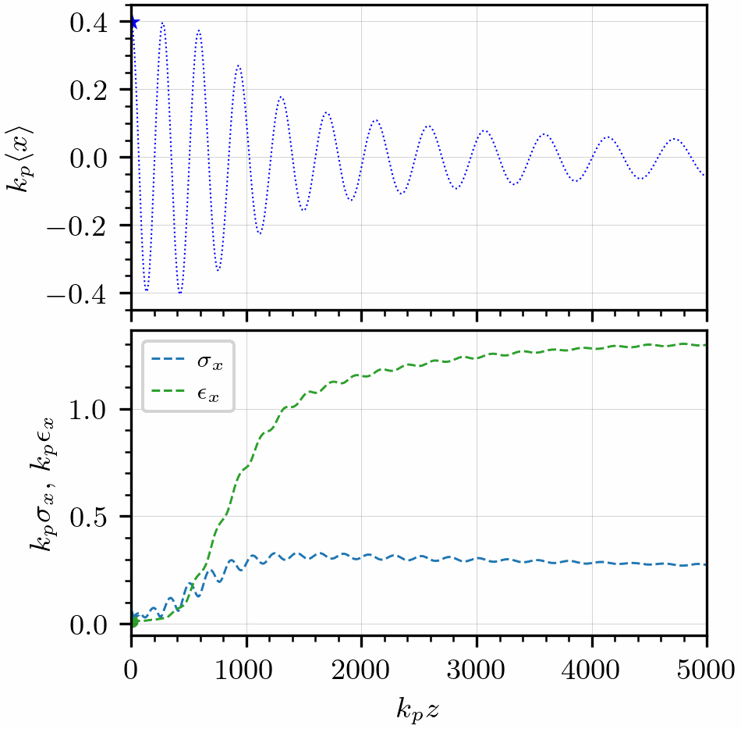
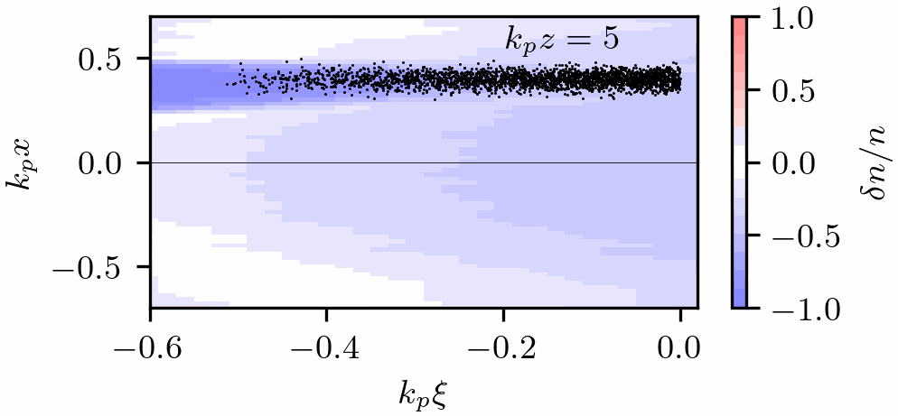
K. Lotov, AWAKE Collaboration Meeting, 07.11.2024, p. 3 of 11
What happens if witness and driver are not aligned?
Different witness slices oscillate at different betatron frequencies, because they are in different focusing fields.
The witness wriggles, its emittance and radius grow,
which is bad (quality is lost).
(There is no such problem in the blowout regime, but in this regime the external witness injection is also not needed since plasma electrons are captured well).
ε_{x0} x 100
σ_{x0} x 10

Slide 4
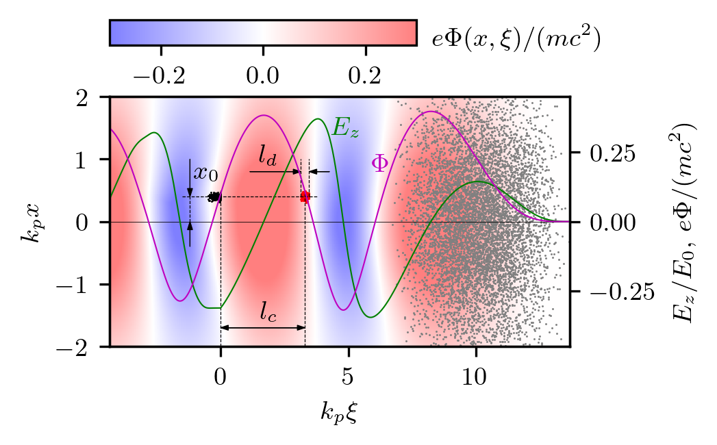
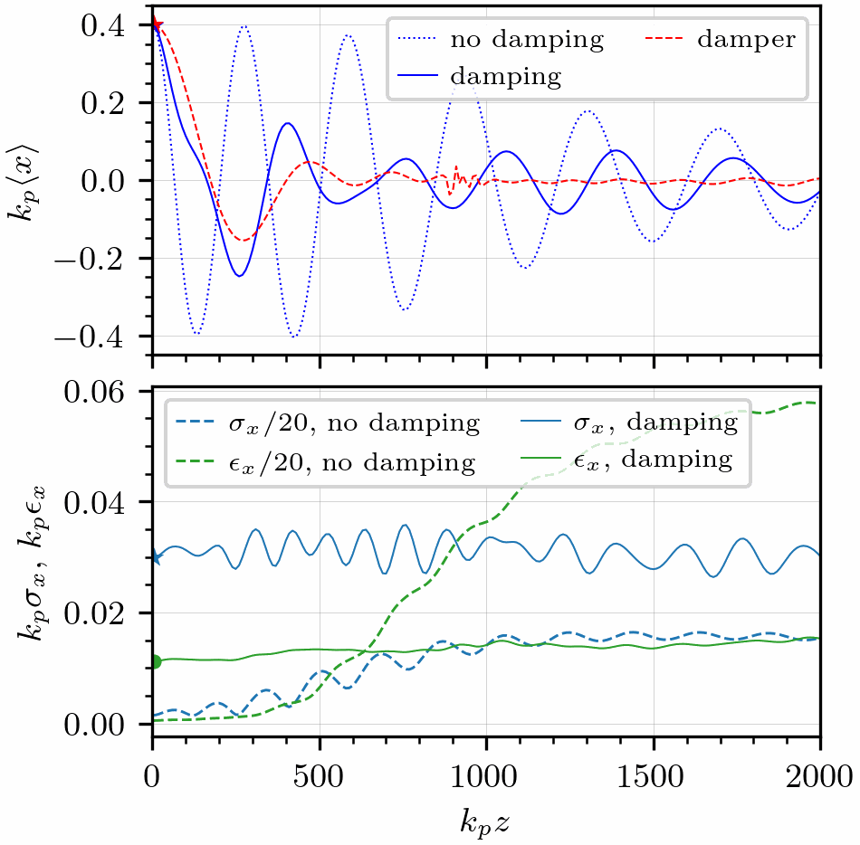
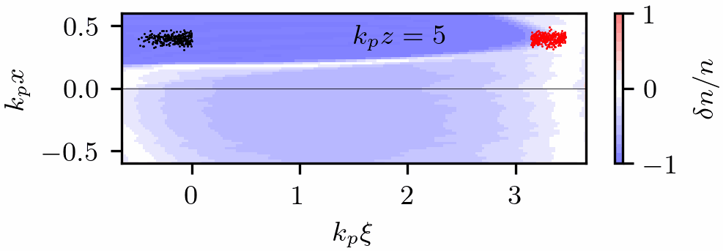
K. Lotov, AWAKE Collaboration Meeting, 07.11.2024, p. 4 of 11
The idea: a short bunch (damper) ahead of the witness
The damper is initially offset in the same way as the witness
(they are produced by the same injector).
The damper oscillates and perturbs the plasma wave.
At a certain (close to 1) ratio of oscillation frequencies (witness-to-damper), the witness aligns to the axis without quality loss.
driver
damper
witness

Slide 5
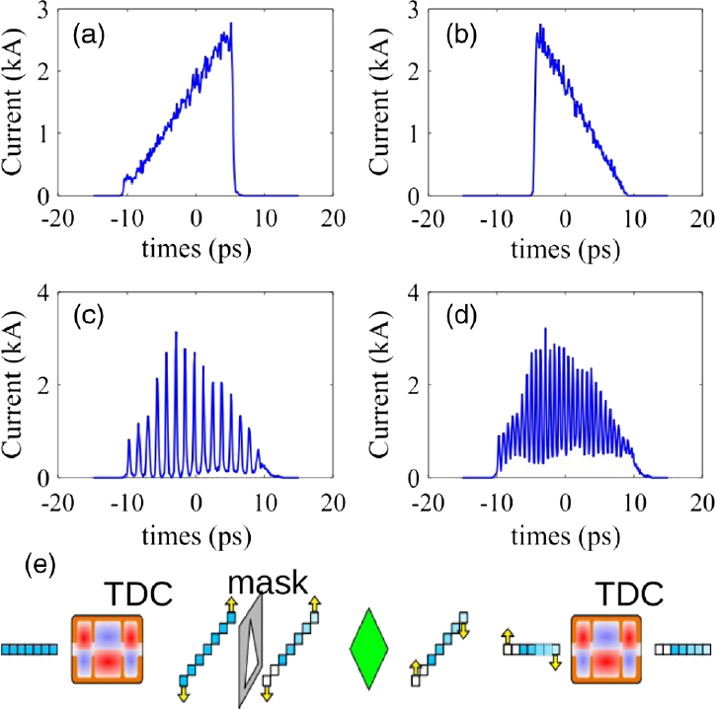
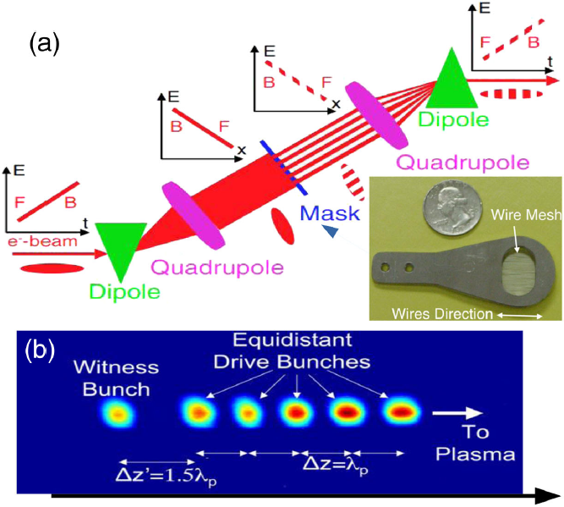
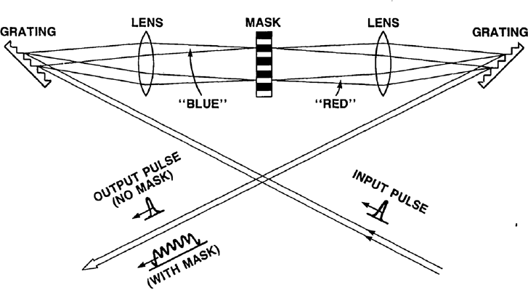
K. Lotov, AWAKE Collaboration Meeting, 07.11.2024, p. 5 of 11
The damping method relies on several physical principles and technological advances
In the wave, there is always a cross-section in which the frequency of damper oscillations equals that of the witness head, but the longitudinal field is decelerating (because ). This cross section is about half a wavelength ahead of the witness.
The technique of generating electron bunch trains or bunches of a given shape is now rapidly developing. The damper could have a different energy, larger emittance, or larger radius than the witness, and it would still work well.
Figures from G. Ha et al., Rev. Mod. Phys. 94, 025006 (2022).

Slide 6
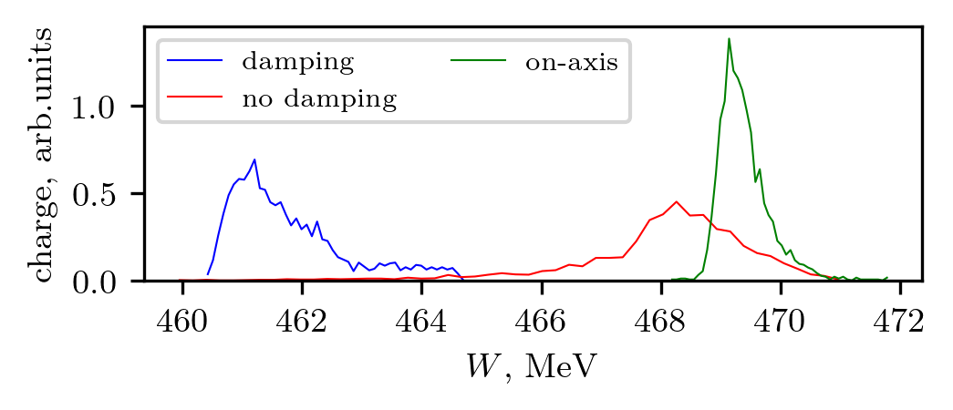
K. Lotov, AWAKE Collaboration Meeting, 07.11.2024, p. 6 of 11
The damping method relies on several physical principles and technological advances
There are plasma electrons around the damper (because the blowout is not reached). The damper locally perturbs the wave, and this perturbation is transferred by the wave exactly to the witness position.
Damper’s effect on the witness is time-limited, because of
  damper deceleration,
  phase mixing of damper oscillations.
The damper gains a lower energy than the witness and can subsequently be separated in energy. The energy difference is about twice the initial damper energy, as the witness gains energy while the damper slows down by a field of the same amplitude. The damper loads the wave and must be taken into account when matching the witness and the wave.
Damper: 140-167 MeV

Slide 7
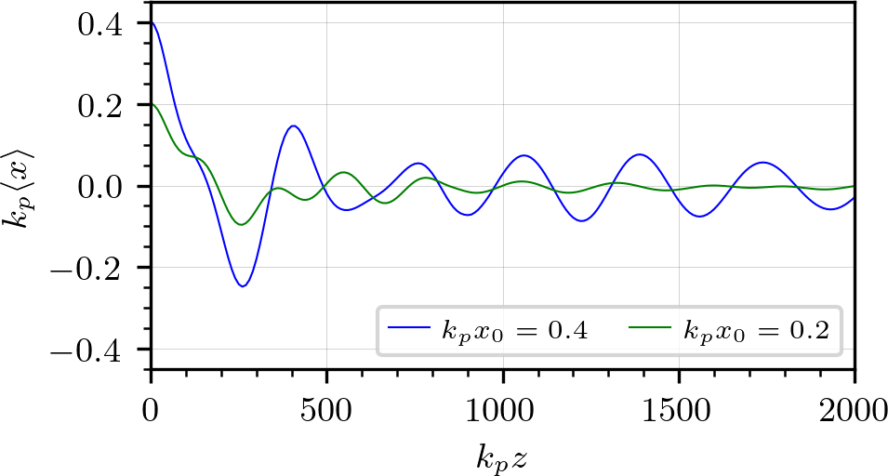
K. Lotov, AWAKE Collaboration Meeting, 07.11.2024, p. 7 of 11
The damping method relies on several physical principles and technological advances
In a moderately nonlinear axially symmetric plasma wave, small transverse oscillations of beam particles are harmonic. The oscillation frequency does not depend on the magnitude and direction of the offset.
  Oscillations are small if their amplitude << k_{p}⁻¹
  The “golden ratio” of oscillation frequencies (damper-to-witness) at which the witness goes exactly on the axis, found for some initial offset x₀, is the same for any other offset.
In reality, things are not so perfect, but the method works

Slide 8
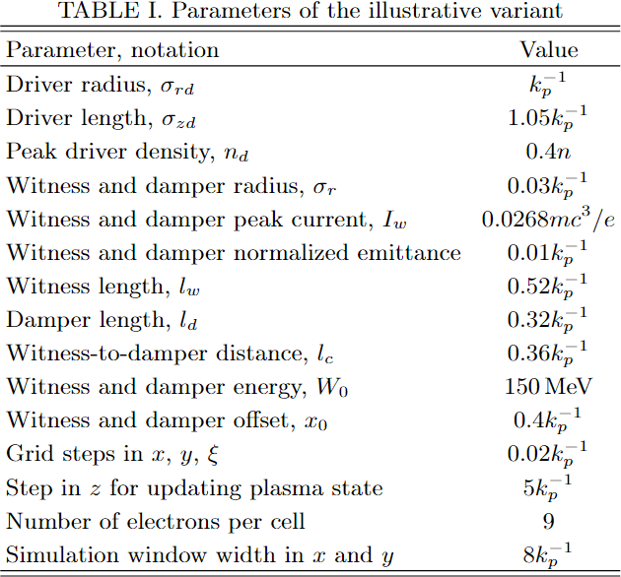
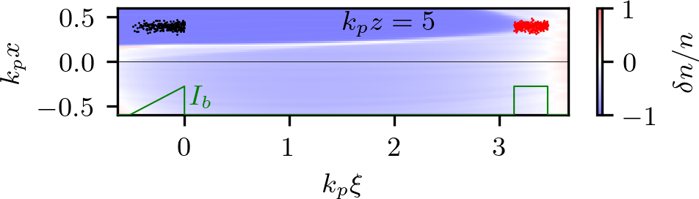
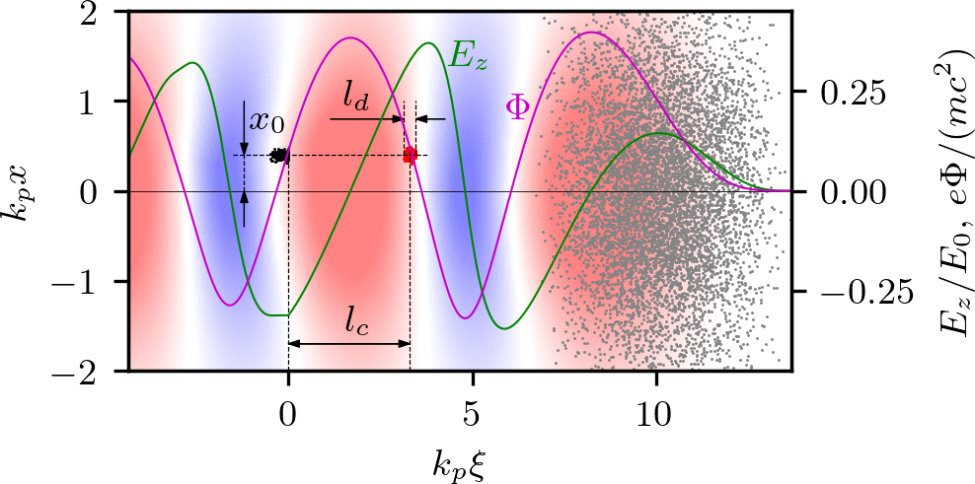
K. Lotov, AWAKE Collaboration Meeting, 07.11.2024, p. 8 of 11
Let us numerically demonstrate the damper operation at parameters close to those at which the external injection could be used:
Wave amplitude (moderately nonlinear)
Witness current profile (triangular) and position are matched to the wave:
Witness radius and emittance are matched to the ion focusing force
Damper: radius, emittance, peak current are the same
Damper charge is controlled by the length
driver is not evolving
Most figures in this presentation are for this parameter set
LCODE 3D

Slide 9
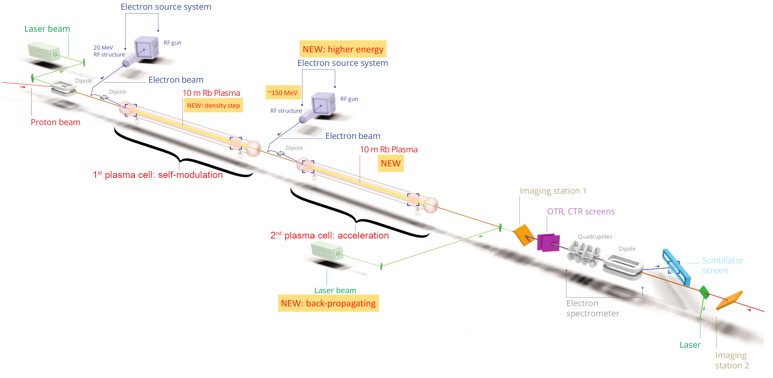
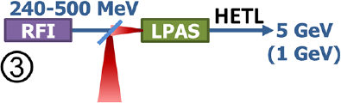
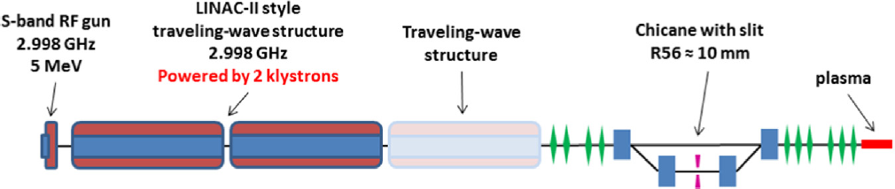
K. Lotov, AWAKE Collaboration Meeting, 07.11.2024, p. 9 of 11
… at parameters close to those at which the external injection could be used
Witness: 80 pC, radius 6 μm, length 100 μm, normalized emittance 2.2 mm mrad, acceleration rate 0.8 GeV/m,
close to AWAKE
E. Gschwendtner et al., Symmetry 14, 1680 (2022).
Witness: 7 pC, radius 0.5 μm, length 9 μm, normalized emittance 0.18 mm mrad, acceleration rate 9 GeV/m,
between SPARC_LAB, SINBAD (DESY) and EuPRAXIA
P.A.P. Nghiem et al., PRAB 23, 031301 (2020).
J. Zhu et al., NIMA 829, 229 (2016).

Slide 10
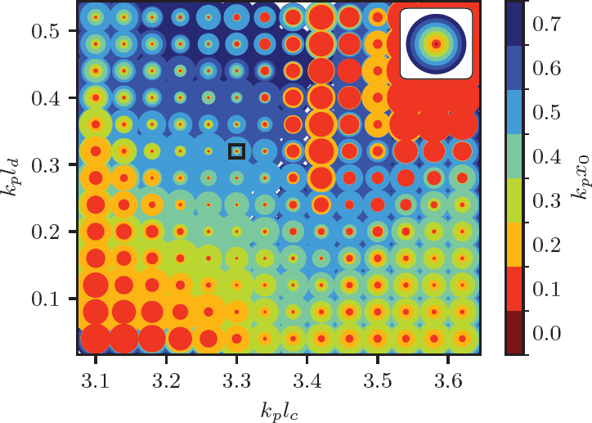

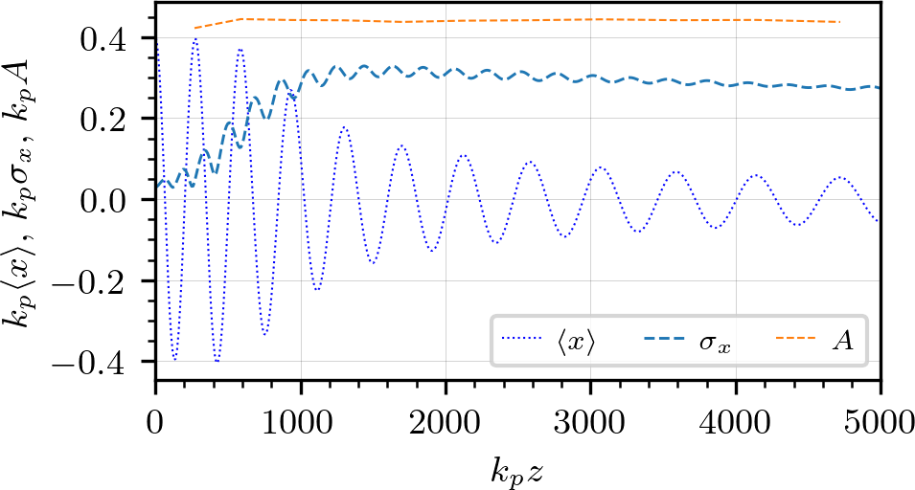

K. Lotov, AWAKE Collaboration Meeting, 07.11.2024, p. 10 of 11
How wide the damping regime is in the parameter space?
illustration case
if no damper
We need some target function to compare the variants: effective witness size:
(damper length)
This function is convenient in that it quickly approaches a constant and does not change further as the witness accelerates (we can «measure» it any time, at for definiteness):
(damper position)
Damping efficiency is a points in the four-dimensional space
We plot circles of radius A on the plane
Color shows the initial offset x₀, smaller offsets over larger ones. If a circle is smaller than
the circle of the same color on the inset, then the damper reduces witness oscillations.
The dominant background color is the maximum offset up to which the damping works efficiently.
The required accuracy:
∼0.2k_{p}⁻¹ of damper positioning,
±20% of damper charge.
Not stricter than needed for %-level energy spread

Slide 11
K. Lotov, AWAKE Collaboration Meeting, 07.11.2024, p. 11 of 11
Message:
If we can put a bunch of comparable charge at a distance ~(π±0.1)k_{p}⁻¹ ahead of the witness, then the tolerable aiming parameter with which a quality witness should hit the wakefield axis
increases by an order of magnitude, from ~0.05k_{p}⁻¹ to ~0.5k_{p}⁻¹
(and the cross-section increases by two orders of magnitude).
https://arxiv.org/abs/2409.12041
Thank you!

