Slide 1
Status of the Experiments
Plenary RRB 59th Meeting
Joachim Mnich
October 28th, 2024

Slide 2
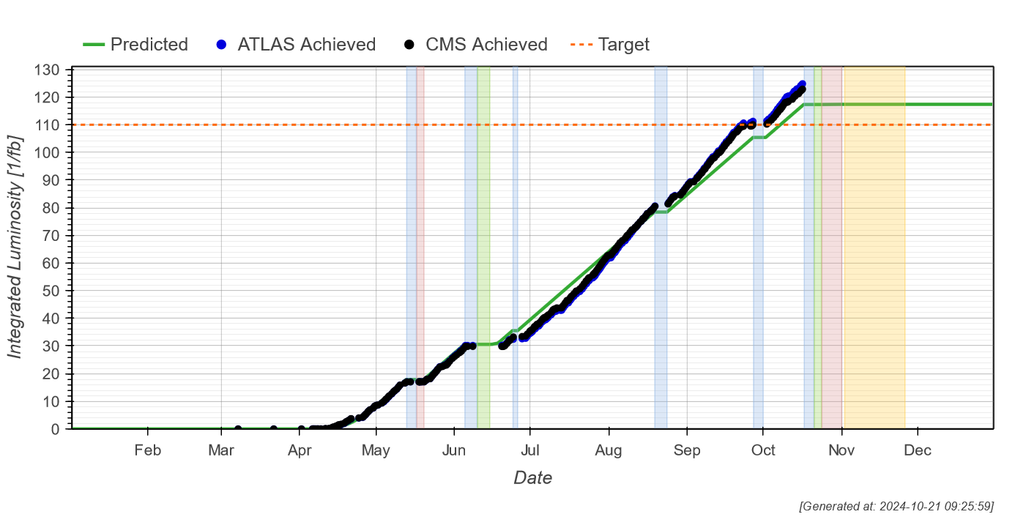
2024 LHC Run
Fantastic LHC performance
> 120 fb⁻¹ delivered to ATLAS & CMS

Slide 3
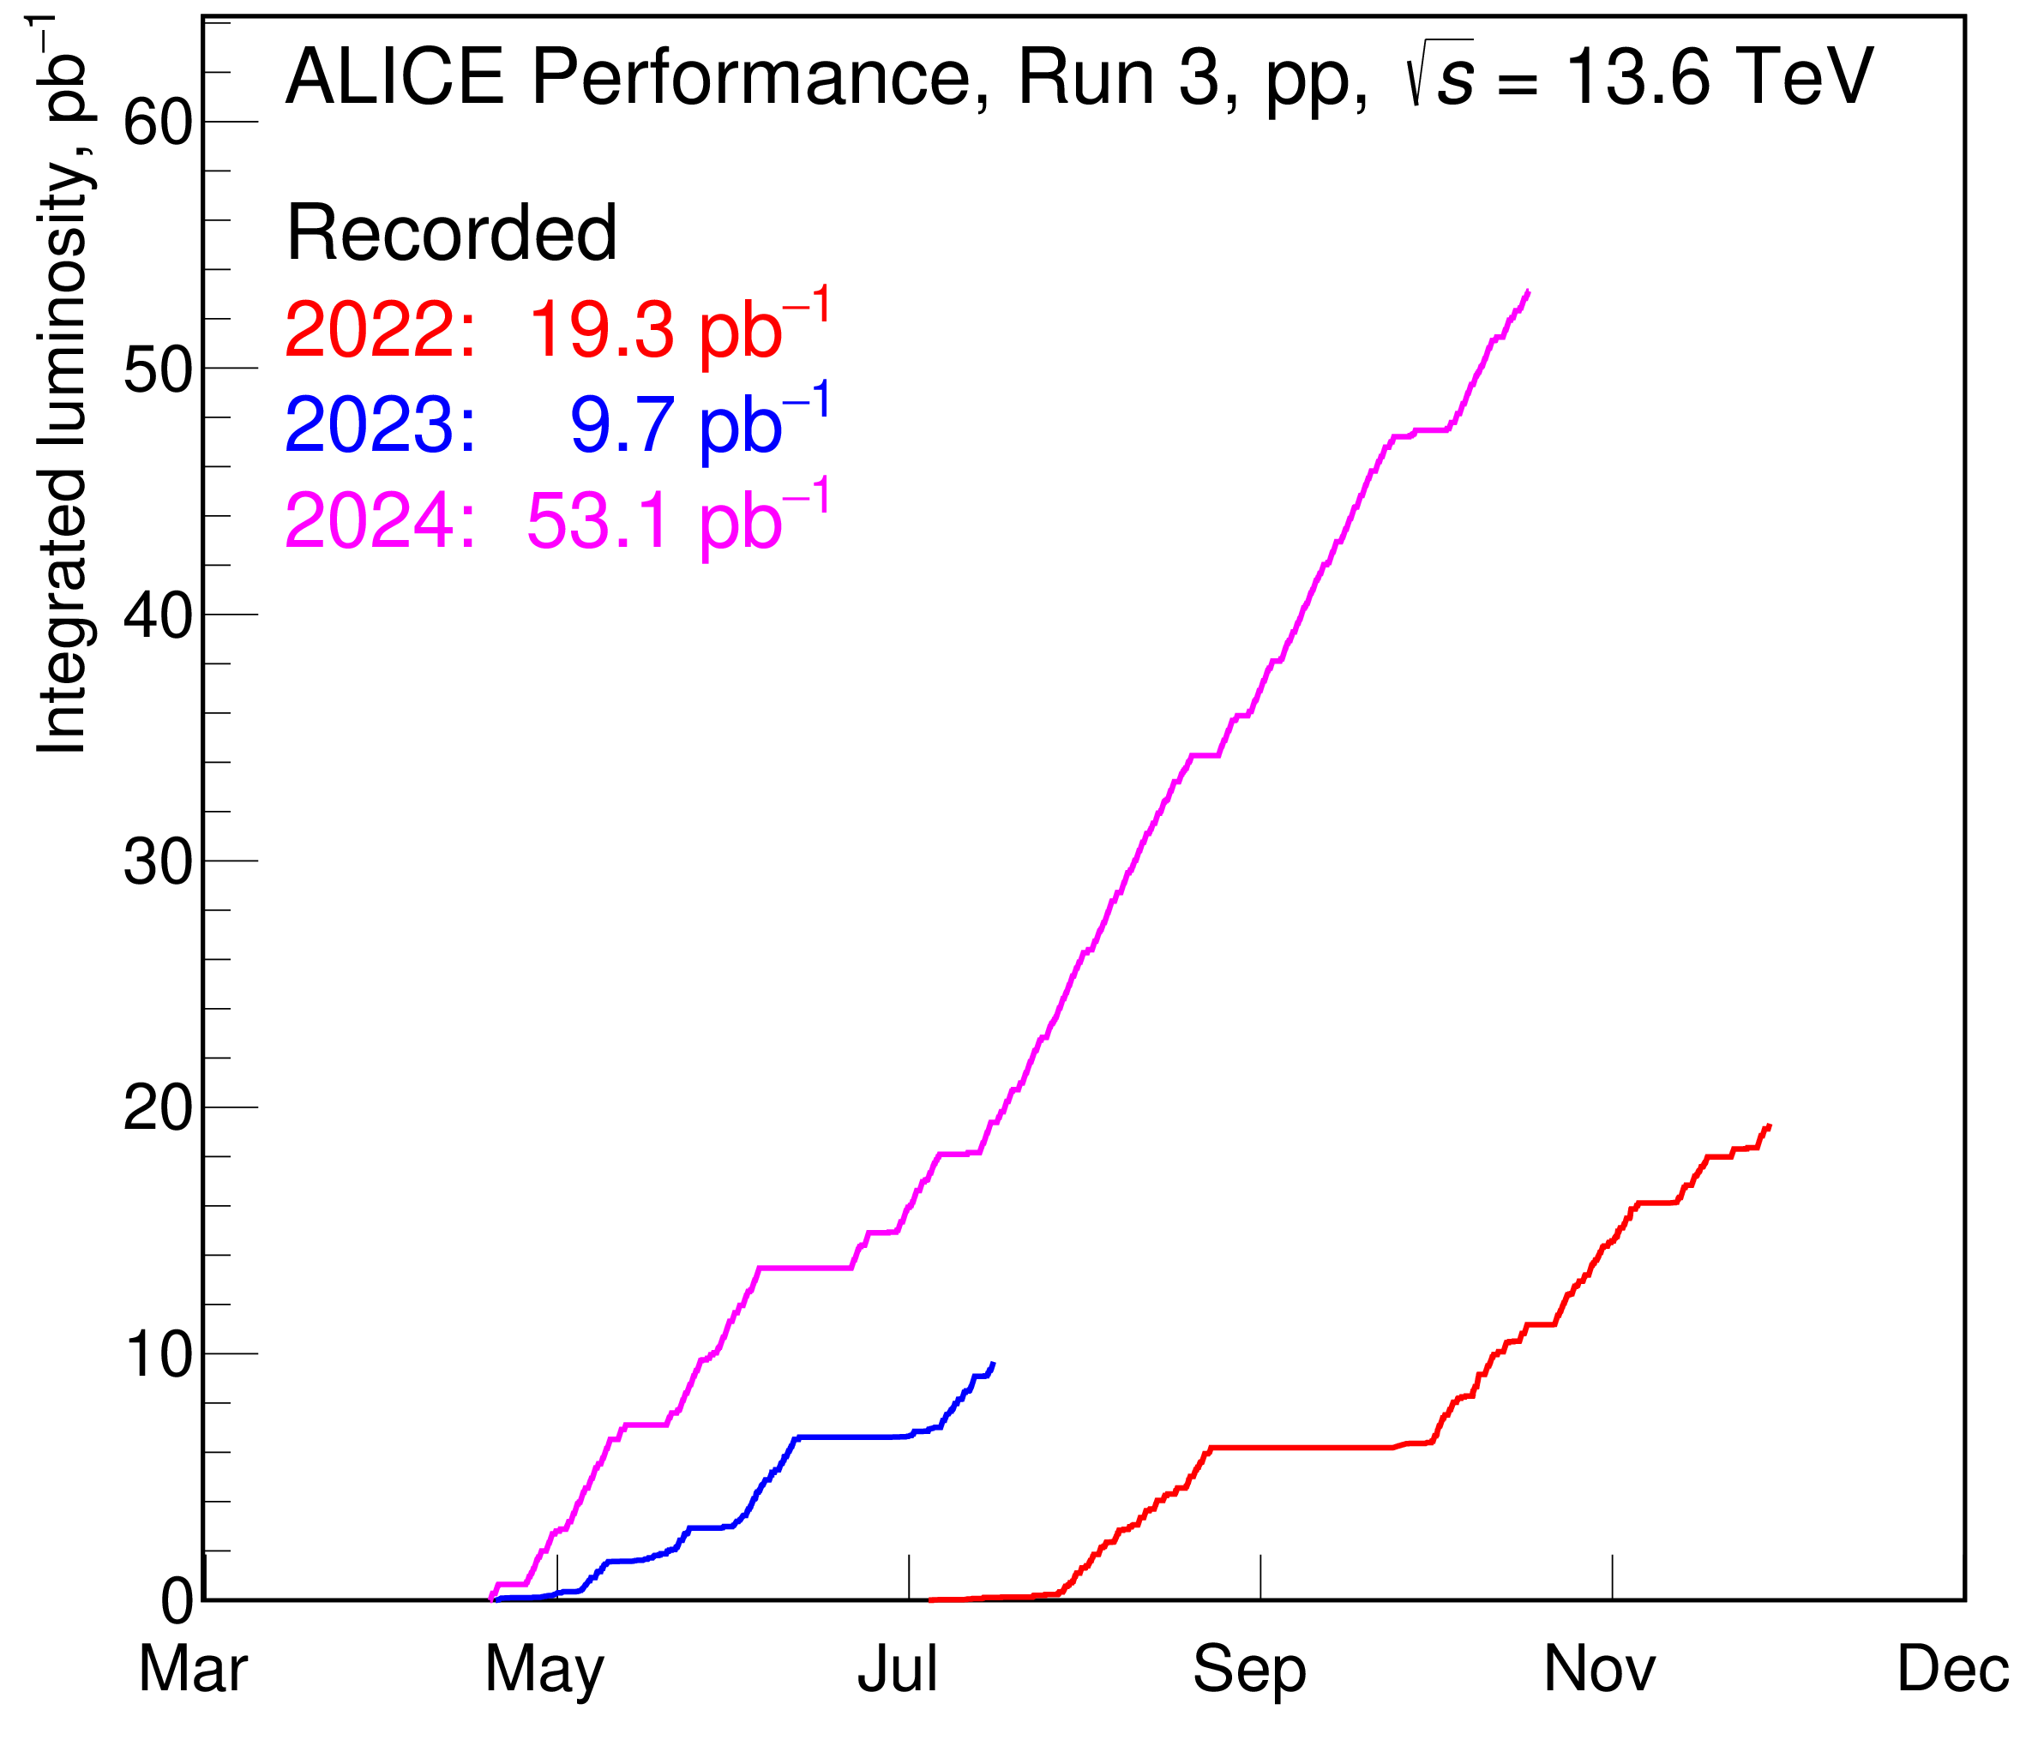
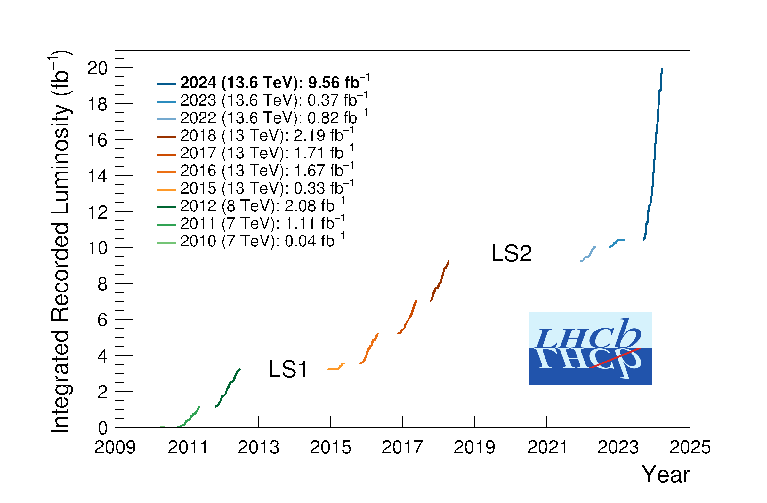
2024 LHC Run
LHCb and ALICE doubled their pp luminosity in 2024
With all Phase I upgrades fully commissioned
e.g. ALICE 1000 times more minimum bias events in central barrel because of continuous readout

Slide 4

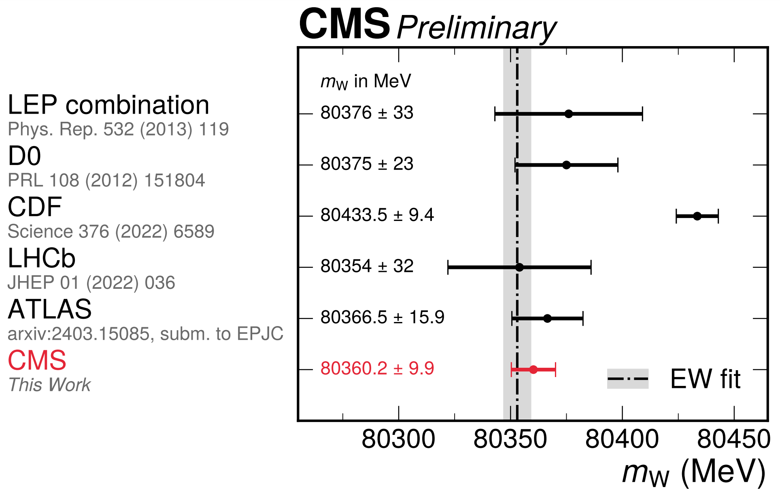
CMS: Measurement of the W Mass
Use well-understood subset of 13 TeV data: 16.8 fb⁻¹ from later part of 2016 run
(~ 30 mean interactions per crossing)
Focus on muon channel
Larger experimental systematics for electrons and hadronic recoil, especially with higher pileup
Result:
m_{W} = 80 360.2 ± 9.9 MeV
This is compatible with the Standard Model expectation and with other measurements
Clear tension with CDF measurement

Slide 5

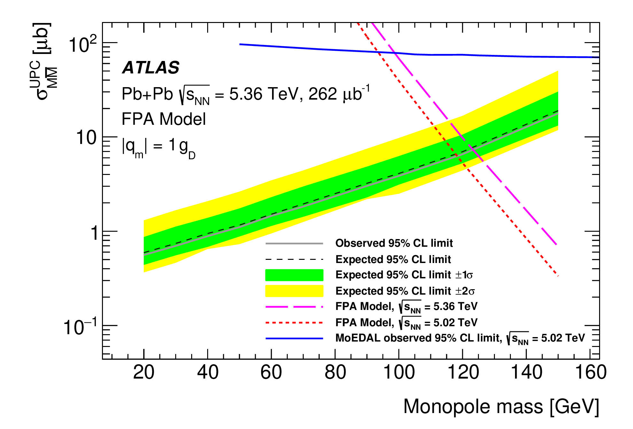
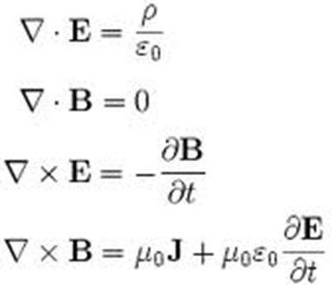
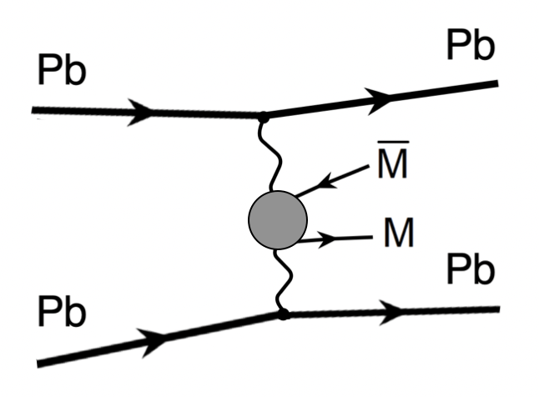
ATLAS: Search for Magnetic Monopoles
Maxwell’s equations governing electro-magnetism
electric charge
but no magnetic „monopoles“!
No fundamental reason why there are no single magnetic charges (monopoles)
ATLAS searched for magnetic monopoles in ultra-peripheral lead-lead collisions:
Excluding magnetic monopoles with mass < 120 GeV
Improves on previous cross section limits set by MoEDAL

Slide 6
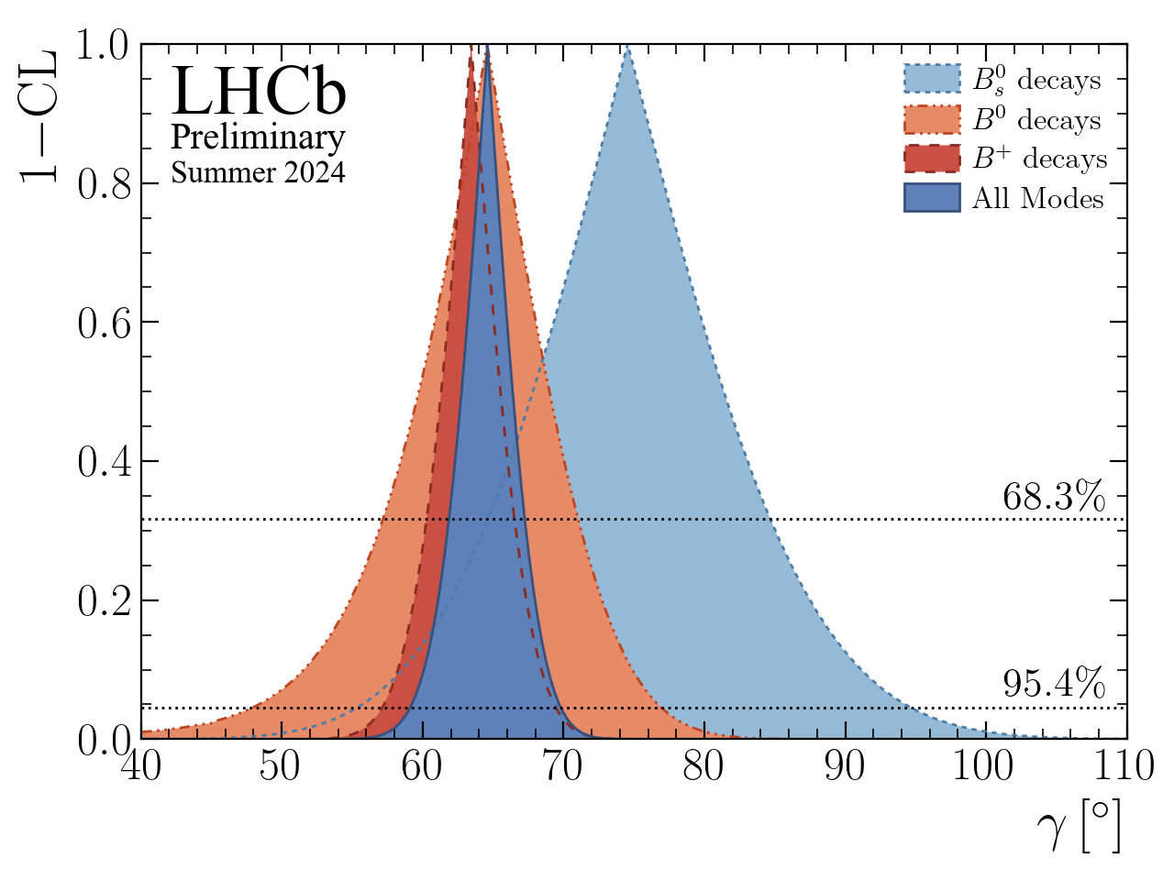
LHCb: Determination of the CKM Angle γ
New measurement of the angle γ of the unitarity triangle
Using new and improved methods, more channels
This measurement is statistically limited
Improvements expected from Run 3 data

Slide 7

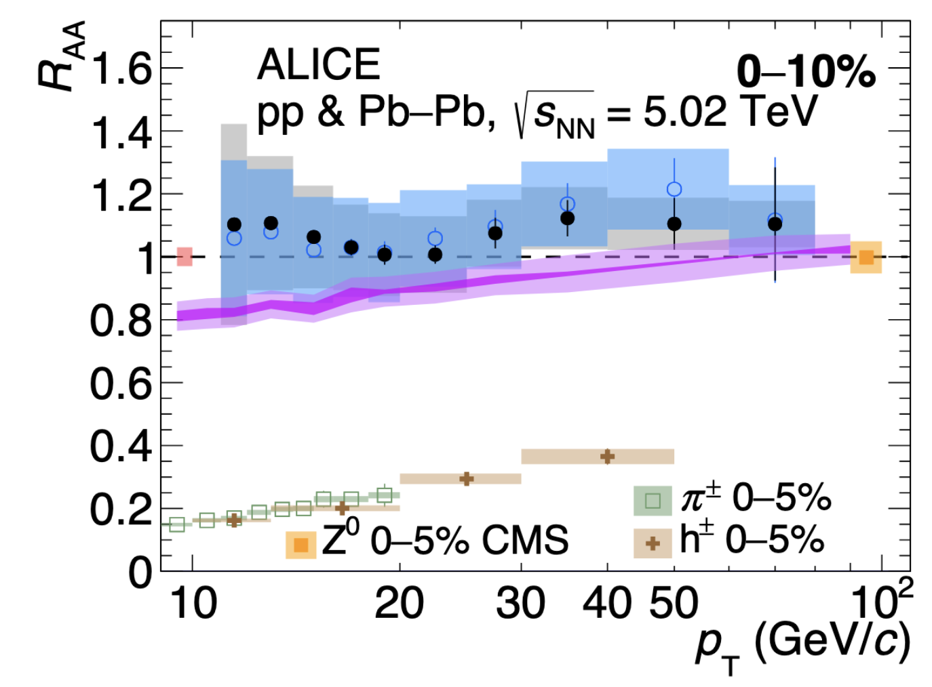
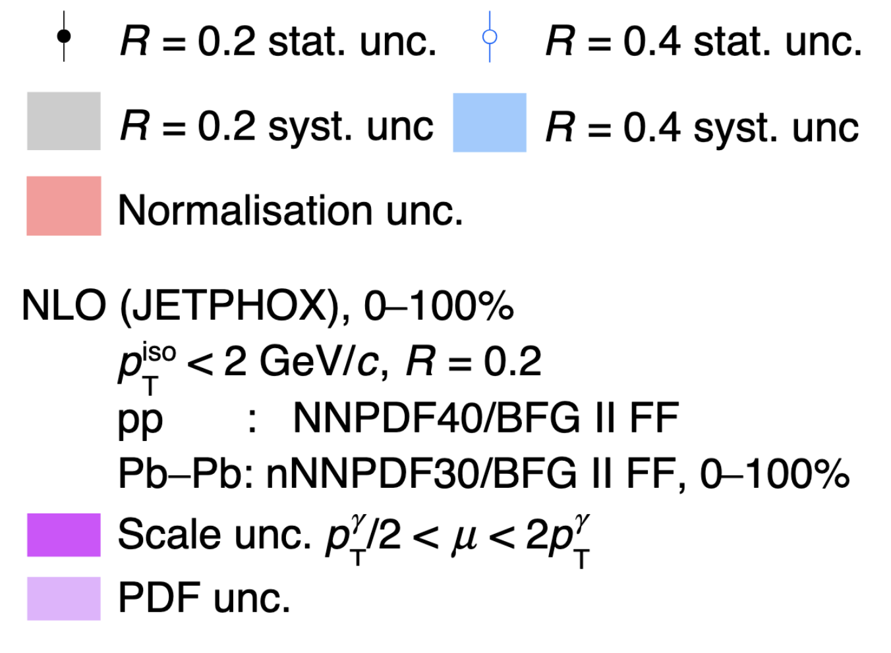
ALICE: Isolated photon production in Pb-Pb collisions
quenched hadrons
Pb
arXiv:2409.12641
Pb
escaping photons
Select photons without any other particle in a surrounding cone (R) to suppress decay and fragmentation photons
Divide by the production in pp collisions scaled by the number of binary nucleon-nucleon collisions (RAA)
➔ Color insensitive probes do not show any nuclear modification (RAA ~ 1) in contrast to coloured probes (hadrons)

Slide 8
Status of HL-LHC and Phase II Projects
A lot of progress in CMS…

Slide 9
Status of HL-LHC and Phase II Projects
And a lot of progress in ATLAS…

Slide 10
Status of HL-LHC and Phase II Projects
BUT: Significant delays in the Phase II projects of ATLAS and CMS
in particular ATLAS ITk and CMS HGCAL
no or even negative time contingency left
in addition, significant schedule risks remaining
P2UG/LHCC/SPC: schedule is not tenable
See also special online
RRB on July 15th
Example: From the P2UG/CMS chair M. Demarteau:
There has been a persistent 50% slip for key elements of the project, though the delay is leveling off for some subprojects.
Based on the information presented and the evolution of the project over the years, the P2UG believes the projects will not be able to deliver the project on the current proposed timeline
Further comments from the P2UG report:
Delivery of the HL-LHC has to be a resounding success and should be viewed as the highest priority of the whole community. Any distraction, in whatever form, may seriously affect particle physics
Success breeds success and future projects will depend on the successful completion of the HL-LHC with the experiments meeting their physics goals
The whole community needs to come together, collaborating institutions, funding agencies, host lab, etc. to deliver this for a healthy future of the field

Slide 11
Key Dates of New HL-LHC Schedule
As decided by the CERN directorate:
Delay start of HL-LHC by 1 year, composed roughly by 1/2 year extension of Run 3 in 2026 and 1/2 year extension of LS3 as required by the LHC and by CMS
Operation in 2026:
short YETS 2025/26
run LHC until end of June with possibly HI run taking place in June
run injectors until September
Restart in 2030
start hardware commissioning in January 2030
closure of experimental caverns mid-May
beam in the machine as of June
restart of injectors to be defined
Post-LS3:
LS4 moved by one year: from 2033/34 to 2034/35
LS5 will become an EYETS
Details still to be worked out, optimization to be performed
Note: this delay of HL-LHC start will incur additional costs to CERN and the Funding Agencies

Slide 12
There are Additional Risks to the New Schedule
ATLAS
CMS
(extracts of long complete versions of the risk registers)
Example:
Recently problems with the low power GigaBit Transceiver (lpGBT) chip observed
  1% of the ASICs do not start at power-up, randomly?
  Equalizer attenuation
Production of corrected chip launched, investigations of impact ongoing
Note: this was not even included in the above lists of risks!

Slide 13
Risk Mitigation
Are there ways to mitigate these known (and also unknown) risks on the schedule?
Any further slippage would require even more resources and reputationally be very detrimental
Measures where Funding Agencies could help:
More flexibility sub-projects which are rigidly defined in the MoUs
flexibility in money and person power
More flexibility in common resources
Mechanism to socialize cost overruns in big items with savings in others (compensation mechanism)
Prioritise Phase II wrt. other LHC related request
Help to spread and raise the awareness among the collaboration members that Phase II is the highest priority project and must be completed on schedule
Help to avoid cash flow problems in the collaborations
e.g. 50% of the CMS Detector Upgrade Fund (DUF) is still missing
Strong support (physicists, engineers, technicians) will be required also during the detector installation in LS3 and after that for commissioning

Slide 14
Phase IIb: ALICE and LHC
Scoping documents submitted
For both experiments scenarios of core costs between ≈ 125 and 180 MCHF are presented
Under scientific and technical review by the LHCC
Results expected by March 2025
In parallel discussions with Funding Agencies to define realistic funding envelopes
Aim to define upgrade scope, based on LHCC and FA input, in spring 2025
Then start to work on TDRs
Detector improvements during LS3:
ALICE: ITS3 and FoCal: TDRs are completed and endorsed by Research Board
LHCb: ECAL, RICH; endorsed by RB; DAQ Enhancement TDR; LHCC recommended for approval

Slide 15
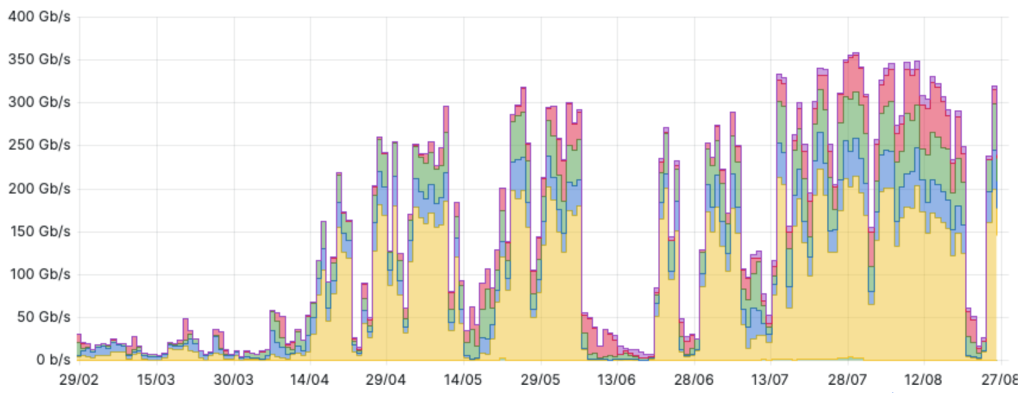
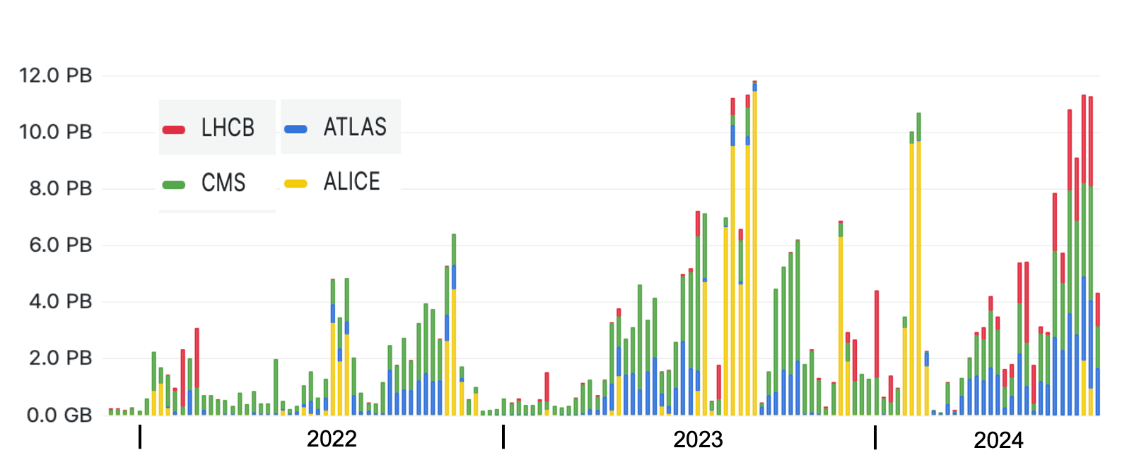
Computing
  Data promptly delivered from the experiments to the Tier-0 with no delay nor sign of network saturation
  CERN Data Centres:
    Prévessin Data Centre (PDC): fully operational.
    Meyrin Data Centre (MDC): record storage rate of 11 PB/week in July 2024, from experiments to MDC
    (guaranteed bandwidth in Run3: 25 PB/week)
  Data promptly archived at CERN and at the Tier-1 centres
Daily data rate from experiments to Tier 0 (Gb/s)
Weekly volume of data archived at the Tier-0 (PB) during Run3
  IT infrastructure handles the data flow from the extraordinary performance of the LHC with headroom

Slide 16
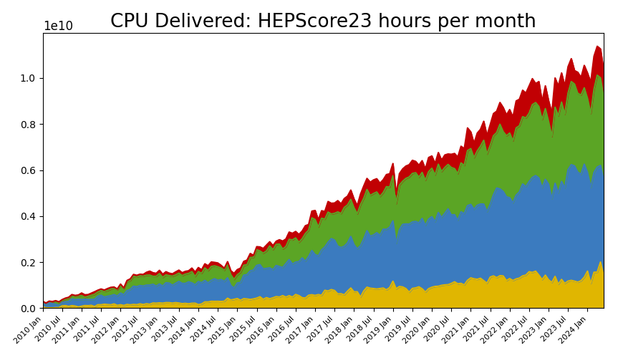
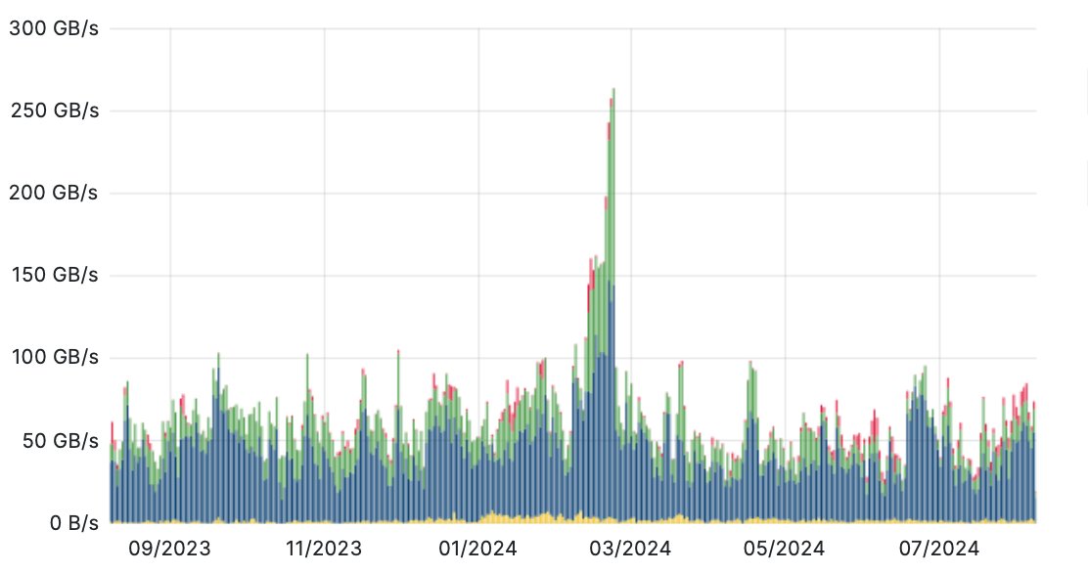
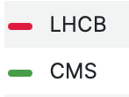
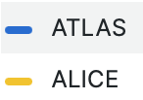
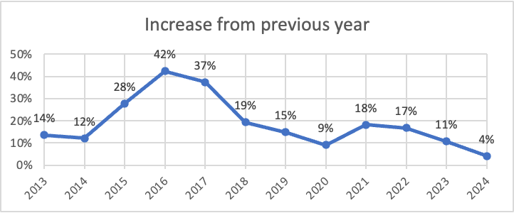
WLCG
WLCG sites are providing experiments with up to ~45% additional capacity beyond their formal commitments
  WLCG reached 1.4 million computing cores and over 4 EB of storage, thanks to about 170 sites worldwide
  IHEP (China) becomes Tier-1
WLCG traffic (GB/s) in the last 12 months
2024 WLCG Data Challenge (~260 GB/s)
Growing number of compute resources provided to the experiments, but less growth recently
Increases delivered year-by-year
2024 average (~60GB/s)

Slide 17
Summary
Very successful proton-proton run in 2024
  More than 120 fb⁻¹ delivered to ATLAS & CMS
  ALICE and LHCb doubled their total pp data sets
  PbPb run is being prepared
Experiments continue to produce excellent physics results
Despite good progress in Phase II upgrades HL-LHC start had to be delayed by 1 year
  As further significant risks to the schedule remain CERN, experiments and Funding Agencies should discuss mitigation measures
  Cash flow issues are potentially an additional hazard to the schedule
WLCG is running smoothly
  Prévessin Data Centre in operation
  To be watched: development of performance over costs
Big thank you to the Funding Agencies for their continuous support!

Slide 18
Thank you for your attention!

Slide 19
Backup

Slide 20
From P2UG/ATLAS
Reporting date
Schedule contingency [days]

Slide 21
Schedule Reporting
Marcel Demarteau
P2UG Chair CMS
May 2024
2 years

