Slide 1
1
General Information
Frank Zimmermann
FCC-ee Optics Design Meeting #192 & 63rd FCCIS WP2.2 meeting, 26 September 2024

Slide 2
Upcoming
Xsuite beam lifetime
Dynamic aperture with Q’~5, 10, 20
Beam-beam at Z with larger RF voltage
400 MHz 2-cell scenario, same RF system for Z, WW, and ZH
– all relevant aspects clarified for CGM 11 October,
voltage, beam-beam, HOM (?), ….
SuperKEKB model in xsuite
Impedance update
Xsuite-BDSIM developments
Specification, requirements & tolerances

Slide 3




Feasibility Study Report for March 2025
Structure:Three Volumes
Vol. 1: Physics, Experiments and Detectors (~200 pages)
Vol. 2: Accelerators, Technical Infrastructures, Safety Concepts (~400 pages)
Vol. 3: Civil Engineering, Implementation & Sustainability (~200 pages)
- Executive Summary of the FCC Feasibility Study: ~40 pages
In addition:
a. Documentation on Cost Estimate – Funding Models
b. Environmental Report
Input for Update of European Strategy for Particle Physics
to be prepared with Overleaf & published by EPJ (Springer-Nature) – FCCIS members

Slide 4
FSR draft table of contents (1)
P. Charitos, M. Benedikt, C. Carli, J.-P. Burnet et al.
INTRODUCTION (~10 pages)
FCC-ee & hh Requirements & Design considerations (approaches & general brief introduction/principles)
FCC-ee & hh Layout and Key Parameters
1 FCC-ee Collider
1.1 Design & Performance (40 pages)
1.1.1 Beam-beam and luminosity
1.1.2 Optics design including synchrotron radiation and tapering
1.1.4 Impact of misalignments and field errors, optics corrections ,
1.1.3 Single beam collective effects (impedance., electron cloud ,ions)
1.1.4 Collimation
1.1.5 Machine - Detector Interface (MDI)
1.1.6 Energy Calibration and polarisation
1.1.7 Injection and Extraction (top up injection)
1.1.8 Radiation Environment
1.1.9 Ongoing studies and possible upgrades
1.1.10 Preliminary requirements on technical systems
1.2 Operation concept (20 pages)
1.2.1 Operation, and performance,
1.2.2+xx requirements (filling schemes, efficiency, physics goals, RF staging?, energy switching. beam-based alignment, luminosity tuning, injection requirements, beam diagnostics requirements)
1.2.3 Preliminary requirements on technical systems
1.3 Technical Systems (40 pages)
1.3.1 Main magnets
1.3.2 Vacuum system, electron-cloud mitigation, and radiation shielding
1.3.3 Radiofrequency systems layout, configurations, and parameters
1.3.4 Survey and alignment concepts and system
1.3.5 Beam Intercepting Devices (halo collimators, beam dump)
1.3.6 Beam Transfer Systems & Separator
1.3.7 Powering Systems
1.3.8 Beam diagnostics instruments (beam position, beam size/length, beam loss, beam current, polarization & spectrometry)
1.3.9 Control systems
1.3.10 Integration
1.3.11 Machine Protection
1.3.13 Dismantling
1.3.14 Preliminary requirements on technical infrastructure systems
split into pieces?

Slide 5
FSR draft table of contents (2)
3 FCC-ee Injector Complex (30 pages)
3.1 Injector Overview
3.2 Electron Gun
3.3 Electron Linacs
3.4 Positron source and linac
3.5 Damping Ring
3.6 High-Energy Linac
3.7 Energy Compressors
3.8 Transfer Lines
3.9 Technical Infrastructure
3.10 Civil Engineering
3.11 Ongoing studies and possible upgrades
4 FCC-hh ??
5 FCC Technical Infrastructure (~110 pages)
5.1 Requirement and design considerations (#5-10)
5.2 3D Integration Studies (#15-20)
5.3 Cooling and Ventilation (#10-15)
5.4 Power consumption and electricity distribution (#15-20)
5.5 Cryogenic systems (#15)
5.6 Transport and Robotics (#10-15)
5.7 Communication, computing and data services (#5-10)
5.8 Geodesy & Survey (#10-15)
6. Safety Concepts (30 pages)
6.1 Regulatory Framework (#3)
6.2 Safety Goals and Objectives (#5)
6.3 Hazard Registry (#3-5)
6.4 Safety Concepts for CE Construction Phase (#5-10)
6.5 Safety Concepts for Machine Installation Phase (#5-10)
6.6 Safety Concept for Operation Phase (#5-10)
2 FCC-ee Booster (60 pages)
2.1 Design & Performance
2.1.1 Optics design and Beam dynamics (including synchrotron radiation and tapering)
2.1.2 Collective effects
2.1.3 Collimation
2.1.4 Injection and Extraction (top up injection)
2.1.5 Ongoing studies and possible upgrades
2.2 Operation concept
2.2.1 Operation, and performance,
2.2.2 requirements (filling schemes, efficiency, physics goals, RF staging, machine protection, alignment tolerances, field error tolerances, vacuum tolerances, optics corrections, emittance tuning…, injection requirements, beam diagnostics requirements)
2.3 Technical Systems
2.3.1 Main magnets
2.3.2 Vacuum system, electron-cloud mitigation and radiation shielding
2.3.3 Radiofrequency systems layout, configurations, and parameters
2.3.5 Survey and alignment concepts and system
2.3.4 Beam Intercepting Devices (halo collimators, beam dump)
2.3.5 Beam Transfer Systems & Separator
2.3.6 Beam diagnostics instruments (beam position, beam size/length, beam loss, beam current, polarization & spectrometry)
2.3.7 Control systems
2.3.8 Integration
2.3.9 Machine Protection
2.3.10 Dismantling

Slide 6
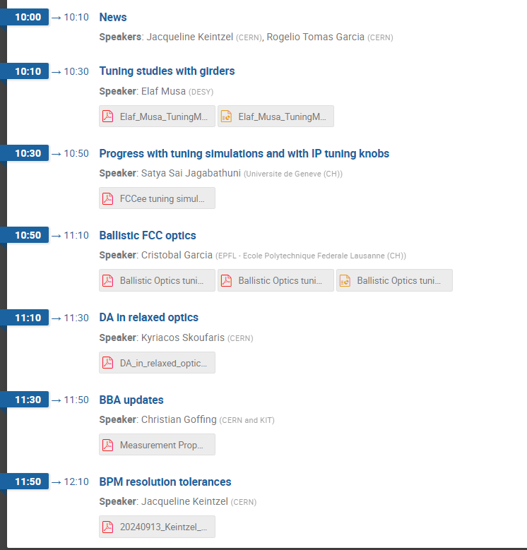
items from last tuning meeting, 13 September
coordinated by J. Keintzel & R. Tomas

Slide 7
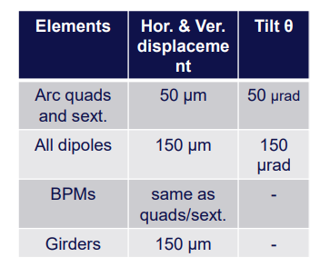
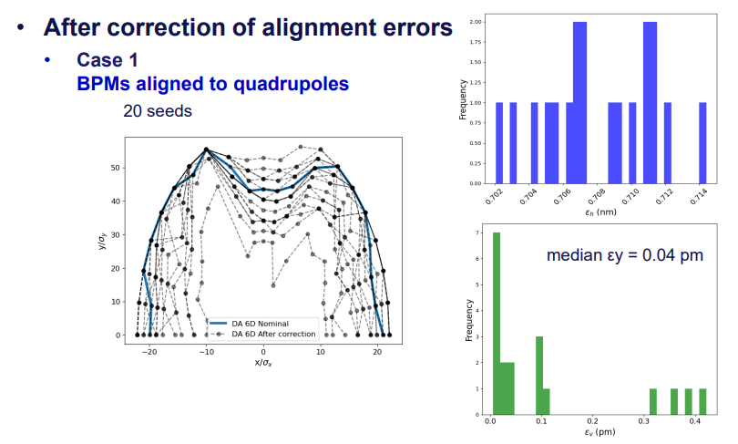
tuning studies with girders
E. Musa
BPMs must be attached to quadrupoles
Results are unchanged with dipole alignment error or 1 mm

Slide 8
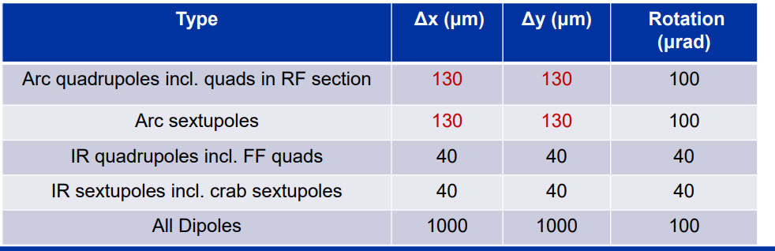
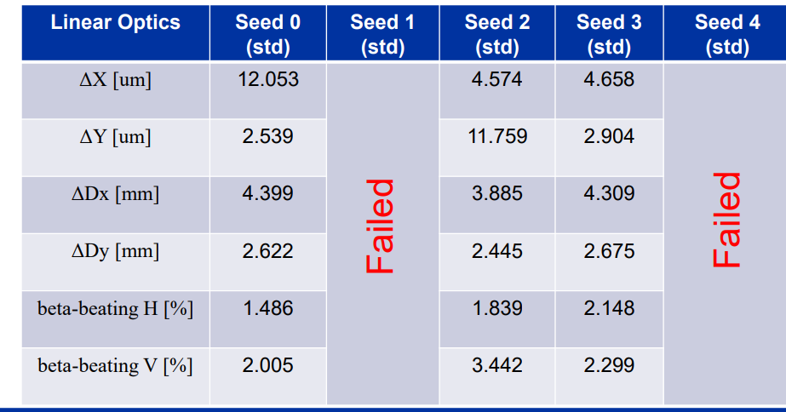
Progress with tuning simulations (Z mode)
S. Sai Jagabathuni

Slide 9
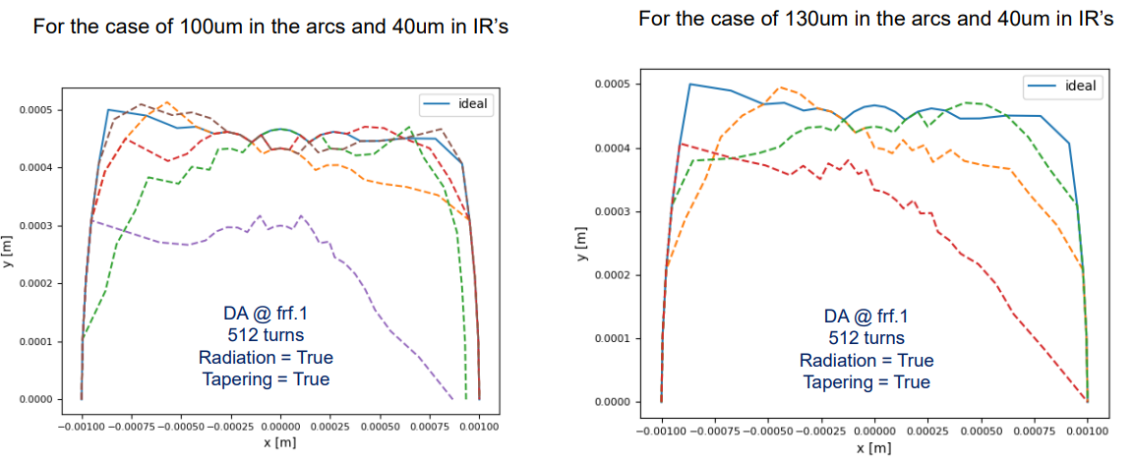
Progress with tuning simulations (Z mode)
S. Sai Jagabathuni

Slide 10
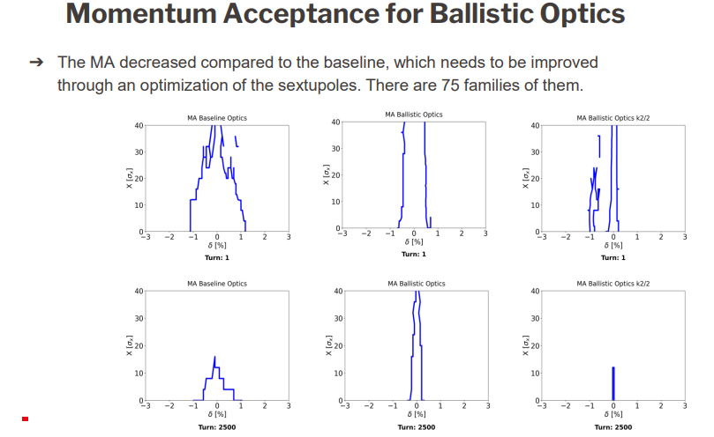
C. Garcia Jaimes
Ballistic optics

Slide 11
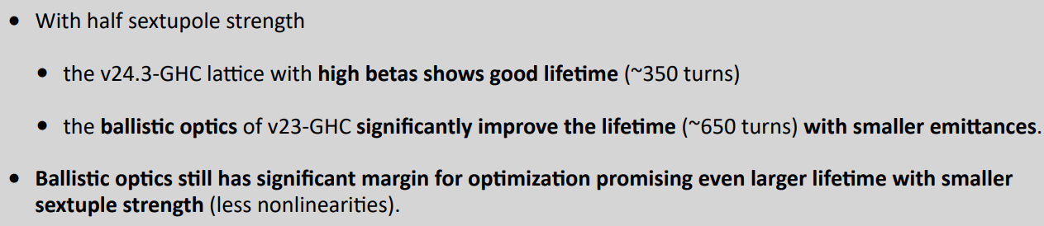
K. Skoufaris
DA in relaxed optics

Slide 12
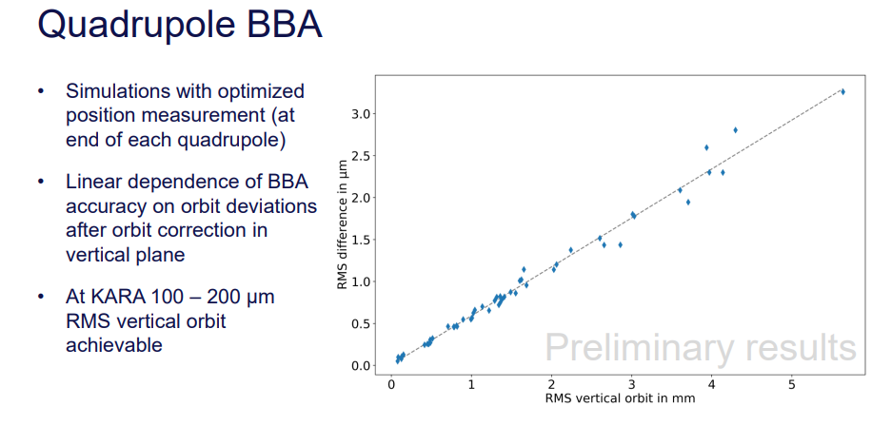
C. Goffing
BBA Update

Slide 13
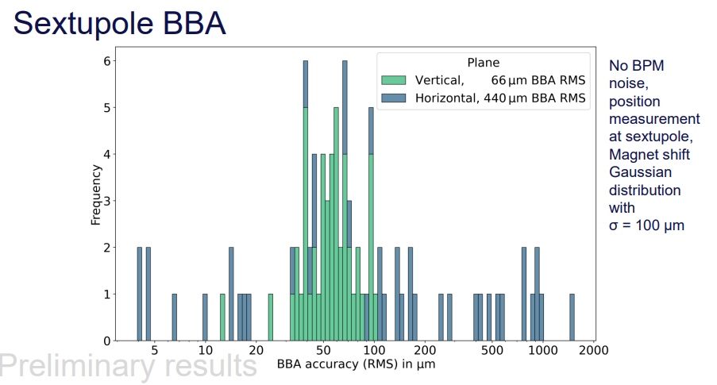
C. Goffing
BBA Update

Slide 14
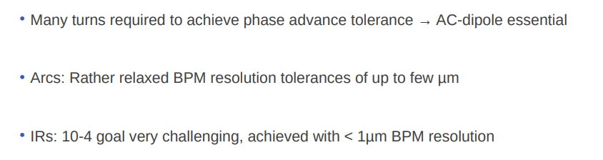
J. Keintzel
BPM resolution studies

Slide 15
USPAS Paired Courses on Colliders and Collider Interaction Regions for HEP & NP, January 27 - February 7, 2025
S. Lund
USPAS Web Site: https://uspas.fnal.gov/index.shtml , USPAs Overview: https://uspas.fnal.gov/about/about-uspas.shtml
USPAS Winter 2025 session: Knoxville, TN (proximity to Oak Ridge National Lab). January 27 - February 7, 2025
Session Web Page (including linked application page): https://uspas.fnal.gov/programs/2025/knoxville/index.shtml
There will be two paired half-courses of interest to the USA collider physics community:
"Colliders for High Energy and Nuclear Physics," Jan 27-31, 2025, Instructors: Vladimir Shiltsev, Northern Illinois University; Vadim Ptitsyn (BNL); + TBA
https://uspas.fnal.gov/programs/2025/knoxville/courses/colliders-henp.shtml
“Collider Interaction Regions for High Energy and Nuclear Physics Applications, “ Feb 3 -7, 2025, Instructors: Michael Sullivan (SLAC), Yulia Furletova (JLab), Dali Georgobiani (Fermilab), and Nikolai Mokhov (Fermilab, retired)
https://uspas.fnal.gov/programs/2025/knoxville/courses/collider-interaction.shtml
Academic credit will be served by Michigan State University (MSU). Scholarship support is available (details on application page) for qualifying students enrolled for credit.
USPAS sessions cover the full scope of accelerator science and engineering. Classes change session-by-session to represent the full field over time. Specialty courses such as these collider classes likely repeat, at most, only every few years. So interested students are encouraged to enroll. Classes are demanding yet rewarding, and the school is an excellent opportunity to make lasting professional connections with people who work, or will work in the field.

Slide 16
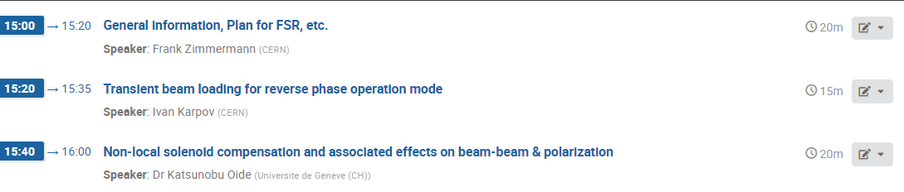
Today’s agenda

