Slide 1

CERN and the Environment
Town Hall meeting
Water
Ingo Ruehl / EN-CV
8 November 2024

Slide 2
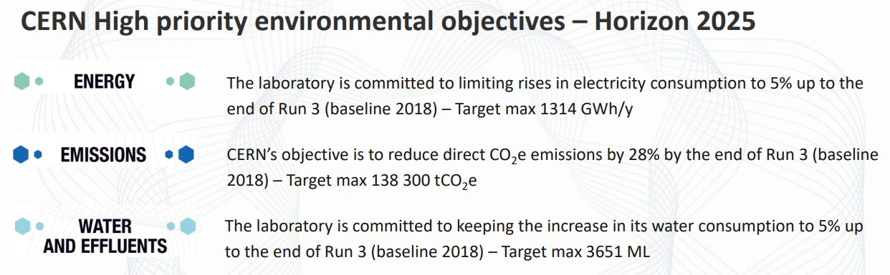
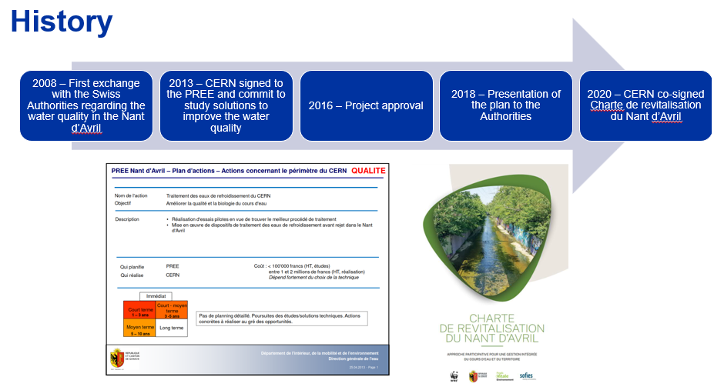
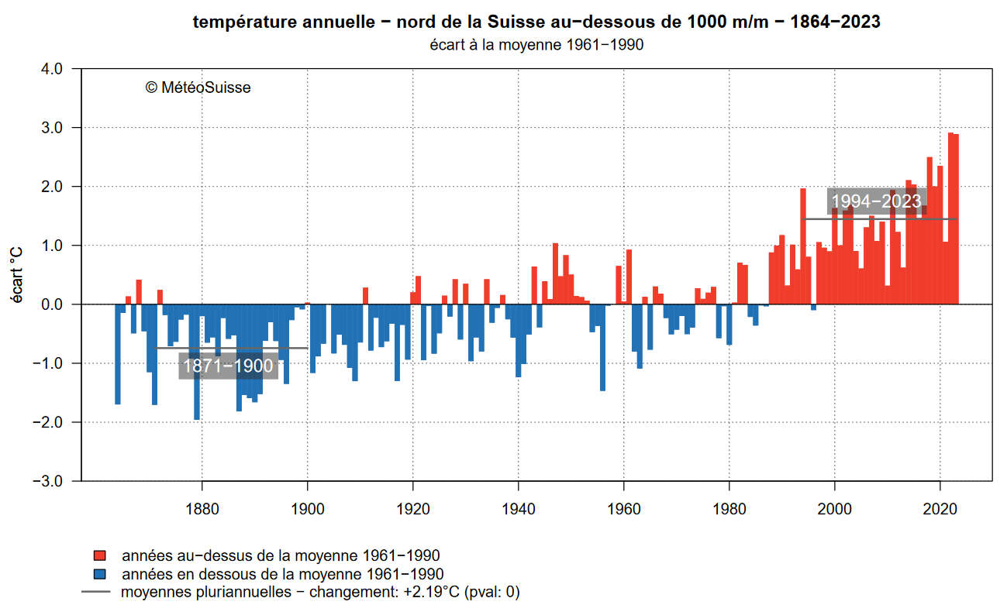
Context
Project launched in 2016
  Reduce effluent water
  Improve effluent water quality
  Contain water consumption
Completion during LS3
ONE Obligation
Respect the regulations regarding the quality of effluent water and reducing the discharge of effluent water into the ‘Nant d’Avril’
ONE Objective
Keep the water consumption at the level (+5% max) of pre LS2 despite:
LIU – power / performance upgrade
HL-LHC – performance upgrade
HostLab detector upgrade

Slide 3

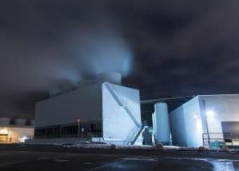
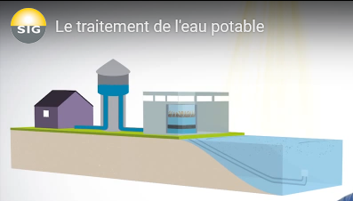
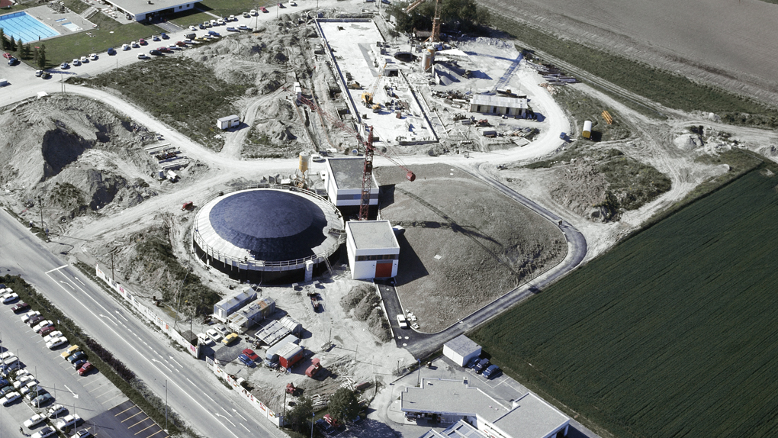
CERN water supply
~99% by Services Industriels de Genève (SIG)
Source – Lac léman
  Used for drinking water and sanitary installations
  Used as raw / make up water for primary water cooling and other industrial services
2.8 Mm³ in 2023 (out of 58 Mm³ distributed by SIG)
Peak consumption at ~1260 m³/h
Water consumption is a direct function of Physics programme and climate
~1% by Régie des Eaux Gessiennes
Source - Nappe phréatique
Used only for drinking water and sanitary installations
24 sets of Cooling Towers
466 MW
27 sets of Cooling Towers
490 MW
Prélèvement à 40m
Tuileries
Filtration plant
 | l/s | m³/ h
Network capacity | 1500 | 5400
CERN allocation | 500 | 1800
CERN max use (~) | 350 | 1260
Others | 1000 | 3600
Pumping
stations
La Berne
Tanks
Vengeron
Pumping station

Slide 4
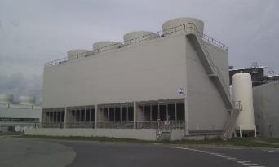
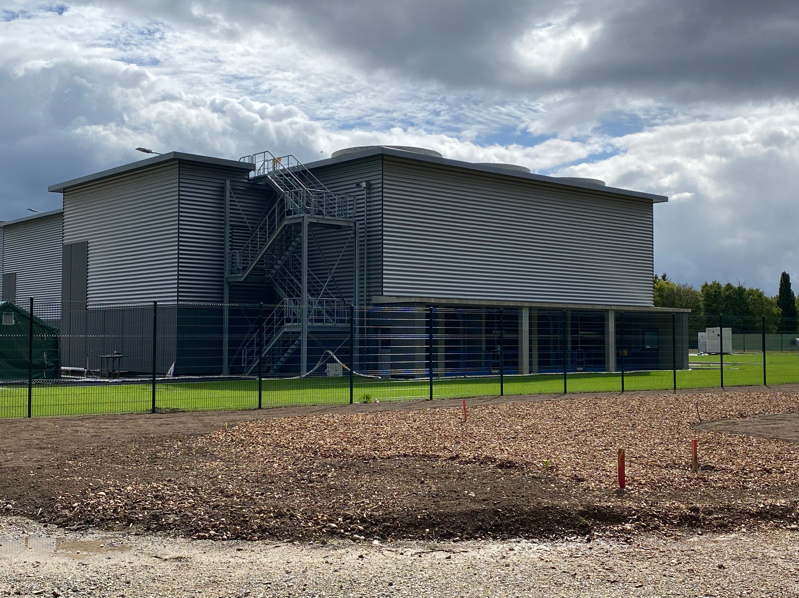
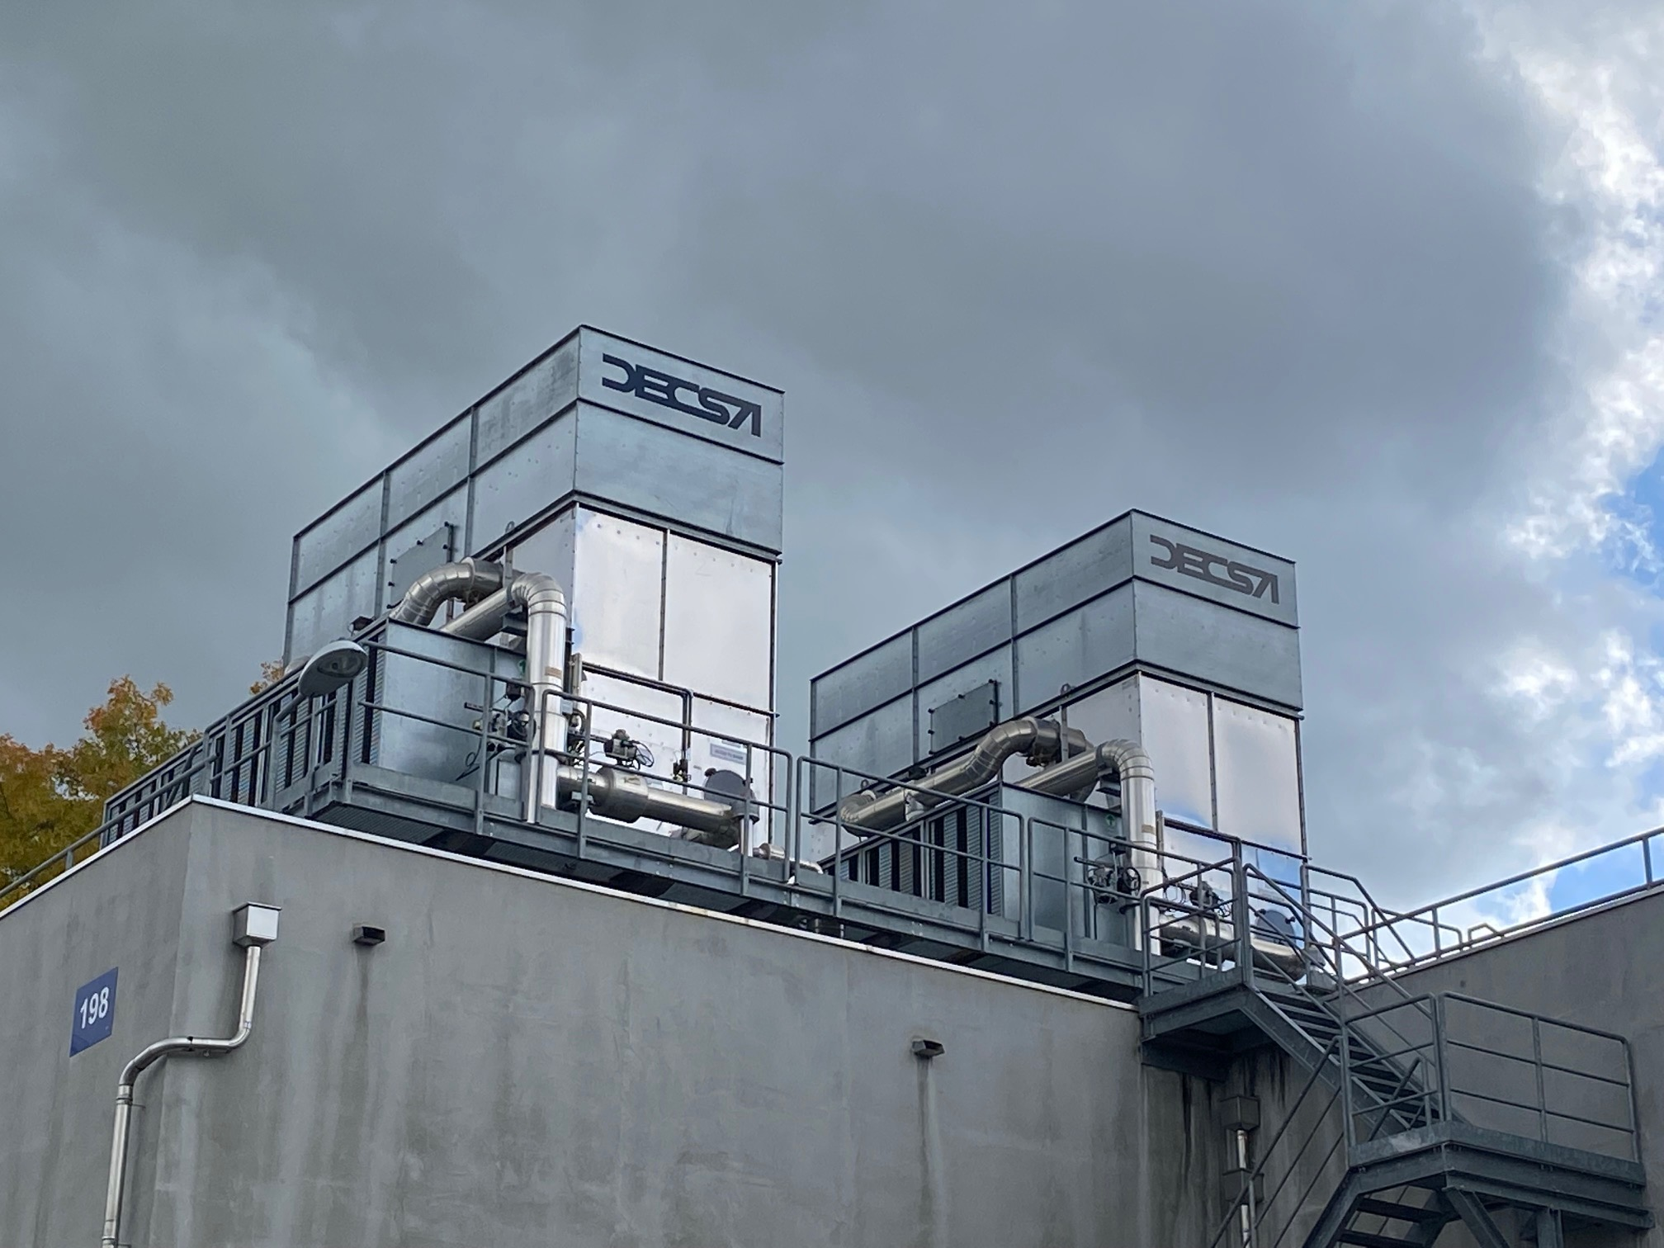
What are we using the water for?
2018 – reference year for RUN2
~1.6 Mm³ for PS, SPS and LHC cooling towers
  Evaporation
  Blowdown water discharged into nearby rivers
~1.3 Mm³ for other cooling/industrial services
  Discharged into nearby rivers
~0.5 Mm³ for Meyrin/Prévessin sanitary use
  Evacuated via wastewater circuit
Total ~3.4 Mm³
Notes:
Human consumption (incl. restaurants, school,..)
Sanitary
Other process (rinsing, cleaning,..) to produce pieces of accelerators or detectors.
Watering green spaces

Slide 5
Water consumption
LS1
LS2

Slide 6
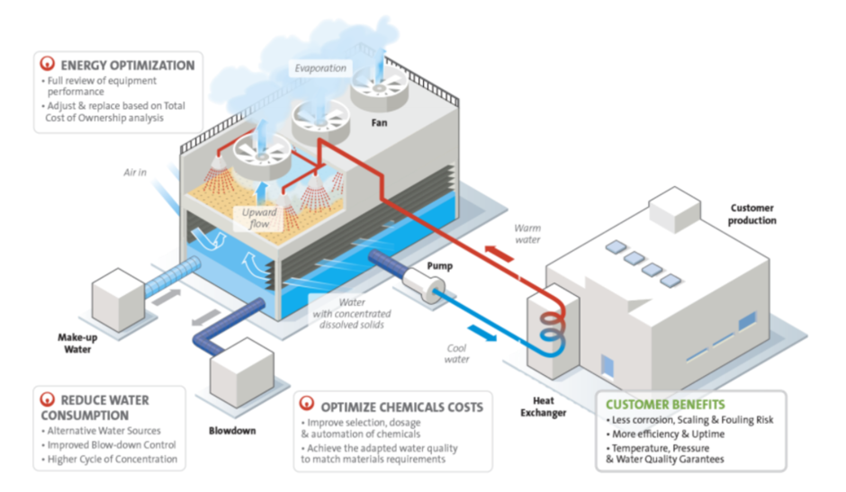
During a run year CERN cooling towers consume ~1’600 Mm3/year
Courtesy – VEOLIA
Contract S294/EN
Water treatment

Slide 7
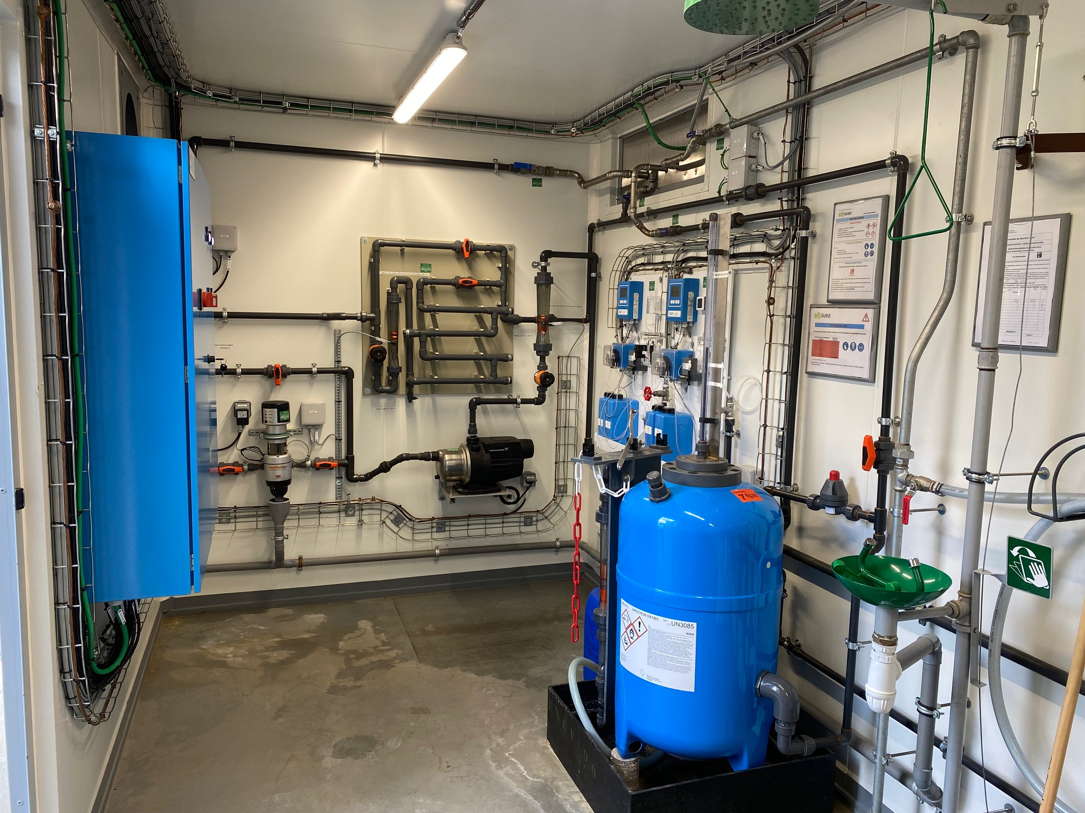
Why cooling tower water treatment ?
For Safety and technical reasons:
Minimise the risk of
  corrosion
  scaling
  fouling
  microbiological build-up
Minimise the risk of
  LEGIONELLA
    Applying French law
    Regular monitoring / laboratory tests
    Annual emptying and cleaning of every cooling tower
Side effect – Blowdown water with residual chemicals that is discharged into the Nant d’Avril
Solution - New specific water treatment station(s)

Slide 8
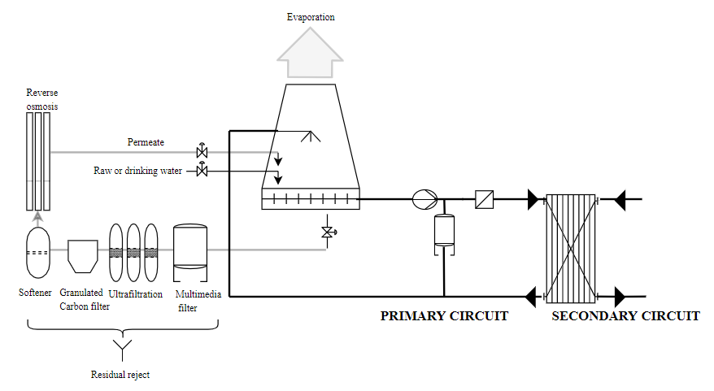
Solution to treat blowdown water quality AND reduce water consumption
Recycled water
Conductivity
<70 µSiemens/cm
Recycling of blowdown water by adding a specific water treatment plant
Strong reduction of effluent water
Residual effluent discharged into wastewater network
No more discharge of cooling water from SPS and LHC cooling towers into the Nant d’Avril
Solution applicable for bigger circuits with sufficient space
Blowdown water Conductivity
~850 µSiemens/cm

Slide 9
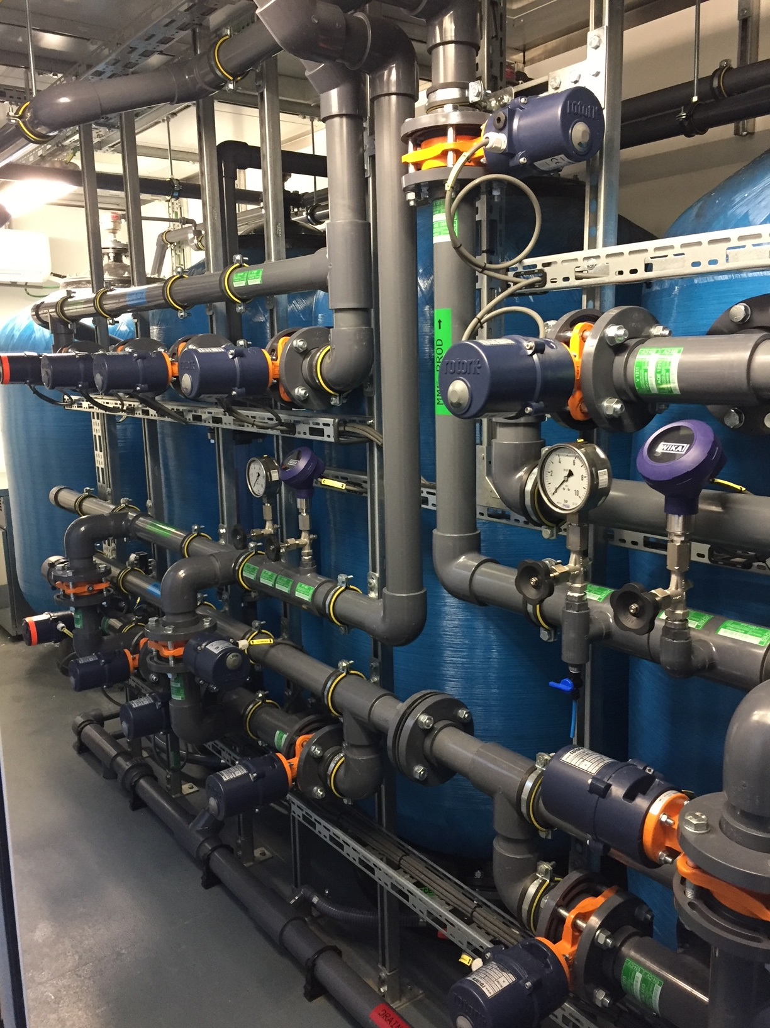
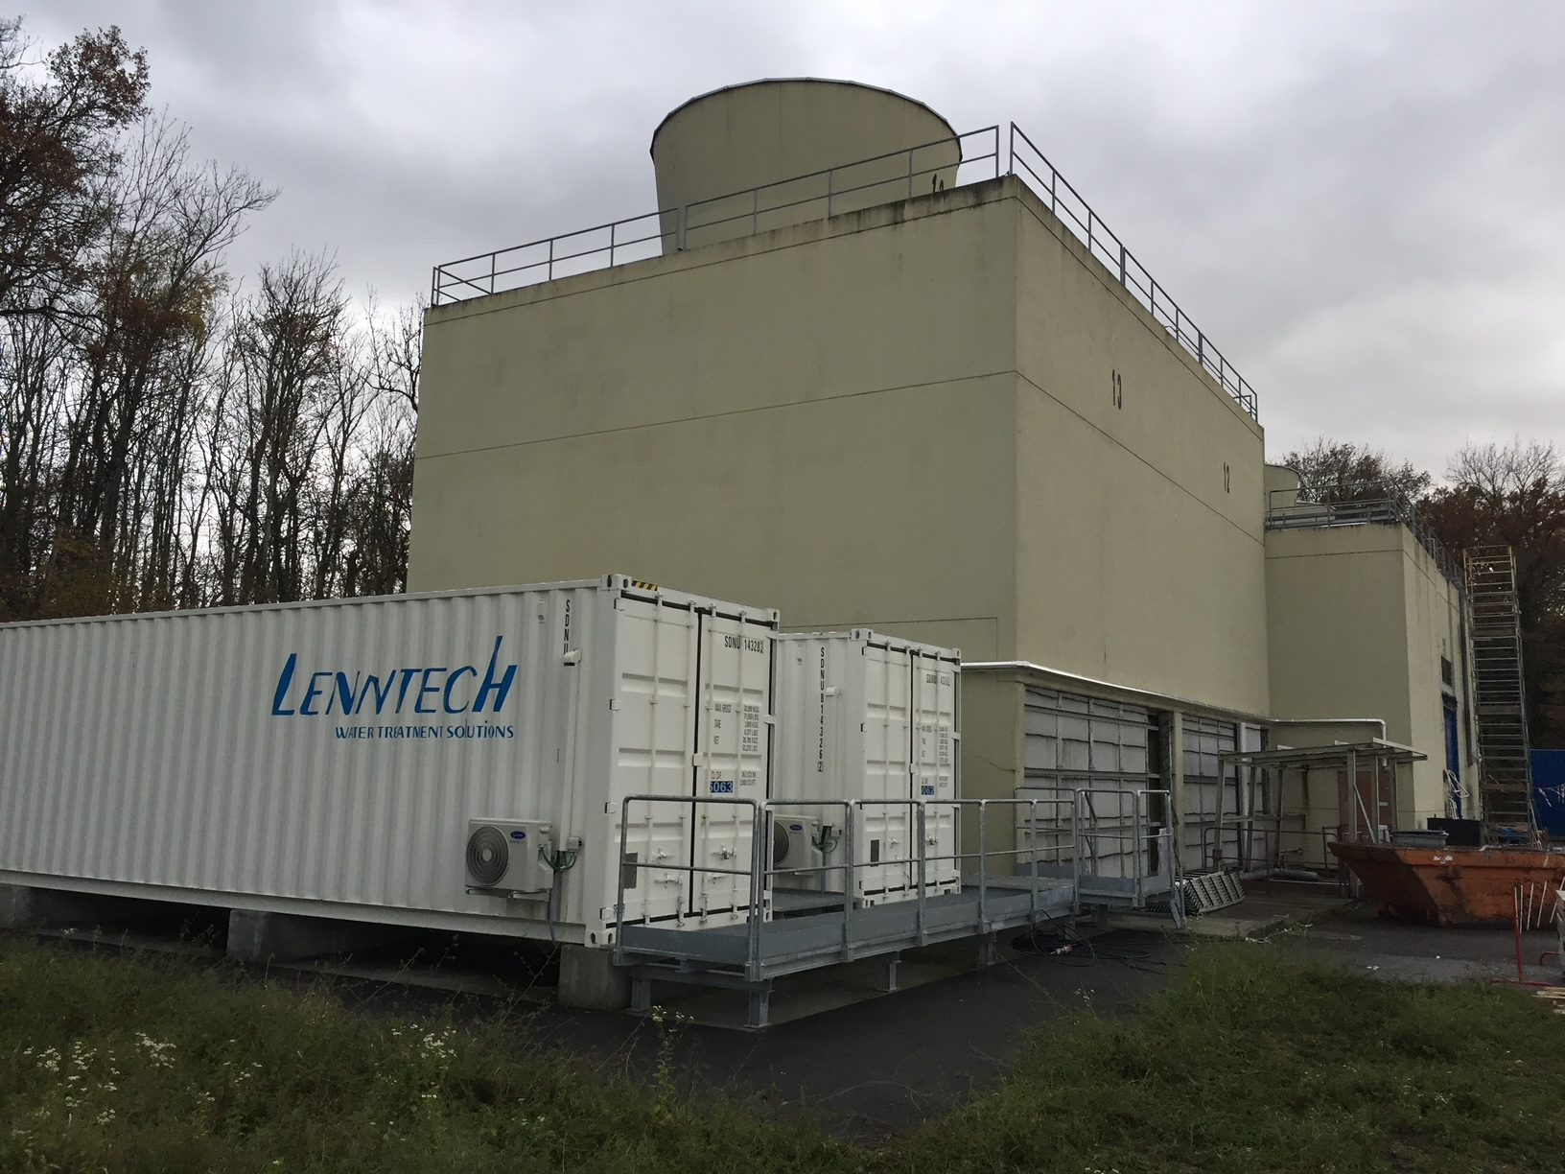
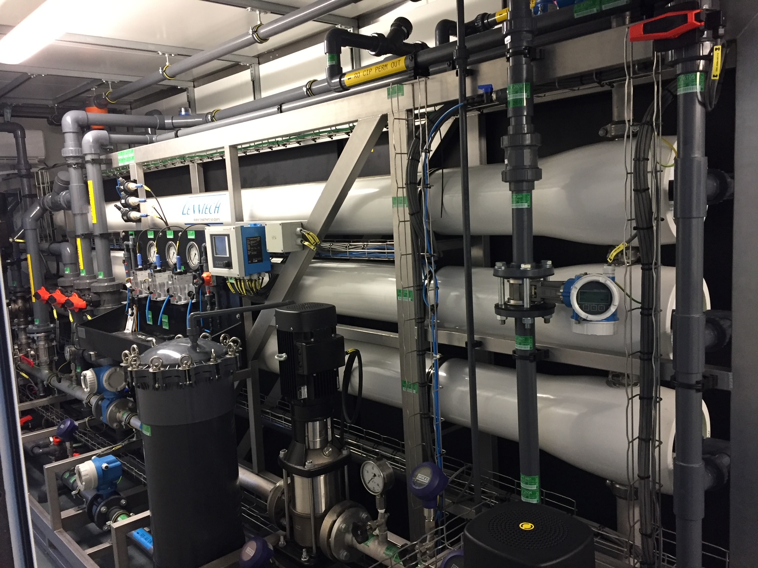
Implementation - cooling tower of the SPS North Area
Cooling capacity = 57 MW; Water flow = 2400 m3/h
 | 2018 | 2022 | ∆ 2022 vs 2018 | 2023 | ∆ 2023 vs 2018
Make up | 164 841 m3 | 145 530 m3 | -12% | 98 115 m3 | -41%
Effluent – blowdown water | 32 283 m3 | 10 109 m3 | -69% | 4 969 m3 | - 85%
Reused | 0 m3 | 26 778 m3 |  | 14 366 m3
Average power in summer | ND | 21 MW |  | 16 MW
In 2023 14’366 m³ of blowdown water recycled and fed back into the cooling towers
Resulted in a strong decrease of the effluent water quantity
Reduction of the water consumption despite the increase of the thermal load
Need to develop a set of more ‘meaningful’ performance indicators

Slide 10
Objective: single water treatment plant for LHC and SPS
One treatment plant for all LHC and SPS circuits
Recycled water will be used in the cooling towers closest to the treatment plant (SF1, SF17 and SPS)
10 out of 27 Cooling Towers
but with a cooling capacity of 354 MW (~72%)
SF 1
SF 17
SF 2
SF 4
SF 5
SF 57
SF 58
SF 6
SF 8
SPS
~400’000 m³/year
Water Treatment Plant PA1
~100’000 m³/year
~300’000 m³/year
Y
SF 1
SF 17
SPS
Wastewater
Notes:
What is the combined cooling capacity of the connected CTs?

Slide 11
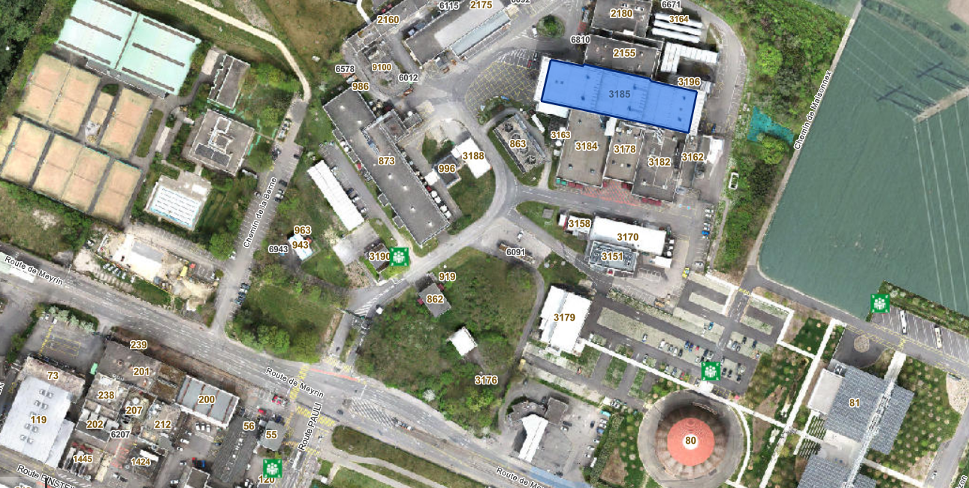
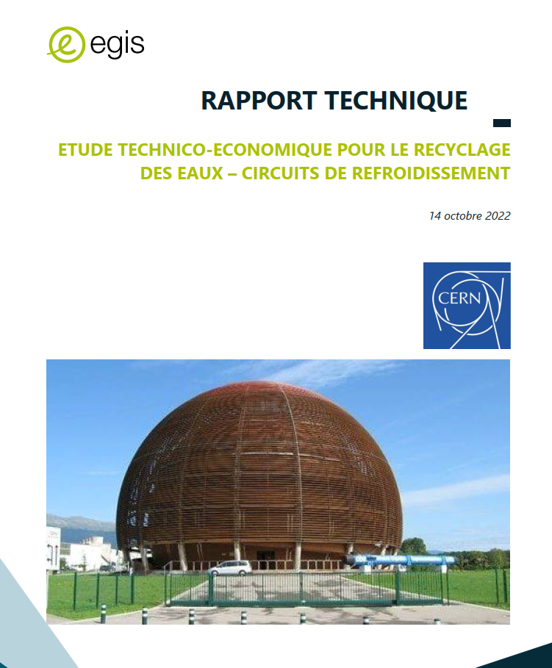
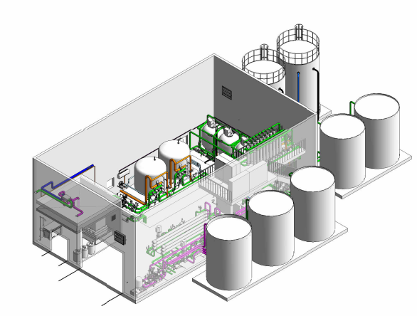
New treatment plant for SPS and LHC cooling tower blowdown water

Slide 12
Summary
Objectives 2025 (completed)
Horizon 2030
Optimisation of all (17) ‘smaller’ cooling towers was done between 2016 and 2023
    AD, LEIR / LINAC, PS TT2 / EAST Area, POPS PS, Booster, …
    Installation and deployment of a new demineralised water production network on the Meyrin site
    ~10% less water consumption, less water treatment and ~80% less effluent water
  Specific blowdown water treatment pilot plant
    Design study
    Implementation at CT2 (SPS / NA)
    Successful operation
    Confirmation of the expected results
Installation of a new water treatment plant at LHC PA1
    No more effluent water coming from the SPS and LHC cooling towers will be discharged into the Nant d’Avril
    Recycling of ~300’000 m³/year for the cooling towers
  Closing last major open cooling circuit
    AD complex - will reduce the water consumption by about 140’000 m³/year
  Optimisation, sustainability and efficiency aspects - new technologies
  Case by case studies for new installations and upgrade of existing installations
  Implementing KPIs
    “Indicateur de performance aquatique”

Slide 13
Conclusion
Water management has always been a priority for the Organization
With the new projects’ respective upgrades, CERN cooling need has increased and will increase even more in the coming years
CERN set up a project in 2016 in close collaboration with the local authorities to improve the quality and to reduce the quantity of effluent water as well as to contain the increase of the water consumption
The modifications and optimisations works have shown the expected positive results
The major investment for a completely new water treatment plant for the blowdown water of LHC and SPS cooling towers will be installed in 2027 – 2028
More to come …

