Slide 1
WP 4.1 Solid State Photon Detectors
Introduction
DRD4 R&D on Photon Detectors and Particle identification Techniques
Rok Pestotnik
DRD4 Collaboration meeting, Oct. 22, 2024

Slide 2
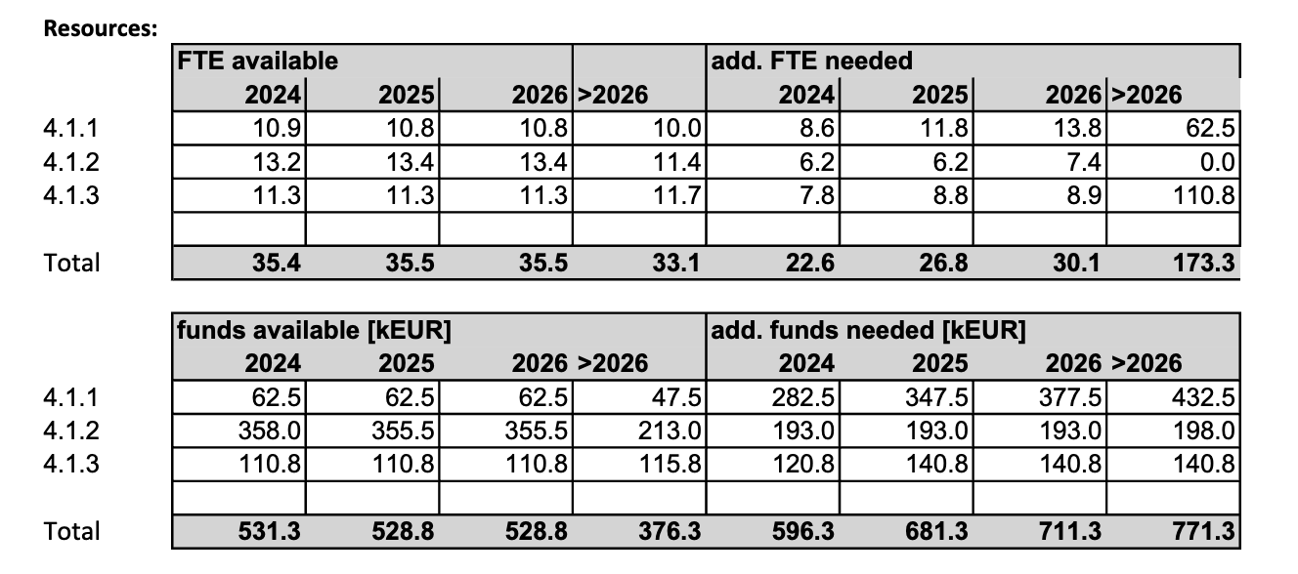
Develop photosensors for extreme environments with ultimate granularity and timing resolution
Work programe defined in a task proposal: https://cds.cern.ch/record/2884872
Three Tasks:
  SSPD wIth new configurations and modes
  Fast radiation hard SiPMs
  Timing of SSPD + Readout electronics
Many groups with heterogenous background
Challenges:
  Find common base & Define the program
  Secure Funding
Fundametal WP for RICH, TOF and SciFI WPs
Claimed WP4.1 Resources in the proposal

Slide 3
MoU - Transformation of tasks to deliverables
  Deliverables will become part of the MoU: Title, Short description, start and end date:
  Transforation of task to deliverables with leaders of the deliverables.
  SSPD wIth new configurations and modes
  D1.1 Demonstrator of BSI SiPM array (M36) -> Alberto Gola
  D1.2 Demonstrator of CMOS-SPAD monolithic sensor (M36) -> Lodovico Ratti
  Fast radiation hard SiPMs
  D1.3 Report on achieved state-of-the-art fast and radiation hard SiPMs and analysis of prospects (M36)
  -> Rok Pestotnik
  Timing of SSPD + Readout electronics
  D1.4 Demonstrator of the ultra-fast SiPM with optimized readout electronics (M36)
  -> David Gascon
Next step Review of the resources for the MoU

Slide 4
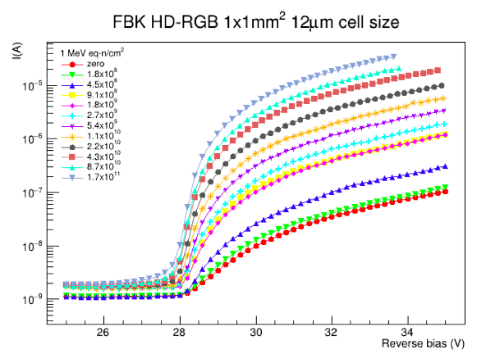
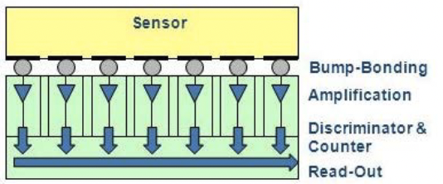
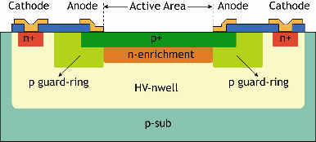
WP 4.1
Solid-State Photodetectors – 3 tasks
Task 4.1.1 - SSPD &new configurations and modes (16 groups)
Backside illuminated (BSI) SiPMs: potential for an enhanced PDE and a better radiation tolerance.
Vacuum ultraviolet (VUV) or near-infrared (NIR) sensitive SiPMs: design, fabrication, and characterisation
Developing ultra-granular SiPM that integrates with the readout electronics by using 2.5D or 3D interconnection techniques. -> to D1.4
CMOS-SPAD light sensors: co-integration of SPADs and electronics, digitized output signals with low power consumption and fast read-out.
New materials for light detection, e.g., SiC, GeC, InGaAs, GaAs technology: possible advantages in SSPDs.
Task 4.1.2 - Fast radiation hard SiPMs (17 groups)
Standardize procedures for quantification of radiation effects.
Characterize the irradiated SiPMs in a wide range of temperatures down to -200 deg..
Study of annealing.
Study and quantify other measures enabling the use of SiPM in highly irradiated areas:
  smaller SiPMs
  macro- and micro-light collectors
D1.1
D1.3
D1.2
Not enough interest at the moment
Bias current increase after the irradiation
© Fraunhofer IMS
Ultra graniular SiPMs
BSI SiPMs

Slide 5
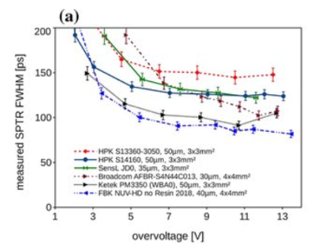
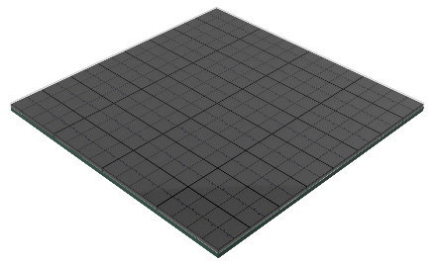
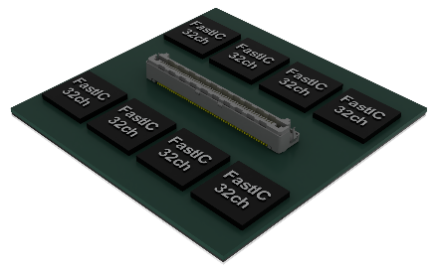
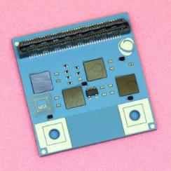
WP 4.1
Solid-State Photodetectors ...
D1.4
Task 4.1.3 Timing of SSPD + Readout electronics (16 groups)
RO electronics - transversal activity for all WPs
Study and improve the timing of SiPMs.
Co-design of a multi-ch. readout ASIC exploiting the timing potential.
Optimized, reliable, cost-effective integration and packaging with integrated cooling.
Vertical integration of SiPM arrays to FEE: optimize timing by reducing the interconnections' parasitic inductances and capacitances.
SPTR of the current sensors
Milestones:
Should be defined internaly
Deliverables:
D1.1 Demonstrator of BSI SiPM array (M36)
D1.2 Demonstrator of CMOS-SPAD monolithic sensor (M36)
D1.3 Report on achieved state-of-the-art fast and radiation hard SiPMs and analysis of prospects (M36)
D1.4 Demonstrator of the ultra-fast SiPM with optimized readout electronics (M36)
Vertical cost effective integration of sensor and readout electronics
Integrated cooling: SUBLIMA

Slide 6
Participants
D1.1 & D1.2 - SSPD w new configurations and modes
18 groups: Bologna, CERN EP, Ferrara, FNAL, Genova, Maryland*, Michigan*, Pavia, Trento, Milano , Virginia*, Bologna, Iowa, SNU, Tokyo Metropolitan, Bari2, EPFL, Ljubljana
D1.3 - Fast radiation hard SiPMs
18 groups: Bologna, Ferrara ,Genova, KEK, Bucharest, CERN-SY-BI, FBK, Giessen, Iowa*, Laussane EPFL, Ljubljana, Nagoya, Padova B2, Padova LHCb, Perugia, SNU, Tokyo Metropolitan, EPFL Aqualab
D1.4 - Timing of SSPD + Readout electronics
16 groups :Barcelona, Bologna, Bucharest , CERN-EP, FNAL , Genova, Ljubljana, Michigan*, Monash, Omega, Padova, Perugia, Virginia, Maryland, FBK, FZU Prague
* Non active

Slide 7
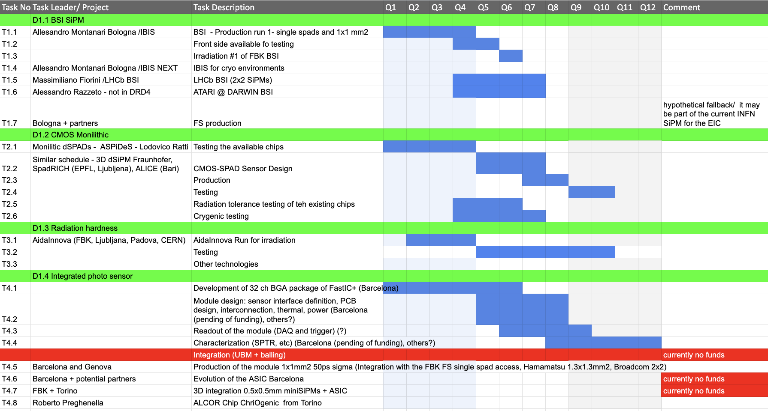
Tasks : Gantt chart

Slide 8
New groups in the SSPD
Milano Bicocca, Claudio Gotti -> work on the irradiation hardness with the Hamamastu SiPMs – development of the cryogenic amplifier (group already in the DRD4)
Institute of Radiation Problems, Azerbaijan, Farid Ahmadov, new SiPM structures (not yet in the DRD4) -> will officialy ask to join the DRD4 during the next CB

Slide 9
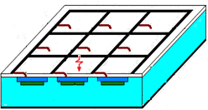
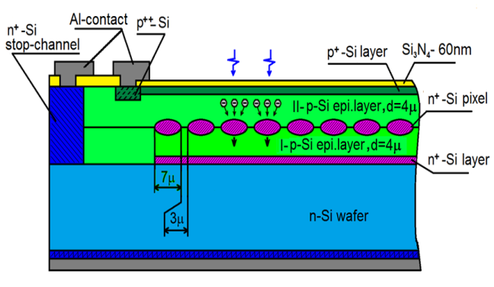

High Sensitive Micropixel APDs
• Geometrical factor --------------50%;
• Quantum efficiency -------------90%;
• Max. gain (today)--------------------10⁷
• Density of pixels --- 3 000 pix/mm²
• Excess noise factor ----------------- 1
• Size--------------------------- 3mm*3mm
Dr. Farid Ahmadov
Institute of Radiation Problems
Azerbaijan
E-mail: farid081211@gmail.com
Patent No. RU. 2102820. 1998
• Geometrical factor ---------- 100%;
• Quantum efficiency ----------- 90%;
• Max. gain (today)------------100 000
• Density of pixels - 40 000 pix/mm²
• Excess noise factor ------------------1
• Size--------------------------- 3.7mm*3.7mm
MAPD modification
Patent No. RU. №2316848.2006
• Geometrical factor ---------------- 50%;
• Quantum efficiency ---------------- 90%;
• Max. gain (today)----------------1000 000
• Density of pixels --------- 3000 pix/mm²
• Excess noise factor ------------------------1
• Size---------------------------->10mm*10mm
Patent No. US20150048472A1.2015
Up until now collaborating with Zecotec, looking for potential partners

Slide 10
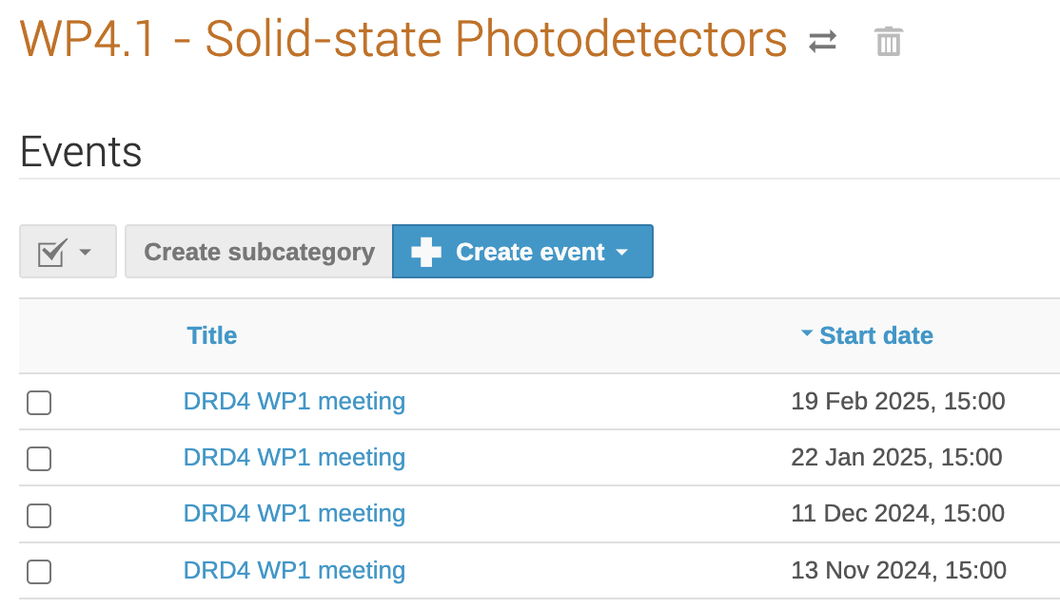
Next WP1 meetings
Presentation of the progress, planning of next steps
Wednesday, Nov. 13, 2024, 15h-17h CEST
Wednesday, Dec. 11, 2024, 15h-17h CEST
Wednesday, Jan. 22, 2025, 15h-17h CEST
Wednesday, Feb. 19, 2025, 15h-17h CEST
Wednesday, March 19, 2025, 15h-17h CEST

Slide 11
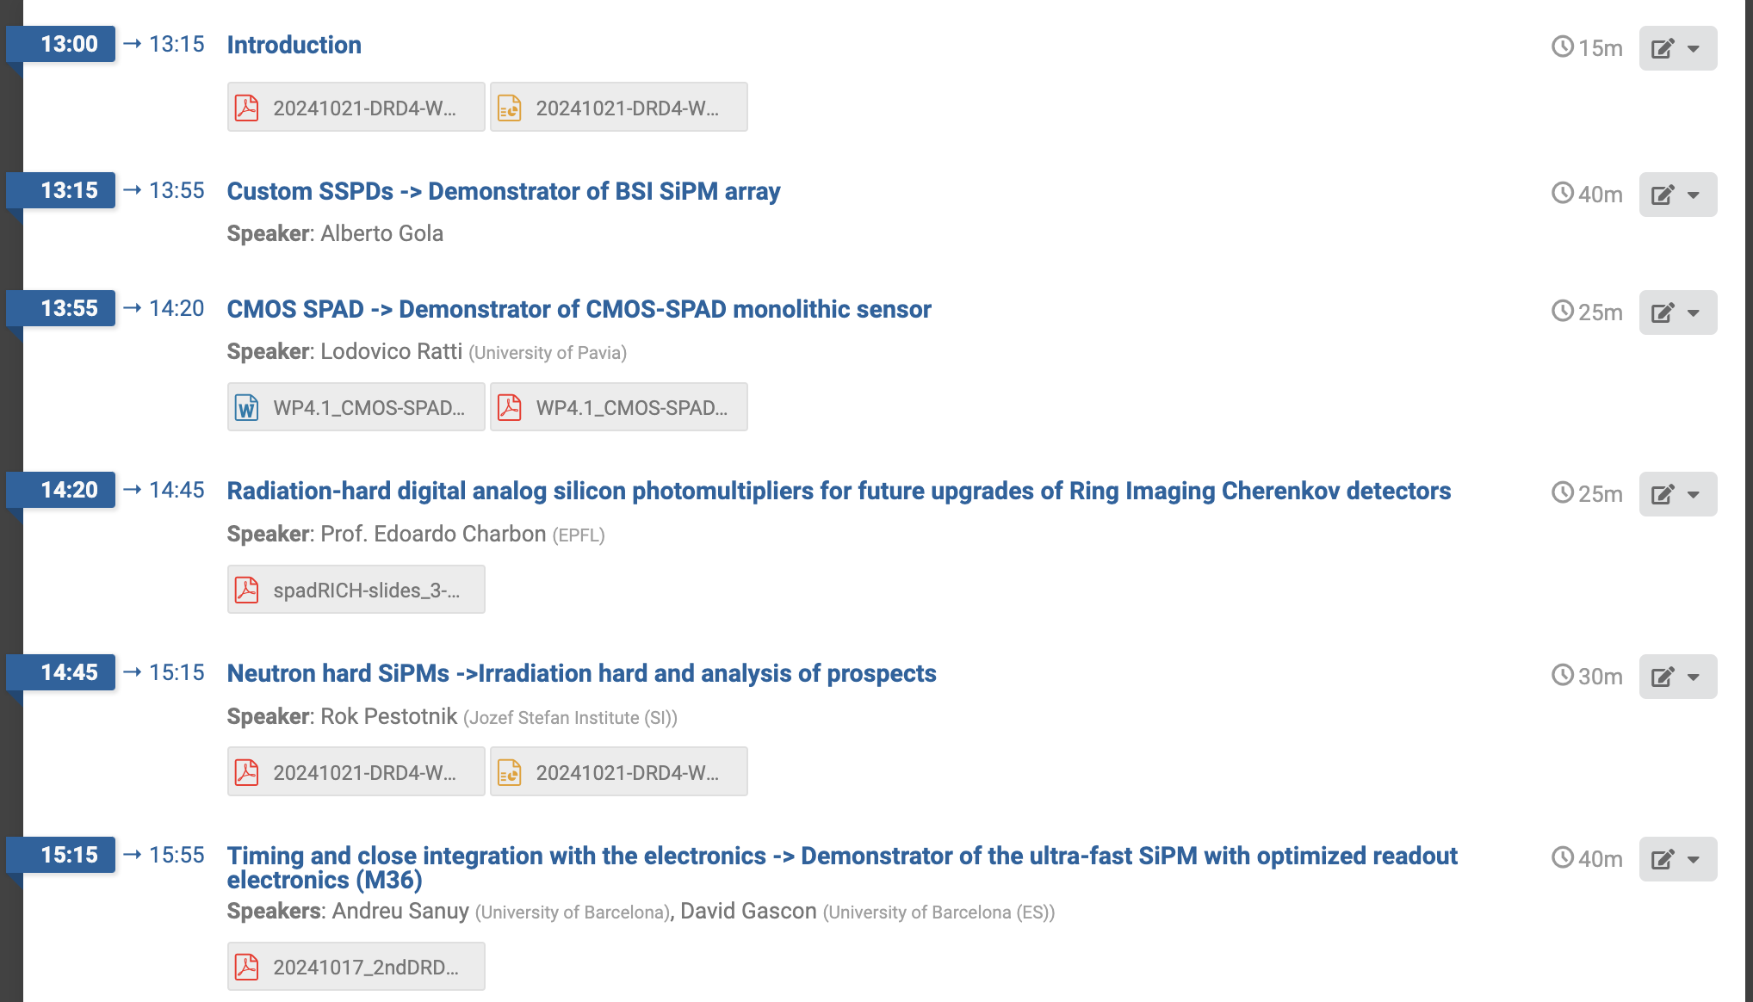
WP1 closed session, 21.10.2024
https://indico.cern.ch/event/1468958/
Access to the event opened only to the members of the drd4-wp1-sspd group

Slide 12
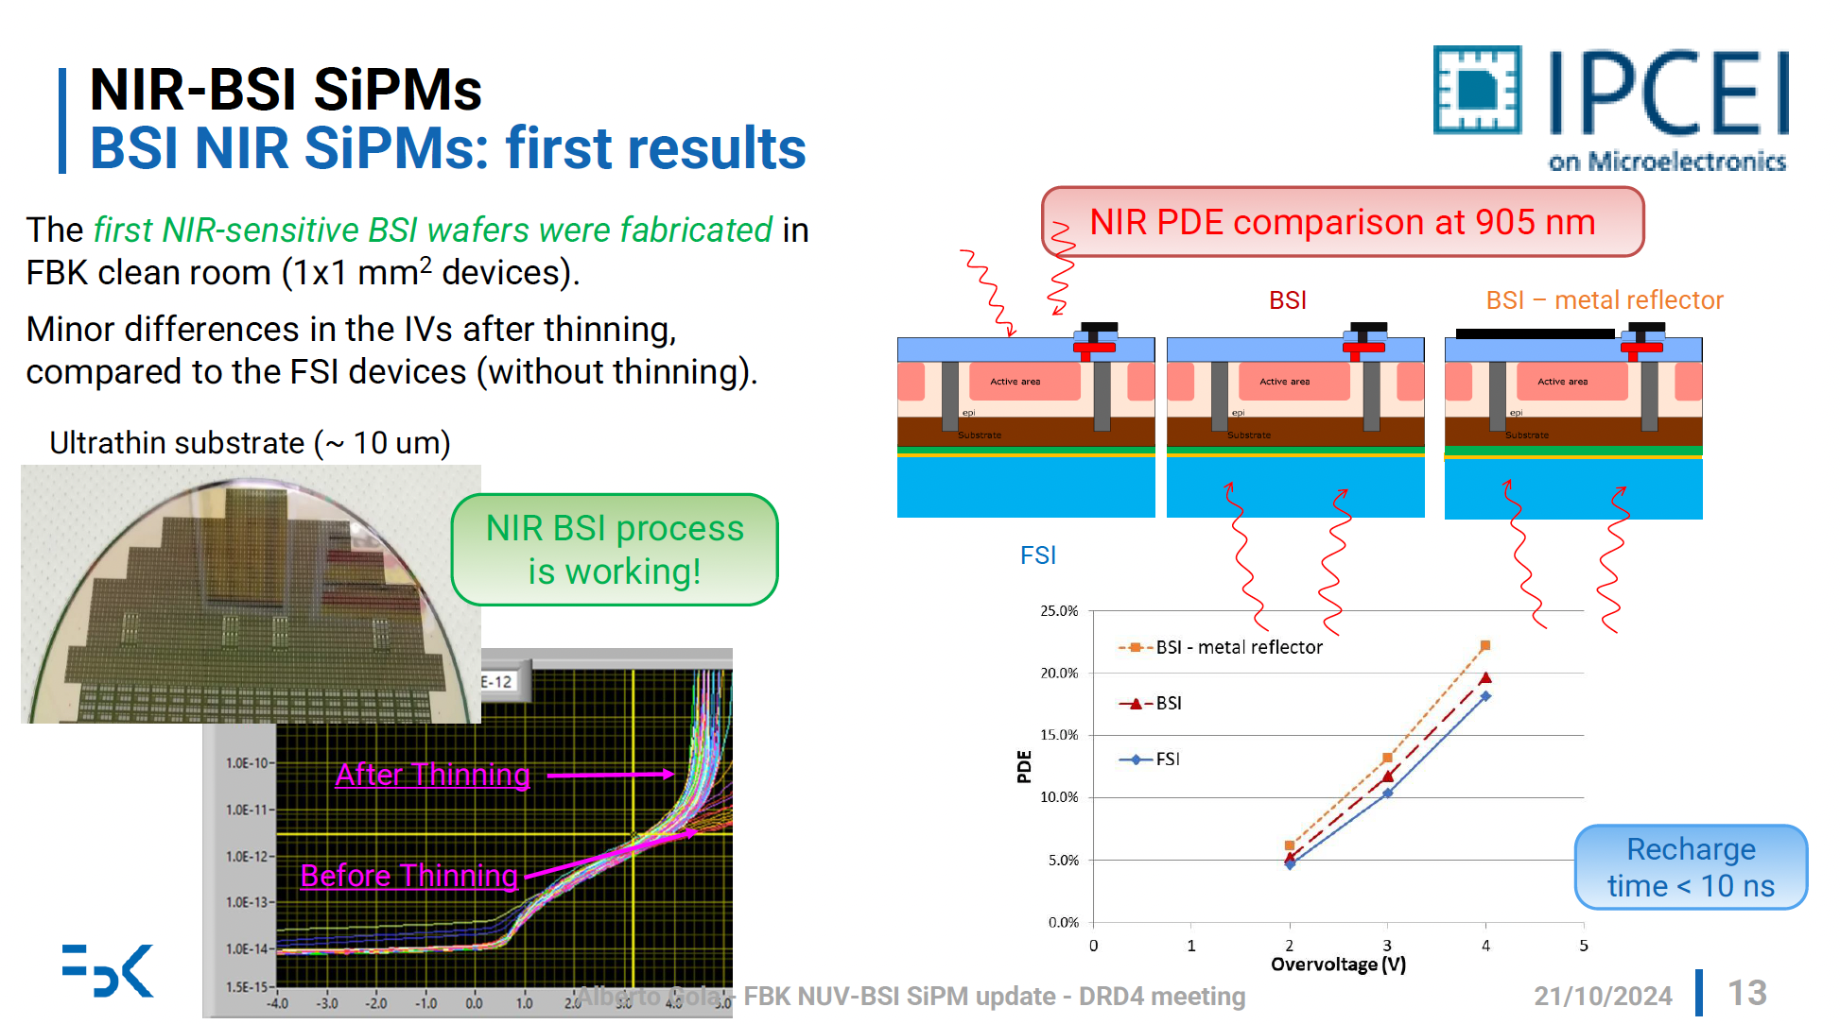
D1.1 First results of the samples of the BSI IBIS Run

Slide 13
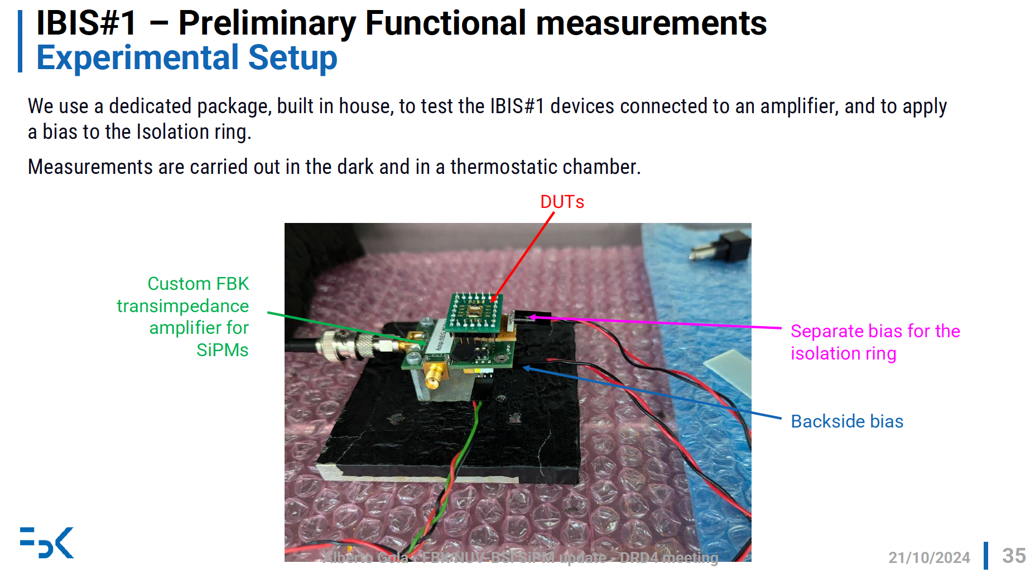
D1.1 First results of the samples of the BSI IBIS Run
The results will be shown in Tampa, IEEE NSS next week

Slide 14
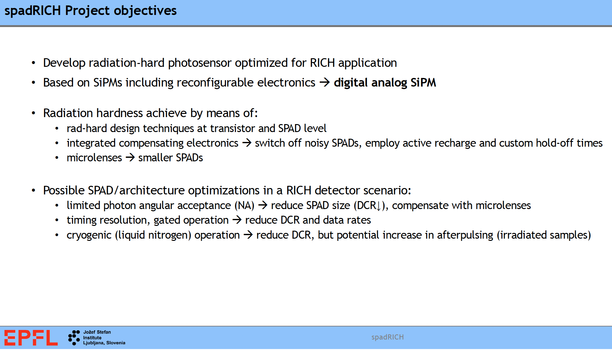
D1.2 SpadRICH
Radiation-hard digital analog silicon photomultipliers for future upgrades of Ring Imaging Cherenkov detectors – bilateral Weave project EPFL, JSI

Slide 15
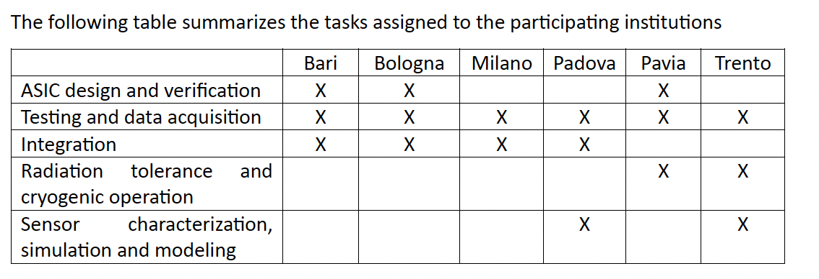
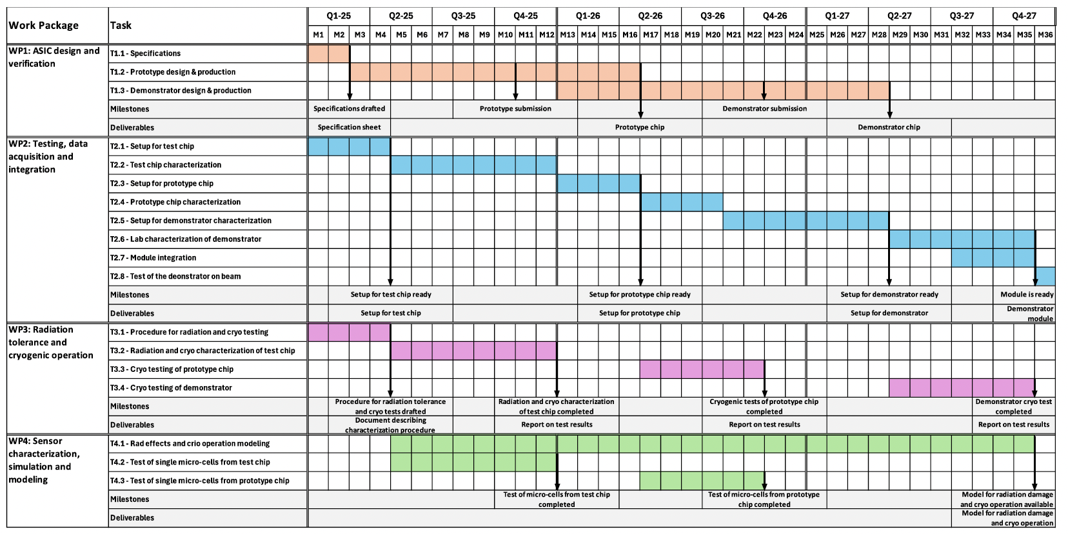
D1.2 ASPiDeS (A CMOS SPAD and Digital SiPM Platform for High Energy Physics)
L. Ratti
Approved INFN Project, starting in 2025

Slide 16
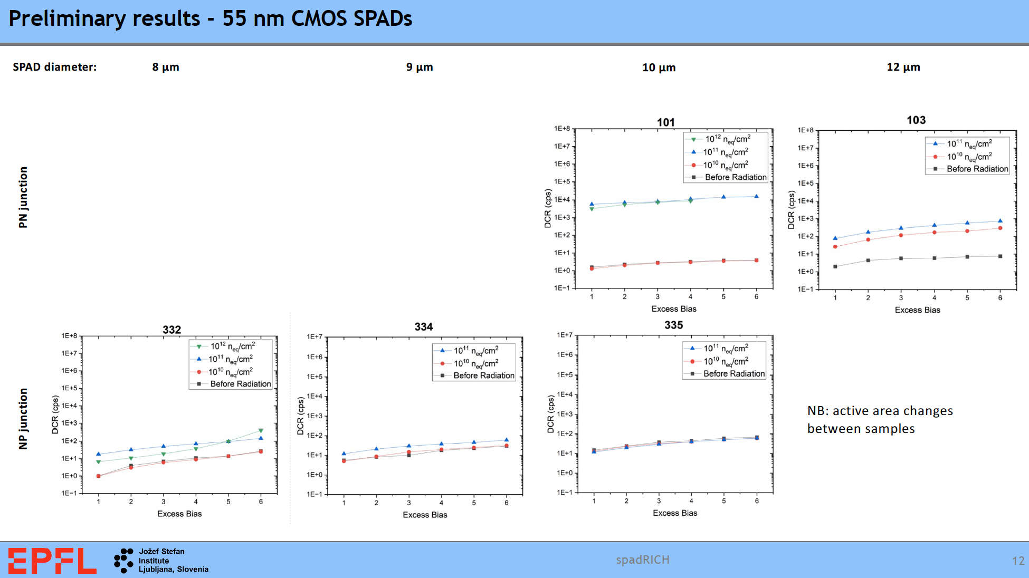
Initial activities
• Radiation hardness measurements (neutrons up to 10¹² neq/cm2 @TRIGA) in 180 nm (actively quenched SPADs) and in GF
55nm BCD
• Operation at cryogenic temperature (starting)
• Planned: 110 nm SPADs
• Microlenses: radiation hardness measurements and cryogenic operation

Slide 17
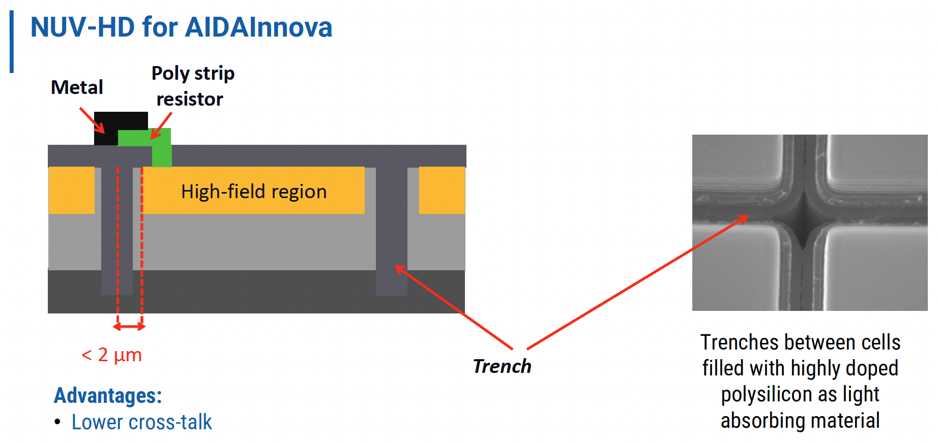
D1.3 AidaInnova run @ FBK
Experimental structures
Two different technologies:
  Low electric field
  Ultra Low electric field
Different samples
Die size: 3.15 mmx3.15mm
Cell pitch: 15um, 25um, 40um, 75um
2x2 array of 1x1 mm² and mini-SiPM
Variants of 2x2 arrays:
1) 2x2 array of SiPM 1x1mm2 with 15um-25um-40um-75um cell size
2) 2x2 array of SiPM 0.75x0.75mm2 with 15um-25um-40um-75um cell size
3) 2x2 array of SiPM 0.5x0.5mm2 with 15um-25um-40um-75um cell size
4) 2x2 array of SiPM 0.25x0.25mm2 with 15um-25um-40um-75um cell size
5) 2x1 array of SiPM 1.5x1.5mm2 with 15um+25um cell size
6) 2x1 array of SiPM 1.5x1.5mm2 with 40um+75um cell size
7) single SiPM 2x2mm2 with 15um cell size
8) single SiPM 2x2mm2 with 40um cell size
Expected end of production Feb 2024
To be tested in the framework of the AidaInnova
Samples will be available for testing for DRD4

Slide 18
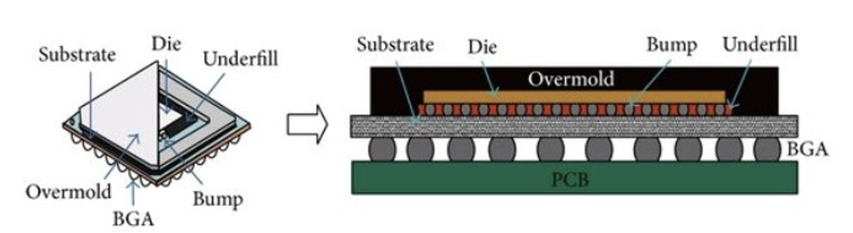
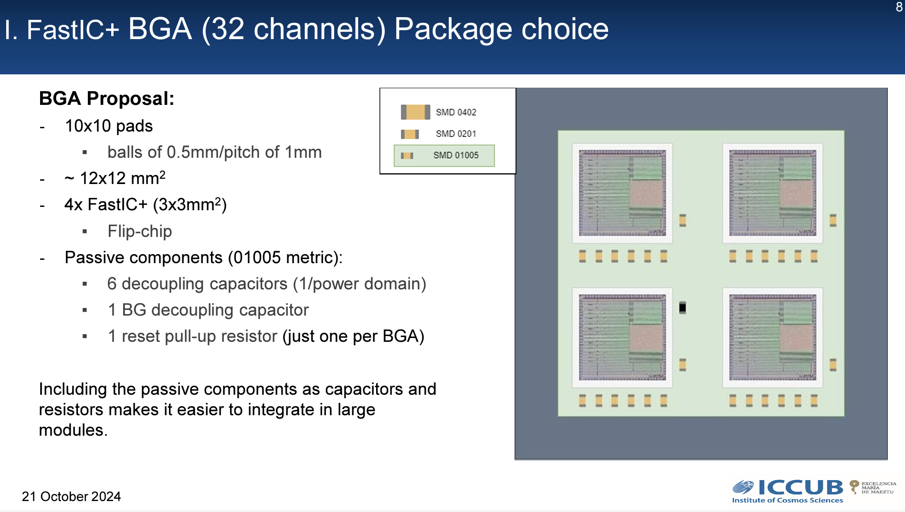
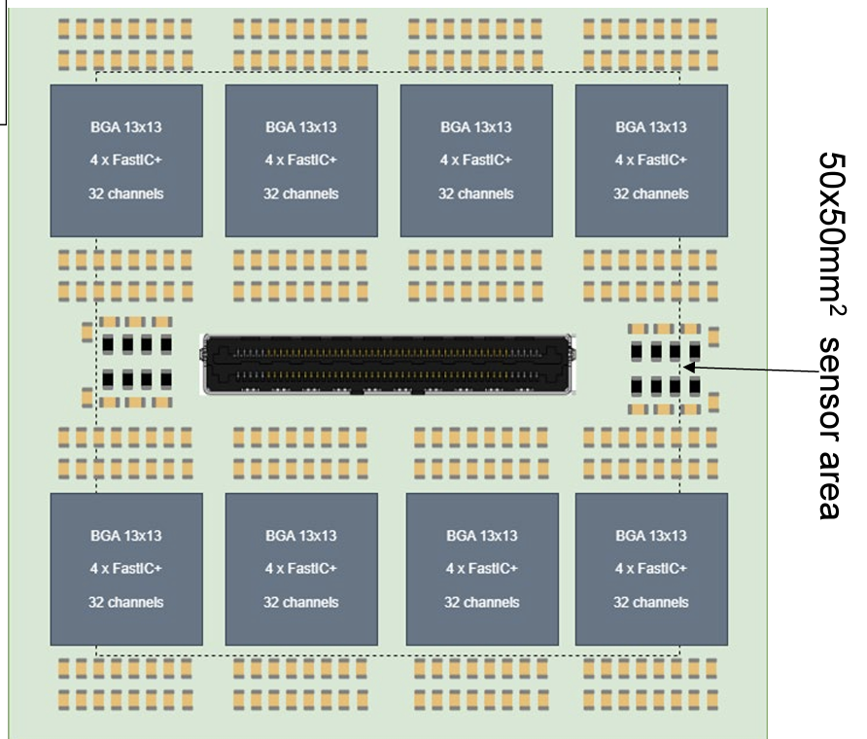
D1.4 Timing and close integration
256 Ch Module proposal

Slide 19
Summary
A lot of interesting activities
Planned monthly meetings
Looking for new funding opportunites to go beyond the first three year period

