Slide 1
ECFA DRD4
Work-Package(s) 4.5
Scintillating Fibres and Transition Radiation Detectors
Blake Leverington¹, Guido Haefeli²
¹Heidelberg Universitaet, ²EPFL

Slide 2
WP 4.5.1 (the only task so far)
Standard fibres like Kurarays SCSF-78MJ are 25+ years old…
Update to match the rise of SiPMs
The deliverable should summarize investigations and efforts at identifying possible scintillators technologies that could be made into a scintillating fibre that are an improvement over the standard fibre by investigation of literature, through contacts with industry, or developments or modifications to existing technology. Physical samples should be studied for their relevant parameters to determine their feasibility as a new fibre before proceeding to producing fibre samples.
D5.1
Text to appear in the MOU Annex for the Work Package Deliverables

Slide 3
WP 4.5.1 (the only task so far)
Assuming the first deliverable 5.1 has a feasible scintillator to be investigated further, scintillating fibres should be produced with an industry partner and developed further. Parameters such as light yield, attenuation length and radiation hardness up to LHC or future accelerator doses will be studied, with a short report explaining the outcomes.
D5.2
Text to appear in the MOU Annex for the Work Package Deliverables

Slide 4
WP 4.5.1
Desired inclusion of Luxium (formerly Saint Gobain Crystals) and Kuraray as Industrial Partners in the WG, as well as scintillator producers (NuveaTech, etc)
  We would like to advance further in our development/selection of new materials
  Continuous market surveys and literature searches in chemistry journals
Strong synergy with DRD6 WP3 (Optical Calorimeters) (TASK 3.4 MATERIALS)
In general this WP so far is a loose envelope around ongoing LHCb and CERN funded developments, without direct funding from funding agencies.
WP 4.5 | 4.5.1
CERN SY-BI | x
CERN-EP | x
CERN-LHCb | x
Clermont-Ferrand | x
Heidelberg | x
Lausanne - EPFL | x
No. of groups | 6

Slide 5
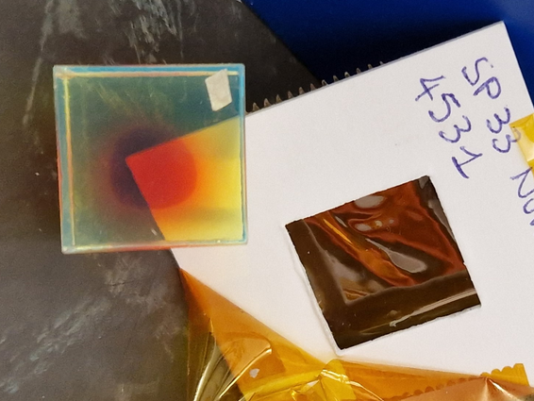
4.5.1 Work in Progress
Nuvea SP32 & SP33 samples confirmed to be irradiated in July 2024 at IRRAD (in the hands of IRRAD now) facility
  Cube samples irradiated in November 2023 showed large brown regions in the inner regions, but not the edges.
  Now sliced in 2mm samples; more similar to a fibre mat than the cube samples
  It took 1 year to repeat this… we need to find a better process
EPFL ordered fibres from Luxium (4km each of 3 types)
  Small samples received
  3x4km Order was placed through CERN in April but not delivered yet
CERN EP investigating a high light yield fibre with a 3rd scintillator dye
SP32 and SP33 Sample 2 months after irradiation at CERN (~50kGy).

Slide 6
4.5.1 Work in Progress
Novel high light yield fiber research from CERN EP
Lead by Sune Jakobsen
Simulations show it would work
Contacts with 3 industry partners to determine a new WLS to enable this fibre
  One WLS determined, but some concerns on the safety of using it. Being investigated
  Two partners could produce the fibres, one to provide base materials
Plans 2025:
  Follow up with all 3 companies.
  If a wls is identified, move forward with prototype fibers. The prototype fibers would then be characterized and if the results are encouraging, samples would be irradiated and re-characterized.
“But it is not really part of the DRD at the moment.”

Slide 7
Old slides

Slide 8
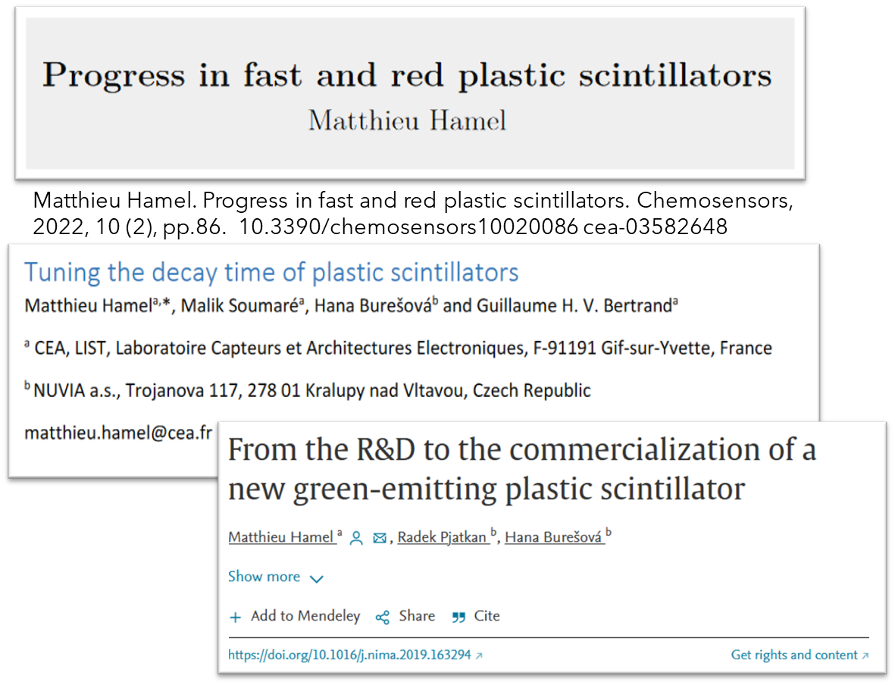
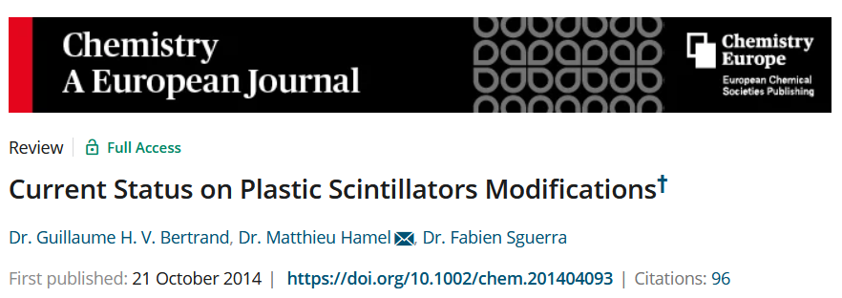
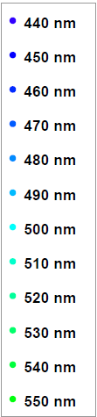
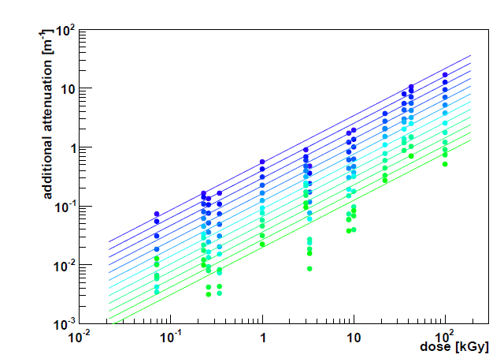
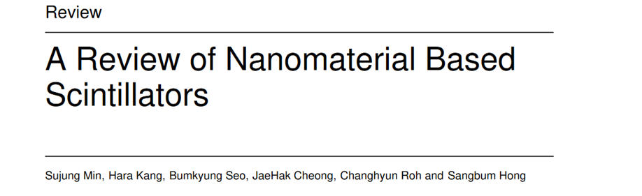
WP 4.5
Task 4.5.1:
“Develop an improved radiation hard scintillating fibre with a fluorescence decay time less than 4 ns.”
The standard fast fibre is over 25 years old (SCSF-78M and -78MJ from Kuraray)
  Peaks at 450nm, 3.5m attenuation length, 2.8ns decay time
  3HF has a decay time of 8ns, but peaks at 550nm.
Goal: A new fibre with larger Stoke’s Shift (to >500nm ) would improve the transmission after irradiation of the fibre
  Should have same or better light yield, attenuation, decay time, and stable in time.
Approx. Operational range of 78MJ
Intrinsic attenuation length 3.5m
Lots of “promising, but…”
From the thesis of R. Ekelhof, 2016. TU Dortmund

Slide 9
Participating Groups
WP 4.5 | 4.5.1
CERN SY-BI | x
CERN-EP | x
CERN-LHCb | x
Clermont-Ferrand | x
Heidelberg | x
Lausanne - EPFL | x
No. of groups | 6
EPFL
  Has produced a few fibre based trackers and telescopes for various experiments and projects
  SiPM development with Hamamatsu and FBK; microlenses; irradiation studies
  Fibre winding for LHCB SciFi Tracker
  Cryo-cooling of SiPMs for LHCb Upgrade 2
  Investigating new scintillators with polymer chemists at EPFL
  Good connection with Kuraray (fibres)
Heidelberg
  Module production for LHCb SciFi Tracker
  Irradiation studies of Fibres
  Development of LHCb Upgrade 2 Fibre and Pixel Tracker
  Ion-beam profile monitor for HIT clinic
  Investigating new scintillators for fibres
CERN-LHCb + -EP + SY-BI
  SPACAL for LHCb ECAL LS3 and Run5/6 Upgrades
  Irradiation of Scintillators
  LHCb SciFi QA
  Scintillator irradiation and characterization
  Beam Instrumentation
Clermont-Ferrand (Pascal Perret et al.)
  LHCb SciFi Tracker Electronics
Other groups expressed interest in the WG, but not willing to commit to a WP (yet?)

Slide 10
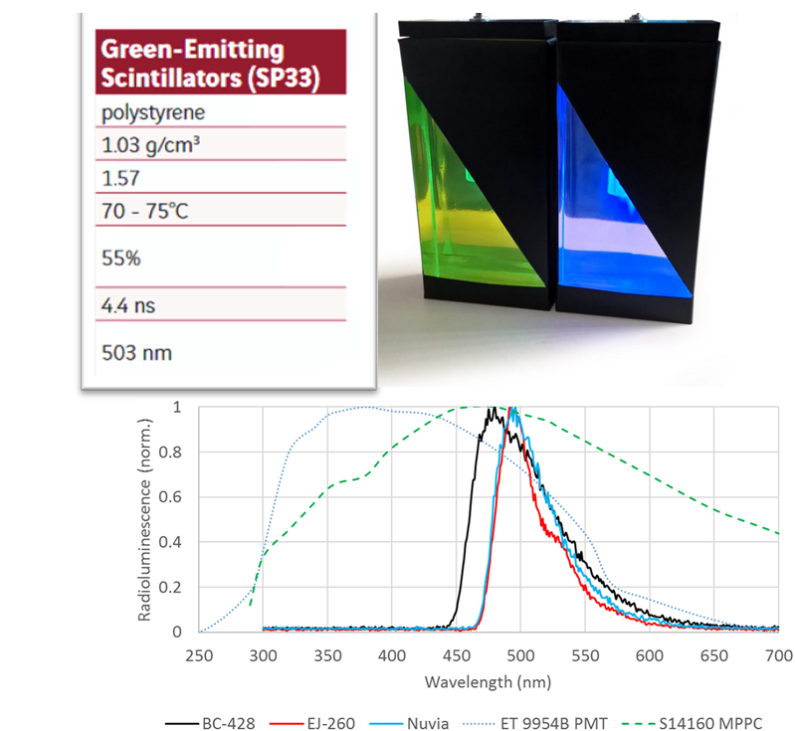
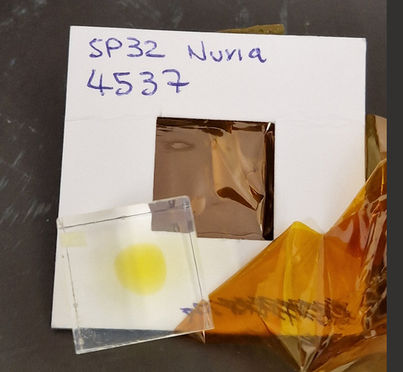
WP 4.5
Task 4.5.1 Milestones:
First, identify new scintillators, fluorescent dyes, or fibre modifications
  Market, literature (organic chemistry journals), simulation. Make contacts.
Obtain samples and characterize the bulk scintillator material → Possibly the hardest part. We can’t produce our own.
  Radiation hardness, timing, wavelength
  Irradiating thin slices of Nuvea SP32/33 in ~May July
Production of fibre samples (a few km) with Industry Partner(s)
  In contact with positive response. Kuraray Production facility closed until mid-2024.
Testing and qualification of prototype fibre samples
  Light yield, attenuation length, timing, radiation hardness
Task 4.5.1 Deliverables:
  Report on candidates (between 2 and 3)
  Report on any produced prototype. Not guaranteed to find any.
SP32 and SP33 Sample 2 months after irradiation at CERN (~50kGy).

