Slide 1

“Green radiators”: Controlling refractive index & reducing Cherenkov gas radiator GWP: a challenge in an era of diminishing fluorocarbon availability
Related paper: https://link.springer.com/article/10.1140/epjp/s13360-023-04703-w
See also: https://indico.cern.ch/event/1263731/contributions/5398511/attachments/2648319/4584649/G_Hallewell_DRD4%20Rad%20Gas%20GWP%20with%20annexes%20May%2016%202023.pdf
https://indico.cern.ch/event/1371158/contributions/5773321/attachments/2788215/4861759/G_Hallewell_ATLAS_sustainability_forum_Jan_26_2024_v2.pptx
ICHEP2024 (July 2024): https://indico.cern.ch/event/1291157/contributions/5900402/
G. Hallewell
Aix Marseille Université,
CNRS/IN2P3, CPPM, Marseille, France
.
DRD4 Collaboration Meeting,
WG-2: CERN Oct 21-25 2024
1
Notes:
1

Slide 2
Abstract
COMPASS and LHCb use C₄F₁₀ and CF₄ Cherenkov gas radiators.
These Saturated FuoroCarbons (C_{n}F_{(2n+2)}) have high GWPs, however
(5000-9000*CO₂) so there is impetus to reduce their consumption.
Oxygenated fluorocarbons (fluoro-ketones: C_{n}F_{2n}O) can offer similar optical performance, with GWPs equivalent to CO₂ (or zero). Their GWPs are geometry-specific however: closed molecular rings with an oxygen atom link have GWPs as high as SFCs. Reactivity & toxicity also likely to be geometry dependent.
Legislation & market forces will limit SFC & FK (PFAS) availability, maybe leaving “holes” in the C_{n}F_{x} FK “spectrum”, unfilled by C_{n}F_{2n}O equivalents.
Blending low molar concentrations of heritage-stock higher-order SFCs
or 3M NOVEC®5110: C₅F₁₀O (GWPzero) with light gases, N₂, Ar, CO₂… would
reduce radiator volume GWP “load”.
Sound velocity monitoring was used for controlling real-time blending C₅F₁₂ with N₂ in the SLD CRID. The technique could be valuable in the future operation to meet optical & low GWP constraints of future blended Cherenkov gas radiators.
Examples are explored.
DRD4 Collaboration Meeting, WG-2: CERN Oct 21-25 2024

Slide 3
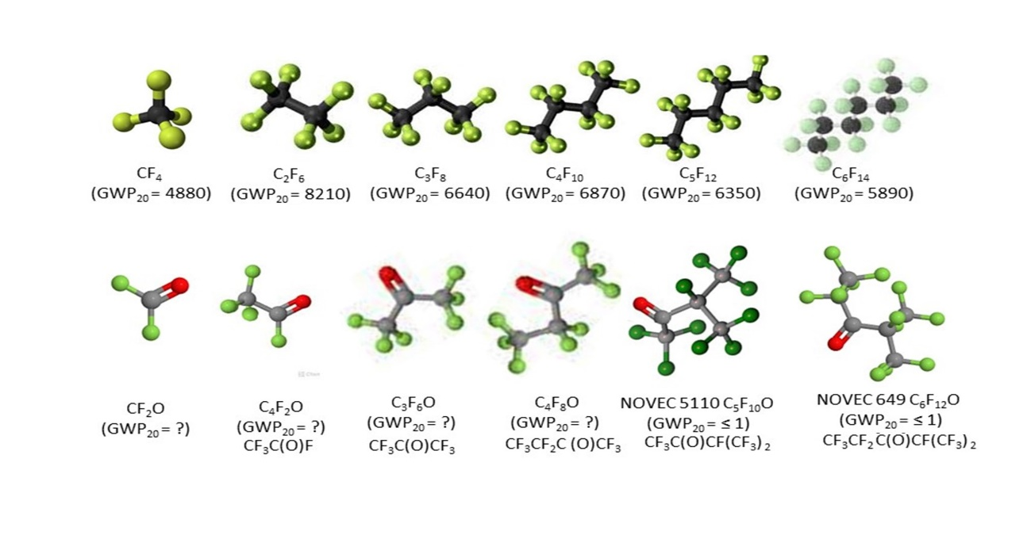
Molecular shapes, GWP & toxicity
Cherenkov
Radiator
Cherenkov
Radiator
(hist.)
Si cooling
(Evap.)
Cherenkov
Radiator
Cherenkov
Radiator
(hist.)
Cherenkov
Radiator
(hist.) + Cooling (Liq.)
Ih.T. H335
Ih.T. H335
Ih.T. H335
Ih.T. H335
Ih.T. H335
Ih.T. H335
Ih.T H330, reactive
Ih.T H331,
reactive
Ih.T H331,
reactive
Ih.T. H335
COOLING (Liq.)
Ih.T. H335
Ih.T. H335
Upper: molecular shapes of SFCs, including common gaseous Cherenkov radiators.
Lower: shapes of some non-cyclic C_{n}F_{2n}O analogues (20-year GWPs & GHS inhalation toxicities (source www.synquest.com

Slide 4
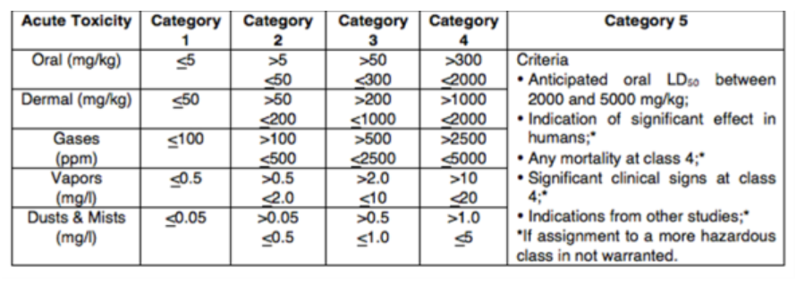
GHS Classification Criteria for Inhalation & skin Toxicity
Global Harmonized System of Classification and Labelling of Chemicals (GHS). 10th revision, United Nations (2023}
About the GHS | UNECE https://unece.org/about-ghs
H330 | Fatal if inhaled
H331 | Toxic if inhaled
H332 | Harmful if inhaled
H333 | May be harmful if inhaled
H334 | May cause allergy or asthma symptoms or breathing difficulties if inhaled
H335 | May cause respiratory irritation
H336 | May cause drowsiness or dizziness
H310 | Fatal in contact with skin
H311 | Toxic in contact with skin
H312 | Harmful in contact with skin
H313 | May be harmful in contact with skin
H314 | Causes severe skin burns and eye damage
H315 | Causes skin irritation
DRD4 Collaboration Meeting, WG-2: CERN Oct 21-25 2024

Slide 5
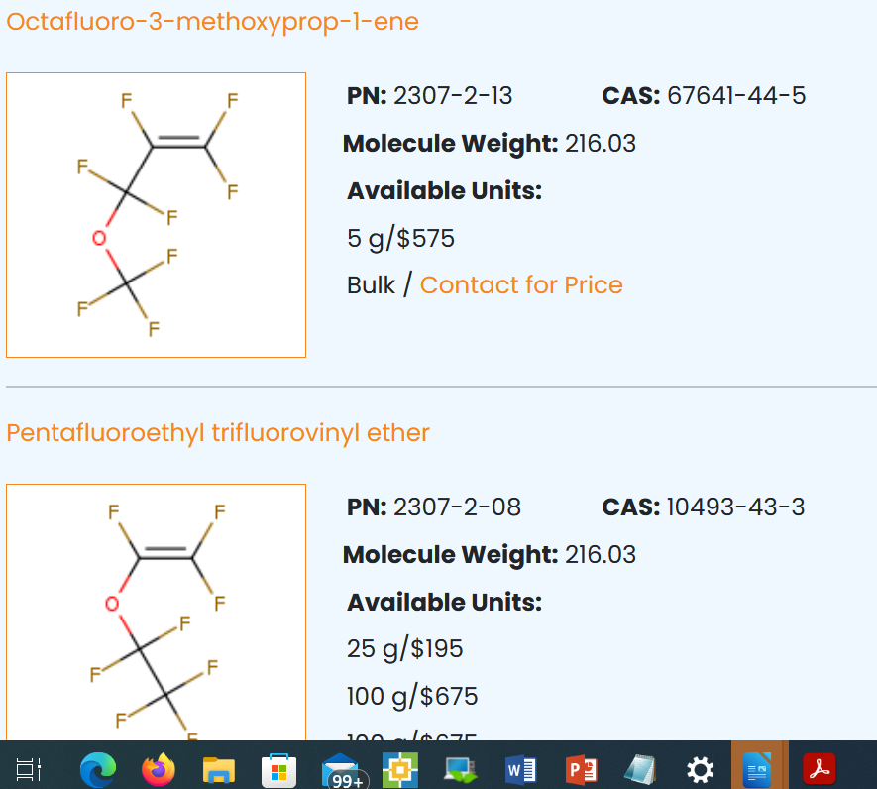
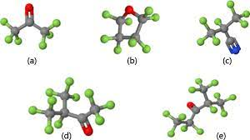
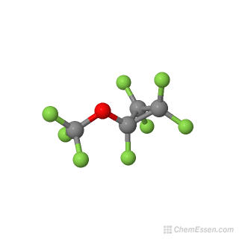
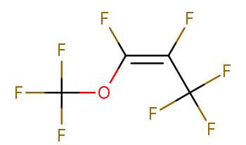
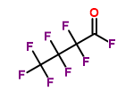
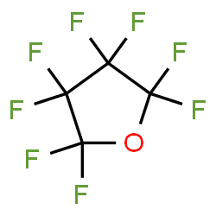
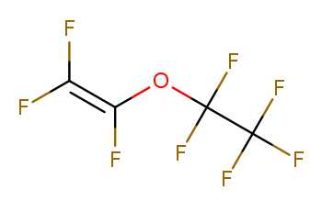
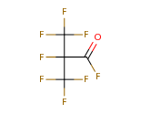
Molecular shape is important for GWP and toxicity
Cyclic, non-cyclic & non-cyclic double c-bonded C₄F₈O isomers
☺
GWP ?
Octafluoro-2-butanone
(GWP₂₀ = ?) [H335]
Optical performance similar
to C₄F₁₀: (BTeV & ALICE VHMPID)
High GWP!!
GWP ?
Octafloro-1-methoxyprop-1-ene
(GWP₂₀ = ?) [H332, 335, 336]
Heptafluorobutyryl fluoride
(GWP₂₀ = ?) [H331]
GWP ?
C₄F₈O
Cyclic
Perfluorotetrahydrofuran,
Octofluorotetrahydrofuran
(GWP₂₀ = 8975) [ref EPJP]
[H335]
Pentafyoroethyltrifluorovinyl ether
(GWP₂₀ = ?) [H332, 335]
Heptafluoroisobutyryl fluoride
(GWP₂₀ = ?) [H335]
C₄F₈O Linear with Oxygen atom as
internal link and double carbon
bonded link
C₄F₈O Linear & iso, with
Oxygen atom on external spur
DRD4 Collaboration Meeting, WG-2: CERN Oct 21-25 2024

Slide 6
So why are some of these spurred fluoro-ketones
C_{n}F_{2n}O potential low GWP substitutes for saturated fluorocarbons?
C_{n}F_{(2n+2)}
DRD4 Collaboration Meeting, WG-2: CERN Oct 21-25 2024

Slide 7
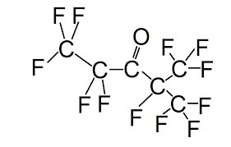
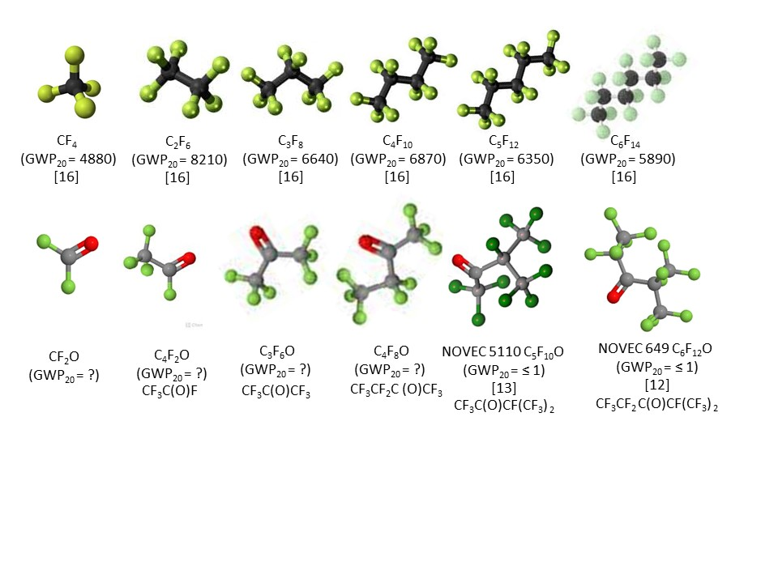
Q: What gives a spurred-Oxygen fluoro-ketone molecule (like 3M NOVEC 649/1230®) its low GWP?
A: Structure!: a double-bonded oxygen atom on a peripheral spur of the molecule
This fluoro-ketone configuration is:
CF₃CF₂C(O)CF(CF₃)₂
7
DRD4 Collaboration Meeting, WG-2: CERN Oct 21-25 2024

Slide 8
Q: What gives NOVEC 649/1230 its low GWP?
https://www.nist.gov/system/files/documents/el/fire_research/R0301570.pdf
[15]
Scission by UV photons of λ around 300 nm
In the atmosphere (low pressure, high UV): the fragments do not reassociate* into saturated fluorocarbons of the type C_{n}F_{(2n+2)} (which would have high GWP)
*The Environmental Impact of CFC Replacements HFCs and HCFCs
T. WALLINGTON et al Environ.Sci.Technol.1994(28)7 320A https://doi.org/10.1021/es00056a714
8
DRD4 Collaboration Meeting, WG-2: CERN Oct 21-25 2024

Slide 9
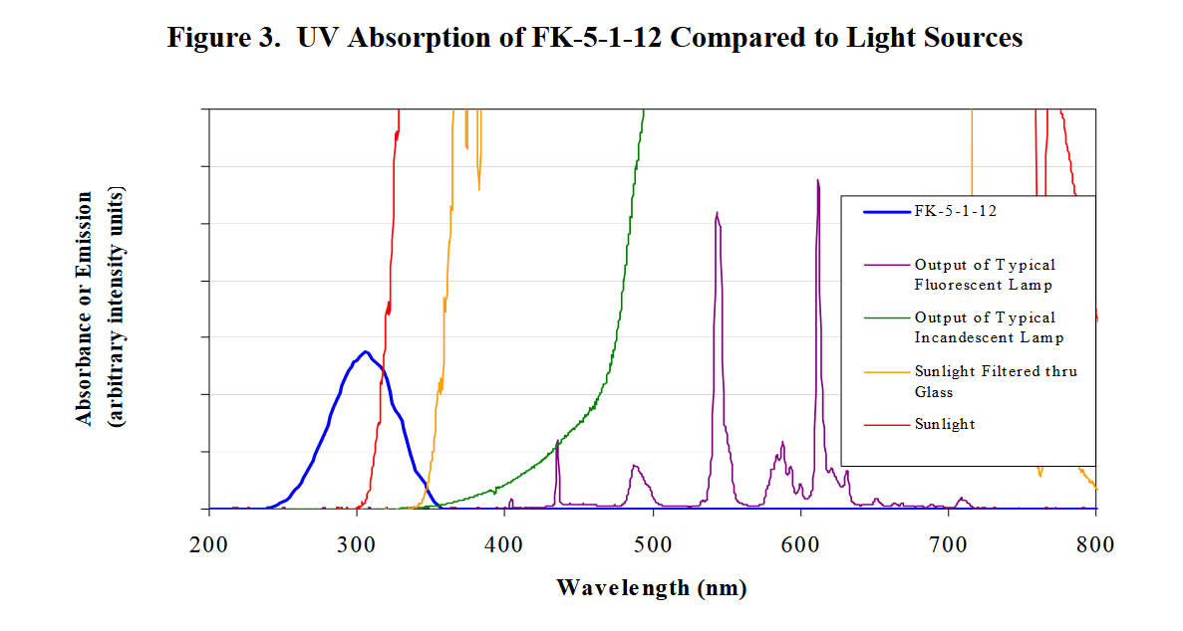
Q: What gives NOVEC 649/1230 its low GWP?
https://www.nist.gov/system/files/documents/el/fire_research/R0301570.pdf
[15]
Scission by UV photons of λ around 300 nm
In the atmosphere (low pressure, high UV): the fragments do not reassociate* into saturated fluorocarbons of the type C_{n}F_{(2n+2)} (which would have high GWP)
*The Environmental Impact of CFC Replacements HFCs and HCFCs
T. WALLINGTON et al Environ.Sci.Technol.1994(28)7 320A https://doi.org/10.1021/es00056a714
9
DRD4 Collaboration Meeting, WG-2: CERN Oct 21-25 2024

Slide 10

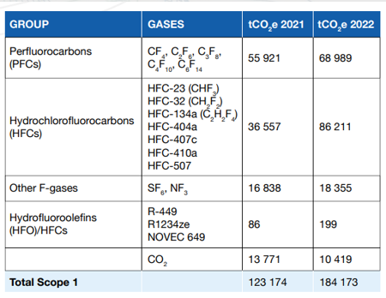
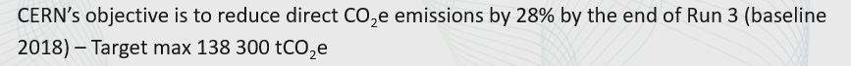
This latest CERN environmental report https://doi.org/10.25325/CERN-Environment-2023-003
CF₄ LHCb RICH2: GWP₂₀ = ¬ 4880_{_CO2}* [16]
C₂F₆ ATLAS evap cooling (potential use): GWP₂₀ = ¬ 8210_{_CO2}* [16]
C₃F₈ F2 Chemicals , Astor, ATLAS evap cooling: GWP₂₀ = ¬ 6640_{_CO2}*[16]
C₄F₁₀ LHCb RICH1, COMPASS RICH: GWP₂₀ = ¬ 6870_{_CO2}* [16]
C₅F₁₂ PP50: GWP₂₀ = ¬ 6350_{_CO2}* [16] (ex-DELPHI, no longer used at CERN)
C₆F₁₄ PP1, F2 Chemicals: Liquid cooling, many expts:
GWP₂₀ = ¬ 5890_{_CO2}*[16]
For some perspective: SF₆ GWP ~ 23000 * CO₂
See also:
https://www.ghgprotocol.org/sites/default/files/ghgp/Global-Warming-Potential-Values%20%28Feb%2016%202016%29_1.pdf
For 100 yr (average of 2nd, 4th & 5th assessment reports; AR2,4,5)
Collective loss of SFCs only around 10 tonnes (whole of LHC + expts)
(compare that to mass-loss at a ‘grande surface’ supermarket!)
R449: (CFH blend) GWP=1397
R1234 (HFO): GWP = 7
NOVEC 649 (C₆F₁₂O): GWP=0
DRD4 Collaboration Meeting, WG-2: CERN Oct 21-25 2024

Slide 11
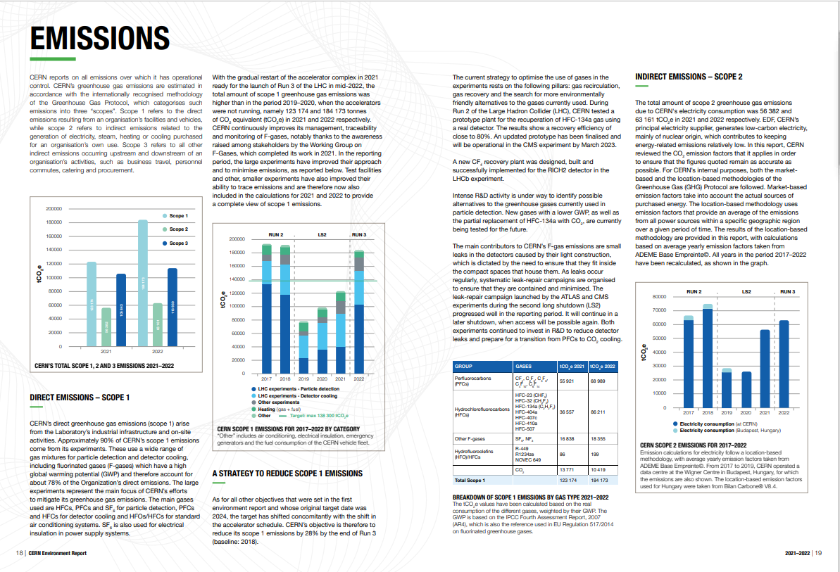
https://doi.org/10.25325/CERN-Environment-2023-003
But no mention at all of the ATLAS ultrasonic fluorocarbon leak monitor system !
G. Hallewell: Seminaire CPPM: 16 sep 2024

Slide 12
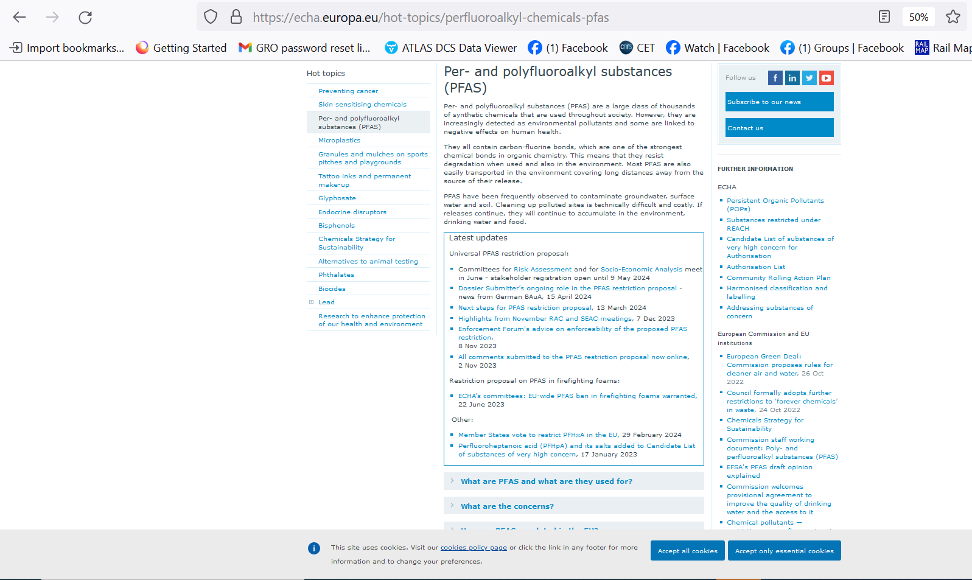
DRD4 Collaboration Meeting, WG-2: CERN Oct 21-25 2024

Slide 13
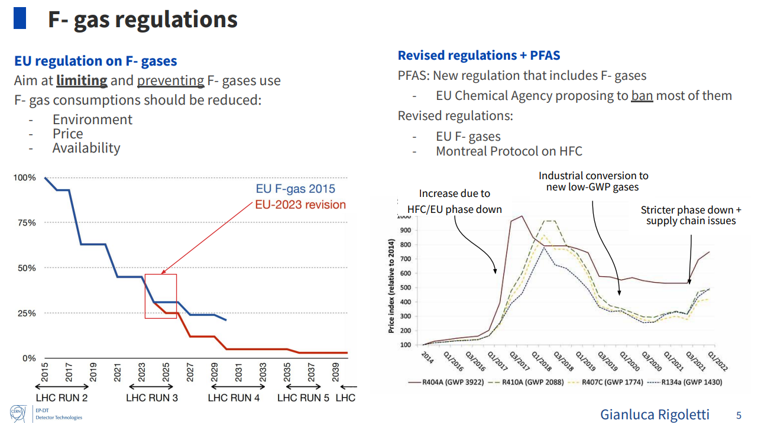
EU strategy to reduce Fluronated (PFAS) compound production and use
(includes also fluorinated plastics not shown here: see back-up material)
Dynamic price hiking :
like imposing demand-dependent customs duty…?
Projected Usage
ICHEP2024
DRD4 Collaboration Meeting, WG-2: CERN Oct 21-25 2024

Slide 14
Cherenkovgreenicity…
DRD4 Collaboration Meeting, WG-2: CERN Oct 21-25 2024

Slide 15
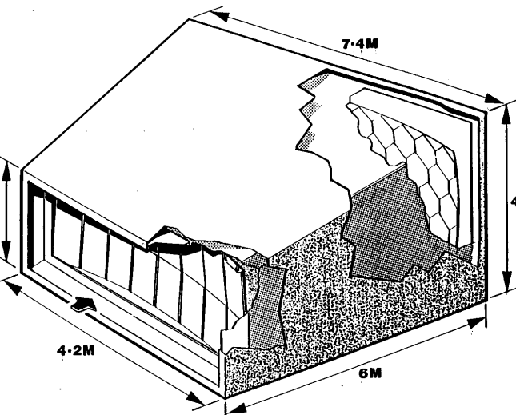
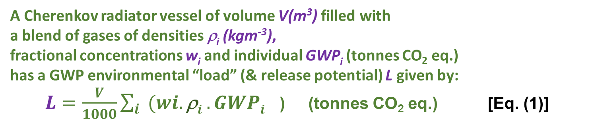
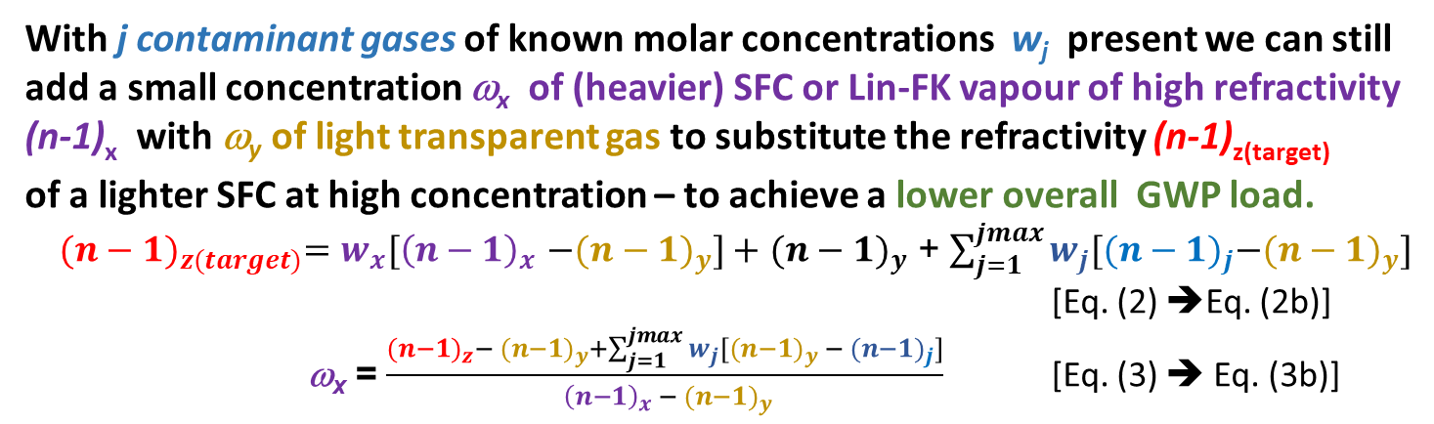
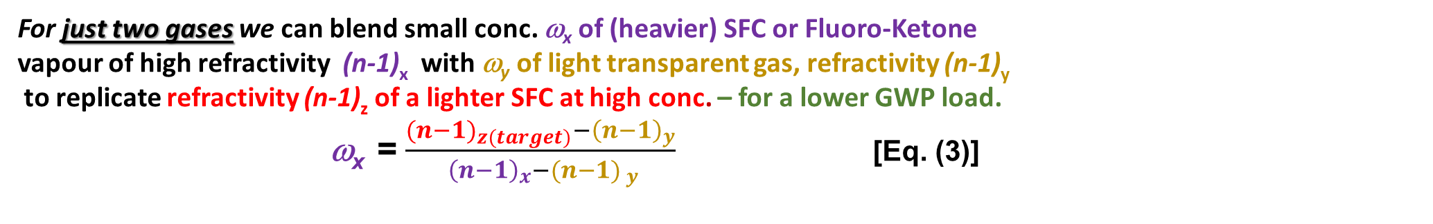
Refractive index & GWP ’load’ in a Cherenkov Gas Radiator
3 large RICH detectors currently in operation at CERN:
using saturated fluorocarbon gas volumes:
C₄F₁₀ (COMPASS: 100m³, LHCb RICH 1: 4m³): GWP₂₀ = 4880,
CF₄ (LHCb RICH 2: 100m³): GWP₂₀ = 6870
V,ρ
A Cherenkov radiator vessel of volume V(m³) filled with
a blend of gases of densities ρ_{i} (kgm⁻³),
fractional concentrations w_{i} and individual GWP_{i} (tonnes CO₂ eq.)
has a GWP environmental “load” (& release potential) L given by:
$L=\frac{V}{1000}\sum_{i}{{(wi.\text{r}i .GWPi}^{}}$) (tonnes CO₂ eq.) [Eq. (1)]
With j contaminant gases of known molar concentrations w_{j} present we can still
add a small concentration ω_{x} of (heavier) SFC or Lin-FK vapour of high refractivity
(n-1)_{x} with ω_{y} of light transparent gas to substitute the refractivity (n-1)_{z(target)}
of a lighter SFC at high concentration – to achieve a lower overall GWP load.
${{(n−1)}_{z(target)}=w_{x}[\left(n−1\right)}_{x}$ ${−(n−1)}_{y}]+$ ${(n−1)}_{y}$ + $\sum_{j=1}^{jmax}{w_{j}[{{(n−1)}_{j}−(n−1)}_{y}]}$
[Eq. (2) ➔Eq. (2b)]
ω_{x} = $\frac{{{(n−1)}_{z}− (n−1)}_{y}+\sum_{j=1}^{jmax}{w_{j}[{{(n−1)}_{y} − (n−1)}_{j}]}}{{ {\left(n−1\right)}_{x} − (n−1)}_{y}}$ [Eq. (3) ➔ Eq. (3b)]
The corresponding radiator gas mixture refractivity is given by :
$\text{(}\text{n}\text{−1)}rad =\sum_{i}{{(wi.\text{(}\text{n}\text{−1)}i}^{}}$) [Eq. (2)]
For just two gases we can blend small conc. ω_{x} of (heavier) SFC or Fluoro-Ketone
vapour of high refractivity (n-1)_{x} with ω_{y} of light transparent gas, refractivity (n-1)_{y}
to replicate refractivity (n-1)_{z} of a lighter SFC at high conc. – for a lower GWP load.
ω_{x} = $\frac{{{(n−1)}_{z(target)}−\left(n−1\right)}_{y}}{{ {\left(n−1\right)}_{x}−(n−1)}_{ y}}$ [Eq. (3)]
DRD4 Collaboration Meeting, WG-2: CERN Oct 21-25 2024

Slide 16
Refractive index & GWP ’load’ in a Cherenkov Gas Radiator
3 large RICH detectors currently in operation at CERN:
using saturated fluorocarbon gas volumes:
C₄F₁₀ (COMPASS: 100m³, LHCb RICH 1: 4m³): GWP₂₀ = 4880,
CF₄ (LHCb RICH 2: 100m³): GWP₂₀ = 6870
V,ρ
A Cherenkov radiator vessel of volume V(m³) filled with
a blend of gases of densities ρ_{i} (kgm⁻³),
fractional concentrations w_{i} and individual GWP_{i} (tonnes CO₂ eq.)
has a GWP environmental “load” (& release potential) L given by:
$L=\frac{V}{1000}\sum_{i}{{(wi.\text{r}i .GWPi}^{}}$) (tonnes CO₂ eq.) [Eq. (1)]
The corresponding radiator gas mixture refractivity is given by :
$\text{(}\text{n}\text{−1)}rad =\sum_{i}{{(wi.\text{(}\text{n}\text{−1)}i}^{}}$) [Eq. (2)]
For just two gases we can blend small conc. ω_{x} of (heavier) SFC or Fluoro-Ketone
vapour of high refractivity (n-1)_{x} with ω_{y} of light transparent gas, refractivity (n-1)_{y}
to replicate refractivity (n-1)_{z} of a lighter SFC at high conc. – for a lower GWP load.
ω_{x} = $\frac{{{(n−1)}_{z(target)}−\left(n−1\right)}_{y}}{{ {\left(n−1\right)}_{x}−(n−1)}_{ y}}$ [Eq. (3)]
DRD4 Collaboration Meeting, WG-2: CERN Oct 21-25 2024

Slide 17

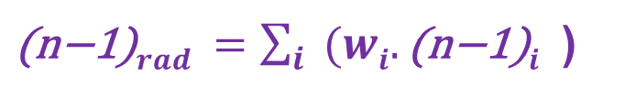
Use real-time speed of sound to get component molar concentrations,ω_{i}
(SoS traditionally also called “c” by acousticians to confuse things)
$\text{(}\text{n}\text{−1)}rad =\sum_{i}{{(wi.\text{(}\text{n}\text{−1)}i}^{}}$)
Then use standard refractivity formula to get from calculated ω_{1,2}
to refractive index of the radiator gas in real-time, along with standard relativistic expressions to get from n to Cherenkov γ thresholds for different particle species and β = 1 angle
Real-time measurement of speed of sound c takes us via the relative concentrations of the components to the speed of light β and beyond!! in the radiator gas
Eyes on the prize…(focus here on LHCb RICH2 (n-1)…)
(488.10⁻⁶)_{CF4} = (~1750.10⁻⁶)_{C5F10O}*0.12+(300.10⁻⁶)_{N2}*0.88
17
DRD4 Collaboration Meeting, WG-2: CERN Oct 21-25 2024

Slide 18
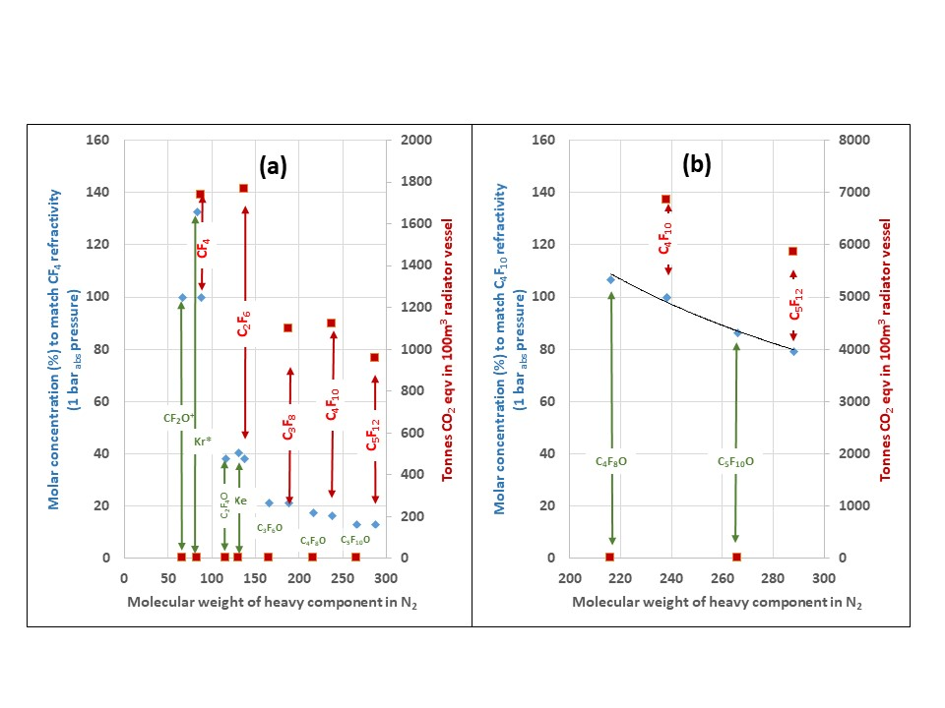
Targeting the refractivity of CF₄ (100 m³: example: LCHb RICH 2) at 1 bar_{abs} with gases of differing molecular weight in varying fractional concentrations (conc. > 100% indicate need for overpressure): includes hypothetical fluoro-ketones
CF₄
DRD4 Collaboration Meeting, WG-2: CERN Oct 21-25 2024

Slide 19
Cherenkov threshold: C₅F₁₀O/N₂ & (heritage) C₅F₁₂/N₂ blend
and GWP load comparison for LHCb RICH2 (100m³ CF₄)
C₅F₁₂ SFC/N₂ and NOVEC5110 (C₅F₁₀O) /N₂ will be very similar (MW 266 vs. 288)
LHCb RICH 2: CF₄ thresholds
GWP load = (0.95 molar*4880*V.ρ)
~ 14% molar C₅F₁₀O
gives a GWP load reduction of 1737 tonnes:
Even substituting CF₄ with ~ 13% molar heritage stock C₅F₁₂ reduces GWP load by ~800 tonnes
C₅F₁₂ or C₅F₁₀O concentration (%)
LHCb RICH 2 with C₅F₁₀O/N₂
GWP load = (0.13 molar*1*V.ρ)
19
DRD4 Collaboration Meeting, WG-2: CERN Oct 21-25 2024

Slide 20
Targeting the refractivity of C₄F₁₀ (100 m³: example: COMPASS RICH) at 1 bar_{abs}
with gases of differing molecular weight in varying fractional concentrations
(conc. > 100% indicate need for overpressure): includes hypothetical fluoro-ketones
C₄F₁₀
DRD4 Collaboration Meeting, WG-2: CERN Oct 21-25 2024

Slide 21
Cherenkov threshold in C₅F₁₀O/N₂ mixtures
and GWP load comparison with COMPASS RICH (100m³)
COMPASS (& LHCb RICH 1): C₄F₁₀ thresholds
COMPASS RICH GWP load = (6849 tonnes)
N₂-NOVEC5110 (C₅F₁₀O) very similar to C₅F₁₂ (MW 266 vs. 288)
85% Novec 5110 gives a huge GWP load reduction of 6849 tonnes
C₅F₁₀O concentration (%)
21
DRD4 Collaboration Meeting, WG-2: CERN Oct 21-25 2024

Slide 22
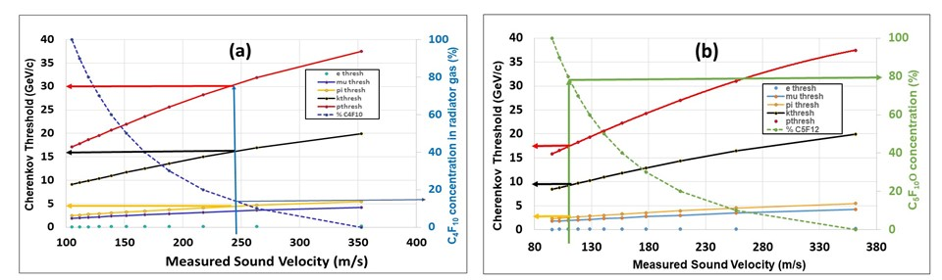
Other (heritage/legacy) options (in N₂)
C₅F₁₂
    Legacy C₄F₁₀ replacing CF₄ in the context of LHCb RICH-2
    Legacy C₅F₁₂ replacing C₄F₁₀ for COMPASS and LHCb RICH-1.
Sound velocity in C₅F₁₂ and C₄F₁₀ is based on extensive thermodynamic data:
corresponding required concentrations for C₅F₁₀O and C₄F₈O
will be slightly higher due to their lower densities.
DRD4 Collaboration Meeting, WG-2: CERN Oct 21-25 2024

Slide 23
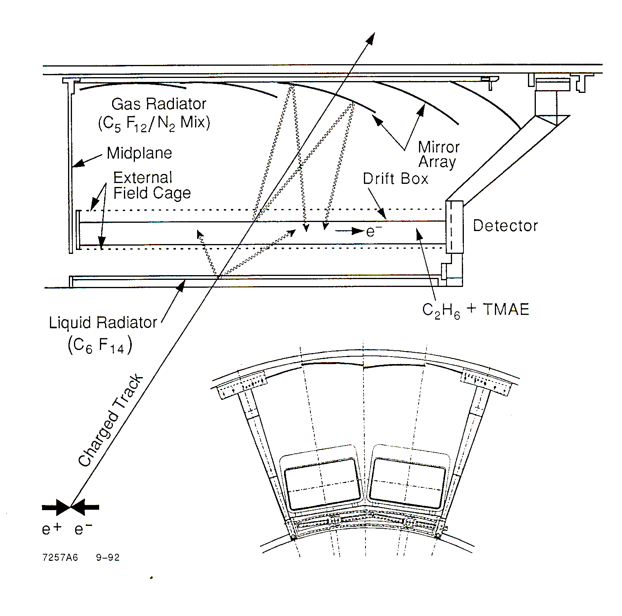
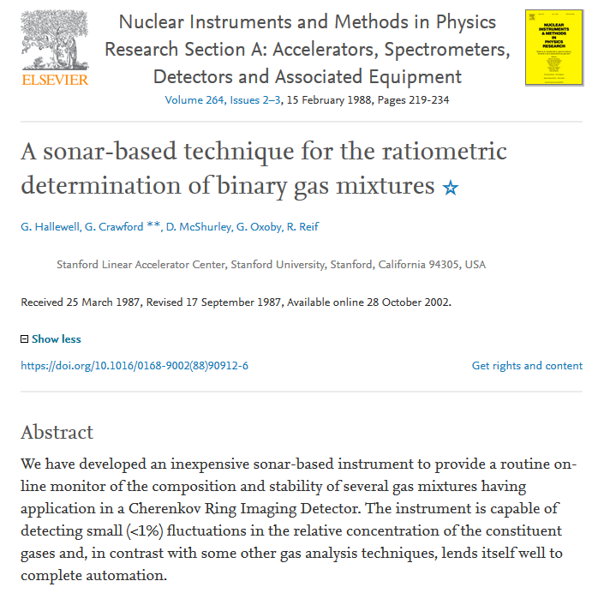


Historical: The SLD barrel CRID gas radiators (SLAC: 1990s)
87% C₅F₁₂/13%N₂
gas radiator
Sonar transducer
6 transducer pairs
@ 3 different heights
(hydrostatics)
23
DRD4 Collaboration Meeting, WG-2: CERN Oct 21-25 2024

Slide 24
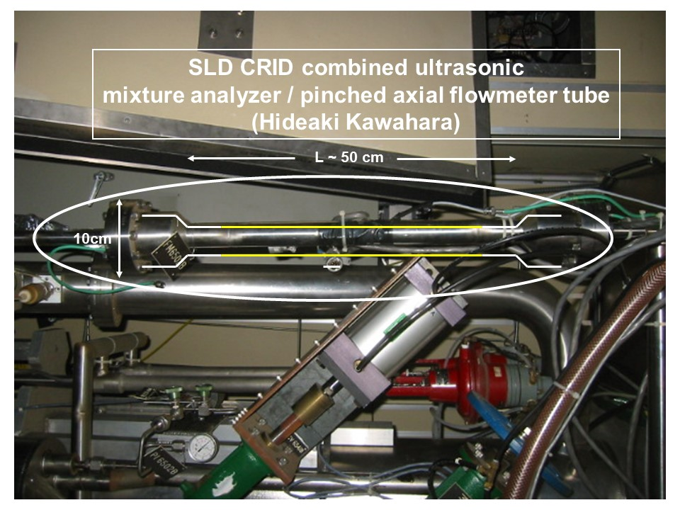
Maintaining C₅F₁₂/N₂ refractive index
through sonar-based active mixture control
(In this paper submitted to IEEE TNS)
Flowmeter
analyzer in supply line
to tune the blend by
hardwired 4-20mA
links to mass flow controllers
24
DRD4 Collaboration Meeting, WG-2: CERN Oct 21-25 2024

Slide 25
SLD-CRID: Cherenkov threshold in C₅F₁₂/N₂ mixtures
vs. measured speed of sound in radiator gas mixture (1)
Typical mix 87%C₅F₁₂,13%N₂
C₅F₁₂ concentration (%)
25
DRD4 Collaboration Meeting, WG-2: CERN Oct 21-25 2024

Slide 26

SLD-CRID: Cherenkov threshold in C₅F₁₂/N₂ mixtures
vs. measured speed of sound in radiator gas mixture (2)
So.. from (“acoustic”) c to β…
Cherenkov Threshold (GeV/c)
β = 1/n
Measured Sound Velocity (m/s)
26
DRD4 Collaboration Meeting, WG-2: CERN Oct 21-25 2024

Slide 27
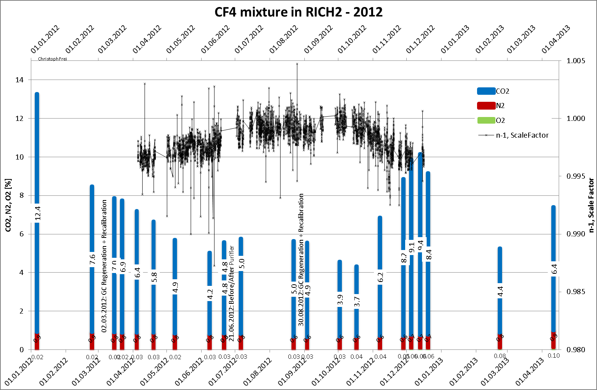
But what if a gas radiator contains more than 2 gas species like this?
(This is old: from RICH2013)
O₂ conc. (ω_{O2}) can be measured by electrochemical fuel cell
CO₂ conc (ω_{CO2}) can be measured by Non-Dispersive Infra Red
leaving a pair of gases of “primary interest” to be measured
acoustically (CF₄/N₂ or a CF₄ replacement gas /N₂ )
Stable N2
content
27
DRD4 Collaboration Meeting, WG-2: CERN Oct 21-25 2024

Slide 28
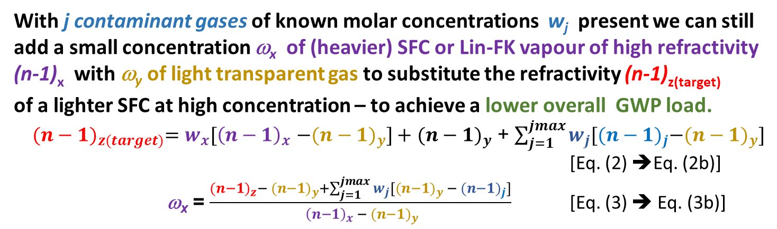
Refractive index & GWP ’load’ in a Cherenkov Gas Radiator
3 large RICH detectors currently in operation at CERN:
using saturated fluorocarbon gas volumes:
C₄F₁₀ (COMPASS: 100m³, LHCb RICH 1: 4m³): GWP₂₀ = 4880,
CF₄ (LHCb RICH 2: 100m³): GWP₂₀ = 6870
V,ρ
A Cherenkov radiator vessel of volume V(m³) filled with
a blend of gases of densities ρ_{i} (kgm⁻³),
fractional concentrations w_{i} and individual GWP_{i} (tonnes CO₂ eq.)
has a GWP environmental “load” (& release potential) L given by:
$L=\frac{V}{1000}\sum_{i}{{(wi.\text{r}i .GWPi}^{}}$) (tonnes CO₂ eq.) [Eq. (1)]
The corresponding radiator gas mixture refractivity is given by :
$\text{(}\text{n}\text{−1)}rad =\sum_{i}{{(wi.\text{(}\text{n}\text{−1)}i}^{}}$) [Eq. (2)]
With j contaminant gases of known molar concentrations w_{j} present we can still
add a small concentration ω_{x} of (heavier) SFC or Lin-FK vapour of high refractivity
(n-1)_{x} with ω_{y} of light transparent gas to substitute the refractivity (n-1)_{z(target)}
of a lighter SFC at high concentration – to achieve a lower overall GWP load.
${{(n−1)}_{z(target)}=w_{x}[\left(n−1\right)}_{x}$ ${−(n−1)}_{y}]+$ ${(n−1)}_{y}$ + $\sum_{j=1}^{jmax}{w_{j}[{{(n−1)}_{j}−(n−1)}_{y}]}$
[Eq. (2) ➔Eq. (2b)]
ω_{x} = $\frac{{{(n−1)}_{z}− (n−1)}_{y}+\sum_{j=1}^{jmax}{w_{j}[{{(n−1)}_{y} − (n−1)}_{j}]}}{{ {\left(n−1\right)}_{x} − (n−1)}_{y}}$ [Eq. (3) ➔ Eq. (3b)]
For just two gases we can blend small conc. ω_{x} of (heavier) SFC or Fluoro-Ketone
vapour of high refractivity (n-1)_{x} with ω_{y} of light transparent gas, refractivity (n-1)_{y}
to replicate refractivity (n-1)_{z} of a lighter SFC at high conc. – for a lower GWP load.
ω_{x} = $\frac{{{(n−1)}_{z(target)}−\left(n−1\right)}_{y}}{{ {\left(n−1\right)}_{x}−(n−1)}_{ y}}$ [Eq. (3)]
DRD4 Collaboration Meeting, WG-2: CERN Oct 21-25 2024

Slide 29
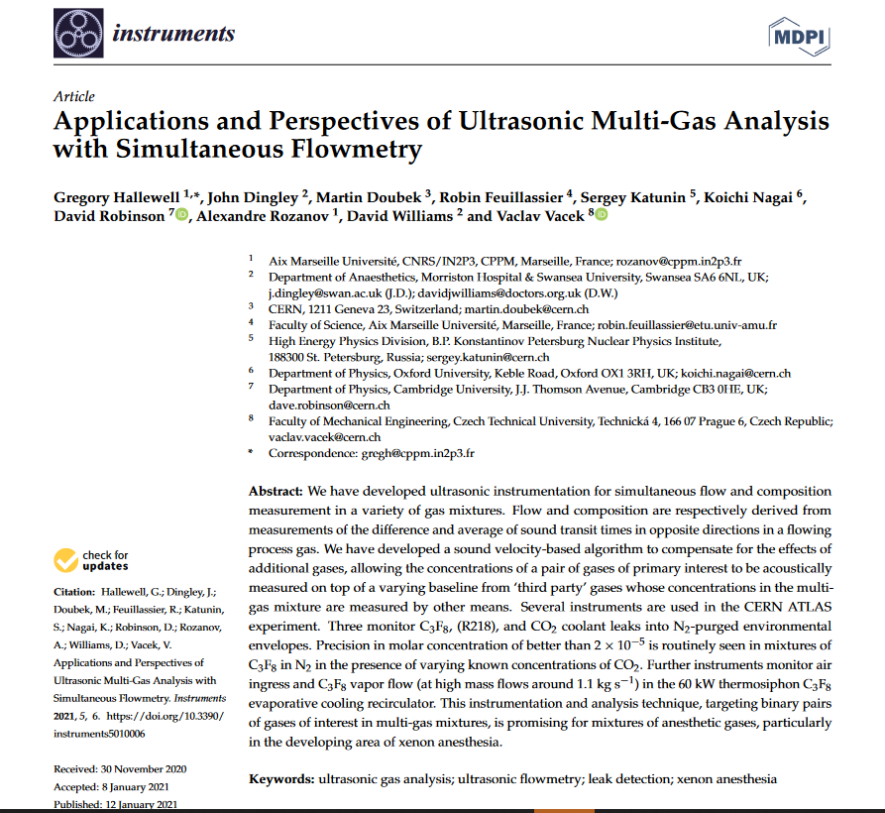
Sophisticated algorithms developed for ultrasonic analysis of a gas pair of primary interest on varying conc. of known background gases
(https://www.mdpi.com/2410-390X/5/1/6)
See back up slides for
more details
29
DRD4 Collaboration Meeting, WG-2: CERN Oct 21-25 2024

Slide 30
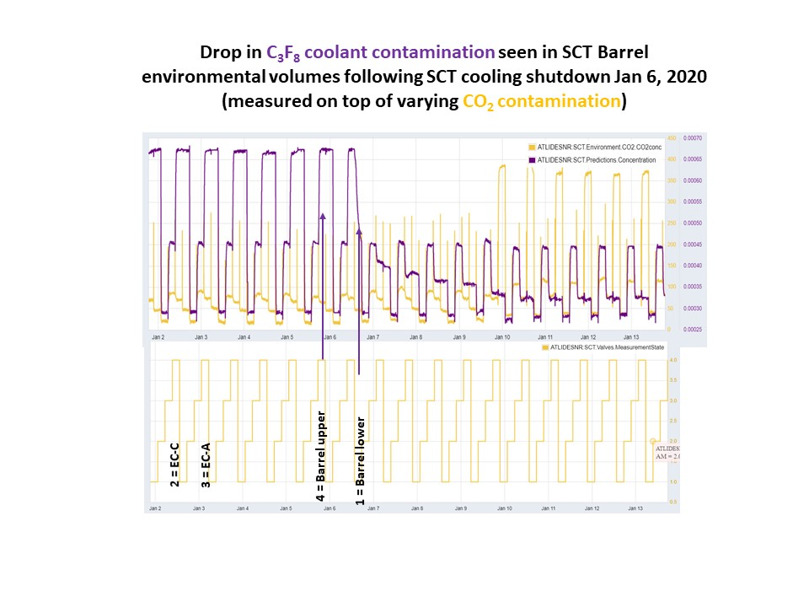
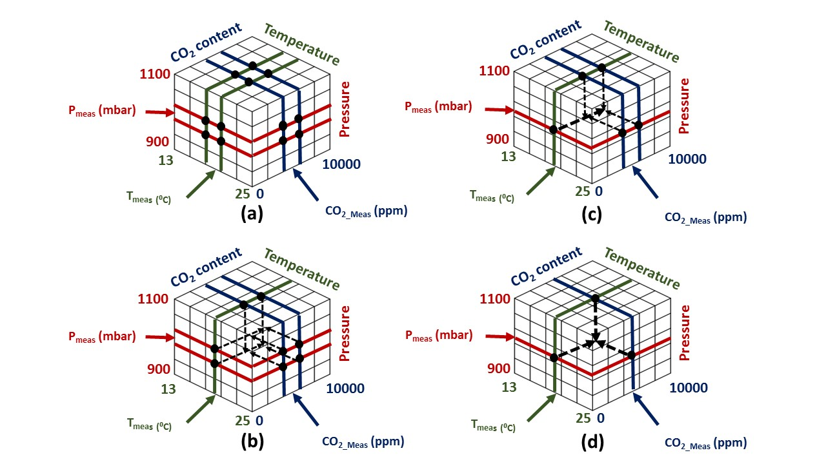


Example: Look-up tables of SoS. vs. composition for C₃F₈/N₂ (+ CO₂) (ATLAS silicon tracker cooling leak analysis)
https://www.mdpi.com/2410-390X/5/1/6
CAN UTILITY DB expanded
from 2-D to 3-D:
C₃F₈/N₂ fit coeffs
stored @{T, P, CO₂} grid
Extra interpolation step,
starting from grid cub(oid) of uncertainty
to T_{meas}, P_{meas},CO_{2 meas}
Calculate sound vel vs. conc. eqns from
C₃F₈ & N₂ AND KNOWN CONTAMINANT GAS
Cp & Cv over expected T,P, %CO₂ range.
Demonstration:
1st acoustic measurement of concentrations of binary gas pair
of interest (C₃F₈/N₂)
in known varying conc. of 3rd gas (CO₂) :
(4 envelopes cycling every 4 hours)
Algorithm: industrial & anaesthesia applications
DRD4 Collaboration Meeting, WG-2: CERN Oct 21-25 2024
30

Slide 31
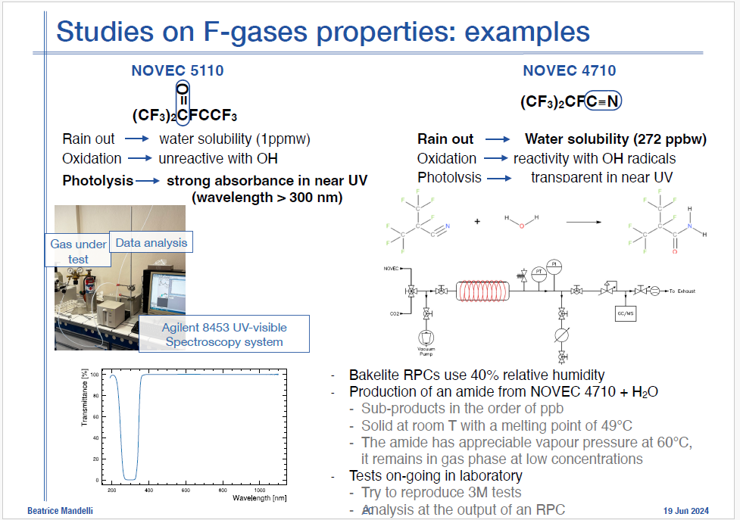
From 1st DRD4 Meeting: 17-20 June 2024
Real? Repeatable?
very crude device,
lacking details
DRD4 Collaboration Meeting, WG-2: CERN Oct 21-25 2024

Slide 32

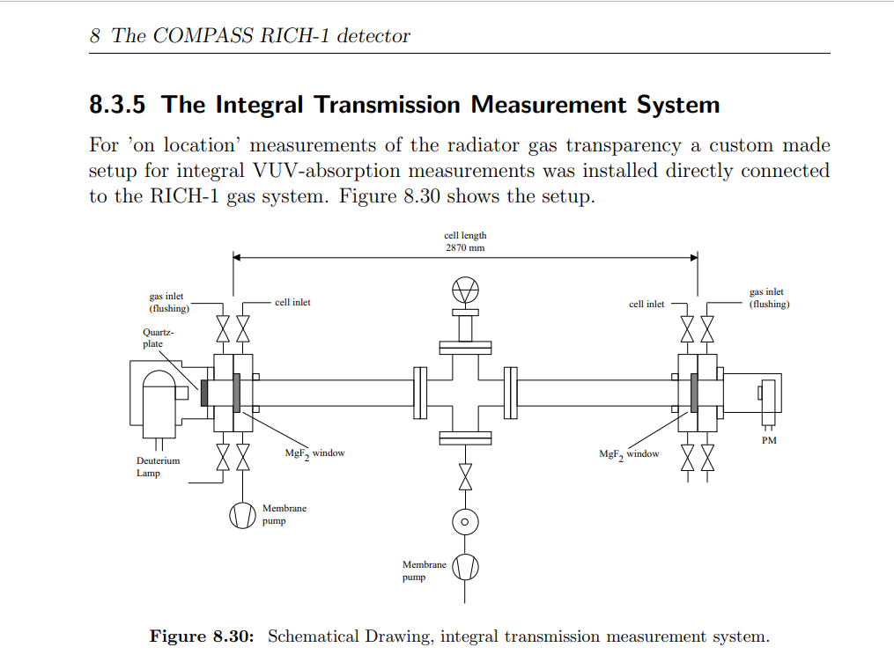
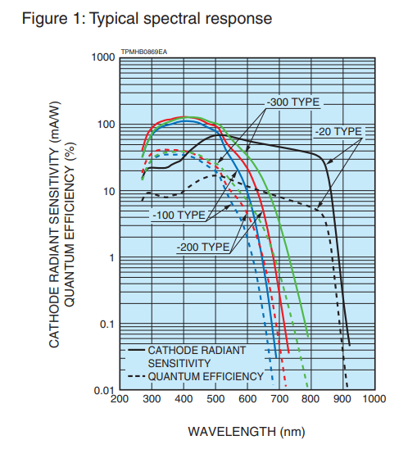
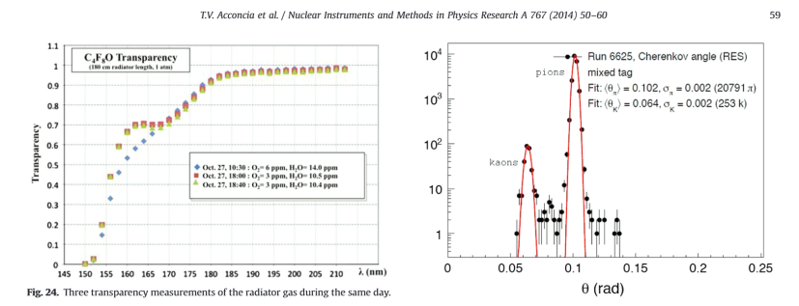
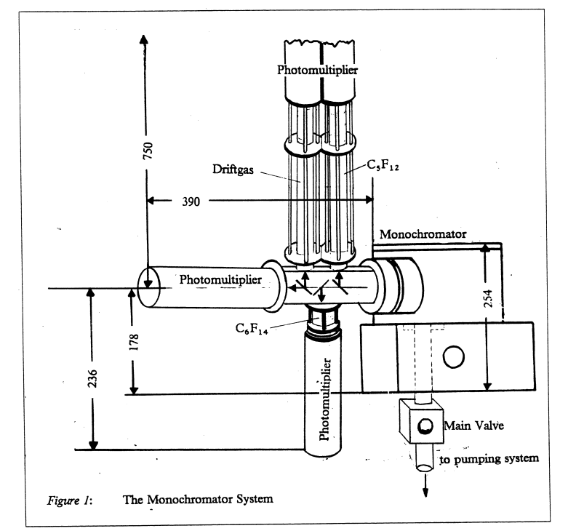
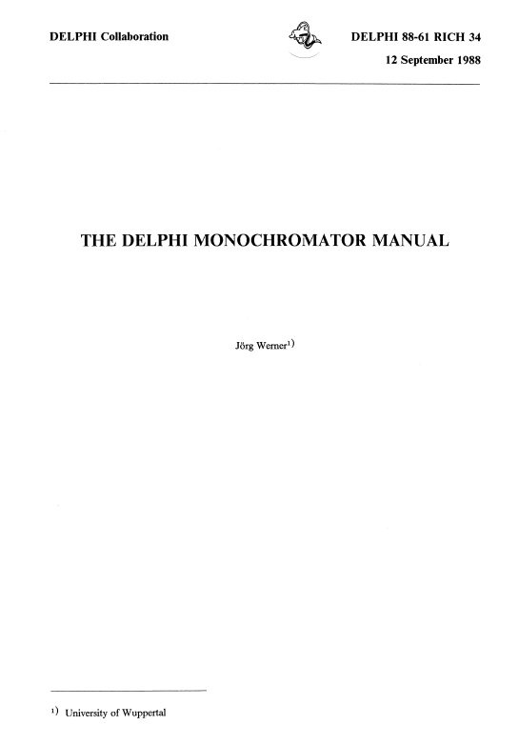
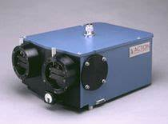
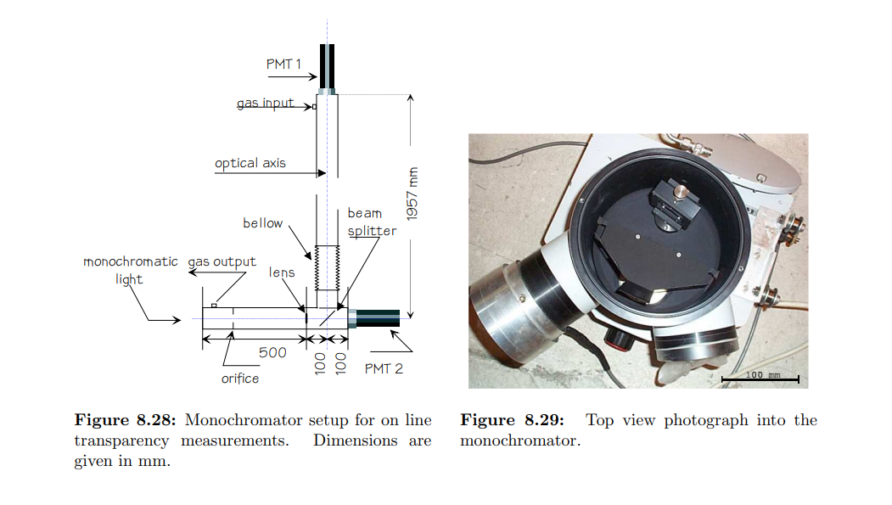
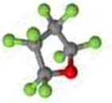
UV transparency, refractivity, cmhemical stability & compatibility studies needed
for different C_{n}F_{2n}O molecular shapes.
RICH detector community very competent & equipped for detailed UVT & (n-1)
- much ex-DELPHI RICH diagnostic equipment at CERN for example
A
Minuteman Model 302 VM.
ALICE VHMPID: transparancy
measurements in c-C₄F₈O
Octafluorotetrahydrofuran
CAS: 773-14-8
Synquest Inc. FL, USA
Most probable PC spectral range
in new build gas RICH detectors
DRD4 Collaboration Meeting, WG-2: CERN Oct 21-25 2024

Slide 33
C_{n}F_{2n}O fluid selection search criteria
Bibliographic
Materials tests
Optotests
Start(ed)
Next C_{n}F_{2n}O fluid
(order & isomer)
to evaluate
Y
Non-
Flammable
(MSDS)
?
Y
Non-
Oxone-
depleting
?
Y
Non-toxic
(MSDS)
?
N
N
N
N
Low GWP!
?
Y
N
N
N
Acid
formation
with H₂O
?
Y
Y
Rad.
Tolerant
(more for
cooling)
?
Y
N
Y
Materials/
purifier
Compatible
?
Dielectric
?
Y
N
Recirc.
Thermo-
dynamics
OK
?
Y
UV-Vis
transparency
OK
?
Y
(n-1) &
Chrom. Disp.
OK
?
Y
Accept
fluid
N
N
N
DRD4 Collaboration Meeting, WG-2: CERN Oct 21-25 2024

Slide 34
Thermodynamics of circulation of heavy Cherenkov radiator vapour and allowed escape of light component
(N₂, Ar, CO₂ etc…)
Similarities with systems for the C₃F₈ evaporative fluorocarbon cooling of the ATLAS Silicon tracker
(CERN EN-CV responsibility)
But with enhanced monitoring, including (n-1), UV transparency
DRD4 Collaboration Meeting, WG-2: CERN Oct 21-25 2024

Slide 35
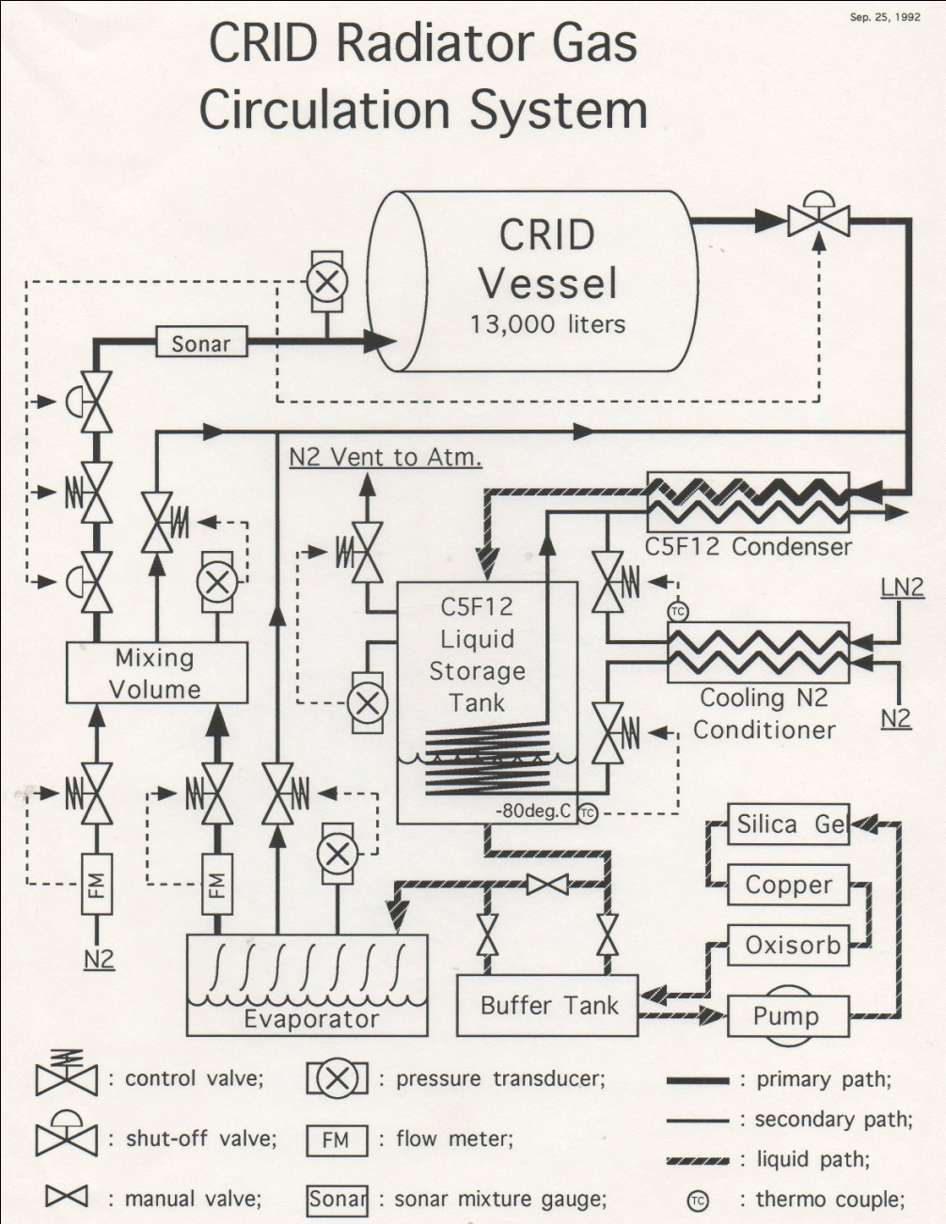
SLD Barrel CRID C₅F₁₂/N₂ gas radiator: continuous thermodynamic recirculation
Low temperature (-80°C)
N₂ gas-induced condensation (B):
of C₅F₁₂ fromC₅F₁₂/N₂ radiator gas (flow~1m³/hr, negligible C₅F₁₂ loss)
followed by (C) electric re-evaporation
(1-1.5m below condenser liq. level)
Cold N₂ gas (‘conditioned’ by
counter-flow with boil-off LN₂
from liquid argon calorimeter: (A))
Ultrasonic (speed of sound) – aided
“on-the fly” mixing of typical
17%N₂ /83%C₅F₁₂ (molar) radiator gas mixture (D)
A
B
D
C
DRD4 Collaboration Meeting, WG-2: CERN Oct 21-25 2024

Slide 36
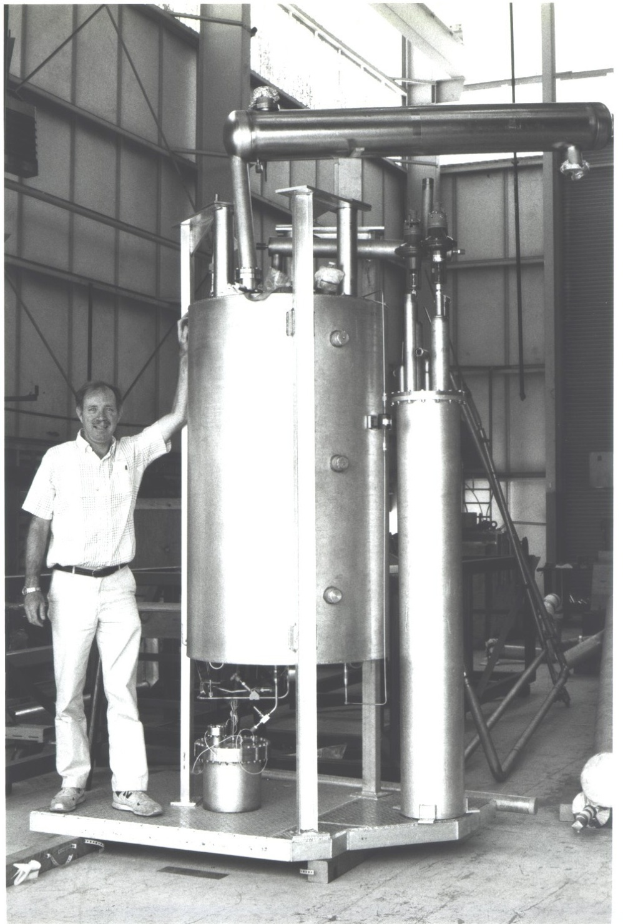
SLD Barrel CRID C₅F₁₂/N₂ gas thermodynamic recirculator
(A) C₅F₁₂ Condenser
(cooled with GN₂)
(B) C₅F₁₂ storage tank
and N₂ separator
LN₂ conditioner
(Chills GN₂ in counterflow with LN₂
from liquid argon calorimeter source)
(C) C₅F₁₂ Evaporator
DRD4 Collaboration Meeting, WG-2: CERN Oct 21-25 2024

Slide 37
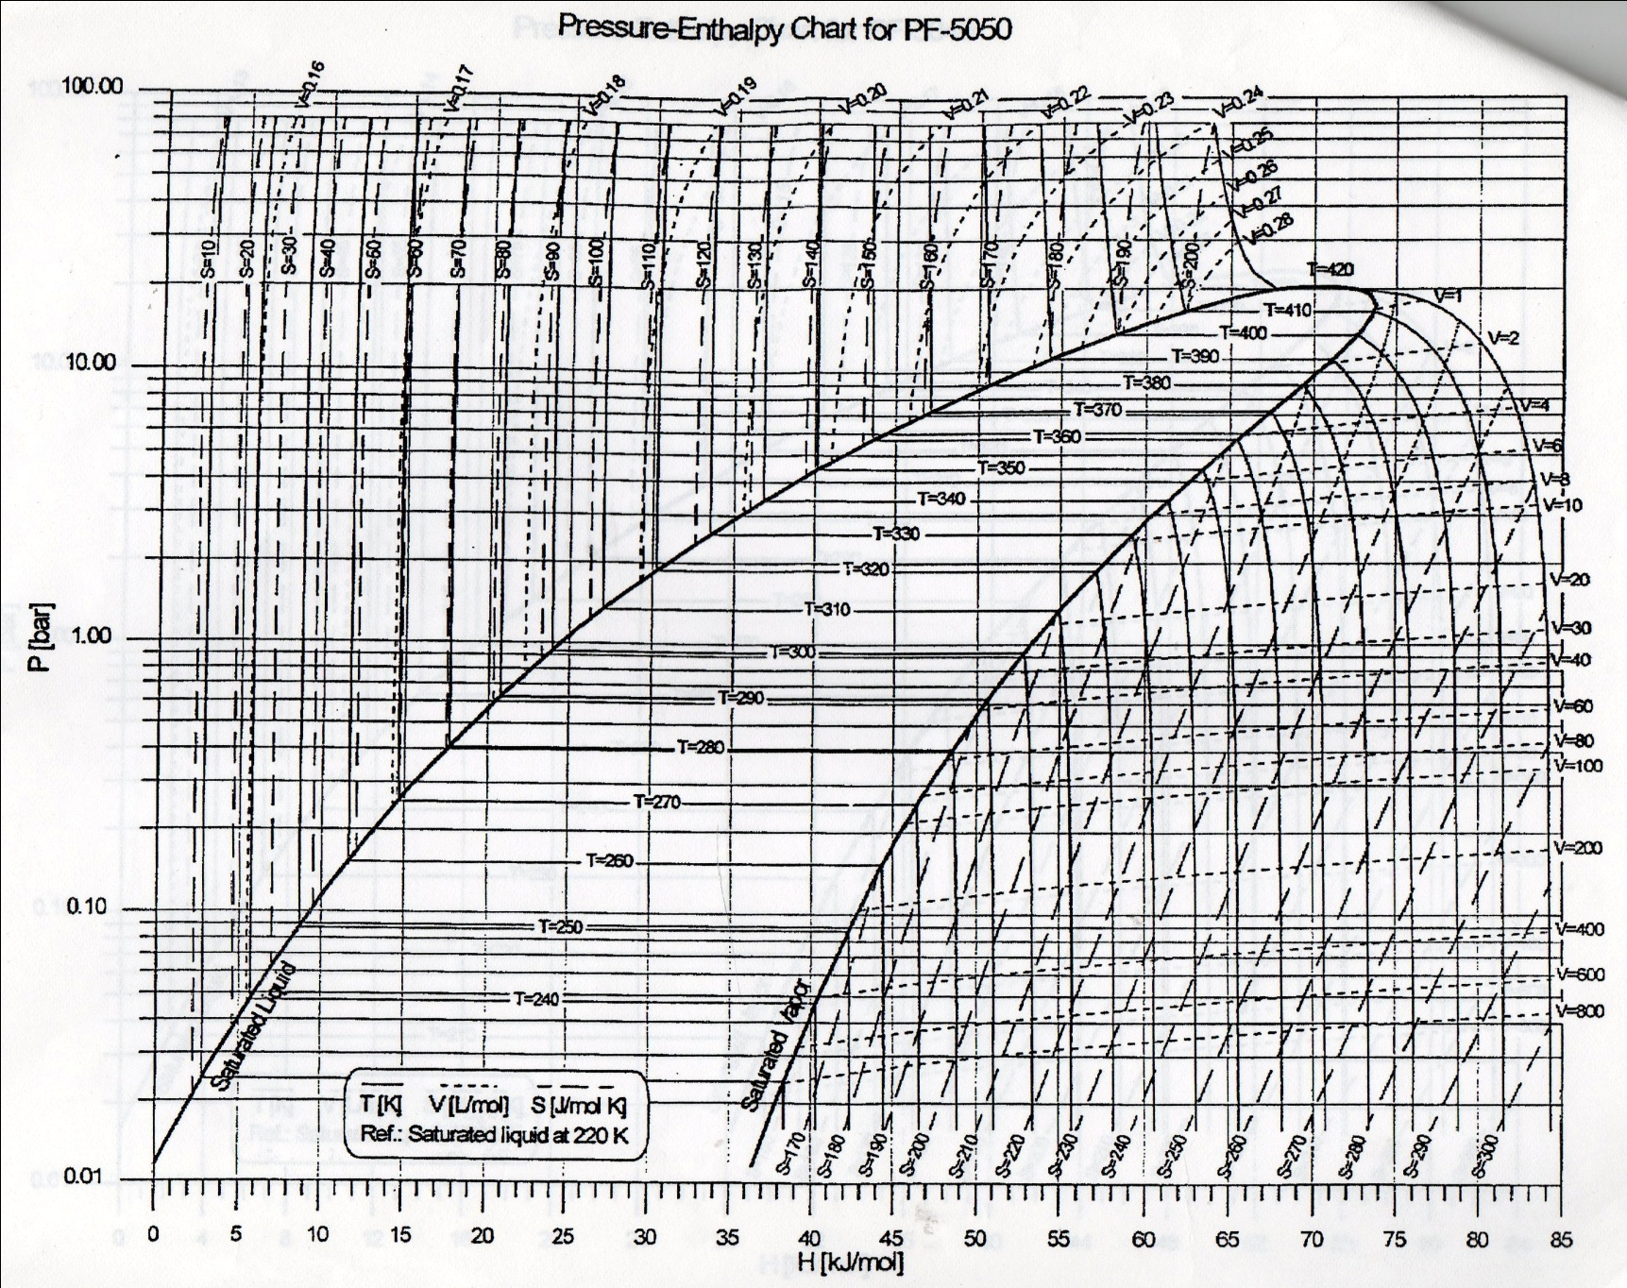
SLD CRID C₅F₁₂ circulation
SLD CRID C₅F₁₂ Thermodynamic circulation: Pressure-Enthalpy
Liquid
ρgh of 1.5m C₅F₁₂ !
(C) Electric heating
of liquid C₅F₁₂
Electric evaporation of C₅F₁₂
(δh ~ 1.3m)
Vapour
Changing Phase
(D) N₂ addition (C₅F₁₂ p.p. reduction)
& flow through CRID Radiator vessel
1bar_{abs} condenser
Headspace (& CRID
radiator vessel)
pressure maintained
by N₂ in return radiator gas & condenser N₂
vent to atmosphere
Pure C₅F₁₂@ -80C from
bottom of tank
Collapsing C5F12 partial pressure
& some condensation in precooler (A)
Condensation in tank (B) @ varying temperature ➔
down to “keep-cold” temp of -80°C (P_{C5F12} ~ mbar),
drastically reduces C₅F₁₂ loss by evaporation
DRD4 Collaboration Meeting, WG-2: CERN Oct 21-25 2024

Slide 38
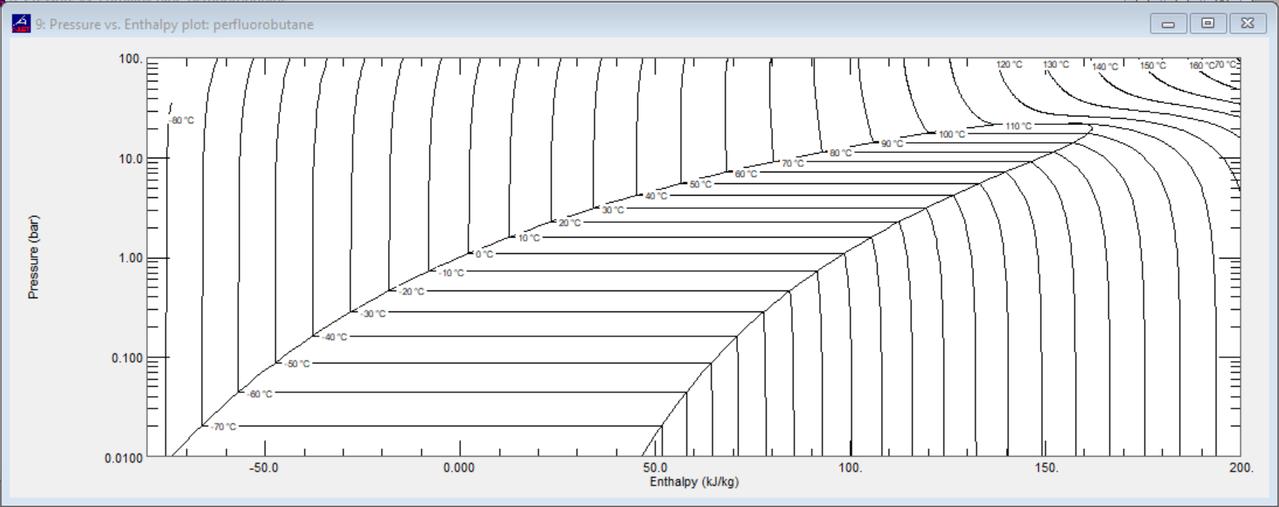
C₄F₁₀
(C₄F₈O thermodynamics will be similar)
Condensation
DRD4 Collaboration Meeting, WG-2: CERN Oct 21-25 2024

Slide 39
Conclusion & avenues of study needed
High GWP SFCs (C_{n}F_{(2n+2)}) have ideal optical properties as Cherenkov radiators: can we secure “heritage” C₄F₁₀ & CF₄ stocks to continue (deferred destruction)?
Future PFAS Availability issues, but total PFAS ban unrealistic, due to demands of electronics industry which we mightprofit from. (Other companies (Dehon (Fr), Synquest (US), various (Ch)) stepping in to fill void left by 3M departure...
While not industrialised over a wide C_{n}F_{2n}O range fluoro-ketones could offer similar performance at very low, or 0 GWP:
➔ Toxicity, materials compatibility & sophisticated optical studies needed ;
Radiation tolerance & thermal performance of 3M NOVEC 649 (lin-C₆F₁₂O) & NOVEC 7110 (C₄F₉OCH₃) sufficiently promising for consideration to replace C₆F₁₄ (cooling); 649 acid formation via residual H2O @ low temp issue to be resolved
By analogy, lin-C₄F₈O might replace C₄F_{10 ,} while lin-C₄F₈O or lin-C₅F₁₀O (or even C₄F₁₀ or heritage C₅F₁₂) blended with N₂ & real-time monitored by sound velocity gas analysis - could replace CF₄ in RICH radiators;
Molecular shape is everything?: lower order C_{n}F_{2n}O toxicity vs. shape needs study (F electron clouds shielding O atom?) : Need to work with chemical experts
Thermodynamics of circulation : usually a neglected area: Involve EN-CV from start –considerable experience at CERN from evaporative fluorocarbon cooling
DRD4 Collaboration Meeting, WG-2: CERN Oct 21-25 2024

Slide 40
C_{n}F_{2n}O fluid selection search criteria
Bibliographic
Materials tests
Optotests
Start(ed)
Next C_{n}F_{2n}O fluid
(order & isomer)
to evaluate
Y
Non-
Flammable
(MSDS)
?
Y
Non-
Oxone-
depleting
?
Y
Non-toxic
(MSDS)
?
N
N
N
N
Low GWP!
?
Y
N
N
N
Acid
formation
with H₂O
?
Y
Y
Rad.
Tolerant
(more for
cooling)
?
Y
N
Y
Materials/
purifier
Compatible
?
Dielectric
?
Y
N
Recirc.
Thermo-
dynamics
OK
?
Y
UV-Vis
transparency
OK
?
Y
(n-1) &
Chrom. Disp.
OK
?
Y
Accept
fluid
N
N
N
DRD4 Collaboration Meeting, WG-2: CERN Oct 21-25 2024

Slide 41
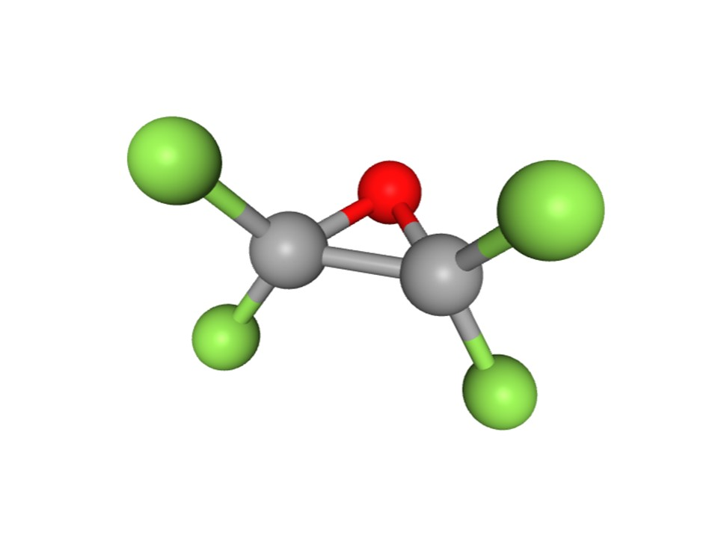
Back up material
DRD4 Collaboration Meeting, WG-2: CERN Oct 21-25 2024

Slide 42
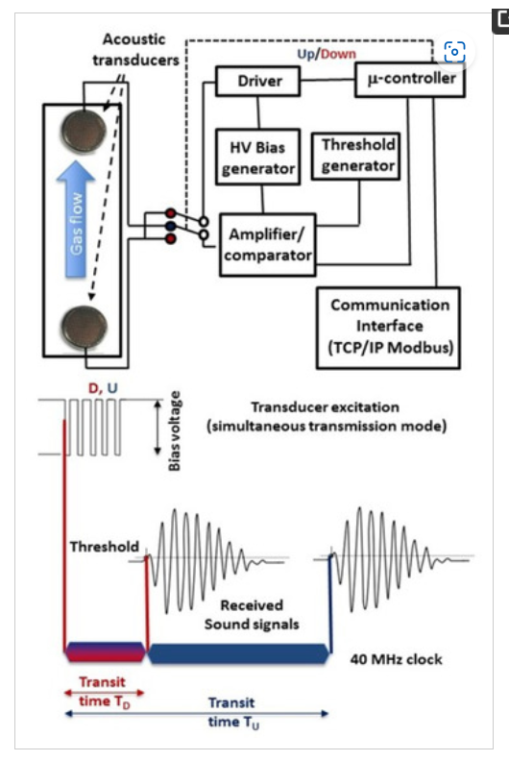
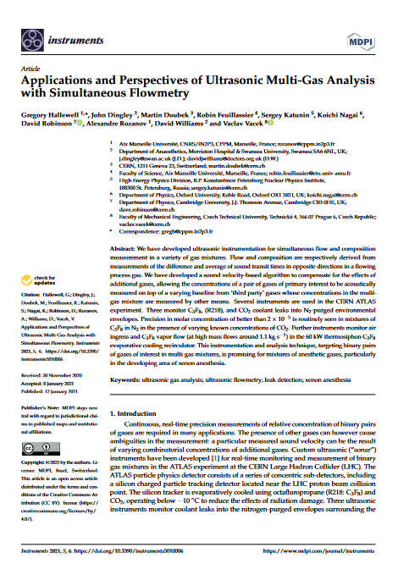
Ultrasonic gas analysis in a process environment with multiple background gases
https://www.mdpi.com/2410-390X/5/1/6
Precision: 10⁻⁵ C₃F₈ into N₂ at 1 bar
42
DRD4 Collaboration Meeting, WG-2: CERN Oct 21-25 2024

Slide 43
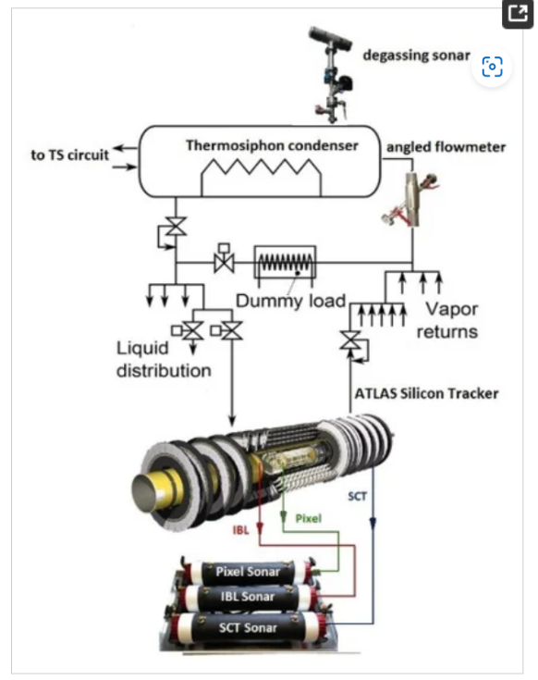

Ultrasonic gas analysis in a process environment with multiple background gases
https://www.mdpi.com/2410-390X/5/1/6
Gas aspirated through
150m tubes from
silicon tracker
N₂ environmental
volumes to
‘sonar’ devices
to look for C₃F₈
leak rates
(C₃F₈ in N₂ )
DRD4 Collaboration Meeting, WG-2: CERN Oct 21-25 2024

Slide 44
DRD4 Collaboration Meeting, WG-2: CERN Oct 21-25 2024

Slide 45

Polaroid Capacitative transducer components
Capacitative 350V activation/ bias ➔ rapid response
37mm diameter determines 50 kHz dominant frequency: can operate over wide pressure range (50mbar ➔>35 bar…)
45
DRD4 Collaboration Meeting, WG-2: CERN Oct 21-25 2024

Slide 46
Ultrasonic algorithm to find component molar concentrations
ω_{i=1,2…}
of a pair of gases of primary interest in multi-gas blends
46
DRD4 Collaboration Meeting, WG-2: CERN Oct 21-25 2024

Slide 47


(1) Calculate data base of individual C_{Vi..n} C_{Pi..n}
over expected T, P. range:
Example here: C₄F₁₀: (mol. wt.) = 238 in N₂ (mol. wt. = 28)
47
DRD4 Collaboration Meeting, WG-2: CERN Oct 21-25 2024

Slide 48

(2) Calculate c_{‘theo’} as a function of concentration from component
Cp, Cv’s over the expected sonar temperature, pressure range to
make database of c_{‘theo’} vs. conc. fit equations to store in ‘cans’
Example here 0- 1% C₃F₈ (m.w.= 188) in N₂ (m.w.= 28): only one pressure shown here for clarity)
Polynomial
Fit
Parameters
48
DRD4 Collaboration Meeting, WG-2: CERN Oct 21-25 2024

Slide 49

(3) CAN UTILITY: Store these c_{‘theo’} vs. molar conc. polyfit coeffs covering expected temperature & pressure range in “cans” at P,T grid intersections
(4) Calculate component concentrations ω_{i} from measured sound velocity c_{meas} & stored fit coeffs. interpolated to correspond to the measured T, P
T_{min}
T ➔
T_{max}
P_{max}
P ➔
P_{meas}
P_{step}
P_{min}
T_{step}
T_{meas}
!! This grid can become 3-D or higher-D with known contaminant gas(es) ➔
49
DRD4 Collaboration Meeting, WG-2: CERN Oct 21-25 2024

Slide 50
Aah…what if 3 gases are present?
Acoustic Ambiguity ?
2 combinations of 3 gases ➔ same c… so must find ω₃ from a different
(non-acoustic) technology source…
Examples inc. clinical…):
CO₂ from ND infra-red,
H₂O from hygrometry,
O₂ from EC cell… etc.
G. Hallewell: Seminaire CPPM: 16 sep 2024
50

Slide 51
Example: Look-up tables of SoS. vs. composition for C₃F₈/N₂ (+ CO₂) (ATLAS silicon tracker cooling leak analysis)
https://www.mdpi.com/2410-390X/5/1/6
CAN UTILITY DB expanded
from 2-D to 3-D:
C₃F₈/N₂ fit coeffs
stored @{T, P, CO₂} grid
Extra interpolation step,
starting from grid cub(oid) of uncertainty
to T_{meas}, P_{meas},CO_{2 meas}
Calculate sound vel vs. conc. eqns from
C₃F₈ & N₂ AND KNOWN CONTAMINANT GAS
Cp & Cv over expected T,P, %CO₂ range.
Demonstration:
1st acoustic measurement of concentrations of binary gas pair
of interest (C₃F₈/N₂)
in known varying conc. of 3rd gas (CO₂) :
(4 envelopes cycling every 4 hours)
Algorithm: industrial & anaesthesia applications
DRD4 Collaboration Meeting, WG-2: CERN Oct 21-25 2024
51

Slide 52
LHCb RICH 2 change in refractivity with varying CO₂ radiator addition
Acoustic ‘pair’ would be CF₄ & N₂ : O₂ by e-chemical cell, CO₂ from NDIR)
G. Hallewell: GasRad GWP: ECFA TF-4 Meeting May16-17th 2023
52
DRD4 Collaboration Meeting, WG-2: CERN Oct 21-25 2024

Slide 53


Example with a second known contaminant gas: here H₂O but could be another measurable gas like O₂ : 4-D {T,P, CO₂, H₂O} Process dataspace example ‘Cans’ of c vs. conc_{1,2} fit coefficients now at corners of tesseract. (Here in Coxeter B4 projection)
8 cube faces:
2 x {T,P,CO₂} exc. H₂O
2 x {T,P, H₂O} exc. CO₂
2 x {T, CO₂, H₂O} exc. P
2 x {P, CO₂, H₂O} exc. T
T
CO2
H2O
P
CO2
T
P
H2O
P
H2O
H2O
P
CO2
T
T
P
H2O
CO2
CO2
T
T
P
P
H2O
H2O
T
CO2
P
H2O
CO2
T
Opposite cubic faces explored in the following slides
53
DRD4 Collaboration Meeting, WG-2: CERN Oct 21-25 2024

Slide 54


Canterpolation (Extractio-reduction)
Tessar-Can-Action
https://www.mdpi.com/2410-390X/5/1/6
54
DRD4 Collaboration Meeting, WG-2: CERN Oct 21-25 2024

Slide 55


Analyseur a ultrasons de mélanges de gaz Xe-O₂
In practice, work in the 100%RH regime:
➔ H₂O molar concentration given by svp:
Xe/O₂ anesthetic gas mixture can contain CO₂ if soda-lime absorber cannister ineffective.
implement Xe/O₂ gas concentration measurement algorithm in T, P, CO₂ space
Pour mesurer la concentration de Xe avec une
précision de 0.1% il faut mesurer la vitesse de son
avec une précision de 0.2 m/s
(instrument @ CERN: typ. 0.05 m/s)
Masse moléculaire Xe: 131
Masse moléculaire di-oxygène: 32
Polyfit parms
in « cans »
Maybe go to 4D (tessaract) if need to monitor on top of varying H₂O conc..
DRD4 Collaboration Meeting, WG-2: CERN Oct 21-25 2024

Slide 56

Database growth control
(important in instruments using embedded μ-controllers)
SoS CALC: Of course, C_{P} & C_{V} for all gases (primary & background)
must be calculated for all T, P points on the n-D grid;
CAN FILLING: Calculate & fit c in gas pair of primary interest from C_{P} & C_{V} over their conc. range AND @T, P, known background gas conc. Grid points.
Database size (3-D example)
DB size = No. primary fit coeffs * $\frac{RoI_T}{d_T}$*$\frac{RoI_P}{d_P}$*$\frac{RoI_Conc. bkd gas 1}{d_Conc. bkd gas 1}$…
RoI_n = range of interest_n: d_n = stepsize_n ➔ Database explosion ?!?
Increasing stepsize (➔ longer interpolation distance) can reduce No. of cans (“cubes” become “cuboids”)…
Some dimensions can be suppressed altogether using physical law (rather than empirical changes):
example for temperature dimension: $c_{t_{abs1}}=c_{t_{abs0}}\sqrt{\frac{t_{abs1}}{t_{abs0}}}$
56
DRD4 Collaboration Meeting, WG-2: CERN Oct 21-25 2024

Slide 57
References; mainly on fluorocarbon fluids and GWP
Related paper: https://link.springer.com/article/10.1140/epjp/s13360-023-04703-w
57
DRD4 Collaboration Meeting, WG-2: CERN Oct 21-25 2024

Slide 58
References
[1] CERN Environment Report 2017–2018 https://doi.org/10.25325/CERN-Environment-2020-001
[2] Eco-gas mixtures and mitigation procedures for Green-house Gases (GHGs);
B. Mandelli ECFA Detector R&D Road-map Symposium: T.F. 1 Gaseous Detectors, 29/4/2021
https://indico.cern.ch/event/999799/contributions/4204191
/attachments/2236047/3789965/BMandelli_ECFA.pdf,
[3] R&D for the optimization of the use of greenhouse gases in particle detector systems; B. Mandelli;
Mini workshop on gas transport parameters for present and future generation of experiments:
CERN April 22, 2021
https://indico.cern.ch/event/1022051/contributions/4325947/
[4] Studies to reduce greenhouse gas emissions from detectors at the LHC;
G. Rigoletti; EP-DT Seminar May 4, 2022.pdf (cern.ch)
[5] Long term experience with C₄F₁₀ in COMPASS RICH-1;
S. Dalla Torre et al; Presentation 11th Intl. Workshop on Ring Imaging Cherenkov detectors,
Edinburgh, Scotland, Sept 12-16 2022.
https://indico.cern.ch/event/1094055/contributions/4932286/attachments/2508724/4311387/
RICH2022_C4F10_dallatorre.pdf
[6] 3M PFG-3480: c-octofluorotetrahydrofuran (C₄F₈O).
Note: fluid out of production : product reference now used for a non-fluidic product.
For historic product data sheet mentioning its high GWP see (for example):
http://static6.arrow.com/aropdfconversion/a7116f41dfdd5b79d2eb7b40afd687f8af23d8ef/
mediawebserver(563).pdf
[7] M. Artuso et al; Nucl. Instr & Meth. A Volume 558, (2006), 373-387
[8] Product #2H07-2-08 Synonyms: 2,2,3,3,4,4,5,5-octafluorotetrahydrofuran,
Perfluorotetrahydrofuran; CAS No: 773-14-8, MDL No. MFCD00465561:
SynQuest Labs Inc., 13201 Rachael Boulevard, Alachua, FL 32615, USA
https://www.synquestlabs.com/Home/ProductDetail?SearchText=Octafluorotetrahydrofuran
[9] T. Acconcia et al ; Nucl. Instr & Meth A 767 (2014) 50–60

Slide 59
References (cont. 1)
[10] Abundances, emissions, and loss processes of the long-lived and potent greenhouse gas
octafluorooxolane (octafluorotetrahydrofuran, c-C4F8O) in the atmosphere;
M. Vollmer et al ; Atmos. Chem. Phys., 19, 3481–3492, 2019
[11] 3M Novec® range of fluorinated fluids; https://www.3m.com/3M/en_US/p/c/b/novec/?Ntt=novec
[12] 3M Novec 649/1230 fluid (C₆F₁₂O);
https://multimedia.3m.com/mws/media/569865O/3m-novec-engineered-fluid-649.pdf,
https://multimedia.3m.com/mws/media/124688O/3m-novec-1230-fire-protection-fluid.pdf]
[13] 3M Novec 5110 fluid (C₅F₁₀O);
https://multimedia.3m.com/mws/media/1132123O/3m-novec-5110-insulating-gas.pdf
[14] CERN report EN-CV 22/12/2017, EDMS 1751219 2017-334 rev 1.0: T
echnical Note NOVEC Fluids Qualification Report: Report on the study executed for the qualification
of the NOVEC Fluid for Detector Cooling applications.
[15] Understanding the stability and environmental characteristics of a sustainable Halon alternative.
J. Owens, 3M Performance Materials 3M Center, St. Paul, MN 55144
[16] CERN Mini-workshop on gas transport parameters for present and future generation of
experiments 20/04/2021;S. Easo; LHCb-RICH detectors and their gas radiators
https://indico.cern.ch/event/1022051/contributions/4333562/attachments/2231064/3780374/
LHCb-RICH-Current-GasRadiators-April-2021.pdf,
Options for alternate radiators in LHCb-RICH system (including calculations by O. Ullaland); S. Easo,
https://indico.cern.ch/event/1022051/contributions/4319538/attachments/2231436/3781060/
LHCb-RICH-Future-Radiators.pdf
[17] S.Easo; Nucl.Inst.& Meth. A 876 (2017) 168-173
[18] E. Lemmon, M. Huber, & M. McLinden; REFPROP Standard reference database 23, version 9.0 (2010)
U.S. National Institute of Standards & Technology.
[19] E. Nappi & J. Seguinot Rivista del Nuovo Cimento Vol. 28, N. 8-9 2005 DOI 10.1393/ncr/i2006-10004-6
[20] K. Abe et al. ; IEEE Trans. Nucl. Sci. 45 (1998) 648 SLAC-PUB-7705 DOI: 10.1109/23.6826
[21] G. Hallewell et al; Nucl. Instr. & Meth A264 (1988) 219-234
[22] G. Hallewell; Nucl. Instr & Meth A 876, (2017) 50-53

Slide 60
References (cont. 2)
[23] G. Hallewell et al; MDPI Instruments (2021) 5(1), 6;
[24] P. Stassi et al; Ultrasonic Gas mixture analysis system in the Forward RICH of DELPHI,
DELPHI Internal Note 95-124 RICH73, 25 July 1995
[25] M.Sannino; Nucl. Instr. and Methods in Physics Research A 595 (2008) 208–211
[26] Monitoring, Alignment and Control of the RICH Detectors; C. D'Ambrosio et al;
LHCb-Memo-2000-80 RICH 6 September 2000.
[27] P. Fauland, PhD thesis; (COMPASS experiment) University of Bielefeld March 2004.
[28] Now marketed as SensComp model 600 transducer, http://www.senscomp.com/ultrasonic-sensors/
[29] T. Blake et al; Nucl. Instr. Meth A791 (2015) 27-31
[30] A. Papanestis; Nucl. Instr. Meth. A766 (2014) 14–18
[31] R. Calabrese et al; 2022 JINST 17 P07013
[32] R. Bates et al; 2013 JINST 8 P02006
[33] ECHA/NR/23/04; https://echa.europa.eu/-/echa-publishes-pfas-restriction-proposal]
[34] ECHA Candidate List of substances of very high concern for Authorisation;
https://echa.europa.eu/candidate-list-table
[35] Annex to the Annex XV restriction report proposal for restriction:
Per- & polyfluoroalkyl substances (PFASs);
ECHA; 22/03/2023 https://echa.europa.eu/documents/10162/d2f7fce1-b089-c4fd-1101-2601f53a07d1
[36] Per- and polyfluoroalkyl substances (PFAS); ECHA
https://echa.europa.eu/hot-topics/perfluoroalkyl-chemicals-pfas

Slide 61
The uncertain ECHA path to prohibition
(a path paved with impracticalities?)
DRD4 Collaboration Meeting, WG-2: CERN Oct 21-25 2024

Slide 62

DRD4 Collaboration Meeting, WG-2: CERN Oct 21-25 2024

Slide 63

DRD4 Collaboration Meeting, WG-2: CERN Oct 21-25 2024

Slide 64

G. Hallewell: Seminaire CPPM: 16 sep 2024

Slide 65
DRD4 Collaboration Meeting, WG-2: CERN Oct 21-25 2024

Slide 66
Positive and Negative exeriences with C₄F₈O as a substitute for C₄F₁₀
Cherenkov radiator gas
66
DRD4 Collaboration Meeting, WG-2: CERN Oct 21-25 2024

Slide 67




F O F
F – C
C – F
F – C
l
F
C – F
l
F
octafluorotetrahydrofuran
MW = 216: GWP=12000
a.k.a.
c-octafluoro-oxolane
67
DRD4 Collaboration Meeting, WG-2: CERN Oct 21-25 2024

Slide 68





Shapes of C_{n}F_{2n}O molecules and GWP:
c-octafluorooxolane (C₄F₈O),
MW = 216: GWP = 12000 BTEV stuff?
Perfluortetrahydrofuran – the probable BTeV choice
From June 2000 3M datasheet
https://repository.library.noaa.gov/
044ed5ad-93ae-40e3-9420-d78
a4729ff0f
3M Specialty Gas PFG-3480 is a high-performance chamber cleaning gas that has environmental advantages and can help reduce operating costs. PFG-3480 reduces emissions of global warming compounds by 90 percent when compared to the traditional plasma enhanced chemical vapor deposition(PECVD) cleaning gas, C2F6. The replacement does not require changes to existing processes
68
DRD4 Collaboration Meeting, WG-2: CERN Oct 21-25 2024

Slide 69



Shapes of C_{n}F_{2n}O molecules and GWP:
Octafluortetrahydrofuran – the probable ALICE VHPID config
F O F
F – C
C – F
F – C
l
F
C – F
l
F
C₄F₈O acquired from Synquest : reported by Antonello di Mauro:
69
DRD4 Collaboration Meeting, WG-2: CERN Oct 21-25 2024

Slide 70

SynQuest Labs Inc.,
13201 Rachael Boulevard Rt 2054, Alachua, FL 32615, USA
70
DRD4 Collaboration Meeting, WG-2: CERN Oct 21-25 2024

Slide 71



SynQuest Labs, Inc. Can manufacture different C₄F₈O configurations
The cyclic molecule seems to be cheaper for SynQuest to manufacture:
whereas 3M make NOVEC 649, which is non-cyclic
71
DRD4 Collaboration Meeting, WG-2: CERN Oct 21-25 2024

Slide 72


Another exciting example: Novec 5110: C₅F₁₀O MW = 266: GWP <1
Mixing potential here with currently-available
low GWP « Fluoro-oxygenate » (C_{n}F_{2n}O) :
Blend with N₂ to match C₄F₁₀ - or even CF₄ - refractivity?
72
DRD4 Collaboration Meeting, WG-2: CERN Oct 21-25 2024

