Slide 1



MIEL (Microscope for the Injection and Emission of Light)
Fabrice Retiere (TRIUMF)
Work done within the PHoton for Astro-particle and Applied Research (PHORWARD) group at TRIUMF
Collaboration with U.Sherbrooke (QC, Canada) for the Photon to Digital Converter

Slide 2
Setup – phase 1
Built in 2020-2021
Two papers:
  K. Raymond, “Stimulated Secondary Emission of Single Photon Avalanche Diodes”, IEEE TED and https://arxiv.org/abs/2402.09634
  Also J. McLaughlin at al., “Characterisation of SiPM Photon Emission in the Dark”, IEEE TED and https://arxiv.org/abs/2107.13753 but the light transmission is overestimated

Slide 3
Main motivation of work up to now is external cross-talk
Big issue for “monolithic calorimeter”
  Original work was for the nEXO experiment, a liquid Xenon TPC with scintillation detection
  Especially worrisome for the ones that work at low threshold, dark matter search detectors in liquid Argon and liquid Xenon
The upshots are:
  External cross-talk with Hamamatsu VUV4 MPPC is on the order of 5% in liquid Xenon for with about 50% photo-coverage
  But full simulation package still does not exist. It is a 3 parts problem: emission + transport + (IR) detection
  It may be higher for FBK VUV SiPM
Also an issue for new design especially BSI SiPMs
MIEL provides a wealth of information about the emission part

Slide 4
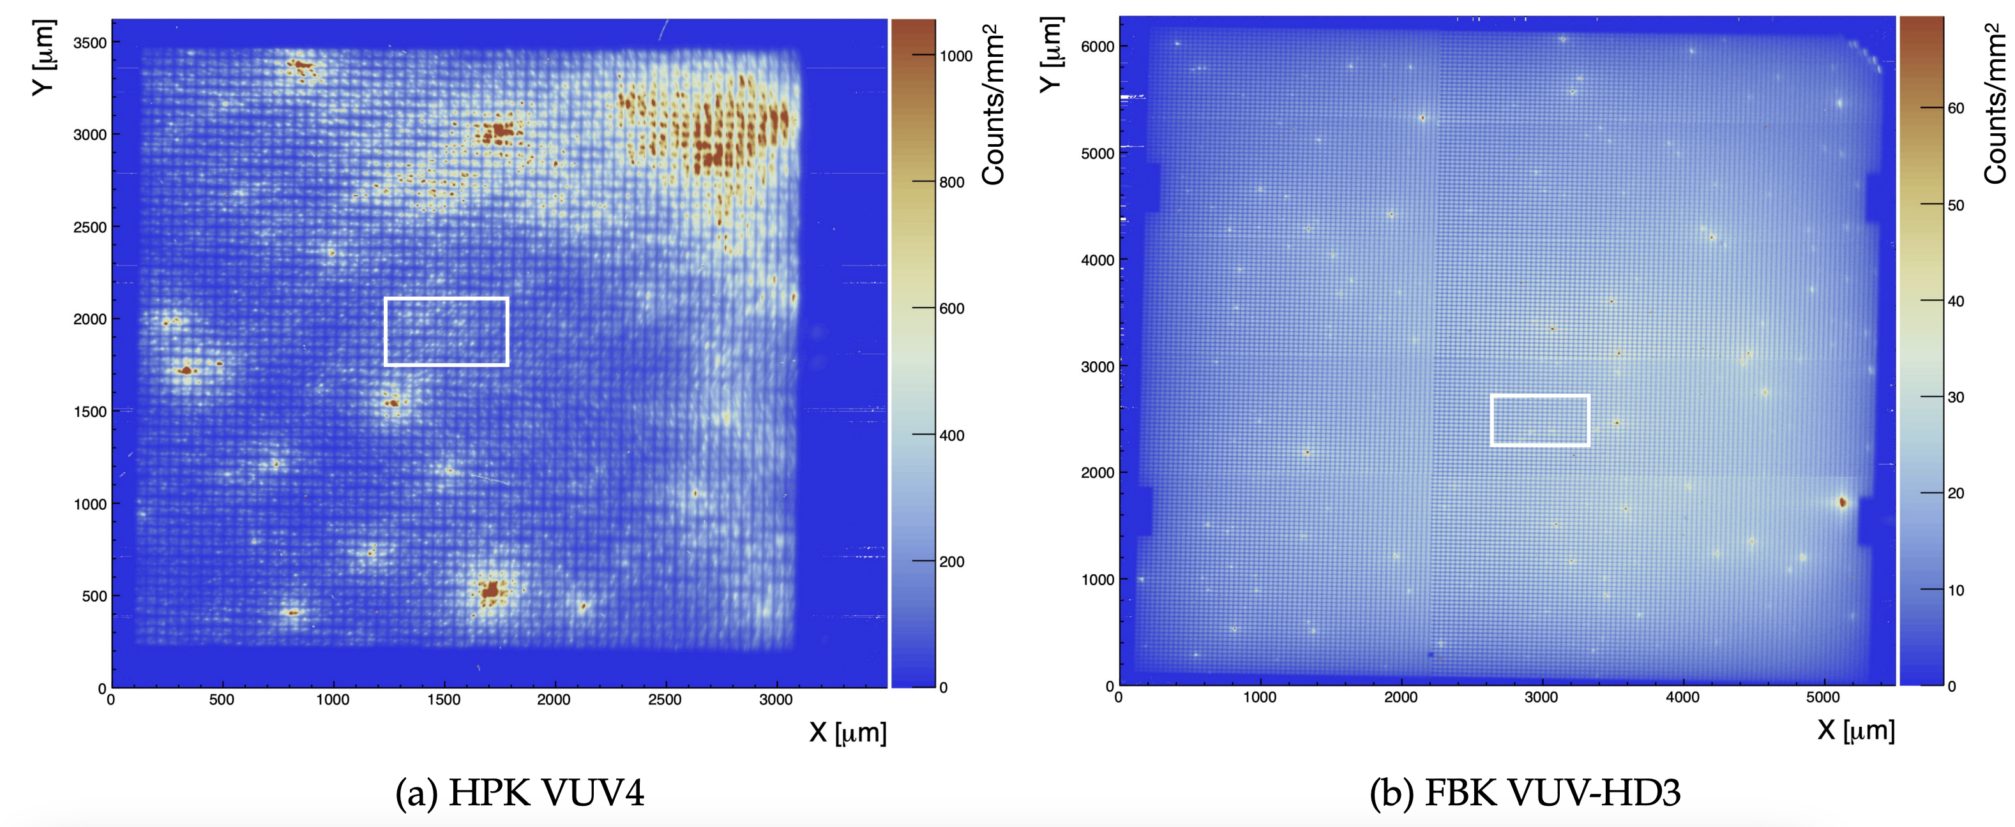
Imaging in the dark shows defect locations
Stitched images of 3x3 mn² SiPM

Slide 5
The spatial distribution of cross-talk
FBK SiPM case (no metallic trenches)
We have not modeled transport within the SiPM in much detail
Anyone interested. It is a very interesting, yet challenging problem

Slide 6
Spectra at room temperature
Hamamatsu VUV4
FBK VUV=HD3 SiPM

Slide 7
Modeling optics and assuming isotropic emission, one calculate photon emission
Hamamatsu VUV4 MPPC
FBK VUV-HD3
Temperature spread likely due to incorrect
after-pulsing correction

Slide 8
Remaining issue with light emission characterization
Experimental
  Objective used has NA=0.45 i.e. incidence angle <26 degrees. Fraction of emitted photon detected estimated to be 10%
  We have another objective with NA=0.78 but still would capture a small fraction of emitted photons.
  There is a question about angular spectrum of light emission
Modeling
  Isotropic assumption may not be correct. Affect yield estimate
  Understanding the parameters that drive light emission may help reduce it
  We have a pseudo-collaboration with ANSYS/Lumerical but short of manpower

Slide 9
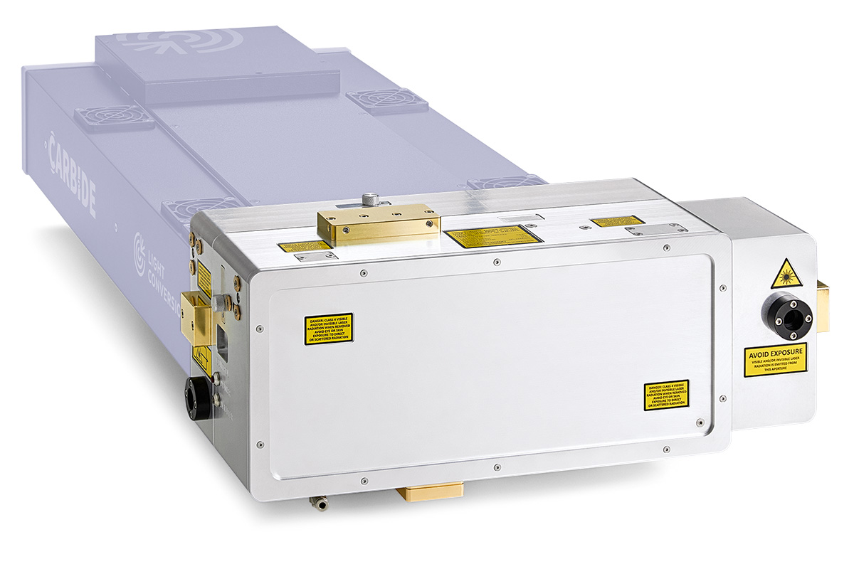
MIEL phase 2 – light injection optimization
Installed LightConversion I-OPA in February 2023
Wavelength tunable from 300 to 2000nm
Pulse width 180fs

Slide 10
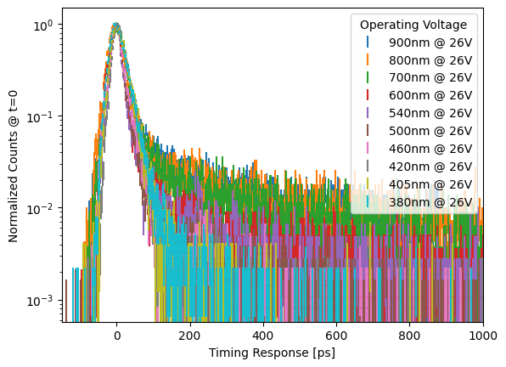
Preliminary results with Sherbrooke PDC
Fire a single SPAD
Best timing resolution about 20ps
The best resolution is not at shortest wavelength
  Indicate low field close to surface
  May be the case for VUV SiPM
Tail in 100ps scale allow studying electric field

Slide 11
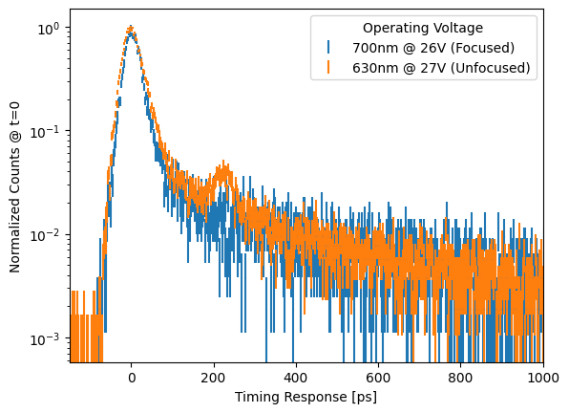
Further studies
Optics is interesting at these short time scale
Can see reflections of window

Slide 12
Scope of future work
Map timing response and PDE vs wavelength and over-voltage: additional model constraints
Develop Two-photon absorption technique for SPAD
  Allow probing response in 3D
  Has been done at CERN for tracking detector, producing about 10,000 e-
  Working at single photon level is likely trickier
Improve automation for faster turn around and data taking
PIQSCL: New setup at conceptual design stage combining capabilities to characterize single photons and tracking detectors
  I am interested in learning about characterization needs

Slide 13
Light emission is most likely a worse issue in BSI than FSI SPADs

Slide 14

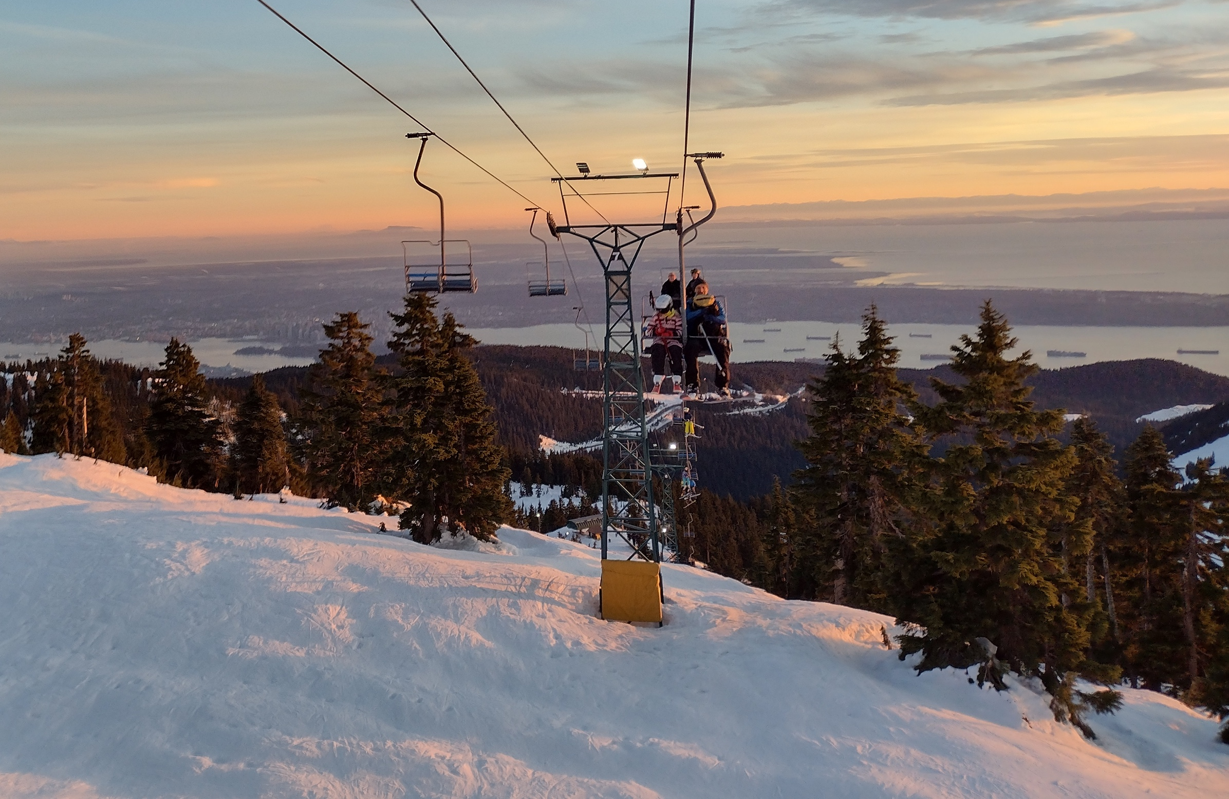
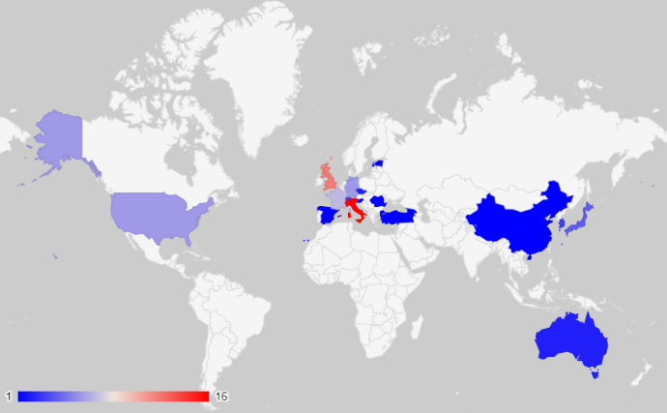
The end

Slide 15
Aim: back-side illuminated SPAD arrays
Front Side illumination (ala Sherbrooke)
photon
Thin passivation ~100nm
e⁻
Ultra-thin contact 1-5nm
Low drift field region
h
e⁻
Drift field region
Versatility
  Visible to IR via thickness control
  Deep UV through Back-side surface processing
    Unconventional Anti-reflective coating: black silicon, graphene, 3D structures
  Non-photon detection
    Minimum ionizing
    keV scale electron (hybrid photo-detector)
    Dark matter
Avalanche region
Molecular bonding
CMOS
Aka. electronics
Back side illumination
photon
Thin passivation ~100nm
Ultra-thin contact 1-5nm
Low drift field region
e⁻
e⁻
Drift field region
Avalanche region
Molecular bonding
CMOS (in 2D or 3D)
Aka. electronics
15

Slide 16
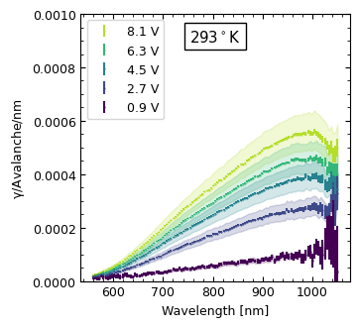
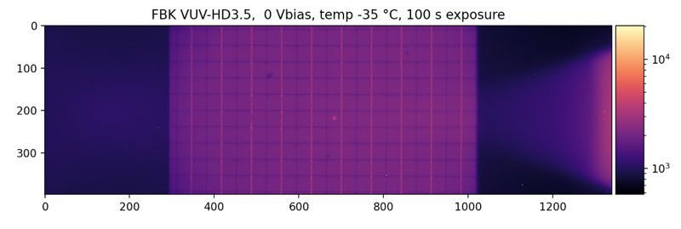
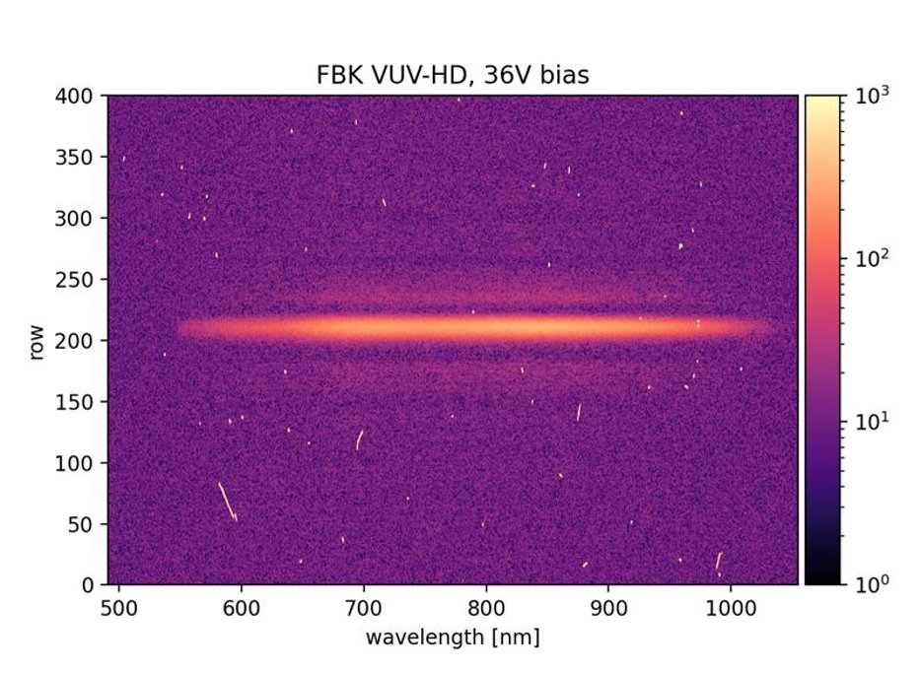
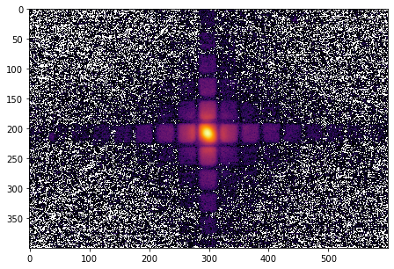
Asset: MIEL
Cooled X-Y Stage
SPAD
Vacuum Window
SiPM Surface
Vacuum Chamber
Objective
FBK Reflected Light and Laser Spot
Dichroic Mirror
Tunable laser
300 - 1500nm
Emission Filter
Emitted Light
IX-83 Microscope
Diffraction
Grating
B)
A)
Spectroscopy
Imaging
Spectrometer and Cryogenically Cooled Camera
2D Emission Map

Slide 17
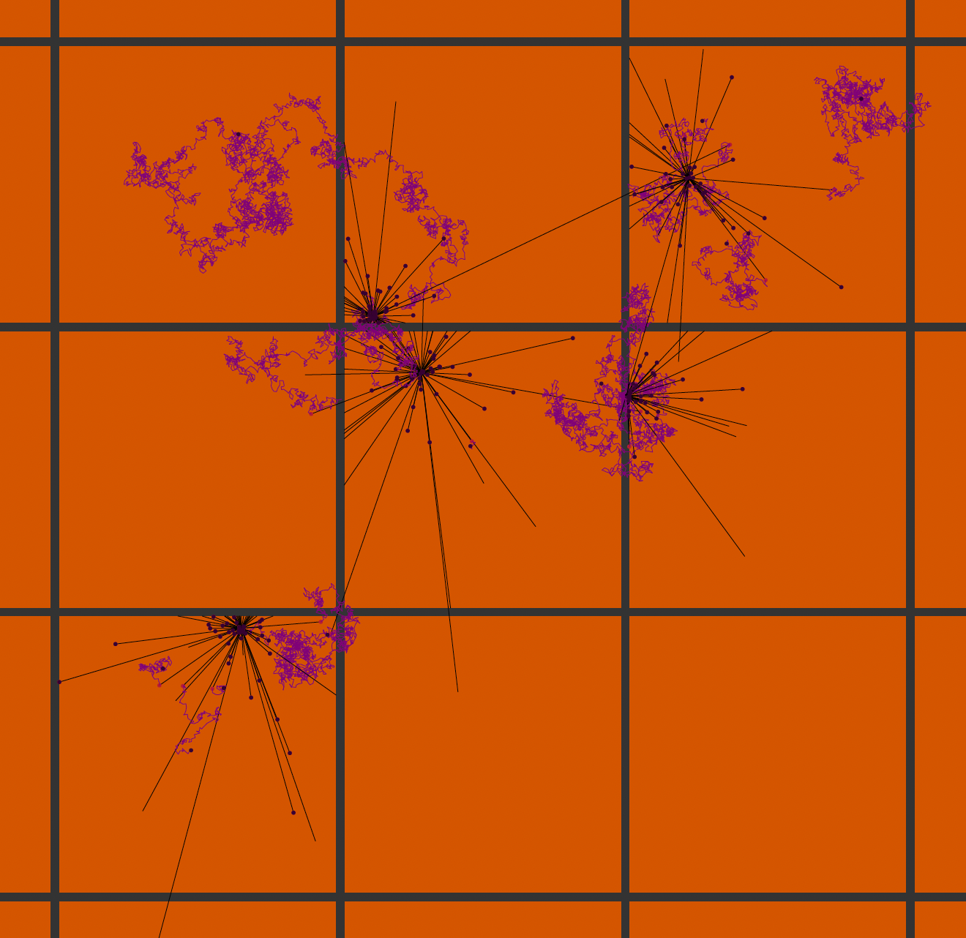
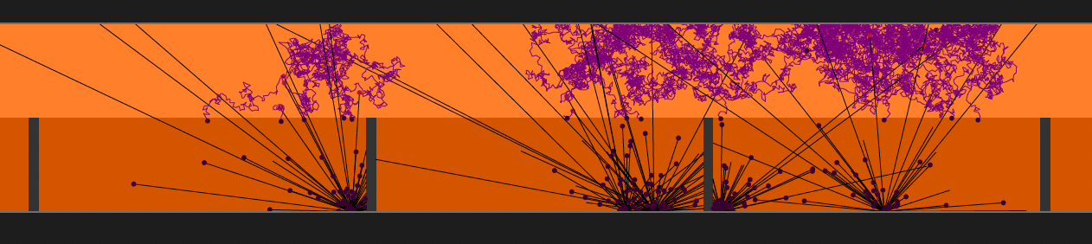
Assets: simulations
Example: QLADS used with diffusion region on top for MIP detection (ASGAP concept)
Collaboration with ANSYS – Lumerical
Development of ”Quanta Level Avalanche Diode Simulator” (QLADS)
  Mixing charge carrier and photon transport
  U. Alberta, TRIUMF, U. Victoria
  Current focus on non-photon applications: Minimum Ionizing, keV electrons and dark matter

Slide 18
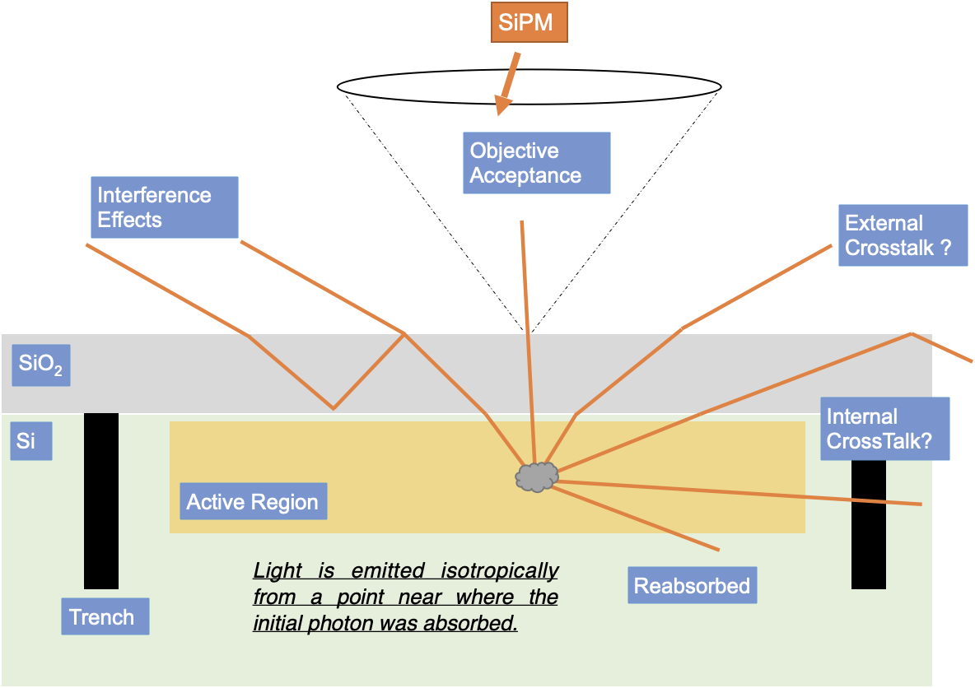
Light emission to crosstalks
Single Photon Avalanche Diode
Light emission assumptions:
  At p-n junction – maximum field
  Isotropic
External cross-talk
  Photon escaping the SiPM surface
Internal cross-talk
  Photons being absorbed in a neibhoring SPAD
We measure photons escaping with objective acceptance

