Slide 1
Modelling SiPM PDE from the VUV to the IR
Harry Lewis
DRD4 collaboration meeting, October 2024

Slide 2
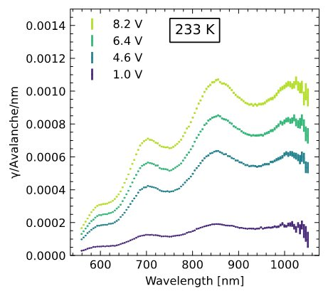
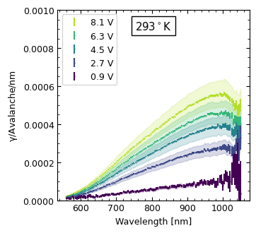
Objectives
FBK VUV-HD3
  Develop a parameterized model of wavelength-dependent PDE for p-on-n SPADs and SiPMs with associated software tool – relate PDE spectrum to device structure
  Long wavelengths: extrapolate full PDE spectrum from limited measurements
    Original motivation is characterizing IR absorption for external crosstalk
  Infer PDE from device parameters - infer device parameters from PDE spectrum
  Short wavelengths: characterize quantum yield – important for VUV and applications beyond SPADs and SiPMs
HPK VUV4
Secondary emission

Slide 3
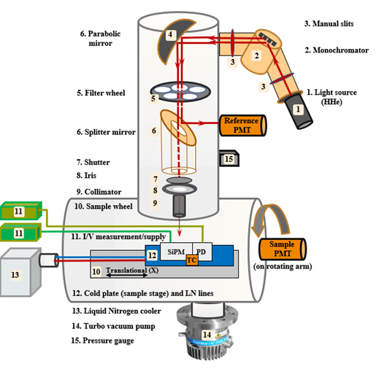
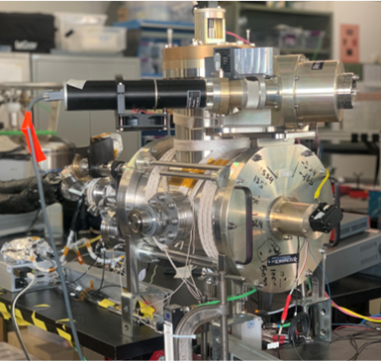
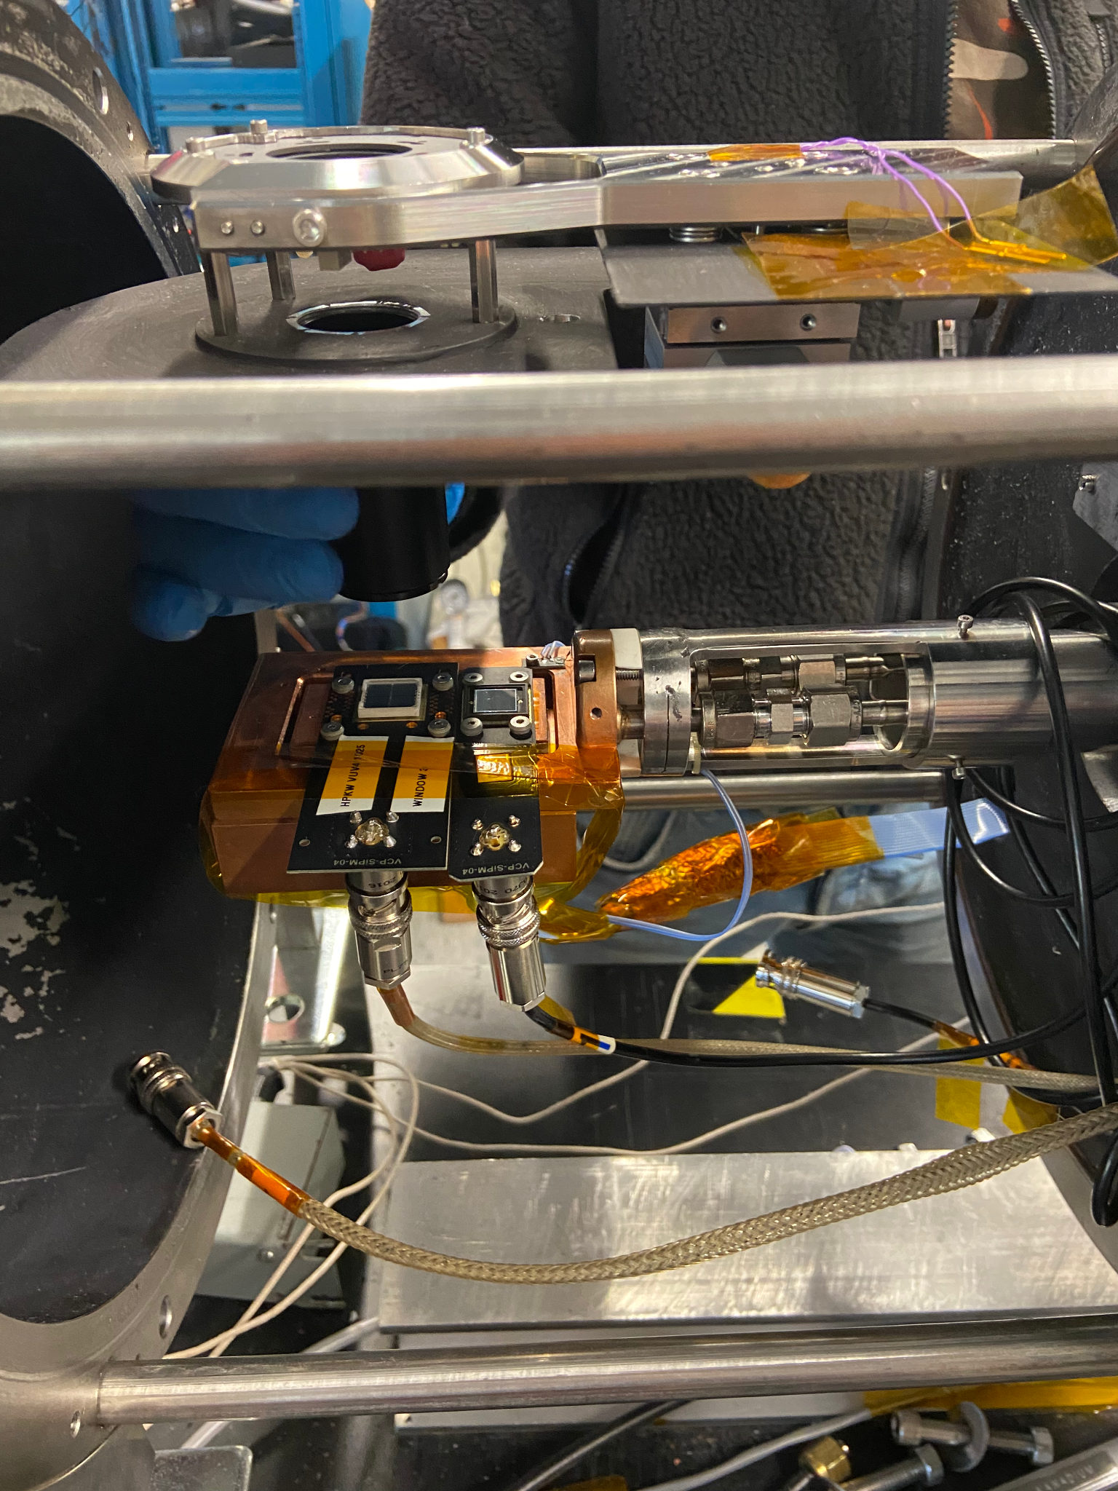
The VERA measurement setup
Vacuum Efficiency, Reflectivity, and Absorption
Vacuum chamber to allow transmission of VUV light
Deuterium light source with emission from VUV to NIR (140-830nm), wavelength controlled with vacuum monochromator
Control of various parameters: Temperature, optical power, light source, optical angle of incidence
Available for VUV or broadband electro-optical characterization work ☺
Lamp
Cooling lines
Calibrated photodiode
Equipment flanges
VUV4 quad

Slide 4
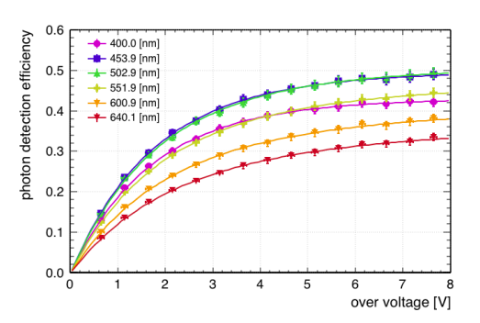
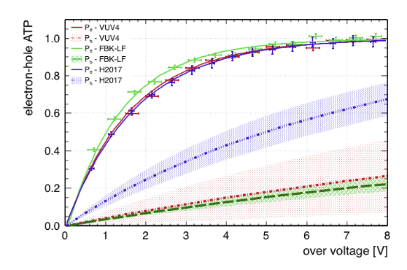
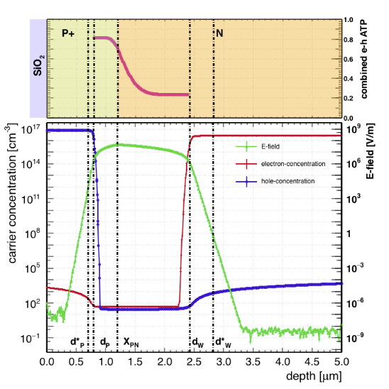

Modelling PDE
Modelling PDE
Model developed from https://arxiv.org/abs/1904.05977
Previously considered ATPs only – now models optical transmission, including thin-film interference and multiple interfaces
Full consideration given to transmission term, gives validity across wavelengths

Slide 5
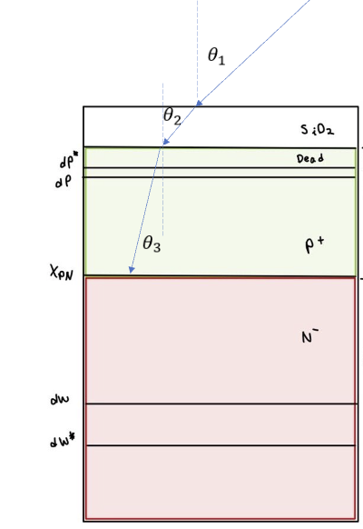
Modelling PDE
Can consider three different wavelength ranges:
  >400nm, quantum yield = 1, photons may be absorbed in p or n regions
  ~250-400nm – quantum yield = 1, all photons absorbed in p⁺ region
  <250nm – photons absorbed close to surface, quantum yield >1
    Possibly significant recombination losses

Slide 6
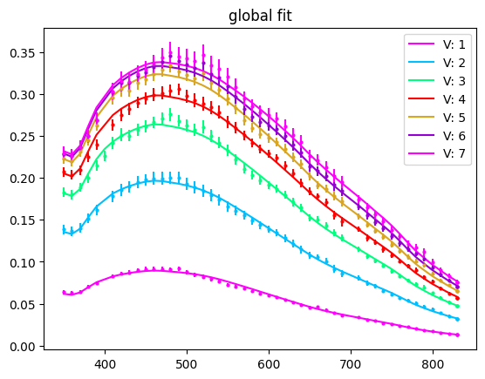
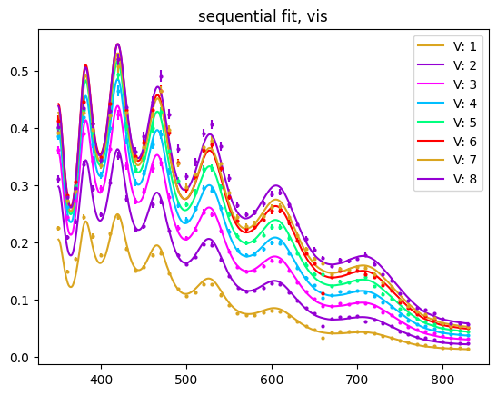
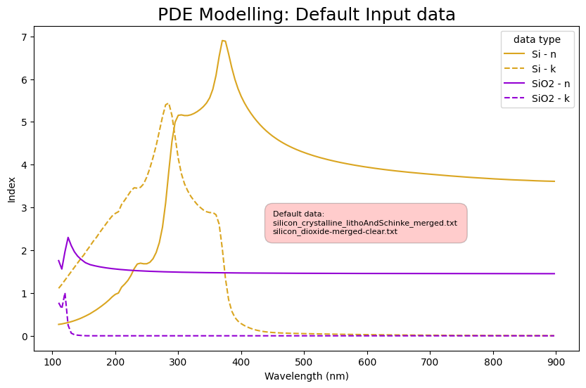
Modelling PDE
PDE is measured at certain wavelengths by comparison to a calibrated diode
  Measurements taken at LXe temperature
Transmission calculated using SiO₂ layer thicknesses and measured optical constants
  Model is sensitive to the accuracy of the input data
Oscillations in FBK device due to interference in SiO₂
  Period constrains oxide thickness
Fitting shorter wavelengths first constrains X_{pn},P_{e}
PDE for HPK VUV4
Wavelength [nm]
PDE for FBK VUV-HD3
Wavelength [nm]

Slide 7
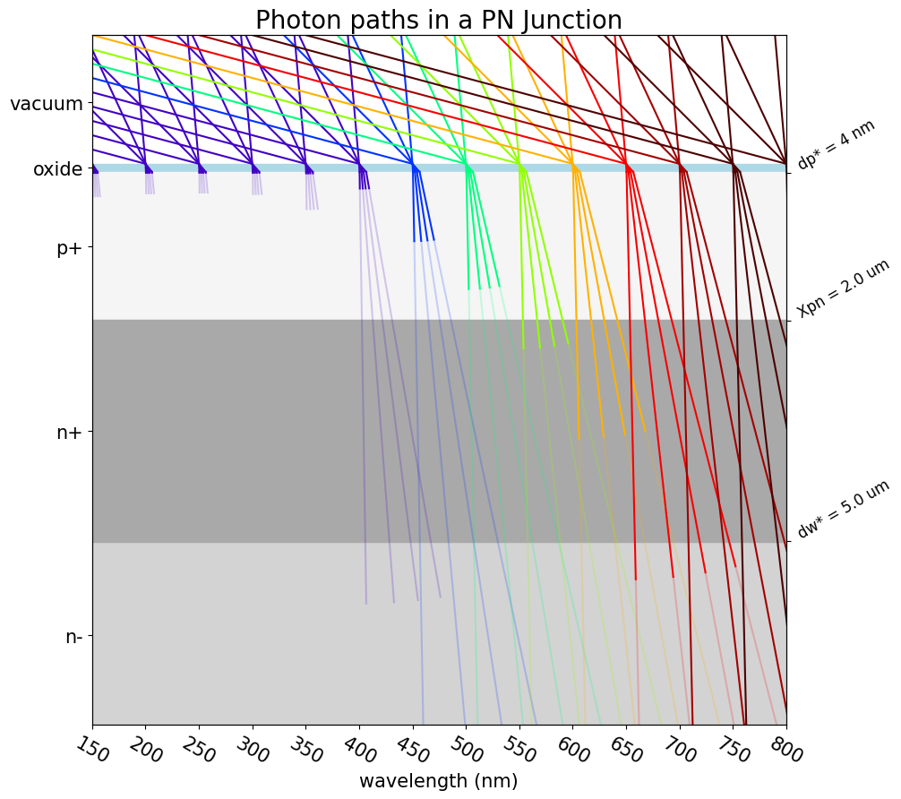
Angular dependence
Simple at first glance – refraction means that the effects of different incidence angles are smeared out
Opposite is true for emission of secondary photons – wide range of emission angles are possible

Slide 8
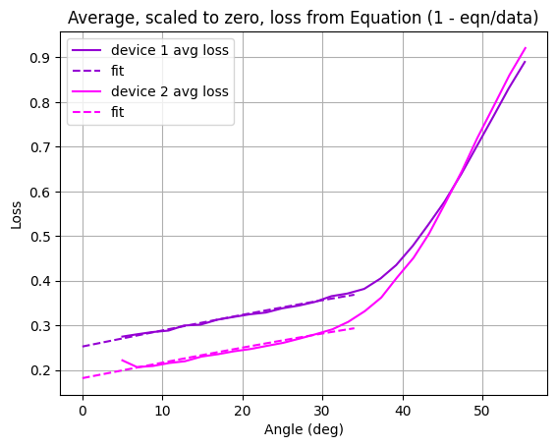
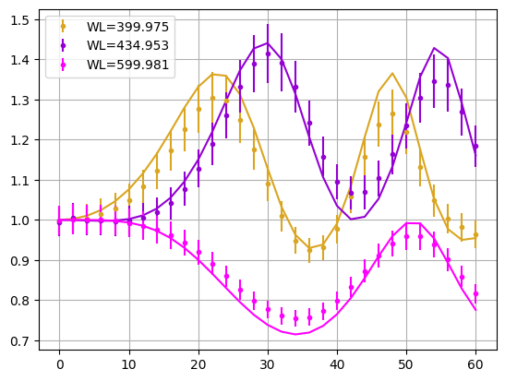
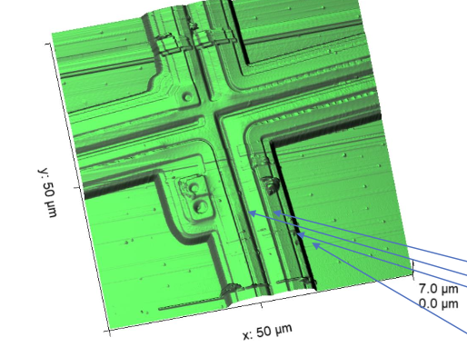
Angular dependence
Losses due to package shadowing
Passivation layer thickness, interference, shape of the device microstructure play a role
Device-specific measurements required
Losses due to microstructure shadowing in VUV4
Interference oscillations in FBK device
Angle (deg)

Slide 9
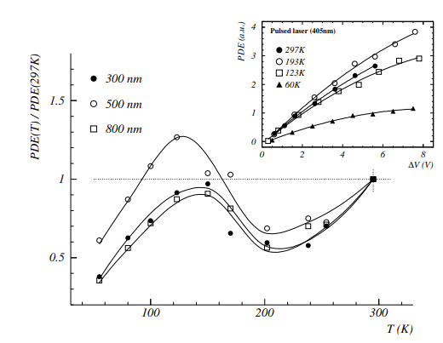
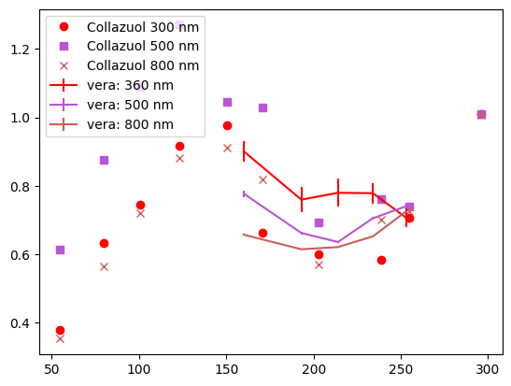
Temperature dependence
https://indico.cern.ch/event/51276/contributions/2034195
/attachments/967044/1373321/278_collazuol.pdf
Various measurements suggest a significant temperature effect
Change in optical constants seems likely – oscillations in FBK data do not match up
Verification needed to ensure validity of model at different temperatures
Our data for VUV4, scaled for comparison

Slide 10
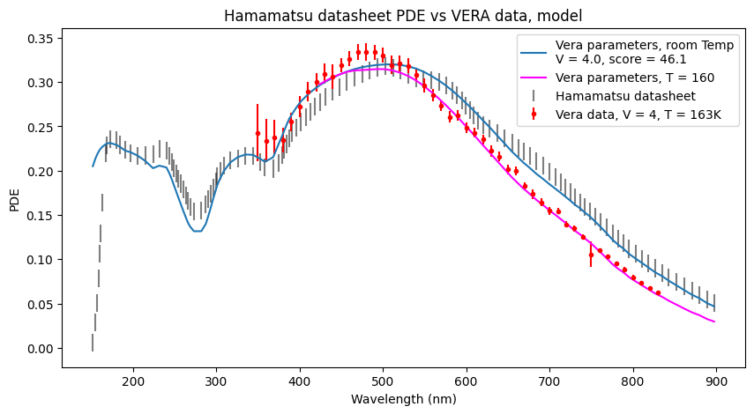
Modelling PDE
Model can be extrapolated to accurately reproduce data at VUV wavelengths
Change in attenuation length with temperature (https://arxiv.org/abs/2010.15844) fits 163K and RT but not intermediate temps
Not fully physical as quantum yield not included, but sensitivity is low at higher overvoltage

Slide 11
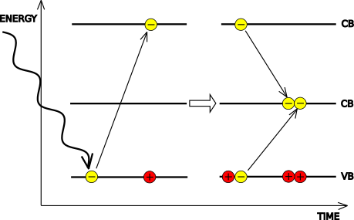
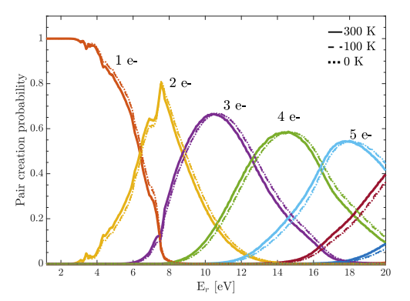
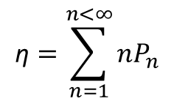
Quantum yield
High energy photons can produce multiple electron-hole pairs when absorbed in silicon with the average number given by the quantum yield, η(λ)
Increases above 1 at UV wavelengths
The PDE of an SiPM at these wavelengths will vary probabilistically
Understanding yield is relevant to:
  Accurate counting of UV photons using SiPMs or other single-photon silicon detectors
  Direct detection of light dark matter in semiconductors
  Assessing performance of high efficiency photodetectors (eg black silicon PDs)
Pair creation probabilities have been modelled, but not experimentally verified
$$\text{η}=\sum_{n=1}^{n<∞}{{nP}_{n}}$$
Ramanathan et al. https://arxiv.org/pdf/2004.10709

Slide 12
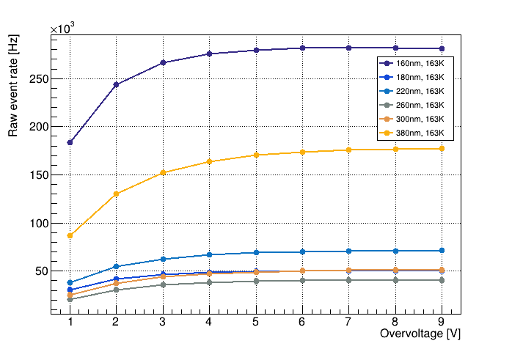
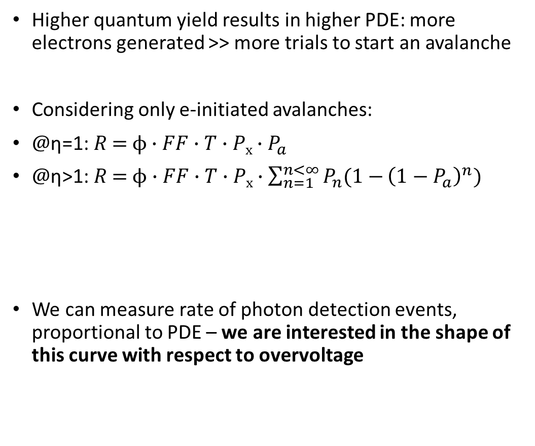
Measuring quantum yield using SiPMs
Higher quantum yield results in higher PDE: more electrons generated >> more trials to start an avalanche
Considering only e-initiated avalanches:
$@\text{η}\text{=1:} R\text{ =} ϕ∙FF{∙T∙Px∙P}_{a}$
$@\text{η}\text{>}\text{1:} R \text{=} ϕ∙FF∙T∙Px∙\sum_{n=1}^{n<∞}{P_{n}(1−}{\left(1−P_{a}\right)}^{n})$
We can measure rate of photon detection events, proportional to PDE – we are interested in the shape of this curve with respect to overvoltage
Probability of avalanche per primary electron
Gross probability of avalanche

Slide 13
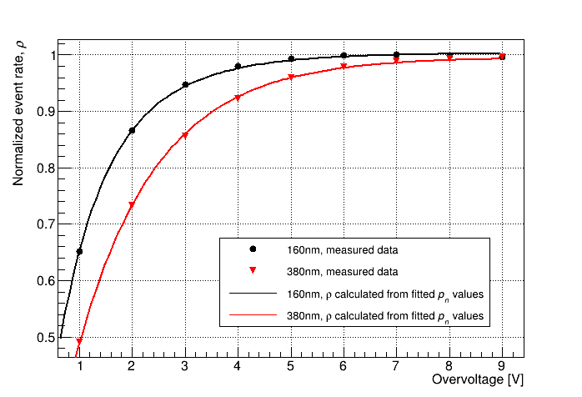
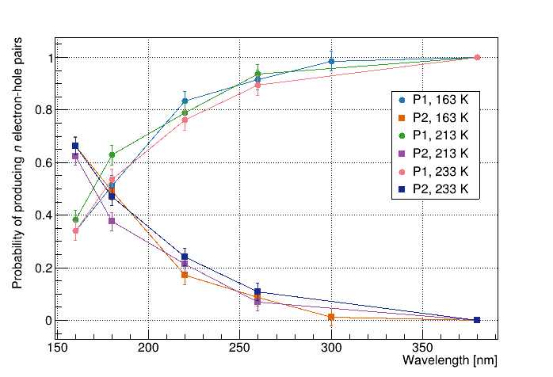

The saturation of PDE - determining the probability distribution of η
$P_{a}$ = 1 at high overvoltage
$R\text{ =} ϕ∙FF$ $∙$T $∙$P_{x}
Normalized rate ρ cancels all terms other than probability of avalanche
$@\text{η}\text{=1:}$ $P_{a}$ , $@\text{η}\text{>}\text{1:}\sum_{n=1}^{n<∞}{P_{n}(1−}{\left(1−P_{a}\right)}^{n})$
Using a long wavelength to get $P_{a}$ , we can fit to this curve to get $P_{n}$ for various values of n

Slide 14
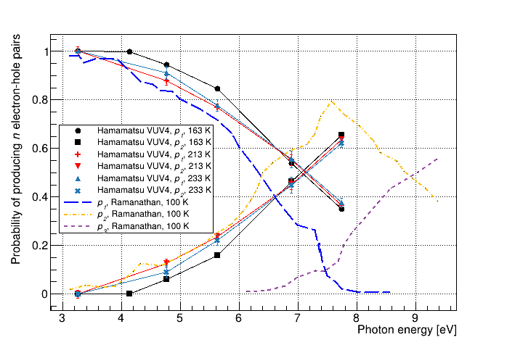
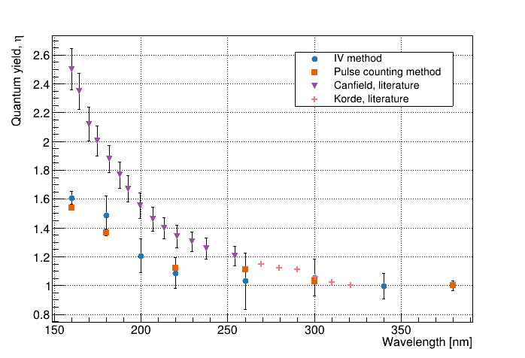
Interpretation of results
Measurement has been done for two different devices, results are consistent
Results indicate higher pair creation energies than are modelled in the literature
Negligible probability of producing 3 e-h pairs at maximum energy measured (7.7eV)
Auxiliary method using IV measurements gives matching results, results match performance of black Si PDs (QE 130% @200nm)

Slide 15
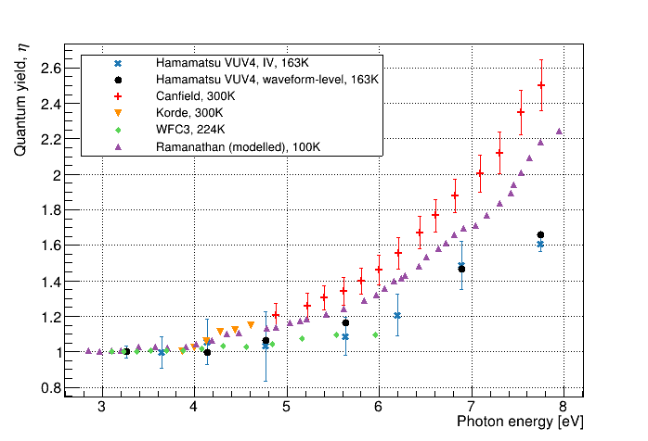
Interpretation of results
Our measured η is significantly lower than previously measured data – indicating higher pair creation energies than for high energy depositions (eg X-rays)
Measurement could be extended to ~10eV/125nm with an appropriate light source
Expected to have implications for physics reach of dark matter experiments using direct detection in silicon
More information available at https://arxiv.org/abs/2410.13033

Slide 16
Unanswered questions
How does reduced QY affect experiment sensitivity?
Full picture of temperature dependence of PDE is still unclear – this is most critical as recent work has shown significant (20%!) PDE drop at LN2 temperature (eg https://arxiv.org/html/2405.01529v1) – key takeaway here is that temperature dependence of optical constants may come in to play
Accounting for border effects – PDE measurements for VUV4 do not stack up with calculated transmission and a P_{e} that saturates to 1, probably fill factor is effectively less than HPK specification

Slide 17




Thank you
Merci
www.triumf.ca
Follow us @TRIUMFLab

Slide 18
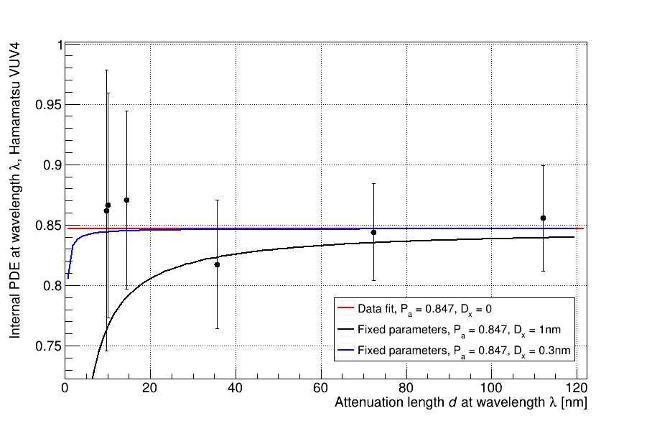
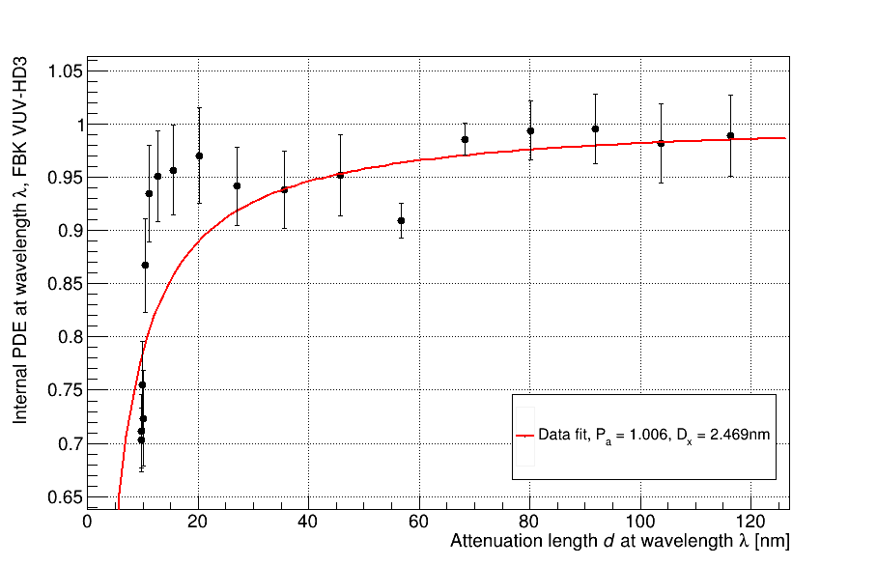
Front-side losses
HPK VUV4 does not show internal losses even with short attenuation length, FBK VUV-HD3 shows significant loss
Need to account for border effects – PDE measurements for VUV4 show P_{a} saturating below 1 – more likely this is due to the fill factor being effectively lower than stated value
PDE/transmission @7OV – indicates internal losses for WLs with short attenuation length

Slide 19
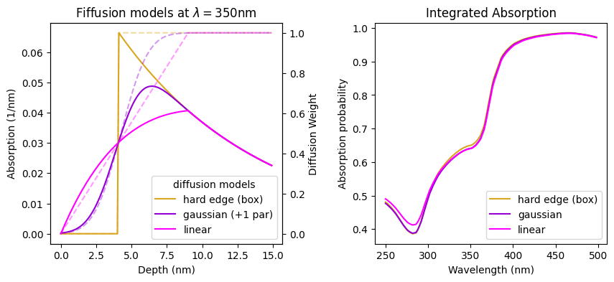
Diffusion
Some different absorption models studied to test effects of diffusion
  ‘Hard edge’ – probability of extraction for a photon absorbed at position x goes from 0 to 1 at a hard threshold
  Linear – probability of extraction increases linearly with absorption depth
  1 parameter Gaussian – assumes photogenerated carriers can drift a fixed distance in any direction
No qualitative difference above 350nm

Slide 20
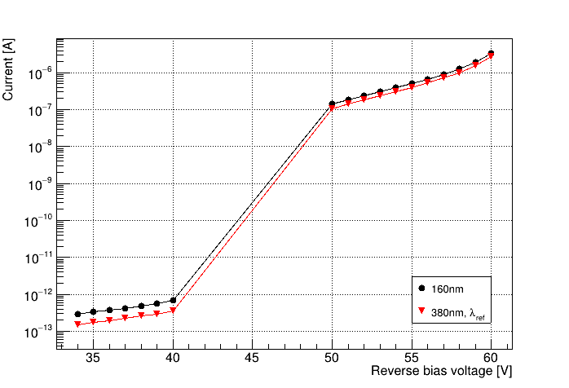
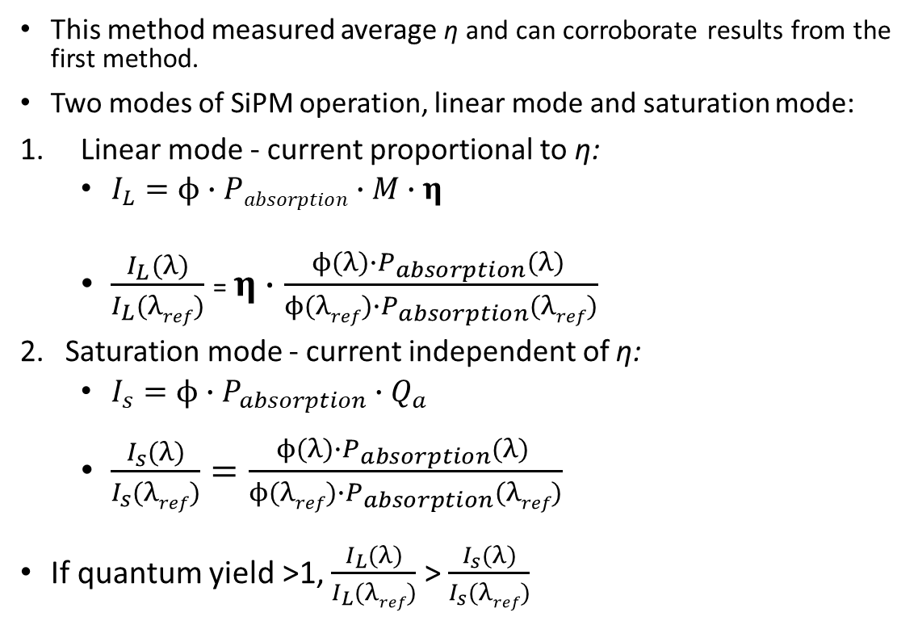
Auxiliary method using DC IV measurements
This method measured average η and can corroborate results from the first method.
Two modes of SiPM operation, linear mode and saturation mode:
Linear mode - current proportional to η:
  $I_{L}=ϕ∙Pabsorption∙M∙η$
  $\frac{I_{L}(λ)}{I_{L}(λref)}$ = $η∙\frac{ϕ(λ)∙P_{absorption}(λ) }{ϕ(λref)∙P_{absorption}(λref)}$
Saturation mode - current independent of η:
  $I_{s}=ϕ∙P_{absorption}{∙Q}_{a}$
  $\frac{I_{s}(λ)}{I_{s}(λref)}=\frac{ϕ(λ)∙P_{absorption}(λ) }{ϕ(λref)∙P_{absorption}(λref)}$
If quantum yield >1, $\frac{I_{L}(λ)}{I_{L}(λref)}$ > $\frac{I_{s}(λ)}{I_{s}(λref)}$

Slide 21
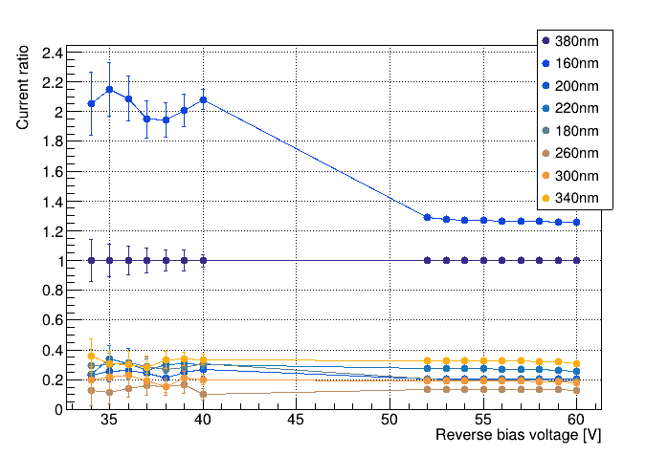
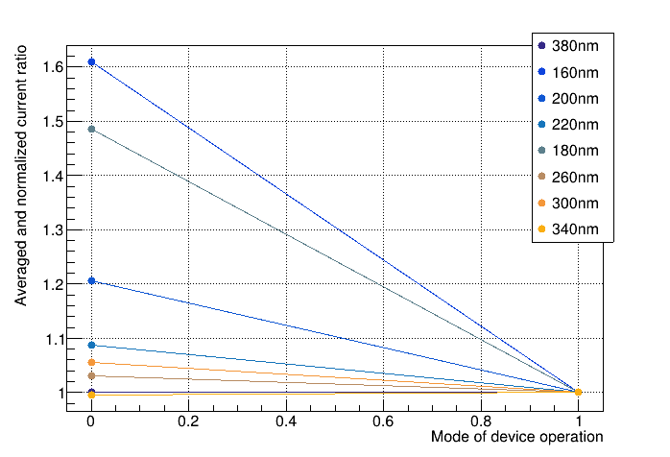
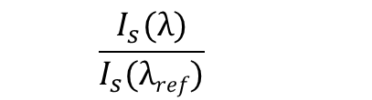


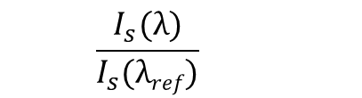

Determining η from current ratios
$$η\left(λ\right)={\frac{I_{L,λ}(V1)}{I_{L,λ_{Ref}}(V1)}}/{\frac{I_{Sat,λ}(V2)}{I_{Sat,λ_{Ref}}(V2)}}$$
  $$\frac{I_{L}(λ)}{I_{L}(λref)}$$
  $$\frac{I_{s}(λ)}{I_{s}(λref)}$$
  $$\frac{I_{L}(λ)}{I_{L}(λref)}$$
  $$\frac{I_{s}(λ)}{I_{s}(λref)}$$

Slide 22
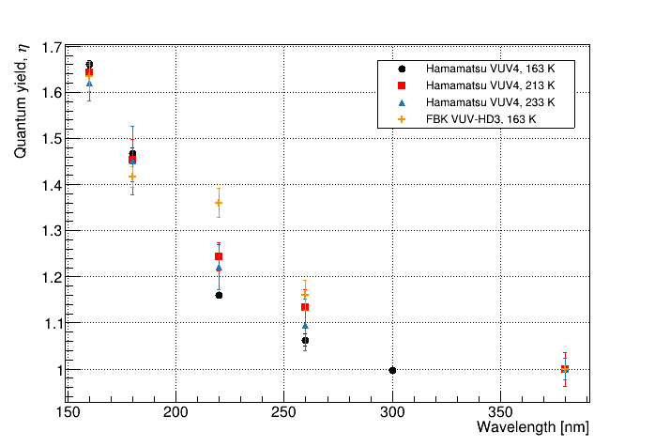
Temperature/device dependence
Measurement has been done for two different devices, results are consistent
Temperature dependence investigated, none observed

Slide 23
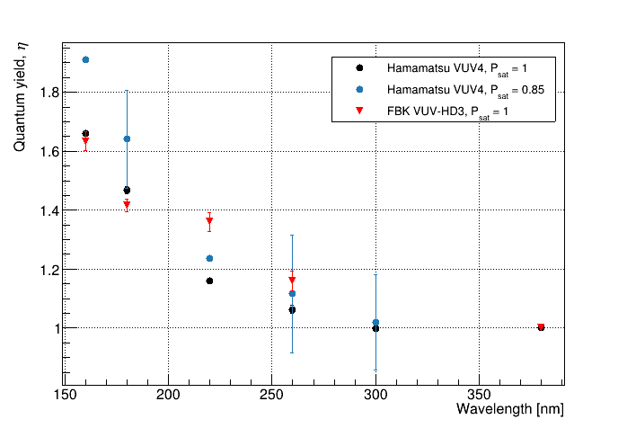
What if Pa saturates at 0.85..?

