Slide 1
2024-25 EYETS planning meeting
22.11.2024
A.Tauro

Slide 2
EYETS 2024-25
EYETS from Mon, November 25th, 2024 to Fri, April 4th, 2025 – 19 weeks beam to beam
  Access starts, in General mode, on Monday 25.11 at 9:00, after the RP search (Klaus)
  Cavern access stops on Tue, April 1st
  Start beam commissioning on Sat, April 5th
Standard maintenance of P2 services and infrastructure:
  Cooling & ventilation maintenance from 3 to 21 February → cooling perturbations, one-day complete cooling stop
  Electricity: test arrets-d’urgence (AUG) on February 4th → power cut of nearly every systems at P2, no access onsite
  Test of safety, gas & fire detection systems → alarms will be triggered, access perturbations
We do not plan to open the L3 doors.
Magnets will be switched-off on November 25th as soon a~1h after the beam is dumped (ARC→CCC)
  Electrical lockout L3 + Dipole power converters (Klaus): Mon 25 November around 10:00
Private visits possible from 25 November 2024 (14:00) to 27 March 2025 (12:00)
  Visitor’s path will be declassified → see next slides
  The ALICE visitor’s path would become a conventional zone. Nonetheless, we would continue monitoring the number of visitors via IMPACT and PAD access, but no signatures and dose recording would be required anymore.

Slide 3
Partial RP Declassification of ALICE Cavern during YETS / EYETS /LS
For this EYETS a RP declassification from supervised radiation area to conventional area is prepared for parts of the ALICE cavern UX25 as already in place for PX24 CRs.
The cavern areas concerned are those outside the green fenced area on A- and C-side and are shown in more detail on the next slide.
The declassification will be only valid and in force after the release of the official memo in the beginning of the shutdown from CERN-HSE-RP (as for the ALICE CRs).
The partial declassification will not change:
  The procedure for bringing in/out material from inside the remaining RP supervised area (L3, FASS, low-beta) inside the green fenced area.
  The requirement to wear a personal dosimeter when accessing UX25
  The requirement to have an IMPACT in progress to access UX25
  The requirement to follow ALICE confined space procedure when working inside L3/FASS
The partial declassification will change:
  The procedure for bringing in & out material to the de-classified zones
  The procedure for doing ALICE private guided visits during EYETS. Details will be communicated in the guides training course and to the ALICE guides e-group
Klaus

Slide 4
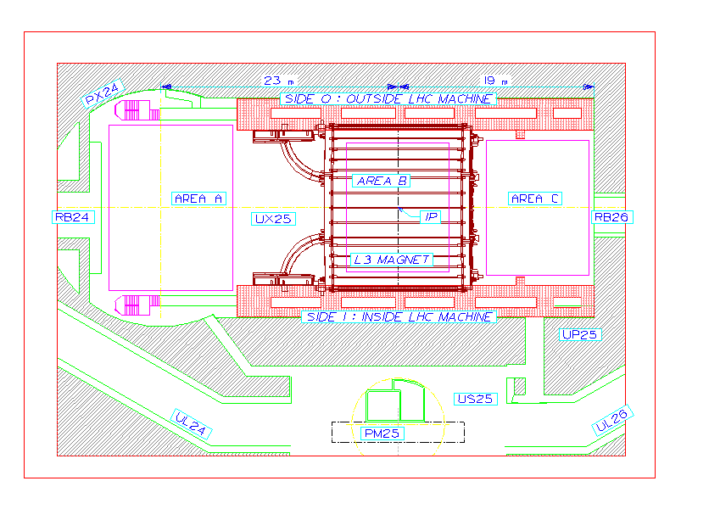
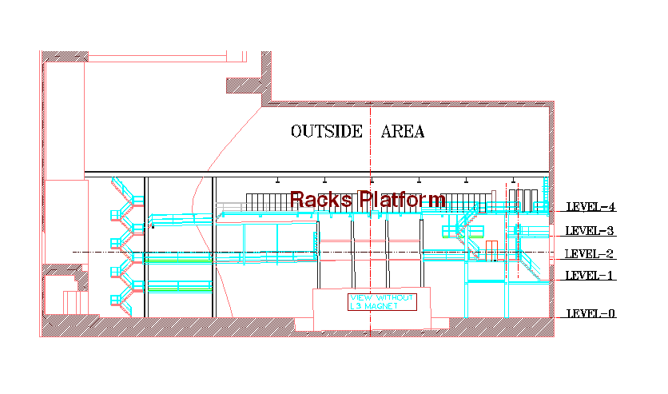
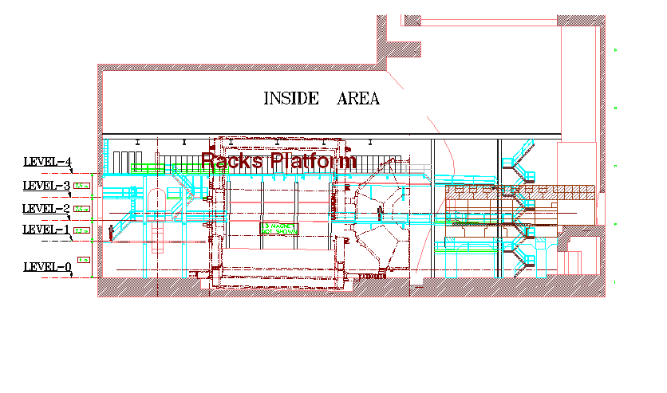
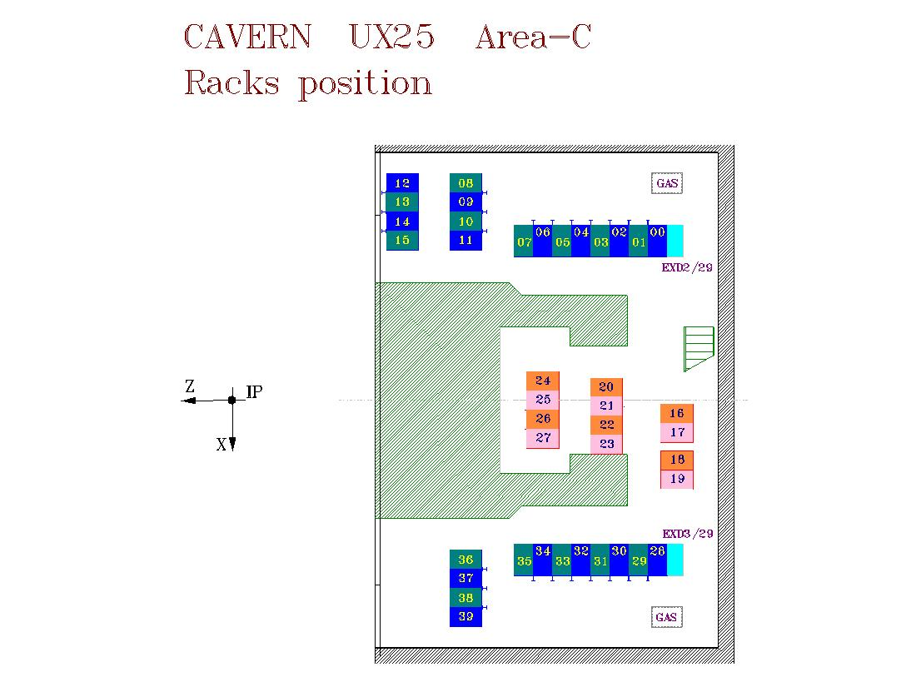
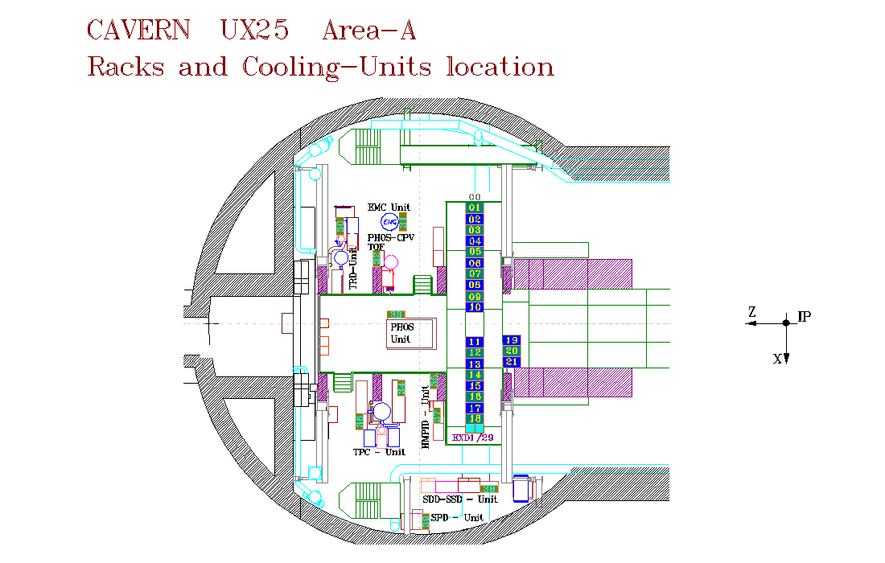
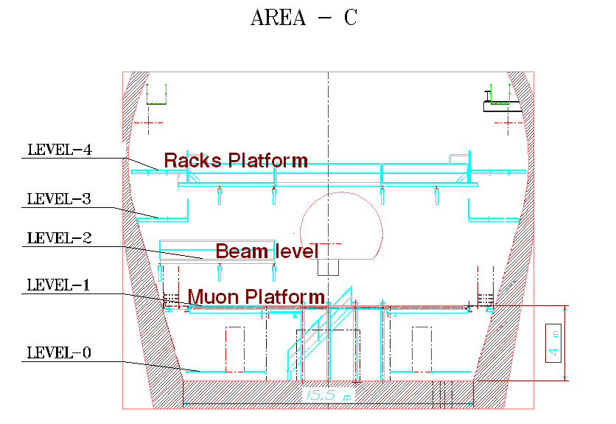
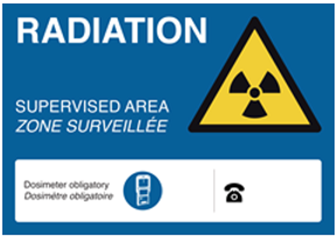
Zones to be declassified during (E)YETS/LS
The loading and visitor platform A-side in front of L3 (2228/U2-001) will be a supervised area only in case material from inside L3/FASS is stored/transported there.
All entrances to the remaining supervised area zones will be clearly indicated with the usual sign.
Klaus

Slide 5
Summary of access interruptions
Opening PX24 shaft: 2 December → no access UX25 and CRs from 8:00 AM to 16:00 PM
Safety tests (sirens and flashing light): 24 December (during EOY closure) → no access UX25
CSAM test: 3 January (during EOY closure) from 8:00 to 13:00 → no access UX25
Test N/S (CERN wide): 8 January 6:00 – 6:10 AM → no access UX25 5:00 AM - 9:00 AM
AUG LHC2 + ALICE: 4 February → no access P2 site
Individual System Test (IST): 28 February from 13:00 to 19:30 and 3 March from 17:00 to 19:30 → no access UX25 from ~1h before the tests
Department Safety Office (DSO) test: 13-14 March → no access UX25 from March 13 at 15:00 to March 14 at 18:00
Closing PX24 shaft: 14 March → no access UX25 and CRs

Slide 6
EOR party
Scheduled on Monday, 25 November noon → 60 people expected inside SX2

Slide 7
DCS
Stop of DCS for backup of WinCC projects on Monday 25.11 from 09h till ~12h (pending final approval by Run Coordination).
1-2 day stop of full DCS for maintenance and upgrades. Most likely around the AUG test (04.02.2025), to be confirmed.
Otherwise DCS will remain operational throughout EYETS (including EoY closure). Upgrades of Framework and patching of WinCC will be coordinated with individual detectors.
Andrè

Slide 8
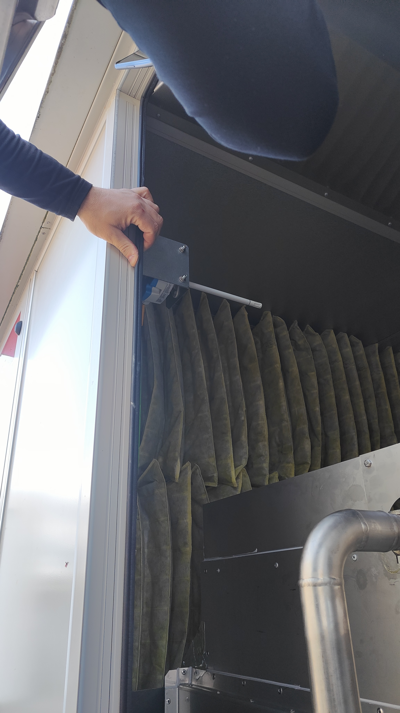
EPN
Switch over to winter mode
Shock treatment (with EN-CV) → spring 2025
Replace air cooling filters (with Philippe/Julien):
  December 2024: IT1, IT2, IT3 (AHU1-AHU2 only) and cleaning all water tanks
  Beginning June 2025: IT1, IT2, IT3
  December 2025: as December 2024
Next week
  November 25h: validate shock treatment procedure on one AHU in IT4
  Install new fluxmeter in RO container (to readout the raw water influx)
Scheduled for 2025:
  displace all external air temperature probes from the AHU section behind the external filters to the section in front of the external filters (reading of external air temperature without air ventilation are biased from the container heat and AHU don’t go in winter mode, i.e., water is flushed from pipes but stays in the AUH tanks)
  Install 4 serial2ssh box (1 per container): needs laying down long ethernet cables for serial connection of all the 4 AHUs of one container to the box
  Install Fire Interlock
Federico

Slide 9
CTP
25 November: C-side, C26 Rack reshuffling boards in C26B and C26T in order to improve cooling

Slide 10
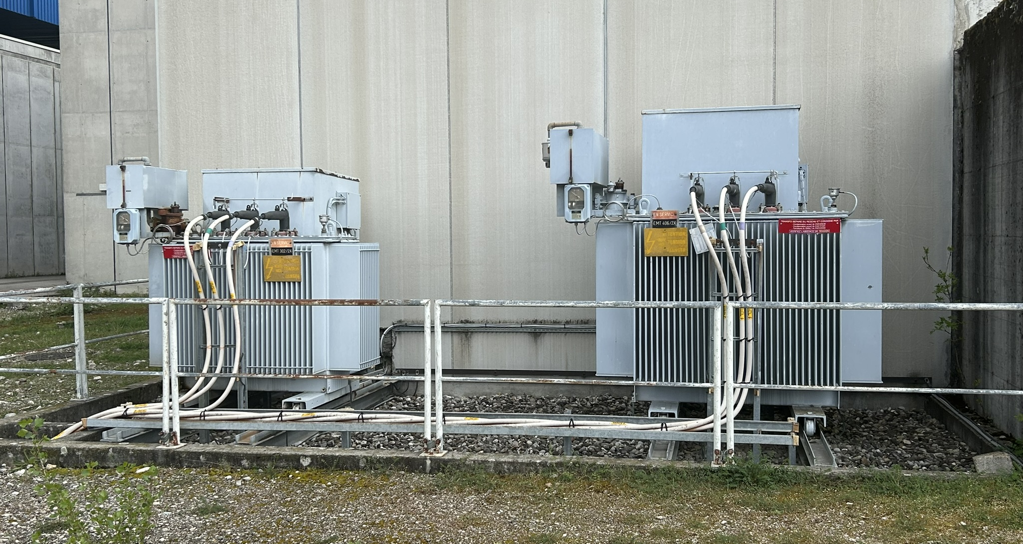
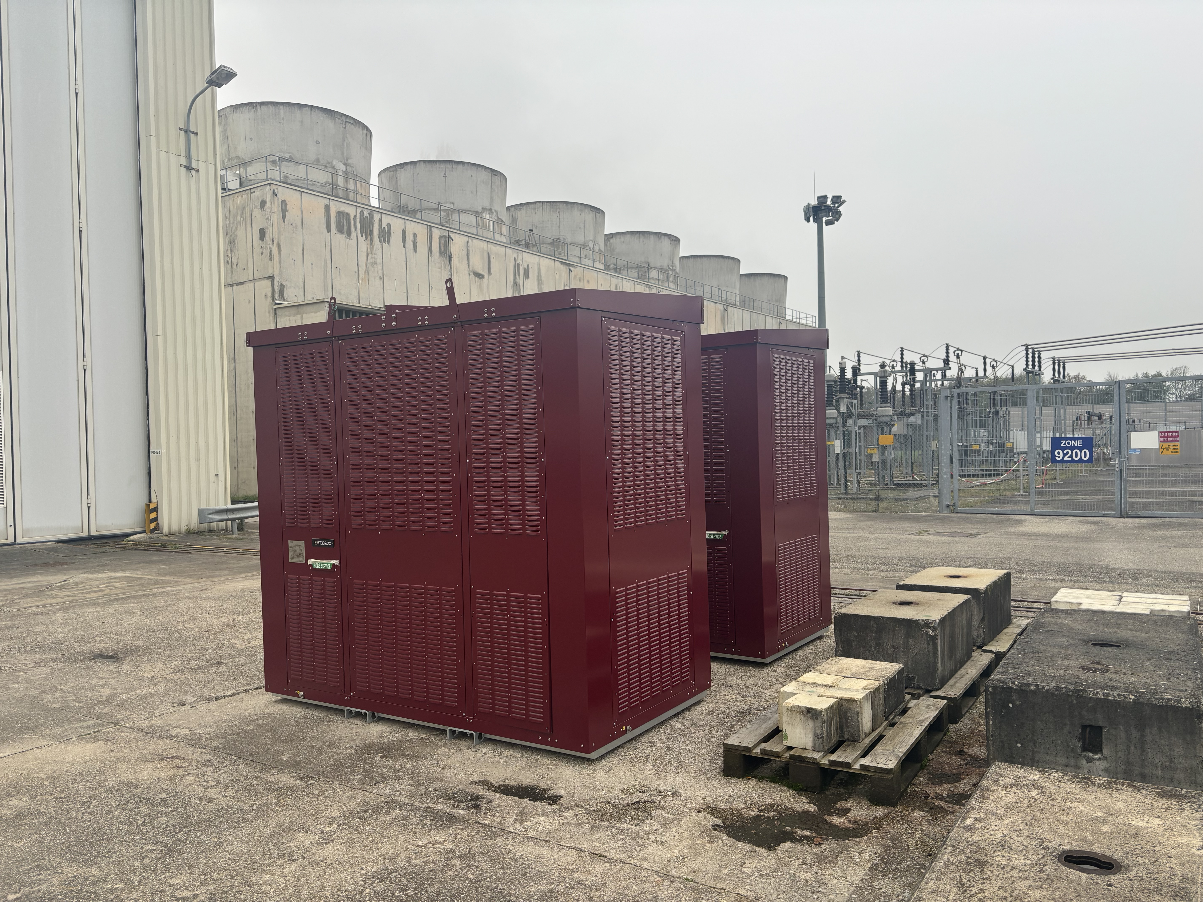
Electrical interventions (EN-EL)
AUG test LHC2 + ALICE: Tue 4th February
  Various power cuts on whole site, no access to P2
  4 Feb: AUG + US25 and SX2 transformers
Replacement of SX2 transformers (EMT302/2X and EMT406/2X)
  Planning: EMT406/2X: 25.11.2024 to 13.12.2024 and EMT302/2X: 27.1.2025 to 14.2.2025
  EMT406/2X power rating will be reduced from 2MVA (2880A) to 1.25MVA (1800A)
  Transparent as it is possible to re-power the switchboards that will be replaced
UPS maintenance:
  9 Dec for the 200KVA (CR3/CR4) and Diesel UPS, 13 Dec for the 500KVA (CR1/ARC/CR0) UPS.
  During the maintenance we will run on bypass (no battery backup in case of power cut); in the past this never caused an issue, so no need to switch things off.
Install cable RAMSES to CROME HSE-RP in PX24
  Planned in week 11
CERN-wide tests:
  Auto-transfert test: 20-22 January (week 4) → transparent
  Test N/S: 8 January 6:00 – 6:10 AM (week 2) → will cut general services and gas systems for few minutes, no access UX25 from 5:00 AM to 9:00 AM
  AUG Adm. Zone Meyrin: 4 January (week 1)
EN-EL overall planning
SX2 transformers
New SX2 transformers
Yann Maurer/Juliano Perret

Slide 11
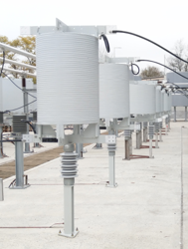
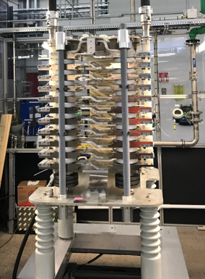
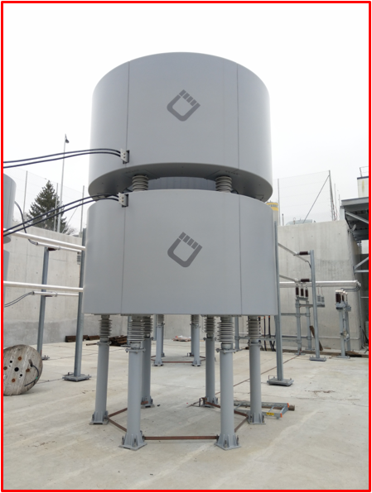
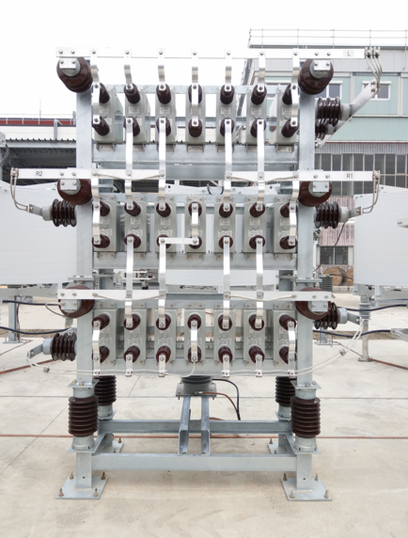
SVC maintenance (SY-EPC)
Switch off SVC
    LHC4 on 13/12 as requested by cryo
    Other points 09/12/2024
Switch on SVC
    LHC2 on 24/02/2025
    LHC4 & LHC6 on 17/02/2025
    LHC8 on 18/02/2025
  No transfer lines magnet switching when SVC is OFF

Slide 12
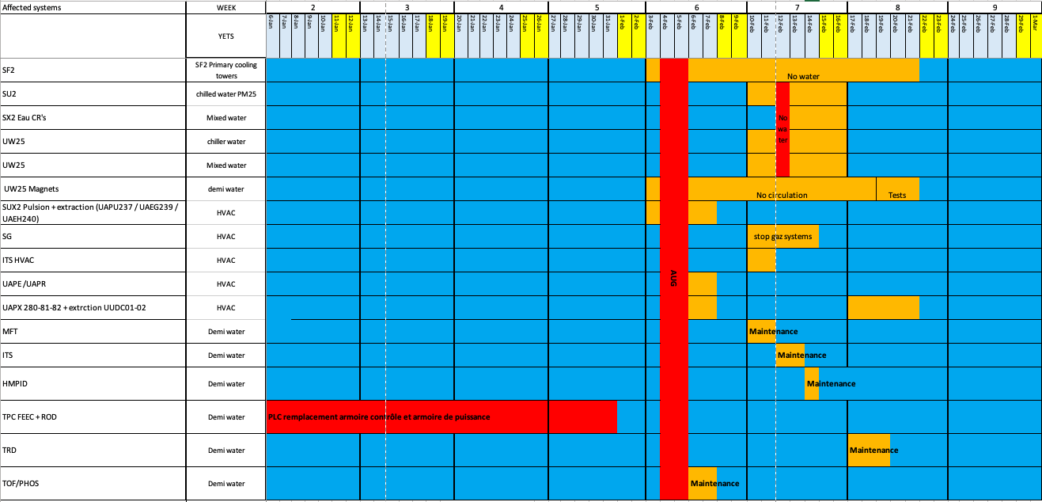
Cooling interventions (EN-CV)
Maintenance water cooling systems: 3 to 21 February 2025 (week 6-7-8)
  Week 6: SF maintenance (cooling towers) → switchover to external chillers
  Week 7: SU2, SX2, UW25 maintenance → various perturbations on iced water & mixed water
    Complete stop of iced & mixed water on Wed 12 February → stop racks cooling + detector cooling (ok if reduced power on detectors)
  Week 8: UW + tunnel ventilation units
Maintenance ventilation units:
  Week 6: UX25, L3. Small cuts (30’) → no impact on access
  Week 7: SG2 → stop flammable gases; ITS → 3 days without air cooling
  Week 8: MCH, MID
Maintenance cooling plants:
  Week 6: TOF/PHOS
  Week 7: MFT, ITS, HMPID
  Week 8: TRD
Replacement of TPC cooling plant electrical cupboard (switch to UNICOS) → postponed to LS3
  2 weeks wo cooling + 1 week commissioning
  TPC should redo the DCS part (DIP)
UX25 sump systems control replacement
EN-CV overall planning
Dominique/Olivier

Slide 13
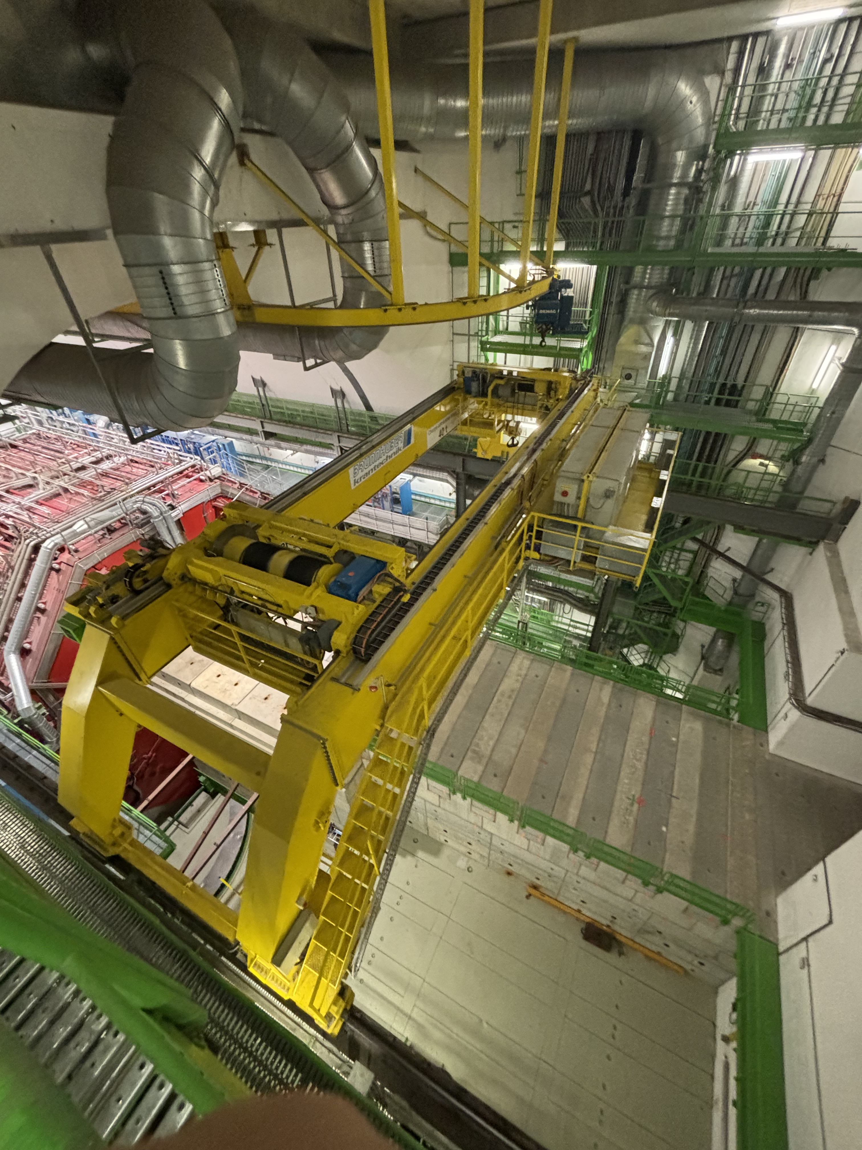
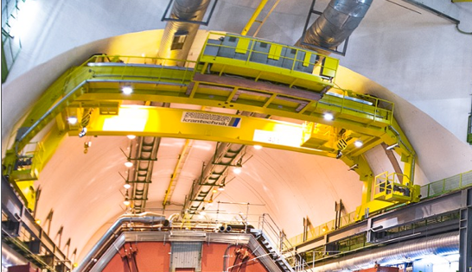
UX25 crane refurbishment (EN-HE)
Refurbishment of cavern crane
  Install new cupboards, cables, sensors and motors
  Check weldings
  Cables and mechanical structure won’t be replaced
  Both crane trolleys will be brought in SX2 for rework
  Will require partial opening of the PX24 plug
Work executed by Visan, Turkish company
Crane will be unavailable between 12 January and 15 February
Detailed planning:
  VIC: 25-29 November
  Opening PX24 shaft: 2 December (start with small blocks on November 26) → no access UX25 and CRs from 8:00 to 16:00
  Load test (check brakes): 5-6 December
  Visan onsite rework: 12 January to 15 february
  Check crane weldings: in January (need nacelle)
  Closing PX24 shaft: 12-14 March → no access UX25 and CRs 14 March
8 x 8 m² storage space needed on surface (SX2) as from 15 December
  Displace AMS robotic arm to SXL2 beforehand
  Create buffer zone in SX2 for material evacuated (EN-HE to discuss with HSE-RP)
Total cost: 600 kCHF (Hostlab)
2 crane drivers onsite from 25 November 2024 to 31 March 2025
UX25 cavern crane
Roberto/Filippo

Slide 14
ITS activities
Exchange of power unit patch cords at PP1 (Mini-frame)
Investigation and possibly implementation of an improved power unit connection scheme at PP1 to reduce the number of patch cord changes in the future (Mini-frame)
Investigation of problems with CAEN bulk power supplies (Rack area A)
Exclusion of L5_19 from cooling to assess leak rate of the rest of the system
Installation of hot-plugging capable back planes in the safety system ITS2S (Rack area A)
No PP1 filter exchange
All longer activities in the mini-frame will be announced in advance.
Markus/Felix

Slide 15
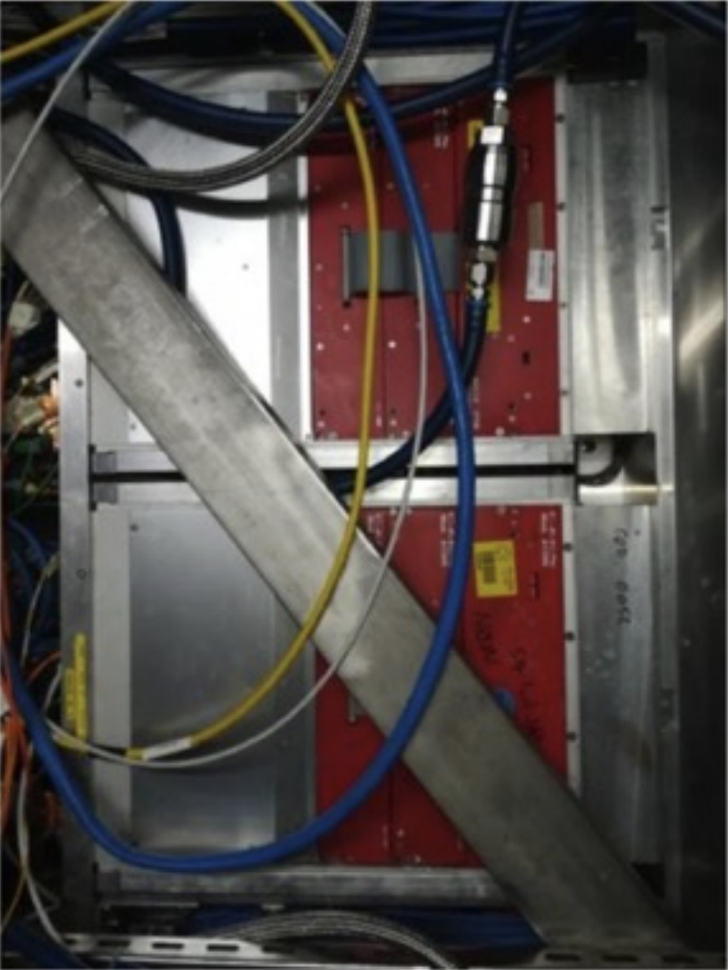
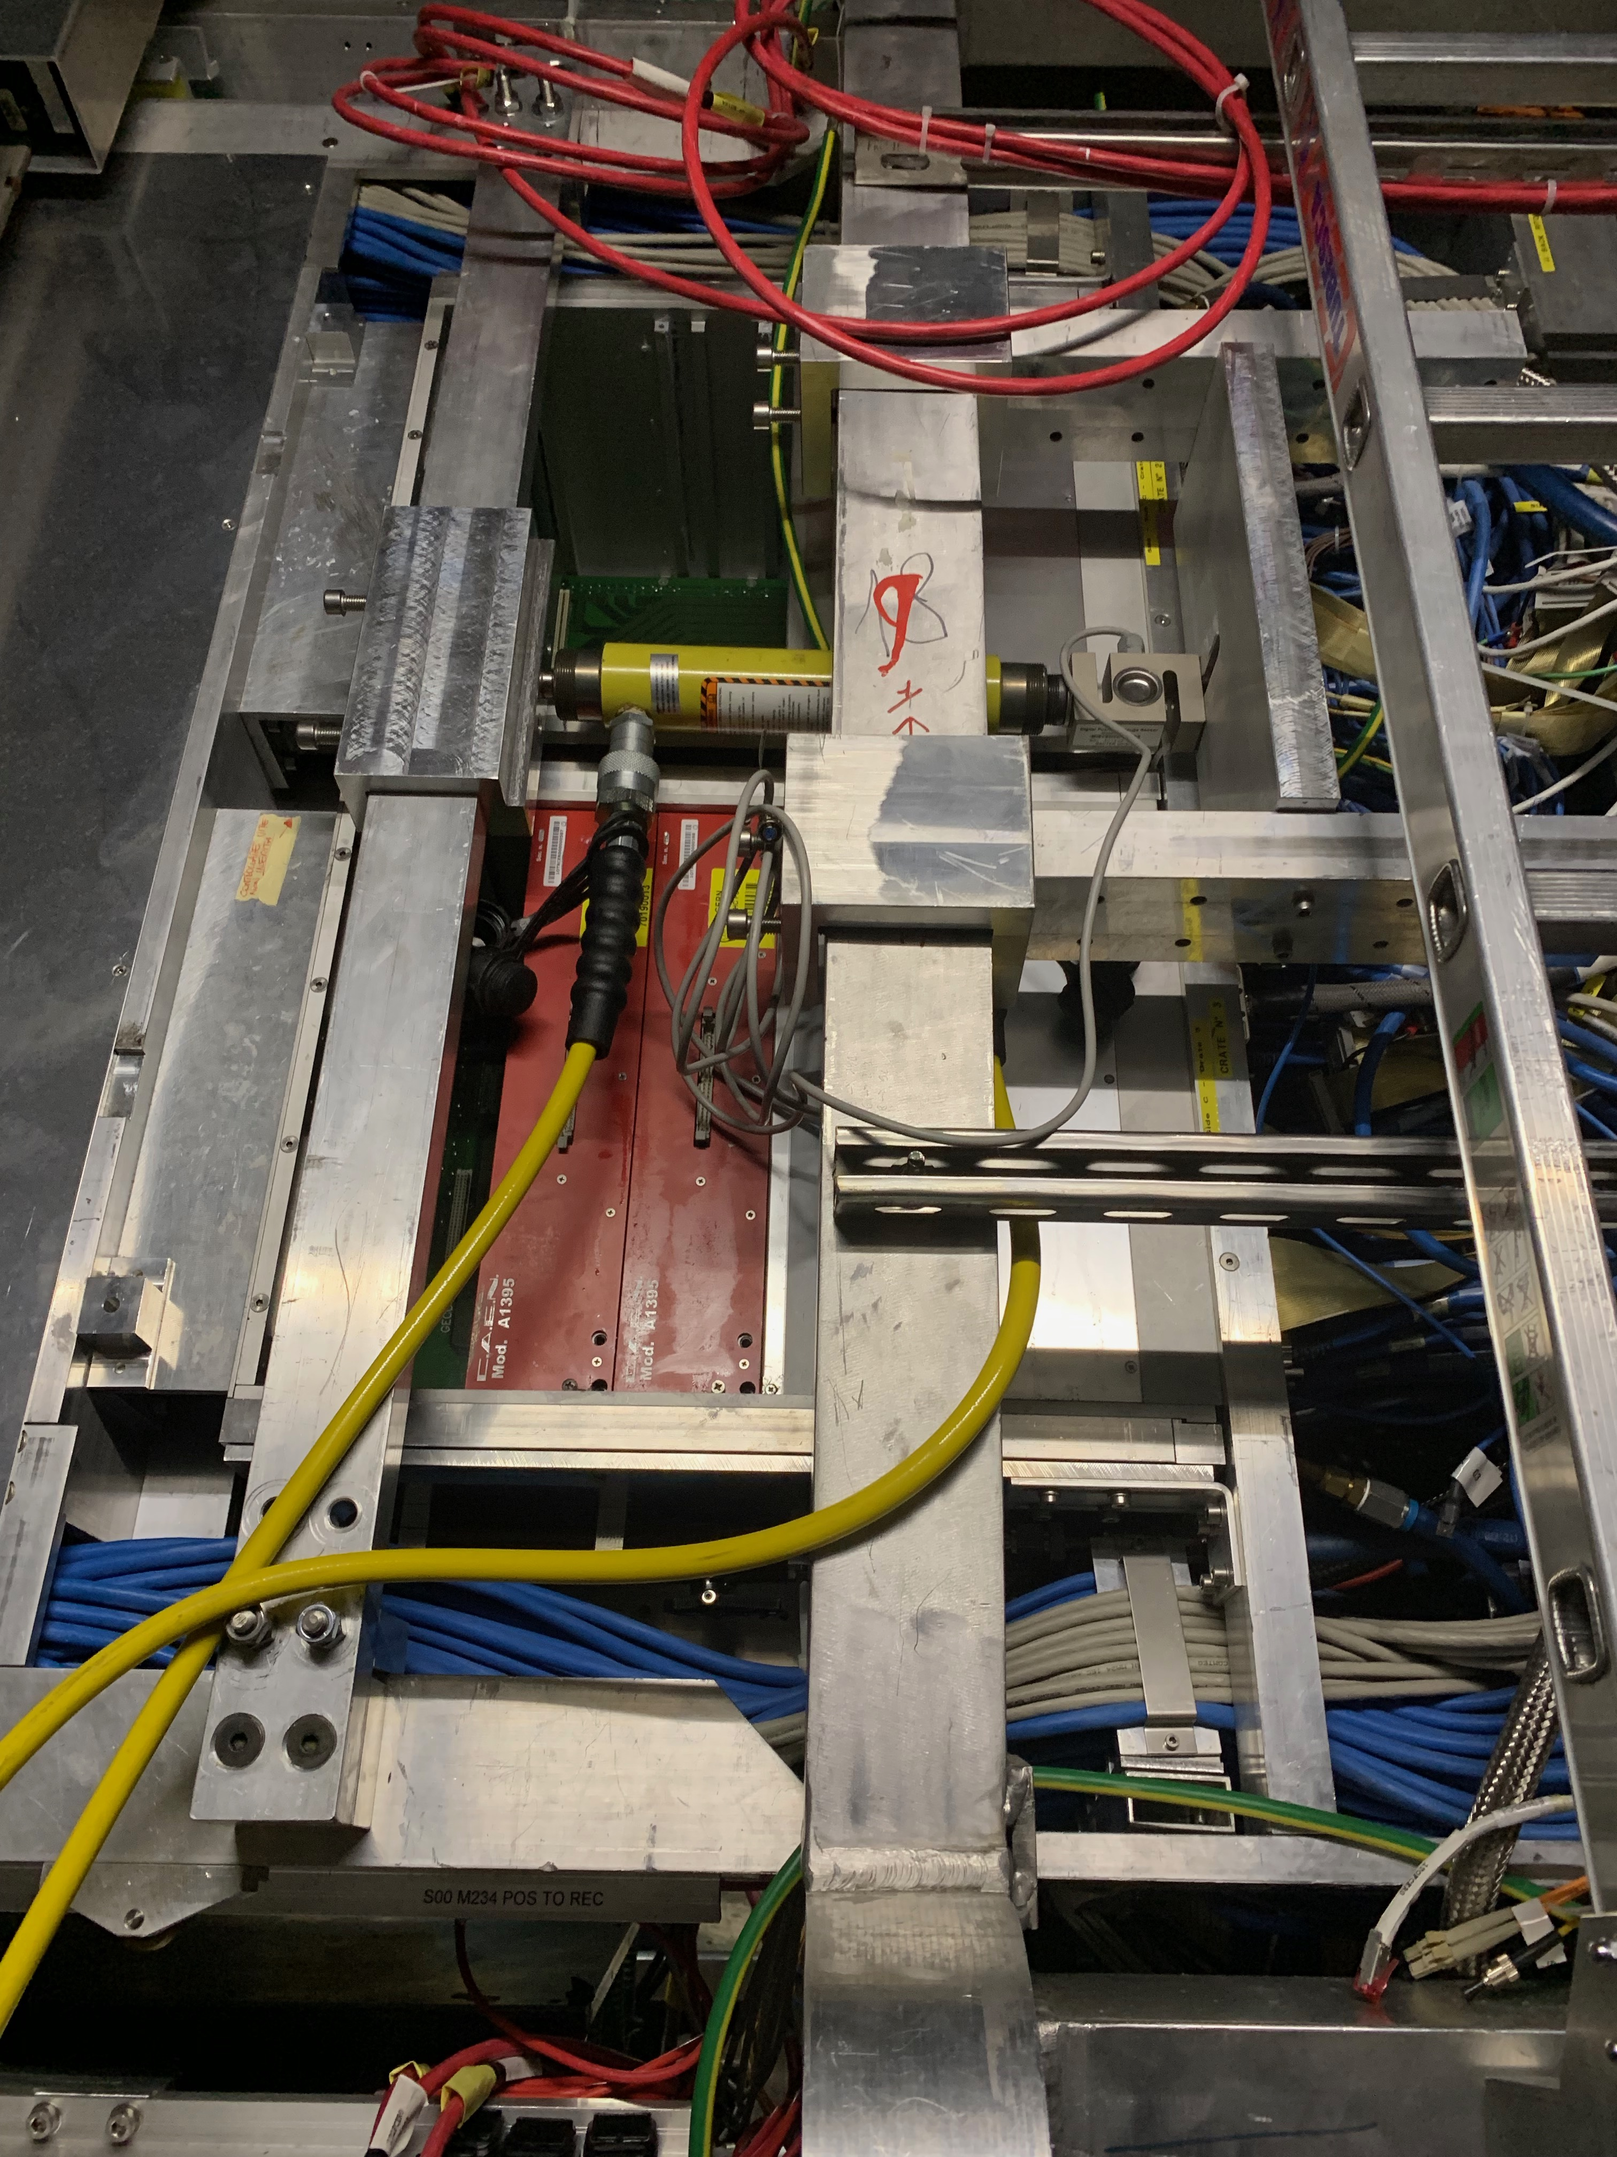
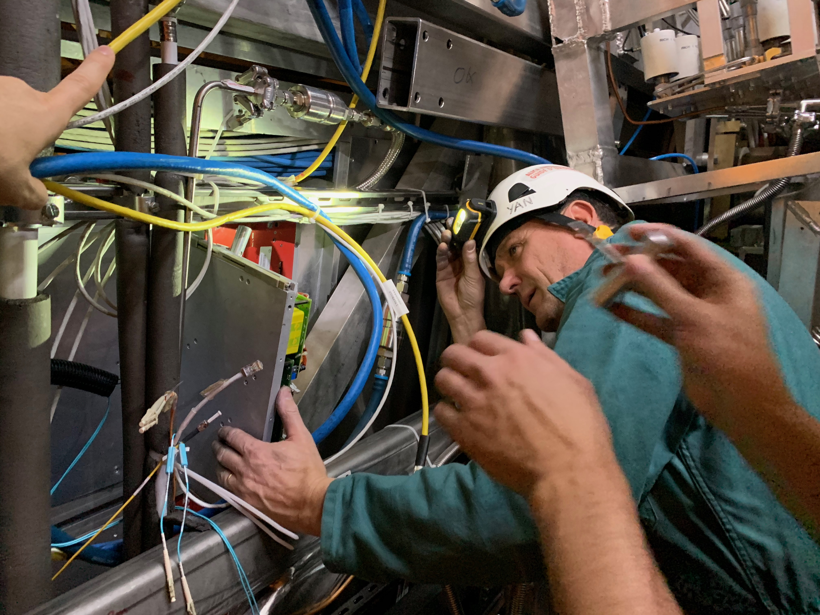
TOF activities
TOF: displace SM1 to replace one DC-DC converter (A-side)
  Mon 27/1: disconnect services TOF SM1 (TOF team)
  Tue 28/1: install hydraulics and prepare for TOF SM1 displacement (Philippe/Julien)
  Wed 29/1: displace TOF SM1, replace DC-DC and put back TOF SM1
Unclogging crates
DCDC to be replaced on crate 21
Fix crates 39, 57, 62 (debug in situ needed)
Fix HV for SM14Mod4Pos
Installation of two new CAEN mainframes (A4527) in CR4
Space-frame beam blocking DC-DC access
Hydraulic jacks used to move TOF SM
Yannick replacing one TOF DRM (LS2)
Sofia/Manuel

Slide 16
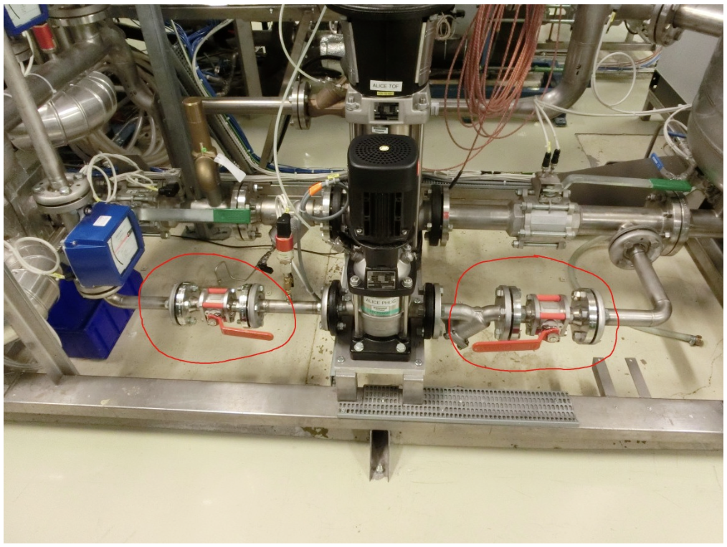
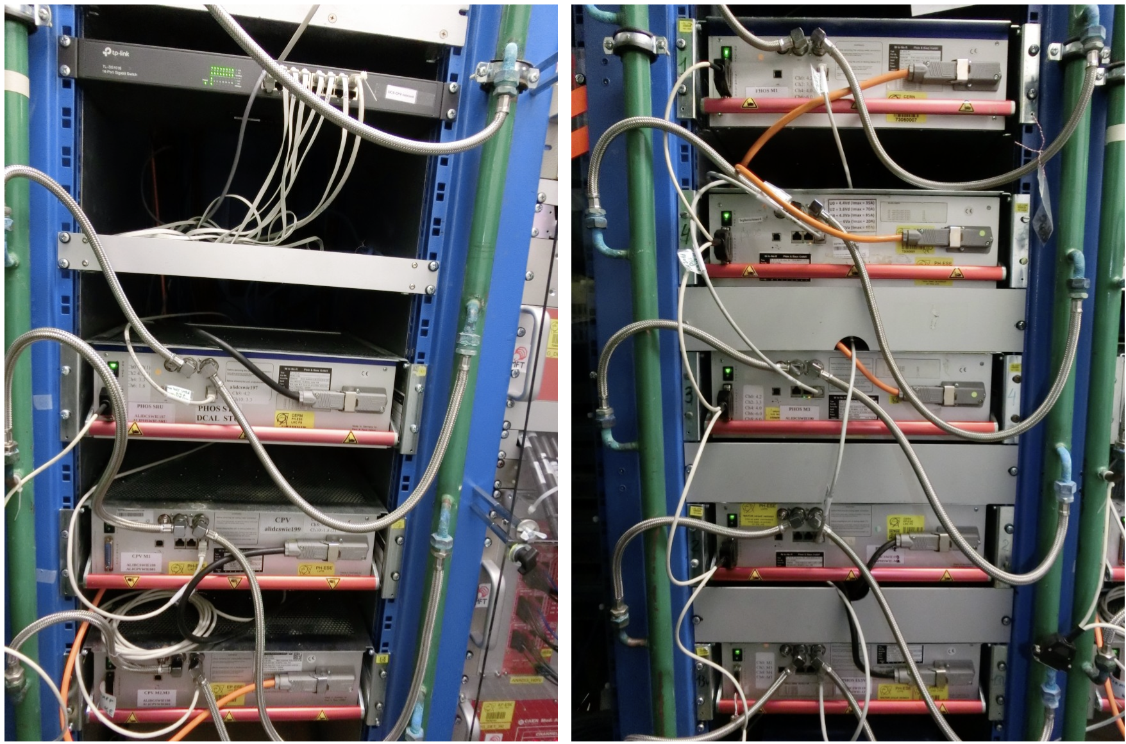
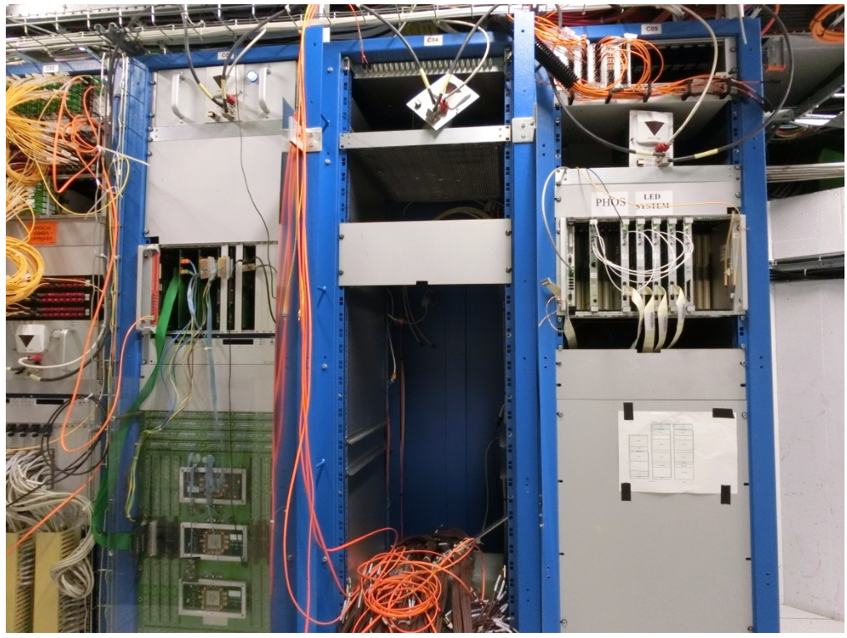
PHOS activities
Switching PHOS & CPV to ‘safe mode’ will begin on 25 November, with the help of P2 technicians and EN-CV:
  Warm up crystals over 10 days, drain C₆F₁₄ from the cooling plant for recycling.
  Lock and drain residual water from PHOS/CPV pipes.
  Switch off racks, power equipment, and cooling plant.
PHOS experts will stay at CERN until 28 November, and DCS access should be maintained until the end of the year. PHOS will be switched-off remotely.
PHOS area in b.167 currently being emptied → it will be attributed to FoCal from next year.
PHOS/CPV main water pump
PHOS Wiener LVPS in A16-17
PHOS VME crates in C05

Slide 17
MFT activities
Cooling:
  Cooling plant maintenance (10-11/02) – EN-CV
  Buffer tank check (loss of water?) – EN-CV - (date tbc)
  No PP1 filter exchange
Electronics:
  Reinforcement of connectors on 8 dispatching boards (glue point + additional 3D printed connector supports) - L3 C-side - 2 days (not necessarily contiguous, date tbc in Dec/Jan)
  Replacement of the 3 VTRx affected by sticky fluid on 23 readout units - L3 C-I-side - 6 days (not necessarily contiguous, dates tbc in Jan/Feb)
Access to power off/on everything (including racks) for Christmas closure and AUG tests (CR4 + cavern)
Charlotte

Slide 18
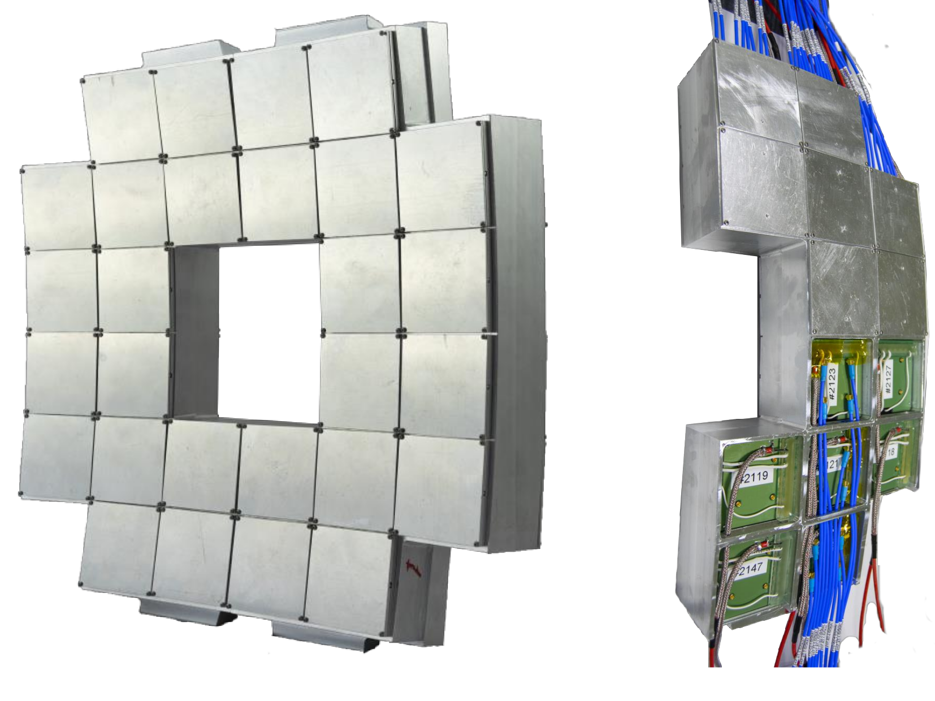
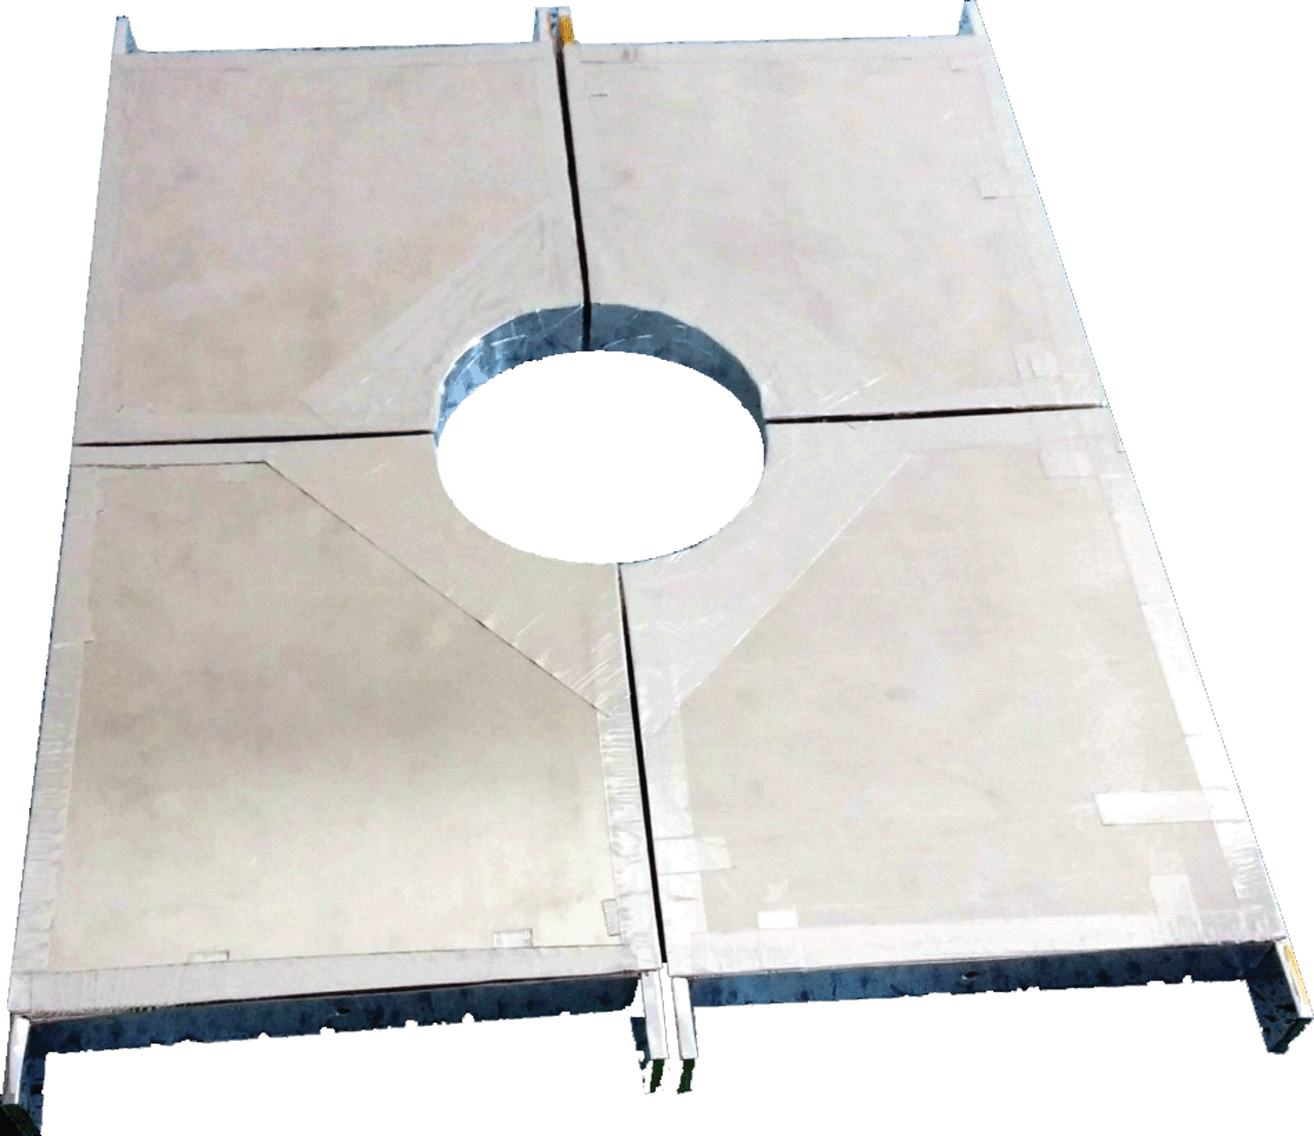
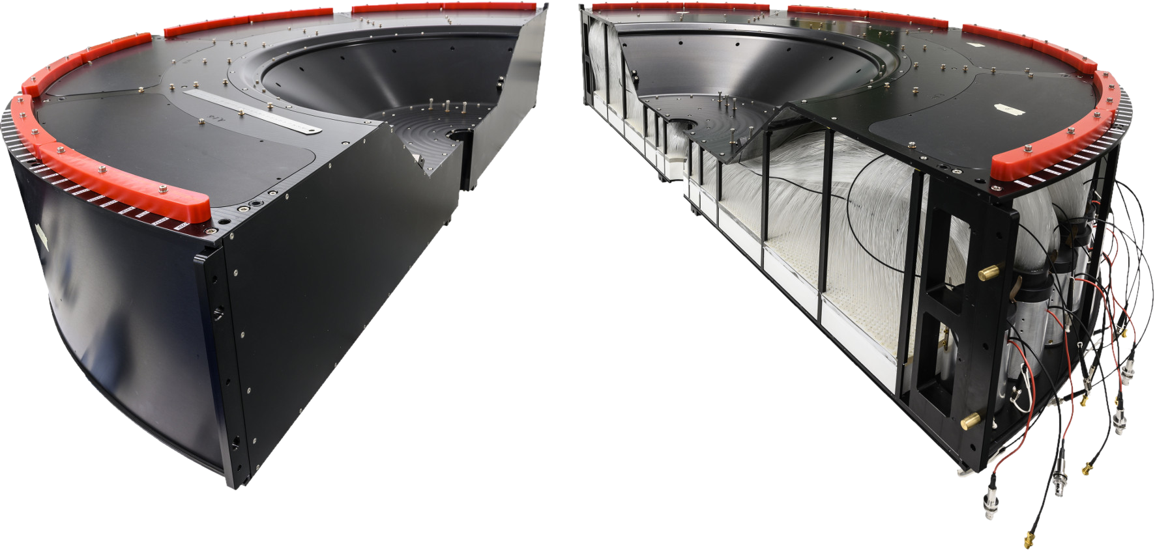
FV0 ALFRED implementation plans
Due to the integration the FIT setup with the ALICE CENTRAL DCS, we plan to start implementation the ALFRED framework on the FV0 detector during the YETS period and conduct thorough testing.
The implementation will utilize a parallel path, where the Central DCS will allocate additional nodes for our use. We will use the DCS for the whole period, however, we may provide the FV0 detector in 15 min in case of need.
Preliminary timeline:
  25–26 November 2024: Central DCS provides the required nodes.
  27 November–19 December 2024: ALFRED framework implementation.
  6 January–2 March 2025: Testing phase.
  3 March: The detector will be handed back to RC.
We’ll use only FV0
Not main trigger;
Working properly;
Good for test;
FT0
FV0
FDD
Monika Kutyla

Slide 19
MCH
Activities resuming in January

Slide 20
Other activities
EN-HE: reinstall batteries on both nacelles (Mon 25 November)
HSE-RP: RP sampling on 25.11 (TOF, ITS, MFT, TPC, TRD, HMPID)
TE-VSC:
  Close manual beampipe valve on Monday, November 25 after 10:00
  Re-open it on Thursday, March 27 AM
HSE-FRS: on February 16th & March 9th & March 23rd, the firefighters will simulate the evacuation of a person injured by electric shock and the spread of a fire in the electrical rack. This exercise will be carried out in collaboration with firefighters from SDIS 01. Red Key required
EN-AA: maintenance cavern lift (AS-724): Thursday, December 5th, between 6:00 AM and 8:00 AM → no access to UX25 cavern

Slide 21
Access, fire, gas and SNIFFER detection systems (EN-AA)
Access system preventive maintenance: 3-4 December → access possible, patrol will be lost
Yearly maintenance red phones: 9 December
Safety test (sirens and flashing light): 24 December → no access underground whole day
CSAM test: 3 January from 8:00 to 13:00 → no access underground
Individual System Test (IST): 28th February from 13h to 19h30 and 3rd March from 17h to 19h30 → ALL DOORS must be closed and no emergency green handle pulled (no patrol needed). Underground access will be stopped ~1h before the tests.
Beam Imminent Warning (BIW) test: 28th February, in the shadow of IST test
Department Safety Office (DSO) test: 13-14 March → patrol and close ALICE on March 13th at 15:00 (test starts at 16:00). No underground access from March 13th at 15:00 to March 14th at 18:00
Tests on Fire, Gas and SNIFFER Detection Systems
System | Buildings | Dates | Comments
Gas Detection Activity #1 | SG2, CR5 and UX25 | 25/11/2024 to 27/11/2024
Gas Detection Activity #2 | SG2, CR5 | 04/02/2025 | Electrical Interlocks test of gas system in the shadow AUG test in collaboration with EN/EL and EP/DT
Fire Detection Activity #1 | UX25 and Counting Rooms | 25/11/2024 to 29/11/2024
Fire Detection Activity #2 | UX25 Racks | 21/02/2025 to 27/02/2025
SNIFFER Activity #1 | CR5 and UX25 | 26/02/2025 | Test of level 3 alarms and DSS after all rotations are done
SNIFFER Activity #2 | CR5 and UX25 | 27/02/2025 or 03/03/2025 | Assistance to ALICE for air sampling network cleaning
Nicolas Broca/Vitor Rios

Slide 22
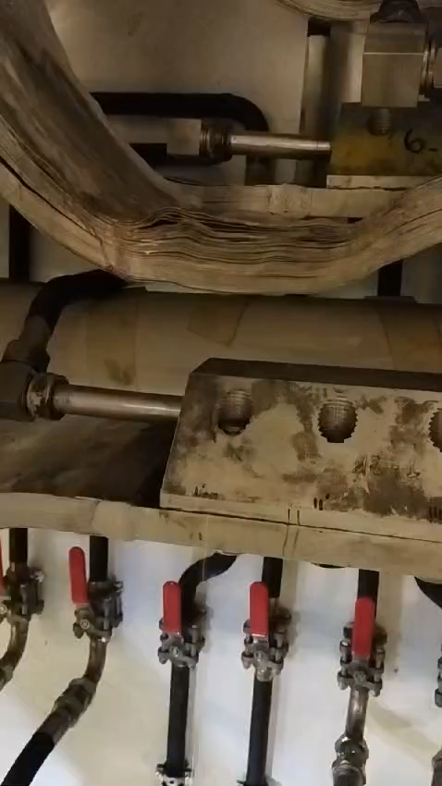
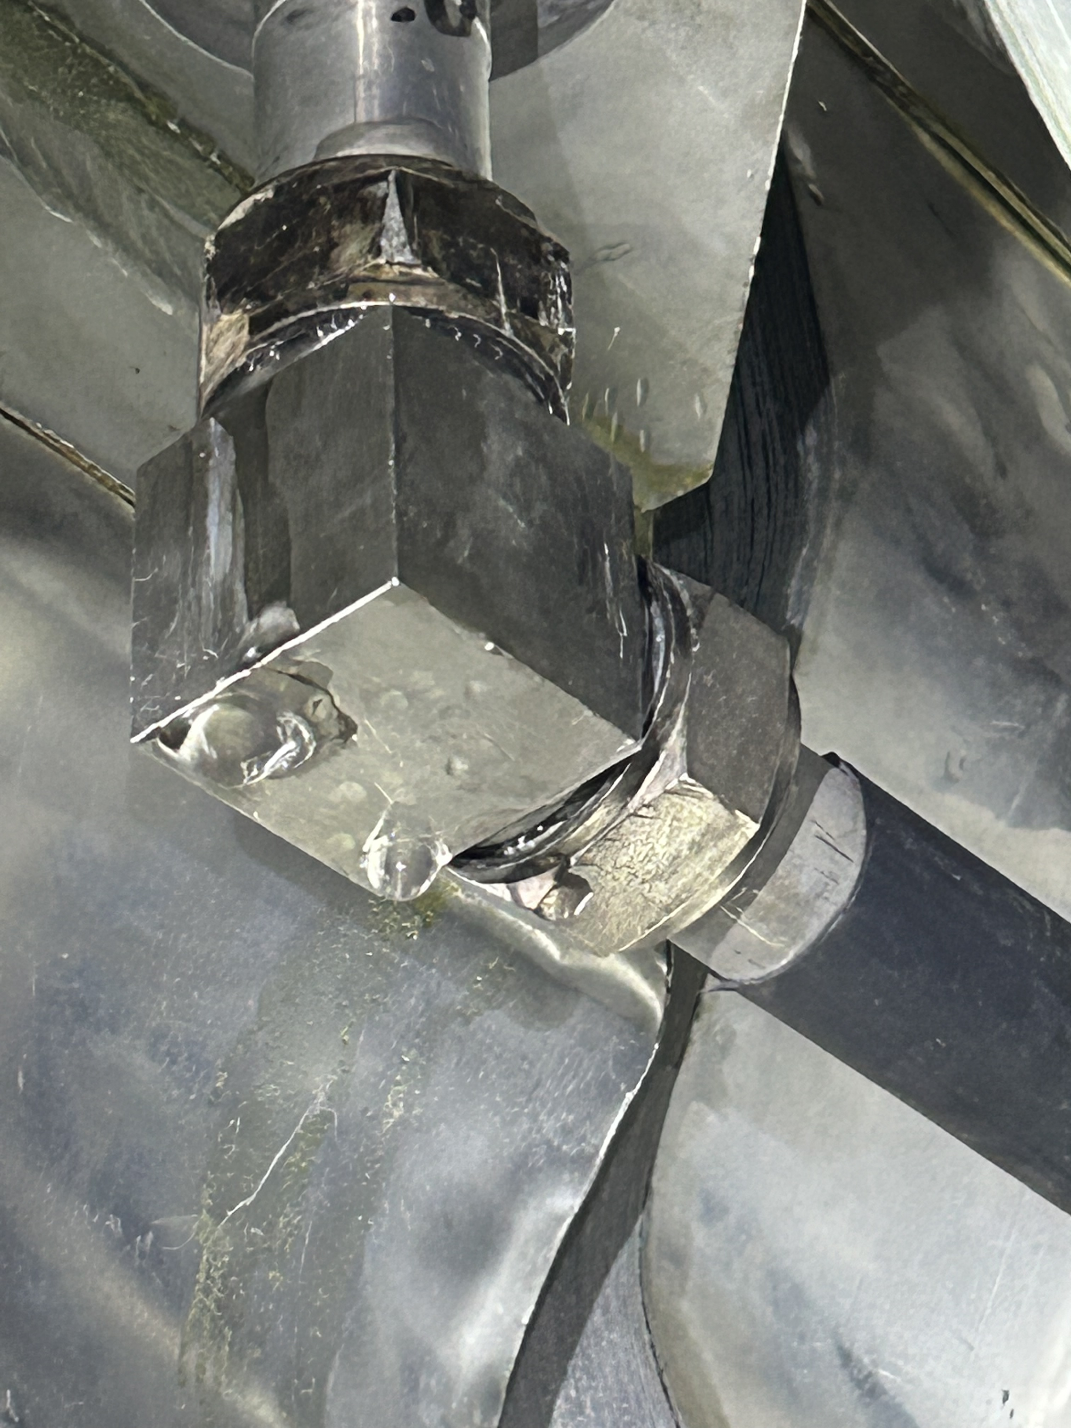
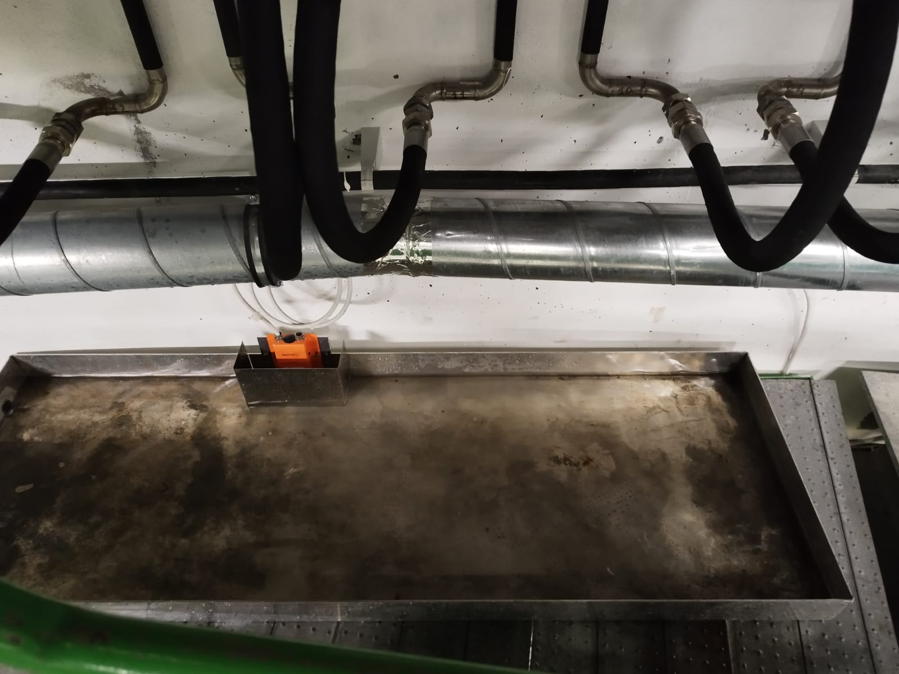
Update on L3 busbar leak
A quite big leak in the L3 busbar cooling system was detected on July 5th.
  Faulty fitting on an inox line.
The leak went unnoticed by the DCS (as it was dripping outside the tray), and the magnet continued operating normally.
An inspection on July 24th successfully brought the leak under control, reducing it to just a few drops per minute.
A complete fix would require cutting the inox pipe, which posed excessive risk during the run. It was decided to postpone the repairs until the EYETS, with the magnet power-cycled only when absolutely necessary to minimize thermal stress on the malfunctioning fitting.
Week 48: Drain line + remove bridge (help transport)
Week 49: weld new pipe on Tuesday, December 3rd. Install fitting and fill up line (EN-CV).
Magnet powering test on Thursday, December 5th AM
The ‘culprit’
Water collector and DCS sensor
Philippe/Julien

Slide 23
Gas activities (EP-DT)

Slide 24
EOY gas consumption
 |  |  |  | In service during the closure (Y/N) | If in service, expected consumption (m3/d) | If not in service during the closure ,proposed date for the switch off (Before the 20th of December) | If restarted in January ,proposed date for the switch on (2023)
ALICE | CRFDG-PGS_ALICE-N2 | CRFDGRF001-00001800 | 2270/R-011
ALICE | CRFDG-PGS_ALICE-AR | CRFDGRF001-00001700 | 2270/R-011
ALICE | CRFDG-PGS_ALICE-CO2 | CRFDGRF001-00011200 | 2270/R-011
ALICE | CRFDG-PGS_ALICE-HE | CRFDGRF001-00001900 | 2270/R-011
ALICE | CRFDG-PGS_ALICE-NE | CRFDGRF001-00002000 | 2270/R-011
ALICE | CRFDG-PGS_ALICE-AR_H2 | CRFDGRF001-00002100 | 2270/R-009
ALICE | CRFDG-PGS_ALICE-C2H2F4 | CRFDGRF001-00002200 | 2270/R-009
ALICE | CRFDG-PGS_ALICE-NE_CO2_N2 | CRFDGRF001-00002500 | 2270/R-009
ALICE | CRFDG-PGS_ALICE-SF6 | CRFDGRF001-00002600 | 2270/R-009
ALICE | CRFDG-PGS_ALICE-ISOBUTANE | CRFDGRF001-00002300 | 2270/R-009
ALICE | CRFDG-PGS_ALICE-CH4 | CRFDGRF001-00002400 | 2270/R-009

Slide 25
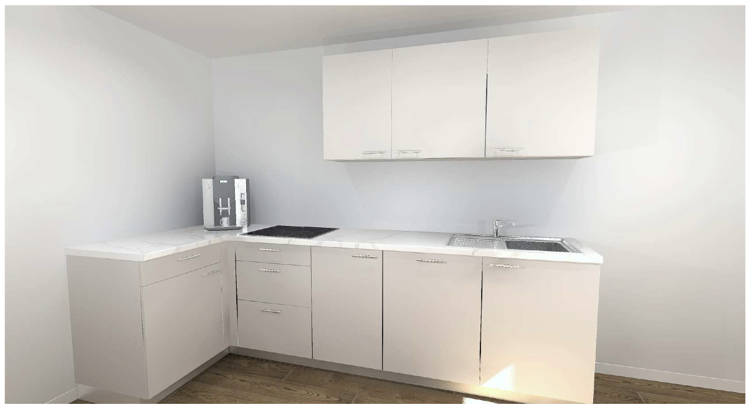
Renovation SX2 kitchen
Renovation SX2 kitchen, starting on Monday, November 25th:
  Disassemble kitchen: 25.11
  Remove floor tiles, floor resin & paint wall: 26.11 to 6.12
  Reassemble kitchen + new hard top: 9.12
  New furniture (tables, chairs)
  Install new TV screens outside ARC and inside kitchen
Kitchen unavailable for 3 weeks, starting on November 25th
  Vending machines moved outside during works
Philippe/Julien

Slide 26
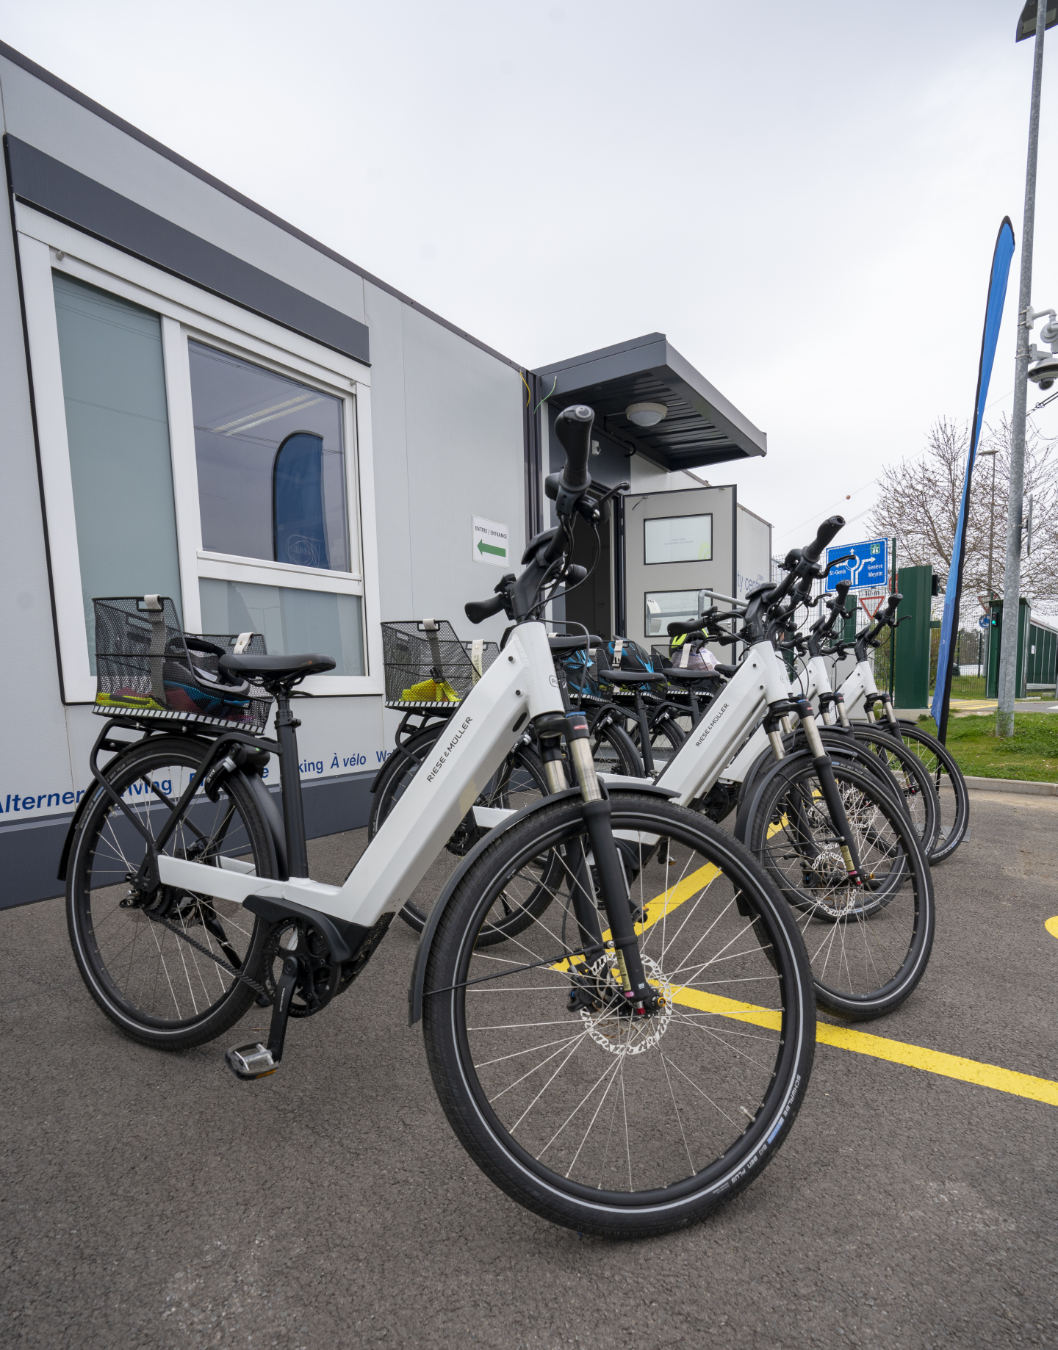
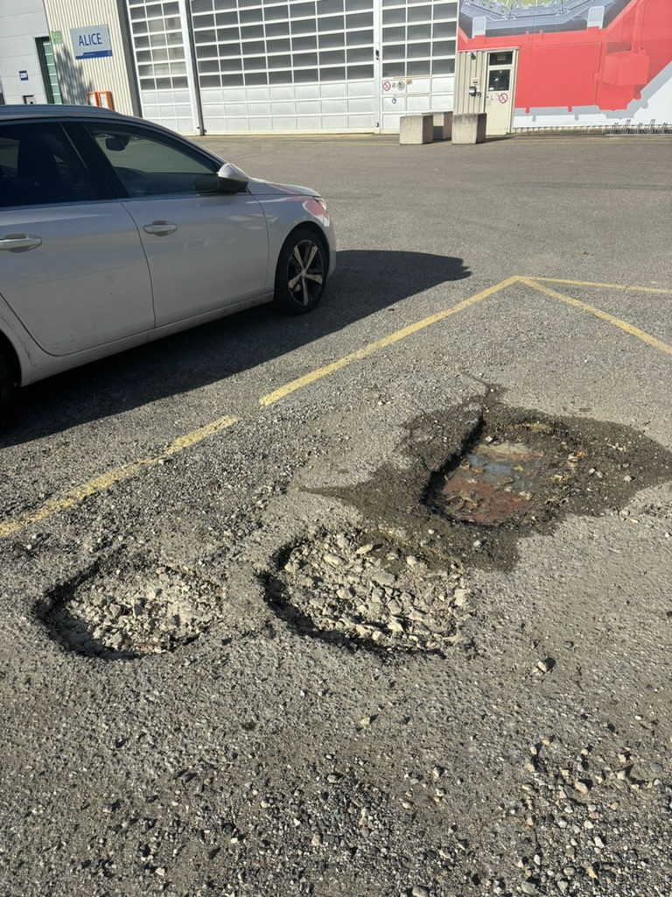
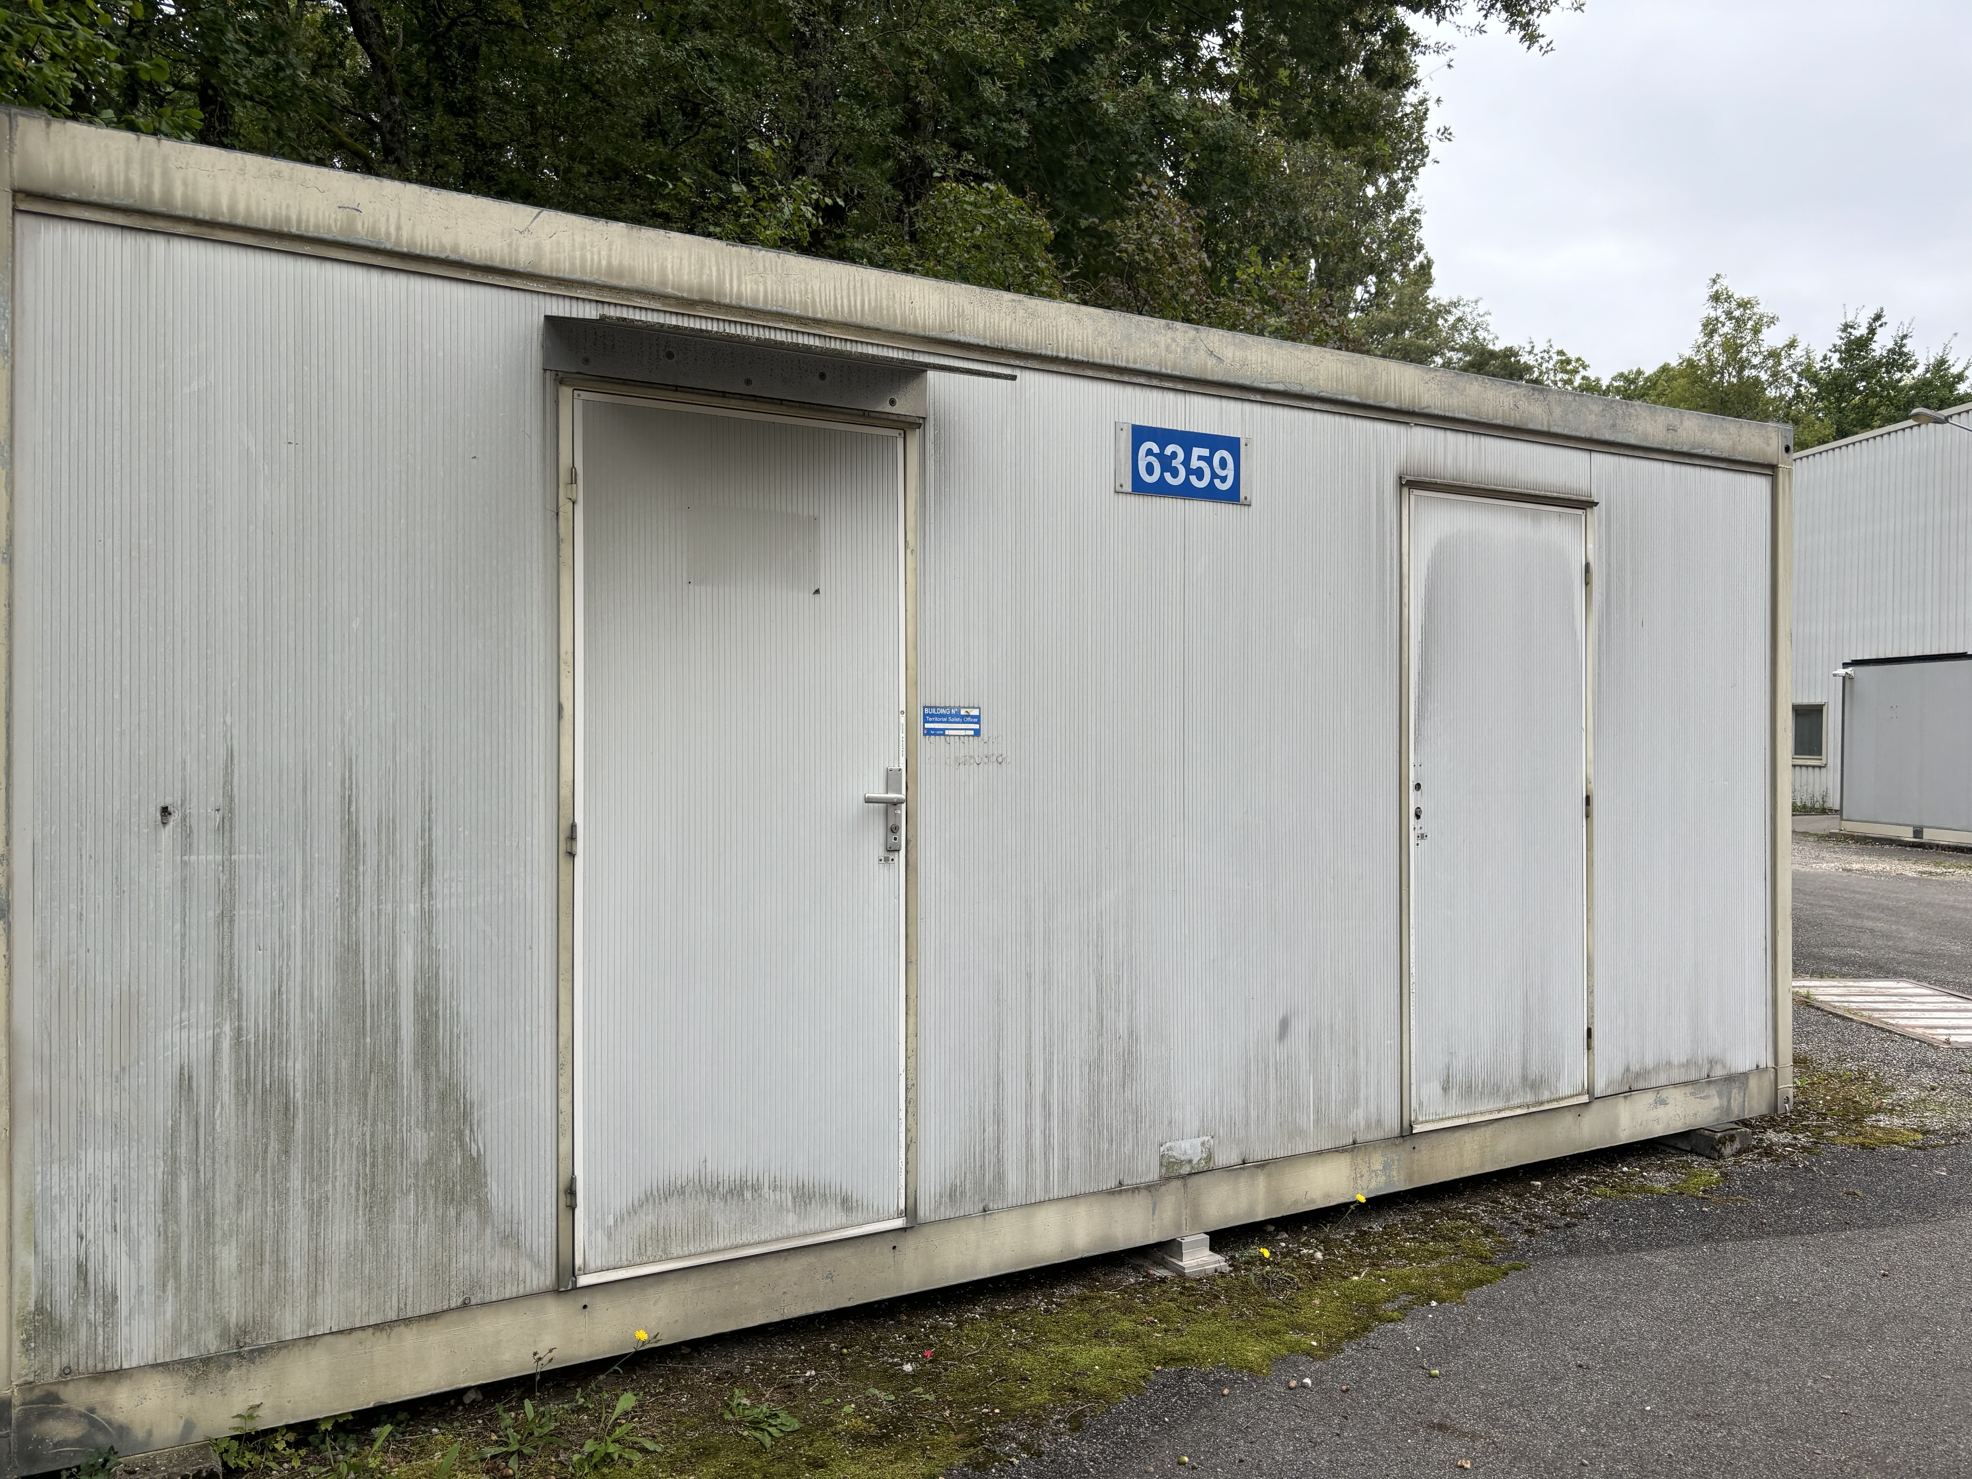
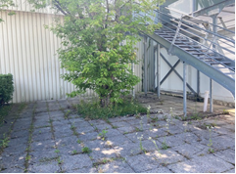
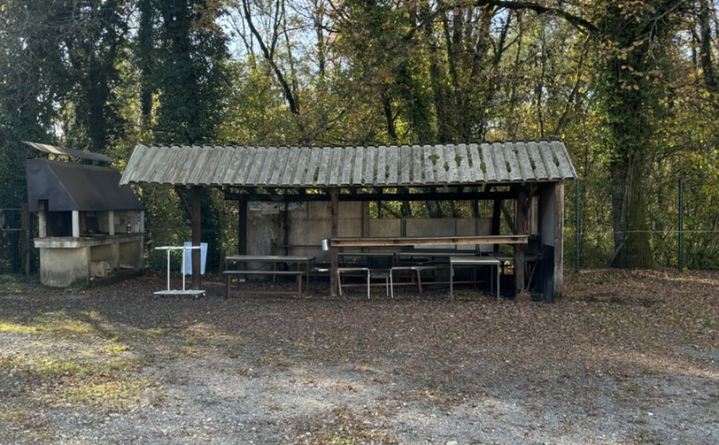
Site activities (SCE)
New charging station for cars
(3-5 Dec)
Parking lot markings
Electric bikes
Repair potholes parking
MCH barrack removal
New rest area outside b.3294
Redo P2 BBQ area !!!

Slide 27
EOY closure – 23 Dec 2024 to 6 Jan 2025
As always, we ask detectors to switch off all equipment that is not strictly needed
  In the past mainly for safety reasons, as there is only limited monitoring; and to protect the equipment itself (e.g. in case of power cuts)
  But also to save power (so this recommendation goes for the whole EYETS)
Gas & cooling systems will go to pre-defined status and no flammable gases will be circulated
  Flammable gases: stop CH4 Dec 2 (restart end March); stop i-butane Dec 2 (restart end Jan); stop Ar-H2 Dec 18 (restart 6 Jan)
There will be the usual inspection tours in ALICE, every second day (schedule tbc)
  Let us know if there is something specific to be checked.
  Let us know if you plan to remain in the local area to help with the tours
Shuttle service to P2 will be stopped between 21st December and end-February
Access to CERN premises during the EOY closure:
  Only for authorized persons for strictly professional reasons such as stand-by service and indispensable maintenance work
  No private visits (even on surface)
  Please send an email to me (with justification) if you need access to CERN during the EOY closure

Slide 28
YETS planning meetings
Friday, December 13th at 10:00
Friday, January 17th at 10:00
Friday, February 7th at 10:00
Friday, February 21st at 10:00
Friday, March 14th at 10:00
Friday, March 28^{h} at 10:00

