Slide 1





Target and proton extraction channel studies
3rd October 2024
J. Mańczak, D. Calzolari, R. Franqueira Ximenes, A.Lechner

Slide 2
Outline
Energy deposition to the graphite target
Radiation load to the HTS magnets with a model taking into account structural constraints
Radiation load to the chicane, chicane shielding studies

Slide 3
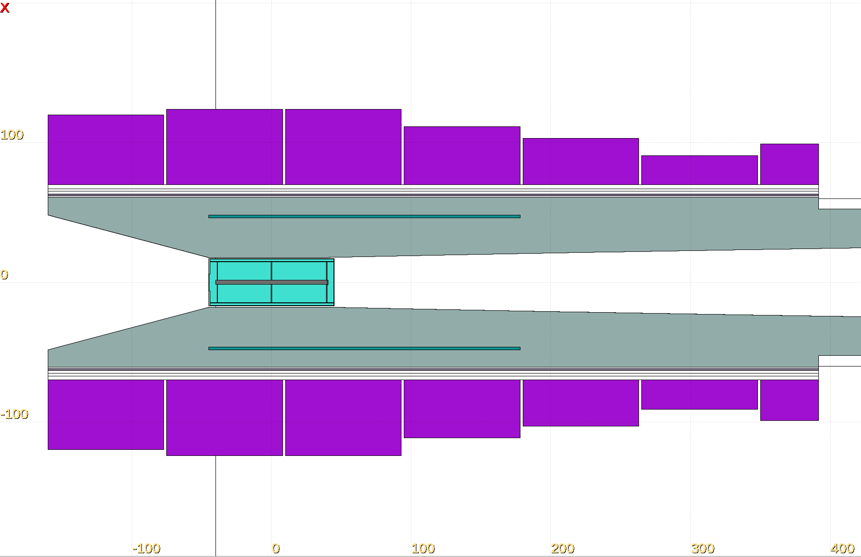
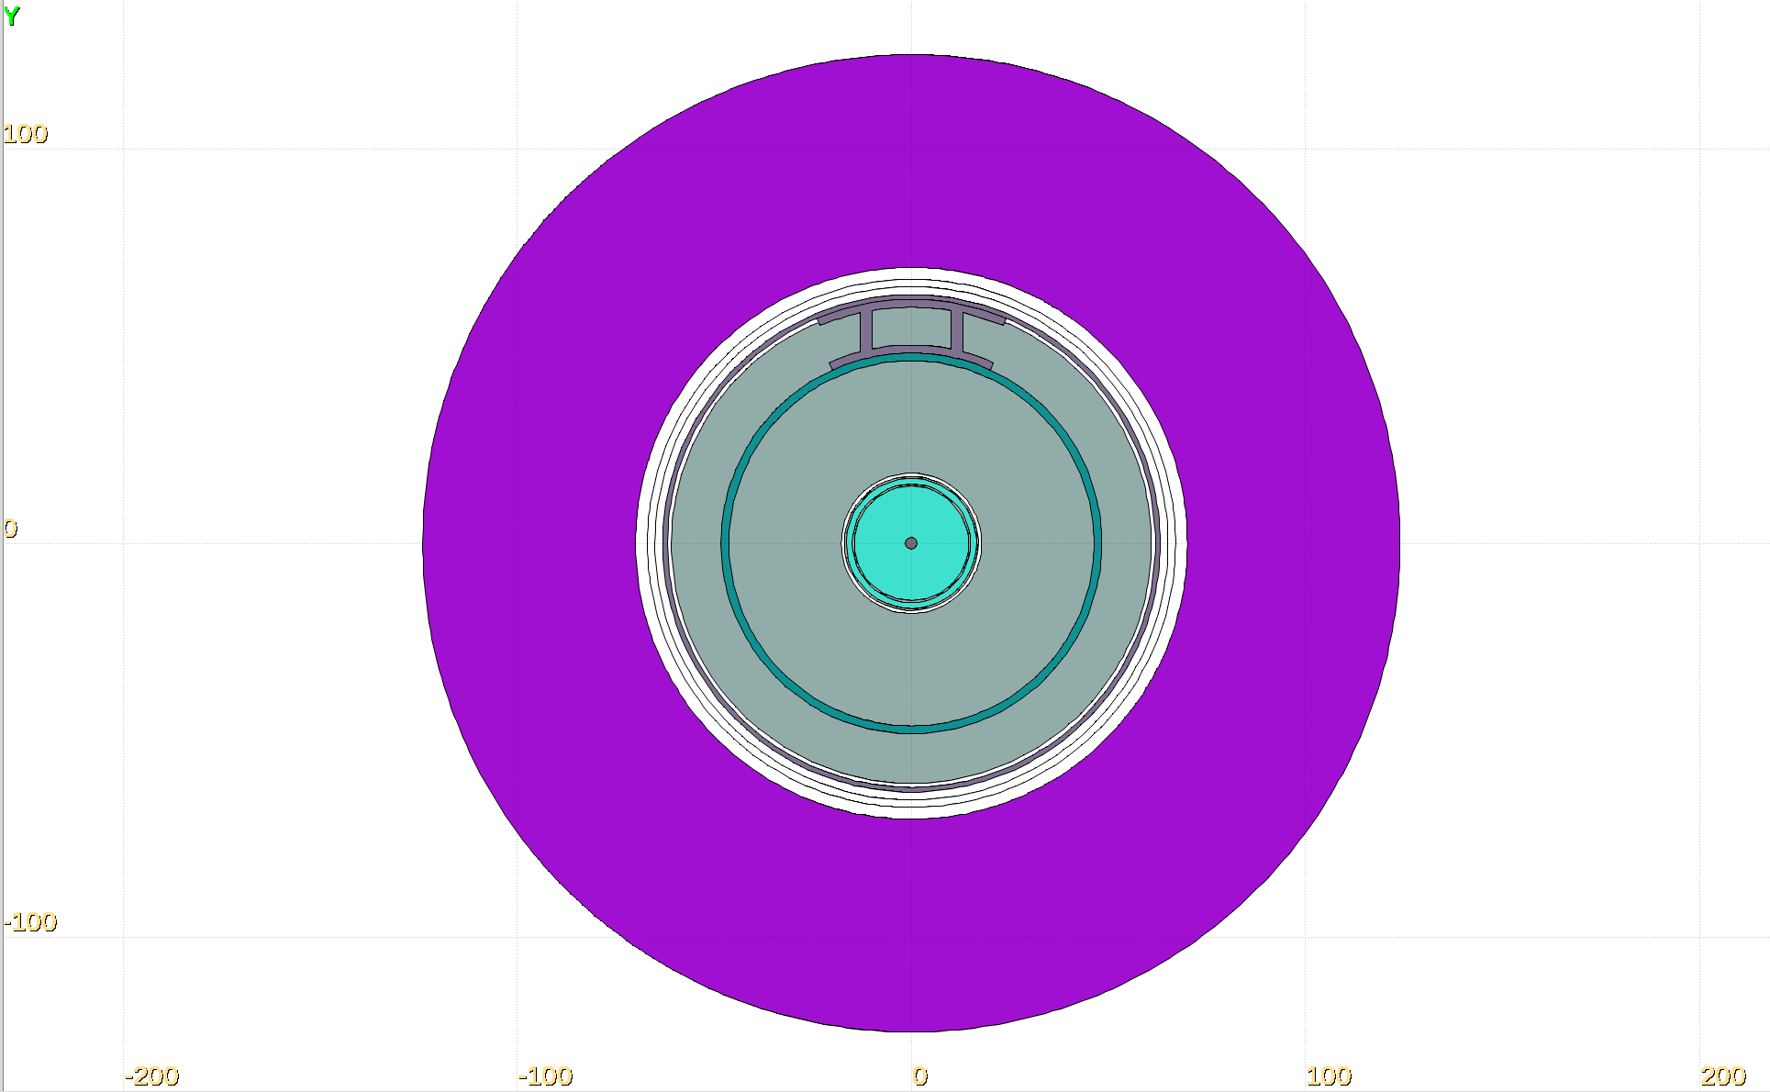
Target arae geometry with structural constraints
Effectively, the vessel for shielding cooling would have to be smaller
Structural beam

Slide 4
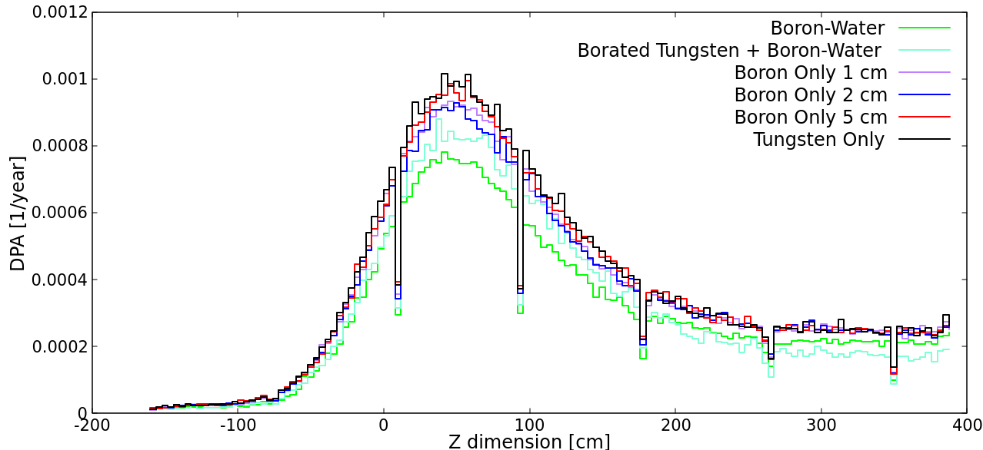
DPA/year with structural constraints shielding materials

Slide 5
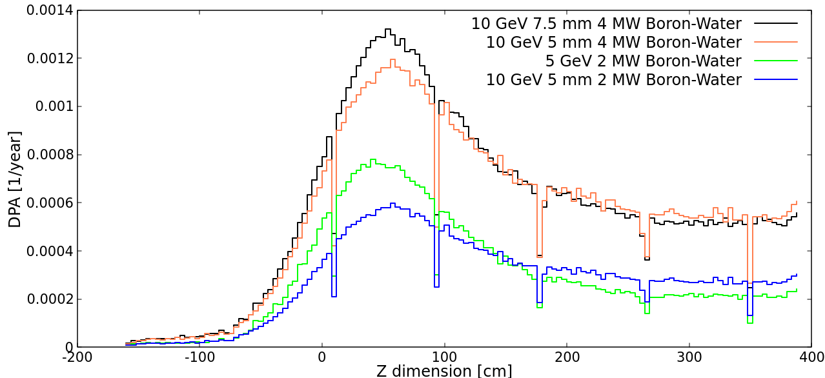
DPA/year with structural constraints
Different beam parameters

Slide 6
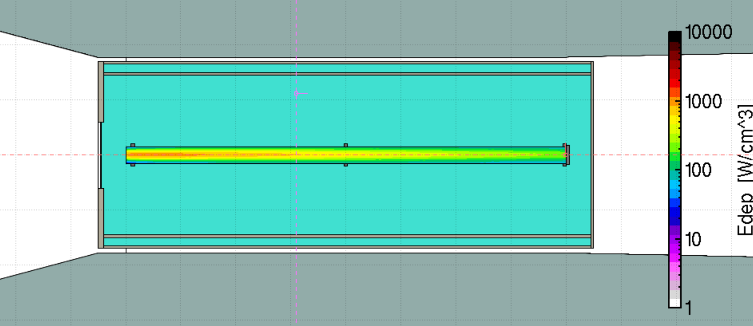
Energy deposition in the graphite target

Slide 7
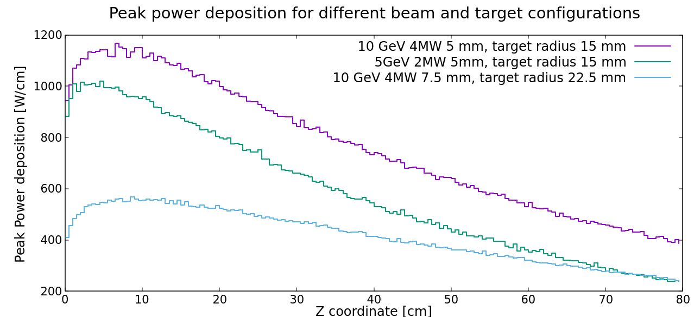
Target energy deposition – different beams

Slide 8
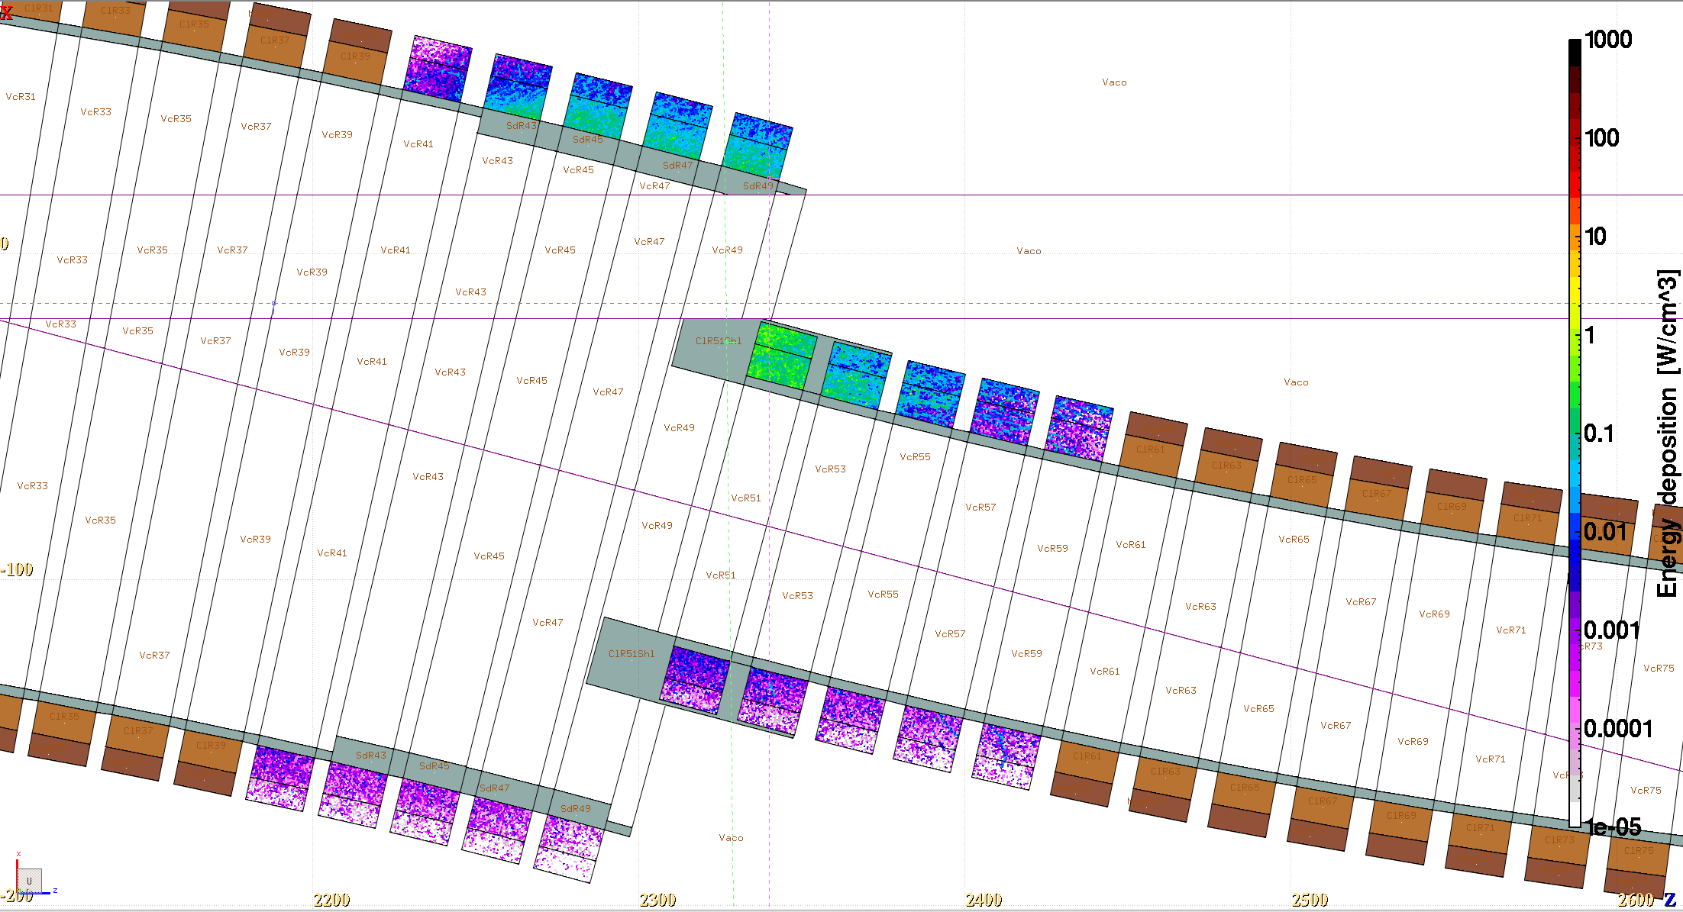
Current chicane shielding design - testing
These two thicknesses were systematically studied

Slide 9
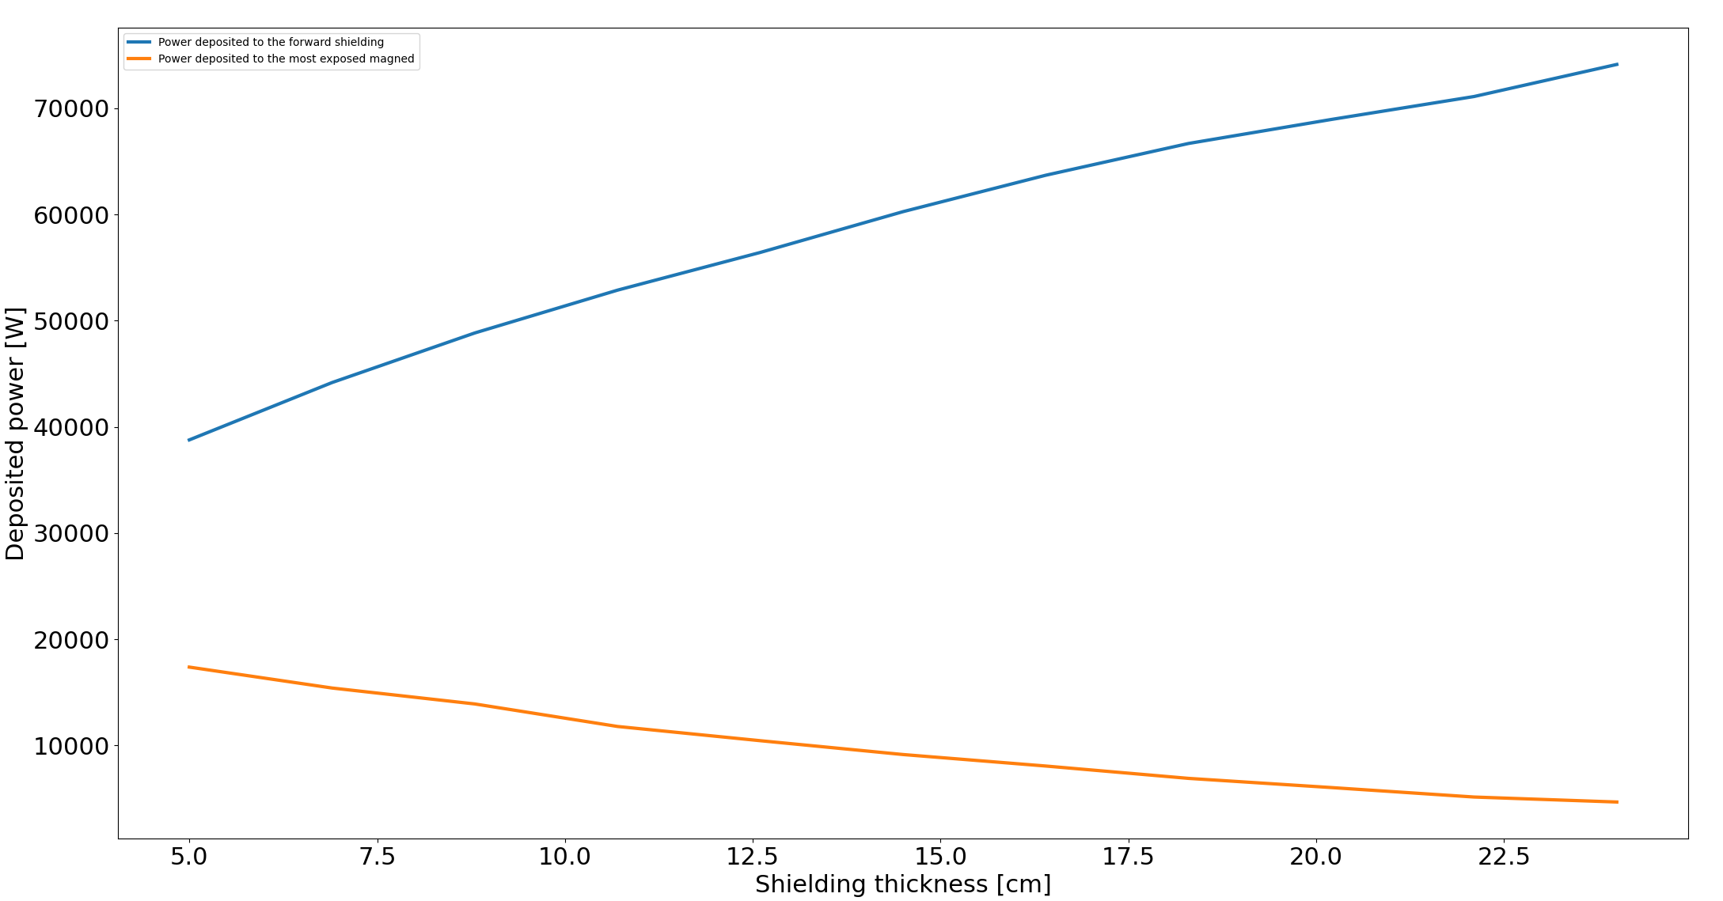
Power deposited to the forward shielding piece and the most exposed magnet
5 GeV
2MW beam

Slide 10
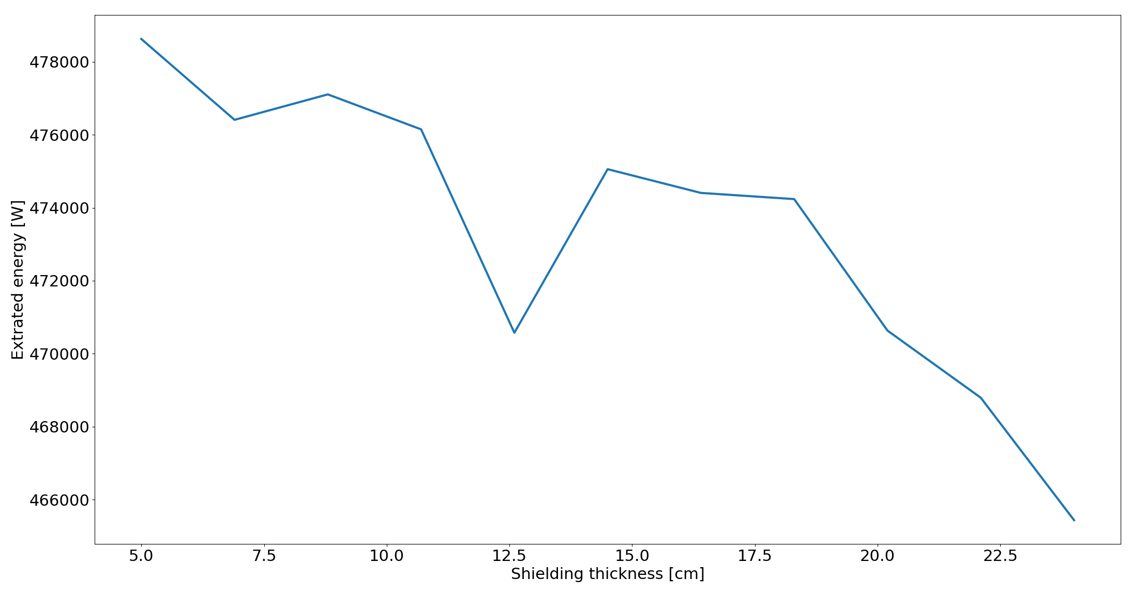
Extracted Power vs thickness
5 GeV
2MW beam

Slide 11
Optimized version
5 GeV 2MW beam
Upper shielding pieces 9.8 kW
4.3 kW
Extracted: 517.5 kW
Deposited in this piece of shielding:
61.7 kW
Deposited in the magnet:
4.7 kW

Slide 12
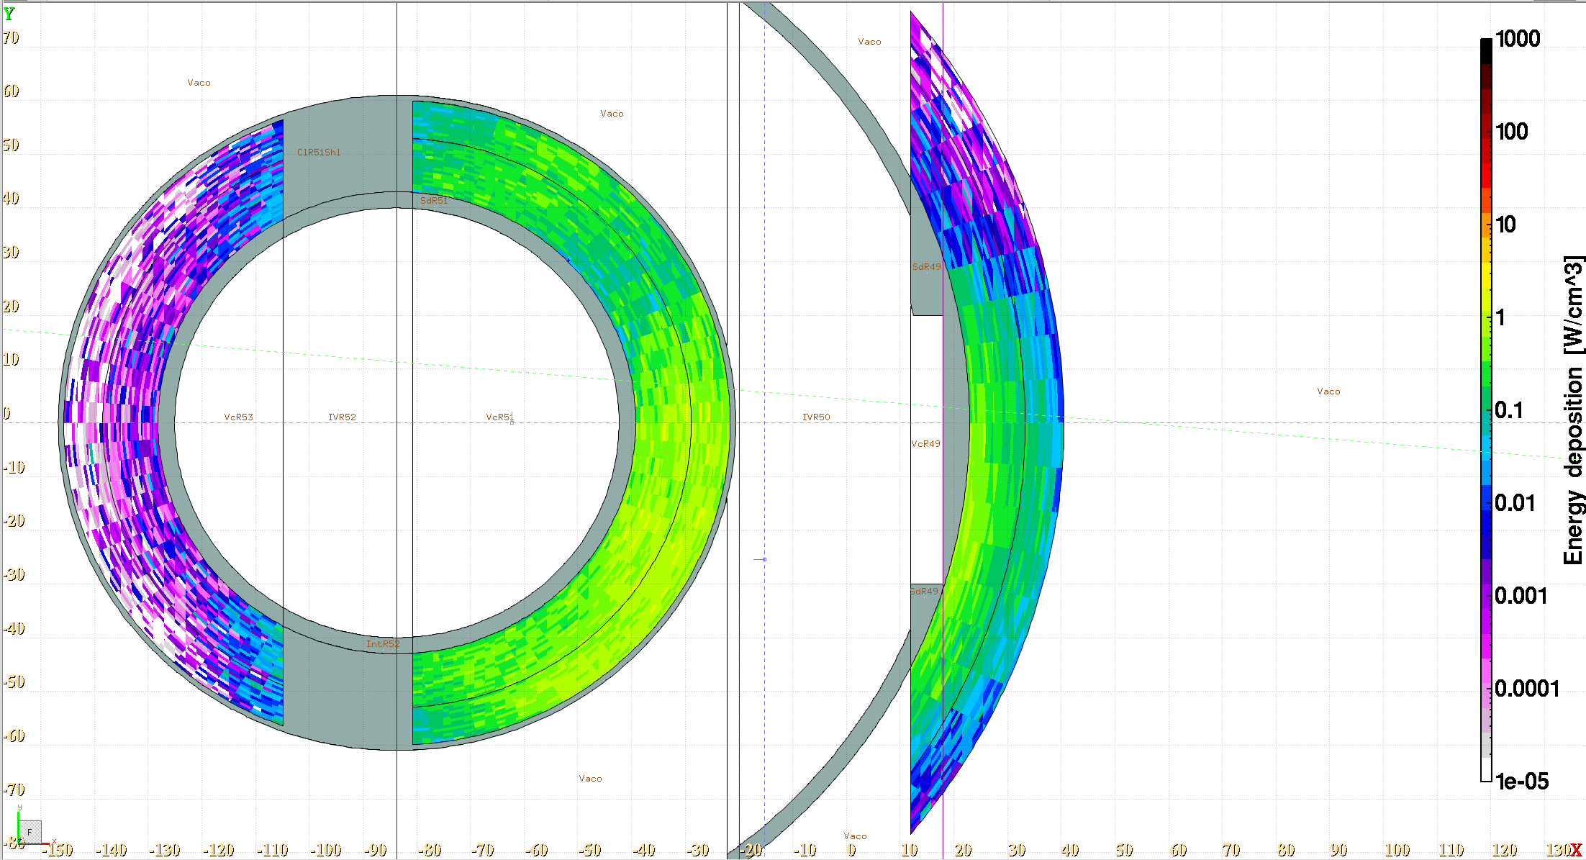
Current chicane shielding design
5 GeV 2MW beam
Aperture to extract the spent proton beam
38 cm
50 cm
90 bins in azimuth angle

Slide 13
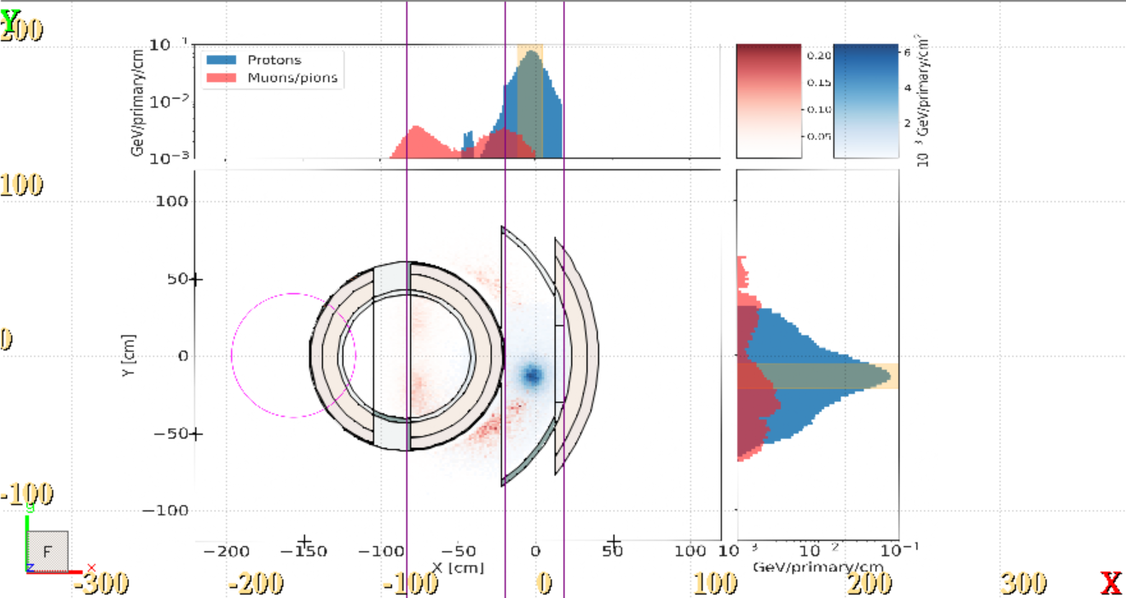
Current chicane shielding design
5 GeV 2MW beam
High-momentum muons/pions are also extracted!

Slide 14
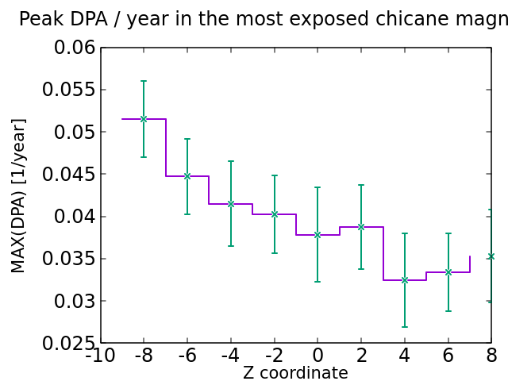
Peak DPA Coil 51

Slide 15
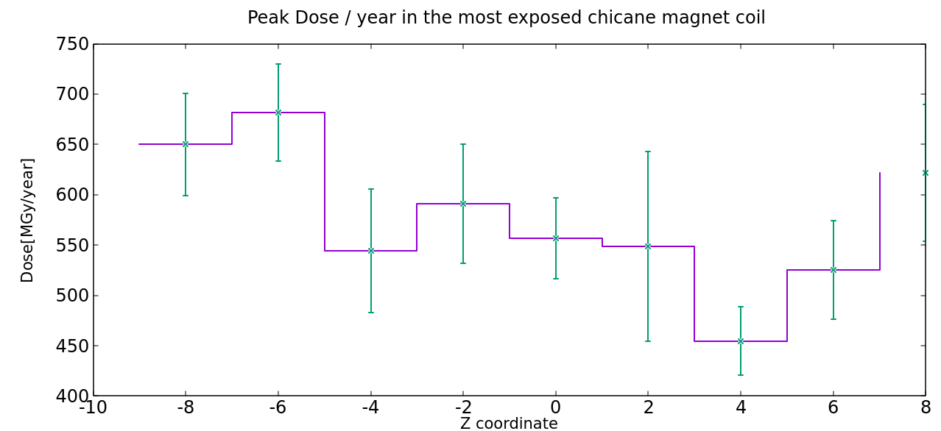
Peak Dose Coil 51 – 5 GeV 2MW beam

Slide 16
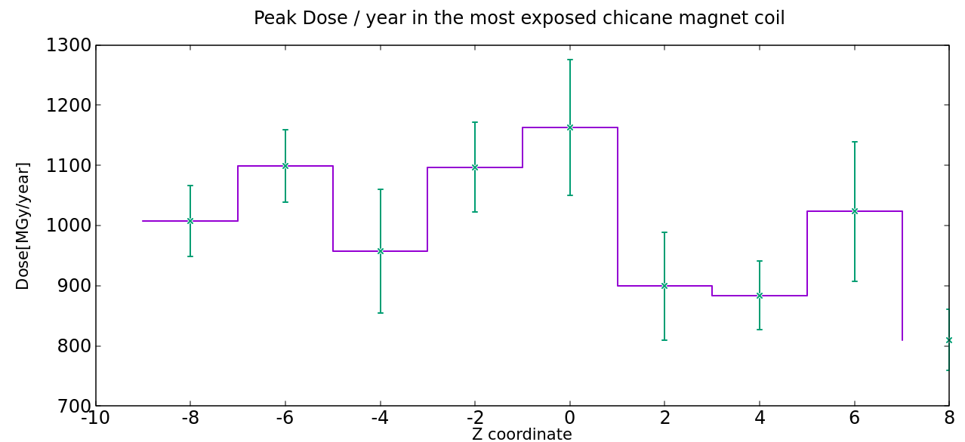
Peak Dose Coil 51 – 10 GeV 4MW beam

Slide 17
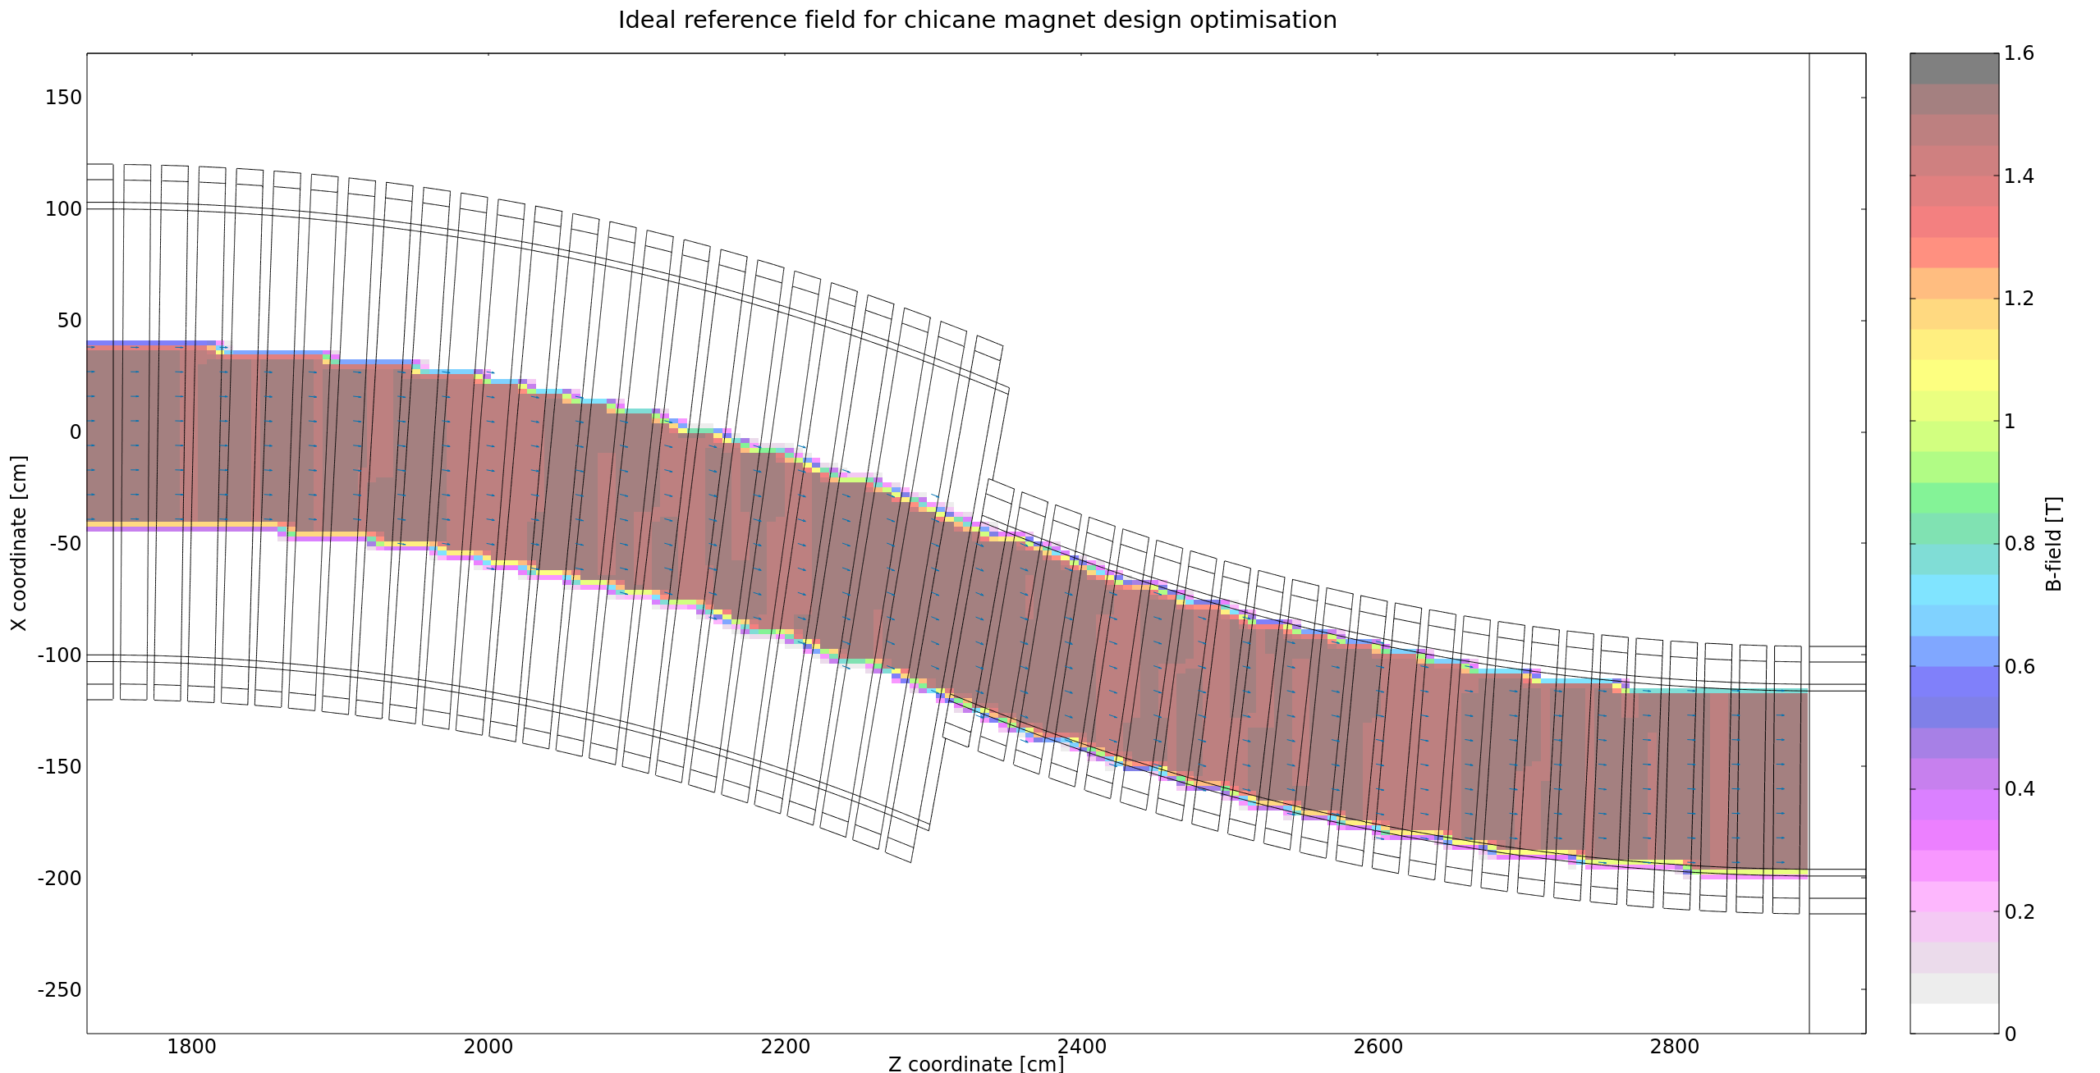
Chicane – field optimization
This doesn’t mean that the field has to be zero – it’s just irrelevant
„Reference” field
1.5 T along the chicane axis with R <= 43 cm

