Slide 1
Lecture 22
The Hybrid Asymmetric Linear Higgs Factory Project (HALHF)
JAI Student Design Project 2024-2025
Professor Emmanuel Tsesmelis
Principal Physicist, CERN
Department of Physics, University of Oxford
Accelerator Physics Graduate Course
John Adams Institute for Accelerator Science
27 November 2024

Slide 2
JAI Training

Slide 3

Foundation of the JAI Programme
One of three pillars of JAI
Students’ design project is very important part of that
JAI
programme
Training next generation of scientists
Research at the forefront of accelerator science
Connections with industry and outreach programme

Slide 4
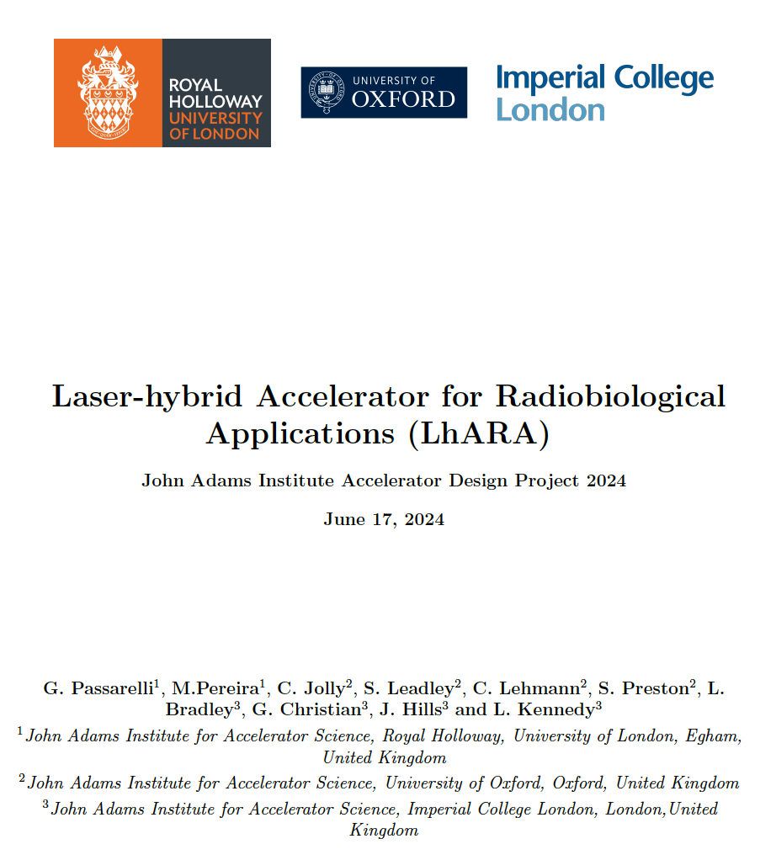
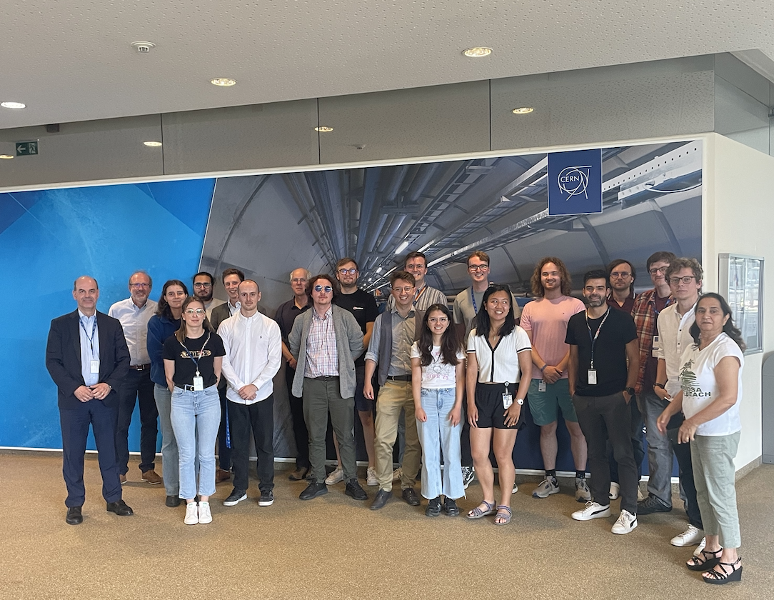
Accelerator Design Project
Accelerator Design Study for
  Electron SPS: 2020-2021
  FCC-ee Booster Ring: 2021-2022
  FCC-ee Positron Damping Ring: 2022-2023
  LhARA: 2023-2024
  Design work consisted of study of the lattice, magnet systems and RF cavities.
“The design project significantly contributes to the value of a PhD at the JAI and is a very effective learning tool ... it played an essential role in helping me to find a postdoc.”
“To me, the design project was by far the best part of the course. It puts the material taught into context and bridges the gap between lectures ... and a DPhil project ... .”
For 2023-2024:
LhARA Report published on CDS (10.17181/CERN.9K4Y.MM92)
Students delivered JAI Seminar on
15 March 2024.
Student Seminar @ CERN, 12 July 2024

Slide 5
HALHF Student Design Project Plan
Study Areas for HALHF (January-March 2025)
Linac for Conventional Drive Beam
  Optics studies, optimization of lattice.
  Design of RF system (similar to CLIC RF technology)
Magnet Design
  Design dipole and quadrupole magnets for combiner ring
Proposal for a hybrid, asymmetric, linear Higgs factory based on plasma-wakefield and radio-frequency acceleration (HALHF)
  https://arxiv.org/abs/2312.04975
  https://iopscience.iop.org/article/10.1088/1367-2630/acf395

