Slide 1



Lecture 20
Beams and Imperfections
Professor Emmanuel Tsesmelis
Principal Physicist, CERN
Visiting Professor, University of Oxford
Graduate Accelerator Physics Course
John Adams Institute for Accelerator Science
27 November 2024

Slide 2
Contents – Lecture 8
  Resonance & Resonant Conditions
  Closed-orbit Distortion
  Chromaticity Correction
  Dispersion

Slide 3
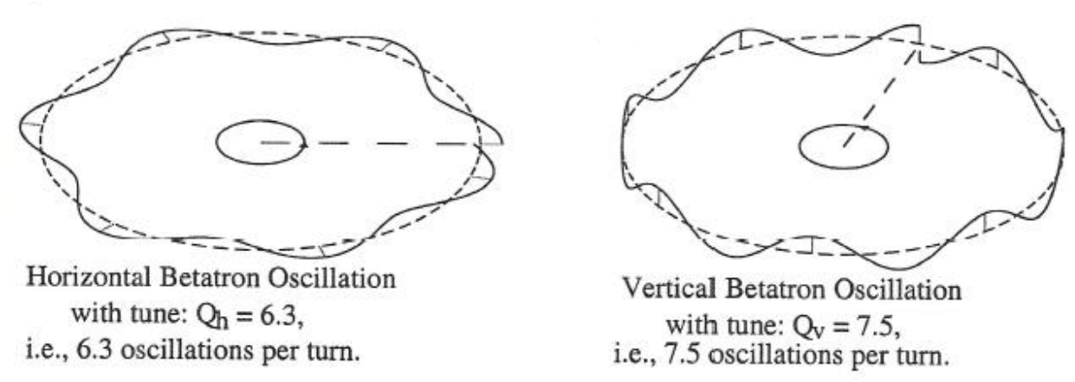
Resonance & Resonant Conditions
After a certain number of turns around the machine the phase advance of the betatron oscillation is such that the oscillation repeats.
For example:
  If the phase advance per turn is 120º then the betatron oscillation will repeat itself after 3 turns.
  This could correspond to tune Q = 3.333 or 3Q = 10.
  But also Q = 2.333 or 3Q = 7.
The order of a resonance is defined as‘n’in n x Q = integer

Slide 4
Q = 3.333
1st turn
2nd turn
3rd turn
Third order resonant betatron oscillation
3Q = 10, Q = 3.333, q = 0.333

Slide 5
Q = 3.333 in Normalised Phase Space
Third order resonance on a normalised phase space plot
2nd turn
3rd turn
1st turn
2πq = 2π/3

Slide 6
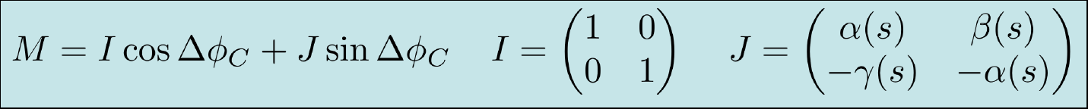
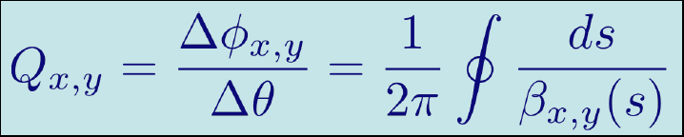
Resonant Conditions: A bit more detail
Synchrotron is periodic focusing system, often made up of smaller periodic regions.
  Can write down a periodic one-turn matrix as
Tune is defined as the total betatron phase advance in one revolution around the ring, divided by 2π

Slide 7
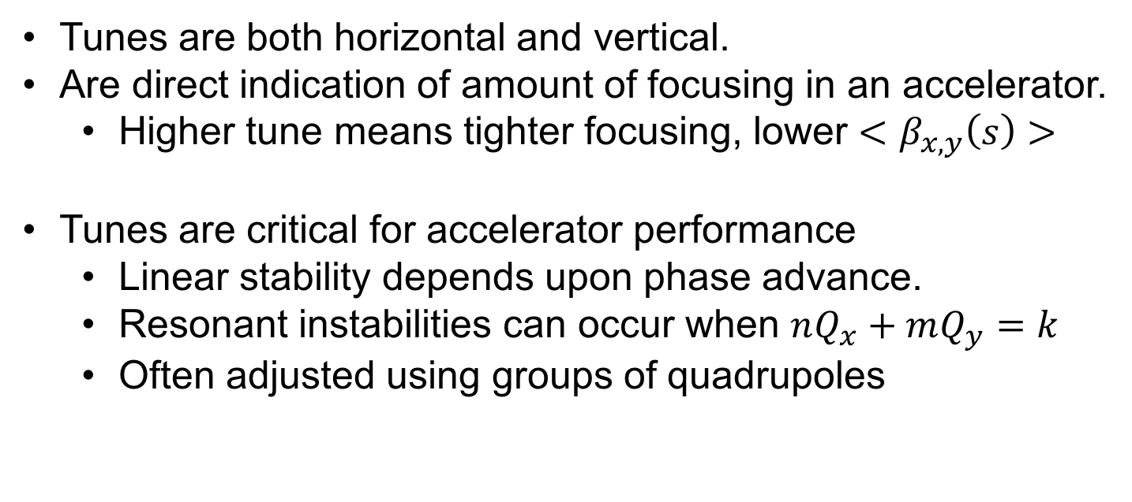
Resonant Conditions: A bit more detail

Slide 8
Resonance & Resonant Conditions
Resonance can be excited through various imperfections in the beamline.
  The magnets themselves.
  Unwanted higher-order field components in magnets.
  Tilted magnets.
  Experiment solenoids (LHC experiments).
Aim is to reduce and compensate these effects as much as possible and then find some point in the tune diagramme where the beam is stable.

Slide 9
Machine Imperfections
It is not possible to construct a perfect machine.
  Magnets can have imperfections.
  The alignment in the machine has non-zero tolerance.
  …
So, have to ask:
  What will happen to betatron oscillation due to various field errors.
  Consider errors in dipoles, quadrupoles, sextupoles, etc…
Study the beam behaviour as a function of ‘Q’.
How is it influenced by these resonant conditions?

Slide 10
Machine Imperfections
Various imperfections in the beamline will alter the tune in a periodic machine.
One way to visualize the influence of these imperfections is by looking at what happens in the normalised phase space plot.

Slide 11
Dipole (deflection independent of position)
y’β
y’β
Q = 2.00
1st turn
Q = 2.50
2nd turn
y
y
3rd turn
For Q = 2.00: Oscillation induced by the dipole kick grows on each turn and the particle is lost (1st order resonance Q = 2).
For Q = 2.50: Oscillation is cancelled out every second turn, and therefore the particle motion is stable.

Slide 12
Quadrupole (deflection ∝ position)
Q = 2.50
1st turn
Q = 2.33
2nd turn
3rd turn
4th turn
For Q = 2.50: Oscillation induced by the quadrupole kick grows on each turn and the particle is lost
(2nd order resonance 2Q = 5)
For Q = 2.33: Oscillation is cancelled out every third turn, and therefore the particle motion is stable.

Slide 13
Sextupole (deflection ∝ position²)
Q = 2.33
1st turn
Q = 2.25
2nd turn
3rd turn
4th turn
5th turn
For Q = 2.33: Oscillation induced by the sextupole kick grows on each turn and the particle is lost
(3rd order resonance 3Q = 7)
For Q = 2.25: Oscillation is cancelled out every fourth turn, and therefore the particle motion is stable.

Slide 14
Resonant Condition - Quadrupole
Let us try to a mathematical expression for amplitude growth in the case with a quadrupole:
2πQ = phase angle over 1 turn = θ
Δβy’ = kick
a = old amplitude
Δa = change in amplitude
2πΔQ = change in phase
y’β
θ
a
y
y does not change at the kick
y = a cos(θ)
θ
Δβy’
In a quadrupole Δy’ = lky
2πΔQ
Δa
Only if 2πΔQ is small
So we have:
Δa = βΔy’ sin(θ) = lβ sin(θ) a k cos(θ)

Slide 15
Resonant Condition - Quadrupole
So have:
Δa = l·β·sin(θ) a·k·cos(θ)
Each turn θ advances by 2πQ
On the n^{th} turn θ = θ + 2nπQ
Sin(θ)Cos(θ) = 1/2 Sin (2θ)
Over many turns:
∴Δa→0
This term will be ‘zero’ as it decomposes in Sin and Cos terms and will give a series of + and – that cancel out in all cases where the fractional tune q ≠ 0.5
For q = 0.5 the phase term, 2(θ + 2nπQ) is constant:
and thus:

Slide 16
Resonant Condition - Quadrupole
In this case the amplitude will grow continuously until the particle is lost.
Therefore, conclude as before that: quadrupoles excite 2nd order resonances for q=0.5
  Namely, for Q = 0.5, 1.5, 2.5, 3.5,…etc……

Slide 17
Resonant Condition - Quadrupole
Study phase θ:
y’β
2πQ = phase angle over 1 turn = θ
Δβy’ = kick
a = old amplitude
Δa = change in amplitude
2πΔQ = change in phase
θ
a
y does not change at the kick
y = a cos(θ)
y
θ
In a quadrupole Δy’ = lky
s
Δβy’
2πΔQ
Δa
2πΔQ << Therefore Sin(2πΔQ) ≈ 2πΔQ

Slide 18
Resonant Condition - Quadrupole
So have:
Since:
can rewrite this as:
, which is correct for the 1st turn
Each turn θ advances by 2πQ
On the n^{th} turn θ = θ + 2nπQ
Over many turns:
‘zero’
Averaging over many turns:

Slide 19
Resonant Condition - Sextupole
Can apply the same arguments for a sextupole:
For a sextupole
and thus
Get :
Summing over many turns gives:
3rd order resonance term
1st order resonance term
Sextupoles excite 1st and 3rd order resonance
q = 0
q = 0.33

Slide 20
Resonant Condition - Octupole
Can apply the same arguments for an octupole:
For an octupole
and thus
We get :
4th order resonance term
2nd order resonance term
Summing over many turns gives:
∝ a²(cos 4(θ+2πnQ) + cos 2(θ+2πnQ))
Amplitude squared
q = 0.5
q = 0.25
Octupole errors excite 2nd and 4th order resonance and are very important for larger amplitude particles.
Can restrict dynamic aperture

Slide 21
Stopband
The tune does not stay constant in the machine. This leads to a variation of Q for each turn.
This variation can go up and down, giving a range of possible values for Q, which we can call ΔQ.
This range of values has a width, which is called the stopband of the resonance.
Not only do you want to avoid the resonances, but you want to avoid being in the stopband of a resonance as well, as it may pull you into the resonance itself.

Slide 22
Stopband
which is the expression for the change in Q due to a quadrupole… (fortunately !!!)
But note that Q changes slightly on each turn
Related to Q
Max variation 0 to 2
Q has a range of values varying by:
This width is called the stopband of the resonance.
So even if q is not exactly 0.5, it must not be too close, or at some point it will find itself at exactly 0.5 and‘lock on’to the resonant condition.

Slide 23
Intermediate Summary
Quadrupoles excite 2nd order resonances.
Sextupoles excite 1st and 3rd order resonances.
Octupoles excite 2nd and 4th order resonances.
This is true for small amplitude particles and low strength excitations.
However, for stronger excitations, sextupoles will excite higher order resonances (non-linear).

Slide 24
Coupling
Coupling is a phenomena that converts betatron motion in one plane (horizontal or vertical) into motion in the other plane.
Fields that will excite coupling are:
  Skew quadrupoles, which are normal quadrupoles, but tilted by 45º about their longitudinal axis.
  Solenoidal (longitudinal magnetic field).

Slide 25
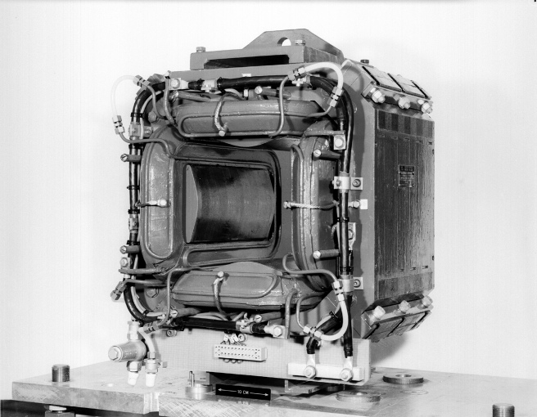
Skew Quadrupole
Magnetic field
S
N
N
Like a normal quadrupole, but tilted by 45º
S

Slide 26
Solenoid - Longitudinal Field (1)
Particle trajectory
Magnetic field
Beam axis
Transverse velocity component

Slide 27
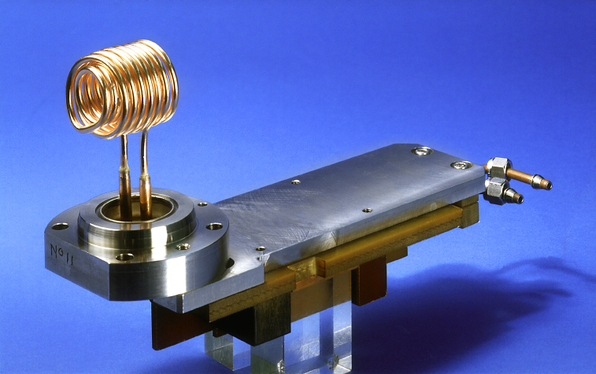
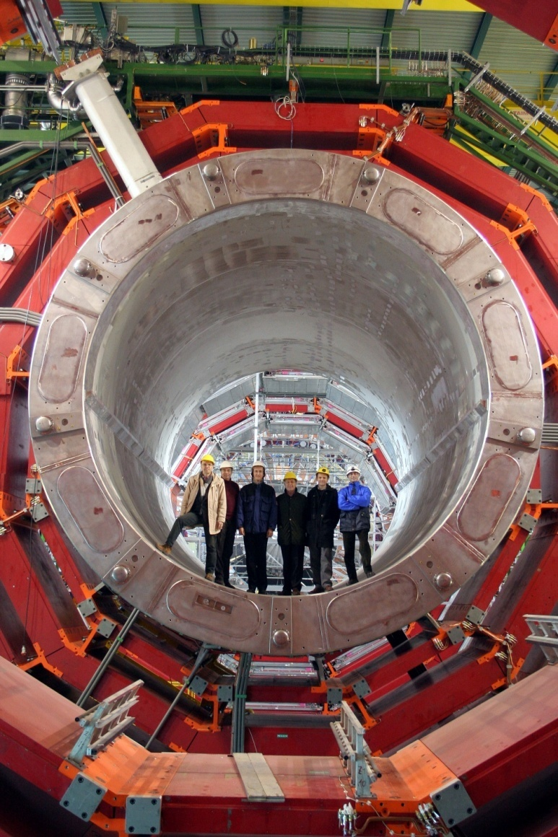
Solenoid - Longitudinal Field (2)
Above:
The LPI solenoid that was used for the initial focusing of the positrons.
It was pulsed with a current of 6 kA for some 7 μs, it produced a longitudinal magnetic field of 1.5 T.
At right:
the somewhat bigger CMS solenoid

Slide 28
Coupling and Resonance
This coupling means that one can transfer oscillation energy from one transverse plane to the other.
Exactly as for linear resonances (single particle) there are resonant conditions.
If meet one of these conditions, the transverse oscillation amplitude will again grow in an uncontrolled way.
nQ_{h} ± mQ_{v} = integer

Slide 29
General Tune Diagramme
Q_{v}
Q_{h} - Q_{v}= 0
2.75
2.5
Q_{h} + Q_{v}= 5
2.25
2
2 2.25 2.5 2.75
Q_{h}
2.33
2.66

Slide 30
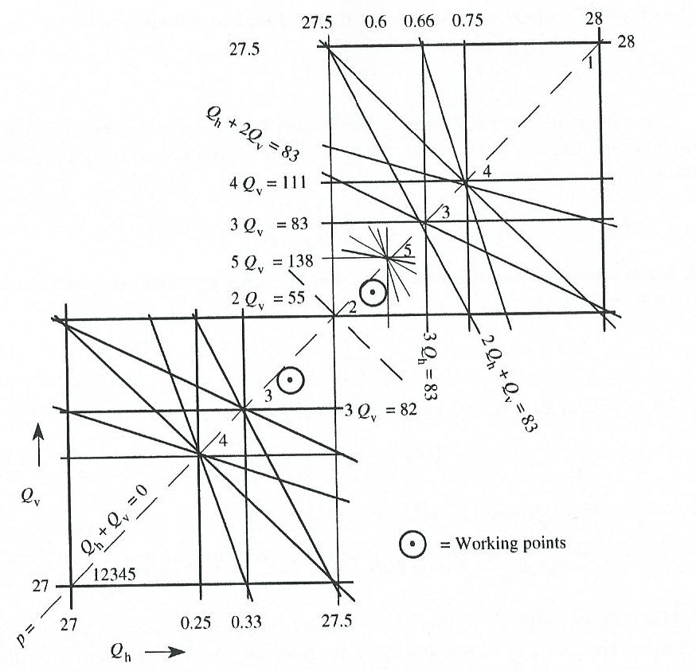


Resonant Conditions
Change in tune or phase advance resulting from errors.
  Steer Q away from certain fractional values which can cause motion to resonate and result in beam loss.
Resonance takes over and walks proton out of the beam for:
where
is resonance order and p is azimuthal frequency that drives it.
SPS Working Diagramme

Slide 31
PS Booster Tune Diagramme
injection
During acceleration change the horizontal and vertical tune
to a place where the beam is least influenced by resonances.
ejection

Slide 32
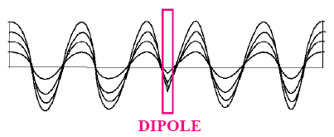
Imperfection: Closed-orbit Distortion
As current is slowly raised in dipole:
  The zero-amplitude betatron particle follows distorted orbit.
  Distorted orbit is closed.
  Particle still obeys Hill’s Equation.
  Except at the kink (dipole) it follows a betatron oscillation.
  Other particles with finite amplitudes oscillate about this new closed orbit.

Slide 33
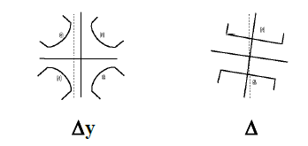
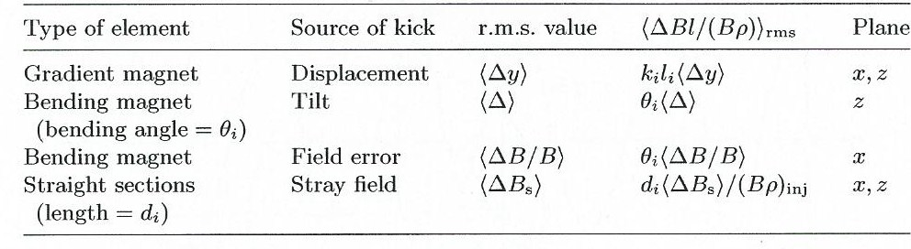
Sources of Closed-orbit Distortion

Slide 34
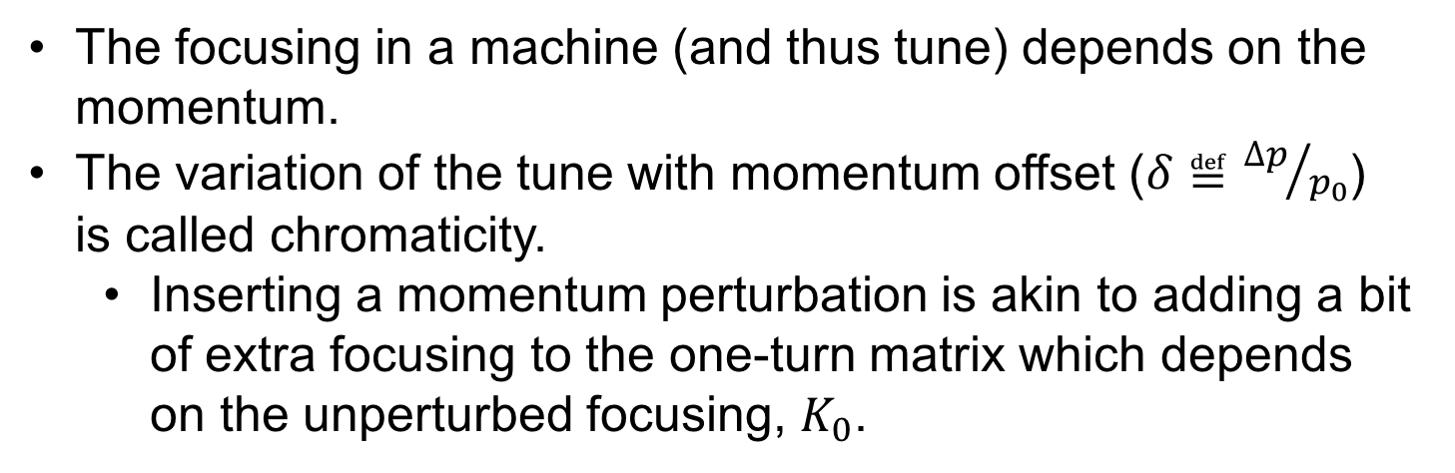
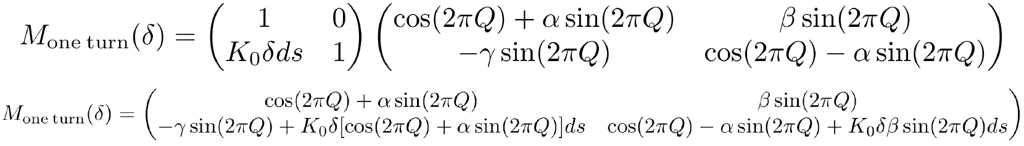
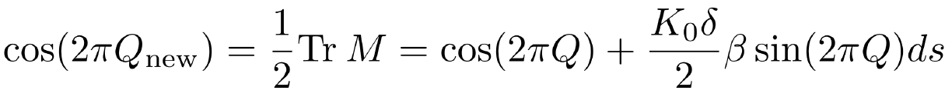
Imperfection: Chromaticity
The trace is related to the new tune:

Slide 35
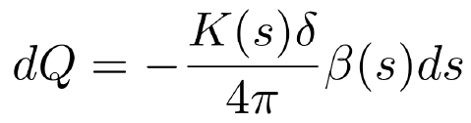
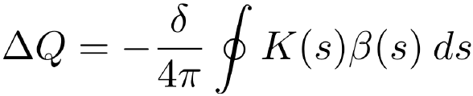
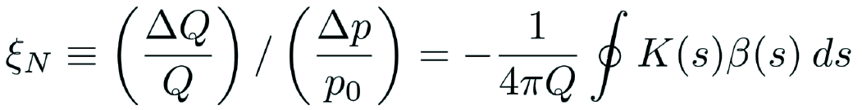
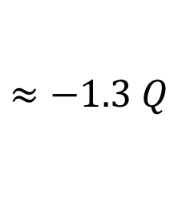
Chromaticity and Tune
Going through a bit of math:
Last two terms must be equal, therefore
Integrate around ring
Total change in tune
The tune will always have a bit of a spread due to the momentum spread. You can define the natural chromaticity as:

Slide 36
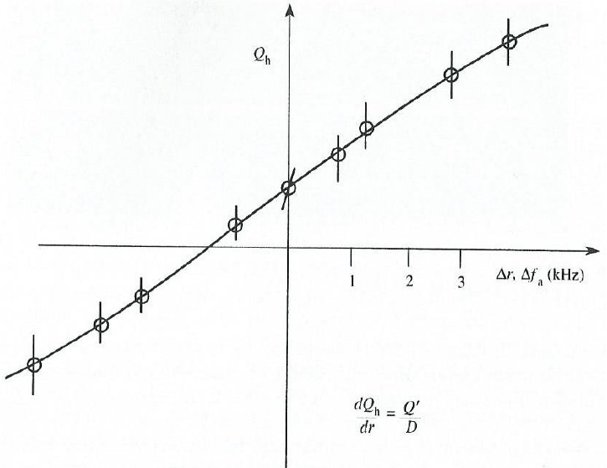
Measurement of Chromaticity
Steering the beam to a new mean radius, and adjusting the RF frequency to vary the momentum, can measure the Q.

Slide 37
Chromaticity Correction
Need a way to connect the momentum offset, δ, to focusing.
We can do this using sextupoles, which give nonlinear focusing (dependent on position) and dispersion (momentum-dependent position).

Slide 38
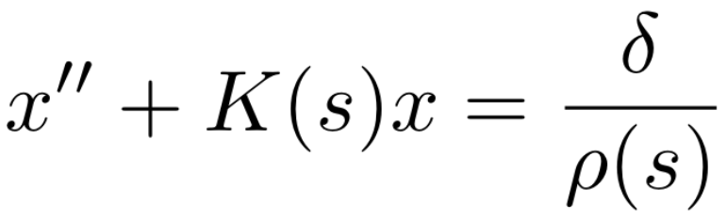
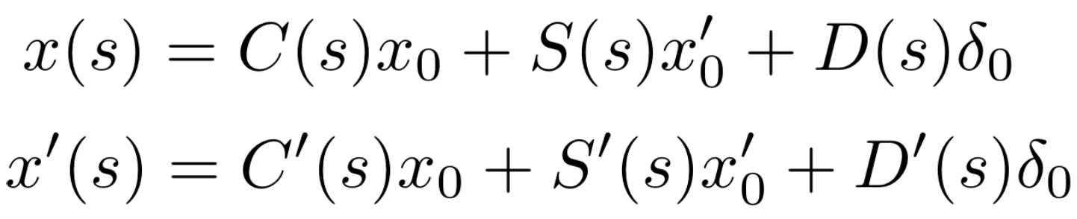
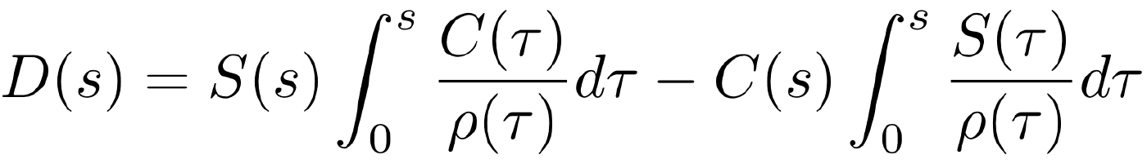
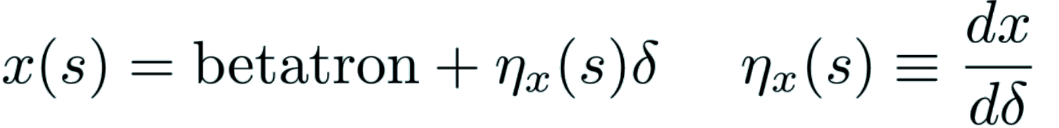
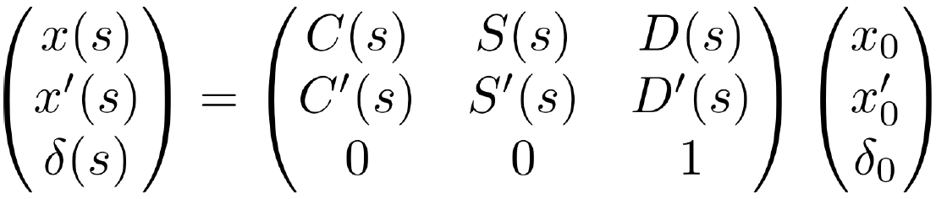
Dispersion (1)
Dispersion, D(s), is defined as the change in particle position with fractional momentum offset, δ.
  Originates from momentum dependence of dipole bends.
Add explicit momentum dependence to EOM:
Particular sol’n inhomog. DE w/ periodic ρ(s).
The trajectory has two parts:

Slide 39

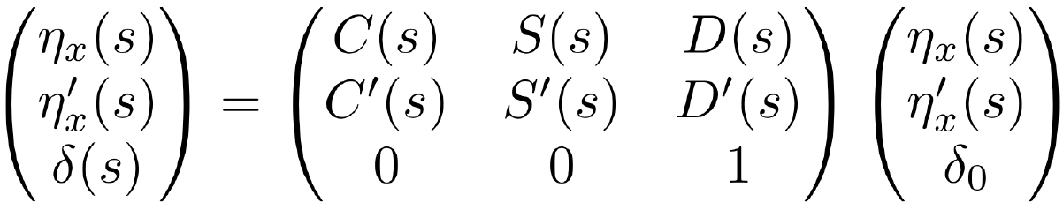
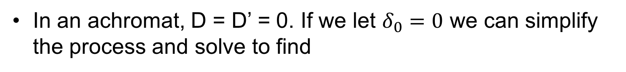
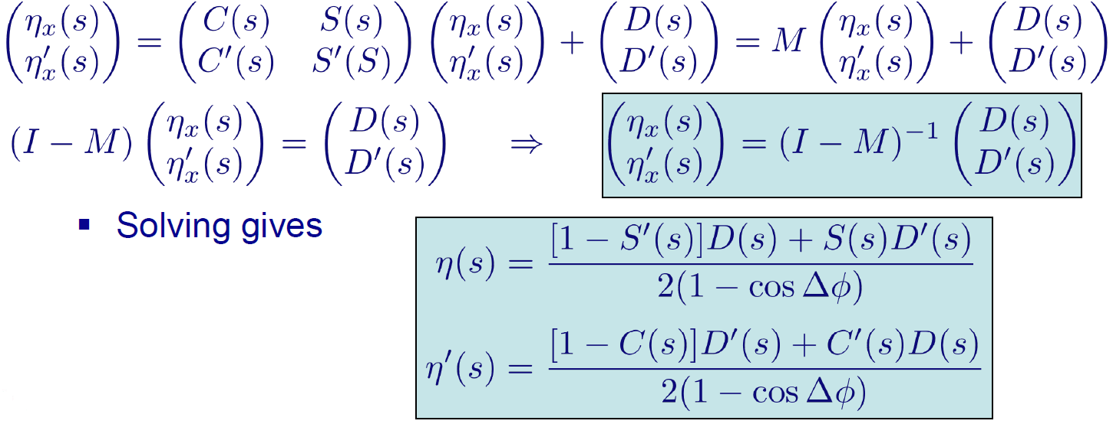
Dispersion (2)
Noting that dispersion is periodic

Slide 40
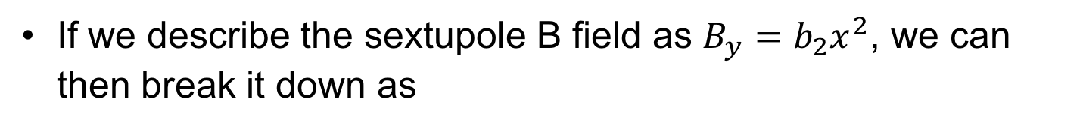
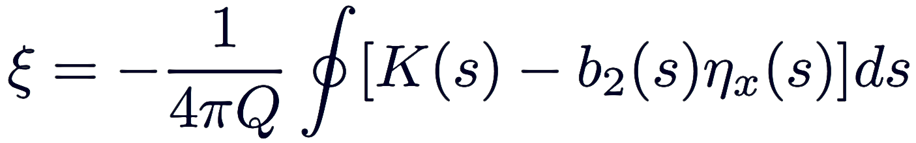
Chromaticity Correction
Recall that we define the natural chromaticity as
And that the trajectory goes as
Nonlinear
Like quad: K(s)
You end up getting a total chromaticity from all sources as
Notice that this means strong focusing (large K) requires large sextupoles!

Slide 41
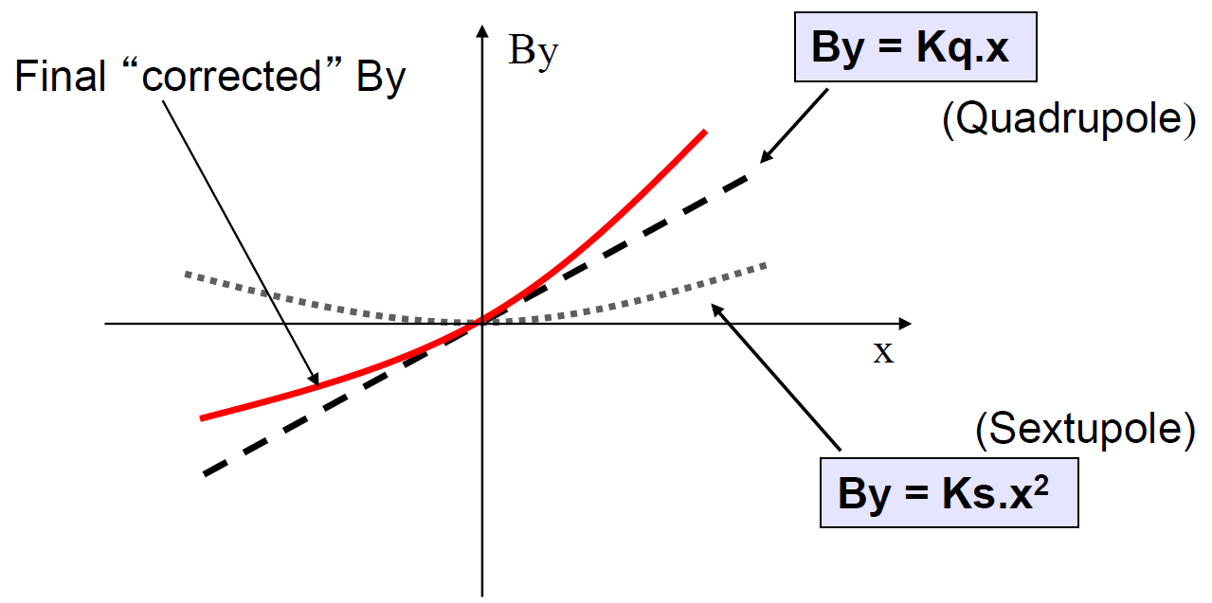
Chromaticity Correction
Since dispersion describes how momentum changes radial position of particles, sextupoles alter focusing field seen by particles as a function of momentum.
Sextupole field acts to increase quadrupole magnetic field for particles that have positive displacement & decrease field for particles with negative displacements.

Slide 42
Sextupoles & Chromaticity
There are two chromaticities ξ_{h}, ξ_{v}
However, the effect of a sextupole depends on β(s) and this varies around the machine.
Two types of sextupoles are used to correct the chromaticity.
One (SF) is placed near QF quadrupoles where β_{h} is large and β_{v} is small, this will have a large effect on ξ_{h}
Another (SD) placed near QD quadrupoles, where β_{v} is large and β_{h} is small, will correct ξ_{v}
Sextupoles should be placed where D(s) is large, in order to increase their effect, since Δk is proportional to D(s).

Slide 43
Bibliography
M. H. Blewett, Theoretical Aspects of the Behaviour of Beams in Accelerators and Storage Rings (CERN Yellow Report, 1977)
S. Y. Lee – Accelerator Physics (World Scientific, 2011)
H. Wiedemann – Particle Accelerator Physics (Springer-Verlag, 2007)
E. Wilson – An Introduction to Particle Accelerators (Oxford University Press, 2001)

