Slide 1
Hamiltonian Dynamics
Lecture 2
David Kelliher
ISIS/Rutherford Appleton Laboratory
November 13th, 2024

Slide 2
Deriving the Hamiltonian for an accelerator
Goal: build a Hamiltonian map to represent entire ring.
Starting point – the Hamiltonian for a relativistic particle in an electromagnetic field H(q,P,t).
Apply following steps
  Transform into convenient coordinates (Frenet-Serret).
  Change the independent variable from time to longitudinal coordinate “s”.
  Convert to small dynamic variables with respect to reference momentum (allows us to expand the square root).
  Introduce convenient longitudinal coordinates.

Slide 3
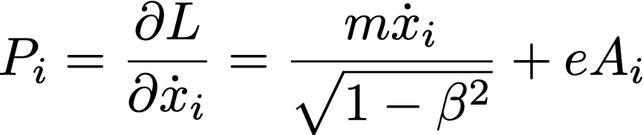
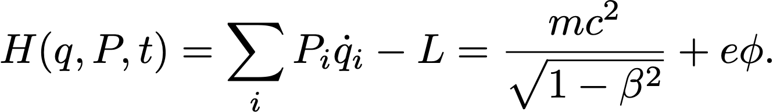
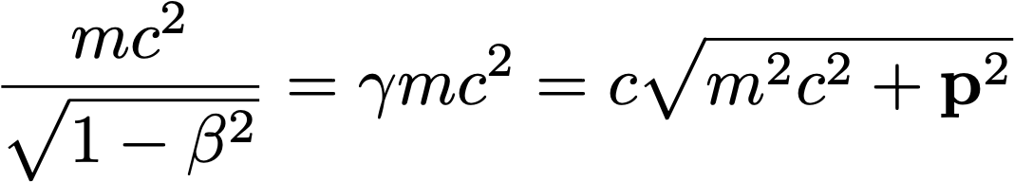
Particle in a general electromagnetic field
The Lagrangian for a free particle in a general EM field U(x, x ̇, t) = e(φ − v · A) is given
Calculate the conjugate momentum as usual. Note the vector potential contributes to the momentum!
The Hamiltonian is given by
which can be written (using )

Slide 4
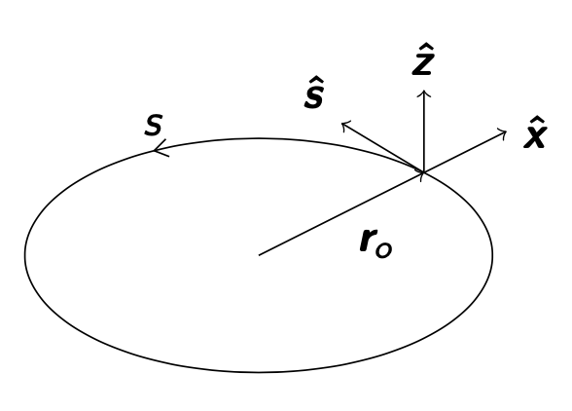
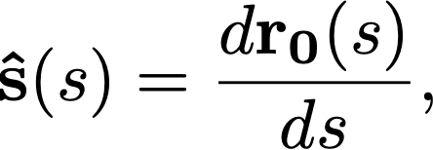
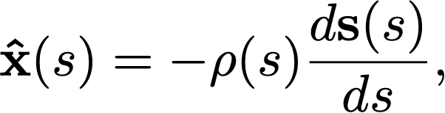

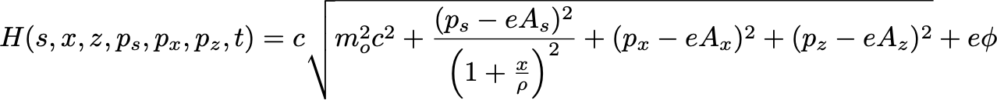
Step 1: Change coordinate system
Along a reference orbit r₀, define set of orthogonal unit vectors $\hat{s},\hat{x}$,$\hat{z}. These vectors form$ the basis of the Frenet-Serret curvilinear coordinate system.
where ρ(s) is the local curvature.
In order to express the conjugate momentum P and vector potential A in these coordinates perform a canonical transformation. It can be shown that the resulting Hamiltonian is

Slide 5



Step 2: Change of independent variable
It is convenient to change the independent variable from time t to location around the ring (”s”).
To do this, rearrange equation so that -p_{s} is on the LHS. Define this the new Hamiltonian H_{1.}
Now the old Hamiltonian is one of the canonical variables which are now
Since the independent coordinate is now in units of distance rather than time, the equations of motion are written

Slide 6
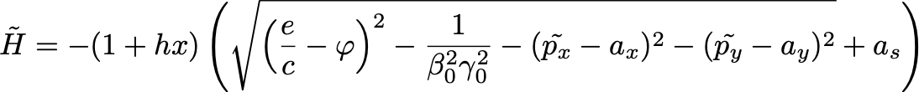
Step 3: Introduce reference momentum
Normalise variables with respect to reference momentum P₀. Usually, we can assume small deviations from the reference momentum.
Updated Hamiltonian (where h = 1/ρ)
Note – in the following slides the tilde is omitted.

Slide 7

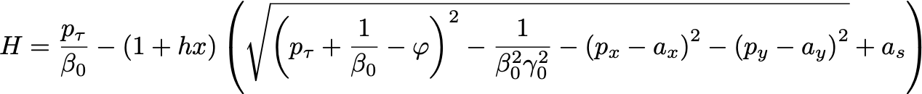
Step 4: Change longitudinal coordinates
Beam has a time and energy spread around a reference particle. Introduce scaled time deviation τ and energy deviation p_{τ}. Note: here we follow the nomenclature of the Xsuite Physics guide (page 9)*
The Hamiltonian for a general accelerator element H(x, p_{x}, y, p_{y}, τ, p_{τ}) is given by
When $φ$is zero (e.g. in magnets) the Hamiltonian simplifies to (δ = dp/p)
The Hamiltonian for each magnet can be found by substituting the corresponding vector potential
* https://xsuite.readthedocs.io/en/latest/index.html

Slide 8
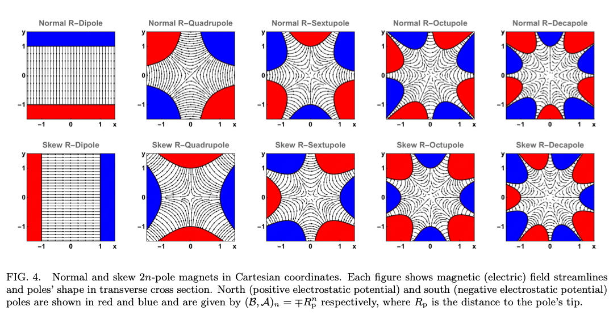
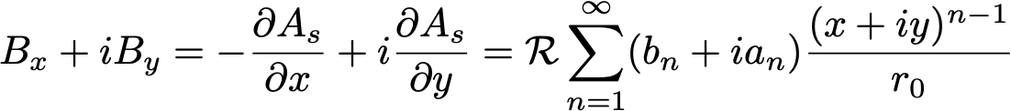
Multipole magnets
The ideal magnetic field for a straight multipole magnet with axial symmetry is

Slide 9
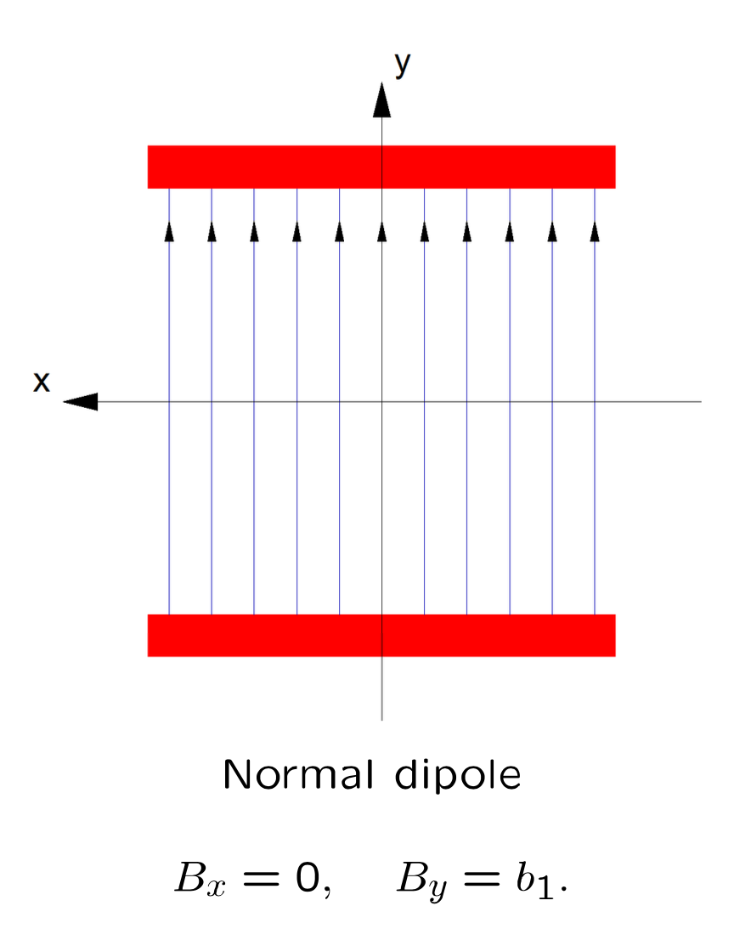
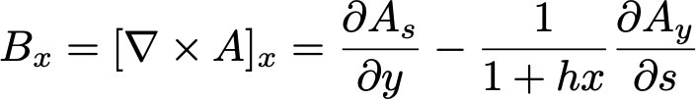

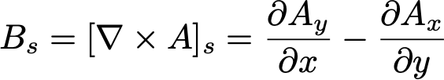

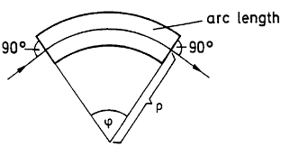

Dipole magnet (sector) – vector potential
Aim to have a constant vertical field only along the design orbit. Note that in general the curl in curvilinear coordinates is given by
The following vector potential results in desired dipole field

Slide 10



Dipole magnet – Hamiltonian
Substitute the vector potential for a sector dipole to obtain the exact Hamiltonian
where the normaliszed dipole strength k₀ is defined as
Assuming small dynamics variables , series expand the square root term to first order (Xsuite manual Eqn. 1.53).
This approximation makes the equation of motion more tractable. The higher order terms that are ignored are known as kinematic terms.

Slide 11

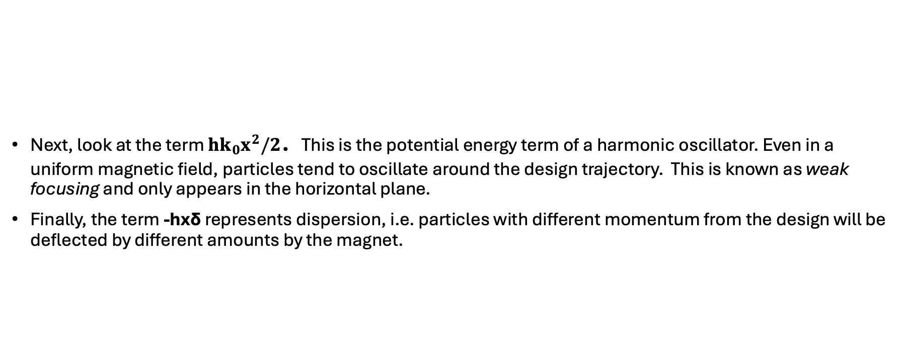
Dipole magnet – Hamiltonian observations
Next, look at the term $hk_{0}x^{2}/2$. This is the potential energy term of a harmonic oscillator. Even in a uniform magnetic field, particles tend to oscillate around the design trajectory. This is known as weak focusing and only appears in the horizontal plane.
Finally, the term -hxδ represents dispersion, i.e. particles with different momentum from the design will be deflected by different amounts by the magnet.
Applying the equations of motion, the (k₀ – h)x term leads to a change in momentum.
This is zero so long as k0 = h = 1/ρ, i.e. the p_{x} is unchanged if the magnet strength matches the design orbit!

Slide 12








Dipole magnet – equations of motion (weak focusing)
Apply Hamilton’s equations (assume k₀ = h)
In the case δ=0, it follows
Hill’s equation
where $ω=\sqrt{hk_{0}}$

Slide 13
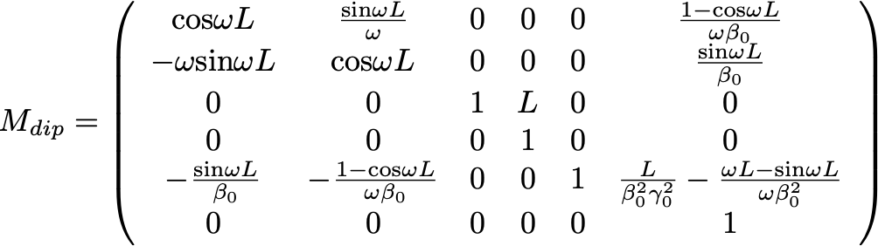

Dipole magnet – transfer matrix
It is convenient to express the map of a dipole magnet of length L in the form of a transfer matrix
M will multiply the phase space vector $z=\left(x,p_{x},y,p_{y},τ, p_{τ}\right)$

Slide 14
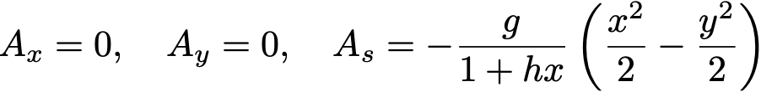
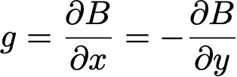
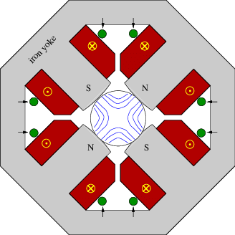
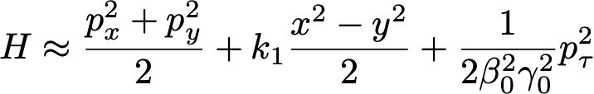
Quadrupole magnet (Hamiltonian)
Starting with vector potential for a quadrupole
where
Use curl equations to find field equations
The vector potential leads to the following Hamiltonian (the norm. quadrupole strength $k_{1}=eg/p).$
Assuming a straight quadrupole, h=0, the expanded Hamiltonian can be written

Slide 15
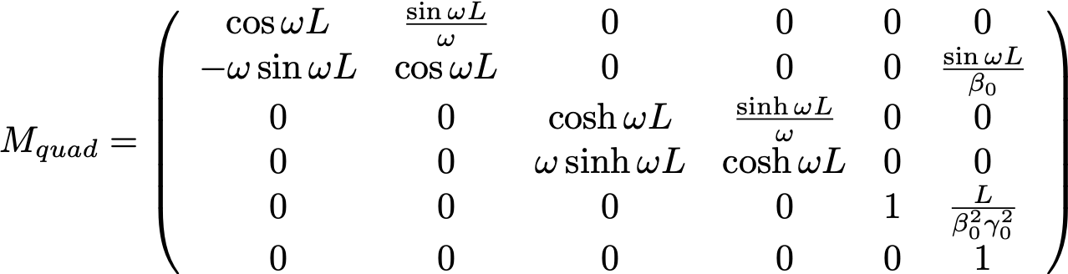

Quadrupole magnet (transfer matrix)
The “focusing” quadrupole transfer matrix (k₁ > 0) is
where $ω=\sqrt{k_{1}}$

Slide 16




Symplectic integration of a Harmonic Oscillator (1)
The Hamiltonian for a harmonic oscillator in one dimension is
where the potential energy is $U\left(q\right)=q^{2}/2$. The equations of motion follow
The exact evolution is given by

Slide 17


Symplectic integration of a Harmonic Oscillator (2)
Note the symplectic condition is met (ΜΩΜ = Ω)
This condition must be satisfied to preserve phase space volume under evolution (Liouville). Next, expand cosine and sine terms to first order (cos τ ~ 1, sin τ ~ τ).
The symplectic condition is not satisfied in this case and furthermore

Slide 18


Symplectic integration of a Harmonic Oscillator (3)
The energy after one timestep
The increase in energy will cause the trajectory to spiral outwards. A symplectic integration (one that preserves phase space volume) can be created as follows
Although the symplectic condition is now met, the effective Hamiltonian becomes
Since H_{integrated} is conserved in this case, the difference between it and H_{true} is a constant and the motion remains bounded.

Slide 19

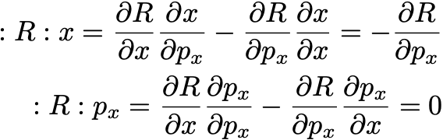
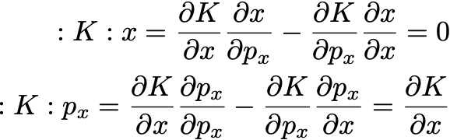
Symplectic integrator – splitting the Hamiltonian (1)
In general, a symplectic integrator is constructed by splitting the Hamiltonian into R and K that depend on momentum and coordinates only, respectively. In 1D we can write
The Lie operator for R and for K become

Slide 20
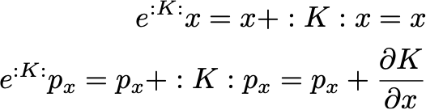
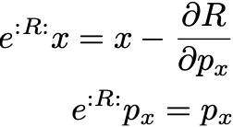
Symplectic integrator – splitting the Hamiltonian (2)
Applying the Lie transform, it is clear that the Hamiltonian K (the “kick”) updates the momentum only
while the Hamiltonian R (the “drift”) updates the position alone

Slide 21
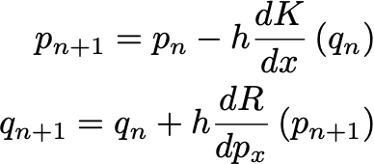
First order integrator – symplectic Euler
To first order we can write
This is the symplectic Euler method. Dividing the interval into steps of length h
Note, the standard (“explicit”) Euler method is non-symplectic as in the lower equation the derivative of R is evaluated at p_{n} rather than p_{n+1}.

Slide 22
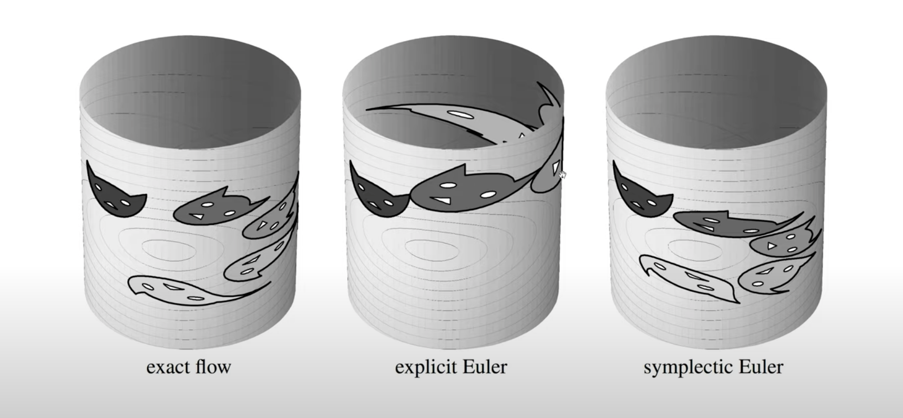
M. Leok - ”Introduction to geometrical numerical integration”, link to Youtube video

Slide 23

Second order integrator – drift-kick-drift
Figure: One step of a symplectic Euler integrator (left) and second order leapfrog (right). [S. Baturin]
If the Hamiltonian is split as follows
then to second order
This is known as the drift-kick-drift integrator (also known as leapfrog or Störmer-Verlet integrator)

Slide 24
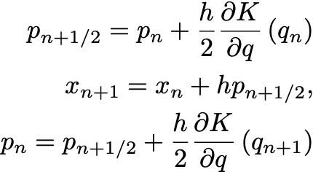
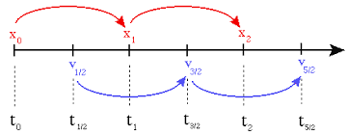
Second order integrator – kick-drift-kick
In simplified terms, the kick-drift-kick integrator is given by

Slide 25

Fourth order integrator – Yoshida
Figure: One step of the fourth order Yoshida integrator. [S. Baturin]
Yoshida found that a set of integrators at order 2n can be found by building on the second order integrator S₂
where $γ=1/\left(2 − 2^{1/3}\right)$, $κ=1/\left[2^{1/3}\left(2−2^{1/3}\right)\right]$
H. Yoshida, ”Construction of higher order symplectic integrators”, Physics Letters A, vol. 150, no. 5, pp. 262 – 268, 1990.

Slide 26

Integrability
The ideal linear Hamiltonian
has two invariants of motion, the transverse actions J_{x}, J_{y}. This ensure the system is integrable.
However, the addition of nonlinearities may compromise this integrability and lead to a reduction in the dynamic aperture.
Nonlinear magnets may be added intentionally, for example sextupole magnets to correct chromaticity, or arise from magnet imperfections or other sources

Slide 27
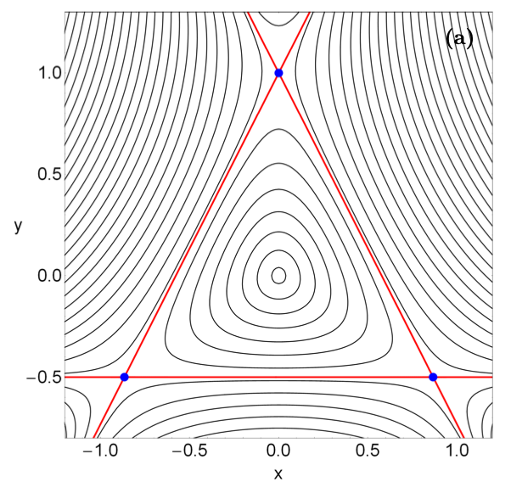


A non-integrable Hamiltonian – the Hénon-Heiles system
The Hénon-Heiles potential may be written
with Hamiltonian
This is a time-independent Hamiltonian. It is integrable only for limited number of initial conditions.
The potential can be realised by adding a sextupole to a linear lattice in such a way that the Hamiltonian is time independent.*
*S.A. Antipov and S. Nagaitsev, “Hénon-Heiles Single particle Dynamics at IOTA”, Proc. IPAC2017 WEOAB1

Slide 28
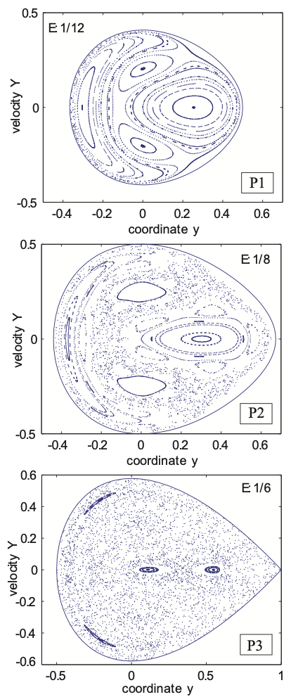
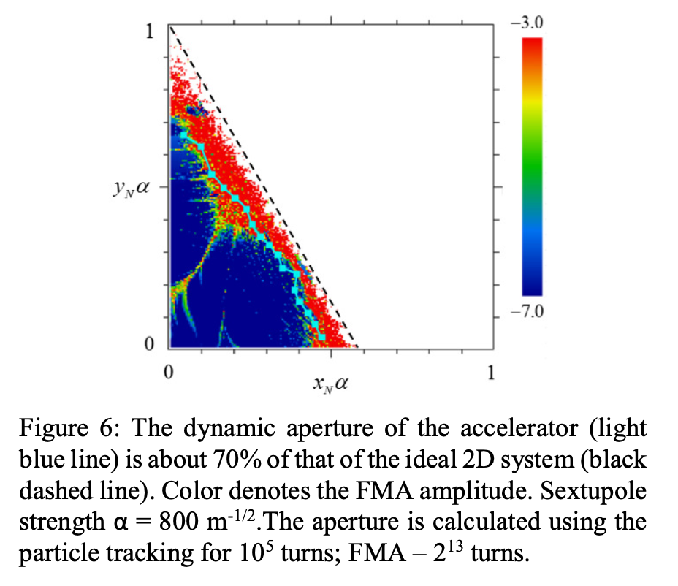
Hénon-Heiles phase space
The figure shows Poincare section in the Henon-Heiles cases for increasing values of E.
The motion tends to be integrable for low values of E but becomes increasingly chaotic as E approaches the escape value E = 1/6.
*S.A. Antipov and S. Nagaitsev, “Hénon-Heiles Single particle Dynamics at IOTA”, Proc. IPAC2017 WEOAB1

Slide 29
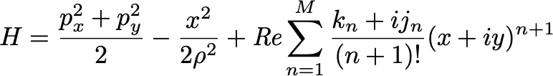


Hamiltonian with nonlinear multipoles
Multipoles of any order in the Hamiltonian we may written as follows
The Hamiltonian may be split into a linear part H₀ and nonlinear part V.
The V_{mn} terms are coefficients for different orders of x and y.
Credit: H. Bartosik, “Non-linear effects”, JUAS 2024

Slide 30

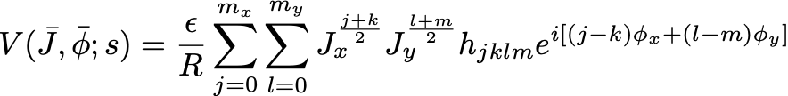
Resonance driving terms
In action-angle coordinates
J+k=m_{x}
l+m=m_{y}
where ε indicates the nonlinear part is a small perturbation. The h_{jklm} terms are known as resonance driving terms.
Each multipole drives a set of resonance driving terms.
Note terms with j=k, l=m has no angular dependence. This terms result instead result in tune shift with amplitude (e.g. the octupole drives detuning terms h₂₂₀₀, h₁₁₁₁, h₀₀₂₂)
Credit: H. Bartosik

Slide 31
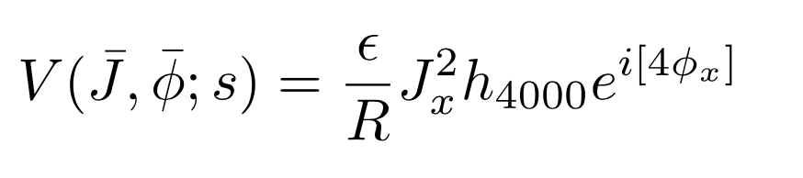

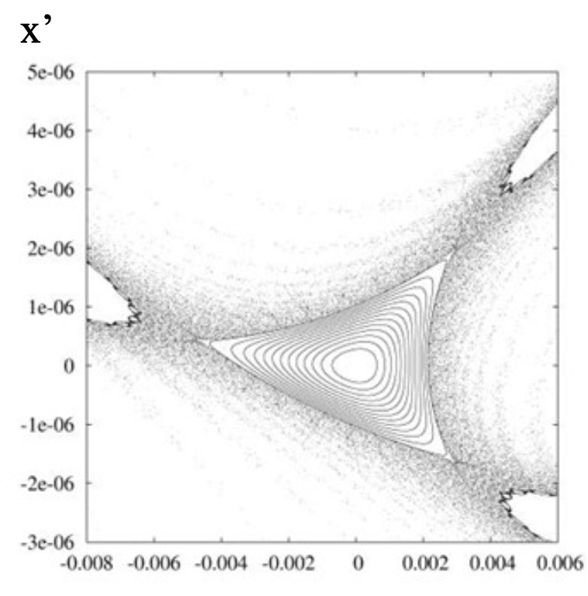
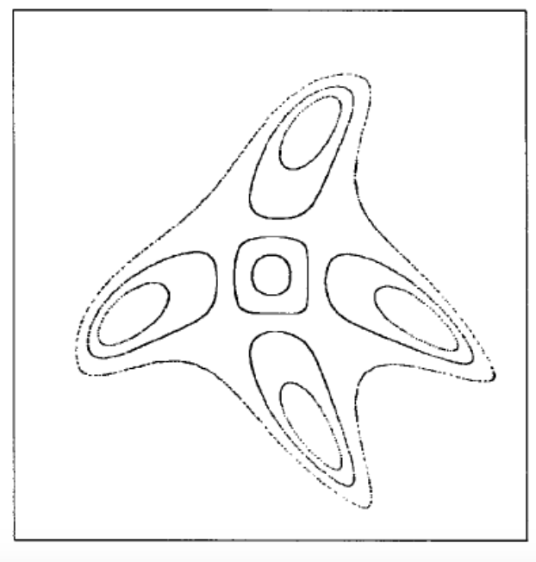
Resonance driving term examples
Sextupole driven resonance
Octupole driven resonance
Credit: H. Bartosik

