Slide 1
Lecture 3
Radiation Damping

Slide 2
Contents
Recap on synchrotron radiation emission
Total power radiated and energy loss per turn
Radiation damping of synchrotron oscillations
equations of motion for the longitudinal plane
Radiation damping of vertical betatron oscillations
modification of the vertical invariant of motion
Radiation damping of horizontal betatron oscillations
modification of the horizontal invariant of motion
Synchrotron radiation integrals
damping partition numbers
Methods for modifying the damping times

Slide 3
Radiation Damping
In this lecture we will investigate the impact that the emission of synchrotron radiation has on the motion of the circulating electrons in all three planes.
We will find that when combined with the re-acceleration in the RF cavities, the energy loss leads to a damping of the oscillations in each plane.
With the emission of synchrotron radiation, the system is not conservative; the Courant-Snyder Invariant (the area of the ellipse in phase space) is no-longer a constant of motion.
Because of the dependence on the rest mass of the particle, the emission of synchrotron radiation and subsequent radiation damping tends only to be significant for electron or position machines.
Radiation damping has many important consequences:
It gives rise to a stable equilibrium distribution in each plane (emittance and energy spread), independent from the injected beam distribution
It permits multi-cycle, off-axis injection, since the beam damps down towards the stored beam distribution before the next injection cycle
It helps to counteract intra-beam scatter and instabilities

Slide 4
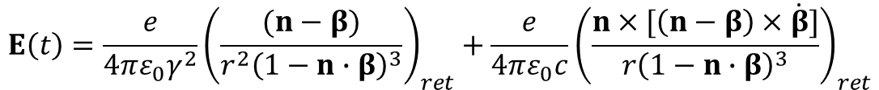
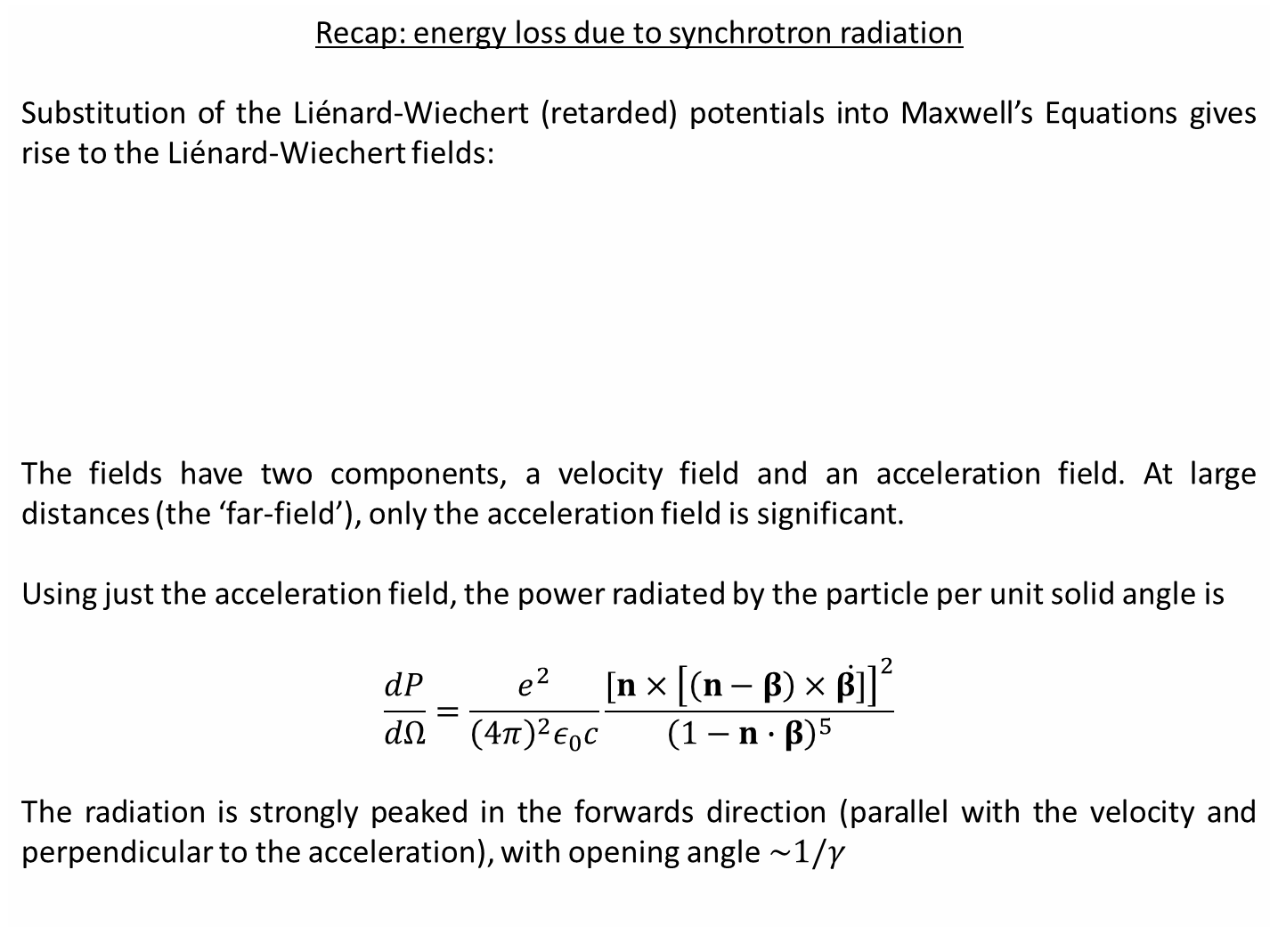

Recap: energy loss due to synchrotron radiation
Substitution of the Liénard-Wiechert (retarded) potentials into Maxwell’s Equations gives rise to the Liénard-Wiechert fields:
The fields have two components, a velocity field and an acceleration field. At large distances (the ‘far-field’), only the acceleration field is significant.
Using just the acceleration field, the power radiated by the particle per unit solid angle is
$$\frac{dP}{dΩ}=\frac{e^{2}}{{\left(4π\right)}^{2}ε_{0}c}\frac{[n×{\left[\left(n−β\right)×\dot{β]}\right]}^{2}}{{\left(1−n∙β\right)}^{5}}$$
The radiation is strongly peaked in the forwards direction (parallel with the velocity and perpendicular to the acceleration), with opening angle $\sim 1/γ$
$$E\left(t\right)=\frac{e}{4πε_{0}γ^{2}}{\left(\frac{(n−β)}{r^{2}{\left(1−n∙β\right)}^{3}}\right)}_{ret}+\frac{e}{4πε_{0}c}{\left(\frac{n×[\left(n−β\right)×\dot{β}]}{r{\left(1−n∙β\right)}^{3}}\right)}_{ret}$$
$$B\left(t\right)=\frac{n×E(t)}{c}$$

Slide 5
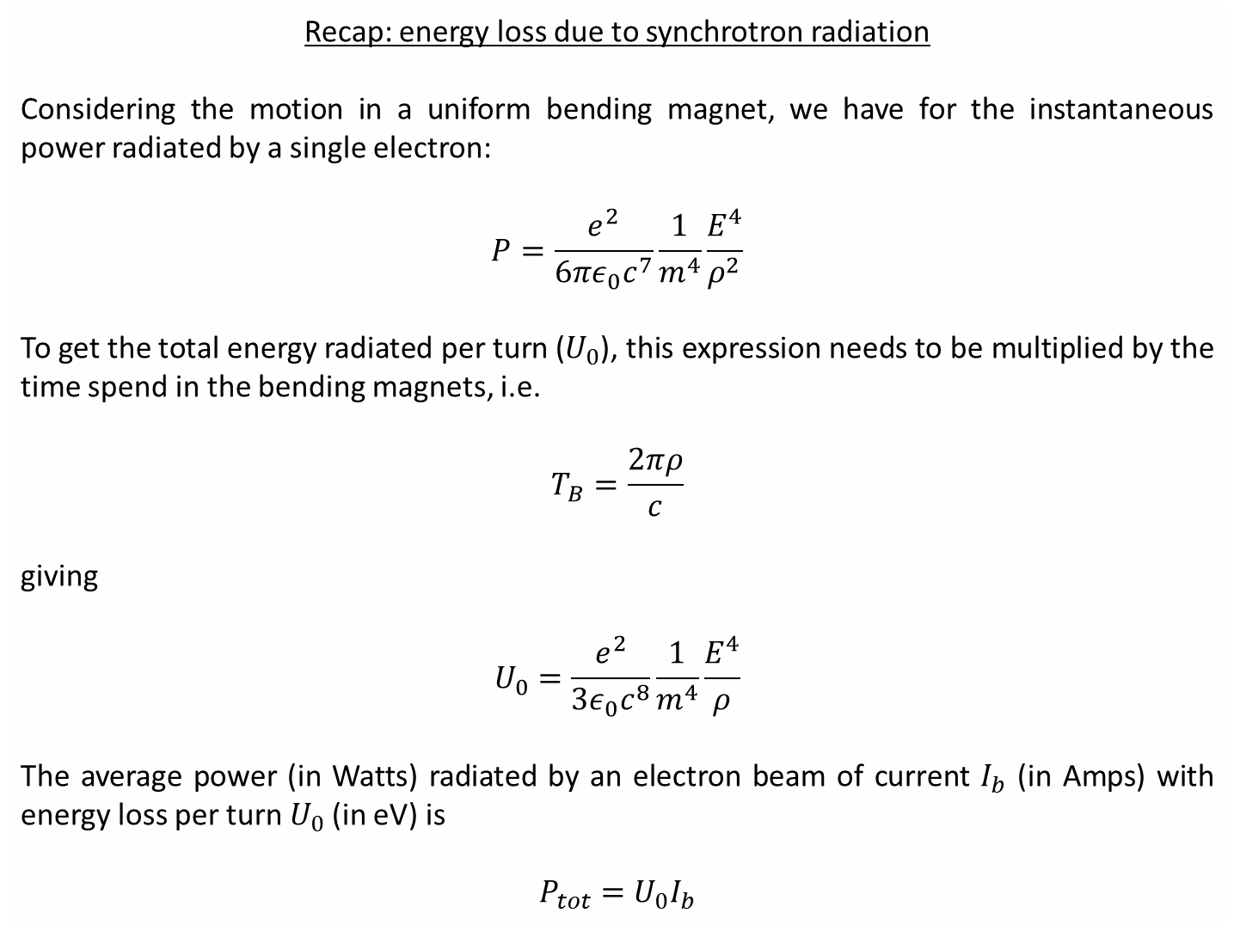
Recap: energy loss due to synchrotron radiation
Considering the motion in a uniform bending magnet, we have for the instantaneous power radiated by a single electron:
$$P=\frac{e^{2}}{6πε_{0}c^{7}}\frac{1}{m^{4}}\frac{E^{4}}{ρ^{2}}$$
To get the total energy radiated per turn ($U_{0}$), this expression needs to be multiplied by the time spend in the bending magnets, i.e.
$$T_{B}=\frac{2πρ}{c}$$
giving
$$U_{0}=\frac{e^{2}}{3ε_{0}c^{8}}\frac{1}{m^{4}}\frac{E^{4}}{ρ}$$
The average power (in Watts) radiated by an electron beam of current $I_{b}$ (in Amps) with energy loss per turn $U_{0}$(in eV) is
$$P_{tot}=U_{0}I_{b}$$

Slide 6
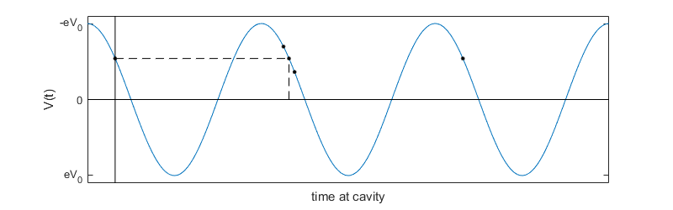







RF Cavity
RF cavities are used to supply energy to the beam. The longitudinal electric field oscillates with time, such that there is one phase per cycle that gives stable acceleration to the beam. The energy gain of the particle is
$$ΔE=eV\left(t\right)=eV_{0}\sin\left(ω_{RF}t+φ_{s}\right)$$
Assuming highly relativistic motion (i.e. above transition), the stable synchronous phase $φ_{s}$ is the one that restores exactly the energy lost to dissipative processes
$$ΔE=U_{0}=eV_{0}\sin\left(φ_{s}\right)$$
Particles which are high in energy travel further in single revolution and will arrive later
Particles which are low in energy travel less distance and will arrive earlier
$$E<E_{0}$$
Negative RF slope for $α_{c}>0$
$$U_{0}$$
$$E=E_{0}$$
$$E>E_{0}$$
$$φ_{s}$$

Slide 7
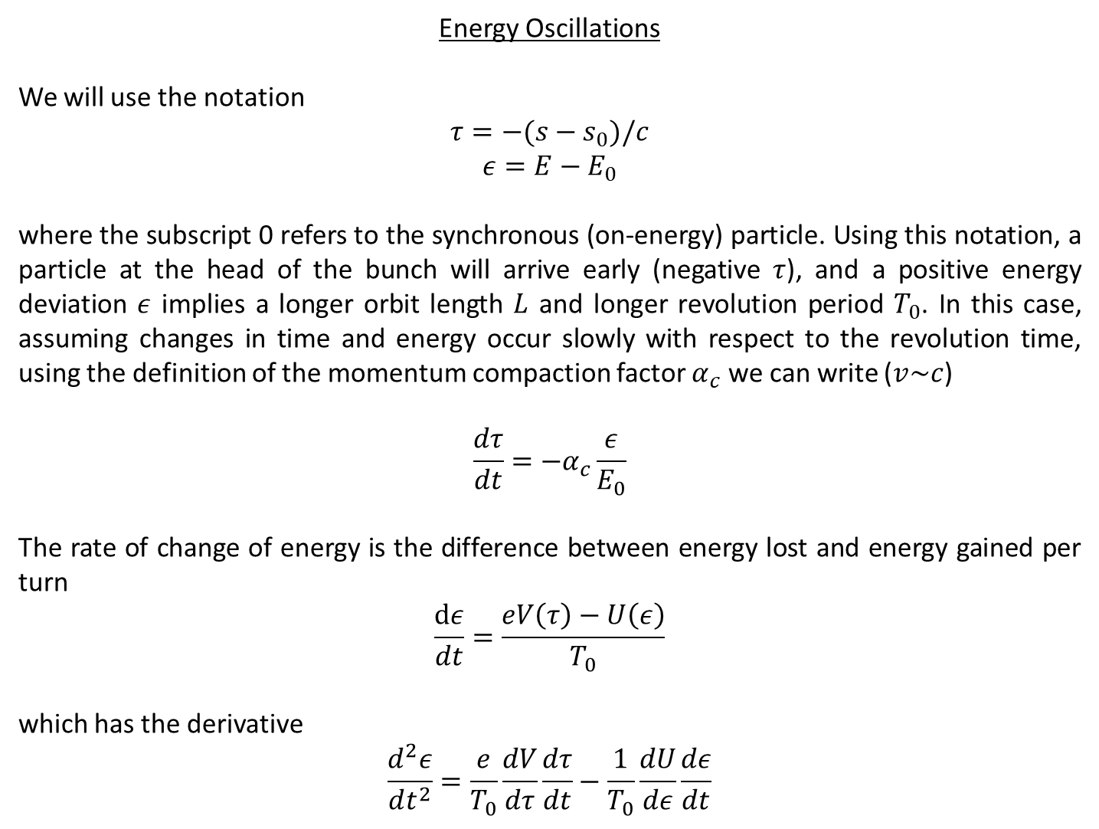
Energy Oscillations
We will use the notation
$$τ=−(s−s_{0})/c$$
$$ε={E−E}_{0}$$
where the subscript 0 refers to the synchronous (on-energy) particle. Using this notation, a particle at the head of the bunch will arrive early (negative $τ$), and a positive energy deviation $ε$ implies a longer orbit length $L$ and longer revolution period $T_{0}$. In this case, assuming changes in time and energy occur slowly with respect to the revolution time, using the definition of the momentum compaction factor $α_{c}$ we can write ($v\sim c$)
$$\frac{dτ}{dt}=−α_{c}\frac{ε}{E_{0}}$$
The rate of change of energy is the difference between energy lost and energy gained per turn
$$\frac{dε}{dt}=\frac{eV\left(τ\right)−U\left(ε\right)}{T_{0}}$$
which has the derivative
$$\frac{d^{2}ε}{dt^{2}}=\frac{e}{T_{0}}\frac{dV}{dτ}\frac{dτ}{dt}−\frac{1}{T_{0}}\frac{dU}{dε}\frac{dε}{dt}$$

Slide 8
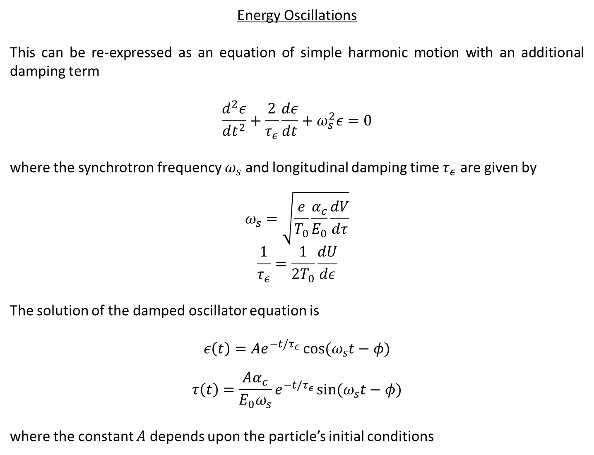
Energy Oscillations
This can be re-expressed as an equation of simple harmonic motion with an additional damping term
$$\frac{d^{2}ε}{dt^{2}}+\frac{2}{τ_{ε}}\frac{dε}{dt}+ω_{s}^{2}ε=0$$
where the synchrotron frequency $ω_{s}$ and longitudinal damping time $τ_{ε}$ are given by
$$ω_{s}=\sqrt{\frac{e}{T_{0}}\frac{α_{c}}{E_{0}}\frac{dV}{dτ}}$$
$$\frac{1}{τ_{ε}}=\frac{1}{{2T}_{0}}\frac{dU}{dε}$$
The solution of the damped oscillator equation is
$$ε\left(t\right)=Ae^{−t/τ_{ε}}\cos{(ω_{s}t−φ)}$$
$$τ\left(t\right)=\frac{Aα_{c}}{E_{0}ω_{s}}e^{−t/τ_{ε}}\sin{(ω_{s}t−φ)}$$
where the constant $A$ depends upon the particle’s initial conditions

Slide 9
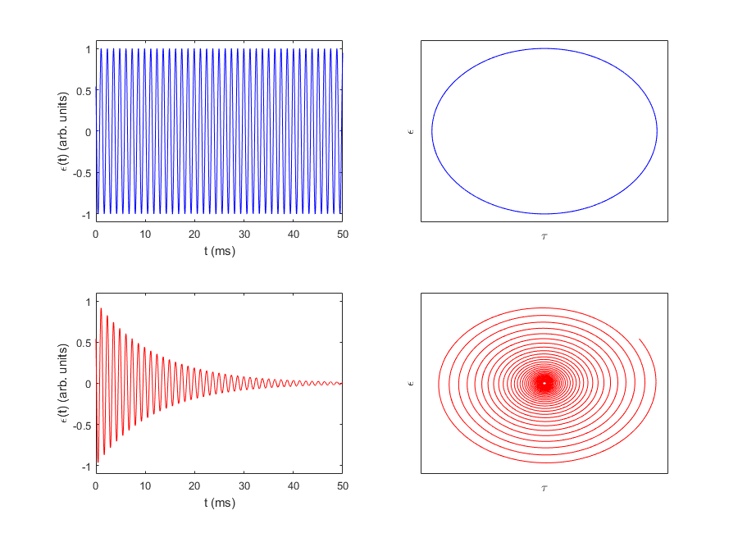


Energy Oscillations
no damping
With damping
Converges to synchronous, on-energy particle
Head gains energy for $α_{c}>0$
Tail loses energy for $α_{c}>0$

Slide 10
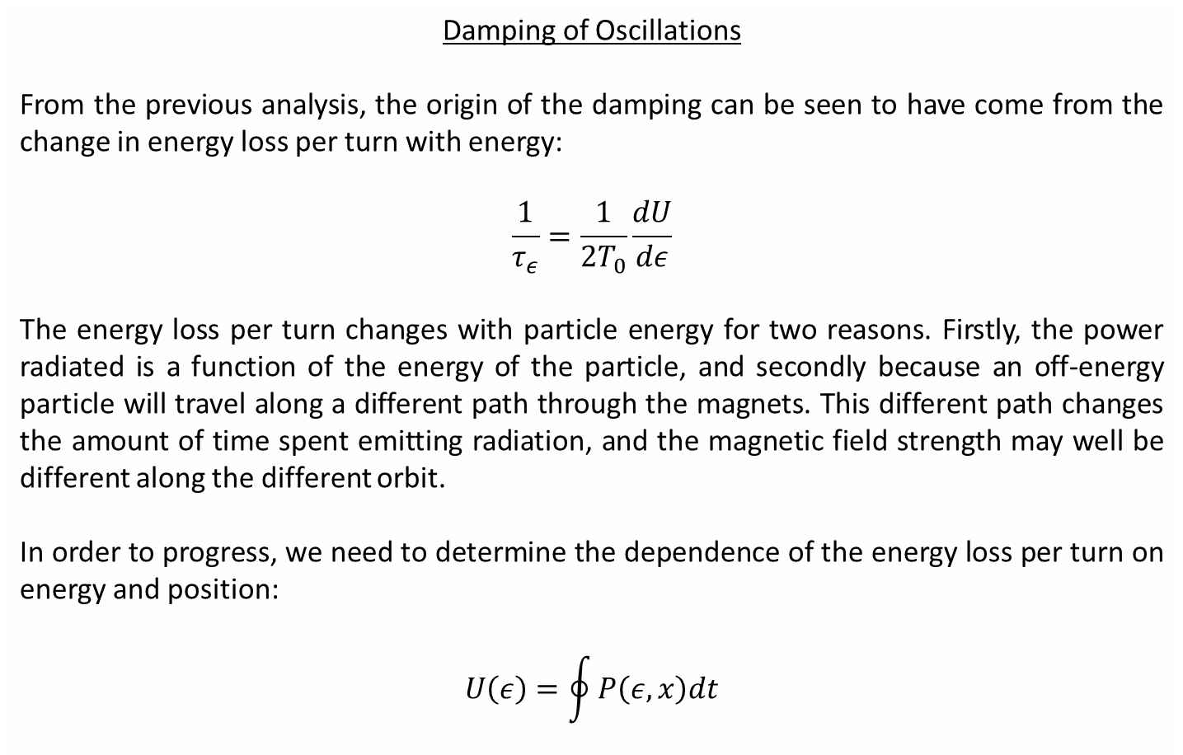
Damping of Oscillations
From the previous analysis, the origin of the damping can be seen to have come from the change in energy loss per turn with energy:
$$\frac{1}{τ_{ε}}=\frac{1}{{2T}_{0}}\frac{dU}{dε}$$
The energy loss per turn changes with particle energy for two reasons. Firstly, the power radiated is a function of the energy of the particle, and secondly because an off-energy particle will travel along a different path through the magnets. This different path changes the amount of time spent emitting radiation, and the magnetic field strength may well be different along the different orbit.
In order to progress, we need to determine the dependence of the energy loss per turn on energy and position:
$$U\left(ε\right)=\oint{P\left(ε,x\right)dt}$$

Slide 11
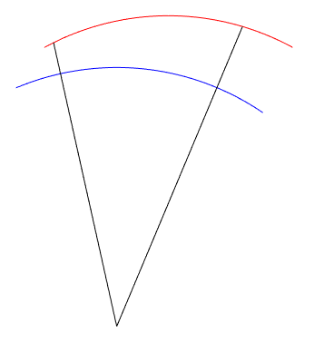


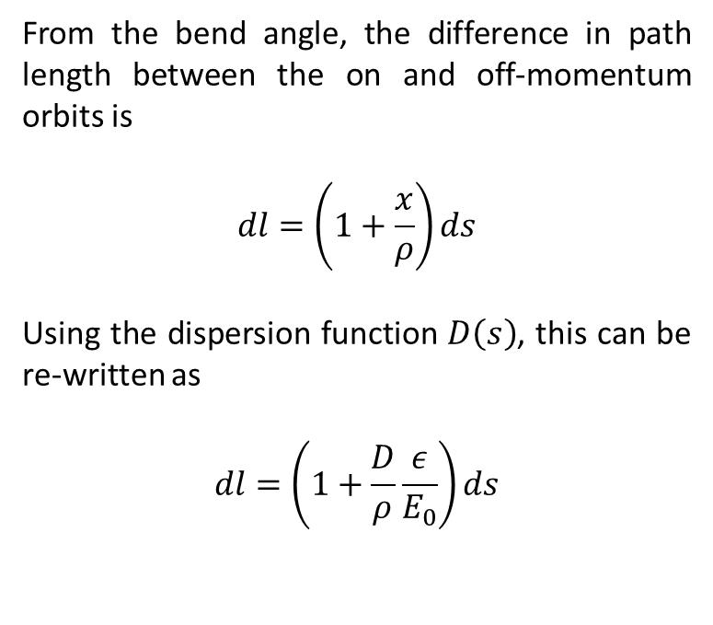



Damping of Oscillations
The difference in time spent in the dipoles depending upon energy can be found from purely geometrical considerations.
$$dl$$
Off-energy orbit
From the bend angle, the difference in path length between the on and off-momentum orbits is
$$dl=\left(1+\frac{x}{ρ}\right)ds$$
Using the dispersion function $D\left(s\right)$, this can be re-written as
$$dl=\left(1+\frac{D}{ρ}\frac{ε}{E_{0}}\right)ds$$
$$x$$
$$ds$$
reference orbit
$$ρ$$
Or in the time domain:
$$dt=\frac{1}{c}\left(1+\frac{D}{ρ}\frac{ε}{E_{0}}\right)ds$$

Slide 12
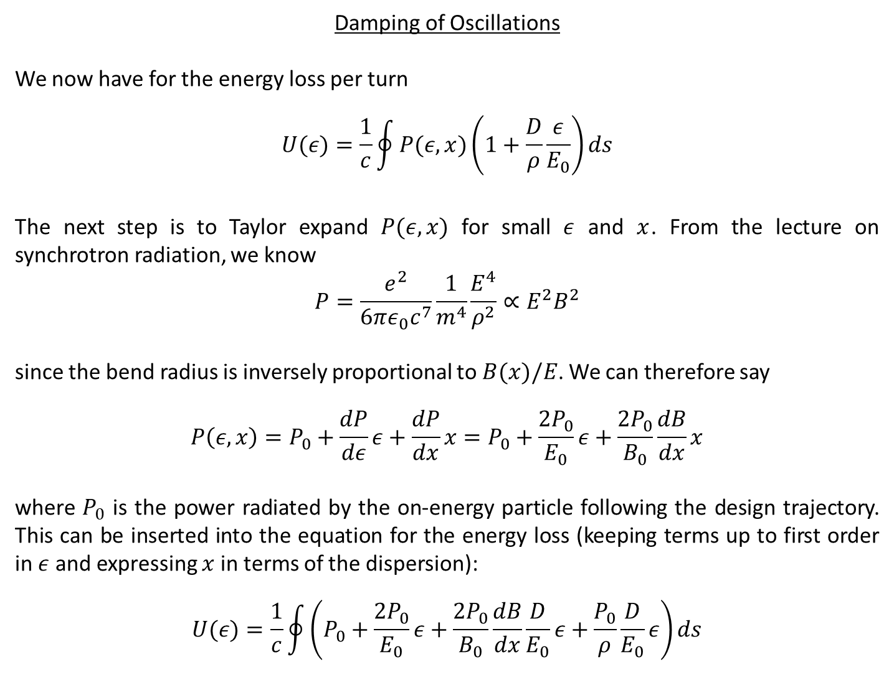
Damping of Oscillations
We now have for the energy loss per turn
$$U(ε)=\frac{1}{c}\oint{P(ε,x)\left(1+\frac{D}{ρ}\frac{ε}{E_{0}}\right)ds}$$
The next step is to Taylor expand $P(ε,x)$ for small $ε$ and $x$. From the lecture on synchrotron radiation, we know
$$P=\frac{e^{2}}{6πε_{0}c^{7}}\frac{1}{m^{4}}\frac{E^{4}}{ρ^{2}}∝E^{2}B^{2}$$
since the bend radius is inversely proportional to$B(x)/E$. We can therefore say
$$P\left(ε,x\right)=P_{0}+\frac{dP}{dε}ε+\frac{dP}{dx}x=P_{0}+\frac{2P_{0}}{E_{0}}ε+\frac{2P_{0}}{B_{0}}\frac{dB}{dx}x$$
where $P_{0}$ is the power radiated by the on-energy particle following the design trajectory. This can be inserted into the equation for the energy loss (keeping terms up to first order in $ε$ and expressing $x$ in terms of the dispersion):
$$U(ε)=\frac{1}{c}\oint{\left(P_{0}+\frac{2P_{0}}{E_{0}}ε+\frac{2P_{0}}{B_{0}}\frac{dB}{dx}\frac{D}{E_{0}}ε+\frac{P_{0}}{ρ}\frac{D}{E_{0}}ε\right)ds}$$

Slide 13
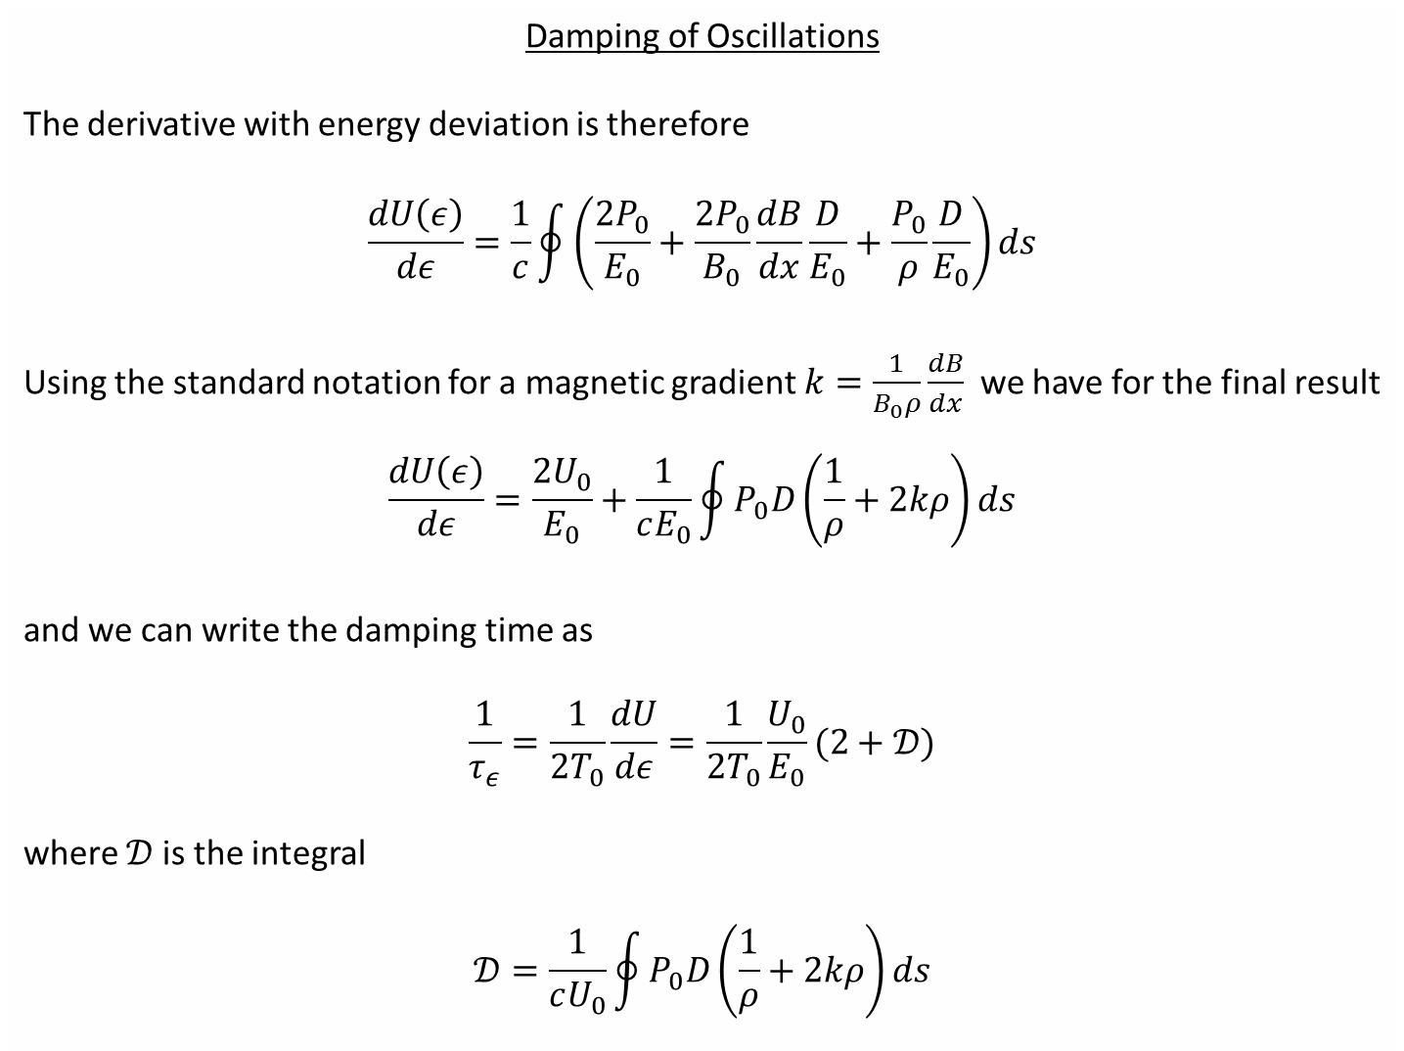
Damping of Oscillations
The derivative with energy deviation is therefore
$$\frac{dU\left(ε\right)}{dε}=\frac{1}{c}\oint{\left(\frac{2P_{0}}{E_{0}}+\frac{2P_{0}}{B_{0}}\frac{dB}{dx}\frac{D}{E_{0}}+\frac{P_{0}}{ρ}\frac{D}{E_{0}}\right)ds}$$
Using the standard notation for a magnetic gradient $k=\frac{1}{B_{0}ρ}\frac{dB}{dx}$ we have for the final result
$$\frac{dU\left(ε\right)}{dε}=\frac{{2U}_{0}}{E_{0}}+\frac{1}{cE_{0}}\oint{P_{0}D\left(\frac{1}{ρ}+2kρ\right)ds}$$
and we can write the damping time as
$$\frac{1}{τ_{ε}}=\frac{1}{{2T}_{0}}\frac{dU}{dε}=\frac{1}{{2T}_{0}}\frac{U_{0}}{E_{0}}(2+𝒟)$$
where $𝒟$ is the integral
$$𝒟=\frac{1}{cU_{0}}\oint{P_{0}D\left(\frac{1}{ρ}+2kρ\right)ds}$$

Slide 14
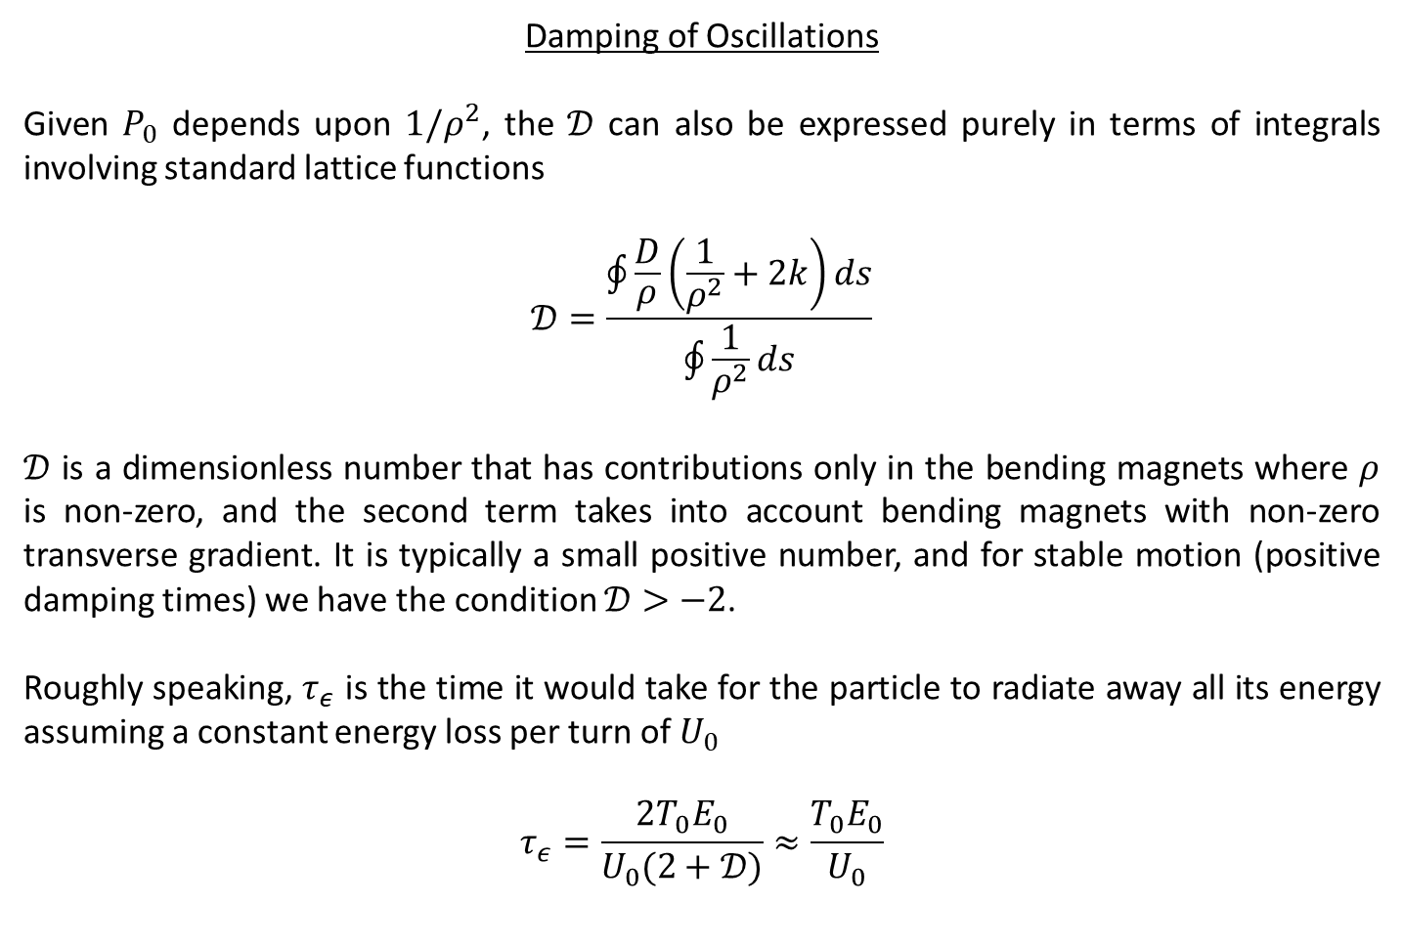
Damping of Oscillations
Given $P_{0}$ depends upon $1/ρ^{2}$, the $𝒟$ can also be expressed purely in terms of integrals involving standard lattice functions
$$𝒟=\frac{\oint{\frac{D}{ρ}\left(\frac{1}{ρ^{2}}+2k\right)ds}}{\oint{\frac{1}{ρ^{2}}ds}}$$
$𝒟$ is a dimensionless number that has contributions only in the bending magnets where $ρ$ is non-zero, and the second term takes into account bending magnets with non-zero transverse gradient. It is typically a small positive number, and for stable motion (positive damping times) we have the condition $𝒟>−2$.
Roughly speaking, $τ_{ε}$ is the time it would take for the particle to radiate away all its energy assuming a constant energy loss per turn of $U_{0}$
$$τ_{ε}=\frac{2T_{0}E_{0}}{U_{0}(2+𝒟)}≈\frac{T_{0}E_{0}}{U_{0}}$$

Slide 15
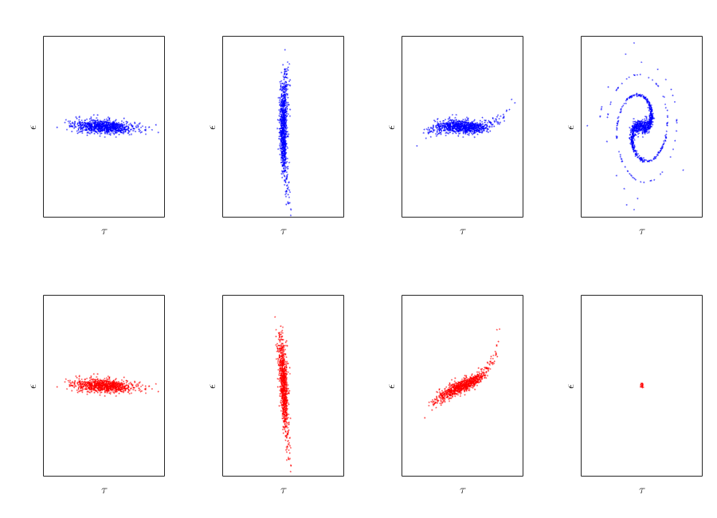
Without Radiation Damping
initial
¼ synch. period
1 synch. period
2 damping periods
Strong filamentation from RF curvature
With Radiation Damping
initial
¼ synch. period
1 synch. period
2 damping periods
Injected beam dimensions reduce in both $τ$ and $ε$

Slide 16
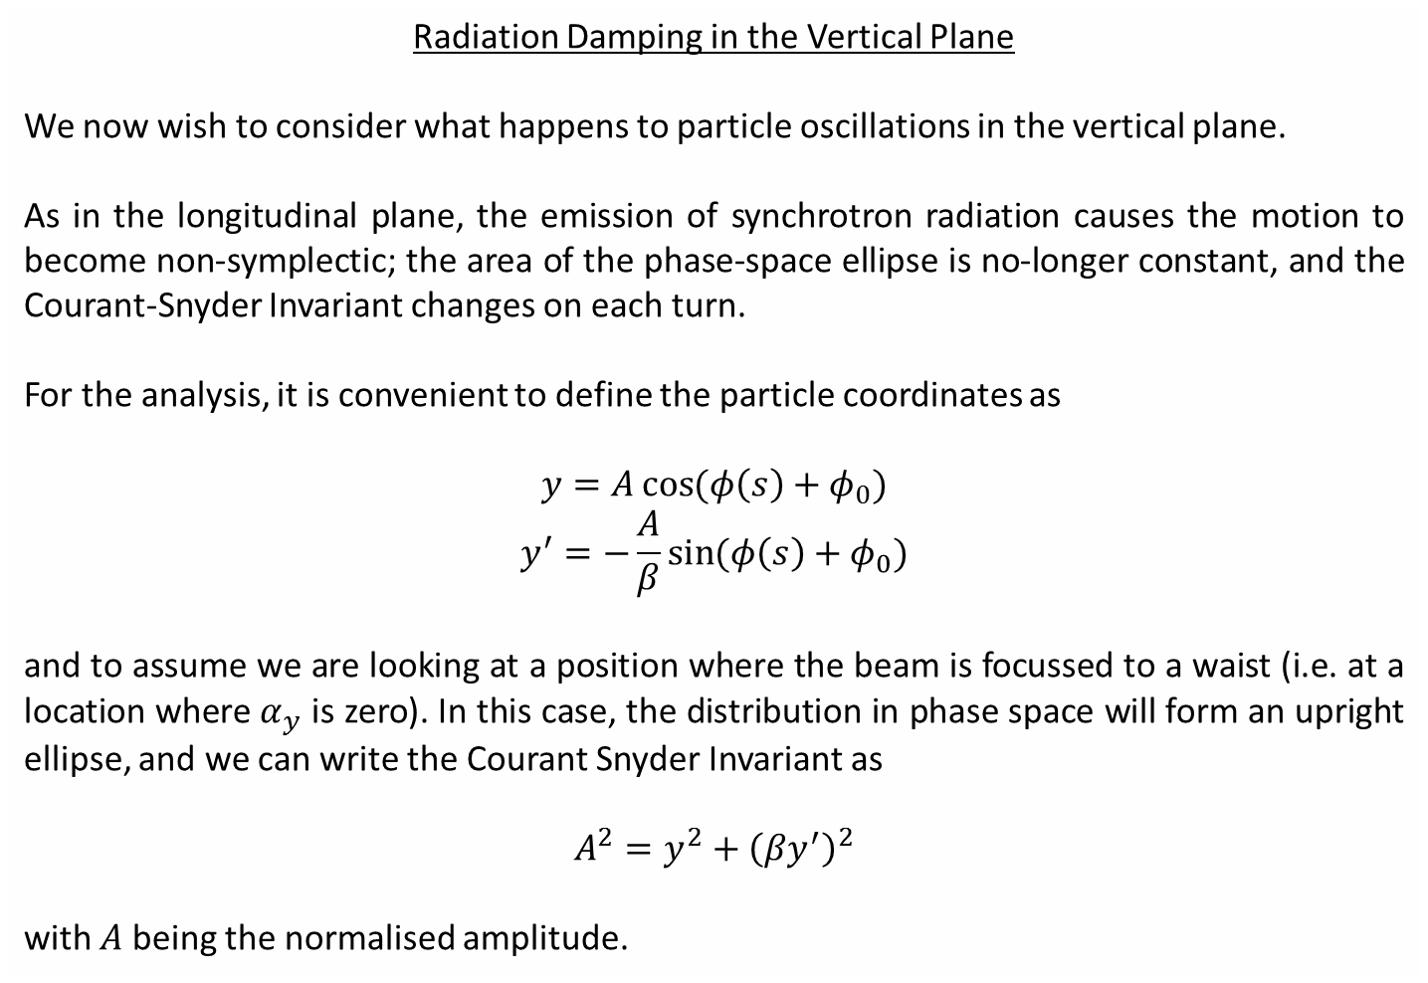
Radiation Damping in the Vertical Plane
We now wish to consider what happens to particle oscillations in the vertical plane.
As in the longitudinal plane, the emission of synchrotron radiation causes the motion to become non-symplectic; the area of the phase-space ellipse is no-longer constant, and the Courant-Snyder Invariant changes on each turn.
For the analysis, it is convenient to define the particle coordinates as
$$y=A\cos{(φ\left(s\right)+φ_{0})}$$
$$y^{′}=−\frac{A}{β}\sin{(φ\left(s\right)+φ_{0})}$$
and to assume we are looking at a position where the beam is focussed to a waist (i.e. at a location where $α_{y}$ is zero). In this case, the distribution in phase space will form an upright ellipse, and we can write the Courant Snyder Invariant as
$$A^{2}=y^{2}+{\left(βy^{′}\right)}^{2}$$
with $A$ being the normalised amplitude.

Slide 17
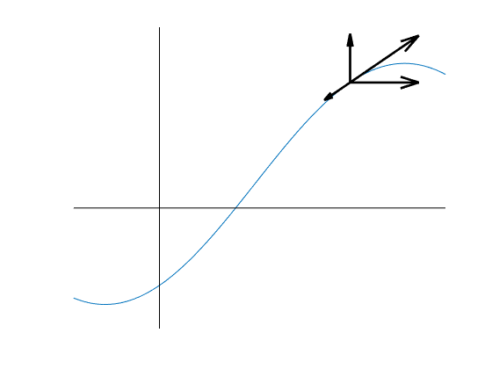


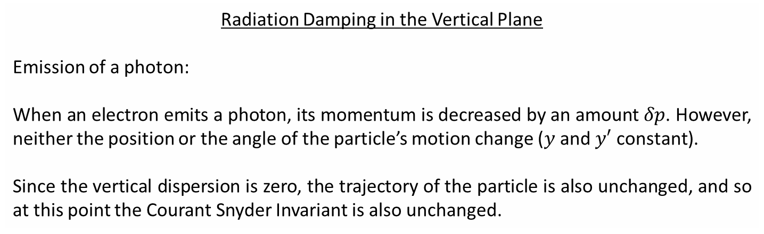




Radiation Damping in the Vertical Plane
Emission of a photon:
When an electron emits a photon, its momentum is decreased by an amount $δp$. However, neither the position or the angle of the particle’s motion change ($y$ and $y′$ constant).
Since the vertical dispersion is zero, the trajectory of the particle is also unchanged, and so at this point the Courant Snyder Invariant is also unchanged.
$$p$$
$$y$$
$$p_{⊥}$$
$$δp$$
$$p_{||}$$
$$s$$

Slide 18
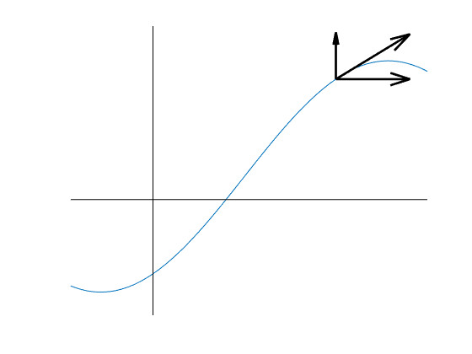
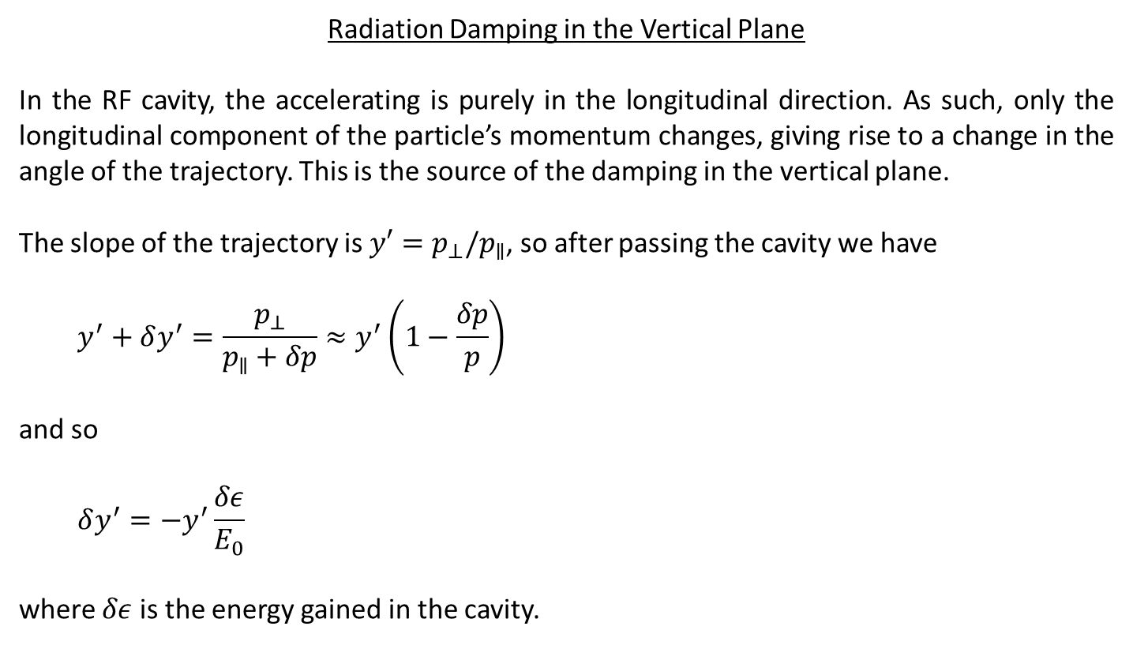

Radiation Damping in the Vertical Plane
In the RF cavity, the accelerating is purely in the longitudinal direction. As such, only the longitudinal component of the particle’s momentum changes, giving rise to a change in the angle of the trajectory. This is the source of the damping in the vertical plane.
The slope of the trajectory is $y′=p_{⊥}/p_{∥}$, so after passing the cavity we have
$$y^{′}+δy^{′}=\frac{p_{⊥}}{p_{∥}+δp}≈y^{′}\left(1−\frac{δp}{p}\right)$$
and so
$$δy^{′}=−y^{′}\frac{δε}{E_{0}}$$
where $δε$ is the energy gained in the cavity.
$$p$$
$$y$$
$$p_{⊥}$$
$$p_{||}+δp$$
$$s$$

Slide 19
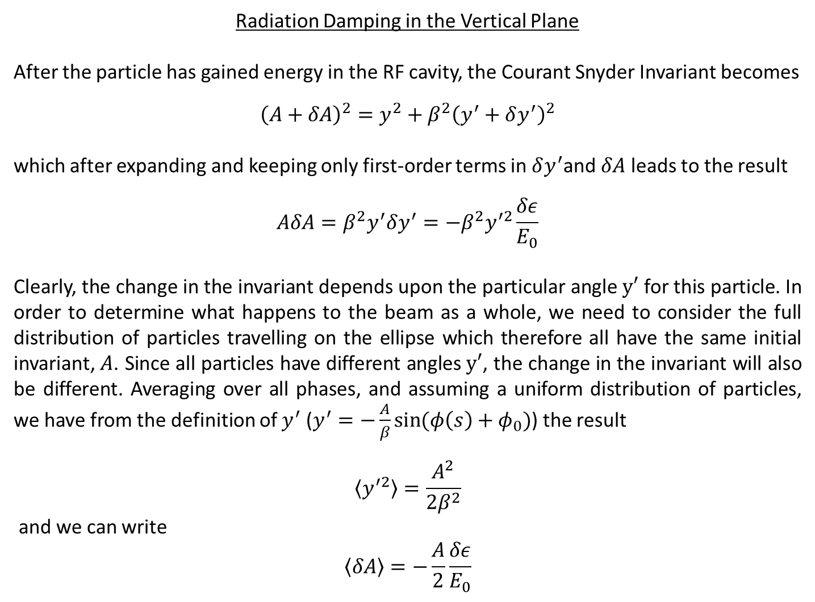
Radiation Damping in the Vertical Plane
After the particle has gained energy in the RF cavity, the Courant Snyder Invariant becomes
$${\left(A+δA\right)}^{2}=y^{2}+β^{2}{\left(y^{′}+δy^{′}\right)}^{2}$$
which after expanding and keeping only first-order terms in $δy^{′}$and $δA$ leads to the result
$$AδA=β^{2}y^{′}δy^{′}=−β^{2}y^{′2}\frac{δε}{E_{0}}$$
Clearly, the change in the invariant depends upon the particular angle $y′$ for this particle. In order to determine what happens to the beam as a whole, we need to consider the full distribution of particles travelling on the ellipse which therefore all have the same initial invariant, $A$. Since all particles have different angles $y′$, the change in the invariant will also be different. Averaging over all phases, and assuming a uniform distribution of particles, we have from the definition of $y^{′}$ ($y^{′}=−\frac{A}{β}\sin{(φ\left(s\right)+φ_{0})}$) the result
$$\left\langle y^{′2}\right\rangle =\frac{A^{2}}{2β^{2}}$$
and we can write
$$\left\langle δA\right\rangle =−\frac{A}{2}\frac{δε}{E_{0}}$$

Slide 20
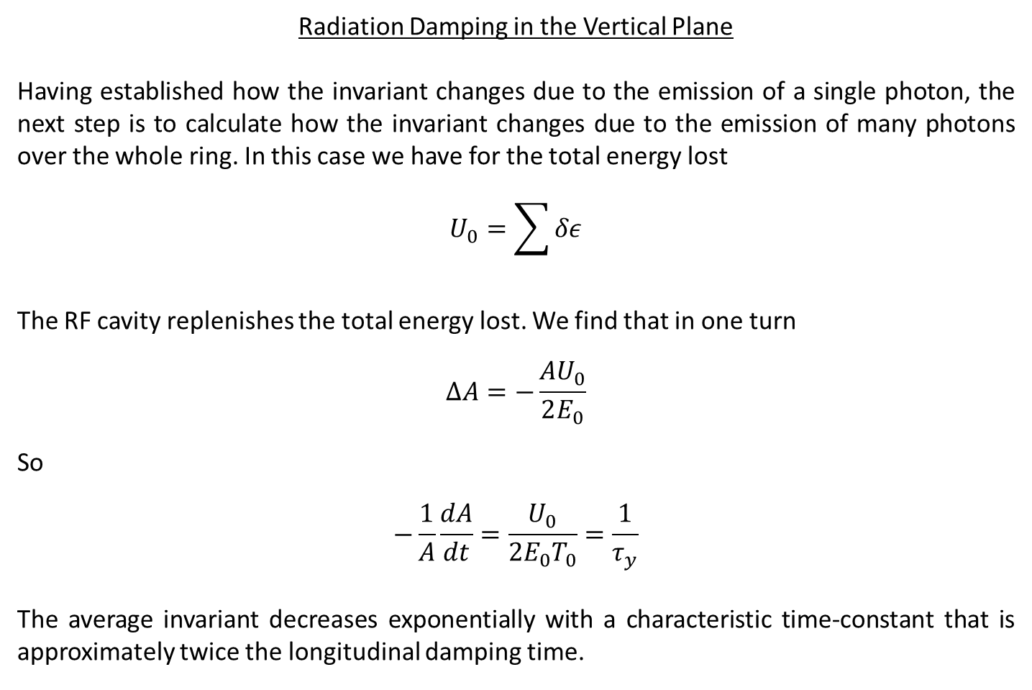
Radiation Damping in the Vertical Plane
Having established how the invariant changes due to the emission of a single photon, the next step is to calculate how the invariant changes due to the emission of many photons over the whole ring. In this case we have for the total energy lost
$$U_{0}=\sum{δε}$$
The RF cavity replenishes the total energy lost. We find that in one turn
$$ΔA=−\frac{AU_{0}}{2E_{0}}$$
So
$$−\frac{1}{A}\frac{dA}{dt}=\frac{U_{0}}{2E_{0}T_{0}}=\frac{1}{τ_{y}}$$
The average invariant decreases exponentially with a characteristic time-constant that is approximately twice the longitudinal damping time.

Slide 21
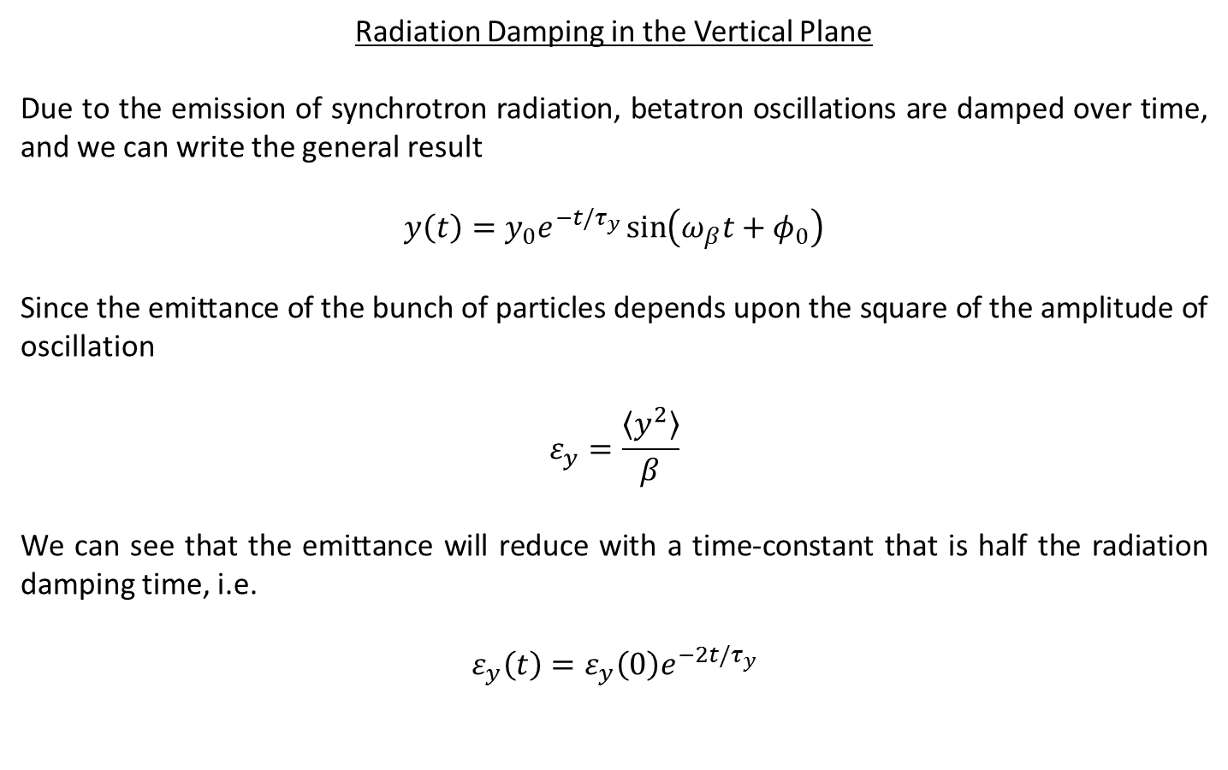
Radiation Damping in the Vertical Plane
Due to the emission of synchrotron radiation, betatron oscillations are damped over time, and we can write the general result
$$y\left(t\right)=y_{0}e^{−t/τ_{y}}\sin\left(ω_{β}t+φ_{0}\right)$$
Since the emittance of the bunch of particles depends upon the square of the amplitude of oscillation
$$ε_{y}=\frac{\left\langle y^{2}\right\rangle }{β}$$
We can see that the emittance will reduce with a time-constant that is half the radiation damping time, i.e.
$$ε_{y}\left(t\right)=ε_{y}\left(0\right)e^{−2t/τ_{y}}$$

Slide 22
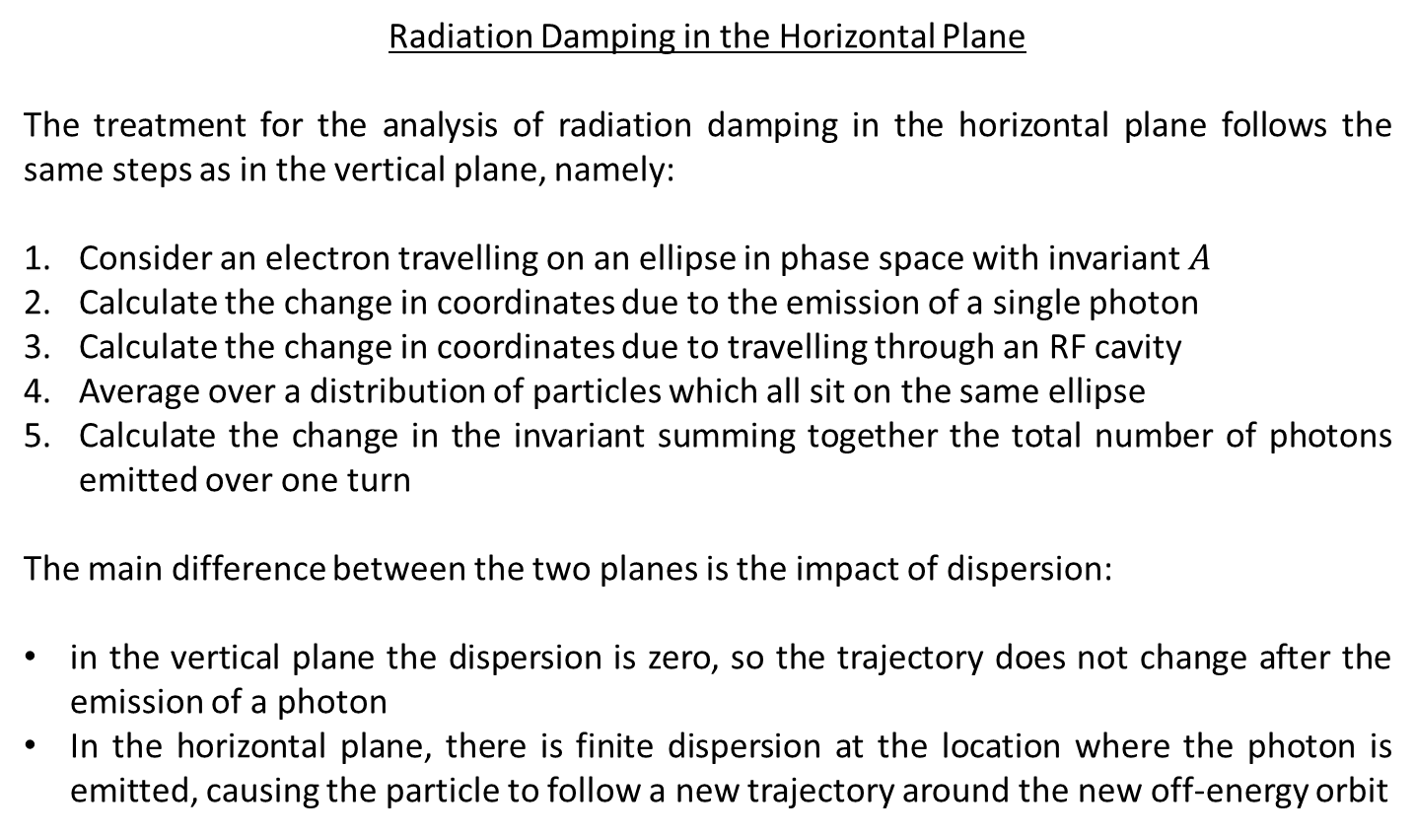
Radiation Damping in the Horizontal Plane
The treatment for the analysis of radiation damping in the horizontal plane follows the same steps as in the vertical plane, namely:
Consider an electron travelling on an ellipse in phase space with invariant $A$
Calculate the change in coordinates due to the emission of a single photon
Calculate the change in coordinates due to travelling through an RF cavity
Average over a distribution of particles which all sit on the same ellipse
Calculate the change in the invariant summing together the total number of photons emitted over one turn
The main difference between the two planes is the impact of dispersion:
in the vertical plane the dispersion is zero, so the trajectory does not change after the emission of a photon
In the horizontal plane, there is finite dispersion at the location where the photon is emitted, causing the particle to follow a new trajectory around the new off-energy orbit

Slide 23
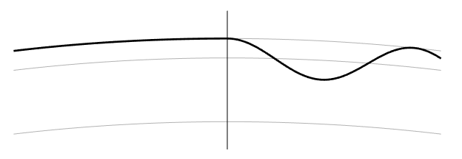


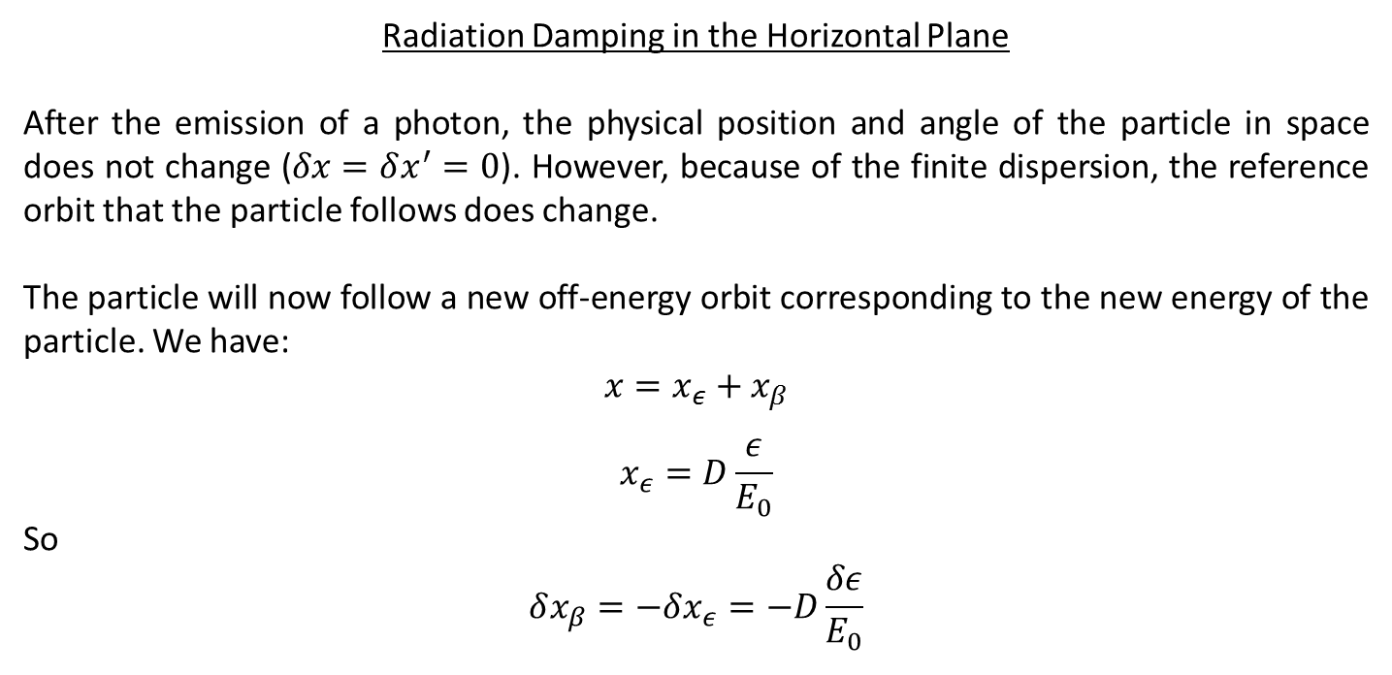





Radiation Damping in the Horizontal Plane
After the emission of a photon, the physical position and angle of the particle in space does not change ($δx=δx^{′}=0$). However, because of the finite dispersion, the reference orbit that the particle follows does change.
The particle will now follow a new off-energy orbit corresponding to the new energy of the particle. We have:
$$x=x_{ε}+x_{β}$$
$$x_{ε}=D\frac{ε}{E_{0}}$$
So
$$δx_{β}=−δx_{ε}=−D\frac{δε}{E_{0}}$$
Before emission
After emission
$$x$$
photon
$$ε$$
$$δx_{ε}$$
$$δx_{β}$$
Closed orbits
$$ε−\frac{δε}{E_{0}}$$
Electron path
$x_{δ}$+$x_{ε}$
$$ε=0$$
$$s$$

Slide 24
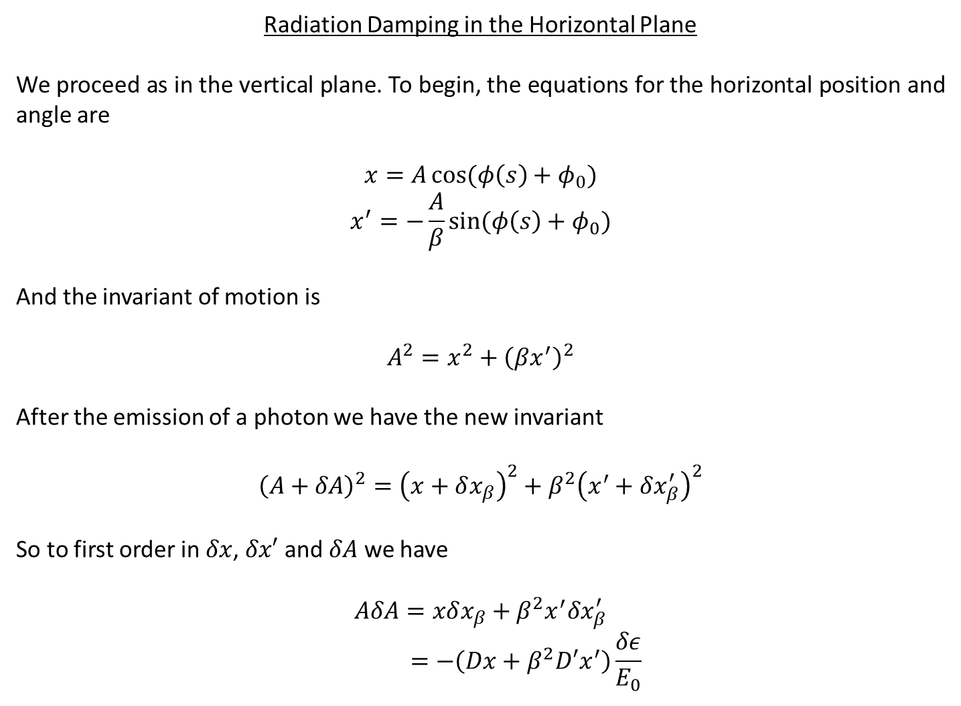
Radiation Damping in the Horizontal Plane
We proceed as in the vertical plane. To begin, the equations for the horizontal position and angle are
$$x=A\cos{(φ\left(s\right)+φ_{0})}$$
$$x^{′}=−\frac{A}{β}\sin{(φ\left(s\right)+φ_{0})}$$
And the invariant of motion is
$$A^{2}=x^{2}+{\left(βx^{′}\right)}^{2}$$
After the emission of a photon we have the new invariant
$${\left(A+δA\right)}^{2}={\left(x+δx_{β}\right)}^{2}+β^{2}{\left(x^{′}+δx_{β}^{′}\right)}^{2}$$
So to first order in $δx$, $δx′$ and $δA$ we have
$$AδA=xδx_{β}+β^{2}x^{′}δx_{β}^{′}$$
$$=−\left(Dx+β^{2}D′x^{′}\right)\frac{δε}{E_{0}}$$

Slide 25
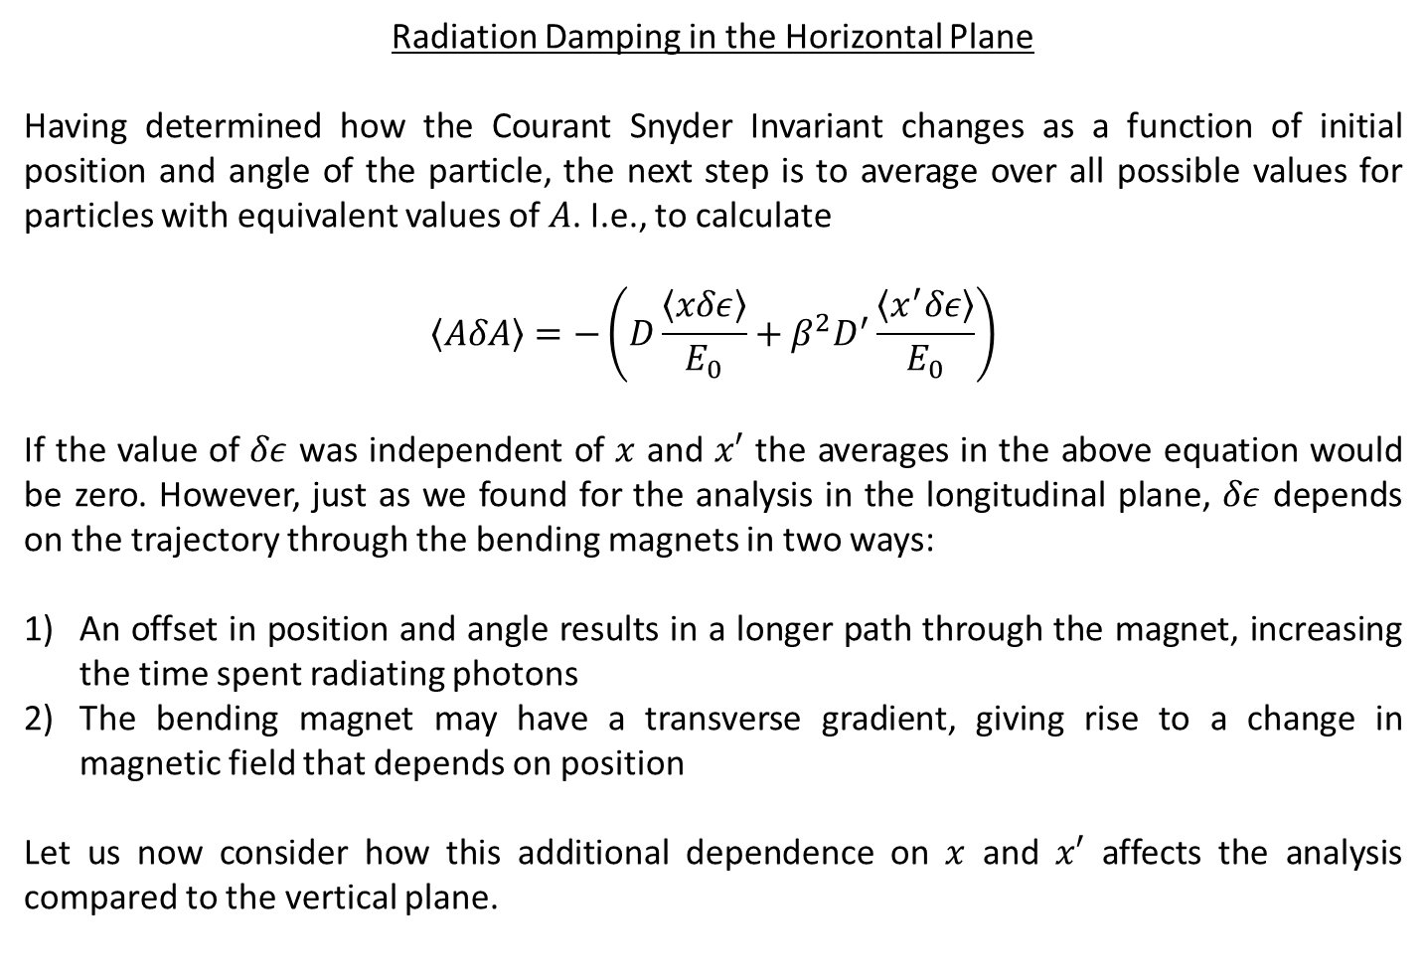
Radiation Damping in the Horizontal Plane
Having determined how the Courant Snyder Invariant changes as a function of initial position and angle of the particle, the next step is to average over all possible values for particles with equivalent values of $A$. I.e., to calculate
$$\left\langle AδA\right\rangle =−\left(D\frac{\left\langle xδε\right\rangle }{E_{0}}+β^{2}D^{′}\frac{\left\langle x^{′}δε\right\rangle }{E_{0}}\right)$$
If the value of $δε$ was independent of $x$ and $x′$ the averages in the above equation would be zero. However, just as we found for the analysis in the longitudinal plane, $δε$ depends on the trajectory through the bending magnets in two ways:
An offset in position and angle results in a longer path through the magnet, increasing the time spent radiating photons
The bending magnet may have a transverse gradient, giving rise to a change in magnetic field that depends on position
Let us now consider how this additional dependence on $x$ and $x′$ affects the analysis compared to the vertical plane.

Slide 26

Radiation Damping in the Horizontal Plane
The energy lost by the particle is given by
$$δε=−P\left(x\right)dt$$
and from the earlier analysis we have
$$dt=\frac{1}{c}\left(1+\frac{x}{ρ}\right)ds$$
We also have the expression for the power
$$P\left(x\right)=P_{0}+\frac{2P_{0}}{B_{0}}\frac{dB}{dx}x=P_{0}(1+2kρx)$$
So to first order in $x$ we can write
$$δε=−\frac{P_{0}}{c}\left(1+2kρx+\frac{x}{ρ}\right)ds$$

Slide 27
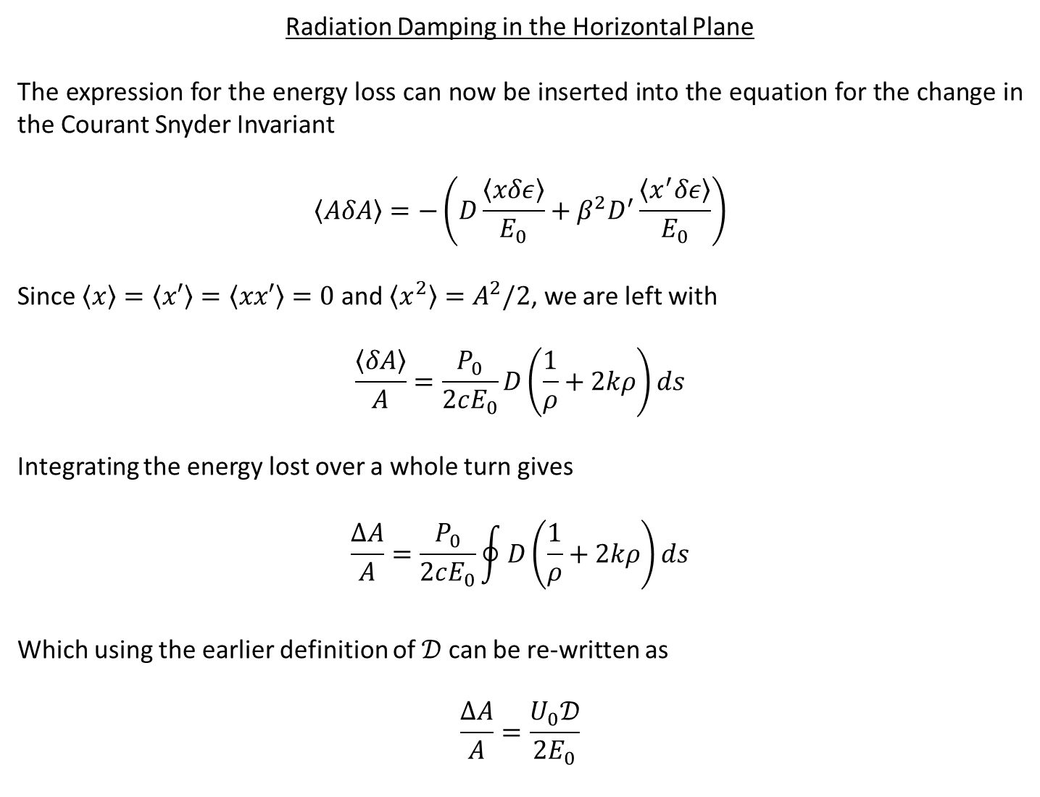
Radiation Damping in the Horizontal Plane
The expression for the energy loss can now be inserted into the equation for the change in the Courant Snyder Invariant
$$\left\langle AδA\right\rangle =−\left(D\frac{\left\langle xδε\right\rangle }{E_{0}}+β^{2}D^{′}\frac{\left\langle x^{′}δε\right\rangle }{E_{0}}\right)$$
Since $\left\langle x\right\rangle =\left\langle x′\right\rangle =\left\langle xx′\right\rangle =0$ and $\left\langle x^{2}\right\rangle =A^{2}/2$, we are left with
$$\frac{\left\langle δA\right\rangle }{A}=\frac{P_{0}}{2cE_{0}}D\left(\frac{1}{ρ}+2kρ\right)ds$$
Integrating the energy lost over a whole turn gives
$$\frac{ΔA}{A}=\frac{P_{0}}{2cE_{0}}\oint{D\left(\frac{1}{ρ}+2kρ\right)ds}$$
Which using the earlier definition of $𝒟$ can be re-written as
$$\frac{ΔA}{A}=\frac{U_{0}𝒟}{2E_{0}}$$

Slide 28
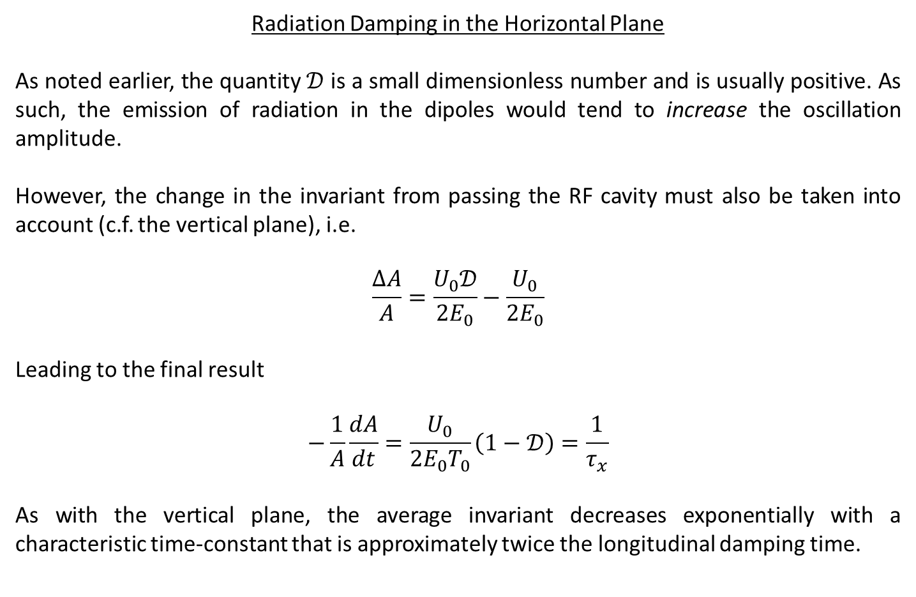
Radiation Damping in the Horizontal Plane
As noted earlier, the quantity $𝒟$ is a small dimensionless number and is usually positive. As such, the emission of radiation in the dipoles would tend to increase the oscillation amplitude.
However, the change in the invariant from passing the RF cavity must also be taken into account (c.f. the vertical plane), i.e.
$$\frac{ΔA}{A}=\frac{U_{0}𝒟}{2E_{0}}−\frac{U_{0}}{2E_{0}}$$
Leading to the final result
$$−\frac{1}{A}\frac{dA}{dt}=\frac{U_{0}}{2E_{0}T_{0}}\left(1−𝒟\right)=\frac{1}{τ_{x}}$$
As with the vertical plane, the average invariant decreases exponentially with a characteristic time-constant that is approximately twice the longitudinal damping time.

Slide 29
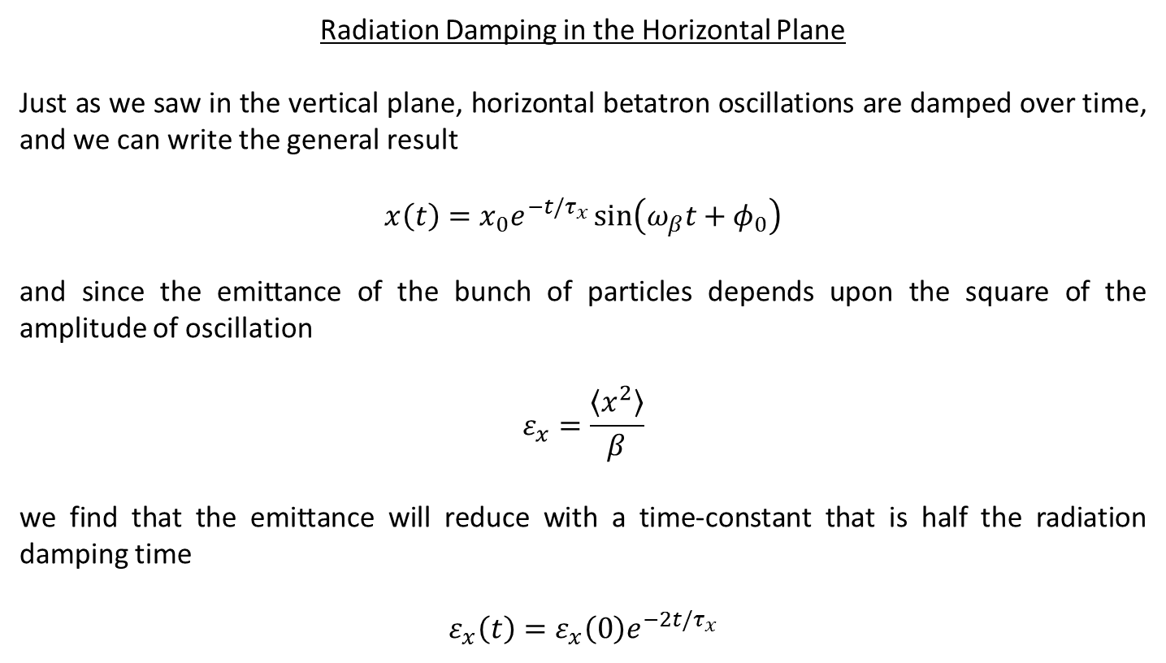
Radiation Damping in the Horizontal Plane
Just as we saw in the vertical plane, horizontal betatron oscillations are damped over time, and we can write the general result
$$x\left(t\right)=x_{0}e^{−t/τ_{x}}\sin\left(ω_{β}t+φ_{0}\right)$$
and since the emittance of the bunch of particles depends upon the square of the amplitude of oscillation
$$ε_{x}=\frac{\left\langle x^{2}\right\rangle }{β}$$
we find that the emittance will reduce with a time-constant that is half the radiation damping time
$$ε_{x}\left(t\right)=ε_{x}\left(0\right)e^{−2t/τ_{x}}$$

Slide 30
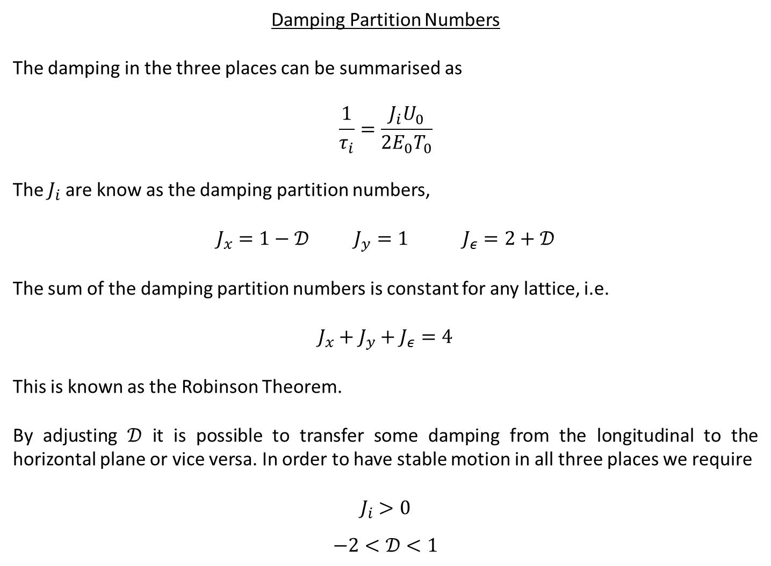
Damping Partition Numbers
The damping in the three places can be summarised as
$$\frac{1}{τ_{i}}=\frac{J_{i}U_{0}}{2E_{0}T_{0}}$$
The $J_{i}$ are know as the damping partition numbers,
$$J_{x}=1−𝒟 J_{y}=1 J_{ε}=2+𝒟$$
The sum of the damping partition numbers is constant for any lattice, i.e.
$$J_{x}+J_{y}+J_{ε}=4$$
This is known as the Robinson Theorem.
By adjusting $𝒟$ it is possible to transfer some damping from the longitudinal to the horizontal plane or vice versa. In order to have stable motion in all three places we require
$$J_{i}>0$$
$$−2<𝒟<1$$

Slide 31
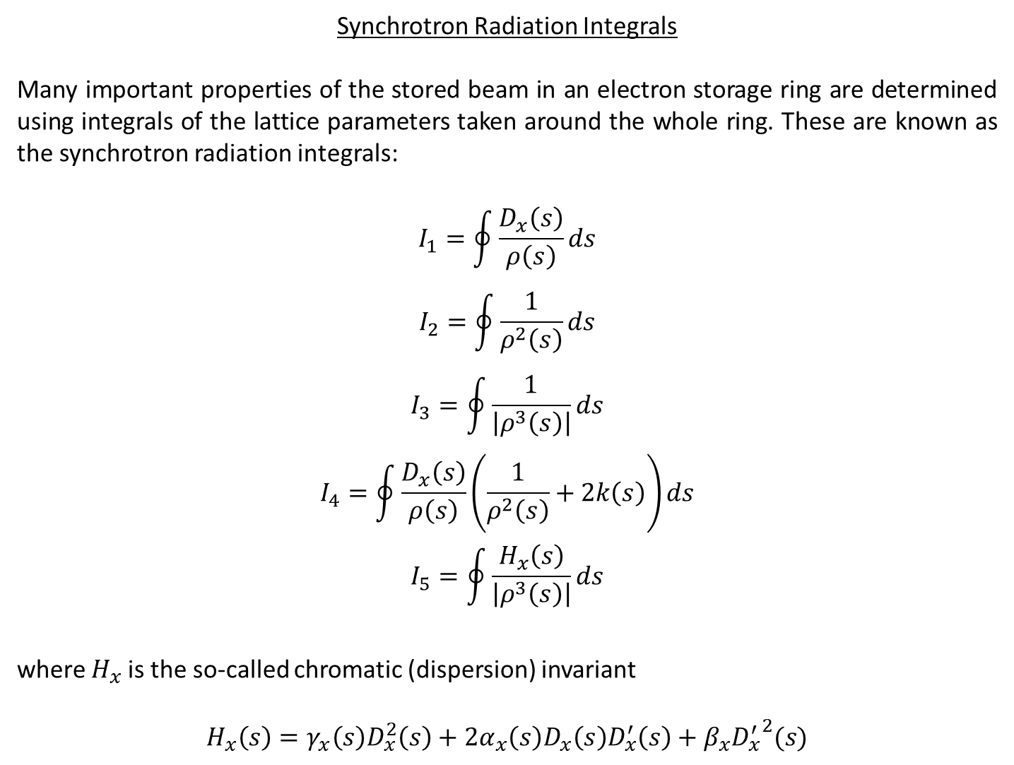
Synchrotron Radiation Integrals
Many important properties of the stored beam in an electron storage ring are determined using integrals of the lattice parameters taken around the whole ring. These are known as the synchrotron radiation integrals:
$$I_{1}=\oint{\frac{D_{x}\left(s\right)}{ρ\left(s\right)}ds}$$
$$I_{2}=\oint{\frac{1}{ρ^{2}\left(s\right)}ds}$$
$$I_{3}=\oint{\frac{1}{\left|ρ^{3}\left(s\right)\right|}ds}$$
$$I_{4}=\oint{\frac{D_{x}\left(s\right)}{ρ\left(s\right)}\left(\frac{1}{ρ^{2}\left(s\right)}+2k\left(s\right)\right)ds}$$
$$I_{5}=\oint{\frac{H_{x}\left(s\right)}{\left|ρ^{3}\left(s\right)\right|}ds}$$
where $H_{x}$is the so-called chromatic (dispersion) invariant
$$H_{x}\left(s\right)=γ_{x}\left(s\right)D_{x}^{2}\left(s\right)+2α_{x}\left(s\right)D_{x}\left(s\right)D_{x}^{′}\left(s\right)+β_{x}{D_{x}^{′}}^{2}(s)$$

Slide 32
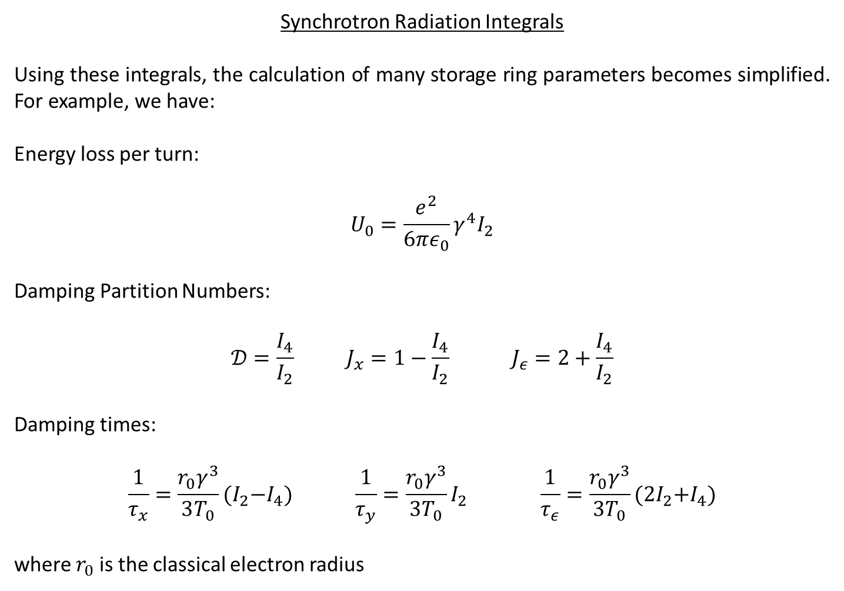
Synchrotron Radiation Integrals
Using these integrals, the calculation of many storage ring parameters becomes simplified. For example, we have:
Energy loss per turn:
$$U_{0}=\frac{e^{2}}{6πε_{0}}γ^{4}I_{2}$$
Damping Partition Numbers:
$$𝒟=\frac{I_{4}}{I_{2}} J_{x}=1−\frac{I_{4}}{I_{2}} J_{ε}=2+\frac{I_{4}}{I_{2}}$$
Damping times:
$$\frac{1}{τ_{x}}=\frac{r_{0}γ^{3}}{3T_{0}}{(I}_{2}−I_{4}) \frac{1}{τ_{y}}=\frac{r_{0}γ^{3}}{3T_{0}}I_{2} \frac{1}{τ_{ε}}=\frac{r_{0}γ^{3}}{3T_{0}}{(2I}_{2}+I_{4})$$
where $r_{0}$ is the classical electron radius

Slide 33
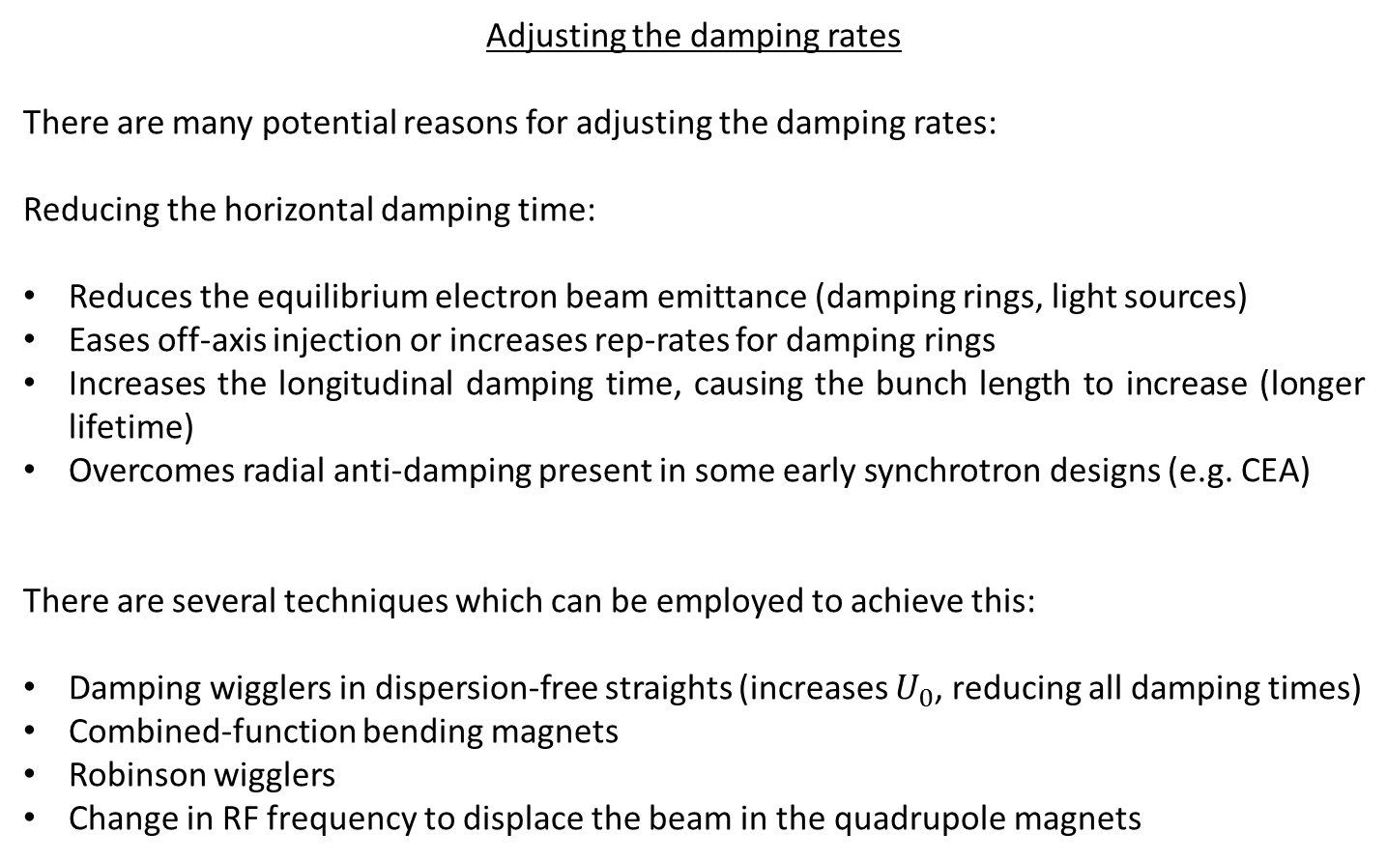
Adjusting the damping rates
There are many potential reasons for adjusting the damping rates:
Reducing the horizontal damping time:
Reduces the equilibrium electron beam emittance (damping rings, light sources)
Eases off-axis injection or increases rep-rates for damping rings
Increases the longitudinal damping time, causing the bunch length to increase (longer lifetime)
Overcomes radial anti-damping present in some early synchrotron designs (e.g. CEA)
There are several techniques which can be employed to achieve this:
Damping wigglers in dispersion-free straights (increases $U_{0}$, reducing all damping times)
Combined-function bending magnets
Robinson wigglers
Change in RF frequency to displace the beam in the quadrupole magnets

Slide 34
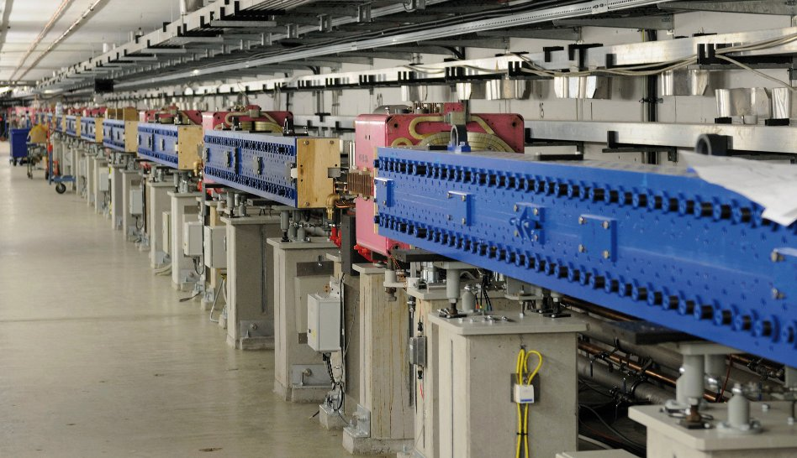
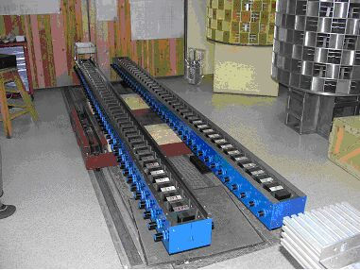
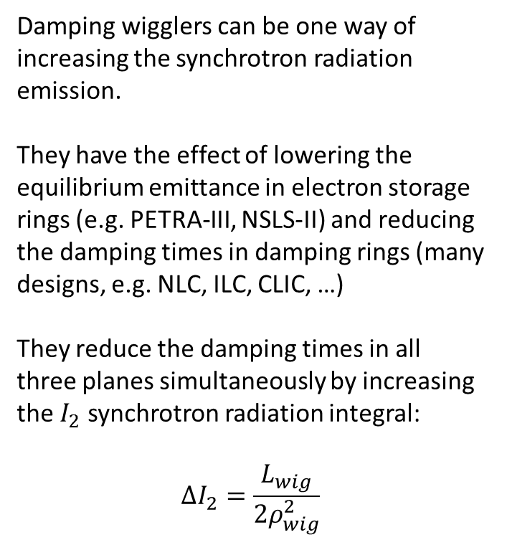
Damping Wigglers
Damping wigglers can be one way of increasing the synchrotron radiation emission.
They have the effect of lowering the equilibrium emittance in electron storage rings (e.g. PETRA-III, NSLS-II) and reducing the damping times in damping rings (many designs, e.g. NLC, ILC, CLIC, …)
They reduce the damping times in all three planes simultaneously by increasing the $I_{2}$ synchrotron radiation integral:
$$ΔI_{2}=\frac{L_{wig}}{2ρ_{wig}^{2}}$$
PETRA-III
PETRA-III

Slide 35
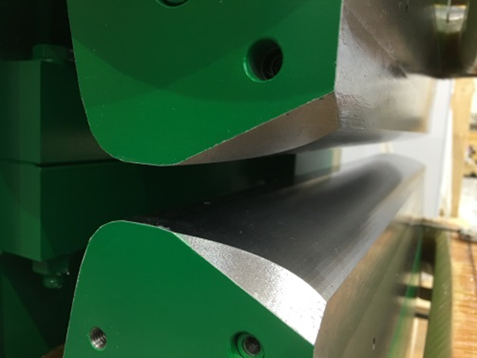
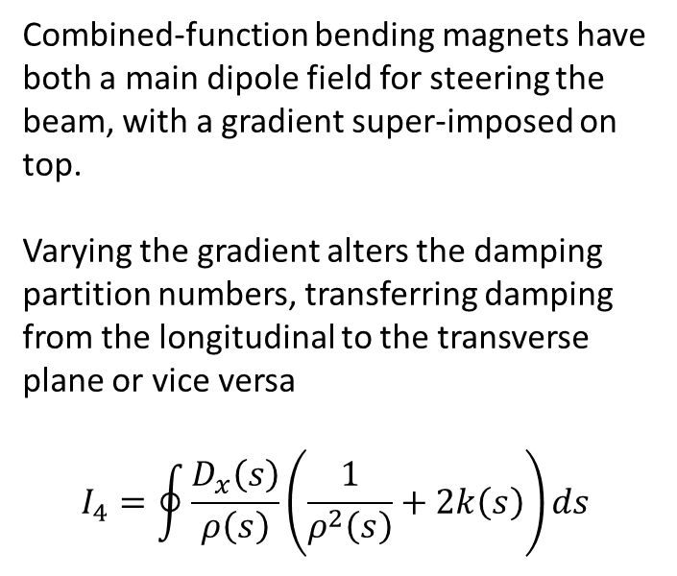
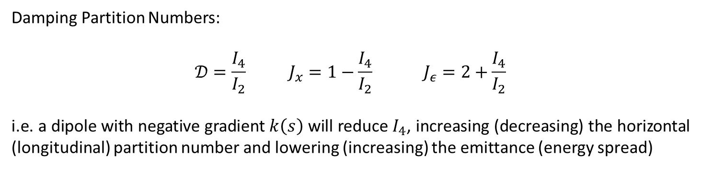
Combined-function Bending Magnets
Combined-function bending magnets have both a main dipole field for steering the beam, with a gradient super-imposed on top.
Varying the gradient alters the damping partition numbers, transferring damping from the longitudinal to the transverse plane or vice versa
$$I_{4}=\oint{\frac{D_{x}\left(s\right)}{ρ\left(s\right)}\left(\frac{1}{ρ^{2}\left(s\right)}+2k\left(s\right)\right)ds}$$
Diamond
Damping Partition Numbers:
$$𝒟=\frac{I_{4}}{I_{2}} J_{x}=1−\frac{I_{4}}{I_{2}} J_{ε}=2+\frac{I_{4}}{I_{2}}$$
i.e. a dipole with negative gradient $k\left(s\right)$ will reduce $I_{4}$, increasing (decreasing) the horizontal (longitudinal) partition number and lowering (increasing) the emittance (energy spread)

Slide 36
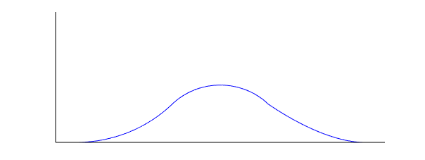


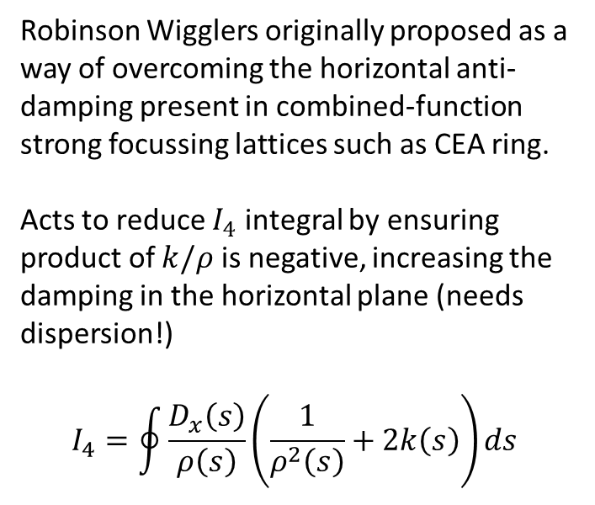






Robinson Wigglers
Robinson Wigglers originally proposed as a way of overcoming the horizontal anti-damping present in combined-function strong focussing lattices such as CEA ring.
Acts to reduce $I_{4}$ integral by ensuring product of $k/ρ$ is negative, increasing the damping in the horizontal plane (needs dispersion!)
$$I_{4}=\oint{\frac{D_{x}\left(s\right)}{ρ\left(s\right)}\left(\frac{1}{ρ^{2}\left(s\right)}+2k\left(s\right)\right)ds}$$
CERN PS
$$x$$
$$+\frac{dB}{dx}$$
$$−\frac{dB}{dx}$$
$$+\frac{dB}{dx}$$
$$−B/2$$
$$+B$$
$$−B/2$$
$$s$$

Slide 37

Change in RF frequency
Altering the RF frequency can also be used as a method for modifying the damping partition numbers.
Changing the RF frequency has the effect of changing the orbit length, forcing the electrons to move to an off-energy orbit:
$$\frac{Δf_{RF}}{f_{RF}}=−\frac{ΔL}{L}=−α_{c}\frac{ε}{E_{0}}$$
If the dispersion is non-zero, the change in energy results in a change in position $x(s)=D(s)ε/E_{0}$, and at the quadrupoles this gives an additional dipole field component for the electrons
$$\frac{1}{ρ_{quad}}=k\left(s\right)D\left(s\right)\frac{ε}{E_{0}}$$
The result of which is a change in $𝒟$
$$Δ𝒟≈\frac{\oint{2D^{2}k^{2}ε/E_{0}ds}}{\oint{1/ρ^{2}}ds}$$

Slide 38
Summary
Emission of synchrotron radiation combined with (longitudinal) energy gain in the RF cavities causes a damping of particle oscillations in all three planes of motion
The damping times are inversely proportional to (energy)³
Since it depends upon the emission of synchrotron radiation, damping is usually only significant for light particles (electrons and positrons)
The dependence on the magnetic lattice parameters can be usefully summarised with the synchrotron radiation integrals
Assuming constant energy loss, the sum of the damping partition numbers is conserved
Damping times can be modified for a given storage ring design, either by increasing the energy loss per turn (damping wigglers), or by transferring damping from one plane to another (i.e. by altering the damping partition numbers)

Slide 39
References
[1] M. Sands, “The Physics of Electron Storage Rings: An Introduction”, SLAC-121, (1970)
[2] R. Walker, “Radiation Damping”, CERN Accelerator School, Finland, CERN 94-01, (1994)
[3] H. Weidemann, “Particle Accelerator Physics I”, Springer, (2003)
[4] J. Clarke, “The Science and Technology of Undulators and Wigglers”, Oxford Science Publications, (2004)
[5] R. Walker, “Wigglers”, CERN Accelerator School, Greece, CERN-1995-006, (1993)

