Slide 1


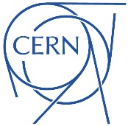
Lecture 2
Applications of Accelerators
Professor Emmanuel Tsesmelis
Principal Physicist, CERN
Visiting Professor, University of Oxford
Graduate Accelerator Physics Course
John Adams Institute for Accelerator Science
16 October 2024

Slide 2
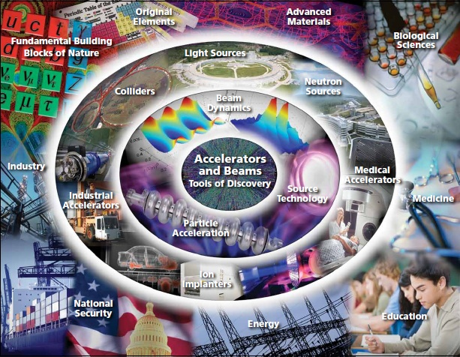
Introduction

Slide 3
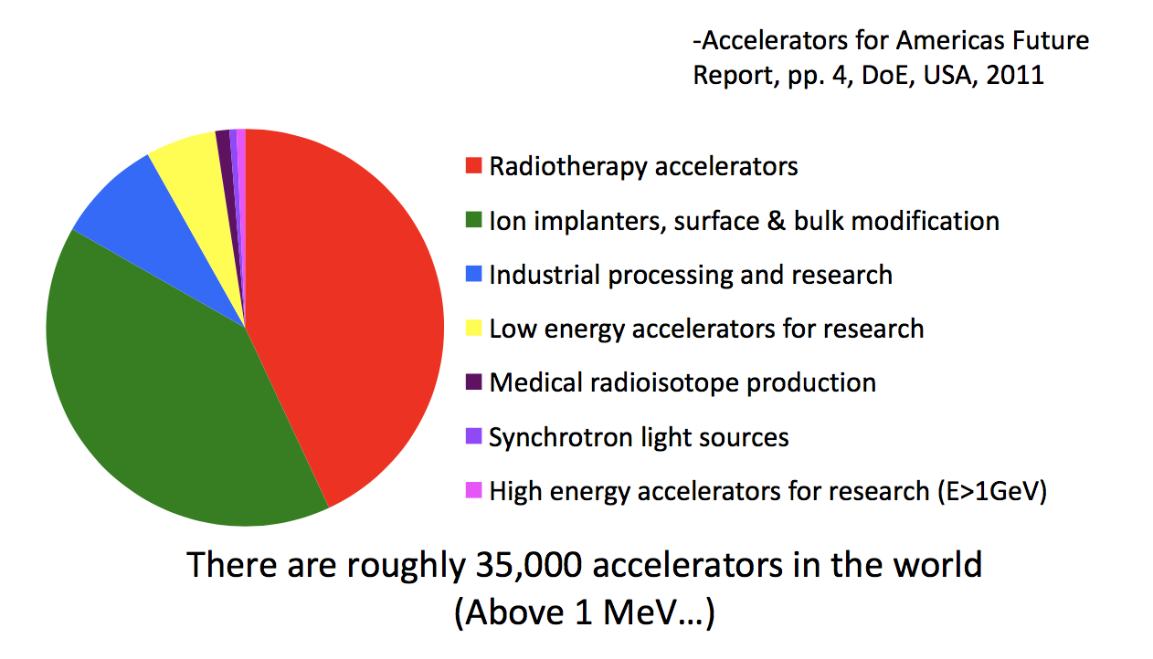
Accelerators Worldwide
Accelerators are not only for particle physics

Slide 4
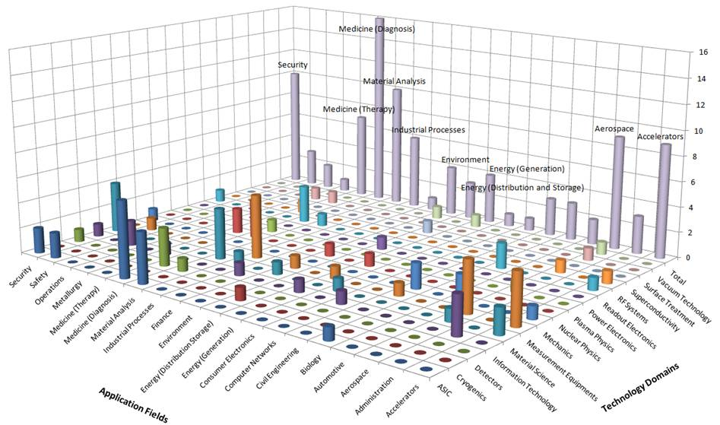
Accelerator Technologies and Innovation
Cutting edge Research Infrastructures play a key role in a knowledge driven society
Knowledge is − and will be more and more −
the most precious resource for a sustainable development
Notes:
4

Slide 5
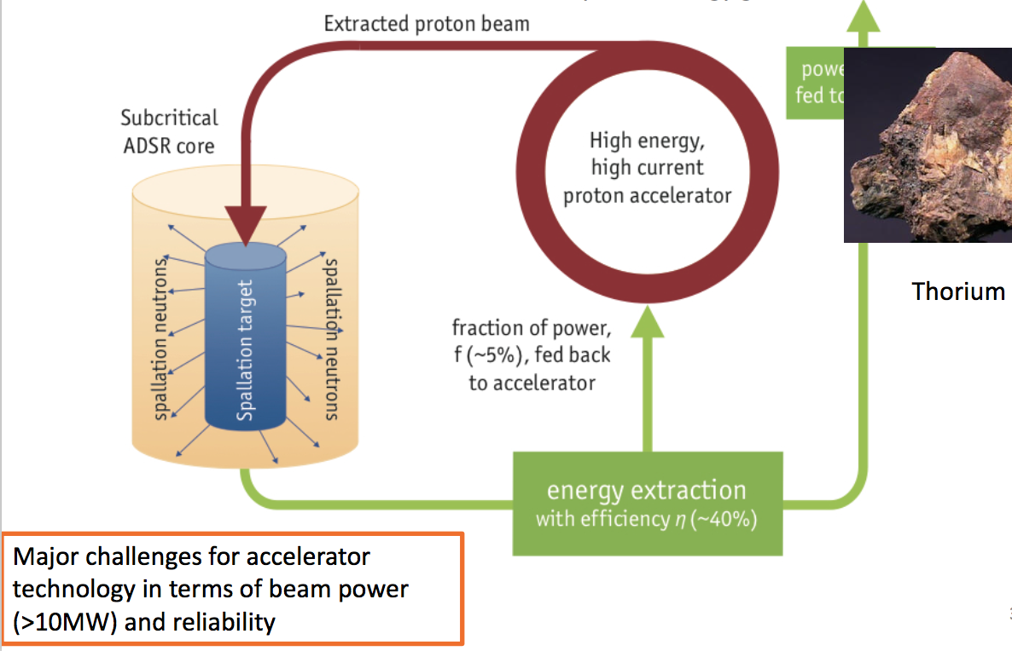
Accelerators for Energy
Accelerator-Driven Subcritical System
  External source of neutrons to drive sub-critical reactor loaded with non-fissile fuel such as ²³²Th.
  Neutrons produced by high-power proton beam through spallation, breeding ²³³U causing it to fission.
  Cannot support self-sustaining chain reaction.
  ²³²Th is widely-available natural resource.
  Released thermal power is 100 times that of beam energy.
  Turning off the accelerator stops the fission reaction.
Use of Th instead of U produces
less actinides.
The cycle produces much less long-lived
radioactive waste (e.g. Pu).
Enough Th is available to sustain
such systems for 10 centuries.

Slide 6
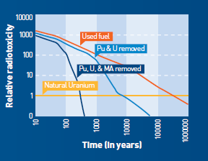
Accelerators for Energy
ADSR & Radioactive Waste Transmutation
  ADSR neutrons interact with surrounding fuel material containing separated long-lived isotopes.
    Transmute these isotopes into shorter-lived products.

Slide 7
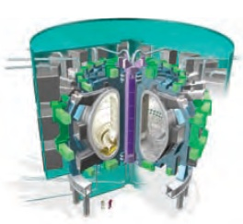
Accelerators for Energy
International Thermonuclear Experimental Reactor (ITER)
  Ion beams to be part of plasma heating techniques for fusion
    Provide high current drive efficiency required magnetic confinement fusion facilities.
    Required tens of A of ion current at 1 MeV kinetic energy.

Slide 8
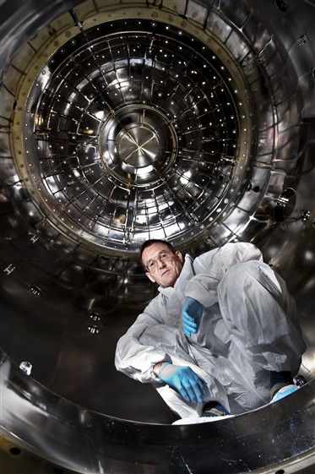
Accelerators for the Environment
CLOUD experiment at the CERN PS
  Experiment using cloud chamber to study possible link between cosmic- rays and cloud formation.
    Studies suggest that cosmic- rays may have an influence on the amount of cloud cover through the formation of new aerosols (tiny particles suspended in the air that seed cloud droplets).
  Understanding the underlying microphysics in controlled laboratory conditions is a key to unraveling the connection between cosmic-rays, clouds and climate.
  First time high-energy physics accelerator used to study atmospheric and climate science.

Slide 9
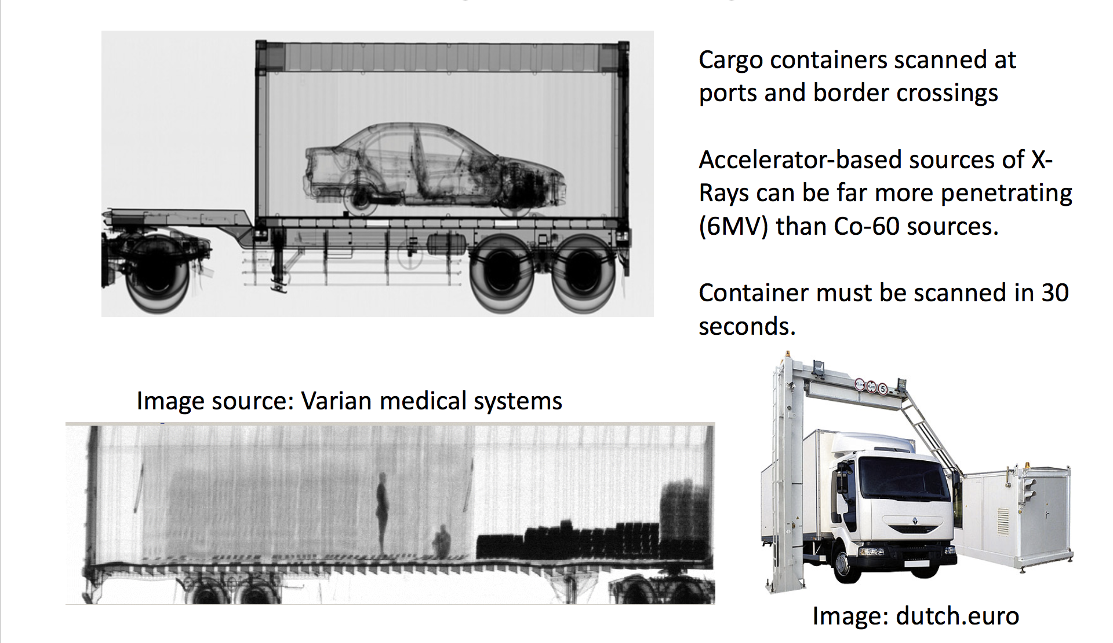
Accelerators for Security
X-ray Scanning of Cargo

Slide 10
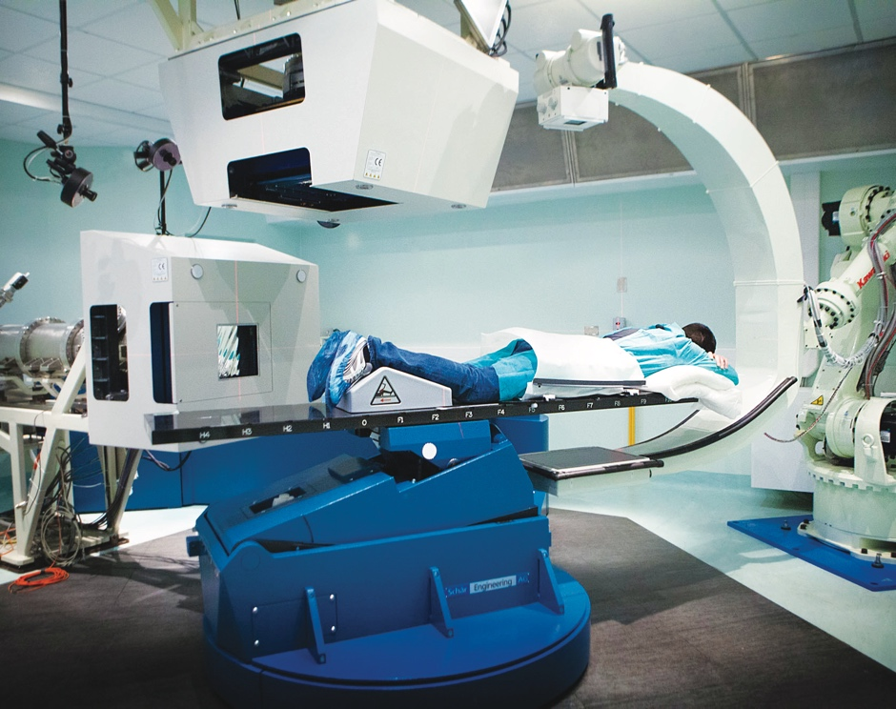
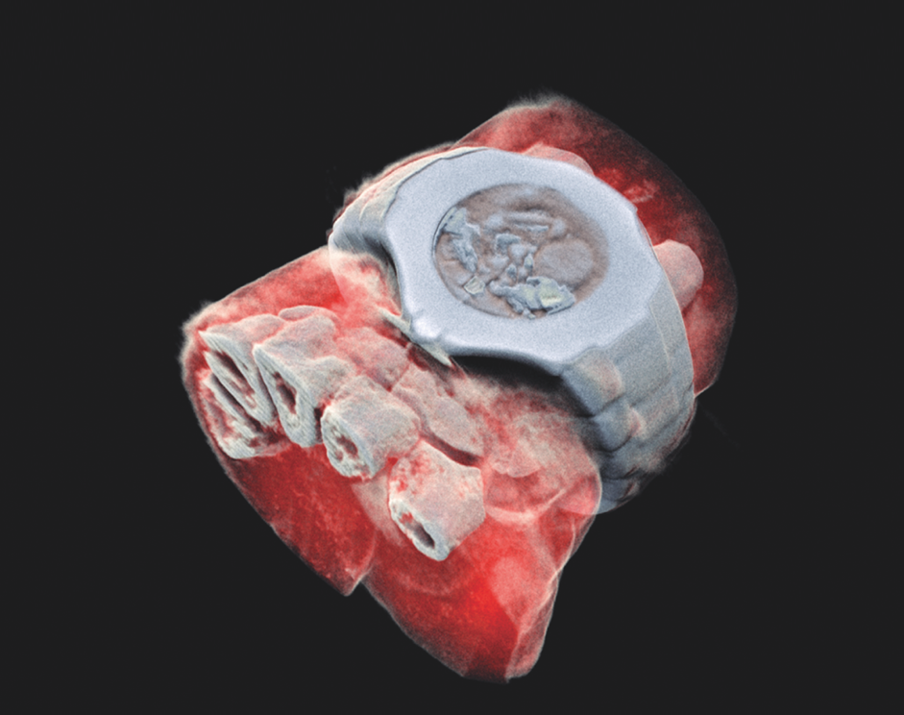
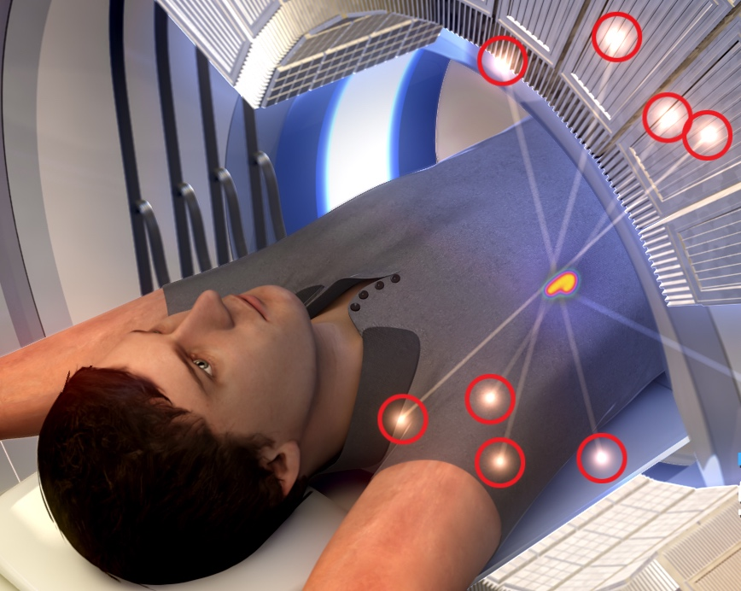
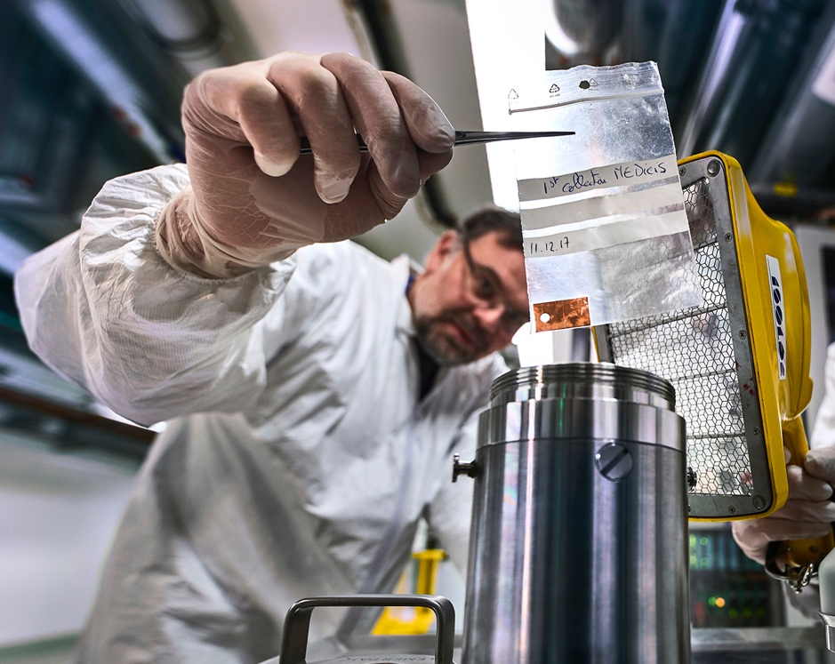
CERN’s technological innovations have important applications in medicine and healthcare
Technologies applied
at CERN are also used in PET, for medical imaging and diagnostics.
CERN produces innovative radioisotopes for nuclear medicine research.
© marsbioimaging
© CNAO
© ENVISION / ENLIGHT
Accelerator technologies are applied in cancer radiotherapy with protons, ions and electrons.
Pixel detector technologies are
used for high resolution
3D colour X-ray imaging.

Slide 11
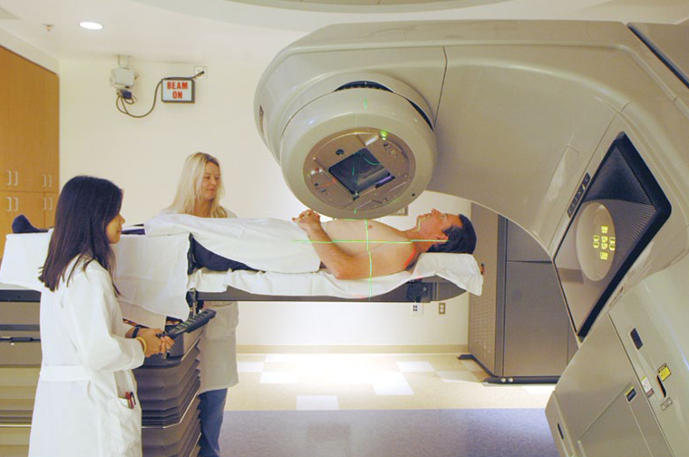
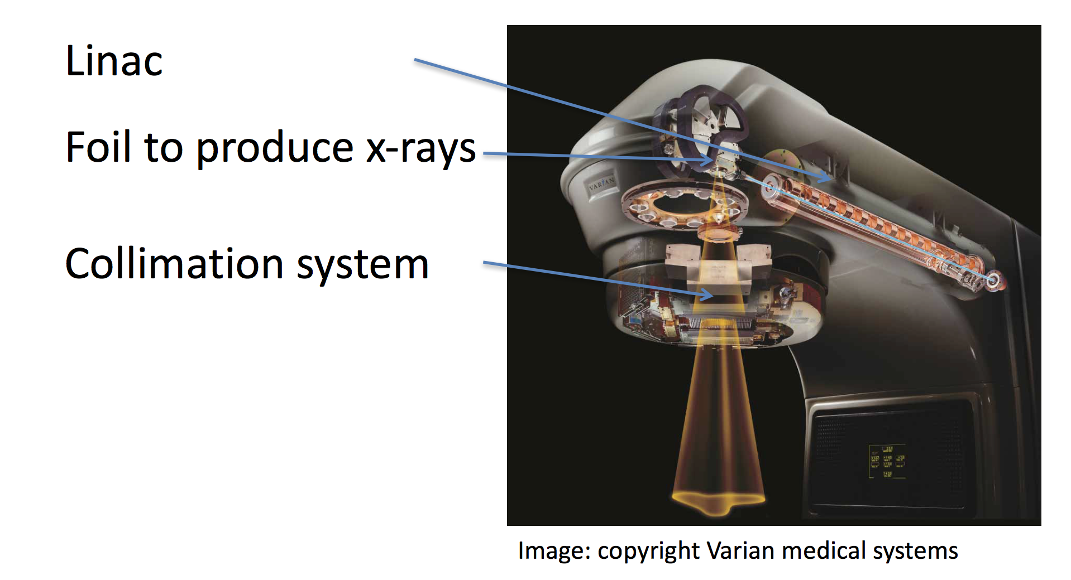
Accelerators for Medicine
X-ray Radiation Therapy
  Electron linacs for conventional X-ray radiation therapy (MV photons).
    X-rays have been used for decades to destroy tumours.

Slide 12
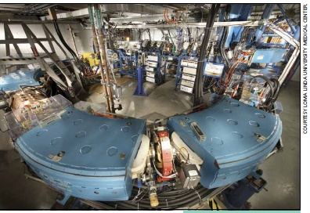
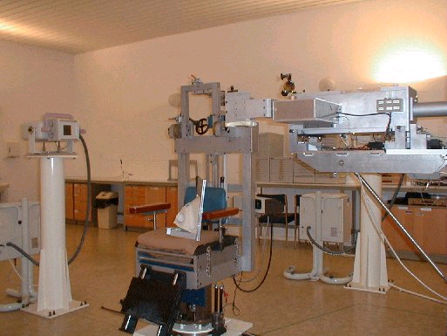
Accelerators for Medicine
Hadrontherapy
  For deep-seated tumours and/or minimizing dose in surrounding healthy tissue use hadrons (protons, light ions).
  Accelerator-based hadrontherapy facilities.
  Based on medium-energy cyclotrons and synchrotrons for hadron therapy with protons (250 MeV) or light ion beams (400 MeV/u 12C-ions
Loma Linda Proton Treatment Centre
Constructed at FNAL
Established 1989
60 MeV protons
First hospital-based
proton therapy

Slide 13
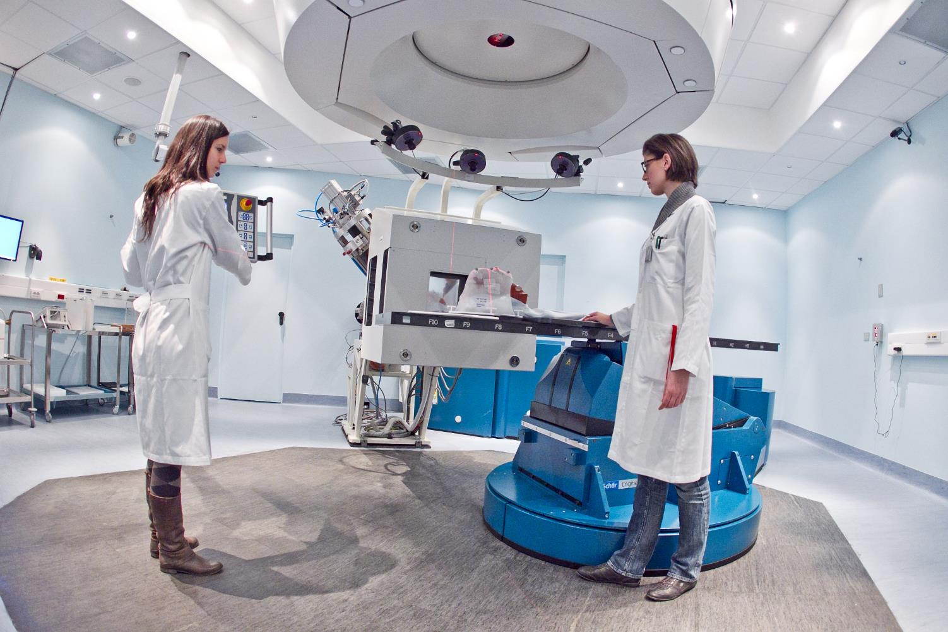
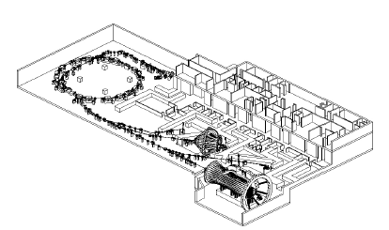
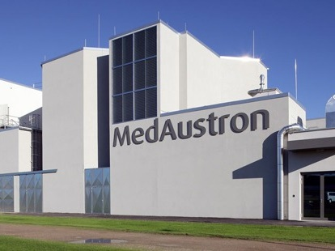
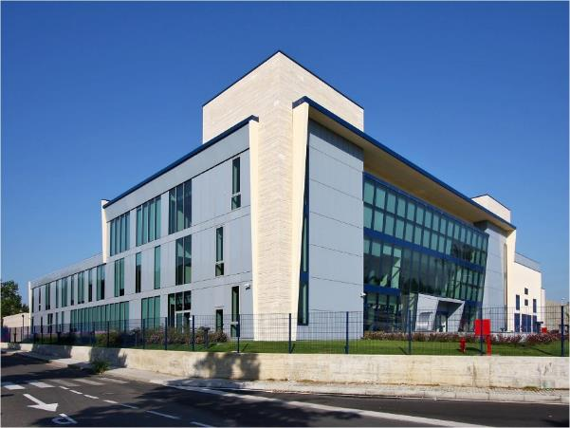


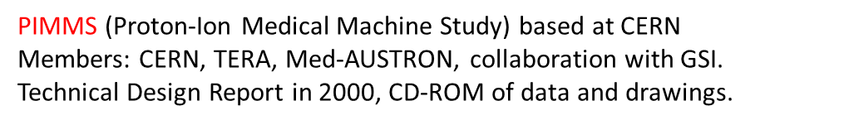
PIMMS @ CERN
Proton-Ion Medical
Machine Study (PIMMS) Study

Slide 14
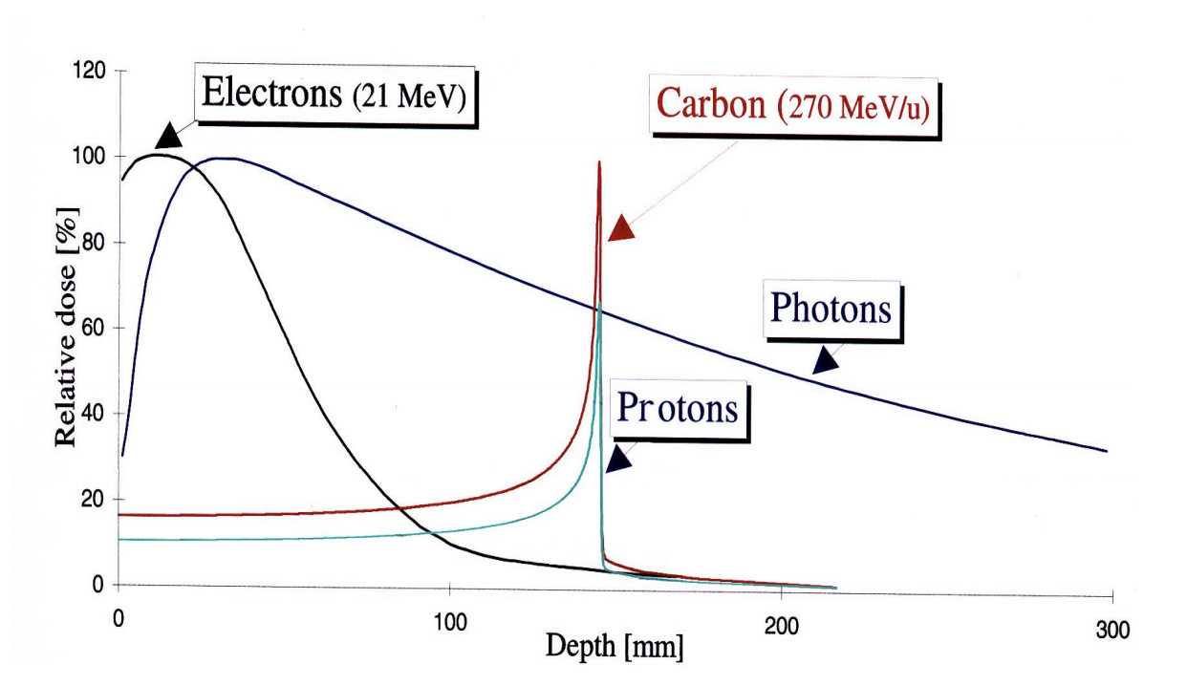
Accelerators for Medicine
The Bragg Peak

Slide 15
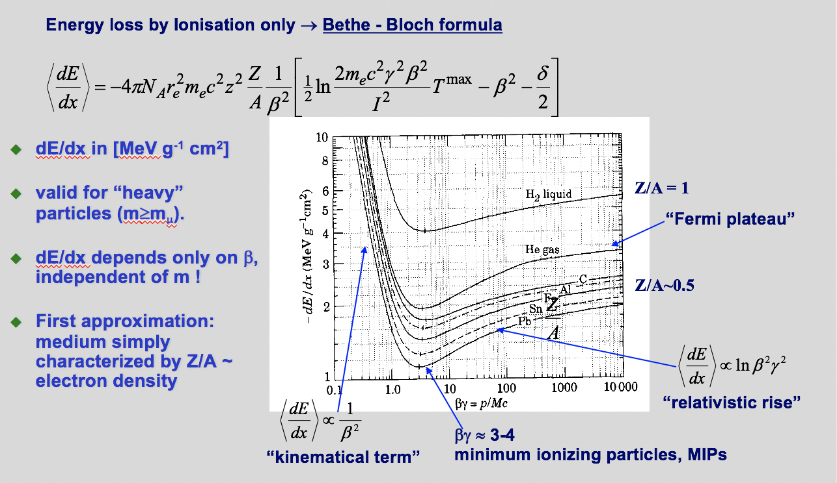
Accelerators for Medicine
Charged particle energy loss in matter
The relativistic Bethe-Bloch formula

Slide 16
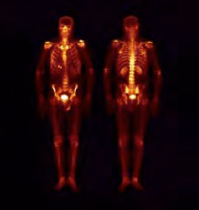
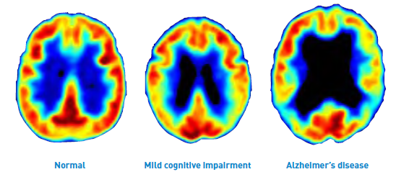
Accelerators for Medicine
Medical Imaging
  Radioisotopes have become vital components in medicine.
    Produced at reactors or accelerators (cyclotrons or linacs).
  Positron Emission Tomography (PET)
    Requires positron emitter ¹⁸F
    From 7-11 MeV proton accelerator
  ⁹⁹Mo / ^{99m}Tc
    100 kW of 200 MeV protons impinging on depleted U target produce neutrons.
    Neutrons targeted on low-enriched U thus producing ⁹⁹Mo.
Bone scans
indicating
increased
^{99m}Tc intake
due to
cancer growth
PET Scan

Slide 17
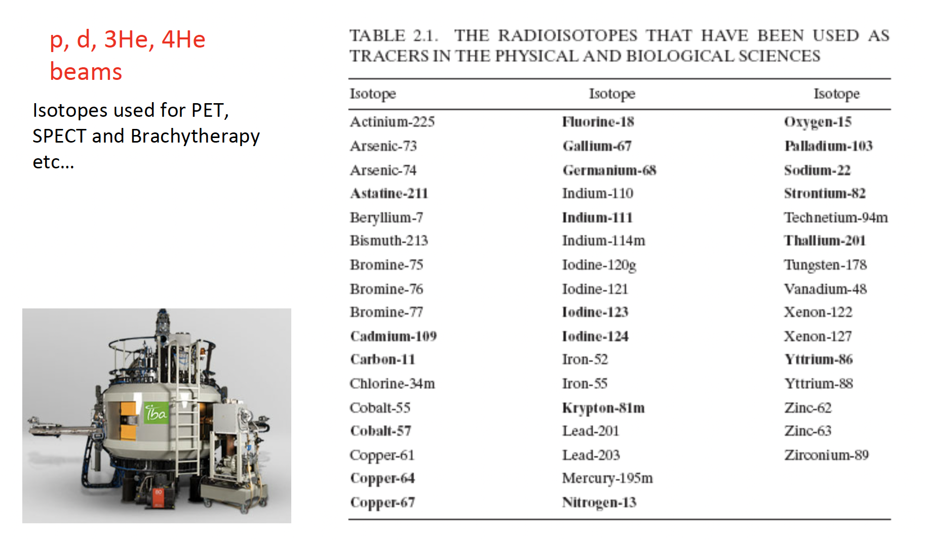
Radiopharmaceuticals

Slide 18
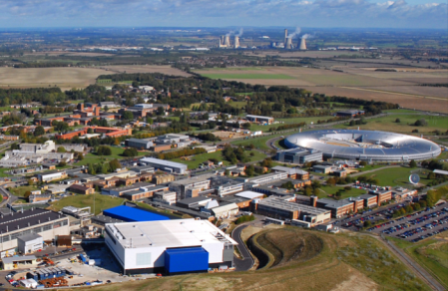
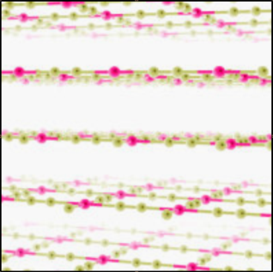


Neutrons & X-rays
Protein structure revealed with help of light sources
ISIS and Diamond neutron and X-ray sources
Harwell, UK
Neutron and X-ray imaging essential for studies of proteins and advanced materials.
2-d material (graphene)

Slide 19
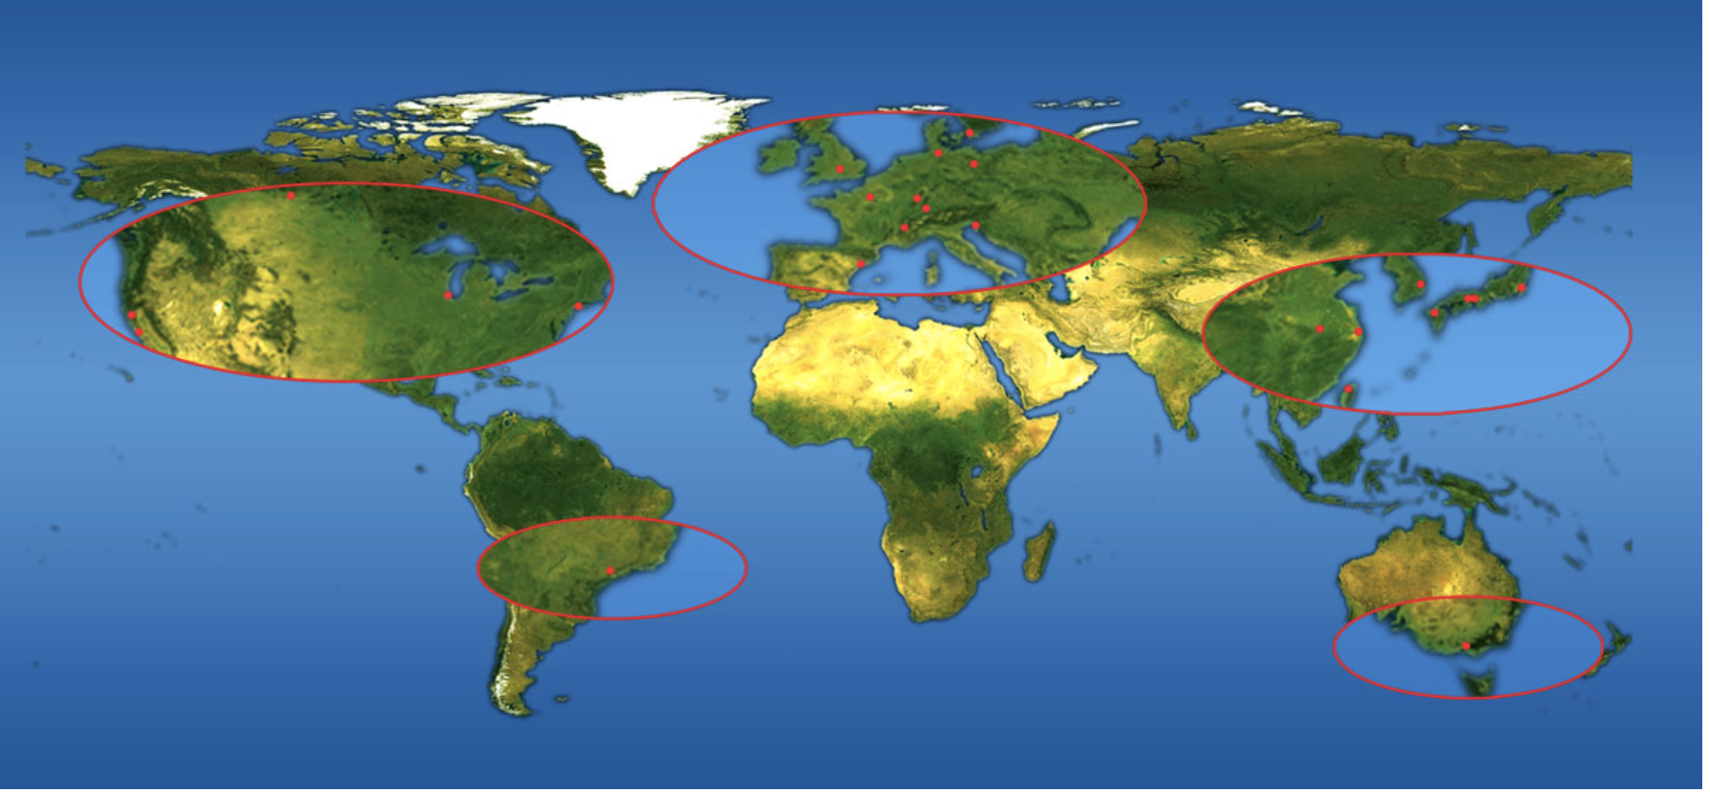
Synchrotron Light Sources
Courtesy ESRF

Slide 20
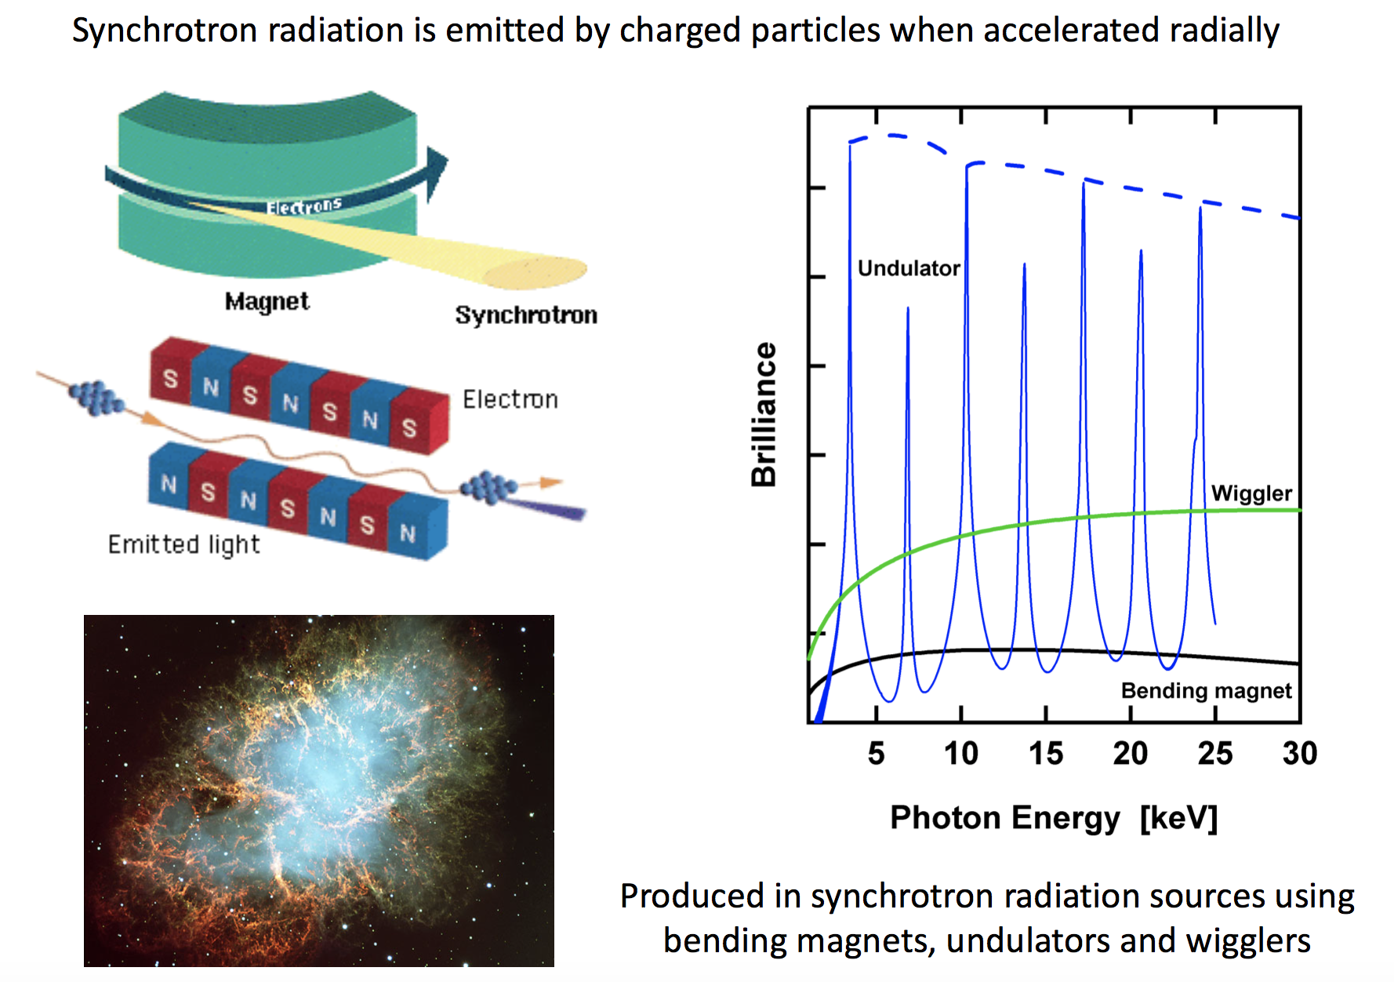
Synchrotron Light Sources

Slide 21
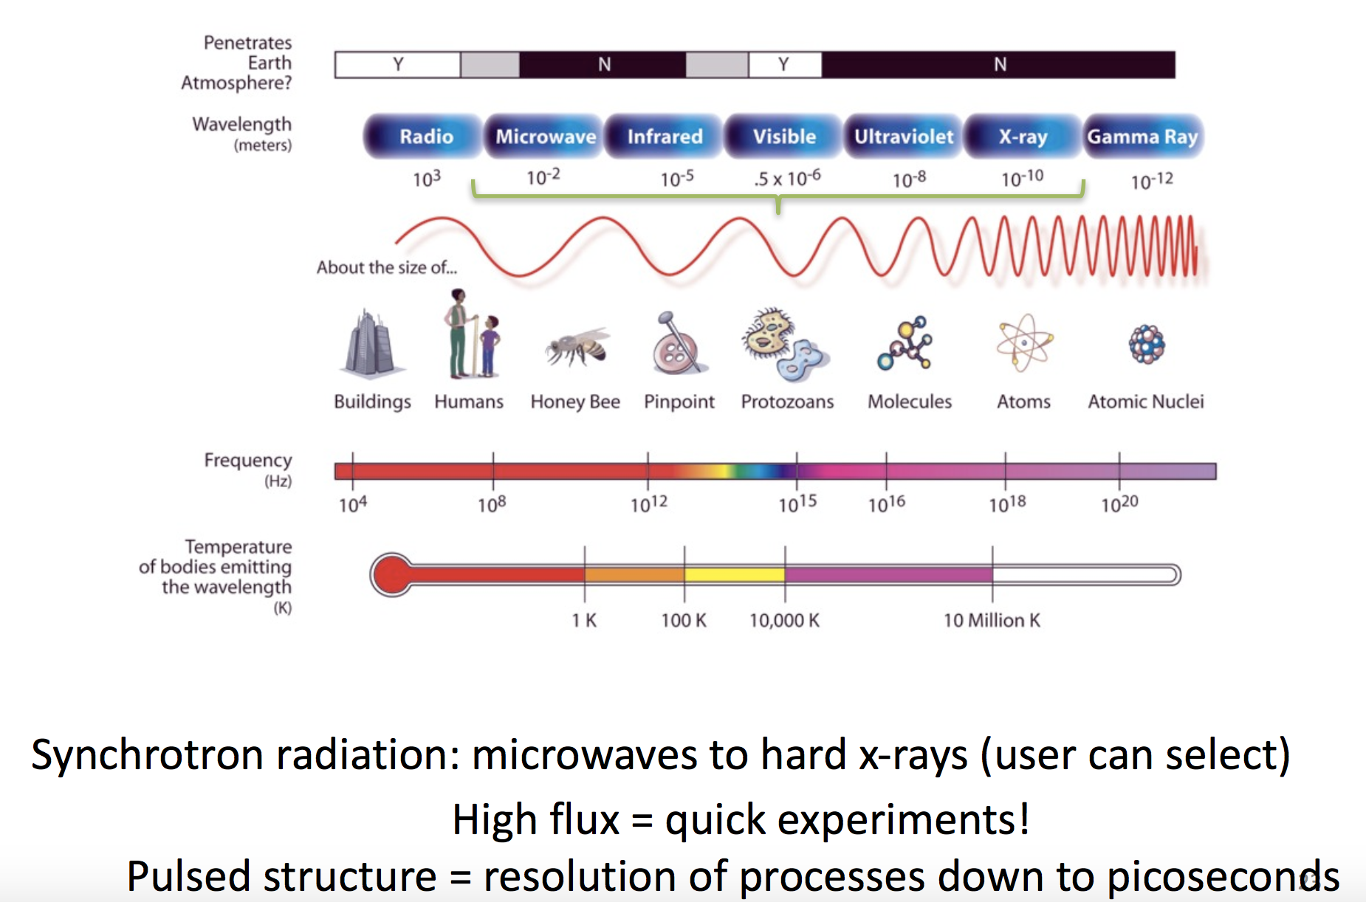
The Electromagnetic Spectrum

Slide 22
Rate of Energy Loss (1)
This EM radiation generates an energy loss of the particle concerned, which can be calculated using:
Electron radius
Velocity of light
Total energy
‘Accelerating’ force
Lepton rest mass
constant
Force can be written as: F = evB = ecB
Thus:
but
Which gives:

Slide 23
Rate of Energy Loss (2)
Have:
,which gives the energy loss
Interested in the energy loss per revolution for which need to integrate the above over one turn.
Thus:
Bending radius inside the magnets
Lepton energy
However:
Finally, this gives:
Gets very large if E is large !!!

Slide 24
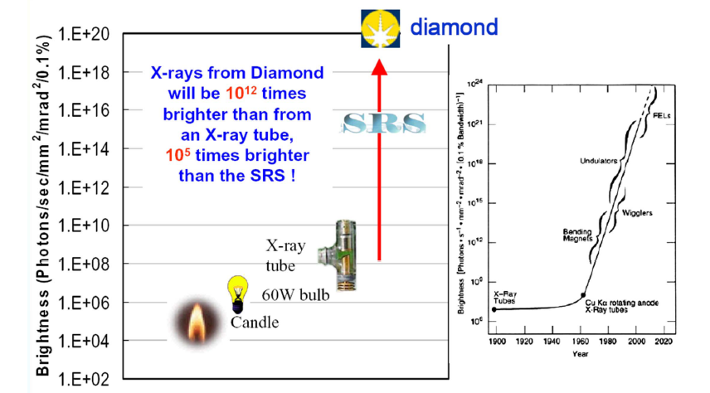
Accelerators for Synchrotron Light

Slide 25
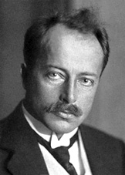
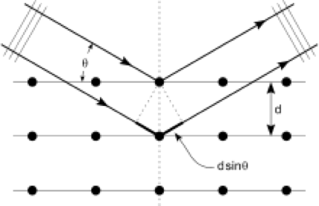
X-ray Diffraction
Max von Laue
1914 Nobel Prize:
‘For his discovery of the
diffraction of X-rays
by crystals’
Constructive interference:
2 d sinθ = n λ
25

Slide 26
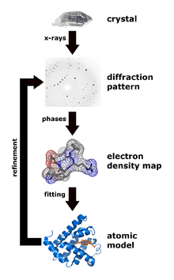
X-ray Diffraction Today
26

Slide 27
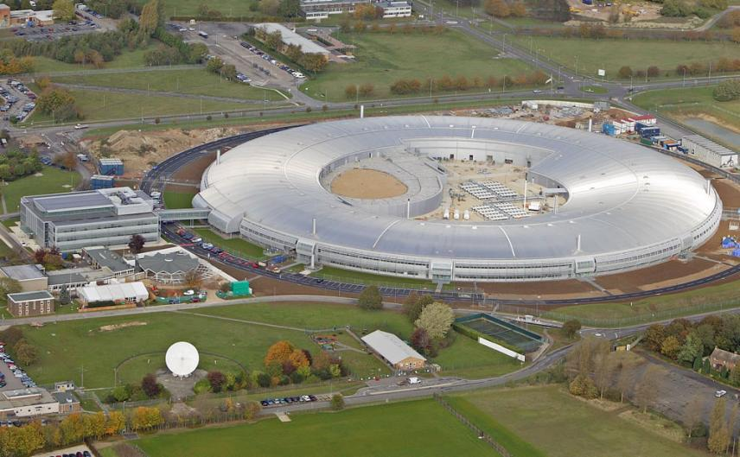
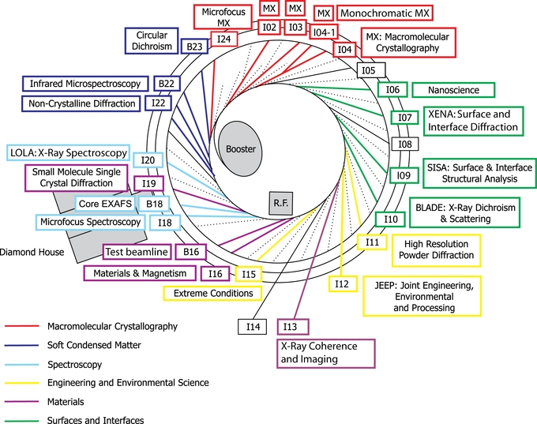
Diamond Light Source
Diamond Light Source, Harwell Science and Innovation Campus, UK
Diamond Light Source Beamlines

Slide 28
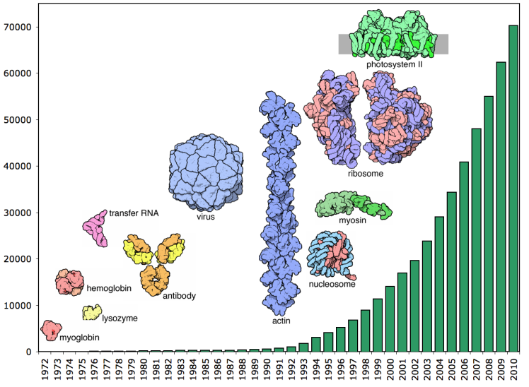
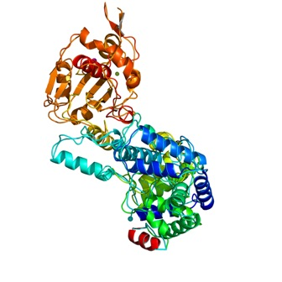
Accelerators for Synchrotron Light
Protein Structures
  Proteins are biological molecules involved in almost every cellular process.
  The protein is produced, crystallised and illuminated by X-rays. The interactions between the X-rays and the crystal form a pattern that can be analysed to deduce the protein structure.
  Over 45,000 structures have been solved by the worldwide synchrotron community.
Protein
Data
Bank
The trimer of the Lassa nucleoprotein,
part of the Lassa virus

Slide 29

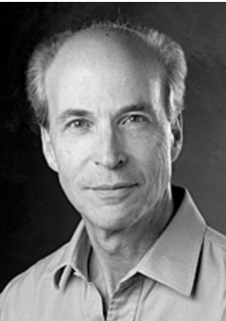
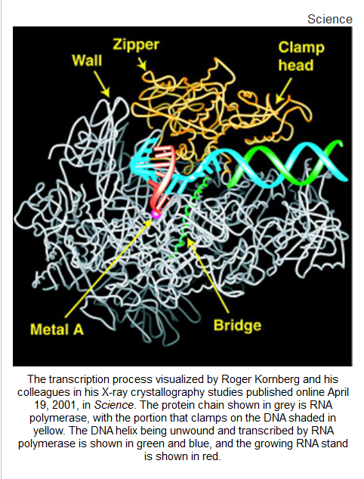
Roger Kornberg’s Nobel Prize-winning determination of the structure of RNA polymerase has been described as a “technical tour de force.” The key to the visualization of this fundamental biological molecule in action was synchrotron radiation, supplied by the powerful X-ray crystallography instruments at the Stanford Synchrotron Radiation Laboratory.

Slide 30
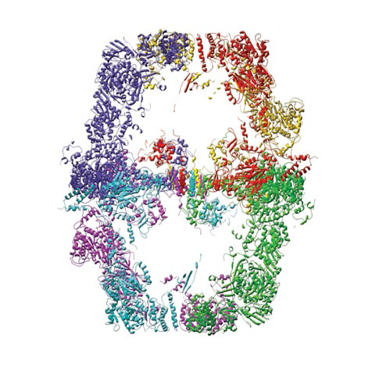
Protein Structure Revealed by Light Sources
mosquito
immune system
yeast enzyme
HIV glycoprotein

Slide 31
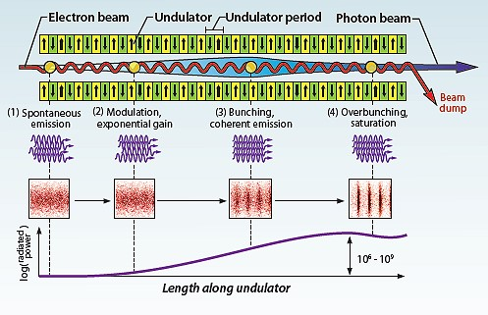
4th Generation Light Source – Free Electron Laser

Slide 32
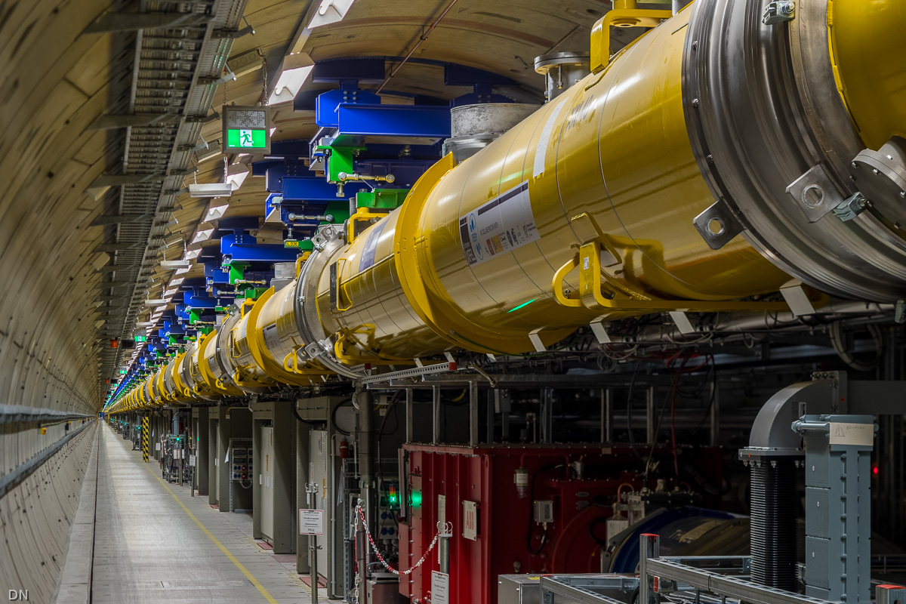
European XFEL
European XFEL at DESY is a large-scale proto-type for the ILC
  100 cryomodules; 23.6 MV/m, accelerator length 2.1 km; 17.5 GeV
  Sucessfully started operation in 2017

Slide 33
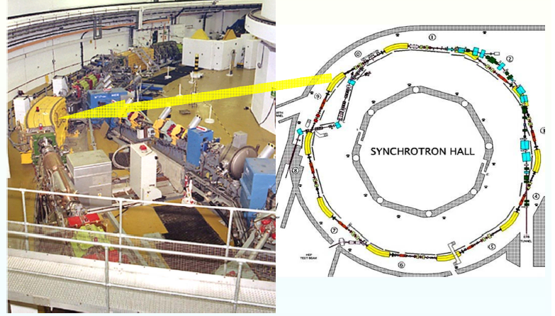
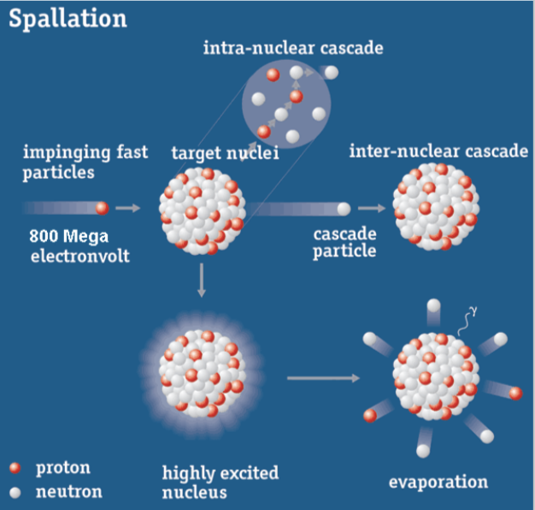
Accelerators for Neutron Science
ISIS Spallation Facility (800 MeV) at RAL
Penetrate deep inside materials since they are deflected only from the nuclei of atoms.
Statistical observation of deflected neutrons at various positions after the sample can be used to find the structure of a material.
Loss or gain of energy by neutrons can reveal the dynamic behaviour of parts of a sample, for example dynamic processes of molecules in motion.

Slide 34
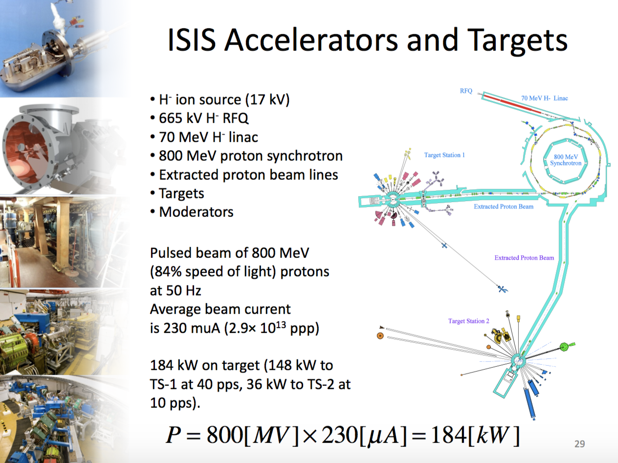
ISIS Accelerators and Targets

Slide 35
Accelerators for Ion Beam Implantation
Ion implantation in semiconductor manufacture
Typical semiconductor fabrication:
140 operations, 70 involving ion
implantation at specific sites in crystal
Ions accelerated to modest energies
  Depth of implant controlled by ion beam energy: typically 2 → 600 keV
35

Slide 36


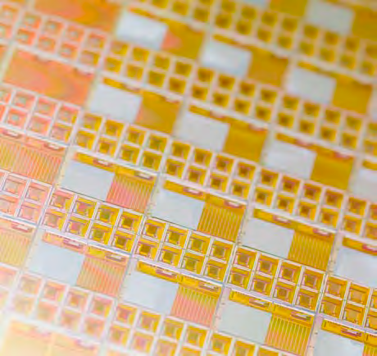

Ion Beam Implantation Products
36
36

Slide 37
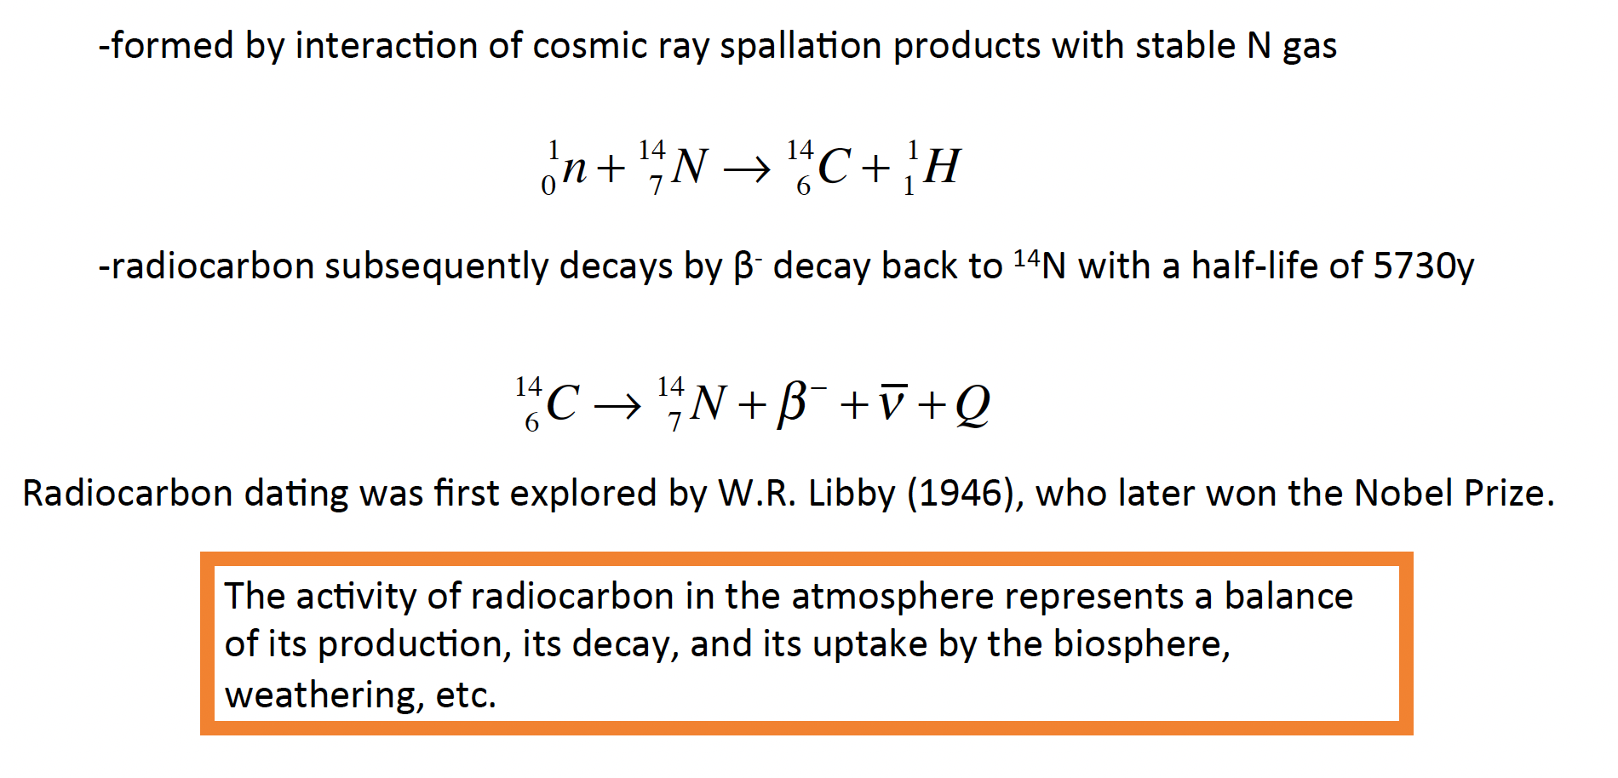
Radiocarbon ¹⁴C Formation & Decay

Slide 38

Radiocarbon ¹⁴C Dating

Slide 39



Accelerators for History & Culture Applications
Accelerator Mass Spectrometer
Radiocarbon
Dating

Slide 40














Accelerator Science
and Technologies
Niels Bohr
Louis Pasteur
Fundamental knowledge
Thomas Edison
Consideration of use

Slide 41


Bibliography

