Slide 1
Lecture 4
Radiation Excitation

Slide 2
Contents
Recap on synchrotron radiation emission
distribution of photon energies
Quantum fluctuations in longitudinal plane
impact of energy fluctuations
equilibrium conditions, relative energy spread and bunch length
Quantum fluctuations in horizontal plane
impact of energy fluctuations
equilibrium conditions and horizontal emittance
Quantum fluctuations in vertical plane
direct fluctuations in invariant
equilibrium conditions and vertical emittance
Quantum Lifetime
Low emittance lattice design
Summary

Slide 3
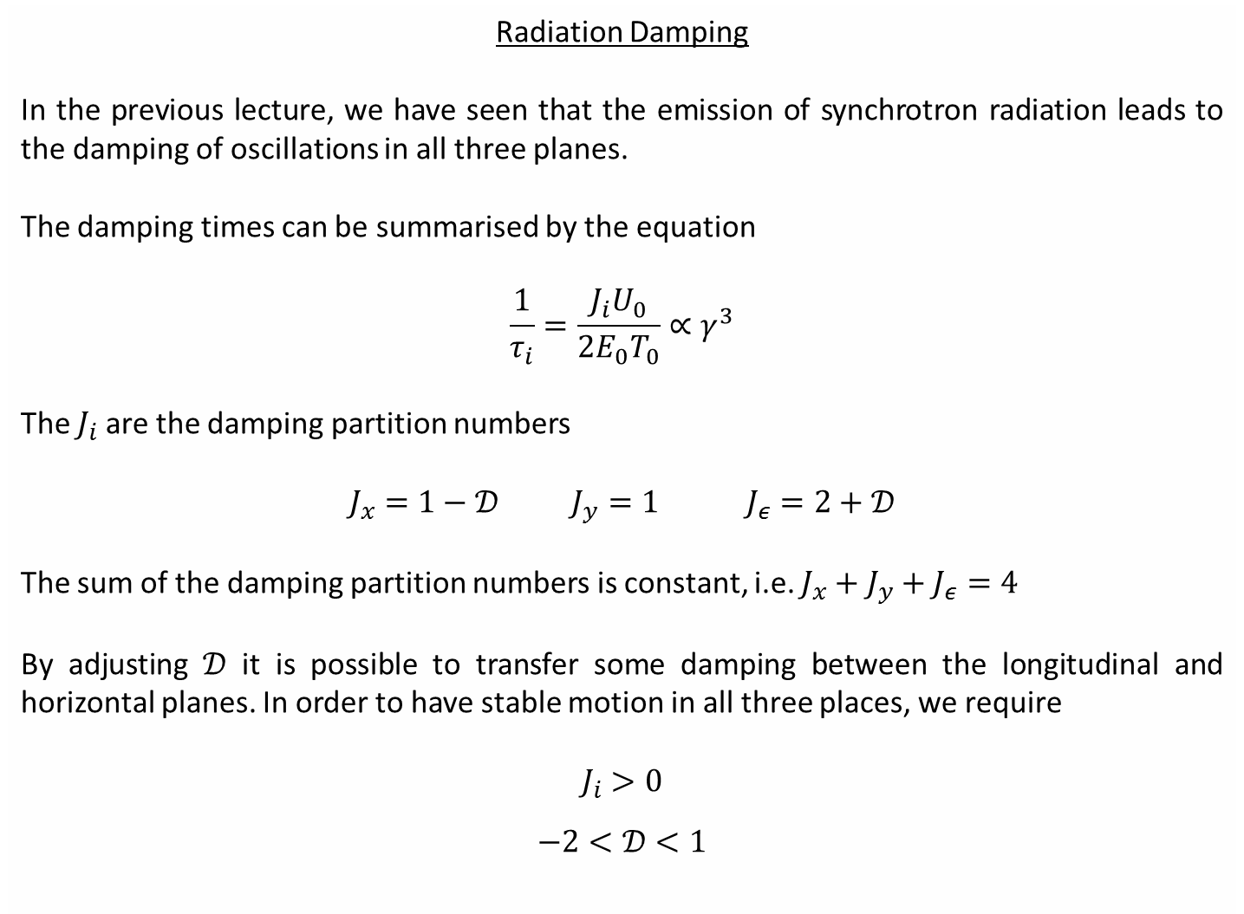
Radiation Damping
In the previous lecture, we have seen that the emission of synchrotron radiation leads to the damping of oscillations in all three planes.
The damping times can be summarised by the equation
$$\frac{1}{τ_{i}}=\frac{J_{i}U_{0}}{2E_{0}T_{0}}∝γ^{3}$$
The $J_{i}$ are the damping partition numbers
$$J_{x}=1−𝒟 J_{y}=1 J_{ε}=2+𝒟$$
The sum of the damping partition numbers is constant, i.e. $J_{x}+J_{y}+J_{ε}=4$
By adjusting $𝒟$ it is possible to transfer some damping between the longitudinal and horizontal planes. In order to have stable motion in all three places, we require
$$J_{i}>0$$
$$−2<𝒟<1$$

Slide 4
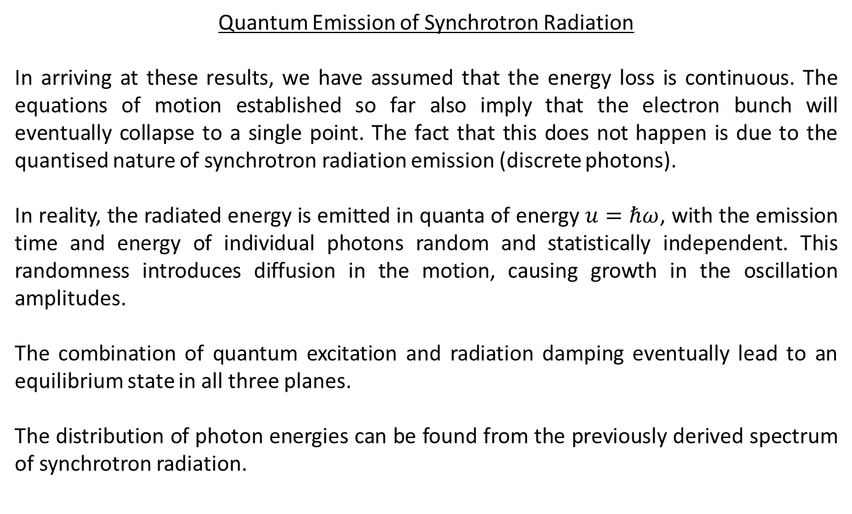
Quantum Emission of Synchrotron Radiation
In arriving at these results, we have assumed that the energy loss is continuous. The equations of motion established so far also imply that the electron bunch will eventually collapse to a single point. The fact that this does not happen is due to the quantised nature of synchrotron radiation emission (discrete photons).
In reality, the radiated energy is emitted in quanta of energy $u=ℏω$, with the emission time and energy of individual photons random and statistically independent. This randomness introduces diffusion in the motion, causing growth in the oscillation amplitudes.
The combination of quantum excitation and radiation damping eventually lead to an equilibrium state in all three planes.
The distribution of photon energies can be found from the previously derived spectrum of synchrotron radiation.

Slide 5
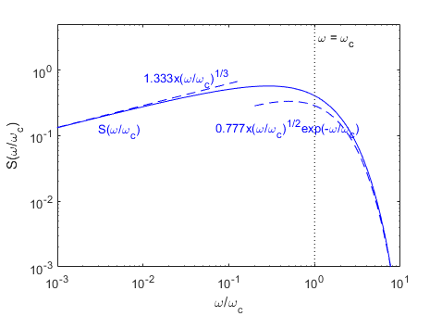
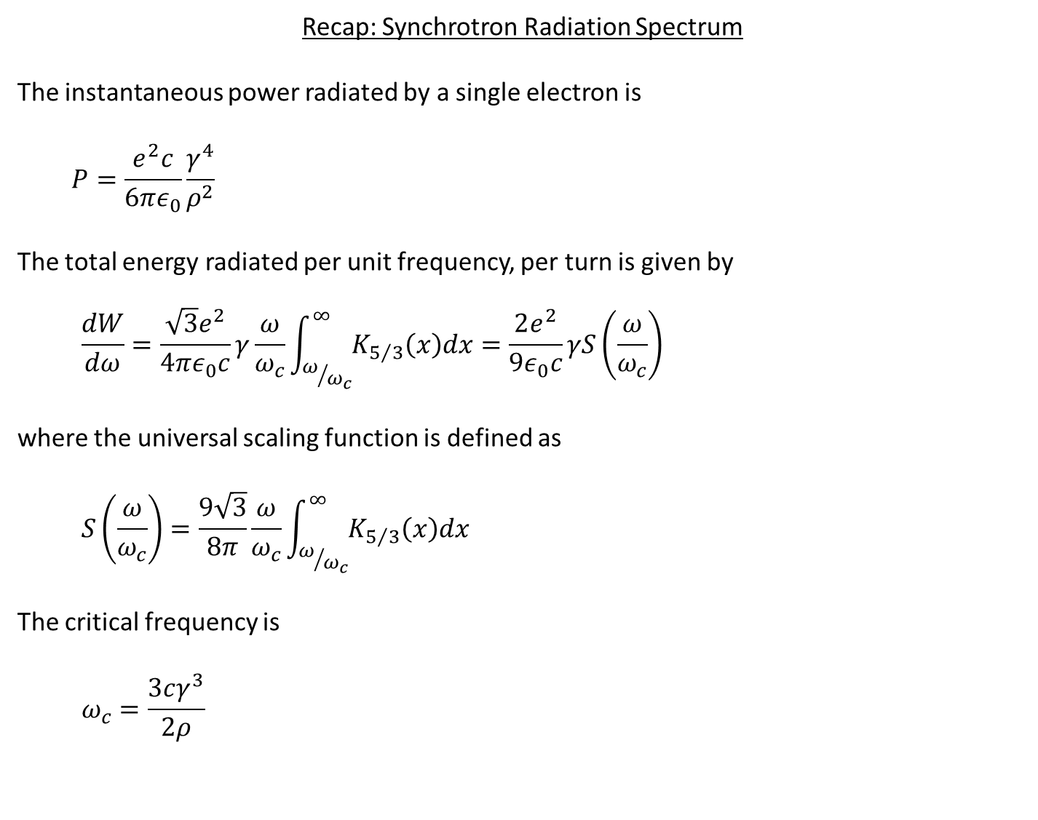
Recap: Synchrotron Radiation Spectrum
The instantaneous power radiated by a single electron is
$$P=\frac{e^{2}c}{6πε_{0}}\frac{γ^{4}}{ρ^{2}}$$
The total energy radiated per unit frequency, per turn is given by
$$\frac{dW}{dω}=\frac{\sqrt{3}e^{2}}{4πε_{0}c}γ\frac{ω}{ω_{c}}\int_{ω/{ω_{c}}}^{∞}{K_{5/3}\left(x\right)dx}=\frac{2e^{2}}{9ε_{0}c}γS\left(\frac{ω}{ω_{c}}\right)$$
where the universal scaling function is defined as
$$S\left(\frac{ω}{ω_{c}}\right)=\frac{9\sqrt{3}}{8π}\frac{ω}{ω_{c}}\int_{ω/{ω_{c}}}^{∞}{K_{5/3}\left(x\right)dx}$$
The critical frequency is
$$ω_{c}=\frac{3cγ^{3}}{2ρ}$$

Slide 6
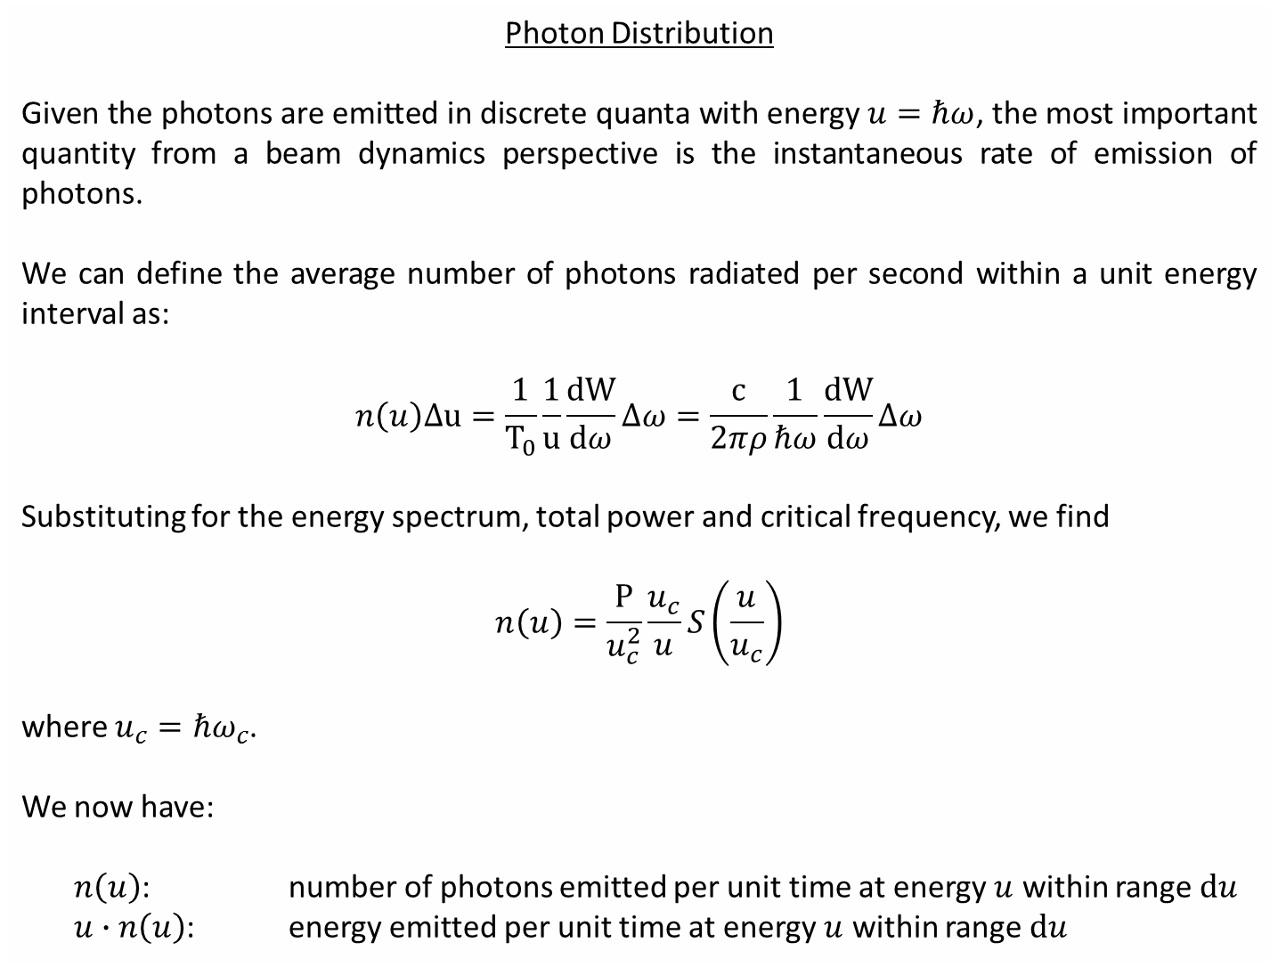
Photon Distribution
Given the photons are emitted in discrete quanta with energy $u=ℏω$, the most important quantity from a beam dynamics perspective is the instantaneous rate of emission of photons.
We can define the average number of photons radiated per second within a unit energy interval as:
$$n\left(u\right)Δu=\frac{1}{T_{0}}\frac{1}{u}\frac{dW}{dω}Δω=\frac{c}{2πρ}\frac{1}{ℏω}\frac{dW}{dω}Δω$$
Substituting for the energy spectrum, total power and critical frequency, we find
$$n\left(u\right)=\frac{P}{u_{c}^{2}}\frac{u_{c}}{u}S\left(\frac{u}{u_{c}}\right)$$
where $u_{c}=ℏω_{c}$.
We now have:
$n\left(u\right)$: number of photons emitted per unit time at energy $u$ within range $du$
$u∙n\left(u\right)$: energy emitted per unit time at energy $u$ within range $du$

Slide 7
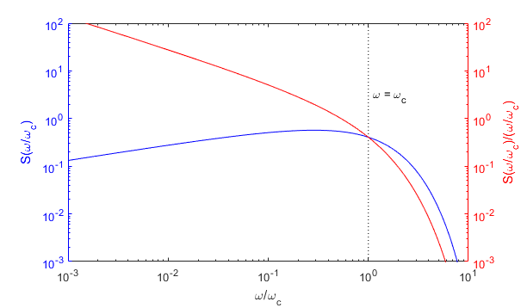
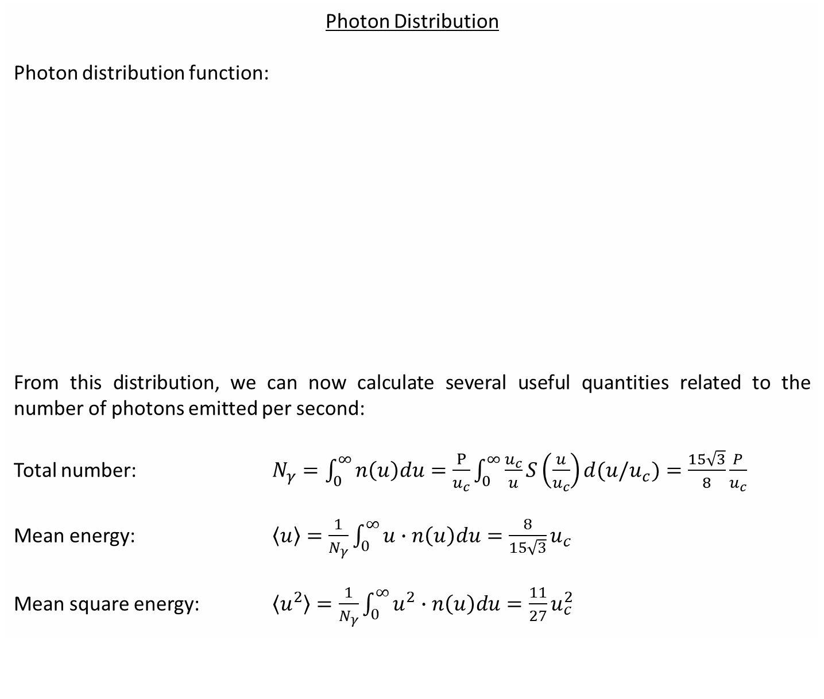
Photon Distribution
Photon distribution function:
From this distribution, we can now calculate several useful quantities related to the number of photons emitted per second:
Total number: $N_{γ}=\int_{0}^{∞}{n\left(u\right)du}=\frac{P}{u_{c}}\int_{0}^{∞}{\frac{u_{c}}{u}S\left(\frac{u}{u_{c}}\right)d(u/u_{c})}=\frac{15\sqrt{3}}{8}\frac{P}{u_{c}}$
Mean energy: $\left\langle u\right\rangle =\frac{1}{N_{γ}}\int_{0}^{∞}{u∙n\left(u\right)du}=\frac{8}{15\sqrt{3}}u_{c}$
Mean square energy: $\left\langle u^{2}\right\rangle =\frac{1}{N_{γ}}\int_{0}^{∞}{u^{2}∙n\left(u\right)du}=\frac{11}{27}u_{c}^{2}$

Slide 8
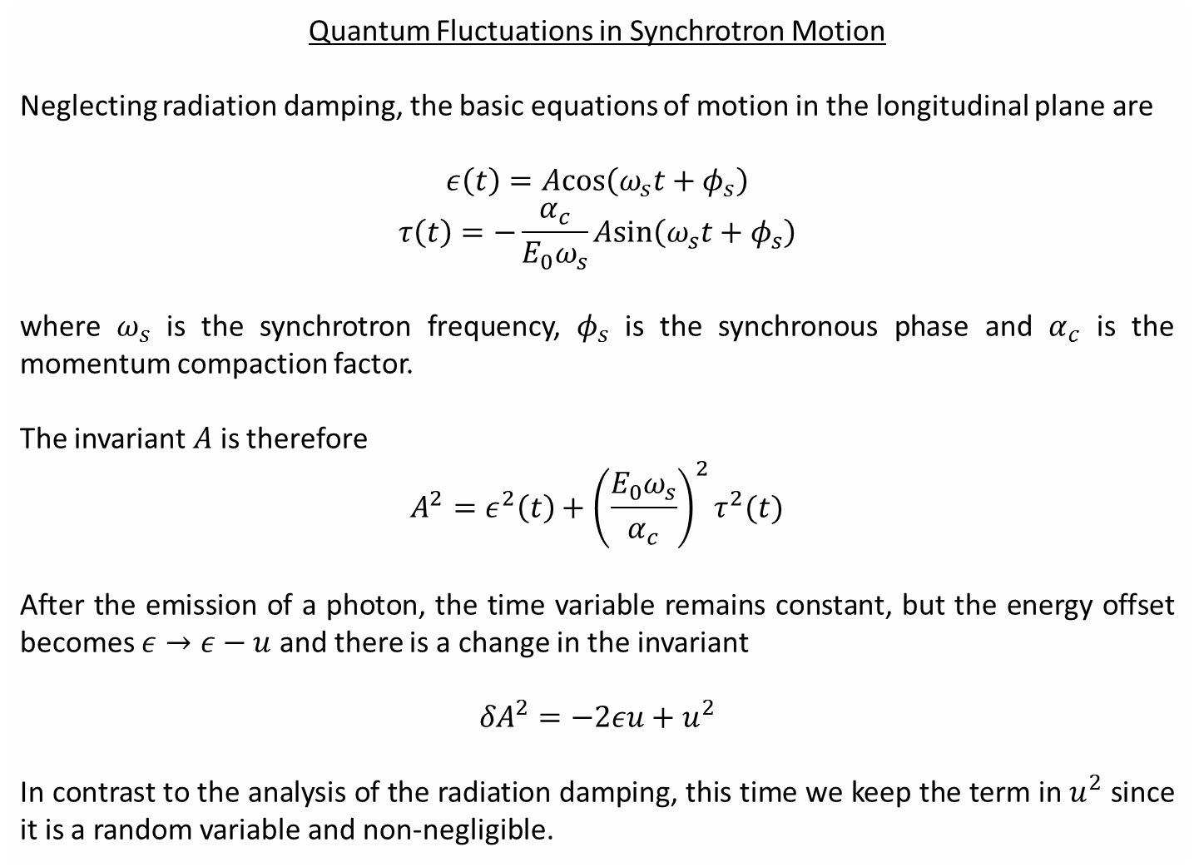
Quantum Fluctuations in Synchrotron Motion
Neglecting radiation damping, the basic equations of motion in the longitudinal plane are
$$ε\left(t\right)=Acos\left(ω_{s}t+φ_{s}\right)$$
$$τ\left(t\right)=−\frac{α_{c}}{E_{0}ω_{s}}Asin\left(ω_{s}t+φ_{s}\right)$$
where $ω_{s}$ is the synchrotron frequency, $φ_{s}$ is the synchronous phase and $α_{c}$ is the momentum compaction factor.
The invariant $A$ is therefore
$$A^{2}=ε^{2}\left(t\right)+{\left(\frac{E_{0}ω_{s}}{α_{c}}\right)}^{2}τ^{2}(t)$$
After the emission of a photon, the time variable remains constant, but the energy offset becomes $ε→ε−u$ and there is a change in the invariant
$${δA}^{2}=−2εu+u^{2}$$
In contrast to the analysis of the radiation damping, this time we keep the term in $u^{2}$ since it is a random variable and non-negligible.

Slide 9
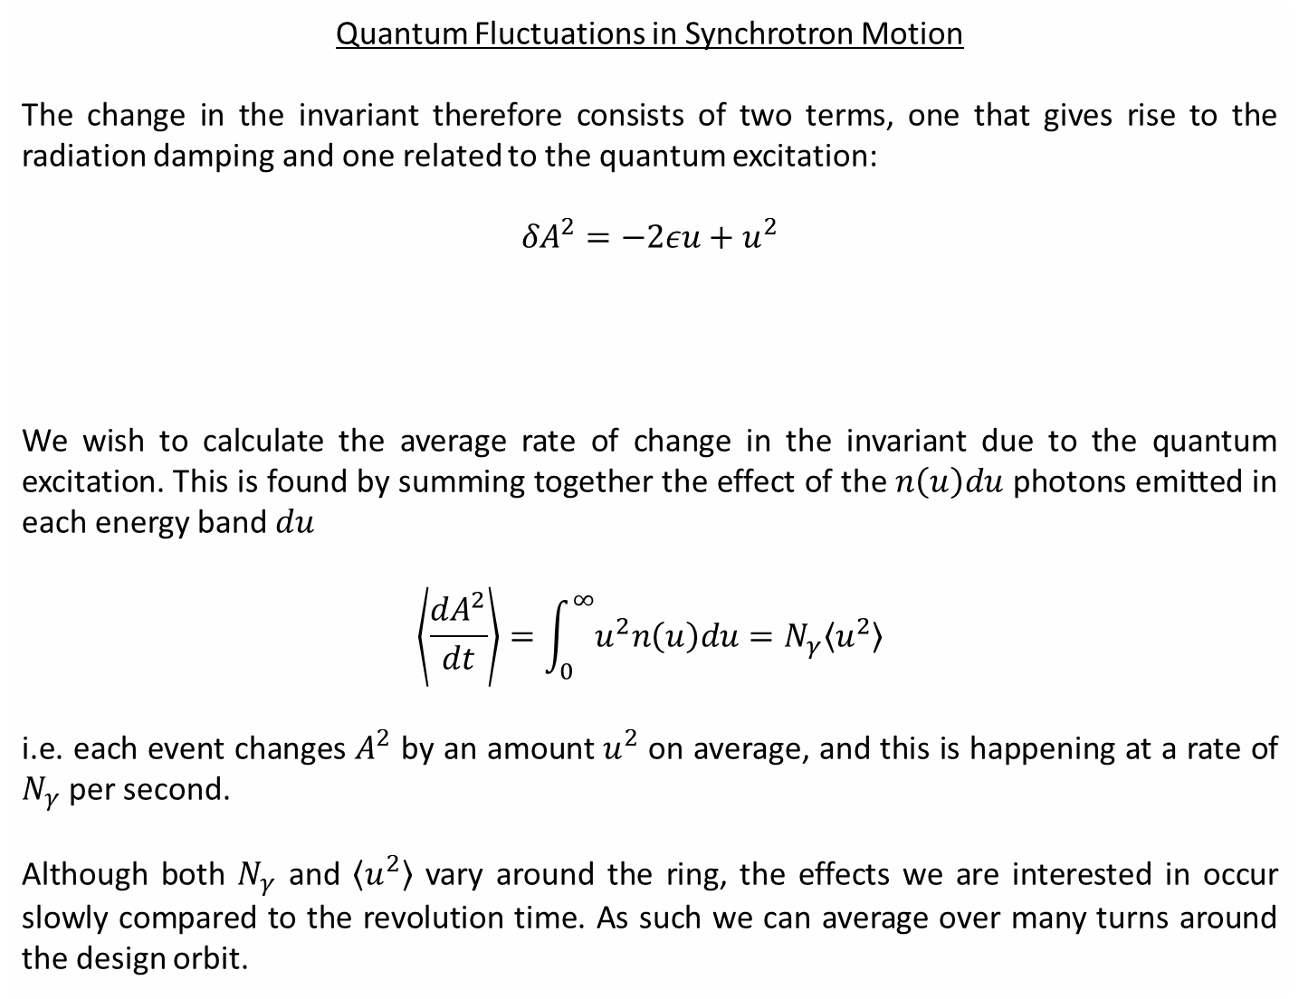
Quantum Fluctuations in Synchrotron Motion
The change in the invariant therefore consists of two terms, one that gives rise to the radiation damping and one related to the quantum excitation:
$${δA}^{2}=−2εu+u^{2}$$
We wish to calculate the average rate of change in the invariant due to the quantum excitation. This is found by summing together the effect of the $n\left(u\right)du$ photons emitted in each energy band $du$
$$\left\langle \frac{dA^{2}}{dt}\right\rangle =\int_{0}^{∞}{u^{2}n\left(u\right)du}=N_{γ}\left\langle u^{2}\right\rangle$$
i.e. each event changes $A^{2}$ by an amount $u^{2}$ on average, and this is happening at a rate of $N_{γ}$ per second.
Although both $N_{γ}$ and $\left\langle u^{2}\right\rangle$ vary around the ring, the effects we are interested in occur slowly compared to the revolution time. As such we can average over many turns around the design orbit.
Radiation damping
(decrement depends on energy deviation)
Quantum excitation
(always increases the amplitude)

Slide 10
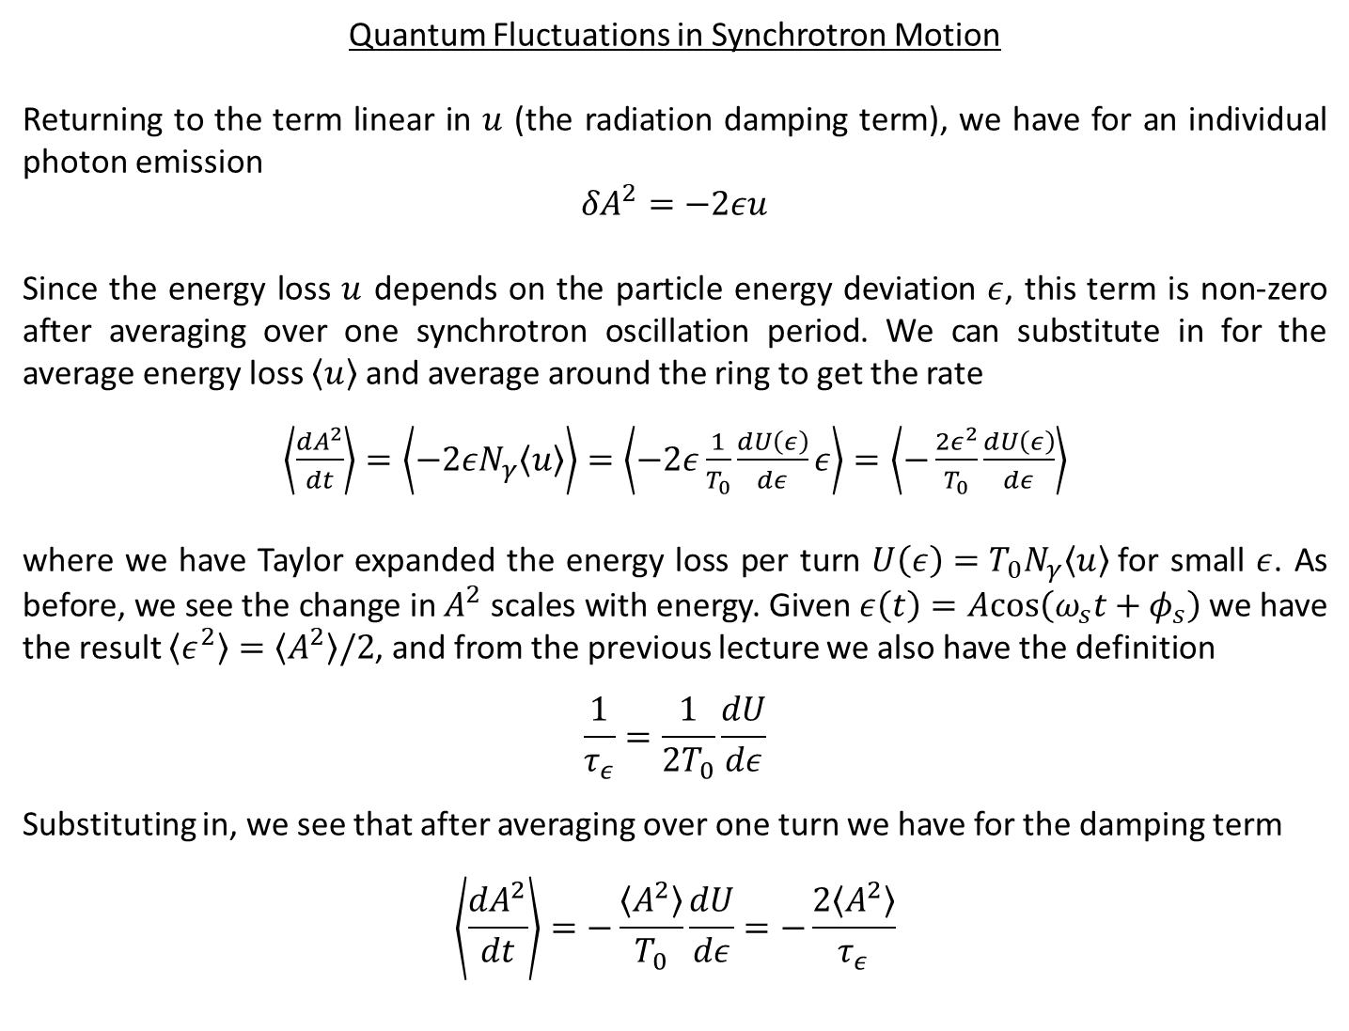
Quantum Fluctuations in Synchrotron Motion
Returning to the term linear in $u$ (the radiation damping term), we have for an individual photon emission
$${δA}^{2}=−2εu$$
Since the energy loss $u$ depends on the particle energy deviation $ε$, this term is non-zero after averaging over one synchrotron oscillation period. We can substitute in for the average energy loss $\left\langle u\right\rangle$and average around the ring to get the rate
$\left\langle \frac{dA^{2}}{dt}\right\rangle =\left\langle −2εN_{γ}\left\langle u\right\rangle \right\rangle =\left\langle −2ε\frac{1}{T_{0}}\frac{dU\left(ε\right)}{dε}ε\right\rangle$ $=\left\langle −\frac{2ε^{2}}{T_{0}}\frac{dU\left(ε\right)}{dε}\right\rangle$
where we have Taylor expanded the energy loss per turn $U\left(ε\right)=T_{0}N_{γ}\left\langle u\right\rangle$for small $ε$. As before, we see the change in $A^{2}$ scales with energy. Given $ε\left(t\right)=Acos\left(ω_{s}t+φ_{s}\right)$ we have the result $\left\langle ε^{2}\right\rangle =\left\langle A^{2}\right\rangle /2$, and from the previous lecture we also have the definition
$$\frac{1}{τ_{ε}}=\frac{1}{{2T}_{0}}\frac{dU}{dε}$$
Substituting in, we see that after averaging over one turn we have for the damping term
$$\left\langle \frac{dA^{2}}{dt}\right\rangle =−\frac{\left\langle A^{2}\right\rangle }{T_{0}}\frac{dU}{dε}=−\frac{2\left\langle A^{2}\right\rangle }{τ_{ε}}$$

Slide 11
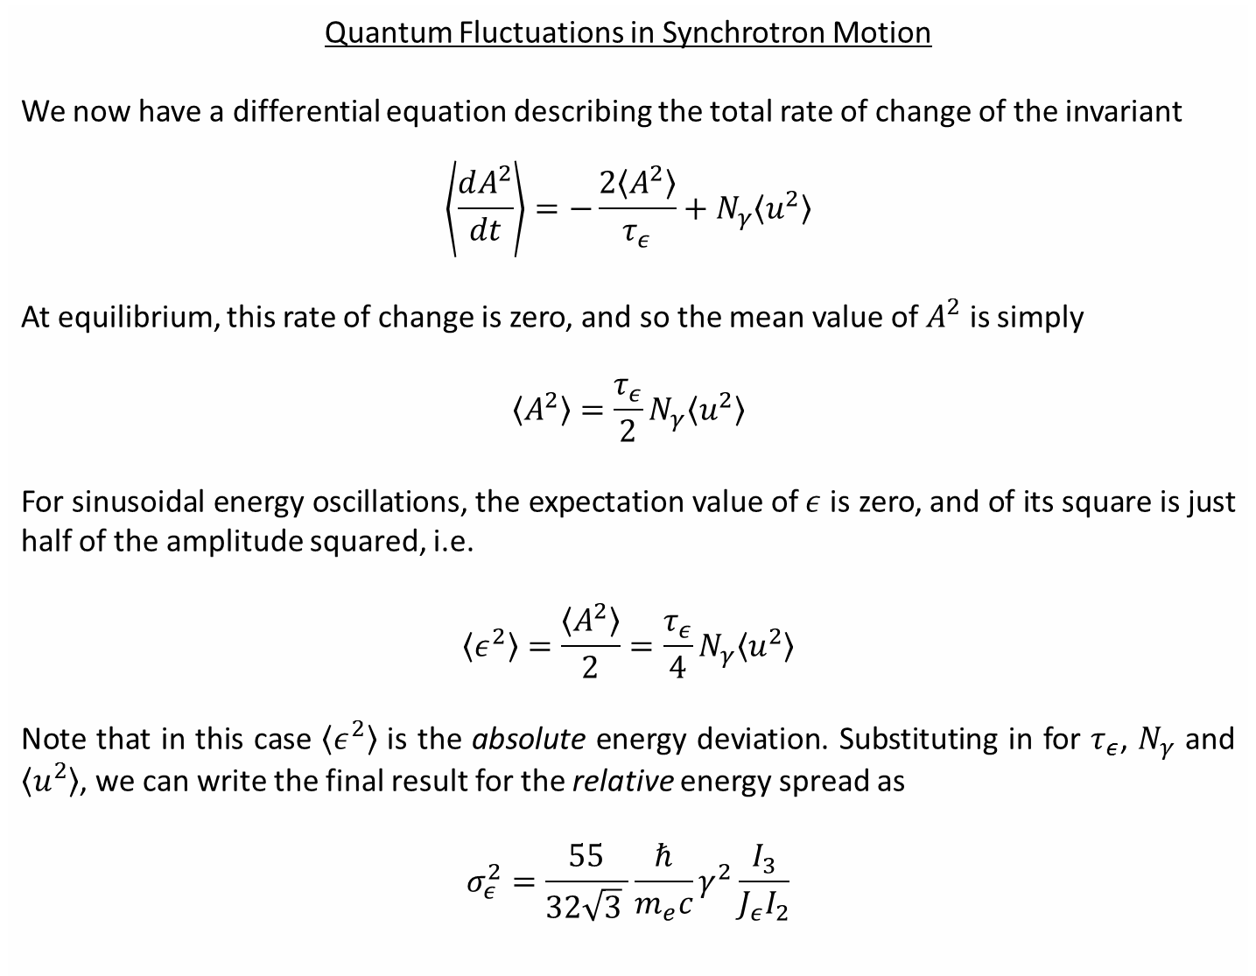
Quantum Fluctuations in Synchrotron Motion
We now have a differential equation describing the total rate of change of the invariant
$$\left\langle \frac{dA^{2}}{dt}\right\rangle =−\frac{2\left\langle A^{2}\right\rangle }{τ_{ε}}+N_{γ}\left\langle u^{2}\right\rangle$$
At equilibrium, this rate of change is zero, and so the mean value of $A^{2}$ is simply
$$\left\langle A^{2}\right\rangle ={\frac{τ_{ε}}{2}N}_{γ}\left\langle u^{2}\right\rangle$$
For sinusoidal energy oscillations, the expectation value of $ε$ is zero, and of its square is just half of the amplitude squared, i.e.
$$\left\langle ε^{2}\right\rangle =\frac{\left\langle A^{2}\right\rangle }{2}={\frac{τ_{ε}}{4}N}_{γ}\left\langle u^{2}\right\rangle$$
Note that in this case $\left\langle ε^{2}\right\rangle$ is the absolute energy deviation. Substituting in for $τ_{ε}$, $N_{γ}$ and $\left\langle u^{2}\right\rangle$, we can write the final result for the relative energy spread as
$$σ_{ε}^{2}=\frac{55}{32\sqrt{3} }\frac{ℏ}{m_{e}c}γ^{2}\frac{I_{3}}{{J_{ε}I}_{2}}$$

Slide 12
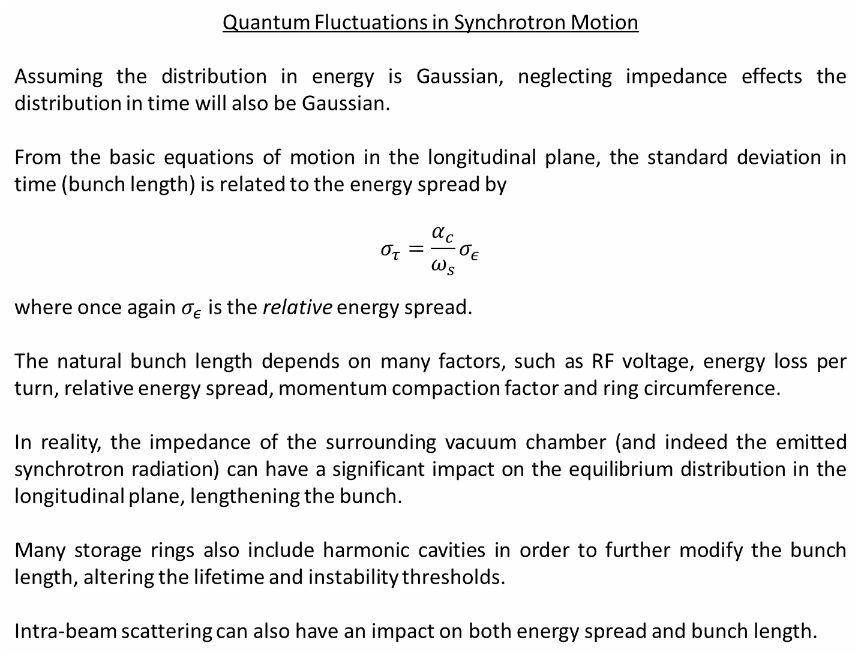
Quantum Fluctuations in Synchrotron Motion
Assuming the distribution in energy is Gaussian, neglecting impedance effects the distribution in time will also be Gaussian.
From the basic equations of motion in the longitudinal plane, the standard deviation in time (bunch length) is related to the energy spread by
$$σ_{τ}=\frac{α_{c}}{ω_{s}}σ_{ε}$$
where once again $σ_{ε}$ is the relative energy spread.
The natural bunch length depends on many factors, such as RF voltage, energy loss per turn, relative energy spread, momentum compaction factor and ring circumference.
In reality, the impedance of the surrounding vacuum chamber (and indeed the emitted synchrotron radiation) can have a significant impact on the equilibrium distribution in the longitudinal plane, lengthening the bunch.
Many storage rings also include harmonic cavities in order to further modify the bunch length, altering the lifetime and instability thresholds.
Intra-beam scattering can also have an impact on both energy spread and bunch length.

Slide 13
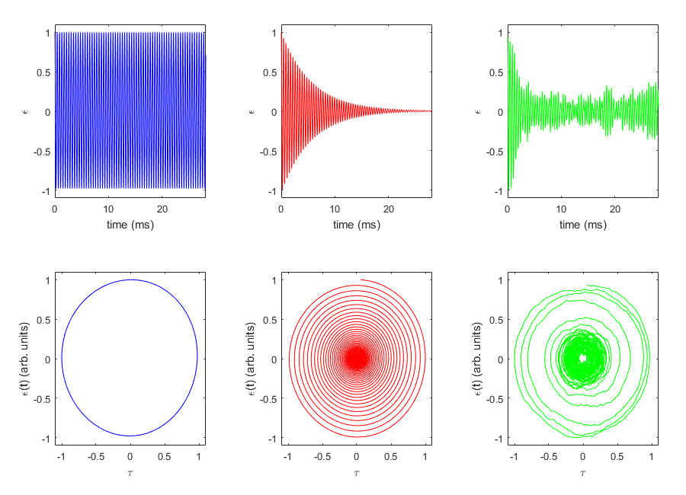
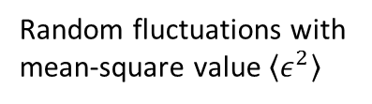
Quantum Fluctuations in Synchrotron Motion
no damping
with damping
damping and excitation
Converges to synchronous, on-energy particle
Random fluctuations with mean-square value $\left\langle ε^{2}\right\rangle$

Slide 14
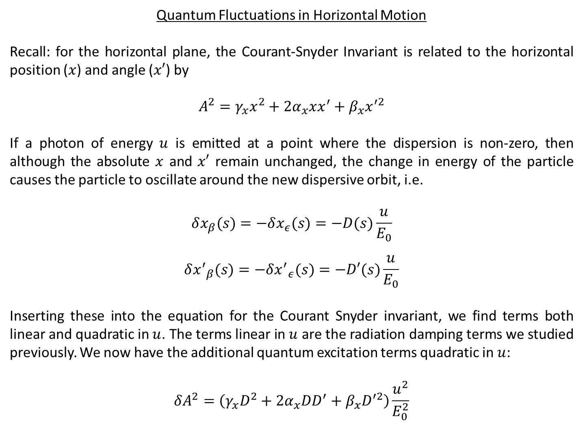
Quantum Fluctuations in Horizontal Motion
Recall: for the horizontal plane, the Courant-Snyder Invariant is related to the horizontal position ($x$) and angle ($x′$) by
$$A^{2}=γ_{x}x^{2}+2α_{x}xx^{′}+β_{x}x^{′2}$$
If a photon of energy $u$ is emitted at a point where the dispersion is non-zero, then although the absolute $x$ and $x′$ remain unchanged, the change in energy of the particle causes the particle to oscillate around the new dispersive orbit, i.e.
$$δx_{β}(s)=−δx_{ε}(s)=−D(s)\frac{u}{E_{0}}$$
$$δ{x^{′}}_{β}(s)=−δ{x^{′}}_{ε}(s)=−D′(s)\frac{u}{E_{0}}$$
Inserting these into the equation for the Courant Snyder invariant, we find terms both linear and quadratic in $u$. The terms linear in $u$ are the radiation damping terms we studied previously. We now have the additional quantum excitation terms quadratic in $u$:
$$δA^{2}=\left(γ_{x}D^{2}+2α_{x}DD^{′}+β_{x}D^{′2}\right)\frac{u^{2}}{E_{0}^{2}}$$

Slide 15
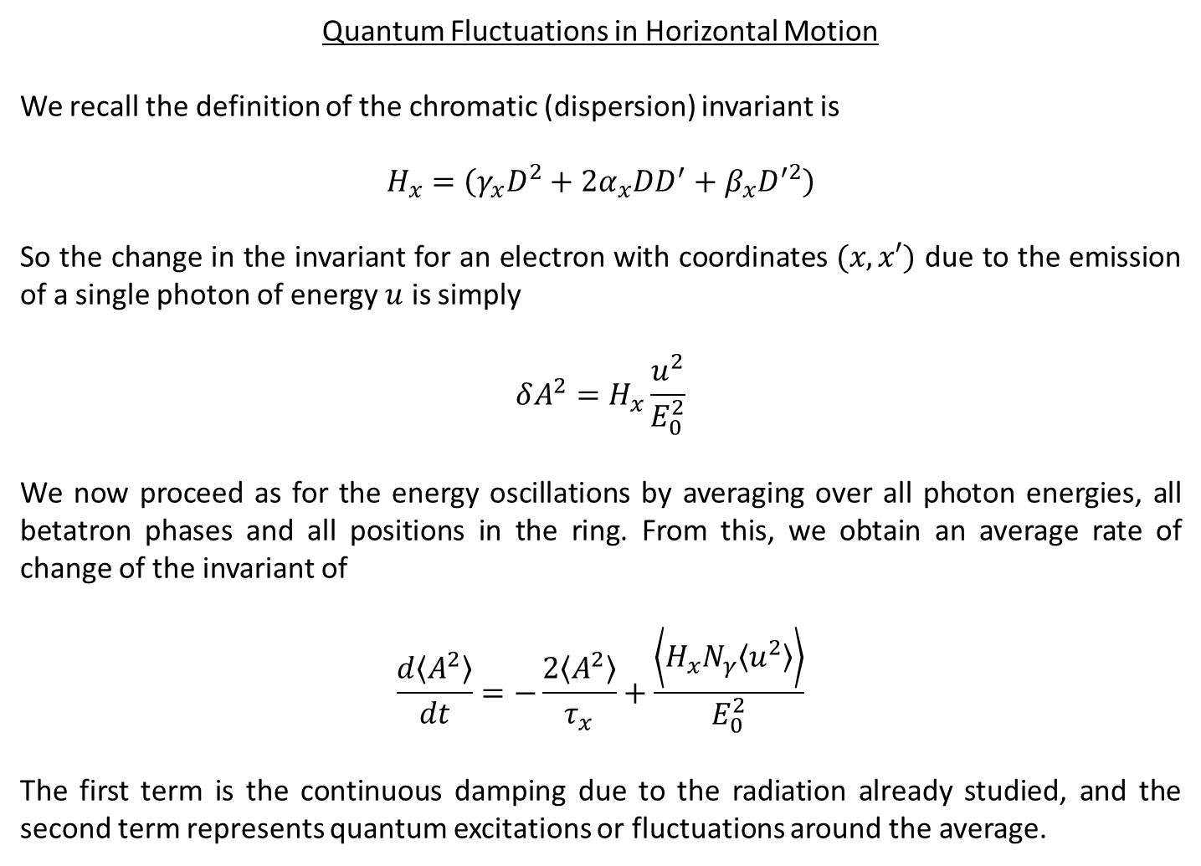
Quantum Fluctuations in Horizontal Motion
We recall the definition of the chromatic (dispersion) invariant is
$$H_{x}=\left(γ_{x}D^{2}+2α_{x}DD^{′}+β_{x}D^{′2}\right)$$
So the change in the invariant for an electron with coordinates $(x, x′)$ due to the emission of a single photon of energy $u$ is simply
$$δA^{2}=H_{x}\frac{u^{2}}{E_{0}^{2}}$$
We now proceed as for the energy oscillations by averaging over all photon energies, all betatron phases and all positions in the ring. From this, we obtain an average rate of change of the invariant of
$$\frac{d\left\langle A^{2}\right\rangle }{dt}=−\frac{2\left\langle A^{2}\right\rangle }{τ_{x}}+\frac{\left\langle H_{x}N_{γ}\left\langle u^{2}\right\rangle \right\rangle }{E_{0}^{2}}$$
The first term is the continuous damping due to the radiation already studied, and the second term represents quantum excitations or fluctuations around the average.

Slide 16
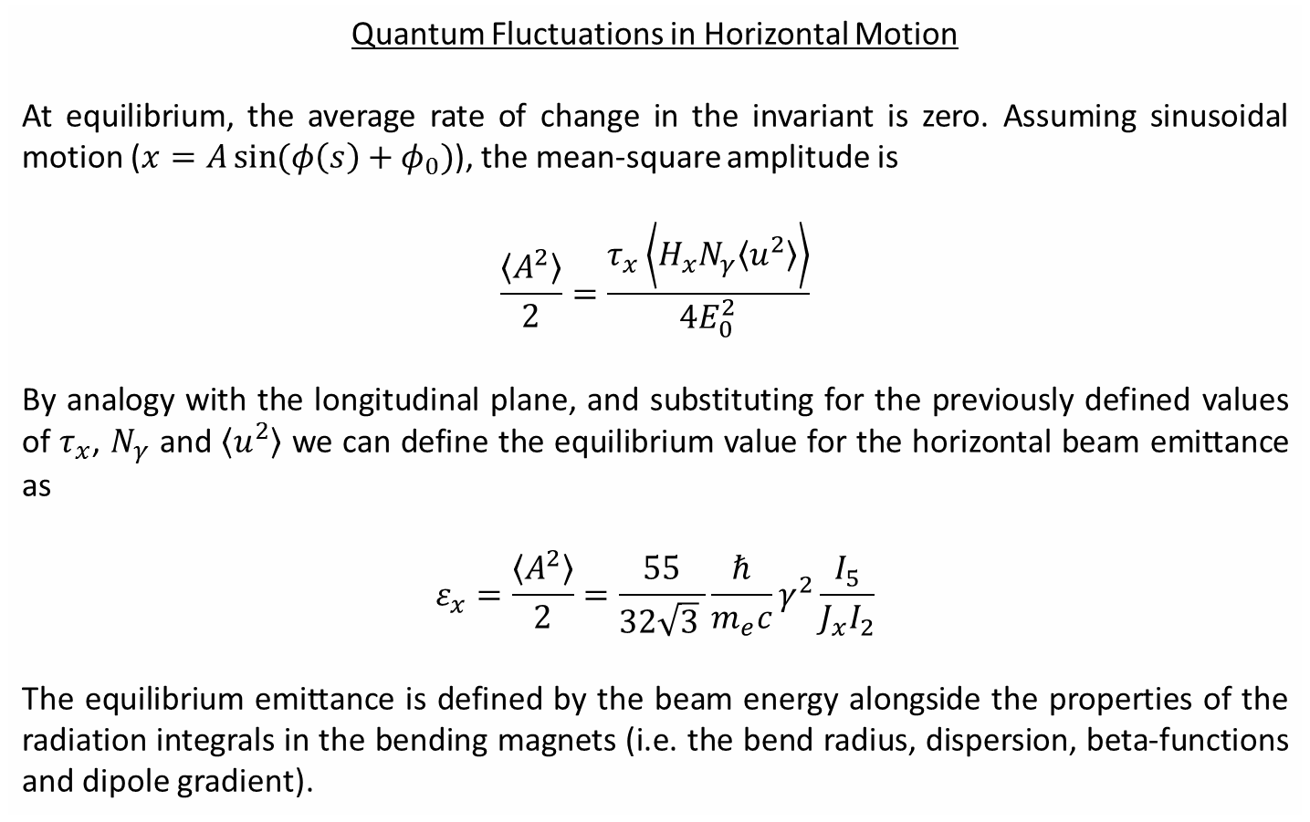
Quantum Fluctuations in Horizontal Motion
At equilibrium, the average rate of change in the invariant is zero. Assuming sinusoidal motion ($x=A\sin{(φ\left(s\right)+φ_{0})}$), the mean-square amplitude is
$$\frac{\left\langle A^{2}\right\rangle }{2}=\frac{τ_{x}\left\langle H_{x}N_{γ}\left\langle u^{2}\right\rangle \right\rangle }{4E_{0}^{2}}$$
By analogy with the longitudinal plane, and substituting for the previously defined values of $τ_{x}$, $N_{γ}$ and $\left\langle u^{2}\right\rangle$ we can define the equilibrium value for the horizontal beam emittance as
$$ε_{x}=\frac{\left\langle A^{2}\right\rangle }{2}=\frac{55}{32\sqrt{3} }\frac{ℏ}{m_{e}c}γ^{2}\frac{I_{5}}{{J_{x}I}_{2}}$$
The equilibrium emittance is defined by the beam energy alongside the properties of the radiation integrals in the bending magnets (i.e. the bend radius, dispersion, beta-functions and dipole gradient).

Slide 17
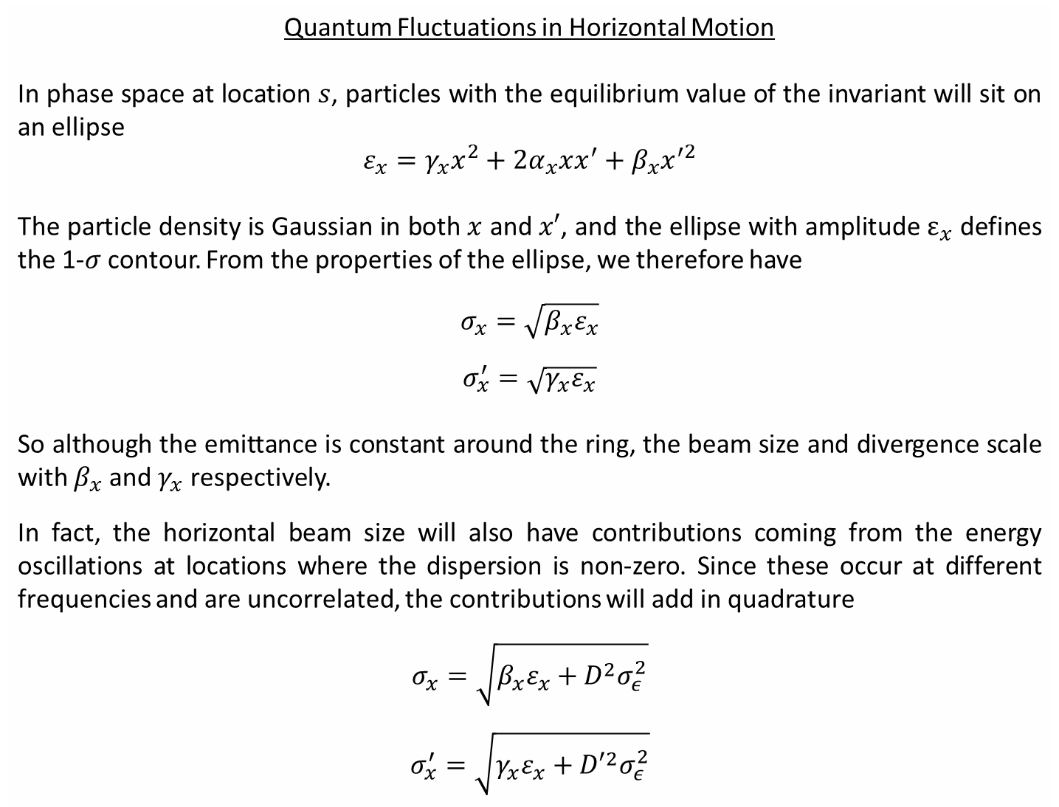
Quantum Fluctuations in Horizontal Motion
In phase space at location $s$, particles with the equilibrium value of the invariant will sit on an ellipse
$$ε_{x}=γ_{x}x^{2}+2α_{x}xx^{′}+β_{x}x^{′2}$$
The particle density is Gaussian in both $x$ and $x′$, and the ellipse with amplitude $ε_{x}$ defines the 1-$σ$ contour. From the properties of the ellipse, we therefore have
$$σ_{x}=\sqrt{β_{x}ε_{x}}$$
$$σ_{x}^{′}=\sqrt{γ_{x}ε_{x}}$$
So although the emittance is constant around the ring, the beam size and divergence scale with $β_{x}$ and $γ_{x}$ respectively.
In fact, the horizontal beam size will also have contributions coming from the energy oscillations at locations where the dispersion is non-zero. Since these occur at different frequencies and are uncorrelated, the contributions will add in quadrature
$$σ_{x}=\sqrt{β_{x}ε_{x}+D^{2}σ_{ε}^{2}}$$
$$σ_{x}^{′}=\sqrt{γ_{x}ε_{x}+{D′}^{2}σ_{ε}^{2}}$$

Slide 18
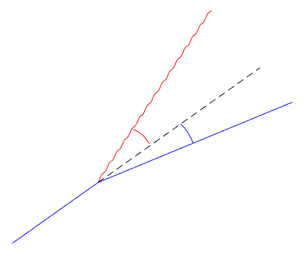


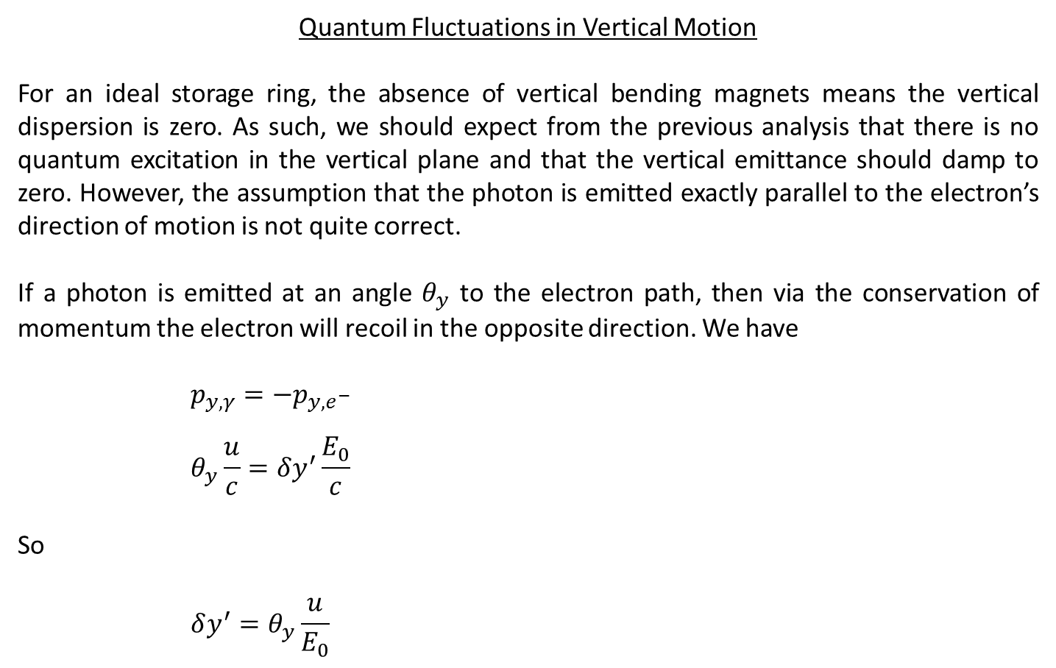




Quantum Fluctuations in Vertical Motion
For an ideal storage ring, the absence of vertical bending magnets means the vertical dispersion is zero. As such, we should expect from the previous analysis that there is no quantum excitation in the vertical plane and that the vertical emittance should damp to zero. However, the assumption that the photon is emitted exactly parallel to the electron’s direction of motion is not quite correct.
If a photon is emitted at an angle $θ_{y}$ to the electron path, then via the conservation of momentum the electron will recoil in the opposite direction. We have
$$p_{y,γ}=−p_{y,e^{−}}$$
$$θ_{y}\frac{u}{c}=δy^{′}\frac{E_{0}}{c}$$
So
$$δy^{′}=θ_{y}\frac{u}{E_{0}}$$
$$p_{γ}$$
$$γ$$
$$θ_{y}$$
$$δy′$$
$$p_{e^{−}}$$
$$e^{−}$$

Slide 19
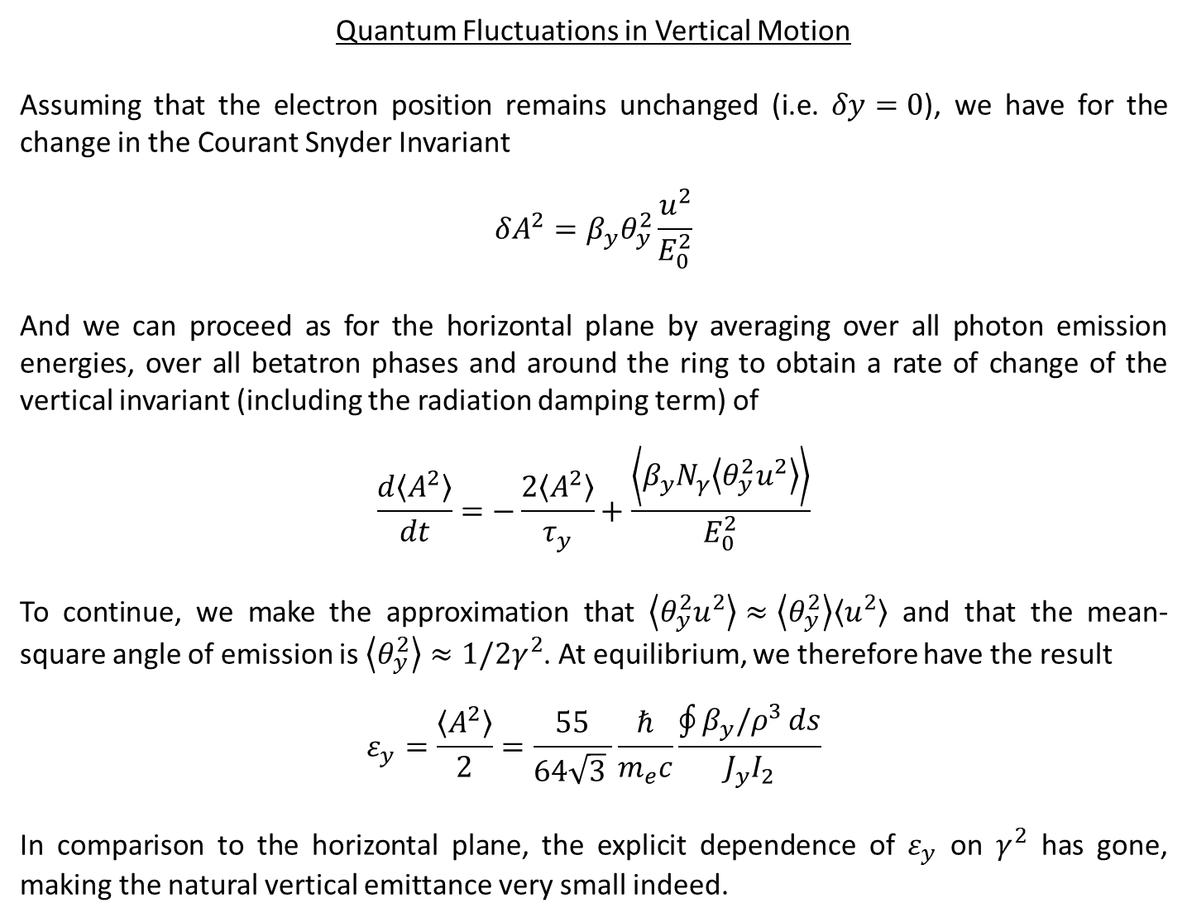
Quantum Fluctuations in Vertical Motion
Assuming that the electron position remains unchanged (i.e. $δy=0$), we have for the change in the Courant Snyder Invariant
$$δA^{2}=β_{y}θ_{y}^{2}\frac{u^{2}}{E_{0}^{2}}$$
And we can proceed as for the horizontal plane by averaging over all photon emission energies, over all betatron phases and around the ring to obtain a rate of change of the vertical invariant (including the radiation damping term) of
$$\frac{d\left\langle A^{2}\right\rangle }{dt}=−\frac{2\left\langle A^{2}\right\rangle }{τ_{y}}+\frac{\left\langle β_{y}N_{γ}\left\langle {θ_{y}^{2}u}^{2}\right\rangle \right\rangle }{E_{0}^{2}}$$
To continue, we make the approximation that $\left\langle θ_{y}^{2}u^{2}\right\rangle ≈\left\langle θ_{y}^{2}\right\rangle \left\langle u^{2}\right\rangle$ and that the mean-square angle of emission is $\left\langle θ_{y}^{2}\right\rangle ≈1/2γ^{2}$. At equilibrium, we therefore have the result
$$ε_{y}=\frac{\left\langle A^{2}\right\rangle }{2}=\frac{55}{64\sqrt{3} }\frac{ℏ}{m_{e}c}\frac{\oint{β_{y}/ρ^{3}}ds}{{J_{y}I}_{2}}$$
In comparison to the horizontal plane, the explicit dependence of $ε_{y}$ on $γ^{2}$ has gone, making the natural vertical emittance very small indeed.

Slide 20
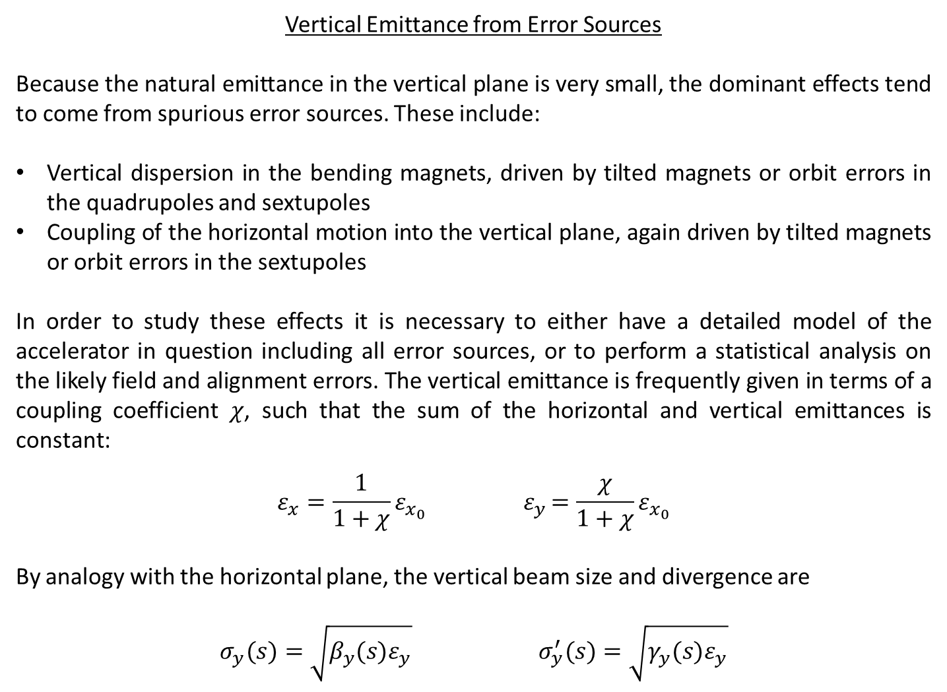
Vertical Emittance from Error Sources
Because the natural emittance in the vertical plane is very small, the dominant effects tend to come from spurious error sources. These include:
Vertical dispersion in the bending magnets, driven by tilted magnets or orbit errors in the quadrupoles and sextupoles
Coupling of the horizontal motion into the vertical plane, again driven by tilted magnets or orbit errors in the sextupoles
In order to study these effects it is necessary to either have a detailed model of the accelerator in question including all error sources, or to perform a statistical analysis on the likely field and alignment errors. The vertical emittance is frequently given in terms of a coupling coefficient $χ$, such that the sum of the horizontal and vertical emittances is constant:
$$ε_{x}=\frac{1}{1+χ}ε_{x_{0}}{ ε}_{y}=\frac{χ}{1+χ}ε_{x_{0}}$$
By analogy with the horizontal plane, the vertical beam size and divergence are
$$σ_{y}(s)=\sqrt{β_{y}(s)ε_{y}} σ_{y}^{′}(s)=\sqrt{γ_{y}(s)ε_{y}}$$

Slide 21
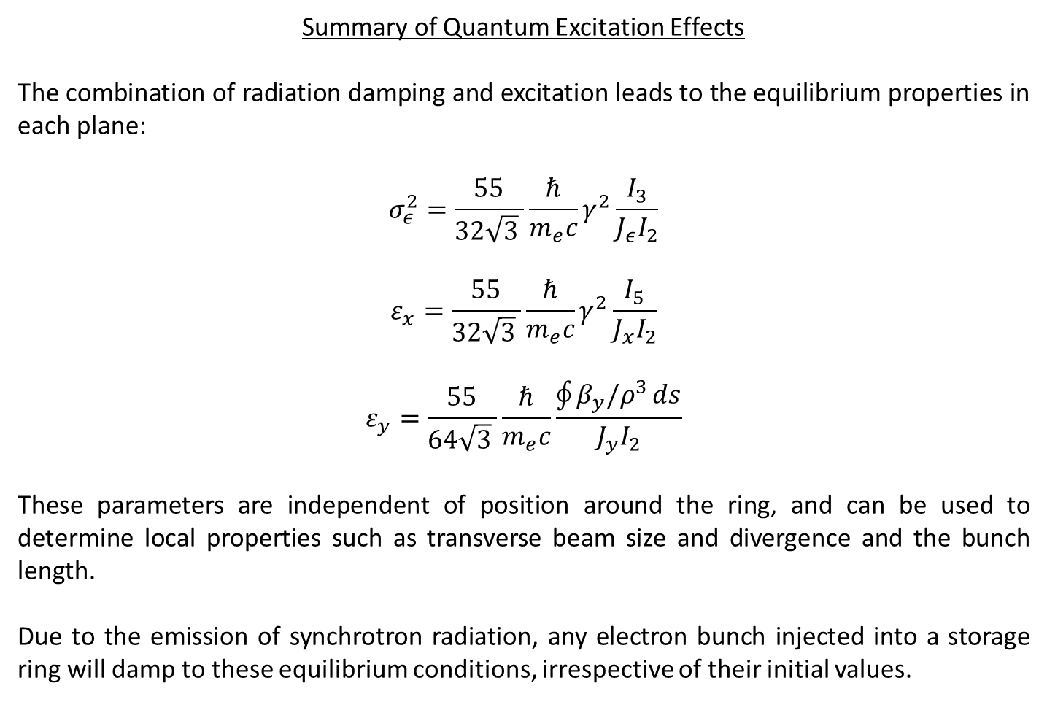
Summary of Quantum Excitation Effects
The combination of radiation damping and excitation leads to the equilibrium properties in each plane:
$$σ_{ε}^{2}=\frac{55}{32\sqrt{3} }\frac{ℏ}{m_{e}c}γ^{2}\frac{I_{3}}{{J_{ε}I}_{2}}$$
$$ε_{x}=\frac{55}{32\sqrt{3} }\frac{ℏ}{m_{e}c}γ^{2}\frac{I_{5}}{{J_{x}I}_{2}}$$
$$ε_{y}=\frac{55}{64\sqrt{3} }\frac{ℏ}{m_{e}c}\frac{\oint{β_{y}/ρ^{3}}ds}{{J_{y}I}_{2}}$$
These parameters are independent of position around the ring, and can be used to determine local properties such as transverse beam size and divergence and the bunch length.
Due to the emission of synchrotron radiation, any electron bunch injected into a storage ring will damp to these equilibrium conditions, irrespective of their initial values.

Slide 22
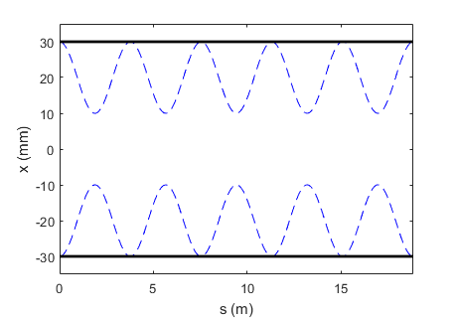
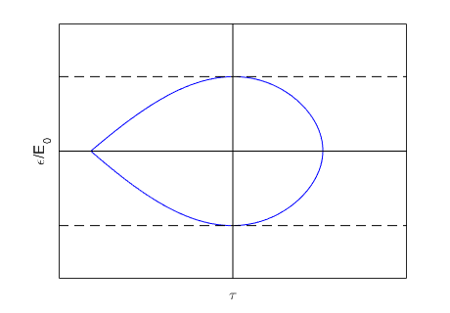
Quantum lifetime
Neglecting collective effects, the equilibrium distribution for circulating electron bunches tends to a Gaussian in all 3 planes. As such, we can anticipate that the continual quantum excitation will lead to particles in the tails of the distribution have large position and energy deviations from the reference values which could be lost over time.
In the horizontal plane, the physical restriction imposed by the vacuum chamber places an upper limit on the oscillation amplitude. In the longitudinal plane, the height of the RF bucket limits the maximum energy deviation.
RF bucket height
Beam envelope
Physical aperture

Slide 23
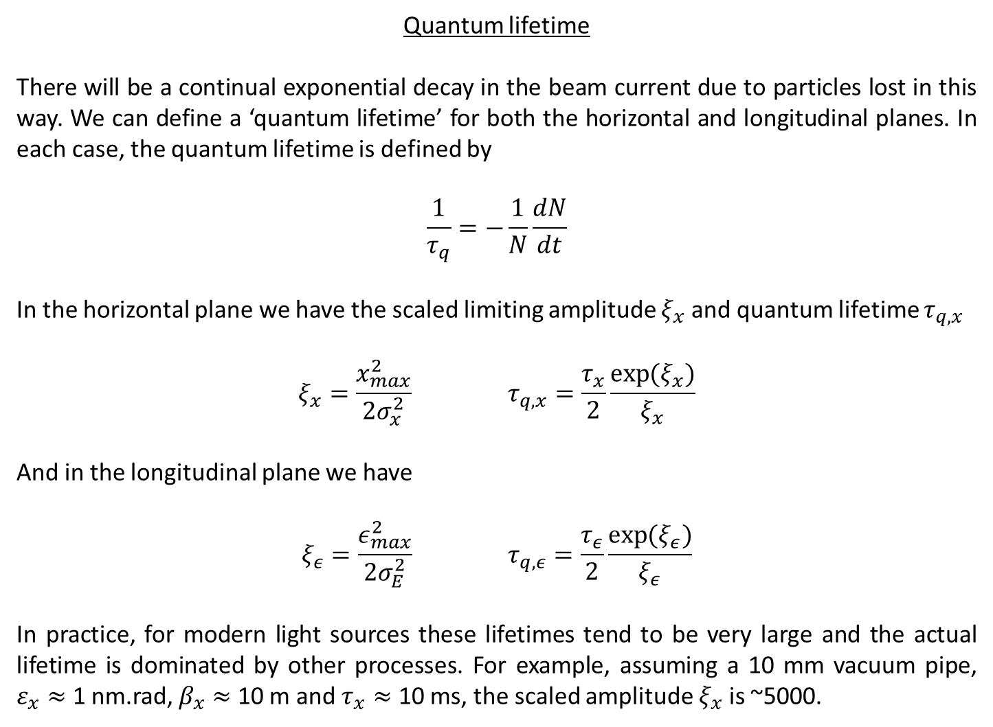
Quantum lifetime
There will be a continual exponential decay in the beam current due to particles lost in this way. We can define a ‘quantum lifetime’ for both the horizontal and longitudinal planes. In each case, the quantum lifetime is defined by
$$\frac{1}{τ_{q}}=−\frac{1}{N}\frac{dN}{dt}$$
In the horizontal plane we have the scaled limiting amplitude $ξ_{x}$ and quantum lifetime $τ_{q,x}$
$$ξ_{x}=\frac{x_{max}^{2}}{2σ_{x}^{2}} τ_{q,x}=\frac{τ_{x}}{2}\frac{\exp{(ξ_{x})}}{ξ_{x}}$$
And in the longitudinal plane we have
$$ξ_{ε}=\frac{ε_{max}^{2}}{2σ_{E}^{2}} τ_{q,ε}=\frac{τ_{ε}}{2}\frac{\exp{(ξ_{ε})}}{ξ_{ε}}$$
In practice, for modern light sources these lifetimes tend to be very large and the actual lifetime is dominated by other processes. For example, assuming a 10 mm vacuum pipe, $ε_{x}≈$ 1 nm.rad, $β_{x}≈$ 10 m and $τ_{x}≈$ 10 ms, the scaled amplitude $ξ_{x}$ is ~5000.

Slide 24
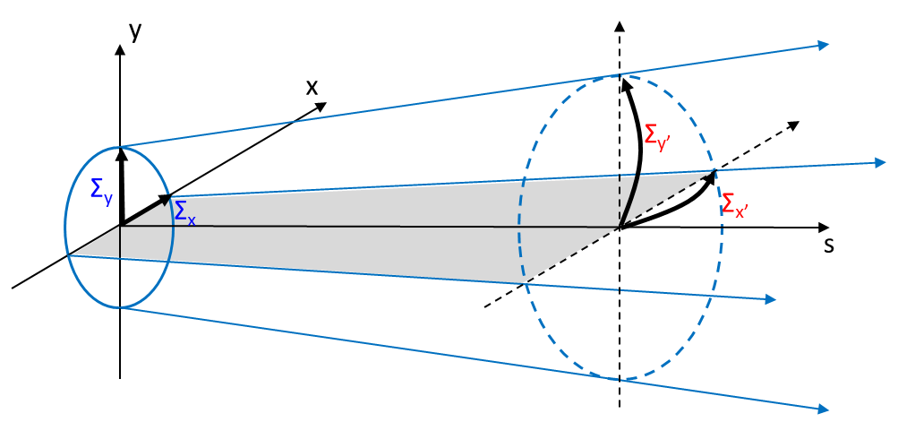
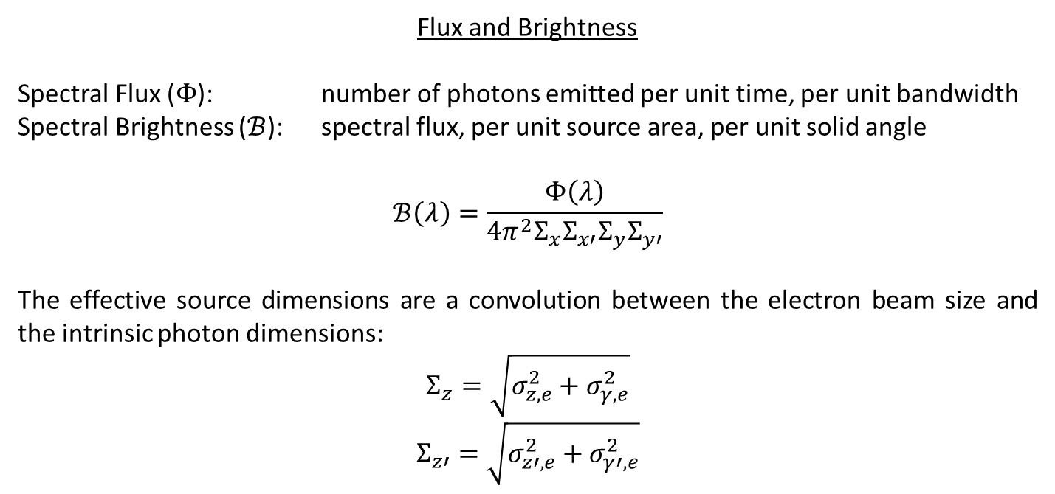
Flux and Brightness
Spectral Flux ($Φ$): number of photons emitted per unit time, per unit bandwidth
Spectral Brightness ($ℬ$): spectral flux, per unit source area, per unit solid angle
$$ℬ\left(λ\right)=\frac{Φ\left(λ\right)}{4π^{2}Σ_{x}Σ_{x′}Σ_{y}Σ_{y′}}$$
The effective source dimensions are a convolution between the electron beam size and the intrinsic photon dimensions:
$$Σ_{z}=\sqrt{σ_{z,e}^{2}+σ_{γ,e}^{2}}$$
$$Σ_{z′}=\sqrt{σ_{z′,e}^{2}+σ_{γ′,e}^{2}}$$
The majority of new storage ring designs aim to increase the photon beam brightness by reducing the dimensions of the source.

Slide 25
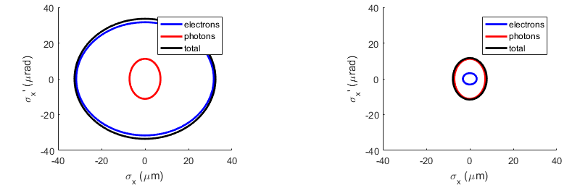
Diffraction-limited storage rings
Goal for future storage rings is to approach ‘the diffraction limit’, i.e. to reduce the electron beam size below the intrinsic size of the radiation
Electron emittance, ε = 1 nm.rad
Beta, β = 1 m
Wavelength, λ = 1 nm
Undulator length, L = 2 m
Electron emittance, ε = 0.01 nm.rad
Beta, β = 1 m
Wavelength, λ = 1 nm
Undulator length, L = 2 m
Existing rings already operate close to the diffraction limit in the vertical plane. The challenge is to reduce the horizontal beam size / divergence.

Slide 26
Low emittance rings
Reduction of the equilibrium (natural) emittance is one of the main goals in storage or damping ring design:
Storage rings
Small emittance means the electron beam size and divergence is small, increasing the brightness of the photon beams
Brighter photon beams implies increased photon flux through small beamline apertures
Smaller electron beam sizes increases the transverse coherence of the photon beams
Reducing the electron beam size and divergence reduces the spot size of the photon beam on the sample, reducing backgrounds when studying small samples and improving the spatial resolution when scanning
Damping Rings
Used as temporary storage rings in colliders as a way of reducing an initial beam emittance via radiation damping
The smaller extracted beam emittance reduces the bunch dimensions, increasing the final luminosity of the machine

Slide 27
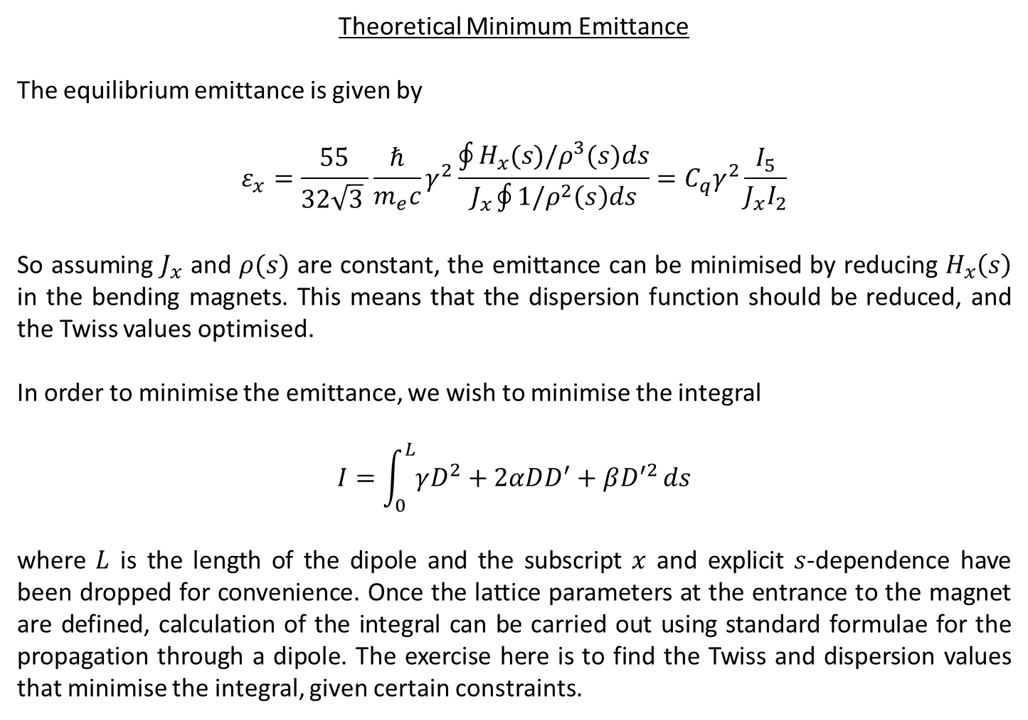
Theoretical Minimum Emittance
The equilibrium emittance is given by
$$ε_{x}=\frac{55}{32\sqrt{3} }\frac{ℏ}{m_{e}c}γ^{2}\frac{\oint{H_{x}(s)/ρ^{3}(s)ds}}{J_{x}\oint{1/ρ^{2}\left(s\right)ds}}=C_{q}γ^{2}\frac{I_{5}}{J_{x}I_{2}}$$
So assuming $J_{x}$ and $ρ(s)$ are constant, the emittance can be minimised by reducing $H_{x}\left(s\right)$ in the bending magnets. This means that the dispersion function should be reduced, and the Twiss values optimised.
In order to minimise the emittance, we wish to minimise the integral
$$I=\int_{0}^{L}{γD^{2}+2αDD^{′}+βD^{′2}}ds$$
where $L$ is the length of the dipole and the subscript $x$ and explicit $s$-dependence have been dropped for convenience. Once the lattice parameters at the entrance to the magnet are defined, calculation of the integral can be carried out using standard formulae for the propagation through a dipole. The exercise here is to find the Twiss and dispersion values that minimise the integral, given certain constraints.

Slide 28
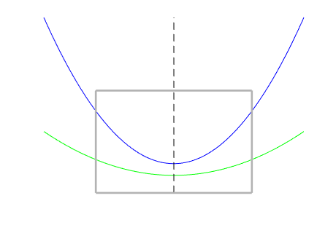
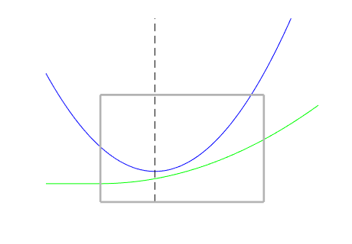



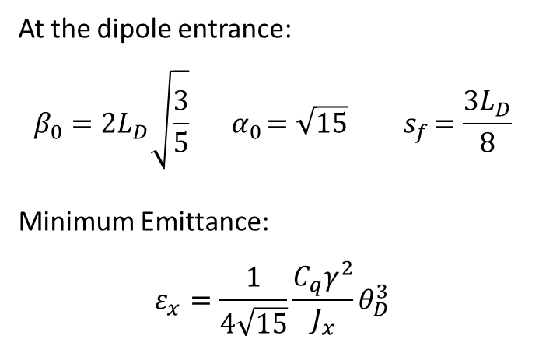

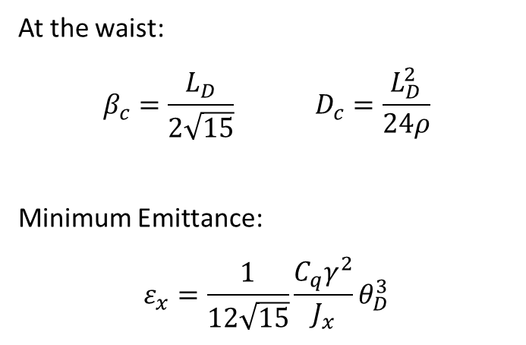


Theoretical Minimum Emittance
Two cases are considered: non-achromatic (left) and achromatic (right) optics
$$β_{x}$$
$$β_{x}$$
$$L_{D}$$
$$s_{f}$$
$$D_{x}$$
$$D_{x}$$
At the waist:
$$β_{c}=\frac{L_{D}}{2\sqrt{15}} D_{c}=\frac{L_{D}^{2}}{24ρ}$$
Minimum Emittance:
$$ε_{x}=\frac{1}{12\sqrt{15}}\frac{C_{q}γ^{2}}{J_{x}}θ_{D}^{3}$$
At the dipole entrance:
$$β_{0}=2L_{D}\sqrt{\frac{3}{5}}{ α}_{0}=\sqrt{15}{ s}_{f}=\frac{3L_{D}}{8}$$
Minimum Emittance:
$$ε_{x}=\frac{1}{4\sqrt{15}}\frac{C_{q}γ^{2}}{J_{x}}θ_{D}^{3}$$

Slide 29
Low emittance rings
For light sources, the storage ring design has to provide straight sections (insertions) where the undulators / wigglers can be located, as well as deliver a low emittance.
A good figure-of-merit in this regard is the ratio between the total length of the straights to the overall circumference.
Although having the dispersion at a waist in the centre of the bending magnet leads to a lower emittance than matching it to zero at the edges, there are many reasons why the achromatic solution is desirable:
It avoids increasing the horizontal beam size due to the energy spread
Beam energy fluctuations do not translate to position offsets in the straights
Provides a good location for the RF cavities and injection elements
Decouples the chromatic and harmonic sextupoles
However, many rings choose to operate with a small amount of dispersion in the straights, as the emittance can be reduced without excessive impact on the other constraints.

Slide 30
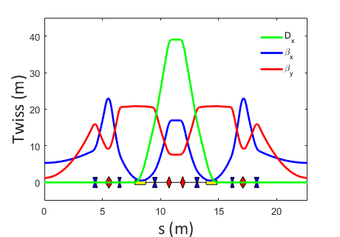
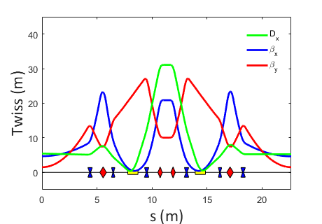
Double Bend Achromat (DBA) cells
Many third-generation light sources use a double-bend achromat structure:
ELETTRA (Italy)
APS (USA)
SPRING8 (Japan)
BESSY-II (Germany)
Diamond (UK)
SSRF (China)
…
Cells of magnets are interspersed with the straight sections that house the insertion devices
There are two dipoles in each cell, with the dispersion and beta functions resembling the achromatic TME solution. Realistic designs tend to operate at slightly above the TME.
achromatic
low emittance

Slide 31
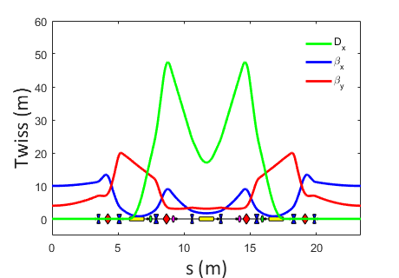
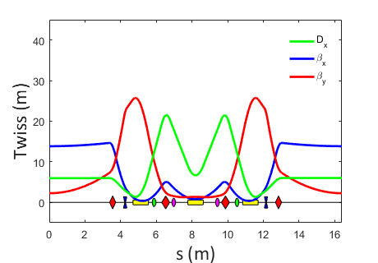
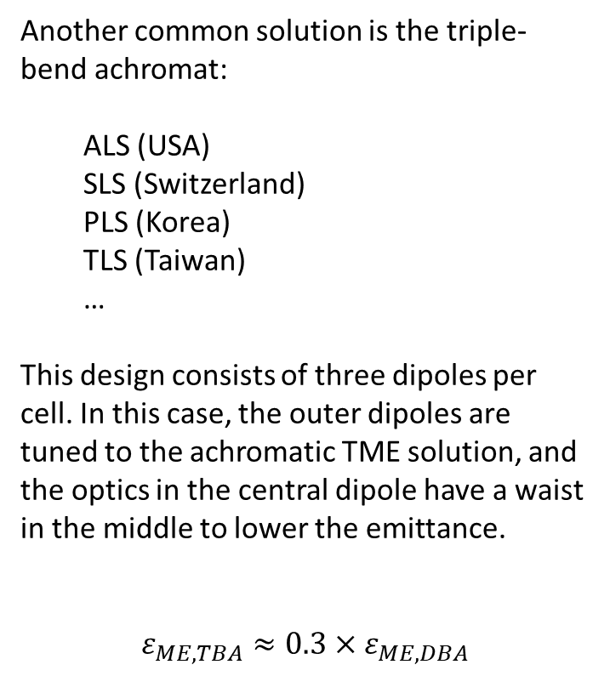
Triple Bend Achromat (TBA) cells
Another common solution is the triple-bend achromat:
ALS (USA)
SLS (Switzerland)
PLS (Korea)
TLS (Taiwan)
…
This design consists of three dipoles per cell. In this case, the outer dipoles are tuned to the achromatic TME solution, and the optics in the central dipole have a waist in the middle to lower the emittance.
$$ε_{ME,TBA}≈0.3×ε_{ME,DBA}$$
PLS
ALS

Slide 32
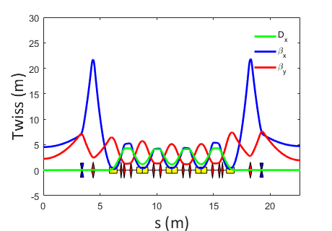
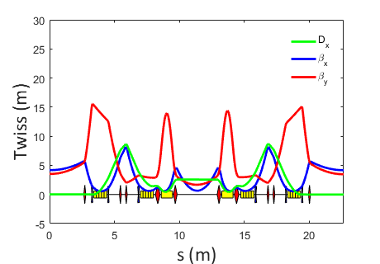
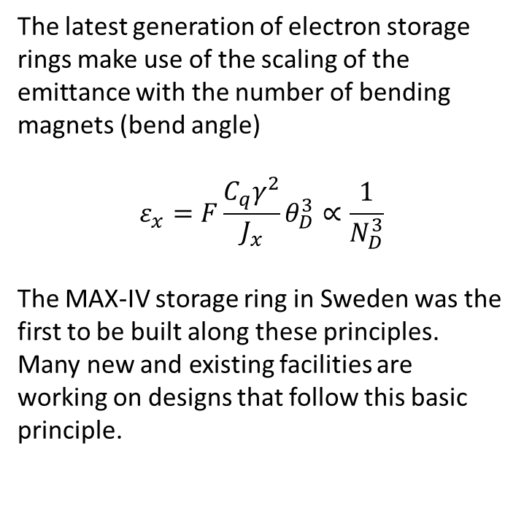
Multi Bend Achromat (MBA) cells
The latest generation of electron storage rings make use of the scaling of the emittance with the number of bending magnets (bend angle)
$$ε_{x}=F\frac{C_{q}γ^{2}}{J_{x}}θ_{D}^{3}∝\frac{1}{N_{D}^{3}}$$
The MAX-IV storage ring in Sweden was the first to be built along these principles. Many new and existing facilities are working on designs that follow this basic principle.
5BA
M-H6BA

Slide 33
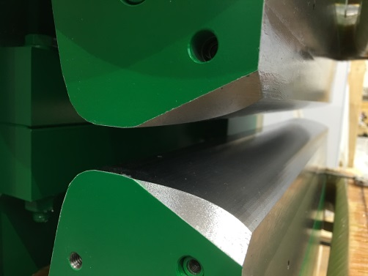
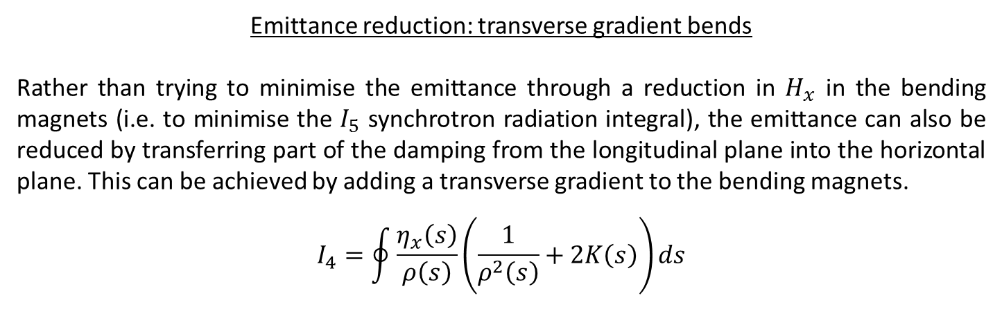
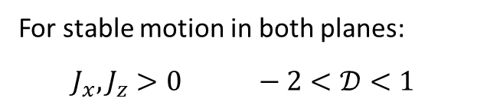
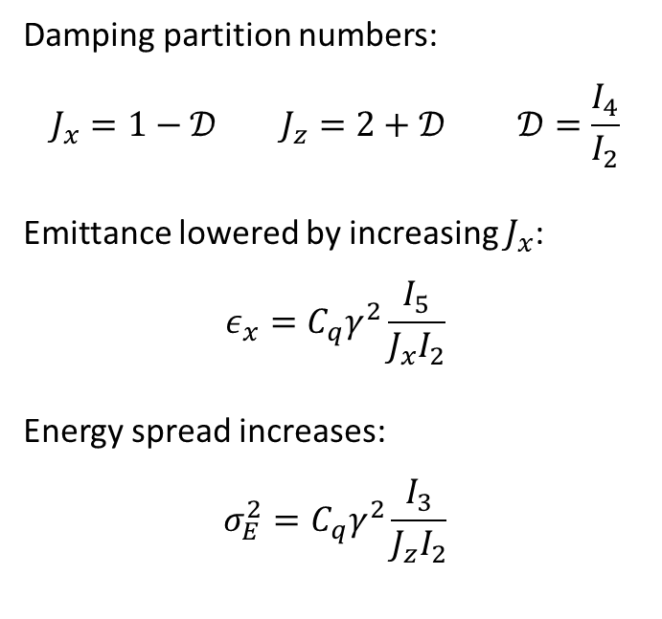
Emittance reduction: transverse gradient bends
Rather than trying to minimise the emittance through a reduction in $H_{x}$ in the bending magnets (i.e. to minimise the $I_{5}$ synchrotron radiation integral), the emittance can also be reduced by transferring part of the damping from the longitudinal plane into the horizontal plane. This can be achieved by adding a transverse gradient to the bending magnets.
$$I_{4}=\oint{\frac{η_{x}\left(s\right)}{ρ\left(s\right)}\left(\frac{1}{ρ^{2}\left(s\right)}+2K\left(s\right)\right)ds}$$
Damping partition numbers:
$$J_{x}=1−𝒟{ J}_{z}=2+𝒟 𝒟=\frac{I_{4}}{I_{2}}$$
Emittance lowered by increasing $J_{x}$:
$$ε_{x}=C_{q}γ^{2}\frac{I_{5}}{J_{x}I_{2}}$$
Energy spread increases:
$$σ_{E}^{2}=C_{q}γ^{2}\frac{I_{3}}{J_{z}I_{2}}$$
For stable motion in both planes:
$$J_{x},J_{z}>0 −2<𝒟<1$$

Slide 34
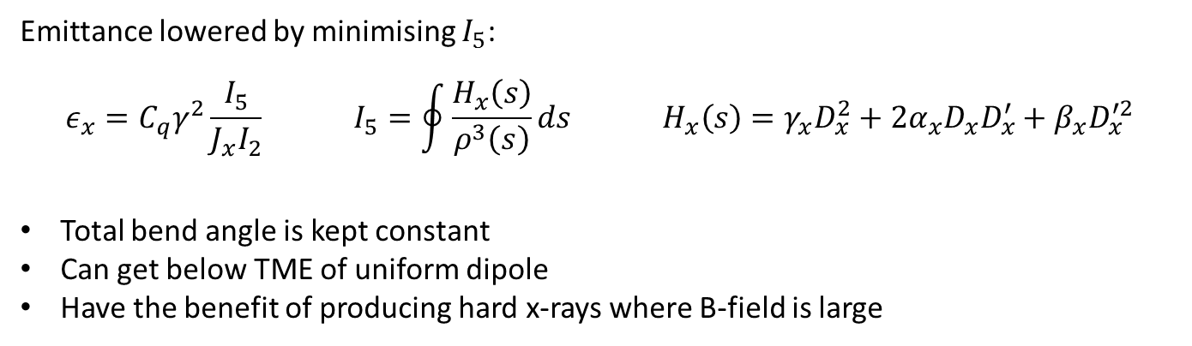
Emittance reduction: longitudinally-varying bends
Another way to reduce the emittance is by varying the B-field within the dipole, such that the deflection is maximised at the location where the dispersion is smallest
Emittance lowered by minimising $I_{5}$:
$$ε_{x}=C_{q}γ^{2}\frac{I_{5}}{J_{x}I_{2}} I_{5}=\oint{\frac{H_{x}\left(s\right)}{ρ^{3}\left(s\right)}ds} H_{x}\left(s\right)=γ_{x}D_{x}^{2}+2α_{x}D_{x}D_{x}^{′}+β_{x}D_{x}^{′2}$$
Total bend angle is kept constant
Can get below TME of uniform dipole
Have the benefit of producing hard x-rays where B-field is large

Slide 35
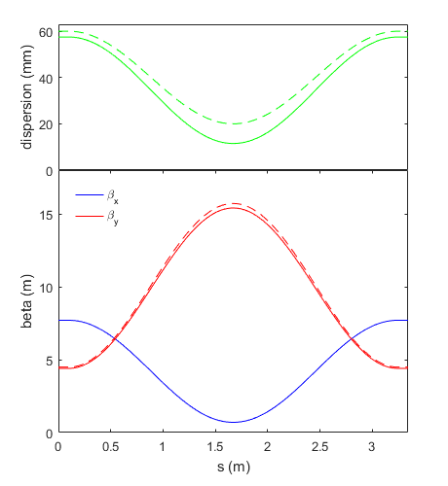
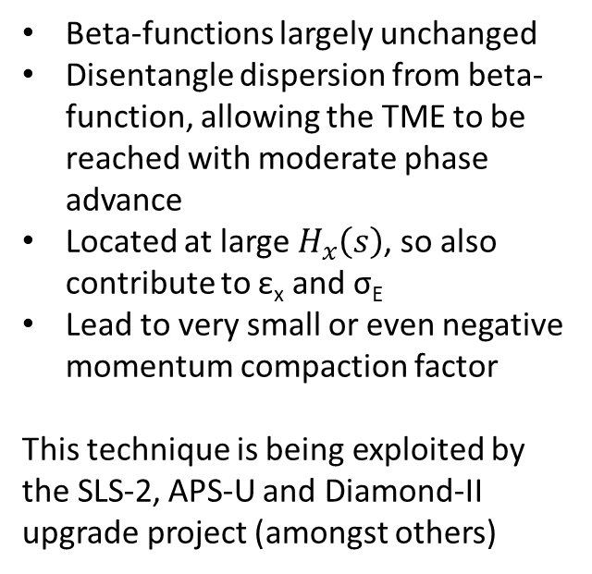
Emittance reduction: reverse bends
Rather than having all bending magnets deflect the beam in the same direction, some storage ring designs include weak dipoles of the opposite polarity. These provide an additional handle with which to control the dispersion function.
Beta-functions largely unchanged
Disentangle dispersion from beta-function, allowing the TME to be reached with moderate phase advance
Located at large $H_{x}\left(s\right)$, so also contribute to ε_{x} and σ_{E}
Lead to very small or even negative momentum compaction factor
This technique is being exploited by the SLS-2, APS-U and Diamond-II upgrade project (amongst others)
without RB
with RB
main bend
reverse bend

Slide 36
Summary
The emission of synchrotron radiation occurs in discrete quanta (photons), the emission time and energy of which are random and statistically independent
Emission of photons introduce a source of ‘noise’ in the electron energy and trajectory, causing the oscillation amplitudes to grow over time
When combined with the radiation damping, the quantum excitation process leads to an equilibrium distribution, defining a ‘natural’ emittance and energy spread and fixing the bunch lengths and (local) beam size around the ring
The excitation process leads to the loss of particles from the tails of the distribution over time via so-called quantum lifetime effects. However, this mechanism is relatively weak when compared with other lifetime effects
The emittance is a key parameter in the performance of a synchrotron light source. Great care is taken in the design of these machines in order to lower the emittance
The theoretical minimum emittance of a ring with uniform bending magnets scales with the square of the energy and the inverse cube of the number of bending magnets

Slide 37
References
[1] M. Sands, “The Physics of Electron Storage Rings: An Introduction”, SLAC-121, (1970)
[2] R. Walker, “Radiation Damping”, CERN Accelerator School, Finland, CERN 94-01, (1994)
[3] R. Walker, “Quantum Excitation and Equilibrium Beam Properties”, CERN Accelerator School, Finland, CERN 94-01, (1994)
[4] H. Weidemann, “Particle Accelerator Physics I”, Springer, (2003)
[5] A. Streun, “The anti-bend cell for ultralow emittance storage ring lattices”, Nuclear Inst. Meth. In Phys. Res. A, 737, p. 148-154, (2014)

