Slide 1
Proton Complex Monthly Meeting
20th Septemeber 2024

Slide 2
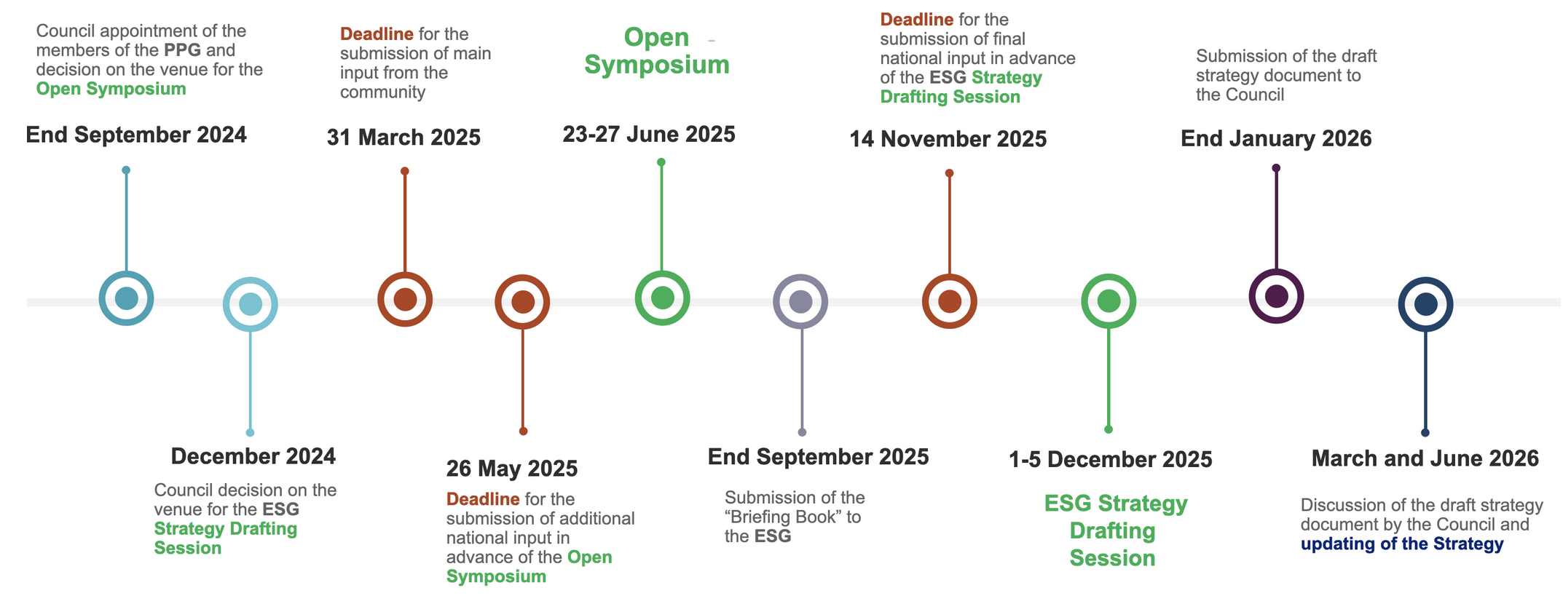
News from the Project
Tentative Parameters documents due October 1st.
  Overleaf available. Started September 1st
European Strategy roadmap

Slide 3
Missing work
A more critical look on chopping schemes for the linac and H- source capabilities.
RCS to energy increase from 5 GeV to 10 GeV
H- stripping estimation for injection in the accumulator ring (here we could already assume laser stripping will be the norm, I think)
A bit further work on the accumulator design/simulations (5 and 10 GeV)
Extraction line design/simulations for the accumulator- to-compressor and compressor-to-transfer line (5 and 10 GeV)
Recombination line before target for the 4MW/10 GeV case.
Check the complex for basic filed strengths, apertures, RF power/frequency etc feasibilities
Other designs for accumulator/compressor (Sofia)

Slide 4
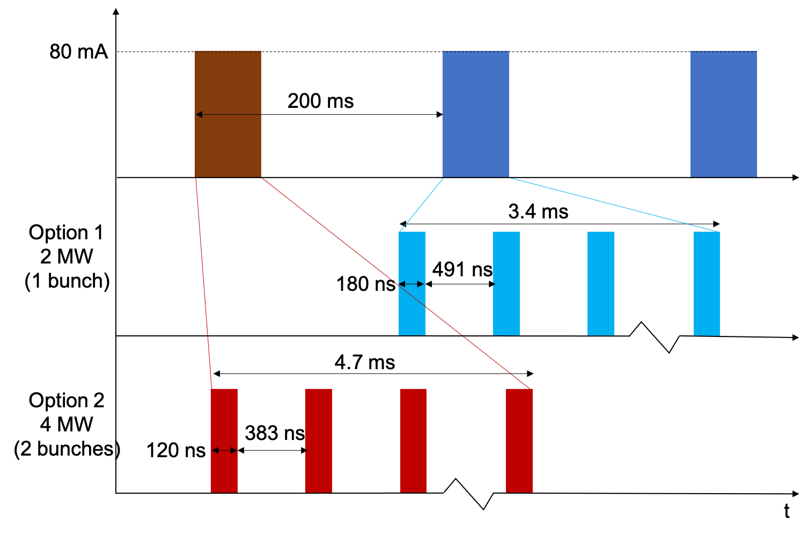
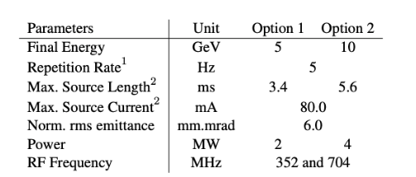
Current issues:
Linac scaled up to 10 GeV (might not be optimal)

Slide 5
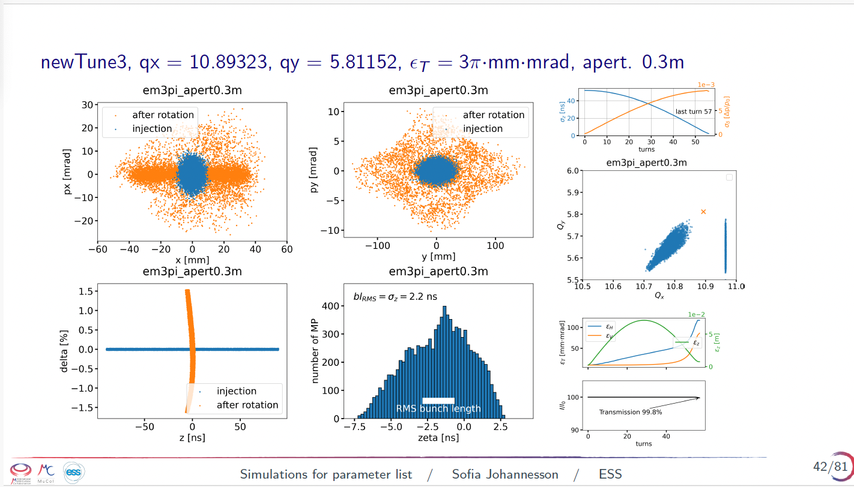
Current issues:
Energy spread from linac/accumulator has to be on the order of 2e-4 to achieve the 2 ns rms bunch length.
For the 5 GeV case we are seeing an instability for the 2MW/5GeV case that blows up the transverse sizes.
Looks like it is SC driven, gets better with high vertical tune, not a lot of improvement with high emittance.

Slide 6
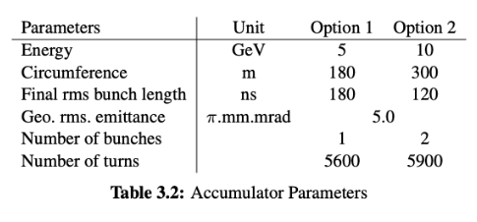
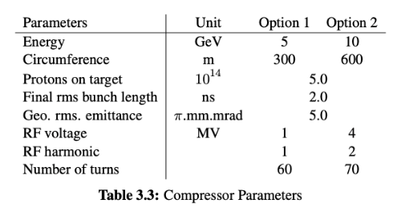
Current issues:

