Slide 1
IT Business Continuity and Disaster Recovery
Tim Bell
IT BC/DR Lead
06/03/2024

Slide 2

IT strategy 2022-2025
Includes as a provider,
Recognise operational risks
  Define IT-specific policies for disaster recovery and business continuity
Enable disaster recovery and business continuity
  Enable teams to apply disaster recovery and business continuity policies through dedicated resources, training and senior buy-in to mitigate risks
Establish security protocols
  Provide the structure to eNsure security policies are implemented with dedicated resources, training and follow-up to reduce associated risks and to preserve CERN’s research outputs, past and future
AS-IS
External
Assessment
Recognise operational risks
Today: IT disaster recovery and business continuity procedures are not adequate. Although failures are limited, the risk is significant to ongoing operations
‘We don’t have a proper disaster recovery and business continuity plan’
Full IT Strategy document

Slide 3
BC & DR lead role
Strategy & Executive Governance
Data & Architecture
Business Engagement
Innovation
Communications
Education & Outreach
Disaster Recovery & Business Continuity
Drives the development of the IT strategy, together with the IT Department Head, ensuring alignment to CERN’s objectives
Establishes and implements a governance framework, including setting out clear accountabilities across the department and ensuing governance forums are functioning effectively
Defines and monitors compliance against IT’s risk management strategy including response to legal threats, reputational damage and financial risk
CHANGES FROM AS-IS
Strategy & Executive Governance Lead
Creation of an IT Strategy to define the strategic direction of the department in supporting CERN’s overall mission
Implementation of effective governance mechanisms to drive decision making across the department
Communications Officer
Education & Outreach Lead
BC & DR Lead
Oversees all internal and external IT communications, ensuring its messaging is consistent and engaging
Promotes IT’s mission as well as ensuring all messages align to CERN’s values
Prepares detailed reports, press releases, and marketing materials where necessary
Creates internal communications protocols and initiatives to foster employee moral
Approves written communications and updates related to service release and change management
Fosters education and training on physics and fundamental research across universities and schools
Develops a 5 year strategy for Education, including training a future generation of researchers with initiatives such as the School of Computing and CERN openlab Summer Student Programme
Improves CERN’s societal impact through the design and delivery of education and outreach programmes
Develops, maintains and organises testing of CERN IT’s Business Continuity and Disaster Recovery approach
Supports business planning activities to enable CERN to manage crisis events before they happen and ensure technical capability areas implement defined policies
Oversees the development and implementation of IT risk management policies and plans
IMPACT
Clarity on IT’s vision, mission and objectives, promoting increased collaboration and alignment
Improved decision making and oversight of department performance
Improved planning and management of educational programs, with higher measurability of societal impact
From IT operating model

Slide 4
Governance Bodies in the Project/Service lifecycle
Project Initiation
Development
Operation
Project Portfolio Review
Oversees the resources, costs, and progress of ongoing projects
C5
Problem and Incident Management
Engagement Channels:
ATS, FHR, RCS
User & business development needs from Org. sectors
Strategic Technical Delivery Forum
Technical enhancements for service delivery
Innovation Review Board
Proposals & requirements from innovation activities
Architecture Review Board
Change and Release Management Board
Operations Review Board
Department Head Office
Drives the departments strategy and oversight
Ideation meetings
Endorse proposed implementation
Decide on service changes/deployment plans
Advise service operations
Demand Management Review Board
Review objectives against department strategy
Assign resources
IT Steering Committee
Reviews the progress of the IT department against objectives.

Slide 5
CERN Enterprise Risk Management
CERN Enterprise Risk Management has high level risk register
  Combines Impact (minor to catastrophic) and Likelihood (rare to frequent) to rank risks
Among the top risks from IT department (2023 rankings):
Risk | Impact | Likelihood
Major infrastructure incident such as fire or flood resulting in substantial loss of computing capacity or data | Catastrophic | Rare
Cyber attack such as compromised accounts leading to data loss, corruption, theft, and the potential inability to perform important function | Catastrophic | Rare
Failure of an important supply or services contract such as company goes bankrupt | Catastrophic | Possible
Human error or malicious actions leading to loss of data and IT services | Catastrophic | Possible
.....

Slide 6
CERN Crisis Team (policy)
The aim of the CERN Crisis Management Framework is to assure the most effective response possible to any crisis of significance affecting CERN. The Crisis Management framework focuses on serious, large scale or high impact incidents where a strategic response is required, and details the people and processes required to manage a crisis affecting CERN
Management will focus on four priorities:
  People - Maintaining the health, safety and well-being of CERN personnel, contractors, visitors, local communities, and members of the public on CERN sites.
  Environment – Preventing harm or damage to the environment on the CERN sites and in the surrounding area.
  Operations – Preventing, minimising, or mitigating the impact on CERN’s activities.
  Reputation – Maintaining the integrity of CERN’s image towards internal and external stakeholders.
5 activations since 2013 - example would be the building 212 fire in 2019
Annual tests with a simulated crisis performed and documented

Slide 7
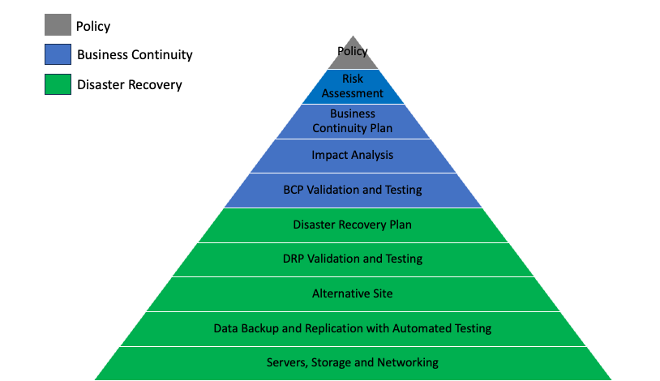
IT BC/DR Policy
There is currently no organisation wide policy for BC/DR
The IT department now has a policy approved by the IT department head office in October 2023 including
  The department should define relevant continuity and recovery planning connected to CERN risk and crisis processes.
  All continuity and recovery plans should cover essential and critical infrastructure elements, systems and networks, in accordance with key business activities.
  The plans should be reviewed and tested periodically to ensure that it can be implemented in emergency situations and that the management and staff understand how it is to be executed.
  All staff must be made aware of the plans and their own respective roles.
  The continuity and recovery plans are to be kept up to date, taking into account changing circumstances.
  No goal for Certification but can use criteria for inspiration
Latest version is here
Notes:
Basic concepts explained for policy, business continuity and disaster recovery to set the picture for the activities in the IT department and the organisation

Slide 8
Business Continuity
Risk assessment to understand what could go wrong and how likely it would be to happen
Impact Analysis to understand the damage to the organisation of a process not being able to be performed and which components are needed for a process to be executed
Business Continuity Plan needs to understand how to limit the damage via mitigations, alternative processes and communications. Latest is here.
BCP Validation and Testing is to simulate the high impact scenario and ensure the BCP is able to function at the capacity that is needed
Business Continuity is an organisation wide analysis. In the case of IT services being non-functional, this will often involve the business partners applying manual processes and interfacing with the CERN wide Enterprise Risk Management and Crisis Teams.
Prepare
Disaster Event
Respond
Recover

Slide 9
Disaster Recovery
In the event of a significant incident with an IT service or services, disaster recovery processes return the service to its prior status (with potential downtime and loss of data)
Depending on the incident, it may involve invoking the recovery for a small set of applications or for an entire site
Different scenarios will require different recovery plans e.g. corruption of a database with a delayed replica and ransom-ware attack would require two distinct actions
Planning should cover unavailability of staff, offices or computing facilities
The only way to validate a disaster recovery plan is by testing such as checking restores of backups, failovers of an application to an alternative site and full disconnect test. Template is here.

Slide 10
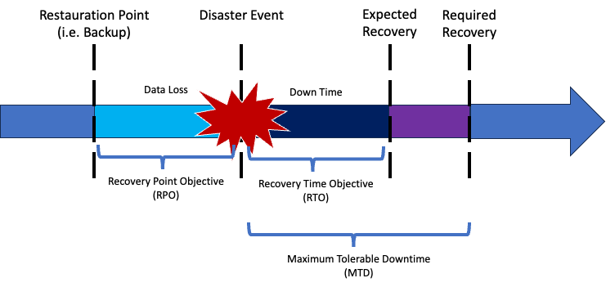
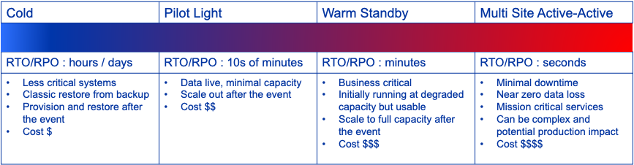
Service levels
Service levels as regards BC/DR need to be agreed with the business partners on 3 key metrics
  Recovery Point Objective is how much data is lost e.g. losing all of today’s bookings because the hostel software is backed up during the night
  Recovery Time Objective is how long does it take to get the service running fully again – business continuity mitigations are needed in the meanwhile
  Maximum Tolerable Downtime indicates the point where there would be significant harm to the organization's mission
The desired RPO/RTO/MTD for the business partner is derived from Business Impact Analysis
The target RPO/RTO is part of the architecture for the IT service
The actual RTO is obtained by testing
If the desired and actual are incompatible, a project would be needed to improve the actual or a risk acceptance by the business partner
Notes:
RPO means lost data, RTO means lost availability, MTD means the organization is at risk.
Through Engagement, we need to have this discussion with the business partners. Currently, significant differences between expactations and deliverable.

Slide 11
Business Continuity Management gives trigger criteria
For each business process, define the mitigations (i.e. workarounds) should there be an incident
Over time, things get worse until there is significant damage to the organisation
Analysis started in November with Finance and Human Resources, aim to expand this analysis during 2024/2025
Going Amber is the proposed trigger for the IT BCP to be invoked

Slide 12
Business Impact Analysis
Identify key processes
Interviews with Business
Define impact if process not performed
Financial, Reputation, Scientific Program
Identify business applications needed
Enterprise Architecture
Derive IT service elements needed
Define supporting IT service elements
Iterate on SE dependencies
Enterprise Architecture
Calculate recovery objectives for an SE
Enterprise Architecture
Service Catalog
Enterprise Architecture
Business mitigations not included
  e.g. pay the same salaries as last month
Highlights inappropriate service selection
  e.g. What does access control need ?
Subset of data so far (Finance, HR, HSE)
  Likely to be the most critical
Many high impact applications are not even run by the IT department
Metric | Count
# Business Functions | 46
# Business Applications | 231
# IT Service Elements | 118
# IT SE SE Dependencies | 818

Slide 13
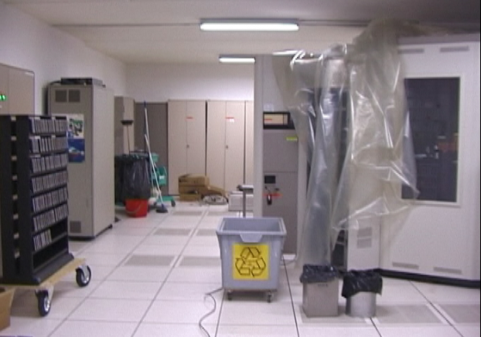
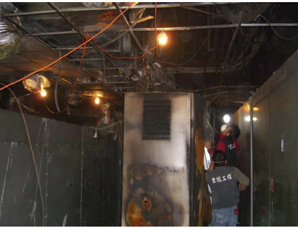
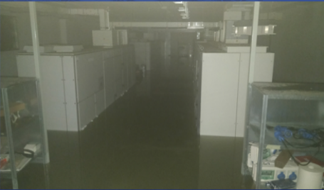
Incidents : some High Energy Physics examples
Incident | When | Site | Details
Tapes ‘dampened’ due to plumbing mistake | 2004 | CERN | HEPiX
Tree cuts all power | 2005 | SLAC | HEPiX
Power outage | 2006 | CERN | Report
EDH down for 3 days due to RAID failure | 2007 | CERN | HEPiX
UPS Fire | 2009 | ASGC/Sineca | Details
20,000 tape files unintentionally deleted | 2010 | CERN | Details
Site wide power outage | 2010 | SLAC | HEPiX
Power outage | 2014 | CERN | Details
Flood of computer centre | 2018 | INFN | CHEP
Power outage during power test | 2021 | CERN | ASDF

Slide 14
BC/DR is not only about Fire and Planes
Scenarios are evaluated based on past significant incidents. Most likely are
  Human error operating an IT system
  Deployment of an application or system with incorrect logic (including software automation)
  Component failure (hardware or software)
Largest impacts are related to significant multi-service outages with long recovery times
  Ransomware
  Significant infrastructure damage (power, cooling, plumbing)
Effort invested in BC/DR can help outside the BCP trigger events
  Mitigations (‘How do I post an SSB if SSO is down’)
  Resilience (‘Are my backups all good in case a user needs files back’)
  Availability (‘Switch to a read-only clone instance while I do the lengthy production schema upgrades’)
  Sharing (‘How do we operate a service when the service manager is on holiday’)
  Flexibility (‘How would we work if the heatwave action plan is invoked’)
  Channels (‘How to communicate with users if outages occur’)

Slide 15
IT Trigger Event Workflow
Scenarios may come from multiple sources
An IT Significant Incident e.g. power loss in B5 may need to be raised to IT management but not a BCP trigger
IT problems may be elevated to CERN Crisis according to their criteria
  e.g. legal, reputation
IT major problems may also be limited in scope to a single service
  May impact others though
CERN Crisis
Management Team
IT Significant Incident Team
Grapevine (MM, corridor chat, …)
CERN Wide Crisis ?
Via TI operator
IT Crisis Silver Team
BCP Trigger?
Standard Recovery?
Invoke IT BCP Trigger for the DBCT activation
Handle Incident With Usual Technical Delivery Procedures

Slide 16




COBIT Maturity Scale and Assessment
Level |  | Description | DR Summary (IT department average)
0 |  | Incomplete process | No testing No service resilience description
1 |  | Performed process | Ad-hoc testing (such as ticket handling) No recovery objectives, no DR plan
2 |  | Repeatable but Intuitive | Full application cold recovery tested Recovery architecture defined (cold to active-active) Estimated recovery times shared with business partners
3 |  | Established process | Manually test recovery architecture Actual recovery times included in service description DR plan documented and published
4 |  | Predictable process | Initiatives to close gap between actual and desired recovery objectives agreed or mitigations by business partners Recoverability compliant with policy
5 |  | Optimising process | DR testing integrated with regular operational procedures Desired and actual recovery objectives consistent

Slide 17
How BC/DR fits into the IT department services
Enterprise Architecture
BC Policy
Enterprise Architecture defines processes, teams, applications and how computing systems at CERN connect together
Business Impact Analysis determines effect on the organisation of outages
Service Levels define the commitment to recovery objectives to support the mitigations by the business units
Business Impact Analysis
BC Plan
BC Mitigations
DR Plan
2023 As-Is Assessment
DR Plan
DR Plan
2024 As-Is Assessment
DR Plan
DR Plans & Tests
Service Level Definition

Slide 18
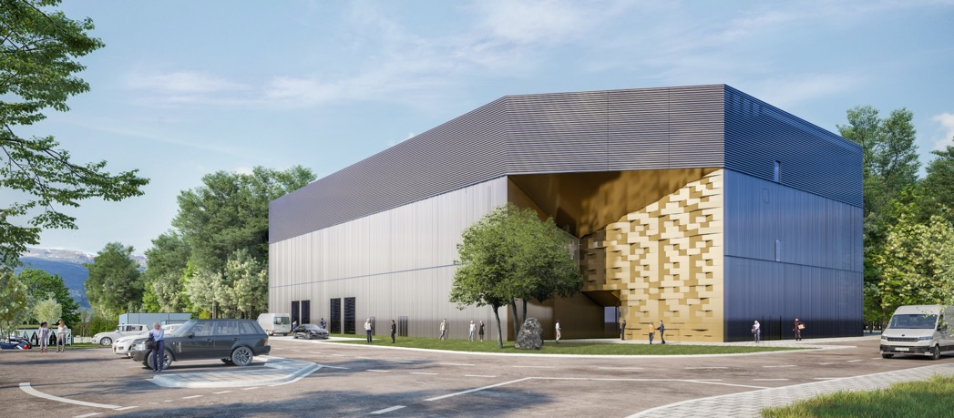
Disaster Recovery to Prevessin Data Centre
Intended for capacity for desired RTO <= 1 day
  Environment
  Safety
  Access control
  Short term financial transactions
  Material damage avoidance
  Services for rapid recovery (e.g. server administration, source code)
Orders placed for 1.8 MCHF, delivery in Q4 2023
  9200 cores, 19 PB (raw) covers the expected capacity above
Install in Q1 2024 with aim to be ready for testing Q2 2024
  Most applications can be tested in Meyrin Data Centre if ready
Suitable for Active-Active and Warm Standby recovery approaches as well as Cold
  And may help in non-’Disaster’ scenarios also e.g. switch read-only during upgrades, integration testing

Slide 19
Disaster Recovery to Public Cloud
Intended for capacity for RTO > 1 day (since <= 1 day covered by PDC)
  Not financially viable to have significant resources under-utilised in the PDC for longer recovery time use cases
  Excluding physics compute and storage (use other grid sites is a better mitigation)
  Only relevant if the outage is a multi-service, multi-day scenario
  Approximate capacity needed is 120K cores, 5PB storage
Proposal (as discussed with CERN Procurement)
  Use of “Accelerated Procedure for Emergency Contracts” (CERN Financial Rules 11.3)
  Full approval within 4-6 days from CERN Finance Committee
  Recovery could start immediately within the price enquiry liimits and usage will ramp up
  Expenditure is O(500K CHF/month) until cause resolved and a 250K CHF one off charge for egress to repatriate the data
Testing capacity will come out of cloud contracts O(5K-10K CHF/month)

Slide 20
Next steps
Socialise the establishment of a Business Continuity Network at CERN
  Not an IT-only problem and many domain specific standards
  Business impact analysis needed for the whole organisation (not an IT-only problem)
  Recent CERN Business Continuity Management System audit is likely to ‘encourage’ this approach
Assess IT’s operational resilience
  Evaluation of current building blocks and investment in appropriate layers to reduce effort
  Embed BC/DR into IT’s service lifecycle via architecture and change/release boards
  Iterate the desired and actual recovery objectives with the user community and define mitigations
  Formalising Service Levels without cross charging / uplift remains a problem
Prepare for DR implementation
  Further information gathering and architecture improvements from the IT department
  Prepare fast recovery infrastructure in the Prevessin Data Centre
  Training material and building blocks for service managers

Slide 21
Hurdles to be overcome
BC/DR standard practise is very oriented towards commercial organisations
  A pre-prepared consultancy approach does not work well
An organisation wide Business Continuity approach is difficult when departments are independent and there is no CIO
  And BC/DR has often not been a priority compared to capability / capacity
  No financial incentives e.g. reduced insurance if mature
  Recent CERN audit may ‘encourage’ this approach
CERN computing services are often not managed by the IT department
  A lot of build-your-own applications which may not have selected the right IT service
  CERN IT could do better to clearly show the resilience of its services
The engineers delivering the IT services are busy
  And Disaster Recovery testing is competing with Quantum, Machine Learning and Kubernetes
  Single expert risk is significant and short term contracts goals do not always include documentation…

Slide 22
Questions?

Slide 23
Backup Slides

Slide 24

BC & DR Team in IT-GOV
BC & DR Team
Develops, maintains and organises testing of CERN IT’s Business Continuity and Disaster Recovery approach
Supports business planning activities to enable CERN to manage crisis events before they happen and ensure technical capability areas implement defined policies
Oversees the development and implementation of IT risk management policies and plans
Tim Bell
From IT operating model
Others involved in Risk/BC/DR such as Wayne Salter and Stefan Lueders

Slide 25

Business Continuity Plan (Link)
The Business Continuity Plan (BCP) defines the “How” for the IT department and is expected to be a dynamic document
  Prepare (“Actions to reduce the length of an outage”)
  Respond (“Steps to perform during the incident to reduce impact”)
  Recover (“How to return to business as usual”)
Roles with responsibilities listed such as
  Department Business Continuity Co-ordinator (DBCC i.e. Tim)
  IT Crisis Silver Team
  Department Business Continuity Team (DBCT)
    Members DBCC, TD GLs, Silver Team …
  IT Service Managers to prepare with a disaster recovery plan
Prepare
Disaster Event
Respond
Recover
Notes:
Will schedule an IT-SC talk on the details of the DBCT and needed actions

Slide 26
Using the new operating model to deliver BC/DR (I)
With Engagement,
  Establish common goals with the sectors on BC/DR (already started with ATS, FHR needed too)
  Perform impact analysis with business partners to define service criticality
  Establish service levels with desired and actual RTO/RPO
    Demand management review board needed where significant effort required (and there will be)
With the Project office,
  Establish a resource plan and milestones with aim of a testable BC/DR plan for critical processes and IT services, identify additional technical resources needed if building blocks not sufficient
  Budget planning for people and infrastructure, both regular needs and disaster scenarios
With Resource management and Technical delivery,
  Identify IT department critical processes and mitigations in the event of system failures for IT Business Continuity
  Analyse Monthly operations review major incidents for risks, impact and mitigation
    DR processes can be used to reduce planned downtime impact such as pro-active failover and read-only replicas
  Plan DR process implementation and testing through the Disaster Recovery Operations in IT team (DROIT)

Slide 27
Using the new operating model to deliver BC/DR (II)
With Architecture, Demand management and Change/Release boards
  Define criteria for assessment of operational resilience
  Best practices defined for backup/restore, resource placement and DR testing
  Reference industry standard DR architecture patterns for service managers
  Implement the critical improvements for the highest risks within the IT budget
AWS
Cold | Pilot Light | Warm Standby | Multi Site Active-Active
RTO/RPO : hours / days | RTO/RPO : 10s of minutes | RTO/RPO : minutes | RTO/RPO : seconds
Less critical systems Classic restore from backup Provision and restore after the event Cost $ | Data live, minimal capacity Scale out after the event Cost $$ | Business critical Initially running at degraded capacity but usable Scale to full capacity after the event Cost $$$ | Minimal downtime Near zero data loss Mission critical services Can be complex and potential production impact Cost $$$$

Slide 28
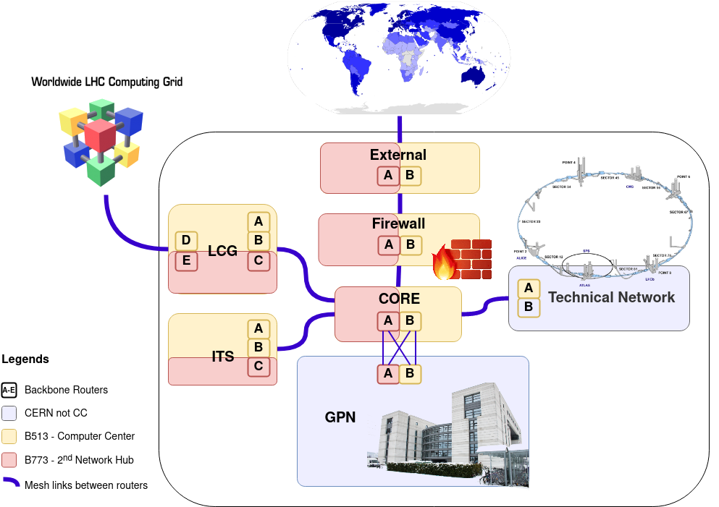
Example: IT/CS’s 2nd network hub tests
Building 773 provides geographic network redundancy build on backbone components of the network, those connecting only routers.
Comprehensive test plan with documented results, monitoring validation, capacity and service impacts for
  Single router failure
  Site router failure
  B773 full site failure
  (Not performed due to service impact) B513 full site failure
ASDF

Slide 29
But won’t the PDC solve DR for me ?
Prevessin Data Centre is scheduled for 2H 2023
  Providing a low latency near-but-no-too-near computer centre (~4 km)
It is planned to provide some infrastructure to support disaster recovery, such as
  VM instances for services (instances in PDC and in Building 513 for active/active)
  Block/File share storage (in addition to the Object stores/NetApp in the 2nd network hub)
However
Services need to study best approach (from cold to active/active), implement and test failover
  Focus on high impact services for CERN with short required RTO (e.g. authentication, safety, access, communications, finance)
  Resource pools may be different depending on the approach (e.g. public cloud may be affordable for cold, active/active in the PDC will not be affordable for all services)
BC/DR procedures also needed where we lose some of the PDC or a SaaS service
DR is not cheap out of the box but disasters cost much more (even the small ones)
Notes:
Budget is a critical item – cold is cheaper but may not meet the RTO. More cold recoveries stresses the archives

Slide 30
DR timeline
DR for IT needs effort from each and every service experts
  DR should be part of the service manager responsibilities by default
Goal will be to establish common building blocks where possible
  e.g. Cloud regions, Storage replication, Database redundancy, Active Directory forests, …
When | What | Who
2H 2023 | Assess as-is situation and perform first maturity analysis | BC/DR Team
1H/2H 2024 | Perform cold recovery testing and determine actual recovery objectives | All Service Managers
1H 2025 | Review mitigation plans with business partners based on the actual recovery times | IT Engagement Channels
2H 2025 | Define disaster recovery plans | Auth, Safety, Access, Communications, Financials

Slide 31
Enterprise Risk Management
DG approved the Enterprise Risk Management policy in 2020 (EDMS)
  “To maintain its position as a leading scientific research centre, and as an exemplary and responsible Organization, CERN must manage the risk associated with its activities. This includes caring for the health and safety of people, the operational efficiency of its installations, and the protection of the environment. In addition, CERN must constantly adapt and strengthen its resilience to adverse circumstances. Enterprise Risk Management (ERM) facilitates decision-making, establishes accountability, and helps CERN to remain an operationally effective Organization.”
ERM Advisory Committee (ERMAC) established: advises the Director-General on matters relating to the top-level risks for the Organization and on the effectiveness of the risk framework in place. ERMAC helps to ensure that the top-level risks are identified and that controls are in place to mitigate them at the required level.
Risk register contains high level risk descriptions and mitigations, some sample IT ones:
  Cyber Attack
  Dependence on unaffordable commercial products and services
  Failure of important supply or service contract,
  …

Slide 32
Risk analysis scoring
Top IT risks are included in the ERM
However, many IT risks are lower than MINOR (e.g. <10M CHF loss) and thus further study to include a granularity for IT ‘minor’ risks is needed
  e.g. printer server down means no contractor orders can be executed

Slide 33
CobiT maturity model
Level | Summary | Description
0 | Incomplete process | The process is not placed or it cannot reach its objective. At this level the process has no objective to achieve. For this reason this level has no attribute.
1 | Performed process | Performed process. The process is in place and achieves its own purpose. This level has only “Process Performance” as process attribute.
2 | Repeatable but intuitive | The process is implemented following a series of activities such as planning, monitoring and adjusting activities. The outcomes are established, controlled and maintained. This level has “Performance Management” and “Work Product Management” as process attributes
3 | Established process | The previous level is now implemented following a defined process that allows the achievement of the process outcomes. This level has “Process Definition” and “Process Deployment” as process attributes.
4 | Predictable process | This level implements processes within a defined boundary that allows the achievement of the processes outcomes. This level has “Process Management” and “Process Control” as process attributes.
5 | Optimising process | This level implements processes in the way that makes it possible to achieve relevant, current and projected business goals. This level has “Process Innovation” and “Process Optimisation” as process attributes.

Slide 34
Business Continuity Management gives trigger criteria
For each business process, define the mitigations (i.e. workarounds) should there be an incident
Over time, things get worse until there is significant damage to the organisation
Analysis started in November with FHR and KPMG consultancy, aim to use same methodology with ATS, HSE and RCS
Going Amber is the proposed trigger for the IT BCP to be invoked

Slide 35
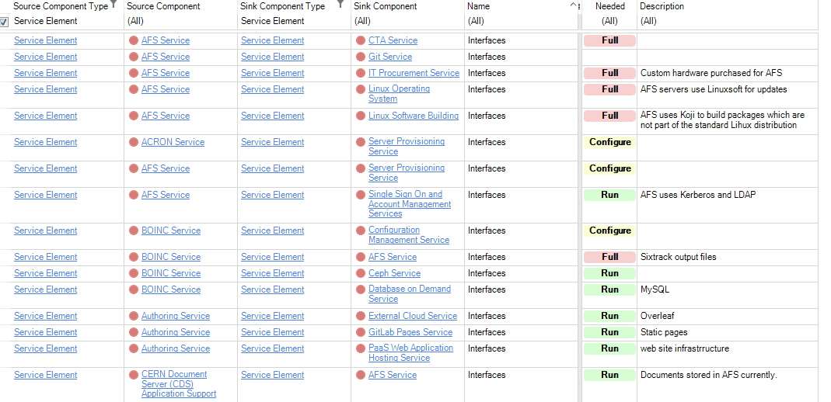
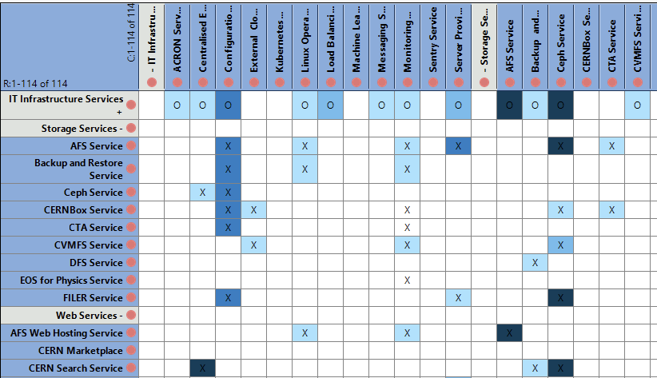
Dependencies using Enterprise Architecture (I)
The IT Service Element dependency data is in the Abacus production model
  Including the importance of the dependency from needing for running (e.g. a database) to full (e.g. monitoring), this is color coded in the matrices and additional descriptions
  Sample data on the Indico page
  Collected from many sources such as review boards, presentations and C5

Slide 36
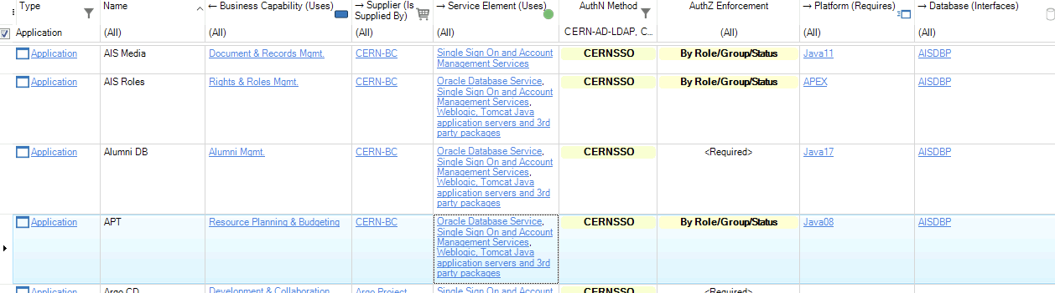
Dependencies (II)
Now linked the FAP-BC applications to the associated service elements (e.g. SSO, Oracle, Database on Demand, Tomcat, Pentaho, …)
  Support from FHR-IT and ATS-IT Steering Committees to form Enterprise Architecture Forum
  FHR done, adding Accelerator Sector in H1 2024

Slide 37
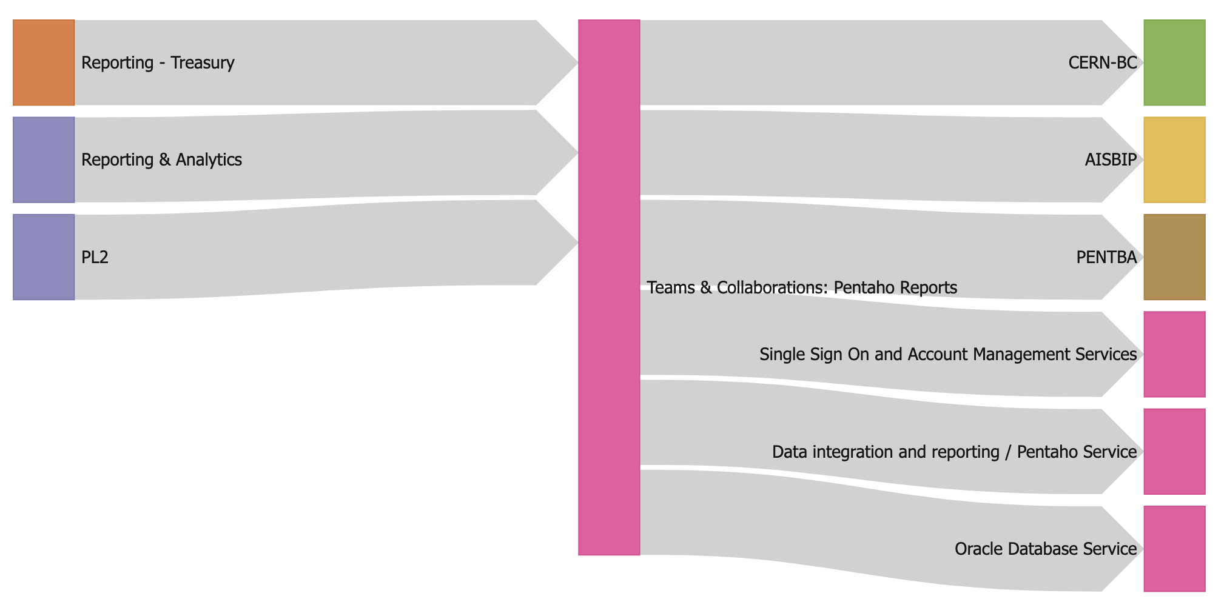
Dependencies (III)
With the dependency data in, the chain from Product to Applications to IT Services/Databases can be visualised (such as from the web interface)

Slide 38
Mini Business Impact Analysis (Link)
Identify key processes
Interviews with Business
Define impact if process not performed
Financial, Reputation, Scientific Program
Identify business applications needed
Enterprise Architecture
Derive IT service elements needed
Define supporting IT service elements
Iterate on SE dependencies
Enterprise Architecture
Calculate recovery objectives for an SE
Enterprise Architecture
Service Catalog
Enterprise Architecture
IT-DA desired objectives are here.
Performed without interviews
  Happy to adjust if I’ve misjudged
Business mitigations not included
Ignores inappropriate service selection
  e.g. Access control needs EOS Web
Subset of data so far (FHR, ATS, HSE)
  Should also do this for RCS/IT processes
Highest impact are often not IT applications
  SAILOR, NEDAP. REMUS, CSAM, RAISIN, WinCC, …
Metric | Count
# Business Functions | 46
# Business Applications | 231
# IT Service Elements | 118
# IT SE SE Dependencies | 818

Slide 39
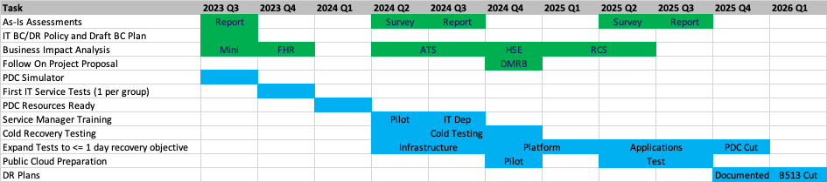
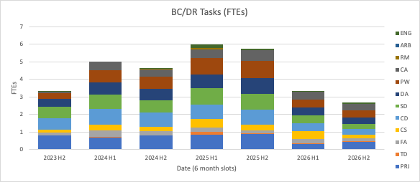
Work Plan to achieve Silver (COBIT 4) (Sheet Schedule)
IT PoW 2023 feel commitment too high
Resources needed are, generally, expert service managers with knowledge of how services are installed and configured
Current maturity limits options to delegate to more junior staff
FTEs does not include linked activities such as Enterprise Architecture, Service Levels or Business Partner effort

Slide 40
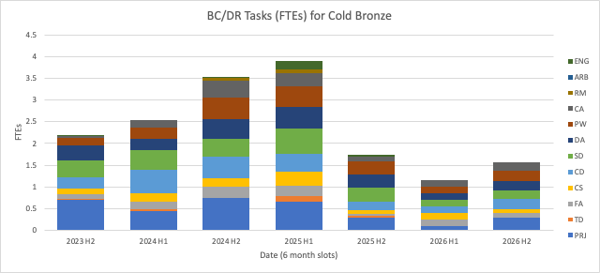
Cold Bronze Work Plan (with major BP mitigations)
Prepare and respond steps as for Silver (i.e. Business Continuity part remains the same)
Investment in Recover steps reduced at the expense of recovery time and major mitigations by user community
  Unavailability may be mitigated but data loss is permanent
  Cold recovery procedures defined, tested and documented (Expert STAF mainly needed – FELL resources would continue work on building blocks). Business partners informed to plan mitigations accordingly – dRTO will be much shorter than aRTO
  Bi-annual cold testing, no active-active or warm standby in the short term i.e. many aRTOs will be multi-days/weeks, but carry on the FELL work
No multi-service outage scenarios to be tested soon (but lower likelihood) – risk acceptance needed
  No planned public cloud recovery testing, no disconnect testing before at least 2028 (end LS3) or 2033 (start LS4)
Agreed at IT PoW 2023 for planning

Slide 41
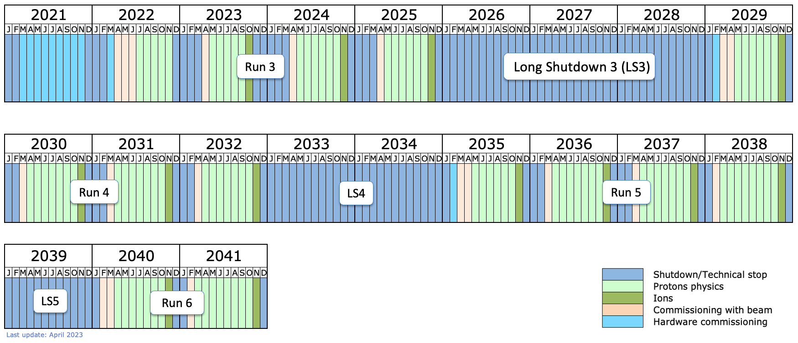
https://lhc-commissioning.web.cern.ch/schedule/LHC-long-term.htm

Slide 42
Standards
There is currently not an agreement to use any specific standards at CERN but these are the ones that have been raised in discussions. The current position is that it is unlikely to be affordable to comply with the entirety of these standards or ensure appropriate certification/actions in a timely manner. However, these can potentially be used as inspiration for some directions to be taken for an organization such as CERN.
Standard | Description
ISO 31000 | Risk Management
ISO 22301 | Business Continuity
ISO 27001 | Disaster Recovery

