Slide 1
Discussion on Tracking Technology
2nd FCC Italy & France Workshop
Venezia, 4-6 November 2024

Slide 2
Detector layouts

Slide 3
Detector layout optimizations
A clear area for common work is simulation of detector performance
  generic detector geometries
    radial (barrel) and z (endcap) location
    curved or stave-base geometry for inner vertex
    number of layers
    ...
  parametric detector parameters
    pitch size
    depletion depth
    dE/dx performance
    timing resolution
    ...
But also open mechanical issues
Need also background simulation
"generic" digitizer?

Slide 4
Topics to study
Minimal radius of the vertex detector
  hit rate background dominated
  define bandwidth/power consumption
  may triggering on the Z or on-detector clusterization reduce service requirements?
Intermediate silicon layers
  low pT particle acceptance and identification
  forward tracking performance
Inner radius of the drift chamber
  performance background-dominated?
  acceptance for particle ID

Slide 5
Topics to study
Si-wrapper layout
  mechanical structure
  cooling distribution
  how it is supported to guarantee alignment stability
Module size
  CMOS reticle size ~2x3 cm2
  Better module modularity: assume n×m cells (?) optimize per region and radial position (especially in the endcaps)
  stitching and overlaps
Particle ID
  Acceptance of drift chamber for particle ID
  Can the loss of hits in the forward regions be compensated by silicon measurements:
    dE/dx by pulse height measurement in silicon layers
    timing is fashionable, but is it really needed and where?
Inner radius of the drift chamber
  performance background-dominated?
  acceptance for particle ID

Slide 6
Topics to study
Others?

Slide 7
technology developments

Slide 8
Silicon for Tracking
Depleted MAPS
  Two technologies presented today
    TPSCo 65 nm
    ARCADIA LFoundry 100 nm
    Platforms available through DRD7.6
  Others are on the market (HVCMOS 180 nm and 55 nm...)
  Is it important to keep more options open?
  compromise: resources ↔ opportunities
Some technologies will also develop timing capabilities
  LGAD and RSD will be discussed in the PID session

Slide 9
Silicon for Tracking
TPSCo 65nm
  strong drive from the ALICE upgrades
  communities both in Italy and France
  can be the seed for a common FCCee development
  which detector area to target:
  inner vertex, outer vertex, wrapper
ARCADIA
  mostly INFN developer team, open to international involvement
  sensor technology demonstrate and scalable
  may also target some shorter-term experiments, before FCCee
  which detector area to target:
  inner vertex, outer vertex, wrapper

Slide 10
DMAPS Feature Development
Features | Earlier experiments | FCC inner vertex | FCC outer vertex | FCC wrapper
10 um pitch
"effective" 10 um pitch with charge sharing
20 ns time-stamping
30 ps time resolution
Serial powering capability
Chip-to-chip data transmission
10 mW/cm2 power
50 mW/cm2 power
100 mW/cm2 power
Extreme stitching (20 cm size sensors)
Moderate stitching (4 cm size sensors)

Slide 11
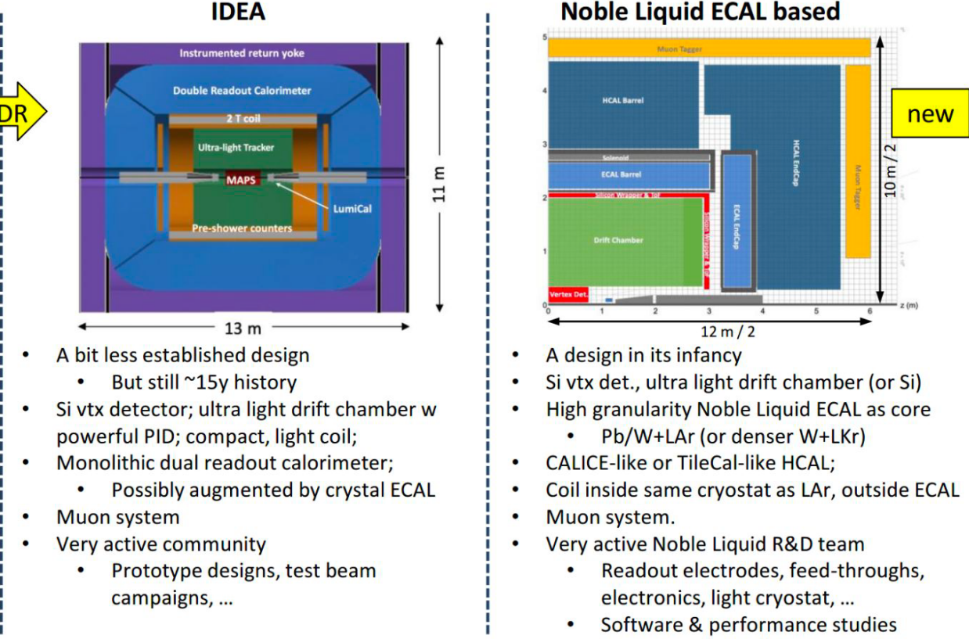
Central Gas Tracker
IDEA and ALLEGRO communities share the Drift Chamber concept
Which are possible synergies or work sharing?

Slide 12
backup

