Slide 1



FCC FRANCE & ITALY 2nd workshop, Venice, 4 - 6 November 2024
Summary VD and PiD detectors for FCC-ee
based on A. Andrezza, G. Boudoul, T. Papaevangelou,
E. Robuti, M. Rolo, S. Senyukov, D. Contardo/P. Schwemling
D. Contardo (IP2I)

Slide 2
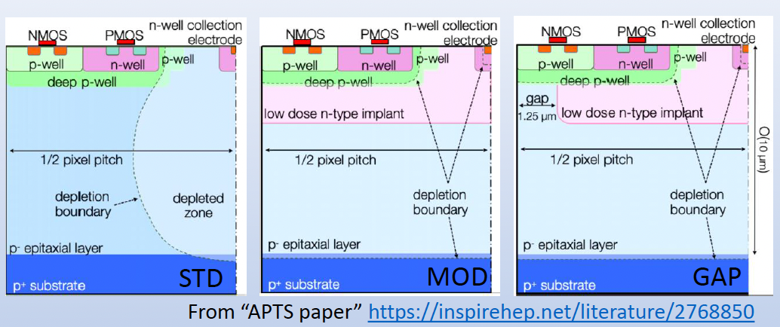
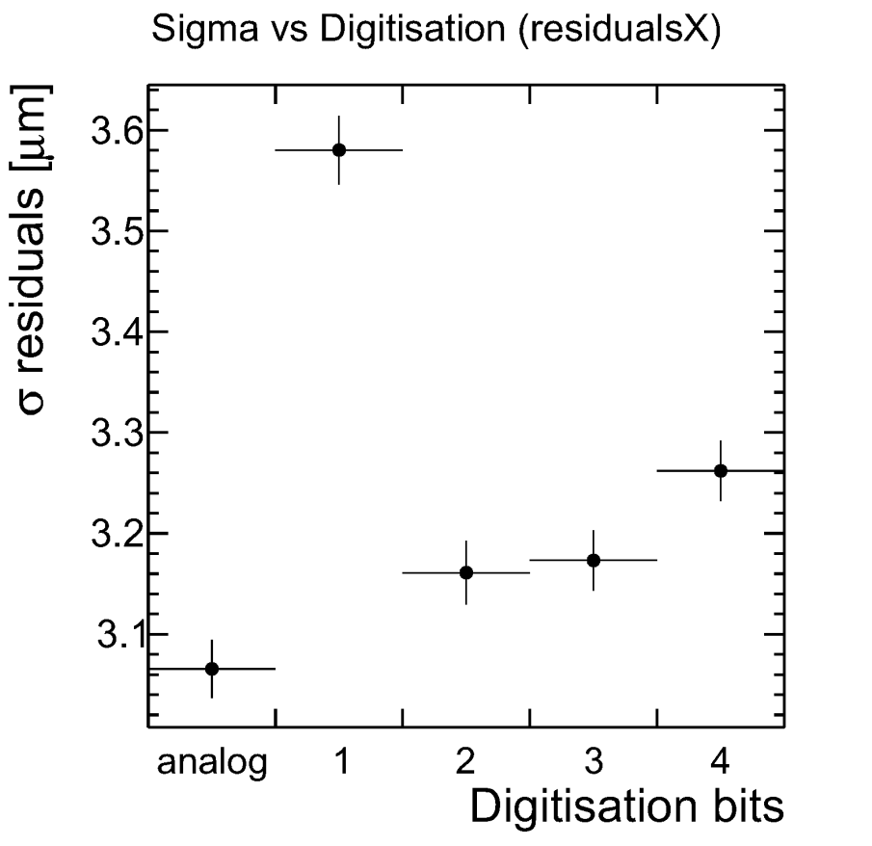
Vertex Detector
target precision ≃ 3 μm and X/X₀ /layer less than 0.1% at low power ≲ 50 mW/cm²
Monolithic CMOS technology is a unique solution to meet this performance
S. Senyukov developments in TPSCo 65 nm processes
  “small electrodes, thin epi-layer (10 μm), large size (ALICE-ITS3)
  “OCTOPUS” DRD3/7 project goal demonstrate best approach/alternatives toward 3 μm
    process variants : STD ≃ 25 μm pitch, GAP ≲15 μm
    STD/GAP 100/5 ns timing precision targets
    Asynchronous readout, digitization few bits for STD higher pitch, pixel grouping for GAP lower pitch
different processes provide differtent charge sharing, few digitisation bits can improve resolution
+ The project has several international collaborators

Slide 3
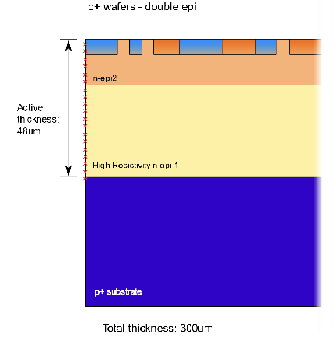
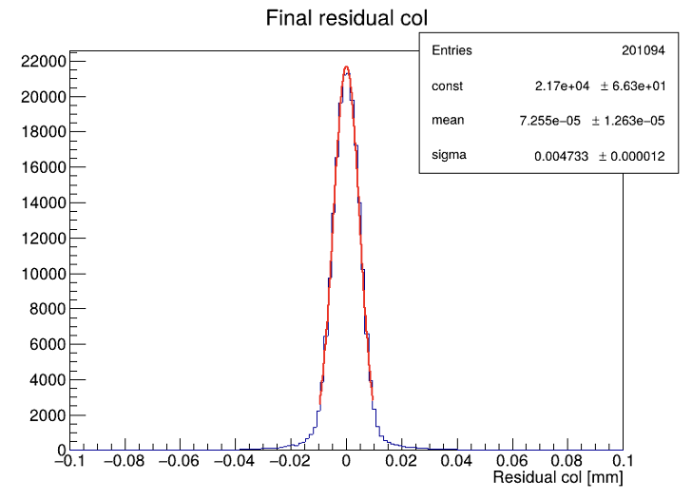
Vertex Detector
target precision ≃ 3 μm and X/X₀ /layer less than 0.1% at low power ≲ 50 mW/cm²
Monolithic CMOS technology is a unique solution to meet this performance
M. Rolo developments in LFoundry 110 nm processes
  large electrodes, HR wafers, active thickness down to 50 μm
  ARCADIA-MD3
    pixels 25 x 25 μm², matrix 512 x 512, 1.28 x 1.28 cm² silicon active area, “side-abuttable”
      < 30 mW/cm² at 100 MHz/cm²
      4.7 μm resolution with binary readout (not deconvoluted from telescope resolution)
4.7 μm
Also studies of 10 μm pitch and grouping in mini-strips

Slide 4
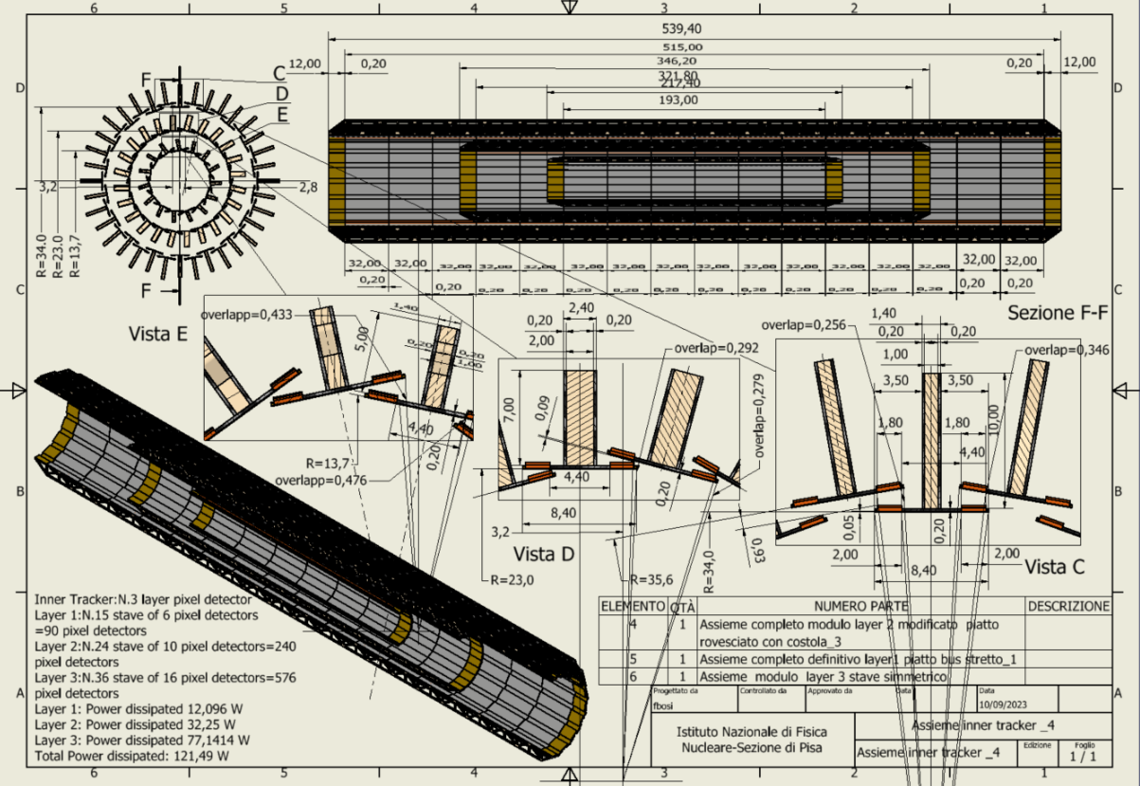
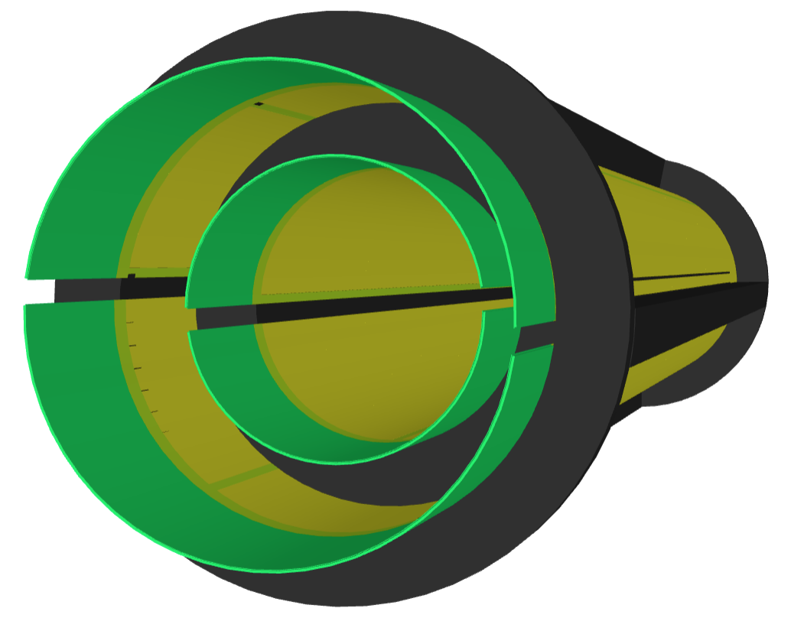
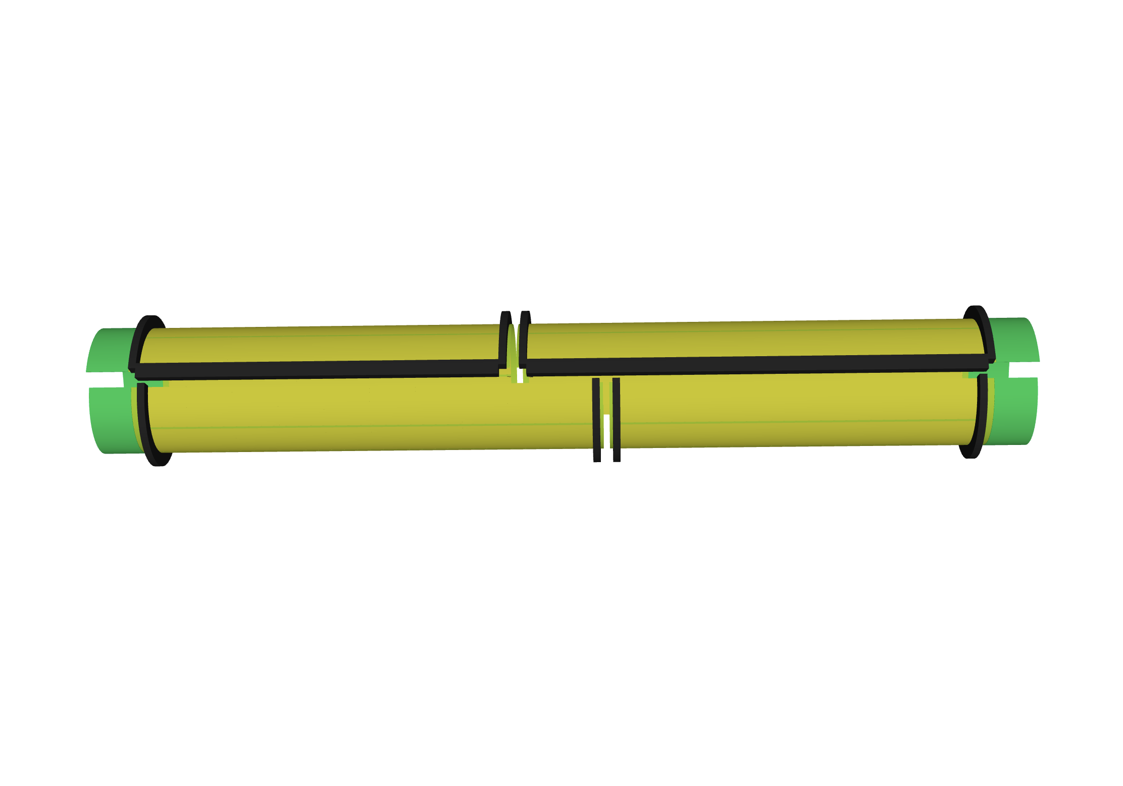
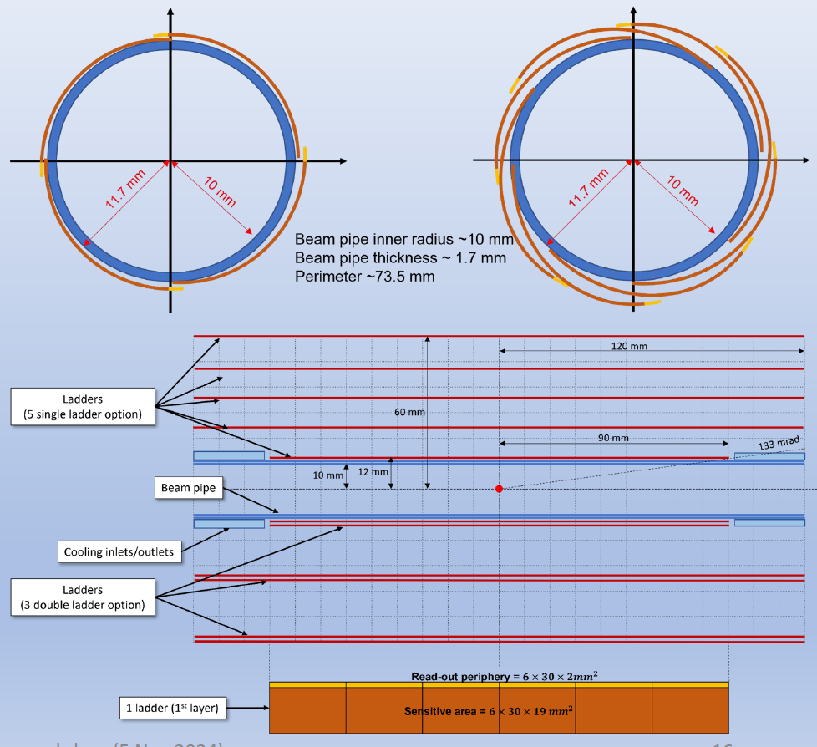
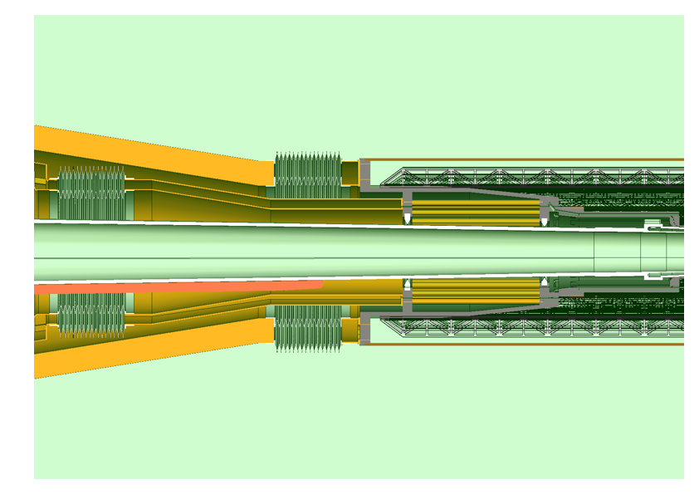
Vertex Detector mechanical designs
crucial to fully benefit from sensor performance (or to avoid over-designing)
F. Palla stave concept
small sensors, 0.25% X/X₀ /layer
large bent sensors 2 in layer 1-2, 4 in layer 3 and 4
improved X/X₀, but fill factor and hermeticity issue
S. Senyukov SEED large sensors in snail shape allowing overlaps
Several other common challenges
  airflow cooling
  stability
  services
  MDI integration
  accessibility
complex MDI integration

Slide 5
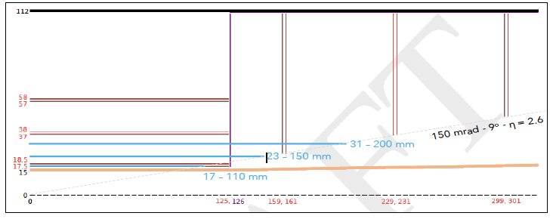
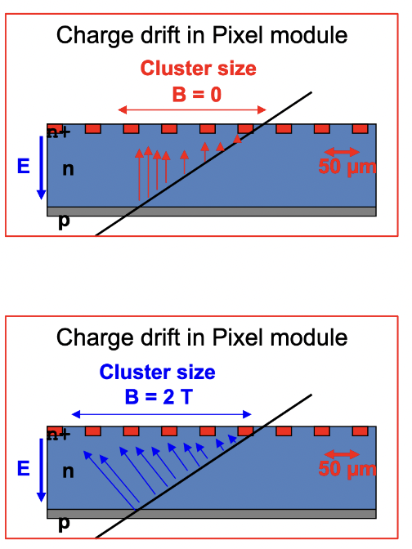
Vertex Detector simulations
G. Boudoul, A. Andreazza
old plot of CLD and IDEA vd on top of each others
Provide guidance on overall configuration
can be parametric
  radius and lentgth of layers
  single versus double layers
  requirements / layer(disk) extended to outer pixel and wrapping layers…
Provide guidance for sensor and system R&D
need detailed geometries, full GEANT simulations
  operation condition, rates and occupancies at different sensor positions including background
    input to readout architecture
  realistic performance estimate with respect to
    sensor parameters, system design (X/X₀, hermeticity, acceptance), mis-calibrations
Essential piece is development of a digitizer (started)
  produce realistic clusters for all tracks
    eg correct hit positions and occupancies
  should be usable in all sensor & detector configurations

Slide 6
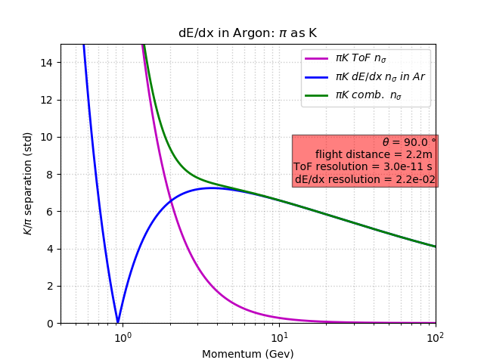
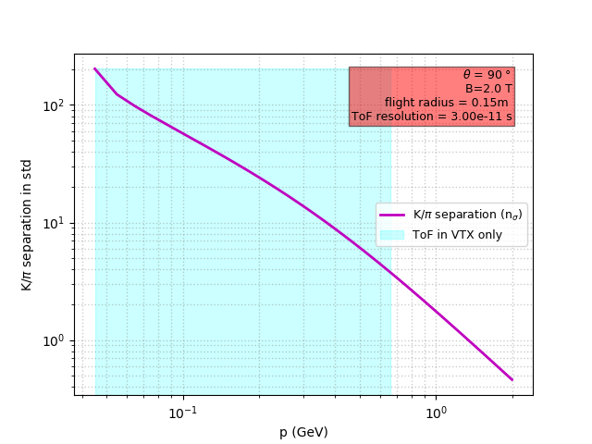
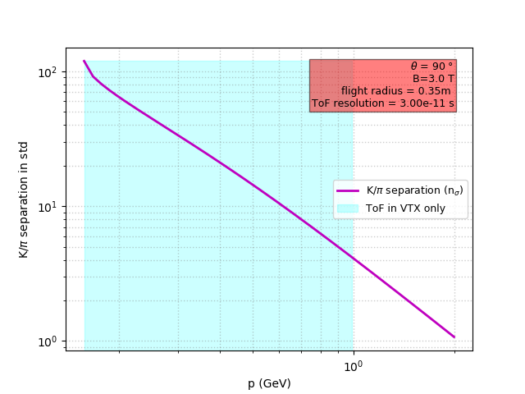
Motivation for PID
Flavor physics, Higgs decays to fermions, HNL mass…
ToF ≃ 30 ps precision at ≃ 2.2(0.15) m provide 3σ π/K discrimination ≳ 3(0.66) GeV standalone
needed in the 1 GeV region to complete dE/dx and dN/dx in LGVD*
strong interest to have combined position and timing precision in a same sensor
courtesy R. Aleksan
30 ps
30 ps
30 ps
3σ
4σ
3σ
courtesy of R. Aleksan
a layer at 15 cm would allow 3σ discrimination up to the 2 T-field cutoff of 0.66 GeV at 2.2 m
at 3T the momentum cut-off is 1 GeV at 2.2 m a ToF layer would be useful in front of the LGVD at 35 cm
position precision target in r/Φ 5(7) μm at .35(2.2) m
* Large Gas Volume Detectors (Drift CHamber or Time Projection Chamber)

Slide 7
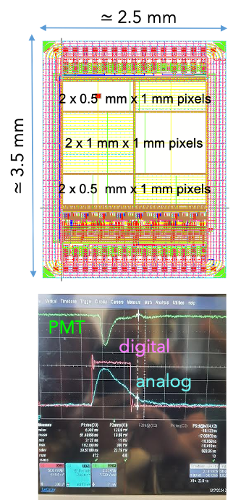
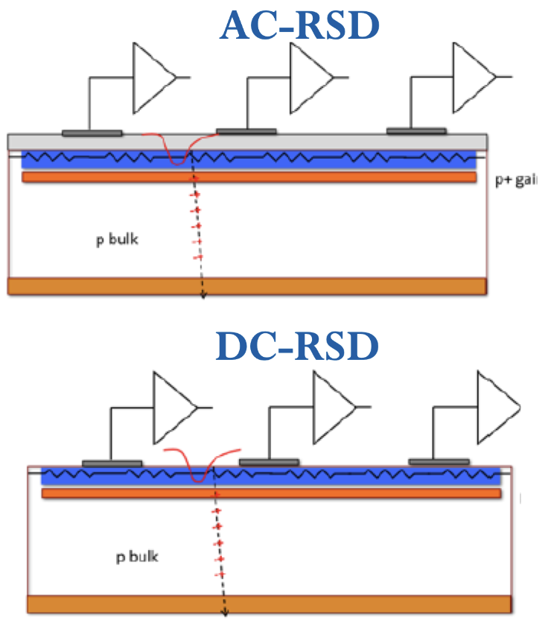
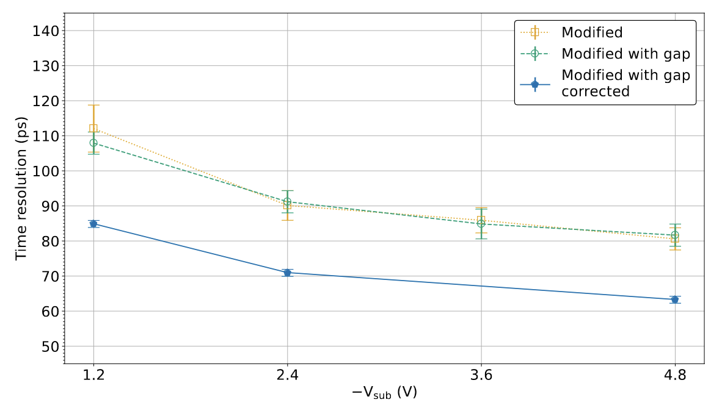
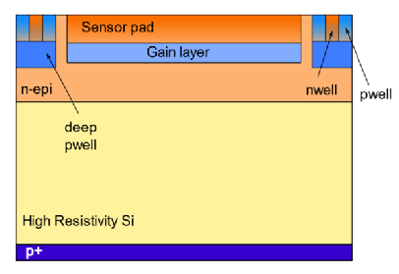
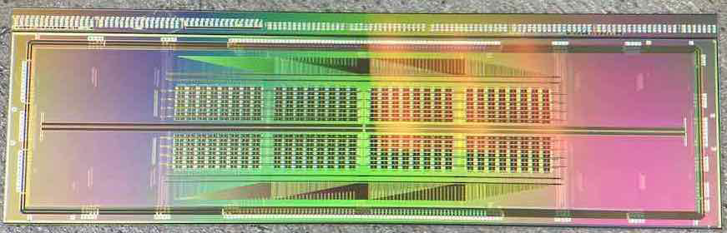
ToF PID / Tracking Layers
Monolithoc CMOS and LGADS
w/o gain
w/ gain
Mini CACTUS-V2 IRFU
LFoundry 150 nm,
175 µm, 0.5 x 0.5 mm²
≃ 60 ps precision
TPSCo 65 nm
modified with gap
10 μm epi., pitch 10 μm
63 ps precision
ARCADIA-MADPIX M. Rolo
LFoundry 110 nm, w/gain
48 μm, 250 x 100 μm²
≃ 72 ps precision**
INFN-FBK LGADs E. Robuti
hybry design
50 μm, .45 x .45 mm²
≃15/50 μm/ps precision
P. Schwemling/D. Contardo
IP2I plans to develop
async. readout architecture
ToA/ToT at end of column
New design pads
trench isolated
to control charge sharing
w/ gain layers started
* the technology could be deployed in first layers of a Si/W elctromagnetic calorimeter and a LumiCal, ** not correcteed for time reference resolution

Slide 8
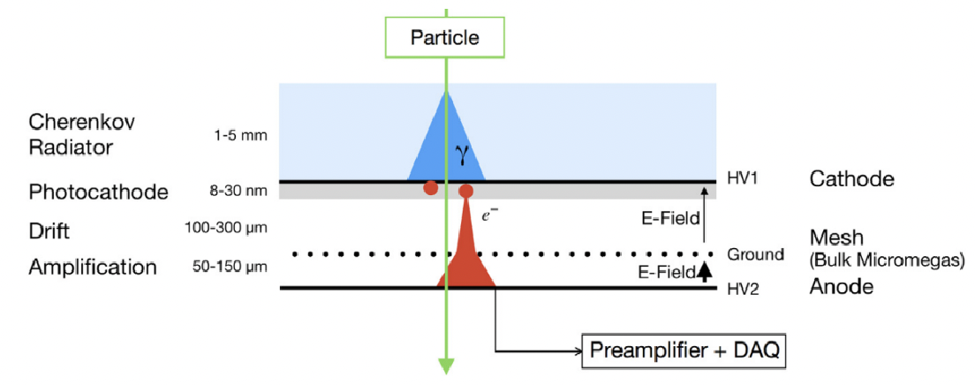
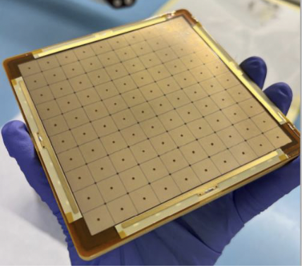
ToF PID / Tracking Layers
Monolithoc CMOS and LGADS
w/o gain
General MCMOS/LGAD technology problematics
Intrinsic time precision limit w/ and w/o gain layer
  versus pixel size/pitch - active thickness - capacitance
Position precision
  channel density versus position/timing performance (driving power)
low power premplification
Other MCMOS technology R&D
TJ 180 nm CASSIA CERN, w/ amplification ≃ 50 x 50 μm²
SiGe tecnnology UniGe (not commercial), w/o and w/ amplifications
MPGD - ex. Picosec T. Papaevangelou
Mini CACTUS-V2 IRFU
LFoundry 150 nm,
175 µm, 0.5 x 0.5 mm²
≃ 60 ps precision
TPSCo 65 nm
modified with gap
10 μm epi., pitch 10 μm
63 ps resolution
ARCADIA-MADPIX M.Rolo
LFoundry 110 nm, w/gain
48 μm, 250 x 100 μm²
≃ 72 ps precision**
INFN-FBK LGADs E. Robuti
hybry design, .45 x .45 mm²
≃15/50 μm/ps precision
IP2I plans to develop
async. readout architecture
ToA/ToT at end of column
New design pads trench isolated to control charge sharing determined
30 – 35 ps precision
w/ gain layers started
* the technology could be deployed in first layers of a Si/W elctromagnetic calorimeter and a LumiCal, ** not correcteed for time reference resolution

Slide 9
ToF PID / Tracking Layers
Monolithoc CMOS and LGADS
w/o gain
w/ gain
Mini CACTUS-V2 IRFU
LFoundry 150 nm,
175 µm, 0.5 x 0.5 mm²
≃ 60 ps precision
TPSCo 65 nm
modified with gap
10 μm epi., pitch 10 μm
63 ps precision
ARCADIA-MADPIX M.Rolo
LFoundry 110 nm, w/gain
48 μm, 250 x 100 μm²
≃ 72 ps precision**
INFN-FBK LGADs E. Robuti
hybry design, .45 x .45 mm²
≃15/50 μm/ps precision
System aspects
Power management
  number of layers versus standalone performance and power sum
  X/X₀ versus power
Mechanical structure and services similar as for VD
  stave design - sensor size and thickness tbd
  bent design – oriented to large and thin sensors
IP2I plans to develop
async. readout architecture
ToA/ToT at end of column
New design pads trench isolated to control charge sharing determined
w/ gain layers started
* the technology could be deployed in first layers of a Si/W elctromagnetic calorimeter and a LumiCal, ** not correcteed for time reference resolution

Slide 10
ToF PID / Tracking Layers
Monolithoc CMOS and LGADS
w/o gain
w/ gain
Mini CACTUS-V2 IRFU
LFoundry 150 nm,
175 µm, 0.5 x 0.5 mm²
≃ 60 ps precision
TPSCo 65 nm
modified with gap
10 μm epi., pitch 10 μm
63 ps precision
ARCADIA-MADPIX M.Rolo
LFoundry 110 nm, w/gain
48 μm, 250 x 100 μm²
≃ 72 ps precision**
INFN-FBK LGADs E. Robuti
hybry design, .45 x .45 mm²
≃15/50 μm/ps precision
Simulation studies
operating conditions – rate and occupancies
position and timing precision requirements versus radius
(can influence technology choices)
effect of X/X₀ versus radii and number of layers
physics benefit of inner radius timing
IP2I plans to develop
async. readout architecture
ToA/ToT at end of column
New design pads trench isolated to control charge sharing determined
w/ gain layers started
* the technology could be deployed in first layers of a Si/W elctromagnetic calorimeter and a LumiCal, ** not correcteed for time reference resolution

Slide 11
Outlook
Sensor R&D
  different technologies shoud eventually converge on similar performance for VD
  technology alternative(s) to achieve PID/Tracking is (are) yet to be established
  work will continue in the first 3-4 years DRD period for comparative evaluations
  on longer term, 3D wafer stacking, finer foundry nodes, could shed new light for channel density and power consumption (DRD& mandate)
System aspects are crucial, they may limit the performance
  particularly for X/X₀, MDI integration and systematic effects
Simulation studies are needed
  to guide R&D
  to define and refine detector configurations and requirments (as a function of r/𝜂)
  to assess effects of hermeticity, acceptance, mis-calibrations
France and Italy are developing complementary technologies
and system approaches, synergies can be exploited
EoIs foressen on VD, tracking Wrapping Layers and ToF/Tracking Layers

Slide 12
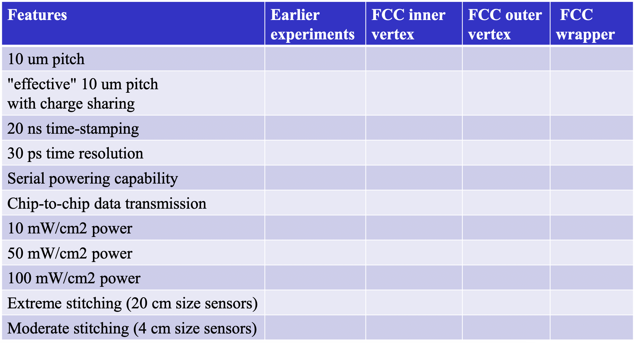
Outlook
Sensor R&D
  different technologies shoud eventually converge on similar performance for VD
  technology alternative(s) to achieve PID/Tracking is (are) yet to be established
  work will continue in the first 3-4 years DRD period for comparative evaluations
  on longer term, 3D wafer stacking, finer foundry nodes, could shed new light for channel density and power consumption
System aspects are crucial, they may limit the performance
  particularly for X/X₀, MDI integration and systematic effects
Simulation (mostly full) studies are needed
  to guide R&D
  to define and refine detector configurations
  to assess effects of hermeticity, acceptance, mis-calibrations
France and Italy are developing complementary technologies
and system approaches, synergies can be exploited
EoIs foressen on VD, tracking Wrapping Layers and ToF/Tracking Layers
Monolithic CMOS
common technology matrix
A. Andreazza
can be connected to system and simulation aspects

