Slide 1


French-Italian contribution to
Hadronic Calorimetry for FCCee
I. Laktineh
Many thanks to Piet Verwilligen, Andrea Pareti and Gabriella Gaudio for their help to prepare this talk

Slide 2
French and Italian groups are involved in two innovative HCAL technologies that they propose for future colliders and in particular the FCCee
High-granular PFA-based
France: IP2I, LPCC, OMEGA: RPC-based SDHCAL
Italy: Bari, Rome, Naples: MPGD-based SDHCAL
CALICE → DRD1-WP1
Dual readout
Italy: Pavia, Milano, Como
RD52→ DRD1-WP3

Slide 3
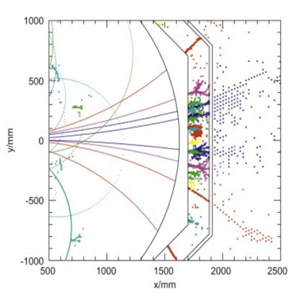
PFA-based granular calorimeters
PFA: Construction of individual particles and estimation of their
energy/momentum in the most appropriate sub-detector.
PFA requires the different sub-detectors including calorimeters to be
highly granular.
PFA uses the granularity to separate neutral from charged
contributions and exploits the tracking system to measure with
precision the energy/momentum of charged particles
E_{jet} = E_{charged t} + E_{γ} + E_{h0}
fraction 65% 26% 9%
Charged tracks resolution ∆p/p ~ few10⁻⁵
Photon(s) energy resolution ∆E/E ~ 12% / √E
Neutral hadrons energy resolution ∆E/E ~ 45% / √E
Two technologies were developed for hadronic calorimeters : AHCAL & SDHCAL

Slide 4
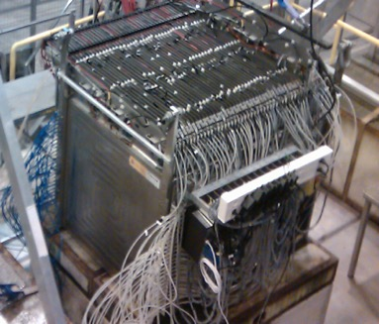
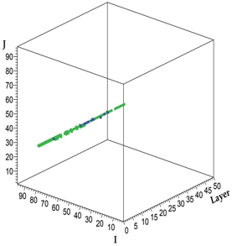
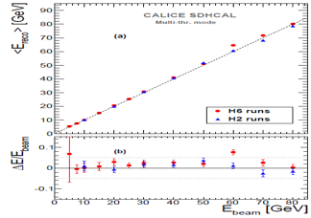
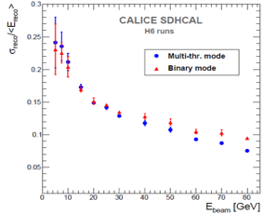
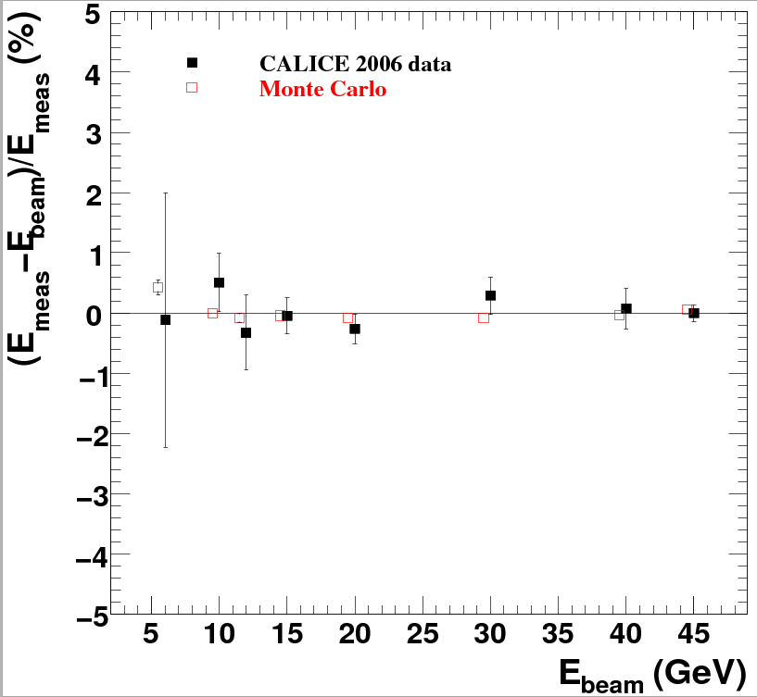
SDHCAL-RPC
48 layers of 2 cm stainless steel interleaved with
planes made of Glass RPC and their embedded readout 2-bit electronics allowing a lateral segmentation of 1 cm²
A technological prototype of 48 layers fulfilling all the ILD requirements :
compactness
self-supporting mechanical structure.
Triggerless mode
Power-pulsing mode
was built and expensively and successfully tested
muon
Hough transform tracks to control the
E_{rec =} α (N_{tot}) N₁ + β (N_{tot}) N₂ + γ (N_{tot}) N₃
electron data (2006)
MOKKA (geant4) simulation
electron data (2006)
MOKKA (geant4) simulation
non-linearity<1%
non-linearity<1%
Ebeam
Ebeam

Slide 5
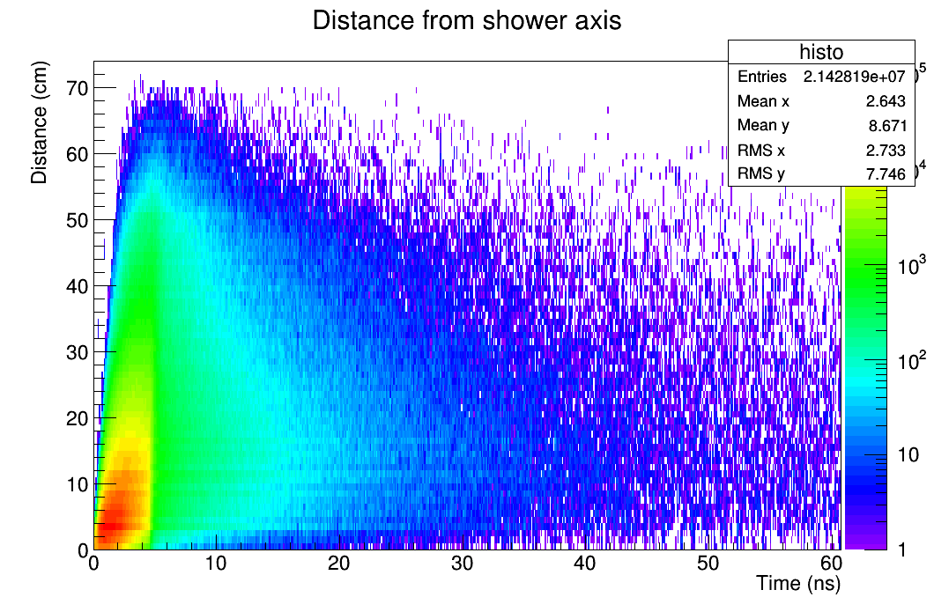
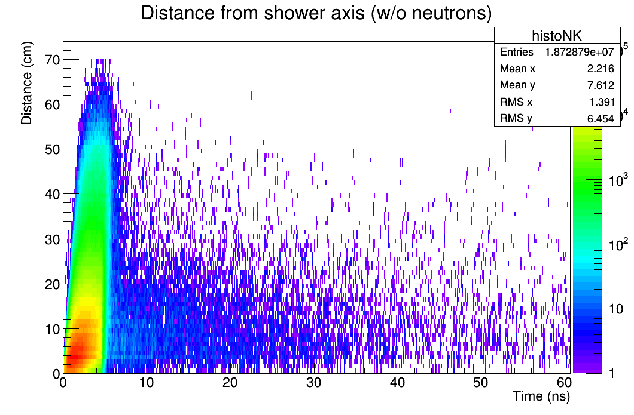
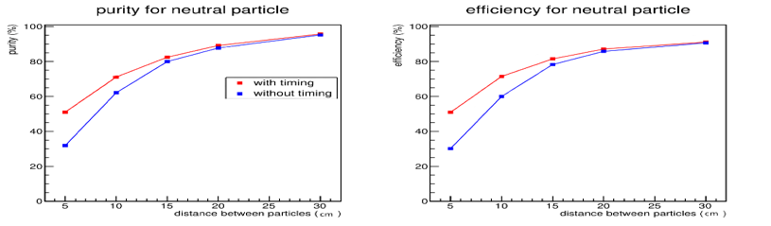
SDHCAL→ T-SDHCAL
SDHCAL was first developed for ILC: low rate and power pulsing
SDHCAL needs to be adapted to cope with circular collider requirements
  Continuous readout
  Higher rate
In addition, we found that time information could improve significantly hadronic showers separation at lower distances → Powerful tool for PFA
PFA-April extended to include time information improves close-by shower separation
Contribution of delayed neutrons could be separated→ better energy reconstruction and better close-by showers separation
electron data (2006)
MOKKA (geant4) simulation
electron data (2006)
MOKKA (geant4) simulation
non-linearity<1%
non-linearity<1%
Ebeam
Ebeam

Slide 6
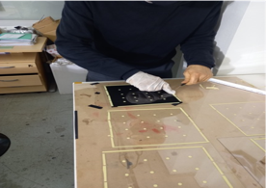
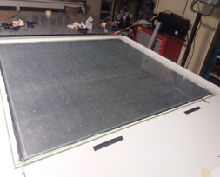
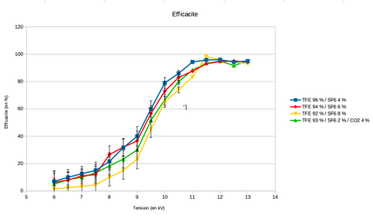
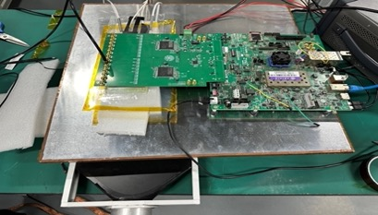
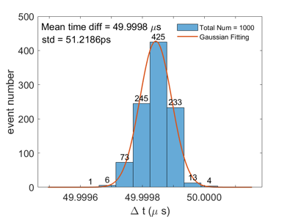
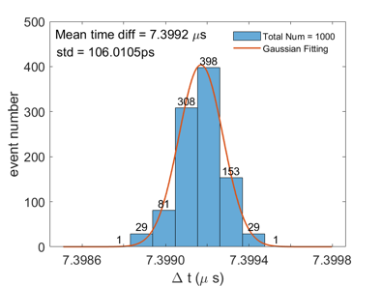
RPC→ MRPC
MRPC provides excellent time resolution (down to 50-70 ps with 2x4 gpas)
MRPC has higher detection rate
New way of producing MRPC was developed in Lyon→ easy production, cheap detector
New eco-friendly gases: HFO1234 and NOVEC could replace green glass gases R134a and SF6 currently used.
Electronics:
HR2 (no timing)→ Petiroc (timing + TDC but dead time) →Caloroc (timing + TDC)
σ_{t} = 36 ps
σ_{t} = 75 ps
petiroc

Slide 7
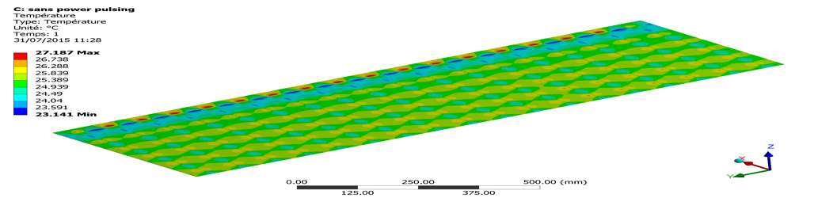
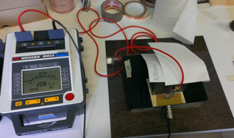
Cooling
Previous studies were performed on HARDROC (full regime) showed efficient heat absorption.
Using water circulating in cooper tubes in contact with the ASICs
We need to re do the studies with the new ASICs and the mechanical structure in mind
High-rate capability
Low-resistivity glass developed by Tsinghua U.
→ problem with the glass thickness and dimensions
Low-resistive PEEK (10⁹ Ω.cm) developed by IP2I-Lyon
Some efforts to have better homogeneity is needed

Slide 8
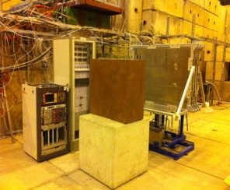
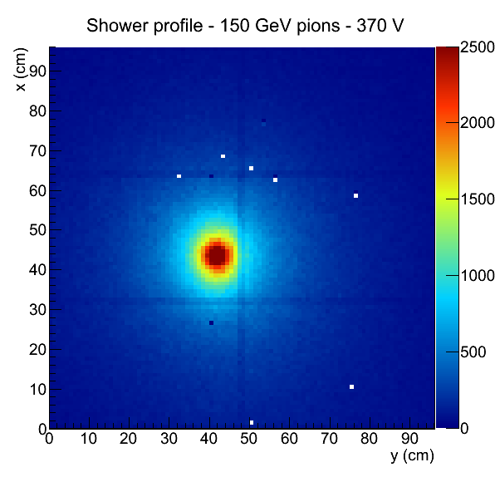
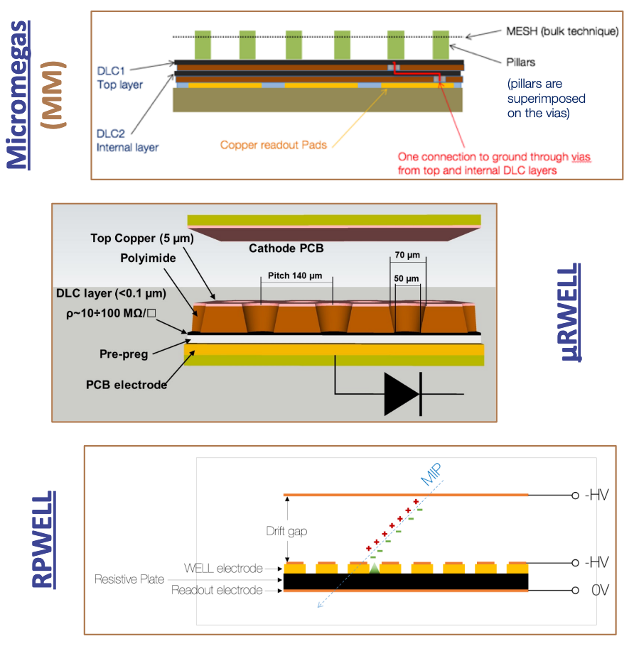
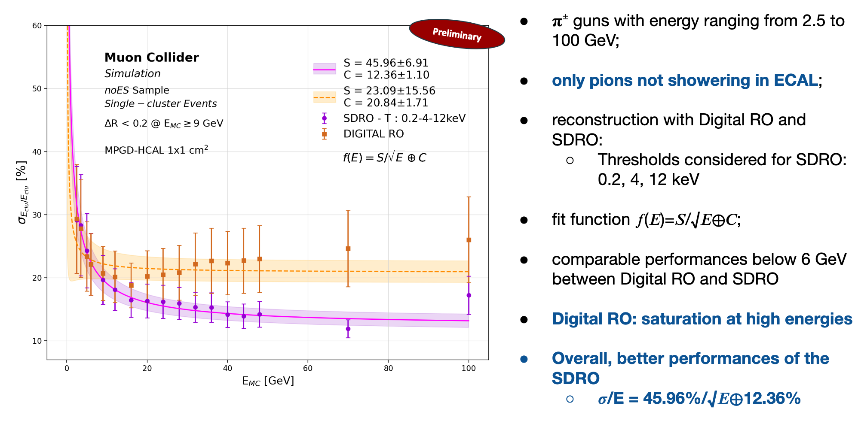
SDHCAL-MPGD
MPGD offers the possibility to operate with high particle rate (> 1 MHz/cm²) and excellent spatial resolution
First attempt was made with standard MM by LAPP colleagues using a variant of HR (allowing a few fC threshold )
10 years later, the second generation of MPGD using resistive anodes allows robustness against discharges

Slide 9
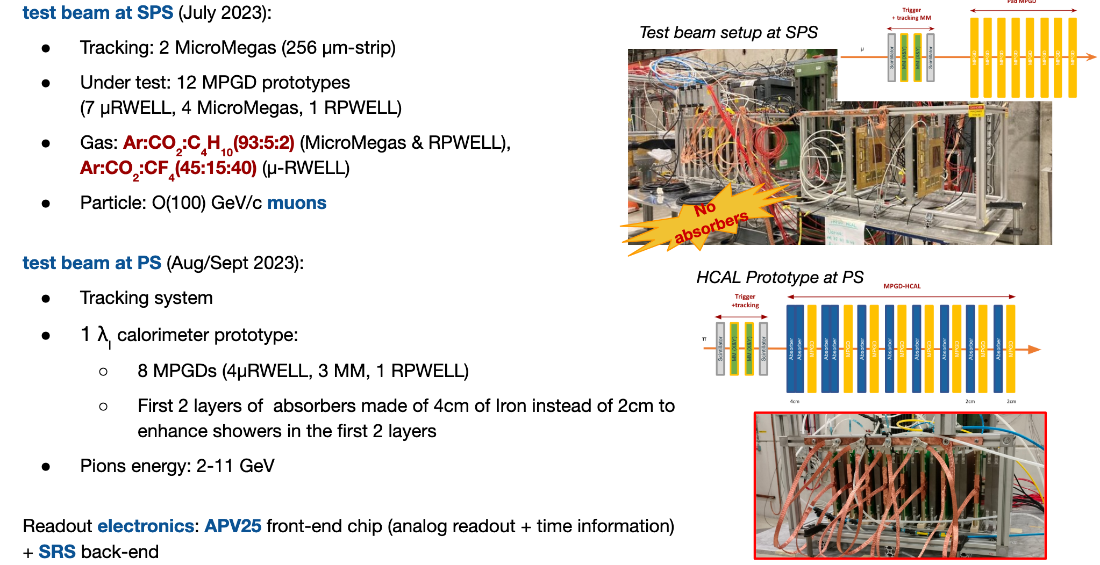
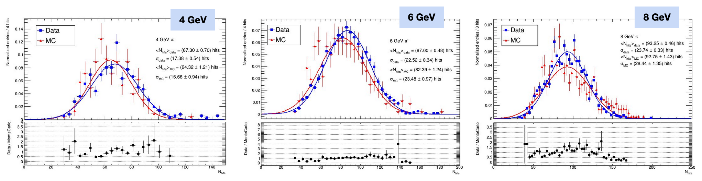
Good agreement in # hits in
Testbeam vs
GEANT4 MC

Slide 10
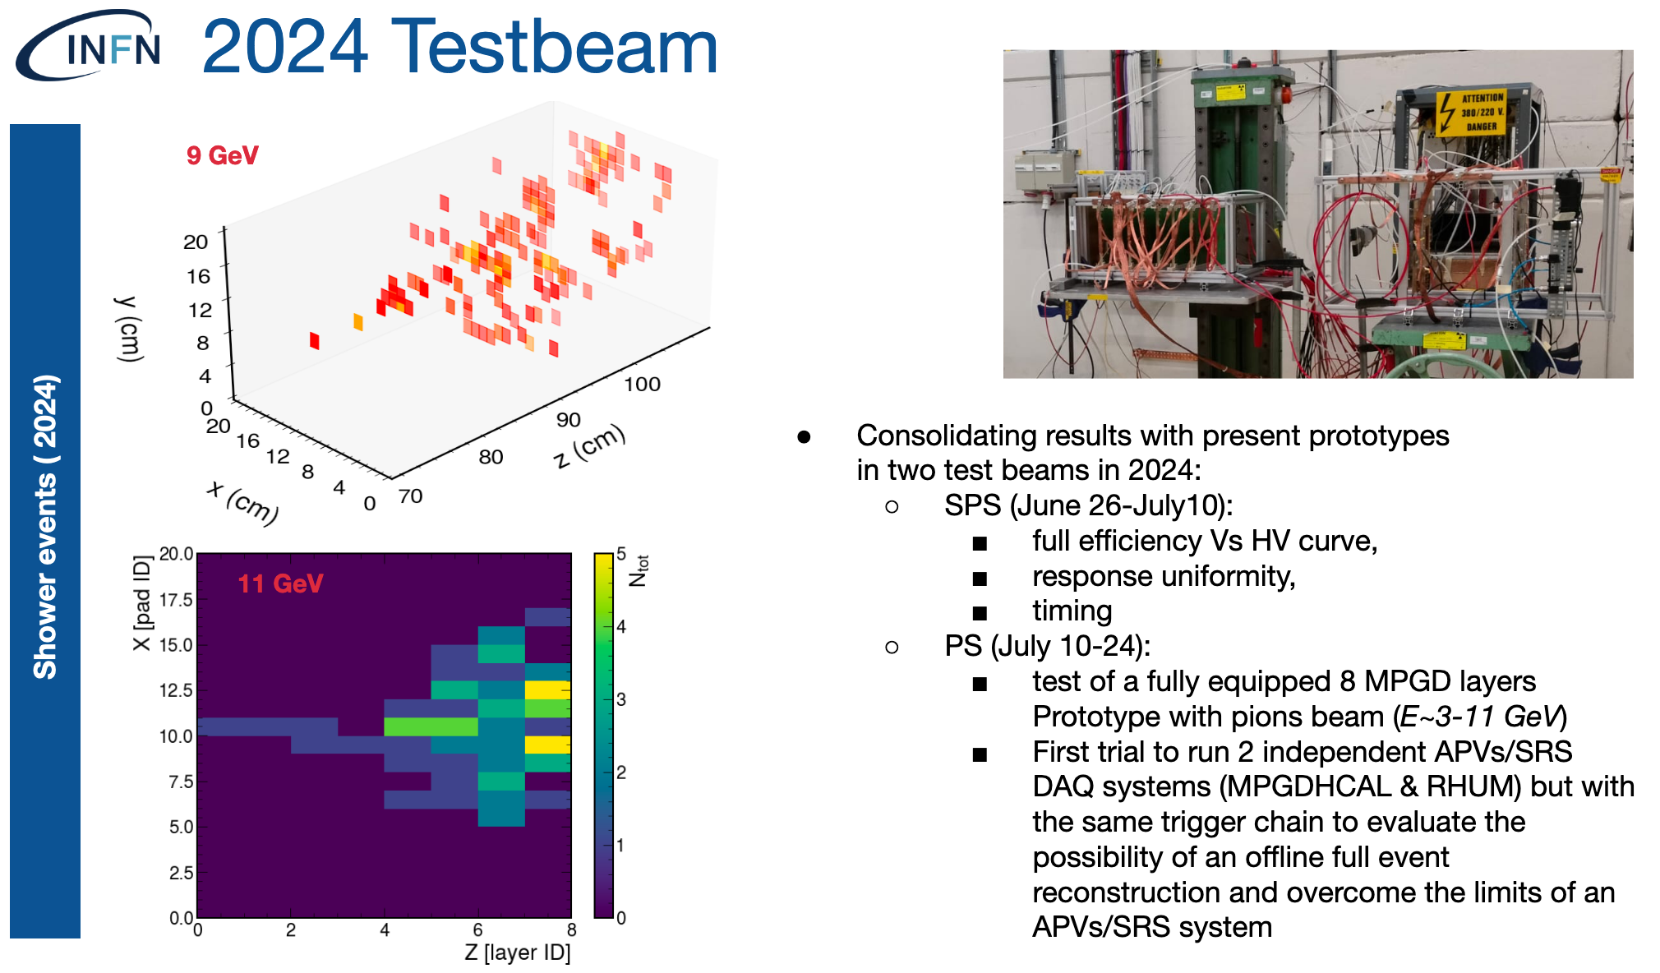
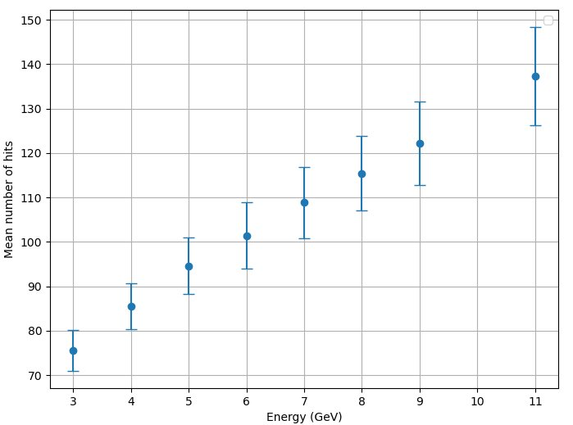
Response Function:
#hits increases with E
High E: loss of linearity due to non-full shower containment
Next steps:
50 cm x 50 cm MPGD compatible with the SDHCAL mechanical structure
New readout electronics→ discussion to use Claroroc

Slide 11
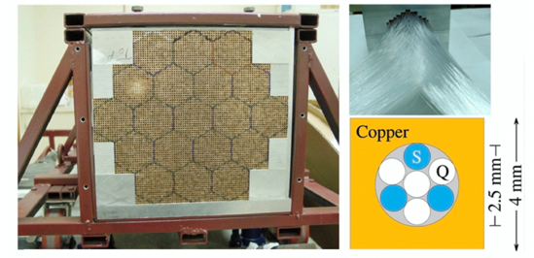
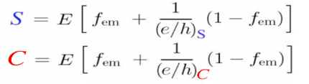
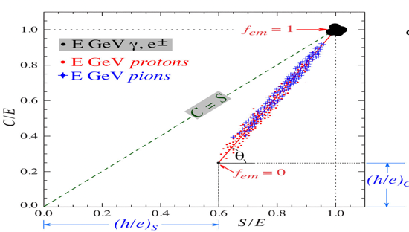


Dual Readout-based calorimeters
Energy is deposited in two different ways
Scintillation light
Cerenkov light → relativistic particles
80% of the hadronic component is not relativistic
If one has (e/h)_{S} and (e/h)_{C} then
Χ Is independent of E and particle nature
Double Readout technique can use either fibers or crystals

Slide 12
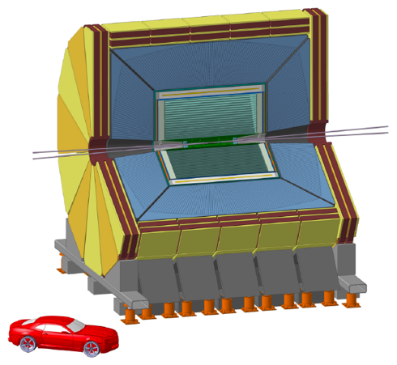
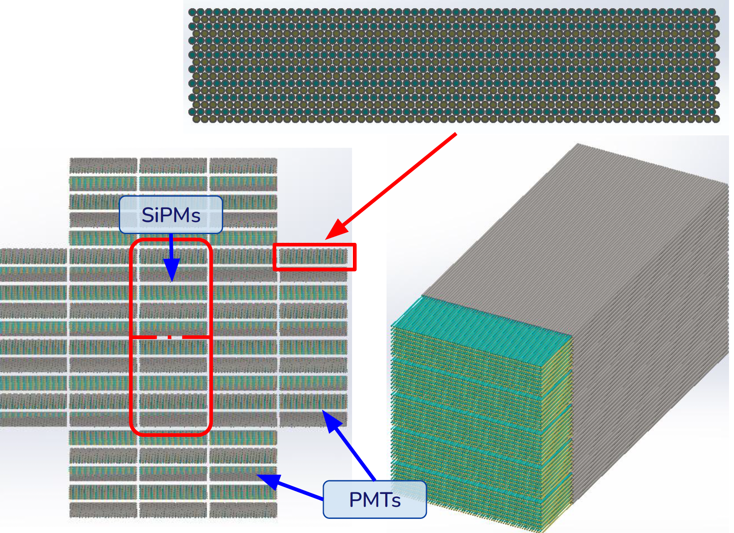
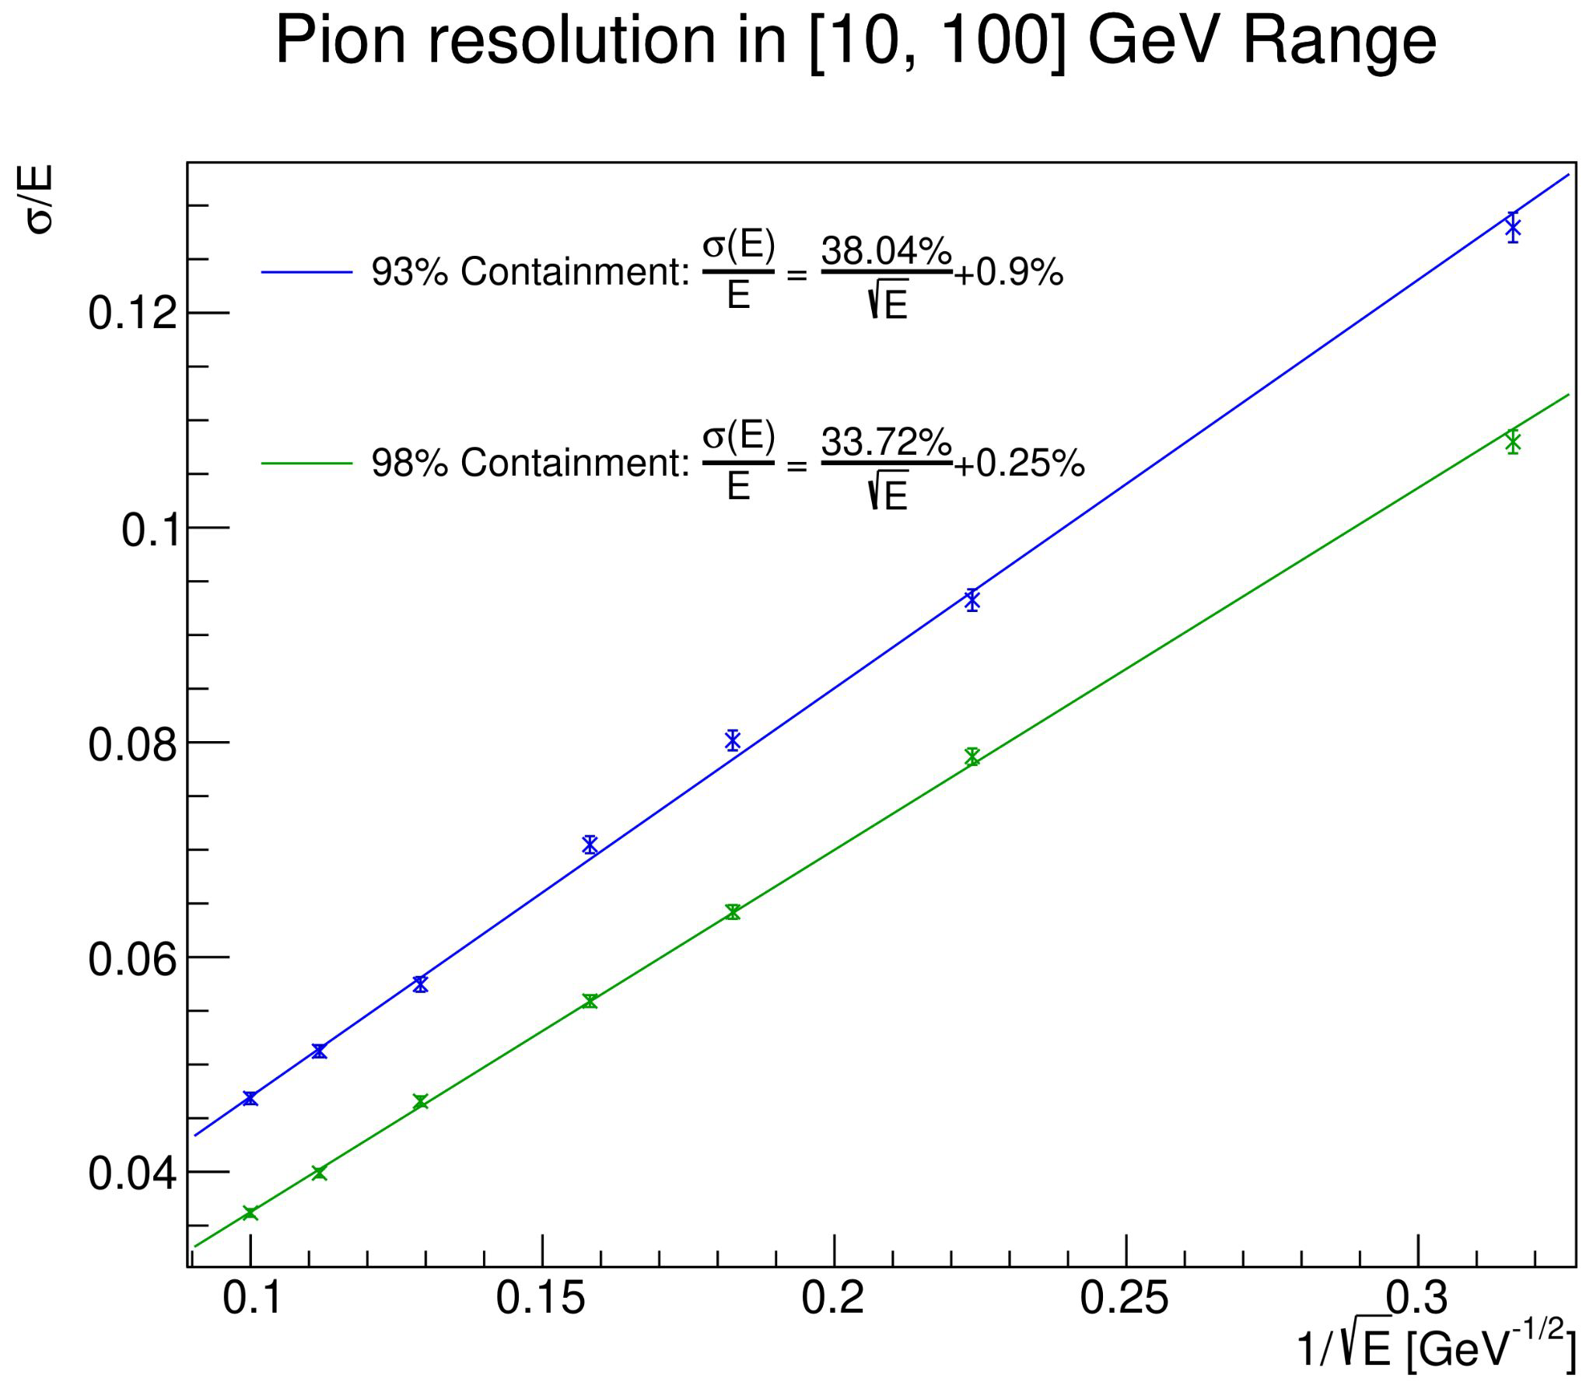
IDEA detector
A hadronic-size prototype (HiDRA) is being built with
8 modules each made of 10 mini modules, 250 cm depth each
Each external module read out by two PMTs, one for S
fibres and the other for C fibres (512 fibres each)
The two central will be equipped with SiPM
This intends to validate the DR concept for future colliders

Slide 13
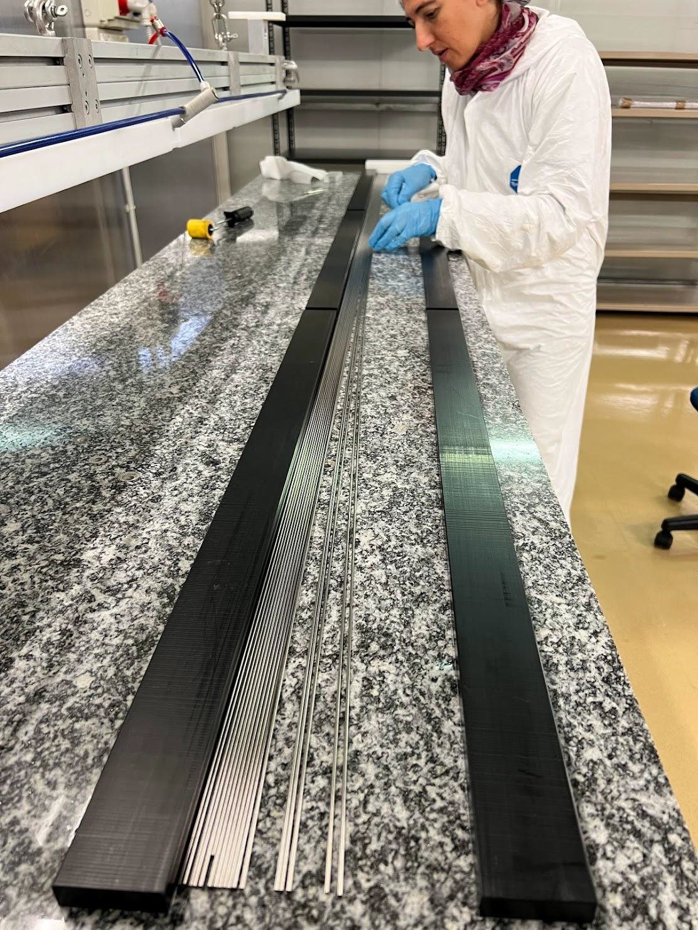
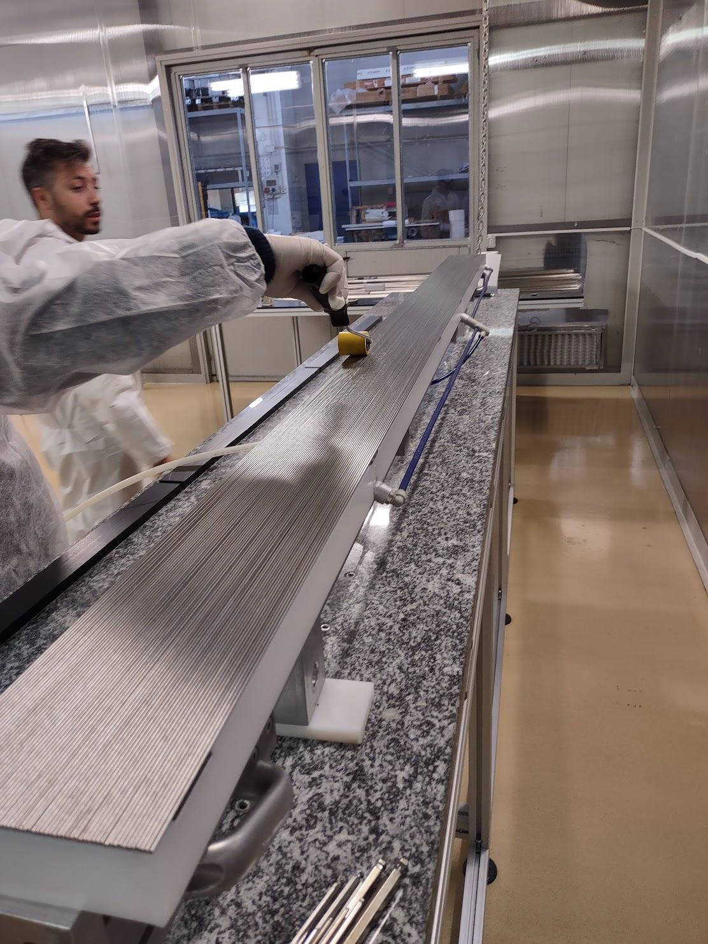
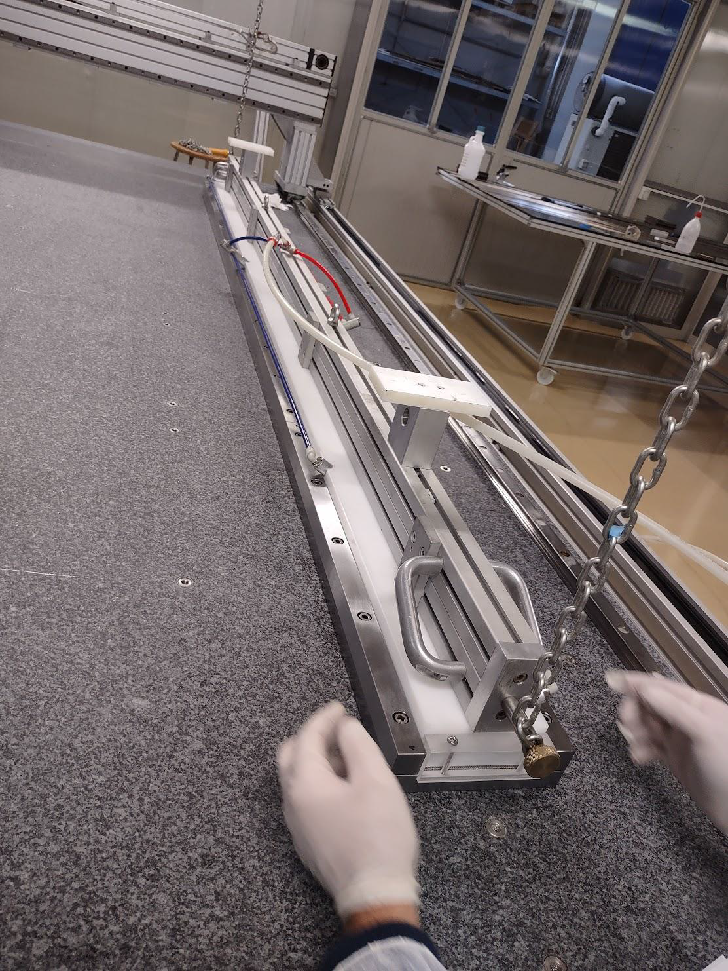
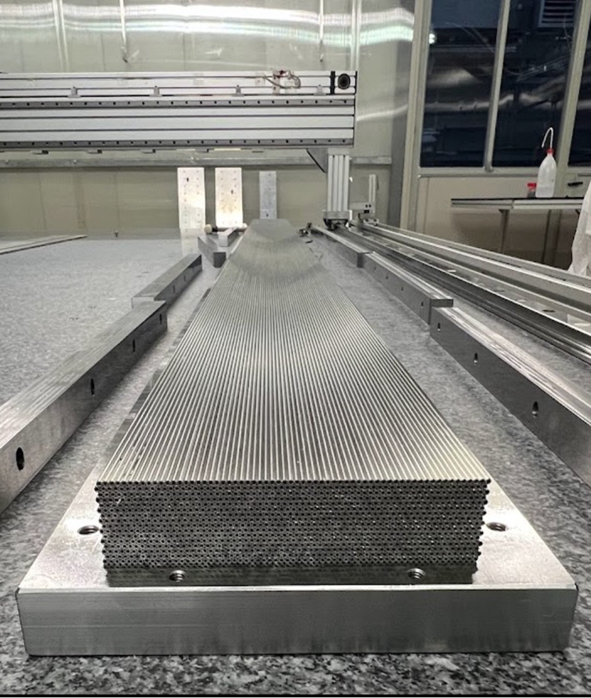
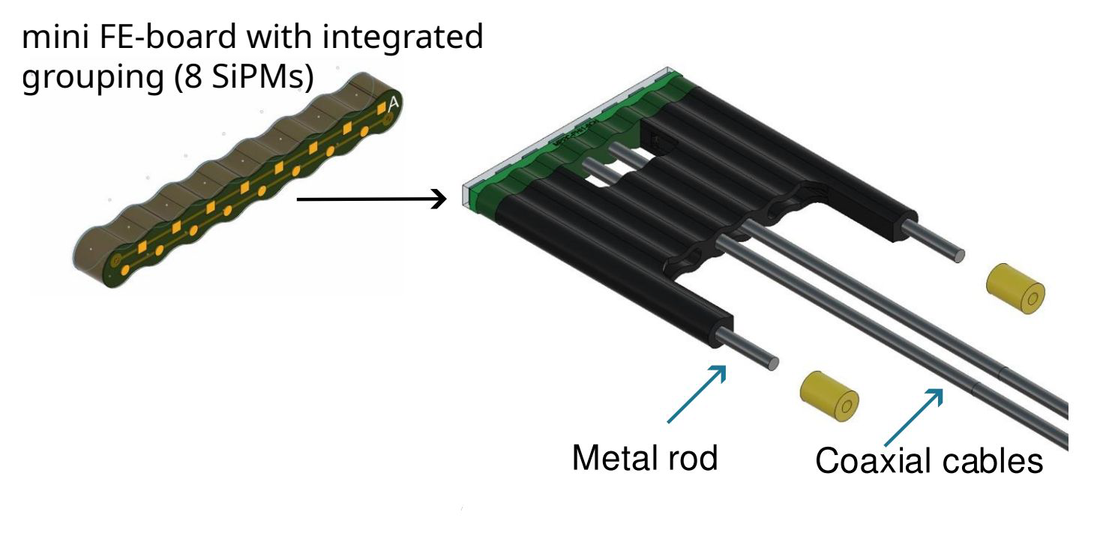
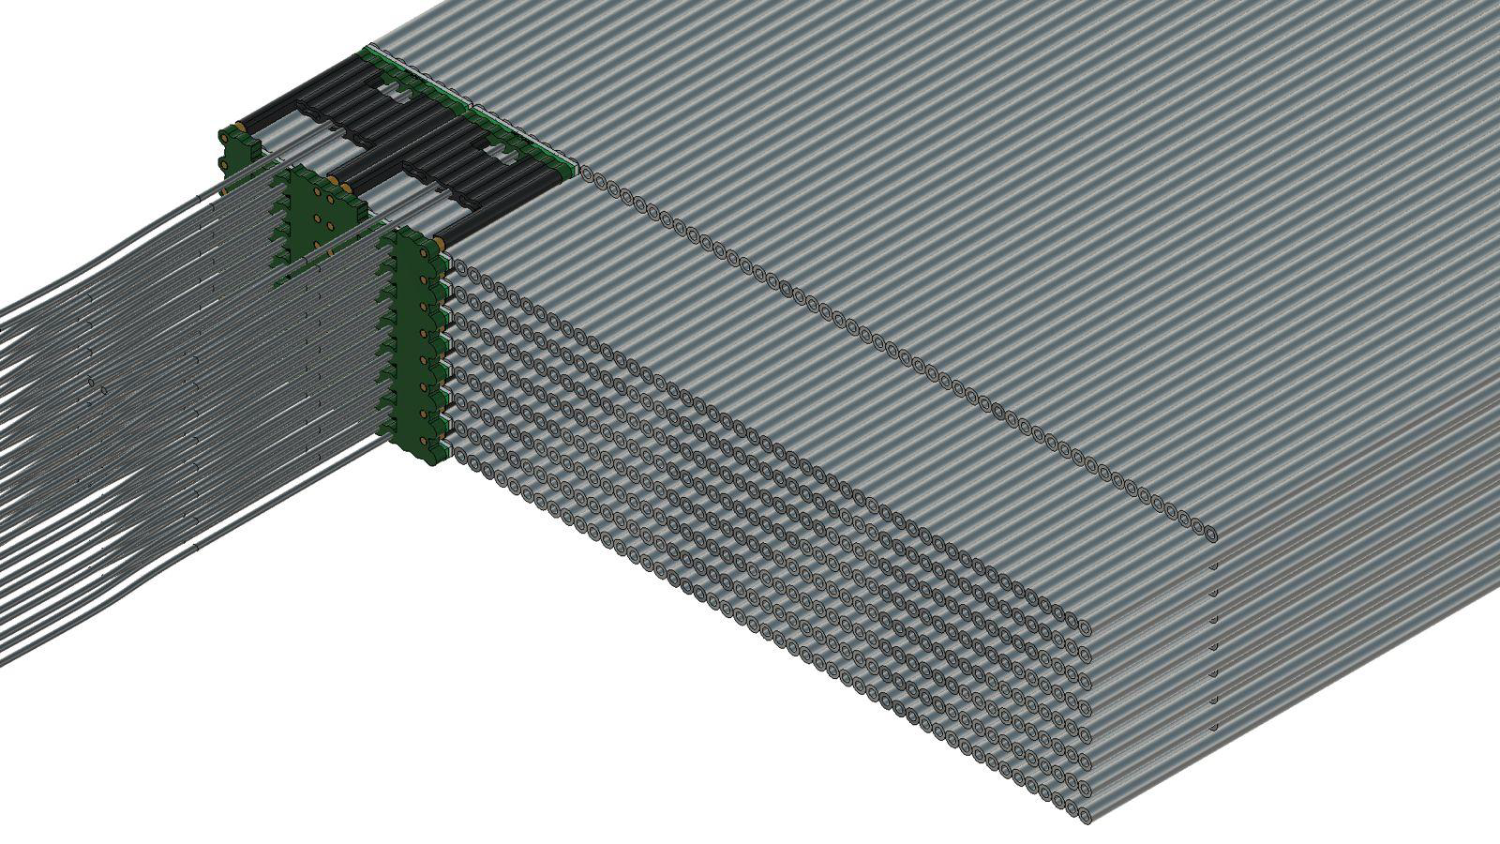
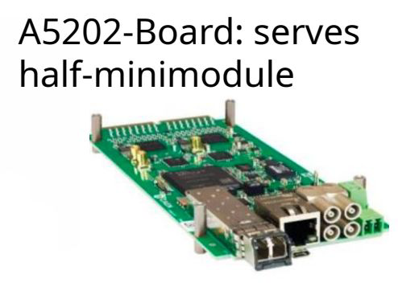
HiDRA Prototype construction : 47/80 are so far assembled

Slide 14
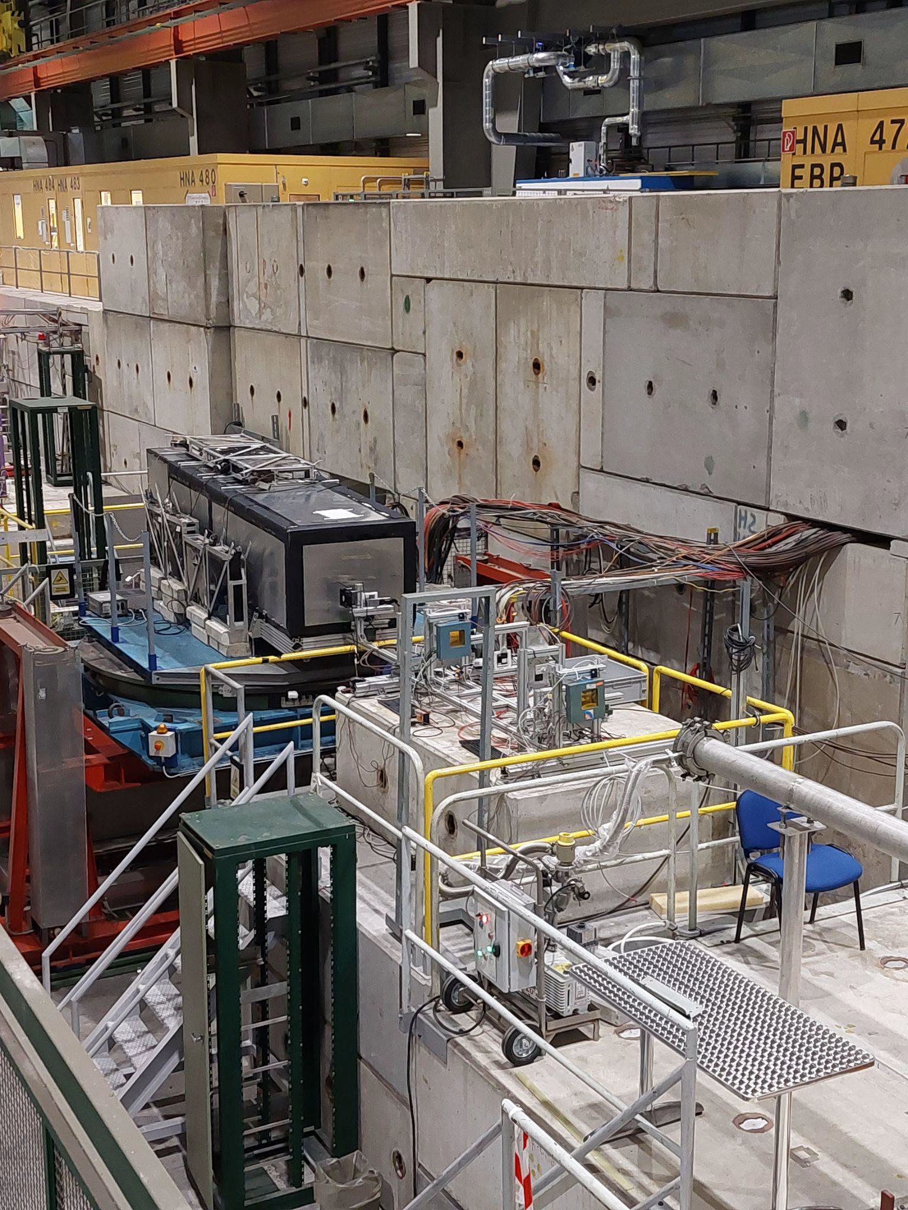
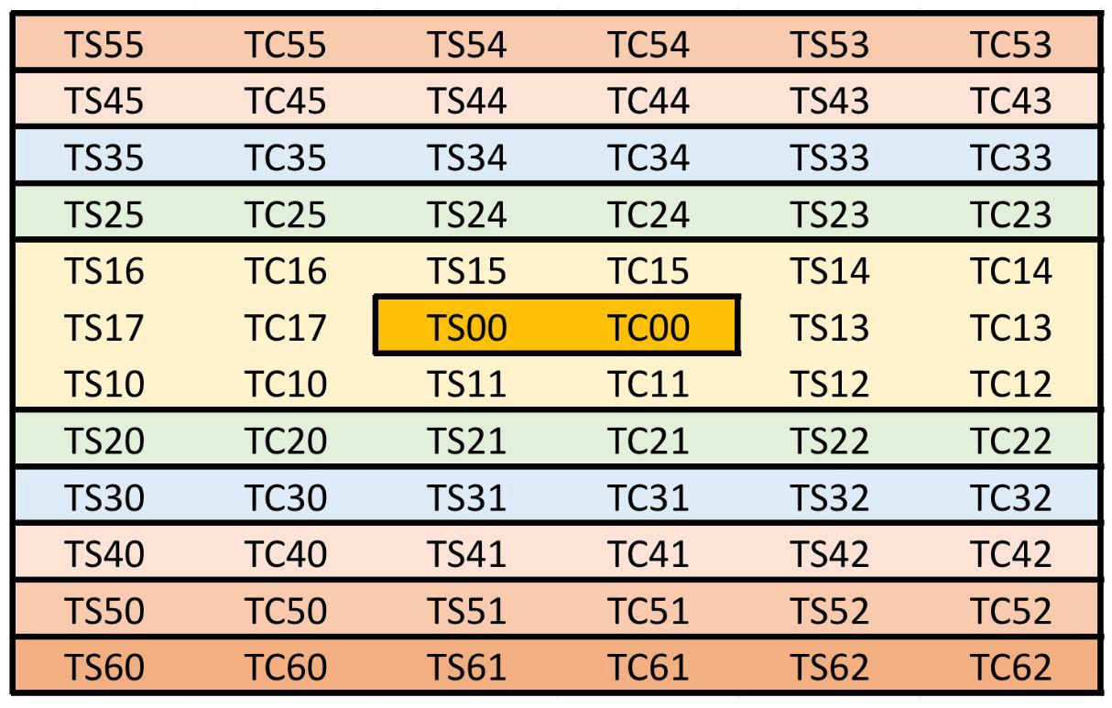
Beam Test 2024
First characterisation of new prototype on
beam at the end of August
Partially completed calorimeter with 36/80
modules, using PMT-only readout
12 x 3 modules, ~ 38.4 x 33.9 x 250 cm3
Containment for hadron showers: ~ 87%
(estimated through Geant4 simulation)
Analyses are ongoing.

Slide 15
Personal view on possible HCAL French Italian Collaboration
DRD6 is the right framework where both communities can work together.
For the SDHCAL, we all belong to the same WP5 of the DRD1 working on large, high rate capability and efficient gaseous detectors.
What we can do more
To work on common readout electronics: timing for instance
To develop or improve on the DAQ systems
To collaborate on the simulation tools ( some issues with hadronic showers in GEANT4)
Develop Deep Learning techniques to better estimate the energy
Develop reconstruction codes (PFA for instance)
Exchange students (European network?)

Slide 16
Many thanks to Piet Verwilligen, Andrea Pareti and Gabriella Gaudio for their help to prepare this talk

Slide 17
Backup

Slide 18
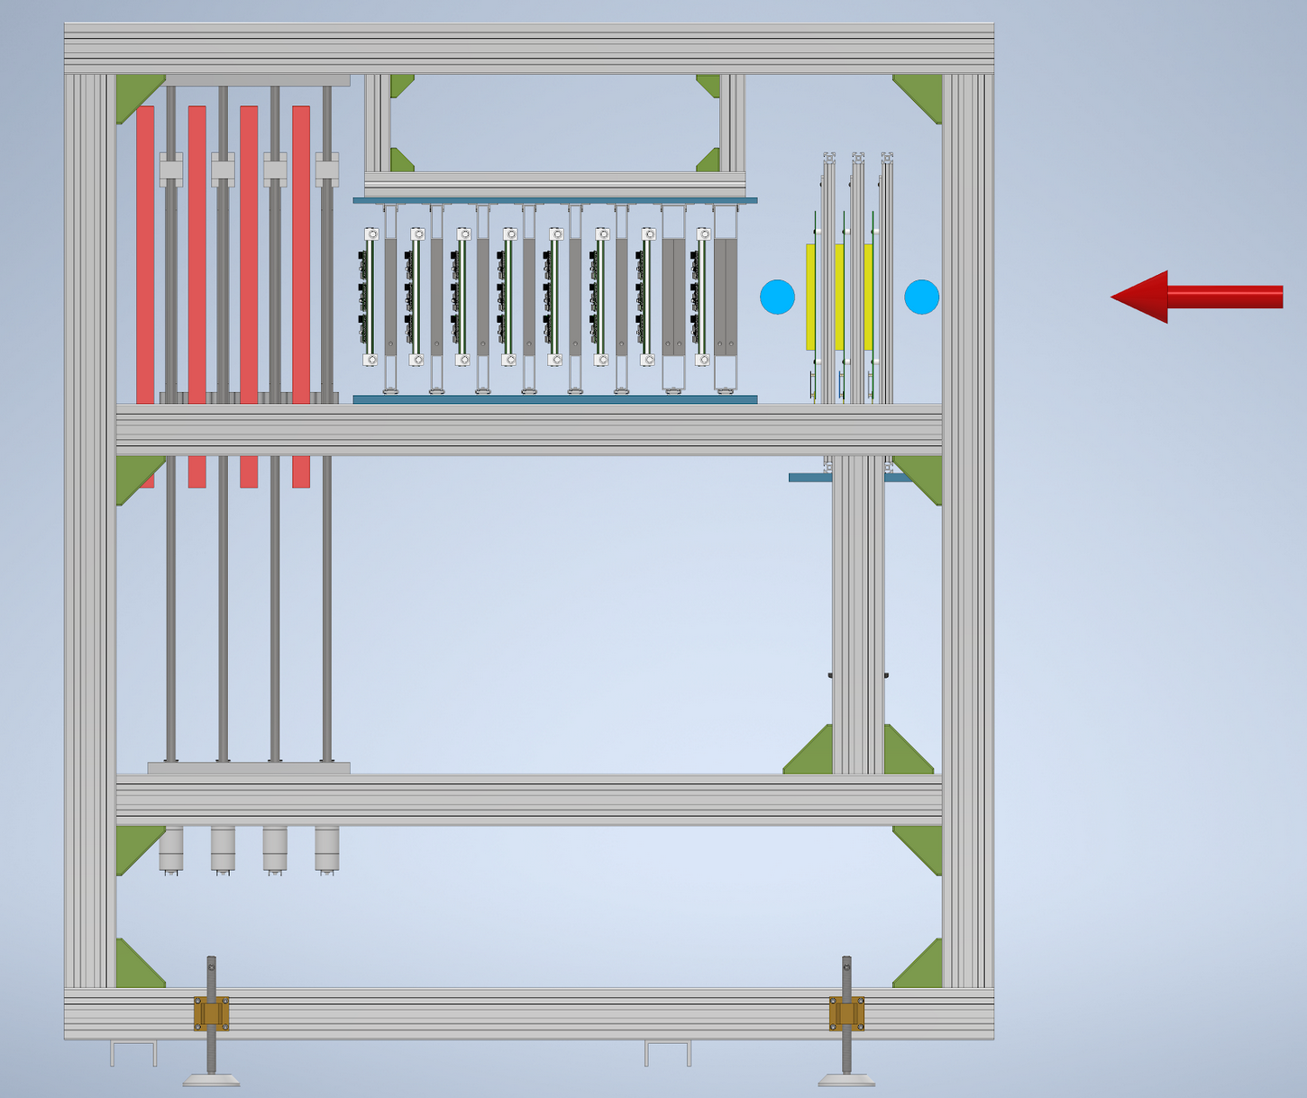
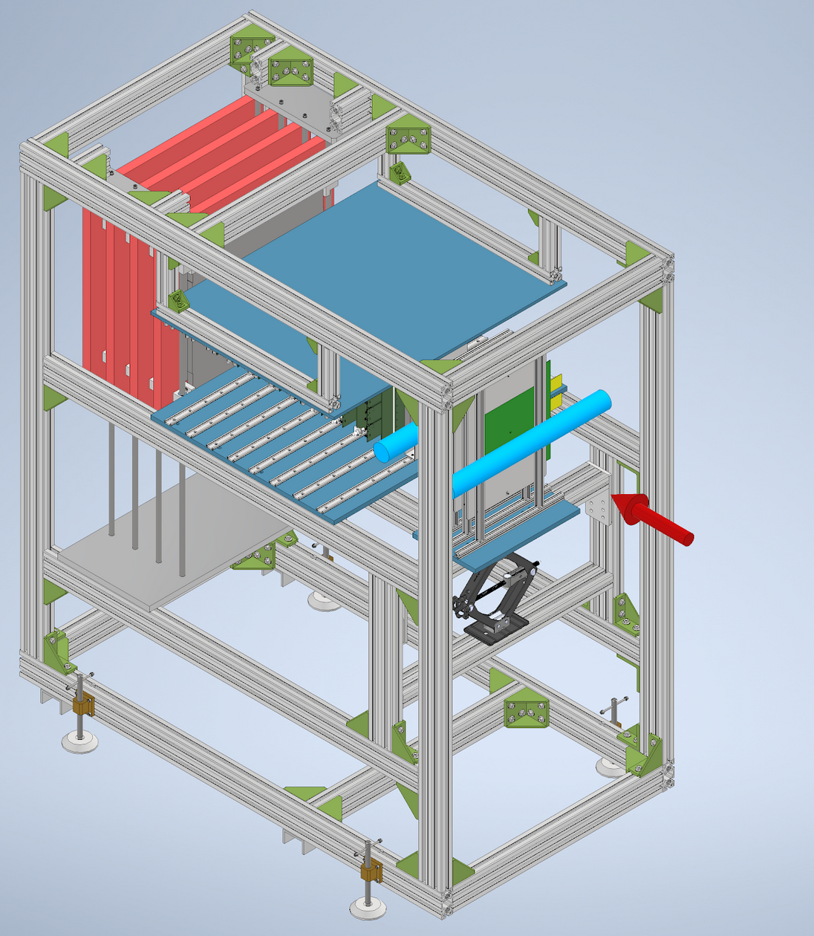
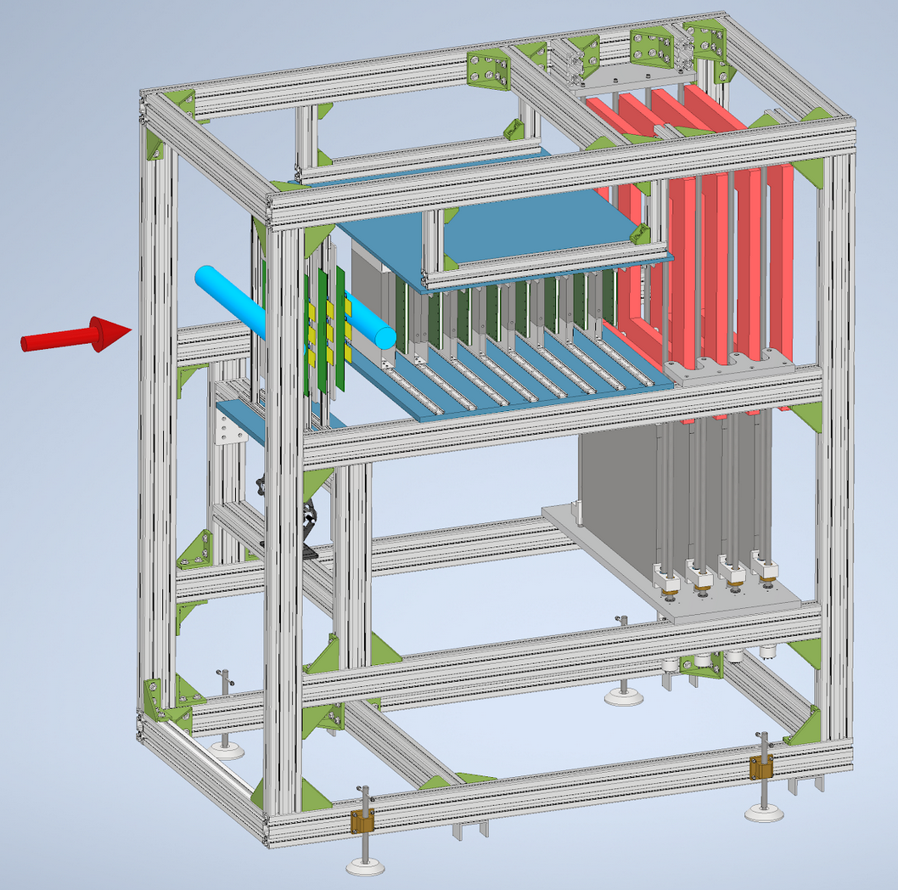

Preparing for 2025 Testbeams
Triple-GEM tracker
  Moveable to scan
  entire surface
1$λ$ with 20x20cm²
  8 dets, 8x2cm steel
1$λ$ with 50x50cm²
  4 dets, 4x4cm steel
Allows to insert / extract steel absorbers
beam
Absorbers extracted

