Slide 1
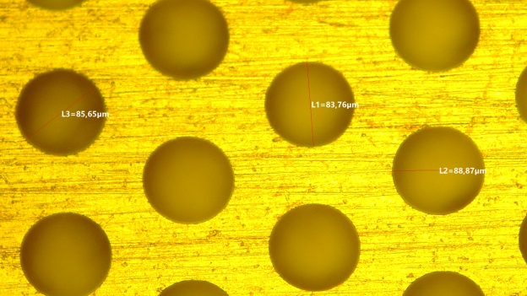
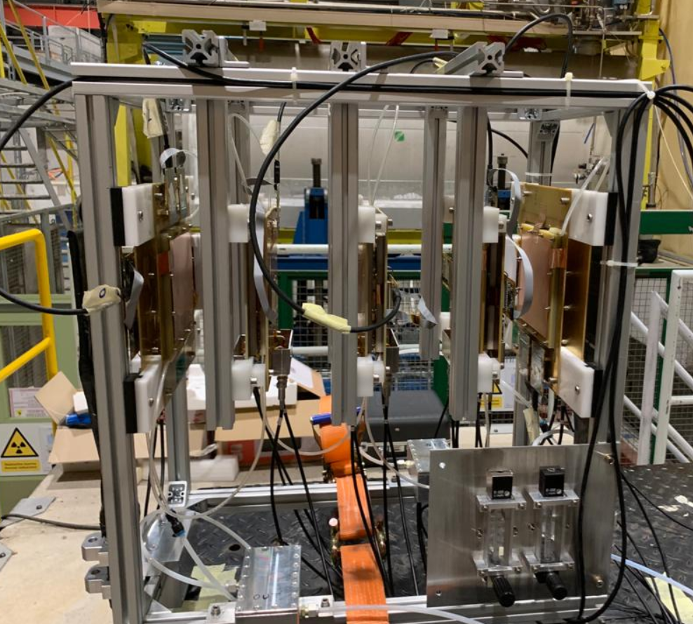
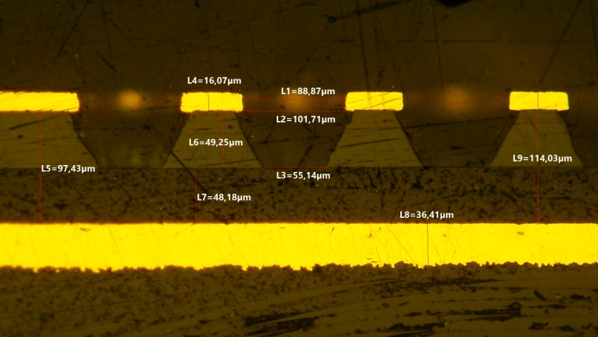


The µ-RWELL technology for the IDEA
MUON and pre-shower system
G. Bencivenni (*)
On behalf of
Bologna, Ferrara, LNF, Torino WP5-RDFCC
(*) Laboratori Nazionali di Frascati – INFN, Frascati (IT)
2nd FCC Italy-France Workshop, Venezia 4th Nov 2024

Slide 2
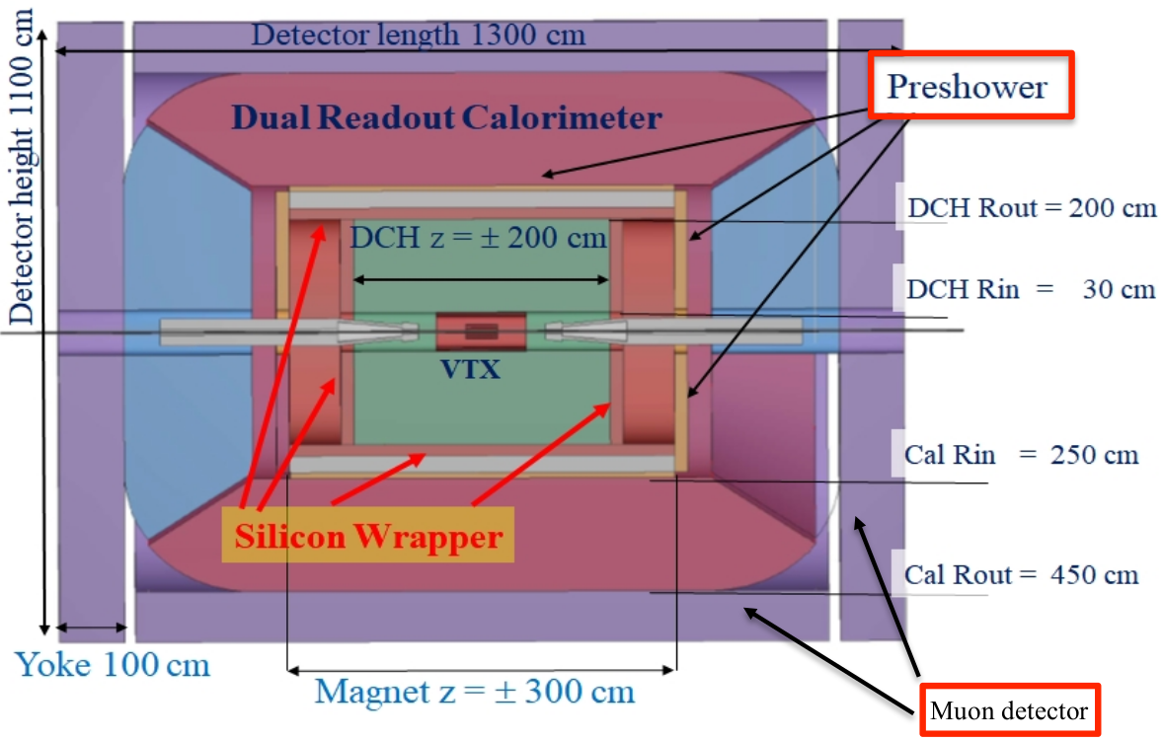
IDEA apparatus & the μ-RWELL
Pre-shower: high resolution detector after the magnet to maximize the energy resolution of the dual readout calorimeter and tag π⁰ and 𝛾.
Muon system: reconstruct and tag the muon using three layers within the iron return yoke, and reconstruct the LLP.
Requirements
Tiles: 50x50 cm² with X-Y readout
Efficiency >98%
Space resolution:
100μm (preshower)
500μm (muon)
Pre-shower
Instrumented surface/FEE
Preshower:
130m², 520 det., 3x10⁵ chs. (0.4 mm strip pitch)
Muon:
1500m², 6000 det., 5x10⁶ chs., (1.2mm strip pitch)
GOALS
Reliability ⊕ high gain
Easy Manufacturing
Mass production → Technology Transfer to Industry
FEE cost reduction → custom made ASIC
Muon
detector
G. Bencivenni, LNF-INFN – 2nd FCC Italy-France Workshop, Venezia 4th Nov 2024
2

Slide 3
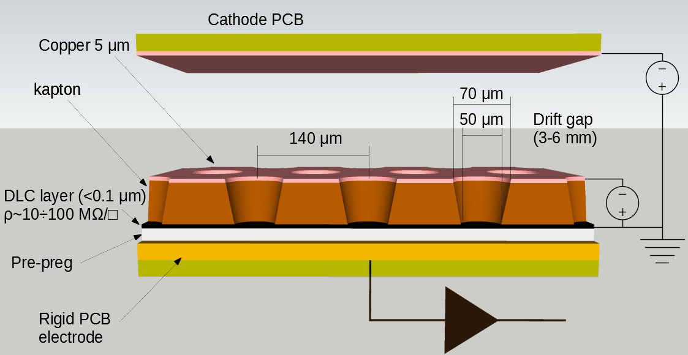
The μ-RWELL: the layout
The μ-RWELL is a resistive MPGD, with a GEM derived amplification stage, composed of two elements:
  Cathode
  μ-RWELL PCB
  a WELL patterned kapton foil (with Cu-layer on top) acting as amplification stage
  a resisitive DLC film with ρ∼50÷100 MΩ/□
  a standard readout PCB with pad/strip segmentation
G. Bencivenni et al., The micro-Resistive WELL detector: a compact spark-protected single amplification-stage MPGD, 2015 JINST 10 P02008
G. Bencivenni, LNF-INFN – 2nd FCC Italy-France Workshop, Venezia 4th Nov 2024
3

Slide 4
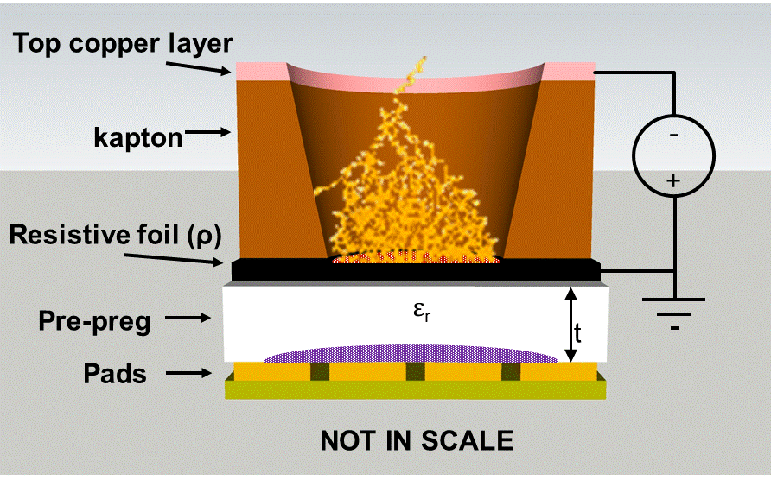

The μ-RWELL: principle of operation
Applying a suitable voltage between the top Cu-layer and the DLC the “WELL” acts as a multiplication channel for the ionization produced in the conversion/drift gas gap.
The charge induced on the resistive foil is dispersed with a
time constant, τ ∼ ρ×C [M.S. Dixit et al., NIMA 566 (2006) 281]:
the DLC surface resistivity → ρ
the capacitance per unit area, which depends on the distance between the resistive foil and the pad/strip readout plane → t
the dielectric constant of the insulating medium → ε_{r}
$$C= ε_{0}×ε_{r}×\frac{S}{t}$$
The main effect of the introduction of the resistive stage is the suppression of the transition from streamer to spark, with a consequent reduction of the spark-amplitude
As a drawback, the capability to stand high particle fluxes is reduced, but appropriate grounding schemes of the resistive layer solves this problem (see High-Rate layouts)
G. Bencivenni, LNF-INFN – 2nd FCC Italy-France Workshop, Venezia 4th Nov 2024
4

Slide 5
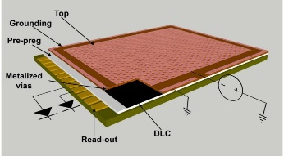
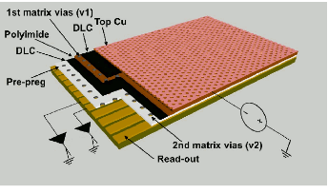
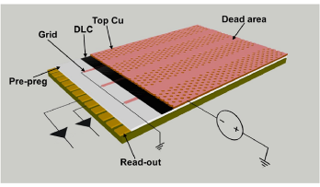
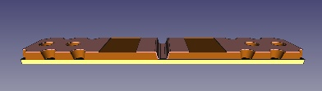
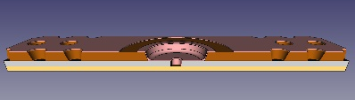
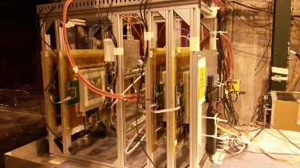
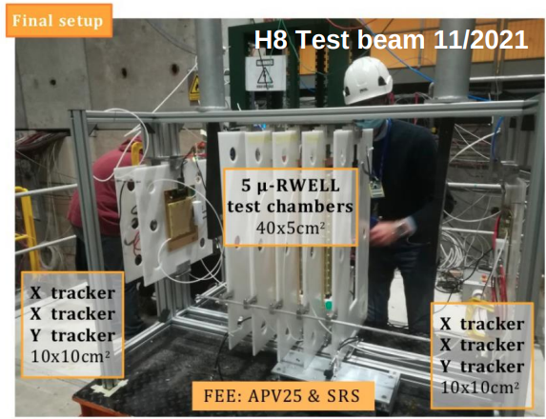
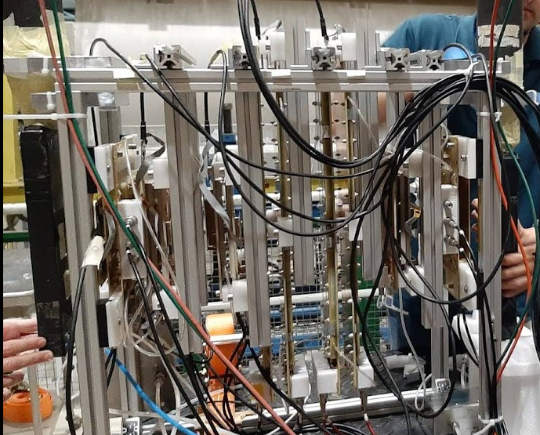
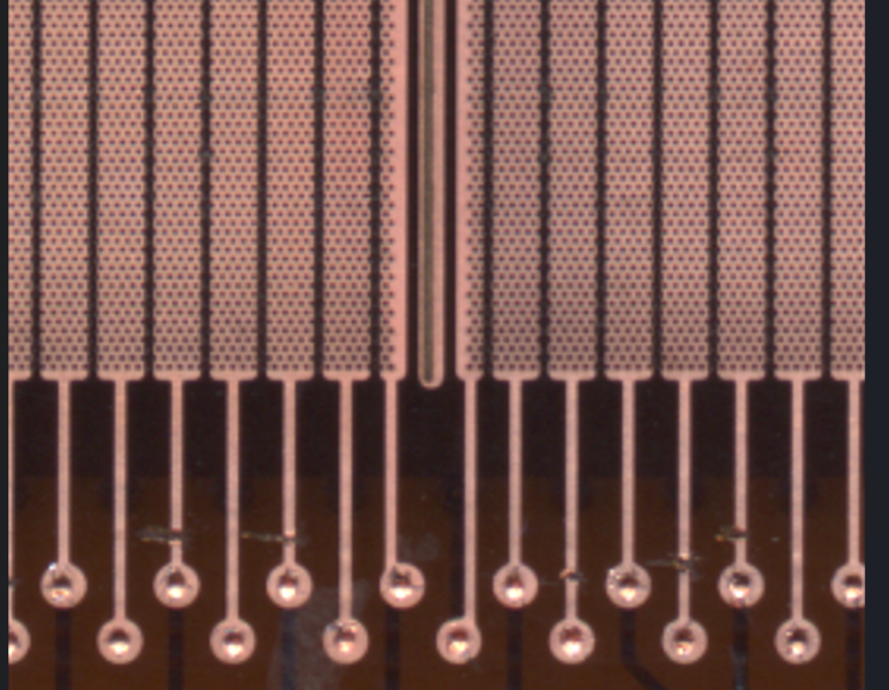
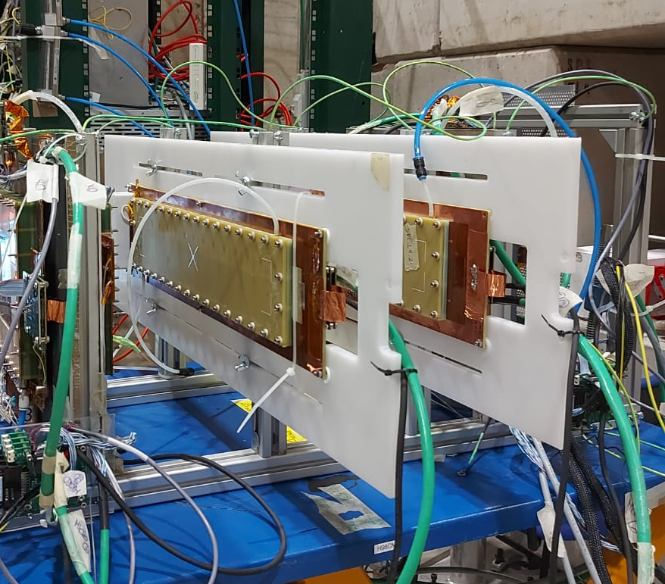
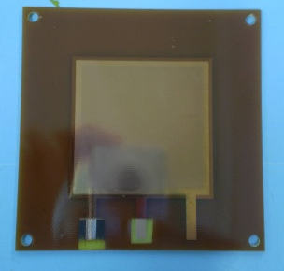
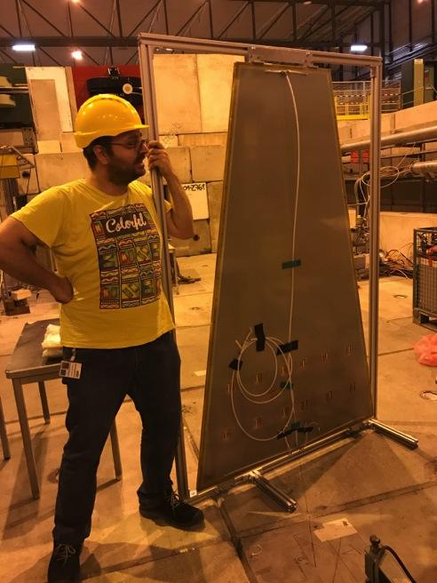
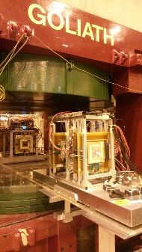
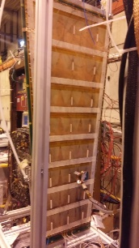
The R&D steps
R&D on low-rate layout
R&D on high-rate layout
Initial Concept in the 2009, but we really started the R&D on this new MPGD on the 2014
SRL
DRL
SG
PEP-Groove
PEP-Dot
R&D start
TT @ ELTOS
2009
2014
2015
2016
2017
2018
2019
2020
2021
2022
2023
2024
IDEA
slice test:
DC+
preshower+
dual_calo+muon
DLC
Resistivity
Readout segmentation
+
2D readout
2D readout
TIGER FEE
R&D on large area and 2D readout
G. Bencivenni, LNF-INFN – 2nd FCC Italy-France Workshop, Venezia 4th Nov 2024
5

Slide 6
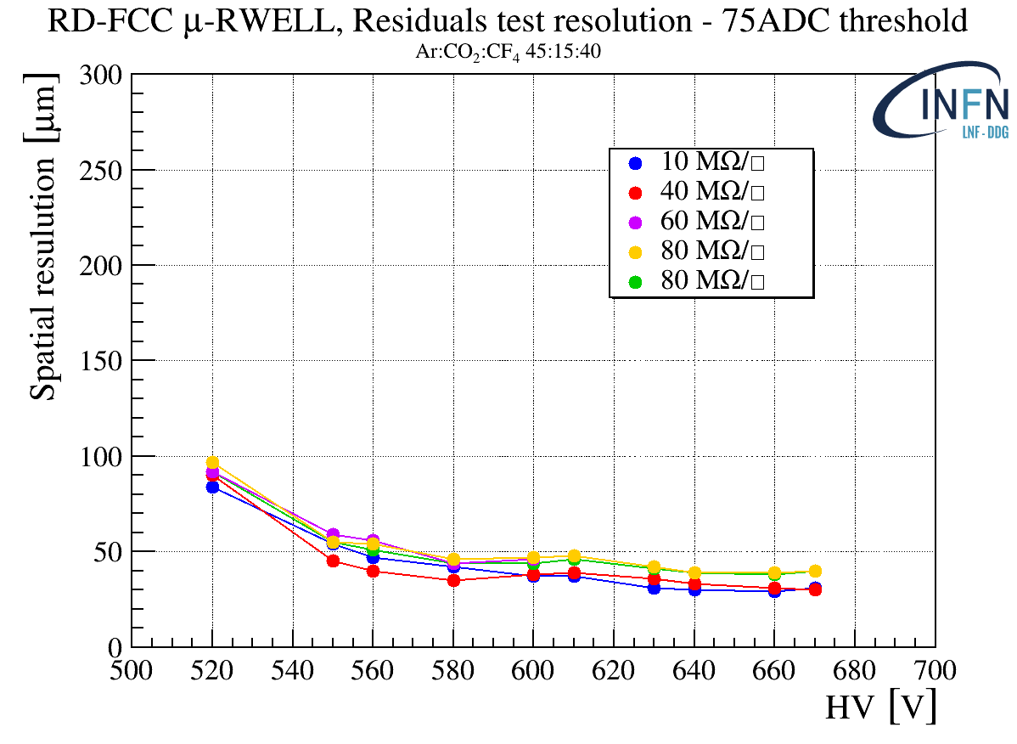
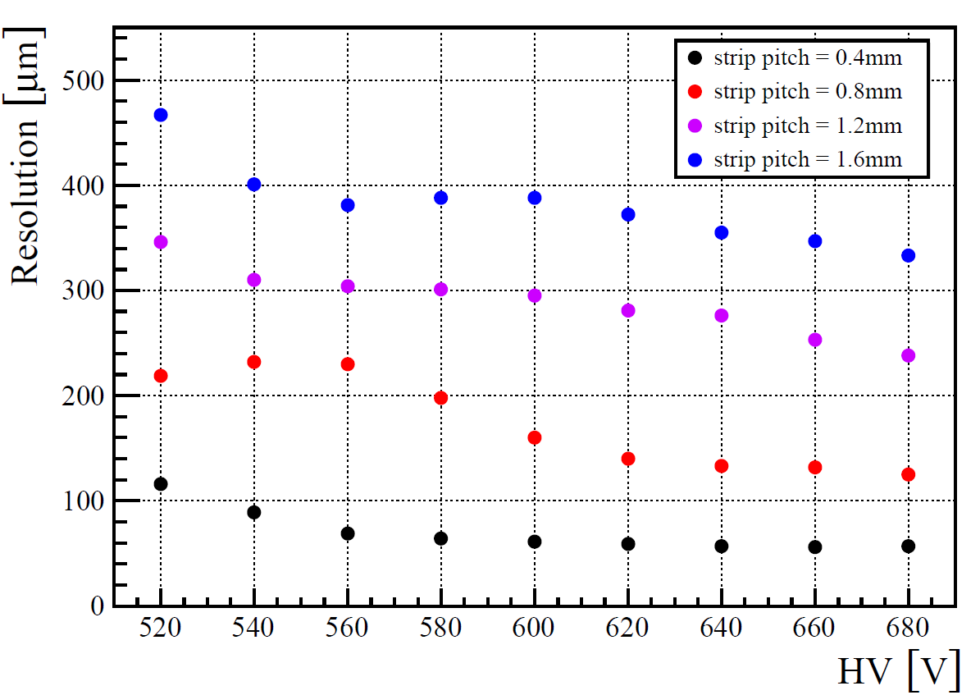
1-D Tracking studies
Resistivity scan
R/O pitch scan
With a 0.4 mm strip pitch and 0.15 mm strip width, no effects were observed within this resistivity range.
Additionally, DLC resistivity uniformity is not a critical parameter for spatial resolution.
Increasing the r/out strip pitch will reduce the spatial resolution: σ_{X} → √12⊗pitch
G. Bencivenni, LNF-INFN – 2nd FCC Italy-France Workshop, Venezia 4th Nov 2024
6

Slide 7
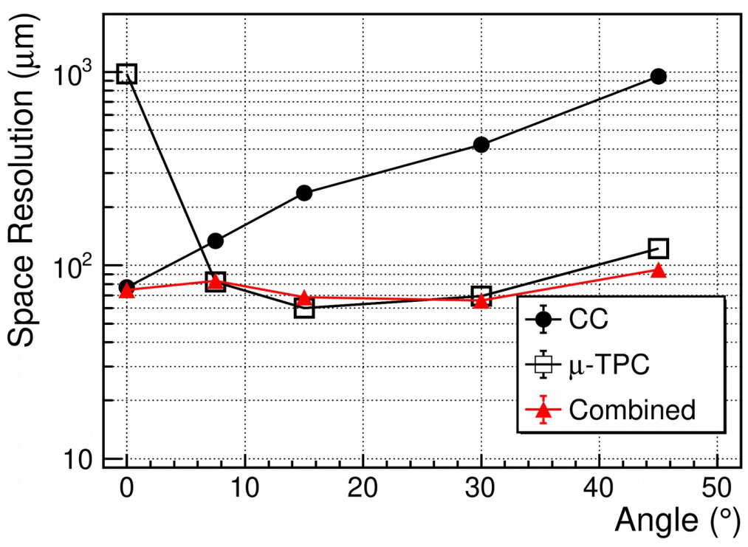
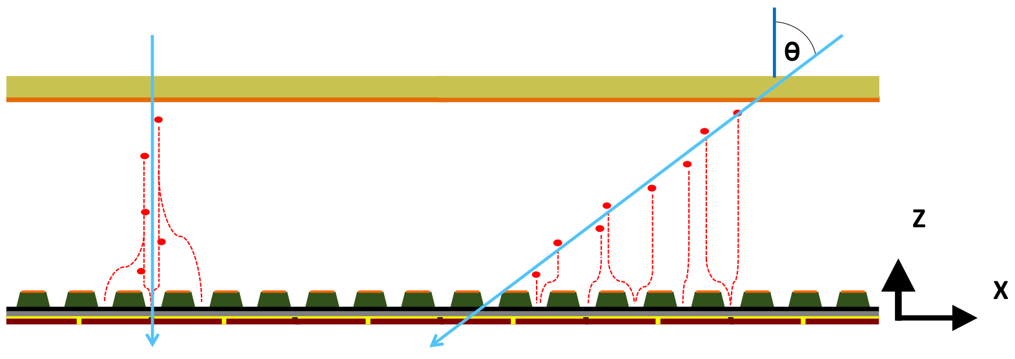
1-D tracking (inclined tracks)
M. Giovannetti et al., On the space resolution fo the μ-RWELL, 2020 JINST 16 P08036
For inclined tracks and/or in presence of high B fields, the charge centroid (CC) method gives a very broad spatial resolution on the anode-strip plane (typical effect observed on MPGDs).
Implementing the μTPC mode^{[1]}, using the knowledge of the drift time of the electrons each ionization cluster is projected inside the conversion gap, and the track segment in the gas gap is reconstructed.
1D Strip R/O: 400um pitch
CC
μTPC
Combining the CC and μTPC reconstruction (through a wheighted average) a resolution well below 100 μm could be reached over a wide incidence angle range.
[1] introduced for ATLAS MMs by T. Alexopoulos
G. Bencivenni, LNF-INFN – 2nd FCC Italy-France Workshop, Venezia 4th Nov 2024
7

Slide 8
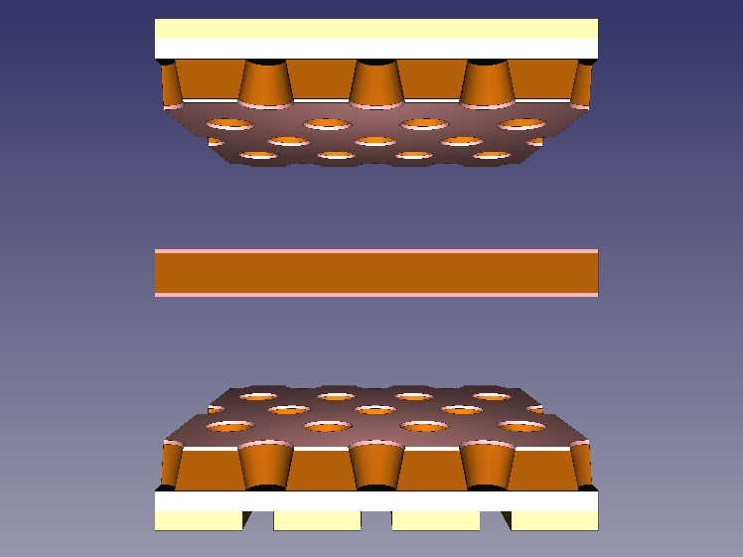

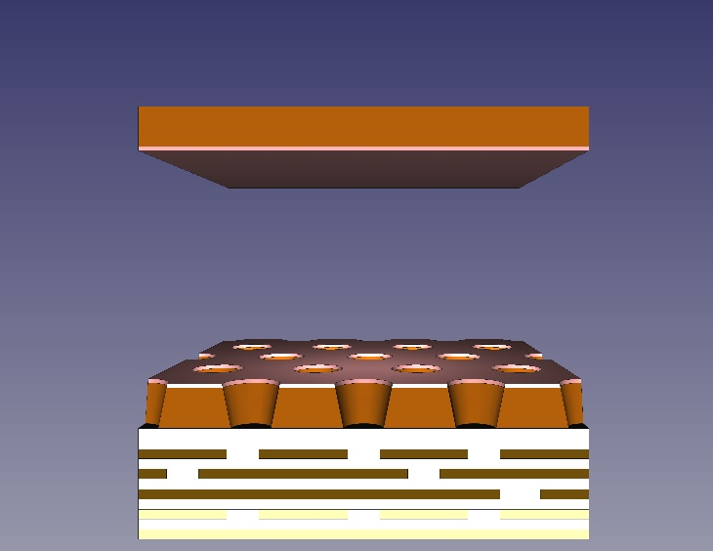
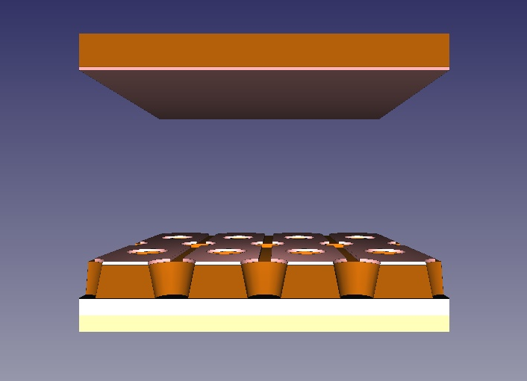
2-D Tracking layouts
N.2 u-RWELLs 1D (2⊗1D)
u-RWELL - Capacitive Sharing r/out
u-RWELL TOP r/out
Y-strips
Chatode
Chatode
Drift gap
Drift gap
Common Cathode
Drift gap
X-strips
Drift gap
Y-strips
X-strips
X-strips
Y-strips
Operation at lower gas gain wrt the «COMPASS» r/out (X-Y r/out decoupled)
- 0.4 mm (0.8mm) X-Y strip pitch for pre-shower (Muon).
The charge sharing is performed through the capacitive coupling between a stack of layers of pads and the r/out board.
- 1.2 mm X-Y strip pitch.
Reduce the FEE channels, but the total charge is shared between the X & Y r/out.
The TOP-readout layout allows to work at low gas gain wrt the «COMPASS» r/out (X-Y r/out decoupled).
- 0.8 mm X-Y strip pitch.
X strips patterned on the TOP of the amplification stage introduces dead zone in the active area.
G. Bencivenni, LNF-INFN – 2nd FCC Italy-France Workshop, Venezia 4th Nov 2024
8

Slide 9
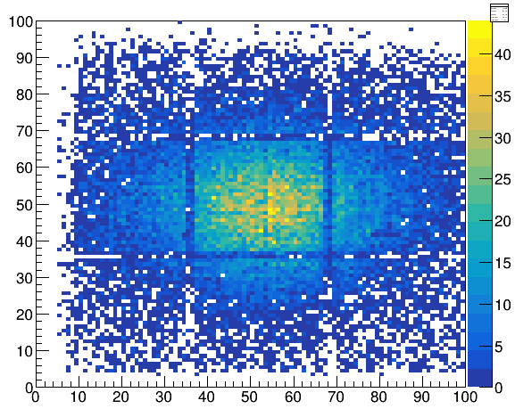
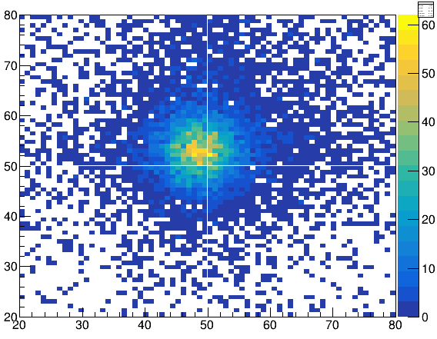
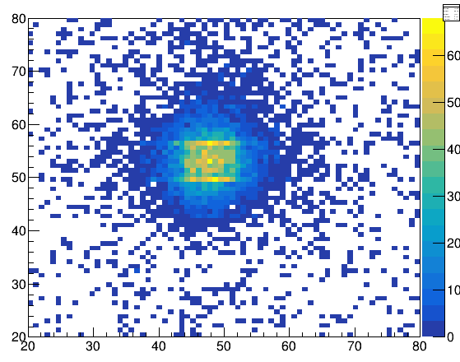
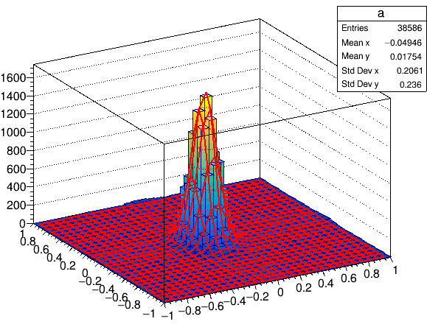
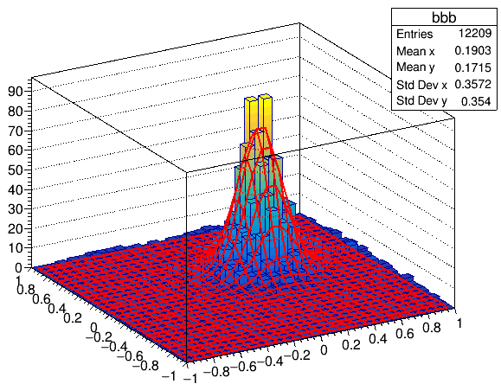
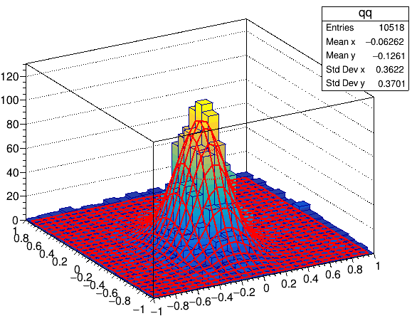
2D layouts performance
0.4 mm X-Y strip pitch
n.2 1D μ-RWELL [2×1D]
Capacitive Sharing
Top R/O
PROFILE 2D
RESIDUAL 2D
0.4 mm X-Y strip pitch
σ_{X} = 85µm
σ_{Y} = 121µm
1.2 mm X-Y strip pitch
σ_{X} = 142 µm
σ_{Y} = 147 µm
0.8 mm X-Y strip pitch
σ_{X} = 173 µm
σ_{Y} = 250 µm
G. Bencivenni, LNF-INFN – 2nd FCC Italy-France Workshop, Venezia 4th Nov 2024
9

Slide 10
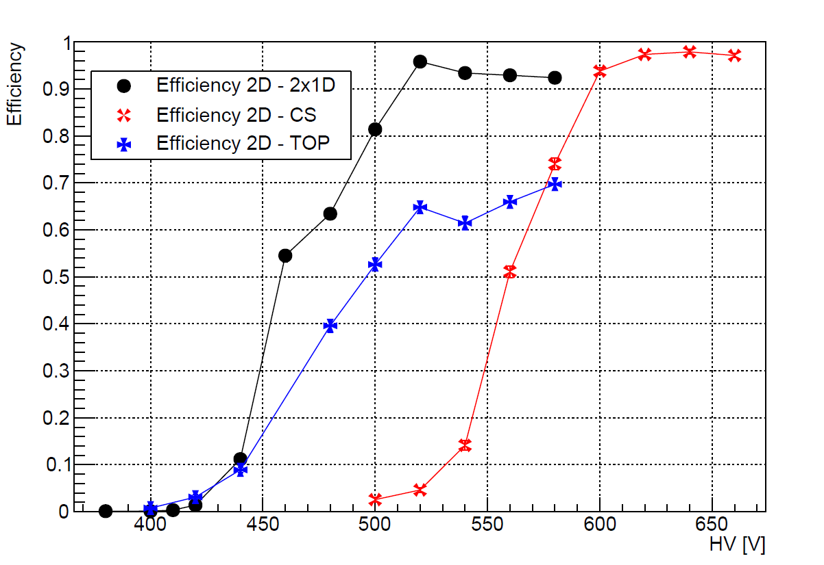
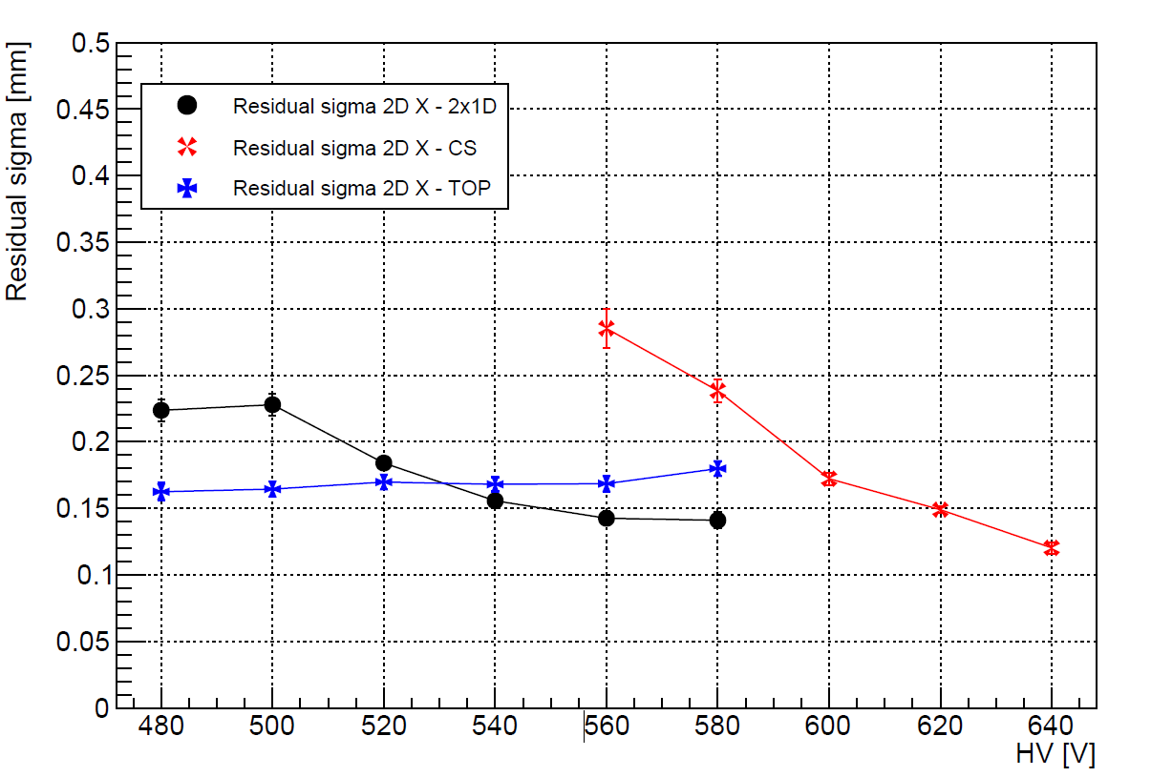
2D layouts performance
2D layouts – 10x10 cm²
2D layouts – 10x10 cm²
2x1D: spatial resolution < 200µm (pitch 0.8 mm), low voltage operating point ∼520V, efficiency ∼ 95%
CS: spatial resolution <200µm (with pitch 1.2 mm), high voltage operating point, ≥ 600V, efficiency ∼ 98%
Top r/out: spatial resolution < 200µm (pitch 0.8 mm), low voltage operating point ∼520V, efficiency ∼70%
G. Bencivenni, LNF-INFN – 2nd FCC Italy-France Workshop, Venezia 4th Nov 2024
10

Slide 11
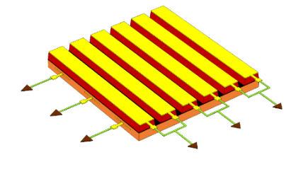
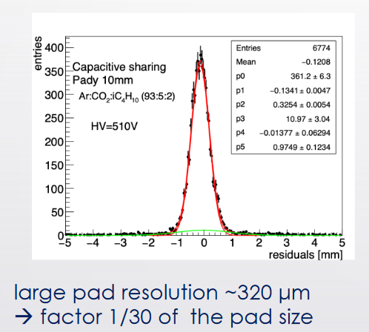
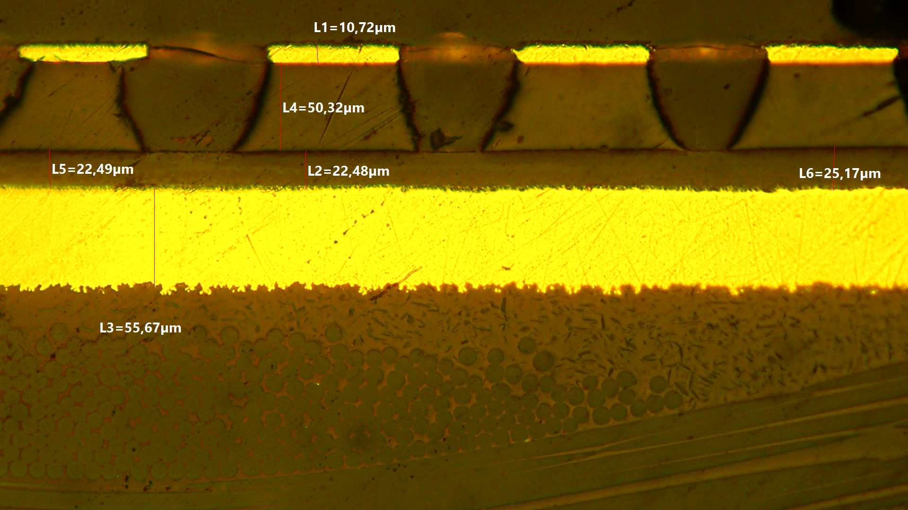
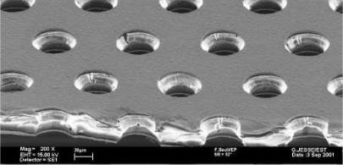
New technology solutions
2D-readout (XY) μRGroove
Y strips
X strips
µ-RGroove → evolution of the top/r-out layout, where the amplification stage is based on «grooves» rather than «wells». This design could facilitate the implementation of the strip readout on the top, without introducing dead-zones ( Z. Yi in RD51).
µ-RWELL with CS layout with pad readout → new design in which the readout PCB is segmented into pads instead of strips. This choice allows for collecting all the charge on a single readout electrode with an increase of FFE channels (30%). With a pad size of ∼ 1 cm², a spatial resolution of ∼ 300 µm has been achieved (M. Iodice in RD51).
GEM + µ-RWELL with CS layout with strip/pad readout → a hybrid design featuring a GEM pre-amplification stage to lower the operating point, greatly enhancing detector stability while maintaining high spatial performance with millimeter strip-pitches
Z. Yi
M. Iodice
Cathode
Drift Gap: 6mm
Transfer Gap: 3mm
G. Bencivenni, LNF-INFN – 2nd FCC Italy-France Workshop, Venezia 4th Nov 2024
11

Slide 12
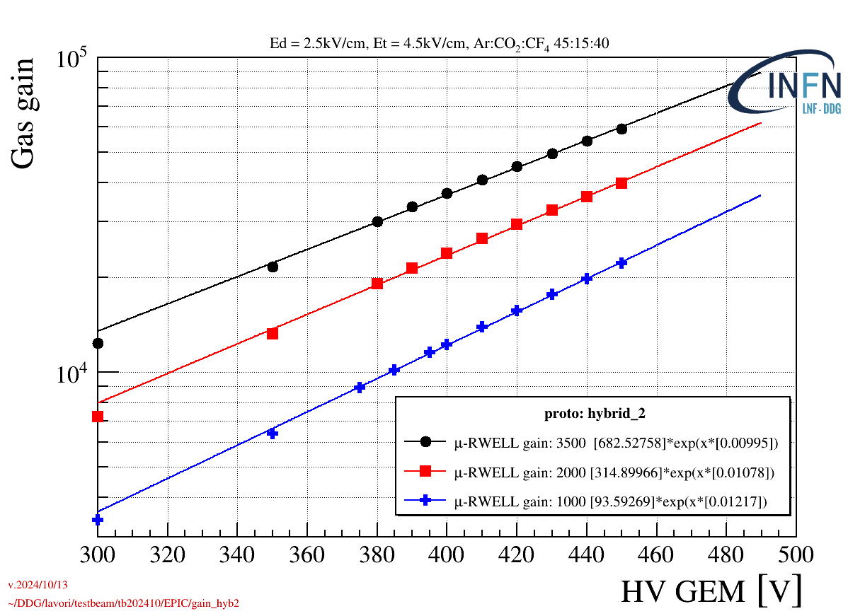
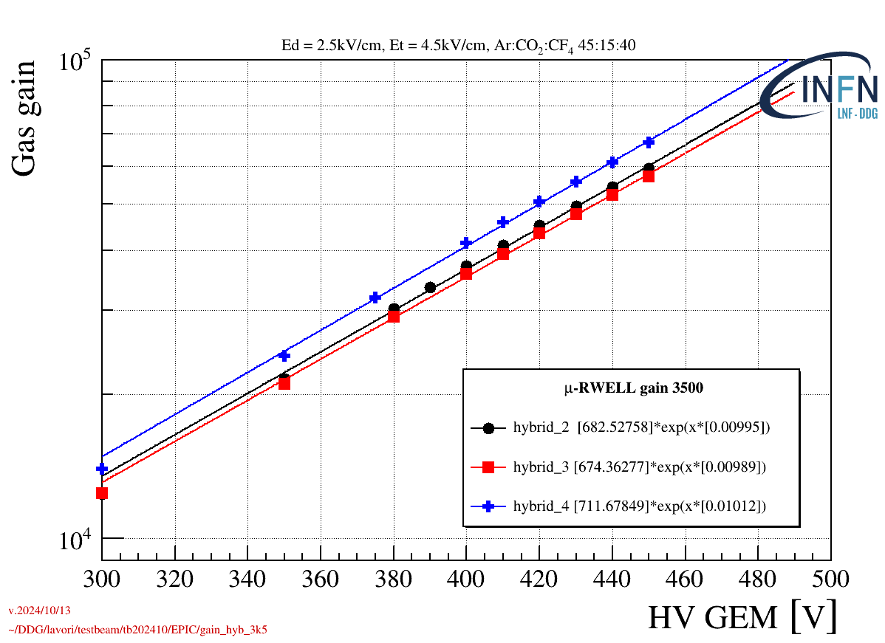
GEM + µ-RWELL
3 different gains for the μ-RWELL
3 different detectors
μ-RWELL gain @ 3500
60k
μ-RWELL 3500
μ-RWELL 2000
μ-RWELL 1000
GEM gain
@ 450V ≈ 20
A very stable detector: it doesn’t show any hint of instabilities even at a gain of 60k.
We stopped because the FEE saturates.
G. Bencivenni, LNF-INFN – 2nd FCC Italy-France Workshop, Venezia 4th Nov 2024

Slide 13
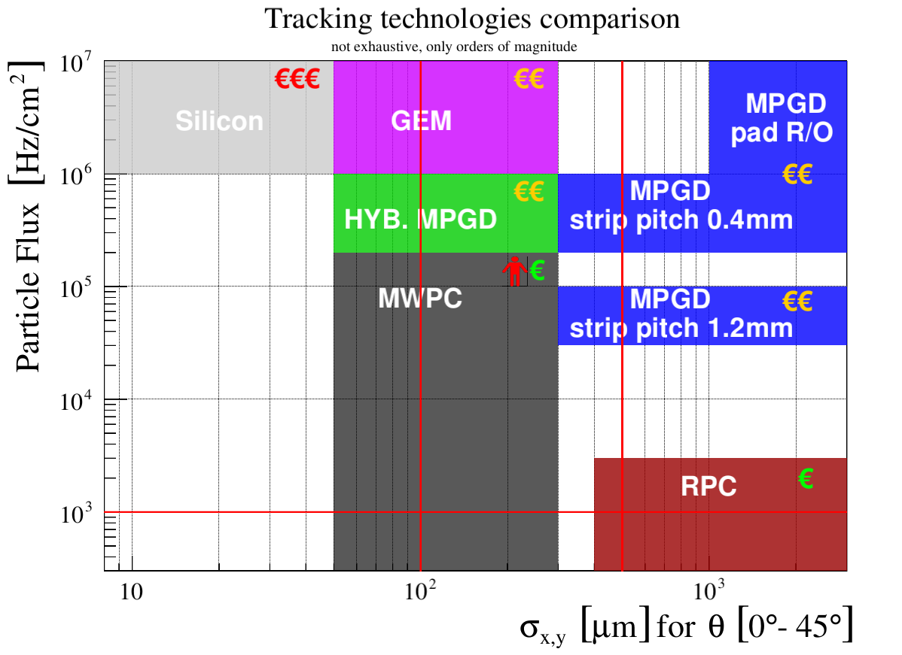
Tracking technologies comparison
well below 10 µm
Muon
Pre-shower
G. Bencivenni, LNF-INFN – 2nd FCC Italy-France Workshop, Venezia 4th Nov 2024
13

Slide 14
Technology Transfer to Industry
G. Bencivenni, LNF-INFN – 2nd FCC Italy-France Workshop, Venezia 4th Nov 2024
14

Slide 15

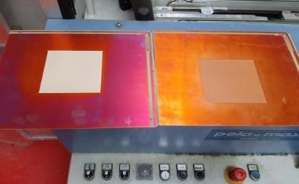
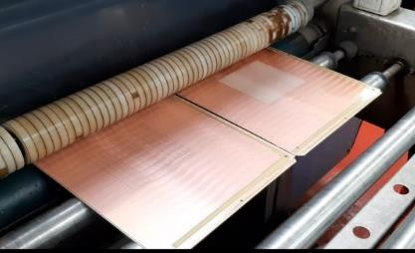
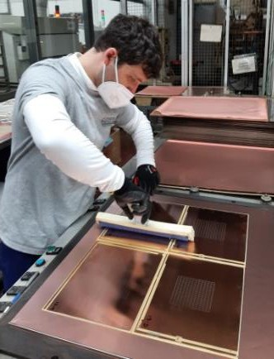
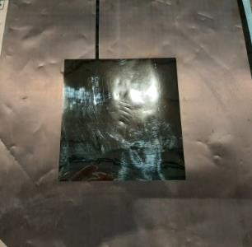
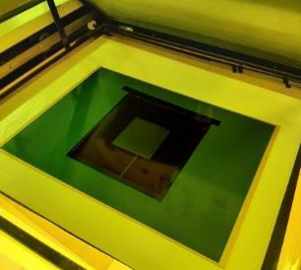
Detector Manufacturing & TT
The μ-RWELL_PCB is a rigid-flex PCB based on SBU technology, that is compatible with standard industrial processes.
The ELTOS is the industrial partner involved in the manufacturing of the µ-RWELL.
The ELTOS SpA was founded in 1980 in Arezzo, Italy.
The Company has a large experience in the construction of MPGDs, including technologies such as Thick-GEM (THGEM) and MicroMegas.
The involvement of a private industry in this R&D opens the way for the use of μ-RWELL technology across various fields of applications.
G. Bencivenni, LNF-INFN – 2nd FCC Italy-France Workshop, Venezia 4th Nov 2024
15

Slide 16
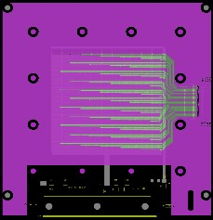
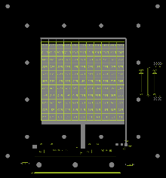

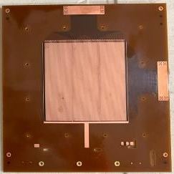


Detector Manufacturing flow chart
LAYOUT design
Feedback from tests
PCB production
Final detector
manufacturing
DLC foil production
G. Bencivenni, LNF-INFN – 2nd FCC Italy-France Workshop, Venezia 4th Nov 2024
16

Slide 17













Detector manufacturing steps
1
Step 0 – Detector PCB design @ LNF
Step 1 – CERN_INFN DLC (C.I.D) sputtering machine installed @ CERN
  In operation since Nov. 2022
  Production by LNF-INFN technical crew
Step 2 – Producing readout PCB by ELTOS
  pad/strip readout
Step 3 – DLC patterning by ELTOS
  photo-resist → patterning with BRUSHING-machine
Step 4 – DLC foil gluing on PCB by ELTOS
  Large press available, up to 16 PCBs workable simultaneously
Step 5 – Top copper patterning by CERN
  Cu amplification holes image and HV connections by Cu etching
Step 6 – Amplification stage patterning by CERN
    PI etching → amplification-holes
Step 7 – Electrical cleaning and detector closure @ CERN
3
0
4
5- 6
7
G. Bencivenni, LNF-INFN – 2nd FCC Italy-France Workshop, Venezia 4th Nov 2024
17

Slide 18





DLC sputtering
The CID (CERN-INFN-DLC) sputtering machine, a joint project between CERN and INFN, is used for preparing the base material of the detector. The potential of the DLC sputtering machine is:
Flexible substrates up to 1.7×0.6m²
Rigid substrates up to 0.2×0.6m²
In 2023, the activity on CID focused on the tuning of the machine on small foils: good results in terms of reproducibility and uniformity.
In 2024, the challenge has been the sputtering of large foils:
DLC+Cu sputtering on 0.8×0.6m² successfully done (May/June 2024)
DLC on 1.7×0.6m² large 0/50/0 Apical foils successfully done (June 2024)
DLC on 1.7×0.6m² large 5/50/0 Apical foils still to be done (July 2024)
C.I.D.
220 +/- 30 MOHm/sq
The graphite target
The three external cathodes
G. Bencivenni, LNF-INFN – 2nd FCC Italy-France Workshop, Venezia 4th Nov 2024
18

Slide 19


Electrical Hot Cleaning
Pilot co-production test
@ CERN
@ LNF
At the end of the manufacturing process at CERN, a conditioning procedure is performed:
Standard PCB washing
Electrical cleaning in dry air (90°C in an oven) from 300 V to 700 V (each step with current < 1 nA)
Detector closure and final test at 600 V in ambient air
The 16 co-produced prototypes have been extensively tested with X-rays:
15/16 are fine
1/16 needs to be re-cleaned
Production yield > 93%
G. Bencivenni, LNF-INFN – 2nd FCC Italy-France Workshop, Venezia 4th Nov 2024
19

Slide 20

Co-production pilot results
16 co-produced protos have been delivered and tested
10/16 (LNF) + 5/16 (CERN) are fine
1/16 should be re-cleaned
Characterized with X-ray gun → Gas gain measurement
G. Bencivenni, LNF-INFN – 2nd FCC Italy-France Workshop, Venezia 4th Nov 2024
20

Slide 21

Max-gain vs resistivity
16 co-produced protos have been delivered and tested
10/16 (LNF) + 5/16 (CERN) are fine
1/16 should be re-cleaned
The maximum gain is larger for ρ ≥ 40 MOhm/square
G. Bencivenni, LNF-INFN – 2nd FCC Italy-France Workshop, Venezia 4th Nov 2024
21

Slide 22


Max-gain: large size vs small size
CS_01 13 MOhm/sq, area 46x38 cm²
M2R1 260 MOhm/sq, area 30x25 cm²
For large-size detectors, the max-gain increases with the DLC resistivity, although, compared to the small-size detectors, the gain curve for the larger size is shifted towards lower values.
G. Bencivenni, LNF-INFN – 2nd FCC Italy-France Workshop, Venezia 4th Nov 2024
22

Slide 23
Summary
The μ-RWELL is a well-established technology with excellent performance.
Several 2D readout layouts have been tested, demonstrating spatial resolution up to 100 µm over a large particle incidence angle range (0°- 45°).
New layouts to improve stability, maximize gain, and enhance overall detector performance are under study.
A significant effort is being made to well define and simplify the manufacturing process and facilitate the technology transfer to industry.
The DLC sputtering process — a crucial manufacturing step— is now fully under our control.
G. Bencivenni, LNF-INFN – 2nd FCC Italy-France Workshop, Venezia 4th Nov 2024
23

Slide 24




MANY
THANKS
G. Bencivenni, LNF-INFN – 2nd FCC Italy-France Workshop, Venezia 4th Nov 2024
24

Slide 25
SPARE SLIDES

Slide 26
References
G. Bencivenni et al., The micro-Resistive WELL detector: a compact spark-protected single amplification-stage MPGD, 2015 JINST 10 P02008
G. Bencivenni et al., The μ-RWEL detector, 2017 JINST 12 C06027
G. Bencivenni et al., Performance of μ-RWELL detector vs resistivity of the resistive stage, Nucl. Instrum. Meth. A 886 (2018) 36.
G. Bencivenni et al., The μ-RWELL layouts for high particle rate, 2019 JINST 14 P05014
G. Bencivenni et al., On the space resolution of the μ-RWELL, 2020 JINST 16 P08036
A.Ochi et al., Carbon sputtering Technology for MPDG detectors, PoS(TIPP2014)351 (2014)..
G. Bencivenni, LNF-INFN – 2nd FCC Italy-France Workshop, Venezia 4th Nov 2024
26

Slide 27

Front end electronics: TIGER
TIGER chip features
64 channels
Event rate 100 kHz/ch
Input dynamic range up to 50 fC
Time resolution < 5 ns
ENC < 2000 e⁻ rms with 100 pF input capacitance
Readout chain
The full readout chain is well known.
A complete setup is under deployment in Beijing for the BESIII CGEM-IT where a cosmic ray data taking is ongoing since Dec. 2019
G. Bencivenni, LNF-INFN – 2nd FCC Italy-France Workshop, Venezia 4th Nov 2024
27

Slide 28




WP5 2024 – Front-end electronics
Detector under test:
Active area = 400x50 mm²
Resistivity = 80 MΩ/□
Strip pitch = 0.4-1.6 mm
Strip width = 0.15 mm
1D readout
The data taking consisted of HV scan, Drift scan and Thr. scan, with Ar:CO₂:CF₄
charge [fQ]
Data analysis is ongoing, and will be the task of the next months
charge [fQ]
time [ns]
G. Bencivenni, LNF-INFN – 2nd FCC Italy-France Workshop, Venezia 4th Nov 2024
28

Slide 29





WP5 2024 – Front-end electronics
Similar results are obtained with TIGER electronics and APV, even though small differences are present in the two setups (noise, threshold): 1-2 fC with APV and 2-4 fC with TIGER.
The grounding scheme must be improved in future setups.
A spatial resolution of 100 µm is achieved with a 0.4 mm strip pitch, a shift between the efficiency plateaus of 0.4 mm and 0.8 mm pitch is observed, as expected (due to larger noise on the 0.8 mm detector)
Pitch scan comparison TIGER - APV
APV
TIGER
TIGER
G. Bencivenni, LNF-INFN – 2nd FCC Italy-France Workshop, Venezia 4th Nov 2024
29

Slide 30


Testing CF₄-free gas mixtures
The gas mixtures based on CF₄ are effective for fast electron drift but are not considered eco-friendly.
Alternatives to CF₄ are needed. Here, we compare the performance of a μ-RWELL using Ar:CO₂ (70/30) and Ar:CO₂:CF₄ (45:15:40). A shift in the working point of approximately 50-100V is observed due to the different Argon ratios, along with a reduction in the plateau width of about 50V.
G. Bencivenni, LNF-INFN – 2nd FCC Italy-France Workshop, Venezia 4th Nov 2024
30

Slide 31


Testing CF₄-free gas mixtures
Comparing the time performance of the two gas mixtures:
12 ns is achieved with Ar with Ar:CO₂
7.8 ns is achieved with Ar:CO₂:CF₄
The contribution of the electronics (approximately 2 ns) and time-walk are included.
Preliminary
Preliminary
G. Bencivenni, LNF-INFN – 2nd FCC Italy-France Workshop, Venezia 4th Nov 2024
31

Slide 32


Spot Effect for SRL – Manufacturer plot
From the mathematical model of the resistive stage of a μ-RWELL:
1. detectors with same size but different resistivity exhibit a rate capability scaling as the inverse of their resistivity.
2. for the SRL, increasing the active area from 10x10 cm² to 50x50 cm² the rate capability should go down few kHz/cm²
3. By using a DLC ground sectoring every 10 cm, large (50x50cm²) detectors could achieve rate capability up to 100kHz/cm² (with X-ray)
10x10 cm²
× 1/3
50x50 cm²
Different primary ionization ⇒
Rate Cap.m.i.p. = 3×Rate Cap.X-ray
G. Bencivenni, LNF-INFN,
32

Slide 33





Irradiation test of DLC and μ-RWELL
Bare DLC foils
DLC foils: monitoring of the resistivity of two foils under x-ray irradiation.
μ-RWELL detectors: prototypes irradiated with different radiation.
500mC/cm²
600mC/cm²
μ-RWELL DETECTORS
X-Ray gun- spot 50 cm²
Φ ~ 700 kHz/cm²
PSI-1, beam spot ~ 9 cm²
Φ ~ 10 MHz/cm²
GIF++ - Full area, Flux ~ 200 kHz/cm²
90mC/cm²
125mC/cm²
175mC/cm²
G. Bencivenni, LNF-INFN – 2nd FCC Italy-France Workshop, Venezia 4th Nov 2024
33

Slide 34

μ-RWELL + GEM
Cathode
Drift Gap: Shekhtman 3mm – LNF+Roma2 6mm
Transfer Gap: Shekhtman 3mm – LNF+Roma2 3mm
Developed for CMD3 upgrade disks (4 sectors 50×50cm²)
The GEM must be stretched: sizes larger than 50×50cm² could be critical (depending on the gas gaps size).
L. Shekhtman, Nuclear Inst. and Methods in Physics Research, A 936 (2019) 401–404
G. Bencivenni, LNF-INFN – 2nd FCC Italy-France Workshop, Venezia 4th Nov 2024
34

Slide 35


μ-RWELL + GEM: gas gain
μ-RWELL
μ-RWELL + GEM
G~60000
G~2000
L. Shekhtman, Nuclear Inst. and Methods in Physics Research, A 936 (2019) 401–404
G. Bencivenni, LNF-INFN – 2nd FCC Italy-France Workshop, Venezia 4th Nov 2024
35

Slide 36

Low Mass μ-RWELL
G. Bencivenni, LNF-INFN – 2nd FCC Italy-France Workshop, Venezia 4th Nov 2024
36

Slide 37








Technology spread
In the last years there has been a significant spread of the technology among several research groups working on Nuclear and Sub-Nuclear experiments
CLAS12 @ JLAB (USA): the upgrade of the muon spectrometer
EPIC @EIC (BNL - USA): endcap tracker disks based on a hybrid GEM$+µRWELL$technology
X17 @ n_TOF EAR2 (CERN):TPC with a $µRWELL based$amplification stage, for the detection of the X17 boson
TACTIC @ YORK Univ. (UK): radial TPC for detection of nuclear reactions with astrophysical significance
Muon collider: R&D for a digital hadron calorimeter
CMD3 (RU): GEM+ $µ$RWELL disk for the upgrade of the tracking system
UKRI (UK): thermal neutron detection with pressurized ³He-based gas mixtures
4
6
1
2
3
5
7
G. Bencivenni, LNF-INFN – 2nd FCC Italy-France Workshop, Venezia 4th Nov 2024
37

Slide 38





High-rate layouts evolution
G. Bencivenni et al., The μ-RWELL layouts for high particle rate, 2019 JINST 14 P05014
Extensive R&D has been performed to optimize the DLC grounding, enabling the detector to withstand up to 1MHz/cm²
2014 - 2016
2017
Single Resistive Layer
Double Resistive Layer
Single DLC layer with edge conductive line
2-D current evacuation
rate capability < 100 kHz/cm²
Easy for industry
Two stacked resistive layers with a double matrix of conductive vias
3-D current evacuation
Rate capability > 10MHz/cm²
Complex manufacturing not easily engineered
2021/22
Silver Grid
PEP Groove (Patterning – Etching -Plating)
2018 - 2020
Single DLC layer
2-D current evacuation: conductive grid by etching from the top Cu, through the kapton foil down to the DLC
No grid alignment issues, scalable to large size – large dead zone (>15%)
Easily engineered, because based on SBU technology
Single DLC layer
2-D current evacuation through conductive grid on the DLC layer
rate capability > 10MHz/cm²
Easily engineered, BUT complex Cu+DLC sputtering/alignment
G. Bencivenni, LNF-INFN
38
38

Slide 39






High-rate layouts: PEP layouts comparison
2022
2023
PEP-Groove:
DLC grounding through conductive groove to ground line
Pad R/O = 9×9mm²
Grounding:
- Groove pitch = 9mm
- width = 1.1mm
→ 84% geometric acceptance
PEP-DOT:
DLC grounding through conductive dots
connecting the DLC with pad r/outs
Pad R/O = 9×9mm²
Grounding:
- Dot pitch = 9mm
- dot rim = 1.3mm
→ 97% geometric acceptance
DOT ≈ plated blind vias
Dead area 1.1 mm
Dead area 1.305 mm
Cu 0.142 mm
GND 0.35 mm
0.23 mm
GND 0.767 mm
DOCA 0.48 mm
Cu 0.094 mm
0.175 mm
DOCA 0.535 mm
G. Bencivenni, LNF-INFN,
39

Slide 40





Groove vs DOT (X-ray characterization)
PEP-Groove layout
PEP-DOT layout
2022
2023
Both layouts exhibit satisfactory performance:
gas gain up to 10⁴
rate capability (@ 90% gain drop) > 10 MHz/cm² , measured with different irradiation spot size.
G. Bencivenni, LNF-INFN,
40

Slide 41





Groove vs DOT (test beam characterization)
APV25 based Fee
PEP-Groove layout
PEP-Dot layout
DOT
Groove
DOT
Groove
G. Bencivenni, LNF-INFN,
41

Slide 42


PEP DOT – time performance (preliminary)
FATIC based Fee
DOT layout
σt ~7ns
CF4 gas mixture
Thr = 6.5 fC
HV = 620 V
Gas Gain = 6000
TB-2023 at H8C with preliminary version of the FATIC chip (developed by Bari Group) in the framework of the R&D for the LHCb-Muon upgrade. A new test beam foreseen next Nov. ‘24 with an updated version of the ASIC, aiming to reduce the FEE thr down 3 – 3.5 fC
G. Bencivenni, LNF-INFN,
42

Slide 43


Detector washing and electrical cleaning
At LNF, we are installing a detector washing station with a stainless-steel tank and a high-pressure car-washing machine using deionized water.
After washing, the detector is placed in an oven at 90°C. After 24 hours, it is gradually powered by increasing voltage from 300V to 680V, following Rui's guidelines.
G. Bencivenni, LNF-INFN – 2nd FCC Italy-France Workshop, Venezia 4th Nov 2024
43

Slide 44



The DOCA
A study born with
the SG μ-RWELL
The DOCA (before discharge) as a function of the DLC resistivity, for different voltages.
The study has been performed with a custom tool, with two thin conductive movable tips.
Cross-section of a μ-RWELL with a conductive line on the DLC (High-Rate scheme).
The concept of DOCA (Distance-Of-Closest-Approach) before discharge is fundamental for the stability of the detector.
The DOCA is defined as the distance between the edges of the conductive lines and its closest amplification hole.
G. Bencivenni, LNF-INFN – 2nd FCC Italy-France Workshop, Venezia 4th Nov 2024
44

Slide 45



Prepreg thickness optimization
28µm thick prepreg maximize both the amplitude of the signal induced on the pad readout, and S/N ratio (measurement done with APV25)
G. Bencivenni, LNF-INFN – 2nd FCC Italy-France Workshop, Venezia 4th Nov 2024
45

