Slide 1



Resistive Plate Chamber for the Muon apparatus
Acknowledge
Many thanks to Bencivenni, Giacomelli, Laktineh, Lee, Poli Lener, Ramos for useful discussions and support.
On behalf of the RPC community and participants to RPC2024

Slide 2
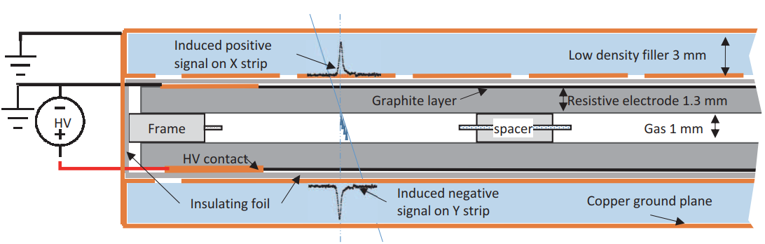
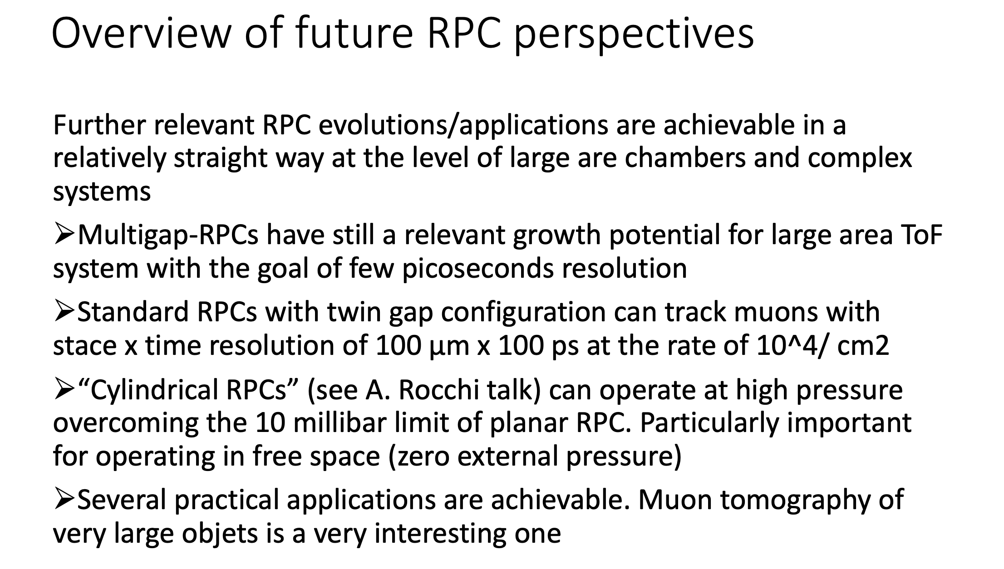
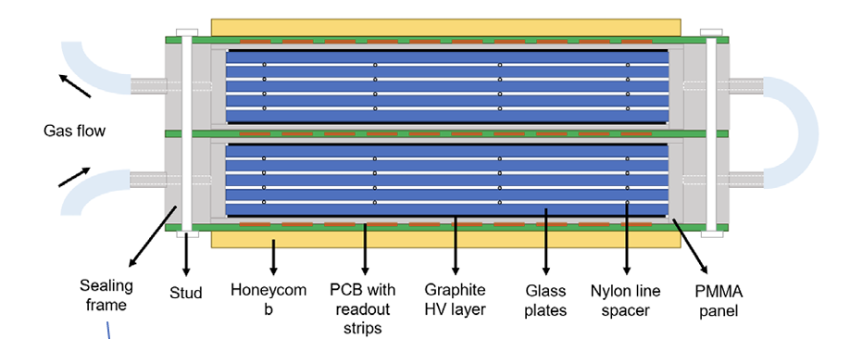
RPC2024 conference outlook
Standard RPC
Statement from prof. Santonico
Multigap RPC

Slide 3
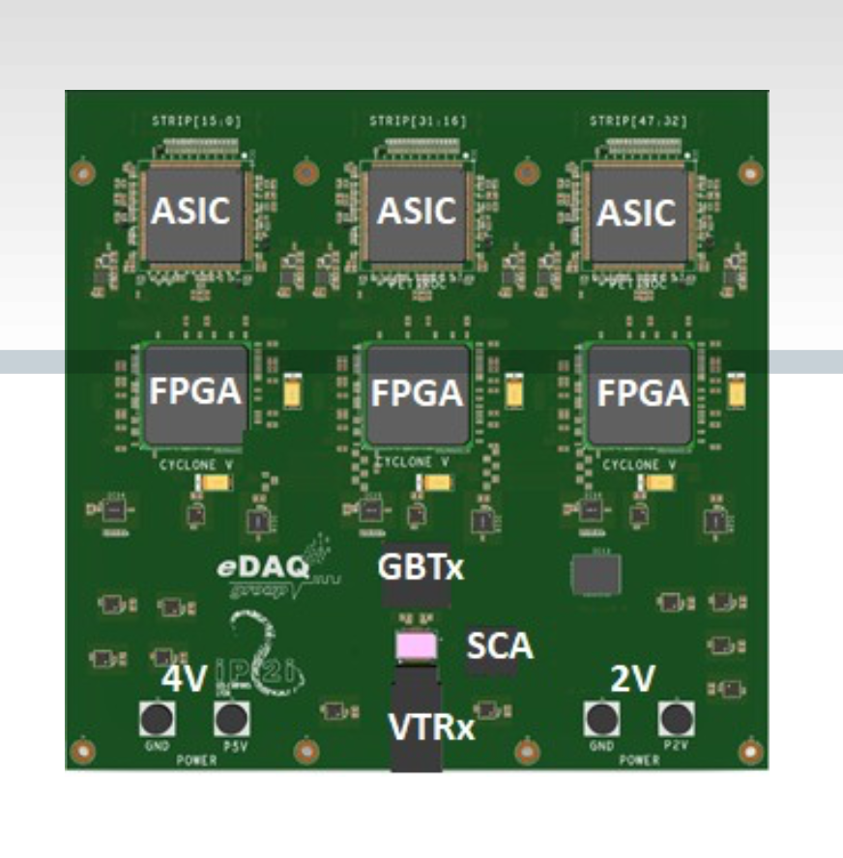
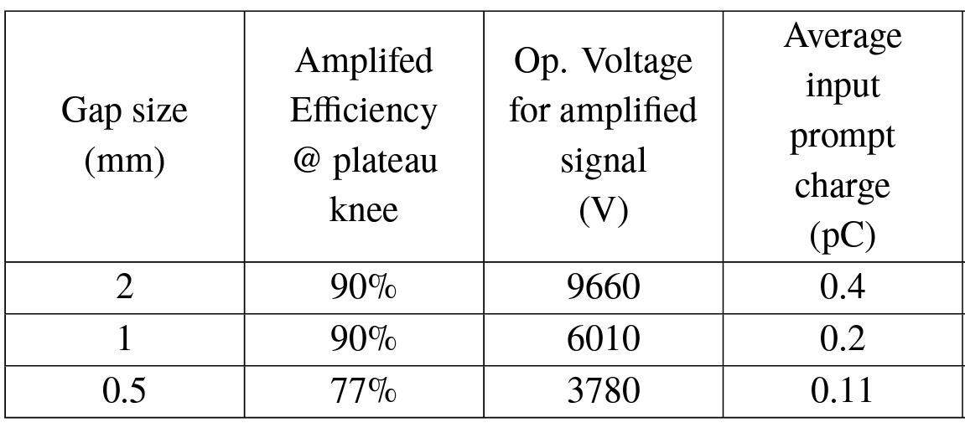
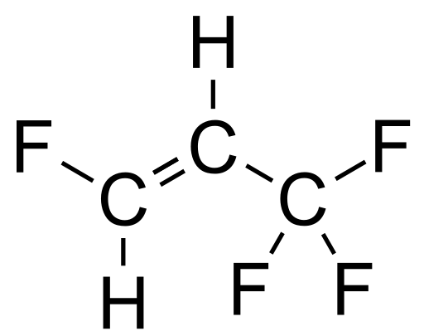
Evolution of “standard RPC”
Detector
Decrease gas gap
Decrease electrode thickness
Double gap concept, decrease the charge on a single gap, study new electrodes
Fron-end
Improve front end to achieve order 10 fC threshold sensitivity and low noise
Study Eco-friendly mixtures
Operation

Slide 4
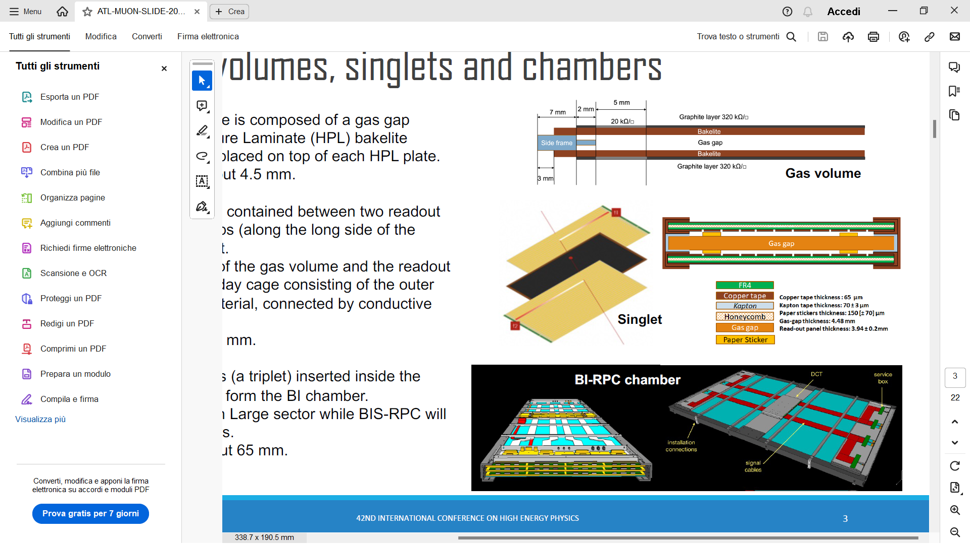
The ATLAS RPC upgrade for LHC
New gap layout
New thin-gap RPCs (1 mm)
Improved time resolution (0.4 ns) for time-of-flight measurements
Gas-gap thickness: reduced from 2 mm to 1 mm.
Electrode thickness: reduced from 1.8 mm to 1.4 mm
1 mm gap
Courtesy of Paolo Camarri

Slide 5
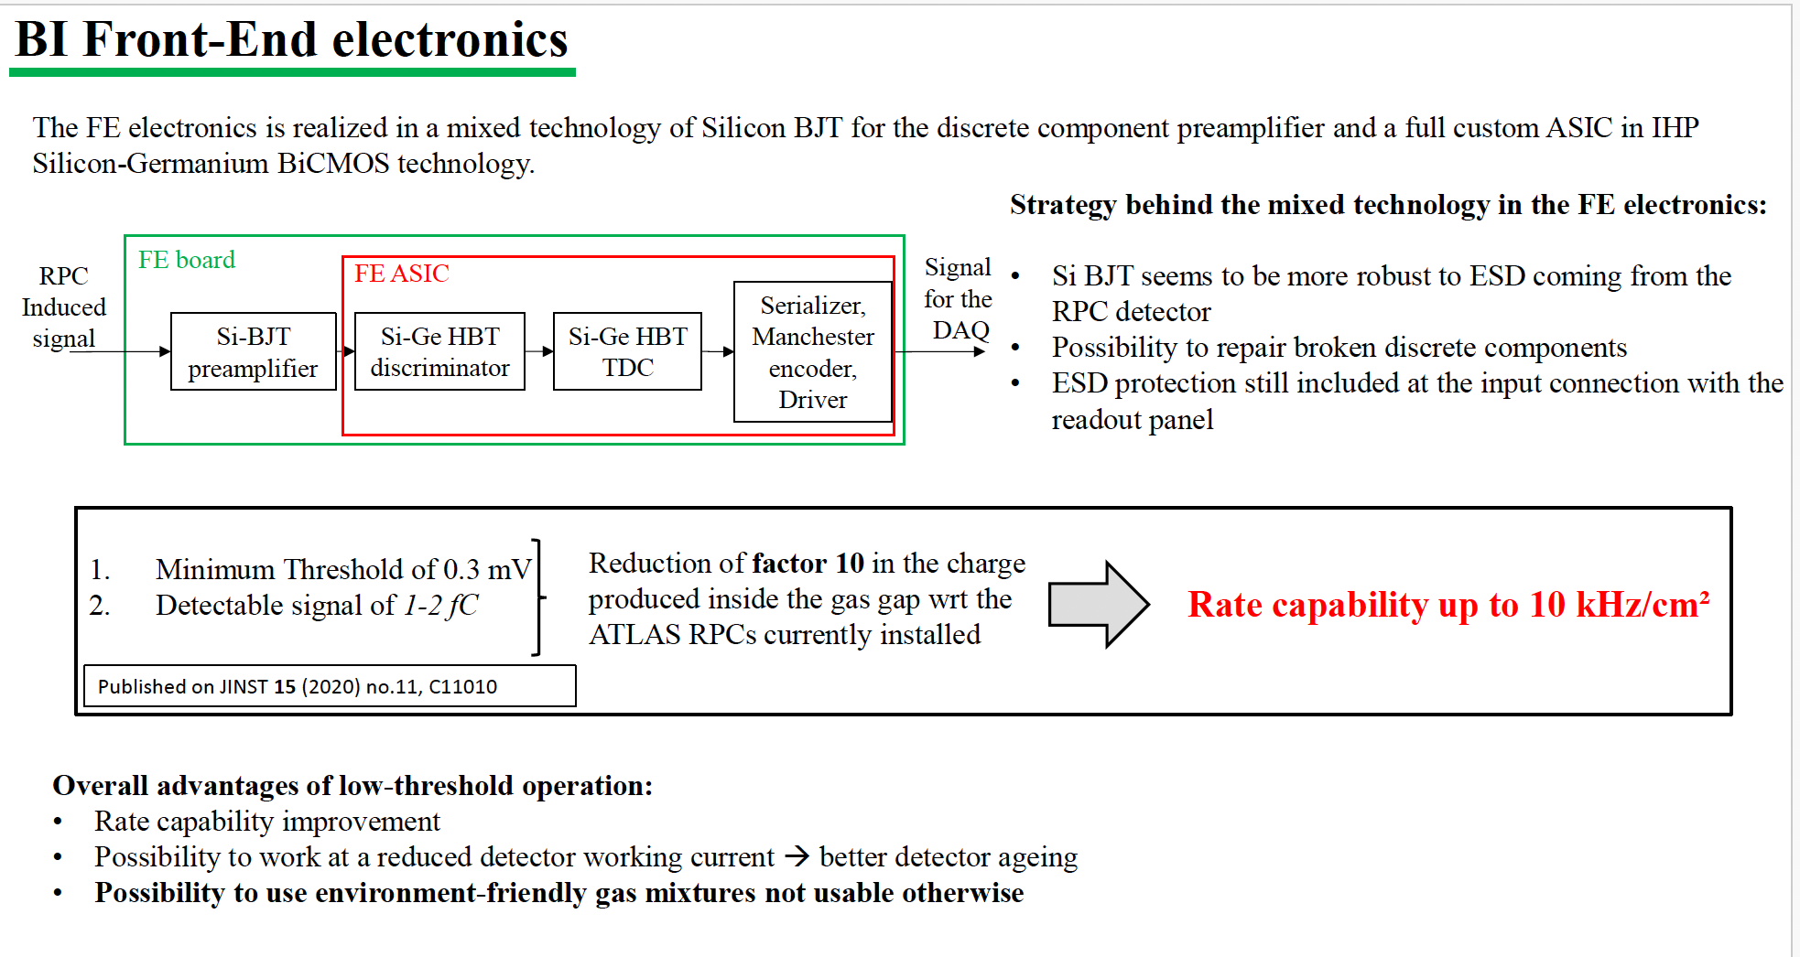
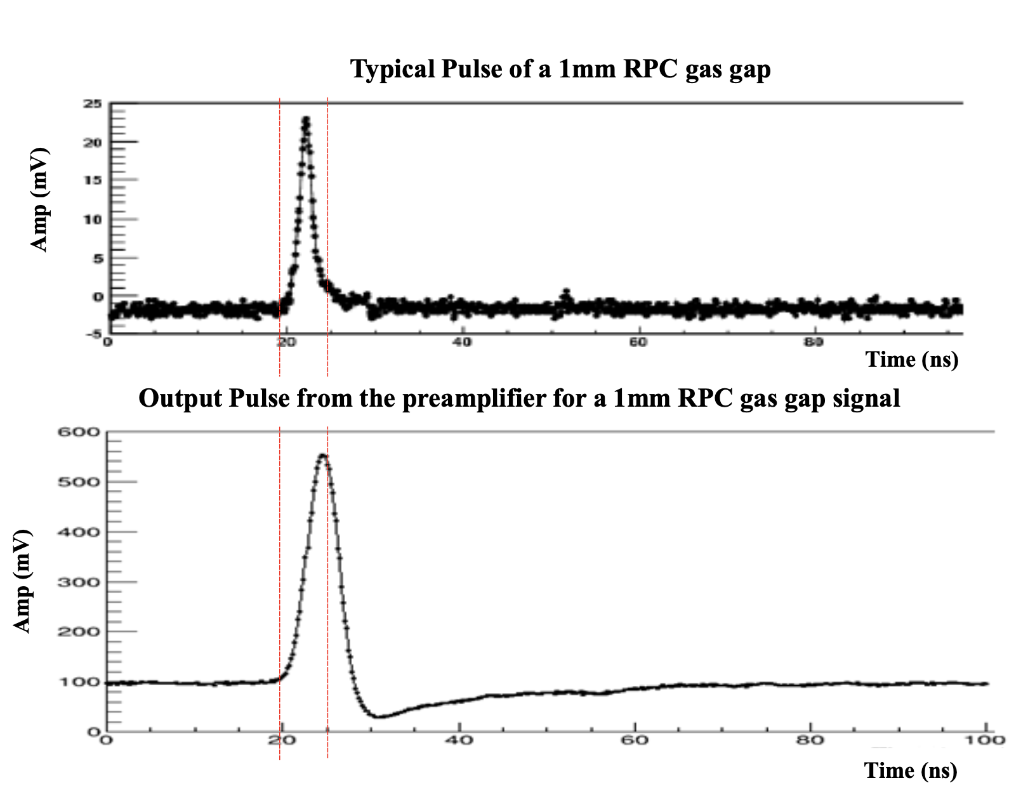
The ATLAS RPC upgrade for LHC
New electronics
Courtesy of Luca Pizzimento

Slide 6
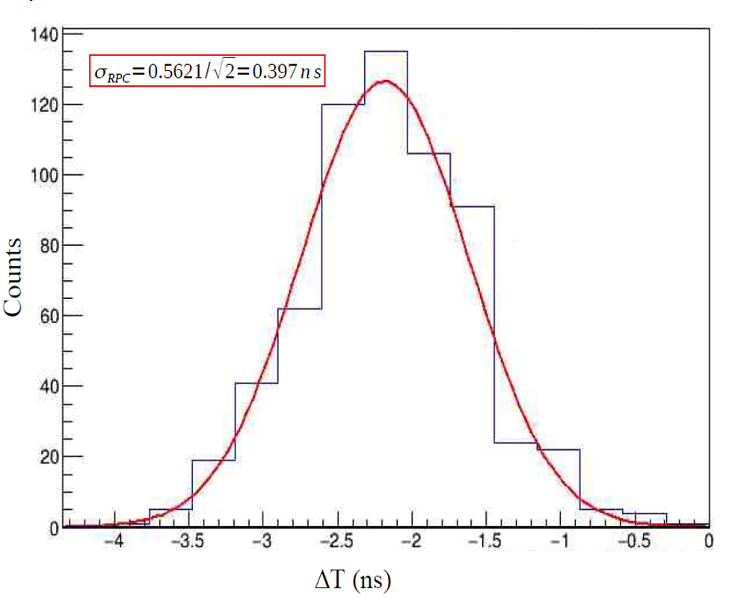
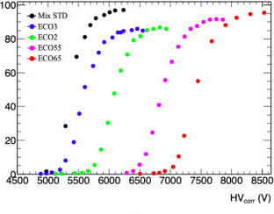

The ATLAS RPC upgrade for LHC
Timing
Efficiency
Time resolution applying the time walk correction ∼ 330 ps with a mono-gap RPC
Performance of the BIS78 RPC detectors: a new concept of electronics and detector integration for high-rate and fast timing large size RPCs
ATLAS Collaboration - Luca Pizzimento (Rome U., Tor Vergata and INFN, Rome3)
Performance of new generation of Resistive Plate Chambers operating with alternative gas mixtures
Nucl.Instrum.Meth.A 1066 (2024) 169580
Giorgia Proto, N. Bangaru, F. Fallavollita, O. Kortner, H. Kroha

Slide 7
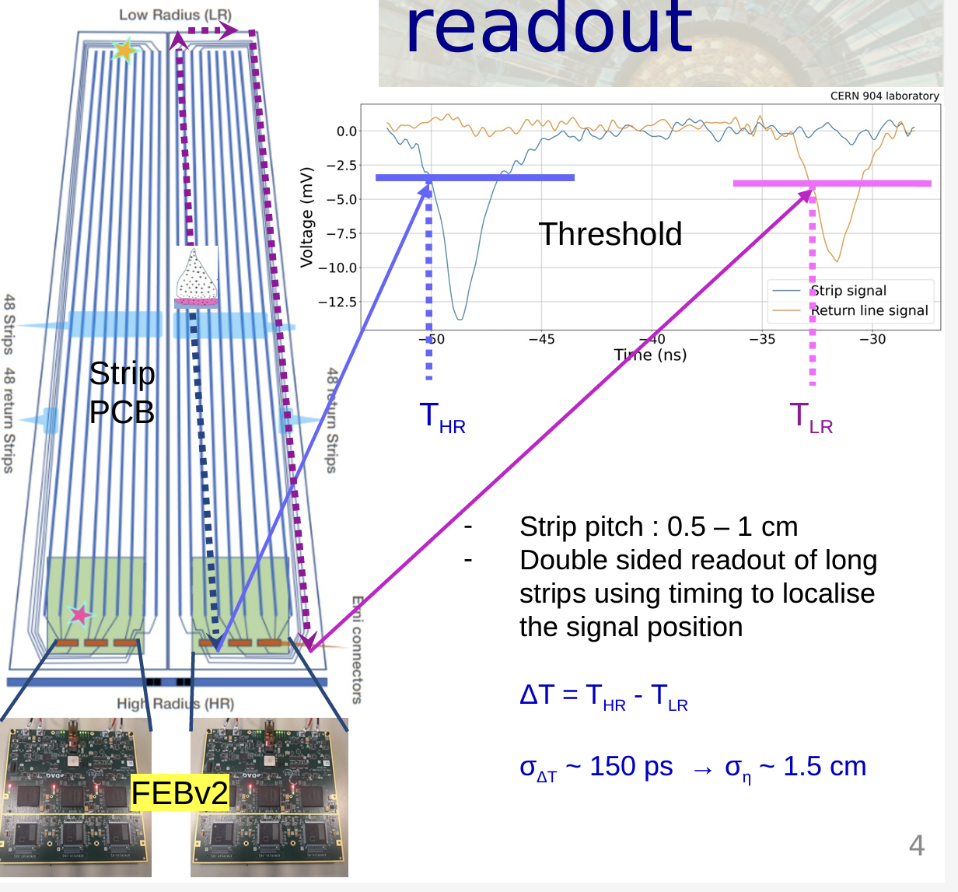
The CMS RPC upgrade for LHC
Gas-gap thickness: reduced from 2 mm to 1.4 mm.
Sub-ns time resolution
High background capability up to 2 kHz/cm²
Innovative FEB with low sensitivity threshold ( below 50 fc)
1.4 mm gap
Double side strip readout for XY recostruction
FEB based on ASIC petiROC2C, specially designed by
OMEGA group
Courtesy of Maxime Gouzevitch

Slide 8
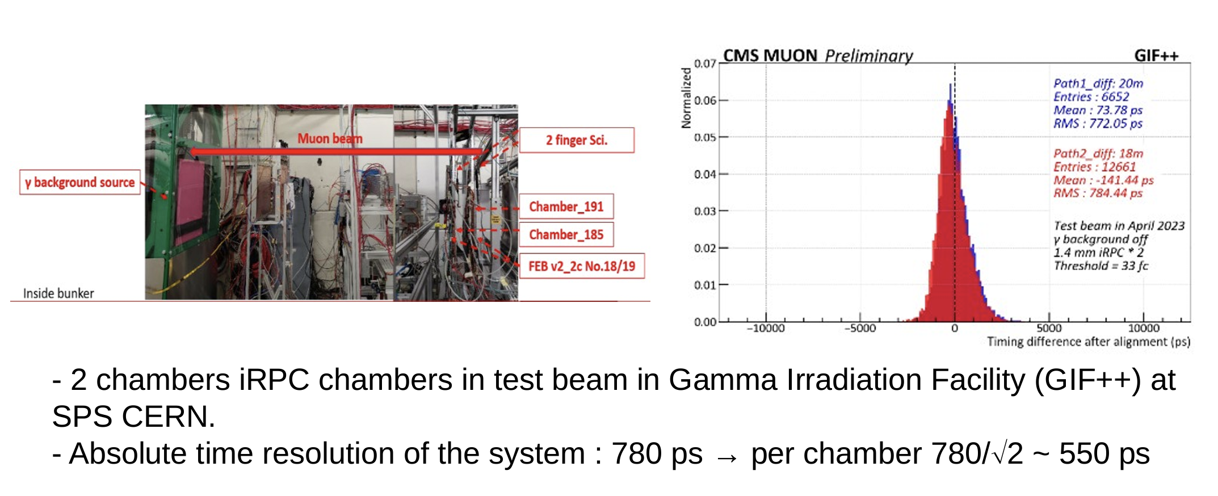
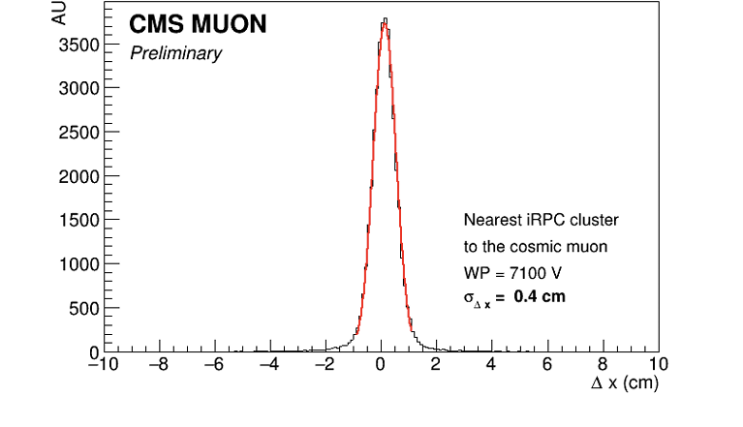
The CMS RPC upgrade for LHC
Timing
Absolute time resolution of a two chambers system: 780 ps
Space resolution on x coordinate
Courtesy of Maxime Gouzevitch

Slide 9
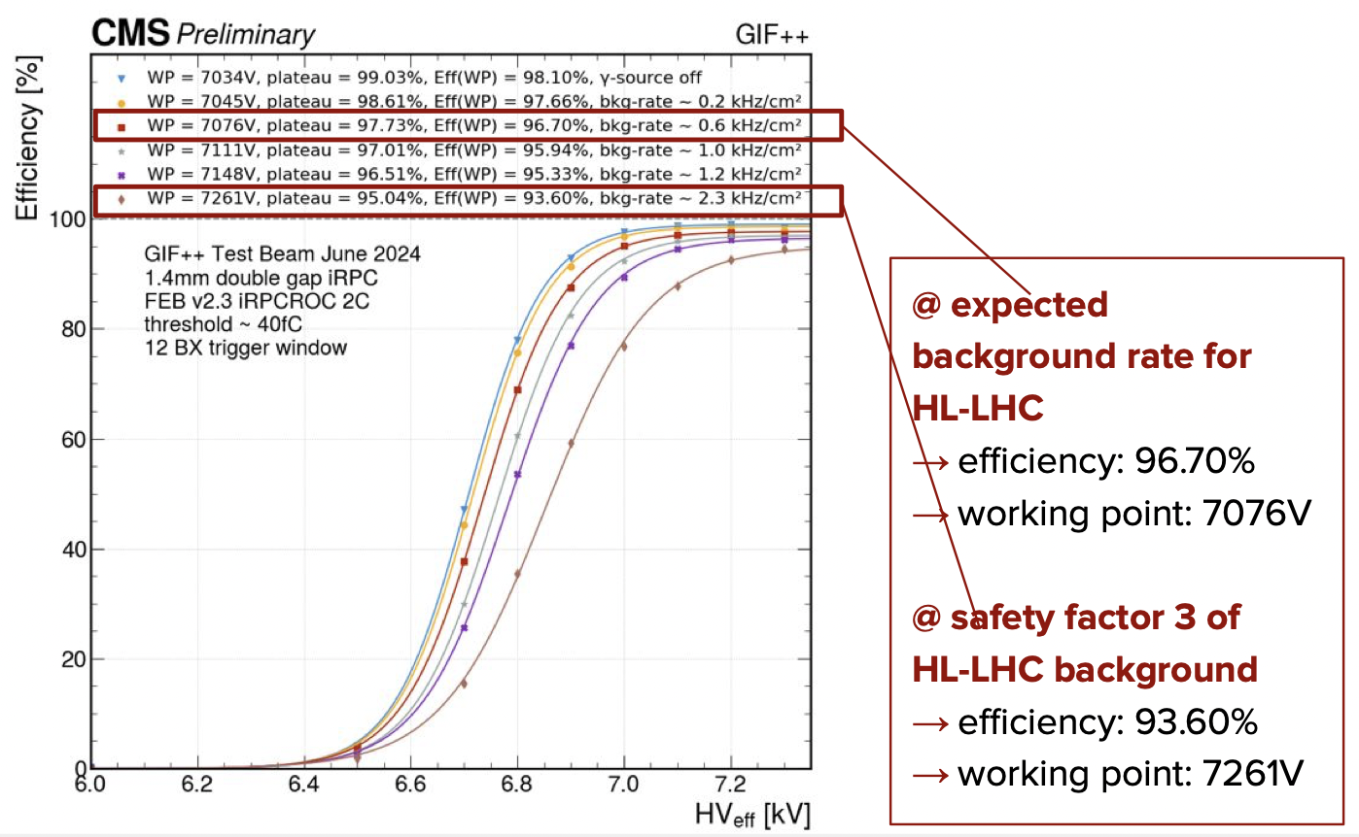
The CMS RPC upgrade for LHC
Efficiency plateau at 2.3 kHz/cm² background rate.
Efficiency plateau at 1.0 kHz/cm² background rate.
Courtesy of Jules Vandenbroeck, Mehar Ali Shah

Slide 10
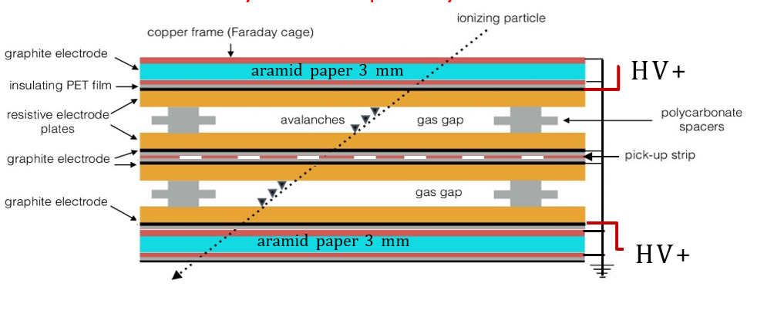
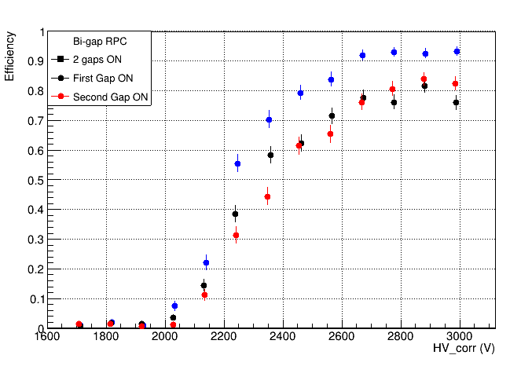
R&D: glass phenolic laminate (Roma2)
Phenolic glass properties:
Electrical Resistivity, Average value: 2-4 x 10¹² Ωcm
Dielectric Constant, Average value: 5.10
Dielectric Breakdown, Average value: 30000 V
Detector features
Gap configurations: 2 parallel/single gap
Electrode thickness: 0.4 mm
Gas-gap thickness: 0.2 mm
Active surface: 8 cm x 30 cm
Spacer lattice: 3 cm x 3.5 cm
Electrode material: phenolic glass
Courtesy of Alessandro Rocchi

Slide 11
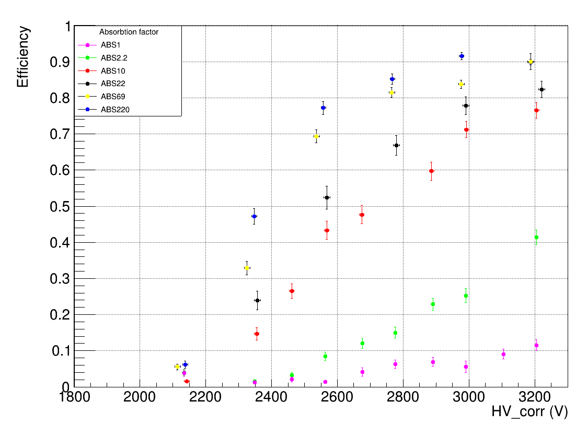
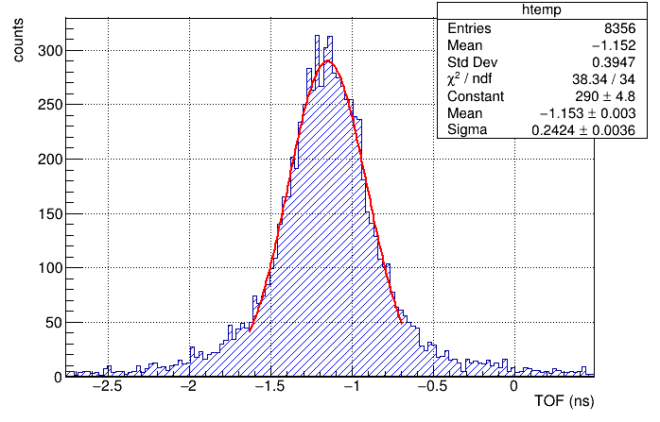

R&D: glass phenolic laminate (Roma2)
Rate capability at GIF++
Time resolution on the H8 beam line
A rate capability of approximately 2 kHz/cm² (ABS 10) at 75% efficiency is observed
All channels
𝝈
𝝈_{𝒕} = = 𝟏𝟕𝟎 𝒑𝒔
√𝟐
Courtesy of Alessandro Rocchi

Slide 12
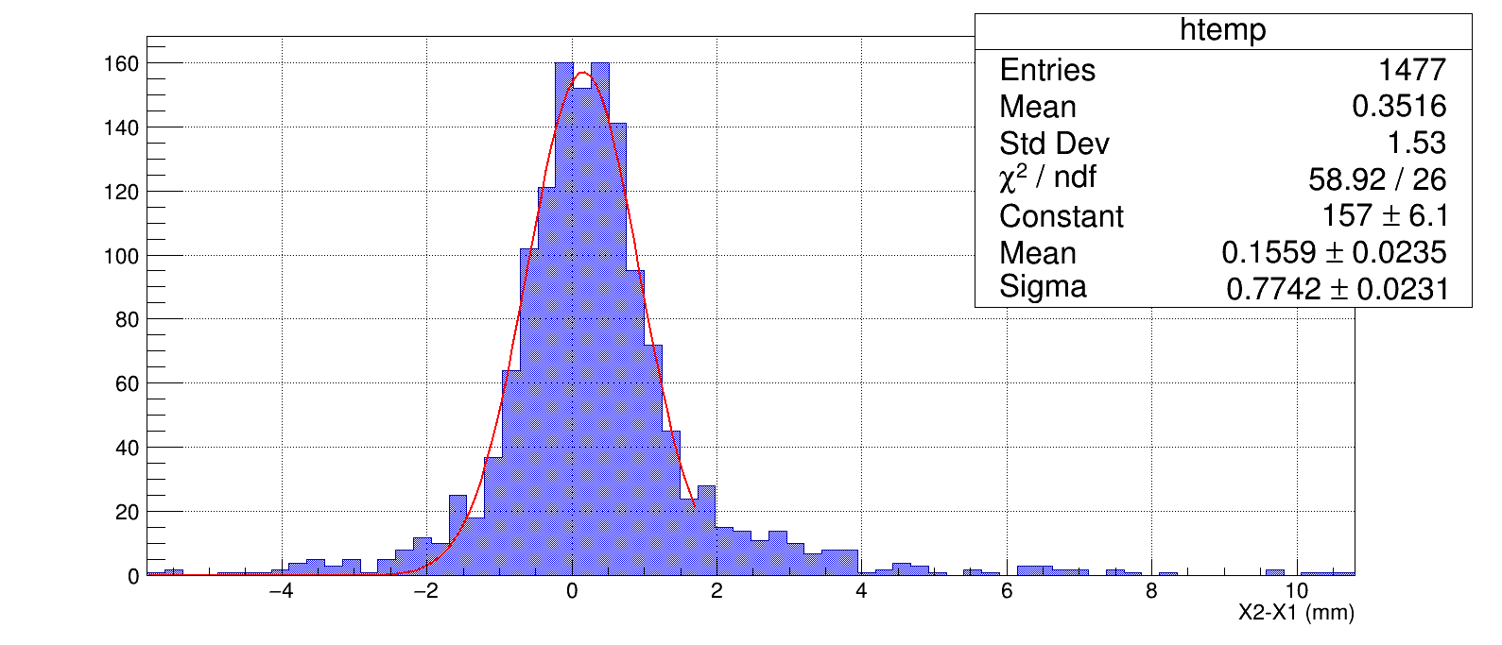

R&D: glass phenolic laminate (Roma2)
Space resolution with the charge centroid method
Perspective for tracking – timing – high-rate capability
        Reduce the graphite resistivity
                Reduce the strip pitch
        Reduce the phenolic glass resistivity by optimizing production processes and selection.
𝜎_{𝑠} =
0.77
𝑚𝑚 = 0,543$±$0,016 𝑚𝑚
√2
Courtesy of Alessandro Rocchi

Slide 13
R&D: 1 mm gas gap (Bari-KODEL)
Double gap HPL equipped with CMS front-end
1 mm gap thick and 1.4 electrode thick
92% efficiency up to ∼ 2.2 kHz/cm²
Working point average ∼ 6 kV
Courtesy of D. Ramos

Slide 14
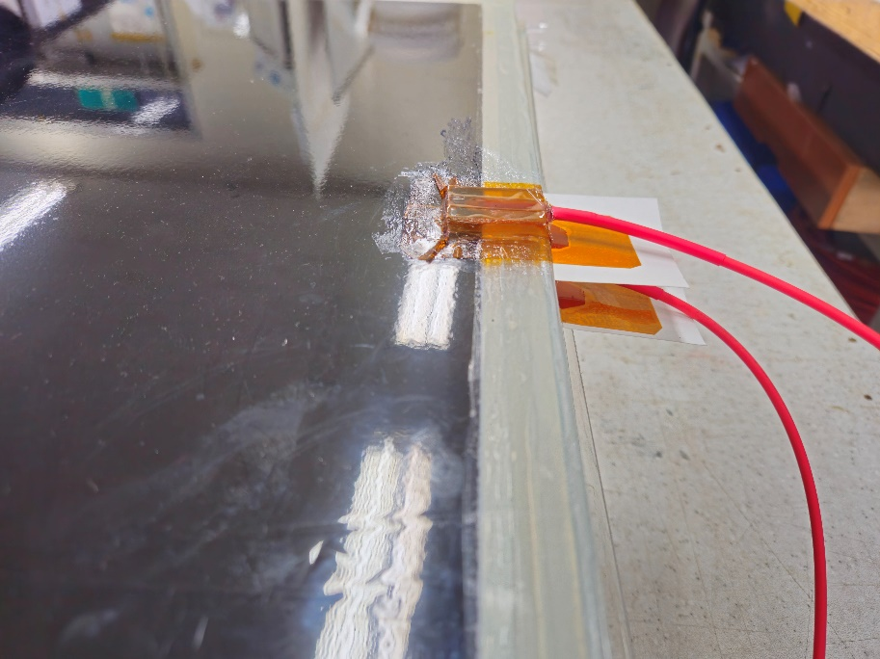
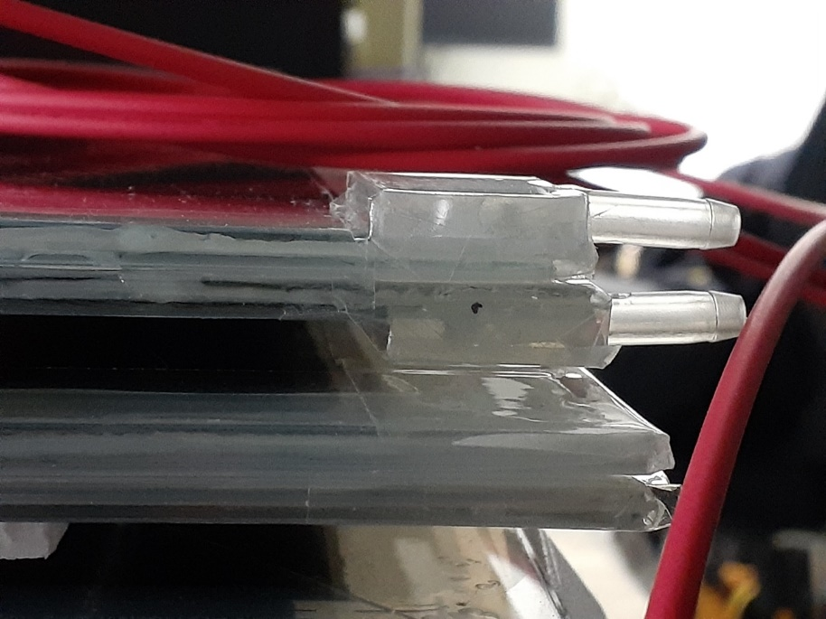
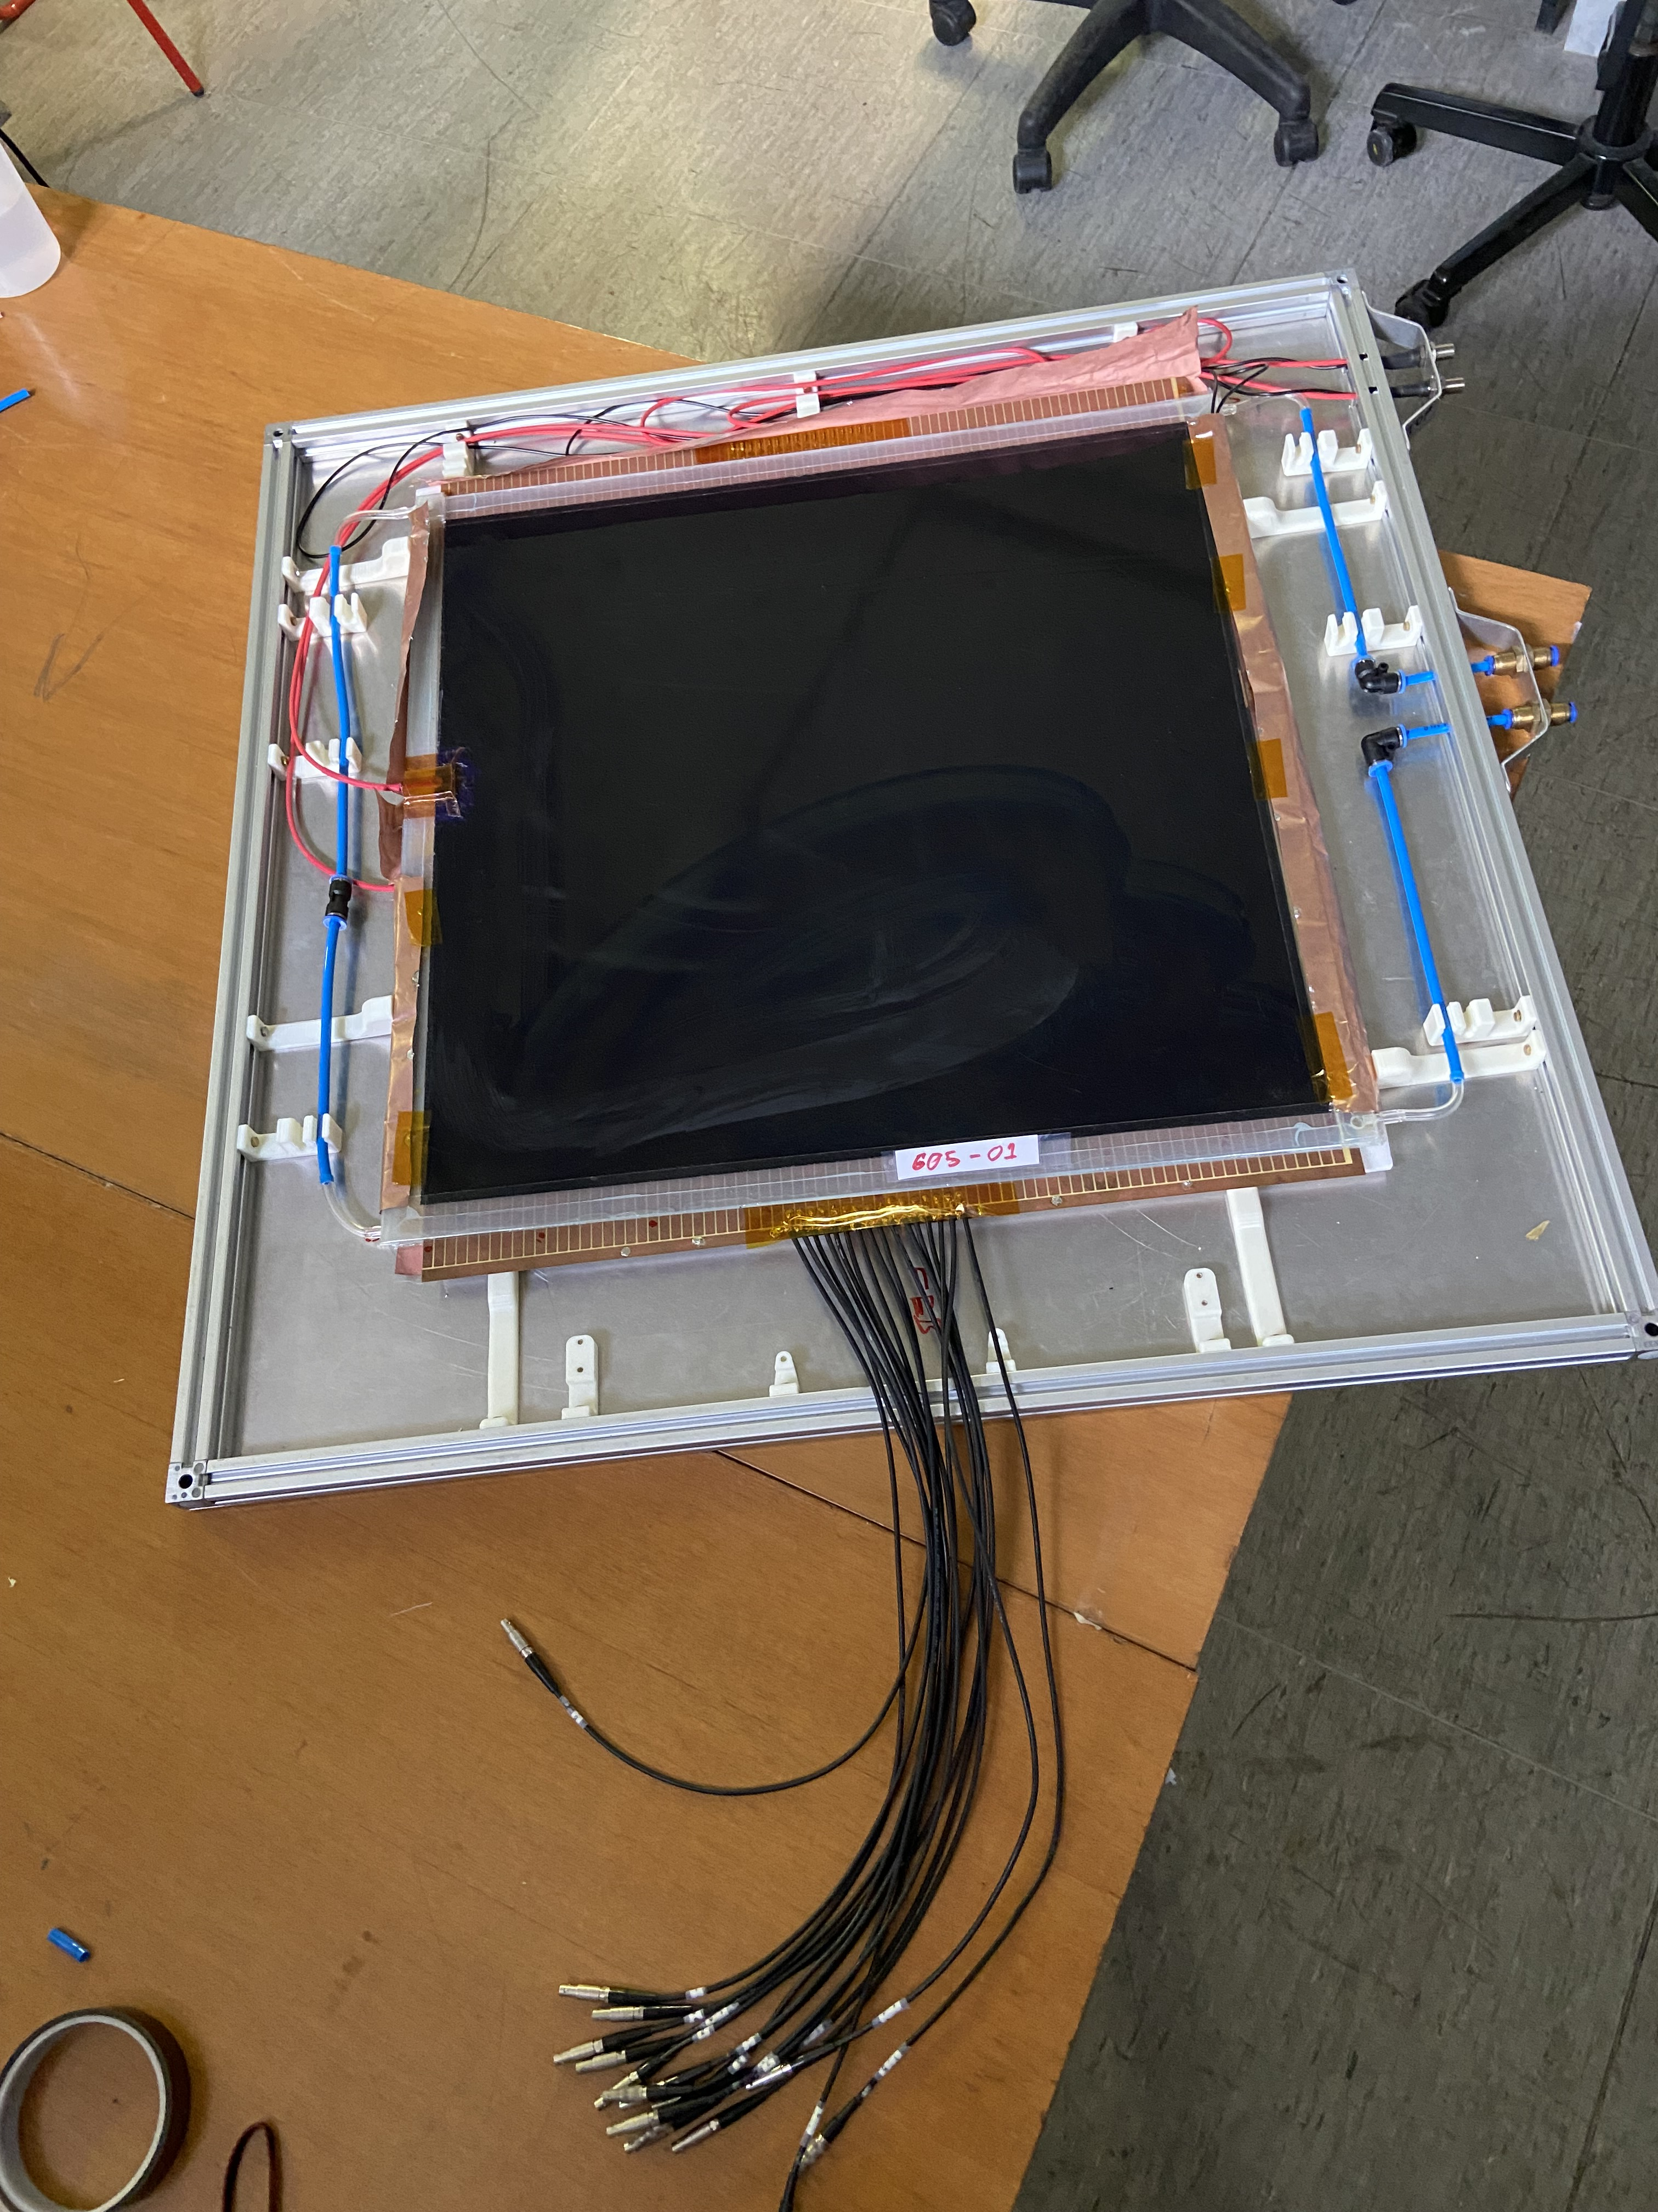
R&D: 500 μm Glass RPC (Bari-KODEL)
50x50cm² prototype double gap glass RPC with gas thickness of 500 um under test for fast timing RPC prototype.
Preliminary signal study by using CAEN digitizer DT5742, strip PCB 5 mm pitch and cosmic trigger
jitter = time_thr – time_0
Study jitter distribution @ 4 kV with standard CMS mixture
Preliminary: 220 ps
Courtesy of D. Ramos

Slide 15
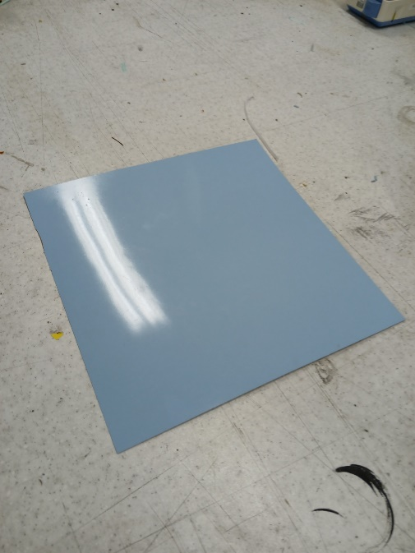
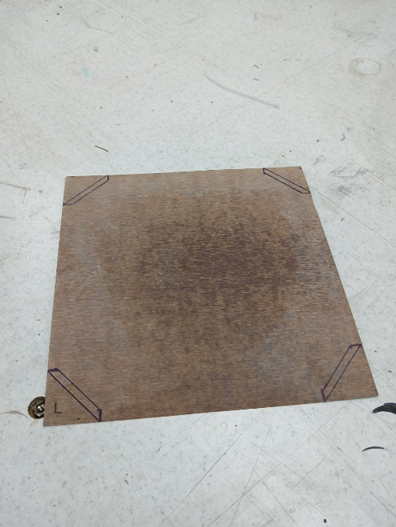
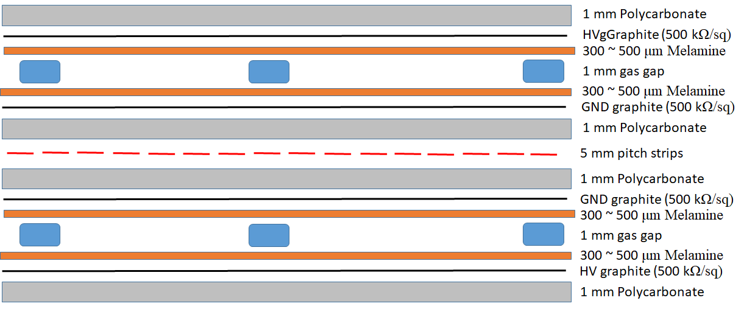
R&D: new melamine electrodes (KODEL)
New RPC electrode material (Melamine sheet):
Thinner gas gap volumes to achieve a better time resolution (~ 300 ps or better)
2 mm thick gas volume RPCs → 1 mm thick gas volume RPCs
→ In next R&D, 0.5 mm thick gas volume RPCs
Thinner RPC electrode for higher rate capability (> 5 kHz cm⁻²)
Hopefully NO oil varnishing needed
Why NOT soda-lime glass instead? (commonly used for timing RPCs)
Resistivity ~ 10¹² Ωcm → Too high to be used at high-rate environment
→ The rate capability at best ~ 1 kHz cm⁻²
Too fragile to make large sized trigger RPC gaps
Thin melamine sheets (ρ ~ 1.5 ⅹ 10¹¹ Ω cm) and polycarbonate sheet to support the gas gaps
300 ~ 500 μm thick Melamine
+ Phenol
Glued to be one piece
Graphite coating on
a PC plate
0.5 mm or 1 mm thick Polycarbonate
Courtesy of K. Lee

Slide 16
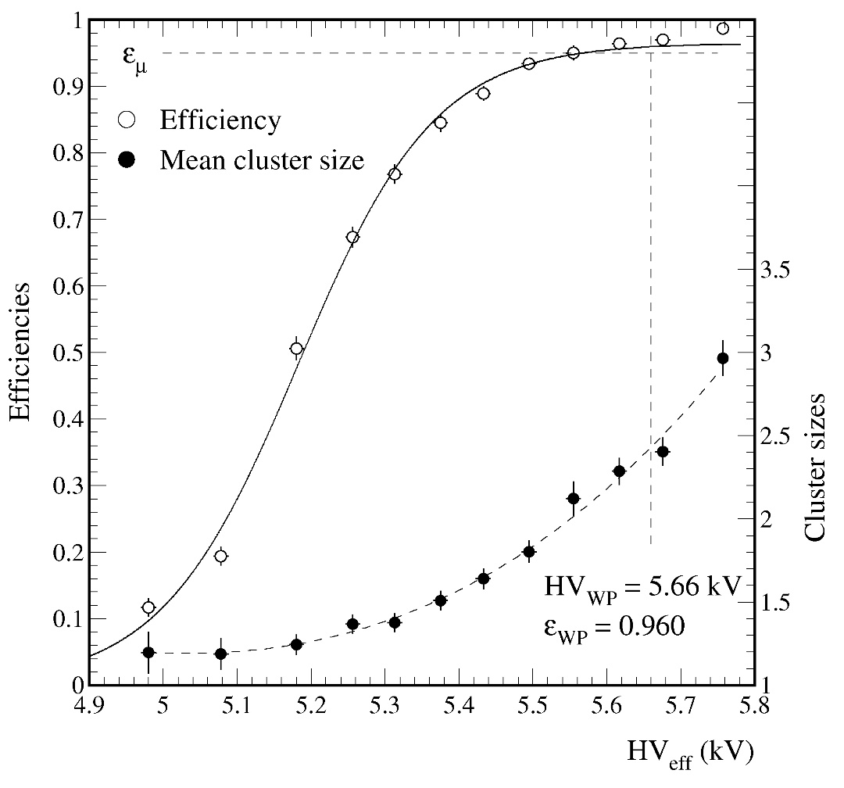
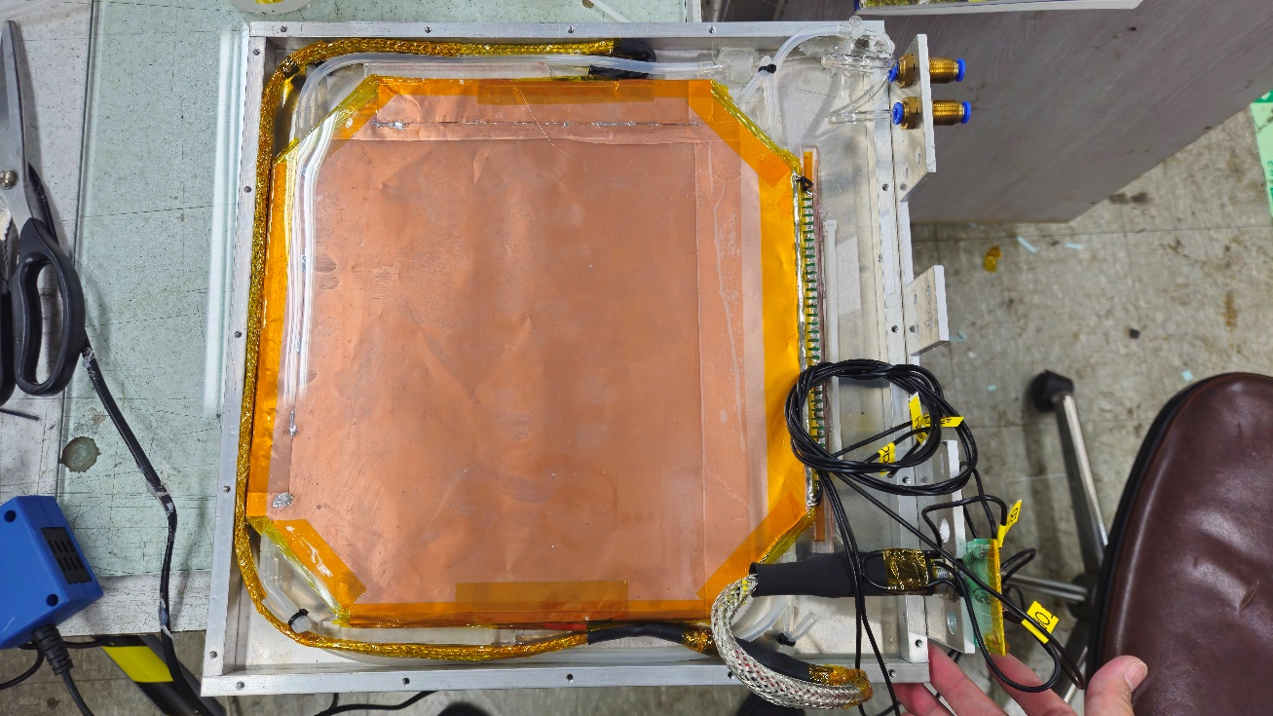
R&D: new melamine electrodes (KODEL)
Small 1-mm thick gas-volume double-gap RPC made of 500 μm-thick melamine-based sheets
Active area of the detector: 26.4 x 26.4 cm²
Strip pitches
5 mm to address a 1 ~ 2 mm position resolution
11 mm for typical RPC triggers
Surface resistivity of graphite ~ 500 kΩ/sq
Absence of good front-end-electronics with a time resolution better than 100 ps
→ Unable to check the time characteristics of the detectors
11 mm pitch strips (read only 24 strip among 32 strips)
Digitization threshold = 0.33 mV (~ 50 fC)
HV_{WP} = HV(abs 95%) + 100 V = 5.71 kV
Efficiency @HV_{WP} = 0.972, ε_{max} = 0.990
Mean cluster size @WP = 2.5
Noise rate ~ 10.8 Hz cm² @ 23.1 ºC
Courtesy of K. Lee

Slide 17
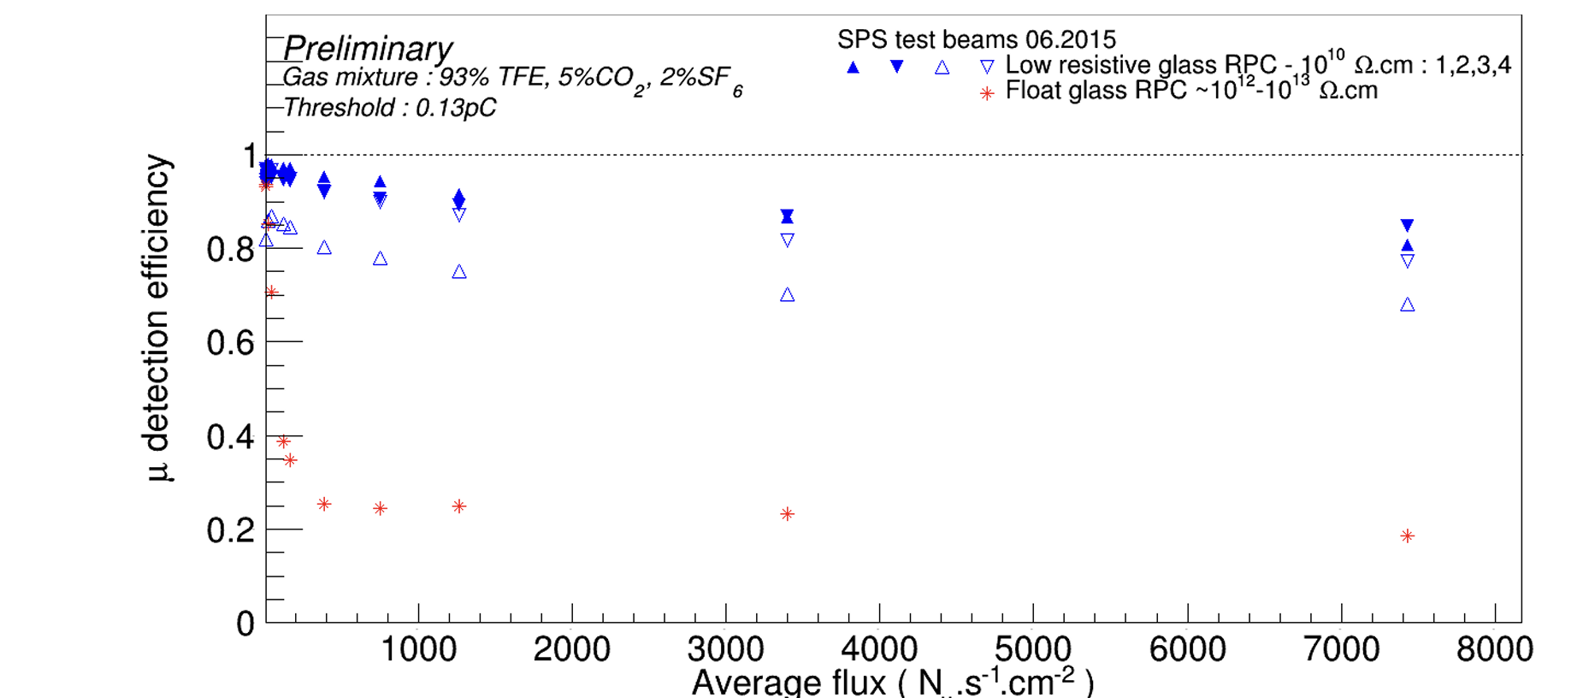
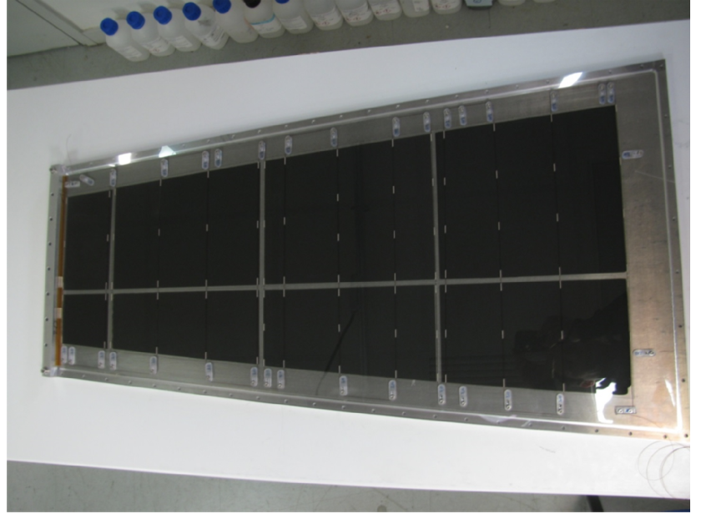
R&D: glass electrodes (Lyon, Tsinghua)
Standard glass RPC have low-rate detection capability (a few hundreds of Hz/cm²)
Tsinghua has developed a low resistive glass 10¹⁰ Ω · cm ( doped glass with metal components) and a very high surface uniformity, with a roughness below 10 nm
Limitation (30 cm x 30 cm) is a problem
REF. F. Lagarde et al 2016 JINST 11 C09006
Courtesy of I. Laktineh

Slide 18
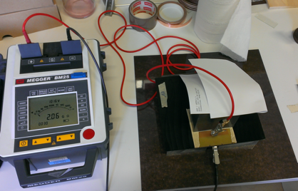
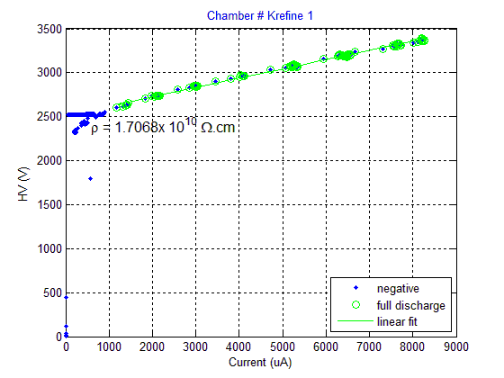
R&D: plastic electrodes (Lyon)
PVdF and PEEK are very stable and chemically inert thermoplastic
New kind of PVdF developed with the help of PolyOne (Germany). Doped with CNT we achieved a bulk resistivity of 10¹¹⁻¹² Ω cm.
New charged PEEK developed with the help of Krefine (Japan).
Doped with BC a bulk resistivity of 10⁸⁻⁹ Ω cm was achieved.
A few small detectors were made using doped PVdF plates of 2-3 mm thickness. An excellent efficiency is obtained with cosmic, but resistivity is not low enough for reaching high rate.
Plates made with charged PEEK were produced reaching 10⁸⁻⁹ Ω cm which could allow reaching rates of hundreds of kHz/cm², but some homogeneity issues are still there.
More efforts and funding are needed to finalize this material.
AIDA2020
Courtesy of I. Laktineh

Slide 19
R&D: Sustainable RPC operation
Eco-friendly mixtures requirements: Low GWP, low toxicity, not flammable, detector performance comparable with standard one. Actions:
Replace C₂H₂F₄ with HFO
Addition of CO₂
SF₆ still needed but studies on replacement on going
HFO moves the operating voltage (WP) at much higher values, so the the addition of CO₂ helps in limiting this increase. For thin gap RPC (es. sub-mm gaps), this might be less important
 | TFE (%) | HFO (%) | CO₂ (%) | iC₄H₁₀ (%) | SF6 (%) | GWP | CO₂e (g/l)*
STD | 95.2 | - | - | 4.5 | 0.3 | 1485 | 6824
ECO2 | - | 35 | 60 | 4 | 1 | 476 | 1522
ECO3 | - | 25 | 69 | 5 | 1 | 527 | 1519
Density (g/l) | 4.68 | 5.26 | 1.98 | 2.69 | 6.61 | - | -
GWP | 1430 | 7 | 1 | 3 | 22800 | - | -
*GWP with respect to CO₂, and their CO₂e, in grams, for one litre of mixture
Courtesy of RPC EcoGas@GIF++ collaboration

Slide 20
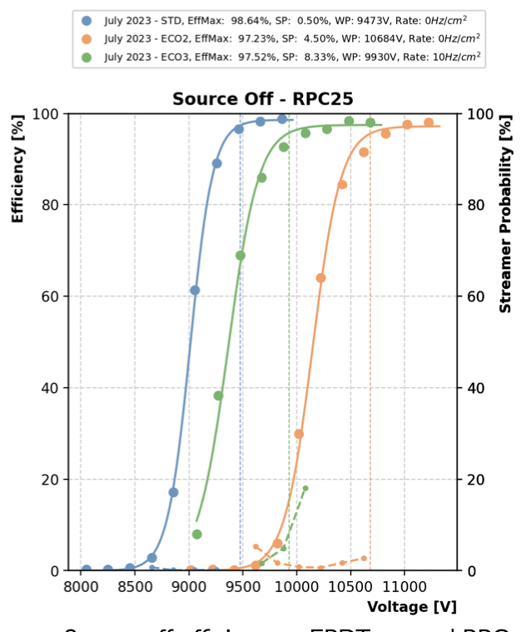
R&D: Sustainable RPC operation
Efficiency single gap HPL RPC 2mm vs 1mm
Single gap (2.0mm)
Courtesy of RPC EcoGas@GIF++ collaboration

Slide 21
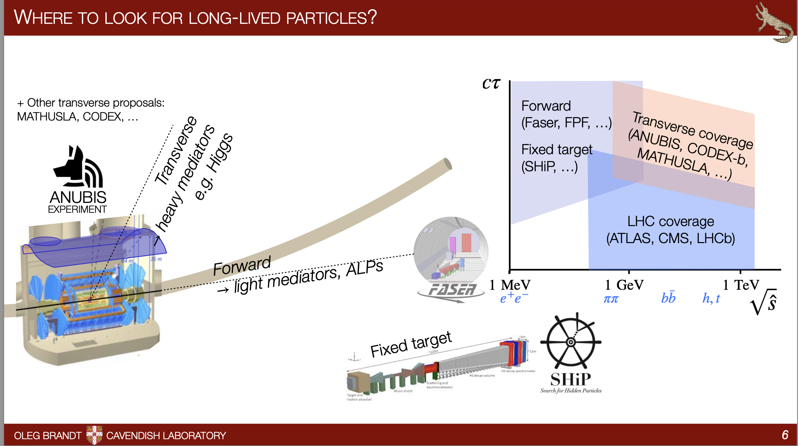
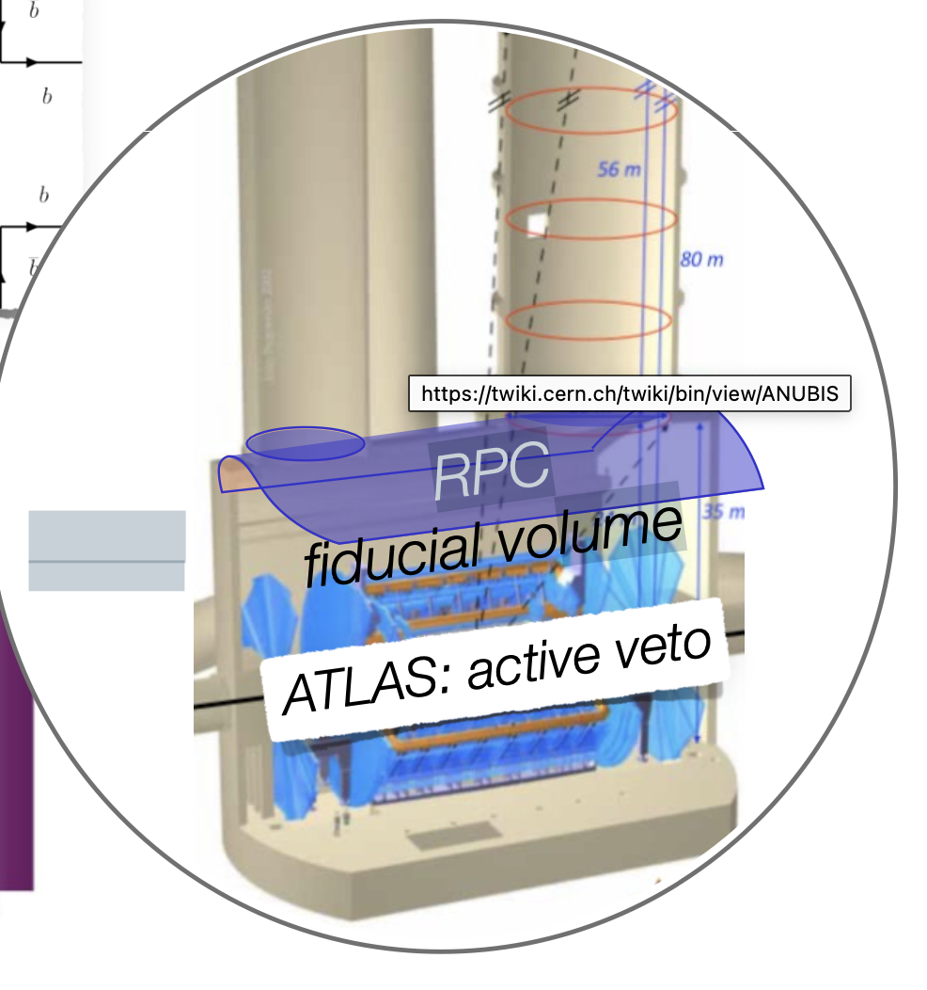
A physics case: Long Lived Particles
The ANUBIS proposal
Instrument with RPC the ATLAS roof
Courtesy of Oleg Brandt

Slide 22
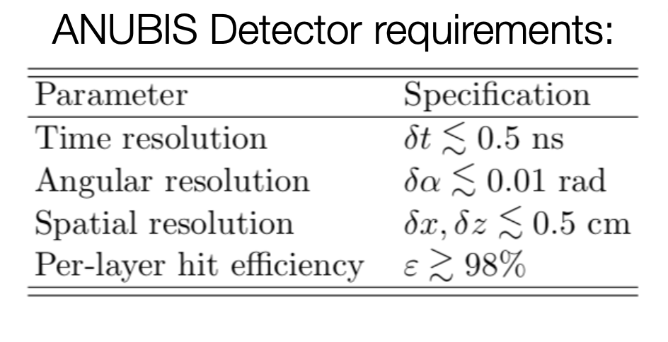
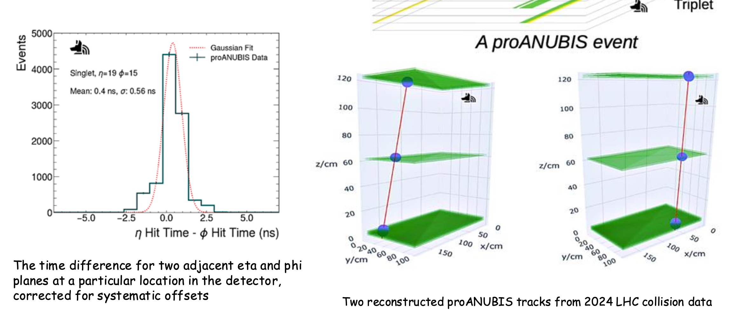
A physic case: Long Lived Particles
The proANUBIS demonstrator with LHC data
Courtesy of Aashaq Shah

Slide 23
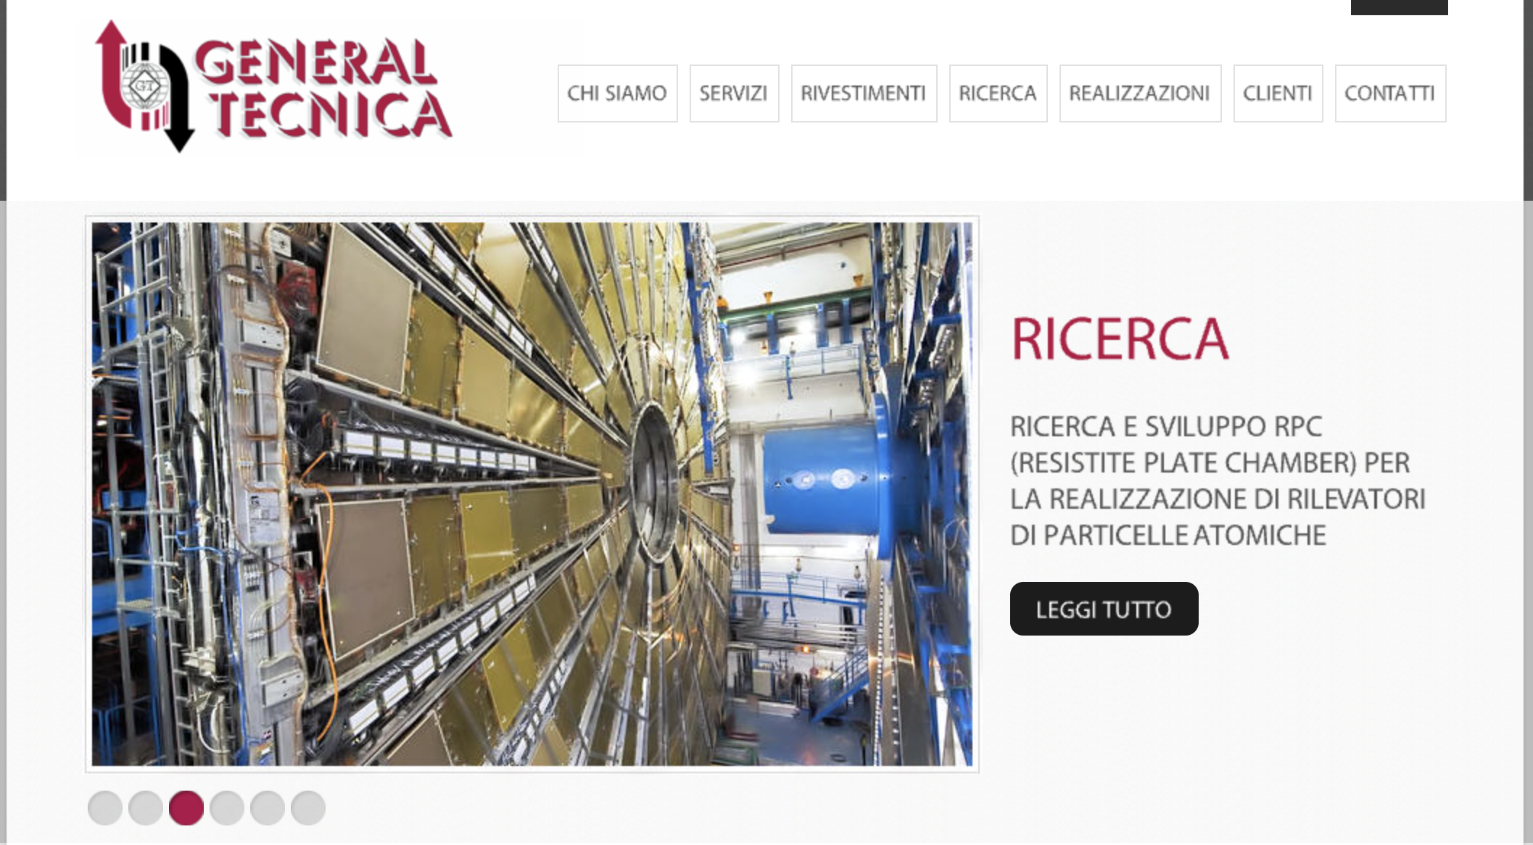
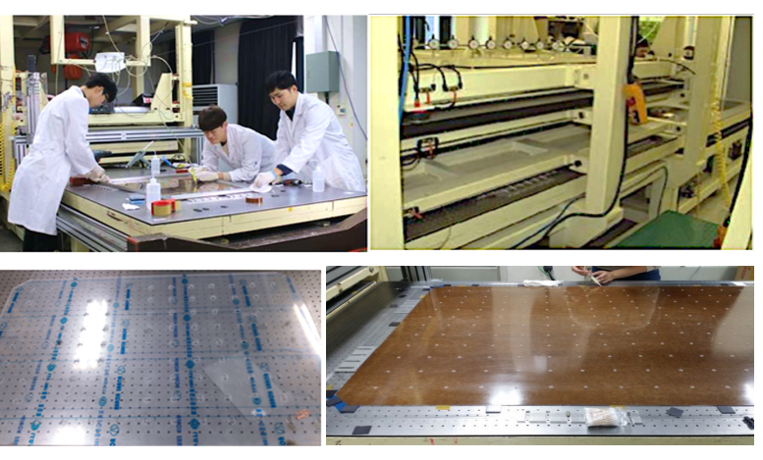
Facility productions
General Tecnica (Italy) has produced the gas gaps for ATLAS phase I and CMS Barrel. It is now producing the new ATLAS RPC gas gap for phase II. Also ready to respond to R&D requests.
KODEL@Korea University has produced the gas gaps for CMS forward (still in production). Also, the group significatively active in R&D activity. Under discussion the future of the mass production facility. Input from scientific community needed.

Slide 24
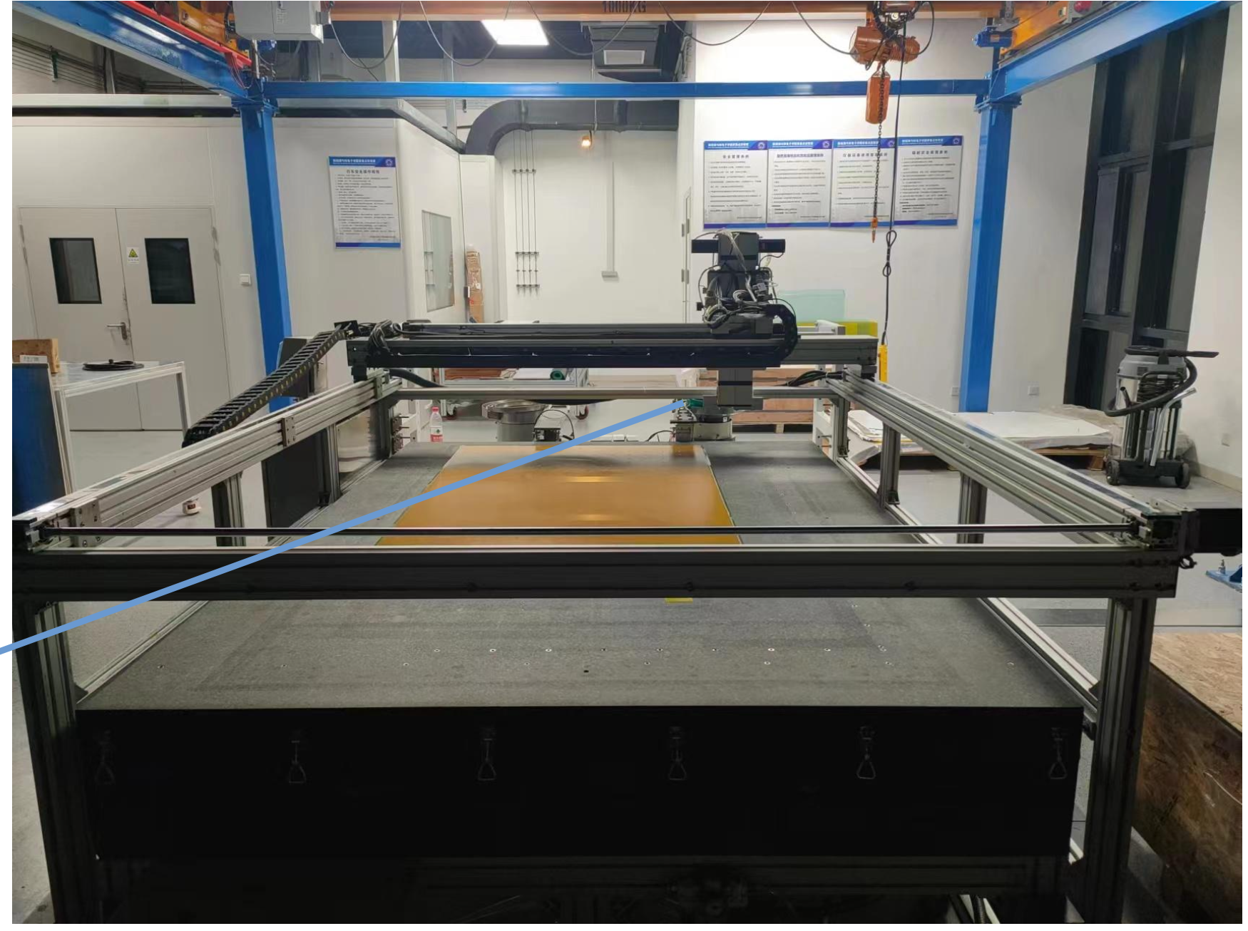
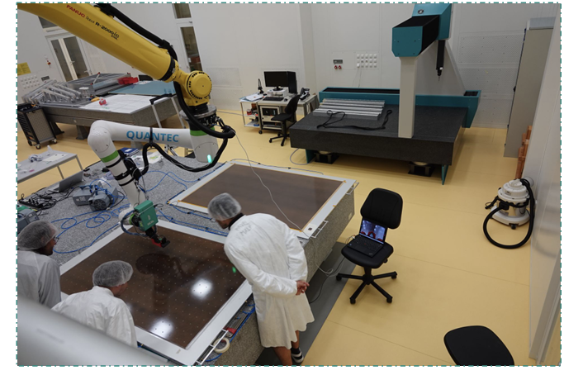

Facility productions (new entries)
University of science and technology of China (USTC) is undertaking a major effort to set up a gas gap production facility for the ATLAS RPC. Preparatory work is over. Ready for production.
Max Plank Institute (MPI) has recently put in operation a new facility for the ATLAS gas gap production. Also, the MPI group has started to establish two additional manufacturers:

Slide 25
Conclusion
Detector performance such as: rate capability of 4-5 kHz/cm², time resolution of 200-300 psec, space resolution of 400-500 μm are easily achievable with the present technology for “standard RPC”. Improvement of at least a factor of 2 is within reach. Inputs from community on FCC muon detector baseline are needed.
Additional R&D should be performed on novel material for electrodes and assembly procedure for thin gas gas RPC (0.2-0.5 mm)
The eco-gas puzzle needs some special effort, but there is the evidence that operation with thin gas gaps would facilitate the definition of a proper eco-friendly mixture
Several facilities are now in operation and can respond to possible call for production
DRD1 has offered a unique platform for collaborative network and could facilitate the discussion for possible FCC muon detector ideas

