Slide 1



FCC FRANCE & ITALY 2nd workshop, Venice, 4 - 6 November 2024
ToF PiD for FCC-ee with Monolithic-CMOS
D. Contardo (IP2I), P. Schwemling (IRFU)

Slide 2
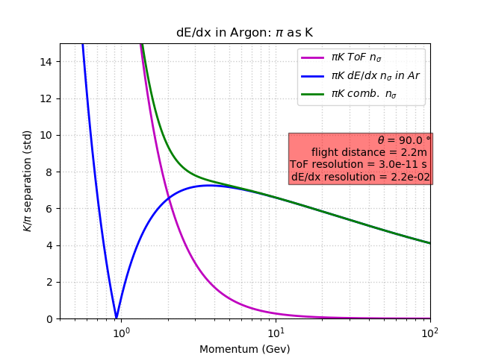
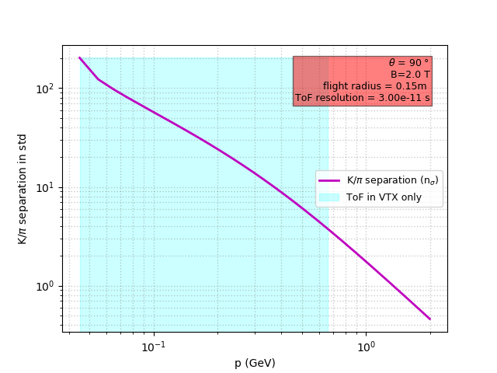
Motivation for PID
Flavor physics, Higgs decays to fermions, HNL mass…
ToF ≃ 30 ps precision at ≃ 2.2(0.15) m provide ≳ 3σ π/K discrimination up to 3(0.66) GeV standalone
needed to complete dE/dx in LGVD*,
possibly lower range (precision requirement) with dN/dx measurements in DCH
a layer at 15 cm would cover 3σ discrimination
up to the 2 T-field cutoff
of 0.66 GeV at 2.2 m
courtesy of R. Aleksan
Monolithoc CMOS sensors is a technology option for layers surrounding a LGVD
to enable at the same time high position precison for track momentum ant PID ToF**
* Large Gas Volume Detectors - Drift CHamber or Time Projection Chamber
** the technology could be deployed in first layers of a Si/W elctromagnetic calorimeter and a LumiCal

Slide 3
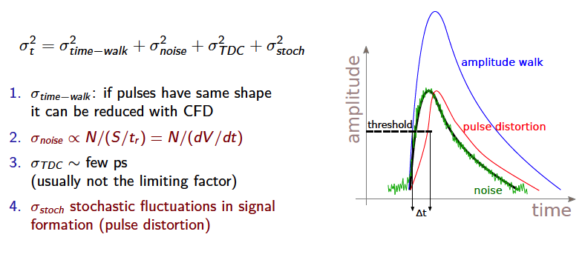
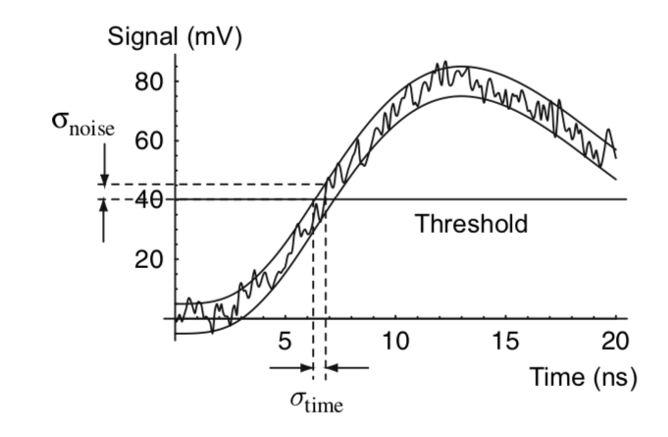
Technology consideration for timing precision
σ_{t} = σ_{signal} ⊕ σ_{jitter} ⊕ σ_{time-walk} ⊕ σ_{TDC} ⊕ σ_{clock}
σ_{signal} parameters:
  Landau fluctuation in “thicker sensors” with “large” electrodes
    LGAD, MCMOS (no Landau fluctuations in 3D designs ex. Timespot)
  pitch effect in “thiner” sensors with “small” electrodes
    ex. TPSCO 65 nm process
σ_{jitter} ∝ Noise/(dV/dt) parameters:
  charge collection velocity - uniform weighting field (sensor design)
  FE speed and noise - sensor capacitance
  amplification (LGADs)
compromise between σ_{signal} and σ_{jitter} technology-dependent
Time over Thres.
t₀
CERN EP seminar W. Riegler: https://indico.cern.ch/event/1083146/

Slide 4
R&D work at IRFU: CACTUS project
LFoundry 150 nm HV-CMOS process
Large size demonstrators for ATLAS ITK - LF-CPIX, LF-MONOPIX1 and 2
DNW/HR p-substrate charge collection diode
HV (≥ 300 V) applied from top or back
large depletion depth (≥ 300 µm)
fast charge collection by drift
no internal amplification
electronics integrated with collection diode
Cactus developments for sub-100ps started in 2017 (ATLAS HGTD and high 𝜂 muon tagger)
first chip issues parasitic capacitance (low S/N) & pulse ringing due to analog digital coupling
modest timing performance ≃ 500 ps

Slide 5
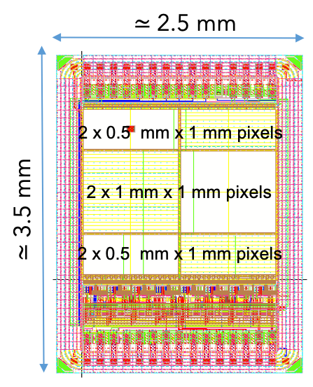
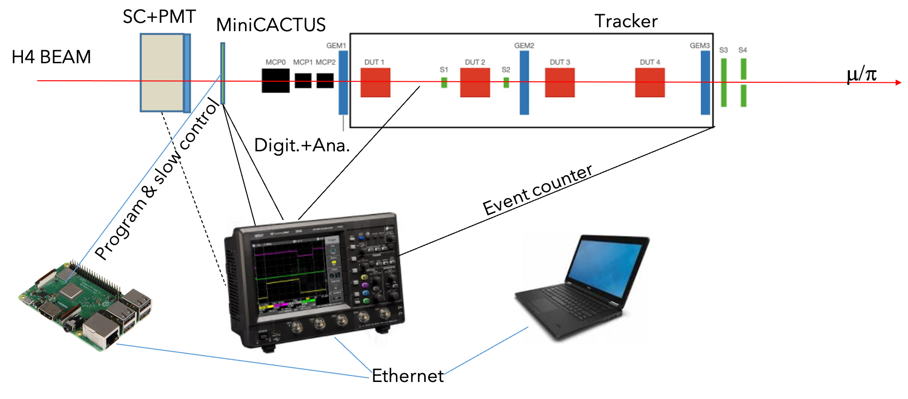
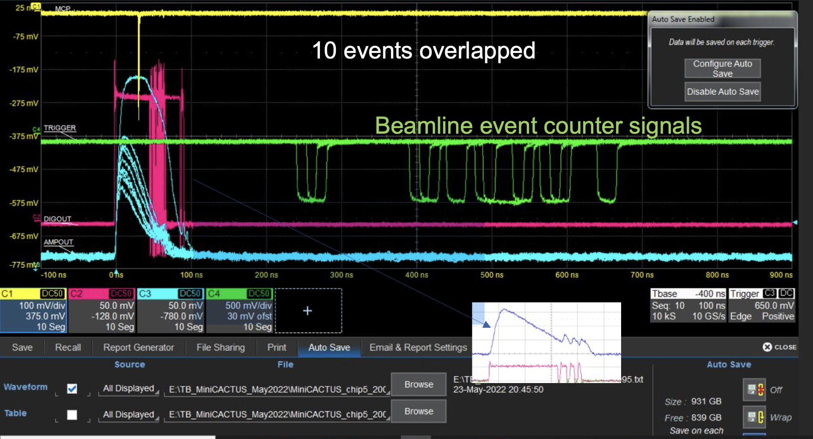
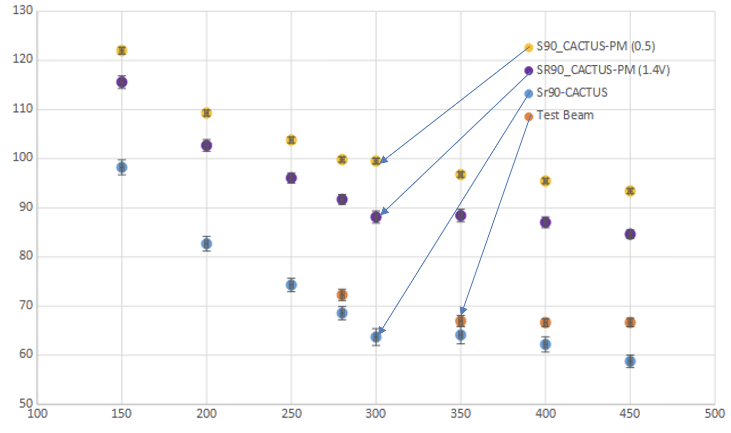
R&D work at IRFU: Mini-CACTUS V1
small size demonstrator to address low S/N issue
8 pixels: 0.5 mm x 1 mm – 1 mm x 1 mm – 2 pixels 50 μm x 50/150 μm
8 FE at column level (pixels mostly passive)
on-chip Slow Control, DACs, bias circuitry
2 discriminated digital (LVDS) & 2 analog monitoring outputs for 2 columns
sensors thinned to 100, 200, 300 µm, backside processing for polarization
time resolution ≃ 60 ps
0.5 x 1 mm², 200 µm
Time resolution (ps)
Bias voltage (V)

Slide 6
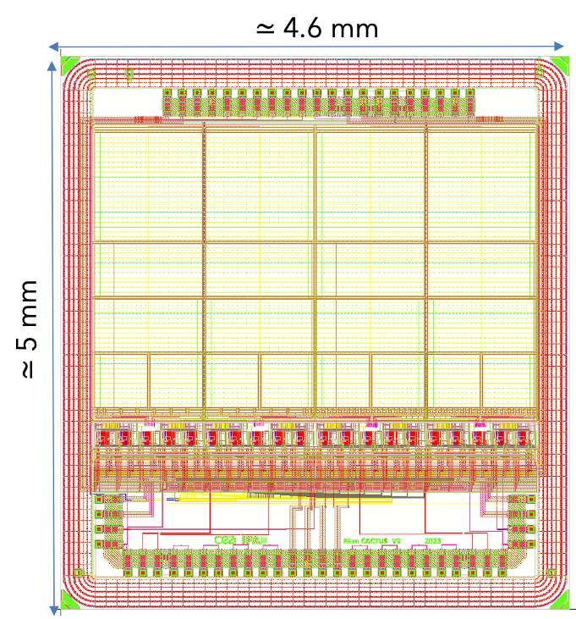
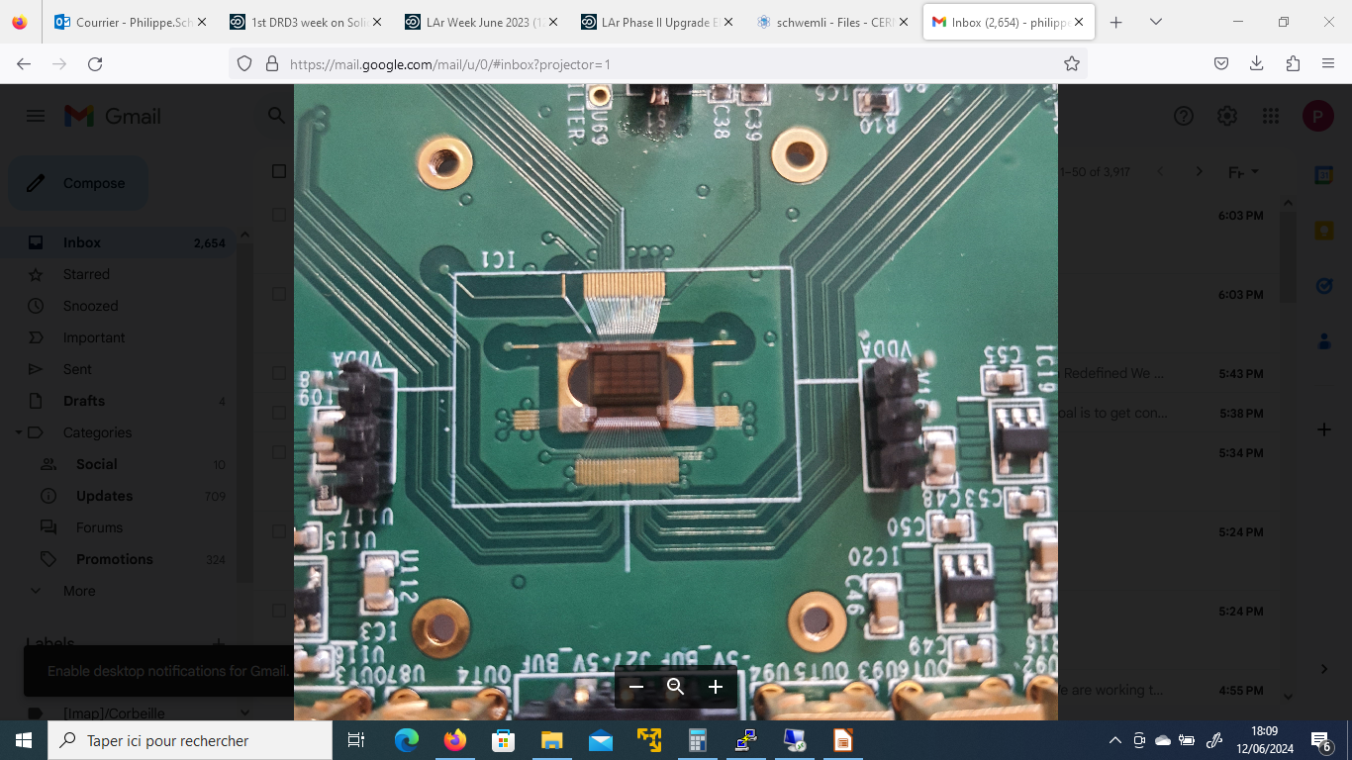
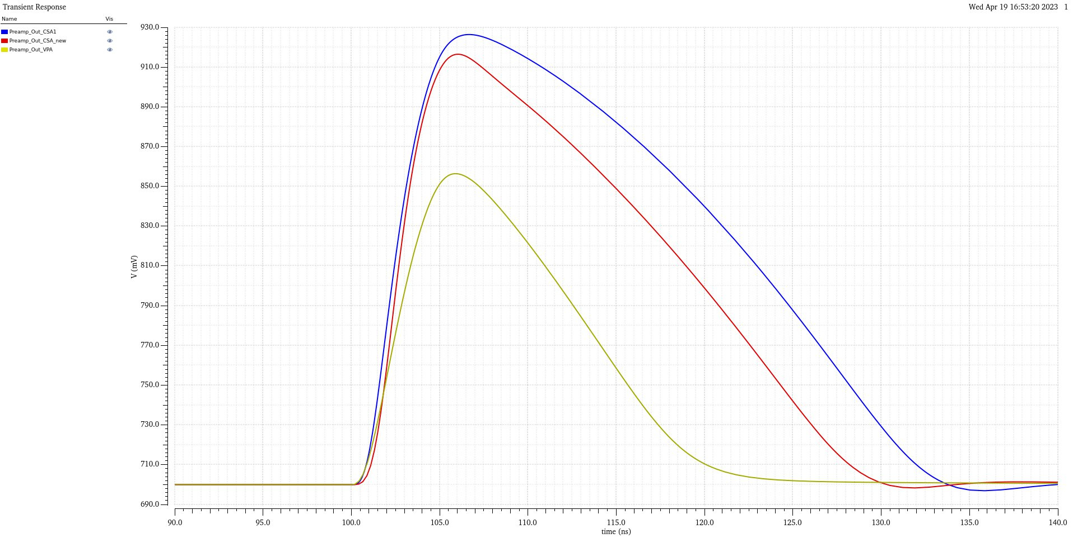
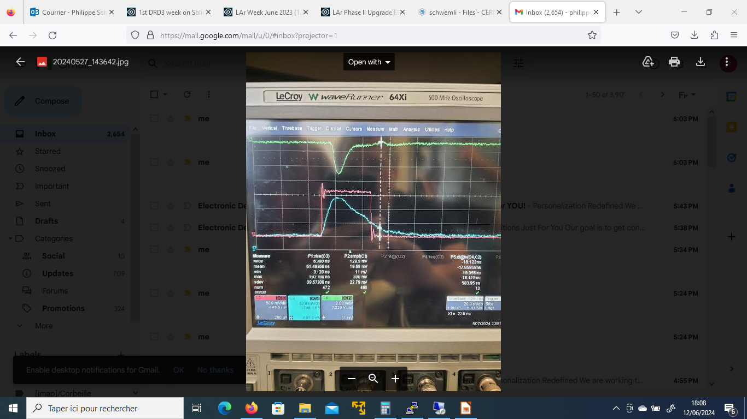
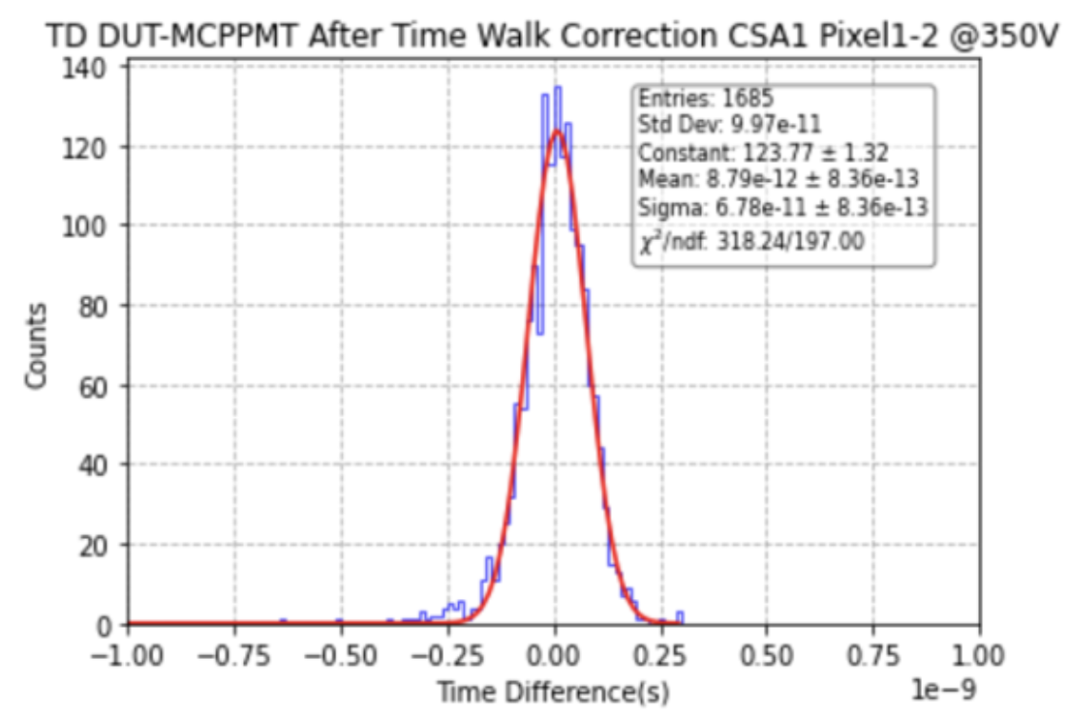
R&D work at IRFU: Mini-CACTUS V2
Y. Degerli, F. Guilloux, J-P. Meyer, P. Schwemling (IRFU); R. Casanova, Y Gan, S. Grinstein (IFAE)
twice larger than Mini-CACTUS V1, 150, 175 & 200 µm thick
0.5 x 1 mm², 1 x 1 mm² 7& 0.5 x 0.5 mm² diodes
50 x 150 µm² and 2 time 50 x 50 µm² test diodes
3 pre-amp (CACTUS V1 CSA, new V2 CSA & VPA
new multi-stage discriminator with programmable hysteresis
improved layout to reduce analog-digital coupling
submitted in May 2023, back from post-processing end May 2024
12 ke⁻
Simulation
V1 CSA
V2 CSA
New VPA
PMT
digital
beam test Jun. 2024
175 µm, 0.5 x 0.5 mm², 300 V time resolution ≃ 60 ps
analog
5 ns

Slide 7
R&D work at IRFU: LF15A MCMOS with amplification
  higher S/N, lower FE power consumption , smaller pitch toward 20 ps resolution
Test structures passive sensors have been submitted in May 2024 LF15A MPW
Six different layouts, identified as promising with TCAD simulations
Production implies only minimal modifications to LF15A standard process
  changes of implant energies for two layers
  addition of one Customer Reserved Layer
HR wafers as for MiniCactus, post-processing underway
30 μm epitaxial wafers (no post-processing), dicing underway
Chips expected by end-2024

Slide 8
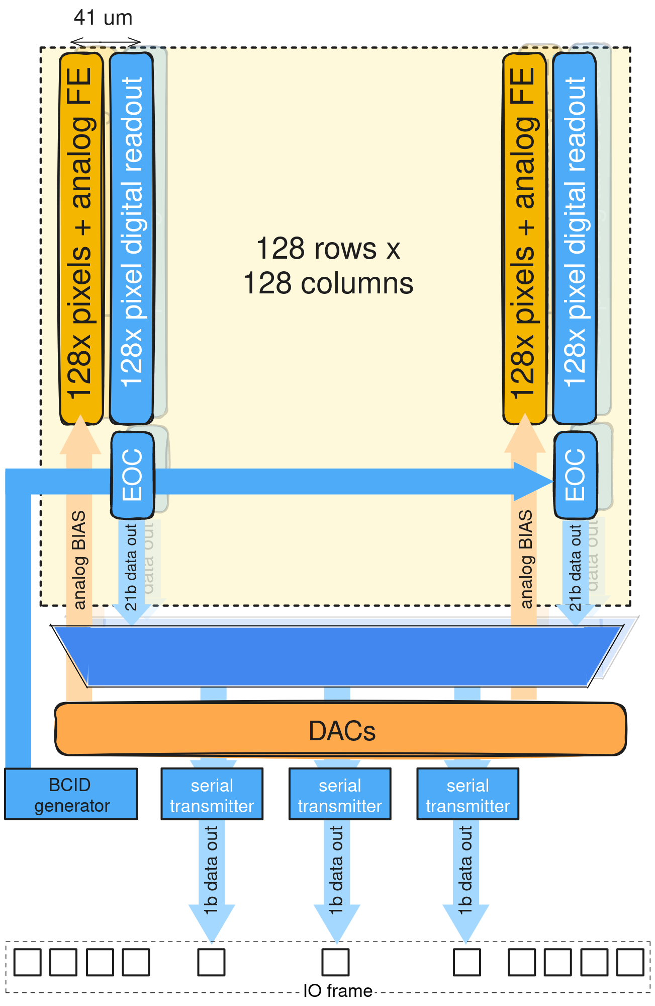
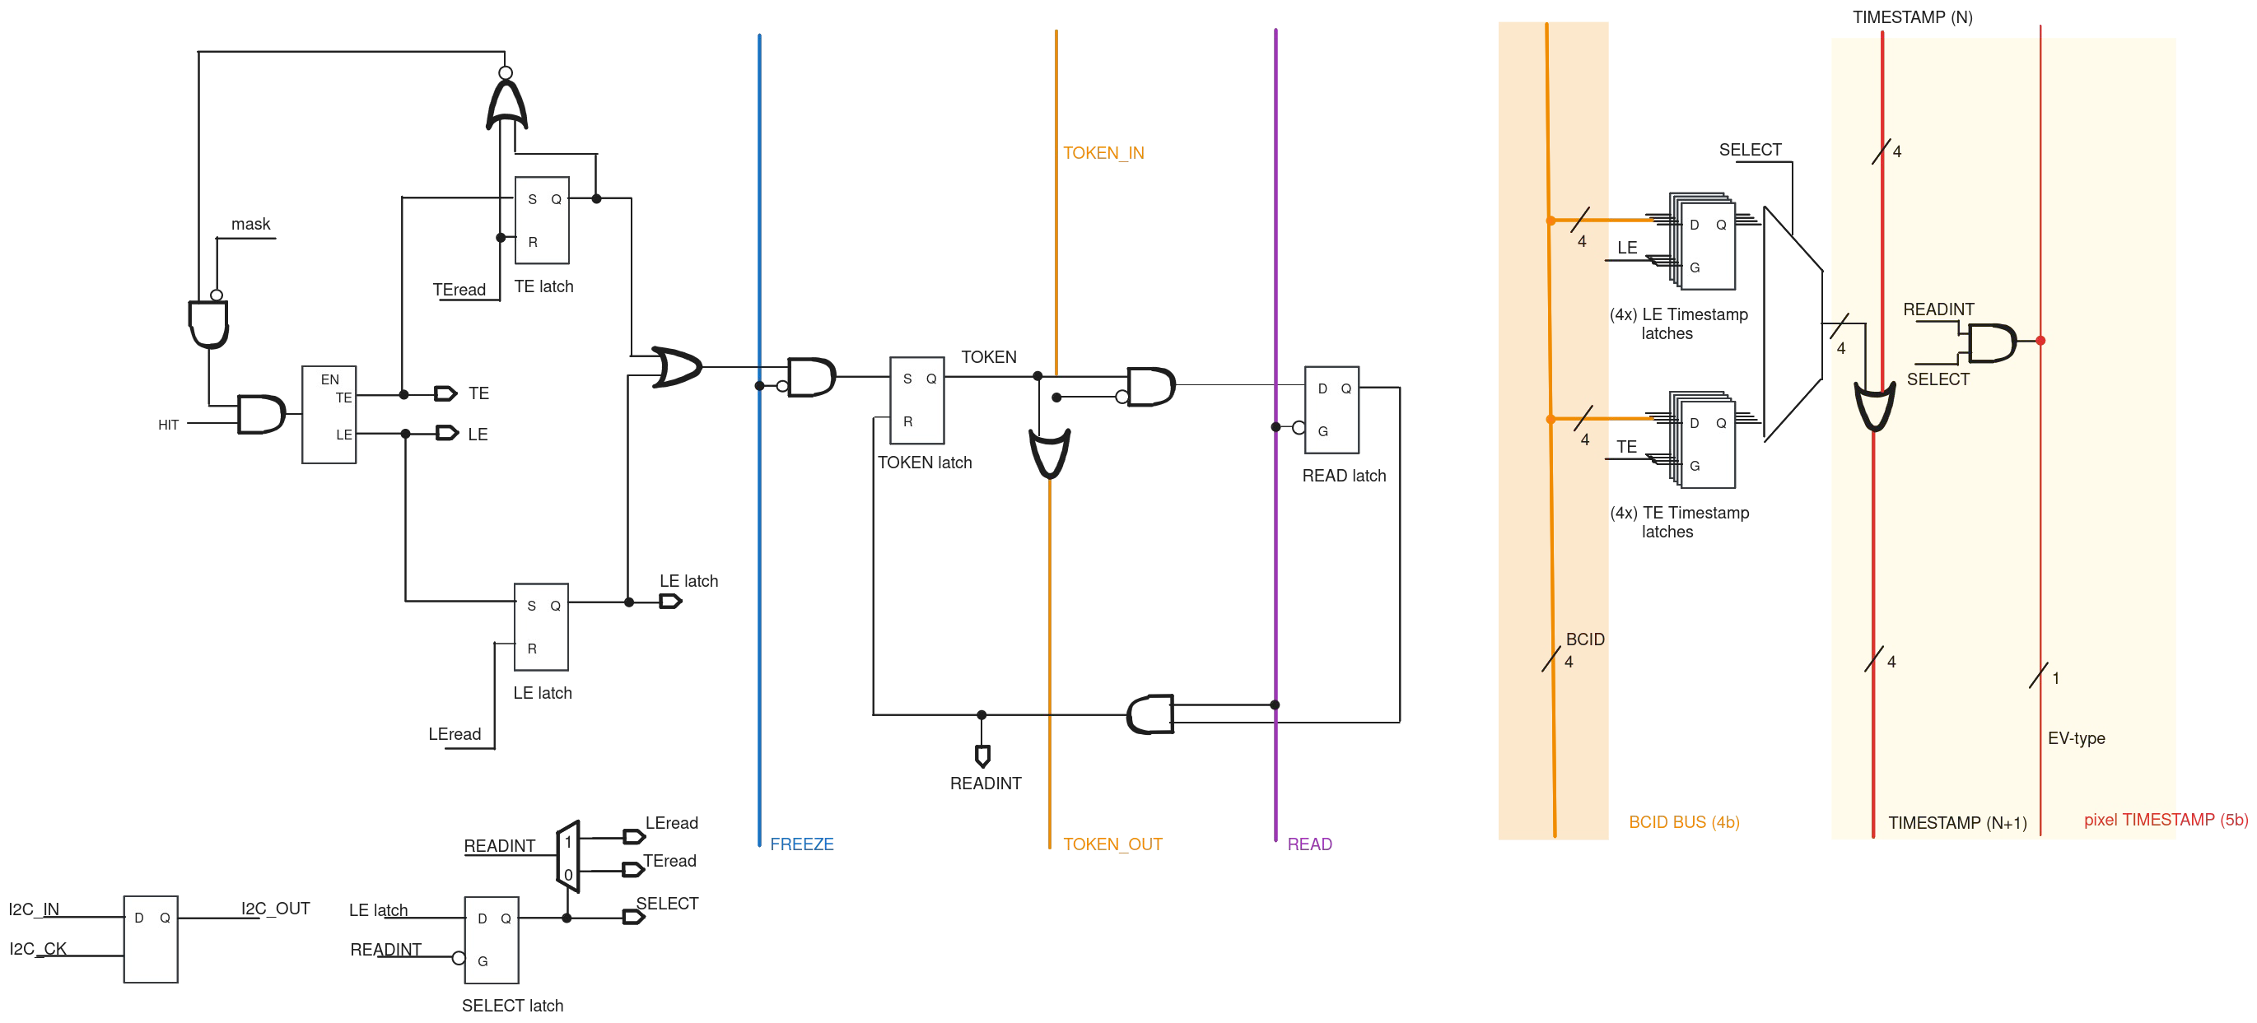
MCMOS design work at IP2I: TIIX
TJ 180 nm (25 μm epitaxial layer) - submission end-2024
128 x 128 pixels
≃ 41 μm pitch
≃ 1ke⁻ to 1Me⁻
hit rate ≃ 1kHz/cm²
frame rate ≃ 5kHz
output 160 MHz
Specifications
  TJ 180 nm (25 μm epitaxial layer)
  128 x 128 pixels - 42 μm pitch
  Dynamic range Qin ≃ 1ke⁻ to 1Me⁻
  Hit rate ≃ 1kHz/cm²
  Frame rate ≃ 5kHz
  Output (serial data) frequency 160 MHz
IP2I – IPHC responsibilities
fixed top-to-bottom priority column drain architecture
pixel data are asynchronously read at the bottom of each column
digital read-out unit at each pixel with foundry standard cells
ToT with 4b timestamp in pixel memory at Leading or Trailing Edge with 10b extension at the EoC level
LE and TE timestamps are serialized in three 160Mbps output links

Slide 9
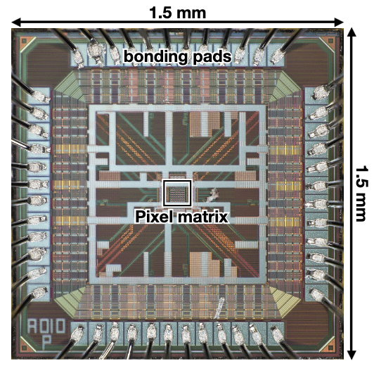
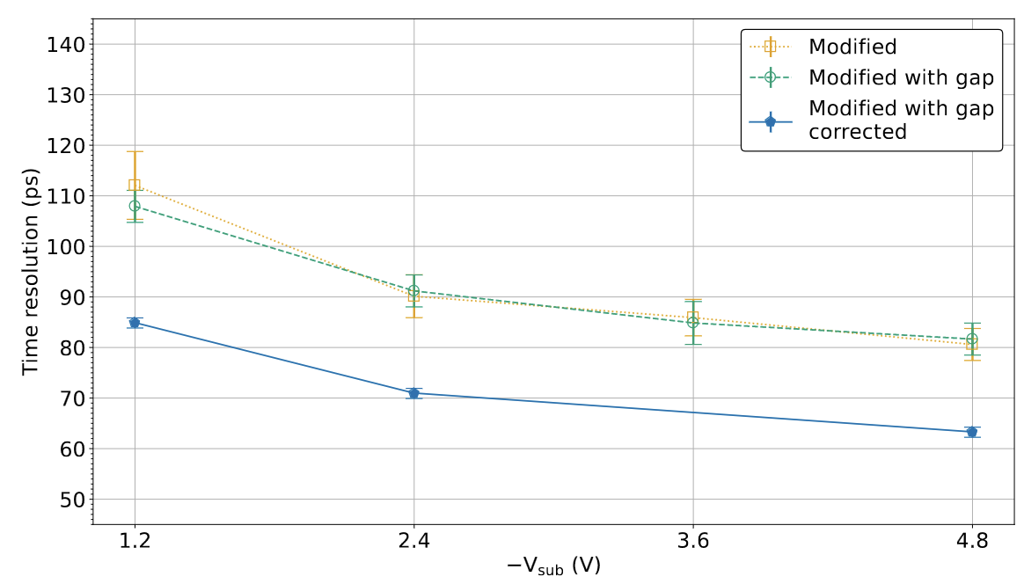
R&D proposal at IP2I in DRD3 WP1
  study readout architecture for precision timing in TPSco 65 nm
plan to develop TDC IP variants based on vernier ring oscillator and delay lines
study implementation of asynchronous readout architecture (similar to TIIX)
  with ToA and ToT at end of column
  on top of low pitch TPSCo 65 nm analog design “modified with gap” process
Study with Analog Pixel Test Structure Operational Amplifier APTS-OA https://arxiv.org/pdf/2407.18528 *
TPSCo 65 nm
design “modified with gap”
pitch 10 μm
63 ps resolution
* the power consumption constraint is not considered in this study

Slide 10
Outlook
Sensor R&D medium and longer-term prospect
  consider progress in different process/designs for intrinsic timing precision
    CACTUS LF 150 nm, CASSIA TJ 180 nm, ARCADIA LF 110 nm, TPSCo 65nm… w/o and w/ gain
  address power consumption versus channel density and position/timing precision
  consider large size sensors and 3D wafer stacking
System design in tracking configuration, start studies of:
  cooling requirements versus power consumption
  cooling impact on material (X/X₀)
  mechanical structures and services
Include ToF layers in tracking simulation studies
IP2I and IRFU are preparing an EoI for the ESPP process
“ Toward a ToF PID detector with Tracking Layers ”

