Slide 1

R&D ACTIVITIES :
HTS QuadrupolE and Beampipe
2nd FCC Italy & France Workshop
Matthieu Marchand, Laurent Brunetti,
Gaël Balik, J.P. Baud, Isabelle De Bonis, Agnès Dominjon, Giovanni Lamanna, Freddy Poirier | LAPP – IN2P3
M.Koratzinos, A. Thabuis | PSI
05.11.2024

Slide 2
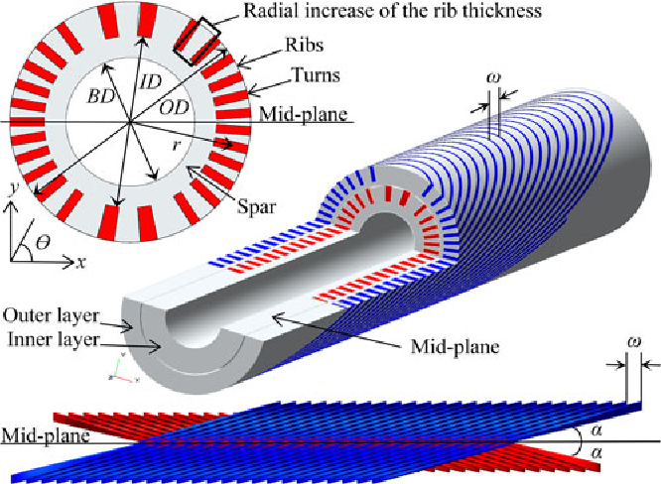
2nd FCC Italy & France Workshop, 05/11/2024| |HTS quadrupole R&D activities, Marchand Matthieu| 2
HTS MAGNET IN FCC – Definition
FCC project must face technologic, economic and ecologic challenges => HTS magnet can be part of the solution
  A High Temperature Superconducting (HTS) magnet => operate at temperature above 30°K, versus 2°K for classic superconducting magnet (NbTi) => sustainable and economical solution since much less energy is needed to cool down the magnets
  => M. Koratzinos, “The FCCee-HTS4 project”, FCC week 2024, San Francisco
REBCO ribbon
  A Canted Cosine Theta (CCT) magnet => a magnet design using two opposed solenoid fields. The HTS material (ribbon) is coiled inside a single and canted groove => reduce the mechanical stress on the conductor + gain of space since it’s a very compact design
  => S. Caspi and all “Canted–Cosine–Theta Magnet (CCT)— A Concept for High Field Accelerator Magnets”, IEEE Transactions on Applied Superconductivity · June 2014
HTS technology is a promising and relevant technology for FCC
Example of a 2-layer CCT magnet layout with rectangular cable - L. Garcia Fajardo

Slide 3
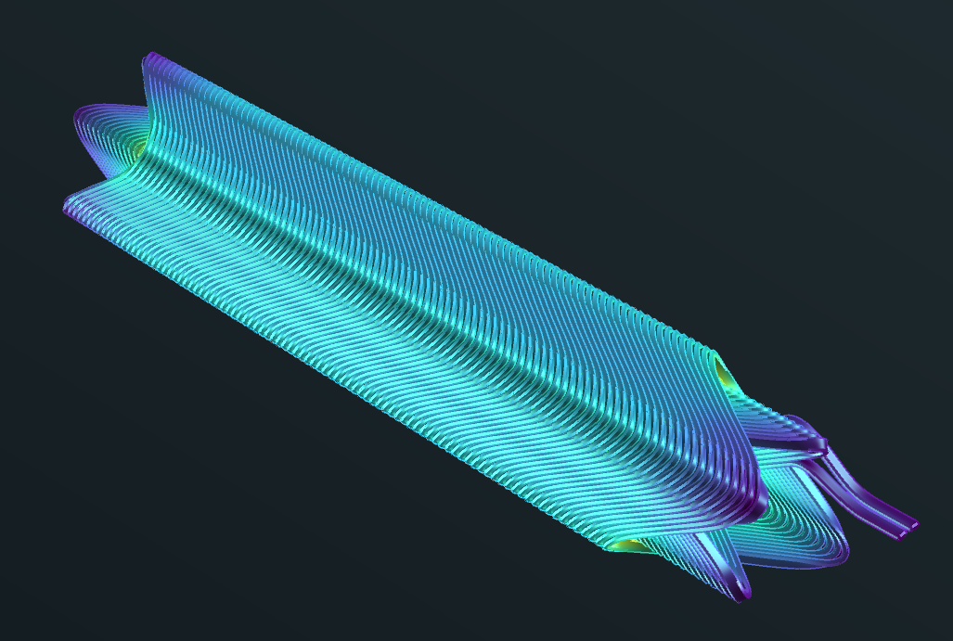
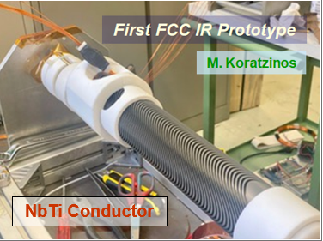
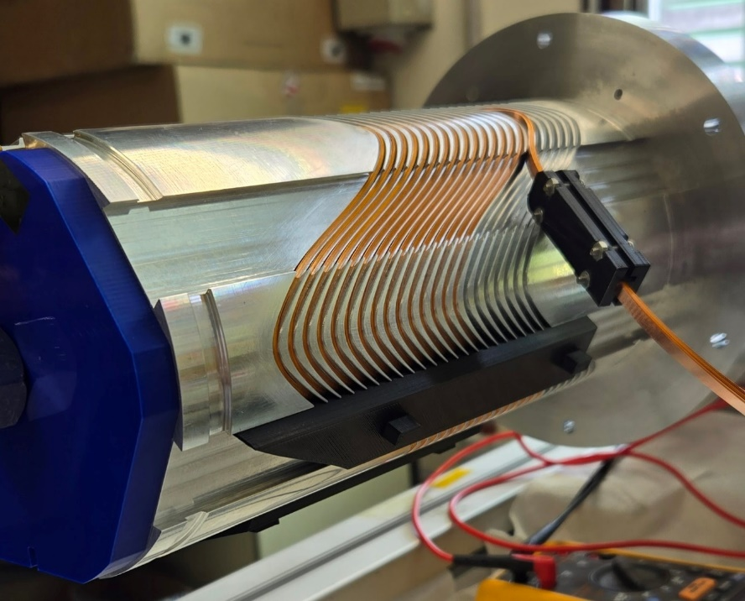
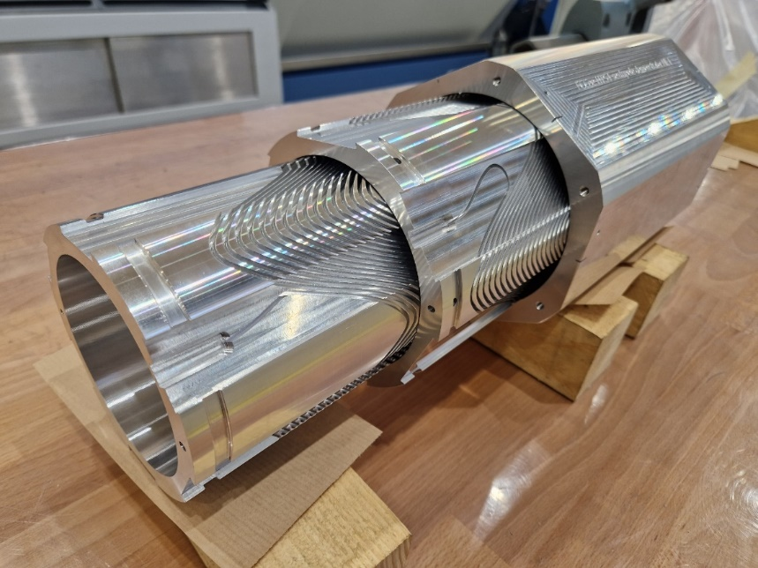
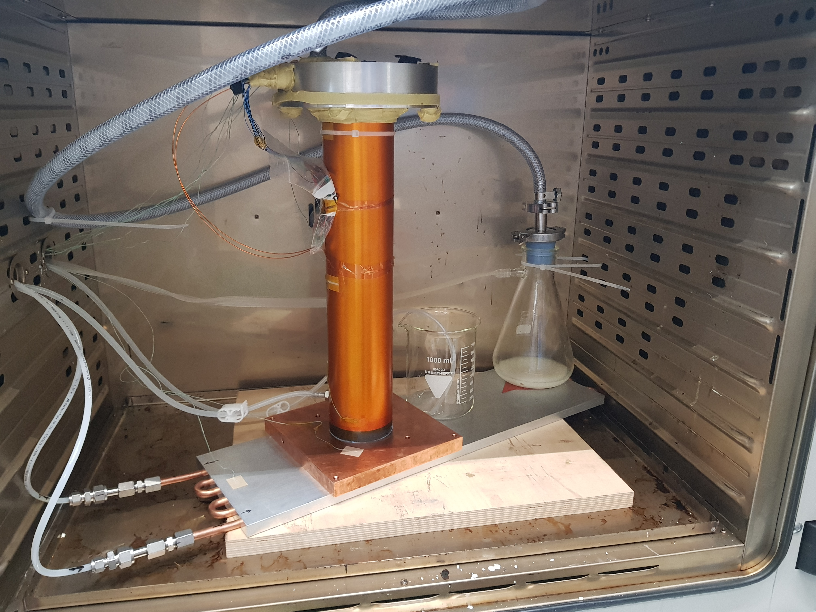
2nd FCC Italy & France Workshop, 05/11/2024| |HTS quadrupole R&D activities, Marchand Matthieu| 3
HTS MAGNET IN FCC – Status and Objectives
Magnetic simulation / HTS shape – M.Koratzinos
HTS project for FFC (HTS4) started in 2022
  In August 2023 => successful cold test of a CCT NbTi quadrupole at PSI
  M.Koratzinos, “New design of FF quads using HTS” in Frascati 2023
  In June 2024 => a successful manufacturing and winding of HTS CCT sextupole at CERN. It will be followed by the cold test in 2025.
  => M.Koratzinos, “The FCCee-HTS4 project”, FCC week 2024, San Francisco
HTS CCT sextupole wiring – M.Koratzinos
Approach of the HTS CCT quadrupole manufacturing (LAPP):
  Quadrupole part is built according to the coil using magnetic field simulation (M.Koratzinos) => compromise between magnetic and mechanical specifications.
  Main objectives : Mechanical design, manufacturing process and prototyping of the HTS quadrupole with local manufacturers.
  In parallel => development of the beam pipe compatible with the quadrupole design.
HTS CCT sextupole – M.Koratzinos
CCT quadrupole cold test – M.Koratzinos

Slide 4
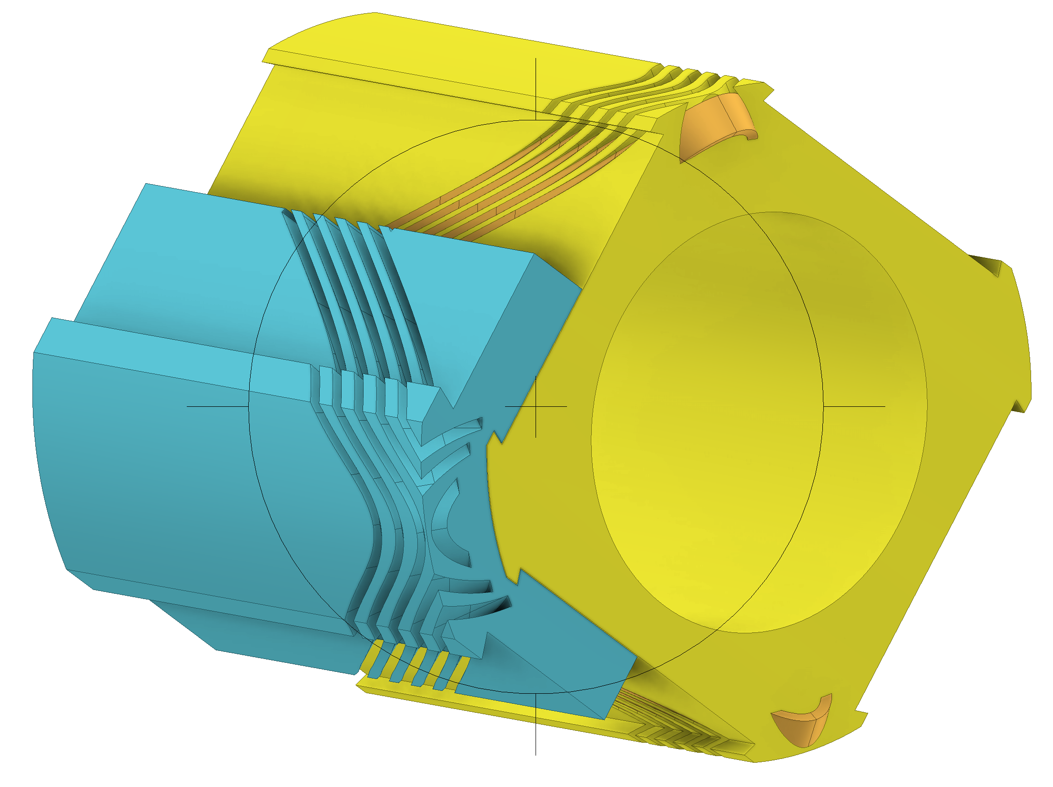
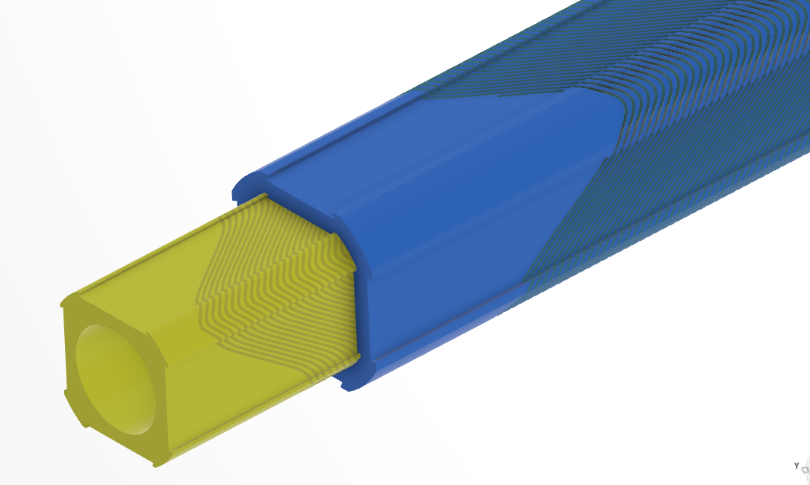
2nd FCC Italy & France Workshop, 05/11/2024| |HTS quadrupole R&D activities, Marchand Matthieu| 4
HTS MAGNET IN FCC – Quadrupole Design (1/2)
Quadrupole specifications
Main characteristics
Two bodies in => the inner body nested in the outer body
Aluminium alloy => to be determine according the best machining process
Square shape + rounded edges to facilitate the assembling of both bodies
General dimensions
700mm long (400mm for the prototype) => two 350mm sections (200mm sections)
Inner part => 40mm diameter for the 36mm diameter beam pipe crossing
Inner body maximal diameter => 65mm Outer body maximal diameter => 64mm
A 0,3mm space between the two bodies => no contact
The groove
4mm (plane surfaces) to 8 mm deep (rounded surfaces)
1mm width with a +0,01mm tolerance
A 1,8mm space between each pass
0 to +/- 60° inclination relative to the magnet axis
A surface finish precise enough to not damage the tape => to be determined
A part with a specific geometry
  To ensure the correct magnetic field is generated => two square aluminium alloy part. The beam pipe passes trough the inner body (yellow), nested in the outer body (blue).
  A final part 700mm long and a 400mm long prototype => the design/prototyping process must be adapted to the final dimensions.
  A single narrow and canted groove is winded along each magnet, with specifications hard to meet => 4 to 8 mm deep, 1mm width and canted up to +/- 60° with very high tolerances (+0,01mm).
Mettre données en tableau
Quadrupole prototype CAD – M.Marchand
Quadrupole CAD – M.Koratzinos

Slide 5
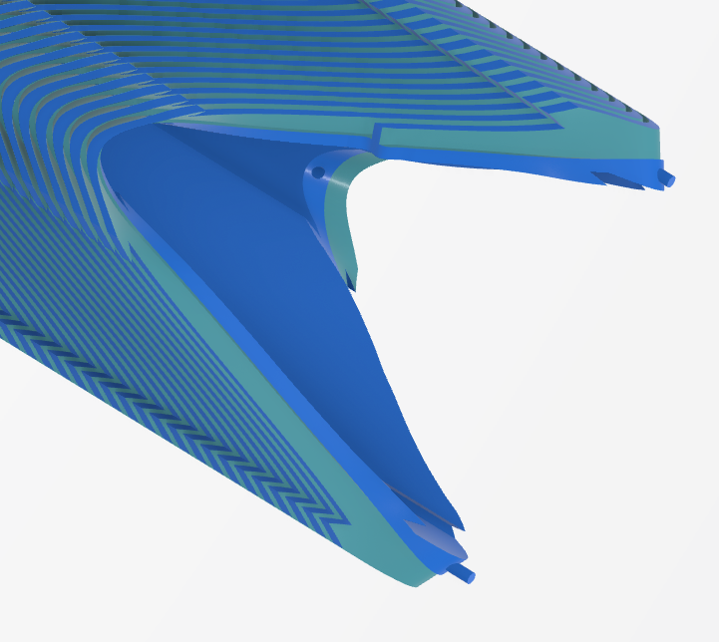

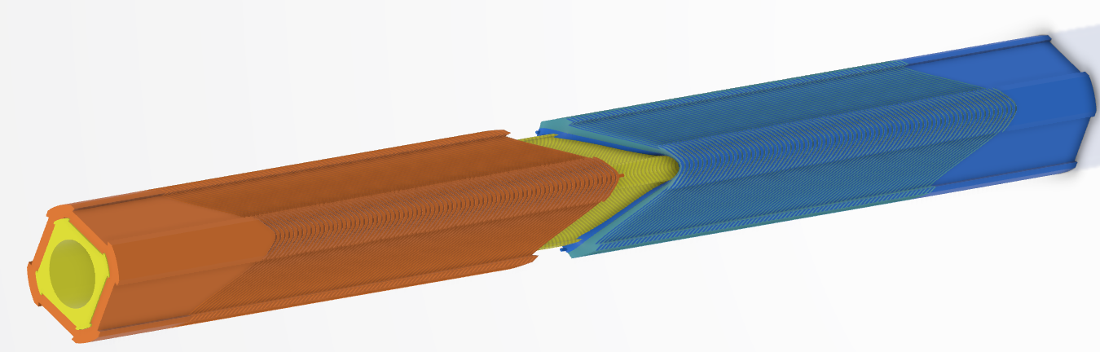
2nd FCC Italy & France Workshop, 05/11/2024| |HTS quadrupole R&D activities, Marchand Matthieu| 5
HTS MAGNET IN FCC – Quadrupole Design (2/2)
Feedback from the manufacturers following the feasibility study:
  Very complex geometry with high precision => magnet is too long to keep the tolerances with current machine technology.
  Choose between dimensions and precisions => adaptation of the design.
Bodies constituted of two sections assembled together:
  Each body is separated in two complementary sections.
  The bodies are cut along the groove trajectory => clean cut and facilitate the assembling.
  Two opposed and complementary sections aligned and indexed by a pins and hole system.
Quadrupole prototype locking and alignment system
  Assembling and fixation made by an external cage (like for the sextupole) => compression of each elements to stop their movements.
Conclusion: a very complex part with high tolerances => find the right manufacturing process and manufacturers.
Quadrupole prototype CAD in 2 parts

Slide 6
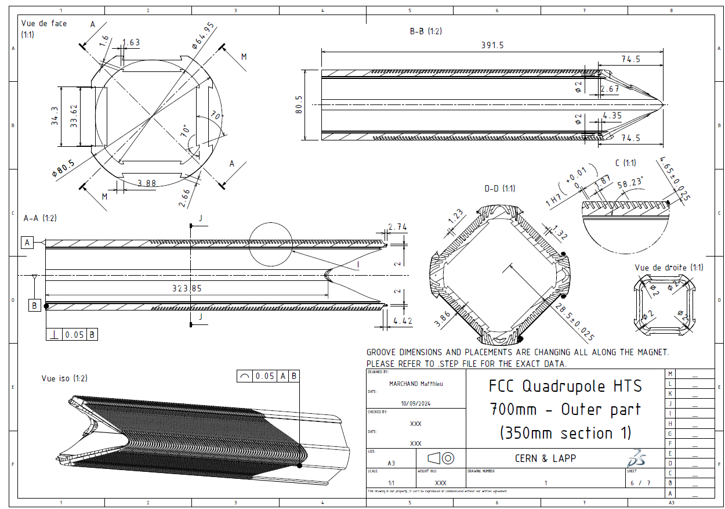
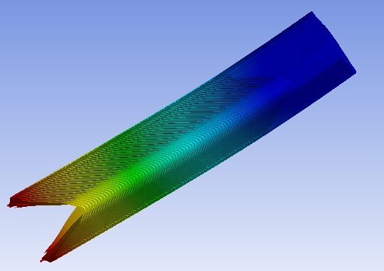
2nd FCC Italy & France Workshop, 05/11/2024| |HTS quadrupole R&D activities, Marchand Matthieu| 6
HTS MAGNET IN FCC - Manufacturing
The manufacturing process
  Electro-erosion wiring cutting => for the particular shape of the intern and extern surfaces.
  Continue multi-axes machining => enables to realise the groove tilt and the section cut geometry.
Vibrations analysis dedicated to the machining process.
Identification of a local industrial network with a strong expertise to manufacture the 40 FCC final focus quadrupoles (and the hundreds of sextupoles).
An evolving design => several evolutions to meet the manufacturing limits and physical specifications => find the best compromises
  A smaller HTS ribbon => 3mm deep groove.
  A groove stretching around the section cut area => make easier the indexation and fewer the machine errors.
  Tolerances reduced to match the machine’s precision.
Magnet prototype drawing
First flexion mode at several hundred Hz
Observation : there is a high risk of manufacturing iteration due to the specifications => need to reduce this risk and the prototyping cost

Slide 7
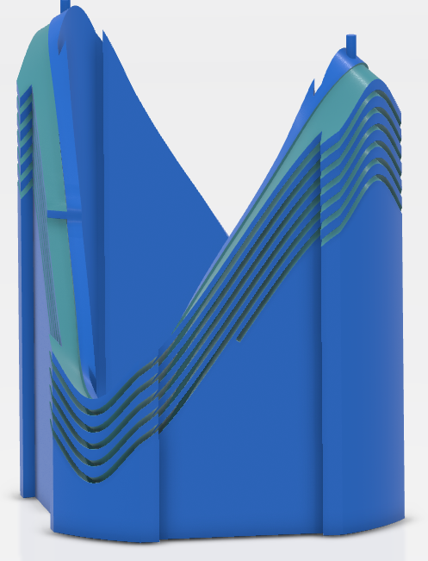
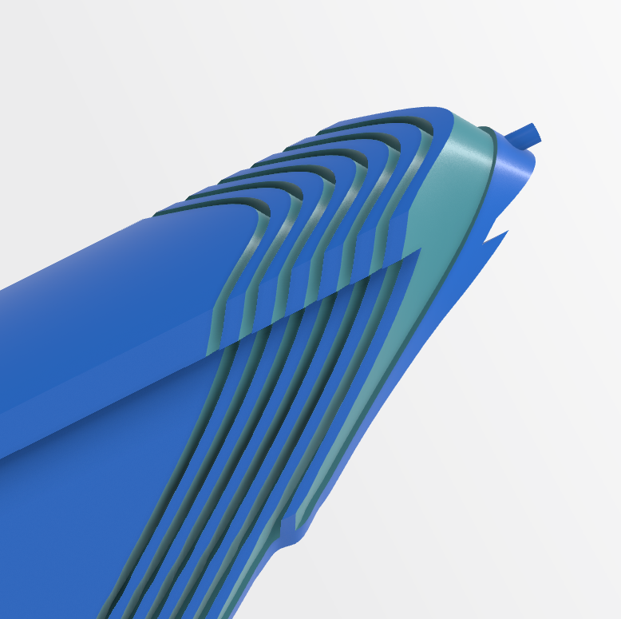
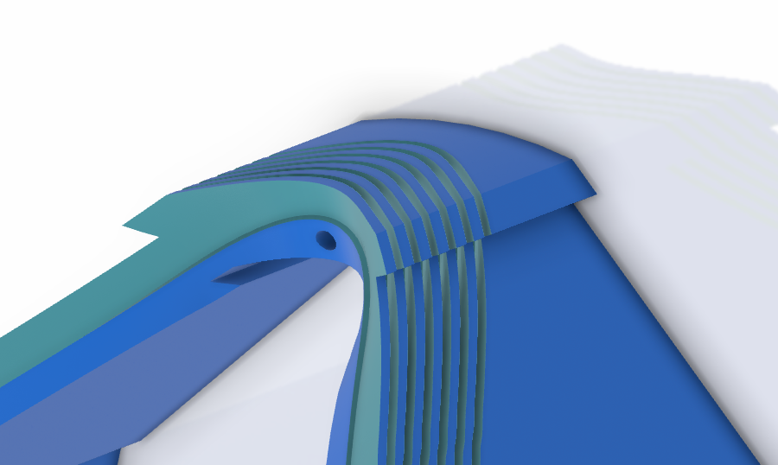
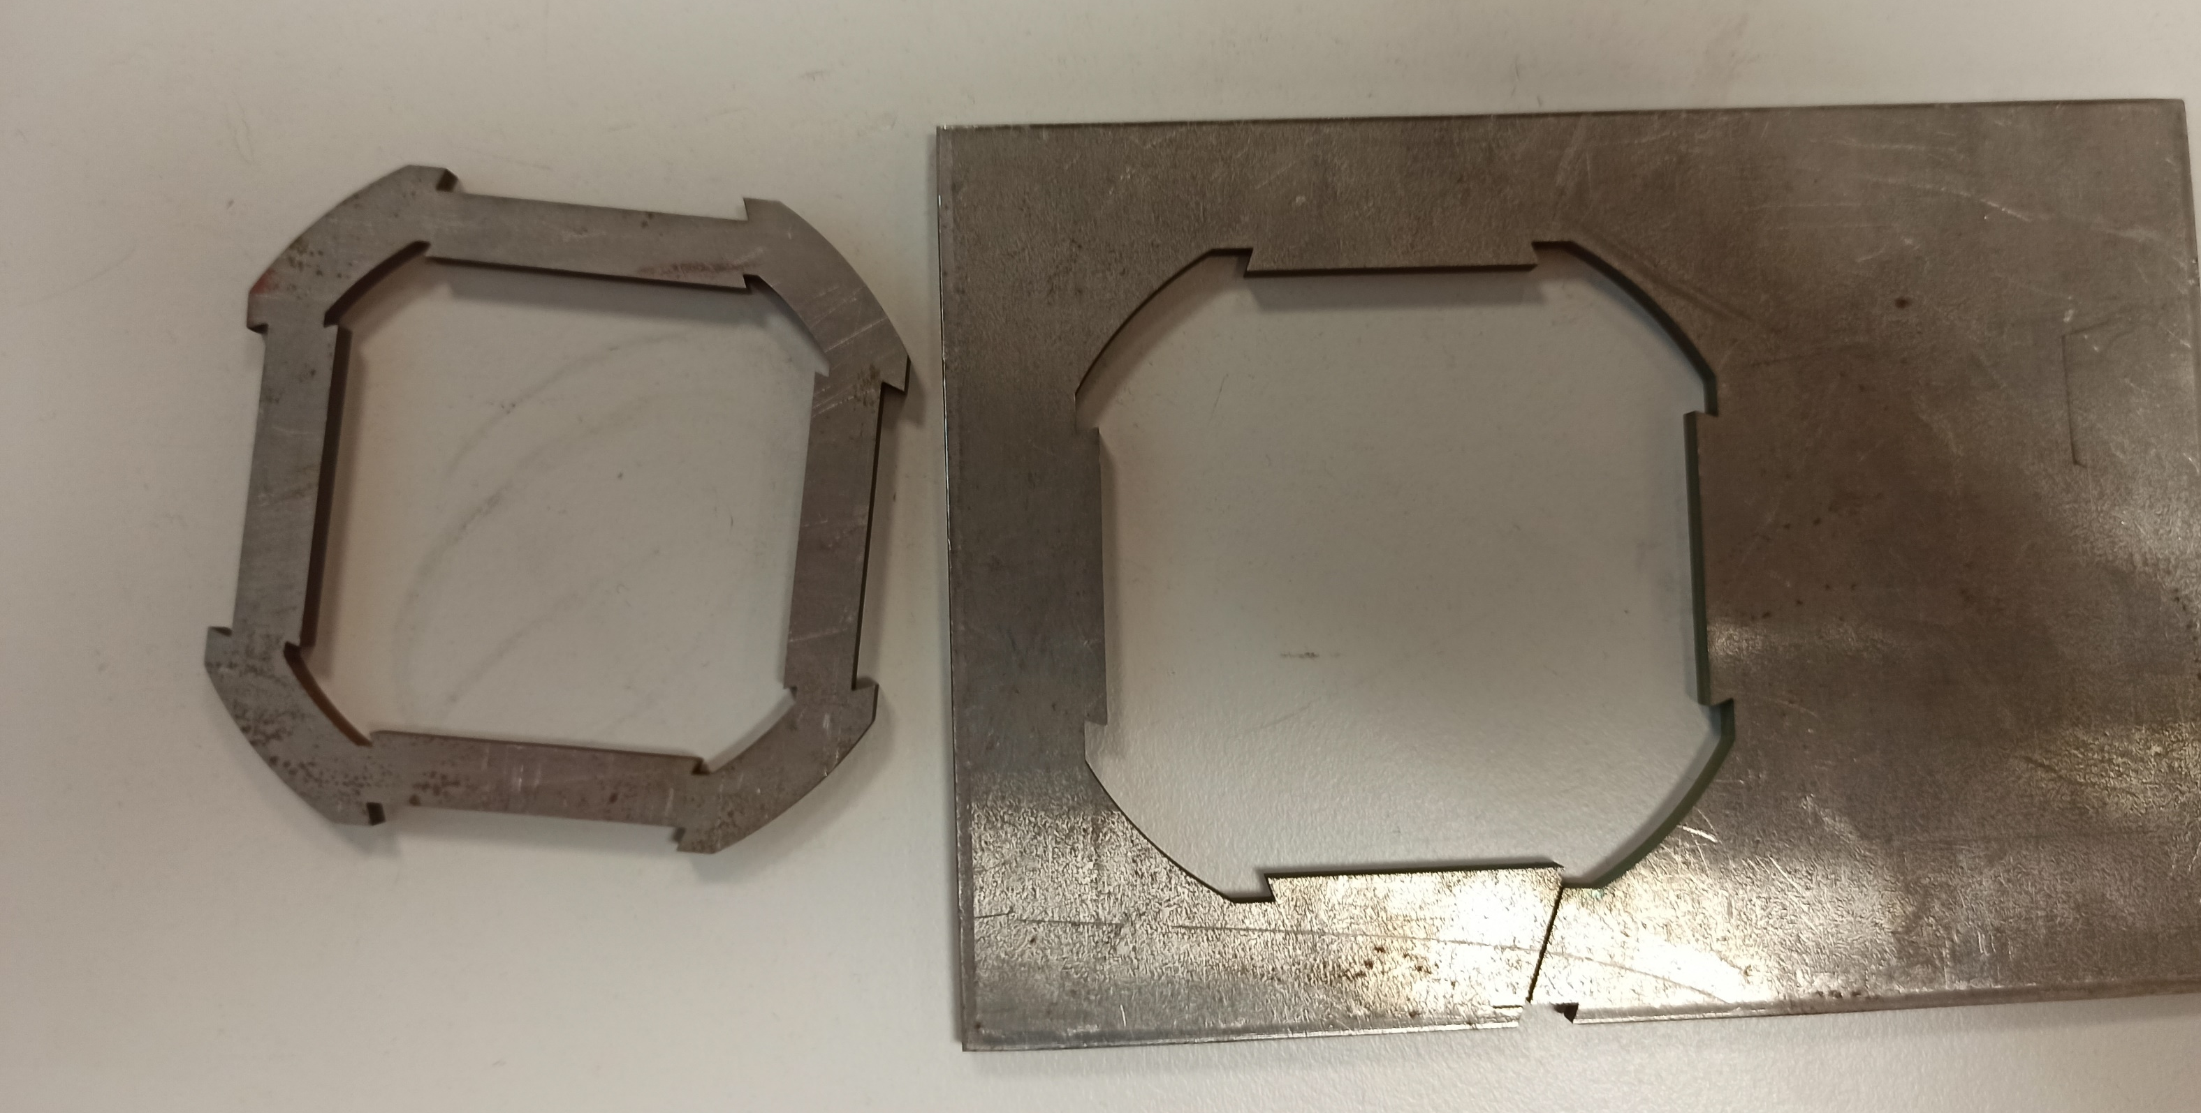
2nd FCC Italy & France Workshop, 05/11/2024| |HTS quadrupole R&D activities, Marchand Matthieu| 7
HTS MAGNET IN FCC – Pre-prototyping at LAPP
Pre-prototyping one section of the outer body magnet at a reduced scale => collaboration local university mechanical department (USMB) and LAPP.
Using the local resources to machine the key elements of the part => manufacturing a 100mm section of the magnet
  strong mechanical expertise
  5 axis machine for the 3-5 groove turns and the section’s cut
  Wire cutting machine for the external surfaces
Identify the “hard spots” and potential difficulties of the machining process => adapt the design and determine an efficient manufacturing process before launching a production at a real scale.
Pre-prototyping : Quadrupole section
Manufacturing other sections of the magnet with metrology, vibration analysis, alignment and assembling tests => validation for the real scale prototyping with an industrial partner.
Objective : Increase number of low-cost trials to solve manufacturing problems => reduce the iteration risks for the industrial prototyping => “one shot”.
Quadrupole section made by wire cutting at USMB

Slide 8
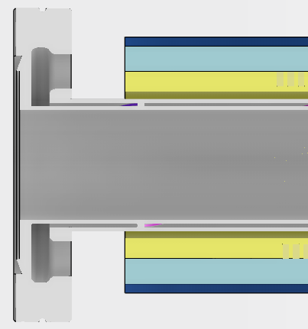
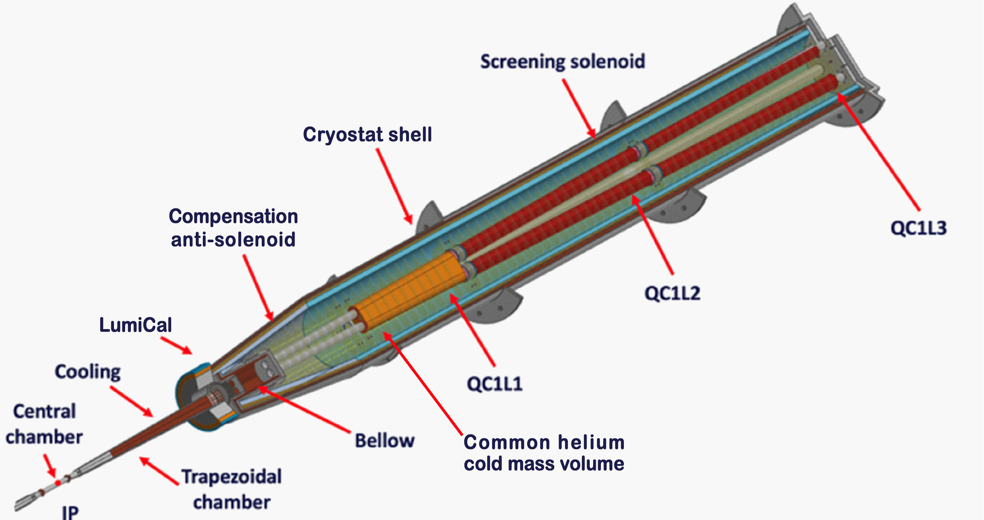
2nd FCC Italy & France Workshop, 05/11/2024| |HTS quadrupole R&D activities, Marchand Matthieu| 8
BEAM PIPE– Definition
The cryostat beam pipe needs to be compatible with the HTS quadrupole design => development of a beam pipe to respect the local constraints :
  Heat dissipation due to the beam radiation => need of a cooling system for the beam pipe.
  A very compact magnet with a 40mm inside diameter and a fixed internal beam pipe diameter of 30mm => a 5mm gap to ensure the beam pipe cooling and the thermic isolation from the cryogeny => integrated cooling system to the beam pipe.
30mm
40mm
  Very little space between the LumiCal and the anti-solenoid, next to the QC1L1 => not enough space to have an access for calorific fluid => fluid access (inlet+outlet) need to be in the same extremity of the pipe, next to QC1L3.
  They share the same environment => complementary integration issues.
  HTS magnet and beam pipe => same industrial local network.
Cutting view of the magnet and pipe assembly
Conclusion : Due to the geometry of the HTS quadrupole and the physical specifications, a specific beam pipe, compatible with the magnet design, has to be developed.
CAD of a cryostat by F. Fransesini

Slide 9
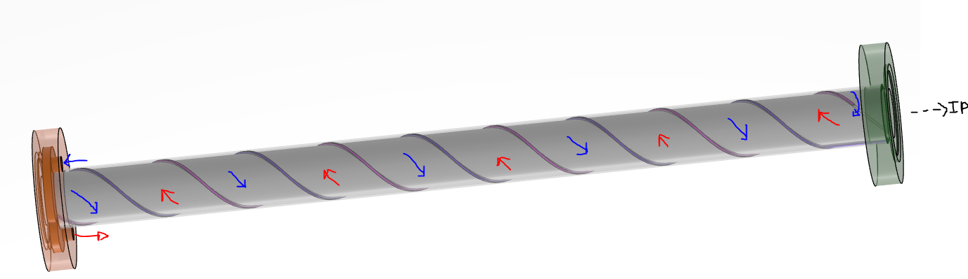
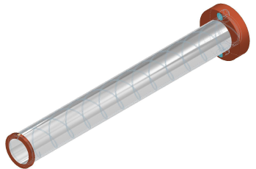
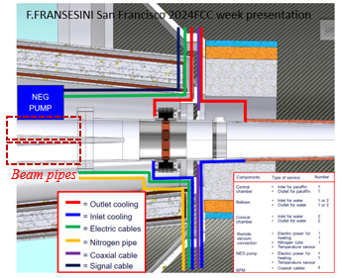
2nd FCC Italy & France Workshop, 05/11/2024| |HTS quadrupole R&D activities, Marchand Matthieu| 9
BEAM PIPE– Design (1/2)
A beam pipe with a singular integrated cooling system (M.Koratzinos concept):
inlet
Beam pipe CAD with its internal helix structure
  A custom flange outside the cryostat, near to QC1L3, with inlet and outlet for the two-way water flow.
outlet
  A tube with an internal structure in helix between two walls => a cooling flow all around the tube, back and forth, cooling it down.
  => M.Koratzinos, “FCC ee interaction region Concepts” 2022 FCC Week, London
M.Koratzinos beam pipe concept
  A second custom flange inside the cryostat close to the IP (without access to external pipes) => an inside channel enabling the fluid to change directions and come back towards the first flange (outlet).

Slide 10
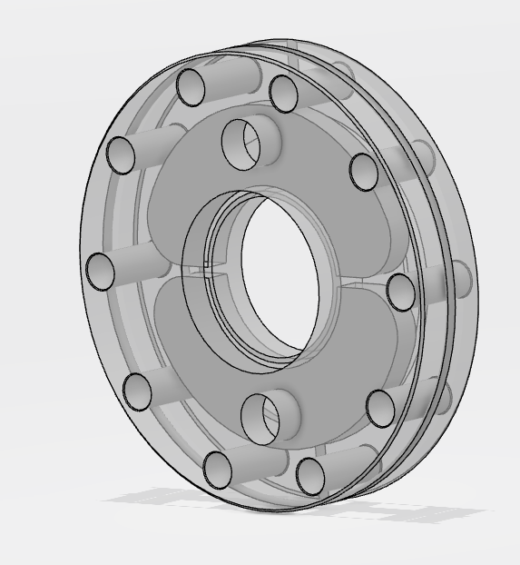
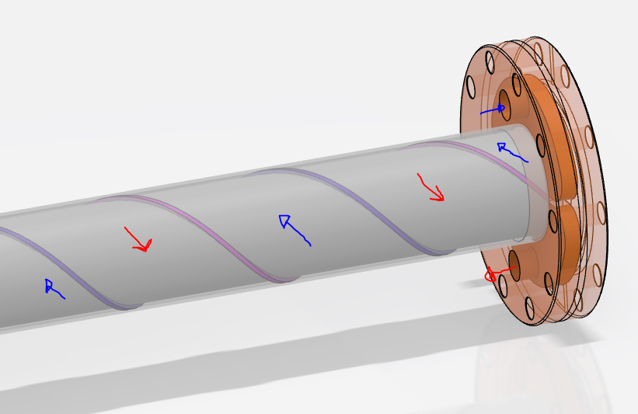
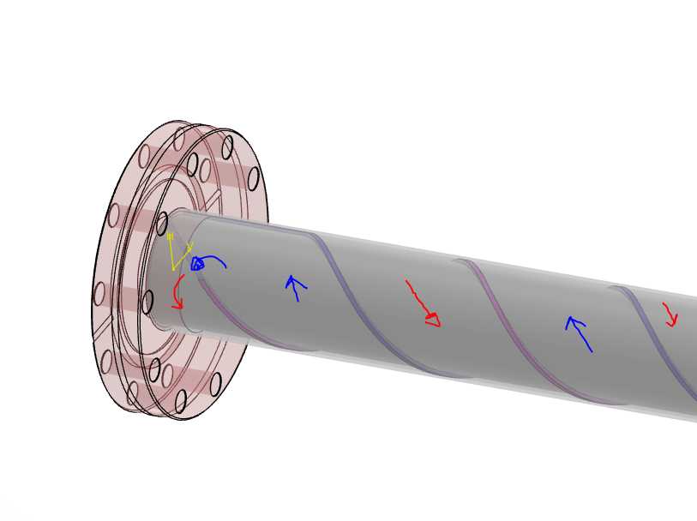
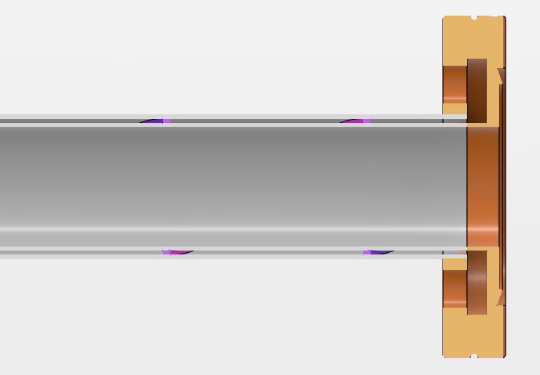
2nd FCC Italy & France Workshop, 05/11/2024| |HTS quadrupole R&D activities, Marchand Matthieu| 10
BEAM PIPE– Design (2/2)
Beam pipe specifications
Main characteristics
Two flanges with inside water channels + a double wall pipe with a intern double spiral structure
Stainless steel => Strong rigidity and non corrosive
Fluid => water
Airtight and leakproof (water flow inside the pipe walls + ultra vacuum inside the pipe + primary vacuum outside the pipe)
General dimensions
3 meters long (~cryostat length)
30mm intern diameter 36mm outside diameter 1mm thick wall
1mm thick space for the water flow
Surface finish sufficient to not disrupt the internal water flow => to be determine
The Flanges
90mm diameter
16,7mm thick
2 1/8” holes for water inlet and outlet for the hydraulics connectors
6*7mm diameter holes to connect the flanges to other beam pipe sections
A singular pipe with strong specifications
Beam pipe CAD and the flange out of the cryostat
Flange CAD with the fluid inlet/outlet
Beam pipe CAD the flange next to the IP
Conclusion : Due to the singular geometry, dimensions and specific water flow, this system needs a strong fluid, thermic and mechanical analysis to study its feasibility.
Beam pipe CAD – Cutting view

Slide 11
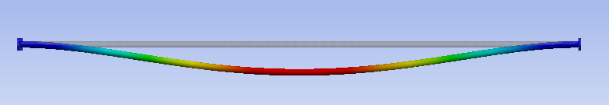
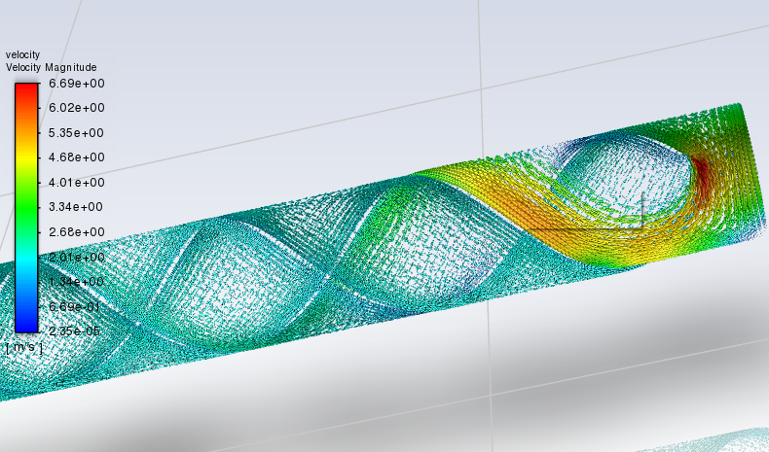
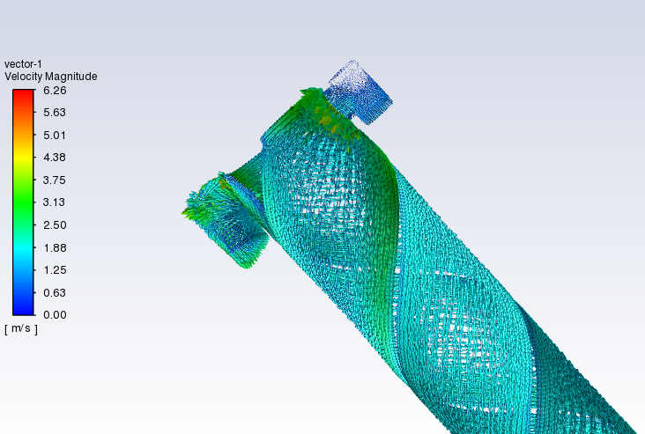
2nd FCC Italy & France Workshop, 05/11/2024| |HTS quadrupole R&D activities, Marchand Matthieu| 11
BEAM PIPE– Fluid, thermic and mechanical analysis
Boundary conditions | Resolutions
Mechanical analysis
Fixed at its two flanges | Max displacement : 0,6mm
Intern hydrostatic pressure for water flow | Max stress : 5,5 MPa
Inside ultra vacuum (1e-10Pa) and outside primary vacuum (1e-4Pa) | First mode : 23Hz
Fluidic analysis
Velocity inlet : 1 m/s | Inlet pressure : to be determine
Temperature inlet : 20°C | pipe temp : to be determine
Surface heat transfer (100W/m) : 1037 W/2 | Water velocity : to be determine
 | Turbulences : to be determine
Several types of numerical simulation => validation of the beam pipe concept + design optimization
  Static analysis to study its mechanical performance.
  Modal analysis to study vibrations.
  Fluid analysis to study the evolution of temperature, pressure, velocity and turbulences along the pipe.
Simulations in progress (temperature, turbulences) => some leads of improvement are identified (smoother shapes in tube/flange, multi-channels, …).
Mechanical displacement analysis
Need of more precise specifications, especially for turbulences, to adapt the design.
Conclusion : need to prototype the pipe to test it and compare the simulation => well-defined manufacturing process.
Velocity and turbulence analysis
Velocity and turbulence analysis

Slide 12
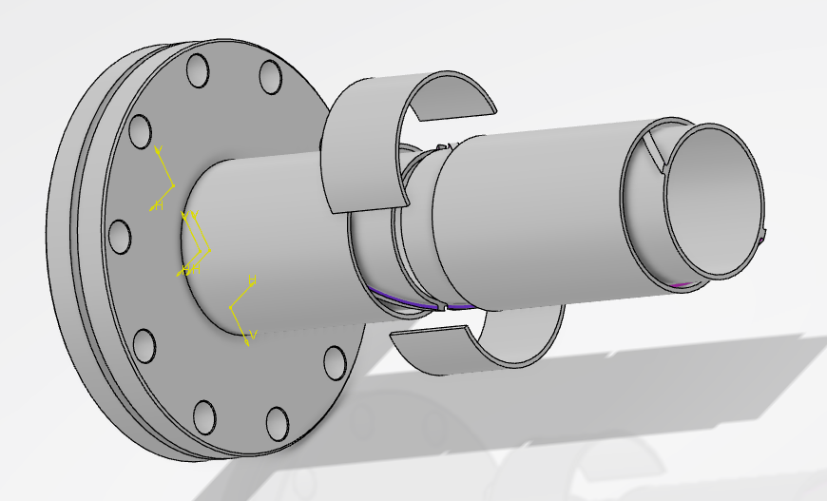
2nd FCC Italy & France Workshop, 05/11/2024| |HTS quadrupole R&D activities, Marchand Matthieu| 12
BEAM PIPE– Manufacturing and pre-prototyping at LAPP
The manufacturing process
  A pipe separated in several sections => a pipe segment, two custom made flanges with a small pipe segment incorporated and a junction part.
  Each section made by 3D metal printing => some machines can combine 3D printing with machining for a better surface finish (inside the cooling channel).
  Sections assembled by welding => TIG, electron beam or laser welding : process to be determined according the metal properties and the precisions needed.
  The quadrupoles mounted before the second flange welding, due to the diameter interference.
  Dis-assembly has to be studied.
Beam pipe assembled sections
Just as for the HTS quadrupole:
  Building a solid local industrial network => combine efforts to find same partners for both parts.
  Pre-prototyping each of the 4 beam pipe sections => collaboration LAPP – USMB
    Identify the potential difficulties we could face during an industrial manufacturing and adapt the design if necessary => establish a precise 3D printing strategy.
    Use this first sections to start assembling (welding), water, thermic, vibration and metrology tests => validation of the process and pipe concept.

Slide 13
2nd FCC Italy & France Workshop, 05/11/2024| |HTS quadrupole R&D activities, Marchand Matthieu| 13
Summary and Outlook
There are major technological and economical benefits for FCC by using HTS magnets. It’s a technology which has a bright future and the FCC project has the opportunity to be one of the major actors in its development.
After the manufacturing of a HTS sextupole and waiting for its cold test, an HTS quadrupole is under study.
The singular magnet design and its environmental constraints make that we need to develop a specific cryostat beam pipe compatible with the quadrupole.
The first steps of both parts manufacturing has started with their pre-prototyping => validate their concept and anticipate a prototyping at a larger scale.
The short term actions:
  Improve the magnet design and manufacturing process through the pre-prototyping project => groove and section design and manufacturing tolerances and strategy.
  Improve the pipe design and manufacturing process through the pre-prototyping project => adapt the design for turbulences + more precise simulations + start to study in detail the welding process for the pipe.
  Prepare the manufacturing of the final prototypes (manufacturers are already identified).
The mid term actions:
  Manufacture the magnet and the pipe prototypes with all the instrumental tests (metrology, vibrations analysis, magnet cold tests, beam pipe cooling tests…).

Slide 14
Thank you for your attention!
14

